Slide 1
2022/2023

Slide 2
ENDOCRINE
Phase 2a Revision Session
Sana Habib & Fiza Sohail
15th December 2022
The Peer Teaching Society is not liable for false or misleading information…

Slide 3
Disease List
Diabetes mellitus (type I and II) including micro/macrovascular complications
Diabetic Ketoacidosis
Hyperosmolar hyperglycaemic state
Hypoglycaemia
Thyroid Disorders
Hyperthyroidism – mainly Graves disease, recognise other causes
Hypothyroidism – mainly Hashimoto’s thyroiditis, recognise other causes
Recognise other causes of thyroid disorders; De Quervain’s thyroiditis, post-partum thyroiditis, amiodarone, lithium toxicity
Thyroid cancer
Pituitary adenomas
Cushing’s syndrome and disease
Acromegaly
Prolactinoma
Carcinoid tumours and syndrome
Conn’s Syndrome
Adrenal insufficiency: primary (Addison’s) and secondary
SIADH
Diabetes insipidus (cranial and nephrogenic)
Hyperparathyroidism (primary secondary tertiary)
Hypoparathyroidism
Pheochromocytoma
Electrolyte imbalances
Hypercalcaemia
Hypocalcaemia
Hyperkalaemia
Hypokalaemia
Hyponatremia (Not included on slides)
Hypernatremia (Not included on slides)

Slide 4
Diabetes Mellitus
General Definition
A group of chronic disorders characterized by the body's impaired ability to produce or respond to insulin resulting in abnormal glucose metabolism leading to hyperglycaemia (elevated blood glucose levels).

Slide 5
Type 1 Diabetes Mellitus
DEFINITION, CAUSE/S & RISK FACTORS | Autoimmune disease which causes the destruction of beta cells leading to absolute insulin deficiency thus causing hyperglycaemia. Cause- unknown, thought to be a combination of genetics (higher rates with family history of T1DM and other autoimmune disease) and environmental triggers (e.g. certain viral infections) but is not fully understood.
PATHOPHYSIOLOGY | No insulin production means the cells of the body cannot take glucose from the blood and use it for fuel. Therefore the cells think the body is being fasted and has no glucose supply. So, the level of glucose in the blood keeps rising, causing hyperglycaemia.
PRESENTATION (Sx) | Typically manifests in childhood. Commonly present with DKA. Polydipsia- extreme thirstiness. Polyuria- excessive urination Sudden unexplained weight loss
Notes:
https://zerotofinals.com/medicine/endocrinology/type1diabetes/
Risk Factors-
Northern European - especially Finnish (from Finland)
Family history of DM T1
Genetic predisposition- HLA-DR3 or HLA-DR4 in > this occurs in 90% of cases
Environmental factors- exposure to a specific virus
Family of personal history of autoimmune disease
Pathophysiology-
Glucose is unable to enter the cells of the body as the GLUT transporter which transports glucose in to cells specifically GLUT 4 is insulin dependent which means without insulin it is unable to transport into cells.
Explain why polydipsia is a symptom/sign of Diabetes Mellitus?
Excessive water excretion leaves the body thirsty as the thirst centre in the hypothalamus is stimulated.
Explain why Weight loss is a symptom/sign of Diabetes Mellitus?
Excessive fluid depletion and the accelerated breakdown of fat (lipolysis) and muscle (proteolysis) secondary to insulin deficiency causing weight loss. Sudden weight loss is more common in T1 DM as there is absolute insulin deficiency which means lipolysis and proteolysis occur much more suddenly/quickly compared to T2 DM as T1 has no insulin so no glucose can enter the cells whereas in T2 DM insulin is still produced (relative insulin deficiency ) so not as much lipolysis and proteolysis occur until Diabetes is more advanced.
Explain why polyuria and glycosuria are a symptom/sign of Diabetes Mellitus?
Glucose draws water into the urine by osmosis this is called osmotic diuresis. There is high levels of glucose in the blood and not enough glucose can be reabsorbed as kidneys have reached the renal maximum reabsorptive capacity of glucose.
This results in excessive levels of glucose and water being excreted.

Slide 6
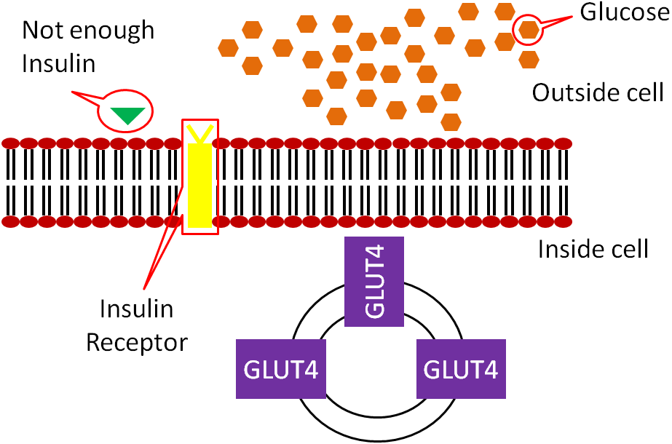
Notes:
Glucose is unable to enter the cells of the body as the GLUT transporter which transports glucose in to cells specifically GLUT 4 is insulin dependent which means without insulin it is unable to transport into cells.
So there is no glucose in the cells but lots in the blood causing hyperglycaemia.

Slide 7
Type 1 Diabetes Mellitus
DIAGNOSIS & INVESTIGATIONS (Ix) | In symptomatic patient: Symptoms of DM AND Raised plasma glucose detected once—fasting ≥7mmol/L or random ≥11.1mmol/L In asymptomatic patient- Patient must show raised glucose on 2 separate occasions Random plasma glucose of ≥11.1 mmol/L or Fasting plasma glucose ≥7 mmol/L or or Oral Glucose tolerance test Fasting ≥7mmol/L and 2 hrs after glucose ≥11.1 mmol/L (Remember If individual is symptomatic need to have one abnormal value for one of the above if asymptomatic require 2 abnormal values)
TREATMENT (Tx) | Patient education is essential- Monitoring dietary carbohydrate intake and monitoring blood sugar levels. Subcutaneous insulin is usually prescribed as a combination of a background, long acting insulin (basal) given once a day and a short acting insulin (bolus) injected 30 minutes before intake of carbohydrate (i.e. at meals). Patients will be on lifelong insulin.
Learn the units and values for the different diabetes investigations
Notes:
https://zerotofinals.com/medicine/endocrinology/type1diabetes/
HbA1c ≥6.5% (≥48 mmol/mol)-- don't tend to use for T1 due to the sudden onset and this gives average for the last 3 months
Injecting into the same spot can cause a condition called “lipodystrophy”, where the subcutaneous fat hardens and patients do not absorb insulin properly from further injections into this spot. For this reason patients should cycle their injection sites.

Slide 8
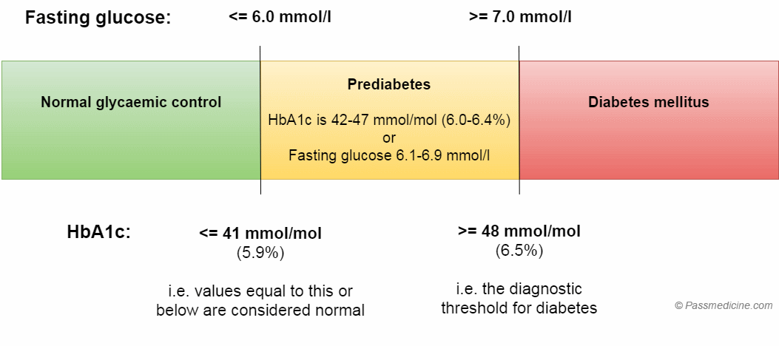
Notes:
Reference- passmed

Slide 9
QUESTION 1
A 3-year-old boy with a history of Type 1 diabetes mellitus presents to Accident and Emergency with vomiting and lethargy. On examination, he appears dehydrated. Capillary blood gas and capillary blood ketone tests are performed, which confirm a diagnosis of moderate diabetic ketoacidosis (DKA).
Which of the following treatments should be commenced first?
IV insulin infusion
IV sodium bicarbonate
IV 0.9% sodium chloride
Oral fluids and subcutaneous insulin
Continuous subcutaneous insulin infusion (CSII) pump
Notes:
Initial management of DKA involves fluid and potassium replacement in order to correct the hypovolaemia, acidosis, ketonemia and total body hypokalaemia associated with this condition. It is important to note that fluid replacement, though vital to treatment, should be cautious as there is also an increased risk of cerebral oedema with fluid overload in DKA patients. Therefore, fluid boluses should be avoided if possible and fluid should be replaced at a slightly reduced rate

Slide 10
QUESTION 1
A 3-year-old boy with a history of Type 1 diabetes mellitus presents to Accident and Emergency with vomiting and lethargy. On examination, he appears dehydrated. Capillary blood gas and capillary blood ketone tests are performed, which confirm a diagnosis of moderate diabetic ketoacidosis (DKA).
Which of the following treatments should be commenced first?
IV insulin infusion
IV sodium bicarbonate
IV 0.9% sodium chloride
Oral fluids and subcutaneous insulin
Continuous subcutaneous insulin infusion (CSII) pump
Notes:
Initial management of DKA involves fluid and potassium replacement in order to correct the hypovolaemia, acidosis, ketonemia and total body hypokalaemia associated with this condition. It is important to note that fluid replacement, though vital to treatment, should be cautious as there is also an increased risk of cerebral oedema with fluid overload in DKA patients. Therefore, fluid boluses should be avoided if possible and fluid should be replaced at a slightly reduced rate

Slide 11
Diabetic Ketoacidosis
DEFINITION, CAUSE/S & RISK FACTORS | Diabetic ketoacidosis is a life threatening, medical emergency. To diagnose DKA you require: Hyperglycaemia (i.e. blood glucose > 11 mmol/l) Ketosis (i.e. blood ketones > 3 mmol/l) Acidosis (i.e. pH < 7.3) Causes/Risk Factors- •Untreated T1DM or Interruption of insulin therapy •Undiagnosed DM •Infection/Illness •Myocardial Infarction
PATHOPHYSIOLOGY | It occurs when they body does not have enough insulin to use and process glucose. Summary- Complete absence of insulin ------ unrestrained production of glucose and decreased peripheral glucose uptake Hyperglycaemia ----- osmotic diuresis----- dehydration Peripheral lipolysis ----- increase FFA ------- oxidised to Acetyl CoA ------ ketones = ACIDOSIS
It is the most common way that children with a new diagnosis of type 1 diabetes present.
The main problems are ketoacidosis, dehydration and potassium imbalance.
Notes:
https://zerotofinals.com/paediatrics/endocrinology/dka/
Pathophysiology-
Ketoacidosis is a state of uncontrolled catabolism (break down) associated with insulin deficiency
Complete absence of insulin leads to unrestrained increased hepatic gluconeogenesis (i.e. unrestrained production of glucose) and decreased peripheral glucose uptake (i.e. decreased uptake of glucose by cells) this leads to hyperglycaemia---causes polyuria, glycosuria
High circulating glucose levels result in an osmotic diuresis (since increased glucose in urine which pull more water into urine) by the kidneys and consequent dehydration and loss of electrolytes.
In additions, lipolysis occurs leading to an increase in circulating free fatty acids (FFAs) which undergo ketogenesis this, in turn, is converted to ketone bodies within the mitochondria.
Accumulation of ketone bodies produces a metabolic acidosis.
Insulin normally drives potassium into cells. Without insulin, potassium is not added to and stored in cells.
Serum potassium can be high or normal in diabetic ketoacidosis as the kidneys continue to balance blood potassium with the potassium excreted in the urine, but total body potassium is low because no potassium is stored in the cells.
When treatment with insulin starts, patients can develop severe hypokalaemia (low serum potassium) very quickly as they can now transport K+ into cells so there is less K+ in the serum, this can lead to fatal arrhythmias.

Slide 12
Diabetic Ketoacidosis
PRESENTATION (Sx) | Nausea and Vomiting Dehydration which can cause hypotension Acetone-smelling breath ('pear drops’/fruity breath) Abdominal pain Drowsy/ Confused can progress to a coma Reduced consciousness Hyperventilation (Kussmaul breathing) DKA patients also show symptoms of DM- Polydipsia Polyuria Glycosuria
DIAGNOSIS & INVESTIGATIONS (Ix) | DKA should be recognised from clinical features and confirmed with a blood glucose measurement (hyperglycaemia) and a blood gas sample (metabolic acidosis with respiratory compensation). Hyperglycaemia (i.e. blood glucose > 11 mmol/l) Ketosis (i.e. blood ketones > 3 mmol/l) Acidosis (i.e. pH < 7.3 and/or bicarbonate < 15 mmol/L) - ABG Urea and electrolytes Urine dipstick –glycosuria and ketonuria
Notes:
U&E results-
Urea and creatinine often raised as a result of dehydration Total body potassium low as a result of osmotic diuresis but serum potassium concentration raised because of absence of insulin.

Slide 13
Diabetic Ketoacidosis
TREATMENT (Tx) | Immediate ABC management (Airway, breathing, circulation) if unconscious. Replace the fluid loss with IV 0.9% saline Replace the deficient insulin: Give insulin + glucose (to prevent hypoglycaemia) which both inhibit gluconeogenesis and thus ketone production Monitor blood glucose closely- Therapy can lead to a shift of K+ into cells resulting in hypokalaemia so treat this if necessary. Treat underlying triggers, for example with antibiotics for septic patients.
COMPLICATIONS | Cerebral oedema.
Why can insulin treatment for DKA cause hypokalaemia and why is this dangerous?
Notes:
Why can cerebral oedema occur?
The theory is that if the blood is initially very concentrated, with corresponding high salt levels (hypernatremia) and is rapidly diluted with IV fluids (to hyponatremia) then osmotic shifts will occur.
Water will move from the blood into the tissues, which in the brain causes swelling of structures in an enclosed space (the skull). Swelling of the brain causes rapid deterioration, coma, and can be fatal. This is the reason that correction of fluid deficit is recommended to be undertaken slowly in DKA, over 48 hours.

Slide 14
Diabetic Ketoacidosis
TREATMENT (Tx) | Immediate ABC management (Airway, breathing, circulation) if unconscious. Replace the fluid loss with IV 0.9% saline Replace the deficient insulin: Give insulin + glucose (to prevent hypoglycaemia) which both inhibit gluconeogenesis and thus ketone production Monitor blood glucose closely- Therapy can lead to a shift of K+ into cells resulting in hypokalaemia so treat this if necessary. Treat underlying triggers, for example with antibiotics for septic patients.
COMPLICATIONS | Cerebral oedema.
Why can insulin treatment for DKA cause hypokalaemia and why is this dangerous?
Insulin decreases potassium levels in the blood by redistributing K+ into the cells via increased sodium-potassium pump activity causing low serum K+ levels--- HYPOKALAEMIA. Low levels of K+ can cause arrythmia, weakness (as the heart and muscles can struggle to contract)
Notes:
Why can cerebral oedema occur?
The theory is that if the blood is initially very concentrated, with corresponding high salt levels (hypernatremia) and is rapidly diluted with IV fluids (to hyponatremia) then osmotic shifts will occur.
Water will move from the blood into the tissues, which in the brain causes swelling of structures in an enclosed space (the skull). Swelling of the brain causes rapid deterioration, coma, and can be fatal. This is the reason that correction of fluid deficit is recommended to be undertaken slowly in DKA, over 48 hours.

Slide 15
QUESTION 2
A 47-year-old male presents to his GP with weight loss, polyuria and polydipsia. The GP suspects type 2 diabetes mellitus.
Which one of the following describes the correct cut-off value for diagnosis of type 2 diabetes mellitus?
Fasting plasma glucose >7.9mmol/L
Oral glucose tolerance test ≥11.1 mmol/L
HbA1c ≥ 58mmol/L
Low random C-peptide
Random plasma glucose >6.9mmol/L

Slide 16
QUESTION 2
A 47-year-old male presents to his GP with weight loss, polyuria and polydipsia. The GP suspects type 2 diabetes mellitus.
Which one of the following describes the correct cut-off value for diagnosis of type 2 diabetes mellitus?
Fasting plasma glucose >7.9mmol/L
Oral glucose tolerance test ≥11.1 mmol/L
HbA1c ≥ 58mmol/L
Low random C-peptide
Random plasma glucose >6.9mmol/L

Slide 17
Type 2 Diabetes Mellitus
DEFINITION, CAUSE/S & RISK FACTORS | Relative insulin deficiency due to the beta cells of the islets of Langerhans not producing enough insulin and insulin resistance as the body's cells respond poorly to insulin and which results in hyperglycaemia. Causes/Risk Factors Non-Modifiable- Older age, Ethnicity (Black, Chinese, South Asian), Family history Male Modifiable- Obesity, Sedentary lifestyles, High carbohydrate diet, Hypertension
PATHOPHYSIOLOGY | Repeated exposure to high levels of glucose leads to the repeated release of insulin which makes the cells in the body become resistant to the effects of insulin. Over time, the pancreas (specifically the beta cells) becomes fatigued and damaged by producing so much insulin and they start to produce less. A continued onslaught of glucose on the body in light of insulin resistance and pancreatic fatigue leads to chronic hyperglycaemia.
PRESENTATION | Polydipsia- extreme thirstiness. Polyuria- excessive urination Polyphagia-exessive hunger Glycosuria- excessive glucose in urine
Type 2 DM is often picked up incidentally on routine blood tests
Notes:
https://zerotofinals.com/medicine/endocrinology/type2diabetes/
Explain why polyphagia is a symptom/sign of Diabetes Mellitus?
Although there's a lot of glucose in the blood it cannot enter the cell which leaves cells starved for energy. This causes the body to undergo lipolysis and proteolysis which causes weight loss which leaves people hungry.
Unexplained weight loss- doesn't become as apparent till more serious for T2 DM

Slide 18
Type 2 Diabetes Mellitus
DIAGNOSIS & INVESTIGATIONS (Ix) | Similar to Type 1 diabetes 1) HbA1c test--- Gold standard (tells us average BG for last 3 months) HbA1c >48mmol/mol = DIABETES DIAGNOSIS HbA1c >42-47 mmol/mol = PRE-DIABETES DIAGNOSIS 2) Blood tests Random plasma glucose > 11.1mmol/L = DIABETES DIAGNOSIS Fasting plasma glucose > 7mmol/L = DIABETES DIAGNOSIS 3) Oral Glucose tolerance test Fasting > 7mmol/L = DIABETES DIAGNOSIS 2 hrs after glucose > 11.1 mmol/L = DIABETES DIAGNOSIS (If individual is symptomatic need to have one abnormal value for one of the above if asymptomatic requires 2 abnormal values)
TREATMENT (Tx) | 1st line- Lifestyle Modifications- e.g. weight loss, dietary modifications (low GI food, smoking cessation, exercise, blood pressure control (ACE-i) and hyperlipidaemia control (Statins) 2nd line- Metformin (if newly diagnosed patients BG are above 48mmol/L after lifestyle modifications) 3rd line- add either a sulfonylurea, pioglitazone, DPP-4 inhibitor or SGLT-2 inhibitor. The decision should be based on individual factors and drug tolerance. 4th line- Insulin
Notes:
https://zerotofinals.com/medicine/endocrinology/type2diabetes/
In symptomatic patient: Symptoms of hyperglycaemia (eg polyuria, polydipsia, unexplained weight loss, visual blurring, genital thrush, lethargy) AND Raised plasma glucose detected once—fasting ≥7mmol/L or random ≥11.1mmol/L
In asymptomatic patient- Patient must show raised glucose on 2 separate occasions Either Random plasma glucose of ≥11.1 mmol/L or Fasting plasma glucose ≥7.0 mmol/L or or Oral Glucose tolerance test Fasting > 7mmol/L and 2 hrs after glucose > 11.1 mmol/L
(Remember If individual is symptomatic need to have one abnormal value for one of the above if asymptomatic require 2 abnormal values)

Slide 19
Complications of Diabetes Mellitus
Retinopathy
Peripheral Neuropathy
Microvascular
Nephropathy
Coronary Artery Disease
Stroke
Macrovascular
Peripheral Artery Disease
Hypertension
Notes:
Chronic exposure to hyperglycaemia causes damage to the endothelial cells of blood vessels. This leads to leaky, malfunctioning vessels that are unable to regenerate. High levels of sugar in the blood also causes suppression of the immune system, and provides an optimal environment for infectious organisms to thrive.
Hyperglycaemia induces oxidative stress and inflammation which can cause endothelial dysfunction which can cause atherosclerosis formation.

Slide 20
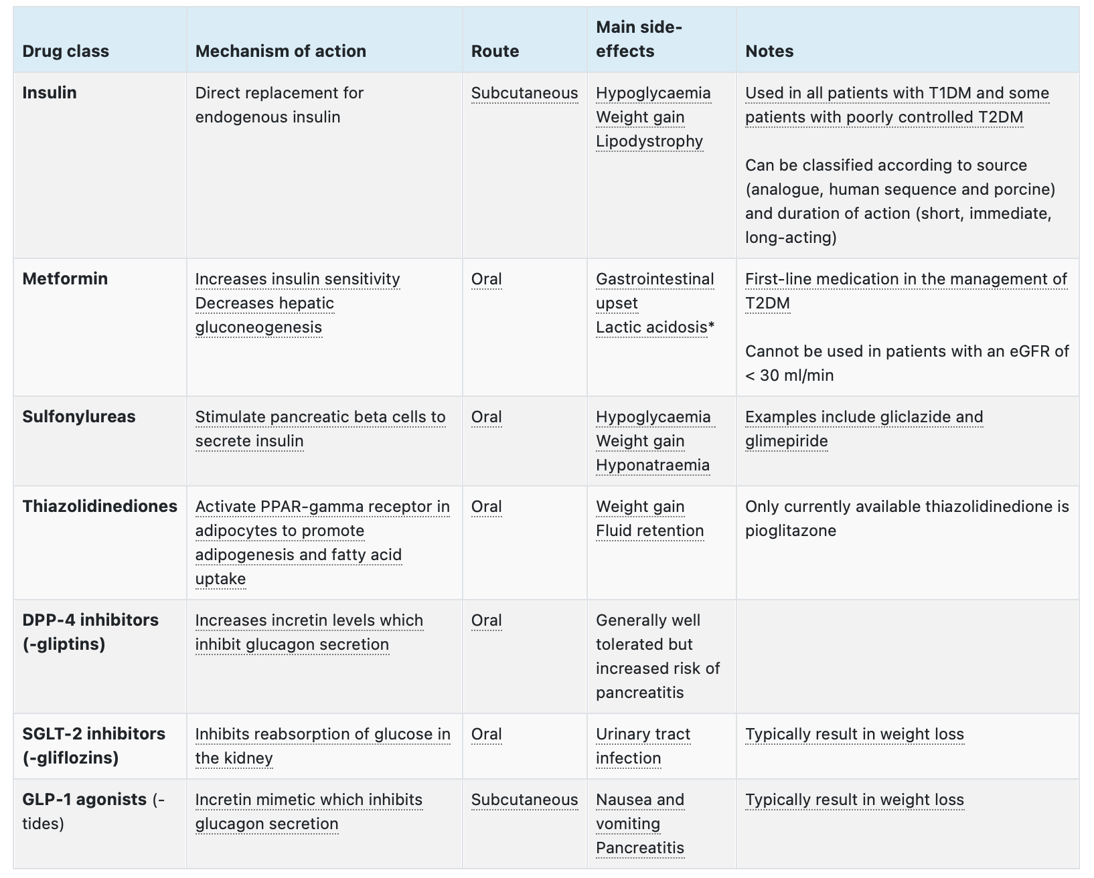
Notes:
Reference- Passmed
Advantage of metformin- rarely cause hypoglycaemia

Slide 21
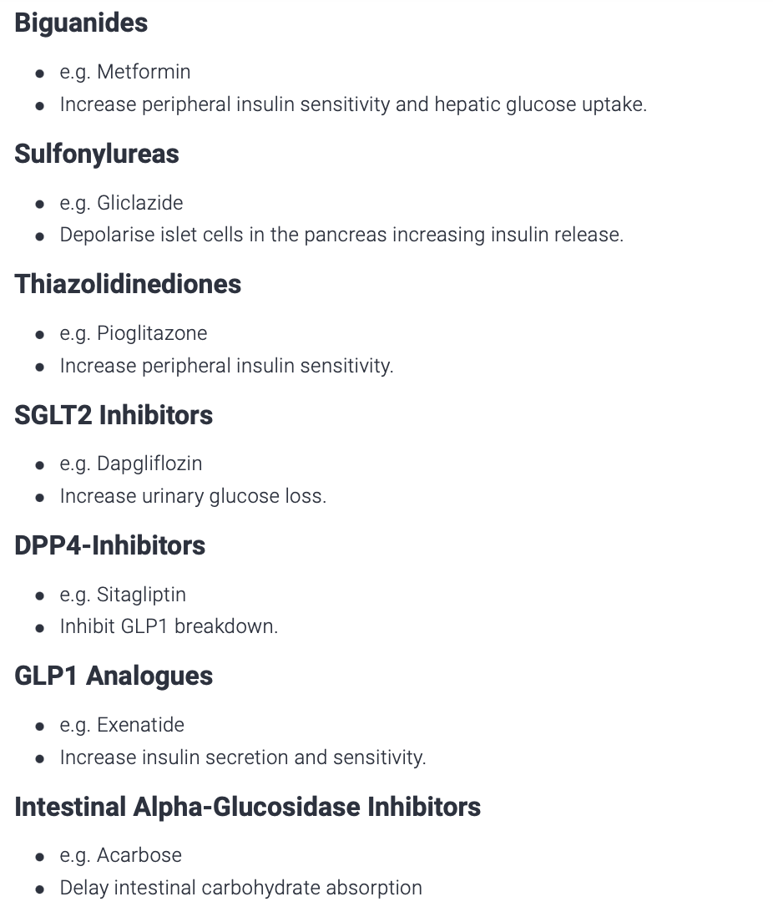
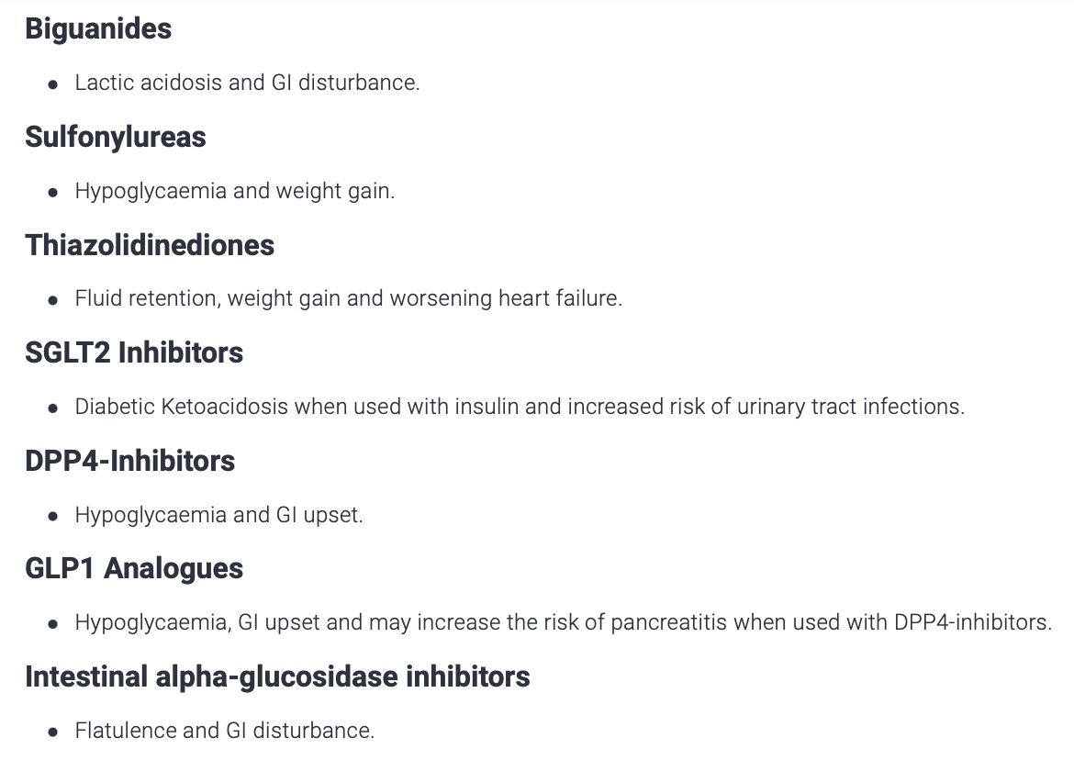
Notes:
Reference- Quesmed

Slide 22
Hyperosmolar Hyperglycemic State
DEFINITION, CAUSE/S & RISK FACTORS | Life-threatening emergency characterised by marked hyperglycaemia, hyperosmolality (because of increased glucose and potassium levels in serum) and usually no ketosis. HHS typically presents in the elderly with type 2 diabetes mellitus (T2DM).
PATHOPHYSIOLOGY | Decreased insulin levels are: - sufficient to inhibit hepatic ketogenesis (i.e. so diabetic ketoacidosis cannot occur as its not absolute insulin deficiency) BUT - insufficient to inhibit hepatic glucose production (so cause increased levels of glucose leading to hyperglycaemia) Hyperglycaemia results in osmotic diuresis with associated loss of sodium and potassium Severe volume depletion results in a significant raised serum osmolarity (typically > than 320 mosmol/kg), resulting in hyper viscosity of blood.
PRESENTATION (Sx) | General: fatigue, lethargy, nausea and vomiting Neurological: altered level of consciousness, headaches, papilloedema, weakness Haematological: hyperviscosity (may result in myocardial infarctions, stroke and peripheral arterial thrombosis) Cardiovascular: dehydration, hypotension, tachycardia
Notes:
Reference- Passmed and Quesmed

Slide 23
Hyperosmolar Hyperglycemic State
DIAGNOSIS & INVESTIGATIONS (Ix) | It is characterised by: severe hyperglycaemia (>30mmol/L) hypotension hyperosmolality (usually >320 mosmol/kg). Unlike in DKA (Diabetic Ketoacidosis), the hyperglycaemia is not accompanied by significant acidosis (pH>7.3; bicarb >15mmol/L) or ketosis (ketones > 3mmol/L).
TREATMENT (Tx) | Fluid replacement with 0.9% saline VTE prophylaxis - these patients are high risk due to dehydration e.g. Low molecular weight heparin (anticoagulant) e.g. Enoxaparin Give Insulin- Only if high levels of ketones or glucose doesn’t decrease after fluid replacement
COMPLICATIONS | Stroke, MI, PE Insulin related Hypoglycaemia- can occur with excessive high-dose insulin therapy Treatment related Hypokalaemia- can occur with excessive high-dose insulin therapy
Notes:
Reference- Passmed and Quesmed

Slide 24
QUESTION 3
A 56-year-old diabetic female is admitted to hospital in order to have intravenous antibiotics for community acquired pneumonia. On day 4 of admission, she becomes confused and drowsy after which she has a short seizure which spontaneously resolves. Her capillary glucose is noted at 2.6mmol/L and she is unconscious.
What is the most appropriate immediate management of this patient?
Oral glucose tables
IV glucose
IV glucagon
IM insulin
Notes:
IV glucose Intravenous glucose - This is the most rapid method of reversing hypoglycaemia and is indicated in this case because the patient is unconscious and has had a seizure

Slide 25
QUESTION 3
Hypoglycaemia
A 56-year-old diabetic female is admitted to hospital in order to have intravenous antibiotics for community acquired pneumonia. On day 4 of admission, she becomes confused and drowsy after which she has a short seizure which spontaneously resolves. Her capillary glucose is noted at 2.6mmol/L and she is unconscious.
What is the most appropriate immediate management of this patient?
Oral glucose tables
IV glucose
IV glucagon
IM insulin
Notes:
IV glucose - This is the most rapid method of reversing hypoglycaemia and is indicated in this case because the patient is unconscious and has had a seizure

Slide 26
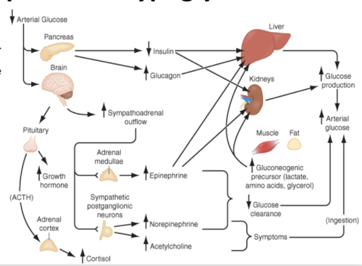
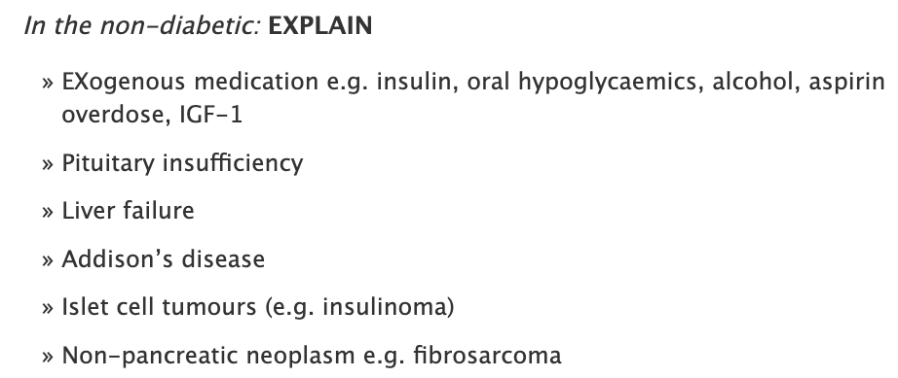
HYPOGLYCAEMIA
DEFINITION | Hypoglycaemia occurs when glucose concentration falls below the normal fasting glucose level. Generally, this is defined as blood glucose levels below 3 mmol/L.
PATHOPHYSIOLOGY | Normal physiological response to hypoglycaemia: Blood glucose taken up by cells, levels of glucose within blood drop. Stimulates alpha islet cells → produce glucagon and reduce production of insulin from beta cells. Glucagon acts to increase liver gluconeogenesis and glycogenolysis. ↓ Blood glucose → All these mechanism act to increase blood glucose rapidly. The pathophysiology of hypoglycaemia depends on its cause, and an interruption to one of these above mechanisms.
↑ Production of adrenaline, growth hormone and cortisol levels
CAUSE/S & RISK FACTORS | Hypoglycaemia most often associated with diabetes and frequently a multifactorial presentation Diabetes: Excess levels of insulin An adverse effect when starting on Sulfonylureas or increasing dose Non-diabetic →
Notes:
https://www.ncbi.nlm.nih.gov/books/NBK279100/
https://medmnemonics.wordpress.com/2011/12/12/hypoglycaemia-causes/

Slide 27
HYPOGLYCAEMIA
PRESENTATION (Sx) | Severe and uncommon features of hypoglycaemia include: - Convulsion - Coma
Blood glucose concentration | Presentation
<3.3 mmol/L (autonomic) | Sweating, Shaking, Hunger, Anxiety, Nausea
<2.8 mmol/L (neuroglycopenic) | Weakness, Vision changes, Confusion, Dizziness
DIAGNOSIS & INVESTIGATIONS (Ix) | 1st LINE : Whipple’s triad aids to help diagnosis of hypoglycaemia: Signs and symptoms of hypoglycaemia Low blood glucose Resolution of symptoms with correction of blood glucose GS: 48 to 72-hour fast with serial blood glucose
TREATMENT (Tx) | In the community setting: - Initially oral glucose 10-20g (liquid, gel, tablet form) - ‘Hypokit’ may be prescribed which contains a syringe and vial of glucagon for IM/SC injection In Hospital setting: - If patient is alert, a quick acting carbohydrate may be given - If patient is unconscious or unable to swallow, SC/IM injection of GLUCAGON - Alternatively IV 20% Glucose solution

Slide 28
QUESTION 4
A 30-year-old female presents with sudden weight gain (5kg) over the last 2 months. She complains of constipation, hair loss with brittle nails. You notice the loss of hair to the lateral third of the left eyebrows.
Which antibody is most likely to be associated with the condition presented above?
Anti TPO
Anti dsDNA
TSH receptor antibodies
Anti Thyroglobulin antibodies
BONUS QUESTION: What is this condition?
Notes:
Anti TPO
https://hairsite.com/hair-loss/board_entry-id-21990-da-DESC-page-112-order-time-descasc-DESC-category-2.html

Slide 29
QUESTION 4
A 30-year-old female presents with sudden weight gain (5kg) over the last 2 months. She complains of constipation, hair loss with brittle nails. You notice the loss of hair to the lateral third of the left eyebrows.
Which antibody is most likely to be associated with the condition presented above?
Anti TPO
Anti dsDNA
TSH receptor antibodies
Anti Thyroglobulin antibodies
BONUS QUESTION: What is this condition? Hashimoto’s hypothyroidism
Notes:
Anti TPO
https://hairsite.com/hair-loss/board_entry-id-21990-da-DESC-page-112-order-time-descasc-DESC-category-2.html

Slide 30
HYPOTHYROIDISM
DEFINITION | Hypothyroidism is a clinical syndrome resulting from a deficiency of thyroid hormones, which results in a generalised slowing of metabolic processes.
CAUSE/S & RISK FACTORS | Primary Hypothyroidism: Autoantibodies: Thyroglobulin and thyroid peroxidase antibodies present at low levels Hashimoto’s thyroiditis (Most common cause of primary hypothyroidism), De Quervain’s thyroiditis, Radiotherapy, Drug therapy e.g. lithium, amiodarone, or anti thyroid drugs such as Carbimazole, Dietary iodine deficiency Secondary Hypothyroidism (rare): From pituitary failure- Not enough TSH Hypothyroidism associations: Downs syndrome, Turner’s syndrome, Coeliac disease
PATHOPHYSIOLOGY | Primary hypothyroidism Peripheral thyroid disorder→ T3/T4 not produced (↓ levels) → Compensatory ↑ TSH Levels Secondary hypothyroidism: Pituitary disorders→ TSH levels ↓ → T3/T4 levels ↓
PRESENTATION | Weight gain, Lethargy, Cold intolerance, Dry, coarse scalp, Loss of lateral aspect of eyebrow, Constipation, Menorrhagia
DIAGNOSIS & INVESTIGATIONS | 1ST LINE: Thyroid function tests(TFTs)- Primarily look at TSH ad T4 levels (Low T4 and High TSH) Antithyroid peroxidase antibodies- elevated Other: Fasting blood glucose- Recommended in assessment of patients with non- specific fatigue and weight gain. Primary hypothyroidism is associated with type 1 diabetes mellitus
TREATMENT (Tx) | Levothyroxine

Slide 31
HASHIMOTO’S THYROIDITIS
DEFINITION | An autoimmune disease, in which the thyroid gland is attacked by a variety of cell- and antibody-mediated immune processes, causing primary hypothyroidism.
CAUSE/S & RISK FACTORS | Autoimmune
PATHOPHYSIOLOGY | Autoimmune disease in which thyroid cells are destroyed via cell and antibody-mediated immune processes. The pathophysiology of Hashimoto thyroiditis involves the formation of antithyroid antibodies that attack the thyroid tissue, causing progressive fibrosis. (Low T4 and High TSH). Associated with type 1 diabetes mellitus, Addison's or pernicious anaemia and may cause transient thyrotoxicosis in the acute phase
PRESENTATION | Same as Hypothyroidism
DIAGNOSIS & INVESTIGATIONS | 1ST LINE = Thyroid function tests(TFTs)- Primarily look at TSH ad T4 levels (Low T4 and High TSH) GS = Antithyroid peroxidase antibodies- POSITIVE
TREATMENT | Levothyroxine

Slide 32
HYPERTHYROIDISM
DEFINITION | Hyperthyroidism= Increase synthesis of T3 and T4 in the thyroid gland Thyrotoxicosis= Increase T3 and T4 in circulation (clinical syndrome)
CAUSE/S & RISK FACTORS | Graves’s Disease (most common), Toxic multinodular goitre, Iodine excess, De Quervain’s thyroiditis, thyroiditis, Drug induced (iodine, amiodarone)
PATHOPHYSIOLOGY | In Hyperthyroidism- HIGH T3 AND T4, LOW TSH levels Thyroid hormone plays a major role in metabolism, growth and development.
PRESENTATION | Weight loss, heat intolerance, palpitations, increased sweating, pretibial myxoedema, diarrhoea, oligomenorrhea, anxiety, tremor
DIAGNOSIS & INVESTIGATIONS | 1ST LINE: Thyroid function tests(TFTs)- Primarily look at TSH ad T4 levels (High T4 and low TSH) Antibodies- TSH-receptor antibodies
TREATMENT | Depends on the cause- Propranolol- This is often used at the time of diagnosis to control thyrotoxic symptoms such as tremor Carbimazole- Blocks thyroid peroxidase> reduces thyroid levels (AGRANULOCYTOSIS IS A COMMON SE) OR Propylthiouracil - Radioiodine treatment- This emits beta particle which causes ionisation of thyroid cell. May exacerbate thyroid eye disease - Surgery

Slide 33
GRAVES’ DISEASE
DEFINITION | Graves’ Disease is an autoimmune thyroid condition and the most common cause of hyperthyroidism caused by TSH receptor antibodies.
CAUSE/S & RISK FACTORS | Autoimmune condition, Alemtuzumab (a drug used to treat MS)
PATHOPHYSIOLOGY | Graves' disease, one of the autoimmune thyroid diseases, is caused by the production of IgG autoantibodies directed against the thyrotropin (TSH) receptor. These antibodies bind to and activate the receptor, causing the autonomous production of thyroid hormones.
PRESENTATION | Weight loss, heat intolerance, palpitations, increased sweating, pretibial myxoedema, anxiety, tremor, diffuse goitre, orbitopathy Eye signs- Exophthalmos and ophthalmoplegia Pretibial myxoedema Thyroid acropachy, a triad of digital clubbing, soft tissue swelling of hands and feet, periosteal new bone formation
DIAGNOSIS & INVESTIGATIONS | Thyroid function tests(TFTs)- Primarily look at TSH ad T4 levels (High T4 and low TSH) TPO-Ab, Isotope scan, MRI, CT, Ultrasound
TREATMENT | Anti-Thyroid drugs- block thyroid hormone synthesis, carbimazole, thiamazole Radioactive iodine therapy- Surgery Patients with active moderate to severe and sight-threatening orbitopathy first-line treatment is intravenous corticosteroid (e.g., methylprednisolone)

Slide 34
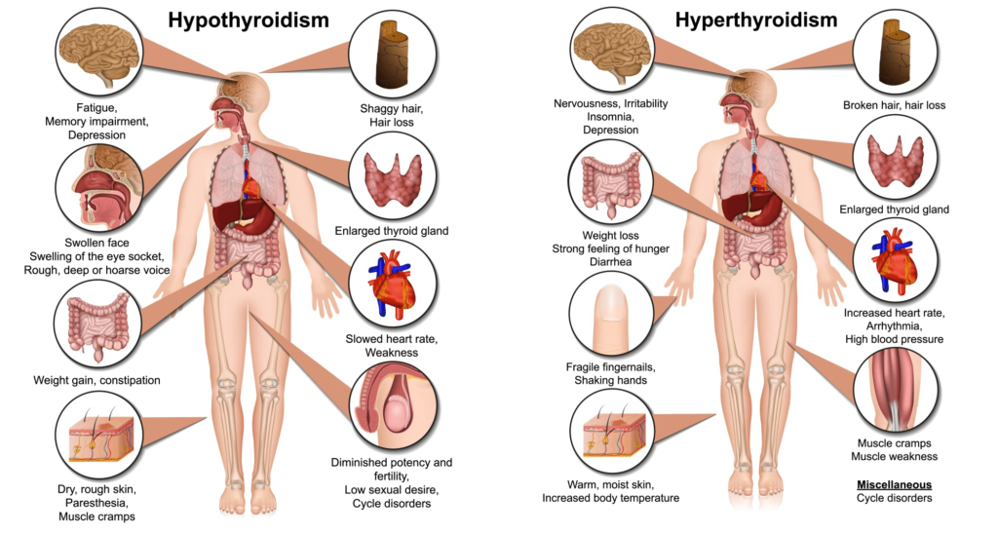
Notes:
https://www.medicdrive.org/thyroid-disease/

Slide 35
QUESTION 5
A 30-year-old man presents to the acute medical unit with agitation, restlessness and palpitations. He has steadily been getting worse over the last four weeks, feeling increasingly tired and run down. He is previously well with no significant past medical or family history. On examination he is noted to have a swollen and painful neck anteriorly. He is tachycardic at 130 reg bpm. He is apyrexial.
Thyroid blood tests reveal:
Thyroid stimulating hormone (TSH) 1.1 (0.5-5.5mu/L)
Free Thyroxine (T4) 30 (9-18pmol/L)
Which of the following is the most likely diagnosis?
Acute thyroiditis
De Quervain’s (Subacute) Thyroiditis
Autoimmune thyroiditis
Thyroid cancer
Notes:
De Quervain’s (Subacute) Thyroiditis – important is the fever like symptoms as this is preceded by a viral infection

Slide 36
QUESTION 5
A 30-year-old man presents to the acute medical unit with agitation, restlessness and palpitations. He has steadily been getting worse over the last four weeks, feeling increasingly tired and run down. He is previously well with no significant past medical or family history. On examination he is noted to have a swollen and painful neck anteriorly. He is tachycardic at 130 reg bpm. He is apyrexial.
Thyroid blood tests reveal:
Thyroid stimulating hormone (TSH) 1.1 (0.5-5.5mu/L)
Free Thyroxine (T4) 30 (9-18pmol/L)
Which of the following is the most likely diagnosis?
Acute thyroiditis
De Quervain’s (Subacute) Thyroiditis
Autoimmune thyroiditis
Thyroid cancer
Notes:
De Quervain’s (Subacute) Thyroiditis – important is the fever like symptoms as this is preceded by a viral infection

Slide 37
De QUERVAIN’S THYROIDITIS
DEFINITION, | AKA Subacute granulomatous thyroiditis is a self-limited inflammation of the thyroid gland. It results in the rapid swelling of the thyroid gland resulting in pain and discomfort.
CAUSE/S & RISK FACTORS | Often thought to occur following a viral infection- Typically presents with hyperthyroidism
PATHOPHYSIOLOGY | There are typically 4 phases: Phase 1- lasts 3-6 weeks: hyperthyroidism, painful goitre, Raised ESR Phase 2- Lats 1-3 weeks: Euthyroid (normal function) Phase 3- weeks to months: Hypothyroidism Phase 4- Thyroid structure and function goes back to normal
PRESENTATION | Neck Pain (may move to jaw and ears), difficulty eating, tender, firm, enlarged thyroid, fever, palpitations (Occur in >70% of patients who have symptoms of thyrotoxicosis)
DIAGNOSIS & INVESTIGATIONS | 1ST LINE: Total T4, T3, T3 resin uptake, free thyroxine index- All elevated, CRP = elevated
TREATMENT | Hyperthyroid phase- NSAIDs and corticosteroids may be used for pain. Hypothyroid phase- Normally no treatment given but if sever hypothyroidism occurs give small dose of levothyroxine.
COMPLICATIONS | Thyroid storm, Long term hypothyroidism
DIFFERENTIAL DIAGNOSIS | Graves’ disease, Hashimoto’s, Thyroid cancer, Toxic multinodular goitre

Slide 38
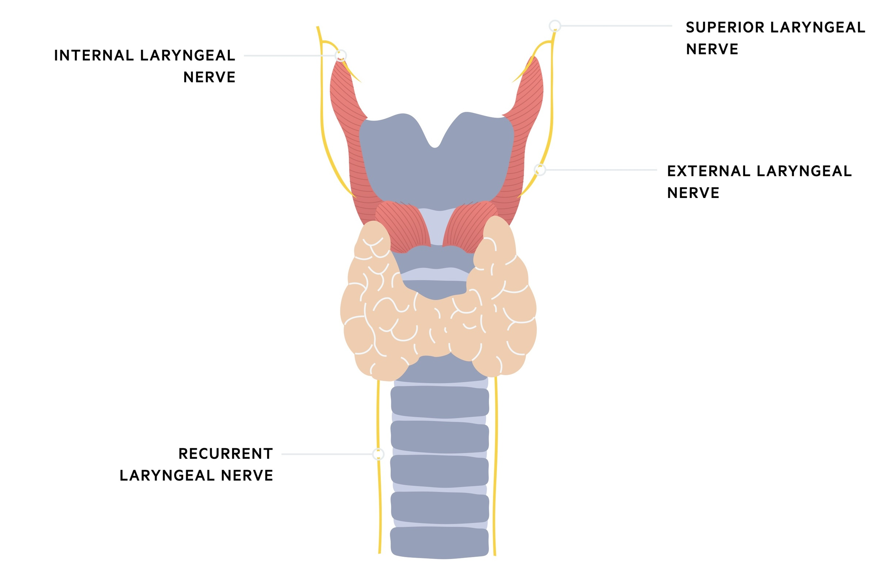
QUESTION 6
A 55-year-old women with a thyroid carcinoma undergoes a total thyroidectomy. The post operative histology report shows a final diagnosis of medullary type thyroid cancer. Which of the tests below is most likely to be of clinical use in screening for disease recurrence?
Serum CA 19-9 levels
Serum thyroglobulin
Serum TSH
Serum Calcitonin
Notes:
Serum calcitonin - Medullary thyroid cancers often secrete calcitonin and monitoring the serum levels of this hormone is useful in detecting sub clinical recurrence
https://app.pulsenotes.com/surgery/ent/notes/thyroid-cancer

Slide 39
QUESTION 6
Thyroid cancer
A 55-year-old women with a thyroid carcinoma undergoes a total thyroidectomy. The post operative histology report shows a final diagnosis of medullary type thyroid cancer. Which of the tests below is most likely to be of clinical use in screening for disease recurrence?
Serum CA 19-9 levels
Serum thyroglobulin
Serum TSH
Serum Calcitonin
Notes:
Serum calcitonin - Medullary thyroid cancers often secrete calcitonin and monitoring the serum levels of this hormone is useful in detecting sub clinical recurrence
https://app.pulsenotes.com/surgery/ent/notes/thyroid-cancer

Slide 40
THYROID CANCER
DEFINITION | Four types of account for more than 98% of thyroid malignancies: papillary, follicular, anaplastic, and medullary
CAUSE/S & RISK FACTORS | Genetic alteration and mutations Rf: Head and neck irradiation and female sex
PRESENTATION | Palpable thyroid nodule
DIAGNOSIS & INVESTIGATIONS | 1ST LINE: US Neck, Fine needle biopsy, Laryngoscopy
TREATMENT | Thyroidectomy, followed by radioactive iodine ablation and suppression of TSH
COMPLICATIONS | Complications of total thyroidectomy include an increased risk of recurrent laryngeal nerve damage or hypoparathyroidism

Slide 41
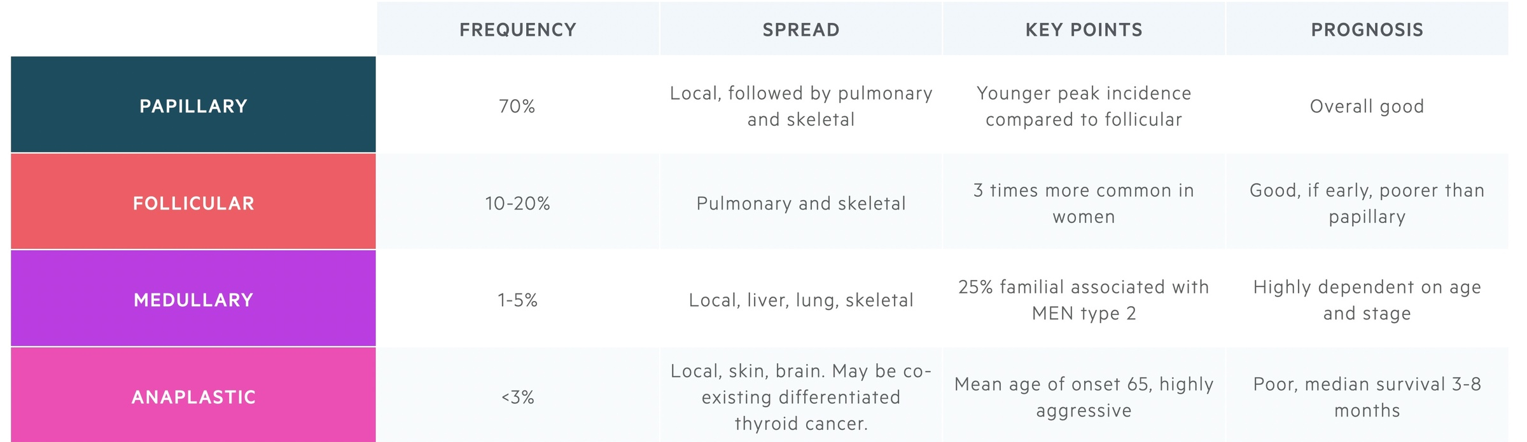
Notes:
https://app.pulsenotes.com/surgery/ent/notes/thyroid-cancer

Slide 42
THYROID STORM
DEFINITION, | Thyroid storm (also known as thyroid or thyrotoxic crisis) represents the severe end of the spectrum of thyrotoxicosis and is characterized by compromised organ function (Rare)
CAUSE/S & RISK FACTORS | Graves disease, Post thyroidectomy, Infection, Trauma, MI, DKA, Pregnancy etc, Exogenous iodine, Abrupt cessation/Lack of adherence with Antithyroid drugs
PATHOPHYSIOLOGY | Thyrotoxicosis is the clinical syndrome that results when tissues are exposed to high levels of circulating thyroid hormone. In most instances, thyrotoxicosis is due to hyperactivity of the thyroid gland, or hyperthyroidism.
PRESENTATION | Fever, cardiovascular dysfunction, profuse sweating, tachyarrhythmias, nausea and vomiting
DIAGNOSIS & INVESTIGATIONS | 1ST LINE: Free thyroxine and TSH- Completely suppressed TSH with high thyroxine
TREATMENT | 1ST LINE: Antithyroid treatment- Carbimazole Hydrocortisone administration is also recommended. It treats possible relative adrenal insufficiency while also decreasing T4 to T3 conversion GS: Thyroidectomy

Slide 43
Prolactinoma
Acromegaly
Cushing’s syndrome
Pituitary Adenomas
Notes:
Adenomas are benign

Slide 44
Cushing’s Syndrome
DEFINITION | Endocrine disorder caused by the chronic abnormal elevation of cortisol (a glucocorticoid).
CAUSE/S & RISK FACTORS | Aetiology can be ACTH dependent or ACTH independent. ACTH independent- i.e. ACTH levels will be normal but cortisol levels are high • Iatrogenic- caused by oral steroids such as glucocorticoid e.g. PREDNISOLONE -- MOST COMMON CAUSE • Adrenal adenoma- benign tumour of the adrenal gland that secretes increased levels cortisol. ACTH dependent- i.e. ACTH levels will be high and cortisol levels are high (something is causing the ACTH levels to be high which is increasing the cortisol levels) • Cushing's disease - caused by an anterior pituitary adenoma which secretes increases ACTH leading to increased levels of cortisol-- MOST COMMON ACTH DEPENDENT CAUSE • Ectopic ACTH production - Essentially neoplasm somewhere in the body secreting excessive levels of ACTH - Especially small cell lung cancer and carcinoid tumours (type of neuroendocrine tumour that grows from neuroendocrine cells) ACTH dependent causes are rare. ACTH independent specifically the taking of oral steroids is the most common cause.
PRESENTATION | Round moon face Central Obesity Abdominal striae Buffalo Hump (fat pad on upper back) Proximal limb muscle wasting--- due to proteolysis
Mood change (depression, lethargy, irritability, psychosis) Irregular periods or Ammenorhea (absence of period) Acne
Hirsutism
Notes:
Reference- https://zerotofinals.com/medicine/endocrinology/cushings/
Quick way to remember the three layers of the adrenal cortex and what they produce?
GFR makes good SEX
G M
F G
R S
Zona glomerulosa---- mineralcorticoids ---- aldosterone (way to remember = am) Zona fasciculata---- glucocorticoids ---- cortisol (way to remember = gc) Zona reticularis---- sex hormones ---- androgens

Slide 45
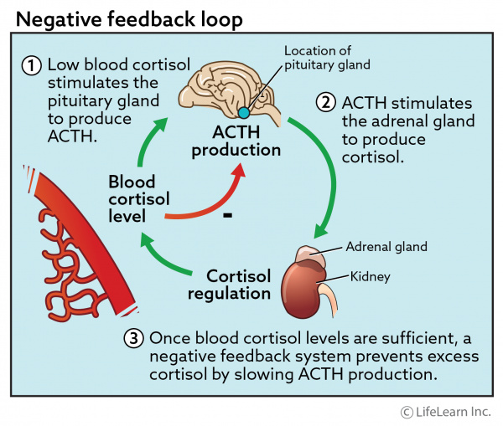
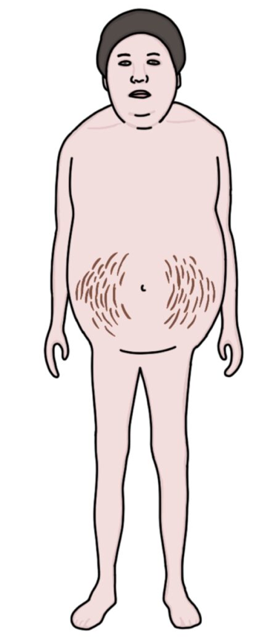
Cushing’s Syndrome
Notes:
Reference- https://zerotofinals.com/medicine/endocrinology/cushings/
Quick way to remember the three layers of the adrenal cortex and what they produce?
GFR makes good SEX
G M
F G
R S
Zona glomerulosa---- mineralcorticoids ---- aldosterone (way to remember = am) Zona fasciculata---- glucocorticoids ---- cortisol (way to remember = gc) Zona reticularis---- sex hormones ---- androgens

Slide 46
Cushing’s Syndrome
DIAGNOSIS & INVESTIGATIONS | 1st-line test - raised plasma cortisol (Don't rely on random plasma cortisol as they may mislead, as illness, time of day, and stress (eg venepuncture) influence results) Gold standard- Dexamethasone suppression test- Low dose 1mg Other tests- 24-hour urinary free cortisol can be used as an alternative to the dexamethasone suppression test but does not indicate the underlying cause. MRI brain for pituitary adenoma Chest CT for small cell lung cancer Abdominal CT for adrenal tumours
TREATMENT | Iatrogenic cause - stop steroids! Adrenal adenoma- Adrenalectomy Cushing’s disease- trans-sphenoidal surgery to remove pituitary adenoma Ectopic ACTH production- surgery to remove neoplasm if can be located and hasn’t metastasised. If surgical removal of the cause is not possible another option is to remove both adrenal glands and give the patient replacement steroid hormones for life.
COMPLICATIONS | Hypertension Cardiovascular disease Osteoporosis Diabetes Mellitus
Notes:
Reference- https://zerotofinals.com/medicine/endocrinology/cushings/
Low Dose Dexamethasone Suppression Test (1mg dexamethasone)
A normal response is for the dexamethasone to suppress the release of cortisol by effecting negative feedback on the hypothalamus and pituitary. The hypothalamus responds by reducing the CRH output. The pituitary responds by reducing the ACTH output. The lower CRH and ACTH levels result in a low cortisol level. When the cortisol level is not suppressed, this is the abnormal result seen in Cushing’s Syndrome
High Dose Dexamethasone Suppression Test (8mg dexamethasone)
The high dose dexamethasone suppression test is performed after an abnormal result on the low dose test.
In Cushing’s Disease (pituitary adenoma) the pituitary still shows some response to negative feedback and 8mg of dexamethasone is enough to suppress cortisol.
Where there is an adrenal adenoma, cortisol production is independent from the pituitary. Therefore, cortisol is not suppressed however ACTH is suppressed due to negative feedback on the hypothalamus and pituitary gland.
Where there is ectopic ACTH (e.g. from a small cell lung cancer), neither cortisol or ACTH will be suppressed because the ACTH production is independent of the hypothalamus or pituitary gland.

Slide 47
Cushing’s Syndrome
Notes:
Reference- https://zerotofinals.com/medicine/endocrinology/cushings/
Low Dose Dexamethasone Suppression Test (1mg dexamethasone)
A normal response is for the dexamethasone to suppress the release of cortisol by effecting negative feedback on the hypothalamus and pituitary. The hypothalamus responds by reducing the CRH output. The pituitary responds by reducing the ACTH output. The lower CRH and ACTH levels result in a low cortisol level. When the cortisol level is not suppressed, this is the abnormal result seen in Cushing’s Syndrome
High Dose Dexamethasone Suppression Test (8mg dexamethasone)
The high dose dexamethasone suppression test is performed after an abnormal result on the low dose test.
In Cushing’s Disease (pituitary adenoma) the pituitary still shows some response to negative feedback and 8mg of dexamethasone is enough to suppress cortisol.
Where there is an adrenal adenoma, cortisol production is independent from the pituitary. Therefore, cortisol is not suppressed however ACTH is suppressed due to negative feedback on the hypothalamus and pituitary gland.
Where there is ectopic ACTH (e.g. from a small cell lung cancer), neither cortisol or ACTH will be suppressed because the ACTH production is independent of the hypothalamus or pituitary gland.

Slide 48
Acromegaly
DEFINITION, CAUSE/S & RISK FACTORS | Endocrine disorder resulting from excessive secretion of Growth hormone. Causes- Anterior Pituitary adenoma (remember adenoma is a benign tumour) this leads to unregulated GH secretion. In rare cases acromegaly can be secondary to a cancer, such as lung or pancreatic cancer which secretes GHRH or GH.
PATHOPHYSIOLOGY | GHRH is released from the hypothalamus and stimulates the release of GH from the anterior pituitary. The excess growth hormone (GH) from the anterior pituitary results in excessive production of insulin like growth factor (IGF-1) which is responsible for inappropriate growth. This stimulates bone and soft tissue growth.
PRESENTATION (Sx) | • Bi-temporal hemianopia • Large spade like hands and feet • Acroparaesthesia - tingling and numbness of arms/legs • Arthralgia (joint pain) • Back ache • Oily skin • Excessive sweating • Headache • Amenorrhoea (absence of period) • Mood disturbances
Notes:
https://zerotofinals.com/medicine/endocrinology/acromegaly/
Risk factor for acromegaly- MEN 1
The optic chiasm sits just above the pituitary gland. The optic chiasm is the point where the optic nerves coming from the eyes crossover to different sides of the head. A pituitary tumour of sufficient size will start to press on the optic chiasm. Pressure on the optic chiasm will lead to a stereotypical “bitemporal hemianopia” visual field defect. This describes loss of vision on the outer half of both eyes.
What is the difference between acromegaly and gigantism?
Gigantism- Excessive GH production in children BEFORE fusion of the epiphyses of the long bones
Acromegaly- Excess GH in adults

Slide 49
Acromegaly
What inhibits the release of GH?
Notes:
https://zerotofinals.com/medicine/endocrinology/acromegaly/
Risk factor for acromegaly- MEN 1
The optic chiasm sits just above the pituitary gland. The optic chiasm is the point where the optic nerves coming from the eyes crossover to different sides of the head. A pituitary tumour of sufficient size will start to press on the optic chiasm. Pressure on the optic chiasm will lead to a stereotypical “bitemporal hemianopia” visual field defect. This describes loss of vision on the outer half of both eyes.
What is the difference between acromegaly and gigantism?
Gigantism- Excessive GH production in children BEFORE fusion of the epiphyses of the long bones
Acromegaly- Excess GH in adults

Slide 50
Acromegaly
What inhibits the release of GH?
Somatostatin High levels of glucose Dopamine (but this is not as potent as Somatostatin)
Notes:
https://zerotofinals.com/medicine/endocrinology/acromegaly/
Risk factor for acromegaly- MEN 1
The optic chiasm sits just above the pituitary gland. The optic chiasm is the point where the optic nerves coming from the eyes crossover to different sides of the head. A pituitary tumour of sufficient size will start to press on the optic chiasm. Pressure on the optic chiasm will lead to a stereotypical “bitemporal hemianopia” visual field defect. This describes loss of vision on the outer half of both eyes.
What is the difference between acromegaly and gigantism?
Gigantism- Excessive GH production in children BEFORE fusion of the epiphyses of the long bones
Acromegaly- Excess GH in adults

Slide 51
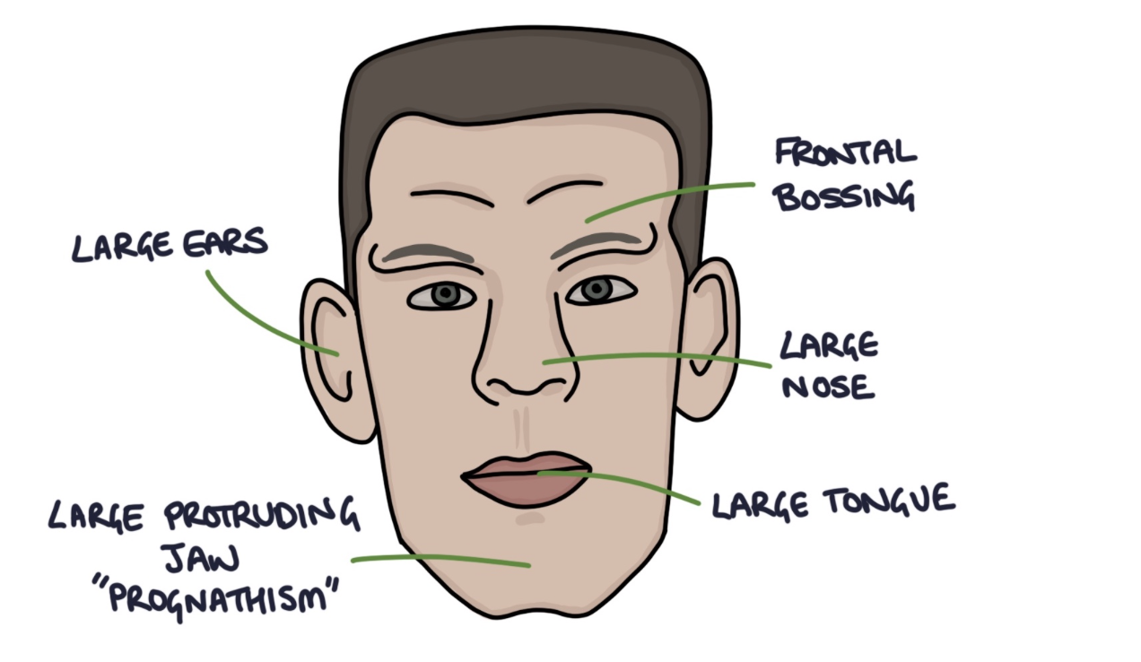
Acromegaly
Somatostatin High levels of glucose Dopamine (but this is not as potent as Somatostatin)
Notes:
https://zerotofinals.com/medicine/endocrinology/acromegaly/
Risk factor for acromegaly- MEN 1
The optic chiasm sits just above the pituitary gland. The optic chiasm is the point where the optic nerves coming from the eyes crossover to different sides of the head. A pituitary tumour of sufficient size will start to press on the optic chiasm. Pressure on the optic chiasm will lead to a stereotypical “bitemporal hemianopia” visual field defect. This describes loss of vision on the outer half of both eyes.
What is the difference between acromegaly and gigantism?
Gigantism- Excessive GH production in children BEFORE fusion of the epiphyses of the long bones
Acromegaly- Excess GH in adults

Slide 52
Acromegaly
DIAGNOSIS & INVESTIGATIONS (Ix) | A random growth hormone level is not helpful as it will fluctuate, giving false positives and false negatives 1st line- Insulin-like Growth Factor 1 (IGF-1) GS- Oral glucose tolerance test- Give patient glucose. Normally serum GH would decrease. In individuals with Acromegaly GH release isn't supressed. MRI brain for the pituitary tumour- to assess the size and extent of the tumour.
TREATMENT (Tx) | Trans-sphenoidal surgery of the pituitary tumour is gold standard tx for acromegaly secondary to pituitary adenomas. Surgical removal of cancer is tx for acromegaly secondary to cancer. If the above don’t work there are medication that can be used to block GH. 2nd line-Somatostatin analogues to block GH release (e.g. octreotide) 3rd line- Pegvisomant (GH antagonist given subcutaneously and daily) OR Dopamine agonists to block GH release (e.g. bromocriptine)
COMPLICATIONS | Type 2 diabetes - due to constant high glucose levels Heart disease- due to possible hypertrophy of the heart due to increased GH Hypertension Arthritis - due to overgrowth of cartilage Carpal tunnel - as muscle growth compresses nerves Visual fields defect- Bitemporal Hemianopia
Notes:
https://zerotofinals.com/medicine/endocrinology/acromegaly/
Reference- Passmed and Quesmed
Why are plasma GH levels not used as a diagnostic factor for acromegaly?
Secretion is pulsatile and increases at certain times such as when stressed, during sleep, puberty, pregnancy. If high GH levels then proceed to Oral glucose tolerance test.

Slide 53
QUESTION 7
A 40 year old man attends his GP because of headaches that have been going on for 3 months. It is also uncovered that he has been experiencing erectile dysfunction and he is low in mood because of this.
Following referral to the Neurologists, he has an MRI scan to investigate his headache. This reveals a pituitary adenoma.
What is the most likely cause for his problems?
ACTH producing tumour
Growth hormone producing tumour
TSHoma
Prolactinoma
Non-secreting tumour

Slide 54
QUESTION 7
A 40-year-old man attends his GP because of headaches that have been going on for 3 months. It is also uncovered that he has been experiencing erectile dysfunction and he is low in mood because of this.
Following referral to the Neurologists, he has an MRI scan to investigate his headache. This reveals a pituitary adenoma.
What is the most likely cause for his problems?
ACTH producing tumour
Growth hormone producing tumour
TSHoma
Prolactinoma
Non-secreting tumour

Slide 55
Prolactinoma
DEFINITION, CAUSE/S & RISK FACTORS | Lactotrophs are the cells in the anterior pituitary which produce and release prolactin (PRL). Prolactinoma- benign lactotroph adenomas expressing and secreting prolactin. It is a type of pituitary adenoma. Risk factors- Biologically female, Peak incidence during childbearing years (20-40 years)
PATHOPHYSIOLOGY | Hypersecretion of prolactin causes secondary hypogonadism (hypogonadism caused by a problem in the pituitary or hypothalamus) this is due its inhibitory effects on gonadotrophin-releasing hormone. Hypogonadism is when sex glands called gonads produce little, if any, sex hormones.
PRESENTATION (Sx) | FEMALES Amenorrhoea - absence of a menstrual period Oligomenorrhoea - irregular menstrual period Infertility- as high prolactin inhibits ovulation in women due to its effect of GnRH Galactorrhoea - spontaneous flow of milk from breasts in both males & females Low libido- due to hypogonadism MALES Low testosterone Erectile dysfunction Reduced facial hair Low libido
What is Prolactin?
Notes:
Reference- BMJ Best practice
Increase in Prolactin inhibits release of GnRH from hypothalamus -> Decrease in LH, FSH from anterior pituitary > This decreases release of oestrogen and progesterone in females and in males decreases the release of Testosterone

Slide 56
Prolactinoma
DEFINITION, CAUSE/S & RISK FACTORS | Lactotrophs are the cells in the anterior pituitary which produce and release prolactin (PRL). Prolactinoma- benign lactotroph adenomas expressing and secreting prolactin. It is a type of pituitary adenoma. Risk factors- Biologically female, Peak incidence during childbearing years (20-40 years)
PATHOPHYSIOLOGY | Hypersecretion of prolactin causes secondary hypogonadism (hypogonadism caused by a problem in the pituitary or hypothalamus) this is due its inhibitory effects on gonadotrophin-releasing hormone. Hypogonadism is when sex glands called gonads produce little, if any, sex hormones.
PRESENTATION (Sx) | FEMALES Amenorrhoea - absence of a menstrual period Oligomenorrhoea - irregular menstrual period Infertility- as high prolactin inhibits ovulation in women due to its effect of GnRH Galactorrhoea - spontaneous flow of milk from breasts in both males & females Low libido- due to hypogonadism MALES Low testosterone Erectile dysfunction Reduced facial hair Low libido
What is Prolactin?
A a hormone made by lactotrophs in the anterior pituitary gland. It causes the breasts to grow and make milk during pregnancy and after birth. Prolactin levels are normally high for pregnant women and new mothers. Levels are normally low for non-pregnant women and for men.
Notes:
Reference- BMJ Best practice
Increase in Prolactin inhibits release of GnRH from hypothalamus -> Decrease in LH, FSH from anterior pituitary > This decreases release of oestrogen and progesterone in females and in males decreases the release of Testosterone

Slide 57
Prolactinoma
DEFINITION, CAUSE/S & RISK FACTORS | Lactotrophs are the cells in the anterior pituitary which produce and release prolactin (PRL). Prolactinoma- benign lactotroph adenomas expressing and secreting prolactin. It is a type of pituitary adenoma. Risk factors- Biologically female, Peak incidence during childbearing years (20-40 years)
PATHOPHYSIOLOGY | Hypersecretion of prolactin causes secondary hypogonadism (hypogonadism caused by a problem in the pituitary or hypothalamus) this is due its inhibitory effects on gonadotrophin-releasing hormone. Hypogonadism is when sex glands called gonads produce little, if any, sex hormones.
PRESENTATION (Sx) | FEMALES Amenorrhoea - absence of a menstrual period Oligomenorrhoea - irregular menstrual period Infertility- as high prolactin inhibits ovulation in women due to its effect of GnRH Galactorrhoea - spontaneous flow of milk from breasts in both males & females Low libido- due to hypogonadism MALES Low testosterone Erectile dysfunction Reduced facial hair Low libido
Notes:
Reference- BMJ Best practice
Increase in Prolactin inhibits release of GnRH from hypothalamus -> Decrease in LH, FSH from anterior pituitary > This decreases release of oestrogen and progesterone in females and in males decreases the release of Testosterone

Slide 58
Prolactinoma
DIAGNOSIS & INVESTIGATIONS (Ix) | 1st line) Serum prolactin levels if elevated ---- prolactinoma 2nd line) Pituitary MRI- to detect adenoma
TREATMENT (Tx) | Unlike other pituitary adenomas a medical approach is more efficient than surgical. 1st line– Dopamine agonists e.g. 1st line- ORAL Cabergoline/Bromocriptine • As dopamine inhibits Prolactin release so want to stimulate the release of Dopamine to shrink the prolactinoma. 2nd line- Hormone replacement therapy e.g. oestrogen, where fertility and galactorrhoea are not an issue
COMPLICATIONS | Infertility, sight loss, raised intracranial pressure due to adenoma growth in the brain.
Notes:
Reference- BMJ Best practice

Slide 59
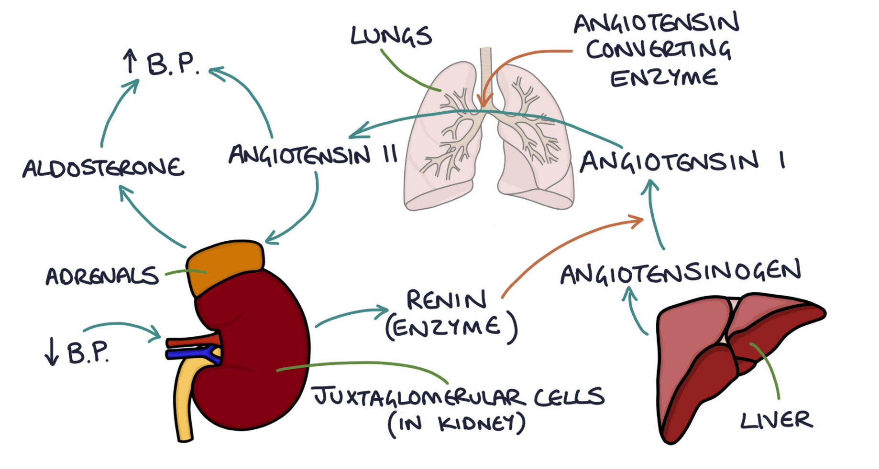
Notes:
In the afferent arteriole in the kidney there are special cells called juxtaglomerular cells. They sense the blood pressure in these vessels. When they sense a low blood pressure in the arteriole they secrete a hormone called renin. This liver secretes a protein called angiotensinogen. Renin acts to convert angiotensinogen to angiotensin I. Angiotensin I converts to angiotensin II in the lungs with the help of angiotensin converting enzyme (ACE). Angiotensin II stimulates the release of aldosterone from the adrenal glands

Slide 60
Aldosterone is a
. It acts on the kidney to:
Increase sodium reabsorption from the distal tubule
Increase potassium excretion from the distal tubule
Notes:
In the afferent arteriole in the kidney there are special cells called juxtaglomerular cells. They sense the blood pressure in these vessels. When they sense a low blood pressure in the arteriole they secrete a hormone called renin. This liver secretes a protein called angiotensinogen. Renin acts to convert angiotensinogen to angiotensin I. Angiotensin I converts to angiotensin II in the lungs with the help of angiotensin converting enzyme (ACE). Angiotensin II stimulates the release of aldosterone from the adrenal glands

Slide 61
Aldosterone is a
. It acts on the kidney to:
Increase sodium reabsorption from the distal tubule
Increase potassium excretion from the distal tubule
mineralocorticoid
Notes:
In the afferent arteriole in the kidney there are special cells called juxtaglomerular cells. They sense the blood pressure in these vessels. When they sense a low blood pressure in the arteriole they secrete a hormone called renin. This liver secretes a protein called angiotensinogen. Renin acts to convert angiotensinogen to angiotensin I. Angiotensin I converts to angiotensin II in the lungs with the help of angiotensin converting enzyme (ACE). Angiotensin II stimulates the release of aldosterone from the adrenal glands

Slide 62
Conn’s
DEFINITION, CAUSE/S & RISK FACTORS | A type of primary hyperaldosteronism caused by an adrenal adenoma. Primary hyperaldosteronism is when the adrenal glands are directly responsible for producing too much aldosterone. Serum renin will be low as it is suppressed by high BP. Causes of primary hyperaldosteronism: Bilateral adrenal hyperplasia (most common ~70%) An adrenal adenoma secreting aldosterone (known as Conn’s Syndrome) Secondary hyperaldosteronism is where excessive renin stimulating the adrenal glands to produce more aldosterone. Serum renin will be high.
PRESENTATION (Sx) | Often asymptomatic but can present with- -Hypertension (primary hyperaldosteronism is usually indistinguishable from hypertension unless Renin and aldosterone are measured) -Headaches -Hypokalaemia (because of the excretion of K+) • Weakness/cramps, paraesthesia, polyuria, nocturia and polydipsia (thirst)
DIAGNOSIS & INVESTIGATIONS (Ix) | 1) FBC/U&E/LFT Plasma potassium ----- Low= Primary Aldosterone/renin ratio -- High ratio (high aldosterone and low renin )= Primary CT/MRI to locate adrenal lesions Selective adrenal venous sampling (Gold Standard)
Notes:
https://zerotofinals.com/medicine/endocrinology/hyperaldosteronism/
High aldosterone and low renin indicates primary hyperaldosteronism
High aldosterone and high renin indicates secondary hyperaldosteronism

Slide 63
Conn’s
TREATMENT (Tx) | Aldosterone antagonists- to control BP levels and low K+ Eplerenone Spironolactone Treat the underlying cause Surgical removal of adenoma (Adrenalectomy) Percutaneous renal artery angioplasty via the femoral artery to treat in renal artery stenosis (a cause of secondary hyperaldosteronism)
Notes:
Reference- BMJ Best practice

Slide 64
Adrenal Insufficiency
DEFINITION, CAUSE/S & RISK FACTORS | Adrenal insufficiency is where the adrenal glands do not produce enough steroid hormones, particularly cortisol and aldosterone. Steroids are essential for life. Therefore, the condition is life threatening unless the hormones are replaced. Primary adrenal insufficiency AKA Addison’s disease is a specific condition where the adrenal glands have been damaged, resulting in reduced cortisol and aldosterone. Most common cause- Autoimmune adrenalitis - Most common in developed countries TB- Most common worldwide Secondary adrenal insufficiency is a caused by inadequate ACTH stimulating the adrenal glands, resulting in low levels of cortisol being released. Due to loss/damage to the pituitary gland. Tertiary adrenal insufficiency is the result of inadequate CRH release by the hypothalamus. This is usually the result of patients being on long term oral steroids (for more than 3 weeks) causing suppression of the hypothalamus.
PRESENTATION (Sx) | Non specific symptoms- Fatigue, Weight loss, Nausea, Vomiting, Hypotension, Abdominal pain Key symptom- Hyperpigmentation especially in the palmar creases for Addison's
Notes:
https://zerotofinals.com/medicine/endocrinology/hyperaldosteronism/
High aldosterone and low renin indicates primary hyperaldosteronism
High aldosterone and high renin indicates secondary hyperaldosteronism

Slide 65
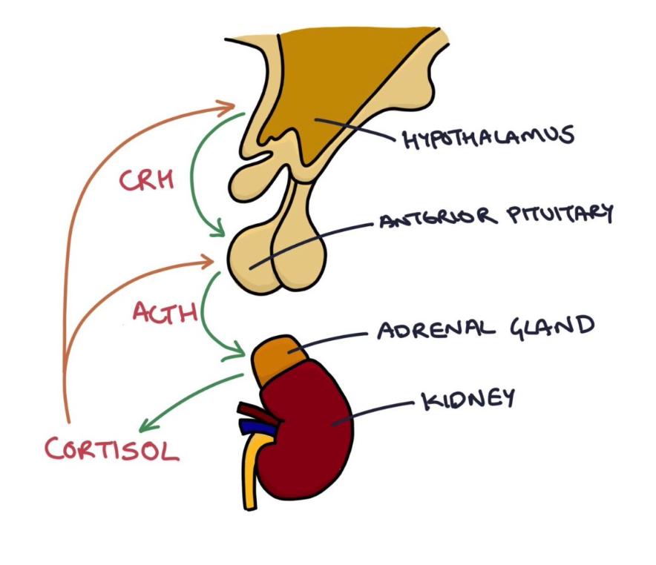
Adrenal Insufficiency
Notes:
https://zerotofinals.com/medicine/endocrinology/hyperaldosteronism/
High aldosterone and low renin indicates primary hyperaldosteronism
High aldosterone and high renin indicates secondary hyperaldosteronism

Slide 66
Adrenal Insufficiency
DIAGNOSIS & INVESTIGATIONS (Ix) | Low sodium- Hyponatremia due to low Aldosterone High potassium- Hyperkalaemia due to low Aldosterone Low cortisol ACTH: High in primary insufficiency, low/low normal in secondary insufficiency Renin (high in Addison’s) Aldosterone (low in Addison’s) GOLD STANDARD- Short synacthen Ideally performed in the morning when the adrenal glands are the most “fresh”. Give patient synacthen (synthetic ACTH). Blood cortisol is measured at baseline, 30 and 60 minutes after administration. In healthy patients should stimulate adrenal glands to produce cortisol. The cortisol level should at least double in response to synacthen. A failure of cortisol to rise (less than double the baseline) indicates primary adrenal insufficiency
TREATMENT (Tx) | Hydrocortisone (glucocorticoid hormone) to replace cortisol. Fludrocortisone (mineralocorticoid hormone) to replace aldosterone- this will correct postural hypotension by increasing Na+, and decreasing K+
COMPLICATIONS | Addisonian Crisis (AKA Adrenal Crisis)---- LEARN ABOUT THIS AND HOW TO MANAGE
Notes:
https://zerotofinals.com/paediatrics/endocrinology/adrenalinsufficiency/

Slide 67
SIADH
DEFINITION, CAUSE/S & RISK FACTORS | Syndrome of inappropriate secretion of ADH. A condition where there is inappropriately high amounts of ADH secretion. Causes Idiopathic Post-operative from major surgery Infection, particularly atypical pneumonia and lung abscesses Head injury Medications (thiazide diuretics, carbamazepine, antipsychotics, SSRIs, NSAIDSs,) Malignancy, particularly small cell lung cancer Meningitis
PATHOPHYSIOLOGY | ADH is produced in the hypothalamus and secreted by the posterior pituitary gland. It stimulates water reabsorption from the collecting ducts in the kidneys. Excessive ADH results in excessive water reabsorption in the collecting ducts. This water dilutes the sodium in the blood so you end up with a low sodium concentration (hyponatraemia). The water reabsorption is not usually significant enough to cause a fluid overload, therefore you end up with a “euvolaemic hyponatraemia”. The urine becomes more concentrated as less water is excreted by the kidneys therefore patients with SIADH have a “high urine osmolality” and “high urine sodium”.
Notes:
https://zerotofinals.com/medicine/endocrinology/siadh/

Slide 68
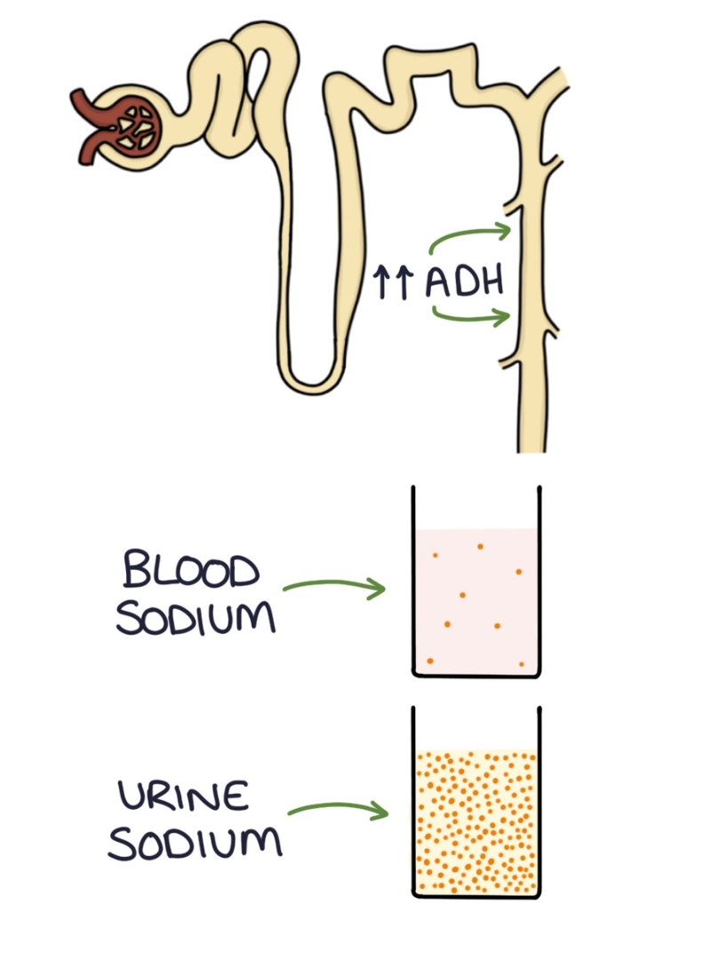
SIADH
Notes:
https://zerotofinals.com/medicine/endocrinology/siadh/

Slide 69
SIADH
PRESENTATION (Sx) | Symptoms largely due to the Hyponatremia Headache Fatigue, confusion Muscle aches and cramps Severe hyponatraemia can cause seizures and reduced consciousness
DIAGNOSIS & INVESTIGATIONS (Ix) | Usually a diagnosis of exclusion Clinical examination will show euvolaemia. U+Es will show a hyponatraemia. Serum osmolality- low Urine sodium and osmolality will be high. Do any imaging to establish the cause
TREATMENT (Tx) | Establish and treat the cause of the SIADH. It is most common for medications to be the cause so if possible it is best to stop the causative medication. Fluid restriction involves restricting their fluid intake to 500mls – 1litre. This may be enough to correct the hyponatraemia without the need for medications. Vasopressin receptor antagonist for chronic SIADH e.g. Tolvaptan.
COMPLICATION | Central pontine myelinolysis. To avoid this it is essential correct the sodium slowly.
Notes:
https://zerotofinals.com/medicine/endocrinology/siadh/

Slide 70
QUESTION 8
A 45-year-old male is seen in the endocrinology clinic for suspected diabetes insipidus. Based on the patient's history, the endocrinologist suspects a central cause of the diabetes insipidus.
Which of the following is a cause of nephrogenic diabetes insipidus?
Craniopharyngioma
Lithium
Head Trauma
CNS Infections
Pituitary Surgery

Slide 71
QUESTION 8
A 45-year-old male is seen in the endocrinology clinic for suspected diabetes insipidus. Based on the patient's history, the endocrinologist suspects a central cause of the diabetes insipidus.
Which of the following is a cause of nephrogenic diabetes insipidus?
Craniopharyngioma
Lithium
Head Trauma
CNS Infections
Pituitary Surgery
Which of the other options are causes of Cranial DI?
Notes:
The rest are all causes of Cranial DI

Slide 72
QUESTION 8
A 45-year-old male is seen in the endocrinology clinic for suspected diabetes insipidus. Based on the patient's history, the endocrinologist suspects a central cause of the diabetes insipidus.
Which of the following is a cause of nephrogenic diabetes insipidus?
Craniopharyngioma
Lithium
Head Trauma
CNS Infections
Pituitary Surgery
Which of the other options are causes of Cranial DI?
ALL OF THEM
Notes:
The rest are all causes of Cranial DI

Slide 73
Diabetes Insipidus
DEFINITION, CAUSE/S & RISK FACTORS | A disease characterised by either the decreased secretion of ADH from the posterior pituitary (Cranial DI) or an insensitivity to ADH (Nephrogenic DI). Most common- Cranial DI Causes of Cranial DI- Cranial diabetes insipidus is when the hypothalamus does not produce ADH for the pituitary gland to secrete. It can be idiopathic, without a clear cause or it can be caused by: Brain tumours Head injury Brain infections (meningitis, encephalitis and tuberculosis) Brain surgery or radiotherapy Causes of Nephrogenic DI- Nephrogenic diabetes insipidus is when the collecting ducts of the kidneys do not respond to ADH. It can also be caused by: Inherited- Most common e.g. mutations in ADH receptor Drugs- lithium used in bipolar affective disorder Systemic disease- e.g. chronic kidney disease Electrolyte disturbance - hypokalaemia and hypercalcaemia
PATHOPHYSIOLOGY | A deficiency of ADH means that there is impaired water retention leading to large volumes of dilute urine– polyuria.
Notes:
https://zerotofinals.com/medicine/endocrinology/diabetesinsipidus/
Cranial DI can also be known as central DI.
Remember ADH is produced by the hypothalamus and secreted from the posterior pituitary,
A way to remember Cranial DI- Hypothalamus which is in the brain i.e. CRANIUM is producing less ADH
A way to remember Nephrogenic DI- Collecting duct is at the end of the nephron and this is what doesn't respond to ADH)

Slide 74
Diabetes Insipidus
PRESENTATION (Sx) | Polyuria (excessive urine production) Polydipsia (excessive thirst) Dehydration Postural hypotension Hypernatraemia
DIAGNOSIS & INVESTIGATIONS (Ix) | Urine osmolality- Low Serum osmolality- High Serum glucose- used to exclude diabetes mellitus should not have glycosuria Serum Na+ - High Water deprivation test– GOLD STANDARD
TREATMENT (Tx) | If possible, treat underlying cause. Cranial diabetes insipidus- Desmopressin (synthetic ADH) Nephrogenic diabetes insipidus- Thiazide diuretics e.g. ORAL BENDROFLUMETHIAZIDE
COMPLICATION | Severe hypernatremia
Notes:
https://zerotofinals.com/medicine/endocrinology/diabetesinsipidus/
Water deprivation test: 2 steps 1) Used to confirm DI
Patients are deprived of fluids for 8 hours. This is referred to as fluid deprivation. The, urine osmolality is measured hourly. If urine still dilute—i.e. urine osmolality low and serum osmolality- high proceed to step 2- indicates DI as a normal response would respond to dehydration
2) Used to distinguish between cranial and nephrogenic DI following water deprivation test. Synthetic ADH (desmopressin) is administered IM. 8 hours later urine osmolality is measured again. 8 hours later-
Patients with cranial DI respond to desmopressin with a reduction in urine output and an increase in urine osmolality to >750 mmol/kg (as they now have a substitute for ther ADH deficiency.
Patients with nephrogenic DI do not respond to desmopressin, with no or little reduction in urine output and no increase in urine osmolality (as they are insensitive to ADH)
Why do we give Thiazide diuretics for Nephrogenic DI?
These work in the DISTAL CONVOLUTED TUBULE to excrete water which will produce a mild hypovolaemia. This will encourage the kidneys to take up more Na+ and water in the PROXIMAL TUBULE, thereby reducing urine output.

Slide 75
Hyperparathyroidism
DEFINITION, CAUSE/S & RISK FACTORS | The excessive secretion of parathyroid hormone. Primary Hyperparathyroidism- tumour/hyperplasia of the parathyroid glands which leads to additional secretive tissue which results in excess PTH production and thus hypercalcaemia. Causes- 80% of cases due to solitary adenoma,20% of cases due to hyperplasia of glands Less than 0.5% due to parathyroid cancer Most common type of hyperparathyroidism Secondary Hyperparathyroidism- where insufficient vitamin D or chronic renal failure leads to low absorption of calcium from the intestines, kidneys and bones causing hypocalcaemia. This causes the Parathyroid gland to release more PTH and becomes hyperplastic to further increase excess PTH secretion. Tertiary hyperparathyroidism causes Usually occurs after prolonged secondary hyperparathyroidism The glands become autonomous, producing excessive PTH even after the cause of hypocalcaemia has been corrected. Don’t respond to negative feedback. Long-standing kidney disease is the most common cause. Risk Factors Elderly women usually who have gone through menopause. Have had prolonged, severe calcium or vitamin D deficiency
Notes:
https://zerotofinals.com/medicine/endocrinology/hyperparathyroidism/
adenoma- benign tumour of glandular epithelium
There are four parathyroid glands situated in four corners of the thyroid gland. The parathyroid glands, specifically the chief cells in the glands, produce parathyroid hormone in response to hypocalcaemia (low blood calcium).
Parathyroid hormone acts to raise blood calcium level by:
Increasing osteoclast activity in bones (reabsorbing calcium from bones)
Increasing calcium absorption from the gut
Increasing calcium absorption and decreasing phosphate absorption from the kidneys
Increasing vitamin D activity
Vitamin D acts to increase calcium absorption from the intestines. Parathyroid hormone acts on vitamin D to convert it into active forms. So vitamin D and parathyroid hormone act together to raise blood calcium levels.

Slide 76
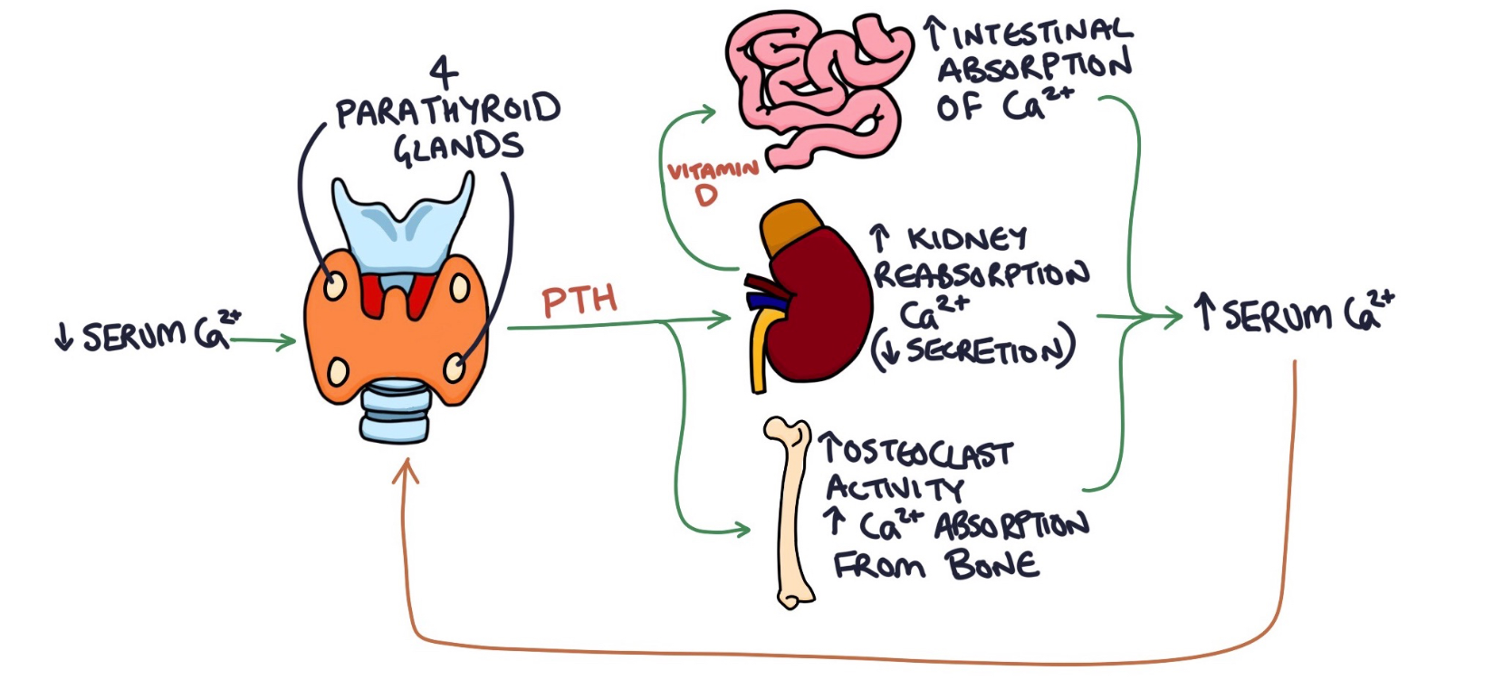
Hyperparathyroidism
Notes:
https://zerotofinals.com/medicine/endocrinology/hyperparathyroidism/
adenoma- benign tumour of glandular epithelium
There are four parathyroid glands situated in four corners of the thyroid gland. The parathyroid glands, specifically the chief cells in the glands, produce parathyroid hormone in response to hypocalcaemia (low blood calcium).
Parathyroid hormone acts to raise blood calcium level by:
Increasing osteoclast activity in bones (reabsorbing calcium from bones)
Increasing calcium absorption from the gut
Increasing calcium absorption and decreasing phosphate absorption from the kidneys
Increasing vitamin D activity
Vitamin D acts to increase calcium absorption from the intestines. Parathyroid hormone acts on vitamin D to convert it into active forms. So vitamin D and parathyroid hormone act together to raise blood calcium levels.

Slide 77
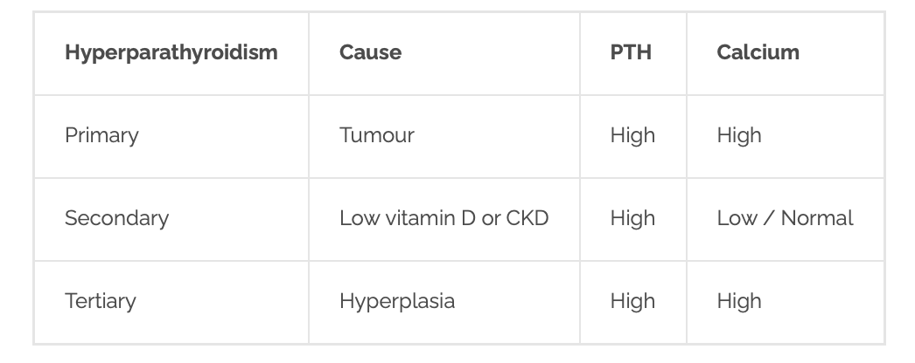
Phosphate
Low
----
High

Slide 78
Hyperparathyroidism
PRESENTATION (Sx) | It is worth remembering the “renal stones, painful bones, abdominal groans and psychiatric moans” mnemonic for the symptoms of hypercalcaemia: Painful bones Renal stones Abdominal groans refers to symptoms of constipation, nausea and vomiting Psychiatric moans refers to symptoms of fatigue, depression and psychosis
DIAGNOSIS & INVESTIGATIONS (Ix) | PTH, Calcium, Phosphate Detect BONES from DEXA bone scan for osteoporosis Detect STONES from Ultrasound for kidney stones Detect GROANS from Abdominal X-ray – renal calculi or nephrocalcinosis Detect ADENOMAS from Radioisotope scanning
TREATMENT (Tx) | Primary- surgical removal of tumour Secondary- Treat Vitamin D deficiency or Kidney transplant in individuals with CKD Tertiary- Total or subtotal parathyroidectomy Calcimimetic e.g.Cinacalet -increases the sensitivity of parathyroid cells to Ca2+ thereby causing less PTH secretion
Notes:
https://zerotofinals.com/medicine/endocrinology/hyperparathyroidism/

Slide 79
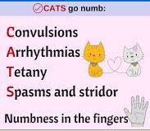
HYPOCALCAEMIA
DEFINITION | Low calcium levels in blood serum (<8.5mg/dL/<2.20mmol/L)
CAUSE/S & RISK FACTORS | Hypoparathyroidism (Post thyroid/parathyroid surgery), pseudohypoparathyroidism, vit D deficiency, hyperventilation, drugs, malignancy, toxic shock
PRESENTATION | SPASMODIC / CATS go Numb:
DIAGNOSIS & INVESTIGATIONS | Lab test- Level of PTH, Vit D, Albumin, Phosphorus and Magnesium Check levels of Ca2+ in blood ~<8.5mg/dL ECG- Prolonged QT interval (Arrythmias)
TREATMENT | Acute management of severe hypocalcaemia is with intravenous calcium gluconate, 10ml of 10% solution over 10 minutes or intravenous calcium chloride is more likely to cause local irritation Vit D supplementation for persistent hypocalcaemia (50000 IU orally once a week for 8 weeks)
COMPLICATIONS | Seizure, cardiac arrest (decreases heart rate and contractility)- a medical emergency! Long QT syndrome
Notes:
https://scvmcmed.com/2016/11/21/am-report-111416-hypocalcemia/
https://www.pinterest.co.uk/pin/351912461553825/

Slide 80
QUESTION 9
A 62-year-old man with metastatic prostate cancer presents to the emergency department with constipation, vomiting, abdominal pain and excessive urination. His wife says that he has become increasingly confused and has complained of increased thirst.
Blood tests reveal the following:
What is the most appropriate initial management option?
Vitamin D and calcium supplementation
IV zoledronic acid
Calcitonin
IV 0.9% sodium chloride
 | Value | Reference range
Calcium (adj) | 3.2 | 2.1-2.6 mmol/l
Phosphate | 1.8 | 0.8-1.4 mmol/l
Albumin | 25 | 35-50 g/L
Alkaline phosphatase | 204 | 30-130 umol/l
Notes:
IV 0.9% sodium chloride – rehydrate

Slide 81
QUESTION 9
Hypercalcaemia
A 62-year-old man with metastatic prostate cancer presents to the emergency department with constipation, vomiting, abdominal pain and excessive urination. His wife says that he has become increasingly confused and has complained of increased thirst.
Blood tests reveal the following:
What is the most appropriate initial management option?
Vitamin D and calcium supplementation
IV zoledronic acid
Calcitonin
IV 0.9% sodium chloride
 | Value | Reference range
Calcium (adj) | 3.2 | 2.1-2.6 mmol/l
Phosphate | 1.8 | 0.8-1.4 mmol/l
Albumin | 25 | 35-50 g/L
Alkaline phosphatase | 204 | 30-130 umol/l
Notes:
IV 0.9% sodium chloride – rehydrate

Slide 82
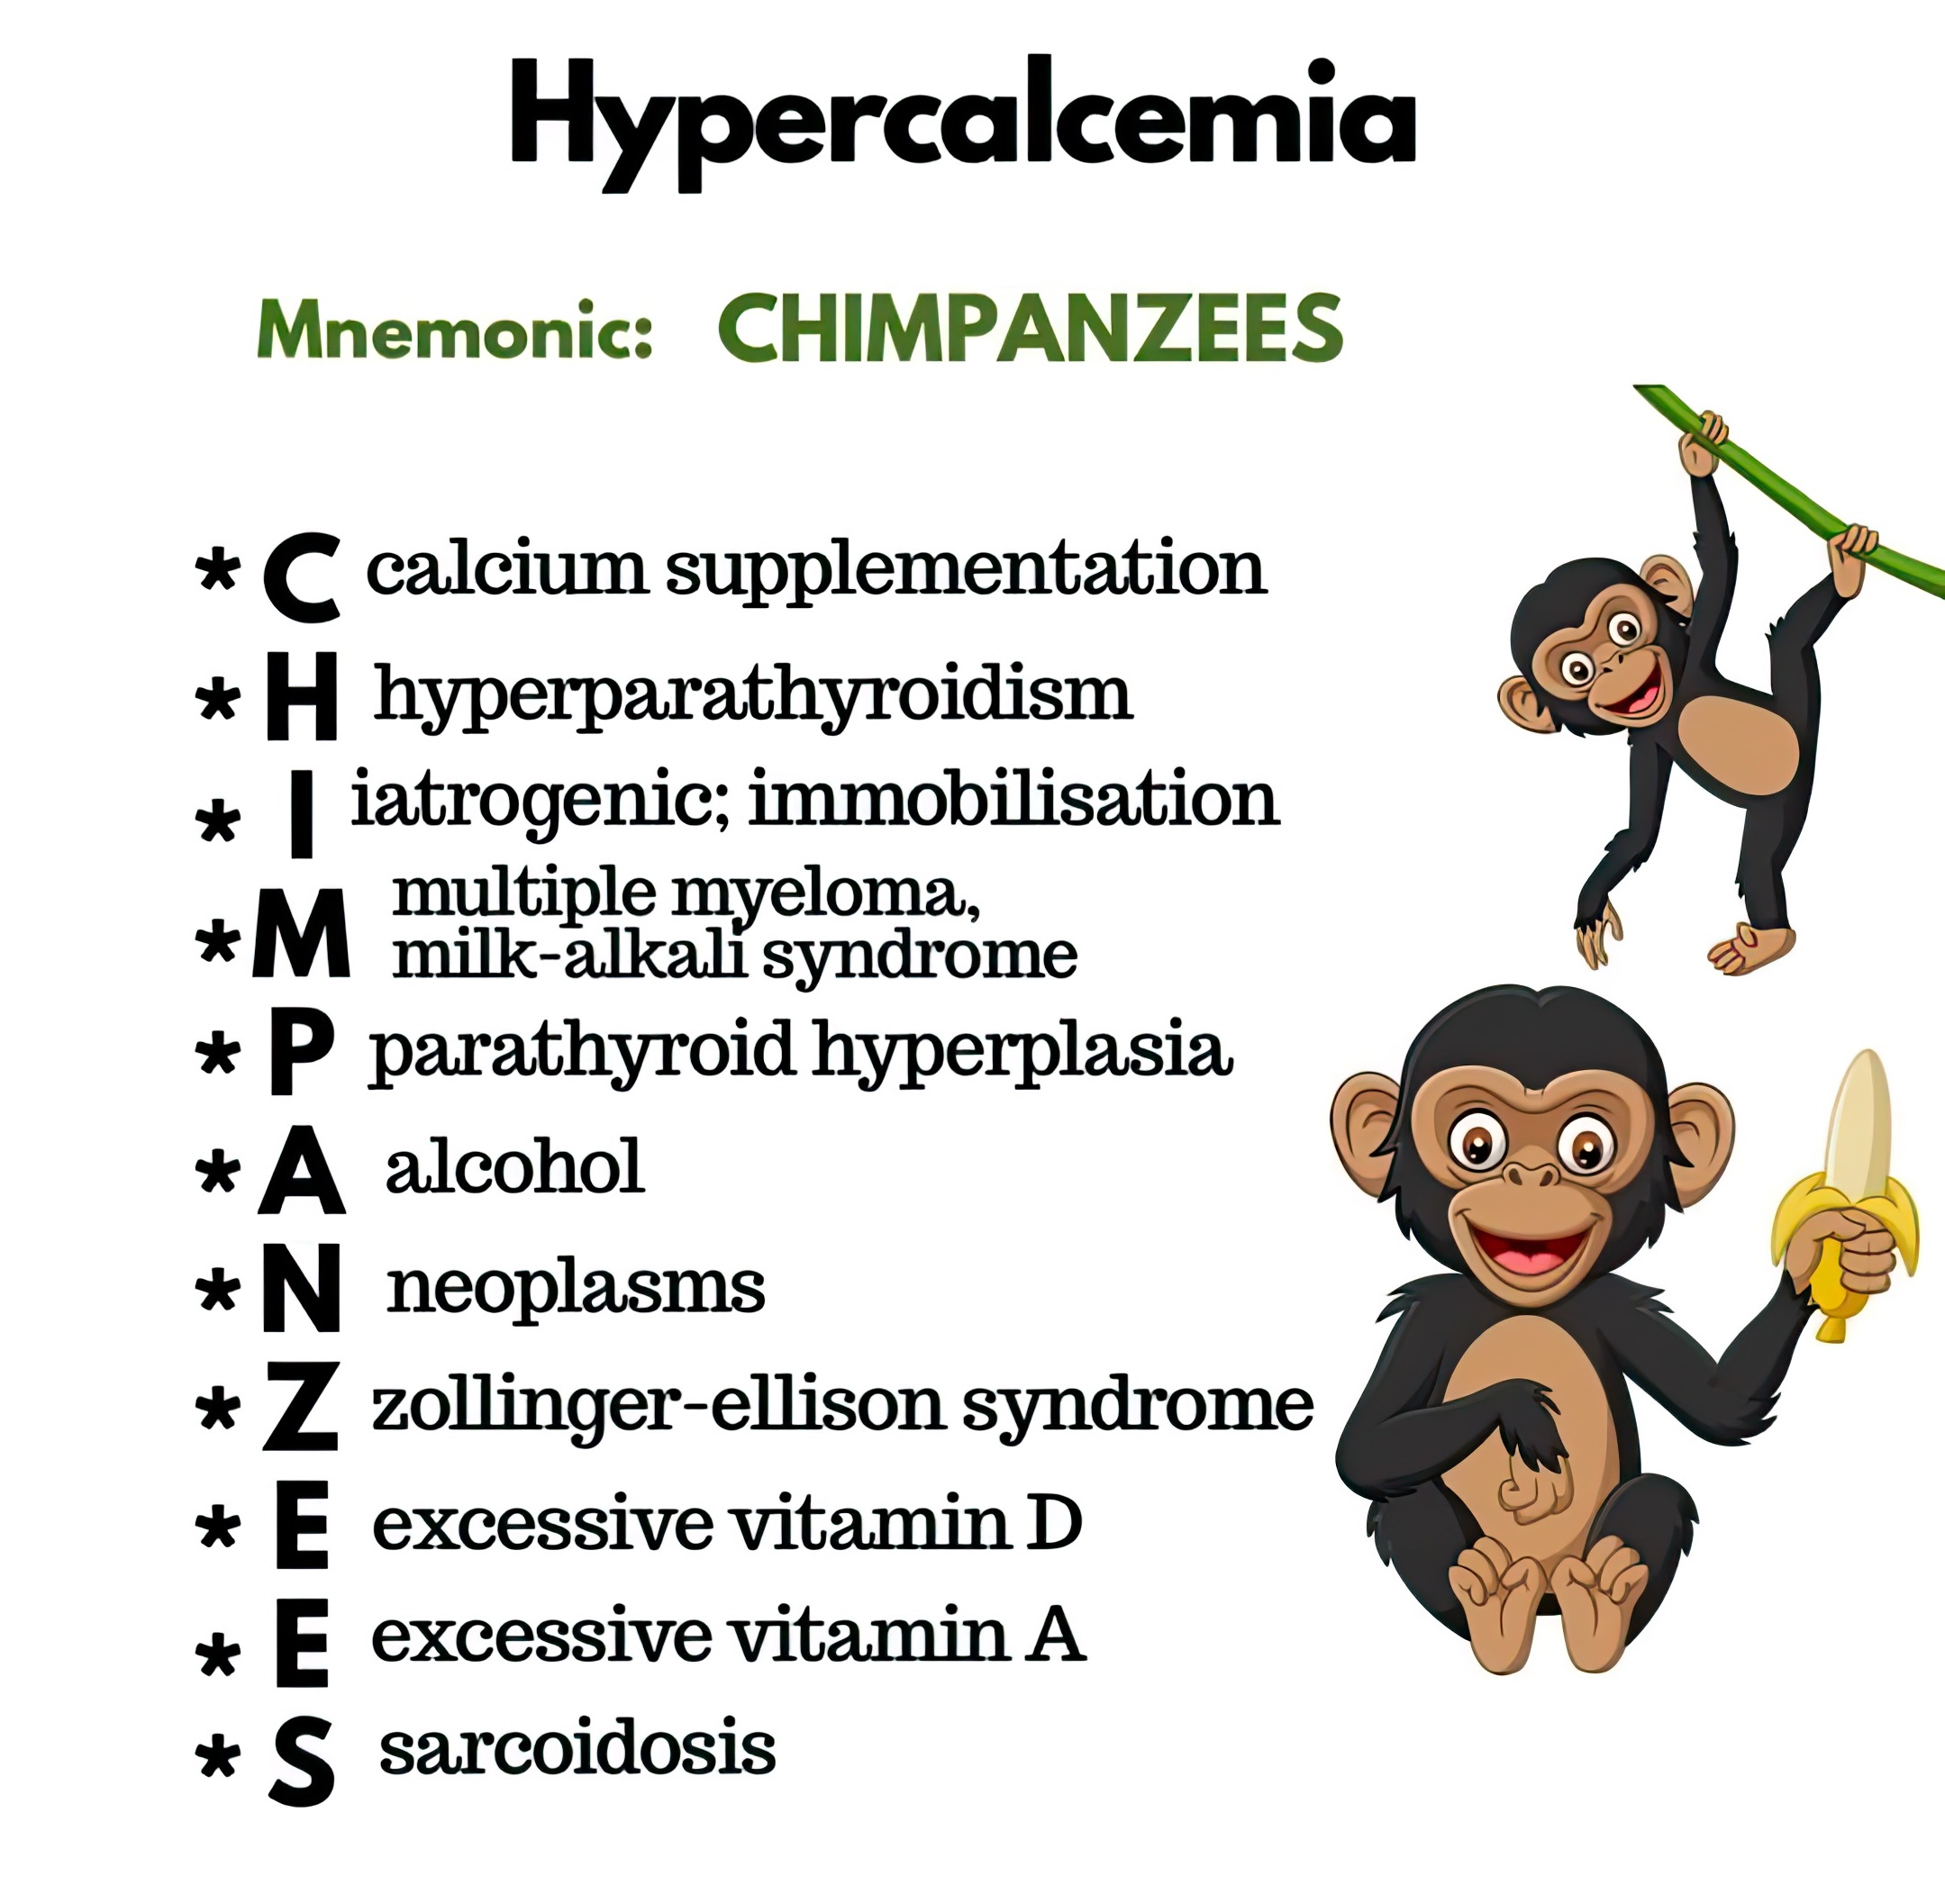
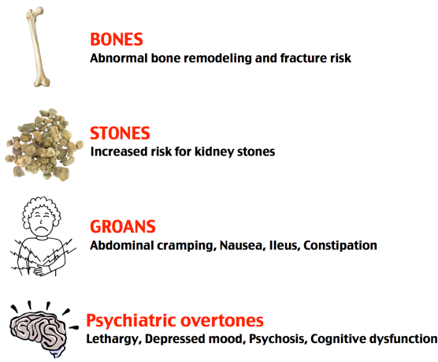
HYPERCALCAEMIA
DEFINITION | ↓PTH, ↑ Ca2+, ?k+ (Appropriate response)
CAUSE/S & RISK FACTORS | Hyperparathyroidism, malignancy, sarcoidosis, thyrotoxicosis, drugs
PRESENTATION | Painful bones, renal stones, abdominal groans, psychiatric moans (+ ECG abnormalities (Short QT))
DIAGNOSIS & INVESTIGATIONS | Fasting serum calcium and phosphate samples to confirm mild hypercalcaemia Serum PTH and Ca2+ levels- elevated Ultrasound if investigations point to primary hyperparathyroidism 24hr urinary calcium is measured in young adults to exclude familial hypocalciuric hypercalcaemia in which PTH levels are also raised
TREATMENT | The initial management of hypercalcaemia is rehydration with normal saline Following rehydration bisphosphonates Loop diuretics such as furosemide are sometimes used
Notes:
https://twitter.com/drkeithsiau/status/1507067022286462979
https://www.pinterest.co.uk/pin/296885800428286390/

Slide 83
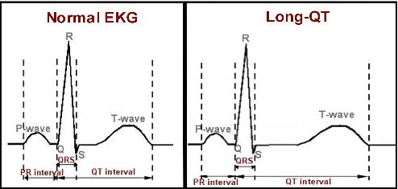
QUESTION 10
A 60-year-old female has a routine health check where she has her observations, ECG and routine blood tests done. The ECG shows a prolonged corrected QT interval. What abnormality found on her blood test may account for the ECG findings?
Hypokalaemia
Hypernatraemia
Hyperkalaemia
Hyponatraemia
Notes:
Hypokalaemia = long QT syndrome
https://www.washingtonhra.com/arrhythmias/long-qt-syndrome.php

Slide 84
QUESTION 10
A 60-year-old female has a routine health check where she has her observations, ECG and routine blood tests done. The ECG shows a prolonged corrected QT interval. What abnormality found on her blood test may account for the ECG findings?
Hypokalaemia
Hypernatraemia
Hyperkalaemia
Hyponatraemia
Notes:
Hypokalaemia = long QT syndrome

Slide 85
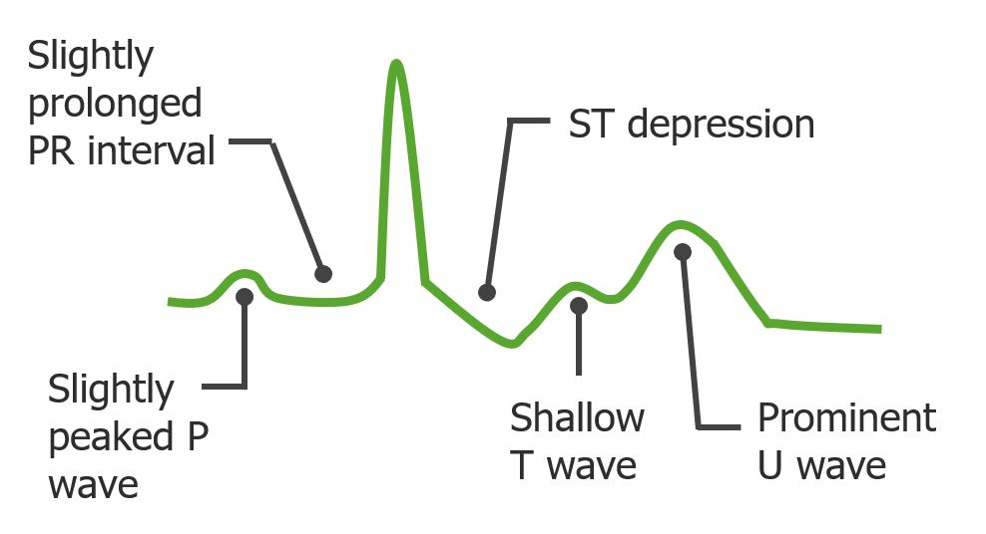
HYPOKALAEMIA
DEFINITION | Hypokalaemia is defined as a serum potassium level <3.5 mmol/L
CAUSE/S & RISK FACTORS | Decrease potassium intake, increased potassium entry into cells, increased potassium excretion (through sweat, urine, GI tract), magnesium depletion, hyperaldosteronism Hypokalaemia with alkalosis- Vomiting, Thiazide and lop diuretics, Cushing’s syndrome, Conn’s syndrome Hypokalaemia with acidosis- Diarrhoea, renal tubular acidosis, acetazolamide, partially treated DKA
PRESENTATION | Muscle weakness, hypotonia, hyporeflexia, cramps, Tetany (intermittent muscle spasm), palpitations, light headedness, arrythmias, Constipation ECG: Small or inverted T waves, Prominent U waves, A long PR interval, Depressed ST segments
DIAGNOSIS & INVESTIGATIONS | Metabolic panel, ECG, Urine electrolytes- useful in differentiating in renal from non-renal causes of hypokalaemia
TREATMENT | MILD: Usually asymptomatic (3.0-3.4mmol/L) Oral replacement- consider IV SEVERE: <2.5mmol/L - IV replacement 40mmol KCL in 1L 0.9 NaCl
COMPLICATIONS | Cardiovascular- Chronic heart failure, Acute MI, arrythmias, Muscle – weakness, depression of deep tendon reflexes, Rhabdomyolysis
Notes:
https://www.lecturio.com/concepts/hypokalemia/

Slide 86
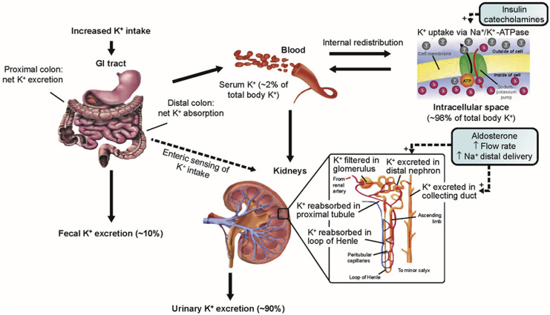
Notes:
https://www.sciencedirect.com/science/article/pii/S0025619620306182

Slide 87
QUESTION 11
You are asked to review a 71-year-old man who is being treated on the ward for community-acquired pneumonia. He has been complaining of palpitations and muscle weakness. An ECG taken on the ward that morning shows peaked T waves and a PR interval of 0.22 seconds. A K+ level of 6.4mmol/L (3.5 – 5.3 mmol/L).
What is the most appropriate immediate management option?
IV calcium gluconate
IV fluids
Intravenous (IV) calcium resonium
IV insulin/dextrose infusion
Notes:
IV calcium gluconate – severe hyperkalaemia with ECG changes

Slide 88
QUESTION 11
Hyperkalaemia
You are asked to review a 71-year-old man who is being treated on the ward for community-acquired pneumonia. He has been complaining of palpitations and muscle weakness. An ECG taken on the ward that morning shows peaked T waves and a PR interval of 0.22 seconds. A K+ level of 6.4mmol/L (3.5 – 5.3 mmol/L).
What is the most appropriate immediate management option?
IV calcium gluconate
IV fluids
Intravenous (IV) calcium resonium
IV insulin/dextrose infusion
Notes:
IV calcium gluconate – severe hyperkalaemia with ECG changes

Slide 89
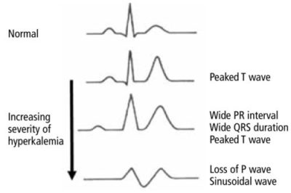
HYPERKALAEMIA
DEFINITION | Significant hyperkalaemia is defined as a serum potassium value >5.5mmol/L
CAUSE/S & RISK FACTORS | Excessive exogenous potassium load (Increased Intake), Excessive endogenous potassium load (Increased Production), Redistribution (Shift from intracellular to extracellular fluid), Diminished potassium excretion (Decreased Excretion)
PRESENTATION | Neuromuscular transmission, Muscle weakness and paralysis, Fast irregular pulse, Chest pain, Light headiness ECG- Tall, tented T waves, Small P waves, Wide QRS complex, Ventricular fibrillations, sine wave
DIAGNOSIS & INVESTIGATIONS | Metabolic panel, ECG, Urine electrolytes
TREATMENT | Untreated hyperkalaemia may cause life-threatening arrhythmias. Precipitating factors should be addressed (e.g. acute kidney injury) and aggravating drugs stopped (e.g. ACE inhibitors). Management may be categorised by the aims of treatment - If ECG changes- stabilise cardiac membrane by IV calcium gluconate/chloride (DOES NOT LOWER SERUM POTASSIUM LEVELS) - If no cardiotoxic changes are seen in ECG, shift potassium into cells (ECF > ICF) by giving combined insulin/dextrose infusion with nebulised salbutamol - Remove potassium from body by giving Calcium resonium, loop diuretics, dialysis All patients with severe hyperkalaemia (≥ 6.5 mmol/L) or with ECG changes should have emergency treatment - IV calcium gluconate: to stabilise the myocardium - insulin/dextrose infusion: short-term shift in potassium from ECF to ICF - other treatments such as nebulised salbutamol may be given to temporarily lower the serum potassium Further management includes: - stop exacerbating drugs e.g. ACE inhibitors - treat any underlying cause - lower body potassium (Calcium resonium, loop diuretics, dialysis)
Notes:
https://emcrit.org/ibcc/hyperkalemia/

Slide 90
CARCINOID SYNDROME
DEFINITION, | Carcinoid syndrome occurs due to release of serotonin (5-hydroxytryptamine) and other vasoactive peptides into the systemic circulation from a carcinoid tumour (type of neuroendocrine tumour that grows from neuroendocrine cells).
CAUSE/S & RISK FACTORS | Most commonly arise from GI tract followed by lungs, liver, ovaries thymus - Small intestine malignancy (Most common) - Appendix most common GI tract site - Liver most common site for metastasis- from ileal tumours
PATHOPHYSIOLOGY | Neuroendocrine tumours normally secrete serotonin into the circulation. With GI tract tumours, hormones secreted> enters enterohepatic circulation> liver inactivates hormones> therefore no symptoms However, when liver metastases are present (liver tumour)> hormone secretion> released into circulation + liver dysfunction> symptoms.
PRESENTATION | Flushing, diarrhoea, abdominal cramps, bronchospasm (wheezing, asthma), fibrosis (heart valve dysfunction, palpitations
DIAGNOSIS & INVESTIGATIONS | 1ST LINE: Urinary 5-hydroxyindoleacetic acid test - elevated levels CXR + Chest/pelvic MRI/CT- Helps locate primary tumours
TREATMENT | Surgery- Resection of tumour is the only cure for carcinoid tumours so it is vital to find the primary tumour. Somatostatin analogues- Octreotide, blocks release of tumour mediators and counters peripheral effects Debulking, embolization, or radiofrequency ablation for hepatic masses/metastases can decrease symptoms

Slide 91
SAQ 1
Carcinoid Syndrome
What hormone is released in carcinoid syndrome? (1 mark)
What is carcinoid syndrome typically caused by? (1 mark)
State two symptoms of presentation. (2 marks)
What is the definitive treatment for carcinoid syndrome? (1 mark)

Slide 92
SAQ 1
Carcinoid Syndrome
What hormone is released in carcinoid syndrome? (1 mark) Serotonin
What is carcinoid syndrome typically caused by? (1 mark) Neuroendocrine tumour in GI tract
State two symptoms of presentation. (2 marks) Flushing, diarrhoea, abdominal cramps, bronchospasm (wheezing, asthma), fibrosis (heart valve dysfunction, palpitations
What is the definitive treatment for carcinoid syndrome? (1 mark) Resection of tumour

Slide 93
SAQ 2
Hyperthyroidism/Hypothyroidism
What is the most common cause of hyperthyroidism and hypothyroidism? (2 marks)
List three symptoms for hyperthyroidism and hypothyroidism each. (3 marks)
What is the first line treatment for hypothyroidism? (1 mark)
What is the antibody most associated with hyperthyroidism? (1 mark)

Slide 94
SAQ 2
Hyperthyroidism/Hypothyroidism
What is the most common cause of hyperthyroidism and hypothyroidism? (2 marks) Graves’ disease and Hashimoto’s thyroiditis
List three symptoms for hyperthyroidism and hypothyroidism each. (3 marks) On next slide
What is the first line treatment for hypothyroidism? (1 mark) Levothyroxine
What is the antibody most associated with hyperthyroidism? (1 mark) TSH-receptor antibodies

Slide 95
Notes:
https://www.medicdrive.org/thyroid-disease/

Slide 96
SAQ 3
Interpret data
TSH: High T4: Low
TSH: Low T4: High
PTH: High Calcium: Low Phosphate: High
PTH: High Calcium: High Phosphate: High

Slide 97
SAQ 3
Interpret data
TSH: High T4: Low = Hypothyroidism, Hashimoto’s
TSH: Low T4: High = Hyperthyroidism, Graves’
PTH: High Calcium: Low Phosphate: High = Secondary Hyperparathyroidism
PTH: High Calcium: High Phosphate: High = Tertiary Hyperparathyroidism

Slide 98
Resources
https://geekymedics.com/endocrinology-quiz/
Zero to Finals
Pass Medicine
Quesmed
BMJ Best Practice

Slide 99
Feedback
https://docs.google.com/forms/d/e/1FAIpQLSdg99hpDzGCvCJwvHs56N-c8kofobsDxm7yvZ1kzxnkAjbQEA/viewform?usp=sf_link
The Peer Teaching Society is not liable for false or misleading information…

Slide 100
Quick Questions to recap basic knowledge
1. Main role of Glucose?
Required for respiration
2. Role of glucagon in glucose homeostasis ?
Increases glucose levels when they are low by stimulating lipolysis, glycogenolysis and gluconeogenesis .
3. Where is glucagon released from?
From the Alpha cells in the Islets of Langerhans in the pancreas.
4. Role of insulin in glucose homeostasis ?
Decreases glucose levels when they are high by inhibiting lipolysis and glycogenolysis and stimulating glycogenesis.
5. Role of insulin in glucose homeostasis ?
From the Beta cells in the Islets of Langerhans in the pancreas.
Notes:
Glycogenolysis- when glycogen (the carbohydrate stored in the liver and muscle cells of animals) is broken down into glucose
Gluconeogenesis- Convert proteins and fats into glucose.

Slide 101
Quick Questions to recap basic knowledge
6. Role of Glycogen in the body?
Main form of storage of glucose in the body.
7. Where is Glycogen stored in the body?
In the liver.
8. What process involving glycogen occurs when glucose levels are high?
The liver stimulates glycogenesis (converts glucose to glycogen.
9. What process involving glycogen occurs when glucose levels are low?
The liver stimulates glycogenolysis (converts glycogen to glucose.

Slide 102
QUESTION 12
A 17-year-old boy presents to his GP with fatigue, weight loss and polyuria. Following relevant investigations, the GP diagnoses type 1 diabetes. The patient is otherwise stable and blood ketones are not present.
Which of the following is the most appropriate next management step?
Basal-bolus Insulin
Fixed-dose Insulin
Metformin
Weight loss
Amylin analogue
Notes:
Basal Bolus Regimes
Insulin regimes are initiated by a specialist in diabetes. Patients are usually initiated on a basal-bolus regime.
This is the first-line treatment in type 1 diabetes. Alternatively, patients with good self-management skills may prefer to use an Insulin pump
The basal part refers to an injection of a long acting insulin, such as “Lantus”, typically in the evening. This gives a constant background insulin throughout the day.
The bolus part refers to an injection of a short acting insulin, such as “Actrapid”, usually three times a day before meals. This is also injected according to the number of carbohydrates consumed every time the patient has a snack.

Slide 103
QUESTION 12
A 17-year-old boy presents to his GP with fatigue, weight loss and polyuria. Following relevant investigations, the GP diagnoses type 1 diabetes. The patient is otherwise stable and blood ketones are not present.
Which of the following is the most appropriate next management step?
Basal-bolus Insulin
Fixed-dose Insulin
Metformin
Weight loss
Amylin analogue
Notes:
Basal Bolus Regimes
Insulin regimes are initiated by a specialist in diabetes. Patients are usually initiated on a basal-bolus regime.
This is the first-line treatment in type 1 diabetes. Alternatively, patients with good self-management skills may prefer to use an Insulin pump
The basal part refers to an injection of a long acting insulin, such as “Lantus”, typically in the evening. This gives a constant background insulin throughout the day.
The bolus part refers to an injection of a short acting insulin, such as “Actrapid”, usually three times a day before meals. This is also injected according to the number of carbohydrates consumed every time the patient has a snack.

Slide 104
QUESTION 13
A 57-year-old male presents to his GP following several hypoglycaemic episodes. He has a history of type 2 diabetes and heart failure. He is currently being treated with Metformin and Gliclazide.
What is the most likely cause of his hypoglycaemic episodes?
Metformin
Gliclazide
Autonomic neuropathy
Insulin overdose
Natural progression of diabetes

Slide 105
QUESTION 13
A 57-year-old male presents to his GP following several hypoglycaemic episodes. He has a history of type 2 diabetes and heart failure. He is currently being treated with Metformin and Gliclazide.
What is the most likely cause of his hypoglycaemic episodes?
Metformin
Gliclazide
Autonomic neuropathy
Insulin overdose
Natural progression of diabetes

Slide 106
QUESTION 14
A 75 year old male presents to the emergency department with a one day history of polyuria, polydipsia, increasing drowsiness and confusion. He has recently been started on oral antibiotics by his general practitioner for a urinary tract infection. His past medical history includes type two diabetes mellitus and hypertension. His medication history includes metformin 1g twice daily and ramipril 5mg once daily. He is apyrexial, tachycardic and hypotensive with dry mucus membranes and decreased skin turgor.
Which of the following investigation results would confirm a diagnosis of hyperosmolar hyperglycaemic state (HHS)?
Blood glucose 14 mmol/l
Urinalysis ketones +++
Serum bicarbonate 10 mmol/l
Serum osmolality 330 mOsm/kg
Arterial blood gas pH 7.21

Slide 107
QUESTION 14
A 75 year old male presents to the emergency department with a one day history of polyuria, polydipsia, increasing drowsiness and confusion. He has recently been started on oral antibiotics by his general practitioner for a urinary tract infection. His past medical history includes type two diabetes mellitus and hypertension. His medication history includes metformin 1g twice daily and ramipril 5mg once daily. He is apyrexial, tachycardic and hypotensive with dry mucus membranes and decreased skin turgor.
Which of the following investigation results would confirm a diagnosis of hyperosmolar hyperglycaemic state (HHS)?
Blood glucose 14 mmol/l
Urinalysis ketones +++
Serum bicarbonate 10 mmol/l
Serum osmolality 330 mOsm/kg
Arterial blood gas pH 7.21
REMEMBER!
Severe hyperglycaemia (>30mmol/L)
Hypotension
Hyperosmolality (usually >320 mosmol/kg)
No/very mild ketosis
No acidosis

Slide 108
QUESTION 15
A 68-year-old man presents to endocrinology clinic with a history of weight loss and increased skin pigmentation. He was found to have an elevated 24-hour urinary cortisol during a recent admission to hospital with pneumonia and was referred for further investigation. He still has a cough following treatment of his pneumonia. He has a past medical history of chronic obstructive pulmonary disease (COPD), hypertension and type 2 diabetes mellitus. Investigation results are as follows:
Cortisol after low dose dexamethasone administration: 743nmol/L (137–429nmol/L) Cortisol after high dose dexamethasone administration: 724nmol/L (137–429nmol/L) Early morning serum adrenocorticotropic hormone (ACTH): 52.4pmol/L (2.2-13.3pmol/L)
Which of the following is the most likely diagnosis?
Cushing’s disease
Small cell lung carcinoma
Cortisol-secreting adrenal adenoma
Iatrogenic Cushing’s syndrome

Slide 109
QUESTION 15
A 68-year-old man presents to endocrinology clinic with a history of weight loss and increased skin pigmentation. He was found to have an elevated 24-hour urinary cortisol during a recent admission to hospital with pneumonia and was referred for further investigation. He still has a cough following treatment of his pneumonia. He has a past medical history of chronic obstructive pulmonary disease (COPD), hypertension and type 2 diabetes mellitus. Investigation results are as follows:
Cortisol after low dose dexamethasone administration: 743nmol/L (137–429nmol/L)
Cortisol after high dose dexamethasone administration: 724nmol/L (137–429nmol/L)
Early morning serum adrenocorticotropic hormone (ACTH): 52.4pmol/L (2.2-13.3pmol/L)
Which of the following is the most likely diagnosis?
Cushing’s disease
Small cell lung carcinoma
Cortisol-secreting adrenal adenoma
Iatrogenic Cushing’s syndrome
Low Dose- High Cortisol
High Dose- High Cortisol, High ACTH

Slide 110
QUESTION 15
A 68-year-old man presents to endocrinology clinic with a history of weight loss and increased skin pigmentation. He was found to have an elevated 24-hour urinary cortisol during a recent admission to hospital with pneumonia and was referred for further investigation. He still has a cough following treatment of his pneumonia. He has a past medical history of chronic obstructive pulmonary disease (COPD), hypertension and type 2 diabetes mellitus. Investigation results are as follows:
Cortisol after low dose dexamethasone administration: 743nmol/L (137–429nmol/L)
Cortisol after high dose dexamethasone administration: 724nmol/L (137–429nmol/L)
Early morning serum adrenocorticotropic hormone (ACTH): 52.4pmol/L (2.2-13.3pmol/L)
Which of the following is the most likely diagnosis?
Cushing’s disease
Small cell lung carcinoma
Cortisol-secreting adrenal adenoma
Iatrogenic Cushing’s syndrome
Low Dose- High Cortisol
High Dose- High Cortisol, High ACTH
Notes:
What does high cortisol after High dose Dexamethasone suppression test rule out? Cushing’s disease (pituitary adenoma)

Slide 111
QUESTION 16
A 29-year-old gentleman, with no past medical history and is otherwise asymptomatic, has a markedly raised blood pressure incidentally diagnosed by his GP. He was referred by his GP to secondary care to investigate for secondary causes of hypertension. Noticing in the preliminary blood tests that the patient's serum sodium was raised at 149 mmol/L while his serum potassium was reduced at 3.3 mmol/L, the consultant cardiologist suspects primary hyperaldosteronism (Conn's syndrome) and sends off a renin-to-aldosterone ratio test among other investigations.
Which of the following is the single most likely result of the renin-to-aldosterone ratio test?
High renin, low aldosterone
High renin, high aldosterone
Normal renin, normal aldosterone
Low renin, high aldosterone
Low renin, low aldosterone

Slide 112
QUESTION 16
A 29-year-old gentleman, with no past medical history and is otherwise asymptomatic, has a markedly raised blood pressure incidentally diagnosed by his GP. He was referred by his GP to secondary care to investigate for secondary causes of hypertension. Noticing in the preliminary blood tests that the patient's serum sodium was raised at 149 mmol/L while his serum potassium was reduced at 3.3 mmol/L, the consultant cardiologist suspects primary hyperaldosteronism (Conn's syndrome) and sends off a renin-to-aldosterone ratio test among other investigations.
Which of the following is the single most likely result of the renin-to-aldosterone ratio test?
High renin, low aldosterone
High renin, high aldosterone
Normal renin, normal aldosterone
Low renin, high aldosterone
Low renin, low aldosterone

Slide 113
QUESTION 17
A 55-year-old gentlemen has a diagnosis of small cell lung cancer. He presents to A&E complaining of nausea and vomiting and is acutely confused with an AMTS of 3/10.
He is triaged, IV fluid resuscitation is initiated and bloods taken. His blood tests show that his plasma sodium is 122 mmol/L. All other blood results are normal.
What is the single most likely diagnosis?
Addison’s disease
Hyponatremia
SIADH
Dehydration
Diabetes Insipidus

Slide 114
QUESTION 17
A 55-year-old gentlemen has a diagnosis of small cell lung cancer. He presents to A&E complaining of nausea and vomiting and is acutely confused with an AMTS of 3/10.
He is triaged, IV fluid resuscitation is initiated and bloods taken. His blood tests show that his plasma sodium is 122 mmol/L. All other blood results are normal.
What is the single most likely diagnosis?
Addison’s disease-
Hyponatremia
SIADH
Dehydration
Diabetes Insipidus
Notes:
Addison’s disease is known to cause hyponatraemia and hyperkalaemia due to the failure of the adrenal glands to produce glucocorticoids and mineralocorticoids
Hyponatraemia is the correct abnormality, however is not the single most likely diagnosis given the presence of small cell lung cancer
Dehydration would lead to hypernatremia not hyponatraemia
Diabetes insipidus is caused by reduced production of ADH leading to hypernatraemia

Slide 115
QUESTION 18
An 83 year old female presents with colicky abdominal pain, constipation and depressed mood. Her medical history includes hypertension and angina. Blood tests are sent which show the following:
Corrected calcium 3.0 mmol/L (2.12-2.65) Phosphate 1.4 mmol/L (2.5-4.5) PTH 15.5 pmol/L (0.8-8.5) ALP 172 mmol/L (30-150)
What is the most likely cause of this patient’s presentation?
Tertiary hyperparathyroidism
Primary hyperparathyroidism
Malignancy
Pseudohypoparathyroidism
Pituitary Surgery
Secondary hyperparathyroidism

Slide 116
QUESTION 18
An 83 year old female presents with colicky abdominal pain, constipation and depressed mood. Her medical history includes hypertension and angina. Blood tests are sent which show the following:
Corrected calcium 3.0 mmol/L (2.12-2.65) Phosphate 1.4 mmol/L (2.5-4.5) PTH 15.5 pmol/L (0.8-8.5) ALP 172 mmol/L (30-150)
What is the most likely cause of this patient’s presentation?
Tertiary hyperparathyroidism
Primary hyperparathyroidism
Malignancy
Pseudohypoparathyroidism
Pituitary Surgery
Secondary hyperparathyroidism

Slide 117
QUESTION 19
A 36-year-old female presents to her GP with heat intolerance, sweating and palpitations. She is 10 weeks pregnant but has no other medical history. Bloods tests reveal raised free thyroxine and depressed TSH.
What is the most appropriate initial step to treat this patient’s condition?
Lithium
Carbimazole
Propylthiouracil
Thyroidectomy
Notes:
Propylthiouracil – the preferred treatment of hyperthyroidism in first trimester pregnancy because it is safer for the foetus than carbimazole. It works by inhibiting the thyroperoxidase enzyme which is involved in preparing iodine for coupling with thyroglobulin
Carbimazole is teratogenic in first trimester of pregnancy

Slide 118
QUESTION 19
Hyperthyroidism
A 36-year-old female presents to her GP with heat intolerance, sweating and palpitations. She is 10 weeks pregnant but has no other medical history. Bloods tests reveal raised free thyroxine and depressed TSH.
What is the most appropriate initial step to treat this patient’s condition?
Lithium
Carbimazole
Propylthiouracil
Thyroidectomy
Notes:
Propylthiouracil – the preferred treatment of hyperthyroidism in first trimester pregnancy because it is safer for the foetus than carbimazole. It works by inhibiting the thyroperoxidase enzyme which is involved in preparing iodine for coupling with thyroglobulin
Carbimazole is teratogenic in first trimester of pregnancy

Slide 119
QUESTION 20
A 50-year-old female presents to her general practitioner with 'pins and needles' around her mouth and frequent muscle cramps. On examination, she appears well, however when taking her blood pressure reading, her wrist and fingers began to cramp and flex.
What is the most likely diagnosis?
Hyperkalaemia
Hypocalcaemia
Hypernatraemia
Hypomagnesaemia
Notes:
Hypocalcaemia – Parasthesia, spasms, tetany

Slide 120
QUESTION 20
A 50-year-old female presents to her general practitioner with 'pins and needles' around her mouth and frequent muscle cramps. On examination, she appears well, however when taking her blood pressure reading, her wrist and fingers began to cramp and flex.
What is the most likely diagnosis?
Hyperkalaemia
Hypocalcaemia
Hypernatraemia
Hypomagnesaemia
Notes:
Hypocalcaemia – Parasthesia, spasms, tetany

