Slide 1
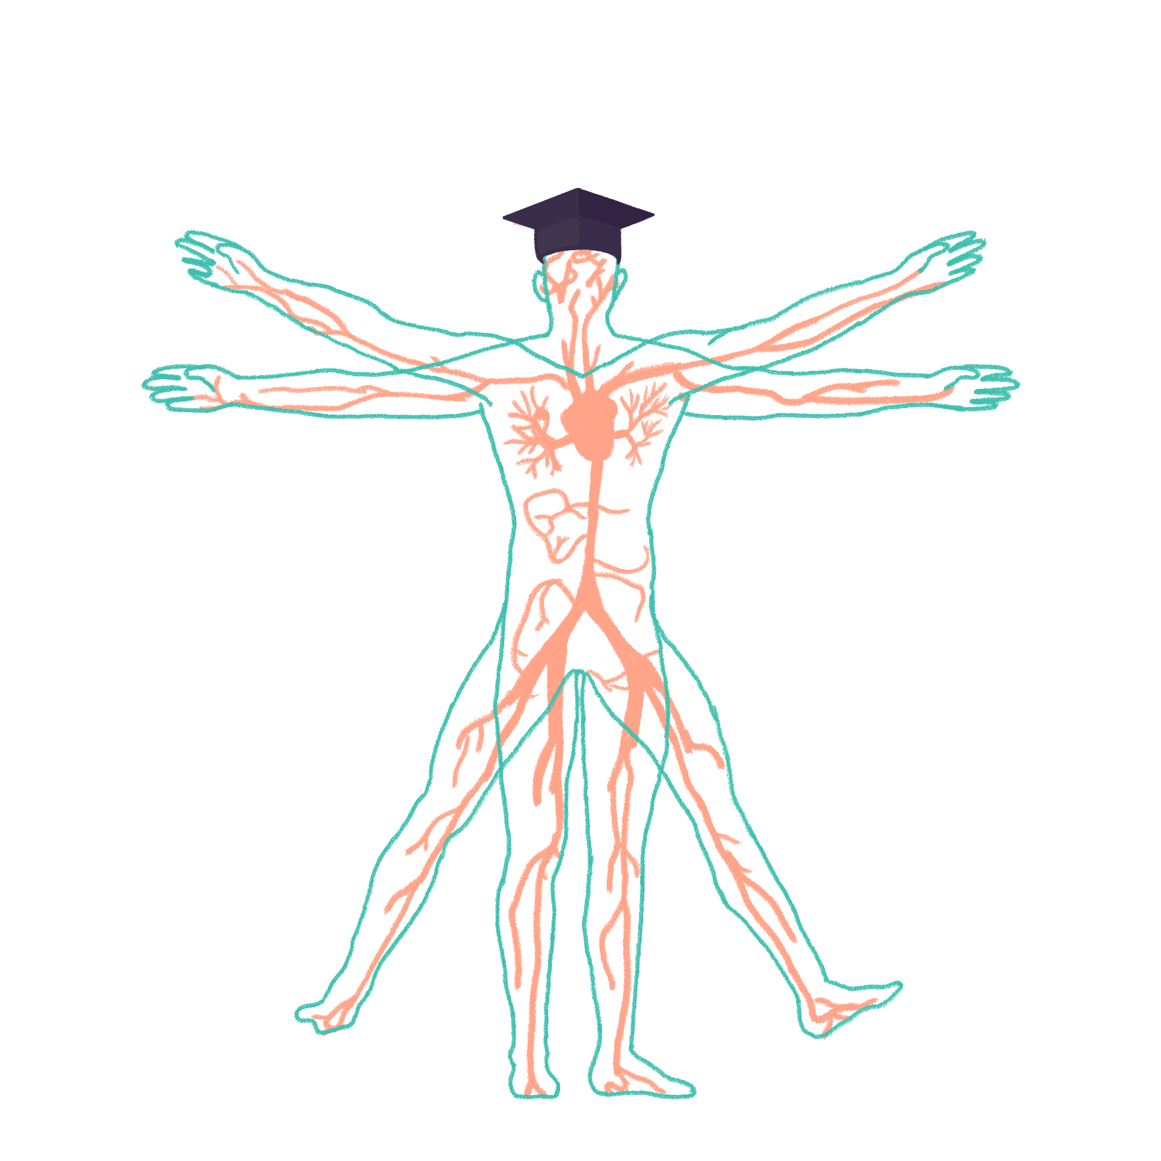
2023/2024

Slide 2
ENDOCRINE
Phase 2a Revision Session
Yusuf Sanni + Josh Palmer
11th January 2024
The Peer Teaching Society is not liable for false or misleading information…

Slide 3
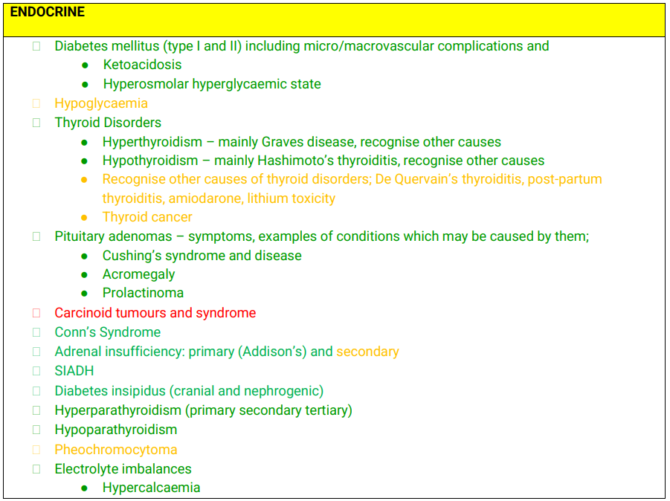
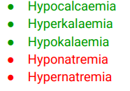
smiley faces we are covering today :)

Slide 4
Contents
What to know in a disease
Hormones
Cortisol
HPA
Cushing’s
Hyper/Hypo-thyroid
T1DM/T2DM
DKA/HHS
PTS 2022 present has good coverage

Slide 5
What to know in a disease
Definition
Pathophysiology
Aetiology
Presentation (signs and symptoms)
Investigations
Management
Complications

Slide 6
Hormones
Chemical messengers that travel in the blood between organs and tissues, regulating organs and processes.

Slide 7
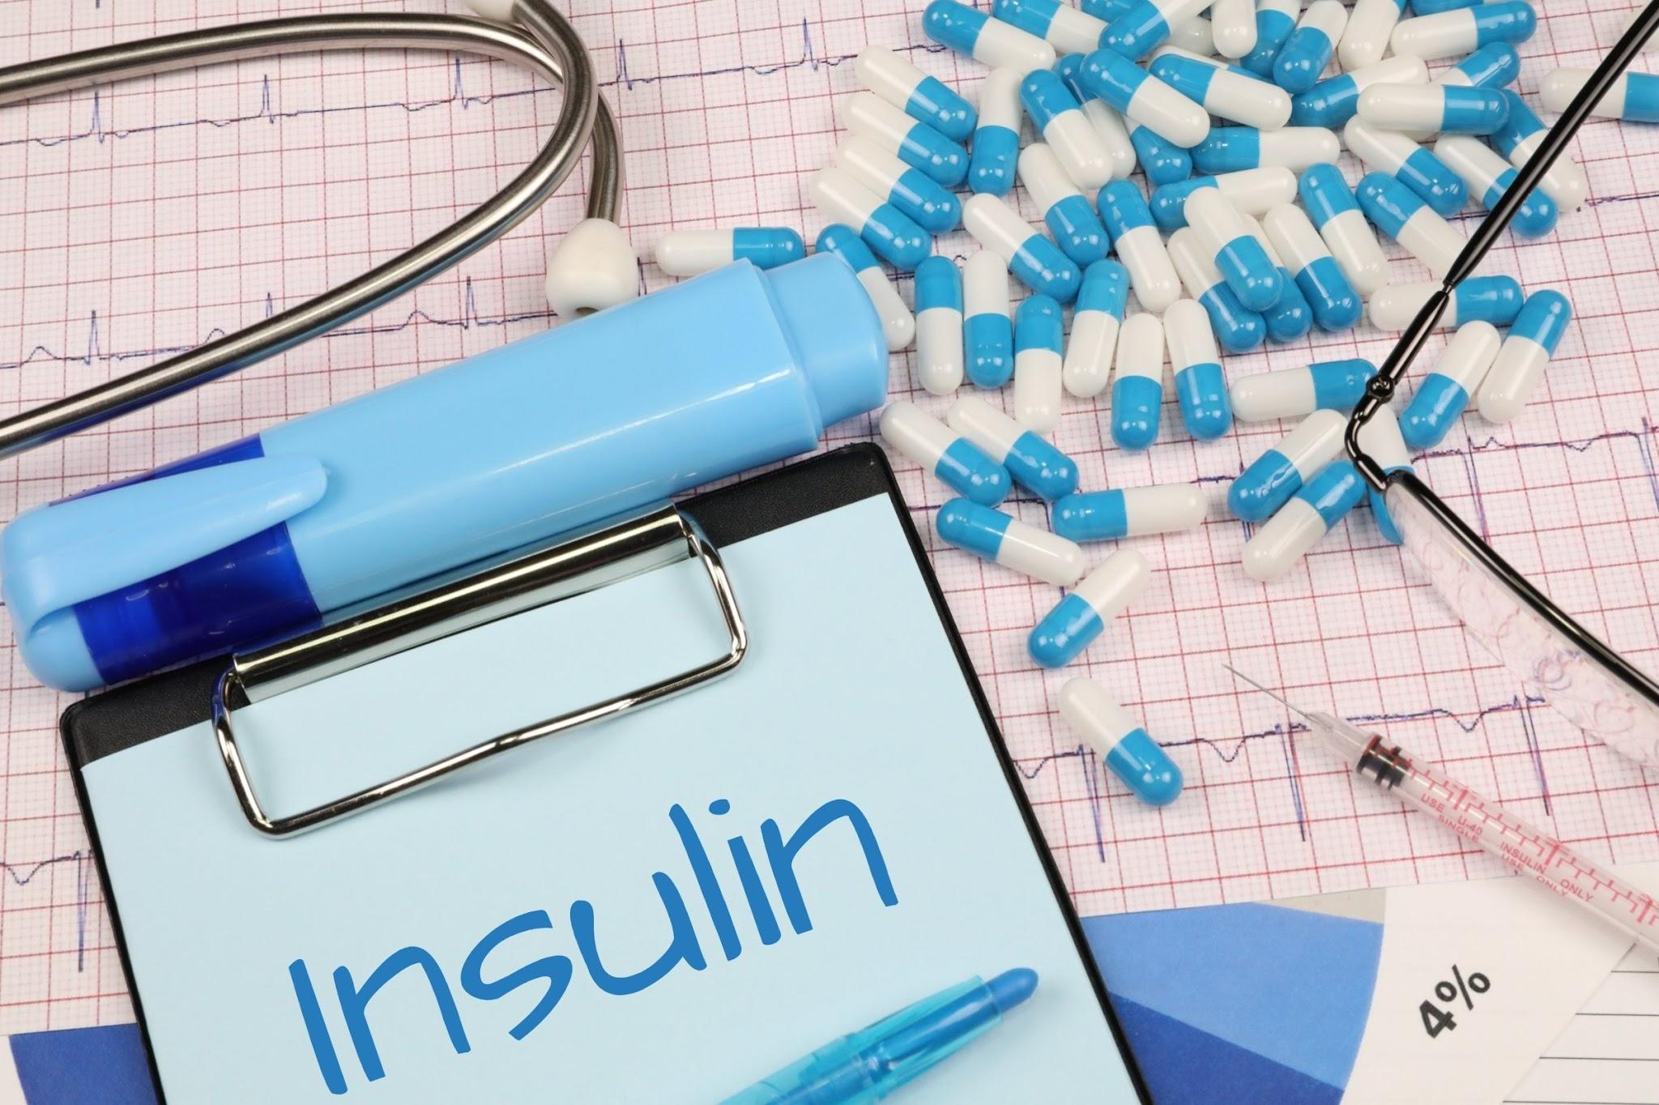
Hormones
Chemical messengers that travel in the blood between organs and tissues, regulating organs and processes.
‘A hormone axis is a system that controls the amount of a hormone in the system. Too much or too little of a hormone can have significant consequences’
I.e. High levels of insulin leading to hypoglycemia

Slide 8
Hormones
Hormones can either be Endogenous (From body) or Exogenous (Outside body)

Slide 9
Hormones
Hormones can either be Endogenous (From body) or Exogenous (Outside of body) I.e Cushing’s disease (Endogenous - Pituitary Adenoma) vs Cushing’s Syndrome (Exogenous - Steroid use)

Slide 10
Which is not a hormone
A - Cortisol
B - Vitamin B
C - Incretin
D - Glucagon
E - Serotonin

Slide 11
Which is not a hormone
A - Cortisol
B - Vitamin B
C - Incretin
D - Glucagon
E - Serotonin

Slide 12
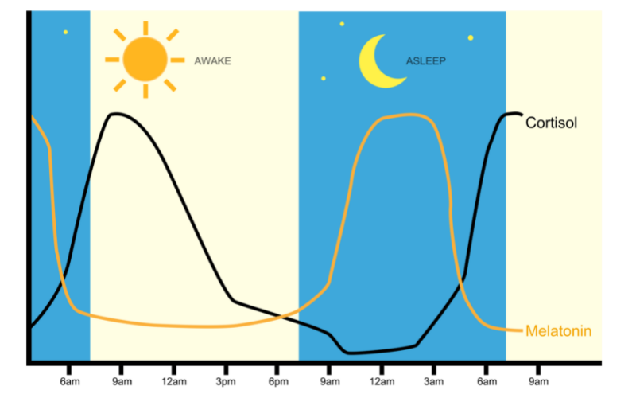
Cortisol
Cortisol is a vital hormone with many functions.
3 key functions are:

Slide 13
Cortisol
Cortisol is a vital hormone with many functions.
3 key functions are:
Stress response, helping the body cope by providing energy and suppressing non-essential functions.

Slide 14
Cortisol
Cortisol is a vital hormone with many functions.
3 key functions are:
Stress response, helping the body cope by providing energy and suppressing non-essential functions.
Metabolic regulation by promoting protein breakdown, gluconeogenesis, and increasing blood glucose levels.

Slide 15
Cortisol
Cortisol is a vital hormone with many functions.
It is a glucocorticoid.
3 key functions are:
Stress response, helping the body cope by providing energy and suppressing non-essential functions.
Metabolic regulation by promoting protein breakdown, gluconeogenesis, and increasing blood glucose levels.
Anti-inflammatory properties, inhibiting immune cell activity and balancing the body's immune response.

Slide 16
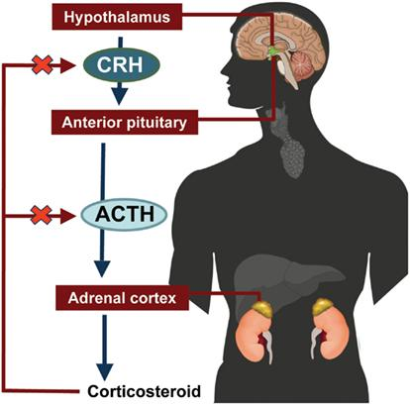
HPA Axis
Cortisol levels are controlled by the Hypothalamus-Pituitary-Adrenal Axis.

Slide 17
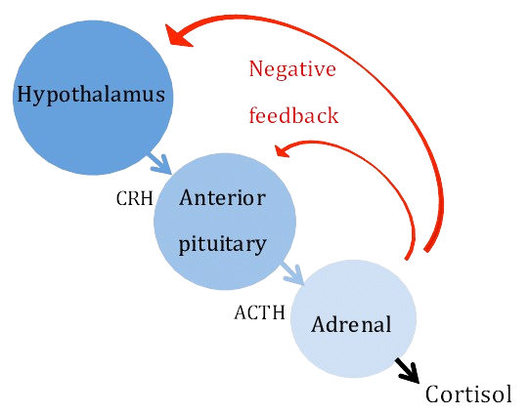
HPA Axis
Corticotropin-releasing hormone

Slide 18
HPA Axis
Corticotropin-releasing hormone
Adrenocorticotropic hormone

Slide 19
HPA Axis
Corticotropin-releasing hormone
Which part of the adrenal gland produces cortisol?
Adrenocorticotropic hormone

Slide 20
HPA Axis
Corticotropin-releasing hormone
Zona fasciculata
Adrenocorticotropic hormone

Slide 21
HPA Axis
Corticotropin-releasing hormone
Zona fasciculata
Adrenocorticotropic hormone
Inhibits the HPA Axis

Slide 22
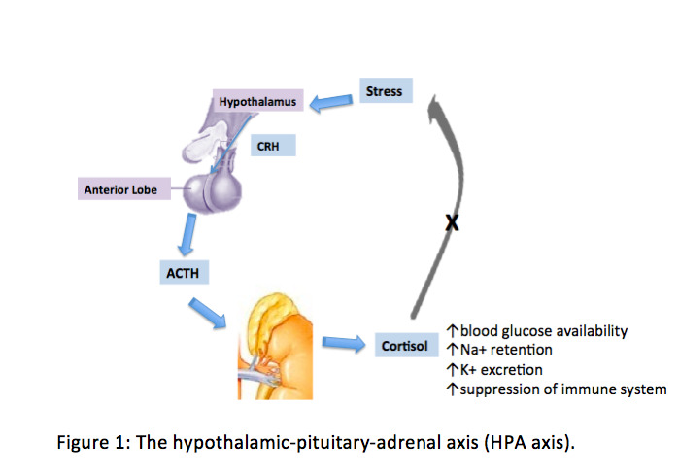
HPA Axis

Slide 23
What does excess cortisol cause?
A - Diabetes Mellitus
B - Diabetes Insipidus
C - Conn’s Syndrome
D - Cushing’s Syndrome
E - Graves Disease

Slide 24
What does excess cortisol cause?
A - Diabetes Mellitus
B - Diabetes Insipidus
C - Conn’s Syndrome
D - Cushing’s Syndrome
E - Graves Disease

Slide 25
Cushing’s Syndrome
Cushing’s syndrome is a term for symptoms caused by excess cortisol.
When it is caused by endogenous cortisol (most commonly ACTH-producing pituitary adenoma) it is known as Cushing’s Disease.

Slide 26
Cushing’s Syndrome
Cushing’s syndrome is a term for symptoms caused by excess cortisol.
When it is caused by endogenous cortisol (most commonly ACTH-producing pituitary adenoma) it is known as Cushing’s Disease.
This causes: Central obesity, Proximal muscle wasting, Hirsutism (Male facial hair), easy bruising.
Key descriptors used are: ‘Purple’ abdominal striae, ‘Buffalo hump’ and ‘hyperpigmentation’.

Slide 27
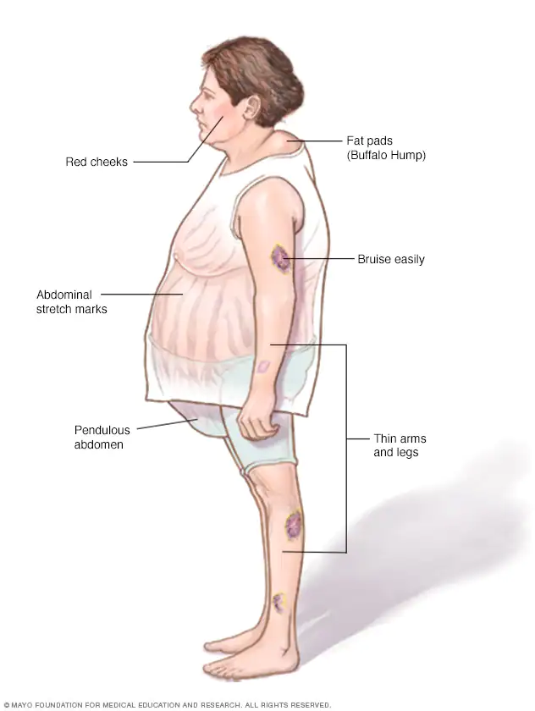
Cushing’s Syndrome
Cushing’s syndrome is a term for symptoms caused by excess cortisol.
When it is caused by endogenous cortisol (most commonly ACTH-producing pituitary adenoma) it is known as Cushing’s Disease.
This causes: Central obesity, Proximal muscle wasting, Hirsutism (Male facial hair), easy bruising.
Key descriptors used are: ‘Purple’ abdominal striae, ‘Buffalo hump’, ‘moon face’, and ‘hyperpigmentation’.
Notes:
Raised ACTH stimulates melanocytes hence the hyperpigmentation. This points towards Cushing’s Disease as the pituitary gland produces ACTH and also Primary Adrenal Insufficiency.
You do not see hyperpigmentation in adrenal adenoma or exogenous steroids as both will lower ACTH due to the negative feedback system.

Slide 28
Cushing’s Syndrome
While most commonly caused by pituitary adenomas (Cushing’s disease), other causes are:
Adrenal adenomas (adrenal glands directly releasing cortisol),
Paraneoplastic syndromes (small cell lung cancer)
Exogenous steroids (Prednisolone)

Slide 29
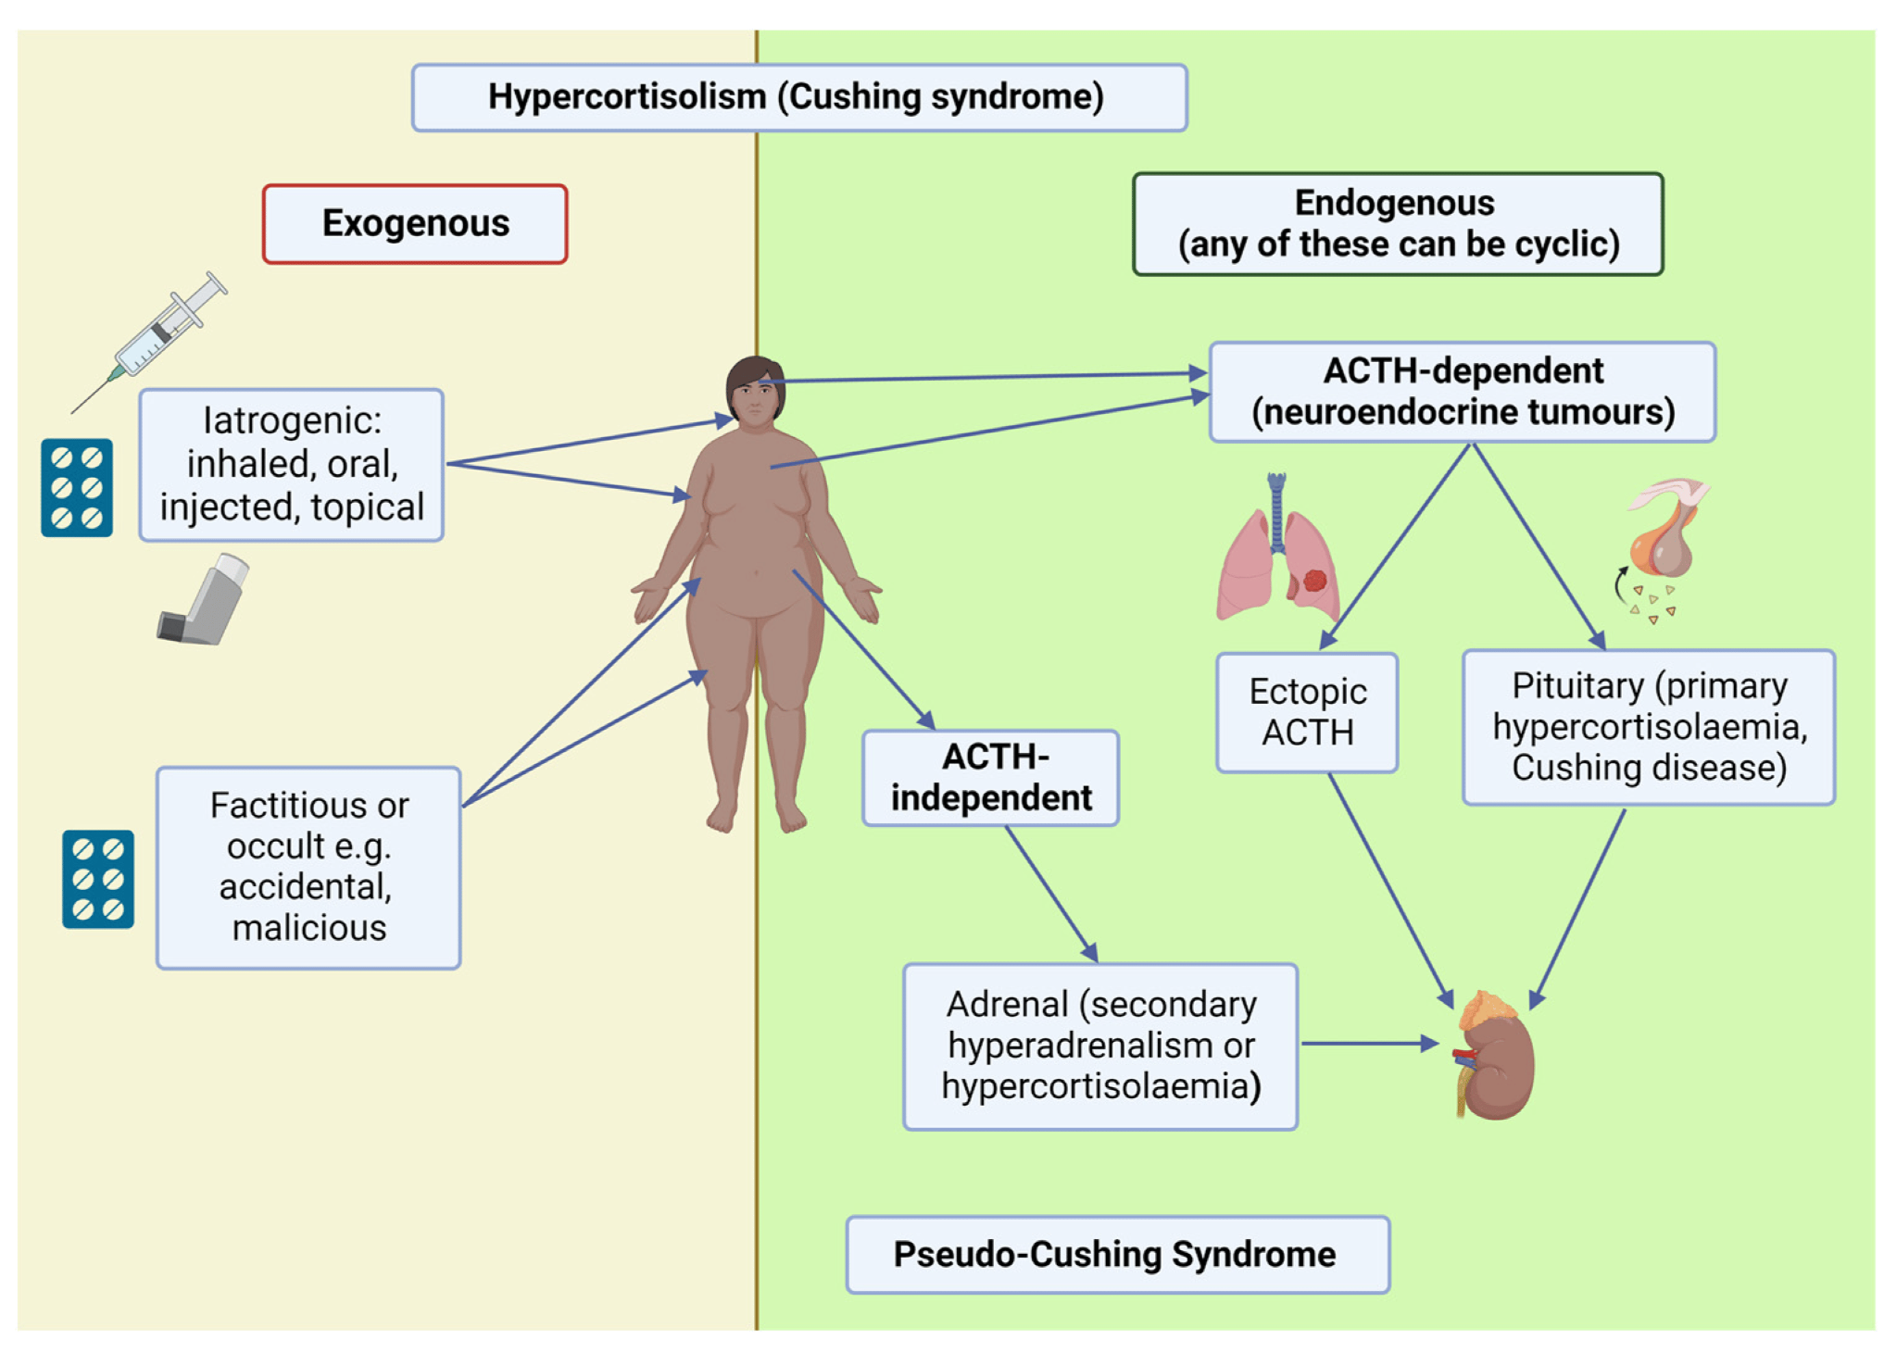

Slide 30
Cushing’s Syndrome
While most commonly caused by pituitary adenomas (Cushing’s disease), other causes are:
Adrenal adenomas (adrenal glands directly releasing cortisol),
Paraneoplastic syndromes (small cell lung cancer)
Exogenous steroids (Prednisolone)
Health consequences of Cushing’s syndrome are:
Metabolic - HTN, T2DM, Dyslipidemia, Osteoporosis
Mental - Anxiety, Depression and Insomnia

Slide 31
Cushing’s Syndrome
Diagnosis is with dexamethasone suppression tests.
Dexamethasone given → negative feedback on hypothalamus → reduced CRH → reduced ACTH from pituitary → low cortisol
No cortisol suppression → suggests Cushing’s syndrome.
Notes:
[Cortisol fluctuates throughout the day and is lowest at night]
High dose dexamethasone can suppress cortisol caused by Cushing’s disease but not adrenal adenoma or ectopic ACTH.

Slide 32
Cushing’s Syndrome
Diagnosis is with dexamethasone suppression tests.
Dexamethasone given → negative feedback on hypothalamus → reduced CRH → reduced ACTH from pituitary → low cortisol
No cortisol suppression → suggests Cushing’s syndrome.
Initially Low-dose (1mg) dexamethasone is given (Overnight) if Cushing’s is suspected.
Low-dose 48 hour test - dexamethasone taken every 6 hours for 8 doses. When cortisol levels are checked on day 3, cortisol should be low (normal result).
Then High-dose 48-hour test is used to determine the cause.
Notes:
[Cortisol fluctuates throughout the day and is lowest at night]
High dose dexamethasone can suppress cortisol caused by Cushing’s disease but not adrenal adenoma or ectopic ACTH.

Slide 33
Cushing’s Syndrome
Notes:
Reference- https://zerotofinals.com/medicine/endocrinology/cushings/
Low Dose Dexamethasone Suppression Test (1mg dexamethasone)
A normal response is for the dexamethasone to suppress the release of cortisol by effecting negative feedback on the hypothalamus and pituitary. The hypothalamus responds by reducing the CRH output. The pituitary responds by reducing the ACTH output. The lower CRH and ACTH levels result in a low cortisol level. When the cortisol level is not suppressed, this is the abnormal result seen in Cushing’s Syndrome
High Dose Dexamethasone Suppression Test (8mg dexamethasone)
The high dose dexamethasone suppression test is performed after an abnormal result on the low dose test.
In Cushing’s Disease (pituitary adenoma) the pituitary still shows some response to negative feedback and 8mg of dexamethasone is enough to suppress cortisol.
Where there is an adrenal adenoma, cortisol production is independent from the pituitary. Therefore, cortisol is not suppressed however ACTH is suppressed due to negative feedback on the hypothalamus and pituitary gland.
Where there is ectopic ACTH (e.g. from a small cell lung cancer), neither cortisol or ACTH will be suppressed because the ACTH production is independent of the hypothalamus or pituitary gland.

Slide 34
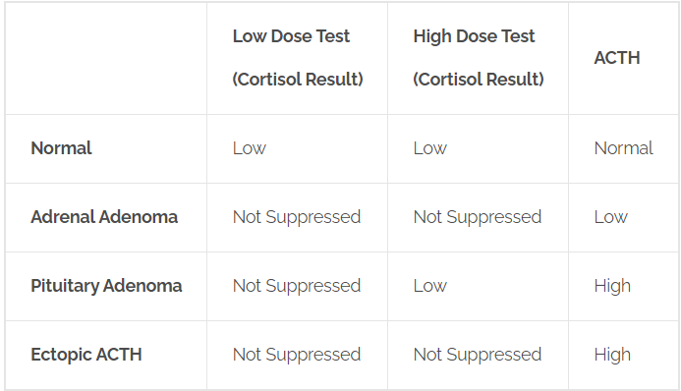
Cushing’s Syndrome
Table from zerotofinals.com

Slide 35
Cushing’s Syndrome
Treatment is correction of the anomaly:
Transsphenoidal removal of the pituitary adenoma
Surgical removal of the adrenal tumour
Surgical removal ectopic tumour ACTH (e.g., small cell lung cancer)
Cessation of steroid

Slide 36
Which of these is antibody mediated
A - T2DM
B - Diabetes Insipidus
C - Conn’s Syndrome
D - Cushing’s Syndrome
E - Graves Disease

Slide 37
Which of these is antibody mediated?
A - T2DM
B - Diabetes Insipidus
C - Conn’s Syndrome
D - Cushing’s Syndrome
E - Graves Disease

Slide 38
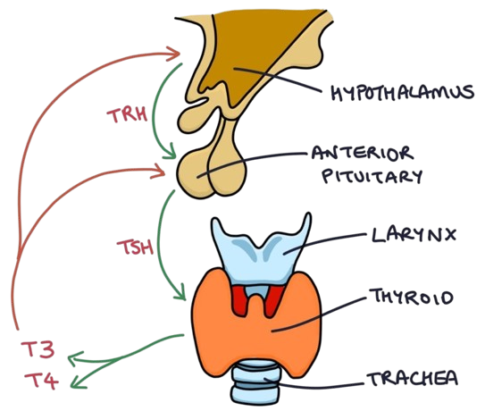
Thyroid
The thyroid serves a crucial role in homeostasis and metabolic regulation.
T4 (thyroxine) is converted into T3 (triiodothyronine).
Image from zerotofinals.com

Slide 39
Thyroid
The thyroid serves a crucial role in homeostasis and metabolic regulation.
T4 (thyroxine) is converted into T3 (triiodothyronine).
Dysregulation of T3 and T4 can give rise to clinical conditions such as hyperthyroidism or hypothyroidism, with each pathology manifesting distinct symptoms.
Image from zerotofinals.com

Slide 40
Thyroid
Thyroid dysfunction can be broadly categorised into:
Hyperthyroidism
Graves disease (Most common), Thyroiditis (De Quervain's or Acute +/-), Solitary toxic thyroid nodule, Toxic Multinodular goitre.

Slide 41
Thyroid
Thyroid dysfunction can be broadly categorised into:
Hyperthyroidism
Graves disease (Most common), Thyroiditis (De Quervain's or Acute +/-), Solitary toxic thyroid nodule, Toxic Multinodular goitre.
Hypothyroidism
Primary - Hashimoto's (Most common 1st), [Which?] Deficiency (Most common developing), Iatrogenic [Can you think of any examples?]
Secondary (Rarer due hypopituitarism) - Trauma, Tumours, Surgeries and Sheehan’s syndrome

Slide 42
Thyroid
Thyroid dysfunction can be broadly categorised into:
Hyperthyroidism
Graves disease (Most common), Thyroiditis (De Quervain's or Acute +/-), Solitary toxic thyroid nodule, Toxic Multinodular goitre.
Hypothyroidism
Primary - Hashimoto's (Most common 1st), Iodine Deficiency (Most common in developing countries), Iatrogenic [Can you think of any examples?]
Secondary (Rarer due hypopituitarism) - Trauma, Tumours, Surgeries and Sheehan’s syndrome

Slide 43
Thyroid
Thyroid dysfunction can be broadly categorised into:
Hyperthyroidism (GIST)
Graves disease (Most common), Inflammation - Thyroiditis (De Quervain's or Acute +/-), Solitary toxic thyroid nodule, Toxic Multinodular goitre.
Hypothyroidism
Primary - Hashimoto's (Most common 1st), Iodine Deficiency (Most common in developing countries), Iatrogenic [treatments for hyperthyroidism, other medications like lithium and amiodarone]
Secondary (Rarer due hypopituitarism) - Trauma, Tumours, Surgeries and Sheehan’s syndrome

Slide 44
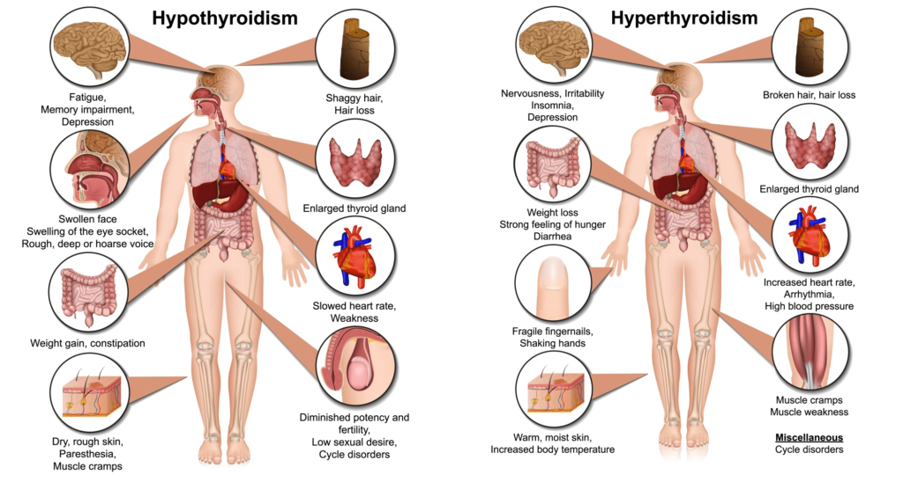
Hypothyroid
Dry Skin and Hair, Brittle Nails (Lateral loss of eyebrows)
Fatigue and Weakness
Weight Gain and Fluid Retention
Cold Sensitivity (Heavy coats in summer)
Constipation
Heavy or irregular periods
Notes:
https://www.medicdrive.org/thyroid-disease/

Slide 45
Hyperthyroid
Nervousness, Anxiety, and Irritability
Increased Heart Rate/ Palpitations
Weight Loss and Increased Appetite
Heat Intolerance and Sweating
Oligomenorrhea
Notes:
https://www.medicdrive.org/thyroid-disease/

Slide 46
Notes:
https://www.medicdrive.org/thyroid-disease/

Slide 47
Thyroxine is the active form of triiodothyronine.
True
False

Slide 48
Thyroxine (T4) is the active form of triiodothyronine (T3)
True
False

Slide 49
Hyperthyroid - Graves’ Disease
Graves’ disease - Thyroid stimulating hormone receptor antibodies stimulate the thyroid gland, leading to overproduction of thyroid T3/T4

Slide 50
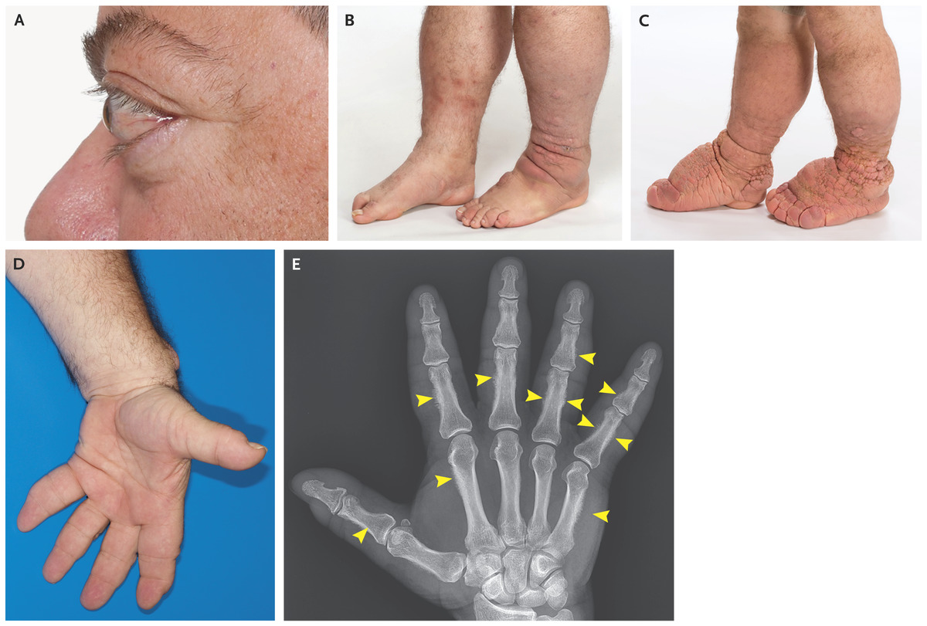
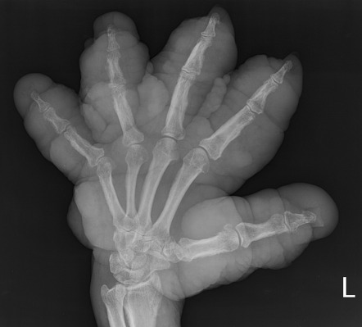
Hyperthyroid - Graves’ Disease
Graves’ disease - Thyroid stimulating hormone receptor antibodies stimulate the thyroid gland, leading to overproduction of thyroid T3/T4
Symptoms: weight ↓, ↑ HR, painless Goitre and pathognomonic:
Exophthalmos
Pretibial myxedema
Thyroid Acropachy

Slide 51
Hyperthyroid - Graves’ Disease
Graves’ disease - Thyroid stimulating hormone receptor antibodies stimulate the thyroid gland, leading to overproduction of thyroid T3/T4.
Symptoms: weight ↓, ↑ HR, painless Goitre and pathognomonic:
Exophthalmos
Pretibial myxedema
Thyroid Acropachy
Medical treatment is Block (1° Carbimazole/ 2° Propylthiouracil) and Replace (Levothyroxine)
Reduction of thyroid gland Surgically with Thyroidectomy or
Radioiodine (Short /life, thyroid-specific)

Slide 52
Hyperthyroid - De Quervain’s Thyroiditis
De Quervain's (Subacute) thyroiditis initially presents similarly to Graves’ Disease.
it is an inflammatory condition typically triggered by a viral infection - flu-like symptoms are present.
Causing the release of stored thyroid hormones (Hyperthyroidism).

Slide 53
Hyperthyroid - De Quervain’s Thyroiditis
De Quervain's (Subacute) thyroiditis initially presents similarly to Graves’ Disease.
it is an inflammatory condition typically triggered by a viral infection - flu-like symptoms are present.
Causing the release of stored thyroid hormones (Hyperthyroidism).
Unlike Graves' disease, De Quervain's thyroiditis causes a painful goitre along with pyrexia.
It is usually self-limiting, so managed conservatively with NSAIDs/ Corticosteroids, beta blockers (Sx relief), and levothyroxine (Hypothyroid phase).

Slide 54
Hypothyroid
Hashimoto's
Autoimmune disorder causing anti-thyroid antibodies to damage the thyroid. Decreasing production of T4/ T3.
Investigations show ↑ TSH with --T3/T4. 90% will have anti-thyroid peroxidase (TPO) antibodies.
Treatment is with levothyroxine.

Slide 55
Hypothyroid
Hashimoto's
Autoimmune disorder causing anti-thyroid antibodies to damage the thyroid. Decreasing production of T4/ T3.
Investigations show ↑ TSH with --T3/T4. 90% will have anti-thyroid peroxidase (TPO) antibodies.
Treatment is with levothyroxine.
Iodine deficiency
Commonly due to decreased dietary intake (Primary prevention via fortifying food, salts/milk, prevent this in the UK)

Slide 56
Hypothyroid
Hashimoto's
Autoimmune disorder causing anti-thyroid antibodies to damage the thyroid. Decreasing production of T4/ T3.
Investigations show ↑ TSH with --T3/T4. 90% will have anti-thyroid peroxidase (TPO) antibodies.
Treatment is with levothyroxine.
Iodine deficiency
Commonly due to decreased dietary intake (Primary prevention via fortifying food, salts/milk, prevent this in the UK)
Medications
Lithium, Amiodarone and Carbimazole can cause hypothyroidism.

Slide 57
Causes painless Goitre
A - Iodine deficiency
B - Cushing’s disease
C - Graves disease
D - Subacute thyroiditis
E - Acute Thyroiditis

Slide 58
Causes painless Goitre
A - Iodine deficiency
B - Cushing’s disease
C - Graves disease
D - Subacute thyroiditis
E - Acute Thyroiditis

Slide 59
Case A
A 14 year old boy presents to your GP clinic with his mother. The patient is complaining of feeling tired and going to the toilet frequently. He mentioned that he always need to keep drinking because he’s so thirsty all the time. His general appearance is quite slim. His PMhx is not significant but his mother mentioned that she suffers from hypothyroidism.
What is the likely diagnosis?
Hashimoto’s Thyroiditis
Grave’s Disease
Type 1 Diabetes Mellitus
Type 2 Diabetes Mellitus
Diabetes Insipidus

Slide 60
Case A
A 14 year old boy presents to your GP clinic with his mother. The patient is complaining of feeling tired and going to the toilet frequently. He mentioned that he always need to keep drinking because he’s so thirsty all the time. His general appearance is quite slim. His PMhx is not significant but his mother mentioned that she suffers from hypothyroidism.
What is the likely diagnosis?
Hashimoto’s Thyroiditis
Grave’s Disease
Type 1 Diabetes Mellitus
Type 2 Diabetes Mellitus
Diabetes Insipidus

Slide 61
Type 1 Diabetes Mellitus
Definition:
Metabolic autoimmune condition characterized by hyperglycemia.
Caused by the autoimmune destruction of beta cells of the islet of langerhans in the pancreas.
Pathophysiology:
No insulin produced -> glucose not transported to cells -> hyperglycaemia.
Insulin allows the glut4 transporter to transport glucose into the cell.
Body therefore thinks the patient is not eating.
Liver increases gluconeogenesis to ‘compensate’.
Notes:
Beta-cell destruction proceeds sub-clinically for months to years as insulitis. When 80-90% of beta cells have been destroyed, hyperglycaemia develops. Patients cannot utilise glucose in peripheral muscle and adipose tissues. This stimulates glucagon secretion which promotes gluconeogenesis, glycogenolysis, and ketogenesis in the liver. Hyperglycaemia and anion gap metabolic acidosis result. Long-term hyperglycaemia leads to complications (below).
Hyperglycaemia induces oxidative stress and inflammation. Oxidative stress can cause endothelial dysfunction by NO. Dysfunctional endothelium allows entry of LDLP into the vessel wall, which induces a slow inflammatory process and leads to atherosclerosis formation.

Slide 62
Type 1 Diabetes Mellitus
Definition:
Metabolic autoimmune condition characterized by hyperglycemia.
Caused by the autoimmune destruction of beta cells of the islet of langerhans in the pancreas.
Pathophysiology:
No insulin produced -> glucose not transported to cells -> hyperglycaemia.
Insulin allows the glut4 transporter to transport glucose into the cell.
Body therefore thinks the patient is not eating.
Liver increases gluconeogenesis to ‘compensate’.
Aetiology:
Younger patients (mostly)
Higher association in northern europeans
Associated with other autoimmune conditions
HLA-DR3-DQ2 and HLA-DR4-DQ8
Presentation:
Polydipsia
Polyuria -> osmotic diuresis
Weight loss
blurred vision
fatigue
first presentation could be DKA!
Notes:
Beta-cell destruction proceeds sub-clinically for months to years as insulitis. When 80-90% of beta cells have been destroyed, hyperglycaemia develops. Patients cannot utilise glucose in peripheral muscle and adipose tissues. This stimulates glucagon secretion which promotes gluconeogenesis, glycogenolysis, and ketogenesis in the liver. Hyperglycaemia and anion gap metabolic acidosis result. Long-term hyperglycaemia leads to complications (below).
Hyperglycaemia induces oxidative stress and inflammation. Oxidative stress can cause endothelial dysfunction by NO. Dysfunctional endothelium allows entry of LDLP into the vessel wall, which induces a slow inflammatory process and leads to atherosclerosis formation.

Slide 63
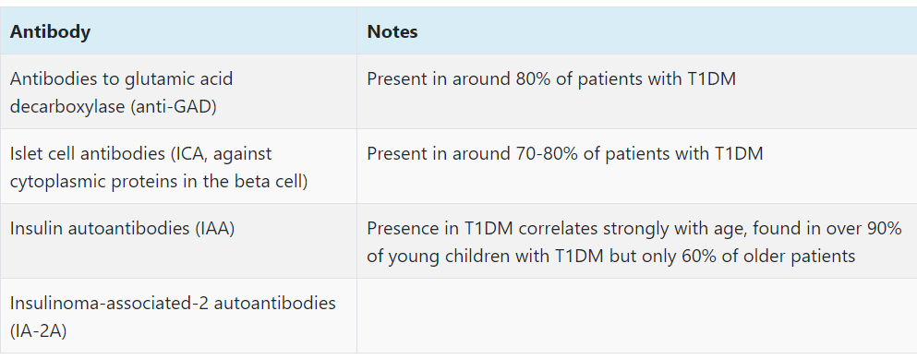
Type 1 Diabetes Mellitus
Diagnosis:
If symptomatic:
fasting glucose greater than or equal to 7.0 mmol/l OR
random glucose greater than or equal to 11.1 mmol/l (or after 75g oral glucose tolerance test)
If Asymptomatic: needs to be proven on 2 separate occasions.
Management:
Individualised insulin plan
Lots of different forms of insulin and devices
Manage Lifestyle issues
Educate on insulin and nutrition
Self monitoring of glucose, BM machines
Targets HbA1C < 48%
Periods of illness
hypoglycemia! - carry snacks
Rotating sites
TLDR;
Insulin and patient education.

Slide 64
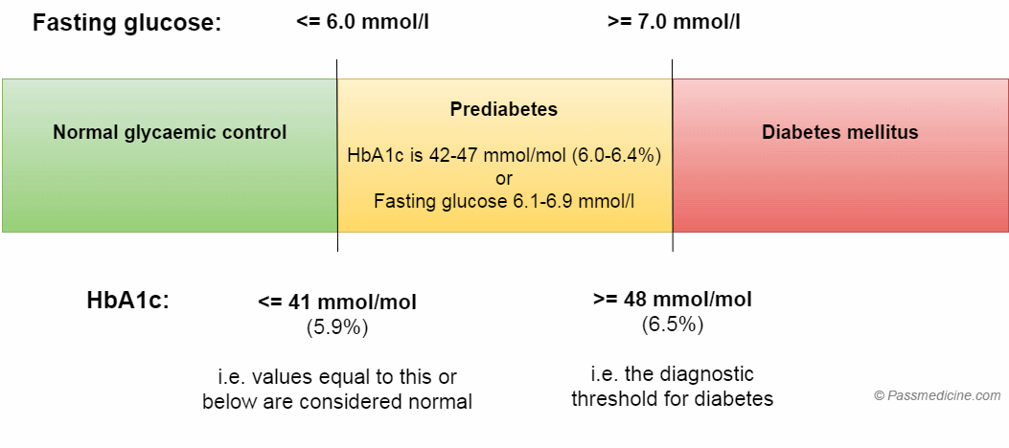

Slide 65
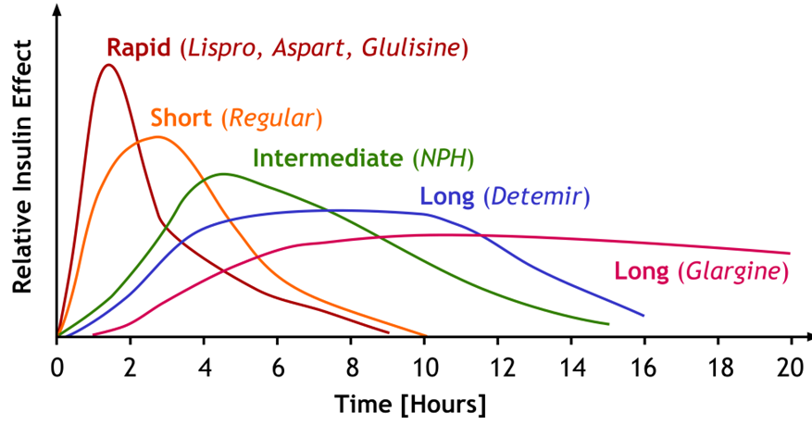

Slide 66
What cells are destroyed in T1DM?
A - Alpha Cells
B - Beta Cells
C - Delta Cells
D - Omega Cells
E - Dura Cells

Slide 67
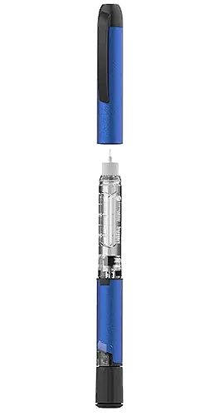
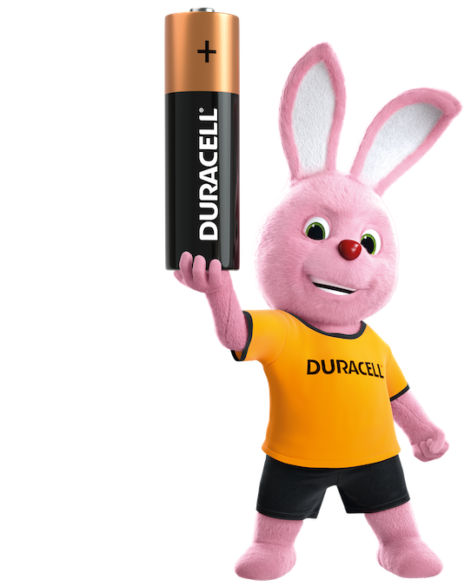
What cells are destroyed in T1DM?
A - Alpha Cells
B - Beta Cells of the islets of langerhans
C - Delta Cells
D - Omega Cells
E - Dura Cells

Slide 68
What is the cut off % for diabetes
A - 42
B - 48
C - 50
D - 38
E - 40

Slide 69
What is the cut off for diabetes in mmol
A - 42 -> prediabetes
B - 48 -> diabetes
C - 50
D - 38
E - 40

Slide 70
Case B
A 14 year old boy presents to the emergency department with his mother. He has been vomiting, looks drowsy and generally unwell. He is breathing very rapidly and you note that his breath smells ‘fruity’. On examination his skin has reduced turgor, his blood pressure is 90/60 and HR 135.
What is the likely diagnosis?
Thyroid Storm
Anaphylaxis
Diabetic Ketoacidosis
Hyperosmolar Hyperglycaemic state
Sepsis

Slide 71
Case B
A 14 year old boy presents to the emergency department with his mother. He has been vomiting, looks drowsy and generally unwell. He is breathing very rapidly and you note that his breath smells ‘fruity’. On examination his skin has reduced turgor, his blood pressure is 90/60 and HR 135.
What is the likely diagnosis?
Thyroid Storm
Anaphylaxis
Diabetic Ketoacidosis
Hyperosmolar Hyperglycaemic state
Sepsis

Slide 72
Diabetic Ketoacidosis (DKA)
Definition:
Metabolic acidosis caused by:
Untreated type 1 diabetes (occasionally type 2)
Undiagnosed diabetes - common presentation
Exacerbations of T1DM
Illness
Alcohol binge
Missed dose
MI
Pathophysiology:
Complete lack of insulin causes uncontrolled lipolysis.
Breakdown of fats -> increased fatty acids -> converted to ketones -> metabolic acidosis.

Slide 73
Diabetic Ketoacidosis (DKA)
Definition:
Metabolic acidosis caused by:
Untreated type 1 diabetes (occasionally type 2)
Undiagnosed diabetes - common presentation
Exacerbations of T1DM
Illness
Alcohol binge
Missed dose
MI
Pathophysiology:
Complete lack of insulin causes uncontrolled lipolysis.
Breakdown of fats -> increased fatty acids -> converted to ketones -> metabolic acidosis.
Presentation:
Polyuria, Polydipsia, dehydration
Kussmaul breathing
acetone-smelling breath
shock
Investigation:
blood glucose >11 mmol - hyperglycaemia
pH < 7.3 - acidosis (need a blood gas)
ketones > 3 mmol in serum or urine ketones ++
bicarbonate < 15 mmol

Slide 74
DKA Management
Follow ABCDE management and hospital DKA protocol
Generally follows FIG PICK
Fluids first! (saline infusion)
Insulin (sliding scale) !!be careful with insulin infusions!!
Glucose (dextrose infusion always given at the same time with insulin)
Potassium
Infection
Chart fluid balance
Ketone monitoring

Slide 75
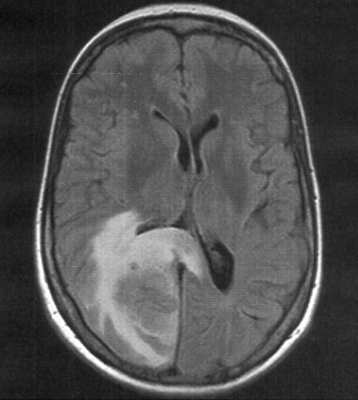
DKA Management Complications
Main complication of dka management is cerebral oedema. Caused by rapid fluid replacement. - watch out for deterioration.
Insulin has 2 problems:
can cause hypoglycemia - therefore always give with dextrose.
Insulin drives potassium into cells -> causing hypokalemia. - Therefore monitor potassium levels and add accordingly.

Slide 76
You have given fluids to a patient with DKA what is the next step?
A - Insulin
B - Insulin with dextrose
C - ketone monitoring
D - add potassium
E - Insulin with potassium

Slide 77
You have given fluids to a patient with DKA what is the next step?
A - Insulin
B - Insulin with dextrose
C - ketone monitoring
D - add potassium
E - Insulin with potassium

Slide 78
What serum ketones is needed to diagnose dka?
A - ketones ++
B - > 3 mmol
C - 11 mmol
D - 7 mmol
E - you don’t need to test ketones

Slide 79
What serum ketones is needed to diagnose dka?
A - ketones ++
B - > 3 mmol
C - 11 mmol
D - 7 mmol
E - you don’t need to test ketones

Slide 80
Case C
A 44 year old man presents to your GP clinic. He is complaining of always needing to urinate and increased thirst. He has a BMI of 30 and has noted that he is ‘losing feeling’ in his toes.
What is the likely diagnosis?
Guillain-Barre syndrome
Alcoholism
Type 1 Diabetes Mellitus
Type 2 Diabetes Mellitus
Diabetes Insipidus

Slide 81
Case C
A 44 year old man presents to your GP clinic. He is complaining of always needing to urinate and increased thirst. He has a BMI of 30 and has noted that he is ‘losing feeling’ in his toes.
What is the likely diagnosis?
Guillain-Barre syndrome
Alcoholism
Type 1 Diabetes Mellitus
Type 2 Diabetes Mellitus
Diabetes Insipidus

Slide 82
Type 2 Diabetes Mellitus
Definition:
Mix of peripheral insulin resistance and insulin deficiency (deficiency less severe than t1dm).
Body still produces insulin.
Pathophysiology:
Repeated exposure to glucose and insulin increases insulin resistance.
Overtime pancreas gets damaged.

Slide 83
Type 2 Diabetes Mellitus
Definition:
Mix of peripheral insulin resistance and insulin deficiency (deficiency less severe than t1dm).
Body still produces insulin.
Pathophysiology:
Repeated exposure to glucose and insulin increases insulin resistance.
Overtime pancreas gets damaged.
Aetiology:
Older age
Ethnicity (south asians and afro-caribbean)
Diet and lifestyle
Family history
Obesity
Presentation:
Polyuria and Polydipsia
Fatigue
Slow wound healing
More infections
Unintentional weight loss (less severe than type 1)

Slide 84
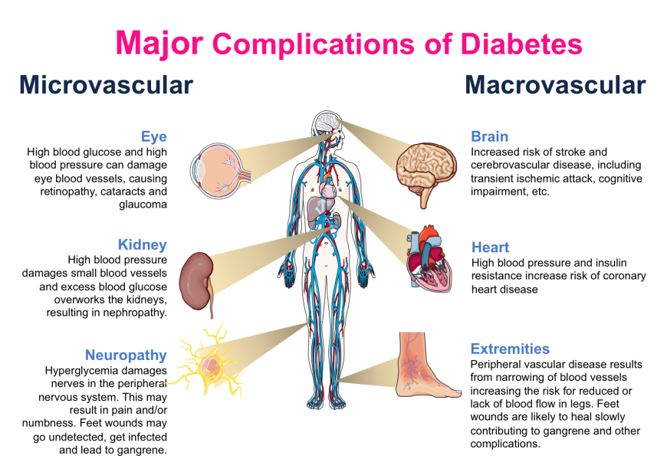

Slide 85
Type 2 Diabetes Mellitus
Diagnosis:
Similar to type 1.
Random glucose test > 11 mmol
Fasting > 7 mmol
HbA1C > 48 mmol GOLD STANDARD
Management:
If prediabetic (HbA1c 42-47) offer diabetes prevention programme.
First Line is lifestyle modifications and regular HbA1c appointments.
Second line if HbA1c still > 48 offer Metformin
Add one of these drugs*:
SGLT-2 inhibitors
DPP-4 inhibitor
Sulfonylurea
Triple drug therapy or start insulin
*SGLT-2 Inhibitors preferred

Slide 86
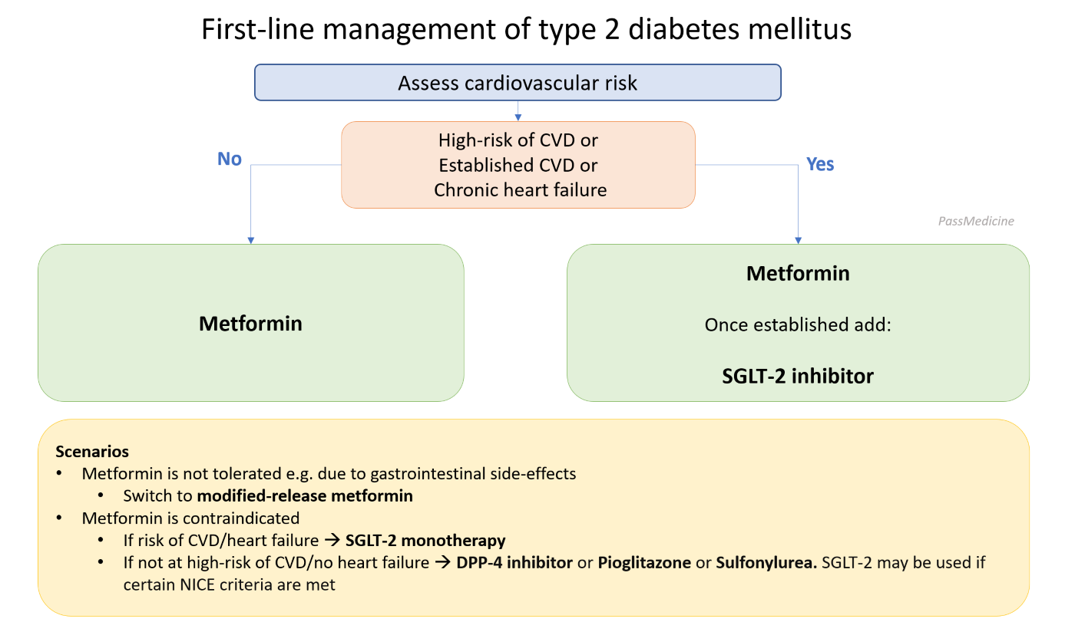
courtesy of passmed

Slide 87
courtesy of passmed

Slide 88
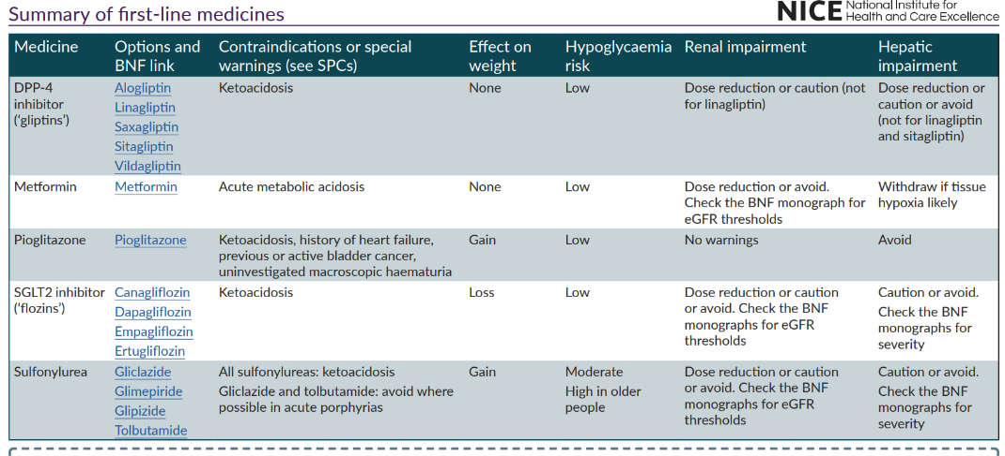

Slide 89
Hyperosmolar Hyperglycaemic State
Definition:
Medical Emergency due to chronic T2DM.
Severe hyperglycemia over time causes:
severe osmotic diuresis
severe dehydration
electrolyte deficiency
Hyperglycaemia
Diuresis causing Hyperosmolality
Mild/No ketosis
Pathophysiology:
There is decreased insulin but enough so that ketogenesis doesn’t happen.

Slide 90
Hyperosmolar Hyperglycaemic State
Definition:
Medical Emergency due to chronic T2DM.
Severe hyperglycemia over time causes:
severe osmotic diuresis
severe dehydration
electrolyte deficiency
Hyperglycaemia
Diuresis causing Hyperosmolality
Mild/No ketosis
Pathophysiology:
There is decreased insulin but enough so that ketogenesis doesn’t happen.
Aetiology:
Chronic uncontrolled T2DM
Illness
Dementia
Sedative drugs
Presentation:
HHS happens over days.
Clinical signs of dehydration
Nausea and vomiting
Altered consciousness
Blood Hyperviscosity (sticky blood)

Slide 91
Hyperosmolar Hyperglycaemic State
Diagnosis:
No specific criteria but:
Hyperglycaemia > 30 mmol
Serum Osmolarity > 320 mosmol/kg
No Ketonaemia
Management:
Fluid Replacement (saline)
LMWH
Restore electrolytes

Slide 92
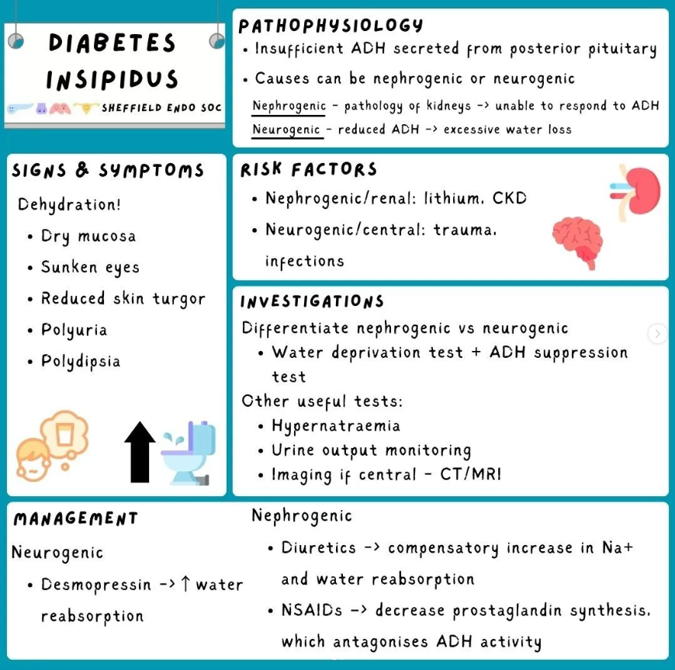
https://linktr.ee/uosendosoc

Slide 93
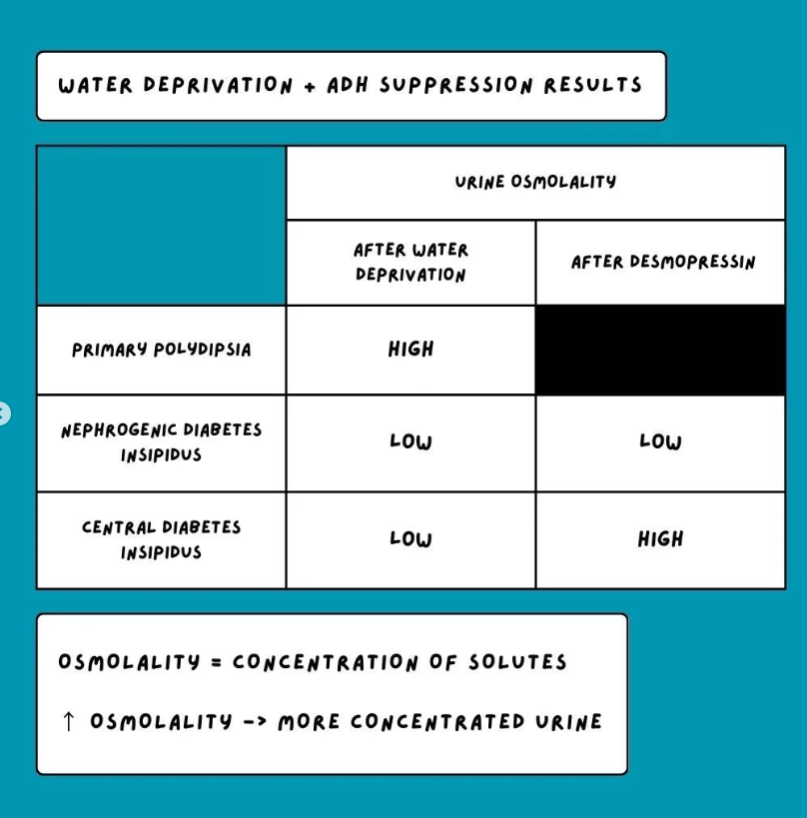
https://linktr.ee/uosendosoc

Slide 94
https://linktr.ee/uosendosoc

Slide 95
pls give feedback!
questions coming up…
https://forms.gle/jmmWGpDgUqHx98AR7

Slide 96
Question 1
A 14 year old boy presents to your GP clinic with his mother. The patient is complaining of feeling tired and going to the toilet frequently. He mentioned that he always need to keep drinking because he’s so thirsty all the time. His general appearance is quite slim. His PMhx is not significant but his mother mentioned that she suffers from hypothyroidism.
What would be the association-link with this disease?
Autosomal Recessive
Autosomal Dominant
HLA B27
HLA-DR3-DQ2 and HLA-DR4-DQ8
ANA antibodies

Slide 97
Question 1
A 14 year old boy presents to your GP clinic with his mother. The patient is complaining of feeling tired and going to the toilet frequently. He mentioned that he always need to keep drinking because he’s so thirsty all the time. His general appearance is quite slim. His PMhx is not significant but his mother mentioned that she suffers from hypothyroidism.
What would be the association-link with this disease?
Autosomal Recessive
Autosomal Dominant
HLA B27
HLA-DR3-DQ2 and HLA-DR4-DQ8
ANA antibodies

Slide 98
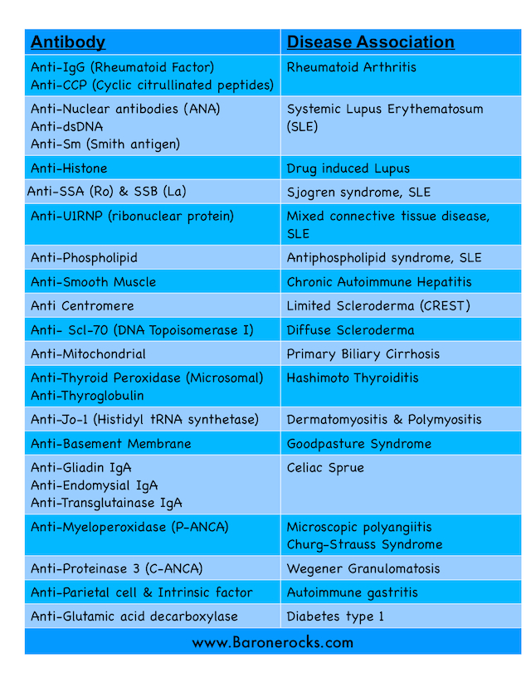
not useful now, but come back to this when revising!

Slide 99
Question 2
A 14 year old boy presents to your GP clinic with his mother. The patient is complaining of feeling tired and going to the toilet frequently. He mentioned that he always need to keep drinking because he’s so thirsty all the time. His general appearance is quite slim. His PMhx is not significant but his mother mentioned that she suffers from hypothyroidism.
What would be the management for this condition?
Lifestyle modifications
Insulin
Metformin
SGLT-2 inhibitor
DPP 4 inhibitor

Slide 100
Question 2
A 14 year old boy presents to your GP clinic with his mother. The patient is complaining of feeling tired and going to the toilet frequently. He mentioned that he always need to keep drinking because he’s so thirsty all the time. His general appearance is quite slim. His PMhx is not significant but his mother mentioned that she suffers from hypothyroidism.
What would be the management for this condition?
Lifestyle modifications
Insulin
Metformin
SGLT-2 inhibitor
DPP 4 inhibitor

Slide 101
Question 3
A 18 year old patient is admitted to the emergency department. They have fast breathing with a pear drop smell. Their BP is 85/65 and HR 125. They are known to be a diabetic.
What would be your initial management for this condition?
Insulin
Fluids
Glucose
Metformin
Dextrose

Slide 102
Question 3
A 18 year old patient is admitted to the emergency department. They have fast breathing with a pear drop smell. Their BP is 85/65 and HR 125. They are known to be a diabetic.
What would be your initial management for this condition?
Insulin
Fluids
Glucose
Metformin
Dextrose

Slide 103
Question 3
A 18 year old patient is admitted to the emergency department. They have fast breathing with a pear drop smell. Their BP is 85/65 and HR 125. They are known to be a diabetic. You have commenced fluid resuscitation with 0.9% saline.
What would be next in your management?
Insulin with dextrose
More Fluids
Humalog
Metformin
Dextrose

Slide 104
Question 3
A 18 year old patient is admitted to the emergency department. They have fast breathing with a pear drop smell. Their BP is 85/65 and HR 125. They are known to be a diabetic. You have commenced fluid resuscitation with 0.9% saline.
What would be next in your management?
Insulin with dextrose
More Fluids
Humalog
Metformin
Dextrose

Slide 105
Question 4
A 36 year old woman is admitted to the emergency department. They have fast heart rate, chest pain, and are pacing around the room. Their BP is 142/129 and HR 125. They are known to be a type 1 diabetic.
What would give the most relief to the patient?
Insulin with dextrose
Levothyroxine
Carbimazole
Propranolol
Propylthiouracil

Slide 106
Question 4
A 36 year old woman is admitted to the emergency department. They have fast heart rate, chest pain, and are pacing around the room. Their BP is 142/129 and HR 125. They are known to be a type 1 diabetic.
What would give the most relief to the patient?
Insulin with dextrose
Levothyroxine
Carbimazole
Propranolol
Propylthiouracil

Slide 107
Question 5
A 35 year old woman presents with 3 year history of hypertension that has been difficult to manage with medication. She has nocturia, palpitations and headaches. The rest of her medical history is unremarkable. Her blood pressure is 155/90. A diagnosis of Conn’s syndrome is made.
What is the definitive treatment of Conn’s syndrome?
Percutaneous renal artery angioplasty
Adrenalectomy
Eplerenone
Spironolactone
Carbimazole

Slide 108
Question 5
A 35 year old woman presents with 3 year history of hypertension that has been difficult to manage with medication. She has nocturia, palpitations and headaches. The rest of her medical history is unremarkable. Her blood pressure is 155/90. A diagnosis of Conn’s syndrome is made.
What is the definitive treatment of Conn’s syndrome?
Percutaneous renal artery angioplasty
Adrenalectomy
Eplerenone
Spironolactone
Carbimazole

Slide 109
pls give feedback!
https://forms.gle/jmmWGpDgUqHx98AR7

Slide 110
Many that we have not covered

