Slide 1
2022/2023

Slide 2
HAEMATOLOGY
Phase 2a Revision Session
26th January 2023
Suhail Raihan & Hamzah Abbas
The Peer Teaching Society is not liable for false or misleading information…

Slide 3
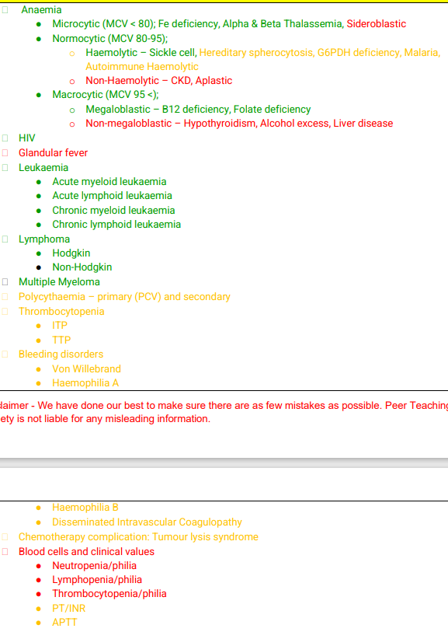
Aims and Objectives
This is the PTS list but in all honesty this is probably what you need to know:
Anaemia – Microcytic, Normocytic, Macrocytic
Blood Cancer
AML, ALL, CML, CLL
Lymphoma
MM
The Peer Teaching Society is not liable for false or misleading information…

Slide 4
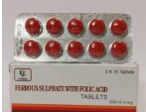
Anaemia Hx
Social History
Alcohol
Diet – Vegan?
Age
Fam History
Autoimmune Disease – Pernicious Anaemia
Malabsorptive Conditions
Past Medical History
Liver Disease
Hypothyroidism
Most common cause of anaemia
Fe Deficiency
The Peer Teaching Society is not liable for false or misleading information…
Notes:
What are some questions you would ask

Slide 5
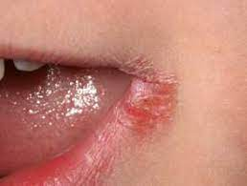
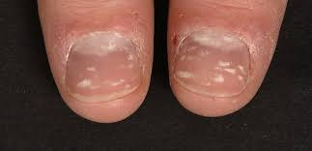
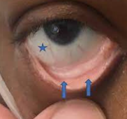
Features of Anaemia
Features
SOB
Peripheral coldness
Conjunctival Pallor
Tachycardia
Tired / Fatigue
Palpitations
Brittle Hair
Leukonychia
Angular Cheilitis
The Peer Teaching Society is not liable for false or misleading information…

Slide 6
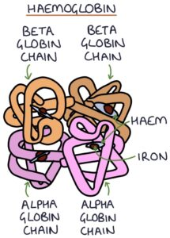
Microcytic Anaemia
MCV < 80 ( Microcytic)
TAILS
Thalassaemia
Anaemia of Chronic Disease
Iron Deficiency
Lead Poisoning
Sideroblastic Anaemia

Slide 7
Microcytic Anaemia
DISEASE NAME | Fe Deficiency Anaemia
DEFINITION, CAUSE/S & RISK FACTORS | Lack of Iron – needed to produce Haem Causes: Intake – Diet Absorption – Malabsorptive Conditions Losses – Bleeding Increased Requirements – Kids, Preggo
PRESENTATION (Sx) | Symptoms = What they tell you Tired Cold Palpitations Signs = What you pick up Koilonychia Brittle Hair Tachycardia Angular Stomatitis
DIAGNOSIS & INVESTIGATIONS (Ix) | FBC Fe Studies
TREATMENT (Tx) | Ferrous Sulphate x3/12
Special Qns:
Triad of dysphagia, Fe deficiency and oesophageal webs
Plummer Vinson Syndrome

Slide 8
Fe Studies
Ferritin = Fe storage
Transferrin = Protein that facilitates Fe absorption
Total Iron Binding Capacity = Affinity for Fe to bind to protein
Test | IDA | Anaemia of chronic disease | Thalassaemia
Ferritin | Low/ Normal/ (High) | Normal/ Raised | Normal /Raised
Serum Iron | Low | Low | Normal/Raised
Transferrin | High | Low | Normal/ Low
Transferrin sat | Low | Normal/ Low | Normal/Raised
TIBC | High | Low | Normal/ Low
So if iron is normal, what further tests would you like to do?

Slide 9
Microcytic Anaemia
DISEASE NAME | Thalassaemia
DEFINITION, CAUSE/S & RISK FACTORS | Inherited
PATHOPHYSIOLOGY (IF APPLICABLE) | Mutation in Alpha / Beta units
PRESENTATION (Sx) | Microcytosis disproportionate to Hb levels
DIAGNOSIS & INVESTIGATIONS (Ix) | Hb Electrophoresis – Hb A2, Hb H Blood Film
TREATMENT (Tx) | Blood Transfusions Venesection Splenectomy
COMPLICATIONS (IF APPLICABLE) | organ failure
Notes:
Hb H = Barts
Splenectomy = decrease consumption of RBC & reduce transfusion complications

Slide 10
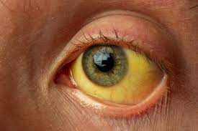
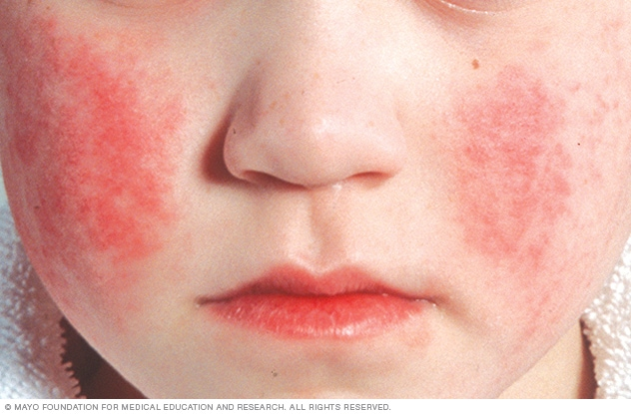
Normocytic Anaemia
80- 100 (Normocytic)
Common Causes:
Haemolysis
CKD
Blood Loss
Haem Malignancy
Aplastic Anaemia
What are some markers for cell turnover?
What is the virus causing Aplastic Anaemia?
LDH, Unconj bili
Haptoglobin
Notes:
LDH – enzyme of cell turnover = loads of RBC breaking down = haemolysis
Haptoglobin = Protein that binds to free Haem – when RBC breaks down, its components are released → haptoglobin binds to it to prevent ROS

Slide 11
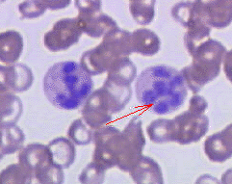
Macrocytic Anaemia
> 100 (Macrocytic)
62 year old comes into ED unsteady on his feet. He smells of alcohol
He seems confused and has nystagmus.
His blood tests revealed the following:
Hb 80g/dL (135-180)
MCV 120 (80-100)
T4 30 (9-18)
TSH 0.1 (0.5-5.5)
Which of the following is a most likely cause of his anaemia
B12 Deficiency
Hypothyroidism
Liver Disease
Alcohol
Fe Deficiency
Megaloblasts
Notes:
non- functional mature blood cells
Normal RBC – no nucleus
Based on picture it does

Slide 12
Macrocytic Anaemia
> 100 (Macrocytic)
Megaloblastic
Liver disease
Alcohol
Hypothyroidism
Myelodysplasia
B12/ Folate
Megaloblasts

Slide 13
Anaemia
Take a detailed history
Initial invs- FBC, U/E, LFTS, TFTS, B12/Folate
Patient presents with anaemia
What is their MCV?
MCV < 80 ( Microcytic)
80- 100 (Normocytic)
> 100 (Macrocytic)
Iron panel
Megaloblasts on blood film?
What are their reticulocytes?
No
Yes
Ferritin
TIBC
N Ferritin
B12/ Folate
TIBC
Low
High
Liver disease
Alcohol
Hypothyroidism
Myelodysplasia
Review other iron studies
Consider Hb studies
CKD
Haem Malig
Mixed pict
Endocrine
LDH, Unconj bili
Haptoglobin
Serum iron
No
Yes
Serum iron
Blood loss
Haemolysis
Iron
deficiency
anaemia
Anaemia of chronic disease
Thalassaemia
OR
Sideroblastic anaemia

Slide 14
Blood Cancers
Blood Cancers
Leukaemia
Lymphoma
Others
Myeloid
Lymphoid
Hodgkin
Non-Hodgkin
Myelodysplasia
Myeloma
Polycythaemia vera, myelofibrosis etc.

Slide 15
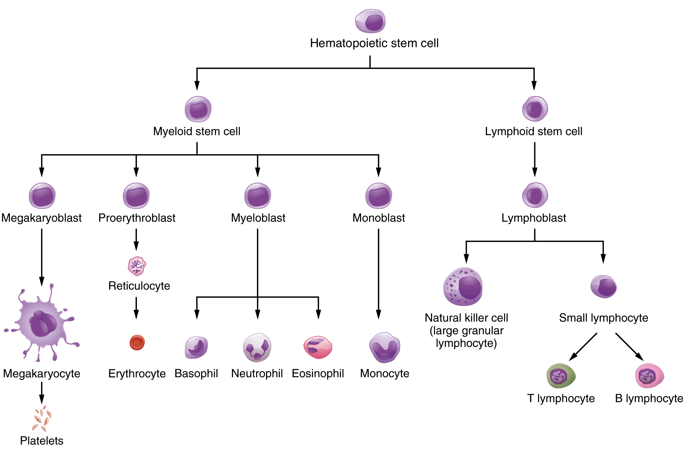
Blood Cancers

Slide 16
Acute Myeloid Leukaemia
Notes:
Production STOPS at myeloblast = no basophil, neutrophil and eosinophil

Slide 17
AML
DISEASE NAME | Acute Myeloid Leukaemia
DEFINITION, CAUSE/S & RISK FACTORS | Proliferation of myeloblasts RFx: Age, Down Syndrome, Chemotherapy, Irradiation
PATHOPHYSIOLOGY (IF APPLICABLE) | Rapid Proliferation of Myeloblasts
PRESENTATION (Sx) | Bone Marrow Failure: Neutropenia, Anaemia, Thrombocytopenia Tissue Infiltration: *Swollen Gums *Splenomegaly
DIAGNOSIS & INVESTIGATIONS (Ix) | Auer Rods on Cytology

Slide 18
Chronic Myeloid Leukaemia

Slide 19
CML
DISEASE NAME | Chronic Myeloid Leukaemia
DEFINITION, CAUSE/S & RISK FACTORS | Excess RBC, platelets, WBC production RFx: M, Philadelphia Chromosome t(9:22) [BCR-ABL Gene]
PATHOPHYSIOLOGY (IF APPLICABLE) | Overproduction of Myeloid Progenitor
PRESENTATION (Sx) | Splenomegaly Hyperviscosity – headaches, thrombotic events Bone Marrow Failure – same as AML Hypermetabolic – weight loss, malaise, night sweats
DIAGNOSIS & INVESTIGATIONS (Ix) | Genetic tests for BCR ABL

Slide 20
Acute Lymphoblastic Leukaemia

Slide 21
ALL
DISEASE NAME | Acute Lymphoblastic Leukaemia
DEFINITION, CAUSE/S & RISK FACTORS | Most common Childhood Ca RFx – Genetics (Down’s Syndrome, Neurofibromatosis), Radiation,
PATHOPHYSIOLOGY (IF APPLICABLE) | Rapid proliferation of lymphoblasts
PRESENTATION (Sx) | Bone Marrow Failure B Sx more common than AML Tissue Infiltration: Hepatosplenomegaly Swollen Testicles
DIAGNOSIS & INVESTIGATIONS (Ix) | > 20% Lymphoblasts on bone marrow biopsy

Slide 22
Chronic Lymphoblastic Leukaemia

Slide 23
CLL
DISEASE NAME | Chronic Lymphoblastic Leukaemia
DEFINITION, CAUSE/S & RISK FACTORS | Insidious accumulation of incompetent lymphocytes RFx: M, Genetics
PATHOPHYSIOLOGY (IF APPLICABLE) | Failure of cell apoptosis
PRESENTATION (Sx) | Asymptomatic Lymphadenopathy BM Failure
DIAGNOSIS & INVESTIGATIONS (Ix) | Smudge Cells on blood film
COMPLICATIONS (IF APPLICABLE) | Richter Transformation

Slide 24
Leukaemia
Acute Myeloid Leukaemia
Auer Rods
Acute Lymphoblastic Leukaemia
Children <6 years
Chronic Myeloid Leukaemia
Philadelphia Chromosome
Chronic Lymphocytic Leukaemia
Smudge Cells

Slide 25
Feedback
https://forms.gle/eyCaht2cQDA5a8Jw5
The Peer Teaching Society is not liable for false or misleading information…

Slide 26
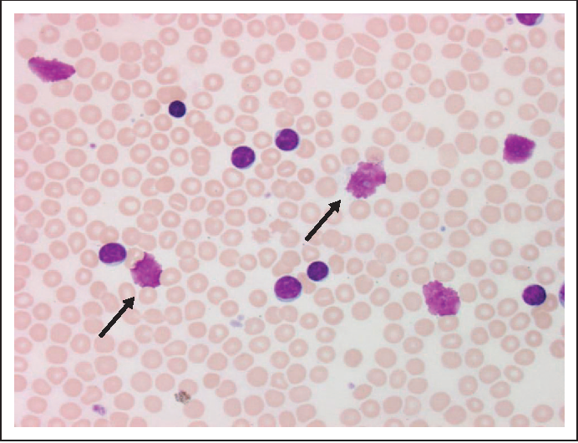
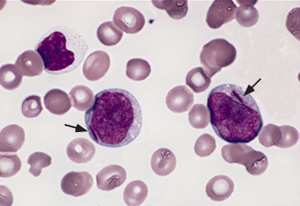
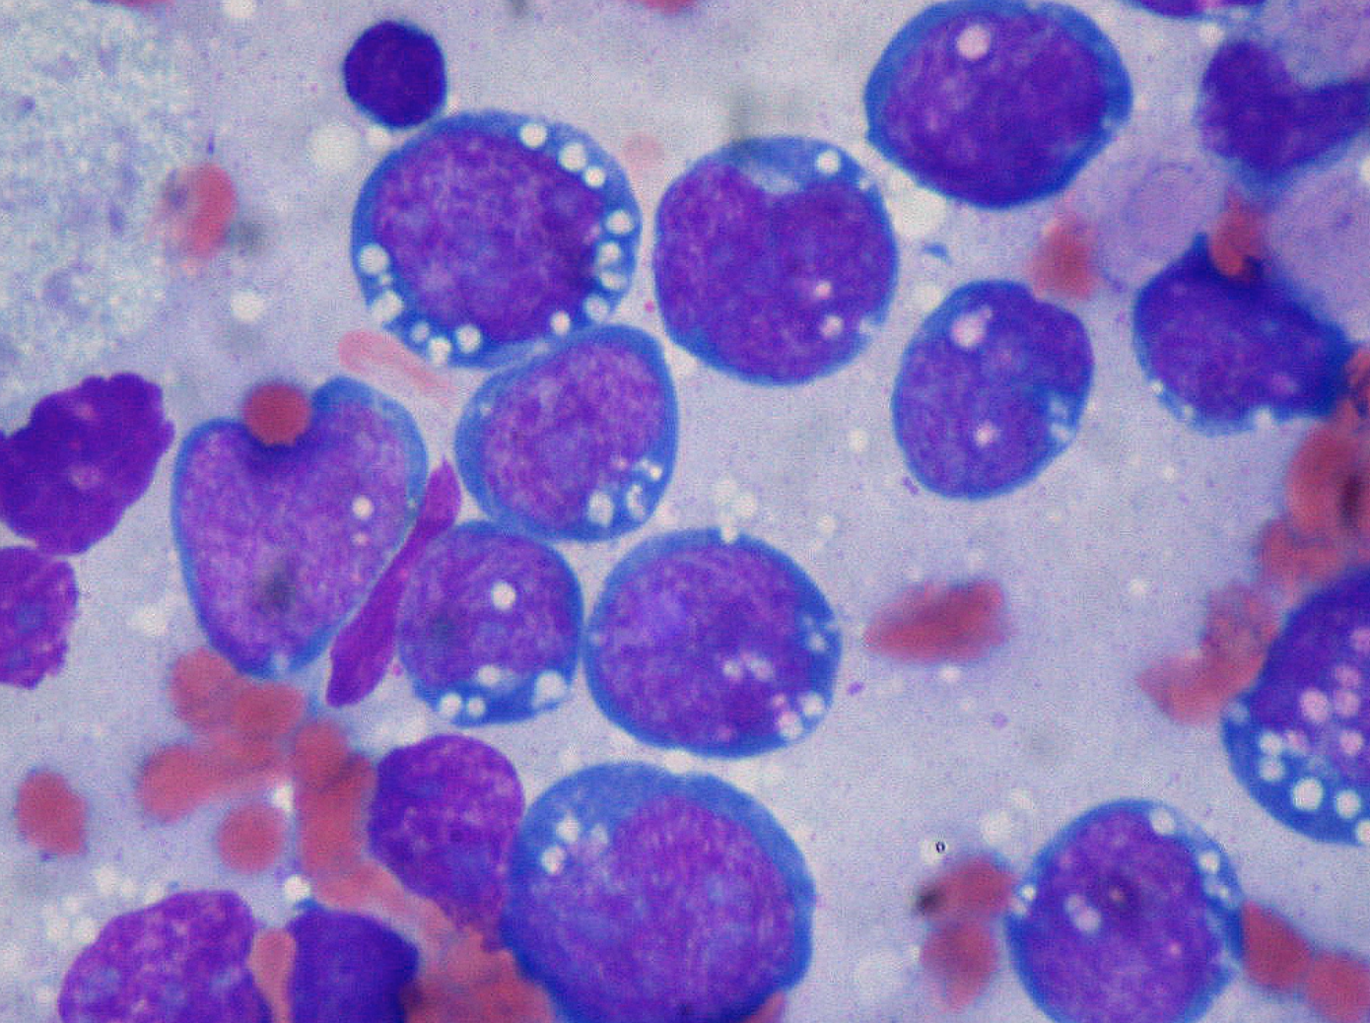
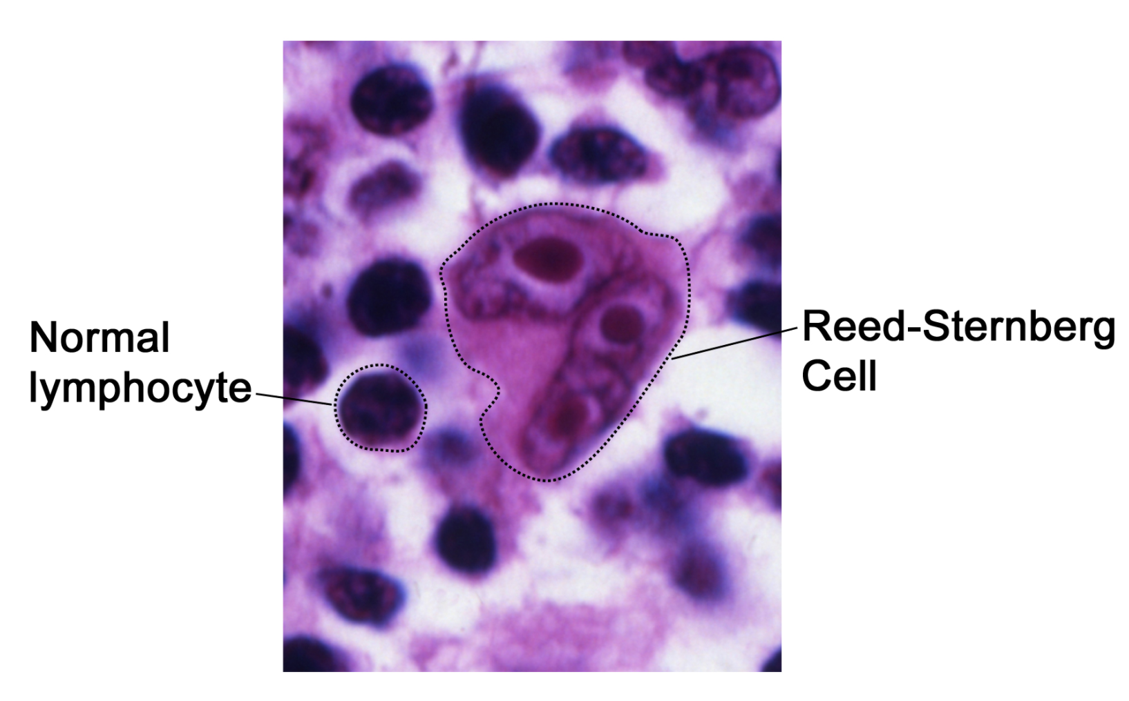
Blood Films
Smudge Cells - CLL
Auer Rods - ALL
Reed Sternberg - Hodgkin
Starry Sky – Burkitt

Slide 27
Blood Cancers
Blood Cancers
Leukaemia
Lymphoma
Others
Myeloid
Lymphoid
Hodgkin
Non-Hodgkin
Myelodysplasia
Myeloma
Polycythaemia vera, myelofibrosis etc.

Slide 28
Lymphoma
DEFINITION, CAUSE/S & RISK FACTORS | Blood Ca from lymphocytes + Tumour in Lymph Nodes RFx: EBV, HIV, SLE, Sjogrens Age
PATHOPHYSIOLOGY (IF APPLICABLE) | Failure of cell apoptosis
PRESENTATION (Sx) | Lymph Tissue enlargement – Lymphadenopathy / Splenomegaly / Hepatomegaly B Symptoms – Fever, Night Sweats, Weight Loss
DIAGNOSIS & INVESTIGATIONS (Ix) | Blood Films Ann Arbor Staging for classification
COMPLICATIONS (IF APPLICABLE)

Slide 29
Lymphoma
Hodgkin’s Lymphoma
Reed-Sternberg Cells
Non-Hodgkin’s Lymphoma
NO Reed-Sternberg Cells
Skin excoriations
Neutrophilia
Skin rashes e.g. mycosis fungoides
Neutropenia

Slide 30
Question
74 year old gentleman comes to surgery complaining of constipation. He has been experiencing the symptom on and on-off basis for the past couple of months. On systemic enquiry, you find out that he has been feeling low in mood and having pains in his limbs. He is a frequent attender with history of recurrent infections.
Which of the following investigations / results would point towards his diagnosis?
Urine Dipstick
Serum Electrophoresis
Bone Marrow Aspirate
Raised ALP
The Peer Teaching Society is not liable for false or misleading information…

Slide 31
Multiple Myeloma
DISEASE NAME | MM
DEFINITION, CAUSE/S & RISK FACTORS | Abnormal Proliferation of single Ig – usually Ig A RFx – age, Afrocarribean, HIV
PRESENTATION (Sx) | CRABBI Calcium high Renal Failure Anaemia Bone Lytic Lesions Bleeding Infections
DIAGNOSIS & INVESTIGATIONS (Ix) | Bloods – high Ca Blood Film – Rouleaux Formation BM Aspirate – Plasma Cells > 10%
COMPLICATIONS (IF APPLICABLE) | Richter Transformation

Slide 32
References
Imperial Med Ed
Passmedicine.com
Hamzah Abbas
The Peer Teaching Society is not liable for false or misleading information…

Slide 33
Feedback
https://forms.gle/eyCaht2cQDA5a8Jw5
The Peer Teaching Society is not liable for false or misleading information…

