Slide 1
Haematology
Phase 2a Recap
Olivia Stevens and Judith Scott

Slide 2
What We’ll Cover
Blood Results
Anaemias
Haematological Malignancies
Haemoglobinopathies
Bleeding Disorders
DVT + PE
Infections - Malaria

Slide 3
The Basics

Slide 4
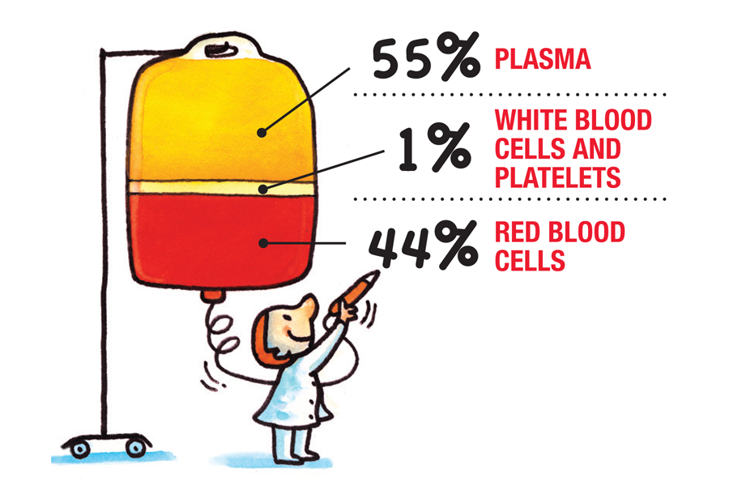
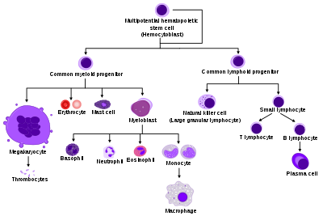
Blood Constituents and Haematopoiesis
Notes:
Plasma is the main component of blood and consists mostly of water, with proteins, ions, nutrients, and wastes mixed in.
Red blood cells are responsible for carrying oxygen and carbon dioxide.
Platelets are responsible for blood clotting.
White blood cells are part of the immune system and function in immune response.
Haematopoietic stem cells live in the bone marrow and can differentiate into all types of blood cells types and tissues. They are self-renewing.

Slide 5
White Blood Cells
There are 5 main types of WBC:
Neutrophils are the most abundant type, they are phagocytes involved in fighting bacterial and fungal infections
Monocytes are mainly involved in bacterial infections, they differentiate into macrophages
Eosinophils are involved in parasitic infections
Basophils are responsible for allergens as they contain histamine granules, resulting in inflammatory IgE responses
Lymphocytes are mainly involved in viral infections. These are the smallest WBC and there are 3 major types: Natural killer cells, T cells and B cells.
White blood cells, or leukocytes, make up 1% of blood
Primarily involved in immune responses
Much larger than red blood cells
Divided into 2 general groups: granulocytes and agranulocytes
Notes:
Natural Killer cells provide non-specific immunity against foreign proteins. They release perforins, which embed into the plasma membrane, creating channels and an influx of extracellular fluid which results in cell lysis.
T cells form in the bone marrow, but mature in the thymus. There are cytotoxic T cells, which directly attack infected cells, and helper T cells which activate the B cells and form memory T cells.
B cells form and mature in the bone marrow. They are involved in antibody secretion. B cells mature into plasma cells and memory B cells.

Slide 6
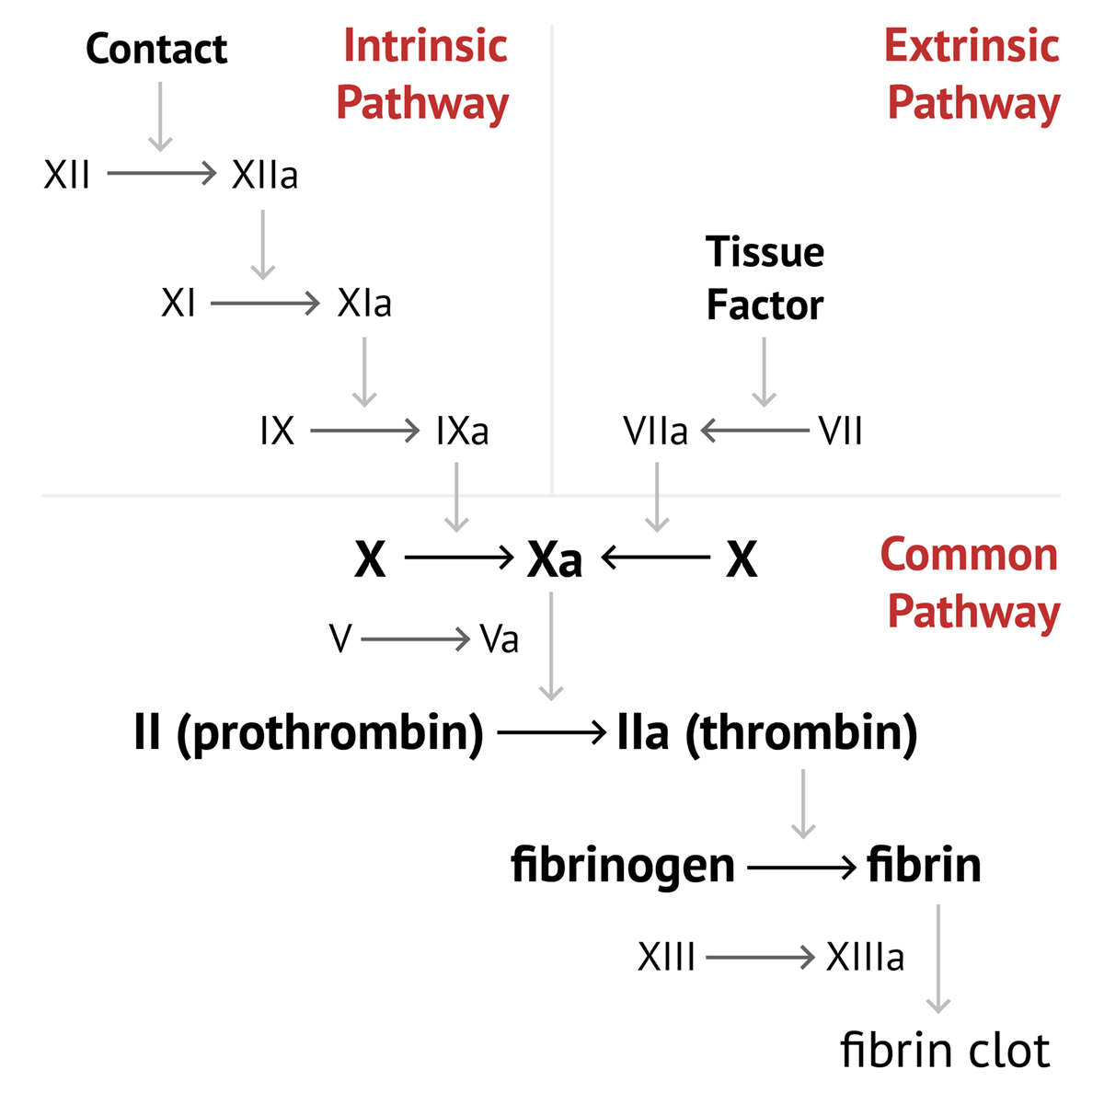
The Coagulation Cascade

Slide 7
Blood Investigations

Slide 8
Blood Investigations - FBC
Neutrophils
Lymphocytes
Neutropenia (Low)
< 2.0 x 10⁹/L
Do a blood film and repeat FBC in 4 weeks
Causes:
Infection (EBV, HIV, Hep B, Hep C
Drugs (Phenytoin, antipsychotics)
Endocrine
Malignancy (myeloma)
Autoimmune
Excess alcohol and liver disease
Lymphopenia (Low)
< 1.3 x 10⁹/L
Treat underlying cause
Causes:
Drugs (steroids)
Infection (post-viral = common)
Malignancy
Renal/hepatic impairment
SLE, RA
Anorexia nervosa
Neutrophilia (High)
> 7.5 x 10⁹/L
Infection most common cause
Repeat FBC in 4 weeks
Causes:
Infection (bacterial, VZV, HSV)
Drugs (steroids)
Malignancy (leukaemia, lymphoma)
Rheumatoid arthritis
Gout
Hypoxia
Lymphocytosis (High)
> 3.5 x 10⁹/L
If > 20x10⁹/L refer urgently – emergency
Causes:
Infection (EBV, CMV, Pertussis)
Stress
Vigorous exercise
Malignancy
Post splenectomy

Slide 9
Blood Investigations - FBC
Monocytes
Platelets
Monocytosis (High)
> 0.8 x 10⁹/L
Causes:
Malaria
Typhoid
TB
Myelodysplastic Syndromes
Thrombocytopenia (Low)
< 150 x 10⁹/L
If < 20 x 10⁹/L refer urgently
Causes:
Viral infection (EBV, HIV, Malaria, TB)
Drugs (NSAIDs, Heparin, Digoxin, PPIs)
Alcohol
Malignancies
Liver and renal disease
Aplastic anaemias
SLE
Eosinophils
Eosinophilia
> 0.44 x 10⁹/L
Check travel and drug history
Do blood film and repeat FBC in 2 weeks
Causes:
Asthma
Parasitic infections
Drugs (penicillin, allopurinol, amitriptyline)
Smoking
Endocrine (Addison’s)
Malignancy
Endocarditis
Post-splenectomy
Thrombocytosis (High)
> 400 x 10⁹/L
If >1000 x 10⁹/L refer urgently – emergency
Causes:
Reactive (infection, inflammation, haemorrhage, post-surgery)
Malignancies
Splenectomy
Iron deficiency

Slide 10
Blood Investigations – Clotting and Coagulation Screen
PT/INR (12-13 seconds/0.8-1.2 seconds)
Measure of the time taken for a blood clot to form via the extrinsic pathway
International Normalised Ratio (INR) is used for patients on anticoagulants
They measure overall clotting factor synthesis/consumption
Affected by liver disease, DIC, vitamin K deficiency and warfarin levels
Bleeding Time (1-6 minutes)
Assesses overall platelet function and levels
Measure of how long it take a patient to stop bleeding from a wound
Platelet specific disorders increase BT
von Willebrand’s disease
ITP
DIC
Thrombocytopaenia
APTT (35-45 seconds)
Measure of the time take for blood to clot via the intrinsic pathway
APTT indicated issued with factors VIII, IX and XI
The main conditions linked to this are:
Haemophilia A (VIII)
Haemophilia B (IX)
von Willebrand’s disease (vWF pairs with factor VIII)
Thrombin Time (10-15 seconds)
Tests how fast fibrinogen is converted to fibrin by thrombin
If the time is prolonged, it is caused by either a synthetic issue or a consumption time:
DIC
Liver failure
Malnutrition
Abnormal fibrinolysis
Notes:
In response to vascular injury, the following steps lead to a platelet plug:
1. von Willebrand’s Factor (vWF) adheres to the vascular injury.
2. vWF then binds to GpIb receptors on surrounding platelets.
3. After binding, the ADP (P2Y12) receptor on the platelet is activated leads to increased expression of GpIIb/IIIa.
4. These newly expressed receptors then finally bind to fibrinogen, which leads to further platelet aggregation.

Slide 11
Anaemias

Slide 12
Causes of Anaemia
Microcytic
Normocytic
Macrocytic
Anaemia of chronic disease
Cancer, HF, CKD
Thalassaemia
Iron deficiency
Blood loss
Poor diet
Malabsorption
Hookworm
Acute blood loss
Anaemia of chronic disease
Pregnancy
Renal failure
Combined haematinic deficiency
Iron and B12/folate deficiency
Required for haematopoiesis
Consider malabsorption as a cause
B12/folate deficiency (pernicious)
Excess alcohol/liver disease
Hypothyroidism
Bone marrow failure

Slide 13
Symptoms and Investigations - Anaemia
Symptoms
Investigations
Symptoms
Fatigue, headache, faintness
Irritability
Difficulty concentrating
Dyspnoea and breathlessness
Anorexia
Intermittent claudication
Palpitations
Signs
Pallor
Tachycardia
Systolic flow murmur
Cardiac failure
Spoon-shaped nails (iron deficiency)
Angular stomatitis (ulcers in corners of mouth – iron deficiency + pernicious)
Lemon-yellow skin (pernicious)
Neurological features, i.e. symmetrical paraesthesia, ataxia, delusions (pernicious)
Blood tests → FBC
Look at white blood cells and platelets
Reticulocyte count
Rate of red blood cell production in the bone marrow
Serum iron and ferritin test
Peripheral blood smear
Assesses shape of red blood cells
Haemoglobin electrophoresis
Evaluates abnormal haemoglobin
Present in thalassemia and sickle cell disease
Osmotic fragility test
Assesses fragility of red blood cells
Endoscopy/colonoscopy
Only if anaemia is suspected due to a bleed

Slide 14
Treatment of Anaemia
Microcytic
Normocytic
Macrocytic
Iron deficiency anaemia
Treat underlying cause
Oral iron – ferrous sulphate
IV iron – emergencies
Ferrous sulphate side effects:
Nausea
Abdominal discomfort
Diarrhoea/constipation
Black stools
Alternative is ferrous gluconate
Anaemia of chronic disease
Control chronic disease
Treat underlying cause
Improve diet with plenty of vitamins
Erythropoietin injections
Dietary → oral B12
Folic acid deficiency
Folic acid tablets
Daily for 4 months
Pernicious anaemia
B12 injections → IM Hydroxocobalamin
Oral B12

Slide 15
Haemoglobinopathies

Slide 16
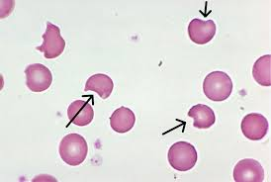
Glucose-6-Phosphate Dehydrogenase (G6PD) Deficiency
Epidemiology and Pathophysiology
G6PD is protective against oxidative damage
G6PD deficiency results in reduced red blood cells lifespan
More common in Africa, the Middle East and SE Asia
More common in males
Investigations and Diagnosis
Blood film
Irregularly contracted cells
Bite cells (membrane indentation)
Reticulocytosis
G6PD enzyme levels low (note: can be normal)
Signs and Symptoms
Most are asymptomatic
Pallor
Fatigue
Palpitations
Shortness of breath
Jaundice
Exacerbated by ingesting fava beans
Treatment
Blood transfusion
Stop any exacerbating drugs
Drug Interactions:
Primaquine – malaria
Nitrofurantoin – UTIs
Sulphonamides – bacterial infections

Slide 17
Thalassaemia
Beta Thalassaemia
Alpha Thalassaemia
Excess alpha chains
Point mutations in the gene
Minor present with:
Mild anaemia
Hypochromic red blood cells (pale)
Often asymptomatic
Intermedia present with:
Infections
Gallstones
Recurrent leg ulcers
Bone deformities
Major present with:
Failure to thrive in first year of life
Severe anaemia from 3-6 months
Thalassaemic faces
Bone abnormalities
Diagnose with a blood film; will see reticulocytosis, microcytic anaemia, and nucleated red blood cells in circulation
Treat with regular life-long transfusions, iron-chelating agents (oral deferiprone), ascorbic acid, and folic acid
Gene deletion of one or both alpha chains
4 gene deletion:
Incompatible with life
Infants are often stillborn
3 gene deletion present with:
Moderate anaemia
Splenomegaly
Not transfusion dependent
2 gene deletion present with:
Microcytosis
Carrier presentation
Diagnosed with FBC showing microcytic anaemia, elevated serum iron and haemoglobin electrophoresis
Treat with transfusions during crises, desferrioxamine to aid iron excretion, and folic acid

Slide 18
Sickle Cell Anaemia
Epidemiology and Pathophysiology
Most common in Africa
Autosomal recessive disorder
Production of abnormal beta-globin chains via a single base mutation of A to T
Sickle cell anaemia is homozygous
Sickle cell trait is heterozygous
Named as over time red blood cells become rigid and have a ‘sickle’ appearance
Investigations and Diagnosis
Blood film
Sickled erythrocytes seen
Blood count
Hb range of 60-80 g/L
Positive sickle solubility test
Haemoglobin electrophoresis
Confirms diagnosis
Aim for diagnosis at birth
Signs and Symptoms
Heterozygous
Symptom free
Protection against falciparum malaria
Homozygous Crisis
Acute pain in hands and feet
Long bone pain, e.g. femur, spine, ribs
Cognitive defects in children
Pulmonary hypertension and chronic lung disease (most common cause of death)
Splenic sequestration (cells get trapped)
Treatment
Precipitating factors should be avoided
E.g. infection, dehydration, cold
Folic acid
Acute attacks:
IV fluids
Analgesia
Oxygen
Possible blood transfusions
Oral hydroxycarbamide to reduce frequency of crises
Stem cell transplant

Slide 19
Haematological Malignancies

Slide 20
Acute Myeloid Leukaemia (AML)
Epidemiology and Pathophysiology
Affects the myeloblasts
Seen in adults aged 40+
Progresses very rapidly; 20% 3 year survival
AML is a medical emergency
Associated with Down’s syndrome and radiation
Investigations and Diagnosis
FBC → anaemia, thrombocytopaenia, neutropoenia
Blood film → leukaemic blast cells
Bone marrow biopsy → Auer rods
Cytogenetic analysis and immuno-phenotyping
Signs and Symptoms
Anaemia → breathlessness, fatigue, pallor
Infection
Hepatosplenomegaly
Peripheral lymphadenopathy
Gum hypertrophy
Bone marrow failure and bone pain
Treatment
Blood and platelet transfusions
IV fluids
Allopurinol to prevent tumour lysis
Infection control with IV antibiotics
Chemotherapy
Steroids
Sibling matched allogenic bone marrow transplant

Slide 21
Acute Lymphoblastic Leukaemia (ALL)
Epidemiology and Pathophysiology
Affects the lymphoblasts
Most commonly affects with children
Highest prevalence between 2-4 years
Associated with Down’s syndrome
Associated with ionising radiation
Investigations and Diagnosis
FBC → anaemia, thrombocytopaenia, neutropoenia
Blood film → leukaemic blast cells
Lumbar puncture → CNS involvement
CXR and CT → lymphadenopathy
Signs and Symptoms
Anaemia → breathlessness, fatigue, pallor
Infection
Hepatosplenomegaly
Peripheral lymphadenopathy
CNS involvement → headache, cranial nerve palsies
SVC obstruction, dilated superficial chest veins
Bone marrow failure and bone pain
Treatment
Blood and platelet transfusion
Chemotherapy
Steroids
Allopurinol to prevent tumour lysis syndrome
Intrathecal drugs, e.g. methotrexate
Acute control of infections with IV antibiotics
Neutropenia makes this high risk
Stem cell transplant

Slide 22
Chronic Myeloid Leukaemia (CML)
Epidemiology and Pathophysiology
Affects neutrophils, basophils, eosinophils and macrophages
Seen the most in adults 40-60
Rare in childhood
Investigations and Diagnosis
FBC → anaemia, raised myeloid cells, high WCC (eosinophilia, basophilia, neutrophilia)
Increased B12
Blood film → left shirt, basophilia
Bone marrow biopsy → increased cellularity
Philadelphia chromosome seen in 80+% of cases → t(9;2)
Stimulates cell division
Signs and Symptoms
Loss of weight, fever, sweats, fatigue
Gout (purine breakdown)
Bleeding (platelet dysfunction)
Abdominal pain (splenic enlargement)
Anaemia → breathlessness, fatigue, pallor
Infection
Massive hepatosplenomegaly
Treatment
Chemotherapy
Tyrosine kinase inhibitors, e.g. Imatinib
Given orally
Stem cell transplant

Slide 23
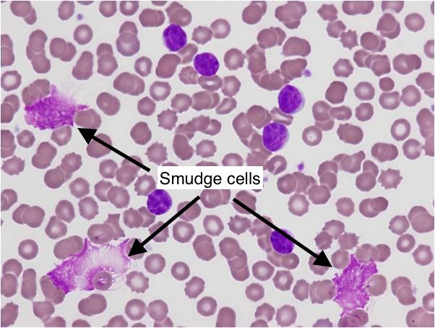
Chronic Lymphocytic Leukaemia (CLL)
Epidemiology and Pathophysiology
Affects the B cells
The accumulation of mature B cells that have escaped apoptosis
Most common leukaemia
Seen in adults 70+
Immunocompromised people are 3 times more likely to develop CLL
Pneumonia can trigger CLL
Investigations and Diagnosis
FBC → High WCC with high lymphocytes
Blood film → small mature lymphocytes, smudge cells
Signs and Symptoms
Often asymptomatic
Enlarged, rubbery non-tender nodes
Severe cases see weigh loss, sweats and anorexia
Complications:
Richter’s syndrome → transformation to aggressive lymphoma
Autoimmune haemolysis
Bone marrow failure
Treatment
Watch and wait
Chemotherapy
Monoclonal antibodies, e.g. rituximab
Targeted therapy, e.g. bruton kinase inhibitors (ibrutinib)

Slide 24
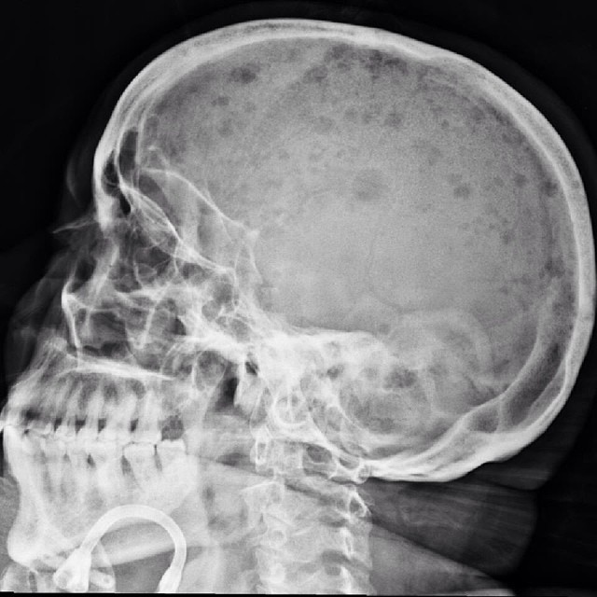
Multiple Myeloma
Epidemiology and Pathophysiology
Affects plasma cells
Results in progressive bone marrow failure
Excess IgG – 55%
Excess IgA 20%
Most commonly seen in adults 75+
More common in Afro-Caribbean's
Investigations and Diagnosis
FBC → anaemia, raised ESR
Blood film → rouleaux
Serum and urine electrophoresis
Bence Jones protein in urine
X-rays → pepper pot skull, fractures
CT → bone lesions, cord compression
Signs and Symptoms
OLD CRAB
Old – over 75
Calcium over 2.75 mmol/L → AKI
Renal Impairment
Anaemia
Bone lesions → pepper pot skull, back pain
Infection due to neutropenia
Fatigue
Treatment
Bisphosphonates for bones, e.g. Zoledronate
Analgesia (avoid NSAIDs due to renal issue)
Radiotherapy
Blood transfusions
Infection control → most common death
Chemotherapy
CTD → Cyclophosphamide, thalidomide and dexamethasone
VAD → Vincristine, Adriamycin, dexamethasone (for fitter people)
Notes:
Multiple myeloma is a palliative disease, so everyone will relapse.
The aim is to control the symptoms and neoplasia as best as possible to get the best quality of life for the patient.
At the end of the disease, end organ damage will occur:
Lytic bone lesions
Infection
Fractures
Renal failure
Proteinuria

Slide 25
Lymphomas
 | Hodgkin | Non-Hodgkin
Affected cell | T and B cells in the lymph nodes
Epidemiology | Bimodal – peaks twice in life Young adults and elderly Male predominance Associated with EBV, SLE, siblings | Adults 40+ Associated with EBV and Burkitt’s lymphoma Family history increases risk
Signs and Symptoms | Fever and sweating Enlarged rubbery non-tender nodes Systemic ‘B’ symptoms, e.g. fever Painful nodes on drinking alcohol | Fever and sweating Enlarged rubbery non-tender nodes Systemic ‘B’ symptoms, e.g. fever GI and skin involvement
Investigations and Diagnosis | FBC → anaemia, high ESR CXR → wide mediastinum PET scan Reed Sternberg cells | FBC → anaemia, high ESR Raised lactose dehydrogenase Lymph node biopsy Bone marrow biopsy for classification
Treatment | Chemotherapy ABVD Adriamycin Bleomycin Vinblastine Dacarbazine Autologous marrow transplant | Steroids Monoclonal antibodies to CD20 → Rituximab CHOP regimen: Cyclophosphamide Hydroxy-daunorubicin Vincristine Prednisolone

Slide 26
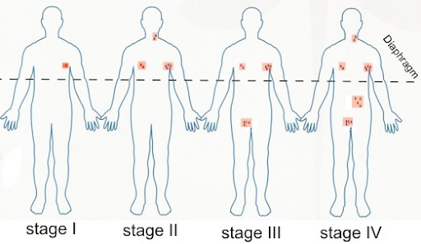
Lymphoma Staging
Staging
I – Confined to a single lymph node region
II – Involvement of 2 or more nodal areas on the same side of the diaphragm
III – Involvement of 2 or more nodal areas on both sides of the diaphragm
IV – Spread beyond the lymph nodes, e.g. bone marrow or liver
Suffix A – No systemic symptoms other than puruitis (severe itching of skin)
Suffix B – Presence of B symptoms, such as fever, night sweats and weight loss

Slide 27
Platelet Dysfunction

Slide 28
Platelet Recap
Platelets
Anucleate cells formed in the bone marrow
Disc shaped
Life span of 7-10 days
Platelet production:
Thrombopoietin (TPO) is produced in the liver
This stimulates the production of platelets by megakaryocytes
Liver damage = decreased platelets
Causes of Platelet Dysfunction
Decreased production
Leukaemia, lymphoma, myeloma
Low B12/folate
Liver disease → reduced TPO
Methotrexate
HIV and TB
Increased destruction
Immune thrombocytopenia purpura
Drug induced → Heparin induced
Disseminated intravascular coagulopathy (DIC)
Thrombotic thrombocytopenic purpura (TTP)
Reduced platelet function
Congenital abnormality
Aspirin
von Willebrand disease
Uraemia (raised urea levels in blood)
Platelet Receptors
Thromboxane A2 (TXA2)
Synthesised in platelets via COX-1
Induces platelet aggregation and vasoconstriction
P2Y12
Receptor on platelets
Amplifies platelets activation
Important for clopidogrel
GP Iib/IIIa
Receptor for von Willebrand factor
vWF is a clotting factor essential for platelet adherence to vessels
Notes:
Clopidogrel is an antiplatelet drug used to prevent clot formation. Used in those who are at risk of a heart attack or stroke.

Slide 29
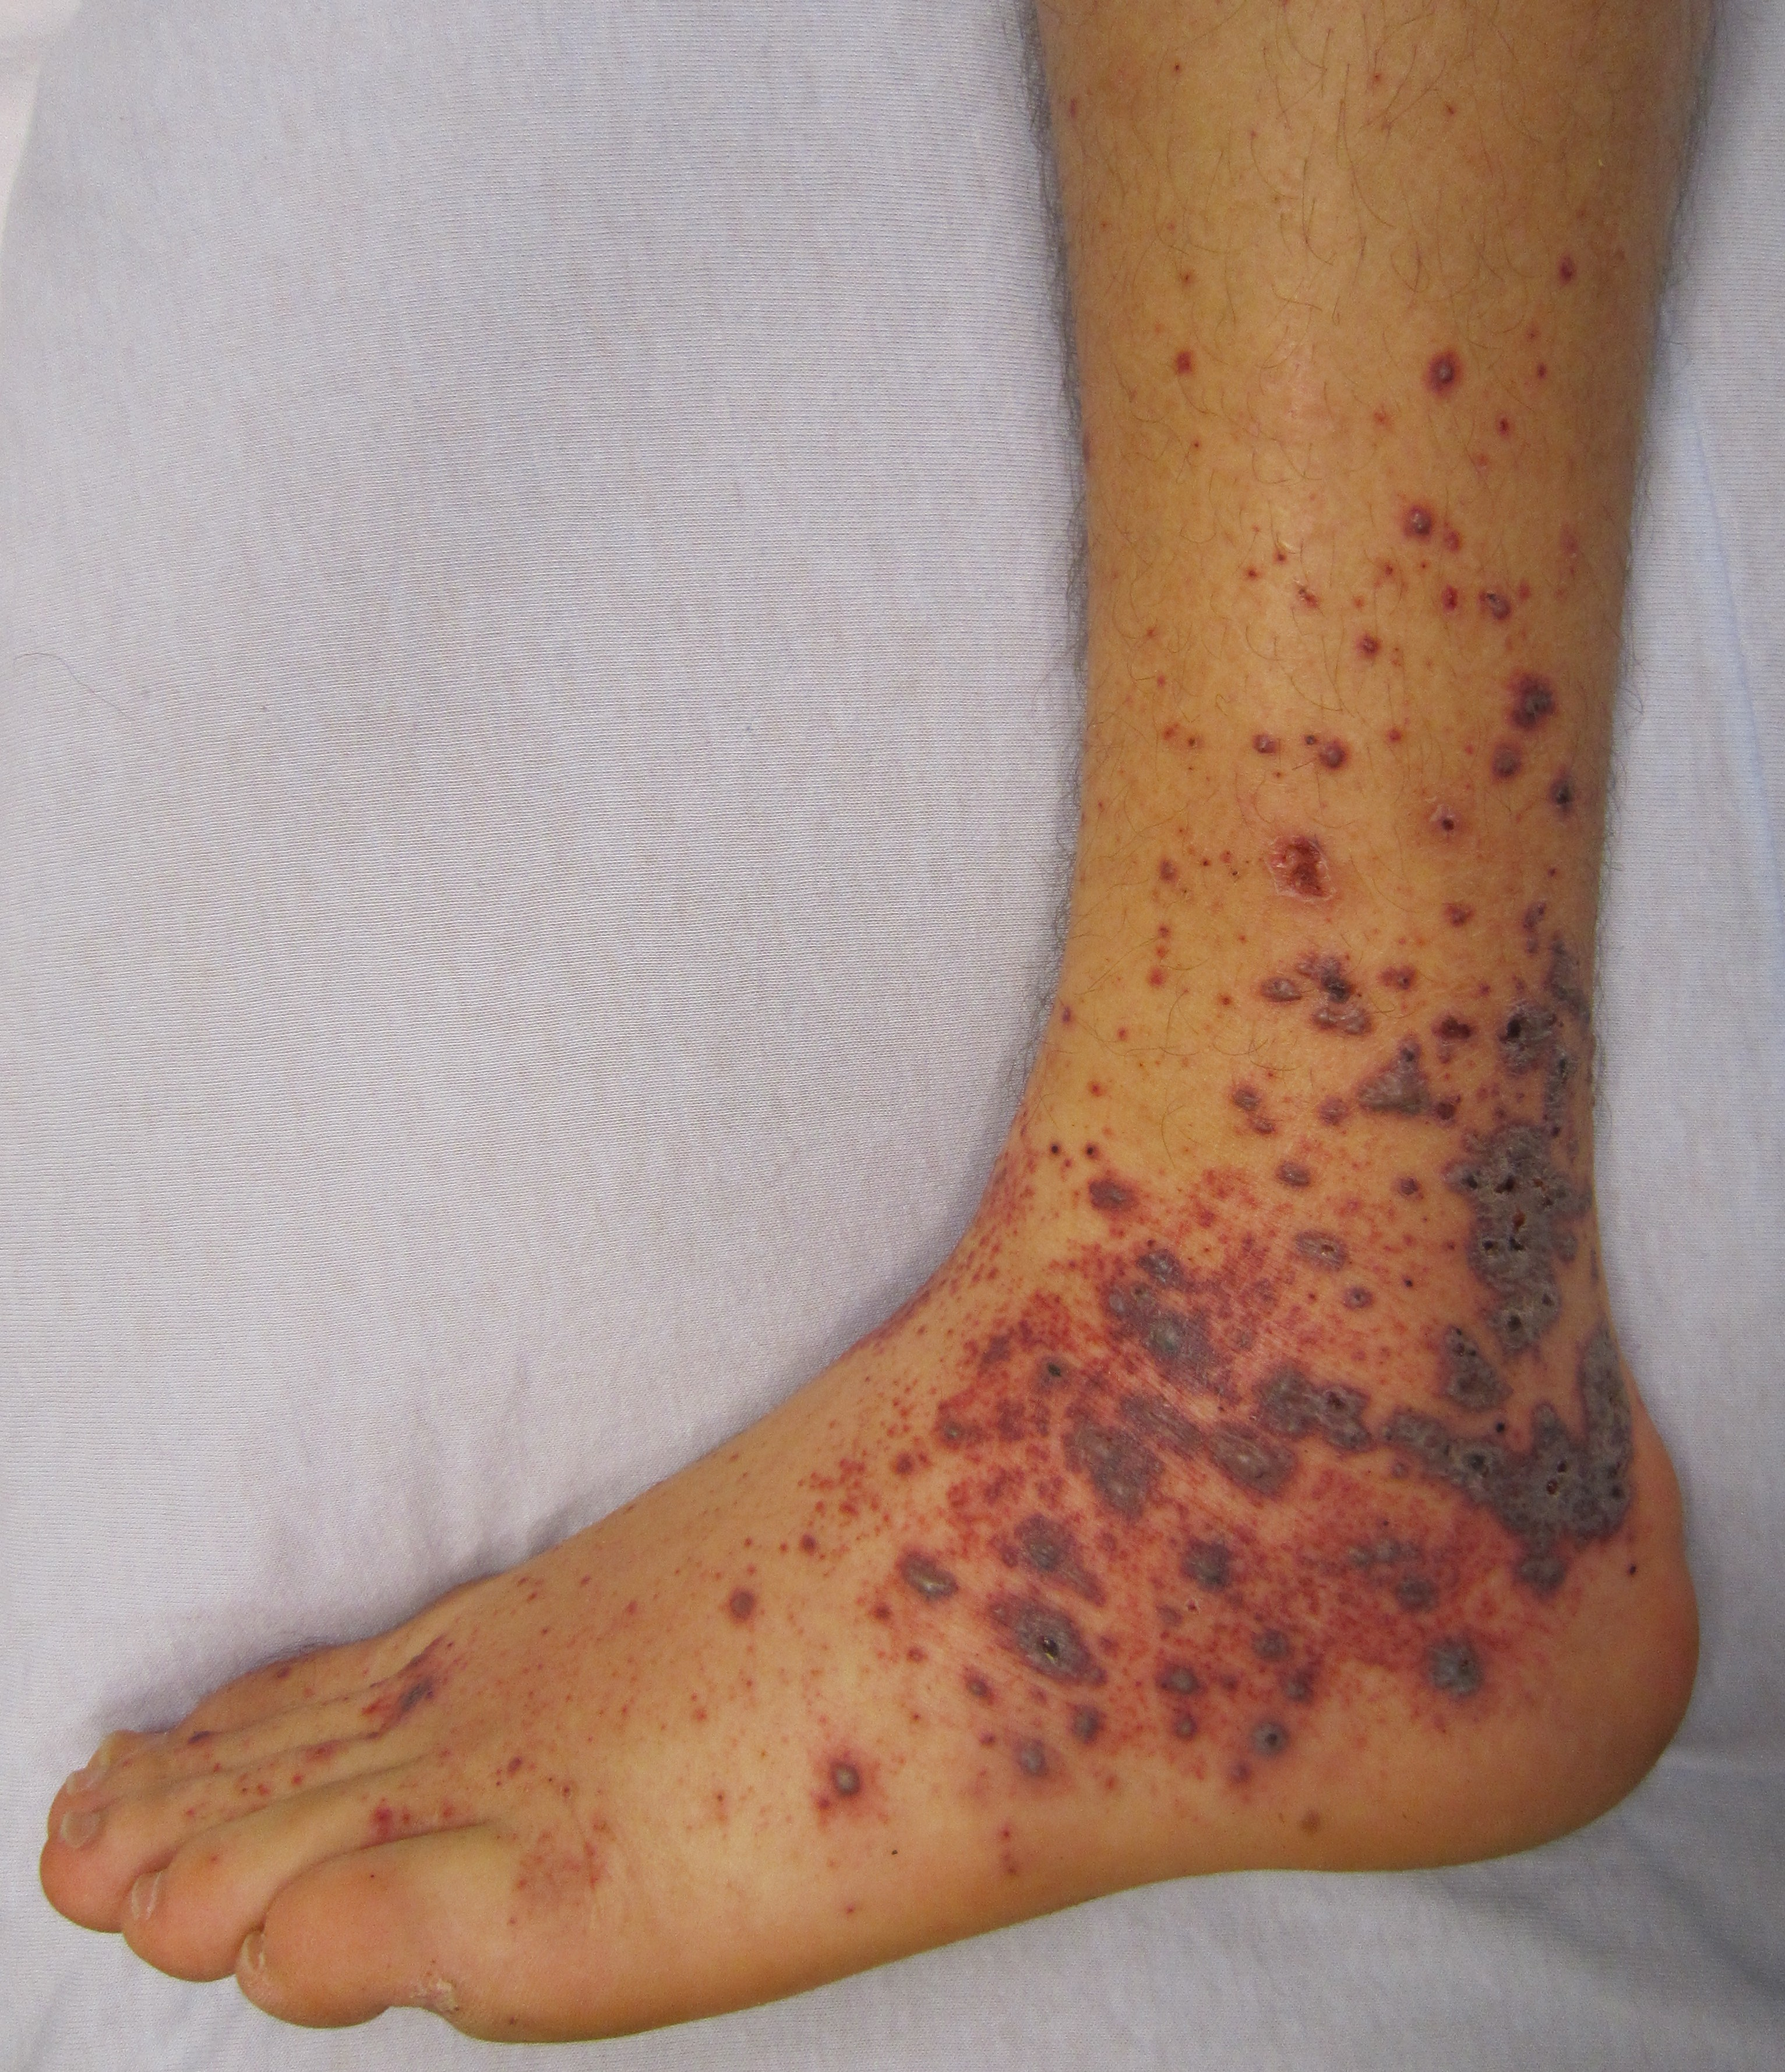
Immune Thrombocytopenia Purpura (ITP)
Epidemiology and Pathophysiology
Caused by the immune destruction of platelets
Autoimmune condition
Mainly seen in children aged 2-6
Primary: often post-viral infection, self-limiting
Secondary: malignancies, HIV
Investigations and Diagnosis
FBC → thrombocytopenia
Bone marrow biopsy
Platelet autoantibodies present in 70% of cases
Signs and Symptoms
Can by asymptomatic
Purpura → bruising and purple/red rash
Epistaxis (nosebleeds)
Menorrhagia (heavy periods)
Prolonged bleeding from the gums
Severe headache
Vomiting
Fatigue
Treatment
Prednisolone
IV immunoglobulins → IV IgG
Platelet transfusions
Immunosuppression → Oral azathioprine

Slide 30
Thrombotic Thrombocytopenic Purpura (TTP)
Epidemiology and Pathophysiology
Caused by a deficiency of von Willebrand factor cleaving protein
Rare condition
More common in adults
More common in females (3:2)
Associated with HIV, cancer and SLE
Investigations and Diagnosis
Normal coagulation screen
Blood smear → fragmented erythrocytes
U&E → raised creatinine
Bilirubin raised
Raised reticulocyte count
Urinalysis → proteinuria & haematuria
Signs and Symptoms
Flu-like symptoms → fever, fatigue, aches
Purpura
Epistaxis (nosebleeds)
Easy bruising
Menorrhagia (heavy periods)
Haemoptysis (coughing up blood)
Headache
Abdominal pain
GI bleeding
Chest pain (rare)
Treatment
IV plasma exchange
Steroids → IV methylprednisolone
Rituximab (monoclonal antibody)
Folic acid
Platelet transfusion are contra-indicated

Slide 31
Disseminated Intravascular Coagulation (DIC)
Epidemiology and Pathophysiology
Caused by systemic activation of blood coagulation
Results in thrombosis of small/medium sized vessels and organ dysfunction
Associated with previous sepsis, malignancies, crush syndrome, transplant rejection, drugs
Investigations and Diagnosis
Severe thrombocytopenia
Prolonged prothrombin time
Prolonged activated partial thromboplastin time
Low fibrinogen levels
Signs and Symptoms
Large bruises
Spontaneous bleeding at venepuncture sites, or after minor trauma
Epistaxis (nosebleeds)
GI bleeds
Confusion and shock
Fever
Adult respiratory distress syndrome (ARDS)
Purpura
Gangrene (severe cases)
Treatment
Treat underlying cause
Platelet transfusion in those who present with bleeding only
Red cell transfusion in those bleeding
Fresh frozen plasma (FFP) to replace coagulation factors
Notes:
Crush syndrome is major bodily shock and kidney failure caused by a crushing skeletal injury.

Slide 32
Bleeding Disorders

Slide 33
Polycythaemia
Epidemiology and Pathophysiology
An increase in red blood cell count and haematocrit
Absolute polycythaemia is due to an increase in RBC mass, i.e. Polycythaemia Vera or mutations
Secondary polycythaemia is due to hypoxia (high altitude, chronic lung disease) and high erythropoietin secretion (renal carcinoma)
95% of patients have the JAK2 mutation
Investigations and Diagnosis
FBC → raised WCC and platelets
Raised haemoglobin
JAK2 mutation on genetic screen
Bone marrow biopsy showing proliferation of granulocytes and megakaryocytes
Low serum erythropoietin
Signs and Symptoms
Headaches and dizziness
Itching
Fatigue
Tinnitus
Erythromelalgia – burning sensation in fingers and toes
Hypertension
Angina
Hepatosplenomegaly (distinguishes 1º from 2⁰)
Treatment
No cure
Treatment aim is to maintain normal blood count
Venesection → relieves symptoms
Low does aspirin
Radioactive phosphorus in those over 70

Slide 34
Haemophilia A
Epidemiology and Pathophysiology
Caused by factor VIII deficiency
Majority are inherited
Split into severe (<1% factor VIII activity), moderate (1-5%) and mid (>5%)
Massive male predominance (X-linked)
5 times more common than haemophilia B
Investigations and Diagnosis
FBC → low haematocrit, low Hb
Normal prothrombin and bleeding time
Prolonged activated partial thromboplastin time
Heavily reduced factor VIII
CT head → look for haemorrhages
Signs and Symptoms
Mild disease bleed after trauma
Moderate disease
Bleeding following venepuncture
Bleeding following trauma
Severe disease
Neonatal bleeding
History of spontaneous bleeding
GI bleeds
Haematuria
Treatment
Prophylactic factor VIII
Fresh frozen plasma containing factor VIII to be given for acute bleeds
Desmopressin to boost factor VIII activity

Slide 35
Haemophilia B
Epidemiology and Pathophysiology
Caused by Factor IX deficiency
Male predominance (X-linked)
Mild disease has factor IX levels of 6-30%
Moderate disease has levels od 1-5%
Severe disease has levels of <1%
This accounts for 50% of cases
Investigations and Diagnosis
Normal prothrombin time
Prolonged activated partial thromboplastin time
Low factor IX levels
Endoscopy if GI bleed suspected
Signs and Symptoms
Bruising
Epistaxis (nose bleeds)
Pallor
Haemoptysis
Heavy bleeding from minor trauma
Bleeding from tooth loss in childhood
Joint pain and stiffness
Headache, irritability, vomiting
Haematemesis → GI bleed
Treatment
Treatment must be started before confirmed diagnosis
Recombinant factor IX
Vaccination against Hep A and B
Patients should wear a medical emergency bracelet

Slide 36
von Willebrand’s Disease
Epidemiology and Pathophysiology
Most common hereditary coagulopathy
Can be congenital or acquired
Also called pseudohaemophilia
Caused by von Willebrand factor deficiency
This assists platelet plug formation
vWF binds to factor VIII preventing clearance from plasma
More common in females
Poorer prognosis in blood type O
Investigations and Diagnosis
FBC
Fibrinogen level
Platelet count → normal
Clotting screen
Plasma vWF decreased
Factor VIII levels → can be decreased as vWF is not present to protect it
Signs and Symptoms
Bleeding from mucosa
Epistaxis (nose bleeds)
Menorrhagia (heavy periods)
Spontaneous bleeding
Blood clots during childbirth (rare)
Spontaneous death (rare)
3 types: Type 1, 2, 3, platelet type
Type 1 is the most common (60-80%)
Platelet type is the most rare (70 cases)
Treatment
Education on bleeding risks
Stop any antiplatelet drugs and NSAIDs
Tranexamic acid → used for minor bleeds
Combined oral contraceptive to control menorrhagia in women
Desmopressin -> increases vWF levels
Platelet transfusions can be helpful in some
Family screening should be offered

Slide 37
Thrombosis

Slide 38
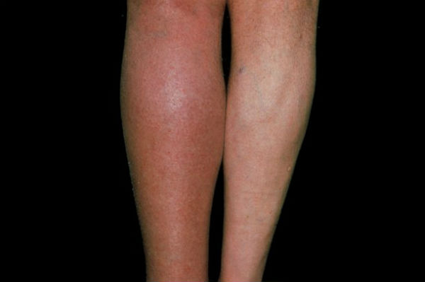
Deep Vein Thrombosis (DVT)
Epidemiology and Pathophysiology
Caused when a blood clot forms in a vein
Common post-operatively due to immobilisation
Associated with contraceptive pill, long haul flights, leg fractures and malignancy
Most commonly seen in calf
Risks: increased age, pregnancy, trauma, previous DVT, obesity, immobility
Investigations and Diagnosis
Well’s score → 2 points or more = proximal leg USS, less than 2 points = D-dimer
D-dimer
Positive D-dimer is not diagnostic
Negative D-dimer exclude DVT
Can be positive in cancer, pregnancy, and post-operatively
Doppler Ultrasound
Signs and Symptoms
Often asymptomatic
Pain in calf
Swelling
Redness and warmth over area
Ankle oedema
Unilateral
Treatment
LMWH
Oral warfarin → target INR of 2.5
DOAC → apixaban (note: not with warfarin)
Compression stockings
Major complication: Pulmonary embolism

Slide 39
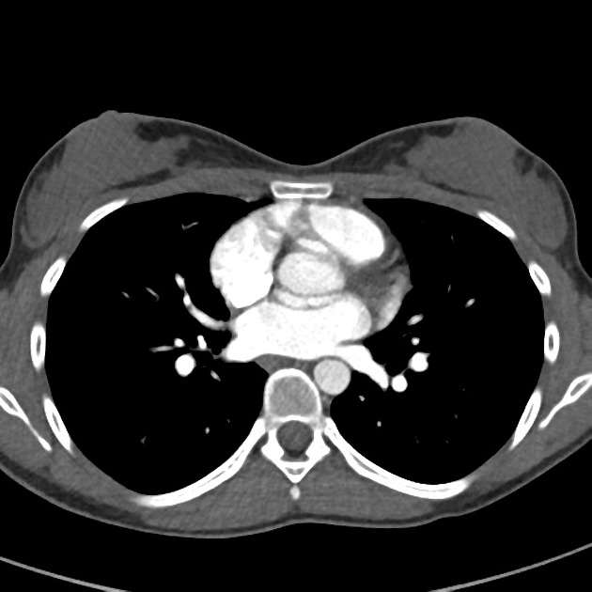
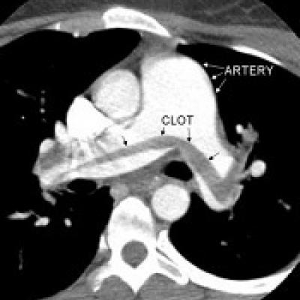
Pulmonary Embolism (PE)
Epidemiology and Pathophysiology
Commonly arises from DVT
Rare causes include sepsis, parasites, fat embolism, neoplastic cells
Risks include: recent surgery, hip/knee replacement, immobility, malignancy, pregnancy, combined contraceptive pill, HRT
Investigations and Diagnosis
CTPA
Wells score → More than 4 requires an immediate CTPA
If Wells score is less than 4 perform D-dimer
CXR
Blood gases
ECG → look for alternate causes
Treatment
If delay on CTPA give LMWH → Delteparin
Oxygen
Analgesia
DOAC → apixaban
Major complications can occur in pregnant women
Signs and Symptoms
Acute onset shortness of breath
Unilateral pleuritic chest pain
Leaning forward to breathe
Tachycardia
Tachypnoea
Haemodynamic instability → pallor, hypotension, shock, collapse
Notes:
CTPA scans → left scan is normal, right scan shows large clot

Slide 40
Infection

Slide 41
Malaria
Epidemiology and Pathophysiology
Parasitic infection, Plasmodium, spread by female anopheles mosquito
4 species: P. falciparum, P. vivax, P. ovale P. malariae
P. falciparum is the most common
P. malariae is the least common
Most common in Africa
Risks include: infants, pregnancy, old age
Notifiable disease
Investigations and Diagnosis
Travel history
Thick and thin blood smears
Negative film can be seen
If negative, 2 more films should be sent over the next 48 hours
Rapid diagnostic tests
Detect parasitic antigens
PCR
FBC, LFTs, U&Es, blood gases, blood culture
CXR, lumbar puncture
Signs and Symptoms
Symptoms occur from 6 days post infection
P. vivax and P. ovale commonly present 6 months post infection
Non-specific symptoms
Fever, chills
Headache
Cough
Splenomegaly
Severe disease in P. falciparum
Shortness of breath
Fits and hypovolaemia
AKI and nephrotic syndrome
Treatment
Chloroquine for non-falciparum malaria
Oral quinine sulphate for falciparum
Add IV quinine dihydrochloride for severe disease
Do not treat those with G6PD deficiency
Need specialist help
Notes:
P. ovale and P. vivax can relapse as it can lay dormant in the liver for years.
Primaquine is contra-indicated in G6PD deficiency and pregnancy

Slide 42
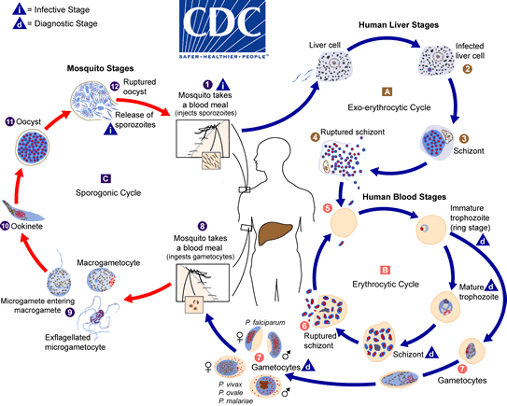
Malaria Life Cycle

Slide 43
Formative Questions

Slide 44
Question 1
Angular stomatitis, lemon-yellow skin, ataxia and delusions are hallmarks of which type of anaemia?
Iron deficiency anaemia
Thalassaemia
Anaemia of chronic disease
Pernicious anaemia
Bone marrow failure

Slide 45
Question 1 - Answer
Answer: D
These are all seen in pernicious anaemia.

Slide 46
Question 2
You are a junior doctor on your haematology rotation. You have just seen a 50 year old woman who presented with anaemia, gum hypertrophy and bone pain. You do a full blood count which shows thrombocytopaenia and neutropoenia. A bone marrow biopsy shows Auer rods.
What would you treat this woman for?
AML
ALL
CML
CLL
Multiple myeloma

Slide 47
Question 2 - Answer
Answer: A
Auer rods are a hallmark of acute myeloid leukaemia. They are not seen in other cancers.

Slide 48
Question 3
You are an F2 on a tropic medicine rotation. You are seeing a patient who has recently been on holiday to Asia and is now complaining of nausea, loss of appetite, abdominal pain and some weight loss. Her symptoms started 6 weeks after returning to the UK. You perform some tests and diagnose tapeworm.
Which of the following would you expect to see?
Monocytosis
Thrombocytopenia
Eosinophilia
Neutrophilia
Lymphocytosis

Slide 49
Question 3 - Answer
Answer: C
Eosinophilia is seen in parasitic disease.
Monocytosis is seen in malaria, typhoid and TB. Thrombocytopenia is seen in viral infection, malignancies, SLE and liver disease. Neutrophilia is seen in malignancy, hypoxia, bacterial infection and rheumatoid arthritis. Lymphocytosis is seen in infection, stress, malignancy and after vigorous exercise.

Slide 50
Question 4
You are a junior doctor working on a paediatric ward. Your patient is aged 3 and has anaemia, hepatosplenomegaly, headaches and bone pain. You perform a number of tests and start treating them for cancer.
Which cancer is the most likely diagnosis?
AML
ALL
CML
CLL
Multiple Myeloma

Slide 51
Question 4 - Answer
Answer: B
Acute lymphoblastic leukaemia is the most common paediatric cancer.
AML, CML and CLL are all more common in adults.

Slide 52
Question 5
What do these cells indicate?
Thalassaemia
Hodgkin lymphoma
Multiple myeloma
DVT
G6PD deficiency

Slide 53
Question 5 - Answer
Answer: E
These are bite cells. They are seen in G6PD deficiency

Slide 54
Question 6
You are an F1 who sees a 5 year-old patient with diagnosed ITP. His mother tells you that he has recently had a lot of nosebleeds and feels tired all the time.
How would you treat this patient?
Platelet transfusion
Apixaban
Heparin
Prednisolone
You would not give medication

Slide 55
Question 6 - Answer
Answer: D
In ITP, steroids are the first-line treatment. Platelet transfusions are also appropriate, but they would not be given initially.

Slide 56
Question 7
Mr. Jones has been in hospital for a week recovering from a knee replacement. He is 75, has hypertension and is a smoker. He hasn’t been able to move very much since his surgery and refuses to wear compression stockings. Suddenly, Mr Jones becomes very short of breath and sits up to breath. His heart rate increases to 108 and he is breathing much faster than usual.
What investigation do you want to order?
ECG
CTPA
CXR
Doppler ultrasound
Arterial blood gas

Slide 57
Question 7 - Answer
Answer: B
This is most likely a pulmonary embolism. He has 5 risk factors and a text book presentation. He would score more than 4 if a Wells Score was carried out, therefore the most appropriate investigation would be a CTPA.

Slide 58
Question 8
Camilla is a 25 year old lady who has just returned home from visiting Ghana. She presents with very generic flu-like symptoms (fever, headache, cough) and is concerned that something is wrong. Whilst taking her history, you learn that she suffered from many mosquito bites during her trip.
What investigation would you organise to confirm your diagnosis?
FBC
Blood culture
Thick and thin blood smears
Haemoglobin electrophoresis
Bone marrow biopsy

Slide 59
Question 8 - Answer
Answer: C
This is most likely Malaria. She has the symptoms and corresponding travel history. To confirm a diagnosis of malaria you need a positive thick and thin blood smear.

Slide 60
Question 9
Last week you saw a patient in GP who was complaining of tiredness and recurrent infection. You ordered a full blood count and the results have shown neutropenia.
Name 2 causes of neutropenia.
When would you want to repeat the patient’s bloods?

Slide 61
Question 9 - Answer
Name 2 causes of neutropenia.
Infection
Drugs (phenytoin, antipsychotics)
Malignancy
Excess alcohol and liver disease
When would you want to repeat the patient’s bloods?
4 weeks’ time

Slide 62
Question 10
You are a GP who has recently seen a patient complaining of fatigue, difficulty concentrating, breathlessness and headaches. You do a full blood count and diagnose iron deficiency anaemia.
What type of anaemia causes iron deficiency anaemia?
What are 2 other causes of this type of anaemia?
You decide to treat your patient with ferrous sulphate. What side effects would you want to alert the patient of?

Slide 63
Question 10 - Answer
What type of anaemia causes iron deficiency anaemia?
Microcytic
What are 2 other causes of this type of anaemia?
Chronic disease (cancer, HF, CKD), and thalassaemia
You decide to treat your patient with ferrous sulphate. What side effects would you want to alert the patient of?
Nausea, abdominal discomfort, GI upset, black stools

Slide 64
Question 11
You are a junior doctor on you oncology rotation. You see a patient who presents with fever, sweating, enlarged, rubbery nodes that are painful when he drinks vodka and he says he feels tired all of the time. You do a blood smear and see reed Sternberg cells. You also organise imaging to be done, and see the disease both above and below his diaphragm, there is no organ involvement.
How would you treat this patient?
Describe the disease using the Ann Arbour classification.

Slide 65
Question 11 - Answer
How would you treat this patient?
Chemotherapy ABVD
Adriamycin
Bleomycin
Vinblastine
Dacarbazine
Describe the disease using the Ann Arbour classification.
Stage III B
I – Confined to a single lymph node region
II – Involvement of 2 or more nodal areas on the same side of the diaphragm
III – Involvement of 2 or more nodal areas on both sides of the diaphragm
IV – Spread beyond the lymph nodes, e.g. bone marrow or liver
Suffix A – No systemic symptoms other than puruitis (severe itching of skin)
Suffix B – Presence of B symptoms, such as fever, night sweats and weight loss

