Slide 2
Phase 2a Revision Session
Friday 15th February
Noemi Jester and Chai Jin Lim

Slide 3
Liver Failure
Causes:
Acute
Viral (A/B/EBV)
Drugs
Alcohol (acute overdose)
Vascular
Obstruction
Chronic
Alcohol (long-term use)
Viral (B/C)
Autoimmune
Metabolic

Slide 4
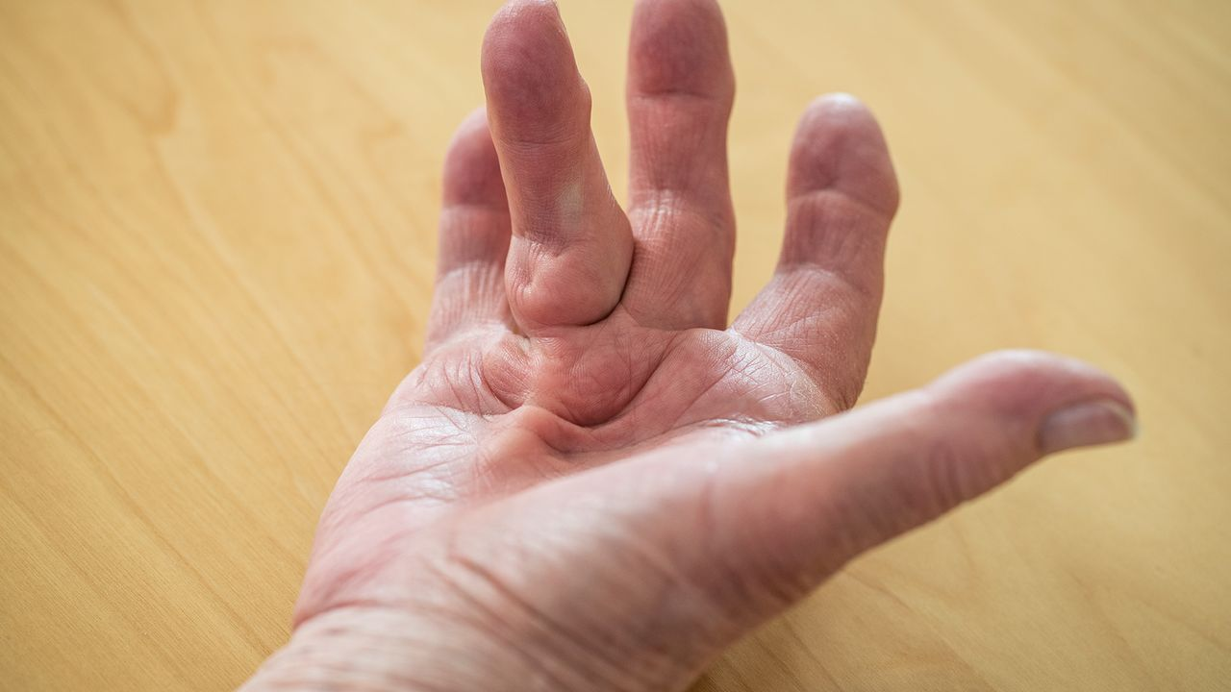
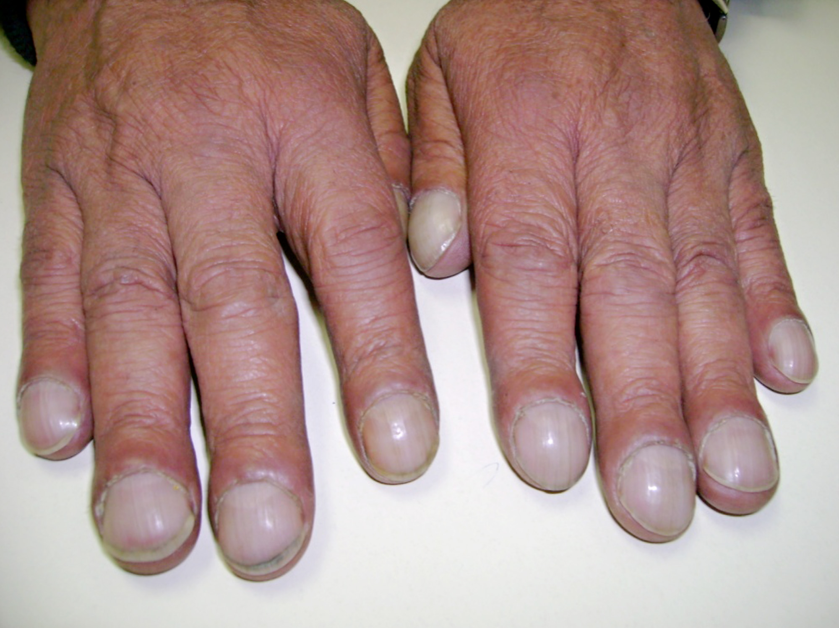
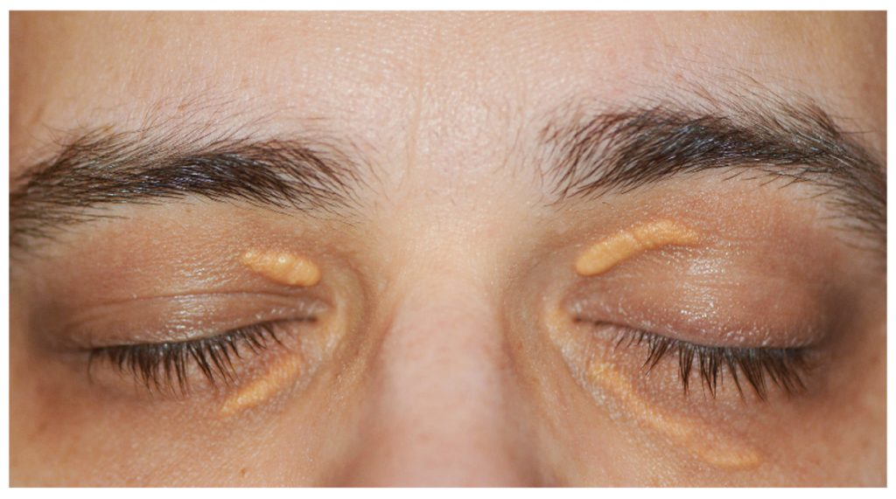
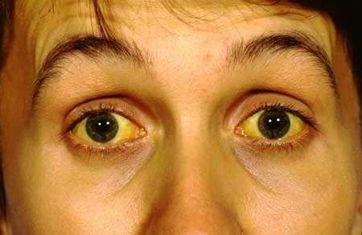
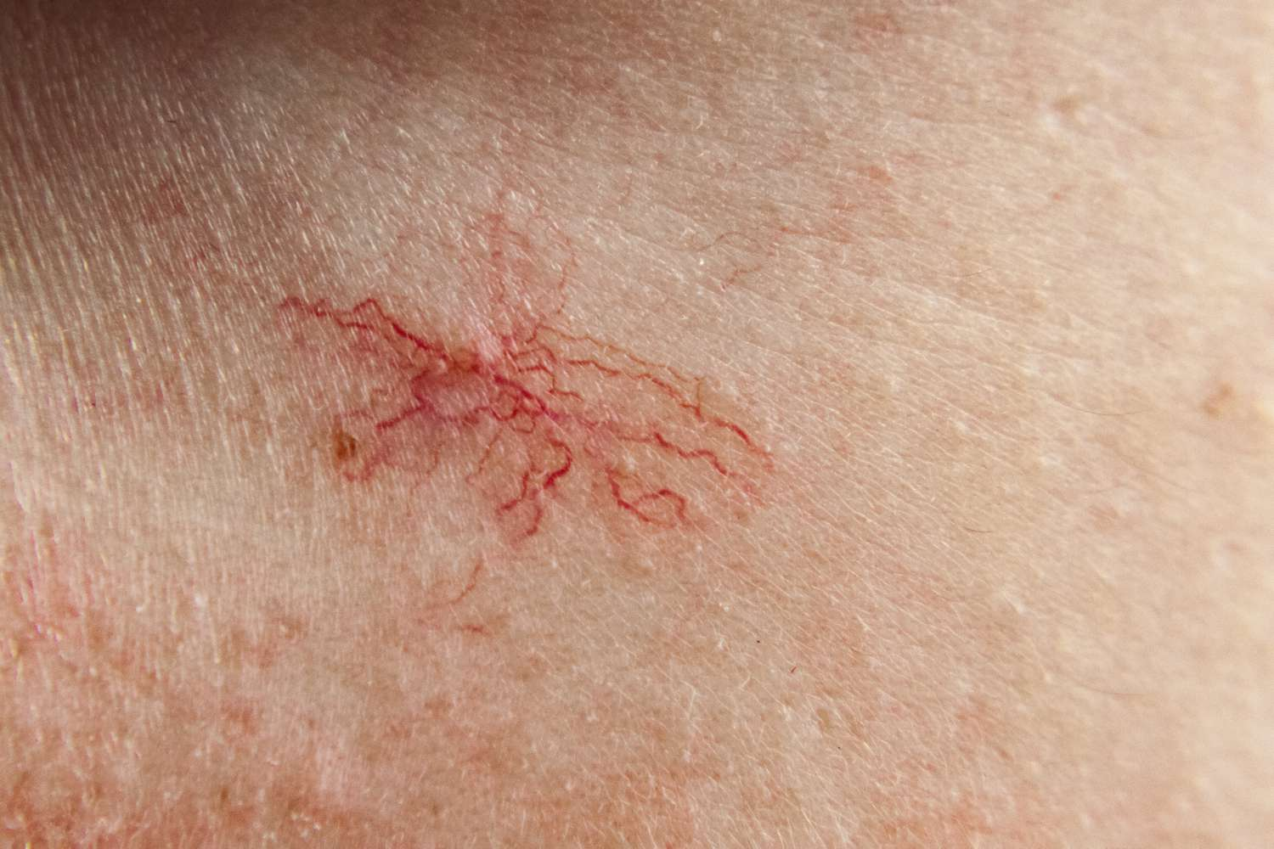
Liver Failure
Symptoms:
Acute
Malaise
Nausea
Anorexia
Jaundice
Chronic
Ascites, oedema
Dupuytren’s contractures
Malaise
Pruritus
Clubbing
Xanthelasma
Spider naevi
Hepatomegaly

Slide 5
Liver Failure
Investigations
Clinical Examination
Imaging - Ultrasound
Blood tests
Raised AST/ALT
Raised PT
FBC and U&E
If ascites present - peritoneal tap with microscopy and culture
Management
Conservative
Analgesia
fluids
Medical (need to treat the complications)
Encephalopathy → Lactulose
Ascites → Diuretics
Cerebral oedema → Mannitol
Bleeding → Vitamin K
Sepsis → antibiotics
Hypoglycemia → dextrose
Transplant

Slide 6
Question
Which of the following is a cause of pre-hepatic jaundice?
Gilbert’s syndrome
Hepatocellular carcinoma
Gallstones
Haemolytic anaemia
Pancreatic head cancer

Slide 7
Question
Which of the following is a cause of pre-hepatic jaundice?
Gilbert’s syndrome - intrahepatic
Hepatocellular carcinoma - intrahepatic
Gallstones - posthepatic
Haemolytic anaemia
Pancreatic head cancer - posthepatic

Slide 8
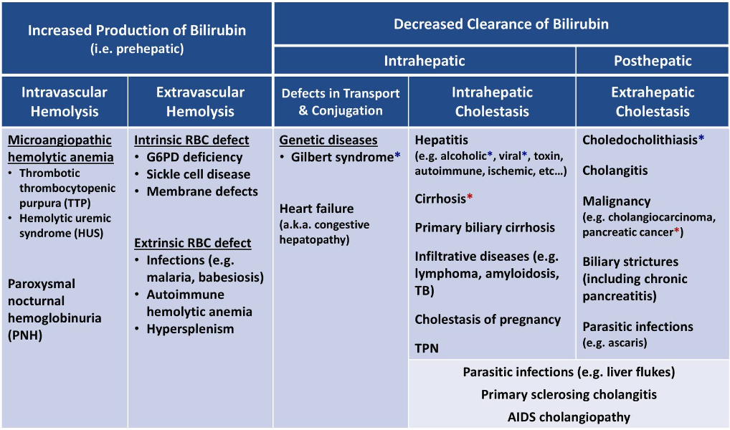

Slide 9
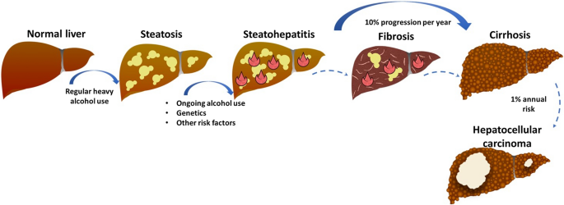
Alcoholic Liver Disease
Investigations
Bloods
Increased bilirubin
Decreased albumin
Increased prothrombin time
Increased GGT
AST:ALT >2
FBC → macrocytic anaemia
Management
Alcohol cessation
Nutritional support and supplementation (B1 and B9 especially)
Liver transplant
Treatment of complications
Wernicke-Korsakoff Syndrome
Wernicke-Korsakoff Syndrome
Combined B1 deficiency and alcohol withdrawal
Symptoms → ataxia, nystagmus, encephalopathy
Management → IV thiamine

Slide 10
Question
Which of the following is not a risk factor for NAFLD?
Obesity
Hypercholesterolemia
Hypertension
Hepatitis C
Female

Slide 11
Question
Which of the following is not a risk factor for NAFLD?
Obesity
Hypercholesterolemia
Hypertension
Hepatitis C
Female
Hepatitis C infection increased the risk for alcoholic liver disease but not found to increase risk for NAFLD.

Slide 12
Non-Alcoholic Fatty Liver Disease
Investigations
Bloods
Increased PT/INR
Decreased albumin
Increased bilirubin
Thrombocytopenia
Hyperglycemia
Ultrasound scan
Hepatic steatosis
Management
Lifestyle factors
Exercise
Healthy diet
Smoking cessation
Stop/reduce alcohol intake
Control risk factors
Statins, metformin, ACEi
Vitamin E treatment
Improves histological steatotic/fibrotic appearance

Slide 13
Hepatitis A
VIRUS TYPE | Single-stranded RNA | Acute
ROUTE OF TRANSMISSION | fAEco-oral: contaminated water and food (shellfish)
RISK FACTORS | Travel, Eating Shellfish, Living w/ other that have Hep A, Homelessness
PRESENTATION (Sx) | Prodromal Phase (1-2 weeks) | Icteric Phase (usually 3 months)
 | N+V, Fever, Malaise, RUQ pain | Jaundice, Dark urine, Pale stools, Pruritus
DIAGNOSIS & INVESTIGATIONS (Ix) | LFTs - ↑ ALT ↑ Total Bilirubin Serology – ↑ HAV IgM Ab (active infection), ↑ Anti-HAV IgG Ab (persist after infection/vaccination)
TREATMENT (Tx) | Self Limiting Supportive care – anti-emetics, rest
COMPLICATIONS (IF APPLICABLE)

Slide 14
Hepatitis B
VIRUS TYPE | DNA Virus | Acute + Chronic
ROUTE OF TRANSMISSION | Blood, Bodily Fluids, Sharing Needles (IVDU, Tattoos), Vertical/Horizontal Transmission, Dialysis
PRESENTATION (Sx) | Prodromal Phase (1-2 weeks) | Icteric Phase (usually few weeks – 6 months)
 | N+V, Fever, Malaise, RUQ pain | Jaundice, Dark urine, Pale stools, Pruritus, Arthralgia,
COMPLICATIONS (IF APPLICABLE) | Fulminant Hepatitis, HCC, Cirrhosis

Slide 15
Hepatitis C
VIRUS TYPE | Single Stranded RNA |  | Acute + Chronic
ROUTE OF TRANSMISSION | Blood, Bodily Fluids, IVDU
PRESENTATION (Sx) | Acute |  | Chronic
 | Asymptomatic or Malaise, Fever, Myalgias, Arthralgias, N+V, Diarrhoea |  | Usual Chronic Liver Signs
DIAGNOSIS & INVESTIGATIONS (Ix) |  | Anti Hc Ab -ve |  | Anti Hc Ab +ve
 | Hc RNA –ve | No infection |  | Resolved infection
 | Hc RNA +ve | Active infection |  | Active Infection (Acute/Chronic)
TREATMENT (Tx) | Direct Acting Antivirals (DAA) + Ribavirin
COMPLICATIONS (IF APPLICABLE) | HCC

Slide 16
Hepatitis E
VIRUS TYPE | Single Stranded RNA | Acute
ROUTE OF TRANSMISSION | fAEco-oral: contaminated water, undercooked pork
PRESENTATION (Sx) | Usually asymptomatic and self limiting
DIAGNOSIS & INVESTIGATIONS (Ix) | Serology
TREATMENT (Tx) | Supportive
COMPLICATIONS (IF APPLICABLE) | Rare. Can progressive to cirrhosis in immunocompromised.

Slide 17
Feedback

Slide 18
Hernias
Abnormal protrusion of an organ or tissue out of the body cavity in which it normally lies
Inguinal Hernia
Hiatal Hernia
Femoral Hernia
-Most common (75%)
-Male, Exertional Lifting, Pressure
-Direct (20%) - Medial to Inferior epigastric
-Indirect (80%) - Lateral to Inferior epigastric
-Sx: Painful, Aching at the groin
-Investigation: Clinical
-Abdominal USS
-Stomach herniate through the diaphragm
-Sliding 80% - LES slides into abdomen
-Rolling 20% - LES stays inside abdomen
-Sx: GORD, Dysphagia, heartburn, bloated
-Investigation: CXR, Barium swallow (diagnostic), OGD
-Abdominal content herniate through femoral canal
-Female
-Sx: swelling in upper groin pointing down
-Investigation: Clinical, Abdominal USS/ Pelvis USS

Slide 19
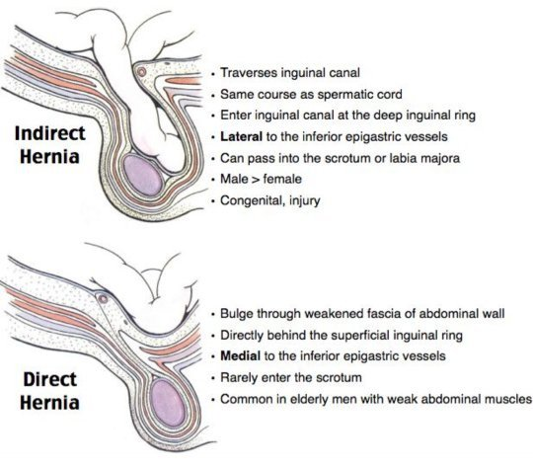
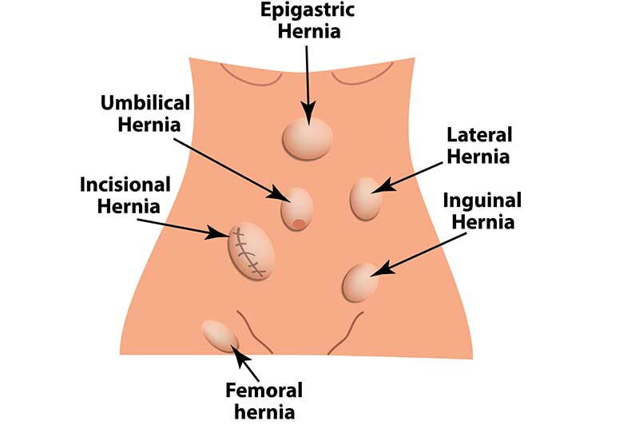
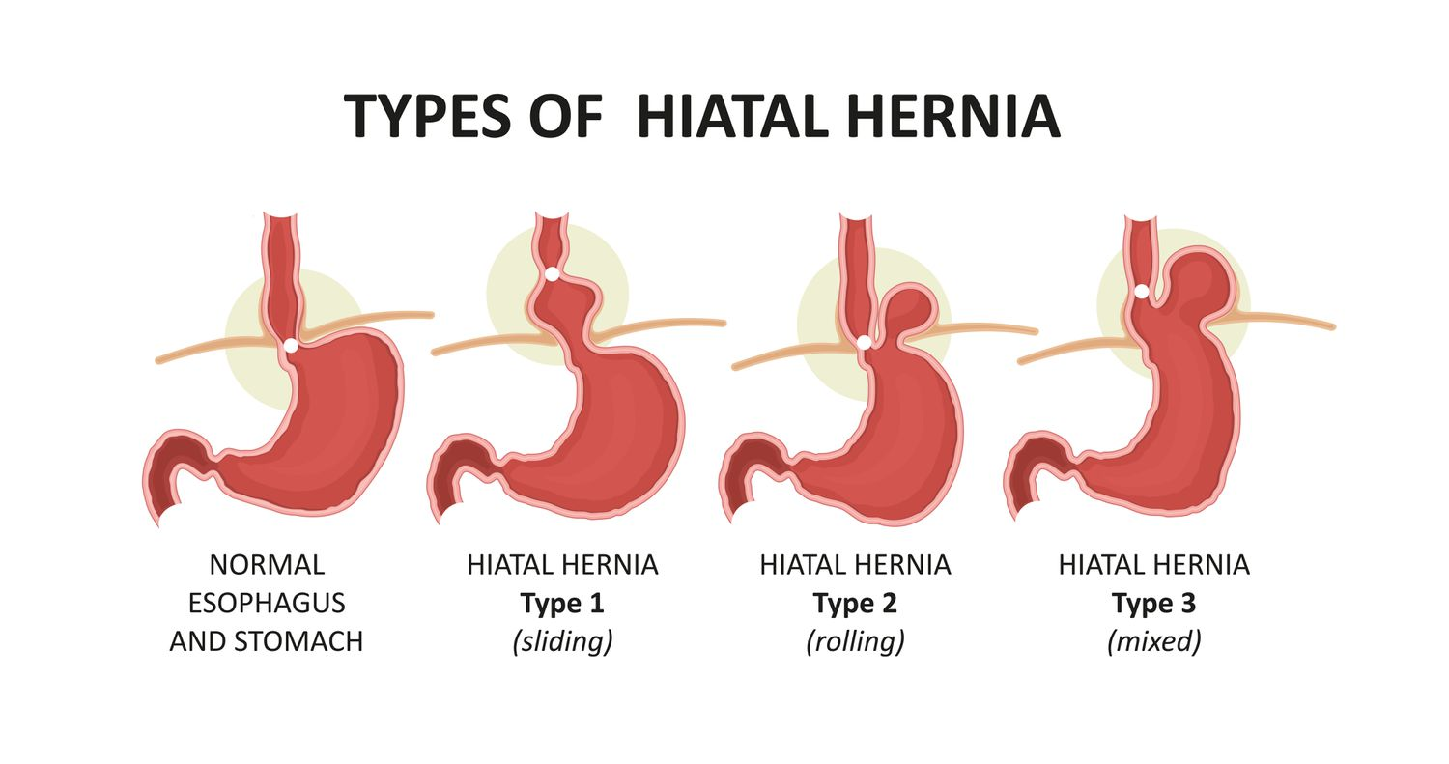
Hernias
Abnormal protrusion of an organ or tissue out of the body cavity in which it normally lies
Inguinal Hernia
Hiatal Hernia
Femoral Hernia

Slide 20
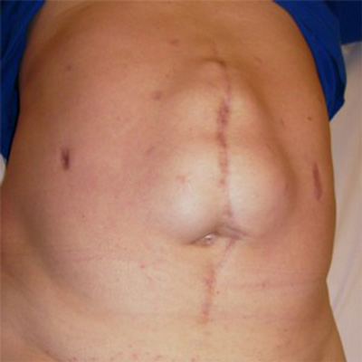
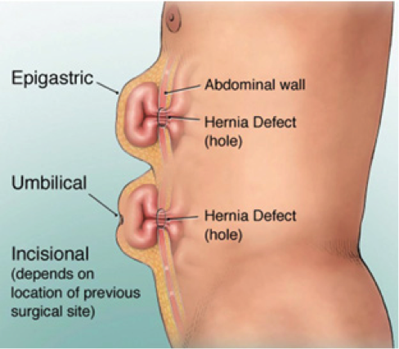
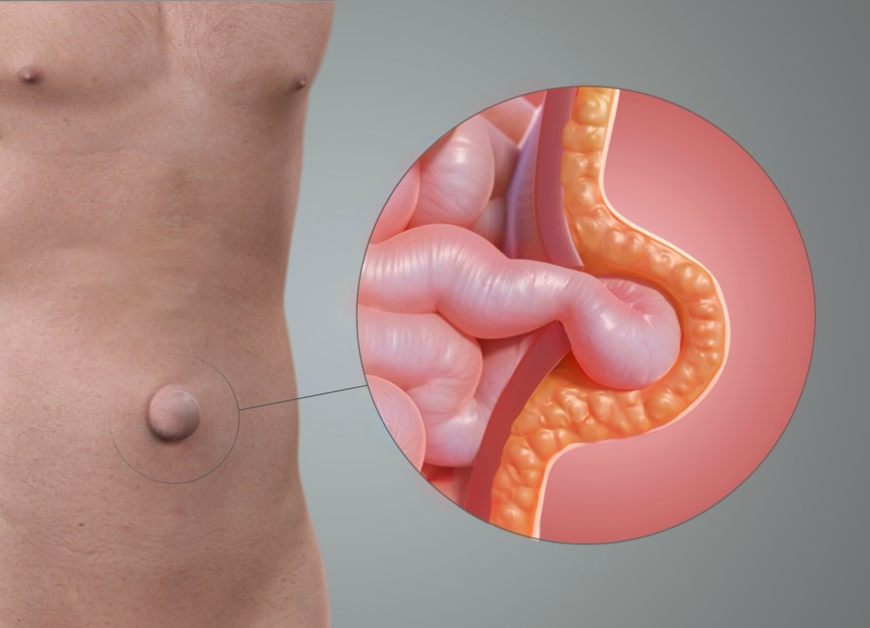
Hernias
Abnormal protrusion of an organ or tissue out of the body cavity in which it normally lies
Incisional Hernia
Umbilical Hernia
Epigastric Hernia
-the defect is the result of an unhealed surgical wound
-Abdominal content herniate through the passage of the umbilical cord at the abdominal wall
-Risk factors: obese women, pregnant women
-part of the intestine push through in the epigastric region of abdominal wall

Slide 21
Question!
Mr Jones, a 57-year-old man, presents to his GP with an intermittent pain in the
right upper quadrant (RUQ), made worse when he eats, especially fatty meals.
He has a BMI of 35 and on examination has yellowish sclera. Last night he had
a fever and rigors (convulsive sweating and shivering). What is the likely
diagnosis?
A. Acute pancreatitis
B. Ascending Cholangitis
C. Biliary colic
D. Primary Biliary cholangitis
E. Vincent’s angina

Slide 22
Answer!
The challenge in this question is differentiating between Biliary colic (C) and Ascending Cholangitis
(B)- both present with RUQ pain, made worse by eating fatty meals and jaundice. Ascending
cholangitis is however characterised by Charcot’s triad of jaundice, RUQ and fever with rigors.
(A)Acute pancreatitis typically presents with epigastric pain which radiates to the back, with very
high serum amylase. PBC is often diagnosed after incidental findings on LFT’s and typically presents
with lethargy and pruritis preceding Jaundice by up to years in some cases. Vincent’s Angina is a
condition characterised by ulceration of the mouth and gingivitis (inflammation of gums), typically
affecting smokers.

Slide 23
Biliary Tract Diseases
 | Biliary Colic | Cholecystitis | Ascending Cholangitis
Risk Factors | Fat (BMI>30), Female, Forty, Fertile, Fair | Fat (BMI>30), Female, Forty, Fertile, Fair | Fat (BMI>30), Female, Forty, Fertile, Fair
Symptoms | Severely, Intensifying abdo pain, triggered after fatty meal, RUQ pain | RUQ Pain, Fever, Tender Gallbladder, referred pain to the right shoulder (phrenic nerve), +ve murphy sign | Charcot Triad: (RUQ pain, Fever, Jaundice) Reynold Pentad: Charcot Triad + altered mental state + hypotension
Investigations | AUSS (1st line) | FBC leukocytosis+neutrophilia, LFT normal, AUSS (thickened gallbladder wall >3mm) | FBC leukocytosis+neutrophilia, LFT increased bilirubin, CBD dilation + gallstones, MRCP (gold standard)
Treatments | Laparoscopic Cholecystectomy within 72 hours (Paracetamol, NSAID, Diclofenac) | Laparoscopic Cholecystectomy within 1 week (IV Fluid, analgesia, antibiotics) | ERCP (bile duct clearance), once stable > Cholecystectomy (IV Fluid, antibiotics, analgesia)

Slide 24
Primary Biliary Cholangitis
Autoimmune disease of the liver, causing destruction of the intralobular bile ducts, resulting in cholestasis> Scarring of the liver, fibrosis and cirrhosis
Risk Factors: Female, 40-50yo, Autoimmune Disease PMH, Smoking
Signs and symptoms: Pruritus, fatigue, jaundice, hepatomegaly, xanthelasma, xanthoma
Complications: Splenomegaly, Oesophageal varices, Ascites, Hepatic encephalopathy, Malabsorption of Fat (Vit ADEK), Osteomalacia + fracture, coagulopathy
Investigation
LFT - increased GGT, ALP, Billirubins
FBC - increased AMA
AUSS, MRCP, ERCP
Liver Biopsy- inflamed bile ducts with intraepithelial lymphocytes, epithelioid granuloma, fibrosis
Treatment: Ursodeoxycholic acid (symptoms control 1st line); Cholestyramine (pruritus), Vit ADEK, Liver transplant

Slide 25
Primary Sclerosing Cholangitis
Progressive autoimmune disease of the liver causing destruction of the intrlobular and extralobular of the bile ducts, resulting in cholestasis> scarring, fibrosis, cirrhosis
Risk Factor: Male, IBD (Ulcerative colitis has a very strong link)
Signs and Sx: fatigue, itching, jaundice, enlargement of liver and spleen, dark urine, malabsorption and steatorrhea, portal hypertension, oesophageal varices, hepatic encephalopathy, Charcot Triad
Investigations: Blood test (Increased ALP), positive pANCA, MRCP (Gold standard)
Treatment: Conservative Management (Cholestyramine for pruritus, FAT soluble vitamin ADEK supplements, Liver transplant if later stage)

Slide 26
Question
Which of the following is a cause of Pancreatitis?
A. Coeliac Disease
B. Gastro-oesophageal reflux disorder (GORD)
C. Horner’s syndrome
D. Mumps
E. Obesity

Slide 27
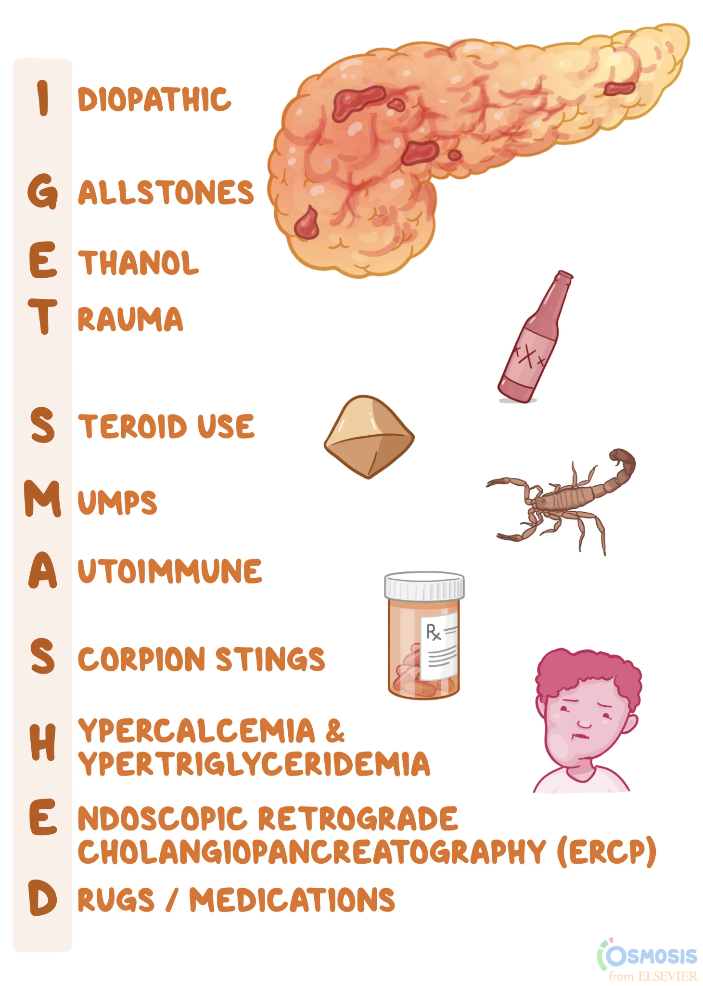
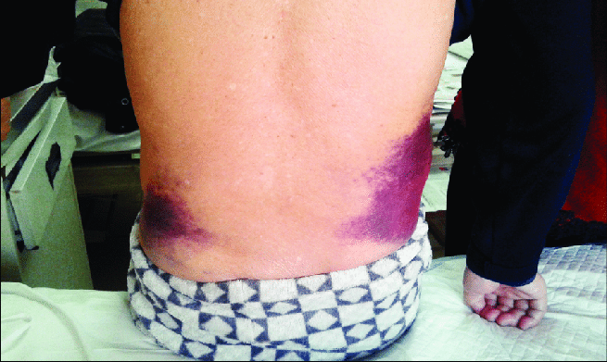
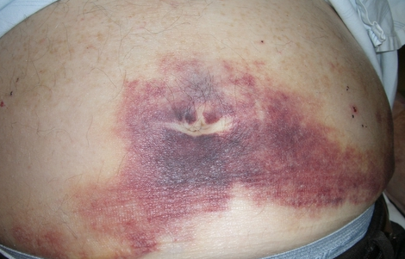
Acute Pancreatitis
Most common cause of acute: gallstones
Most common cause of chronic: ethanol
Signs and Sx: Severe epigastric pain radiating to the back, fever, nausea, vomiting, jaundice, steatorrhoea, Grey Turner sign (flank bleeding) and Cullen Sign (periumbilical bleeding)

Slide 28
Acute Pancreatitis
Investigations:Emergency Hospital Admission, Bloods (Increase amylase, lipase GS), AUSS for gallstone, CT and MRI for extent of damage, Pancreatic Scoring System: Glasgow + Ranson’s Score, APPACHE II score (severity within 24 hours)
Treatments:Emergency Hospital Admission, IV Fluid, Oxygen, Analgesia, IV antibiotics, Nil by mouth and NG tube for feeding
Complications:
Systemic Inflammatory response Syndrome (tachycardia, tachypnoea, pyrexia, WBC increased
localised complications eg. pancreatic necrosis, pseudocyst, pancreatic abscess
systemic complications eg. multi organ failure, sepsis, acute kidney injury, acute respiratory distress syndrome, DIC

Slide 29
Chronic Pancreatitis
Chronic, irreversible, inflammation and/or fibrosis of the pancreas, often characterised by severe pain and progressive endocrine and exocrine insufficiency for 3 months or more.
Alcohol is the major cause (70-80%), other risk factors include smoking, hypertriglyceridemia, hypercalcaemia, autoimmune disease, genetic causes, drugs
Symptoms:Epigastric pain radiating to the back, exacerbated by alcohol, exocrine and endocrine dysfunction
Investigations: Bloods (Lipase and amylase do not usually raised in chronic), increased feacal elastase, Abdo USS + CT (diagnostic)
Treatments: Lifestyle modification (Alcohol cessation), NSAIDs for pain management, pancreatic enzyme replacement therapy (lipase, amylase and protease)

Slide 30
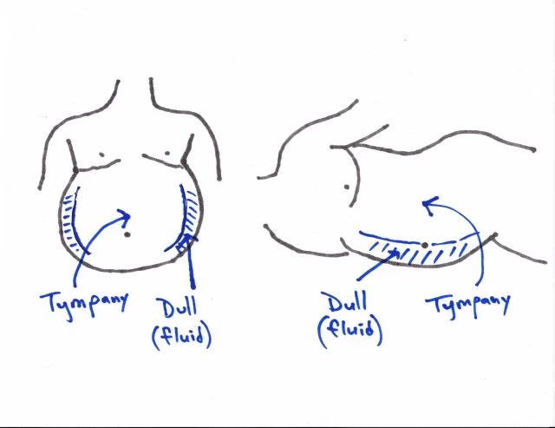
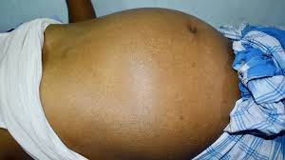
Ascites
Pathologic accumulation of fluid within the peritoneal cavity
most common complications of cirrhosis
Causes of Ascites:
Local Inflammation: Peritonitis, Abdo cancer, TB
Low Proteins: Nephrotic Disease, Hypoalbuminemia (Liver Failure)
Flow Stasis: Cirrhosis (MC), Congestive HF, Budd chiari
Symptoms: Abdominal Distension, Shifting Dullness, Possible Jaundice and Pruritus
Investigations: Shifting Dullness (flank dullness, then flank resonance)
Abdominal Paracentesis + Ascitic fluid analysis
Cytology + MCS
Protein Measurement (serum albumin to calculate serum albumin-ascites albumin gradient SAAG Gradient)
> 1.1g/dL (or >30g/L protein)- exudate, cloudy fluid, inflamate mediated exudation, eg. malignancy, peritonitis, pancreatitis
<1,1g/dL (or <30g/L protein)- transudate, clear fluid, increased hydrostatic pressure, portal hypertension, budd chiari, CHF, nephrotic syndrome, constrictive pericarditis
Treatments: treat underlying cause, paracentesis, spironolactone, liver transplantation

Slide 31
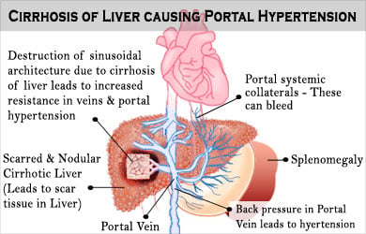
Portal Hypertension
most common complications of cirrhosis
Increased portal pressure gradient (difference between portal vein and IVC/hepatic vein)
Usually < or equal to 5mmHg
Causes:
Prehepatic: Portal Vein Thrombosis
Intrahepatic: Cirrhosis, Schistosomiasis
Posthepatic: RHS HF, BuddChiari, Constrictive pericarditis
Pathophysiology
Portal vein pressure is usually 1-4mmHg more than hepatic vein
In liver cirrhosis, theres increased resistance to the flow in the bile ducts architecture, causing splanchnic dilation (due to release of the vasodilator) and increased in cardiac output> fluid overload in portal vein
Shunting of the blood to the gastroesophageal vein> causing esophageal varices

Slide 32
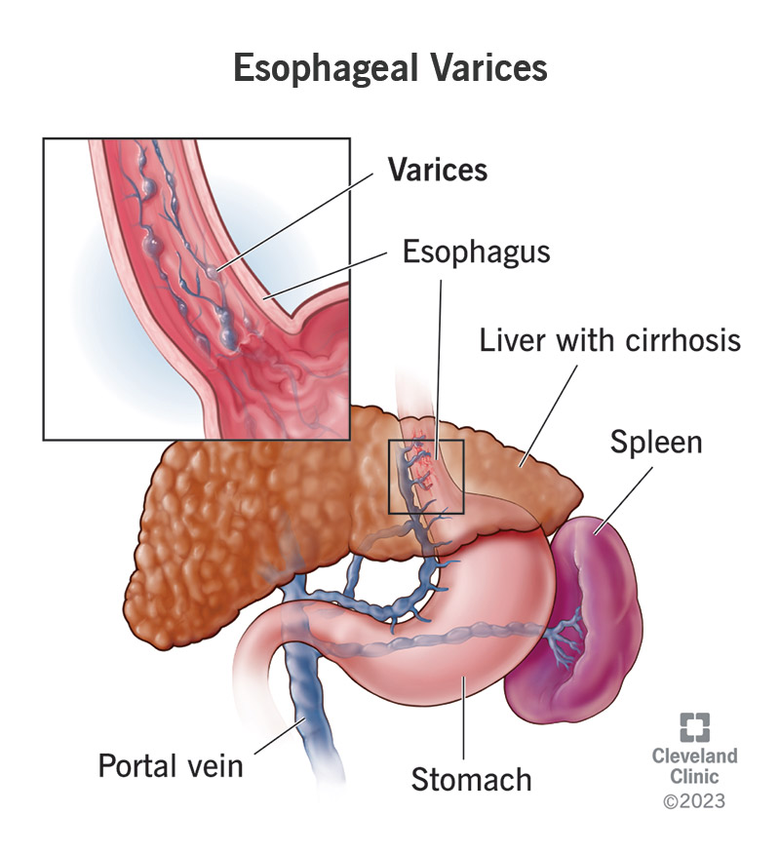
Oesophageal Varices
Dilated submucosal distal oesophageal veins connecting the portal and systematic circulations
Patient usually presents with haematemesis if rupture of the varices happened
How to differentiate oesophageal varices rupture and mallory weiss tear?
MW Tear- Very acute history, Hx of retching, acute alcohol consumption (increased abdo pressure)
Varices Rupture- Long Hx of alcoholism, Hx of Liver Cirrhosis
Investigations: Upper GI OGD
Treatments:
Acute management: Haemodynamic resuscitation, IV Fluid, Blood Transfusion if severe (Hb<70/L)
Bleeding Management:IV Terlipressins, Variceal Band ligation, TIPPS (Transjugular Intrahepatic Portosystemic Shunt- divert pressure to other veins to lower the pressure)
Prevention:Beta Blocker (Nitrate as alternative), Repeat Varcieal Banding, Liver Transplantation

Slide 33
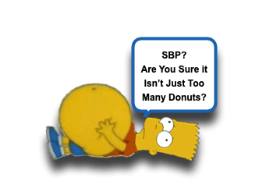
Spontaneous Bacterial Peritonitis
Peritonitis could be due to infection, ascites, malignancy, bile
Bacteria involved:
Gram +ve: Staphh aureus
Gram -ve: Ecoli, Klebsiella
Sx: Sudden onset severe abdominal pain, possible collapse, septic shock, fever; rigidity helps pain, initially poorly localised, then well localised (visceral > parietal)
Investigations:
Ascitic tap shows neutrophilia, cultures MCS shows microorganisms, Increased ESR + CRP, Beta HCG to exclude pregnancy, Abdo Xray for bowel obstruction, Erect CXR shows air under diaphragm > perforated colon
Treatments:
ABCDE, Treat underlying cause, IV fluid and AB course, Surgical peritoneal lavage
Complications: septicaemia, paralytic ileus, pelvic abscess

Slide 34
Question
A 45-year old man has come in complaining of fatigue over the last month. In
addition, he notes pain in his joints and that he is going to the toilet more
frequently and is weeing more than usual. He also finds that he has difficulty
getting an erection and his wife has noticed that his skin has become “darker
than usual”. What is the most likely diagnosis?
A. Wilson’s Disease
B. Haemochromatosis
C. Addison’s Disease
D. Renal cell carcinoma
E. Type 2 Diabetes Mellitus

Slide 35
Answer
This is a hard question as haemochromatosis is not one of the commonest conditions you see. Renal
cell carcinoma does not present with darkening skin so that answer is wrong. While you can get
decompensated liver failure with Wilson’s Disease causing jaundice, the other symptoms don’t quite
match. Addison’s Disease presents with hyperpigmentation and fatigue but the urinary symptoms
don’t match. T2DM is a close answer but doesn’t explain arthralgia and the skin discolouration.
Haemochromatosis is therefore the best answer.

Slide 36
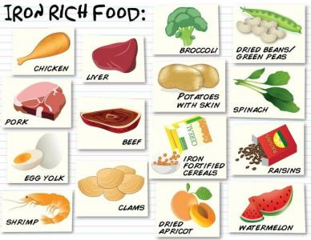
Haemochromatosis
Auto Recessive mutation of HFE gene(chromosome 6)
Risk Factor: male, Fam Hx, Increased intake of extra iron
Pathophysiology: Excess uptake by transferrin 1 and decreased synthesis of hepcidin (regulate the Iron metabolism), usually Fe 3-4g, in haemochromatosis, we see 15-20g of iron
Symptoms:
Triad : bronze statue skin, hepatomegaly, T2DM
Fatigue, joint pain, hypogonadism, liver cirrhosis, osteoporosis, HF
Investigations: Iron studies (ferritin, serum Fe, transferrin saturation, TIBC); HFE genetic test, Liver biopsy
Treatments: 1st line venesection (if CI> desferrioxamine); lifestyle: decreased Fe diet intake

Slide 37
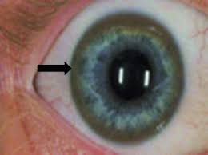
Wilson’s Disease
Auto Recessive mutation of ATP78 gene on chromosome 13 (long arm 13q), Excessive Body copper
Risk factors: young patient around the age of 20, Fam Hx
faulty copper excretory mechanism, causing copper to accumulate in the liver
spill into the blood > accumulate in other organs and tissues eg subthalamus, putamen, and cortex of the brain, kidneys, and cornea
Symptoms:
Hepatic: jaundice
Neurological: Parkinsonism, memory issues
Opthalmological: Kayser Fleischer Ring (pathognamonic) -
green brown ring in the cornea
Investigations:Cu blood test (decreased serum copper due to increased body copper; decreased ceruloplasmin); liver biopsy (increased CU), MRI Brain (cerebellar + BG degeneration)
Treatments:
D-penicillinamine (Cu chelation, lifelong)
Diet (avoid Cu intake)- shellfish and mushroom
Liver transplantation for last resort

Slide 38
Alpha 1 Antitrypsin Deficiency
Deficiency of Alpha 1 antitrypsin enzyme(vs neutrophil elastase), autorecessive , mutation of protease inhibitor gene on chromosome 14
SERPINA 1 gene
A1AT usually inhibits neutrophil elastase, in this condition, NE increases, and causes effect in the lung and liver
Lung: panacinar emphysema
Liver:fibrotic, cirrhosis
Presentations: Young midaged male without/little smoking Hx with COPD symptoms
SOB, cough, sputum production (pink puffer), might present with jaundice too
Investigations: Decreased serum A1AT, Barrel chest, CT shows panacinar emphysema, LFT spirometry shows obstructions, genetic tests show mutation
NO TREATMENT
Stop smoking
Manage emphysema with inhalers
Liver transplantation if hepatic decompensation

Slide 39
-End of Slide-

Slide 40
Feedback

