Slide 1
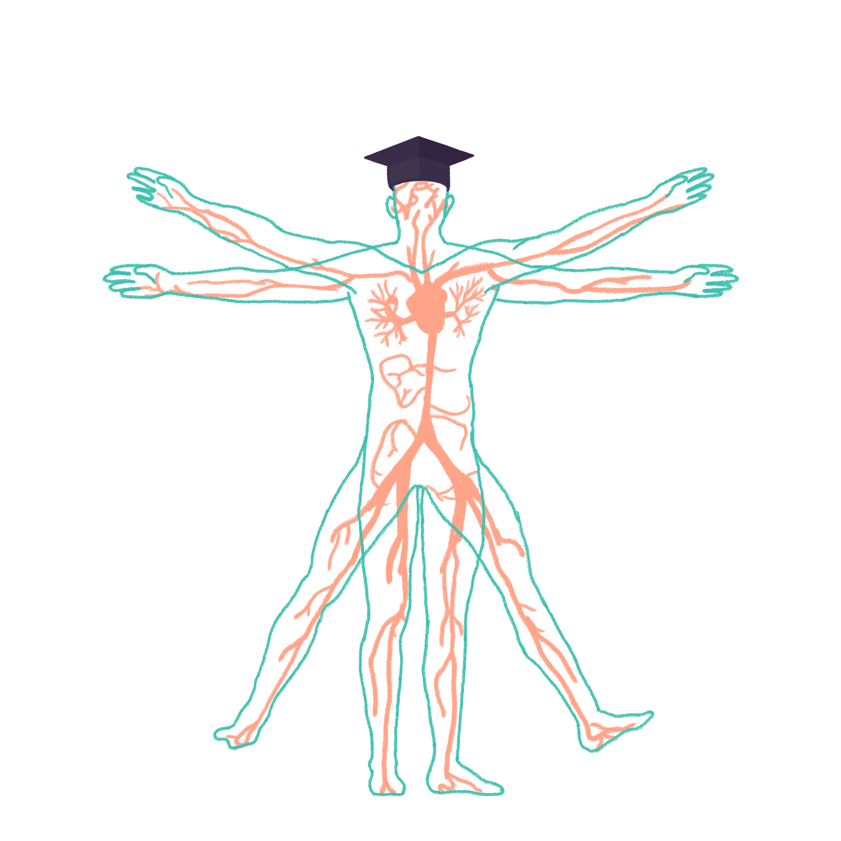
2022/2023

Slide 2
IMMUNOLOGY
Phase 2a Revision Session
Jonathan Sheridan
The Peer Teaching Society is not liable for false or misleading information…

Slide 3
Lecture outline
Organs and Cells of the Immune system
Innate and Adaptive Response
Antibodies
Autoimmunity
Immunodeficiency
Hypersensitivity
*Slide notes contain detailed notes on slide content + some extra bits. Bold text is key information on slides + notes. Index slides are also included for things not covered during the lecture or for extra background. SBAs also included at the end.

Slide 4
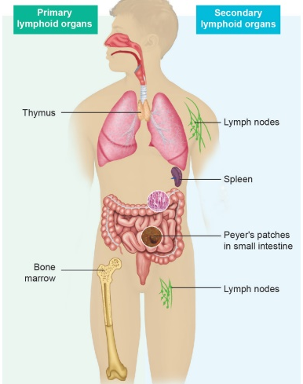
Organs of the Immune System
Primary Lymphoid organs
Bone marrow; All Immune cell origin. B cell maturation site.
Thymus; T-Cell maturation site.
Secondary Lymphoid organs
Lymph nodes; Site of DC, B, and T-cell interactions.
Spleen; Site of removal of RBCs and Ab-coated bacteria
Tertiary Lymphoid organs
Transient formation of germinal centres, usually pathology related.
Notes:
Secondary lymphoid tissues provide the stage to allow foreign antigen to interact with lymphocytes.
There are also mucosal associated lymphoid tissues such as the gut-associated lymphoid tissues which have greater plasma cell density than LNs, the spleen, and bone marrow combined. Peyer’s patches are essential lymphoid follicles of the gut.
Tertiary lymphoid organs (TLOs) are lymph node like ectopic structures that form during chronic inflammation such as in chronic infection, transplant graft rejection, and autoimmunity. For example in multiple sclerosis focal TLOs form in the brain which produces anti-myelin antibody leading to the demyelinating pathology.

Slide 5
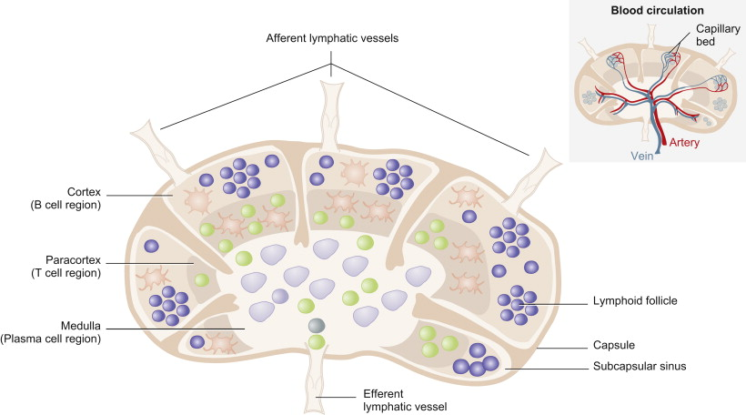
Lymph Nodes
Notes:
LNs are the site of B cell and T cell interaction. They also interact with dendritic cells that are delivering antigen to the LN. Think of it as LNs and other secondary tissues are sites of innate and adaptive interaction.
DC enter with Ag in afferent lymphatics and interact with naïve CD4+ cells to activate them in the paracortex. T cell either become effector cells or memory cells. Cells exit via the efferent lymphatics.
The lymphoid follicles are predominantly B cells.

Slide 6
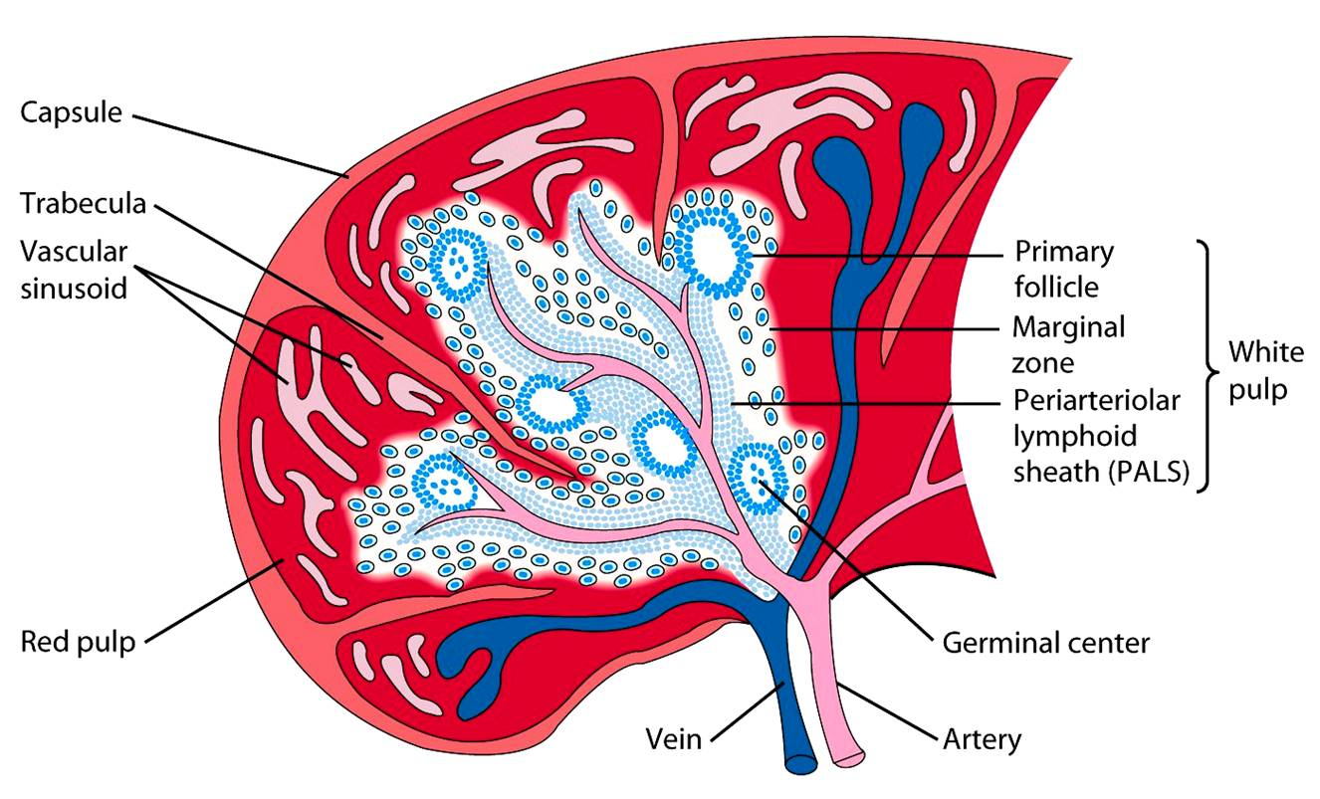
Spleen
Notes:
Red pulp; Mechanical filtration of RBCs, reserve for monocytes in mice.
White Pulp; Active immune responses through humoral and cell-mediated immunity. PALS is rich in T cells. Lymphoid follicles are rich in B cells.
Other functions;
Production of RBCs; up to the 5th month of gestation. In thalassaemia (decreased or abnormal Hb) resulting in haemolytic anaemia haematopoesis occurs in the context of pathology and the spleen produces RBCs once more.
Storage of RBCs, lymphocytes, and other elements. ~25% of lymphocytes are stored. ~30% of RBCs are stored that can be released in hypovolaemia and hypoxia. It can also store platelets and clears old platelets from circulation.

Slide 7
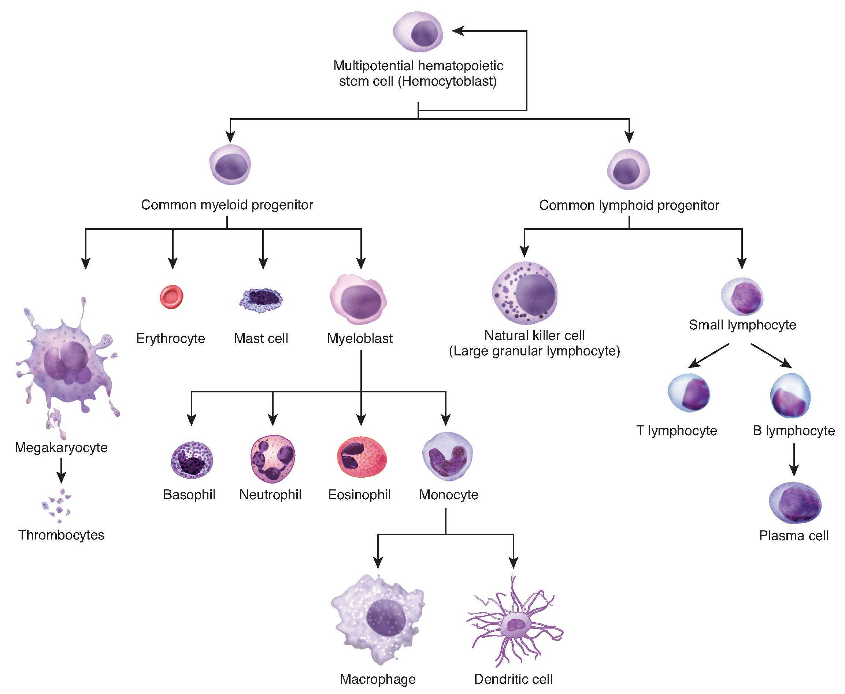
Haematopoesis
Notes:
Hematopoiesis is the production of all the cellular components of blood and blood plasma
In haematopoesis differentiation is determined the presence of specific cytokines and chemokines and the induction of specific transcription factors.
The innate immune system is the initial rapid and non-specific response to antigenic material with no immunological memory.
Common myeloid progenitor decedents can be considered as the innate branch of the immune system. On the other side decedents of the common lymphoid progenitor can be considered cells of the adaptive immune response. The only notable exception are natural killer cells that are considered innate cells.

Slide 8
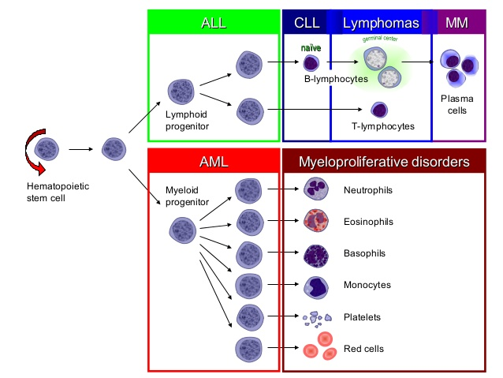
Haematopoesis
Notes:
ALL comes from Lymphoid progenitors causing increased amounts of immature lymphocytes
CLL affects naïve (not exposed to antigen) mature B cells.
Lymphomas affect Mature naïve T cells and B cells in germinal centres
Multiple myeloma is a cancer of plasma cells.
AML is the cancer of myeloid progenitors causing a decrease in their downstream cells.
Myeloproliferative Disorders include chronic myeloid leukaemia includes proliferation of granulocytes
This slide will make more sense and be useful after haematology teaching!

Slide 9
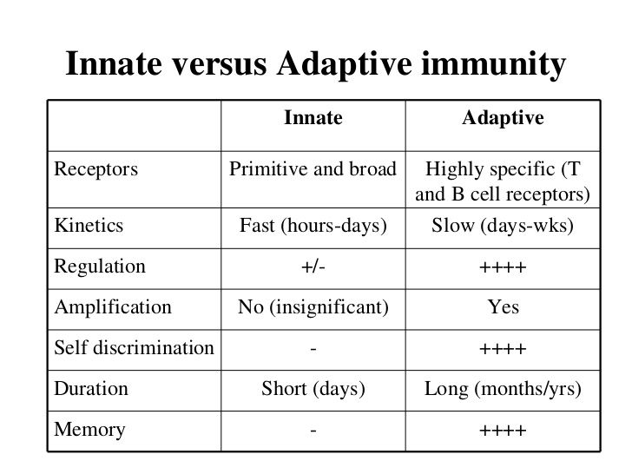
Innate vs Adaptive Immunity
Notes:
Not much to say other than learn half of this table and reverse it for the rest.

Slide 10
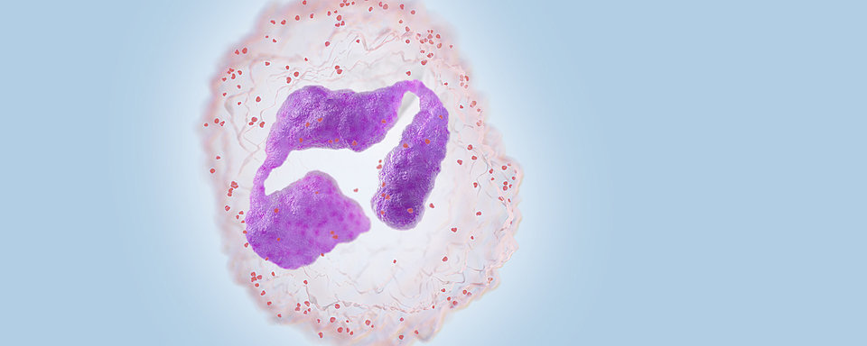
Innate Immunology
Notes:
Ask them if they know what innate cell this is already.

Slide 11
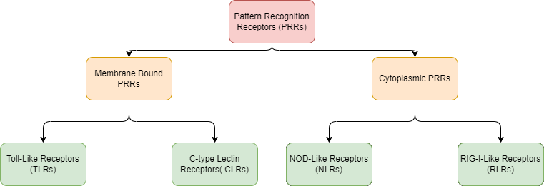
Innate Recognition
Innate Immune system
Innate Recognition
Notes:
Can be split by membrane or cytoplasmic

Slide 12
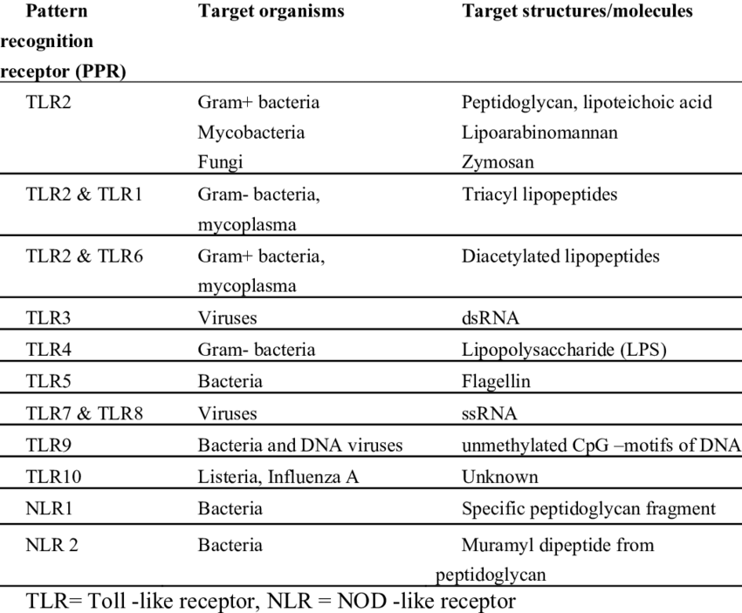
Innate Recognition
Pattern Recognition Receptor (PRR) | Pathogen associated molecular pattern (PAMP) | Present on
TLR2 | Peptidoglycan | G+ve Bacteria
TLR3 | dsRNA | Viruses
TLR4 | Lipopolysaccharide (LPS) | Gram-ve Bacteria
TLR5 | Flagellin | Flagellated Bacteria
TLR7/8 | ssRNA | Viruses
TLR9 | dsDNA | Viruses
Notes:
Ask them how does the innate immune system detect antigenic material.
PRRs are germline encoded receptors and have a great degree of evolutionary conservation. Detects pathogen-associated molecular patterns (PAMPs) and damage associated molecular patterns (DAMPs)
PRRs mostly all have leucine-rich repeats
Toll-Like receptors so called as they are like Toll receptors in fruit flies (drosophila)
TLRs (and C-type lectin receptors) are membrane bound.
TLRs 3, 7,8,9 are intracellular and detect nucleic acids. They detect intracellular material and ergo viruses!
TLR 5. Five. Flagellin, Flagellated bacteria
TLR 9 = Nine begins with N = Nonmethylated CpG (Cytosine and guanine) motifs of ssDNA in bacteria and DNA viruses.
TLR2 Detects lipoteichoic acid G+ve. Also think TLR-2 Two begins with a T as does TB so therefore TLR2 detect mycobacteria.
TLR4 Detects LPS on G-ve
Rule of thumb is that TLRs detecting genetic material are located on endosomes within cells whereas TLRs detecting other bacterial material are located on cell surface.
Do a bit and then give them the simplified table.
There are exceptions to the TLRs noted but if they ask you that in an exam it would be unfair and far too in depth.
NOD-Like Receptors and RIG-Like receptors are cytosolic
NLRs are cytosolic. NOD1/2 have CARD domains (caspase activation and recruitment domains (CARDs)) → activating NF-κB → apoptosis.
NALP3 has a pyrin domain that activates caspase 1 leading to pro-inflammatory cytokine (e.g. IL-1β, IL-18) release and causing pyroptosis. There is a downstream protein called absent in melanoma 2.
Just for interest – Pyroptosis is an inflammatory programmed cell death in response to bacterial infection.
Say that if you’re gonna remember any at all remember TLR2 and TLR4.

Slide 13
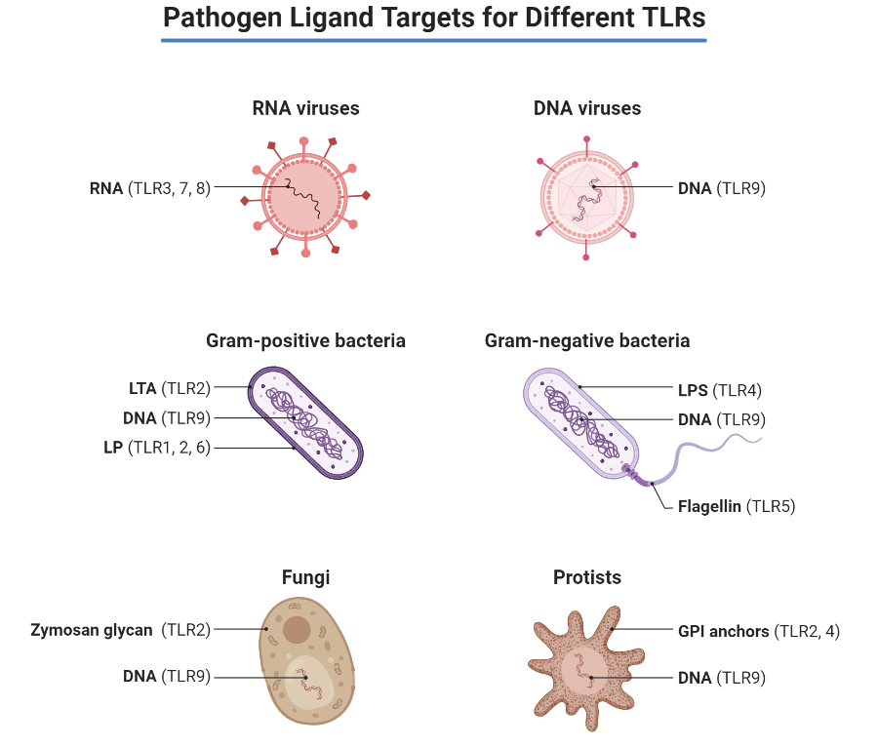
Innate Recognition
Notes:
For more visual learners.

Slide 14
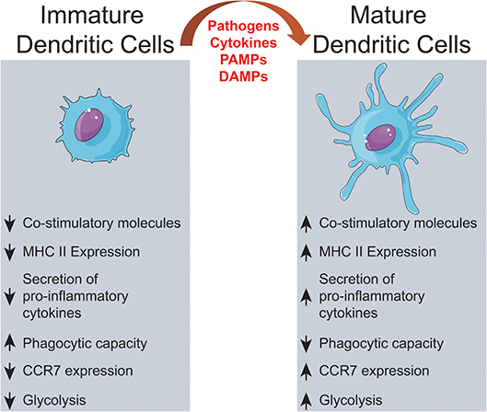
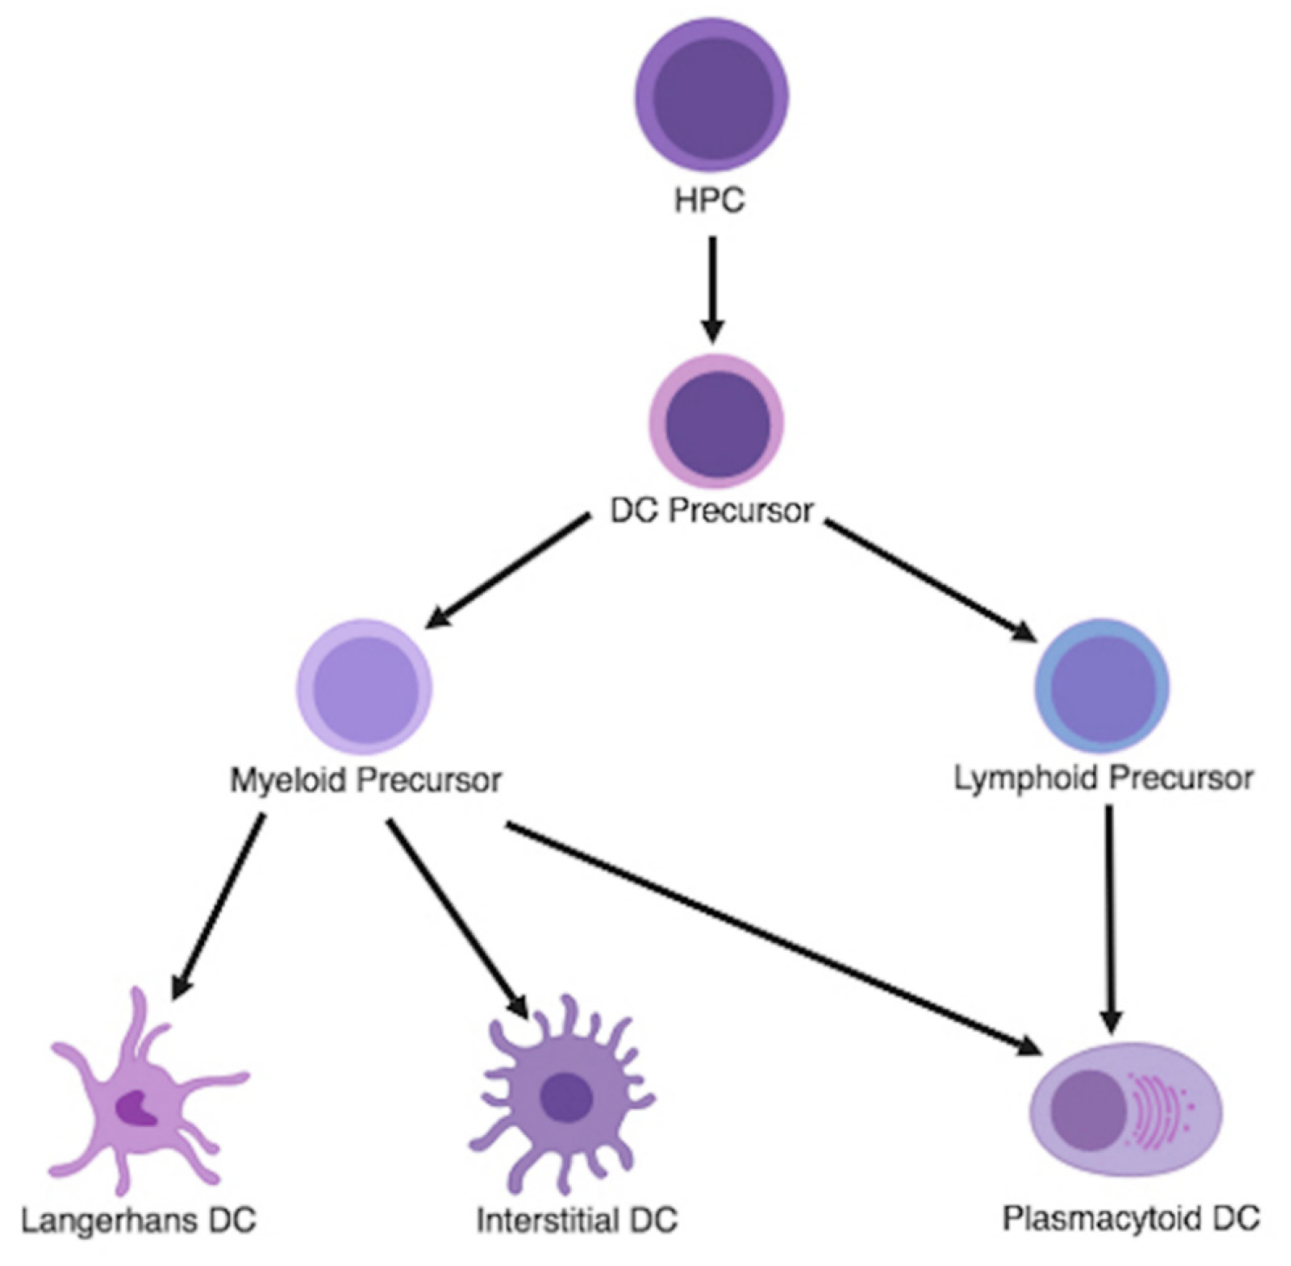
Innate Cells; Dendritic Cells
Notes:
Thought of as a bridge between the two systems.
A few different types but you would not be expected to know them. Your main cell is the interstitial DC. Langerhans cells have been considered as mostly DC cells but now there are populations of Langerhans cells that are also tissue resident macrophages. Plasmacytoid DCs respond to viral infection by releasing type I interferons (alpha and beta}
Dendritic cells are phagocytic and antigen presenting.
Become activated and start scooping up antigen.
Digest and present to other cells in the context of MHC-II
CCR7 is a chemokine receptor that guides DCs to secondary lymphoid organs.

Slide 15
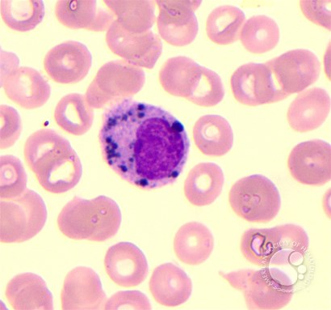
Innate Cells; Macrophages
Phagocytosis, antigen presentation, and cytokine secreting
TNF-α, IL-1, IL-12
Round single nuclei often with a small indentation.
CD14+ and CD40+
Either derived from blood monocytes or as tissue resident macrophages.
Detect PAMPs and DAMPs by PRRs
One of the principle cells in chronic inflammation.
Notes:
Tissue resident macrophages are derived from the yolk sac and foetal liver during development and persist in tissues via self renewal.
Can be derived from circulating monocytes under the correct conditions.
INF gamma activates macrophages.
TNF-alpha is a major pro-inflammatory molecule and is predominantly produced by macrophages.
Two phenotypes M1 is considered pro-inflammatory due to its ability to metabolise arginine to nitric oxide. M2 are considered anti-inflammatory due to their ability to metabolise arginine to the repair molecule ornithine. However this dichotomy is dictated in the literature as greater complexities are being discovered.
Remember PRRs detects PAMPs and DAMPs.
Opsonisation – essential marking for phagocytosis by antibody and complement.
Antibody bind pathogens by their Fab regions. Macrophages have Fc receptors that bind antibody and in turn phagocytoses the bacteria the antibody has bound.
Antibody binds pathogens. Complement then binds antibody Fc regions forming a complex. Macrophages have complement receptors that recognise this complex. Then phagocytose.

Slide 16
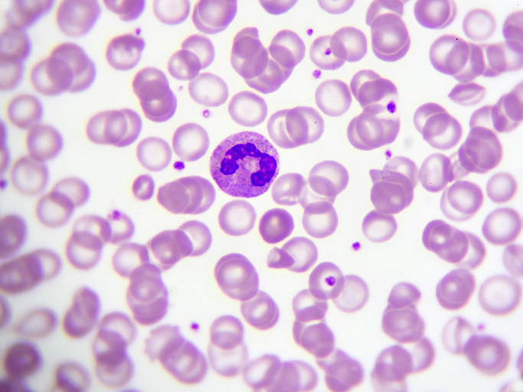
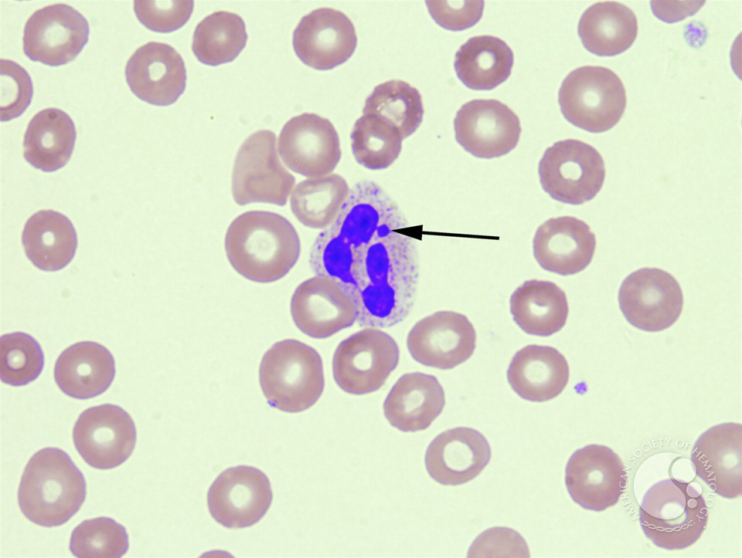
Innate Cells; Neutrophils
Most abundant (70%) WBC f
Short lived
Rapidly egress into tissues during acute infection
Phagocytic and bactericidal.
Principle cell of acute inflammation – IL-8 Chemokine!
Polymorphonuclear cells
Barr Body (inactivated X chromosome in women)
Notes:
In phagocytosis pathogens are detected by pattern recognition receptors of innate phagocytic cells.
live 1-3 days in vivo.
They are attracted to site by the chemokine IL-8 (CXCL8). Remember clean up on isle 8!
They kill by releasing internalising bacteria and degranulating their contents into a phagolysosome. Major components include alpha-defensins and lactoferrin.
Their other killing mechanism is the respiratory burst. Here electrons are pumped into the phagolysosome by NADPH Oxidase. The electrons combine with molecular oxygen to produce superoxide ions. These ions combine with protons present in the granules to produce peroxide which is bactericidal in itself. Myeloperoxidase can then chlorinate the peroxide to produce a hypohalous acid which is also bactericidal.
Neutrophils are the principal cell of acute inflammation. This doesn’t have to be infective! Any acute inflammation can include post-MI, burns, etc.
Movement of neutrophils out of capillaries in acute inflammation:
1. E-selectin (an adhesion molecule on the capillary endothelium), is activated by IL-1 and TNF-α from damaged cells and binds to the glycoprotein CD15 on neutrophils in blood.
2. This causes neutrophils in the blood to slow down and roll along the endothelium lining.
3. ICAM-1 on endothelium (induced by LPS, IL-1, TNF-α) binds to integrin on neutrophil; the neutrophil stops.
4. Diapedesis: neutrophil squeezes through endothelium (holes caused by C3a, C5a, chemokines, histamines, prostaglandins, leukotrienes (causing smooth muscle contractions in the bronchioles))

Slide 17
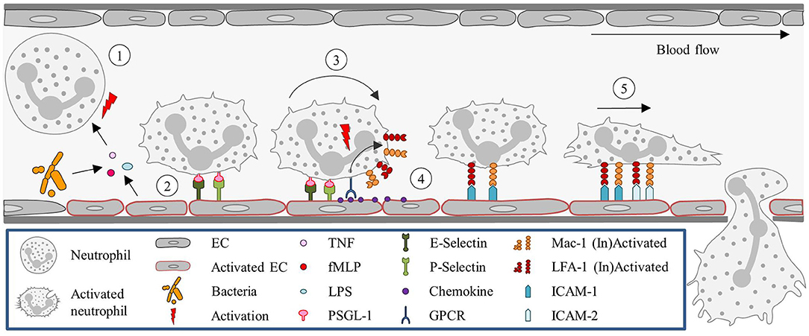
Innate Cells; Neutrophils
Notes:
Movement of neutrophils out of capillaries in acute inflammation:
1. E-selectin (an adhesion molecule on the capillary endothelium), is activated by IL-1 and TNF-α from damaged cells and binds to the glycoprotein CD15 on neutrophils in blood.
2. This causes neutrophils in the blood to slow down and roll along the endothelium lining.
3. ICAM-1 on endothelium (induced by LPS, IL-1, TNF-α) binds to integrin on neutrophil; the neutrophil stops.
4. Diapedesis: neutrophil squeezes through endothelium (holes caused by C3a, C5a, chemokines, histamines, prostaglandins, leukotrienes (causing smooth muscle contractions in the bronchioles))

Slide 18
Innate Cells; Other Granulocytes
Basophil
Can be thought of as circulating mast cells that release histamine upon IgE crosslinking Fcε receptors.
They also secrete serotonin and heparin
Important in asthma, anaphylaxis, atopic dermatitis, and hay fever.
Key point; They do not egress into tissues and become mast cells .
Eosinophil
Important cells in dealing with parasitic infections.
Release cationic granules such as major basic protein.
Release ROS, eicosanoids, leukotrienes, elastase among other molecules.
Notes:
You can remember the granulocytes (polymorphonuclear cells) as BEN; Basophil, Eosinophil, and Neutrophil.

Slide 19
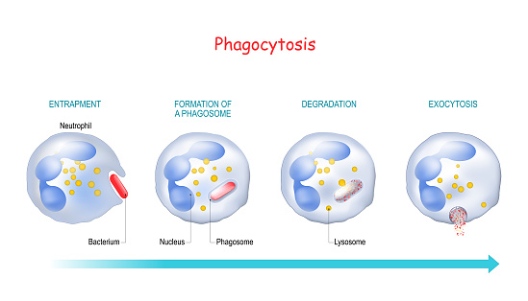
Phagocytosis
Neutrophils, macrophages, monocytes, dendritic cells, and eosinophils can be classified as professional phagocytes
Notes:
Professional phagocytes are neutrophils, macrophages, and dendritic cells.
Phagosome + Lysosome = phagolysosome.
Lytic granules, cationic peptidases such as granzyme B, and azurophilic granules that stain blue. Phagolysosome changes pH to allow this.
This is the oxygen independent route killing mechanism
Second mechanism Respiratory Burst.

Slide 20
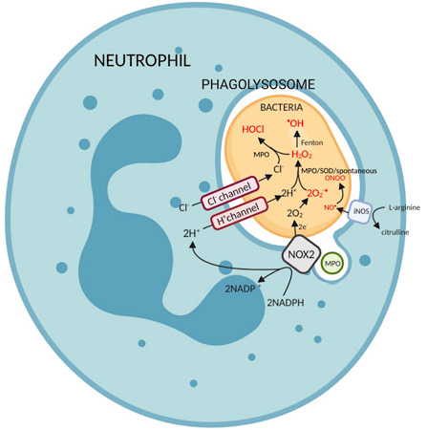
Phagocytosis: Respiratory Burst
Notes:
Second mechanism Respiratory Burst. Oxygen dependent mechanism.
Elections pumped in via NADPH Oxidase.
Electrons combined with molecular oxygen to make superoxide.
Hydrogen ions and Chloride ions co-transported in.
H+ combined with superoxide to make peroxide
Peroxide combines with Chloride ions, catalysed by MPO to make HOCl which is bacteriacidal.
Clinically important as NOX2 mutations lead to CGD.
Autoantibody to MPO causes granulomatosis with polyangiitis (formerly known as Wegener’s Granulomatosis) and allergic granulomatosis.

Slide 21
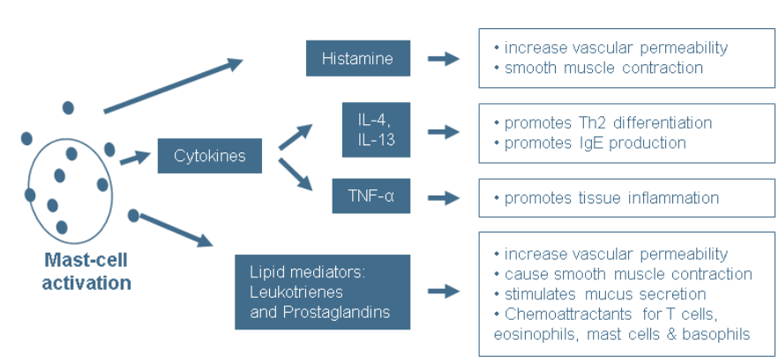
Innate Cells; Mast cells
Important in parasitic infection and allergic reactions.
At mucosal surfaces.
Stem cell factor is essential for development.
Main source of histamine.
Activated by immune complex IgE crosslinking FcεR1
Notes:
IgE binds allergen -> Activated mast cells via Fc Receptor.

Slide 22
Innate Cells; NK Cells
In blood and tissues
CD16+
Not phagocytic
Antibody-dependent cellular cytotoxicity (ADCC)
Release lytic granules that kill virus infected cells.
Recognise self and non-self by the presence of MHC-I on cell surfaces
Notes:
ADCC is an independent mechanism that does not require complement and uses only one cell type. It is classically NK cells that do this. Typically IgG will bind surface antigens on the pathogen-infected or cancer cell. NK have Fc receptors (CD16) that recognise the antibody Fc region. This cross-linking triggers degranulation and cell apoptosis. Viral proteins are expressed on the surface of cells during viral replication can become antibody targets.
Granules contain perforin and granzymes that induce apoptosis and cell lysis.
Cancers tend to downregulate MHC-I mediated antigen presentation. NK cell inhibitory receptors detect levels of MHC I on cell surfaces, if cells lack enough MHC I, NK cells will activate and try to kill the cell. Cell that have MHC I activate the inhibitory receptor and therefore does not elicit a response. Cytotoxic T cells only act on tumour cells in response to NK cell cytokine production.

Slide 23
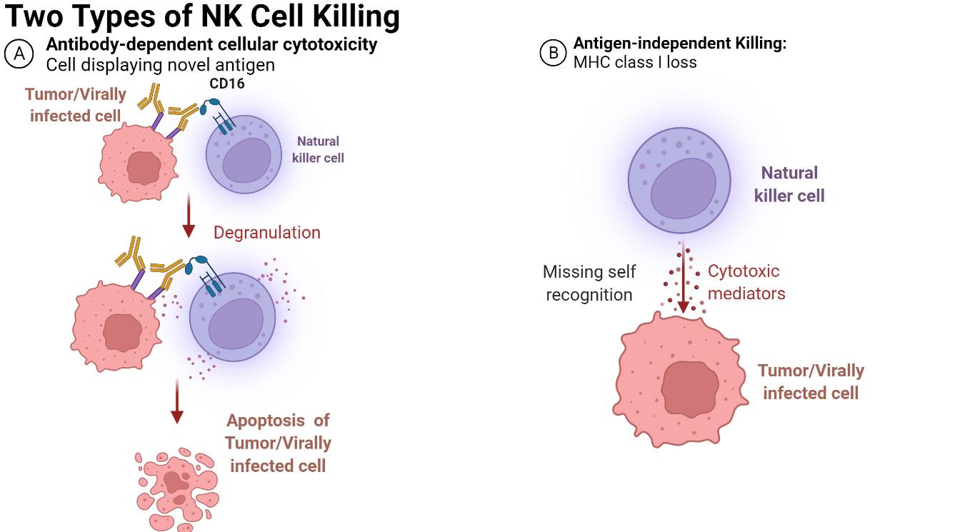
Innate Cells; NK Cells
Notes:
Just for interest: There also exists another innate population called NK T cells that have both TCRs and NK cell surface markers. This will likely never come up on a medical school exam.
Antibody bind antigen on target cells. NK cells engage Fc portions of antibody using CD16,
Cross linkage leads to degranulation of lytic agents.

Slide 24
Antigen Presenting Cells
The professional antigen presenting cells (APCs)
Macrophages
B-Cells
Dendritic Cells
They all present exogenous Ag in the context of MHC-II
Dendritic cells are the most potent antigen presenting cell. They egress to secondary organs to aid the adaptive response.
All nucleated cells are capable of MHC-I presentation.
Notes:
MHC (major histocompatibility complex) molecules are coded on chromosome 6
Exogenous antigen is processed in the ER and presented on cell surface in the context of MHC II. Endogenous proteins present in the cytosol such as viral proteins or cancer-related proteins are processed in endosomes and presented in the context of MHC-I
Dendritic cells are phagocytic. Dendritic cells are also capable of cross-presentation; They can present exogenous Ag in the context of MHC-I in order to activate Tc cells.
There are two types of dendritic cells – conventional and plasmacytoid but this that come from lymphoid and myeloid lineages respectively. This is just for interest.
Technically thrombocytes are anucleate and still have MHC-I molecules but distinctly RBCs do not present MHC-I.

Slide 25
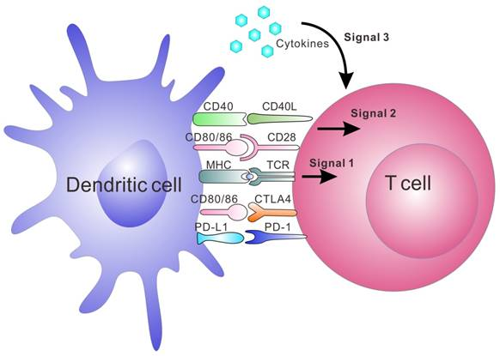
Antigen Presenting Cells
Title
Notes:
Dendritic cells can be thought of as the bridge between the innate and adaptive immune responses in secondary lymphoid organs.
When immune cells come together they form what is know as an immune synapse. For a response to occur 3 things are essential 1. Binding of primary receptors e.g. TCR to MHC II. 2. Binding of co-stimulatory molecules e.g. CD28/CTLA4 to CD80/CD86. 3. A robust release of the appropriate cytokines. MHC binding without other stimulation leads to anergy (lack of response as a form of peripheral tolerance). Just keep the concept in mind, don’t get too bogged down in all the receptors here bar MHC and TCR.
During initial encounter with a novel antigen T cells will differentiate into either memory or effector T cells.
There are a multitude of co-receptors for specific immune cell interactions. Unless they are specifically taught to you or included into your curriculum they are not worth memorising.

Slide 26
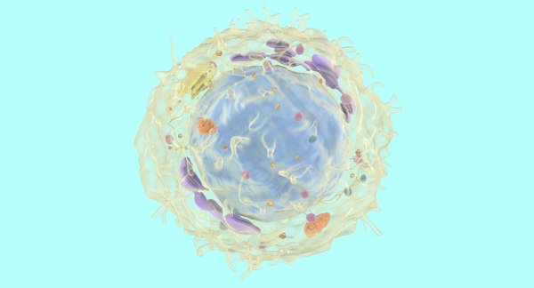
Adaptive Immunology
Adaptive Immunology

Slide 27
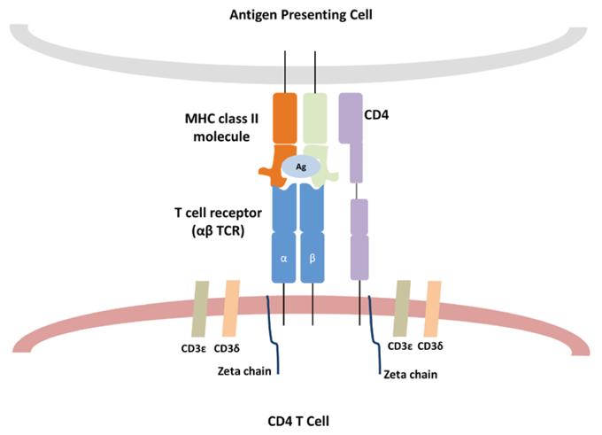
Adaptive Cells: T cells
CD3 is the common T cell marker
Can express CD4 or CD8*
T cell receptor
Can be naïve, effector, or memory.
CD25 is their marker of activation.
Notes:
CD3 is the identifying co-stimulating molecule for all T cells. Its main function is intracellular signalling that activates the T cell. It is a protein complex comprised of one gamma, one theta, and two epsilon polypeptide chains.
T-cells begin their lives in the bone marrow as HSCs and differentiate through the lymphoid pathway into immature T cells. *They initially start as naïve CD4+CD8+ double positive cells. During maturation in the thymus they undergo thymic education to retain either CD4 or CD8, and they undergo VDJ recombination in the thymus to determine the antigen epitope that their TCR will recognise.
Take home point = TCRs are specific to a certain antigen. There are tens of thousands different TCRs within an individual. Allowing response to a wide range of antigens.
Naïve = not encountered antigen.
T-cells must recognise antigen in the context of MHC molecules using their T-cell receptors. The only exception to this is superantigens. Superantigens bind the beta/alpha chains of TCR regardless of TCR. Since there are only around 50 variants of the chain superantigens activate ~20% of the whole T cell population, compared to a normal T cell response of around 0.001%
Naïve T cells are identified by being CD45RA+ whereas memory T cells are identified by being CD45RO+. The general marker for T cell activation is CD25 expression.

Slide 28
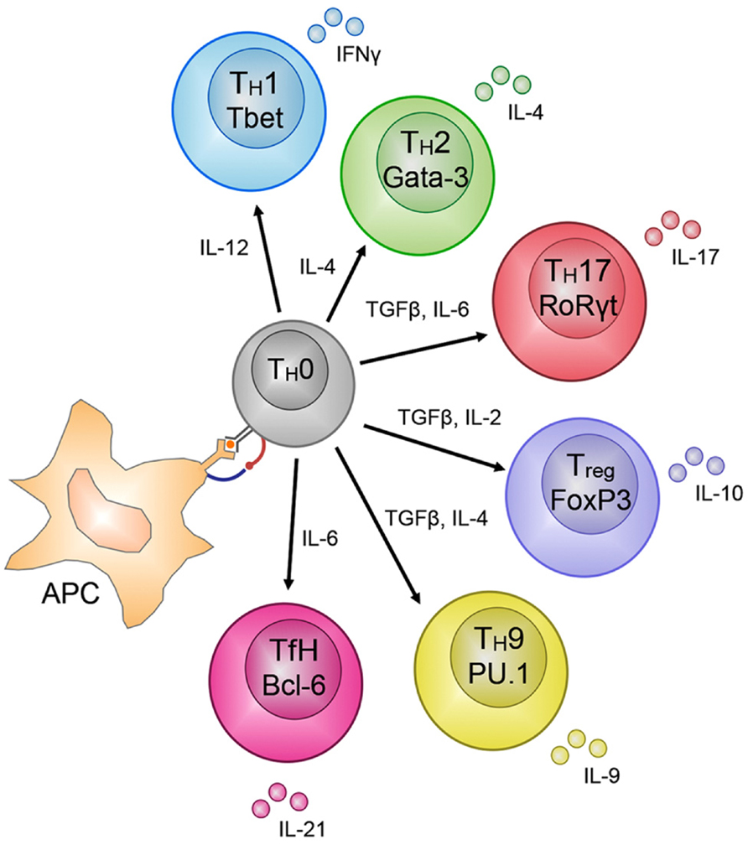
Adaptive Cells: T cells
Notes:
Upon antigen presentation by APCs naïve T cells can become a wide variety of effector T cells depending on transcription factors, and cytokine stimulation
No need to learn each pathway!

Slide 29
Adaptive Cells: Cytotoxic T cells (CD8+)
Cytotoxic T Cells (Tc)
CD8+
Cytotoxic. Release perforins and granzymes.
Expresses Fas Ligand which binds to Fas → apoptosis
Recognise Ag in the context of MHC I
Become effector or memory cells
Notes:
Tc kills cells via two mechanisms;
1. Perforin and Granzymes; Perforin is pore forming cytolytic protein that allows salt and water to enter cells and causing them to lyse. Granzymes are a group of serine proteases. They cleave a caspase protein (CPP-32) which will activate a nuclease (CAD) which initiations DNA degradation and apoptosis.
2. CD8 T cells also express the Fas ligand, this binds Fas on target cells which activates the caspase cascade and therefore apoptosis.
Tc kill cells that present endogenous antigen, e.g. cancers, viruses.
Ask can anyone think of intracellular bacterial infection?

Slide 30
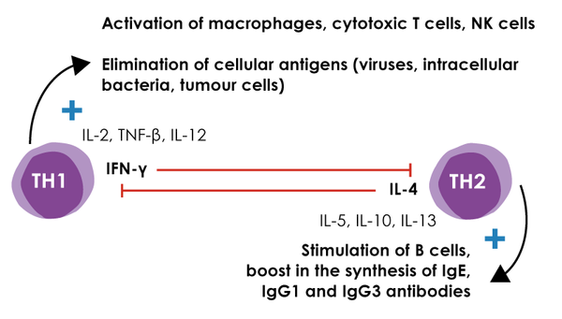
Adaptive Cells: T helper cells (CD4+)
Th1
Cell-mediated immunity
Regulate monocytes and macrophages.
Th2
Humoral immunity .
Regulators of eosinophils, basophils, and mast cells.
Notes:
These are antagonistic and work to supress each other. We call this T cell polarisation.
Can remember quite simply as cell-mediated response occurring before humoral response. Ergo Th1 is the associated with the 1st response and Th2 is associated with the 2nd response.

Slide 31
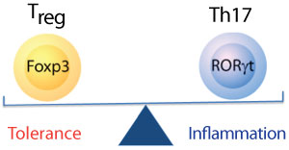
Adaptive Cells: T helper cells (CD4+)
Treg
The principle cell in peripheral immune tolerance.
IL-10 is their key cytokine that has a mass anti-inflammatory action
Th17
Important cells at mucosal membranes.
Principle cytokine is IL-17
IL-17 induces innate immune cells to produce IL-8 (CXCL8)
Notes:
Th17 and Treg cells are antagonistic. Transcription factors and cytokines produced by Th17 cells suppressive T reg cells and vice versa.
IL-8 is the most important cytokine in neutrophil production and recruitment.
IL-23 maintains Th17 populations and is a target for biologics.

Slide 32
Adaptive Cells: B-Cells
The BCR
Can be naïve, effector, memory.
CD19 is the co-stimulatory molecule of mature cells.
CD20 is the mature B cell marker.
B-cell activation in secondary lymphoid organs.
Somatic hypermutation and affinity selection aided by dendritic and T cells.
Activated B cells either become short lived plasma cells (IgM+) or long-lived plasma cells (IgG, E, or A+).
Notes:
BCR is just a cell bound antibody.
B-cells can either be activated directly by antigen in the absence of T cell help for a rapid but short-lived response. These tend to have less affinity and IgM releasing.
In Hodgkin lymphoma there is the appearance of Reed–Sternberg cell. These are B-cell derived giant cells that are distinctive of this lymphoma. CD15 is a distinctive marker. They have prominent eosinophilic inclusion-like nucleoli (thus resembling an "owl's eye" appearance) under microscopy.
CD20 is the target of Rituximab which is used in RA, CLL, Non-Hodgkin lymphoma. Ask them if they know the clinical significance of CD20.
Long lived plasma cells can remain in secondary organs or egress back into the bone marrow.

Slide 33
B-Cell Activation
Notes:
Happens in the cortex of lymph nodes predominantly

Slide 34
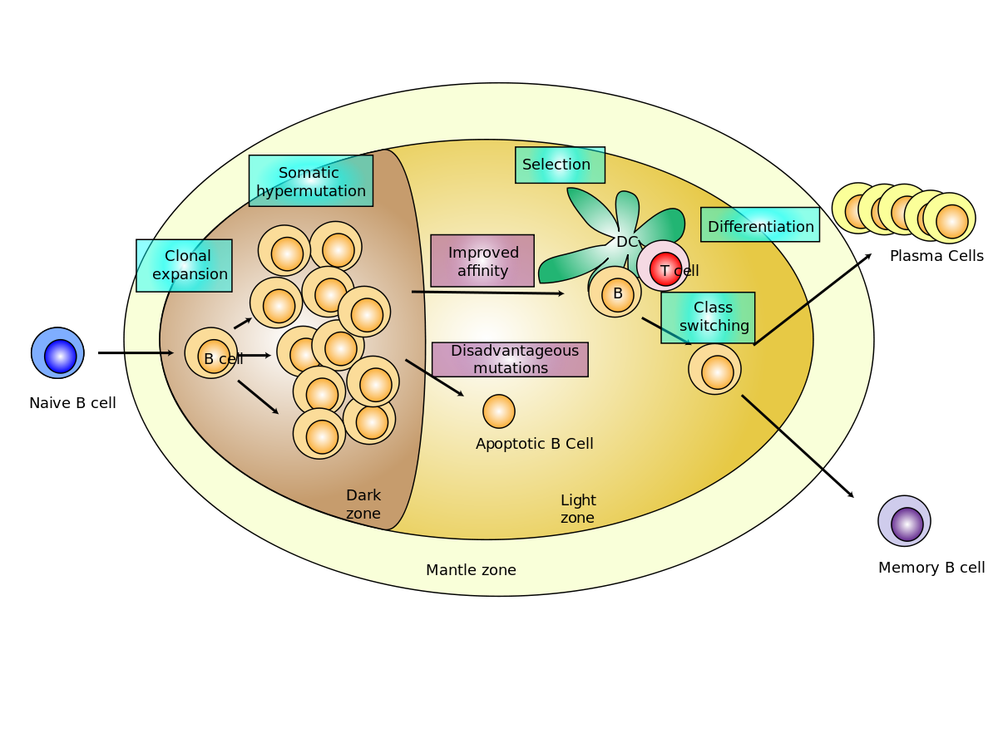
B-Cell Activation
Notes:
When B-cells are activated in lymphoid follicles, the follicles develop into germinal centres – where mature B cells proliferate, differentiate, and mutate their antibody genes
B-cells can be activated directly by antigen in the absence of T cell help for a rapid but short-lived response. These tend to have less affinity and IgM releasing.
B cells that are activated when they internalise antigen and present it to T cells in the context of MHC II. They do this in lymph nodes. After activation they migrate to newly formed germinal centres to undergo somatic hypermutation. This is when activation-induced cysteine deaminase (AID) introduces random mutations in the variable region of the antibody gene. Dendritic cells in germinal centres will present the same antigen to the B cell to test if the avidity of its antibodies has increased. B cells with less avidity will be negatively selected and those with greater avidity will be positively selected and undergo class switching and clonal proliferation.
Fun fact germinal centre dendritic cells are not classical immune cells. Instead of a haematopoietic origin they are of mesenchymal origin.
When memory cells encounter their specific antigen, they become activated and undergo clonal proliferation and begin secreting IgG.
Effector B cell = plasma cell!!!
Which T cell helps this process? – Th2. Well technically they are another distinct set called T follicular helper. But you do not need to know this. Just remember that Th2 cells help humoral immunity.

Slide 35
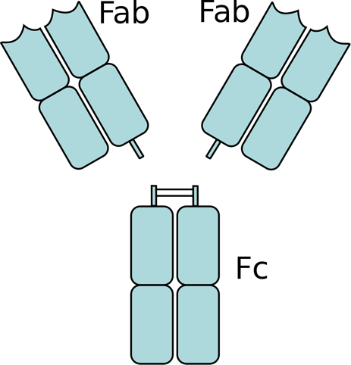
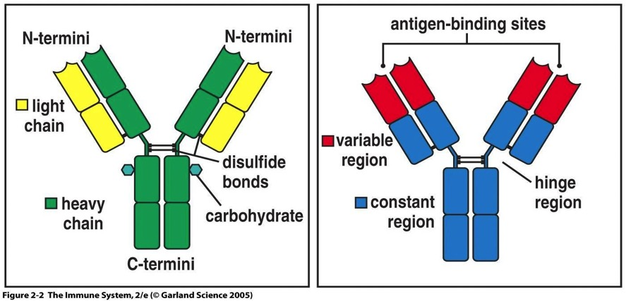
Antibodies
Notes:
Constant region determines Antibody type and therefore effector function.
Fab region (antigen-binding fragment) bind epitopes of antigen. Fab regions are initially determined by a process called VDJ recombination during maturation in the bone marrow.
Avidity for antigen is increased during infection through somatic hypermutation in the germinal centres of secondary organs.
Fc region (fragment crystallizable region) is the area that binds Fc receptors on immune cell surfaces.
Fc region also binds complement to aid in opsonisation of pathogens for phagocytosis.
Functions of Antibodies; Neutralisation of toxins, agglutination, precipitation, opsonisation of pathogens, complement activation via the classical pathway → cell lysis and chemoattraction.

Slide 36
Antibodies
Antibody | Function and Features
IgA | The mucosal Ab. A dimer. Present in colostrum and coats neonate gut.
IgM | Pentameric and not entirely specific to antigen. Highest capacity to activate complement.
IgG | Most abundant in the blood. Highly specific. Important during secondary responses. 4 subclasses. Can cross the placenta.
IgE | Bound to Mast cells and basophils by FcεR. Important in allergy and helminth infection. Least abundant in the blood.
IgD | Not that important. Function is debated in the literature.
Notes:
Colostrum contains IgA, IgM, and IgG where IgA is the principle antibody.

Slide 37
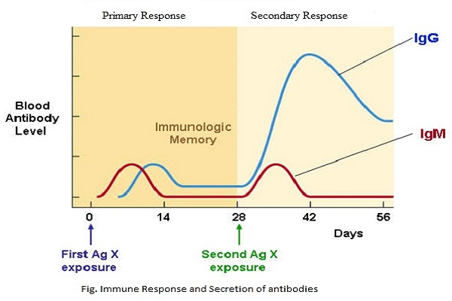
Antibodies
Notes:
Immunologists have seen this graph more times than they’ve had hot dinners.
Which cell type is raised in bacterial infection. - Neutrophilia especially in pyogenic infections.
Which cell type is raised in viral infections. – Lymphocytosis
And in Intracellular bacterial infections e.g. TB some protozoal infection such as toxoplasmosis.

Slide 38
Hypersensitivity
Type | Mechanism | Examples
Type I – Anaphylactic | Antigen reacts with IgE bound to mast cells | • Anaphylaxis • Atopy (e.g. asthma, eczema and hayfever)
Type II - Cell bound | IgG or IgM binds to antigen on cell surface | • Autoimmune haemolytic anaemia • Goodpasture's syndrome • Pernicious anaemia • Rheumatic fever
Type III - Immune complex | Free antigen and antibody (IgG, IgA) combine | Systemic lupus erythematosus Post-streptococcal glomerulonephritis
Type IV - Delayed hypersensitivity | T-cell mediated | • Tuberculosis / tuberculin skin reaction • Graft versus host disease • Multiple sclerosis • Guillain-Barre syndrome
Notes:
Hypersensitivy = undesirable response to antigenic, allergenic, self material. This requires a pre-sensitized state of the host.
The Gell and Coombs classification of hypersensitivity is the most widely used
Type 1 is a fast reaction occurring in minutes. Cross-linking of antigen to IgE on mast cells and basophils causes massive degranulation and therefore massive release of histamine.
Type 2 IgM or IgG binds to self antigen leading to cell destruction by the membrane attack complex and cellular mechanisms.
Type 3 IgG binds soluble antigen forming a circulating immune complex. These deposit in vessel walls especially in the kidneys. Here they kick off an inflammatory response causing complement deposition, opsonisation, phagocytosis etc. RBCs carrying the complement receptor 1 bind complement coated immune complexes and transport them to the liver and spleen for phagocytosis.
Type 4; This is helper T cell mediated. Specifically, Th1. Th1 are activated by antigen presenting cells. Memory T cells are formed. When the memory T cells encounter the antigen again, they will activate macrophages leading to tissue damage.
Type 5 are an increasing recognised hypersensitivity. IgM or IgG bind cell surface receptors and either stimulating or blocks endogenous ligand binding. Grave’s disease and myasthenia gravis are among the only recognised pathologies of this type.

Slide 39
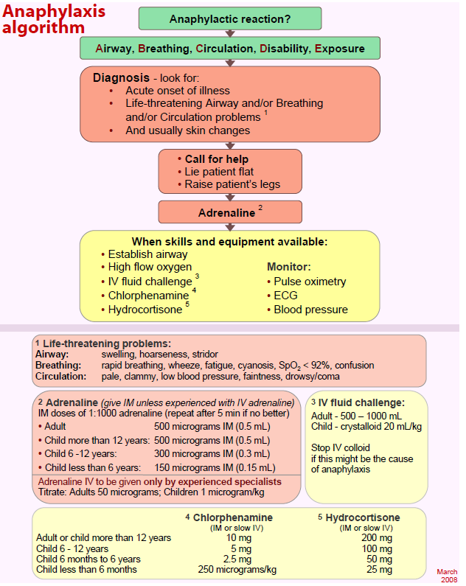
Hypersensitivity
Anaphylaxis
IgE binds antigen which then cross-links FcεRI on mast cells and basophils leading to massive degranulation and histamine release.
Medical emergency that can be fatal.
IM Adrenaline is 1st line
Chlorphenamine (antihistamine) and hydrocortisone (cortisol) can be used after this.*****
Notes:
Gotta know this.
If unsure it is better to call for help than do nothing.
Chlorphenamine and hydrocortisone has recently been removed from national guidance and therefore should only be used if local guidelines say to do so.

Slide 40
Autoimmunity
Immune tolerance vs Autoimmunity
How autoimmunity develops: Many ways!
Thymic education
Tregs
CD4 activation against autoantigen
Features of autoimmunity
Often relapsing-remitting
Organ-specific vs Systemic
Damage to or destruction of tissues
Altered organ growth/function
Generation of autoantibodies
Notes:
Central tolerance is when TCRs and BCRs are tested against self antigen. B cells are tested in the bone marrow, BCRs that recognise self antigen either leads to clonal deletion (apoptosis), receptor editing, or anergy. T-cells undergo positive and negative selection in the thymus. Positive selection; T-cells that recognise MHC molecules. If they cannot they do not receive survival signals. This also determines CD4 or CD8 lineage. Negative selection; This test their affinity to self. If they bind self antigen they receive signals to apoptose. T cells that pass both stages move to secondary organs as mature naïve T cells.
Peripheral tolerance; Low affinity self reactive T cells can escape the thymus to the periphery. In secondary lymphoid organs T cells are presented self antigen again by dendritic cells and if they recognise they either are clonally deleted or converted to Treg. Tregs can also deplete IL-2 from the environment and secrete the tolerogenic cytokine IL-10. Induced anergy can also occur if there is no co-stimulatory (and therefore pro-inflammatory cytokine presence).
There a lot of other ways autoimmunity develops such as molecular mimicry, but do not worry about this detail.
Tx involve reducing inflammation and suppressing the immune system. This usually relieves symptoms but do not typically cure.

Slide 41
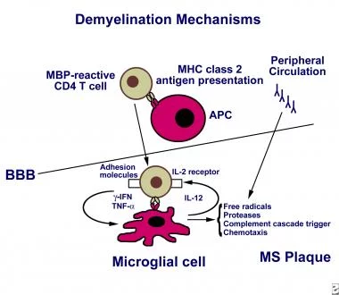
Autoimmunity – MS
Notes:
Multiple sclerosis is the most common CNS immune mediated condition. It is a demyelinating condition. Caused by a failure of central and peripheral tolerance to eliminate self reactive T cells. These T cells are reactive to myelin proteins such myelin basic protein.
Tertiary Lymphoid organs form in the brain of MS allowing T and B cell interactions and the generation of autoantibodies.
(Current research hasn’t made a definite link to MBP but several studies show a role of the autoantibody into the pathogenesis of MS. Another proposed mechanism is molecular mimicry where T cells in essence confuse MBP with herpes virus 6. Like a current theory of Guillain-Barre)
Researchers often say diseases like MS “develop from interactions of an individuals genetics and with unidentified environmental causes”
MS can be either;
Relapsing remitting (RRMS); Where there are periods of disease activity and no activity. Often incomplete recovery will occur → disability. Some will progress to secondary progressive.
Primary progressive (PPMS); Worsening neurological function from onset of symptoms with no early relapses or remissions.
Secondary progressive (SPMS); Progressive worsening of neurological function over time. There will be periods of active disease with progression of the disease as well as periods of non-active disease where it still progresses.
And clinically isolated syndrome; clinical situation of an individual's first neurological episode, caused by inflammation or demyelination of nerve tissue. CIS with enough paraclinical evidence can be considered as a clinical stage of multiple sclerosis but can be due to other Dx.
Diagnosis
Spinal tap; demonstrating MS associated autoantibodies
MRI; Highlights brain lesions.
Evoked potential tests, which record the electrical signals produced by your nervous system in response to stimuli
Management
Acute attacks are managed with IV methylprednisolone
RRMS; Immunomodulators → Interferon beta 1a, or 1b, or peg-interferon beta 1a
SPMS; Siponimod or methylprednisolone.
PPMS; Ocrelizumab an anti CD20 MAb similar to rituximab.
This page will be more clear and useful after neuro teaching!

Slide 42
Immunodeficiency/Immunosuppression
Primary Immunodeficiency
Those born with intrinsic defects in their immune system.
Rare and mostly genetic disorders
E.g. SCID
Secondary Immunodeficiency
These are acquired and are referred to generally as immunosuppression
Drug induced e.g. Steroids, azathioprine, chemotherapy.
Cancers of the bone marrow and blood cells
AIDS.
Notes:
Suppression and not deficient because there isn’t a lack of availability but production is being negated or blocked.
SCID = severe combined immunodeficiency. Also known as bubble boy disease where both B and T cells lose functionality, leading to a agammaglobulinaemia. One of the most severe primary immunodeficiency with various genetic causes and subtypes. SCID mice are, however, amazing to use in research and help isolated areas of the immune system.
Profound immunodeficiency is a hallmark of AIDS.
There also are a number of other secondary immunodeficiencies such as hypothyroidism, diabetes and hypoglycaemia. Keep this in mind when caring for these patients.
Steroids, specifically glucocorticoids, are anti-inflammatory by blocking eicosanoid production. They also suppress cell-mediated immunity by inhibiting NF-κB transcription pathway which supresses IL-2 production which in turn reduced T cell proliferation.
Azathioprine is an immunosuppressive drug that is a purine analogue that inhibits fast proliferating cells such as T cells.
Cancers; Leukaemia, Lymphoma, and Myeloma.
HIV has a cell tropism for CD4+ T cells. In uncontrolled infection there is increasing destruction of CD4 cells. Once it drops below 200 cells/uL there is profound immunodeficiency and is defining aspect of the development of AIDS.

Slide 43
Useful Resources
Whirlwind tour but hope this helped!
I’ll send out a good (but v detailed) set of notes!
YouTube; Armando Hasudungan
Textbooks: Roitt’s Essential Immunology or Immunology for Medical Students by Helbert
Sites; BiteSized Immunology – BSI.

Slide 44
Feedback
https://docs.google.com/forms/d/e/1FAIpQLSdZ7CPEXU39NQTivqIlWhbhIyUbFZ3UrZCDx0iFO_1T40w9Ug/viewform?usp=sf_link
The Peer Teaching Society is not liable for false or misleading information…

Slide 46
INDEX SLIDES

Slide 47
Vaccines
Active immunity | Passive immunity
Produced by the host immune system. | Passive with no host participation
Induced by infection or vaccines. | Usually pooled antibodies transferred into the host
Durable effective protection | Transient and less effective
Effective after initial lag period | No lag period, effective immediately.
Immunological memory is present | No memory present
Boosted effect on subsequent dose | Subsequent doses do not boost immunity due to elimination.
Negative phase | No negative phase
Notes:
The principle of vaccination; Controlled and safe exposure to part of a pathogen that is immunogenic and will induce immunological memory with little to no harm to the host. A lot of vaccines have an initial “prime” dose followed by a “boost dose”. An ideal vaccine will induce both T and B memory cells. Adjuvants help boost the immune response. Viral vectors are often used to boost the immune response. Vectors and Prime-boost regimes can be used to direct memory to specific tissues.
Natural active immunity is after exposure to antigen from pathogens in the environment. Unnatural active immunity is with vaccines. Natural passive immunity is maternal antibodies in colostrum. Active passive immunity is the transfer of antibodies from one organism to another e.g. IVIG.
The negative phase is a period after initial antigen exposure where ones immunity is actually lower than before encountering the antigen.

Slide 48
Macrophage names
Cell Name* | Location
Monocytes | Bone marrow/Blood
Kupffer cells | Liver
Sinus histiocytes | Lymph nodes
Alveolar macrophages | Alveoli
Tissue macrophages leading to giant cells | Connective tissue
Microglia* | CNS
Hofbauer cells | Placenta
Intraglomerular mesangial cells | Kidney
Osteoclasts | Bone
Epithelioid cells | Granulomas
Sinusoidal lining cells | Red pulp of the spleen
Langerhans cells* | Skin
Notes:
Microglia and Langerhans cells are unique in that they arise in the yolk sac only during the early stages of pregnancy. They seed themselves into their respective tissues were they undergo local proliferation if needed. Other Tissue resident macrophages can be derived from bone marrow as well as the yolk sac and foetal liver.

Slide 49
Notes:
Cheat Sheet.

Slide 50
Cytokine | Main sources | Functions | Inflammation
IL-1 | Macrophages | Acute inflammation Induces fever | Pro-inflammatory
IL-2 | Th1 cells | Stimulates growth and differentiation of T cell response | Pro-inflammatory
IL-3 | Activated T helper cells | Stimulates differentiation and proliferation of myeloid progenitor cells | Pro-inflammatory
IL-4 | Th2 cells | Stimulates proliferation and differentiation of B cells | Anti-inflammatory
IL-5 | Th2 cells | Stimulate production of eosinophils | Pro-inflammatory
IL-6 | Macrophages, Th2 cells | Stimulates differentiation of B cells Induces fever | Pro-inflammatory
IL-8 | Macrophages | Neutrophil chemotaxis | Pro-inflammatory
IL-10 | Th2 cells | Inhibits Th1 cytokine production | Anti-inflammatory
IL-12 | Dendritic cells, macrophages, B cells | Activates NK cells and stimulates differentiation of naive T cells into Th1 cells | Pro-inflammatory
Tumour necrosis factor-α (TNF-α ) | Macrophages | Induces fever, Neutrophil chemotaxis. | Pro-inflammatory
Interferon-γ | Th1 cells | Activates macrophages + NK cells. | Pro-inflammatory
Notes:
IL-4 promotes class switching to IgE in B cells as well as clonal proliferation. Also promotes M2 phenotype macrophages and therefore aids in wound healing. Positive feedback loop when released from T cells so Th2 is favoured and Th1 is suppressed.
IL-8 is also known as CXCL9. Can actually be released by any TLR bearing cell. Promotes phagocytosis. Can actually attract all granulocytes but attracts neutrophils most potently. Also a known angiogenesis promoter.
Interferons are cytokines released by the body in response to viral infections and neoplasia. They are classified according to cellular origin and the type of receptor they bind to. IFN-alpha (all WBC) and IFN-beta (Fibroblasts) bind to type 1 receptors whilst IFN-gamma (from NK and Th) binds only to type 2 receptors.
Be mindful that a cytokine that active a cell is usually also produced by the cell it activates!

Slide 51
Immune Based Therapies
Therapy | Mechanisms and examples
Monoclonal Antibodies (mAbs) | Very targeted. Do not carry antigenic segments. Designed to either deplete certain cell populations or functionally downregulate a population.
Immunosuppressive drugs | Glucocorticoids. Ciclosporin, tacrolimus and rapamycin Purine analogues. Alkylating agents.
Cytokines and Anti-cytokines | Either activate or block cytokine receptors to achieve immunomodulatory effects. E.g. Pegylated interferon.
Intravenous Immunoglobulin | Replacing IgG in patients with immunodeficiencies. Can also be used in certain inflammatory conditions.
Notes:
An example of mAbs are anti-TNF therapy. These mAbs are often used in autoinflammatory conditions such as Crohn’s Disease (CD). Infliximab is a chimeric mAb used in CD often in acute infusions. Adalimumab is a humanised mAb that is a subcut injection that is patient administered and can be preferred when encouraging patient autonomy.
Glucocorticoids; E.g. Hydrocortisone, prednisone. They downregulate the monocyte production of IL-1 and TNF-alpha. They block the T-cell production of IL-2 and IFN-gamma and therefore humoral immunity. They also reduce the activation and migration of innate and adaptive cells in general.
Ciclosporin, tacrolimus and rapamycin; Are all calcineurin inhibitors and inhibit Ca2+ dependent second messenger signals in T cells following TCR activation. This makes them potent T cell inhibitors.
Purine analogues; The most important is azathioprine. Used in IBD and organ rejection. They incorporate into DNA resulting in chain termination. They are a potent antiproliferative in dividing adaptive immune cells.
Alkylating agents; e.g. Cyclophosphamide. Interfere with DNA synthesis and induce immunosuppression. Used a lot in oncology as anti-neoplastics
Cytokines and anticytokines; Cytokines are pleotropic and regulate the immune system so are attractive targets for therapy. Anakinra is a IL-1 receptor antagonist which is beneficial in type 2 DM. Pegylated interferon is used in chronic hepatitis C infection.
IV Ig; Is a preparation of poly specific IgG pooled from a large number of healthy donors (>20k). It is used in patients with primary or secondary immunodeficiencies e.g. Selective IgA deficiency. Recommended for a small number of other diseases such as immune-mediated thrombocytopenia, and Kawasaki’s. Possible mechanisms include Fc receptor blockade to prevent phagocytosis, inhibition of autoantibody synthesis, inhibition of complement activation, induction of T cell regulation.

Slide 52
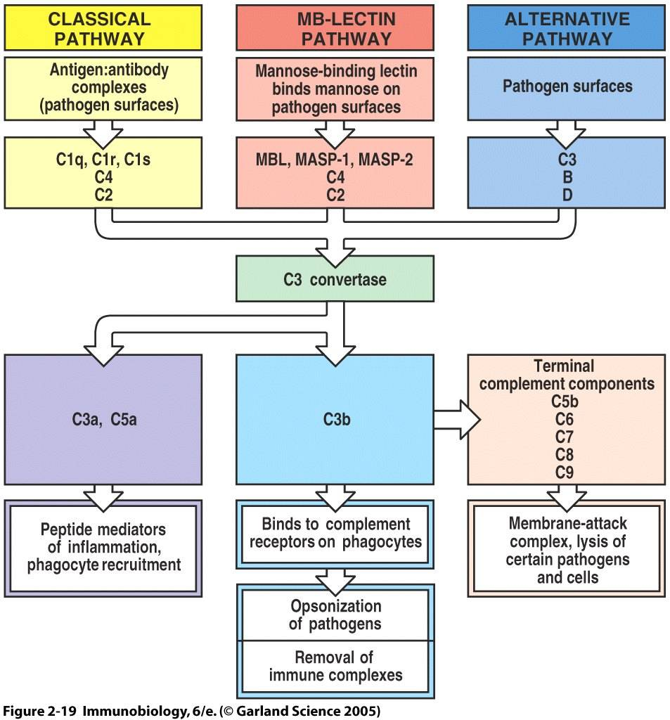
Complement
Notes:
Complement is an acute phase protein that are synthesised by the liver and circulate in an inactive form.
Complement proteins are cleaved by convertases into two components e.g. C3 becomes C3a and C3b. Those ending with a are involved with inflammation and chemotaxis. C3b opsonises pathogens. The membrane attack complex inserts itself into pathogen membranes and causes lysis.
All pathways converge to active C3 convertase.
The classical pathway is initiated by antigen-antibody complexes (IgM/IgG) which bind complement and activate the cascade.
The alternative pathway is activated when C3b (which is free and abundant in plasma) binds pathogens surfaces directly e.g. in G-ve bacteria. C3 has the ability to auto hydrolyse into C3a and C3b where C3b then goes on to activate the cascade.
Mannose binding lectin (MBL) pathway; MBL binds mannose on pathogens’ surface. Mannose is not present on human cells. This activates MASP proteins (serine proteases) and cleave C2 and C4.

Slide 53
HLA Associations
HLA Type | Associations
HLA-A3 | Haemochromatosis
HLA-B51 | Behcet's disease
HLA-B27 | Ankylosing spondylitis Reiter's syndrome Acute anterior uveitis
HLA-DQ2/DQ8 | Coeliac disease
HLA-DR2 | Narcolepsy Goodpasture's
HLA-DR3 | Dermatitis herpetiformis Sjogren's syndrome Primary biliary cirrhosis
HLA-DR4 | Type 1 diabetes mellitus Rheumatoid arthritis
Notes:
Sometimes exams like to be mean and ask about HLA associates.
If in double B27 is always a good guess.
HLA-A, B, and C correspond to MHC-1 class molecules. HLA-DR, DQ, DP, and DM correspond to MHC-II

Slide 54
Cells and their markers
Type of cell | Cell surface markers
Haematopoietic stem cells | CD34
Helper T cell | CD4, TCR, CD3, CD28
Cytotoxic T cell | CD8, TCR, CD3, CD28
Regulatory T cell | CD4, CD25, TCR, CD3, CD28
B cell | CD19, CD20, CD40, MHC II, B7
Macrophage | CD14, CD40, MHC II, B7
Natural killer cell | CD16, CD56
Notes:
CD1 MHC molecule that presents lipid molecules
CD2 Found on thymocytes, T cells, and some natural killer cells that acts as a ligand for CD58 and CD59 and is involved in signal transduction and cell adhesion
CD3 The signalling component of the T cell receptor (TCR) complex
CD4 Found on helper T cells. Co-receptor for MHC class II Used by HIV to enter T cells.
CD5 Found in the majority of mantle cell lymphomas
CD8 Found on cytotoxic T cells. Co-receptor for MHC class I Found on a subset of myeloid dendritic cells
CD14 Cell surface marker for macrophages
CD15 Expressed on Reed-Sternberg cells (along with CD30)
CD16 Bind to the Fc portion of IgG antibodies
CD21 Receptor for Epstein-Barr virus
CD28 Interacts with B7 on antigen presenting cell as co-stimulation signal
CD45 Protein tyrosine phosphatase present on all leucocytes. CD45RA is marker of naïve cells, CD45RO is the marker for memory cells.
CD56 Unique marker for natural killer cells
CD95 Acts as the FAS receptor, involved in apoptosis

Slide 55
SBAs
The following are a series of SBAs for you to try. The answers to each question with explanations are written in the presenter notes. Good luck!

Slide 56
SBAs
The immune system is made up of both innate and adaptive aspects and involves a variety of cells. Which is the most abundant white blood cell in humans?
Basophils
CRP
Neutrophils
Mast Cells
Lymphocytes
Notes:
ANSWERS BELOW HERE
C) Neutrophils are the most abundant WBC. CRP is an acute phase protein that indicates general inflammation. Basophils are circulating cells that release histamine. Mast cells are tissues cells that release histamine. Lymphocytes are cells of the adaptive response.

Slide 57
SBAs
A mother brings her 3-year-old child to the GP saying he has a fever and is generally unwell. The GP suspects the they have a viral infections such as respiratory syncytial virus. What cell would you expect to be raised in this patient?
Mast Cell
Microglia
Neutrophils
Macrophages
Lymphocytes
Notes:
ANSWERS BELOW HERE
e) Lymphocytes are raised during viral infection and generally any sort of intracellular infection. All the other cells are innate cells that generally deal with extracellular threats such as bacteria.

Slide 58
SBAs
A 34-year-old male comes into the GP complaining of haemoptysis. He notes that he wakes up at night due to waking up in a pool of sweat and mentions he recently returned from a holiday in Pakistan. The GP suspects tuberculosis. Which of the following cytokines is primarily responsible for activating macrophages?
IL-2
IL-4
TNFα
IL-1β
IFN-γ
Notes:
ANSWERS BELOW HERE
E. INF gamma is the main activator of macrophages. IL-2 is secreted by macrophages. IL-4 is involved in B-cell differentiation. IL-1β is a pyrogen

Slide 59
SBAs
A 5-year-old girl is brought to the GP after repeated episodes of allergic rhinitis and eczema. Which cytokine is involved in atopy and, amongst other things, causes class switching of immunoglobulins to IgE?
IL-4
IL-17
IL-5
IL-1β
IFN-γ
Notes:
ANSWERS BELOW HERE
IL-4 is the key cytokine for allergic inflammation and has multiple roles in allergy and asthma including; IgE class switching, Th2 polerisation, Increases VCAM-1 expression, promotes eosinophils to enter tissues, and mucous secretions.

Slide 60
SBAs
A 35-year-old woman presents to her GP complaining of unintentional weight loss, palpitations, and oligomenorrhoea. She is subsequently diagnosed with Graves disease by a specialist. Given their involvement in autoimmunity, where does T cell maturation occur?
Spleen
Bone Marrow
Bursa of Fabricius
Thymus
Liver
Notes:
ANSWERS BELOW HERE
D) The thymus is the site of T cell maturation. The spleen is a secondary organ providing a stage for antigen to interact with lymphocytes, and T and B cell interactions. The bone marrow is where all immune cells derive and the site of B cell maturation. The bursa of Fabricius is the site of b cell immunity in birds and where they get their namesake. The liver produces acute phase proteins in an immune response.

Slide 61
SBAs
It’s your first day on placement and you take a history from an elderly gentleman who is currently running a high-grade fever. You later find out he is currently suffering from a Pseudomonas aeruginosa infection. Which pattern recognition receptor is most likely to detect this infection?
TLR2
TLR6
TLR4
NOD-2
RIG1
Notes:
ANSWERS BELOW HERE
C) TLR4 detects LPS on Gram negative bacteria, of which pseudomonas aeruginosa is one. TLR2 detects lipoteichoic acid on Gram positive bacteria . TLR 6 dimerises with TLR2 and detects the same things. NOD-2 is an intracellular cytosolic PRR which detects muramyl dipeptide from G-ve and G+ve bacteria. RIG-1 is an cytosolic PRR that detects viral dsRNA and activates the inflammasome.

Slide 62
SBAs
It’s your second day on placement and you take a history from an elderly gentleman who is currently running a high-grade fever. You later find out he is currently suffering from a Streptococcus pneumoniae infection. Which pattern recognition receptor is most likely to detect this infection?
TLR2
TLR6
TLR4
NOD-2
RIG1
Notes:
ANSWERS BELOW HERE
C) TLR2 detects lipoteichoic acid on the surface of gram positive bacteria.

Slide 63
SBAs
An intravenous drug presents to A&E complaining of fever, a hot painful red lump, and general malaise. The F1 who clerked them suspects an MRSA infection. Which white blood cell is most likely to be raised in this patient?
Neutrophil
Mast Cell
Basophil
Lymphocyte
Dendritic cell
Notes:
ANSWERS BELOW HERE
a) Neutrophils are normally raised in bacterial infection, especially pyogenic infections.

Slide 64
SBAs
An infant presents to hospital with a fever, shortness of breath and a cough producing yellow sputum. She has had many previous admissions due to similar infections and has been diagnosed with a deficiency in mannose binding lectin (MBL). Which substance is failing to trigger a complement cascade reaction in this patient?
IgE
IgM
C3 Convertase
Pathogen surface carbohydrates.
Membrane attack complex
Notes:
ANSWERS BELOW HERE
d) Mannose is a carbohydrate found on bacterial cell walls but not human cells. The lectin pathway of the complement system is triggered when MBL binds to mannose on bacteria. a and b are incorrect as antibodies activate the classical complement pathway. C3 convertase and the membrane attack complex are downstream components of the complement system and therefore do not trigger the cascade.

Slide 65
SBAs
A 13-year-old boy has been brought to the GP by his dad after having a sore throat and a cough for the last week. After an examination, the GP concludes that he likely has a viral infection that will resolve without other treatment. Which immune cells are responsible for directly combating this type of infection through apoptosis?
Basophils
Plasma Cells
T helper cells Neutrophils
Cytotoxic T-cells
CD8 T Cells
Notes:
ANSWERS BELOW HERE
e) CD8 T cells are responsible for inducing apoptosis in virally infected cells. Cytotoxic T cells are responsible for inducing apoptosis. T helper cells produce cytokines for promoting the immune response. Basophils are a sign of chronic inflammation and produce histamine. Neutrophils (macrophages) kill extracellular microbes through phagocytosis and not apoptosis. T helper cells release cytokines to alter the immune response.

Slide 66
SBAs
A 10-year-old boy presents with an itchy rash on his elbows. The rash is red and there are excoriation marks. He has a past history of hay fever and has generally dry skin. The GP diagnoses him with eczema and he is prescribed hydrocortisone. Which antibody is responsible for mediating type 1 hypersensitivity?
IgG
IgA
IgM
IgE
IgD
Notes:
ANSWERS BELOW HERE
d) IgE is the antibody responsible for type I hypersensitivity.

Slide 67
SBAs
An office worker has recently taken time off due to contracting the flu. A few weeks later other members of their office start showing flu symptoms. The worker asked his GP if he is at risk of contracting the flu again. Which antibody is responsible for secondary responses to a previous infection?
IgG
IgA
IgM
IgE
IgD
Notes:
ANSWERS BELOW HERE
d) IgG is the antibody of secondary responses and has a higher affinity for antigen than other antibodies.

Slide 68
SBAs
A mother is concerned about infection of her newborn child. She asks her GP about best to protect their child from infections. Which is the most abundant antibody in colostrum?
IgG
IgA
IgM
IgE
IgD
Notes:
ANSWERS BELOW HERE
b) IgA is the most abundant and coats mucosal surfaces.

Slide 69
SBAs
A mother is concerned about infection of her newborn child. She asks her GP about best to protect their child from infections. Which is the most abundant antibody in colostrum?
IgG
IgA
IgM
IgE
IgD
Notes:
ANSWERS BELOW HERE
b) IgA is the most abundant and coats mucosal surfaces.

Slide 70
SBAs
A 38-year-old male attends the human immunodeficiency virus (HIV) clinic for routine blood tests for monitoring of his condition. The number of which of the following cells is used to measure the progression of disease in HIV positive patients?
Neutrophils
B Cells
NK cells
CD4 T cells
CD8 T cells
Notes:
ANSWERS BELOW HERE
d) CD4+ T cells are the specific cell tropism for HIV are is correlated to disease progression. HIV uses CD4 to enter CD4+ cells. Other immunological changes are seen but are not correlated clinically with progression. The following immunological changes are seen in progressive HIV:
Reduction in CD4 count
Increase B2-macroglobulin
Decreased IL-2 production
Polyclonal B-cell activation
Decrease NK cell function
Reduced delayed hypersensitivity responses

Slide 71
SBAs
A 34-year-old man is referred to the gastroenterologist due to persistent epigastric pain and nausea. He returned travelling from south-east Asia ten weeks ago. Blood tests reveal iron deficiency anaemia, and faecal microscopy reveals the presence of hookworm eggs. Which immune cell is responsible for the defense against helminths (parasitic worms)?
Basophils
Eosinophils
Neutrophils
Macrophages
Dendritic Cells
Notes:
ANSWERS BELOW HERE
b) Eosinophils are the innate response to helminth infection. Basophils could be thought of as circulating mast cells that secrete histamine. Neutrophils are the principle cell in acute inflammation and are particularly good at combating pyogenic (pus forming) bacteria. Macrophages serve a similar role to neutrophils but also antigen present and are present in chronic inflammation. Dendritic cells are antigen presenting cells that serve as a joining of the adaptive and innate immunity.

Slide 72
SBAs
A 14-year-old boy complains of a 3-day history of fatigue, aches and pains, and fever. Upon examination his temperature is 38ºC and his tonsils are inflamed. He is suspected to have a bacterial infection which will be fought by his adaptive immune system. Which of the following cell-surface proteins are found on cytotoxic T-cells?
CD4
CRP
MHC I
CD 8
MHC II
Notes:
ANSWERS BELOW HERE
d) CD8 is the identifying surface marker for cytotoxic T cells. CD4 is the marker for T helper cells. CRP is an acute phase protein raised during infection and inflammatory responses. MHC I and MHC I are antigen presenting molecules.

Slide 73
SBAs
A 65-year-old man is admitted to hospital following a fall. He subsequently developed a bacterial hospital-acquired pneumonia. Given the most likely causative microorganism, which molecule is responsible for presenting its antigenic material to immune cells?
CD4
MHC III
MHC I
TCR
MHC II
Notes:
ANSWERS BELOW HERE
e) Hospital-acquired pneumonia is most commonly caused by bacteria. MHC-II is responsible for presenting exogenous antigen to other immune cells. CD4 is the marker/co-receptor for T-helper cells. MHC-III is a region of genes on the short arm of chromosome 6 that contains proteins for signalling molecules such as TNFs, and heat shock proteins. MHC-I is responsible for presenting endogenous proteins. TCR is the T cell receptor that binds antigen in the context of MHC.

Slide 74
SBAs
A father brings their 6-year-old boy to the GP complaining of an incredibly lengthy chest infection and recurrent gastritis. He is referred to an immunologist. His bloods extremely low levels of IgA and IgG. He is diagnosed with common variable immunodeficiency (CVID). Which adaptive cell type is essential in aiding class switching of B cells?
Natural Killer T cells.
Th17 cells
Th2 cells
Th1 cells
Dendritic Cells
Notes:
ANSWERS BELOW HERE
d) Th2 cells are the T helper cell involved in humoral (antibody) immunity. Natural Killer T cells are an Interesting cell that expresses TCRs and surface receptors for NK cells so has characteristics of both innate and adaptive cells. Th17 cells are important in mucosal immunity and in the balance between regulation and inflammation. Th1 cells are involved in helping the innate immune system and cell-mediated immunity. (Follicular) Dendritic cells are involved in the generation of humoral immunity but are generally considered innate cells.

Slide 75
SBAs
A 24-year-old lady collapses after being stung by a wasp. You run to her aid and find marked facial oedema and a loud wheeze. You suspect anaphylaxis. Which type of immunoglobulin (Ig) is associated with this kind of reaction?
IgG
IgA
IgM
IgE
IgD
Notes:
ANSWERS BELOW HERE
d) IgE is the principle antibody involved in type 1 hypersensitivity. IgA is the secretory mucosal antibody. IgM is the less specific antibody that forms a pentamer. IgE is involved in atopy and allergy. IgD no one cares about xoxo.

