Slide 1
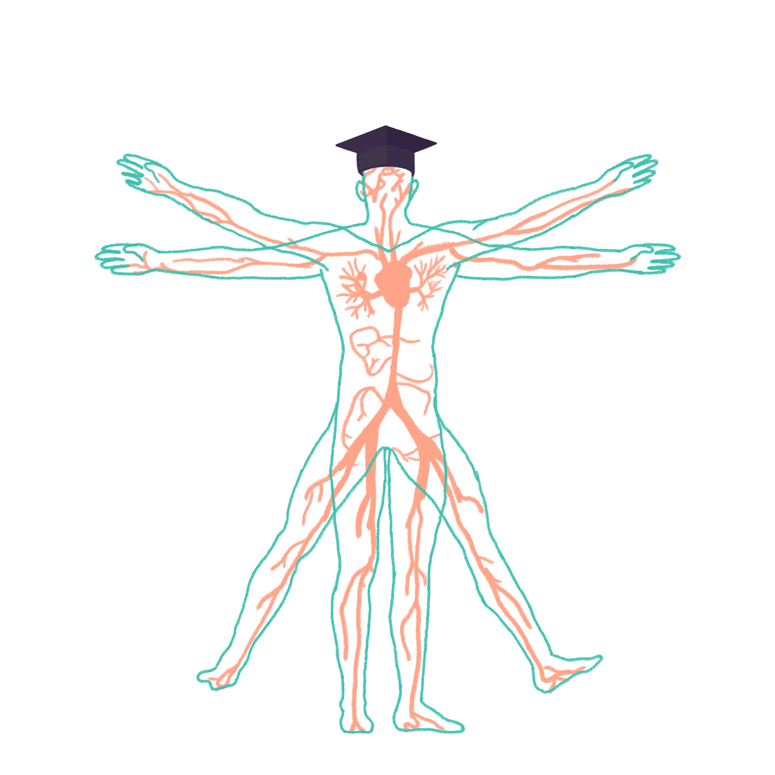
2022/2023

Slide 2
LIVER & FRIENDS
Phase 2a Revision Session
Thursday 9th February
Hamzah Ahmed & Haaris Ahmed
The Peer Teaching Society is not liable for false or misleading information…

Slide 3
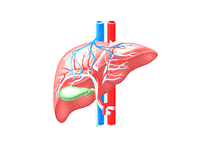
Liver Failure
What you need to know:
Function of the liver and what happens when it goes wrong?
Acute and chronic presentation of liver failure
Causes of liver failure
Investigations
Management
Complications

Slide 4
Functions of the liver
Function | What happens when it goes wrong
Oestrogen Regulation | Gynaecomastia in men Spider Naevi Palmar Erythema
Detoxification | Hepatic encephalopathy
Metabolises carbohydrates | Hypoglycaemia
Albumin Production | Oedema Leukonychia Ascites
Clotting factor production | Easy bleeding and bruising
Bilirubin Regulation | Pruritus Jaundice with stool and urine changes
Immunity - Kupffer cells | Spontaneous bacterial infections can occur

Slide 5
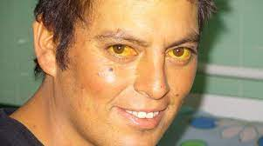
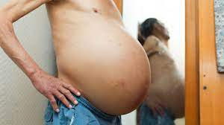
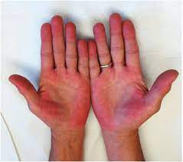
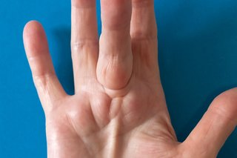
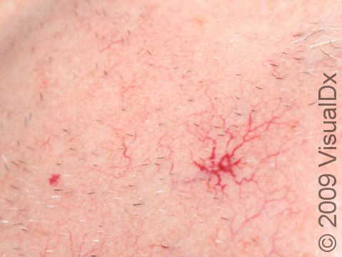
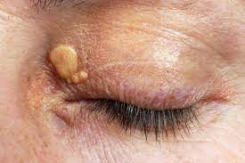
Acute vs Chronic Presentation
ACUTE
Jaundice
Nausea
Anorexia
Malaise
Rare
Confusion
Pain
Bleeding
Hypoglycaemia
CHRONIC
Ascites
Oedema
Malaise
Dupuytren's Contracture
Anorexia
Pruritus
Clubbing
Xanthelasma
Palmar Erythema
Spider naevi
Hepatomegaly
Bleeding
Haematemesis
Easy bruising

Slide 6
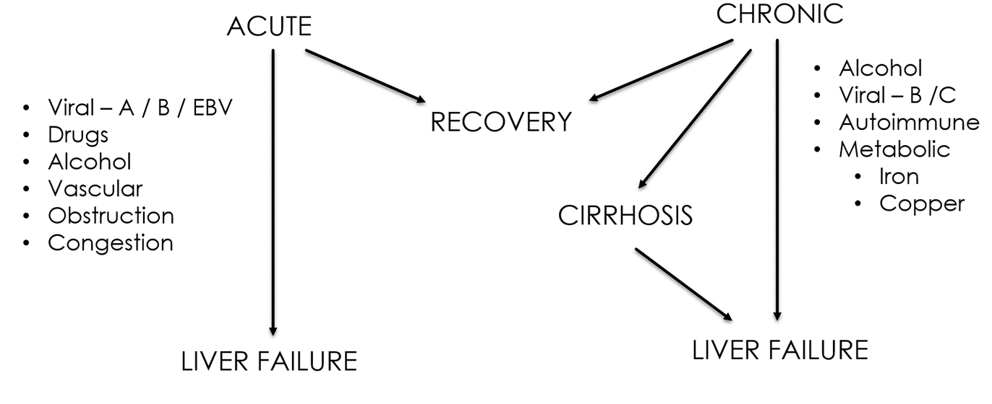
Liver Failure Causes
Acute
Chronic
(PBC/PSC)

Slide 7
Progression of chronic liver failure
Chronic Liver condition
Liver Damage
Liver symptoms
Liver cirrhosis if prolonged
Liver failure + higher risk of hepatocellular carcinoma

Slide 8
Liver failure
Definition - liver loses its ability to repair and regenerate leading to decompensation
Compensated — when the liver can still function effectively and there are no, or few, noticeable clinical symptoms
Jaundice
Abnormal Bleeding
Ascites
Hepatic encephalopathy

Slide 9
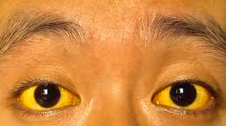
Liver failure presentation
Symptoms same as acute presentation of liver failure
Signs
Jaundice
Coagulopathy
Fetor hepaticus
Sweet and musty breath / urine
Hepatic encephalopathy
Altered mood/dyspraxia
Liver flap/Asterixis

Slide 10
Liver Failure
Investigations
Clinical Examination
Imaging - Ultrasound
Blood tests
Raised AST/ALT
Raised PT
FBC and U&E
If ascites present - peritoneal tap with microscopy and culture
Management
Conservative
analgesia
fluids
Medical - Need to treat the complications!
Encephalopathy - Lactulose
Ascites - Diuretics
Cerebral oedema - Mannitol
Bleeding- Vitamin K
Sepsis - antibiotics
Hypoglycemia - dextrose
Transplant

Slide 11
Question
Which of the following is not found in an acute presentation of liver failure?
Jaundice
Nausea
Hepatomegaly
Anorexia

Slide 12
Question
Which of the following is not found in an acute presentation of liver failure?
Jaundice
Nausea
Hepatomegaly
Anorexia

Slide 13
Question
Which of the following is given to treat cerebral oedema?
Mannitol
Dextrose
Vitamin K
Lactulose

Slide 14
Question
Which of the following is given to treat cerebral oedema?
Mannitol
Dextrose
Vitamin K
Lactulose

Slide 15
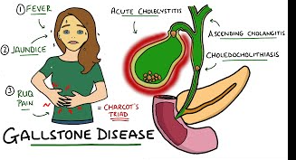
Biliary tract diseases
Biliary colic - Gallstones
Cholecystitis
Cholangitis
Learn these three conditions together. They often follow on from each other as gallstones get worse, easier to understand this way!
Use Charcot’s triad to distinguish between biliary tract diseases

Slide 16
Biliary Colic - Gallstones
Pathophysiology: No Inflammatory response!
Gallstones are small stones that form within the gallbladder. The stones form from concentrated bile in the common bile duct/cystic duct.
Most stones are made of cholesterol (excess production: obesity and fatty diets), but can also be made out of pigment (seen in haemolytic anaemia) and can be a mixture of both
These may be completely asymptomatic. They can also cause pain and lead to complications, such as acute cholecystitis, acute cholangitis and pancreatitis. → Gallstones blocking the drainage of the pancreas (i.e. the pancreatic duct) result in pancreatitis.

Slide 17
Biliary Colic - Gallstones
PRESENTATION (Sx) | Classic colicky RUQ pain, that's worse after eating large fatty meals as gallbladder contracts against blockage, can radiate to epigastrium/back. Nausea and vomiting
DIAGNOSIS & INVESTIGATIONS (Ix) | important to rule out the cholecystitis and cholangitis FBC and CRP → look for inflammatory response suggesting cholecystitis LFTs: Raised ALP → ALP is associated with biliary pathology. Bilirubin and ALT usually normal. Amylase → Check for pancreatitis as it can also give RUQ. Diagnostic test → ultrasound - duct dilation, stones, gallbladder wall thickness
TREATMENT (Tx) | NSAIDS/Analgesia Optional cholecystectomy as gallstones often recur
RISK FACTORS | 5 F’s Fat, female, forty, fair, fertile
DIFFERENTIALS (DDx) | Other causes of RUQ pain Cholecystitis and cholangitis IBD, Pancreatitis, GORD, Peptic Ulcers

Slide 18
Acute Cholecystitis
DEFINITION | Acute inflammation of the gallbladder - 95% of cases involve a gallstone
PATHOPHYSIOLOGY (IF APPLICABLE) | Stone is blocking the ducts. Bile builds up, distending the gallbladder. Vascular supply may be reduced from this distension. Transmural Inflammation follows these events secondary to the retained bile
PRESENTATION (Sx) | Symptoms: RUQ pain which may radiate to right shoulder Fatigue - inflammation Signs: Fever - inflammation Positive Murphy’s Sign → Severe pain on deep inhalation with examiners hand pressed into the RUQ Tenderness and guarding
DIAGNOSIS & INVESTIGATIONS (Ix) | Abdominal ultrasound scan → Stones, thick gallbladder walls, fluid around the gallbladder
TREATMENT (Tx) | Conservative management before surgery → Antibiotics IV, heavy analgesia, IV fluids Cholecystectomy

Slide 19
Acute Cholangitis
DEFINITION | Acute inflammation and infection of bile duct due to common bile duct obstruction. 85% due to gallstones and 15% other causes → Tumours and surgery. 10-30% mortality rate
PATHOPHYSIOLOGY | Prolonged Bile duct blockage → bile stasis → bacteria climbs up from the duodenum → biliary tree infection and consolidation Surgical emergency → high mortality due to sepsis and septicaemia infection can affect the pancreas too since it shares ducts with the gallbladder
PRESENTATION (Sx) | Charcot's Triad: RUQ pain Jaundice - common bile duct blocked, bilirubin builds up Fever + rigors Septic presentation - Hypotension/altered mental state Reynolds pentad → Charcot’s triad +confusion + septic shock
DIAGNOSIS & INVESTIGATIONS (Ix) | FBCs, LFTs, CRP - Leukocytosis, Raised ALP and Bilirubin, raised CRP Blood cultures/MC&S: work out what the pathogen is so you can use the trust’s advised ABs Ultrasound +/- ERCP (Endoscopic Retrograde Cholangiopancreatography) (basically a biliary tree contrast x-ray)
TREATMENT (Tx) | Treat Sepsis - IV antibiotics, aggressive fluid resuscitation ERCp and stenting to mechanically clear the blockage Cholecystectomy when better

Slide 20
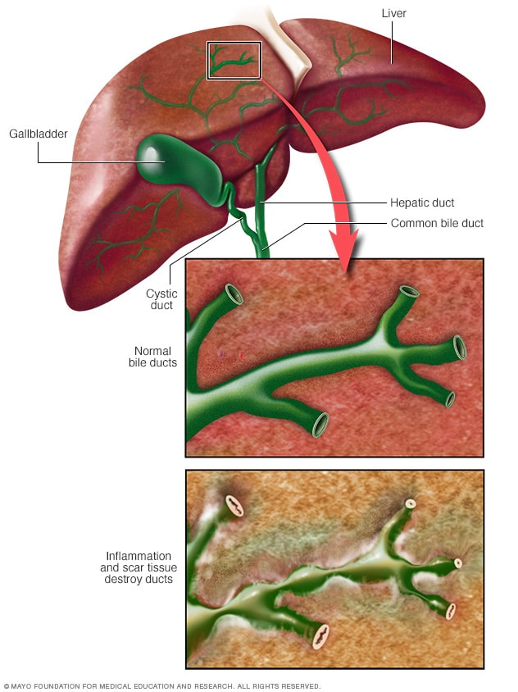
Primary biliary Cholangitis
Definition:PBS is where the immune system attacks the small bile ducts within the liver. This causes obstruction of the outflow of bile, which is called cholestasis. The back-pressure of the bile obstruction and the overall disease process ultimately leads to fibrosis, cirrhosis and liver failure.
Associated with autoimmune disease and rheumatoid conditions e.g rheumatoid arthritis
Female to male ratio 9:1
Presentation : Fatigue, Pruritus, GI disturbance and abdominal pain, Jaundice, Pale stools, Xanthoma and xanthelasma, Signs of cirrhosis and failure (e.g. ascites, splenomegaly, spider naevi)
Investigations: LFTs → ALP, GGT and bilirubin raised, AMA (anti-mitochondrial antibodies) - most specific to PBC, ANA (antinuclear antibodies) - present in 35% of patients, Liver biopsy for staging and diagnosing
Management: Ursodeoxycholic acid to reduce cholestasis, Cholestyramine - bile acid sequestrate that binds to bile acid to prevent absorption in gut and reduce pruritus, immunosuppressants e.g steroids in some patients.

Slide 21
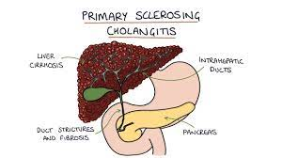
Primary Sclerosing Cholangitis
Where the biliary tree becomes strictured and fibrotic. Obstruction to the flow of bile out of the liver. Sclerosis= stiffening and hardening of the bile ducts, and cholangitis = inflammation of the bile ducts. Chronic bile obstruction eventually leads to liver inflammation (hepatitis), fibrosis and cirrhosis
Risk Factors: Male, FHx, aged 30-40, Ulcerative Colitis - 70%
Presentation: Jaundice, Chronic RUQ pain, Pruritus, Fatigue, Hepatomegaly
Investigations: LFT, pANCA (94%), ANA (77%), aCL (63%), U&E, FBC, Gold standard - MRCP - may show bile duct lesions or strictures
Management: Liver transplantation, ERCP can be used to dilate and stent any strictures, monitoring for complications, Cholestyramine
Complications: Acute bacterial cholangitis, Cholangiocarcinoma develops in 10-20% of cases, Colorectal cancer, Cirrhosis and liver failure, Biliary strictures, Fat soluble vitamin deficiencies

Slide 22
Question
Which of these is not a risk factor for Gallstones?
Fat
Forty
Forty
Fertile
FHx
Fair

Slide 23
Question
Which of these is not a risk factor for Gallstones?
Fat
Forty
Forty
Fertile
FHx
Fair

Slide 24
Acute pancreatitis
Pathophysiology:
Main two causes are gallstones and alcohol:
Gallstones: Get trapped at the end of the biliary system (ampulla of Vater), blocking the flow of bile and pancreatic juice into the duodenum. The reflux of bile into the pancreatic duct, and the prevention of pancreatic juice containing enzymes from being secreted, results in inflammation in the pancreas
Alcohol: directly toxic to pancreatic cells, resulting in inflammation.
Sudden onset of pancreatic inflammation → autodigestion of gland (reversible) and nearby structures → haemorrhage + Turner's sign (abdominal skin discoloration due to retroperitoneal bleeding)
Deranges normal pancreatic function e.g reduced insulin production → hyperglycaemia

Slide 25
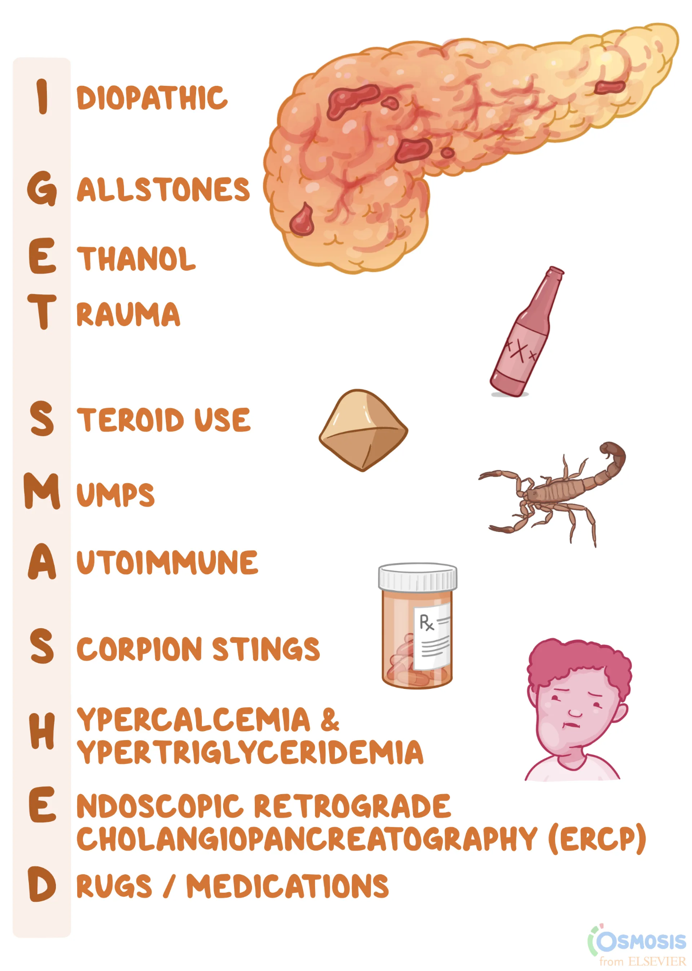
Acute pancreatitis
Causes:

Slide 26
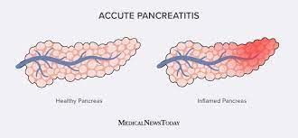
Acute pancreatitis
Presentation:
Severe epigastric pain radiating to back
Nausea and vomiting
Fever and chills
Tachycardia
Anorexia
Haemodynamic instability
Retroperitoneal haemorrhage → Cullen’s and Grey turner's sign
Investigations:
Serum amylase: Raised Amylase
Urinalysis: Raised Urinary Amylase
Serum Lipase: Raised and more specific than amylase
CRP and routine bloods: Raised CRP
Abdo Ultrasounds, CT, MRI

Slide 27
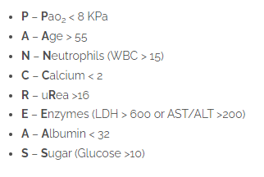
Acute pancreatitis
Scoring:
Need to be aware of APACHE 2 and Glasgow scoring system

Slide 28
Acute pancreatitis
Treatment:
Nil by mouth - to decrease pancreatic stimulation
Analgesics
Prophylactic antibiotics
Treat gallstones if present (ERCP / cholecystectomy)
Careful monitoring
Treatment of complications (e.g., endoscopic or percutaneous drainage of large collections)

Slide 29
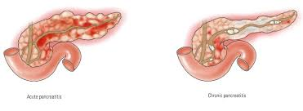
Chronic pancreatitis
Pathophysiology/Causes:
Persistent inflammation of the pancreas which occurs due to changes to pancreatic structure - Obstruction of bicarbonate secretion in the pancreatic lumen causes autodigestion which leads to fibrosis
Chronic Alcohol abuse is the most common cause. Can also be hereditary, autoimmune, CKD, CF and idiopathic
Presentation:
Presents with similar symptoms to acute pancreatitis, but generally less intense and longer-lasting
Epigastric pain boring through the back, Worse after alcohol and better on leaning forward
Nausea and vomiting
Steatorrhea
weight loss due to malabsorption
Insulin dependant DM

Slide 30
Chronic pancreatitis
Investigations:
Serum Amylase and lipase - may still be raised if enough cells remain to make them
Abdo Ultrasound, MRI, CT,
Management :
Alcohol cessation
pancreatic enzyme supplements with PPI to help with digestion
Insulin
ERCP or Surgery as required

Slide 31
Non-alcoholic fatty liver disease
NAFLD is characterised by fat deposited in liver cells
These fat deposits can interfered with the functioning of the liver cells. NAFLD does not cause problems initially, however it can progress to hepatitis and cirrhosis.
NAFLD is a spectrum of liver diseases with various stages.

Slide 32
Non-alcoholic fatty liver disease
Risk Factors:
NAFLD shares the same risk factors as for cardiovascular disease and diabetes.
Obesity
Poor diet and low activity levels
Type 2 diabetes
High cholesterol
Middle age onwards
Smoking
High blood pressure
Presentation:
Asymptomatic
N+V, diarrhoea, hepatomegaly
Investigations:
Liver Ultrasound
Biopsy (Diagnostic)
Treatment:
Weight loss
Exercise
Stop smoking
Control of diabetes, blood pressure and cholesterol
Avoid alcohol

Slide 33
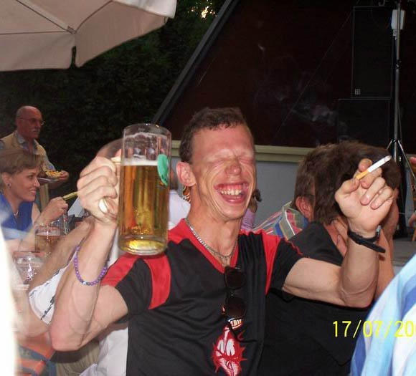
Alcoholic liver disease
Progression of ALD:
Investigations:
FBC - Macrocytic Anaemia
LFTs - elevated AST and ALT, GGT particularly raised
clotting profile - elevated prothrombin time due to reduced synthetic function of the liver
Presentation of chronic liver disease on previous slide
Complications:
Wernicke-Korsakoff encephalopathy
Ataxia, confusion, nystagmus, memory impairment, behavioural changes
treatment involving IV thiamine (Vitamin B1)
Alcohol withdrawal - delirium tremens
Cirrhosis complications - hepatocellular carcinoma
pancreatitis
mallory weiss tear
Management:
alcohol cessation
detoxification regime
treat complications of cirrhosis e.g ascites
referral for liver transplant
Nutritional support with vitamins (particularly thiamine)
Alcohol related fatty liver
Alcoholic hepatitis
Cirrhosis
Irreversible
Unit calculation:
Strength (ABV) x volume (ml) ÷ 1,000 = units

Slide 34
Question
Which of these is the diagnostic investigation for NAFLD?
LFT’s
Liver ultrasound
Liver CT/MRI
Liver Biopsy
Urinalysis

Slide 35
Question
Which of these is the diagnostic investigation for NAFLD?
LFT’s
Liver ultrasound
Liver CT/MRI
Liver Biopsy
Urinalysis

Slide 36
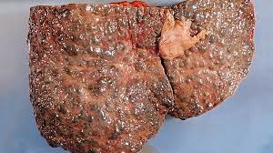
Liver Cirrhosis
Liver cirrhosis is the result of chronic inflammation and damage to liver cells. When the liver cells are damaged they are replaced with scar tissue (fibrosis) and nodules of scar tissue form within the liver. Thought to be irreversible
Causes:
Alcoholic liver disease - common in developed countries
Non Alcoholic Fatty Liver Disease
Hepatitis B - common in developing countries
Hepatitis C - common in developing countries
Other causes:
Haemochromatosis
Wilson's disease
Alpha- antitrypsin deficiency

Slide 37
Liver Cirrhosis
Clinical presentation:
Ascites, jaundice, hepatomegaly, splenomegaly, Spider Naevi, Palmar erythema, bruising, asterixis, caput medusae
Investigations :
Low platelets, high INR, low albumin
US and CT - hepatomegaly
FBC - thrombocytopenia
liver biopsy - diagnostic
Treatment:
Liver transplantation
Alcohol abstinence and good nutrition
Treat the complications of liver failure
screen for hepatocellular carcinoma every 6 months - Marker for HCC is AFP
Complications:
Ascites
Portal Hypertension
Varices/bleeding varices
hepatic encephalopathy
hepatocellular carcinoma
malnutrition
Jaundice
Coagulopathy
oedema - hypoalbuminemia

Slide 38
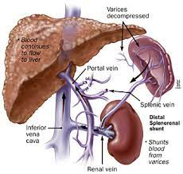
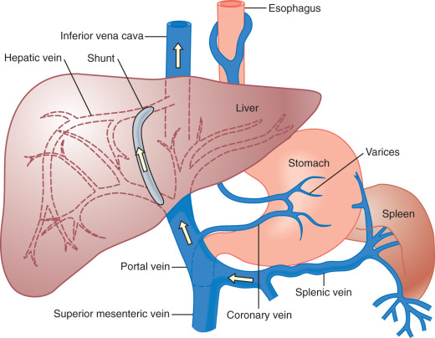
Portal hypertension
Portal hypertension is elevated pressure in your portal venous system
Causes:
Prehepatic
portal vein thrombosis
Intrahepatic
Schistosomiasis
Cirrhosis
Budd Chiari syndrome
Post hepatic
RH failure
IVC obstruction
Presentation:
Usually asymptomatic

Slide 39
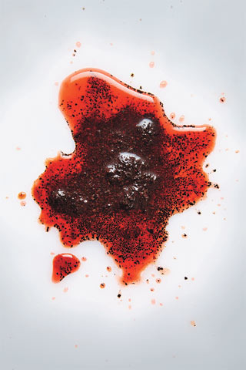
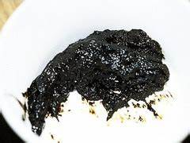
Oesophageal varices
Oesophageal varices are dilated collateral blood vessels that develop as a complication of portal hypertension, usually in the setting of cirrhosis
The veins are thin and are not meant to transport high pressure blood so they can easily rupture
Rupture can cause haematemesis (coffee ground vomit), blood is ingested and causes melaena

Slide 40
Oesophageal varices
Investigation:
Upper GI endoscopy - gold standard
Treatment:
Urgent gastroscopy/endoscopy
Fluid resuscitation as bleeding can be massive
Beta blocker to reduce cardiac output and reduce portal pressure
Nitrate to reduce portal pressure
Terlipressin (ADH analogue)/Octreotide
Balloon tamponade
Gold standard - endoscopic therapy: band ligation or sclerotherapy
Prophylaxis → propranolol and TIPSS

Slide 41
Question
What is the gold standard investigation for oesophageal varices?
Upper GI ultrasound
MRCP
Upper GI CT/MRI
Stool MC&S
Upper GI endoscopy

Slide 42
Question
What is the gold standard investigation for oesophageal varices?
Upper GI ultrasound
MRCP
Upper GI CT/MRI
Stool MC&S
Upper GI endoscopy

Slide 43
Question
Primary sclerosing cholangitis (PSC) is a chronic liver disease characterised by a progressive fibrosis of the hepatic ducts. Which of the following conditions is most commonly linked to PSC?
a. Coeliac disease
b. Irritable Bowel Syndrome
c. Pancreatic cancer
d. Ulcerative colitis
e. Endometriosis

Slide 44
Question
Primary sclerosing cholangitis (PSC) is a chronic liver disease characterised by a progressive fibrosis of the hepatic ducts. Which of the following conditions is most commonly linked to PSC?
a. Coeliac disease
b. Irritable Bowel Syndrome
c. Pancreatic cancer
d. Ulcerative colitis
e. Endometriosis

Slide 45
Question
Bart is a 74 year old gentleman presenting to the emergency department with jerky hands, widespread bruising and jaundice. When questioned he reveals he is an ex IVDU and drinks at least 80 units a week for the last 25 years. On examination you note palmar erythema and spider angioma. Based on the most likely underlying condition, which of the following is the gold standard diagnostic investigation?
a. Full blood count
b. Liver ultrasound
c. Ascitic tap
d. MRI abdomen
e. Liver biopsy

Slide 46
Question
Bart is a 74 year old gentleman presenting to the emergency department with jerky hands, widespread bruising and jaundice. When questioned he reveals he is an ex IVDU and drinks at least 80 units a week for the last 25 years. On examination you note palmar erythema and spider angioma. Based on the most likely underlying condition, which of the following is the gold standard diagnostic investigation?
a. Full blood count
b. Liver ultrasound
c. Ascitic tap
d. MRI abdomen
e. Liver biopsy → liver Cirrhosis

Slide 47
Hepatitis A
VIRUS TYPE | Single-stranded RNA | Acute
ROUTE OF TRANSMISSION | fAEco-oral: contaminated water and food (shellfish)
RISK FACTORS | Travel, Eating Shellfish, Living w/ other that have Hep A, Homelessness
PRESENTATION (Sx) | Prodromal Phase (1-2 weeks) | Icteric Phase (usually 3 months)
 | N+V, Fever, Malaise, RUQ pain | Jaundice, Dark urine, Pale stools, Pruritus
DIAGNOSIS & INVESTIGATIONS (Ix) | LFTs - ↑ ALT ↑ Total Bilirubin Serology – ↑ HAV IgM Ab (active infection), ↑ Anti-HAV IgG Ab (persist after infection/vaccination)
TREATMENT (Tx) | Self Limting Supportive care – anti-emetics, rest
COMPLICATIONS (IF APPLICABLE)
ALL TYPES OF VIRAL HEPATITIS MUST BE NOTIFIED TO PUBLIC HEALTH
Notes:
Incubation phase usually lasts 1-6 months
Contaminated food – raw shellfish concentrate the virus from sea water that is contaminated from human sewage

Slide 48
Hepatitis B
VIRUS TYPE | DNA Virus | Acute + Chronic
ROUTE OF TRANSMISSION | Blood, Bodily Fluids, Sharing Needles (IVDU, Tattoos), Vertical/Horizontal Transmission, Dialysis
PRESENTATION (Sx) | Prodromal Phase (1-2 weeks) | Icteric Phase (usually few weeks – 6months)
 | N+V, Fever, Malaise, RUQ pain | Jaundice, Dark urine, Pale stools, Pruritus, Arthralgia,
COMPLICATIONS (IF APPLICABLE) | Fulminant Hepatitis, HCC, Cirrhosis
Notes:
Vertical Transmission = pass from mother to child
Horizontal Transmission = pass between siblings
Fulminant Hepatitis = acute, severe liver injury where mass necrosis of hepatocytes = HE, coagulopathy…

Slide 49
Hepatitis B Serology
Hb S Ag
Appear in initial infection (1-6 months)
Anti Hb S Ag
- Indicates immunity or vaccination
- Appear 1-3 months after infection/vaccination
Hb E Ag
Infectivity and viral replication
Anti Hb E Ag
- Low activity and infectivity
HBV DNA
Viral load
Hb C Ag
Not measured in practice
Anti Hb C Ag (Anti Hb C IgM & Anti Hb C IgG)
Anti Hb C IgM –recent infection
Anti Hb C IgG –resolved or chronic infection
Notes:
IgM form first then IgG form later

Slide 50
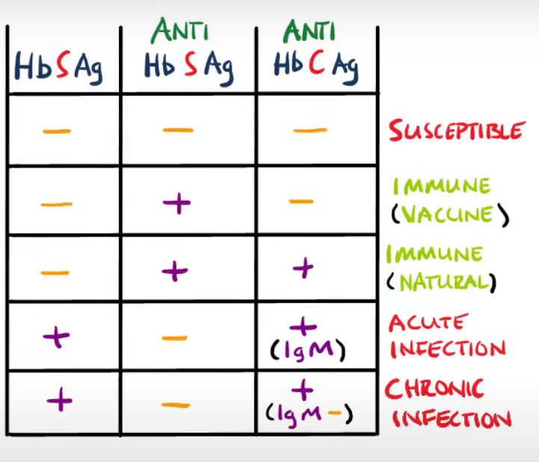
Hepatitis B Diagnosis and Treatment:
Treatment:
Pegylated interferon alpha 2a (anti-viral properties)
Tenofovir
Transplant
Would show +ve IgG too

Slide 51
Hepatitis D
Single Stranded RNA virus
Can only survive in patients with Hep B infection
Attaches itself to Hb S Ag
Hep B + Hep D together means greater chance of getting cirrhosis/HCC
Treatment, Transmission, Presentation are the same as Hep B

Slide 52
Hepatitis C
VIRUS TYPE | Single Stranded RNA |  | Acute + Chronic
ROUTE OF TRANSMISSION | Blood, Bodily Fluids, IVDU
PRESENTATION (Sx) | Acute |  | Chronic
 | Asymptomatic or Malaise, Fever, Myalgias, Arthralgias, N+V, Diarrhoea |  | Usual Chronic Liver Signs
DIAGNOSIS & INVESTIGATIONS (Ix) |  | Anti Hc Ab -ve |  | Anti Hc Ab +ve
 | Hc RNA –ve | No infection |  | Resolved infection
 | Hc RNA +ve | Active infection |  | Active Infection (Acute/Chronic)
TREATMENT (Tx) | Direct Acting Antivirals (DAA) + Ribavirin
COMPLICATIONS (IF APPLICABLE) | HCC
Notes:
Acute infection is often asymptomatic
Anti-HCV antibodies may take as long as 6 weeks after HCV exposure to be detectable on tests.
HCV RNA may take as long as 2–3 weeks after viral exposure to be detectable on tests.

Slide 53
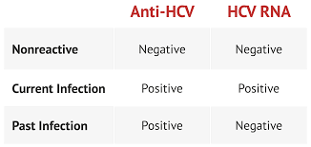
Hepatitis E
VIRUS TYPE | Single Stranded RNA | Acute
ROUTE OF TRANSMISSION | fAEco-oral: contaminated water, undercooked pork
PRESENTATION (Sx) | Usually asymptomatic and self limiting
DIAGNOSIS & INVESTIGATIONS (Ix) | Serology
TREATMENT (Tx) | Supportive
COMPLICATIONS (IF APPLICABLE) | Rare. Can progressive to cirrhosis in immunocompromised.
Notes:
Normally produces only a mild illness

Slide 54
Autoimmune Hepatitis
RISK FACTORS: Females, Other Autoimmunity, Viral Hepatitis
 | Type 1 | Type 2
WHO DOES IT AFFECT? | Adult Females | Younger Females
AUTOANTIBODIES INVOLVED | Anti-Nuclear Antibodies (ANA) Anti-Smooth Muscle Antibodies (ASMA) Anti Soluble Liver Antigen (Anti-SLA/LP) | Anti-Liver Kidney Microsoms-1 (Anti-LKM1) Anti-Liver Cytosol Antigen Type 1 (Anti-LC1)
PRESENTATION (Sx) | May be asymptomatic or have features of liver disease | Jaundice
INVESTIGATIONS | Based on Autoantibodies
TREATMENT | Steroids (prednisolone) + Immunosuppressants (azathioprine) Liver Transplant
COMPLICATIONS | Cirrhosis

Slide 55
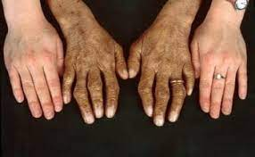
Haemochromatosis
DEFINITION | Genetic disorder that causes the body to absorb and store excess Iron
AETIOLOGY & RISK FACTORS | Autosomal Recessive inheritance of mutated HFE gene Middle Age, Male, Alcohol
PATHOPHYSIOLOGY (IF APPLICABLE) | Excess Iron is absorbed by the body and deposited in multiple organs: Liver, Joints, Pancreas, Heart, Skin and Gonads
PRESENTATION (Sx) | Symptoms: Joint Pain, Fatigue and Weakness, Abdominal Pain, Loss of Sex Drive/ED Signs: Slate Grey Skin, Irregular Heartbeats, Diabetes
DIAGNOSIS & INVESTIGATIONS (Ix) | Bloods – ↑ serum Fe, serum ferritin, serum transferrin Genetic Tests Liver Biopsy
TREATMENT (Tx) | 1st line = Venesection 2nd line = Iron chelation Lifestyle changes – reduce alcohol, exercise….
COMPLICATIONS (IF APPLICABLE) | Hepatomegaly, Liver Cirrhosis, HCC, Hypothyroidism, Diabetes
Notes:
F+W – caused by excess iron = anaemia & damaged organs = decrease production of enzymes/hormones
Abd pain – caused by damage and inflammation of pancreas and liver
Diabetes – excess iron = damage to beta cells = decreased insulin production (also to do with inflammation of pancreas)
PathP - Decreased expression of Hepcidin (regulates Iron offloading in liver) & increased uptake

Slide 56
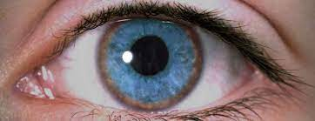
Wilson’s Disease
DEFINITION | Excessive accumulation of Copper in the body and tissues
CAUSES RISK FACTORS | Autosomal Recessive mutation of ATP7B copper-binding-protein = reduced removal of Cu in liver FHx, Male, 5-35,
PATHOPHYSIOLOGY (IF APPLICABLE) | Build of excess Cu in liver, brain and other organs
PRESENTATION (Sx) | Jaundice, Parkinsonism (Cu in BG), dystonia, dysarthria, Kayser-Fleischer Ring (Cu in cornea)
DIAGNOSIS & INVESTIGATIONS (Ix) | Serum Cu & ceruloplasmin = ↓ Liver biopsy (Gold Standard) 24h Urine Cu Assay – elevated
TREATMENT (Tx) | Cu chelation – penicillamine Liver transplant if severe
COMPLICATIONS (IF APPLICABLE) | Cirrhosis, anaemia renal dysfunction
Notes:
Dysarthria = speech difficulties
Dystonia = abnormal muscle tone

Slide 57
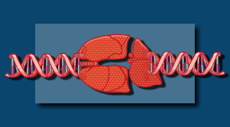
Alpha 1 Antitrypsin Deficiency
DEFINITION | Deficiency of Alpha 1 Antitrypsin Enzyme
CAUSES & RISK FACTORS | Autosomal recessive mutation in SERPINA1 gene (provides instructions for A1A synthesis) FHx, Male, Smoking
PATHOPHYSIOLOGY (IF APPLICABLE) | A1A is an enzyme that neutralises neutrophil elastase in the lungs – reduced A1A = excess breakdown of elastic fibres in lungs Accumulation of A1A also occurs in the liver
PRESENTATION (Sx) | Symptoms: COPD like symptoms – dyspnea, chronic cough, sputum production Signs: Jaundice
DIAGNOSIS & INVESTIGATIONS (Ix) | Low serum A1A Liver biopsy = cirrhosis Genetic testing CT – bronchiectasis and emphysema
TREATMENT (Tx) | Stop smoking Symptomatic management
COMPLICATIONS (IF APPLICABLE) | HCC, Cirrhosis (after 50)

Slide 58
Pancreatic Cancer
DEFINITION | Typically an adenocarcinoma and most occur in the head of the pancreas
RISK FACTORS | Old age (60+), smoking, obesity, T2DM, FHx, Chronic Pancreatitis
PATHOPHYSIOLOGY (IF APPLICABLE) | Adenocarcinoma typically in the head of the pancreas and can compress bile ducts
PRESENTATION (Sx) | Obstructive/Painless Jaundice, pale stools, dark urine, generalized itching (pruritus), weight loss, worsening of T2DM (or new onset) Courvoisier’s Sign – palpable gallbladder + jaundice Can get epigastric pain that radiates to back (body and tail)
DIAGNOSIS & INVESTIGATIONS (Ix) | Abdominal Ultrasound CT of pancreas (identifies mass and helps with staging of cancer) – GOLD STANDARD Tumour marker – Ca19-9 not diagnostic but helps with monitoring progression
TREATMENT (Tx) | Surgery to remove tumour – Whipple procedure (pancreaticoduodenectomy + others) Chemo/Radiotherapy
COMPLICATIONS (IF APPLICABLE) | Poor prognosis as identified late, metastasis to liver, lungs…

Slide 59
Hepatocellular Carcinoma
CAUSES & RISK FACTORS | Liver Cirrhosis due to: Viral Hepatitis (B and C), Alcohol, NAFLD, other chronic liver diseases Males (90%)
PATHOPHYSIOLOGY (IF APPLICABLE) | Arise from liver parenchyma Metastasises to lymph nodes, bones, lungs
PRESENTATION (Sx) | Liver Symptoms | Non-Specific Symptoms
 | Jaundice, Ascites, HE, Pruritus | Weight Loss, Fatigue, Weakness, N+V
DIAGNOSIS & INVESTIGATIONS (Ix) | 1st Line: Abdominal Ultrasound CT to confirm (GOLD STANDARD) Serum Alpha-Fetoprotein (AFP) = tumour marker for HCC
TREATMENT (Tx) | Poor Prognosis Resection of Tumour Liver Transplant (if isolated to the liver)

Slide 60
Cholangiocarcinoma
CAUSES & RISK FACTORS | Liver Fluke Infections, Chronic Viral Hep B/C, Liver Cirrhosis, Biliary Cysts
PATHOPHYSIOLOGY (IF APPLICABLE) | Arise from biliary tree – usually adenocarcinomas
PRESENTATION (Sx) | Signs of Cholestasis (impaired bile prod/secretion) | Non-Specific Symptoms
 | Jaundice, Pale Stools, Dark Urine, Pruritus + Courvoisier’s Sign | Weight Loss, Fatigue, Weakness, N+V
DIAGNOSIS & INVESTIGATIONS (Ix) | 1st line – Abdominal Ultrasound and CT ERCP – used to take biopsies - Gold Standard CA19-9 – Tumour marker for Cholangiocarcinoma LFTs – raised bilirubin and ALP
TREATMENT (Tx) | Surgical Resection ERCP used to place a stent in the blocked duct = relieves symptoms
Notes:
ERCP – provides imaging of biliary and pancreatic ductal systems

Slide 61
Spontaneous Bacterial Peritonitis
DEFINITION | Infection of the ascitic fluid = inflammation of the peritoneum
CAUSES & RISK FACTORS | Gram –ve bacteria (E.coli, Klebsiella spp.) & Gram +ve (streptococcus spp. etc.) Liver disease, cirrhosis, ascites
PATHOPHYSIOLOGY (IF APPLICABLE) | Bacteria from gut → to lymph nodes → blood stream → ascitic fluid = SBP
PRESENTATION (Sx) | Severe acute abdominal pain, guarding, N+V, diarrhea, fever, can have acites
DIAGNOSIS & INVESTIGATIONS (Ix) | Ascitic tap – raised ascitic fluid neutrophils Culture – shows causative organisms ESR + CRP
TREATMENT (Tx) | ABCDE IV antibiotics (cefotaxime), supportive therapy (IV fluids, analgesics, electrolytes) Paracentesis
COMPLICATIONS (IF APPLICABLE) | Septicaemia
Notes:
Peritoneum – the lining that covers the inner wall of the abdomen and most organs within it
Paracentesis – removes excess ascites fluid

Slide 62
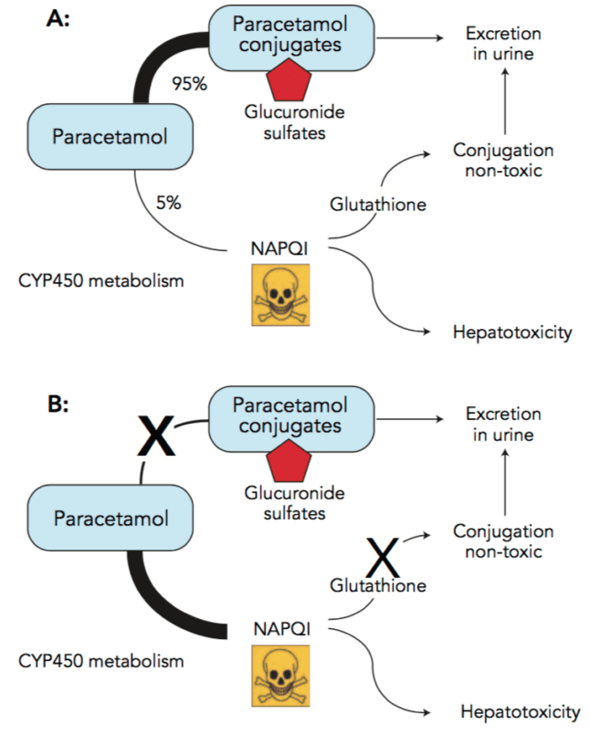
Paracetamol Overdose

Slide 63
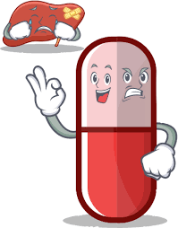
Paracetamol Overdose
PRESENTATION (Sx)
Sudden Onset Severe RUQ Pain
N + V
Jaundice
Confusion
Anorexia
DIAGNOSIS & INVESTIGATIONS (Ix)
Based off History
LFTs – ALT raised
Serum Paracetamol Concentration
TREATMENT (Tx)
Acetylcysteine – give straight away – replenishes glutathione
Activated Charcoal – helps absorb any paracetamol in the stomach

Slide 64
Gilbert’s Syndrome
DEFIINITION | Liver's ability to metabolize bilirubin is affected
DEFINITION, CAUSE/S & RISK FACTORS | Autosomal Recessive inheritance of UGT1A1 Gene Males, FHx, Post-Pubertal Age
PATHOPHYSIOLOGY (IF APPLICABLE) | Normal RBC breakdown Reduced conjugation Accumulation of bilirubin in blood = JAUNDICE
PRESENTATION (Sx) | Painless Jaundice (especially under physical/psychological stress)
DIAGNOSIS & INVESTIGATIONS (Ix) | Blood Tests – raised unconjugated bilirubin LFTs – Normal
TREATMENT (Tx) | No Treatment
Notes:
hereditary condition that affects the liver's ability to metabolize bilirubin, a waste product produced when red blood cells break down
The cause of hyperbilirubinaemia under stress is not entirely understood, though several hypotheses have been presented including increased haem turnover, increased enterohepatic uptake of unconjugated bilirubin, and altered hepatic uptake mechanism

Slide 65
Hepatic Encephalopathy
DEFINITION | Hepatic encephalopathy is a brain dysfunction caused by advanced liver insufficiency
CAUSES & RISK FACTORS | Cirrhosis, liver cancer, Hepatitis, Intestinal Bleed
PATHOPHYSIOLOGY (IF APPLICABLE) | Decreased Liver function → build up of toxic metabolites (NH3) → Astrocyte ion channels activated, increased production of cytokines and stimulation of osmotic pumps → swelling of astrocytes → contributes to cerebral oedema = NEUROLOGICAL CHANGES
PRESENTATION (Sx) | Mood Disturbances – Depression Sleep Disturbances – Insomnia Motor Disturbances – Ataxia, Muscle Rigidity, Bradykinesia Confusion Liver Symptoms too – ascites, jaundice, peripheral oedema
DIAGNOSIS & INVESTIGATIONS (Ix) | FBC and Basal Metabolic Panel Blood Alcohol Blood ammonia – raised
TREATMENT (Tx) | 1st Line: Lactulose Rifaximin – reduces number of ammonia producing intestinal bacteria Liver transplant
COMPLICATIONS (IF APPLICABLE) | Cerebral Oedema, Aspiration Pneumonia
Notes:
Intestinal bleeding can cause hepatic encephalopathy by increasing the amount of toxins in the blood that the liver needs to remove.
Ataxia - a group of disorders that affect co-ordination, balance and speech
FBC and BMP – rules out hypoglycaemia, hyponatraemia, ketoacidosis
Blood Alcohol – rule out alcohol intoxication
Lactulose is converted to lactic acid by intestinal flora → acidification in the gut → conversion of ammonia
(NH3) to ammonium (NH₄⁺) → ammonium is excreted in the faeces → decreased blood ammonia concentration
Aspiration Pneumonia – unable to control airways due to altered mental status

Slide 66
Things left out:
Wernicke’s encephalopathy and Korsakoff syndrome (done in neuro)
Hernias
Jaundice

Slide 67
Conclusion
Know the “Green” conditions inside out
Use ZeroToFinals, watch NinjaNerd and Osmosis videos to understand concepts
Use Quesmed and Passmed as question banks
Don’t stress, you got this!

Slide 68
Feedback
https://forms.gle/kzUvJGtFkCmzdfpG6
The Peer Teaching Society is not liable for false or misleading information…

