Slide 1
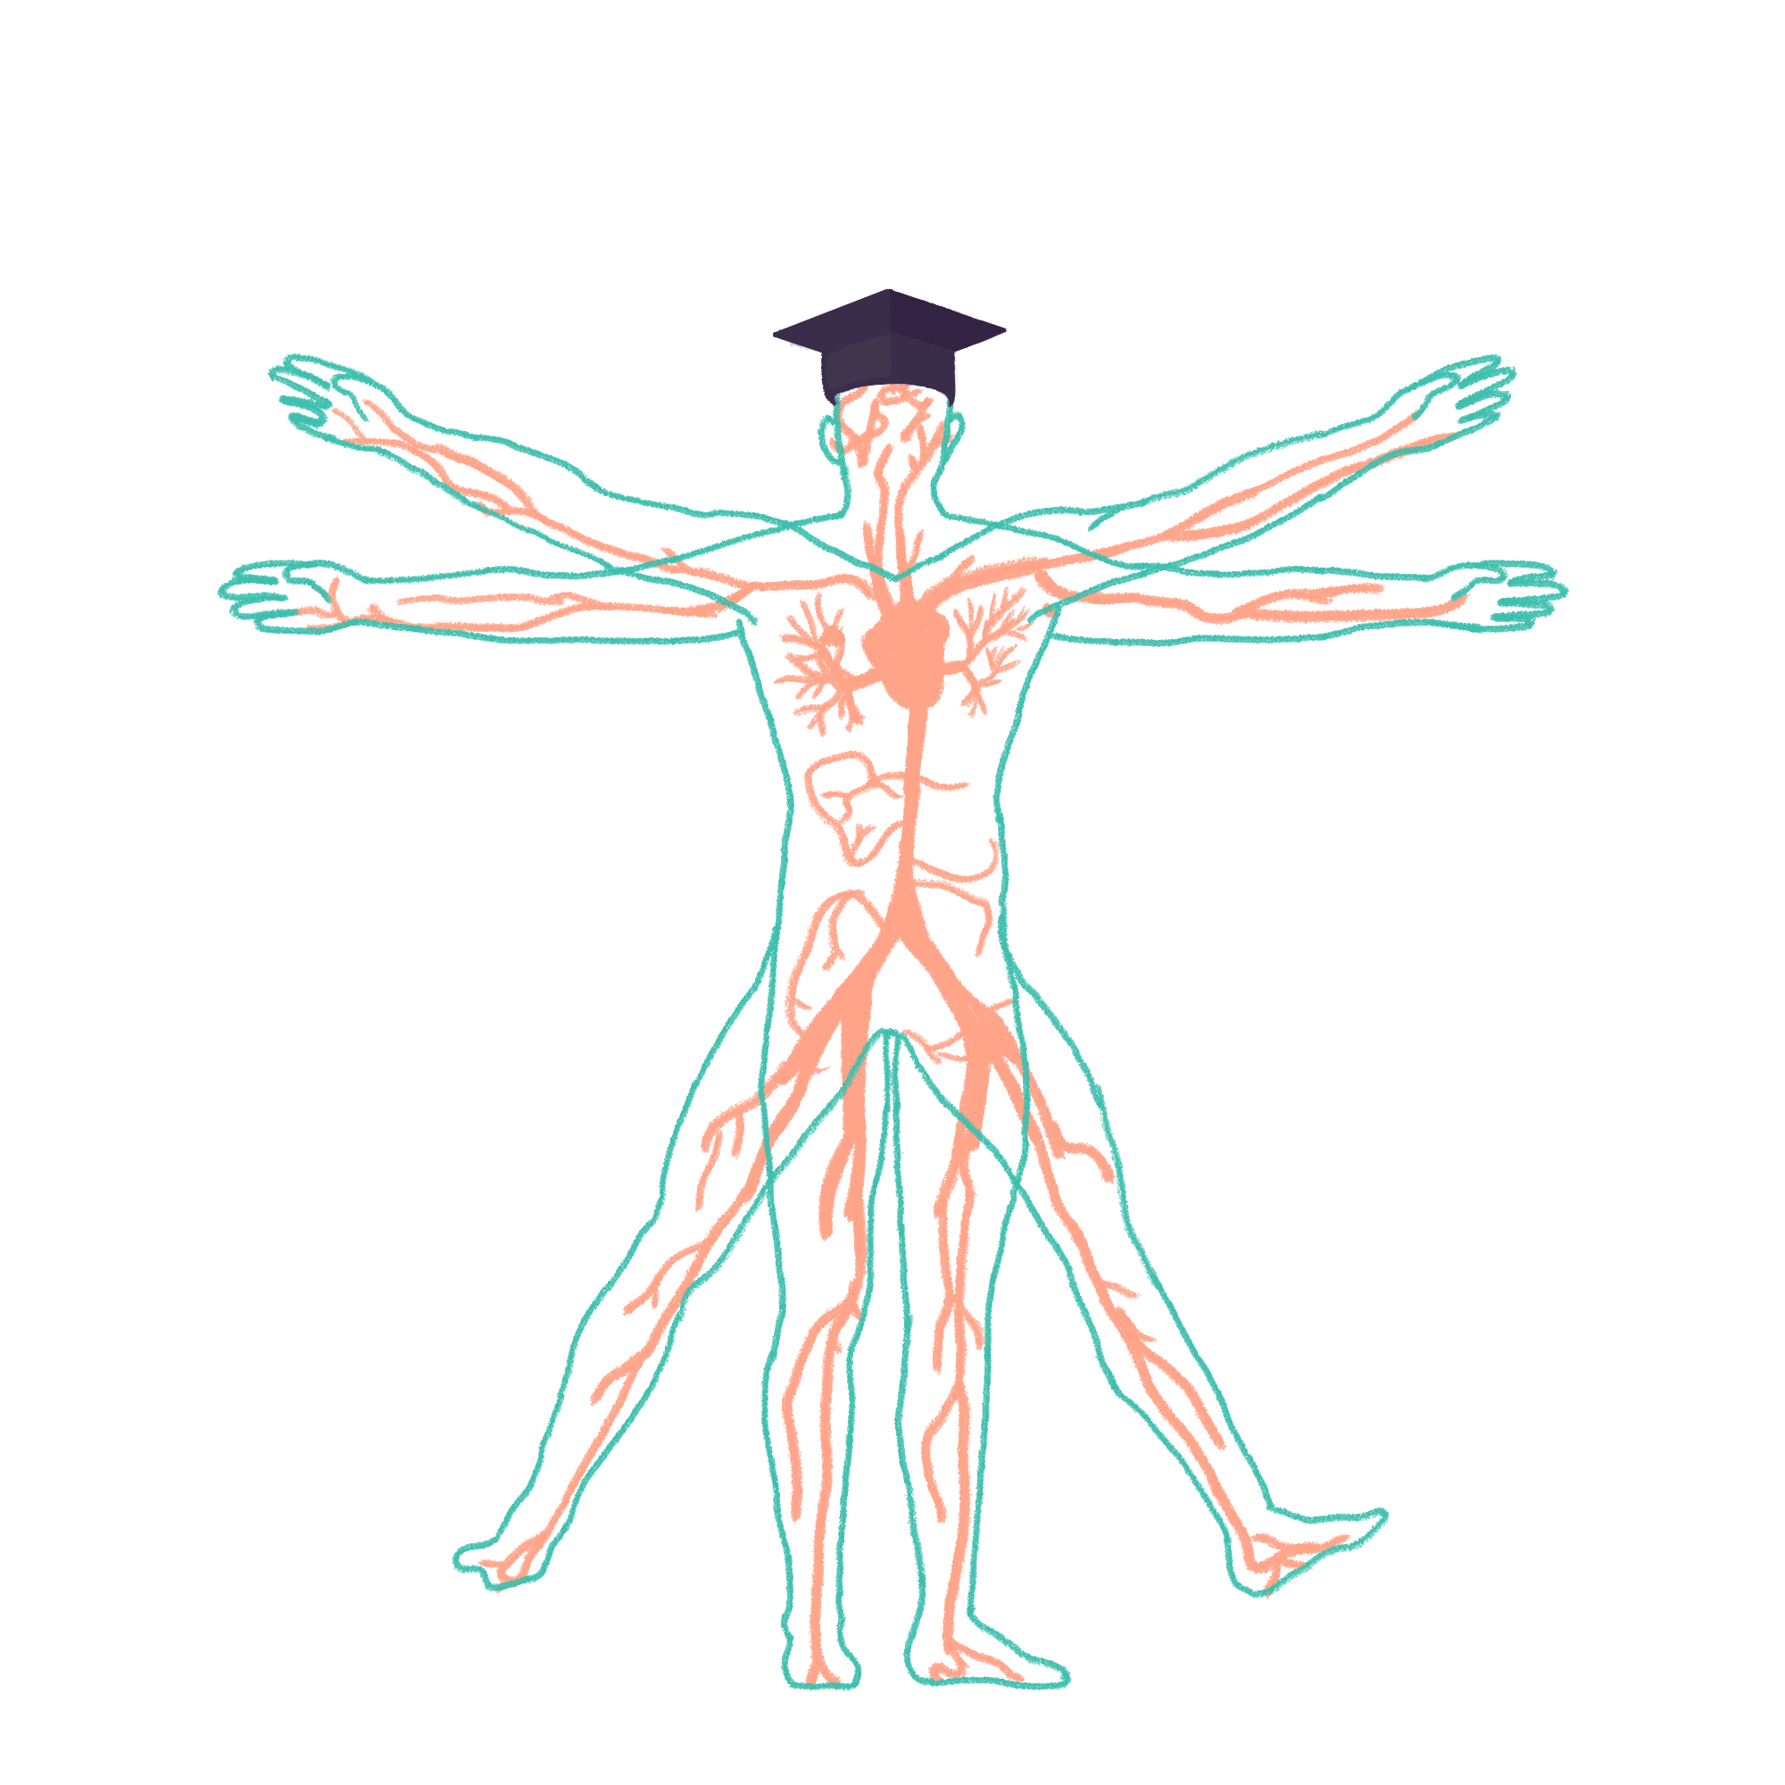
2022/2023

Slide 2
MSK
Phase 2a Revision Session
Monday 27th February
Jessica To & Adam Orford
The Peer Teaching Society is not liable for false or misleading information…

Slide 3
Aims and Objectives
Osteoarthritis Rheumatoid arthritis Crystal arthritis; Gout, Pseudogout Osteoporosis (+ osteopenia) Fibromyalgia Sjogren’s syndrome Vasculitis; Giant cell arteritis, Wegener’s granulomatosis (granulomatosis with polyangiitis), Polyarteritis nodosa Paget’s disease of bone Spondyloarthropathies (SPINEACHE) · Ankylosing spondylitis · Psoriatic arthritis · Reactive arthritis · Enteric arthritis Infective arthritis; Septic arthritis, Osteomyelitis Systemic lupus erythematosus Antiphospholipid syndrome Dermatomyositis/polymyositis Scleroderma (CREST) Polymyalgia rheumatica Mechanical lower back pain, including vertebral disc degeneration Osteomalacia Primary and secondary bone tumours (KNOW WHICH TUMOURS METASTASISE TO BONE) Connective tissue disorders; Marfan’s, Ehlers Danlos
We’ll go through green, then yellow, then red stuff but if we run out of time you’ll have the notes for every condition when they send this out!
The Peer Teaching Society is not liable for false or misleading information…

Slide 4
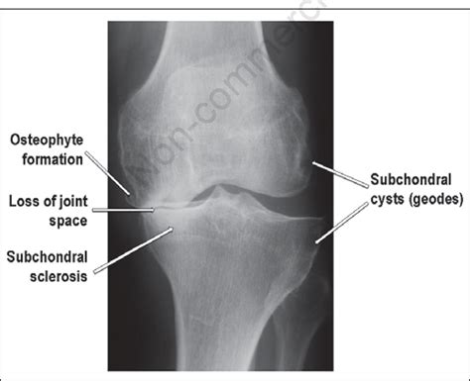
Osteoarthritis
Pathology Causes | It is not an inflammatory condition like rheumatoid arthritis. The –itis ending is misleading. It occurs in the synovial joints and is a result of a combination of genetic factors, overuse and injury. It is thought to be the result of an imbalance between the cartilage being worn down and the chondrocytes repairing it leading to structural issues in the joint
Risk Factor | High intensity labour, older age, obesity, trauma, being female, FHx
Presentation | Symptoms: painful joints stiff for 30 minutes or less in the morning. worse throughout the day (worsened by activity in contrast to inflammatory arthritis). Can also lead to deformity, instability and reduced function in the joint. Commonly affected joints → Hips, Knees, Sacro-Iliac Joints, Distal-interphalangeal joints in the hands (DIPs), the CMC joint at the base of the thumb, Wrist, Cervical spine. Signs: proximal Bouchard nodes (PIP joints), distal Heberden nodes (DIP joints), squaring at the base of the thumb at the carpo-metacarpal joint, weak grip, reduced range of motion.
Investigations | X-ray – LOSS (loss of joint space, osteophytes, sclerosis (increased density of the bone along the joint line), subchondral cysts(fluid filled holes in the bone, aka geodes))
Management | Patient Education (Lifestyle → weight loss (reduce load on joint), physiotherapy (improve strength to support the joint), occupational therapy and orthotics to support activities and function) Analgesia: Paracetamol, topical NSAIDs or topical capsaicin Oral NSAIDS and PPI to protect stomach → better used intermittently Opiates e.g., codeine and morphine (don’t work for chronic pain and leads to addiction) Intra-articular steroid injections → provide temporary reduction in inflammation and improve symptoms Joint replacement (hip and knee most common
Complications | Destruction of the joint and loss of function
Notes:
Clinical diagnosis – made without investigation if patient is:
Over 45
Typical activity related joint pain
No morning stiffness or morning stiffness that lasts less than 30 minutes

Slide 5
Rheumatoid Arthritis
Pathology Causes | Autoimmune destruction of the synovium. Chronic inflammation of the synovial lining of the joints, tendon sheaths and bursa causes damage to bone, cartilage, tendons and ligaments. RA tends to be symmetrical and affects multiple joints (symmetrical polyarthritis). Inflammation of the tendons increases the risk of tendon rupture
Risk Factors | Young (middle age), female (3x more common), family history, other autoimmune diseases
Presentation | Symptoms: painful, swollen, stiff joints for more than an hour in the morning, better with movement. Pain and stiffness in small joints (hands, feet, wrist, MCP, PIP) and larger joints (knees, shoulders, elbows). Onset can be very rapid or over months to years. Systemic Symptoms include → Fatigue, Weight loss, Flu like illness, muscle aches and weakness Signs: swan neck thumb (hyperextended PIP with flexed DIP), ulnar deviation at the knuckle, boutonniere deformity. Extra articular manifestations → RA with pulm nodules (Caplan’s syndrome), Felty’s Syndrome (RA, neutropenia, splenomegaly), Anaemia of chronic disease, Lymphadenopathy, Secondary Sjogren’s Syndrome, Amyloidosis etc.
Investigations | Bloods: Anti CCP (specific), rheumatoid factor (sensitive), raised ESR/CRP X ray: LESS lost joint space, bony erosion, soft tissue swelling, periarticular osteopenia. Genetic Testing (HLA DR4 and HLA DR1 often and occasionally present in RA patients)
Management | Involve MDT and invoke early treatment Ibuprofen/NSAIDS → GI bleeding (PPI) Steroids initially and flare ups to quickly settle Disease Modifying Anti-Rheumatic Drugs (DMARDs) Methotrexate, leflunomide, sulfasalazine. Hydroxychloroquine (mildest anti rheumatic drug) 2º → two of above in combination, 3⁰ → methotrexate + TNF inhibitor, 4º → methotrexate + Rituximab (biologics) Health Assessment Questionnaire (HAQ) → using this at diagnosis to check response to treatment Prognosis → worse with younger onset, male, more joints and organs affected, presence of RF and anti-CCP, Erosions on xray
Notes:
Pregnancy → improvement but sulfasalazine and hydroxychloroquine are considered.
“The most important biologics to remember are the TNF inhibitors adalimumab, infliximab and etanercept and it is also worth remembering rituximab. Just remember they all lead to immunosuppression so patients are prone to serious infections. They can also lead to reactivation of dormant infections such as TB and hepatitis B.”

Slide 6
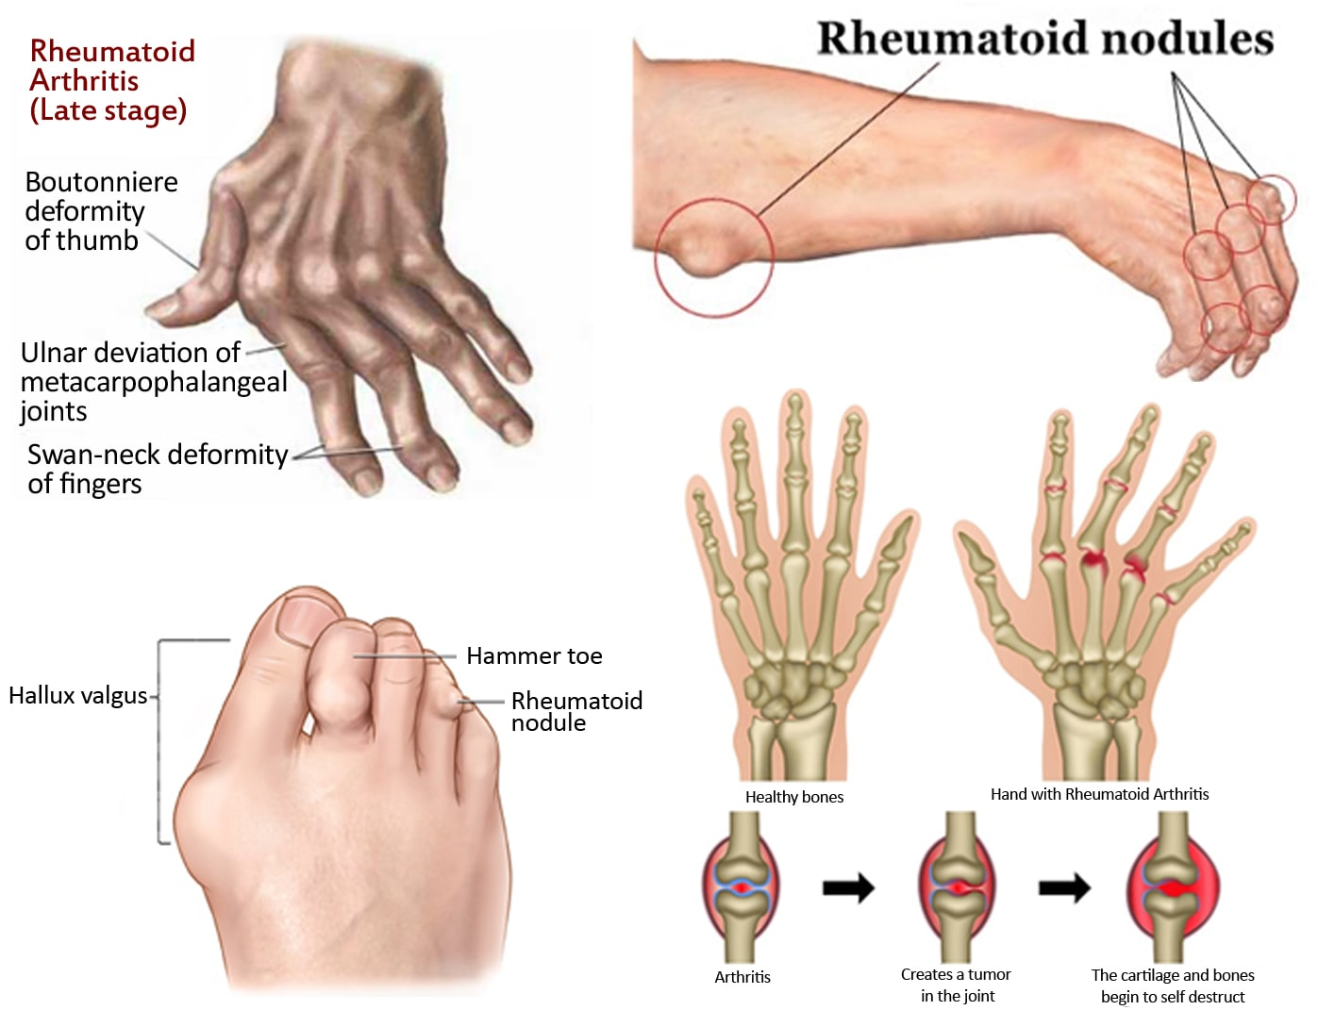
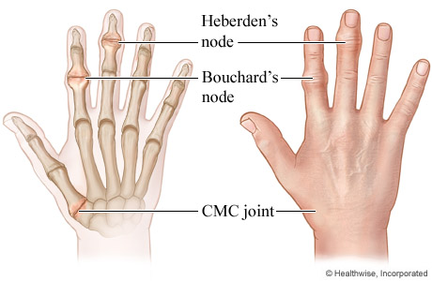
RA VS OA
From https://www.healthclues.net/rheumatoid-arthritis

Slide 7
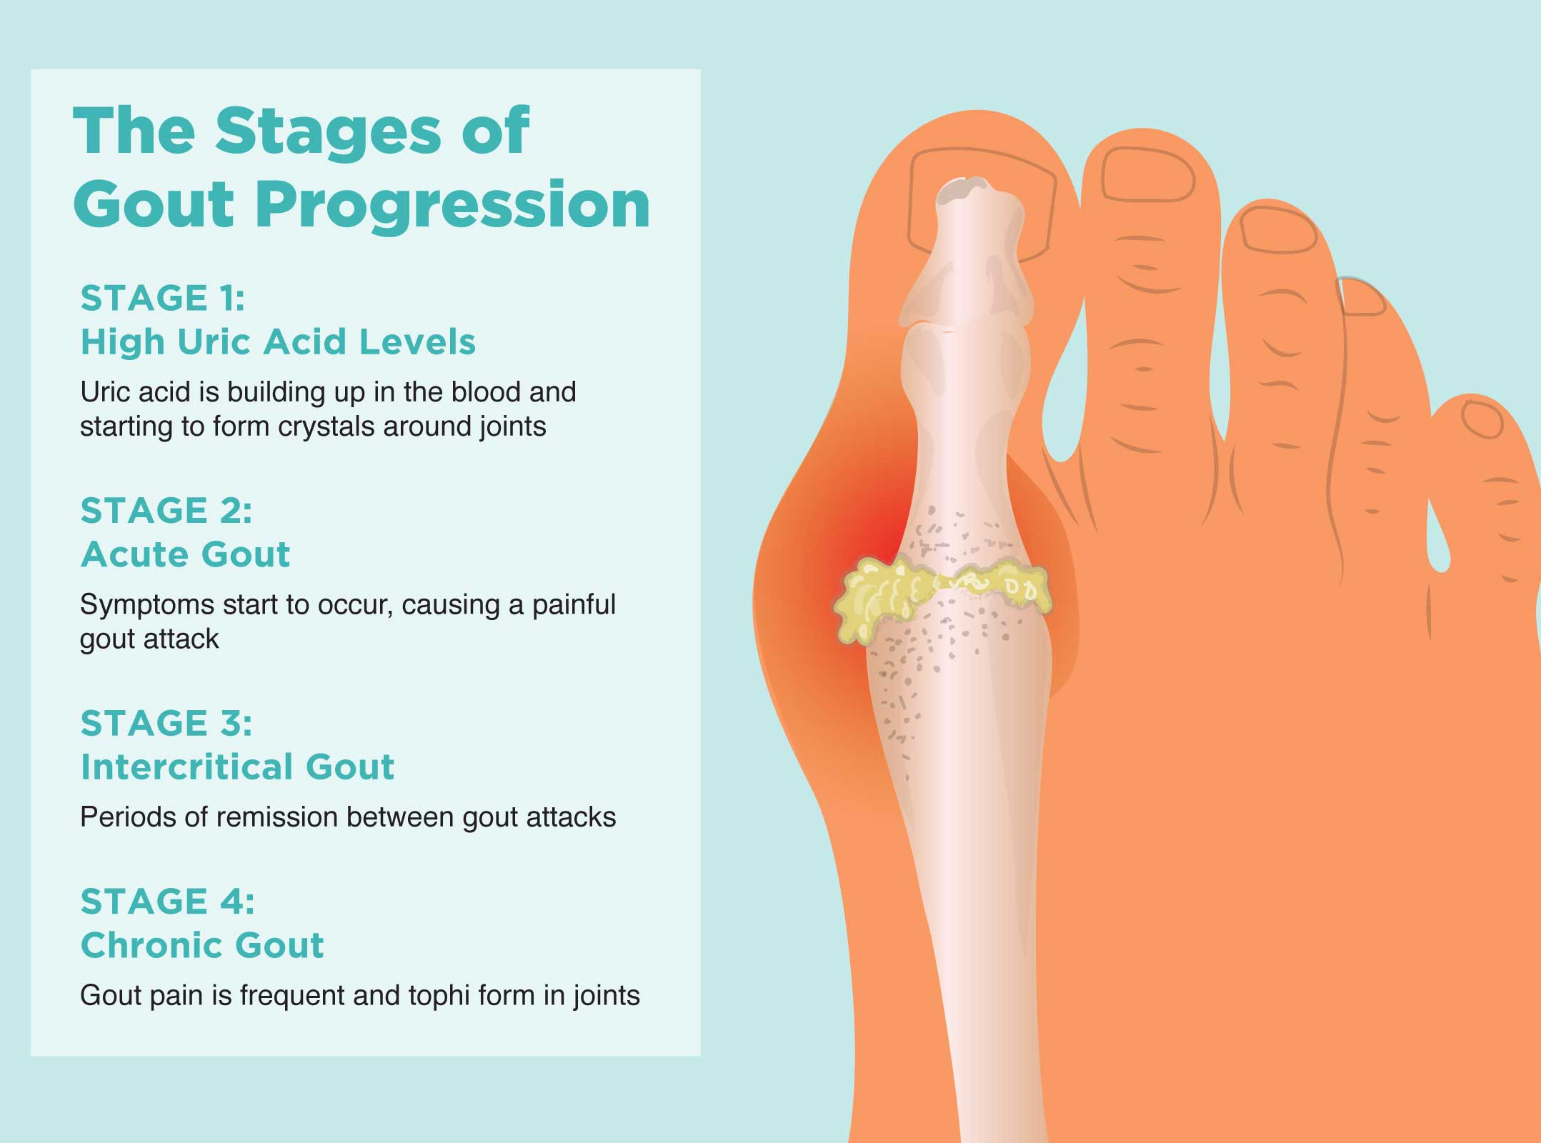
Gout
Pathology | Overproduction/under excretions of uric acid causes build up and precipitated out in joints. Urate crystals are deposited in the joint causing it to become hot, swollen and painful. Gouty tophi are sc deposits of uric acid typically affecting the small joints and connective tissues of the hands, elbows and ears. DIP joints are most affected in hands
Risk Factors | Middle, age, overweight, high purine diet (meat and seafood), alcohol, diuretics, FHx, kidney disease / existing cardiovascular disease
Presentation | Symptoms: inflamed joints. 1st metatarsal and distal interphalangeal often affected. Base of the big toe (metatarsophalangeal joint, wrists, bases of thumb (carpometacarpal joints)
Investigations | Joint aspiration & polarised light microscopy (needle like negative birefringent crystals, monosodium urate crystals and no bacterial growth) Increased Urate on blood test Joint Xray → space between is maintained, lytic lesions in the bone, punched out erosions, can have sclerotic borders with over hanging edges.
Management | Acute flare up → 1⁰ (NSAIDS), 2⁰ (colchicine), 3⁰ (steroids) Colchicine is used for patients who cant have NSAIDS (sig heart disease, renal impairment, but diarrhoea is a common side effect → DOSE DEPENDANT!) Prophylaxis Allopurinol (Xanthine oxidase inhibitor, reduces uric acid production) → not during initial acute attack but once started can be continued during one Lifestyle changes → losing weight, staying hydrated, minimising alcohol, meat and seafood)
Complications | infection in the tophi Destruction of the joint

Slide 8
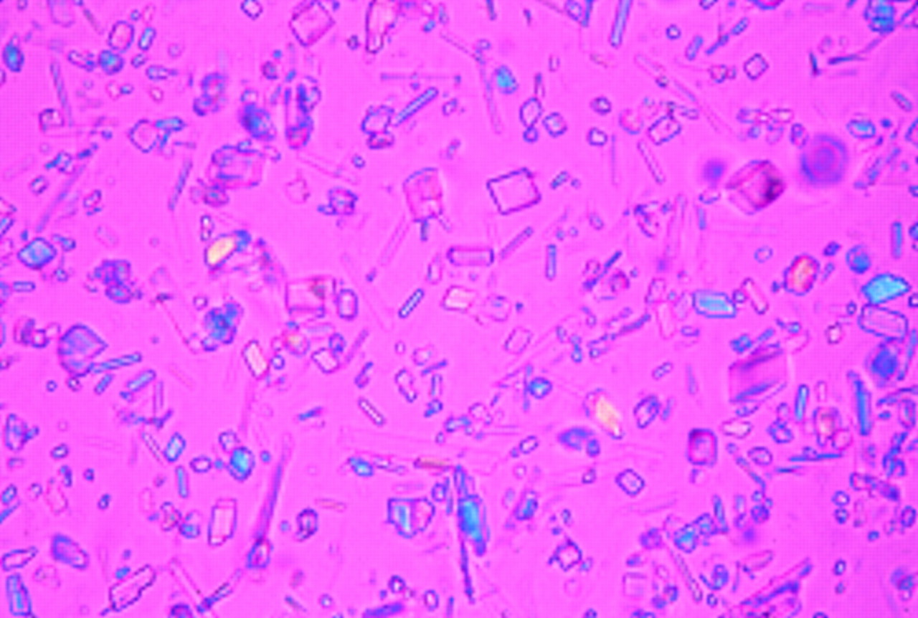
PseudoGout
Pathology | Crystal Arthropathy → Damage to a joint caused by pathological formation of calcium pyrophosphate crystals. Also known as chondrocalcinosis.
Risk Factors | Females over 70, hyperthyroidism, hyperparathyroidism, excess iron or calcium
Presentation | Older adult with Symptoms: hot, swollen, tender joint, usually knees → other joints (shoulders, wrists, hips) Signs: recent injury to the joint in the history Can be chronic, affect multiple joints but also asymptomatic and only picked up incidentally on an xray of the joint.
Investigations | Discount septic arthritis → PG tends to be milder in presentation Joint aspirate and polarised light (rhomboid positive birefringent of polarised light, calcium pyrophosphate crystals and no bacterial growth) Xray → Chondrocalcinosis (appears as a thin white line in the middle of the joint space caused by the calcium deposition. This is pathognomonic (diagnostic) of pseudogout Other changes similar to osteoarthritis (LOSS → Loss of joint space, osteophytes, subarticular sclerosis, subchondral cysts)
Management | Chronic asymptomatic changes found on xray don’t require action Symptoms usually resolve spontaneously over several weeks. If Symptomatic: NSAIDS Colchicine Steroid injections // orally Joint aspiration / joint washout (arthrocentesis) in severe cases
Complications | Damage to the joint – loss of function over time.

Slide 9
Tristate Arthritis + Rheumatology

Slide 10
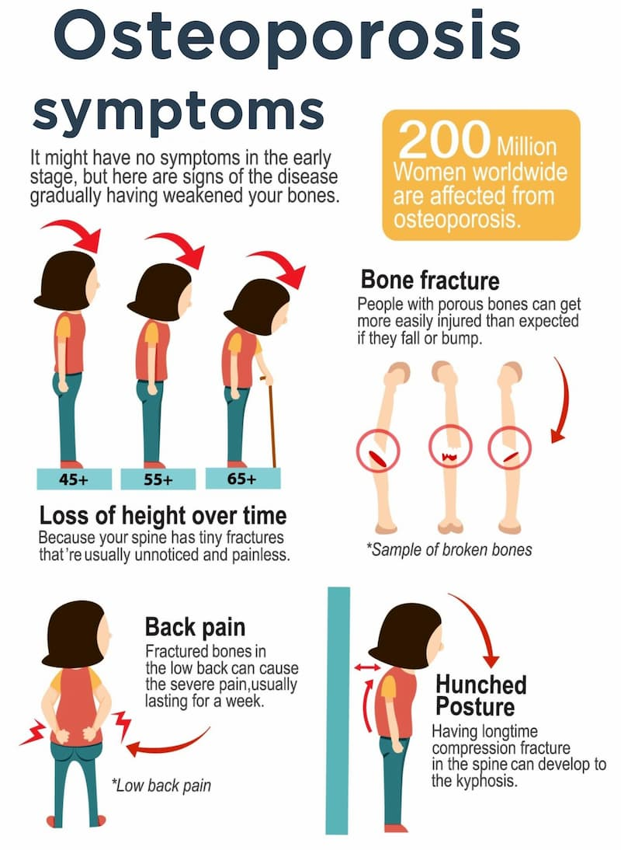
Osteoporosis
Pathology | Osteoporosis is a condition where there is a reduction in the density of the bones. Osteopenia refers to a less severe reduction in bone density than osteoporosis. Reduced bone density makes bone less strong and more prone to fractures
Risk Factors | ‘SHATTERED’ Steroid use (NICE → 7.5mg of prednisolone per day for more than 3 months) Hyperthyroidism, hyperparathyroidism, hypercalciuria Alcohol + tobacco use Thin (BMI < 18.5) Testosterone (low) → women Early menopause → women after menopause (oestrogen is protective) Renal or liver failure Erosive / inflammatory bone disease (e.g., myeloma or RA) Dietary low calcium / malabsorption or DM1
Presentation | Fractures → especially after an event where one would be unlikely
Investigations | DEXA Scan → BMD measurement at hip is key, T score of hip → FRAX score → 10 year prob of a major osteoporotic/hip fracture → uses info (BMI, co-morbidities, smoking, alcohol, FHx)
Management | Lifestyle advice → exercise, maintaining a healthy weight, stop smoking, reduce alcohol. Avoiding Falls. Vitamin D + calcium supplementation - 1st line Bisphosphonates e.g. alendronate, risendronate, zolendronic acid - 1st line (reduces osteoclastic activity). SE are reflux, oesophageal erosions, atypical fractures, osteonecrosis of jaw or external auditory canal. Denosumab - 2nd line (monoclonal Ab that blocks activity of osteoclasts – binds to RANK-ligand) HRT → especially for early-menopausal women
Complications | Follow ups are needed → Low risk patients not on treatment (lifestyle advice and follow up in 5 years). Bisphosphonates (3-5 years and a treatment holiday if BMD improve and no fragility fractures → break from treatment of 18 months to three years before repeating the assessment)

Slide 11
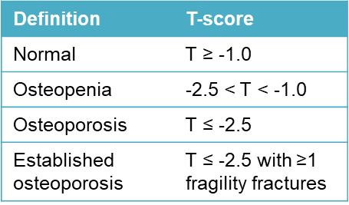
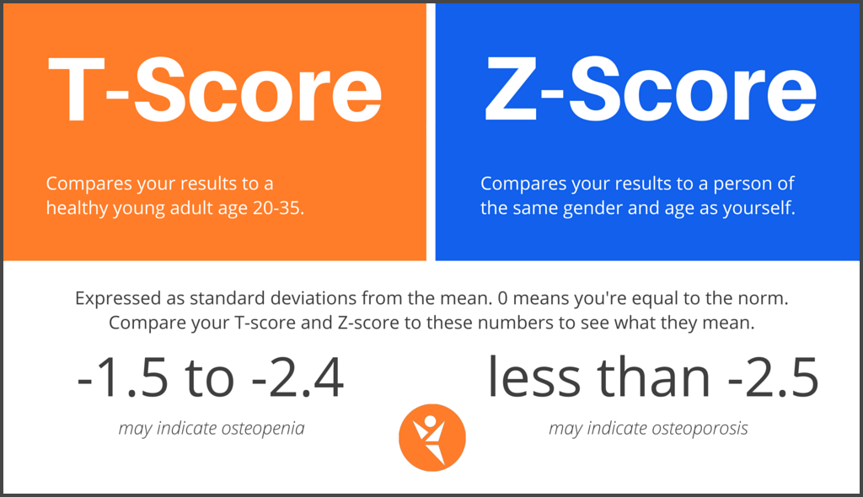
DEXA Scan, T-Score, Z-Score
You do a DEXA Scan to work out a T-Score/Z-Score
The Peer Teaching Society is not liable for false or misleading information…

Slide 12
Spondyloarthropathies
Chronic inflammatory diseases that most commonly affect SI joints + axial skeleton
Group of conditions that are all associated with HLA B27 gene
Seronegative (RF –ve)
Examples include:
Ankylosing spondylitis, Psoriatic arthritis, Reactive arthritis, IBD associated arthritis, Juvenile idiopathic arthritis
Features (SPINEACHE)
Sausage digit (dactylitis)
Psoriasis
Inflammatory back pain
NSAID → good response
Enthesitis (heel)
Arthritis
Crohn’s/ colitis/ elevated CRP (can be normal)
HLA B27
Eye (uveitis)

Slide 13
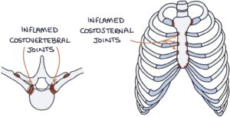
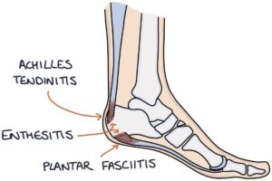
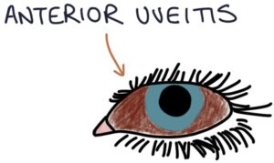
Ankylosing Spondylitis
Pathology | Chronic, multisystem inflammatory disorder involving primarily the sacroiliac joints + axial skeleton Inflammatory arthritis of spine + rib cage → leads to new bone formation + fusion of joints
Risk Factors | HLA-B27 genes (alongside arthritis and psoriatic arthritis), Male(3x more common) → now seen that it affects women and men in similar numbers
Presentation | Typical presentation male in late teens or 20s, gradual symptoms over more than 3 months Lower back pain + stiffness → worse with rest + improves with movement Sacroiliac pain (buttock region) Flares of worsening symptoms Fusion of the spine and sacroiliac joints leads to classical ‘bamboo spine’
Investigations | CRP + ESR - raised HLA B27 genetic test MRI spine - bone marrow oedema in early disease before x-ray changes Schober’s Test → Mark a point at L5 and put a point 10cm above and 5cm below. If when bending over forwards the distance is less than 20cm this supports a diagnosis of AS
Management | NSAIDs, bisphosphonates Steroids during flares anti-TNF drugs - etanercept Monoclonal antibodies against TNF - infliximab or adalimumab Physiotherapy, lifestyle advice (exercise, smoking cessation)
X-ray of spine + sacrum
Bamboo spine
Squaring of vertebral bodies
Subchondral sclerosis + erosions
Syndesmophytes – bony growth originating from a spinal ligament
Ossification of ligaments, discs + joints
Fusion of facet, SI + costovertebral joints

Slide 14
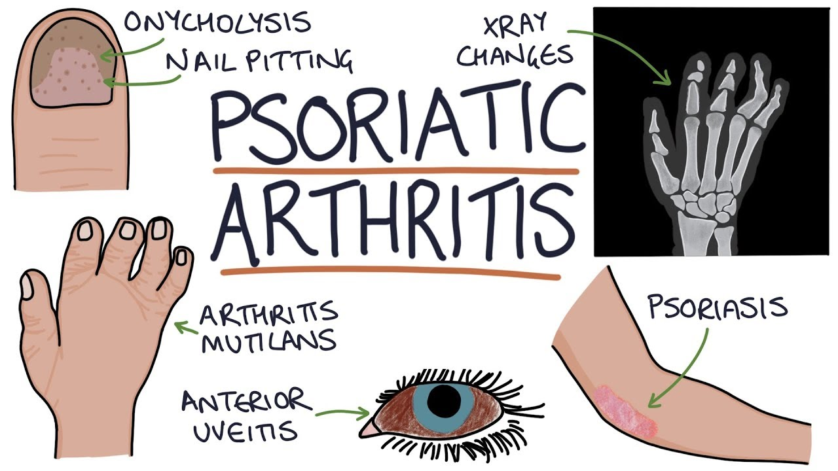
Psoriatic Arthritis
Pathology | Inflammatory arthritis associated with psoriasis 1 in 5 patients with psoriasis have psoriatic arthritis (PEST Tool screens for this and asks about joint pain, swelling, nail pitting etc.) → Done Annually!
Presentation | Symmetrical Polyarthritis → F, Hands wrists, ankles and DIP joints affects, MCP joints are less commonly affected (unlike rheumatoid but rest of presentation is similar) Asymmetrical Pauciarthritis → affects mainly fingers, toes and feet. Pauciarthritis describes when the arthritis only affects a few joints. Spondylitic Pattern → M. Back stiffness, sacroiliitis, atlanto-axial joint involvement. Other areas affected can be the spine, Achilles tendon, plantar fascia. Signs → Plaques of psoriasis, Onycholysis (separation of nail from nail bed), Dactylitis (inflammation of full finger), Enthesitis (inflammation of entheses)
Investigations | X-ray Erosion in DIPJ + periarticular new-bone formation Osteolysis (destruction of bone), Dactylitis (inflam of whole digit appears as soft tissue swelling) Pencil-in-cup deformity (central erosions of the bone beside the joint → one bone appears hollow (cup) and the other bone is narrow and sits in cup (pencil) ESR + CRP - normal or raised Rheumatoid factor -ve anti-CCP - negative
Management | NSAIDs for pain Physio Steroid injection DMARDs - methotrexate, sulfasalazine TNF inhibitor or monoclonal antibodies - etanercept, infliximab or adalimumab
Complications | Arthritis Mutilans Most severe form of psoriatic arthritis Occurs in phalanxes Osteolysis of bones around joints in digits → leads to progressive shortening Skin then folds as digit shortens → telescopic finger

Slide 15
Reactive Arthritis
Pathology Causes | Inflammatory arthritis that occurs after exposure to certain GI or GU infections Chlamydia - C trachomatis v common, Campylobacter jejuni, Salmonella enteritidis, Shigella
Presentation | Begin 1-4 weeks after onset of infection Asymmetrical oligoarthritis Painful, swollen, warm, red + stiff joints Dactylitis Classic triad → conjunctivitis, urethritis + arthritis (can’t see, can’t pee, can’t climb a tree) → Reiter’s Syndrome (bilateral conjunctivitis, anterior uveitis, circinate balanitis)
Investigations | ESR + CRP - raised ANA - negative RF - negative X-ray – sacroiliitis (pain in SI joints) or enthesopathy (inflamed ehtheses) Joint aspirate (gram staining, culture and sensitivity) - negative (exclude septic arthritis + gout → if sent for crystal examination)
Management | Giving antibiotics until possibility of septic arthritis is excluded. NSAID Steroid injections into the affected joints with systemic steroids being required particularly when multiple joints are affected DMARD or anti-TNF medications - chronic arthritis (if not resolved within 6 months and don’t recur)

Slide 16
Enteric Arthritis

Slide 17
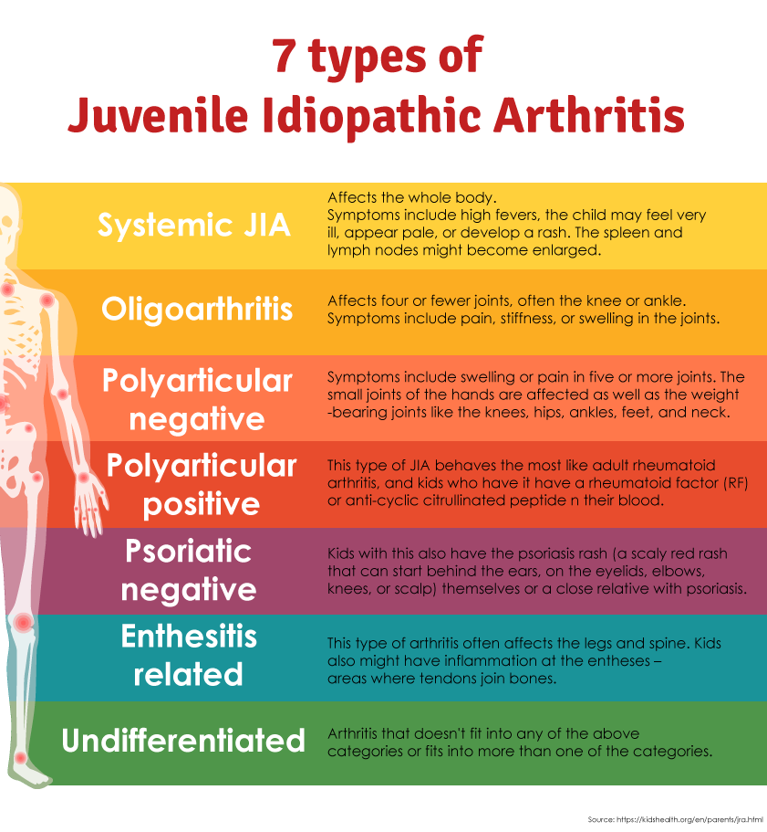
Juvenile Idiopathic Arthritis
Still’s Disease (Systemic JIA)
Px → Subtle salmon-pink rash, high swinging fevers, enlarged lymph nodes, weight loss, joint inflammation and pain, splenomegaly, muscle pain, pleuritis + pericarditis
Ix → Antinuclear antibodies + rheumatoid factors are typ negative. Raised CRP, ESR, platelets and serum ferritin
Think of it if rash, fevers, joint pain and fever for more than 5 days (Kawasaki, Stills, RF and leukaemia)
Complications → Macrophage Activation Syndrome (MAS) → acutely unwell, DIC, anaemia, thrombocytopenia, bleeding, non-blanching rash. Key finding (low ESR
Management:
NSAIDS (ibuprofen)
Steroids, oral, IM, intra-articular in oligoarthritis
DMARDS (methotrexate)
TNF Inhib (etanercept)

Slide 18
Septic Arthritis
Pathology Causes | Infection of ≥1 joints caused by pathogenic inoculation of microbes - via direct inoculation or via haematogenous spread Most common in children under 4 years or older adults. Predominant organisms responsible are staphylococcus Aureus (most common) or Group A streptococcus (Streptococcus pyogenes), E.Coli, Neisseria gonorrhoea, Haemophilus Influenza Complication of joint replacement and revision surgery→ mortality 10%
Risk Factors | Pre-existing joint disease (OA or RA) Joint prostheses IVDU Immunosuppression Alcohol misuse Diabetes Intra-articular corticosteroid injection
Presentation | Hot, swollen, painful, restricted joint, refusing to weight bear, stiffness and reduced range of motion, systemic symptoms such as fever, lethargy and sepsis. Onset < 2 weeks In children consider it in every patient with joint problems Commonest → knee or hip, usually only affects one knee DDx → Transient sinovitis, perthes disease, slipped upper femoral epiphysis, juvenile idiopathic arthritis
Investigations | Aspirate joint → gram staining, crystal microscopy, MC+S. Gram stating will come back quite quickly and can begin to guide treatment. Blood culture WCC → may be raised ESR + CRP → raised
Management | Aspirate joint, Surgical drainage and washout of the joint to clear the infection in severe Empirical Abx e.g. flucloxacillin Pathogen-directed Abx (only after results from aspirate come back) → continued for 3 to 6 weeks Analgesia Involve the orthopaedic team and be partic cautious with immunosuppressed patients

Slide 19
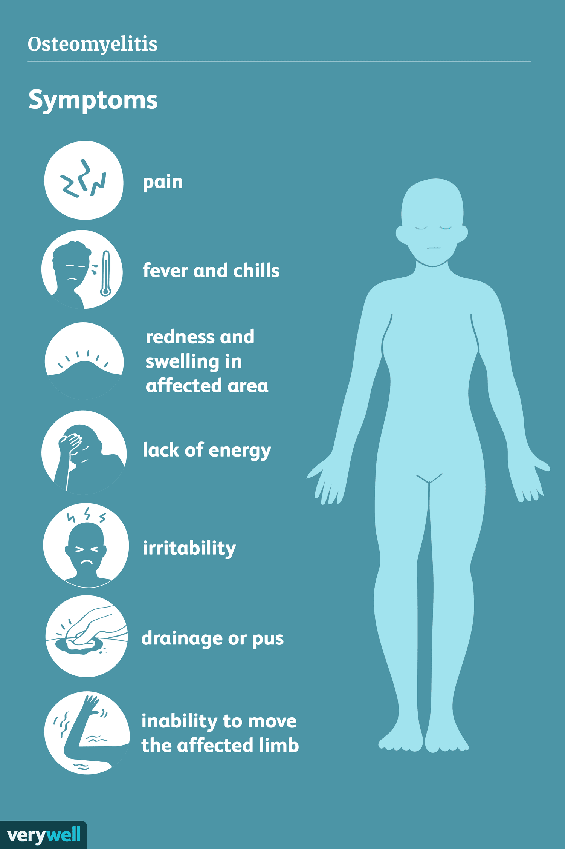
Osteomyelitis
Pathology Causes | Inflammatory condition of bone caused by infecting organism → most commonly staph aureus Haematogenous osteomyelitis refers to when a pathogen is carried through the blood and seeded in the bone. This is the most common mode of infection. Alternatively, osteomyelitis can occur due to direct contamination of the bone, for example, at a fracture site or during an orthopaedic operation. Patients may develop recurring or chronic infections after treatment for acute osteomyelitis
Risk Factors | Open fractures Orthopaedic operations, particularly with prosthetic joints (1% of replacements) Diabetes, particularly with diabetic foot ulcers Peripheral arterial disease IV drug use Immunosuppression Children → upper resp tract or varicella infection
Presentation | Limp or reluctance to weight-bear (children) Non-specific pain and tenderness at site of infection Low grade fever Erythema, swelling
Investigations | FBC - elevated WCC ESR + CRP - raised X-ray (can’t exclude osteomyelitis → can see periosteal reaction (change to surface of bone, localised osteopenia (thinning of bone), destruction of areas of bone. MRI Scans are best imaging investigation for establishing a diagnosis Blood culture, Bone Cultures can find out any antibiotic sensitivities
Management | Abx (acute osteomyelitis → 6 weeks of flucloxacillin (pos rifampicin for first 2 wks) Clindamycin in penicillin allergy. Vancomycin in MRSA. Chronic Osteomyelitis (3 months or more of abx) Supportive care Surgery → debridement of the infected bone and tissue. Revision surgery

Slide 20
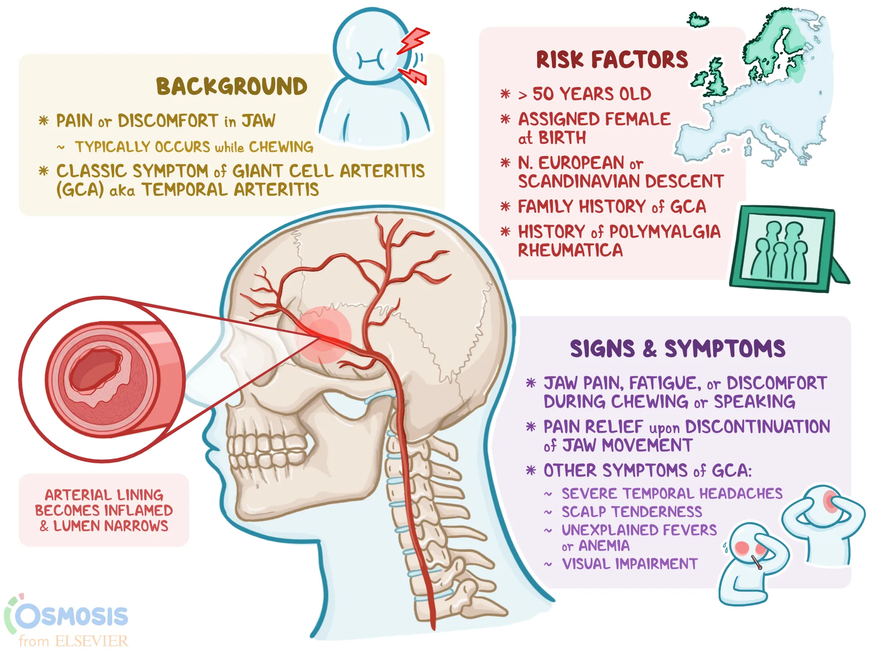
Vasculitis – Large (Giant Cell Arteritis)
Pathology Risk Factors | Affects aorta and/or its major branches (carotid and vertebral arteries) Temporal artery often involved (temporal arteritis) Almost exclusively in >50 y.o, Northern European descent, Females 2-3x more affected, Hx of polymyalgia rheumatica
Presentation | Headache! New onset, typically unilateral over temporal area Scalp tenderness (hurts to brush hair) Jaw claudication Visual disturbances → blurred vision, diplopia, amaurosis fugax – also blindness
Investigations | ↑ESR and/or CRP (=highly sensitive) ESR >50 mm/hr Halo sign on US of temporal and axillary artery Temporal artery biopsy = gold standard for Dx (show giant cells, granulomatous inflammation) On exam → temporal arteries may be tender on palpitation and thickened. Pulses may be diminished
Management | High dose glucocorticoid ASAP → usually prednisolone 40-60mg
Complications | Blindness Irreversible neuropathy

Slide 21
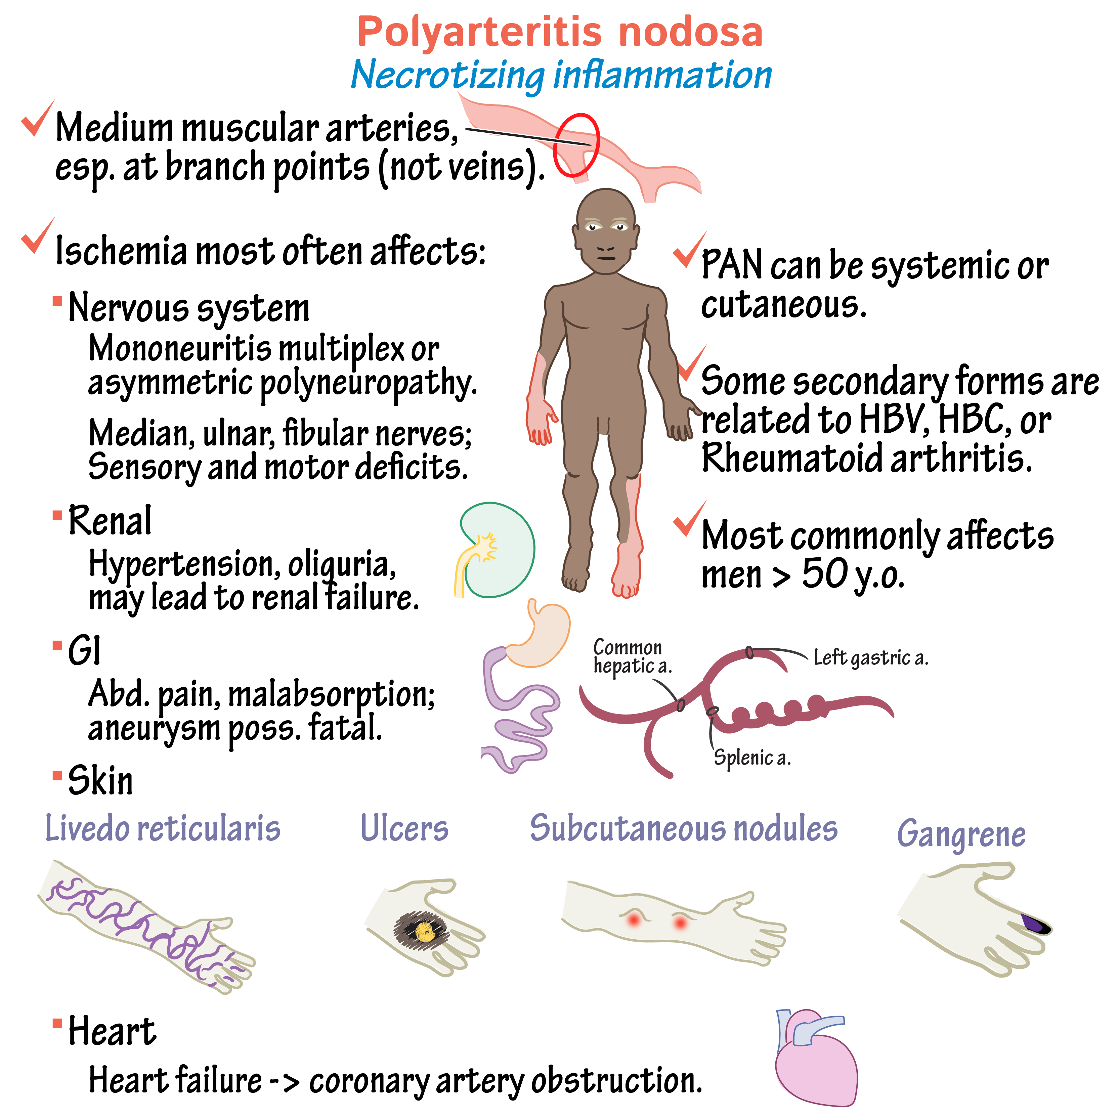
Vasculitis – Medium (Polyarteritis Nodosa)
Pathology Epidemiology | Affects the medium sized vessels in locations such as skin, GI tracts, kidneys and heart Associated with Hep B (also Hep C and HIV), More common in developing countries → affects all ages, all racial groups, no sex predominance
Presentation | Peripheral neuropathy -- mononeuritis multiplex Cutaenous/subcutaneous nodules (hallmark feature) Abdo pain Unilateral orchitis (characteristic feature) Livedo reticularis → mottled, purplish, lace like rash HTN
Investigations | ↑ESR and/or CRP HBsAg Biopsy: shows transmural fibrinoid necrosis
Management | If Hep B negative – corticosteroids + cyclophosphamide If Hep B positive – antiviral agent, plasma exchange and corticosteroids
Complications | GI perforation & haemorrhages, Arthritis, Renal infarcts, Strokes, MI

Slide 22
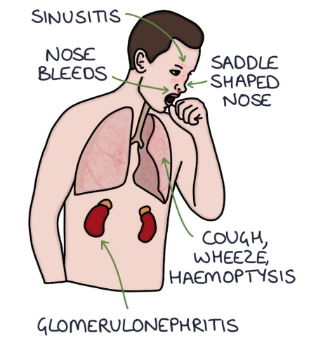
Vasculitis – Small (Granulomatosis with Polyangiitis)
Pathology Risk Factors | Small vessels vasculitis Affects respiratory tracts and kidney Late teenage years, early adulthood
Presentation | Classic sign on exams: saddle shaped nose (due to perforated nasal septum) Epistaxis Crusty nasal/ ear secretions → hearing loss Sinusitis, Cough, wheeze, haemoptysis (CXR mistaken pneumonia)
Investigations | High eosinophils on FBC Histology shows granulomas Presence of c-ANCA (not p-ANCA)
Management | Nasal) corticosteroid Cyclophosphamide
Complications | Glomerulonephritis
Notes:
Triad of ENT, lung and kidney signs

Slide 23
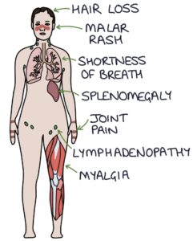
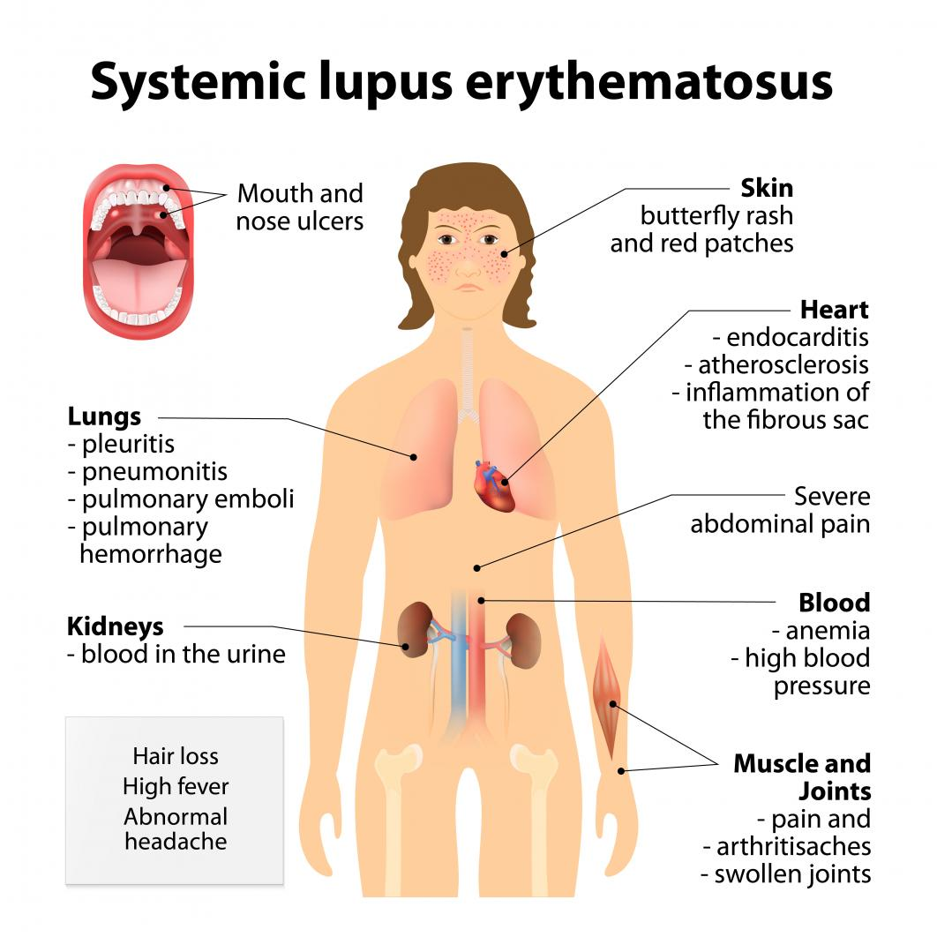
SLE
Pathology Causes | aNA and aDsDNA antibodies attack soft tissue causing chronic inflammation and damage Young to middle aged, black/Asian, women
Presentation | Symptoms: usual non-specific symptoms → butterfly rash, wt loss, fever, fatigue, joint pain, mouth ulcers Signs: correctable ulnar deviation
Investigations | Bloods: ESR raised, CRP normal (can be raised with active inflame), ANA and aDsDNA (patients without condition are very unlikely to have them) antibodies present. Normocytic anaemia of chronic disease. C3 and C4 levels (decreased in active disease) Immunoglobulins (raised due to activation of B cells with inflammation), Urinalysis and urine protein: creatinine ratio for proteinuria in lupus nephritis. Renal biopsy can be used to investigate for lupus nephritis You can use the SLICC Criteria or the ACR Criteria for establishing a diagnosis. This involves confirming the presence of antinuclear antibodies and establishing a certain number of clinical features suggestive of SLE.
Management | Ibuprofen, Prednisolone, Hydroxychloroquine (first line for mild SLE. Sun cream for malar rash) Severe or resistant lupus (Methotrexate, Tacrolimus. Non-responsive ((Rituximab (monoclonal antibody), Belimumab (MA)
Complications | Cardiac, lung, kidney involvement. Anaemia of chronic disease. Pericarditis, Pleuritis, Lupus, Nephritis, miscarriage Widespread inflammation causing damage

Slide 24
Green Quiz – Question 1
1)a) What is the gold standard investigation for osteoarthritis? (1 mark)
1)b) Give 4 features that may be seen on the above investigation. (4 marks)
The Peer Teaching Society is not liable for false or misleading information…

Slide 25
Green Quiz – Answer 1
1)a) What is the gold standard investigation for osteoarthritis? (1 mark)
X-ray
1)b) Give 4 features that may be seen on the above investigation. (4 marks)
Loss of joint space
Osteophyte formation
Subchondral cysts
Subchondral sclerosis
The Peer Teaching Society is not liable for false or misleading information…

Slide 26
Green Quiz – Question 2
Which of the following is correct regarding gout?
A – Can be treated by a joint washout (arthrocentesis)
B – Monosodium urate crystals will be seen under microscopy
C – Joint aspiration for synovial fluid may show bacterial growth
D – Rhomboid shaped crystals will be seen under microscopy
E – Crystals are positively bifringent under polarised light
The Peer Teaching Society is not liable for false or misleading information…

Slide 27
Green Quiz – Answer 2
Which of the following is correct regarding gout?
A – Can be treated by a joint washout (arthrocentesis)
B – Monosodium urate crystals will be seen under microscopy
C – Joint aspiration for synovial fluid may show bacterial growth
D – Rhomboid shaped crystals will be seen under microscopy
E – Crystals are positively bifringent under polarised light
The Peer Teaching Society is not liable for false or misleading information…

Slide 28
Green Quiz – Question 3
You see Claire, a 50-year-old women who comes to the GP after experiencing multiple fractures over the past 6 months. You refer her to have a DEXA scan and her T-score is -2.5. She is subsequently diagnosed with osteoporosis. She is prescribed vitamin D, calcium supplementation and alendronate. What advice should be given to Claire regarding her prescription of alendronate? (3 marks)
The Peer Teaching Society is not liable for false or misleading information…

Slide 29
Green Quiz – Answer 3
You see Claire, a 50-year-old women who comes to the GP after experiencing multiple fractures over the past 6 months. You refer her to have a DEXA scan and her T-score is -2.5. She is subsequently diagnosed with osteoporosis. She is prescribed vitamin D, calcium supplementation and alendronate. What advice should be given to Claire regarding her prescription of alendronate? (3 marks)
Taken first thing in the morning
On an empty stomach
Remain upright 30 minutes after taking
The Peer Teaching Society is not liable for false or misleading information…

Slide 30
Green Quiz – Question 4
What is the most common cause of septic arthritis?
A – Streptococcus pyogenes
B – E. coli
C – Staphylococcus aureus
D – Haemophilus influenza
E – Neisseria gonorrhoea
The Peer Teaching Society is not liable for false or misleading information…

Slide 31
Green Quiz – Answer 4
What is the most common cause of septic arthritis?
A – Streptococcus pyogenes
B – E. coli
C – Staphylococcus aureus
D – Haemophilus influenza
E – Neisseria gonorrhoea
The Peer Teaching Society is not liable for false or misleading information…

Slide 32
Green Quiz – Question 5
You see Angela, a 55-year-old women who comes to the GP after experiencing a headache which she points to be over the temporal area of her forehead. Angela also mentions that she found it difficult eating steak yesterday evening, as well as experiencing pain all over her scalp when she brushes her hair in the morning. On examination, her temporal arteries were tender on palpation. What is the most likely diagnosis?
A – Giant cell arteritis
B – Polyarteritis nodosa
C – Granulomatosis with polyangiitis
D – SLE
E – Rheumatoid arthritis
The Peer Teaching Society is not liable for false or misleading information…

Slide 33
Green Quiz – Answer 5
You see Angela, a 55-year-old women who comes to the GP after experiencing a headache which she points to be over the temporal area of her forehead. Angela also mentions that she found it difficult eating steak yesterday evening, as well as experiencing pain all over her scalp when she brushes her hair in the morning. On examination, her temporal arteries were tender on palpation. What is the most likely diagnosis?
A – Giant cell arteritis
B – Polyarteritis nodosa
C – Granulomatosis with polyangiitis
D – SLE
E – Rheumatoid arthritis
The Peer Teaching Society is not liable for false or misleading information…

Slide 34
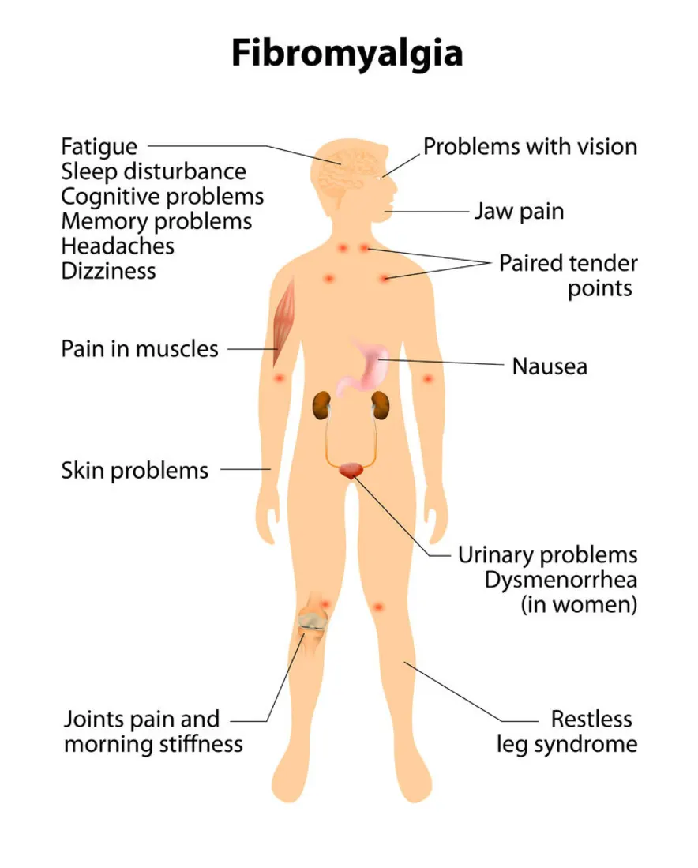
Fibromyalgia
Pathology Risk Factors | Unknown, possibly pain perception/hyper excitability of pain fibres Women, poor socioeconomic status, 20–50-year-olds
Presentation | Symptoms: increased sensitivity to pain, fatigue, fibro-fog(probs with memory + conc), morning stiffness, headaches, IBS
Investigations | 11 tender points in nine pairs of sites, for at least 3 months, Front/Back, Left/Right, Above diaphragm/below diaphragm Not usually recommended now → focus on identifying widespread pain in combination with fatigue, memory, sleep difficulties
Management | Educating patient on the condition Exercise Relaxation Analgesia (paracetamol, tramadol/codeine) CBT, counselling, low dose tricyclic antidepressants
Complications | Can really affect quality of life Anxiety, depression, insomnia Opiate Addiction
Notes:
A chronic pain syndrome diagnosed by the presence of widespread body pain
A diagnosis of exclusion
Amitriptyline is the first line drug for neuropathic pain

Slide 35
Sjogren’s
Pathology Risk Factors | Autoimmune condition that affects exocrine gland, resulting in dry mucous membranes Primary → condition occurs in isolation. Secondary Sjogren’s → related to SLE or RA Fx (first degree relative = 7x increased risk, Female, ≥40 y.o.
Presentation | Dry mucous membranes e.g., dry mouth, dry eyes, dry vagina
Investigations | Presence of anti-Ro and anti-La antibodies (more sensitive) Schirmer Test (inserting a folded piece of filter paper under the lower eyelid with a strip hanging out over the eyelid) – tears travelling <10mm is significant! (healthy adults → tears travel 15mm)
Management | Artificial tears, artificial saliva, vaginal lubricants Hydroxychloroquine used to halt progression
Complications | Eye infections (conjunctivitis, corneal ulcers) Oral problems (dental cavities, candida infections) Vaginal problems (candidiasis, sexual dysfunction)

Slide 36
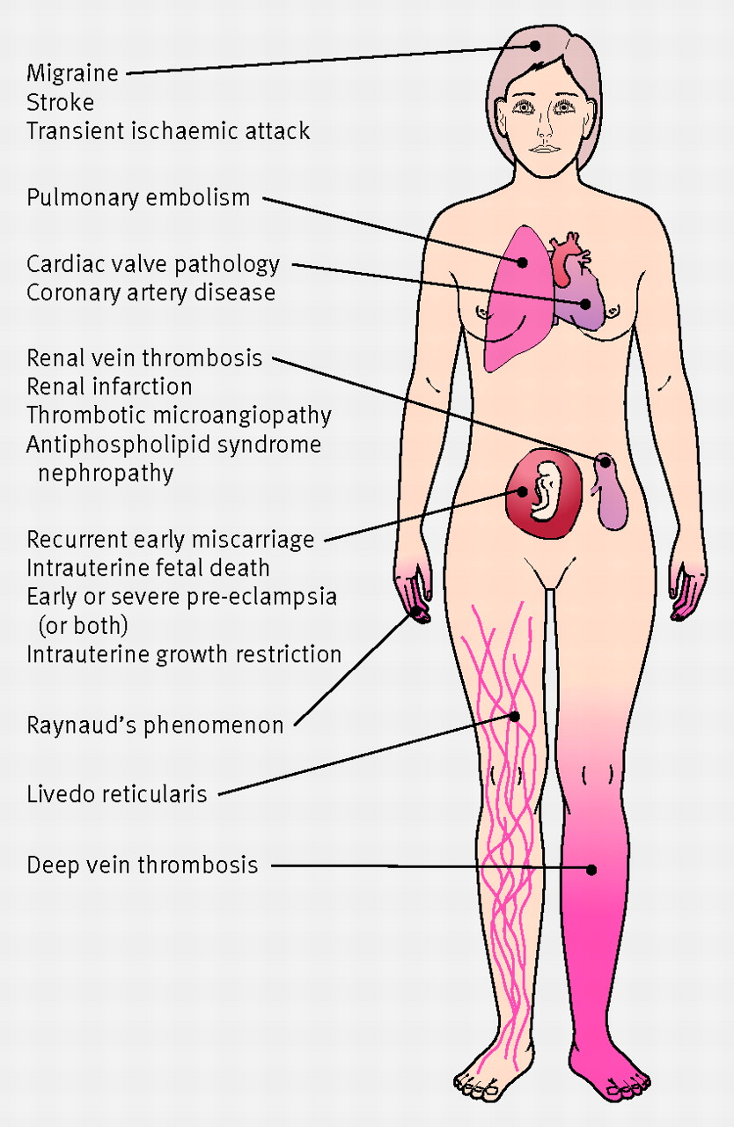
Antiphospholipid Syndrome
Pathology Risk Factors | APS is an autoimmune disease present mostly in young women. Those with APS make abnormal proteins called antiphospholipid autoantibodies in the blood. This causes blood to flow improperly and can lead to dangerous clotting in arteries and veins, problems for a developing fetus and pregnancy miscarriage. Associated with antiphospholipid antibodies where blood becomes prone to clotting = hyper-coagulable state Can occur on its own or 2˚ to AI disorder (esp. SLE) Diabetes, HTN, Obesity, Female, Smoking, Oestrogen therapy (Menopause)
Presentation | Thrombosis → DVT, PE, // Stroke, MI Recurrent miscarriages Livedo reticularis → purple lace like rash Balance probs, headaches, double vision etc.
Investigations | Hx of thrombosis/ pregnancy complications + Antibody screen with raised: anticardiolipin antibodies lupus anticoagulant anti-beta-2 glycoprotein I antibodies Dx only made after 2 abnormal blood tests 12 weeks apart
Management | Low dose aspirin (if not antiplatelets e.g, clopidogrel) → x history Warfarin → history of clots, and APS ab Pregnancy (LMWH + aspirin) Lifestyle (smoking cessation, reg exercise, healthy weight etc)
Complications | See presentation
Notes:
A disorder where blood becomes prone to clotting so the patient is in a hypercoagulable state
Acronym CLOT:
C – coagulation defect
L – livido reticularis
O – obstetric issues e.g miscarriage
T – thrombocytopenia
Warfarin is contraindicated in pregnancy as it can cause birth defects and bleeding from the placenta

Slide 37
Dermatomyositis / Polymyositis
Pathology | AI where inflammation in the muscles (myositis) Polymyositis is a condition of chronic inflammation of muscles. Dermatomyositis is a connective tissue disorder where there is chronic inflammation of the skin & muscles.
Presentation | Muscle pain, fatigue and weakness Occurs bilaterally and typically affects the proximal muscles (Mostly affects the shoulder and pelvic girdle Develops over weeks Poly → occurs without skin features. Derma associated with skin features (Gottron lesions (scaly erythematous patches on knuckles, elbows, knees), Photosensitive erythematous rash on back, shoulders + neck, purple rash on face and eyelids, periorbital oedema, SC calcinosis (calcium deposits in SC Tissue)
Investigations | Clinical presentation Elevated creatine kinase Over 1000 U/L → could be because of AKI, MI, Statins, Rhabdo High ALT, AST, LDH Autoantibodies Anti-Jo-1 (polymyositis, but also in in dermatomyositis) Anti-MI-2/ANAs → dermatomyosities Electromyography (EMG) → fibrillation, PSWs (positive sharp waves) Muscle biopsy can be used to establish a definitive diagnosis.
Management | Check for Lung, Breast, Ovarian, Gastric cancers as can often be caused by them (paraneoplastic syndrome Corticosteroids → first line When response is inadequate: Immunosuppressants (azathioprine) IV immunoglobulins Biological therapy (infliximab, etanercept)
Notes:
CK – elevated
Muscle biopsy - muscle inflammation and determine the type of myositis
Check for underlying cancers because the 2 can be related

Slide 38
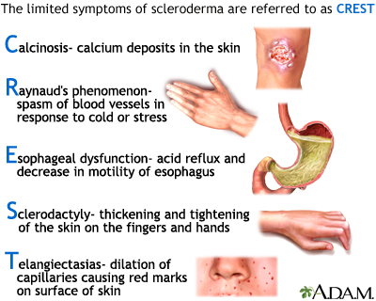
Scleroderma
Pathology | Vascular damage(fibrosis) of the small arteries, arterioles and capillaries. Most common in women Caused by excess collagen production that leads to thickening and tightening of skin Diffuse S = CREST syndrome + organ problems → Limited S = CREST syndrome
Presentation | CREST Syndrome Calcinosis- calcium deposition in subcutaneous tissue Raynauds phenomenon → extremities going a different colour (white, purple, blue) Eosophageal dysmotility and strictures Sclerodactylyl- thickening of skin over the fingers distal to MCP. Telenagiectasia (dilated capillaries, particularly in cheeks → fine, thready appearance) First Symptoms are usually → Skin becoming tight, fingers becoming stiff and inflexible, Raynauds (fingers turning cold and blue in response to minor triggers)
Investigations | Anti-centromere antibodies (ACA) more associated with limited sclerosis, Anri-Scl-70, anti-topoisomerase and anti RNA polymerase III is most associated with diffuse systemic sclerosis
Management | Immunosuppressants are used to slow progression → cyclophosphamide MDT → Physiotherapy and occupational health Symptomatic Treatment = Analgesia, CCB (Raynauds e.g., nifedipine), Topic skin emollients, PPI for reflux, treating PAH (Sildenafil)
Notes:
An autoimmune inflammatory and fibrotic connective tissue disease, affecting skin and organs
> Anti-Scl-70 antibodies
> Anti-topoisomerase
Anti RNA polymerse III
CREST syndrome plus organ problems:
> CV problems e.g pulmonary hypertension, coronary artery disease, myocardial fibrosis
> Lung problems e.g pulmonary hypertension, pulmonary fibrosis
> Kidney problems e.g glomerulonephritis
CXR – lung problems
Albumin/creatinine ratio – kidney problems
> Avoid smoking
> Avoid cold triggers - Raynaud's
> Gentle skin stretching - maintain range of motion
> Physiotherapy - maintain healthy joints
> Occupational therapy - adaptations to daily living to cope with limitations
> Nifedipine (CCB) - Raynaud's as it can cause vasodilation
> Lansoprazole (PPI) - GI symptoms
> Analgesia - joint pain
> Ramipril (ACE-inhibitor) - hypertension

Slide 39
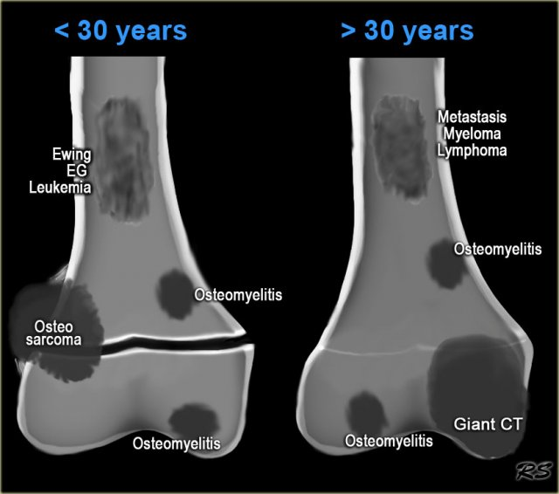
Bone Tumours
Pathology | Most common → Chondrosarcoma, Osteosarcoma, Ewing sarcoma (bone marrow) Other types → Chordoma (occurs at base + length of spine + base of skull), Spindle cell sarcoma of bone, Adamantinoma, Angiosarcoma of bone , Giant cell tumour of bone (benign)
Risk Factors | Previous radiotherapy Previous cancer Paget’s disease Benign bone lesions
Presentation | More common in males Common sites → long bones Bone pain Worse at night, Constant or intermittent (not associated with movement, Resistant to analgesia May increase in intensity Atypical bony or soft tissue swelling/ masses, Easy Bruising Mobility issues → unexplained limp, joint stiffness, reduced range of motion Inflammation + tenderness over bone Systemic symptoms
Investigations | 1st line → x-ray Gold standard → bone biopsy Bloods → FBC, ESR, ALP, lactate dehydrogenase, Ca, U+E CT chest/abdo/pelvis
Management | Chemo Radiotherapy Surgery → limb sparing pr amputation
Complications | Hypercalcemia, bone pain, metastases, pathological fractures
Secondary Bone Cancer → Common sites:
Bronchus
Breast
Brostate
Byroid
Bidney
Notes:
Giant Cell Tumour
Primary bone malignancy in children – osteosarcoma
Osteosarcoma – fluffy appearance (due to bone destruction), sun burst appearance, Codman’s triangle
Chondrosarcoma – popcorn calcification and endosteal scalloping
Ewing’s sarcoma – onion skin change

Slide 40
Osteomalacia
Pathology | Poor bone mineralization leading to soft bone due to lack of vitamin D. In ADULTS. Rickets: inadequate mineralization of the bone and epiphyseal cartilage in the growing skeleton of CHILDREN. Calcium deficiency → usually due to vitamin D deficiency
Risk Factors | Malabsorption Disorders (IBD), Vit D deficiency in CKD, darker skin, low exposure to sunlight, live in colder climates and spend the majority of their time indoors
Presentation | Osteomalacia Fatigue, bone pain and tenderness. Dull ache that is worse on weight-bearing exercises Fractures – esp NOF, abnormal fractures Muscle weakness/aches - waddling gait, difficulty with stairs Rickets Growth retardation Hypotonia, Knock-kneed, bow-legs.
Investigations | X-ray → loss of cortical bone – defective mineralisation (osteopenia (more radiolucent bones). DEXA → shows low bone mineral density Serum 25-hydroxyvitamin D ( less than 25 nmol/L is Vit D deficiency, 25-50 nmol/L is vit D insufficiency, greater than 75 nmol/L is optimal. Bloods → Low serum calcium and phosphate, Bone Biopsies → incomplete mineralisation
Management | Vitamin D supplements – rapid mineralization of bone and resolution of symptoms. If due to deficiency → 50,000 IU 1/wk for 6wks, 20,000 IU 2/wk for 7 wks, 4000 IU daily for 10 wks (Colecalciferol) If dietary insufficiency or after initial treatment – 800 IU or more per day should be continued for life If due to malabsorption, give IM calcitriol
Notes:
Defective bone mineralisation
Causes of osteomalacia – inherited, low vitamin D, liver failure, renal failure
Bow legs = varus
Knock knees = valgus
> Vitamin D is essential for Ca2+ and phosphate absorption from the intestines
> Deficiency results in less Ca2+ and phosphate in the blood
> Defective bone mineralisation
Vitamin D deficiency resulting in low Ca2+ can result in secondary hyperparathyroidism where PT glands release more PTH to try and increas serum Ca2+ which results in bone resorption
Blood tests – everything is low except raised ALP
> Serum vitamin D - low
> Serum Ca2+ - low
> Serum phosphate - low
Serum ALP - high
Causes of osteomalacia – inherited, low vitamin D, liver failure, renal failure

Slide 41
Paget’s Disease
Pathology | Excessive bone turnover (formation + resorption) due to excessive osteoblast + osteoclast activity Leads to patchy areas high density (sclerosis) + low density (lysis) Enlarged + misshapen bones → risk of fracture. Partic affects the axial skeleton (bones of the head and spine)
Presentation | Bone pain Bone deformity Fractures Hearing loss (if bones of ear affected)
Investigations | X-ray: Bone enlargement + deformity Osteoporosis circumscripta (well defined osteolytic lesions) Cotton wool appearance of skull (poorly defined areas of sclerosis + lysis) V-shaped defects in long bones Bloods Raised ALP → other LFTs are normal (monitoring of this in future as effective treatment should normalise the ALP and eliminate symptoms) Normal calcium + phosphate
Management | Bisphosphonates NSAIDs for bone pain Calcium + Vit D supplements particularly whilst on bisphosphonates Surgery to correct bone deformities
Complications | Osteosarcoma Spinal stenosis (narrowing of the spinal cord) + cord compression → neurological symptoms
Notes:
Disorder of bone turnover
Everything is normal except a raised ALP
3 phases of Paget's disease…
1) Lytic phase - excessive osteoclastic bone resorption
2) Mixed phase - excessive osteoclastic bone resorption and disorganised osteoblastic bone formation
3) Blastic phase - disorganised osteoblastic bone formation

Slide 42
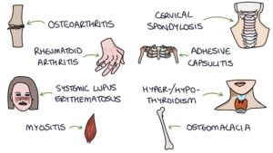
Polymyalgia Rheumatica
Pathology | inflammatory condition that causes pain and stiffness in the shoulders, pelvic girdle and neck. There is a strong association to giant cell arteritis and the two conditions often occur together. Both conditions respond well to treatment with steroids Older adults (above 50), Female, Caucasian
DDx
Presentation | Be present for at least 2 weeks: Bilateral shoulder pain that may radiate to the elbow Bilateral pelvic girdle pain Worse with movement Interferes with sleep
Investigations | Diagnosis is mainly based on the clinical presentation and the response to steroids Inflammatory markers (ESR, plasma viscosity and CRP) Creatinine is normal – allows it to be differentiated from myositis Before starting steroids (FBC, U&Es, LFTs, Ca, TSH, CK, Rheumatoid Factor, Serum protein electrophoresis)
Management | Initially patients are started on 15mg of prednisolone per day – rapid improvement! Assess 1 week after starting steroids. If there is a poor response in symptoms it is probably not PMR and an alternative diagnosis needs to be considered. Stop the steroids. Assess 3-4 weeks after starting steroids. You would expect a 70% improvement in symptoms and inflammatory markers to return to normal to make a working diagnosis of PMR. → reducing regime (15mg until fully controlled, then 12.5 mg for 3 wks, 10mg for 4-6 weeks, then reduced by 1mg ever 4-8wks.
Other Features:
Systemic symptoms such as weight loss, fatigue, low grade fever & low mood
Upper arm tenderness
Carpel tunnel syndrome
Pitting oedema
Notes:
Comp of Steroids:
DON’T – Make them aware that they will become steroid dependent after 3 weeks of treatment and should not stop taking the steroids due to the risk of adrenal crisis if steroids are abruptly withdrawn
S – Sick Day Rules: Discuss increasing the steroid dose if they become unwell (“sick day rules”)
T – Treatment Card: Provide a steroid treatment card to alert others that they are steroid dependent in case they become unresponsive
O – Osteoporosis prevention: Consider osteoporosis prophylaxis whilst on steroids with bisphosphonates and calcium and vitamin D supplements
P – Proton pump inhibitor: Consider gastric protection with a proton pump inhibitor (e.g. omeprazole)

Slide 43
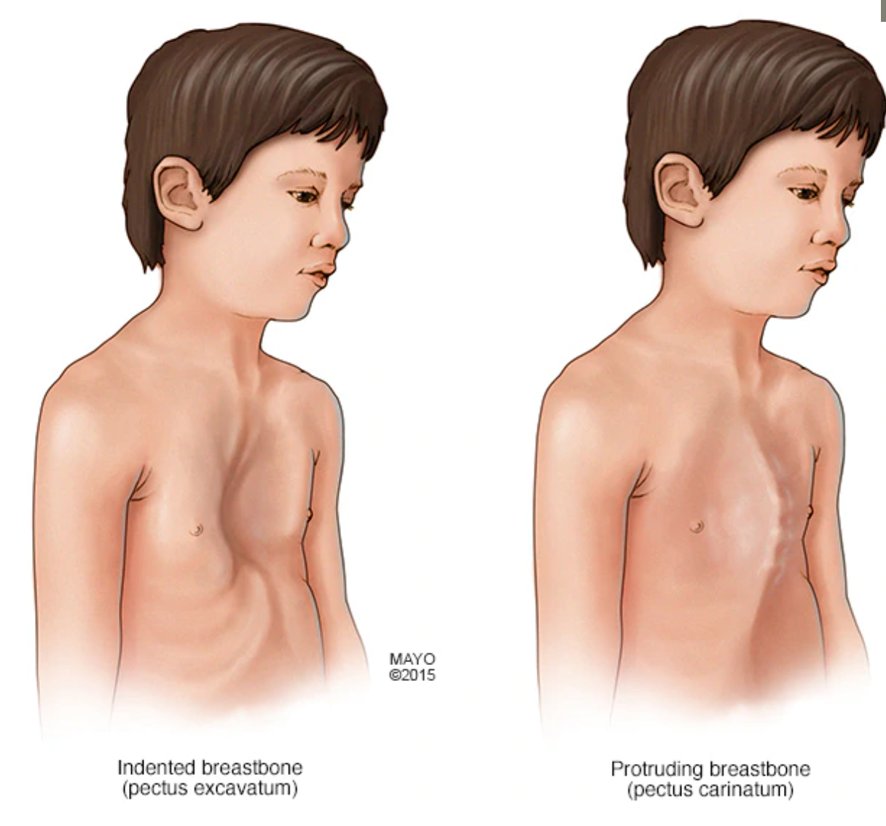
Marfan’s Syndrome
Pathology | Autosomal dominant condition Affects gene involved in creating fibrillin → fibrillin is an important component of connective tissue therefore people with Marfan’s have features resulting from abnormal connective tissue
Presentation | Tall stature Long neck/limbs Long fingers
Investigations | Physical exam: Cross their thumb across their palm, if the thumb tip goes past the opposite edge of the hand this indicates arachnodactyly. Next ask them to wrap the thumb and fingers of one hand around the other wrist, if the thumb and fingers overlap this also indicates arachnodactyly (fingers are abnormally long and slender). Murmur suggestive of mitral or aortic regurgitation. Mouth has high arch palate Ghent Criteria: Major: enlarged aorta, lens dislocation, Fx, at least 4 skeletal problems Minor: myopia, loose joints, high arched palate Can do echo to check heart, valves and aorta conditions MRI Eye exam
Management | Beta-blockers / ARBs (avoid intense exercise + coffee) Physio to strengthen joints + genetic counselling for implications Yearly echo / review by ophthalmologist
Complications | Mitral/aortic valve prolapse (with regurgitation) Aortic aneurysms (espc preg) Lens dislocation Pneumothorax
Hypermobility
Pectus Carinatum / Pectus Excavatum
High arch plate
GORD
Scoliosis
Joint dislocation and pain
Notes:
Management involves reducing the risk of cardiac complications

Slide 44
Marfan’s

Slide 45
Ehlers-Danlos Syndrome
Pathology | EDS is an umbrella term used for a group of genetic conditions that cause defects in collagen, resulting in hypermobility of joints and abnormalities in connective tissue such as the skin, bones, blood vessels and organs EDS is a multisystemic disorder so symptoms vary based on which type of EDS (13 types) → Most common type is “hypermobile EDS) → joint hypermobility, soft and stretchy skin.
Presentation | Varies between types but generally: Joint hypermobility Easily stretched skin (hyperextensibility) Easy bruising Chronic joint pain Re-occurring dislocations
Investigations | Use Beighton score to assess hypermobility. One point is scored for each side of the body, with a maximum score of 9: Palms flat on floor with straight legs (score 1) Elbows hyperextend Knees hyperextend Thumb can bend to touch the forearm Little finger hyperextends past 90 degrees Exclude marfans (would have high arch palate, arachnodactyly, arm span)
Management | Fitness and avoid contact sports Physiotherapy (strengthen and stabilize joints. Occupational therapy → maximise function Psychological support (manage chronic condition+pain) Genetic counselling
Poor wound healing / bleeding
Headaches, Dizziness, Syncope
GORD, abdo pain, IBS
Menorrhagia, Dysmenorrhea
UIncontinence, Pelvic Organ Prolapse
Notes:
Some other types:
Classical EDS → stretchy skin (smooth and velvety to touch), joint hypermobility, joint pain, abnormal wound healing.
Vascular EDS → most dangerous! Need monitoring for vascular abnormalities, very prone to rupture. Px → thin, translucent skin
Kyphoscoliotic EDS → poor tone as neonate and infant followed by kyphoscoliosis as they grow. Sig joint hypermobility, tall and skin px, risk of medium sized artery rupture.
Complications:
Classical type: prone to hernias, prolapse, aortic root dilation, joint pain, abnormal wound healing
Vascular EDS: skin, internal organs, vessels are prone to rupture
Postural orthostatic tachycardia syndrome (POTS) can occur with hypermobile Ehlers-Danlos syndrome, and is a result of autonomic dysfunction. Inappropriate tachycardia on sitting or standing up, resulting in distressing symptoms such as presyncope, syncope, headaches, disorientation, nausea and tremor.

Slide 46
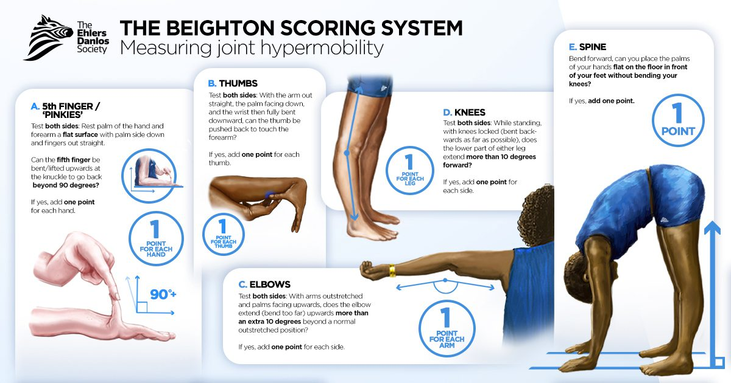
Ehlers-Danlos Syndrome
Notes:
Some other types:
Classical EDS → stretchy skin (smooth and velvety to touch), joint hypermobility, joint pain, abnormal wound healing.
Vascular EDS → most dangerous! Need monitoring for vascular abnormalities, very prone to rupture. Px → thin, translucent skin
Kyphoscoliotic EDS → poor tone as neonate and infant followed by kyphoscoliosis as they grow. Sig joint hypermobility, tall and skin px, risk of medium sized artery rupture.
Complications:
Classical type: prone to hernias, prolapse, aortic root dilation, joint pain, abnormal wound healing
Vascular EDS: skin, internal organs, vessels are prone to rupture
Postural orthostatic tachycardia syndrome (POTS) can occur with hypermobile Ehlers-Danlos syndrome, and is a result of autonomic dysfunction. Inappropriate tachycardia on sitting or standing up, resulting in distressing symptoms such as presyncope, syncope, headaches, disorientation, nausea and tremor.

Slide 47
Red Flags For Back Pain
TUNA FISH:
> Trauma - osteoporosis
> Unexplained weight loss - cancer
> Neurological symptoms - cauda equina syndrome
> Age > 50 or < 20 - secondary bone cancer, ankylosing spondylitis, herniated disc
> Fever - infection
> IV drug use - infection
> Steroid use - infection
> History of cancer - cancer metastasised to the spine

Slide 48
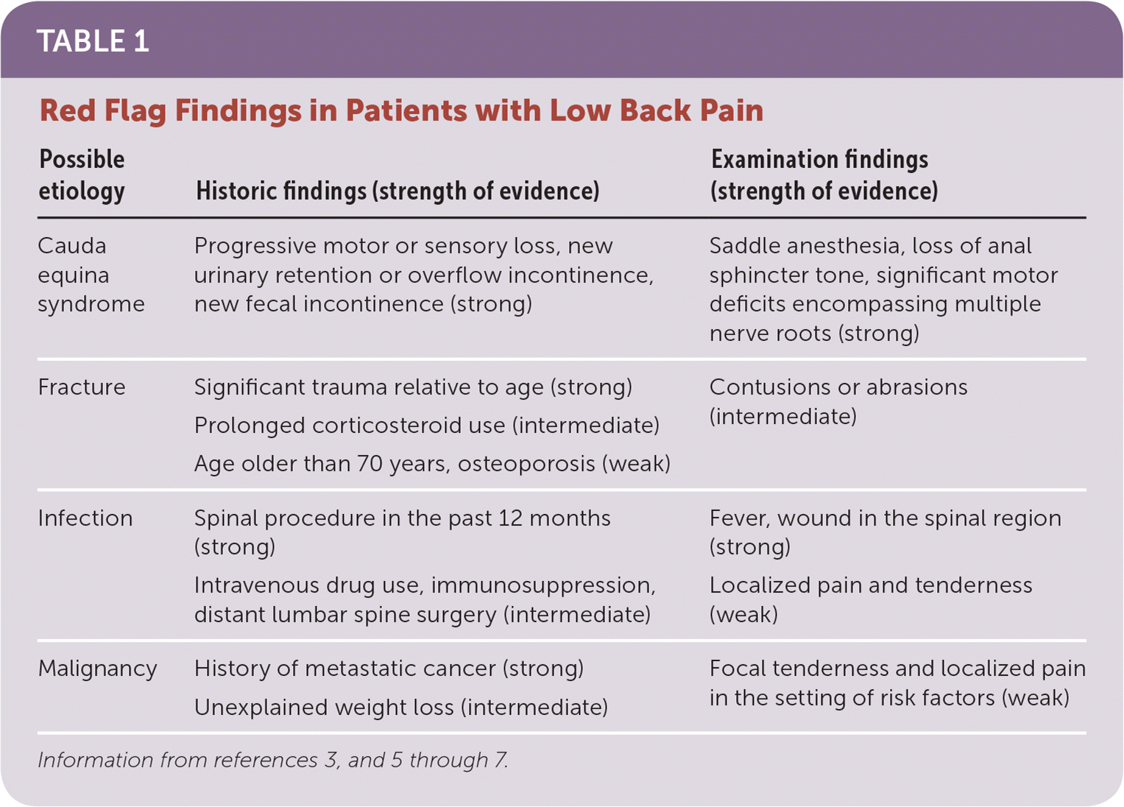
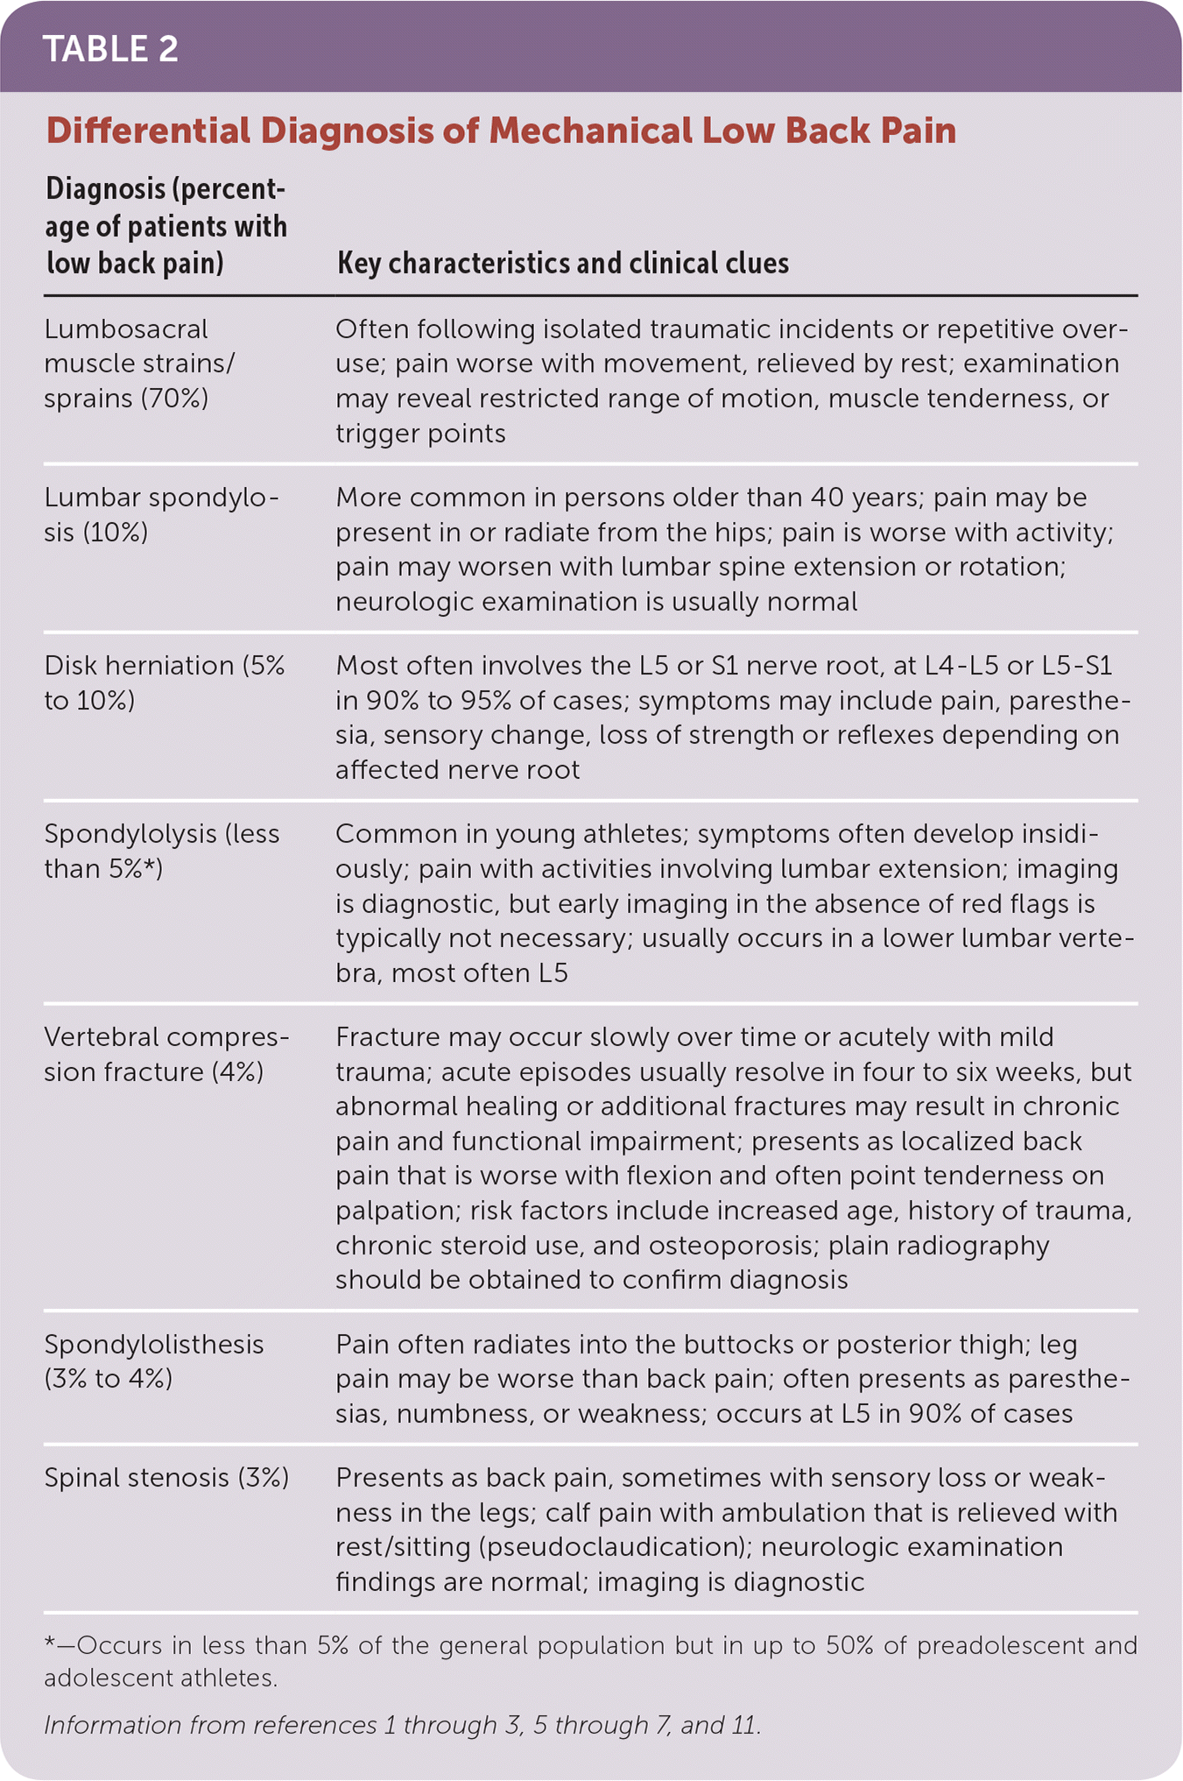
Lower Back Pain
Notes:
https://www.aafp.org/pubs/afp/issues/2018/1001/p421.html
TUNA FISH:
> Trauma - osteoporosis
> Unexplained weight loss - cancer
> Neurological symptoms - cauda equina syndrome
> Age > 50 or < 20 - secondary bone cancer, ankylosing spondylitis, herniated disc
> Fever - infection
> IV drug use - infection
> Steroid use - infection
> History of cancer - cancer metastasised to the spine

Slide 49
Conclusion
PTS
Zero to Finals
BMJ Best Practice
PassMed
The Peer Teaching Society is not liable for false or misleading information…

Slide 50
Feedback
https://forms.gle/xekDrivKaxdQKwDW9
The Peer Teaching Society is not liable for false or misleading information…

Slide 51
Quiz – Question 1
Which of the following antibodies is specific to SLE?
A – Anti-CCP antibodies
B – Anti-Ro antibodies
C – Anticardiolipin antibodies
D – Anti-nuclear antibodies (ANA)
E – Anti-double stranded DNA (anti-dsDNA)
The Peer Teaching Society is not liable for false or misleading information…

Slide 52
Quiz – Answer 1
Which of the following antibodies is specific to SLE?
A – Anti-CCP antibodies
B – Anti-Ro antibodies
C – Anticardiolipin antibodies
D – Anti-nuclear antibodies (ANA)
E – Anti-double stranded DNA (anti-dsDNA)
The Peer Teaching Society is not liable for false or misleading information…

Slide 53
Quiz – Question 2
You see Judy, a 40-year-old women who comes to the GP after experiencing recurrent episodes of conjunctivitis. She also mentions she has been drinking more water than usual as her mouth has felt very dry recently. A blood test is done and anti-Ro and anti-La antibodies are present.
What is the most likely diagnosis? (1 mark)
Give 2 things which could be used to improve her condition. (2 marks)
What can be used to halt the progression of this condition? (1 mark)
The Peer Teaching Society is not liable for false or misleading information…

Slide 54
Quiz – Answer 2
You see Judy, 40-year-old women who comes to the GP after experiencing recurrent episodes of a conjunctivitis. She also mentions she has been drinking more water than usual as her mouth has felt very dry recently. A blood test is done and anti-Ro and anti-La antibodies are present.
What is the most likely diagnosis? (1 mark)
Sjogren’s syndrome
Give 2 things which could be used to improve her condition. (2 marks)
Artificial tears
Artificial saliva
Vaginal lubricants
What can be used to halt the progression of this condition? (1 mark)
Hydroxychloroquine
The Peer Teaching Society is not liable for false or misleading information…

Slide 55
Quiz – Question 3
Name 3 areas of the body in which bone cancers are most likely to metastaise from. (3 marks)
The Peer Teaching Society is not liable for false or misleading information…

Slide 56
Quiz – Answer 3
Name 3 areas of the body in which bone cancers are most likely to metastaise from. (3 marks)
Prostate
Breast
Kidney
Thyroid
Lung
The Peer Teaching Society is not liable for false or misleading information…

Slide 57
Quiz – Question 4
Which of the following features is typical of Paget’s disease?
A – Raised ALP
B – Raised ALT
C – Raised serum vitamin D
D – Raised serum calcium
E – Raised serum phosphate
The Peer Teaching Society is not liable for false or misleading information…

Slide 58
Quiz – Answer 4
Which of the following features is typical of Paget’s disease?
A – Raised ALP
B – Raised ALT
C – Raised serum vitamin D
D – Raised serum calcium
E – Raised serum phosphate
The Peer Teaching Society is not liable for false or misleading information…

Slide 59
Quiz – Question 5
You see Dave, a 40-year-old male who comes to the GP explaining his fingers have become progressively stiffer. He says it is beginning to really impact his ability to work as a phlebotomist. He also mentions that his fingers have been turning blue when it’s cold outside and he also been experiencing reflux after eating. Given his most likely diagnosis, what antibodies would be expected.
A – Anti-TTG antibodies
B – Antiphospholipid antibodies
C – c-ANCA antibodies
D – Anti-centromere antibodies
E – Anti-musk antibodies
The Peer Teaching Society is not liable for false or misleading information…

Slide 60
Quiz – Answer 5
You see Dave, a 40-year-old male who comes to the GP explaining his fingers have become progressively stiffer which is beginning to really impact his ability to work as a phlebotomist. He also mentions that his fingers have been turning blue when it’s cold outside and he also been experiencing reflux after eating. Given his most likely diagnosis, what antibodies would be expected.
A – Anti-TTG antibodies
B – Antiphospholipid antibodies
C – c-ANCA antibodies
D – Anti-centromere antibodies
E – Anti-musk antibodies
The Peer Teaching Society is not liable for false or misleading information…

