Slide 1
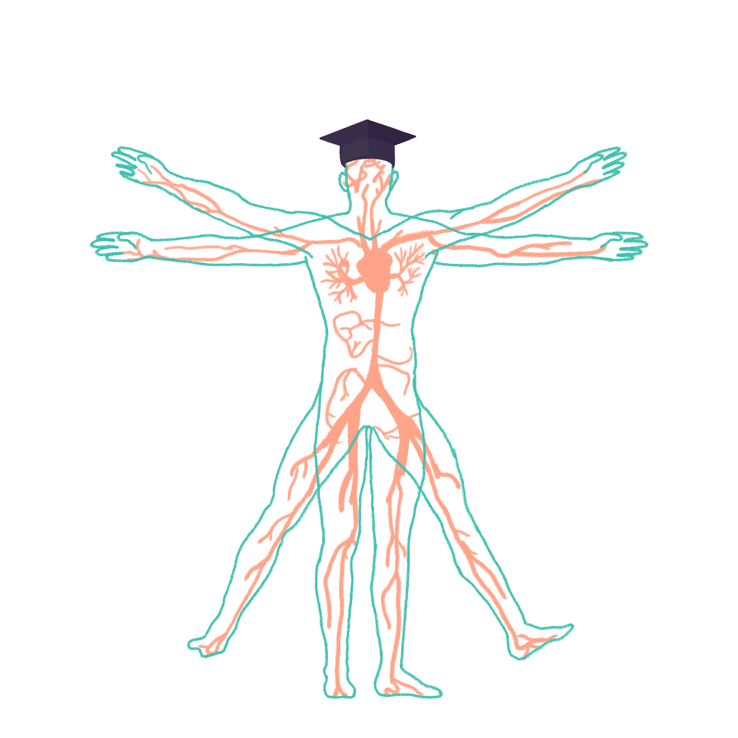
2022/2023

Slide 2
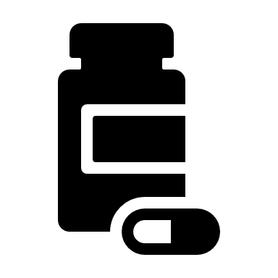
PHARMACOLOGY
Phase 2a Revision Session
HAROON TARIQ
02/12/2022
The Peer Teaching Society is not liable for false or misleading information…

Slide 3
DON’T PANIC…
Use PTS sessions as a way to recap what you’ve read through
I’ve already done pharmacology in my ICS video but this is more focused and INTERACTIVE so please don’t be boring ☺
Plenty of time to still figure out best revision methods for you
Look out for exam question session in person…

Slide 4
AIMS AND OBJECTIVES
Today:
understanding the BASICS of pharmacology;
definitions (pharmacodynamics/kinetics, affinity, efficacy…), routes of administration, key pathways involved, neurotransmission, key drugs and classes
By the end of 2a:
To look at 2a holistically and understand WHY certain meds are prescribed when, and to know condition-specific pharmacological treatments
The Peer Teaching Society is not liable for false or misleading information…

Slide 5
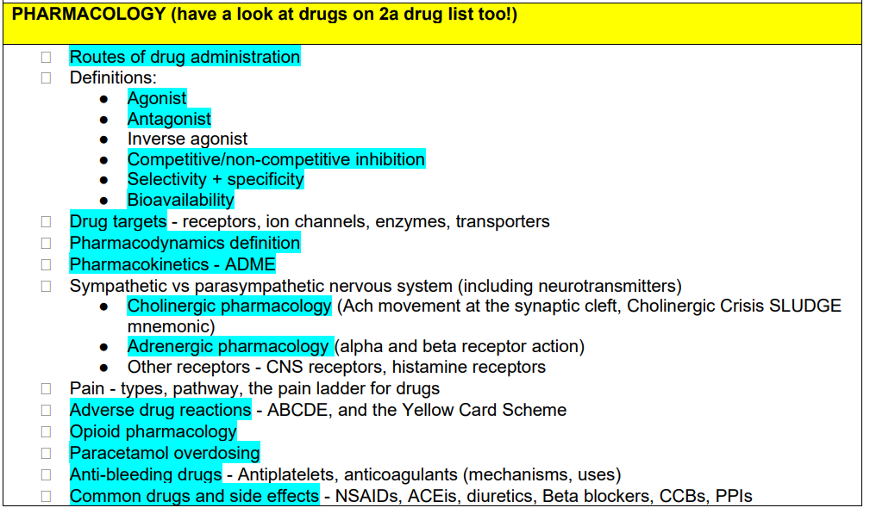
Content; LOOK AT THE 2A SPEC
+ OTHER STUFF:
- 2a DRUG LIST
- ILA 3: PHARMACODYNAMICS AND PHARMACOKINETICS
The Peer Teaching Society is not liable for false or misleading information…

Slide 6
CONTENT…

Slide 7
ROUTES OF ADMINISTRATION
ENTERAL (THROUGH GIT) – systemic effect
Oral (PO)
Rectal suppository (PR)
PARENTERAL (NON GIT) – systemic effect
Subcutaneous (SC)
Intramuscular (IM)
Intravenous (IV)
Sublingual
Inhalers (INH)
LOCAL EFFECT, OTHERS: Transdermal e.g. patches, Topical cream e.g. steroid
DON’T NEGLECT PRESCRIBING FP10 TASKS IN GP;
NEW 2B OSCE HAS A PRESCIBING TASK!
The Peer Teaching Society is not liable for false or misleading information…

Slide 8
DEFINITIONS…
AGONIST
ANTAGONIST
AFFINITY
EFFICACY
POTENCY

Slide 9
DEFINITIONS
AGONISTS HAVE FULL AFFINITY AND FULL EFFICACY, THEREBY INCREASING ACTIVATION OF THE RECEPTOR
ANTAGONISTS HAVE FULL AFFINITY AND ZERO EFFICACY THEREBY DECREASING THE ACTIVATION OF THE RECEPTOR
AFFINITY: how well a ligand BINDS TO its receptor
EFFICACY: how well a ligand SUCCESSFULLY ACTIVATES its receptor
POTENCY: relative STRENGTH of the drug, i.e. Lower dose needed for response = more potent.

Slide 10
RECEPTOR INHIBITION
COMPETITIVE INHIBITORS
NON COMPETITIVE INHIBITORS
BINDS AWAY FROM ACTIVE SITE, CHANGING ITS SHAPE. DECREASES EFFICACY IRREVERSIBLY, AFFINITY IS REDUCED
BINDS AT THE ACTIVE SITE. DECREASES EFFICACY REVERSIBLY, AFFINITY IS UNCHANGED

Slide 11
RECEPTOR INHIBITION – dose/response curve
COMPETITIVE INHIBITORS NON-COMPETITIVE INHIBITORS
RESPONSE
RESPONSE
EC50
EC50
NEW EC50
DOSE
DOSE
Curve SHIFTED RIGHT.
Drug has LESS AFFINITY, but SAME EFFICACY (response will eventually be maximal, SAME EC50).
Drug is LESS POTENT.
Curve SHIFTED RIGHT AND DOWNWARDS .
Drug has LESS AFFINITY, and LESS EFFICACY (response CANNOT be maximal, and EC50 DECREASED).
Drug is LESS POTENT.

Slide 12
BIOAVAILABILITY and THERAPEUTIC RANGE
BIOAVAILABILITY= how much drug is uptaken systemically for effect.
IV Route 🡪 always 100%
Other routes 🡪 suboptimal
THERAPEUTIC RANGE = upper and lower bounds of safe doses of a drug. Narrower range – need more care in dispensing!

Slide 13
DRUG TARGETS
Need to understand drugs act on mechanisms to serve their purpose
RECEPTOR ACTION (MOST COMMON)
ENZYMES
ION CHANNELS
TRANSPORTERS
Example of each plz ☺
Notes:
RECEPTOR – ARBs, Beta Blockers, salbutamol, tamoxifen, alpha blockers...
ENZYME – ACE-I, 5-alpha reductase inhibitors
ION CHANNELS – CCB
TRANSPORTERS – PPI

Slide 14
PHARMACODYNAMICS & PHARMACOKINETICS
Think of this as a pathway:
ADMINISTRATION🡪 pharmacoDYNAMICS 🡪 pharmacoKINETICS
THE EFFECT OF THE DRUG ON THE BODY.
Literally think of the drug running through the blood to the tissues, and then what does there.
THE EFFECT OF THE BODY ON THE DRUG. Think of this as the drug’s done messing around, and it’s time to be broken down

Slide 15
PHARMACOKINETICS
4 ASPECTS; ADME
ADMINISTRATION (route)
DISTRIBUTION (systemic spreading)
METABOLISM (aka as 1st pass metabolism. IV route skips this!)
EXCRETION (hepatically or renally)

Slide 16
METABOLISM
GIT, Renal and Hepatic
GIT = Mechanical and chemical digestion, for majority of food.
RENAL = simple, already soluble molecules. Easy to pee out directly.
HEPATIC = more complex, hydrophobic molecules. undergo phase 1 and/ or phase 2 reactions;
🡪 phase 1; non-conjugation. Aims to slightly increase hydrophilicity. By microsomal enzymes e.g. CYP450
🡪 phase 2; conjugation. Adds functional groups e.g. glucuronidation to massively increase hydrophilicity

Slide 17
NERVOUS SYSTEM
PARASYMPATHETIC & SYMPATHETIC NEUROTRANSMISSION
PARASYMPATHETIC:
-presynaptic Ach (n)
-postsynaptic Ach (m)
SYMPATHETIC:
-presynaptic Ach (n)
-postsynaptic NAd
SKELETAL MUSCLE MOTOR:
Ach at the NMJ
Notes:
PARA&SYMP= AUTONOMIC (self governing)
MOTOR = SOMATIC (voluntary)

Slide 18
CHOLINERGIC PHARMACOLOGY
Less key to know than adrenergic
2 main receptors = nicotinic and muscarinic
Nicotinic usually presynaptic. Muscarinic usually postsynaptic.
M1 = Brain. M2 = Heart. M3 = LUNGS (SAMA e.g. ipratropium bromide)
Be aware of the mechanism of neurotransmission (synthesis, storage, release, breakdown, reuptake)

Slide 19
CHOLINERGIC PHARMACOLOGY
Q1.
a. WHICH CONDITION IS RELATED TO DISRUPTED Ach TRANSMISSION AT THE NMJ?
b. WHAT IS THE TREATMENT FOR THIS?
Q2.
NAME SOME SIDE EFFECTS OF EXCESSIVE ACETYLCHOLINE STIMULATION.
Don’t expect you to know this now but good to bear in mind ☺
Notes:
1. MYASTHENIA GRAVIS
2. Ach-ASE INHIBITORS E.G. RIVASTIGMINE
3. Cholinergic crisis= SLUDGE
SAKIVATION, LACRIMATION, URINATION, DEFACTION, GI DISTRESS, EMESIS

Slide 20
ADRENERGIC PHARMACOLOGY

Slide 21
ADRENERGIC PHARMACOLOGY
ADRENERGIC PHARMACOLOGY

Slide 22
ADRENERGIC PHARMACOLOGY
Notes:
CONTRAINDICATED BB IN ABSOLUTE ASTHMA.

Slide 23
ADRENERGIC PHARMACOLOGY

Slide 24
ADRENERGIC PHARMACOLOGY
Name 2 conditions where salbutamol may be prescribed.
Notes:
ASTHMA, COPD

Slide 25
ADVERSE DRUG REACTIONS
A – Augmented (common)
B – Bizarre
C – Chronic Use
D – Delayed
E – End of use
Report to MHRA, using the YELLOW CARD SCHEME!

Slide 26
OPIOID PHARMACOLOGY
Opiates = morphine, diamorphine (heroin), codeine, pethidine
50% oral bioavailability
USE 🡪 CHRONIC SEVERE PAIN RELIEF (mostly Cancer Pain)
5mg diamorphine= 10mg morphine= 100mg pethidine
A) Main SE of opiate use?
B) Opiate overdose can cause respiratory depression. What is the treatment and route of administration?
Notes:
A) constipation
B) Naloxone, IV

Slide 27
THE PAIN LADDER (come across in GP)
OPIOID ANALGESIA – MORPHINE, DIAMORPHINE
SEVERE PAIN
MODERATE PAIN
MODERATE OPIATES (CODEINE), OR TRAMADOL
MILD PAIN
WEAK ANALGESICS LIKE PARACETAMOL OR NSAIDs (IBUPROFEN, NAPROXEN)

Slide 28
PARACETAMOL OVERDOSE
Paracetamol = weak analgesia for pain
Undergoes phase 2 hepatic metabolism 95%, phase 1 for 5%
Relatively wide therapeutic range but can cause MAJOR COMPLICATIONS in overdose state;
Fulminant (rapidly acute) liver failure
Shutdown of basic physiological systems e.g. shock 🡪 DEATH…

Slide 29
PARACETAMOL OVERDOSE

Slide 30
PARACETAMOL OVERDOSE
Shunting down the phase 1 pathway due to saturated phase 2; buildup of NAPQI 🡪 HEPATOTOXICITY 🡪 LIVER FAILURE…

Slide 31
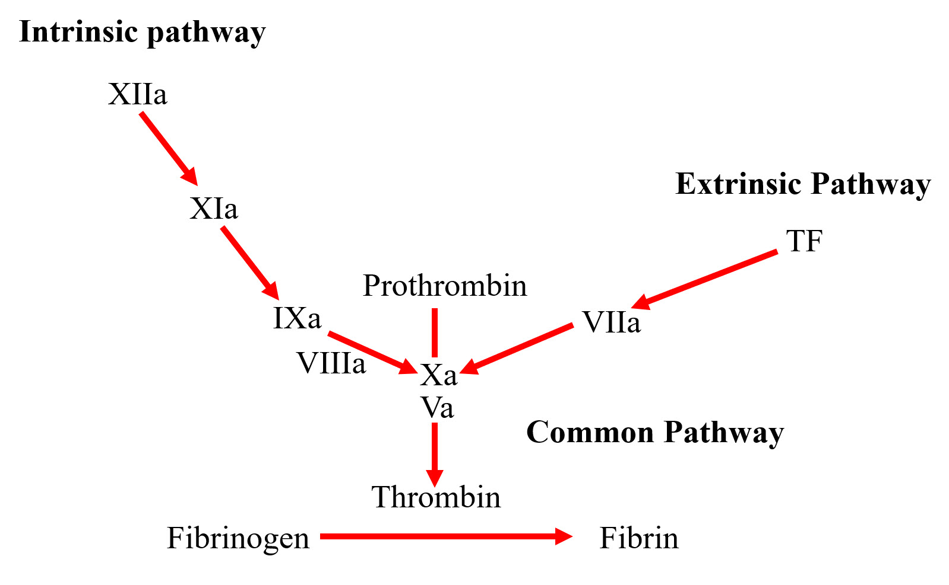
COMMON DRUGS; BLOOD THINNERS
INDICATIONS FOR USE:
DVT/PE
Atrial fibrillation
Prosthetic valves
Bleeding disorders
Ischemic stroke
MI
DOACs – Apixaban, Rivaroxaban
Warfarin
LMWH
Alteplase (IV)
Antiplatelets - Clopidogrel, ticagrelor
Notes:
DOACs – inhibit factor 10a
Warfarin – inhibits 10, 9, 7, 2 (Vit K dependent factors)
LMWH – inhibits 10 and thrombin
Alteplase – fibrinolytic. Essentially tPa (activates plasmin to eat the fibrin mesh)
Antiplatelets – inhibit P2Y12 (affects primary platelet plug)

Slide 32
COMMON DRUGS; NSAIDs
COMMON DRUGS; NSAIDs
Ibuprofen, naproxen. Weak analgesics for mild pain.
Mechanism = inhibits arachidonic acid pathway Cox-1 and Cox-2
Cox-1 = involved in PROSTAGLANDIN SYNTHESIS which protects gastric mucosa. Side effect?
Cox-2 = the targeted pathway. Activation of this is involved in inflammation. An example of a selective Cox-2 inhibitor?
Notes:
1- Peptic ulcer disease. NSAIDs notoriously cause gastric ulcers.
2 - Celecoxib

Slide 33
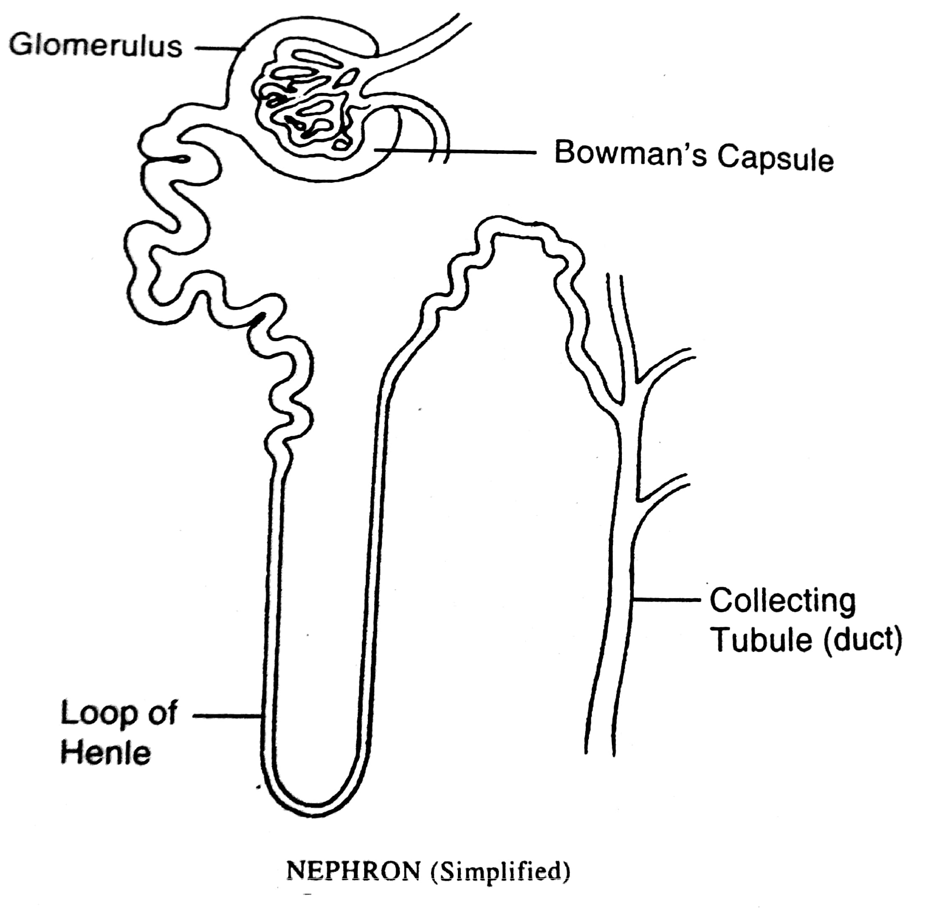
COMMON DRUGS; DIURETICS
COMMON DRUGS; DIURETICS
THIAZIDE DIURETIC
Acts on DCT, inhibiting Na-Cl cotransporter
🡪 BENDROFLUMETHIAZIDE
LOOP DIURETIC
Acts on Ascending limb of loop of Henle, inhibiting NKCC2 channels
🡪 FUROSEMIDE
ALDOSTERONE ANTAGONIST
A K+ sparing diuretic, acting on aldosterone receptors of the collecting duct. Increases Na+ excretion and retains K+
🡪 SPIRONOLACTONE

Slide 34
COMMON DRUGS; OTHER CLASSES
ACE-INHIBITORS = Ramipril. An anti-hypertensive.
CALCIUM CHANNEL BLOCKERS = Amplodipine, verapamil. Another anti-hypertensive.
PROTON PUMP INHIBITORS = Lanzoprazole. Reduces acidity of GI lumen.
CORTICOSTEROIDS = Prednisolone. Anti-inflammatory.

Slide 35
Feedback
https://docs.google.com/forms/d/e/1FAIpQLSfc9haX5-Z-cBE4w9nmsHXreRYJznphPBymdF5qEoUNH7-rWw/viewform?usp=sf_link
The Peer Teaching Society is not liable for false or misleading information…

Slide 36
A FEW QS…
NAME THE MAIN SIDE EFFECT OF ACE-I USE AND WHY THIS MAY BE (2)
WHAT IS THE DIFFERENCE BETWEEN TOLERANCE AND DEPENDENCE? (2)
NAME THE MAIN SIDE EFFECT OF CCB USE, AND WHAT CONDITION MAY THIS BE MISTAKEN FOR? (2)
Notes:
DRY COUGH DUE TO BRADYKININ ACCUMULATION
TOLERANCE IS PHYSIOLOGICAL. DEPENDANCE IS PSYCHOLOGICAL (CRAVING EUPHORIA)
ANKLE SWELLING – MAY BE MISTAKEN FOR HEART FAILURE.

Slide 37
A FEW QS…
Which of these is a loop diuretic? (1)
Bendroflumethiazide
Ramipril
Spironolactone
Furosemide
Clopidogrel

Slide 38
A FEW QS…
A FEW QS…
A FEW QS…
Which of these is a loop diuretic? (1)
Bendroflumethiazide
Ramipril
Spironolactone
Furosemide
Clopidogrel

Slide 39
PLEASE PLEASE LEARN YOUR ANAPHYLAXIS TREATMENT….
You need to know this, specifically!!! (DID NOT come up in SAQ…)
Q. What is the 1st line treatment for anaphylaxis? Name the drug, dose, and route. (3 marks)
Notes:
ADRENALINE. 500MCG. IM.

Slide 40
NOTE ON SYSTEMS PHARMACOLOGY
For the modules of 2a, you need to be able to name pharmacological treatments for the main conditions
Briefly will name some examples and show you how to apply your knowledge from this ppt… APPLICATION IS WHAT YOU NEED TO FOCUS YOUR PHARMACOLOGY KNOWLEDGE AROUND

Slide 41
SYSTEMS PHARMACOLOGY
MYOCARDIAL INFARCTION
Acutely; Morphine (pain relief), Oxygen (if sats <94%), Nitrates (anginal relief), Aspirin, Clopidogrel (to degrade clots in coronary arteries) MONAC
Prophylactically; ACE-I (to maintain BP), CCB (BP), Aspirin, Atorvastatin (or any statin) , Beta blocker (reduce HR to prevent shearing of coronary arteries), ACAAB
LOTS OF INFO – YOU DON’T NEED TO KNOW ALL OF THIS RIGHT NOW! BUT… THIS IS MORE TO APPLY WHY YOU USE CERTAIN MEDS WHEN ☺

Slide 42
SYSTEMS PHARMACOLOGY
SYSTEMS PHARMACOLOGY
DIABETES (T2)
1ST LINE = A BIGUANIDE (Metformin)
Why? 🡪 Increases PERIPHERAL TISSUE SENSITIVITY TO INSULIN.
Main SE = GI distress and tummy pain
2nd LINE = A SULFONYLUREA (Gliclazide)
Why? 🡪 Increases INSULIN PANCREATIC SECRETION
Main SE = HYPOGLYCAEMIC EPISODES, also WEIGHT GAIN

Slide 43
TAKE HOME POINTS
Pharmacology is a VERY vast topic. You’re not training to be a pharmacist ☺
A broad range of knowledge >>>> massive notes – something everyone agrees on but no one seems to appreciate lol
This is a good level of detail to learn from. Don’t go overboard with ICS – save your mental fuel for the modules please
And of course any stress, any queries come to me

