Slide 1
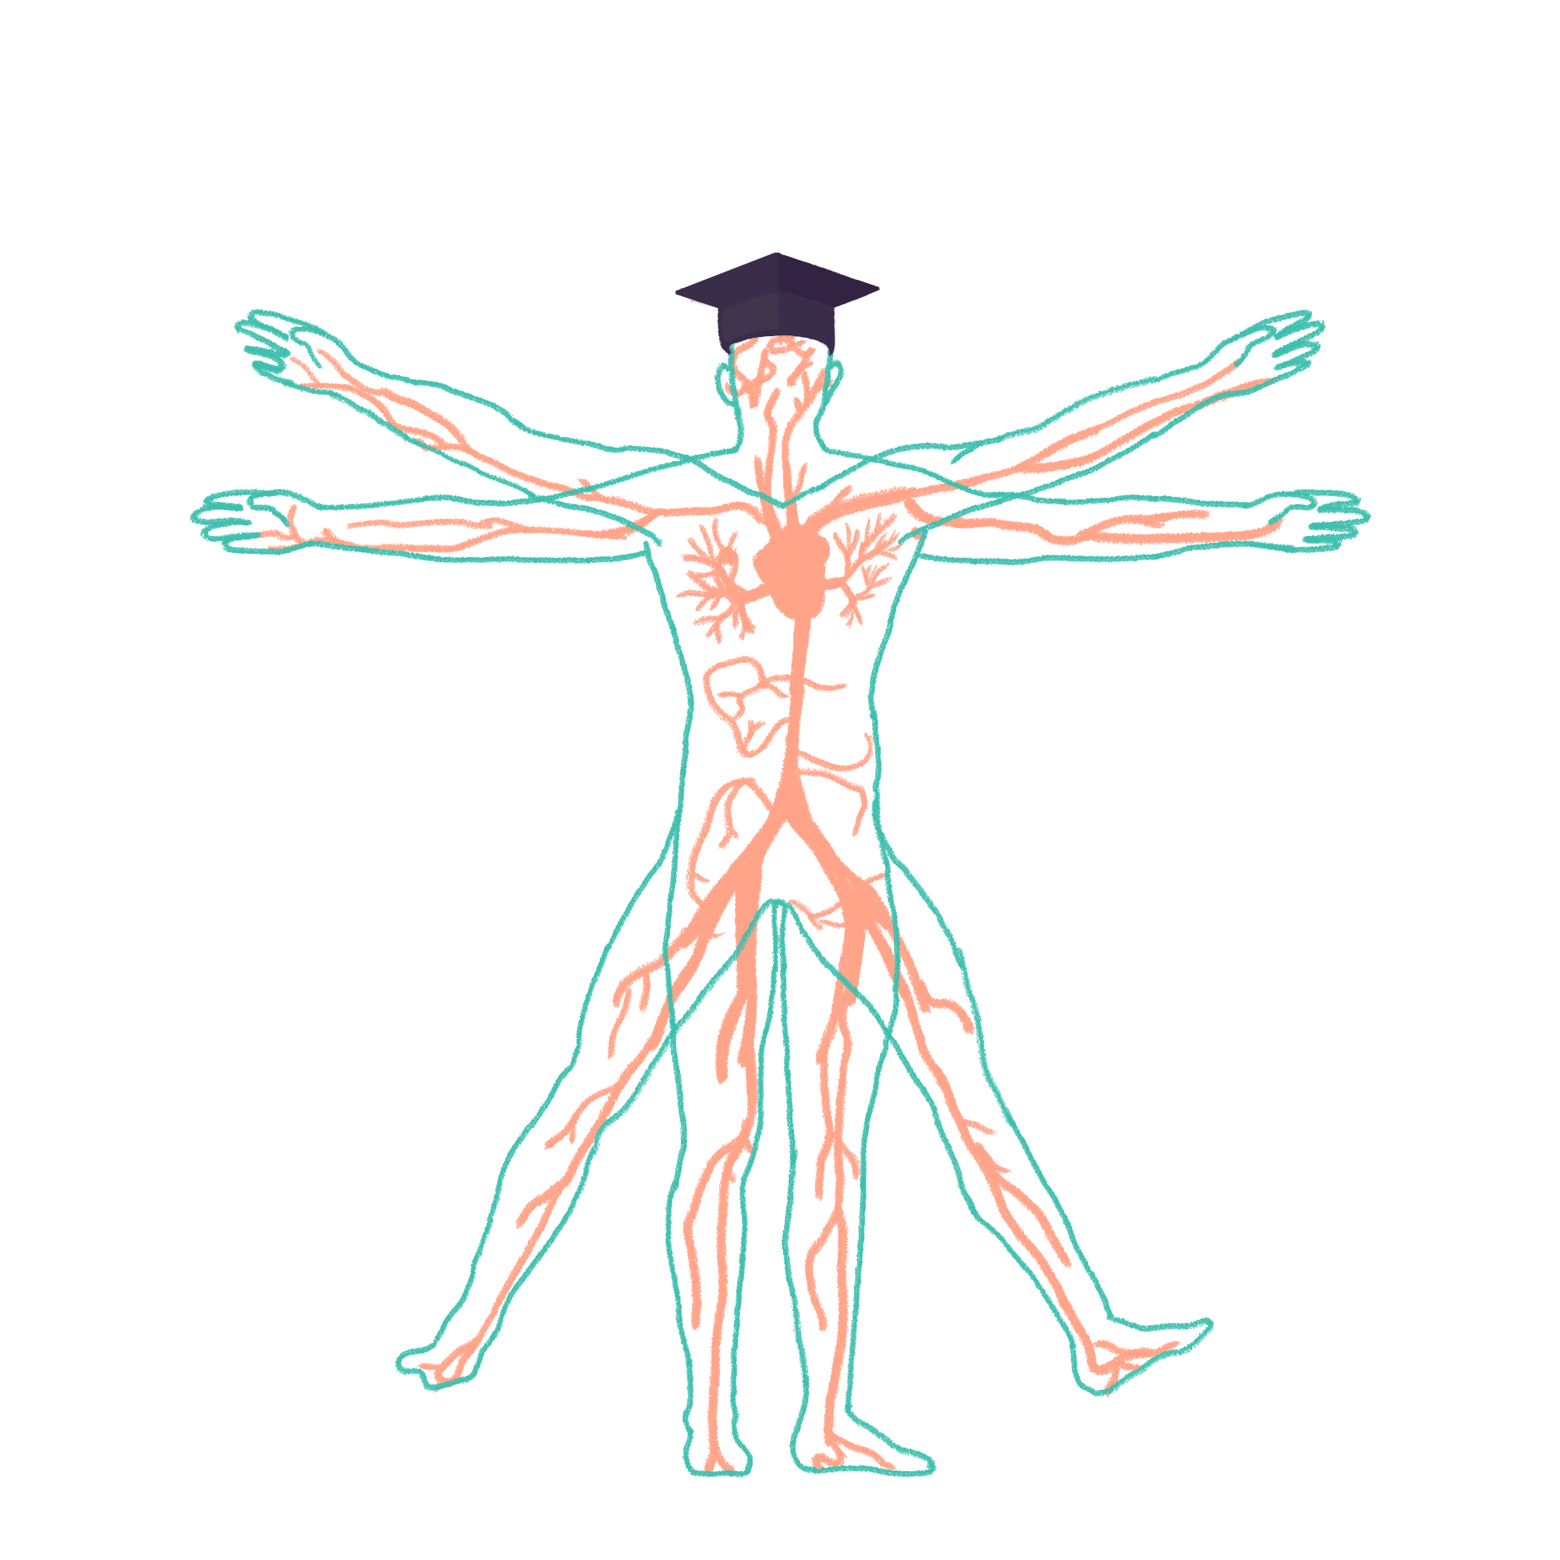
2023/2024

Slide 2
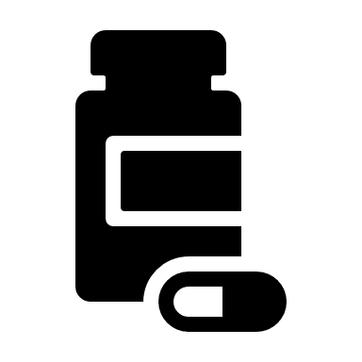
PHARMACOLOGY
Phase 2a Revision Session
Yusuf Sanni & Anna McCarthy-Totton
24/11/2023
The Peer Teaching Society is not liable for false or misleading information…

Slide 3
DON’T PANIC…
Use PTS sessions as a way to recap what you’ve read through
Plenty of time to still figure out best revision methods for you
The Peer Teaching Society is not liable for false or misleading information…

Slide 4
AIMS AND OBJECTIVES
Today:
understanding the BASICS of pharmacology;
definitions (pharmacodynamics/kinetics, affinity, efficacy…), routes of administration, key pathways involved, neurotransmission, key drugs and classes
By the end of 2a:
To look at 2a holistically and understand WHY certain meds are prescribed when, and to know condition-specific pharmacological treatments
The Peer Teaching Society is not liable for false or misleading information…

Slide 5
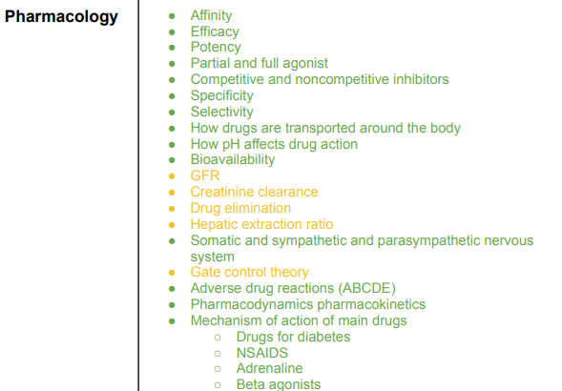
Content; LOOK AT THE 2A SPEC
+ OTHER STUFF:
- 2a DRUG LIST
- ILA 3: PHARMACODYNAMICS AND PHARMACOKINETICS
The Peer Teaching Society is not liable for false or misleading information…

Slide 6
CONTENT…
The Peer Teaching Society is not liable for false or misleading information…

Slide 7
BASICS
Drugs work by binding to specific receptors
Different receptors have different effects
Some drugs work better than others at different receptors - agonists, antagonists, efficacy, affinity, potency
Drug is then cleared from body - metabolism & excretion
The Peer Teaching Society is not liable for false or misleading information…

Slide 8
ROUTES OF ADMINISTRATION
Can you think of any?
The Peer Teaching Society is not liable for false or misleading information…
Notes:
Oral - first pass metabolism
PR - can be used if pt can’t tolerate oral route. Highly vascular tissue so fast absorption.
Subcut - Has to diffuse through subcut fat so is a slower absorption.
IM - muscle tissue is vascular so rapidly absorbed.
IV - directly into systemic circulation
Sublingual - avoids first pass metabolism and rapidly enters circulation. drugs like GTN.
Inhalers - passes through the trachea into the lungs. good if lung is the target site.
Intrathecal - into spinal column, spinal anesthesia, chemotherapy etc.
transdermal - directly into skin/mucosa. avoids first pass.

Slide 9
ROUTES OF ADMINISTRATION
ENTERAL (via GI) – systemic effect
Oral (PO)
Rectal suppository (PR)
PARENTERAL (NON GI) – systemic effect
Subcutaneous (SC)
Intramuscular (IM)
Intravenous (IV)
Sublingual
Inhalers (INH)
Intrathecal
LOCAL EFFECT, OTHERS: Transdermal e.g. patches, Topical cream e.g. steroid
The Peer Teaching Society is not liable for false or misleading information…
Notes:
Oral - first pass metabolism
PR - can be used if pt can’t tolerate oral route. Highly vascular tissue so fast absorption.
Subcut - Has to diffuse through subcut fat so is a slower absorption.
IM - muscle tissue is vascular so rapidly absorbed.
IV - directly into systemic circulation
Sublingual - avoids first pass metabolism and rapidly enters circulation. drugs like GTN.
Inhalers - passes through the trachea into the lungs. good if lung is the target site.
Intrathecal - into spinal column, spinal anesthesia, chemotherapy etc.
transdermal - directly into skin/mucosa. avoids first pass.

Slide 10
DEFINITIONS…
AGONIST
ANTAGONIST
AFFINITY
EFFICACY
POTENCY
The Peer Teaching Society is not liable for false or misleading information…

Slide 11
DEFINITIONS
AFFINITY = how well a ligand binds to its receptor.
EFFICACY = how well a ligand successfully activates its receptor
POTENCY = relative strength of the drug. Lower dose needed for response → more potent.
AGONISTS = full affinity and full efficacy. Increase activation of the receptor.
ANTAGONISTS = full affinity and zero efficacy. Decrease activation of the receptor.
The Peer Teaching Society is not liable for false or misleading information…
Notes:
ligand - drugs are considered to bind to receptors and any chemicals that bind to receptors are usually termed ligands (e.g. drugs

Slide 12
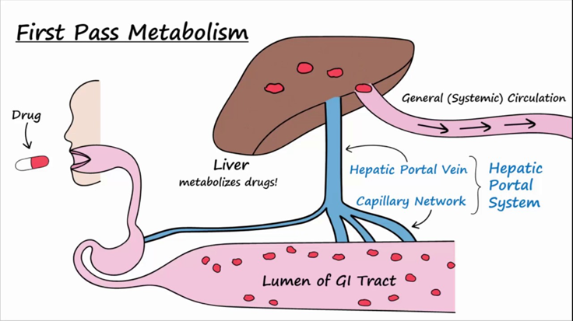
BIOAVAILABILITY and THERAPEUTIC RANGE
Bioavailability = proportion of the drug given that enters circulation and can exert an effect on the body.
IV Route 🡪 always 100%
Other routes 🡪 suboptimal
Therapeutic range = upper and lower bounds of safe doses of a drug. Narrower range – need more care in dispensing!
Notes:
oral route - first pass metabolism via the liver will reduce how much enters systemic circulation.
this is why things have a different dose if they’re given IV/IM/parental in contrast to oral.
drugs with narrow therapeutic ranges: Warfarin, tacrolimus, sirolimus, phenytoin, carbamazepine, levothyroxyine

Slide 13
DRUG TARGETS
Receptor action (most common)
Enzymes
Ion channels
Transporters
Can you think of examples of each?
The Peer Teaching Society is not liable for false or misleading information…
Notes:
RECEPTOR – ARBs, Beta Blockers, salbutamol, tamoxifen, alpha blockers...
ENZYME – ACE-I, 5-alpha reductase inhibitors
ION CHANNELS – CCB
TRANSPORTERS – PPI

Slide 14
DRUG TARGETS
Receptor action (most common) → ARBs, beta blockers, salbutamol, tamoxifen, alpha blockers
Enzymes → ACE inhibitors, 5-alpha reductase inhibitors
Ion channels → CCB
Transporters → PPI
The Peer Teaching Society is not liable for false or misleading information…
Notes:
RECEPTOR – ARBs, Beta Blockers, salbutamol, tamoxifen, alpha blockers...
ENZYME – ACE-I, 5-alpha reductase inhibitors (finasteride, BPH)
ION CHANNELS – CCB
TRANSPORTERS – PPI

Slide 15
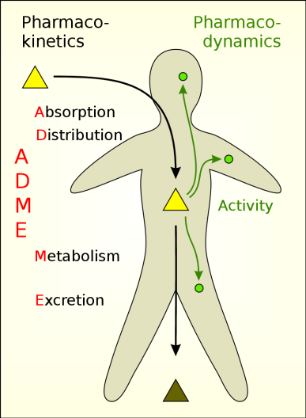
PHARMACODYNAMICS & PHARMACOKINETICS
The Peer Teaching Society is not liable for false or misleading information…
Notes:
PharmacoDYNAMICs = THE EFFECT OF THE DRUG ON THE BODY.
Literally think of the drug running through the blood to the tissues, and then what does there.
PharmacoKINETICS = THE EFFECT OF THE BODY ON THE DRUG. Think of this as the drug’s done messing around, and it’s time to be broken down
A drug's affinity refers to the chemical forces that cause a substance to bind its receptor. It tells us how attracted a drug is to its receptors. Efficacy refers to a drug's ability to effectively activate the receptor once it has bound to it. Efficacy tells us how good a drug is at producing a desired effect.
Image: https://www.differencebetween.com/difference-between-pharmacokinetics-and-pharmacodynamics/

Slide 16
PHARMACODYNAMICS & PHARMACOKINETICS
Pharmacodynamics
= what the drug does to the body i.e. what does the drug do once it’s in the body?
Affinity.
Efficacy.
Potency.
The Peer Teaching Society is not liable for false or misleading information…
Notes:
PharmacoDYNAMICs = THE EFFECT OF THE DRUG ON THE BODY.
Literally think of the drug running through the blood to the tissues, and then what does there.
PharmacoKINETICS = THE EFFECT OF THE BODY ON THE DRUG. Think of this as the drug’s done messing around, and it’s time to be broken down
A drug's affinity refers to the chemical forces that cause a substance to bind its receptor. It tells us how attracted a drug is to its receptors. Efficacy refers to a drug's ability to effectively activate the receptor once it has bound to it. Efficacy tells us how good a drug is at producing a desired effect.
Image: https://www.differencebetween.com/difference-between-pharmacokinetics-and-pharmacodynamics/

Slide 17
PHARMACODYNAMICS & PHARMACOKINETICS
Pharmacodynamics
= what the drug does to the body i.e. what does the drug do once it’s in the body?
Affinity.
Efficacy.
Potency.
Pharmacokinetics
= what the body does to the drug i.e. what does the body do once the drug is in it?
ADME
Absorption/Administration
Distribution
Metabolism
Excretion
The Peer Teaching Society is not liable for false or misleading information…
Notes:
PharmacoDYNAMICs = THE EFFECT OF THE DRUG ON THE BODY.
Literally think of the drug running through the blood to the tissues, and then what does there.
PharmacoKINETICS = THE EFFECT OF THE BODY ON THE DRUG. Think of this as the drug’s done messing around, and it’s time to be broken down
A drug's affinity refers to the chemical forces that cause a substance to bind its receptor. It tells us how attracted a drug is to its receptors. Efficacy refers to a drug's ability to effectively activate the receptor once it has bound to it. Efficacy tells us how good a drug is at producing a desired effect.
Image: https://www.differencebetween.com/difference-between-pharmacokinetics-and-pharmacodynamics/

Slide 18
Pharmacodynamics
The drug needs to bind to the receptor. The degree in which how well it does this is called AFFINITY.
If a drug has high affinity to a receptor, it will bind well.

Slide 19
Pharmacodynamics
The drug needs to bind to the receptor. The degree in which how well it does this is called AFFINITY.
If a drug has high affinity to a receptor, it will bind well.
If a drug has low affinity to a receptor, it will bind less well.

Slide 20
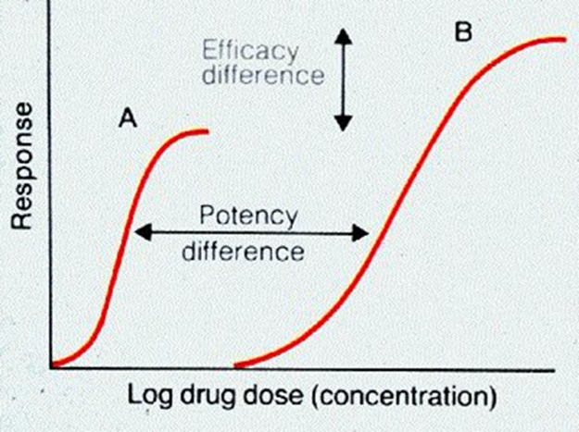
Pharmacodynamics
Once the drug has bound to its receptor, how well does it work?
Efficacy → maximum effect a
drug can have on the body
Potency → How much of a drug
is needed to elicit a response
The Peer Teaching Society is not liable for false or misleading information…
Notes:
already said that efficacy = how well the drug works on that specific receptor
potency = amount of drug needed to achieve a response
The graph: You need a lot more of drug B than drug A before a response happens, but if you increase the amount of drug B you can get much more response whereas drug A stops providing a response after a certain level.

Slide 21
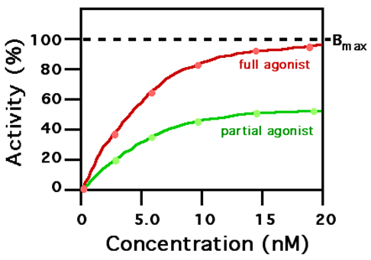
Pharmacodynamics
Agonist → stimulates the receptor, causing a reaction in the cell.
Partial agonist → attaches to receptor, stimulates the same reaction as a full agonist but to a lesser degree
The Peer Teaching Society is not liable for false or misleading information…

Slide 22
Notes:
Competitive inhibitors = BLOCKS other things from binding to the receptor by sitting in its action site.
Non-competitive inhibitors = BLOCKS other things from binding to the receptor but not by sitting in its action site. May attach to a different part of the receptor.
Image: https://psychonautwiki.org/wiki/Antagonist

Slide 23
Competitive inhibitors….
Non-competitive inhibitors…
Notes:
Competitive inhibitors = BLOCKS other things from binding to the receptor by sitting in its action site.
Non-competitive inhibitors = BLOCKS other things from binding to the receptor but not by sitting in its action site. May attach to a different part of the receptor.
Image: https://psychonautwiki.org/wiki/Antagonist

Slide 24
PHARMACOKINETICS
ADME
Administration/Absorption (route, through the gut vs parenteral)
Distribution (systemic spreading)
Metabolism (aka as 1st pass metabolism. IV route skips this!)
Excretion (hepatically or renally)
The Peer Teaching Society is not liable for false or misleading information…
Notes:
First pass metabolism, drug enters the lumen of the GI tract after being ingested & is transported via the hepatic veins to the liver to be metabolised before being released into the systemic circulation.
What affects distribution - blood flow in an area, size of the drug molecules, how lipophilic/phobic the drug, blood brain barrier, blood testicle barrier.

Slide 25
METABOLISM
GI, Renal and Hepatic
GI = Mechanical and chemical digestion, for majority of food.
Renal = simple, already soluble molecules. Easy to pee out directly.
Hepatic = Aim is to produce more water soluble molecules. hydrophobic → hydrophilic.
🡪 phase 1; non-conjugation. Mediated by cytochrome p450.
🡪 phase 2; conjugation. Adds functional groups to increase hydrophilicity
The Peer Teaching Society is not liable for false or misleading information…
Notes:
cytochrome p450 - can have inducers and inhibitors. inducers will increase the activity of p450 and then increase the breakdown of other drugs.
CYP450 inducers = rifampin, carbamazepine, st john’s wort, erythromycin, isoniazid
CYP450 Inhibitors = amiodarone, amitriptyline, ciprofloxacin, clarithromycin, risperidone, grapefruit

Slide 26
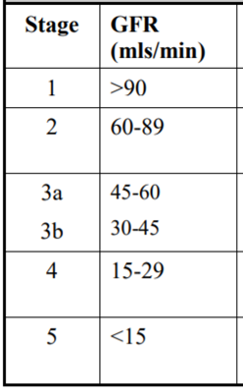
Glomerular Filtration Rate - GFR
GFR is used to check how well the kidneys are functioning.
It estimates how much blood passes through the glomeruli each minute.
Used to stage chronic kidney disease (CKD)
Creatinine Clearance = volume of blood plasma cleared of creatinine per unit of time. Used to estimate GFR.
The Peer Teaching Society is not liable for false or misleading information…
Notes:
Serum creatinine is compared with urine creatinine.
check BNF. Conditions you’d therefore need to look out for when prescribing would be CKD, AKI, diabetes, HTN, polycystic kidney disease….etc

Slide 27
Glomerular Filtration Rate - GFR
Creatinine Clearance = volume of blood plasma cleared of creatinine per unit of time. Used to estimate GFR.
GFR is used to check how well the kidneys are functioning.
It estimates how much blood passes through the glomeruli each minute.
Used to stage chronic kidney disease (CKD)
Drugs are excreted by the kidneys.
Poorly functioning kidneys → reduced renal excretion of drugs → build up of drugs → toxicity
NSAIDS, PPIs, Antibiotics, all needed to be dose adjusted or avoided in renal impairment.
The Peer Teaching Society is not liable for false or misleading information…
Notes:
Serum creatinine is compared with urine creatinine.
check BNF. Conditions you’d therefore need to look out for when prescribing would be CKD, AKI, diabetes, HTN, polycystic kidney disease….etc

Slide 28
NERVOUS SYSTEM
PARASYMPATHETIC & SYMPATHETIC NEUROTRANSMISSION
PARASYMPATHETIC:
-presynaptic Ach (n)
-postsynaptic Ach (m)
SYMPATHETIC:
-presynaptic Ach (n)
-postsynaptic NAd
SKELETAL MUSCLE MOTOR:
Ach at the NMJ
Notes:
PARA&SYMP= AUTONOMIC (self governing)
MOTOR = SOMATIC (voluntary)

Slide 29
CHOLINERGIC PHARMACOLOGY
Less key to know than adrenergic
2 main receptors = nicotinic and muscarinic
Nicotinic usually presynaptic. Muscarinic usually postsynaptic.
M1 = Brain. M2 = Heart. M3 = LUNGS (SAMA e.g. ipratropium bromide)
Be aware of the mechanism of neurotransmission (synthesis, storage, release, breakdown, reuptake), when this is helpful and not so helpful
The Peer Teaching Society is not liable for false or misleading information…

Slide 30
CHOLINERGIC PHARMACOLOGY
Don’t expect you to know this now but good to bear in mind ☺
Q1.
a. WHICH CONDITION IS RELATED TO DISRUPTED Ach TRANSMISSION AT THE NMJ?
b. WHAT IS THE TREATMENT FOR THIS?
Q2.
NAME SOME SIDE EFFECTS OF EXCESSIVE ACETYLCHOLINE STIMULATION.
The Peer Teaching Society is not liable for false or misleading information…
Notes:
1. MYASTHENIA GRAVIS
2. Ach-ASE INHIBITORS (Pyridostigmine)
3. Cholinergic crisis= SLUDGE
SALIVATION, LACRIMATION, URINATION, DEFECTION, GI DISTRESS, EMESIS

Slide 31
ADRENERGIC PHARMACOLOGY
The Peer Teaching Society is not liable for false or misleading information…

Slide 32
ADRENERGIC PHARMACOLOGY
ADRENERGIC PHARMACOLOGY
The Peer Teaching Society is not liable for false or misleading information…

Slide 33
ADRENERGIC PHARMACOLOGY
Beta Receptors Found within the heart and the lungs.
Agonism
B1 - will increases force (Inotropy) and rate (Chronotropy) of the cardiac contraction. (Dobutamine, Shock)
B2 - Bronchodilation in the lungs. (SABA - Salbutamol, Asthma)
Antagonism
Does the opposite ↓ CO = ↓ BP useful in Heart Failure (BB - Propranolol)
The Peer Teaching Society is not liable for false or misleading information…
Notes:
CONTRAINDICATED BB IN ABSOLUTE ASTHMA.

Slide 34
ADRENERGIC PHARMACOLOGY
Name 2 conditions where salbutamol may be prescribed.
The Peer Teaching Society is not liable for false or misleading information…
Notes:
ASTHMA, COPD

Slide 35
ADVERSE DRUG REACTIONS
A – Augmented (common)
B – Bizarre
C – Chronic Use
D – Delayed
E – End of use
Report to MHRA, using the YELLOW CARD SCHEME!
https://yellowcard.mhra.gov.uk/
The Peer Teaching Society is not liable for false or misleading information…

Slide 36
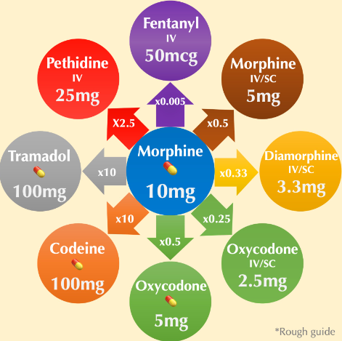
OPIOID PHARMACOLOGY
Opiates = morphine, diamorphine (heroin), codeine, pethidine
USE 🡪 CHRONIC SEVERE PAIN RELIEF (mostly Cancer Pain)
Effective but high risk of addiction, abuse and overdose
Overdoses can be treated using Naloxone
50% oral bioavailability - important when altering drug routes and calculating dose
The Peer Teaching Society is not liable for false or misleading information…

Slide 37
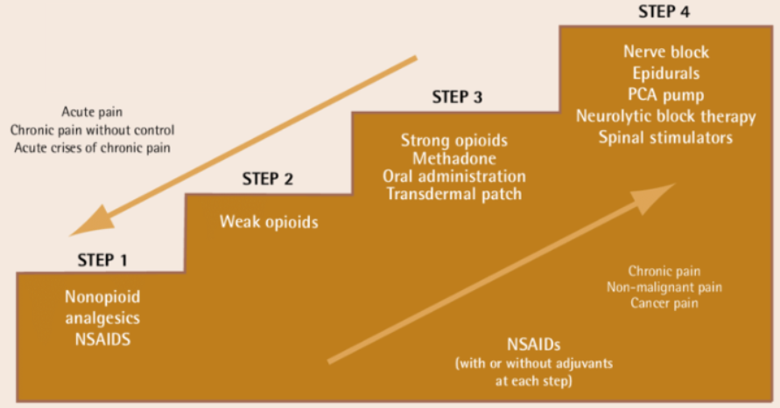
WHO Pain Ladder
4
3
2
1
The Peer Teaching Society is not liable for false or misleading information…
Notes:
Non opioid analgesics (Paracetamol/ Ibuprofen)
Weak opiates (Co-codamol/ codeine)
Strong opiates (Morphine/ Diamorph/ Fentanyl)
Other pain relief. At this point increasing opiates would not be efficacious

Slide 38
WHO Pain Ladder
4
3
2
The Peer Teaching Society is not liable for false or misleading information…
Notes:
Non opioid analgesics (Paracetamol/ Ibuprofen)
Weak opiates (Co-codamol/ codeine)
Strong opiates (Morphine/ Diamorph/ Fentanyl)
Other pain relief. At this point increasing opiates would not be efficacious

Slide 39
WHO Pain Ladder
4
3
The Peer Teaching Society is not liable for false or misleading information…
Notes:
Non opioid analgesics (Paracetamol/ Ibuprofen)
Weak opiates (Co-codamol/ codeine)
Strong opiates (Morphine/ Diamorph/ Fentanyl)
Other pain relief. At this point increasing opiates would not be efficacious

Slide 40
WHO Pain Ladder
4
The Peer Teaching Society is not liable for false or misleading information…
Notes:
Non opioid analgesics (Paracetamol/ Ibuprofen)
Weak opiates (Co-codamol/ codeine)
Strong opiates (Morphine/ Diamorph/ Fentanyl)
Other pain relief. At this point increasing opiates would not be efficacious

Slide 41
WHO Pain Ladder
The Peer Teaching Society is not liable for false or misleading information…
Notes:
Non opioid analgesics (Paracetamol/ Ibuprofen)
Weak opiates (Co-codamol/ codeine)
Strong opiates (Morphine/ Diamorph/ Fentanyl)
Other pain relief. At this point increasing opiates would not be efficacious

Slide 42
PARACETAMOL OVERDOSE
Paracetamol is a non-opioid analgesic that can be bought over the counter
Undergoes phase 2 hepatic metabolism 95%, phase 1 for 5%
Relatively wide therapeutic range but causes MAJOR COMPLICATIONS in overdose state
Fulminant (rapidly acute) liver failure
Shutdown of basic physiological systems e.g. shock 🡪 DEATH…
The Peer Teaching Society is not liable for false or misleading information…

Slide 43
PARACETAMOL NORMALLY
The Peer Teaching Society is not liable for false or misleading information…

Slide 44
PARACETAMOL IN OVERDOSE
Shunting down the phase 1 pathway due to saturated phase 2; buildup of NAPQI 🡪 HEPATOTOXICITY 🡪 LIVER FAILURE…
The Peer Teaching Society is not liable for false or misleading information…

Slide 45
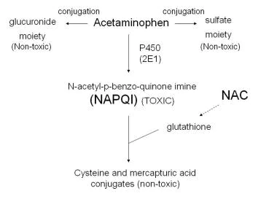
PARACETAMOL OVERDOSE
The Peer Teaching Society is not liable for false or misleading information…

Slide 46
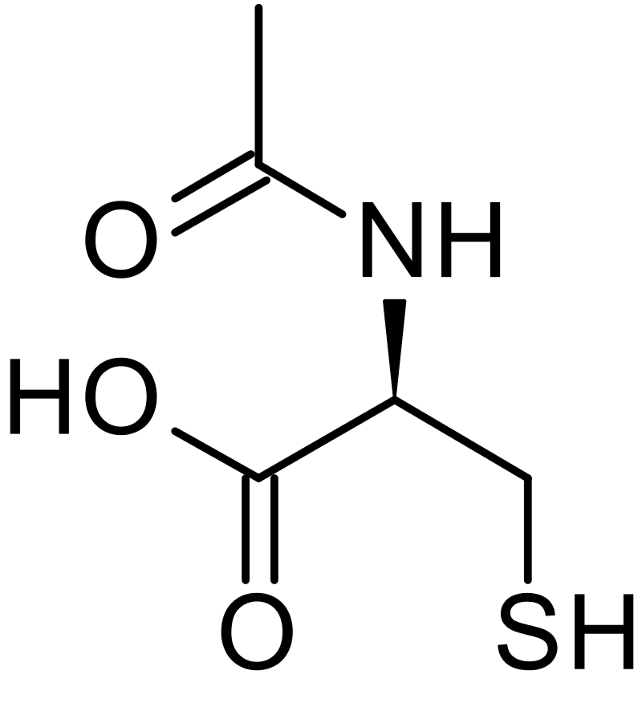
PARACETAMOL OVERDOSE
N-acetylcysteine
The Peer Teaching Society is not liable for false or misleading information…

Slide 47
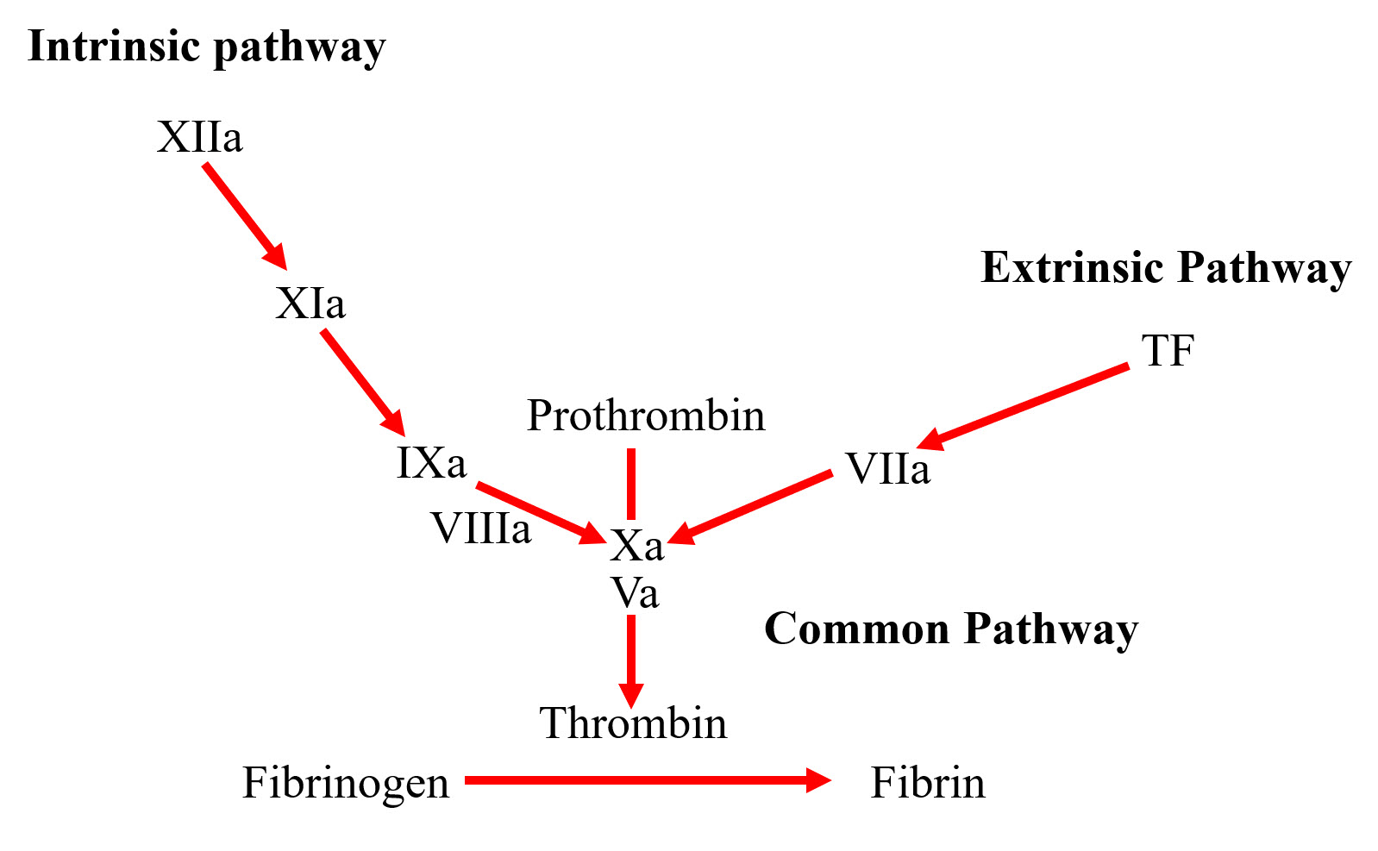
COMMON DRUGS; BLOOD THINNERS
INDICATIONS FOR USE:
DVT/PE
Atrial fibrillation
Prosthetic valves
Bleeding disorders
Ischemic stroke
MI
DOACs – Apixaban, Rivaroxaban
Warfarin
LMWH
Alteplase (IV)
Antiplatelets - Clopidogrel, ticagrelor
The Peer Teaching Society is not liable for false or misleading information…
Notes:
DOACs – inhibit factor 10a
Warfarin – inhibits 10, 9, 7, 2 (Vit K dependent factors)
LMWH – inhibits 10 and thrombin
Alteplase – fibrinolytic. Essentially tPa (activates plasmin to eat the fibrin mesh)
Antiplatelets – inhibit P2Y12 (affects primary platelet plug)

Slide 48
COMMON DRUGS; NSAIDs
COMMON DRUGS; NSAIDs
Ibuprofen, naproxen. Weak analgesics for mild pain.
Mechanism = inhibits arachidonic acid pathway Cox-1 and Cox-2
Cox-1 = involved in PROSTAGLANDIN SYNTHESIS which protects gastric mucosa. Side effect? What do you co-prescribe?
Cox-2 = the targeted pathway. Activation of this is involved in inflammation. An example of a selective Cox-2 inhibitor?
The Peer Teaching Society is not liable for false or misleading information…
Notes:
1- Peptic ulcer disease. NSAIDs notoriously cause gastric ulcers. GIve PPI’s
2 - Celecoxib

Slide 49
COMMON DRUGS; DIURETICS
COMMON DRUGS; DIURETICS
The Peer Teaching Society is not liable for false or misleading information…

Slide 50
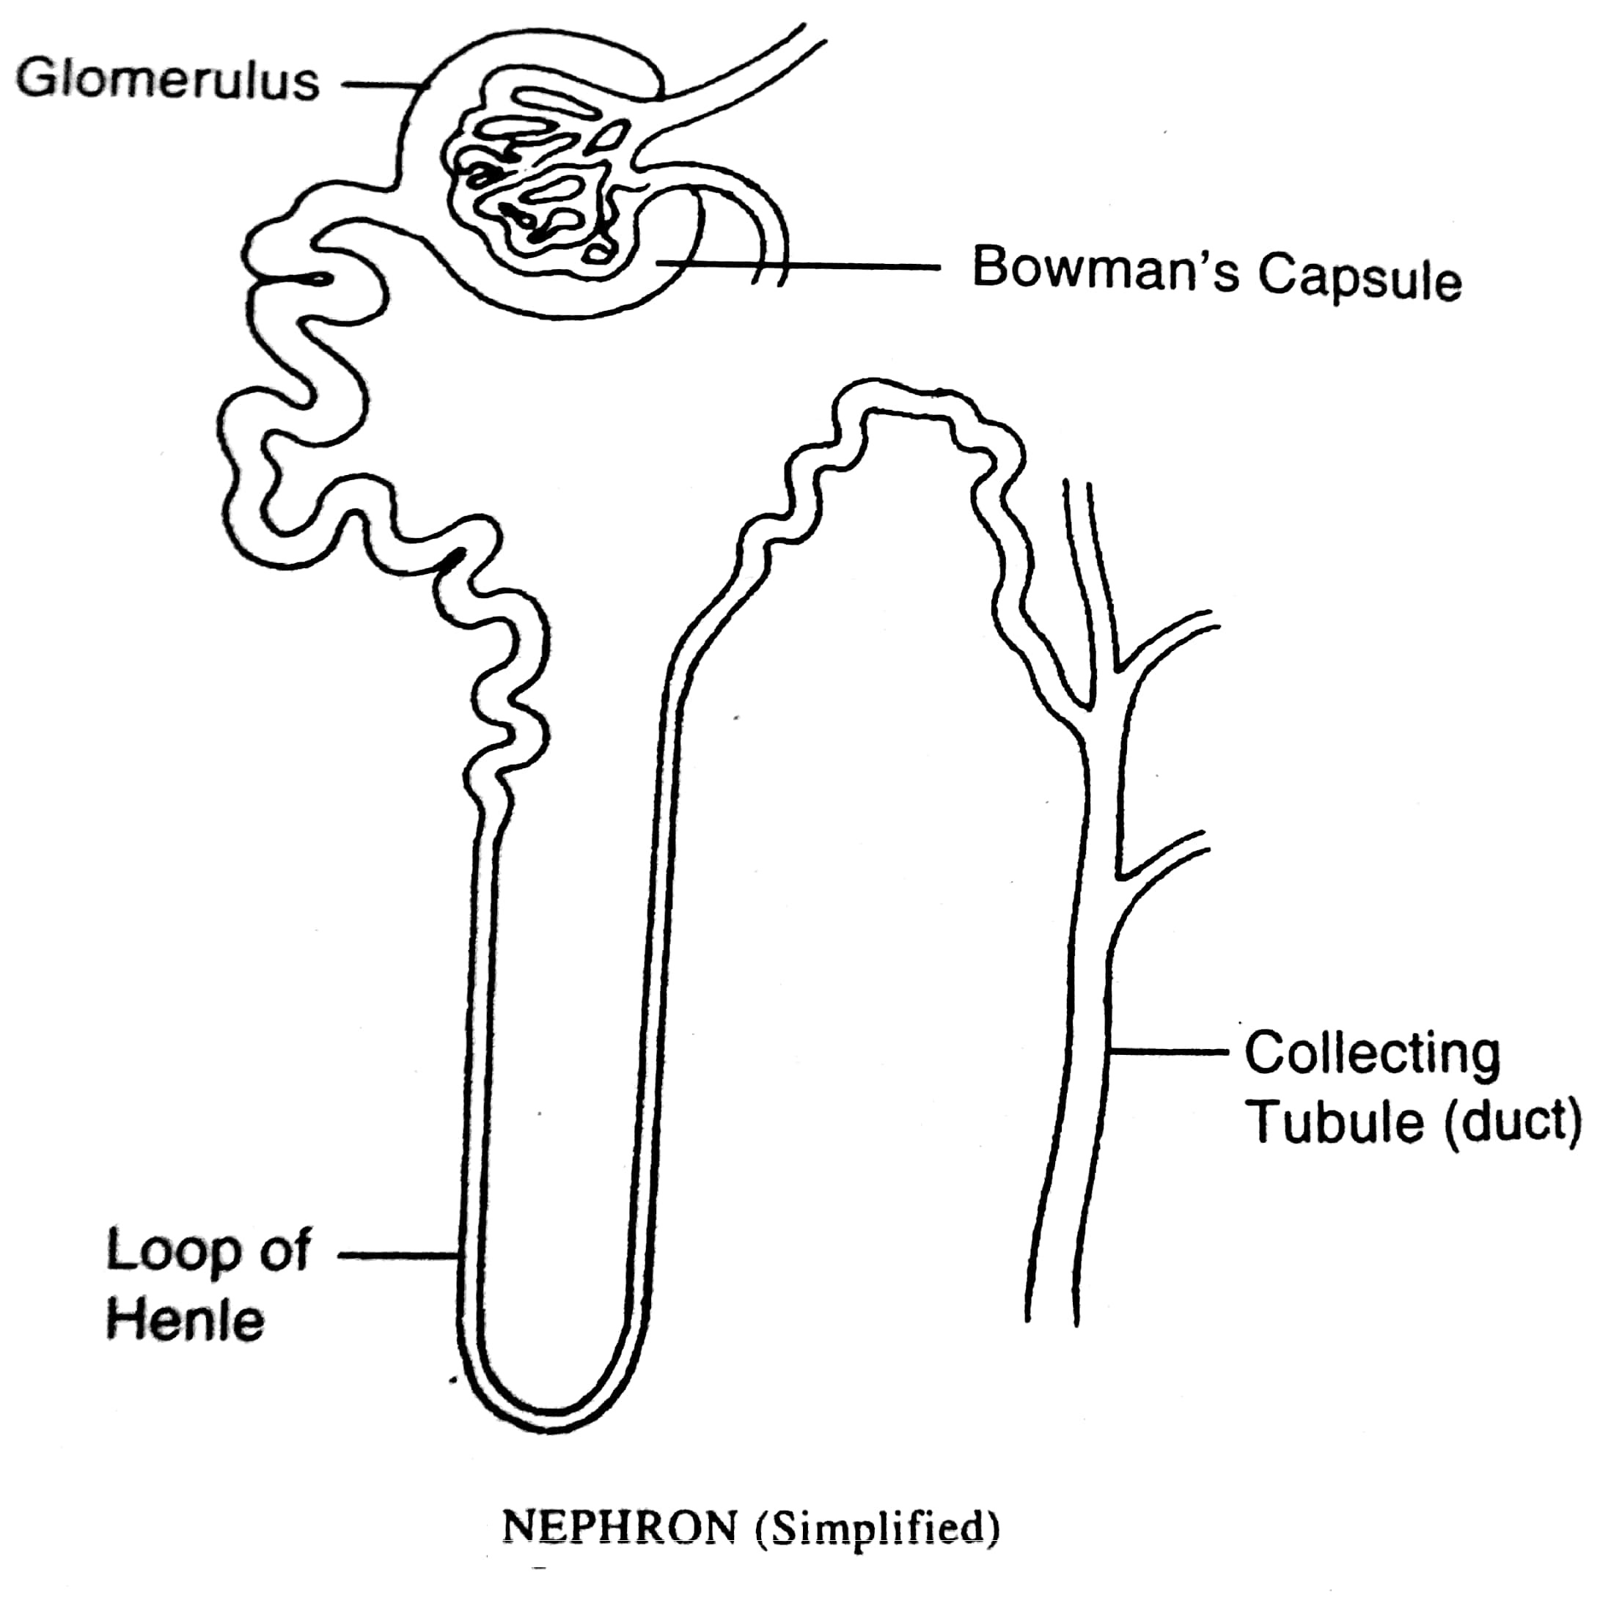
COMMON DRUGS; DIURETICS
COMMON DRUGS; DIURETICS
The Peer Teaching Society is not liable for false or misleading information…

Slide 51
COMMON DRUGS; DIURETICS
COMMON DRUGS; DIURETICS
LOOP DIURETIC
Acts on Ascending limb of loop of Henle, inhibiting NKCC2 channels
🡪 FUROSEMIDE
The Peer Teaching Society is not liable for false or misleading information…

Slide 52
COMMON DRUGS; DIURETICS
COMMON DRUGS; DIURETICS
THIAZIDE DIURETIC
Acts on DCT, inhibiting Na-Cl cotransporter
🡪 BENDROFLUMETHIAZIDE
LOOP DIURETIC
Acts on Ascending limb of loop of Henle, inhibiting NKCC2 channels
🡪 FUROSEMIDE
The Peer Teaching Society is not liable for false or misleading information…

Slide 53
COMMON DRUGS; DIURETICS
COMMON DRUGS; DIURETICS
THIAZIDE DIURETIC
Acts on DCT, inhibiting Na-Cl cotransporter
🡪 BENDROFLUMETHIAZIDE
LOOP DIURETIC
Acts on Ascending limb of loop of Henle, inhibiting NKCC2 channels
🡪 FUROSEMIDE
ALDOSTERONE ANTAGONIST
A K+ sparing diuretic, acting on aldosterone receptors of the collecting duct. Increases Na+ excretion and retains K+
🡪 SPIRONOLACTONE
The Peer Teaching Society is not liable for false or misleading information…

Slide 54
COMMON DRUGS; OTHER CLASSES
ACE-INHIBITORS
Ramipril. An anti-hypertensive.
CALCIUM CHANNEL BLOCKERS
Amlodipine, verapamil. Another anti-hypertensive.
PROTON PUMP INHIBITORS
Lansoprazole. Reduces acidity of GI lumen.
CORTICOSTEROIDS
Prednisolone. Anti-inflammatory.
The Peer Teaching Society is not liable for false or misleading information…

Slide 55
A FEW QS…
Name the main side effect of ace-i use and why this may be (2)
What condition does this make it contraindicated and why? (2)
Name the main side effect of ccb use, and what condition may this be mistaken for? (2)
The Peer Teaching Society is not liable for false or misleading information…
Notes:
DRY COUGH DUE TO BRADYKININ ACCUMULATION
Asthma and due to precepitating bronchoaspam worsening Asthma/ RF/ Coughing
ANKLE SWELLING – MAY BE MISTAKEN FOR HEART FAILURE.

Slide 56
A FEW QS…
Name the main side effect of ace-i use and why this may be (2)
Dry cough due to bradykinin accumulation.
What condition does this make it contraindicated and why? (2)
Asthma. Due to precipitating bronchospasm worsening asthma.
Name the main side effect of ccb use, and what condition may this be mistaken for? (2)
Ankle swelling. May be mistaken for heart failure.
The Peer Teaching Society is not liable for false or misleading information…
Notes:
DRY COUGH DUE TO BRADYKININ ACCUMULATION
Asthma and due to precepitating bronchoaspam worsening Asthma/ RF/ Coughing
ANKLE SWELLING – MAY BE MISTAKEN FOR HEART FAILURE.

Slide 57
A FEW QS…
Main SE of opiate use?
Opiate overdose can cause respiratory depression. What is the treatment and route of administration?
What class of drug is morphine?
The Peer Teaching Society is not liable for false or misleading information…
Notes:
A) constipation
B) Naloxone, IV
A

Slide 58
A FEW QS…
Main SE of opiate use?
Constipation, nausea
Opiate overdose can cause respiratory depression. What is the treatment and route of administration?
Naloxone, IV
What class of drug is morphine (legally)?
A
The Peer Teaching Society is not liable for false or misleading information…
Notes:
A) constipation
B) Naloxone, IV
A

Slide 59
A FEW QS…
Which of these is a loop diuretic?
Bendroflumethiazide
Ramipril
Spironolactone
Furosemide
Clopidogrel
The Peer Teaching Society is not liable for false or misleading information…

Slide 60
A FEW QS…
Which of these is a loop diuretic?
Bendroflumethiazide
Ramipril
Spironolactone
Furosemide
Clopidogrel
The Peer Teaching Society is not liable for false or misleading information…

Slide 61
A FEW QS…
What to give in a paracetamol overdose?
Naloxone
Adrenaline
Chlordiazepoxide
N-acetylcysteine
Prothrombin complex concentrate
The Peer Teaching Society is not liable for false or misleading information…

Slide 62
A FEW QS…
What to give in a paracetamol overdose?
Naloxone
Adrenaline
Chlordiazepoxide
N-acetylcysteine
Prothrombin complex concentrate
The Peer Teaching Society is not liable for false or misleading information…

Slide 63
A FEW QS…
What to give in an opiate overdose?
Naloxone
Adrenaline
Chlordiazepoxide
N-acetylcysteine
Prothrombin complex concentrate
The Peer Teaching Society is not liable for false or misleading information…

Slide 64
A FEW QS…
What to give in an opiate overdose?
Naloxone
Adrenaline
Chlordiazepoxide
N-acetylcysteine
Prothrombin complex concentrate
The Peer Teaching Society is not liable for false or misleading information…

Slide 65
PLEASE PLEASE LEARN YOUR ANAPHYLAXIS TREATMENT….
You need to know this, specifically!!! (DID NOT come up in SAQ…)
Q. What is the 1st line treatment for anaphylaxis? Name the drug, dose, and route. (3 marks)
The Peer Teaching Society is not liable for false or misleading information…
Notes:
ADRENALINE
0.5ml 1:1000
IM.

Slide 66
PLEASE PLEASE LEARN YOUR ANAPHYLAXIS TREATMENT….
You need to know this, specifically!!! (DID NOT come up in SAQ…)
Q. What is the 1st line treatment for anaphylaxis? Name the drug, dose, and route. (3 marks)
Adrenaline.
0.5ml 1:1,000
Intramuscular (IM)
The Peer Teaching Society is not liable for false or misleading information…
Notes:
ADRENALINE
0.5ml 1:1000
IM.

Slide 67
NOTE ON SYSTEMS PHARMACOLOGY
For the modules of 2a, you need to be able to name pharmacological treatments for the main conditions
The Peer Teaching Society is not liable for false or misleading information…

Slide 68
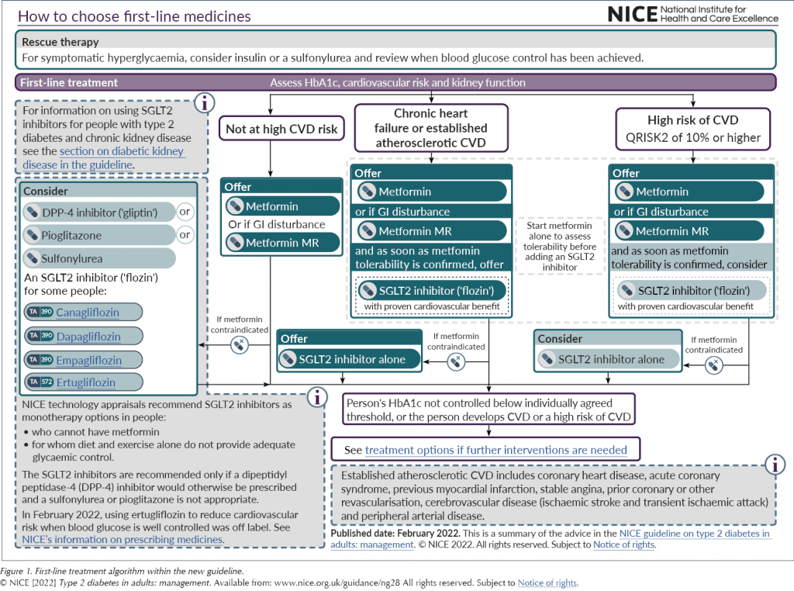
SYSTEMS PHARMACOLOGY
SYSTEMS PHARMACOLOGY
The Peer Teaching Society is not liable for false or misleading information…

Slide 69
SYSTEMS PHARMACOLOGY
SYSTEMS PHARMACOLOGY
DIABETES (T2)
1ST LINE = A BIGUANIDE (Metformin)*
Why? 🡪 Increases PERIPHERAL TISSUE SENSITIVITY TO INSULIN.
Main SE = GI distress and tummy pain
2nd LINE = A SGLT2 (Dapagliflozin)
Why? 🡪 Increases glycosuria
Main SE = Recurrent UTIs and Decreases DKA threshold
* = Except in severe CKD
**= Except when patient has recurrent UTIs and renal failure
The Peer Teaching Society is not liable for false or misleading information…

Slide 70
TAKE HOME POINTS
Pharmacology is a VERY vast topic. You’re not training to be a pharmacist ☺
A broad range of knowledge >>>> in depth specific knowledge
The Peer Teaching Society is not liable for false or misleading information…

Slide 71
The Peer Teaching Society is not liable for false or misleading information…

Slide 72
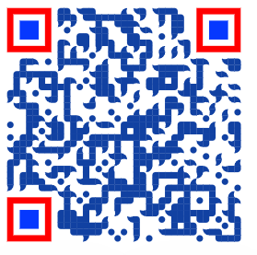
Feedback
https://forms.gle/SKGW5f68CuiViHY3A
The Peer Teaching Society is not liable for false or misleading information…

