Slide 1
2019/2020

Slide 2
Phase 2a GI
Phase 2a GI Revision Session
by
Will Giles & Stan McKenzie
15/2/2021

Slide 3
What we’re covering tonight
Coeliac disease
Inflammatory bowel disease (IBD)
Ulcerative Colitis
Crohn’s disease
Irritable bowel syndrome (IBS)
Acute appendicitis
Bowel obstruction
Small bowel
Large bowel
Pseudo-obstruction
Diarrhoea
Ischaemic bowel diseases

Slide 4
Coeliac disease

Slide 5
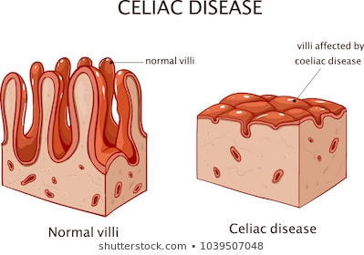
Coeliac disease
Inflammation of the mucosa of the upper small bowel in response to GLUTEN
Autoimmune – T cell mediated
Intolerance to Prolamin (in wheat, barely, rye, oats) – component of gluten protein
Causes VILLOUS ATROPHY
Leads to malabsorption

Slide 6
Coeliac disease
Epidemiology
~1% of population in UK
Yet only ~25% diagnosed
Males and females equally
Any age, peaks in infancy + 40-60 yrs
Familial link & risk
10% risk in 1st degree relatives
HLA associated
HLA-DQ2 and HLA-DQ8
Risk factors
Other autoimmune diseases
Type 1 diabetes
Autoimmune thyroid disease
Sjogren’s syndrome
Addison’s disease
IgA deficiency

Slide 7
Coeliac disease
Pathophysiology
a-Gliadin is resistant to digestion from protease enzymes (pepsin & chymotrypsin) in Small Intestine lumen
Passes through damaged epithelial wall, into cells
Deaminated by tissue transglutaminase
Interacts with antigen-presenting cells via HLA-DQ2 or HLA-DQ8
These activate gluten-sensitive CD4+ T-cells
T-cells produce pro-inflammatory cytokines → Inflammatory cascade
Causes VILLOUS ATROPY and CRYPT HYPERPLASIA

Slide 8
Coeliac disease
Clinical presentation (1)
Villous atrophy leads to malabsorption
Steatorrhoea & stinking stools
Inability to properly absorb fat from diet
Anaemia
Due to inability to absorb B12, folate, iron
Weight loss
Fatigue & weakness
Diarrhoea
Abdominal pain
Bloating
Nausea + vomiting

Slide 9
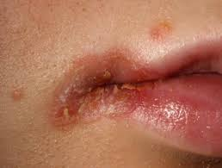
Coeliac disease
Clinical presentation (2)
Aphthous ulcers
Angular stomatitis
Osteomalacia
Decreased absorption of Vitamin D
Failure to thrive (children)
Dermatitis herpetiformis
Raised red patched of skin
Blisters, burst with scratching
Elbows, knees, buttocks, torso, scalp
Deposition of IgA in skin

Slide 10
Coeliac disease
Complications
Most patients who follow a strict diet recover
A few are non-responsive
Anaemia
Osteoporosis
Hyposplenism
Neuropathies
Increased risk of malignancy:
T-cell lymphoma
Increased T-cells in GI wall
Gastric, oesophageal, small bowel, colorectal cancer
Increased cell turnover

Slide 11
Coeliac disease
Investigations (1)
Serum antibody testing
FIRST LINE
IgA tissue transglutaminase (tTG)
Very high sensitivity & specificity
False negatives in IgA deficiency
Offered to people with other autoimmune diseases
Positive/negative with high index of suspicion → Biopsy
Duodenal biopsy
GOLD STANDARD
Endoscopically
Required for definite diagnosis
+ve Findings:
Villous atrophy
Crypt hyperplasia
Increased epithelial WBCs
Can also test for IgA Endomysial antibody (EMA) – less sensitive

Slide 12
Coeliac disease
Investigations (2)
Full Blood Count (FBC)
Low Hb
Low folate
Low ferritin
Low B12
~50% have mild anaemia
Genetic testing
HLA-DQ2 & HLA-DQ8 genotyping
DEXA scan
Because of the increased risk of osteoporosis

Slide 13
Coeliac disease
Management
Lifelong gluten-free diet
Avoid foods containing wheat, barley, rye, oats
Gluten-free food are now more available
Poor compliance is the main reason for recurrence
Symptoms & serology used to monitor response & compliance
Correct vitamin deficiencies
Pneumococcal vaccine given
Hyposplenism

Slide 14
Coeliac disease summary
Autoimmune (HLA) inflammation of upper SI mucosa → villous atrophy + crypt hyperplasia → malabsorption
In response to dietary gluten
Suspect in all with diarrhoea, weight loss & anaemia
Malabsorption → steatorrhoea, anaemia, weight loss, fatigue
Other symptoms include abdo pain, bloating, ulcers
First line: serum antibody testing
Gold standard: endoscopy → duodenal biopsy
Treat with lifelong gluten-free diet + monitoring

Slide 15
Inflammatory bowel disease (IBD)

Slide 16
Inflammatory Bowel Disease (IBD)
Chronic
Autoimmune
Two major forms:
Ulcerative colitis (UC)
Crohn’s disease
Jewish people are the most affected group
Mucosal immune system responds inappropriately to luminal antigens (e.g. bacteria) when they enter mucosa via leaky epithelium
Relapsing & remitting

Slide 17
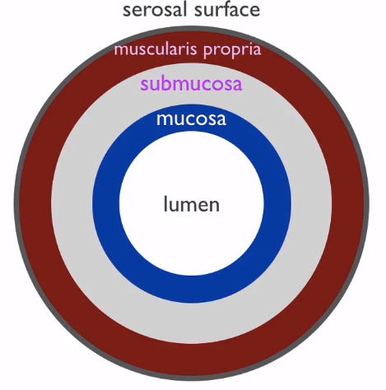
Ulcerative Colitis
Macroscopic
ONLY colon affected
Starts at rectum, can progress as far as ileocaecal valve
Circumferential + continuous inflammation – no skip lesions
Ulcers & pseudo-polyps in severe disease
Microscopic
Mucosa ONLY inflamed – no deeper (not transmural)
Crypt abscesses
Depleted goblet cells

Slide 18
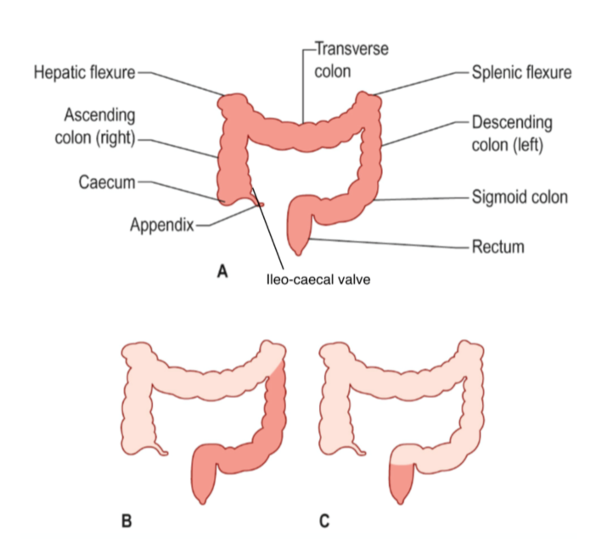
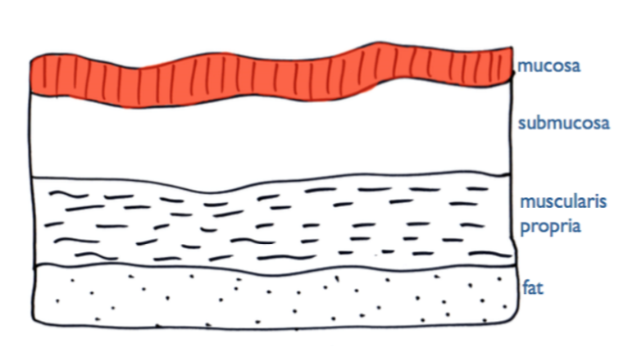
Ulcerative Colitis
Text

Slide 19
Crohn’s disease
Macroscopic
Affects ANY PART of GI tract – mouth to anus
Especially terminal ileum & proximal colon
Non-continuous inflammation – skip lesions
Cobblestone appearance – ulcers & fissures in mucosa
Microscopic
Transmural inflammation – through all layers of bowel wall
Granulomas
Non-caseating
Increased chronic inflammatory cells & lymphoid hyperplasia

Slide 20
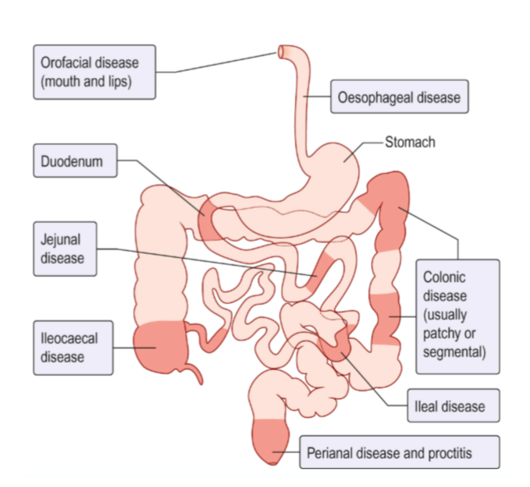
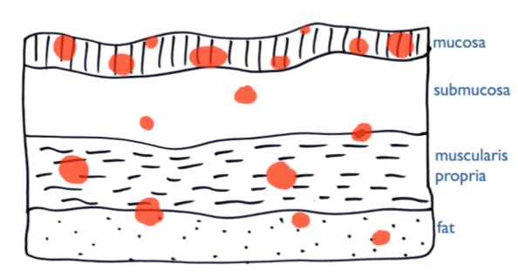
Crohn’s disease
(Example locations only)

Slide 21
Ulcerative Colitis

Slide 22
Ulcerative Colitis
Cause: “Inappropriate immune response against (possibly abnormal) colonic flora in genetically susceptible individuals
Risk factors
Family history
NSAIDS
Onset
Flares/relapse
Chronic stress + depression
Triggers flares

Slide 23
Ulcerative Colitis
Epidemiology
Highest prevalence in northern Europe & North America
Affects males & females equally
Presentation mostly at 20-40 years
Higher incidence than Crohn’s
Smoking is a protective factor against UC
Incidence is 3x higher in non-smokers
Symptoms may relapse on stopping smoking

Slide 24
Ulcerative Colitis
Clinical presentation – symptoms
Remissions + exacerbations
Abdo pain – lower left quadrant
Abdo cramps/discomfort
Episodic or chronic diarrhoea
Blood and mucus
Urgency
Frequency relates to severity
Night & day in severe attacks
Systemic symptoms in attacks:
Fever
Anorexia
Malaise
Weight loss

Slide 25
Ulcerative Colitis
Clinical presentation – signs
Might be no signs
Acute, severe UC
Fever
Tachycardia
Tender, distended abdomen
Extraintestinal signs:
Clubbing
Oral aphthous ulcers
Nutritional deficits
Extraintestinal complications

Slide 26
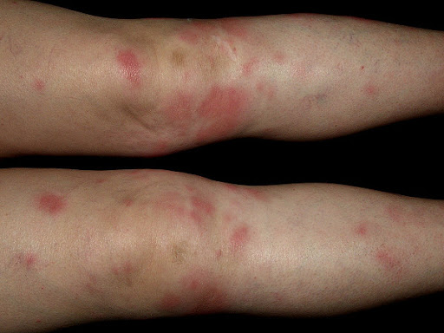
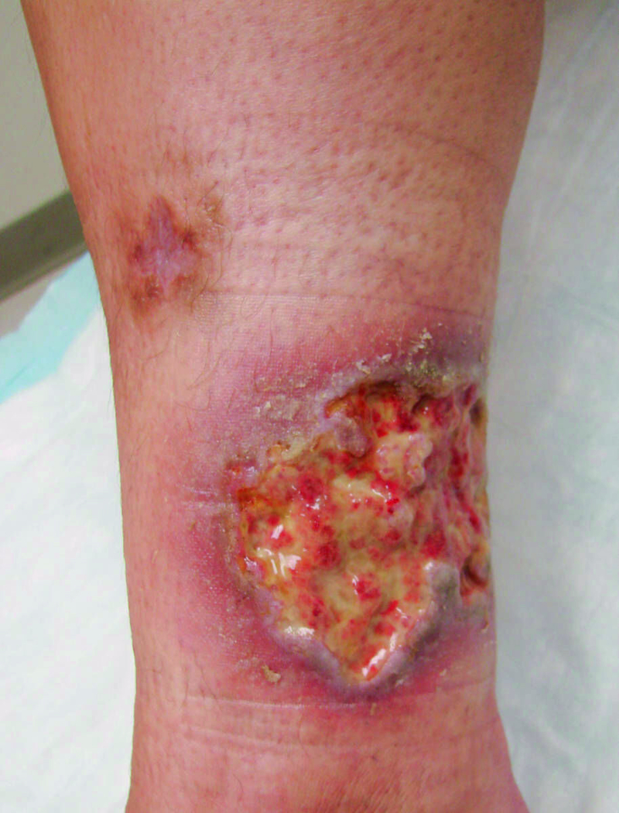
Ulcerative Colitis
Complications (1)
Colon
Blood loss
Perforation
Toxic dilatation
Colorectal cancer
Skin
Erythema nodosum
Tender red bumps
Symmetrically on shins
Pyoderma gangrenosum
Painful ulcers on skin

Slide 27
Ulcerative Colitis
Complications (2)
Joints
Ankylosing spondylitis
Arthritis
(HLA-B27 associated)
Eyes
Iritis
Uveitis
Episcleritis
Liver
Fatty change
Chronic pericholangitis
Sclerosing cholangitis
Venous thromboembolism

Slide 28
Ulcerative Colitis
Investigations (1)
Blood tests
Raised WCC
Raised platelets
Raised CRP & ESR
Anaemia
Normocytic of chronic disease most likely
Liver biochemistry may be abnormal
Hypoalbuminemia – in severe disease
pANCA may be positive
It’s negative in Crohn’s

Slide 29
Ulcerative Colitis
Investigations (2)
Stool samples
To exclude C.diff, Campylobacter & others
Faecal calprotectin
Indicates IBD if raised, doesn’t differentiate UC & Crohn’s
Colonoscopy – biopsy
GOLD STANDARD
Sigmoidoscopy – diagnosis
Full colonoscopy – to define extent, once controlled
Abdominal X-Ray
To exclude colonic dilatation
Also useful when UC is too severe for colonoscopy

Slide 30
Ulcerative Colitis
Management (1)
Aiming to induce remission
Aminosalicylates
Active component is 5-aminosalicyclic acid (5-ASA)
Oral – FIRST LINE for left sided/extensive
Rectal (suppository) – for proctitis (inflammation of rectal lining)
Commonly prescribed 5-ASAs:
Sulfasalazine
Mesalazine
Olsalazine
Used in mild/moderate cases

Slide 31
Ulcerative Colitis
Management (2)
Mild/moderate:
Oral Prednisolone
Glucocorticoid steroid
SECOND LINE – if they don’t respond to a 5-ASA
Also used in severe cases
Severe with systemic features:
IV Hydrocortisone
Ciclosporin
Infliximab
Maintaining remission:
5-ASA
Azathioprine
If still relapsing on 5-ASA

Slide 32
Ulcerative Colitis
Management (3)
SEVERE cases with NO RESPONSE to treatment:
Surgery
Colectomy
Whole colon removed
Ileoanal anastomosis
OR ileostomy → Stoma

Slide 33
Crohn’s disease

Slide 34
Crohn’s disease
Cause: “Inappropriate immune response against (possibly abnormal) colonic flora in genetically susceptible individuals
Risk factors
Family history
Stronger genetic association than UC
Smoking – 2-4x risk
NSAIDs – exacerbate it
Chronic stress + depression
Triggers flares

Slide 35
Crohn’s disease
Epidemiology
Highest prevalence in northern Europe & north America
Affects females more than males
Presentation mostly at 20-40 years
Lower incidence than UC

Slide 36
Crohn’s disease
Clinical presentation – symptoms
Remissions + exacerbations
Depends on the area of the GI tract that’s involved
Small bowel:
Abdo pain
Weight loss
Terminal ileum → Right iliac fossa pain mimicking appendicitis – less common
Colon:
Bloody diarrhoea
Urgency
Pain on defecation
Systemic symptoms in attacks:
Fever
Anorexia
Malaise
Fatigue

Slide 37
Crohn’s disease
Clinical presentation – signs
Bowel ulceration
Abdo tenderness
Abdo mass
Perianal disease
Extraintestinal signs:
Clubbing
Oral aphthous ulcers
More common than UC
Skin, joint & eye problems

Slide 38
Crohn’s disease
Complications (1)
Bowel
Malabsorption
From Crohn’s
Or following surgery
→ Malnutrition
Small bowel obstruction
Toxic dilatation
Bowel perforation
Abscess formation
Fistula formation
Sclerosing cholangitis
Colorectal cancer
Anaemia
Iron/folate deficiency

Slide 39
Crohn’s disease
Complications (2)
Perianal disease
Abscesses
Fistulae
Skin tags
Fissures
Amyloidosis (systemic)
Rare
Venous thromboembolism
Extra-intestinal complications are rarer than in UC

Slide 40
Crohn’s disease
Investigations (1)
Blood tests
Raised WCC
Raised platelets
Raised CRP & ESR
Anaemia
Normocytic of chronic disease
Iron, folate or B12 deficiency
Liver biochemistry may be abnormal
Hypoalbuminemia – in severe disease
pANCA negative

Slide 41
Crohn’s disease
Investigations (2)
Stool samples
To exclude C.diff, Campylobacter & others
Faecal calprotectin
Indicates IBD if raised, doesn’t differentiate UC & Crohn’s
Colonoscopy – biopsy
GOLD STANDARD
Granulomatous transmural inflammation
Small bowel imaging
To detect proximal disease
E.g. Capsule endoscopy
Abdominal X-Ray
MRI – strictures & fistulae
Ultrasonography

Slide 42
Crohn’s disease
Management (1)
Aiming to induce remission
Mild/moderate:
Oral Prednisolone
Glucocorticoid steroid
FIRST LINE
Severe disease:
IV hydrocortisone
Smoking cessation
Correct iron/folate/B12 deficiencies
Antibiotics for perianal disease
E.g. Metronidazole
Liquid enteral nutrition

Slide 43
Crohn’s disease
Management (2)
If not responsive to steroids:
Anti-TNF antibodies
Infliximab
Adalimumab
Maintaining remission:
Azathioprine
Methotrexate
If intolerant to azathioprine
Infliximab/Adalimumab
If resistant to immunosuppressives

Slide 44
Crohn’s disease
Management (3)
Surgery
Resection of worst affected areas of bowel
Up to 80% require 1+ operation
Never fully cures
Kept to a minimum
Recurrence is almost inevitable in remaining bowel
Short bowel syndrome - lifelong
Diarrhoea
Malabsorption
Indications
Failure of medical therapy
Obstruction from strictures
Fistulae, abscesses, perianal disease
Toxic dilatation & perforation
Temporary ileostomy
Allows time for affected areas to rest

Slide 45
Ulcerative Colitis vs Crohn’s disease
Ulcerative Colitis | Crohn’s disease
Colon only | Whole GI tract
Continuous lesions (circumferential) | Skip lesions – non-continuous
Only mucosal inflammation | Transmural inflammation
Lower RIGHT quadrant pain | Lower LEFT quadrant pain
Pseudo-polyps | -
Crypt abscesses | -
Depleted goblet cells | -
- | Granulomatous inflammation
- | Cobblestone appearance
Mucus + blood in stools | Blood in stools

Slide 46
Irritable bowel syndrome (IBS)

Slide 47
Irritable bowel syndrome (IBS)
Mixed group of abdominal symptoms with no organic cause
Epidemiology
Age of onset under 40 yrs
More common in females than males
1 in 5 in western world
Theories on pathophysiology
Disorders of intestinal motility
Enhanced visceral perception
Disfunction of brain-gut axis
Microbial dysbiosis (imbalance)

Slide 48
Irritable bowel syndrome (IBS)
Risk factors
GI infections
Previous severe long-term diarrhoea
Anxiety and depression
Psychological stress, trauma, abuse
Eating disorders
3 types:
IBS-C – with constipation
IBS-D – with diarrhoea
IBS-M – mixed, with alternating constipation & diarrhoea

Slide 49
Irritable bowel syndrome (IBS)
Clinical presentation (1)
Consider IBS if patient reports ANY of:
Abdominal pain/discomfort
Bloating
Change in bowel habit

Slide 50
Irritable bowel syndrome (IBS)
Clinical presentation (2)
Diagnosis criteria
Abdominal pain/discomfort associated with 2+ of:
Relieved by defecation
Altered stool form
Altered bowel frequency
Other symptoms:
Urgency
Incomplete evacuation
Abdo bloating/distension
Mucus in rectum & stool
Worsening of symptoms after food
Abdo tenderness

Slide 51
Irritable bowel syndrome (IBS)
Clinical presentation (3)
IBS is a multi-system disorder
Painful periods
Bladder symptoms: frequency, urgency, nocturia, incomplete emptying
Back pain
Joint hypermobility
Fatigue
Nausea
Symptoms are chronic – 6+ months
Symptoms are exacerbated by:
Stress
Menstruation
Gastroenteritis
Food

Slide 52
Irritable bowel syndrome (IBS)
Differential diagnoses
Coeliac disease
Lactose intolerance
Bile acid malabsorption
Inflammatory bowel disease (IBD)
Colorectal cancer
GI infection
Pancreatic insufficiency
Red flag symptoms for colon cancer:
Unexplained weight loss
Bleeding on defecation/wiping
Abdo/rectal mass
Raised inflammatory markers
Anaemia
Family history
Aged over 50
Nocturnal symptoms

Slide 53
Irritable bowel syndrome (IBS)
Investigations
To rule out the differentials
Blood tests
FBC – anaemia
ESR & CRP – inflammation
tTG/EMA – Coeliac disease
Faecal calprotectin – raised in IBD
Colonoscopy – IBD, colorectal cancer

Slide 54
Irritable bowel syndrome (IBS)
Management (1)
For mild IBS:
Education & reassurance
Dietary modification
Regular meals, or
Small frequent meals
Plenty of fluids
Avoid caffeinated, alcoholic, fizzy drinks
Keep a food diary – identify trigger foods
Avoid fermentable oligosaccharides, disaccharides, monosaccharides, and polyols (FODMAPs):
Found to cause IBS symptoms
Include apples, cherries, peaches, lactose, legumes, green vegetables (broccoli, sprouts, cabbage, peas), artificial sweeteners

Slide 55
Irritable bowel syndrome (IBS)
Management (2)
IBS-C (constipation)
Soluble fiber
Dissolves in water
Broken down by bacteria
Softens stool
Barley, oats, beans, prunes, figs
IBS-D (diarrhoea)
AVOID insoluble fiber
Makes diarrhoea worse
Doesn’t dissolve in water
Passes through gut unchanged
Bulks up faeces
Increases gut motility
Cereals, whole-wheat bread, lentils, apples, avocados

Slide 56
Irritable bowel syndrome (IBS)
Management (3)
For moderate IBS:
Pharmacotherapy
For pain/bloating:
Antispasmodics
Mebeverine, Buscopan
For diarrhoea:
Loperamide (Imodium)
For constipation:
Laxatives
Macrogol, Docusate, Senna
Linaclotide
>12 months constipation not relieved by 2 different max dose laxative classes
Prucalopride
Alternative when other laxatives fail

Slide 57
Irritable bowel syndrome (IBS)
Management (4)
If still no better:
Tricyclic antidepressants
Amitriptyline, nortriptyline
Warn about drowsiness
Take 4-6 weeks to have an effect
Dampen down gut severity
If tricyclic antidepressants aren’t tolerated, move to SSRIs
Consider side effects
Can be used in conjunction with psychological therapies
E.g. Cognitive Behavioral Therapy (CBT)
For severe IBS:
Refer to pain treatment center

Slide 58
Any questions before we move on?

Slide 59
Aims and Objectives
Acute Appendicitis
Aetiology
Presentation
Diagnosis
Management
Bowel Obstruction
Small vs. large bowel vs pseudo-obstruction
Diarrhoea
Aetiology
Management
Ischaemic Bowel Disease
Aetiology
Presentation
Diagnosis
Management
The Peer Teaching Society is not liable for false or misleading information…

Slide 60
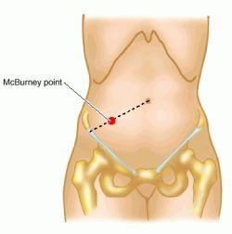
Acute Appendicitis
The appendix is a vestigial organ with disputed functionality.
The appendix is located at McBurney’s point which lies 2/3rds of the way from the umbilicus to the anterior superior iliac spine (ASIS)
Appendicitis can occur at any age, although its highest incidence is ~10-20yrs
Appendicitis is the most common surgical emergency and is commonly examined…

Slide 61
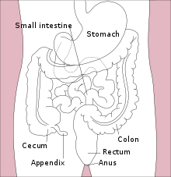
Acute Appendicitis
Acute appendicitis is sudden inflammation of the appendix.
Most commonly, acute appendicitis occurs because of an obstruction within the appendix, however this obstruction can arise in many different ways…
The obstruction of the appendix results in the invasion of gut organisms into the appendix wall. This leads to inflammation, necrosis and eventually perforation
Faecoliths
Bezoars/foreign bodies
Trauma
Intestinal worms
Lymphoid hyperplasia

Slide 62
Acute Appendicitis
Clinical Presentation
Early pain/discomfort around the umbilicus that migrates the the right iliac fossa
As the inflammation of the appendix progresses, it irritates the overlying peritoneum causing severe, localised pain at McBurney’s point
Guarding
Tender mass in RIF
Pyrexia
Anorexia
Nausea & vomiting
Rosving’s sign
Moving/coughing causes pain due to peritonism
You can get chronic (grumbling) appendicitis, but this is not examined and presents with much milder symptoms

Slide 63
Acute Appendicitis
Differential Diagnoses
Acute Crohn’s disease
Ectopic pregnancy
UTI
Diverticulitis
Perforated ulcer
Food poisoning
Constipation
Strangulated hernia

Slide 64
Acute Appendicitis
Diagnosis/Investigations
Blood tests
Raised WCC (+/- ^neutrophils)
Raised CRP & ESR
Ultrasound
Can detect an inflamed appendix
May show an appendiceal mass
CT = GOLD STANDARD
Highly sensitive & specific
Pregnancy test to exclude
Urinalysis to exclude UTI

Slide 65
Acute Appendicitis
Management
Complications
Appendicectomy = Gold standard
This is a laparoscopic (keyhole) procedure in most cases, however in severe cases laparotomy (open) surgery is required
IV antibiotics & fluids both pre & post-operatively
Metronidazole, Cefuroxime
Perforation
Appendix mass
Small bowel & omentum adhere to appendix
Appendiceal abscess
Adhesions
Pelvic inflammatory disease (PID)

Slide 66
Acute Appendicitis
Summary
Most common surgical emergency & an exam favourite
Pain migrates from umbilicus > RIF
Guarding & tenderness
Rosving’s sign
Pryexia + N&V
Diagnose w/ CT
Manage with appendicectomy to prevent complications like perforation

Slide 67
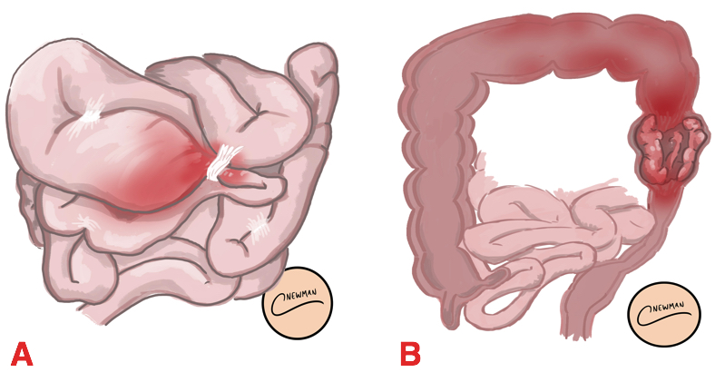
Bowel Obstructions
Bowel obstructions are common and are separated into 3 key types:
Small bowel obstruction
Large bowl obstruction
Pseudo-obstruction
A bowel obstruction is an arrest of the onward propulsion of intestinal contents
Small bowel obstructions are the most common (60-75%).
All can be serious & potentially fatal.

Slide 68
Small Bowel Obstruction
Aetiology
Pathophysiology
Adhesions (~60%)
Usually due to previous abdo/pelvic surgery
Can be caused by previous abdo infections eg. peritonitis
Hernias
Due to intestinal contents being unable to pass through a strangulated loop
Malignancy
Crohn’s disease
Obstruction of the bowel leads to distension above the blockage due to a build up of fluid & contents
This causes increased pressure which pushes on the blood vessels within the bowel wall causing them to become compressed
These compressed vessels cannot therefore supply blood resulting in ischaemia & necrosis, and eventually perforation

Slide 69
Small Bowel Obstruction
Clinical Presentation
Pain
Initially colicky but then diffuse
Pain is higher in the abdomen than LBO
Profuse vomiting following pain
Vomiting occurs earlier in SBO than LBO
Less abdominal distension than LBO
Tenderness suggests strangulation/ risk of perforation
Constipation with no passage of gas occurs late in SBO
Increased bowel sounds (tinkling)

Slide 70
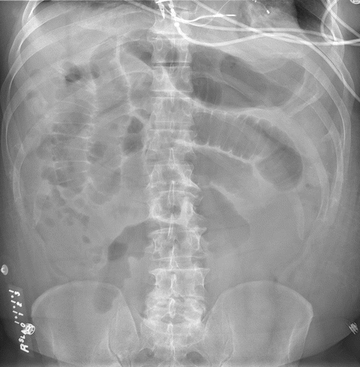
Small Bowel Obstruction
Diagnosis/Investigations
Abdominal x-ray = 1st line
Shows central gas shadows that completely cross the lumen
No gas is seen in the large bowel
There will be distended loops proximal to be obstruction
May see fluid levels within bowel
Examinations of hernia orifices & rectum
FBC
Non-contrast CT = Gold standard
Accurately localizes the obstruction

Slide 71
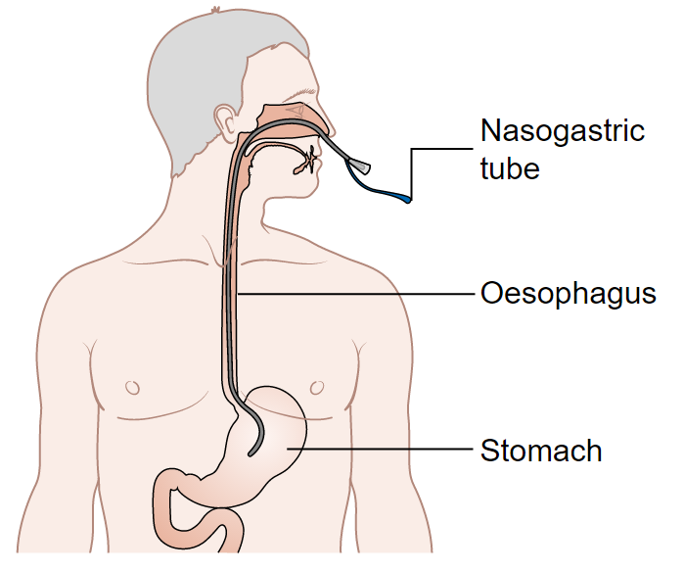
Small Bowel Obstruction
Management
Aggressive fluid resuscitation
Decompression of the bowel
“Drip & suck”
IV fluids with Nasogastric (NG) tube
Analgesia & anti-emetics for symptoms
Antibiotics
Surgery to remove obstruction
Usually laparotomy (open)

Slide 72
Large Bowel Obstruction
Aetiology
Malignancy (90%)
Much more common in EU/West than in Africa
Volvulus
Rotation/twisting of the bowel on its mesenteric axis
Sigmoid colon is the most common place for this to occur
Diverticulitis
Crohn’s disease
Intussusception
Where the bowel roles inside of itself
Almost exclusively in neonates/infants as they has “softer” bowels
Large bowel obstructions are less common as the lumen is much larger and can distend more, therefore it is harder to block

Slide 73
Large Bowel Obstruction
Clinical Presentation
Abdominal pain
More constant & diffuse than SBO
Usually occurs lower in abdomen, especially LIF
Much more abdominal distension than SBO
Normal bowel sounds initially, then increased and eventually silent as no movement
Palpable mass eg. hernia
Most common in LIF
Vomiting occurs much later than in SBO, and may be absent
Constipation earlier than in SBO

Slide 74
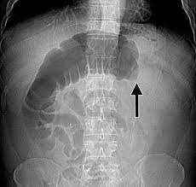
Large Bowel Obstruction
Diagnosis/Investigations
Digital rectal exam (DRE)
Empty rectum
Hard, compacted stools
Might be blood
FBC
CT = gold standard
Abdo x-ray = 1st line
Peripheral gas shadows proximal to blockage, but doesn’t show rectum hence why DRE is essential
Caecum & ascending colon will be distended

Slide 75
Large Bowel Obstruction
Management
Aggressive fluid resuscitation
Decompression of the bowel
“Drip & suck”
IV fluids with Nasogastric (NG) tube
Analgesia & anti-emetics for symptoms
Antibiotics
Surgery to remove obstruction
Usually laparotomy (open)
Yes, this is identical management to a small bowel obstruction, nice & easy to learn!!

Slide 76
Pseudo-bowel Obstructions
Pseudo-bowel obstructions present identically to LBOs or SBOs, dependent on the location. Occasionally, the entire bowel is obstructed so it presents as both at the same time.
The best way to manage a pseudo-bowel obstruction is to treat the underlying problem.
Aetiology:
Intra-abdo trauma
Post-operative states eg. paralytic ileus
Intra-abdo sepsis
Drugs eg. opiates, antidepressants
Electrolyte imbalances

Slide 77
SUMMARY
SBO most often caused by adhesions, LBO most commonly caused by malignancy
SBO presents with colicky pain + severe & early vomiting
LBO has a more distended abdomen + earlier constipation
All bowel obstructions are diagnosed first via abdo x-ray and then confirmatory via CT
Management is by “drip & suck” first, if that fails then requires surgery
Pseudo-bowel obstructions present identically to SBO/LBO but the underlying cause should be treated first

Slide 78
Diarrhoea
Acute diarrhoea = less than 2wks
Chronic diarrhoea = >2wks
Aetiology
Bacterial
Campylobacter jejuni
E.coli
Salmonella
Shigella
Viral (majority)
Children = rotavirus
Adults = norovirus
Parasitic
Giardia lamblia
Entamoeba histolyitca
Cryptosporidium
E. coli, Salmonella, Shigella are all associated with bloody diarrhoea!!

Slide 79
Diarrhoea
Management
Treat the underlying causes
Bacterial diarrhoea is normally treated with Metronidazole
Oral rehydration therapy
IV fluids given in very severe
Anti-emetics eg. metoclopramide
Anti-motility agents eg. Loperamide
Diarrhoea is usually self-limiting so doesn’t need much treatment unless severe. Oral rehydration therapy is essential to prevent dehydration, however.

Slide 80
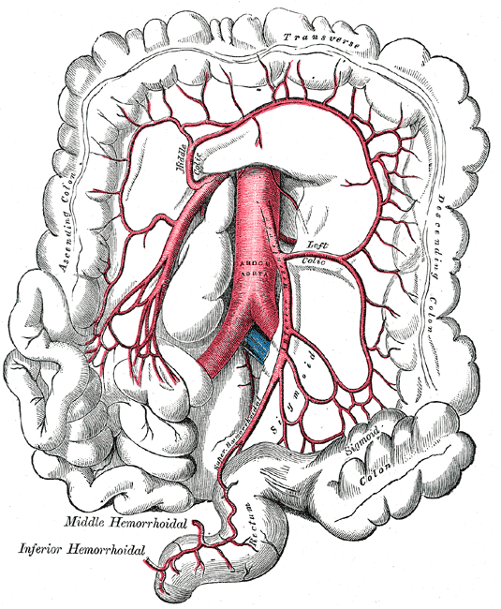
Ischaemic Bowel Diseases
Ischaemic bowel diseases can be classified into 3 main types:
Acute mesenteric ischaemia
Chronic mesenteric ischaemia
Ischaemic colitis
Acute & chronic mesenteric ischaemia almost always affect the small bowel, whereas ischaemic colitis affects the large bowel.
The bowel mostly gets its blood supply from the superior & inferior mesenteric arteries.
”Watershed areas” like the splenic flexure & caecum are the most susceptible to ischaemia.

Slide 81
Acute Mesenteric Ischaemia
Aetiology
Clinical Presentation
Superior mesenteric artery(SMA) thrombosis
SMA embolism (due to AF)
Mesenteric vein thrombosis
Typically young patients who are in hypercoaguable states
Non-occlusive disease
eg. poor blood flow, poor cardiac output
Classical triad:
Acute, severe abdo pain
Usually constant & central
No abdo signs on exam
Rapid hypovolaemia > shock
The symptoms are often way out of proportion with clinical signs
If you see AF with severe abdo pain, think AMI

Slide 82
Acute Mesenteric Ischaemia
Diagnosis/Investigations
Bloods
^^Hb due to blood loss
Persistent metabolic acidosis due to ischaemia
Abdo x-ray
Used to rule out bowel obstruction
Laparoscopy
Used to visualise the necrosis
CT/MRI angiography
Non-invasive way to look at arteries to see blockages, but is a difficult scan to perform
Chronic mesenteric ischaemia is very similar to AMI, except the symptoms are on a lower level & persist for much longer. It is described as “abdominal angina”

Slide 83
Acute Mesenteric Ischaemia
Management
Complications
Fluid resuscitation
Antibiotics
Metronidazole, Gentamicin
IV Heparin to reduce clotting
Surgery to remove necrotic bowel
Sepsis
Peritonitis

Slide 84
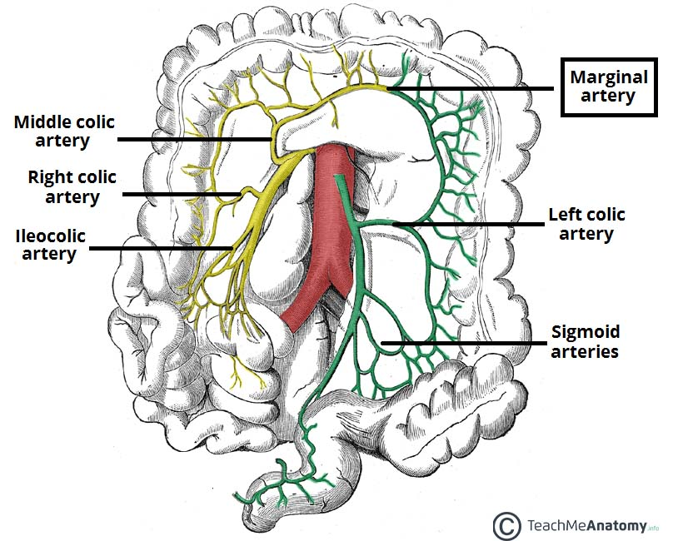
Ischaemic colitis
Aetiology
Clinical Presentation
Thrombosis
Emboli
Low flow states
Low cardiac output/arrhythmias
Surgery
Vasculitis
Coagulation disorders
Oral contraceptive pill
Idiopathic
Sudden onset LIF pain
Passage of bright red blood
Signs of hypovolaemic shock

Slide 85
Ischaemic colitis
Diagnosis/Investigations
Urgent CT to rule out perforation
Flexible sigmoidoscopy w/ biopsy
Will show epithelial cell apoptosis
Colonoscopy w/ biopsy = Gold standard
Only done AFTER patient has fully recovered to exclude the formation of a strictures at the site and to confirm mucosal healing
Barium enema

Slide 86
Ischaemic colitis
Management
Most patients will be fine with only symptomatic treatment
Fluid replacement
Antibiotics
Reduce infection risks due to translocation of bacteria across the drying bowel wall
Strictures at the disease site are common
Gangrenous ischaemic colitis
Peritonitis & hypovolaemic shock
Will require surgical intervention

Slide 87
Any questions or anything you want me to recap?

Slide 88
Questions!!
Questions!!
But first feedback ☺
The Peer Teaching Society is not liable for false or misleading information…

Slide 89
A quick game of “name that disease”

Slide 90
IBS, UC, Crohn’s or coeliac?
Continuous lesions
Can be managed with TCAs or SSRIs
Transmural lesions
Nocturnal diarrhoea
Villous atrophy
Mucoid diarrhoea
Dermatitis herpetiformis
pANCA positive IBD
Smoking is a protective factor for this disease
tTG & EMA positive
Has 3 distinct sub-types
Can use methotrexate to maintain remission

Slide 91
IBS, UC, Crohn’s or coeliac?
Continuous lesions - UC
Can be managed with TCAs or SSRIs - IBS
Transmural lesions - Crohn’s
Nocturnal diarrhoea – IBD, not IBS
Villous atrophy - Coeliac
Mucoid diarrhoea - UC
Dermatitis herpetiformis - Coeliac
pANCA positive - UC
Smoking is a protective factor for this disease - UC
tTG & EMA positive - Coeliac
Has 3 distinct sub-types - IBS
Can use methotrexate to maintain remission – Crohn’s

Slide 92
Some more traditional SBAs for you…

Slide 93
Question 1
A patient presents to you in your GP practice. She tells you that she has had diarrhoea, abdominal pain and some bloating for months now, maybe even years. After asking her a few questions you ascertain that her stool is quite pale and often floats, it also has a rather vile stench. Looking at her past history, you notice she is known to have Hashimoto’s thyroiditis.
What investigation should be offered to her to definitively confirm her most likely diagnosis?
Genetic testing
Colonoscopy + biopsy
Duodenal biopsy
DEXA scan
Serum antibody testing

Slide 94
Question 1
A patient presents to you in your GP practice. She tells you that she has had diarrhoea, abdominal pain and some bloating for months now, maybe even years. After asking her a few questions you ascertain that her stool is quite pale and often floats, it also has a rather vile stench. Looking at her past history, you notice she is known to have Hashimoto’s thyroiditis.
What investigation should be offered to her to definitively confirm her most likely diagnosis?
Genetic testing
Colonoscopy + biopsy
Duodenal biopsy
DEXA scan
Serum antibody testing

Slide 95
Question 2
A woman presents to you with LLQ abdo pain with episodes of bloody & mucoid diarrhoea. You send him for a colonoscopy + biopsy; his results come back showing continual inflammatory lesions extending from the rectum.
What is the first line management to induce remission in this patient?
Prednisolone
Azathioprine
Infliximab
Olsalazine
Hydrocortisone

Slide 96
Question 2
A gentleman presents to you with LLQ abdo pain with episodes of bloody & mucoid diarrhoea. You send him for a colonoscopy + biopsy; his results come back showing continual inflammatory lesions extending from the rectum.
What is the first line management to induce remission in this patient?
Prednisolone
Azathioprine
Infliximab
Olsalazine
Hydrocortisone

Slide 97
Question 3
A 13 year-old child presents to you in A&E with severe pain and vomiting. The pain has migrated over the last few hours from a dull ache around their umbilicus to what is now a sharp pain in the RLQ over McBurney’s point. Upon examination, you elicit guarding and rebound tenderness in this area.
Which of the following is the least common cause of acute appendicitis?
Trauma
Metastases
Intestinal worms
Bezoars
Lymphoid hyperplasia

Slide 98
Question 3
A 13 year-old child presents to you in A&E with severe pain and vomiting. The pain has migrated over the last few hours from a dull ache around their umbilicus to what is now a sharp pain in the RLQ over McBurney’s point. Upon examination, you elicit guarding and rebound tenderness in this area.
Which of the following is the least common cause of acute appendicitis?
Trauma
Metastases
Intestinal worms
Bezoars
Lymphoid hyperplasia

Slide 99
Question 4
An elderly gentleman presents to A&E with constant pain throughout his abdomen as well as lots of distension. You find out he has not passed wind or emptied his bowels in 3 days. You listen to his abdomen as hear no bowel sounds. He is known to have bowel cancer.
Which of the following is the 1st line investigation used to confirm a diagnosis of a bowel obstruction?
MRI
Abdo x-ray
Ultrasound
CT
ERCP

Slide 100
Question 4
An elderly gentleman presents to A&E with constant pain throughout his abdomen as well as lots of distension. You find out he has not passed wind or emptied his bowels in 3 days. You listen to his abdomen as hear no bowel sounds. He is known to have bowel cancer.
Which of the following is the 1st line investigation used to confirm a diagnosis of a bowel obstruction?
MRI
Abdo x-ray
Ultrasound
CT
ERCP (endoscopic retrograde cholangiopancreatography)

Slide 101
Question 5
The abdominal x-ray you ordered before comes back showing peripheral gas shadows proximal to a blockage as well as severe distension of the caecum and ascending colon. Your consultant doesn’t congratulate you on your fast actions and diagnostic skills, instead he treats you to a question:
“What is the most common cause of large bowel obstructions in the UK?”
Sigmoid volvulus
Adhesions
Intussusception
Hernias
Malignancy

Slide 102
Question 5
The abdominal x-ray you ordered before comes back showing peripheral gas shadows proximal to a blockage as well as severe distension of the caecum and ascending colon. Your consultant doesn’t congratulate you on your fast actions and diagnostic skills, instead he treats you to a question:
“What is the most common cause of large bowel obstructions in the UK?”
Sigmoid volvulus
Adhesions
Intussusception
Hernias
Malignancy

Slide 103
Question 6
A 52 year-old woman presents to you in your GP clinic complainging of 10 days of quite severe vomiting and diarrhoea. You start to think about what are the most common causes of diarrhoea as you need to decide if you prescribe her something else alongside loperamide.
Which of the following are the most common cause of diarrhoea in adults?
Norovirus
Campylobacter jejuni
Rotavirus
E. Coli
Salmonella

Slide 104
Question 6
A 52 year-old woman presents to you in your GP clinic complaining of 10 days of quite severe vomiting and diarrhoea. You start to think about what are the most common causes of diarrhoea as you need to decide if you prescribe her something else alongside loperamide.
Which of the following are the most common cause of diarrhoea in adults?
Norovirus
Campylobacter jejuni
Rotavirus
E. Coli
Salmonella

Slide 105
Any questions or anything you want us to recap?

