Slide 1
2022/2023

Slide 2
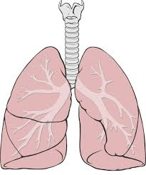
RESPIRATORY
Phase 2a Revision Session
19/04/23
Haroon Tariq & Hannan Tariq
The Peer Teaching Society is not liable for false or misleading information…

Slide 3
Aims and Objectives
Type 1 and 2 respiratory failure – understand differences, name conditions which are type 1 + 2
COPD
Asthma
Pulmonary hypertension
Lung cancer
Small cell
Non-small cell
Mesothelioma
Goodpasture’s syndrome
Lung Infection
Tuberculosis
Pneumonia (Community acquired and Hospital acquired)
Pleural space pathology
Pleural Effusion
Pneumothorax
Cystic fibrosis
Bronchiectasis
Interstitial lung diseases
Pulmonary fibrosis
Sarcoidosis
Hypersensitivity pneumonitis
NOT INCLUDED:
occupational lung disorders
dyspnoea
Upper resp tract infection (Pharyngitis/otitis media/sinusitis/epiglottitis/croup/whooping cough
The Peer Teaching Society is not liable for false or misleading information…

Slide 4
Content - WHAT TO INCLUDE?
CONDITIONS
The Peer Teaching Society is not liable for false or misleading information…

Slide 5
RESPIRATORY FAILURE
HYPOXAEMIA with systemic effects, +/- hypercapnea
TYPE 1
Restrictive
→ Problem getting air IN
→ More airway scarring
Pulmonary fibrosis, sarcoidosis, Goodpasture’s (ILDs)
Low O2 and NORMAL CO2
FVC < 0.8
TYPE 2
Obstructive
→ Problem getting air OUT
→ More mucus + lumen blockage
COPD, asthma, CF, bronchiectasis, (bronchiolitis)
Low O2 and RAISED CO2
FEV1:FVC < 0.7

Slide 6
MAIN DIFFERENTIAL?
A 70 YEAR OLD MAN WITH A 45 YEAR PACK HISTORY PRESENTS WITH A CHRONIC PRODUCTIVE COUGH, CONSTANTLY, FOR THE LAST 4 YEARS

Slide 7
COPD (CHRONIC OBSTRUCTIVE PUL. DISORDER)
DEFINITION, CAUSE/S & RISK FACTORS | Characterised by Progressive, Irreversible airflow limitation RF: CIGARETTE SMOKING!!! air pollution, genetics
PATHOPHYSIOLOGY (IF APPLICABLE) | 3 main types: CHRONIC BRONCHITIS → hypertrophy + hyperplasia of mucous glands to protect vs cigarette smoke → chronic inflammatory cells in bronchial walls = luminal narrowing , thus more mucus, inflamed bronchi + narrower lumen EMPHYSEMA → destruction of elastin layer of resp bronchioles/alv ducts/alv sacs (keeps them open) = leads to distal air trapping. can form BULLAE → can be centriacinar (resp bronchioles involved only - SMOKERS) or panacinar (A1AT deficiency!) ALPHA 1 ANTITRYPSIN DEFICIENCY → auto rec panacinar emphysema. suspect in male px <40 with little/ no smoking Hx

Slide 8
COPD (CHRONIC OBSTRUCTIVE PUL. DISORDER)
PRESENTATION (Sx) | Symptoms: CHRONIC PRODUCTIVE COUGH (NO DIURNAL VARIATION, constant, for 2+ years), dyspnoea, often get chest infections. NOTES - pink puffer (thinner px, barrel chest, muscle wasting, pursed lip breathing) blue bloater (more overweight, cyanotic) Signs: classic barrel chest in exam question
DIAGNOSIS & INVESTIGATIONS (Ix) | PULMONARY FUNCTION TESTS! Pathway as follows: do Fraction expired nitrous oxide (feNO) = raised non specific in lung damage Then do Spirometry = FEV1:FVC less than 0.7 (obstruction) Then do bronchodilator reversibility test = less than 12% increase in FEV1 (IRREVERSIBLE)
TREATMENT (Tx) | THE SINGLE MOST IMPORTANT THING YOU MUST DO IS…
Notes:
mc causes of IECOPD - H influenzae and S pneumoniae (exam SAQ in the past)

Slide 9
COPD (CHRONIC OBSTRUCTIVE PUL. DISORDER)
TREATMENT (Tx) | THE SINGLE MOST IMPORTANT THING YOU MUST DO IS… STOP SMOKING!!!! (often exam q) THEN, at-home pharmacalogical algorithm: SABA (salbutamol) (PRN) SABA + LABA (salmeterol) + LAMA (tiotropium bromide) SABA + LABA + LAMA + ICS (e.g. prednisolone) For acute exacerbations: → O2 sats maintained to 88-92% as opposed to 92-96% in normal lungs. → SABA, SAMA, ICS, Abx if IECOPD LONG TERM OXYGEN THERAPY (LTOT) given in v severe COPD - chronic readings of <88% O2 sats, given 15+h daily for 3 weeks → MUST BE NON SMOKING WHEN ON LTOT!!!!! WHY?
COMPLICATIONS (IF APPLICABLE) | IECOPD, cor pulmonale (RHS failure due to pul htn)
Notes:
Obstruction means chronic CO2 retainers; giving excessive O2 will be trapped in dead space (esp in emphysema) and increase V/Q mismatch → ultimately leading to resp acidosis
Must not smoke on LTOT due to risk of FLAMMABILITY - can literally blow up xD

Slide 10
MAIN DIFFERENTIAL?
A 13 YEAR OLD GIRL PRESENTS WITH A HISTORY OF 4 REALLY BAD COUGHING EPISODES. SHE REPORTS ALLERGIES TO CATS AND TO PEANUTS.

Slide 11
ASTHMA
DEFINITION, CAUSE/S & RISK FACTORS | CHRONIC REVERSIBLE AIRWAY DISEASE characterised by reversible airway obstruction, inflamed bronchioles, and airway hypersensitivity. Allergic (70%, IgE mediated, Type 1 hypersensitivity, raised EOSINOPHILS) and Non allergic (30%, smokers) subtypes Triggers: infections, allergens, cold, dust, damp, exercise, drugs (Beta blockers, aspirin) NOTE the ATOPIC TRIAD (allergic rhinitis, atopic eczema and asthma)
PATHOPHYSIOLOGY (IF APPLICABLE) | Overexpression of TH2 cells in the airway stimulates IgE production (mast cell degranulation) → T1 hypersensitivity Eosinophilia → release of toxic proteins e.g. MBP leading to chronic remodelling and mucus hypersecretion
Notes:
Samters triad = aspirin sensitivity, asthma and nasal polyps (also related to asthma but much less so than atopic)

Slide 12
ASTHMA
PRESENTATION (Sx) | Symptoms: Wheeze, dyspnoea, cough with DIURNAL VARIATION (worse at night) and worse during EPISODES (i.e. not constant) Signs: bilateral wheeze on auscaltation NOTE: Microscopy of mucus shows: Curshmann spirals Charcot-Leydig crystals
DIAGNOSIS & INVESTIGATIONS (Ix) | PULMONARY FUNCTION TESTS! Pathway as follows: do Fraction expired nitrous oxide (feNO) = raised non specific in lung damage Then do Spirometry = FEV1:FVC less than 0.7 (obstruction) Then do bronchodilator reversibility test = more than 12% increase in FEV1 (REVERSIBLE)

Slide 13
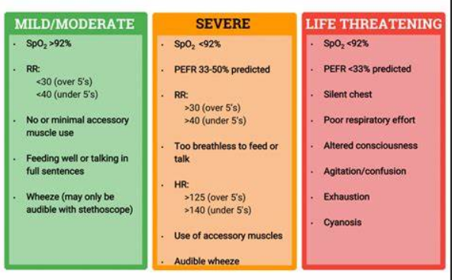
ASTHMA

Slide 14
ASTHMA
NEED TO KNOW THIS SLIDE
TREATMENT:
ACUTE ALGORITHM:
OSHIT ME
OXYGEN
SABA
HYDROCORTISONE (ICS)
IPRATROPIUM BROMIDE
THEOPHYLLINE
MgSO4 (IV)
Escalate care…
EPISODIC ALGORITHM:
SABA
SABA + ICS
------------------------------------------
SABA + ICS + LTRA
SABA + ICS + LABA +/- LTRA
Increase ICS dose
Notes:
Dashed line - before going from 2 to 3 MUST CHECK COMPLIANCE TO MEDICATION AND INHALER TECHNIQUE!

Slide 15
2 DIFFERENTIALS?
A 65 YEAR OLD MAN PRESENTS TO THE EMERGENCY DEPARTMENT WITH HAEMOPTYSIS. HE’S HAD A COUGH FOR THE LAST 4 WEEKS. HE HAS LOST 4KG UNEXPECTEDLY IN THIS TIME FRAME AND HIS TEMPERATURE IS 38.1 DEGREES C.
Notes:
TB or lung cancer

Slide 16
LUNG CANCER
PLEURAL?
MESOTHELIOMA*
PRIMARY LUNG CANCER
SMALL CELL*
PARENCHYMAL?
(BRONCHIAL CARCINOMA)
NON SMALL CELL
SQUAMOUS*
ADENOCARCINOMA*
CARCINOID
LARGE CELL

Slide 17
MESOTHELIOMA
DEFINITION, CAUSE/S & RISK FACTORS | A pleural malignancy, which affects pleura (MC) and peritoneum (LC) EXAMS: suspect in MALES 40-70 with ASBESTOS EXPOSURE DECADES AGO (a latent period)
PRESENTATION (Sx) | Lung Sx - SOB, recurrent chest pain, constant cough w haemoptysis Compression: e.g. recurrent laryngeal (hoarse voice), bone pain CONSTITUTIONAL - TATT, night sweats, weight loss, rigors
DIAGNOSIS & INVESTIGATIONS (Ix) | 1st line= IMAGING (first CXR, then CT) - pleural thickening +/- effusion GOLD STANDARD = biopsy CA-125 may be raised nonspecifically (mainly associated w OVARIAN ca)
TREATMENT (Tx) | purely palliative :(
COMPLICATIONS (IF APPLICABLE) | Very severe aggressive cancer with super low survival rates.

Slide 18
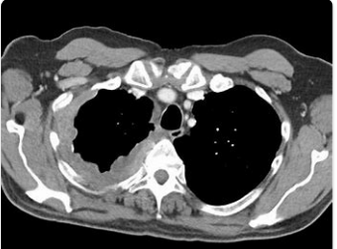
Notes:
RHS mesothelioma seen on CT. Note CT taken in transverse plane slices from the feet upwards.

Slide 19
SMALL CELL LUNG CANCER
DEFINITION, CAUSE/S & RISK FACTORS | 15% bronchial carcinomas Malignancy affecting central respiratory system (bronchi), appears as small cells with minimal cytoplasm on biopsy. EXCLUSIVELY SMOKERS are affected
PRESENTATION (Sx) | Lung Sx: cough w haemoptysis, SOB, recurrent chest pain Constitutional Sx (same in all ca) Compression Sx PARANEOPLASTIC SYNDROMES!!!!! (3)
DIAGNOSIS & INVESTIGATIONS (Ix) | 1st line = Imaging (CXR then CT) GS = Bronchoscopy and biopsy Staging with TNM
TREATMENT (Tx) | If very early, may try chemo/radio (usually unsuccessful). Palliative often
COMPLICATIONS (IF APPLICABLE) | Paraneoplastic syndromes. Also a very malignant cancer so poor prognosis.
Notes:
Paraneoplastic syndromes
ACTH - Cushings
ADH - SIADH
Lambert Eaton syndrome (dysfunction of Ach at the nmj)

Slide 20
NON-SMALL CELL LUNG CANCER
DISEASE NAME | SQUAMOUS CELL CARCINOMA (30-35%)
DEFINITION, CAUSE/S & RISK FACTORS | Bronchial carcinoma arising from lung epithelium histologically resembling squamous epithelium Mainly affects smokers (more than any NSCLC)
PRESENTATION (Sx) | Lung Sx; Constitutional Sx, Compression Sx, PARANEOPLASTIC SYNDROME = PTHrP Metastasises late, spreads locally in most cases
DIAGNOSIS & INVESTIGATIONS (Ix) | 1st = Imaging (CXR then CT) GS = Bronchoscopy + biopsy TNM staging
TREATMENT (Tx) | Surgical excision in most cases. If mets - chemo and/or radiotherapy
COMPLICATIONS (IF APPLICABLE) | Less aggressive and more treatable than SCLC

Slide 21
NON-SMALL CELL LUNG CANCER
DISEASE NAME | ADENOCARCINOMA (40-45%)
DEFINITION, CAUSE/S & RISK FACTORS | Bronchial carcinoma arising from mucus secreting glandular epithelium Main risk factor is ASBESTOS EXPOSURE! MC bronchial carcinoma
PRESENTATION (Sx) | Lung Sx; Constitutional Sx, Compression Sx, Metastasises common Adenocarcinoma NSCLC is also closely related to HYPERTROPHIC PULMONARY OSTEOARTHROPATHY → Triad of clubbing, arthritis and long bone swelling
DIAGNOSIS & INVESTIGATIONS (Ix) | 1st = Imaging (CXR then CT) GS = Bronchoscopy + biopsy TNM staging
TREATMENT (Tx) | Surgical excision in some cases. If mets (more likely) - chemo and/or radiotherapy
COMPLICATIONS (IF APPLICABLE) | Relatively treatable unless distant spread of cancer

Slide 22
What’s going on here?
A patient with known Adenocarcinoma of the bronchi presents with new onset weakness and tingling in his right arm. His right eyelid seems to be drooped and his right pupil is evidently constricted.
On examination, he has a hoarse voice and when his arms are raised above his head, his face becomes severely erythematous.

Slide 23
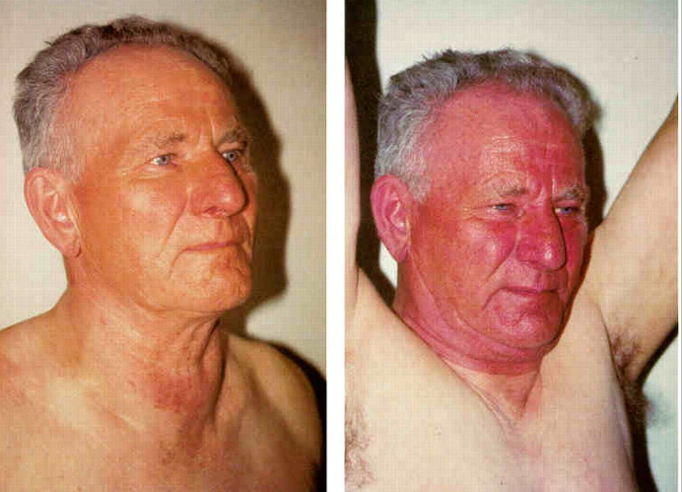
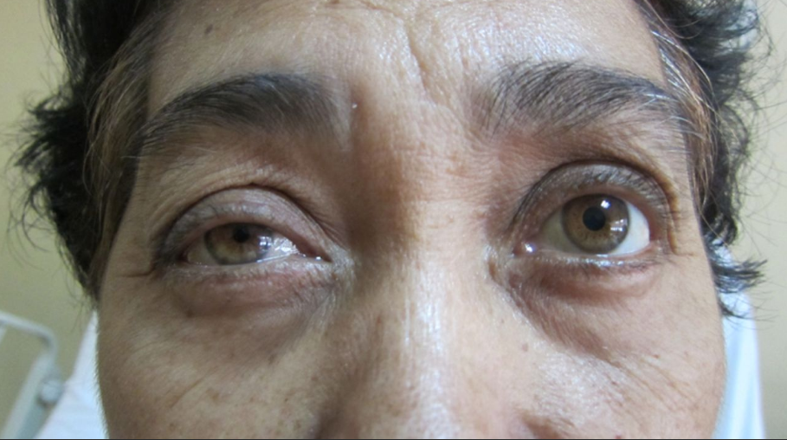
COMPRESSION!!!
Raising his arms and facial flushing = PEMBERTON’S SIGN. Shows SVC obstruction due to compression
Compression of the sympathetic chain T1-L2 from a resp tumour is a PANCOAST TUMOUR which can cause IPSILATERAL HORNER’S SYNDROME:
Miosis
Ptosis
Anhidrosis
RIght arm weakness
Hoarse voice = compression of the RECURRENT LARYNGEAL NERVE

Slide 24
PULMONARY HYPERTENSION
DEFINITION, CAUSE/S & RISK FACTORS | Resting mPAP is >25mmHg mild 25-40, mod 40-55, severe 55+ CAUSES Precapillary = primary pul htm, pul emboli Capillary = COPD, asthma Post capillary = LV failure Chronic hypoxemia = COPD, high altitude
PATHOPHYSIOLOGY (IF APPLICABLE) | Reactive pulmonary vasoconstriction in response to hypoxemia (body thinks this is DEAD SPACE) → RVH and resp failure
PRESENTATION (Sx) | EXERTIONAL DYSPNOEA + FATIGUE first later on RV failure: JVP distension, peripheral oedema, cannon A waves
DIAGNOSIS & INVESTIGATIONS (Ix) | DIAGNOSTIC = RH catheter (measure pressure directly) CXR = RVH ECG = Evidence of RA dilation (‘p pumonale’ - peaked p waves)
TREATMENT (Tx) | Sildenafil (VIAGRA!) - phosphodiesterase 5 inhibitor
COMPLICATION | COR PULMONALE!

Slide 25
GOODPASTURE’S DISEASE
DEFINITION, CAUSE/S & RISK FACTORS | Hypersensitivity response resulting in pulmonary and renal pathology. EXAM = HAEMOPTYSIS + HAEMATURIA SIMULTANEOUSLY IS TELL TALE SIGN!!! HLA DR15 implicated. Cigarette smoking, asbestosis.
PATHOPHYSIOLOGY (IF APPLICABLE) | ANTI-GBM antibodies attack basement membranes of alveoli and glomeruli → alveolar haemorrhage and nephritic syndrome
PRESENTATION (Sx) | Lung: cough, haemoptysis, chest pain Renal: haematuria, htn, oedema
DIAGNOSIS & INVESTIGATIONS (Ix) | Serology = anti GBM +ve Lung and kidney biopsy = Ig complex formation, general damage
TREATMENT (Tx) | corticosteroids (prednisolone) + plasma exchange
Notes:
type 2 hypersensitivity (antigen antibody complex formation)

Slide 26
MAIN DIFFERENTIAL?
A 55 year old man complains of persistent coughing after coming back from Pakistan 3 weeks ago. He also mentions that he has noticed weight loss recently and his cough has now started to bring up blood.

Slide 27
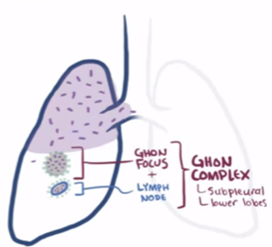
Tuberculosis
DEFINITION, CAUSE/S & RISK FACTORS | Mycobacterium infection Aerobic, non-motile, non-sporing, slow growing bacilli with a thick waxy capsule Acid-fast bacilli – turns red/pink with Ziehl-neelsen stain Resistant to phagolysosomal killing and able to remain dormant Very common in Africa/S Asia
PATHOPHYSIOLOGY (IF APPLICABLE) | TB is spread via respiratory droplets as it is an airborne infection. Alveolar macrophages ingest the bacteria, but the bacteria resist being killed so a granuloma forms. T-cells are recruited and surround the granuloma. The central part of the granuloma undergoes necrosis and has a cheese-like appearance = caseating granuloma which is referred to as a primary ghon focus. The ghon focus spreads to nearby lymph nodes. Ghon focus + lymph node spread = ghon complex. If TB spreads systemically it is referred to as miliary TB. Most often it is contained within the granuloma but stays alive so known as latent TB.

Slide 28
Tuberculosis
PRESENTATION (Sx) | Systemic symptoms: Weight loss, Low grade fever, Anorexia, Drenching night sweats, Malaise Pulmonary symptoms: Productive cough,Haemoptysis, Cough >3 weeks (dry or productive), Breathlessness Signs: Dullness to percuss, Decreased breathing, Fever, Crackles
DIAGNOSIS & INVESTIGATIONS (Ix) | CXR Sputum culture for acid-fast bacilli: – Ziehl-Neelsen stain -> turns red/pink Biopsy: Shows caseating granuloma Diagnosing latent TB: Tuberculin skin test ‘Mantoux’ Interferon gamma release assay

Slide 29
Tuberculosis - treatment
Drug | Length | Side effects
Rifampicin | Approx. 6 months | Red/bloody urine (haematuria)
Isoniazid | Approx. 6 months | perIpheral neuropathy
Pyrazinamide | Approx. 2 months | hePatitis, gout
Ethambutol | Approx. 2 months | Eye problems (optic neuritis)

Slide 30
MAIN DIFFERENTIAL?
A 60 Y.O. man presents with a 2 week history of shortness of breath on exertion and productive cough. His temperature was 38.3oC when he last checked it.

Slide 31
Pneumonia
DEFINITION, CAUSE/S & RISK FACTORS | Inflammation of the air sacs in the lungs caused by an infection. Community acquired - pneumonia acquired outside hospital environment or healthcare services. Hospital acquired - an acute lower respiratory tract infection that is by definition acquired after at least 48 hours of admission to hospital and is not incubating at the time of admission. Atypical pneumonia - caused by atypical organisms not detectable by gram stain If question has water cooler/air conditioner very likely to be legionella! If question mentions HIV patient - likely pneumocystis jiroveci which is a fungal infection!
Notes:
Highlight that in HIV patients, pneumocystitis jirovecci is mc pneumonia (a FUNGUS)

Slide 32
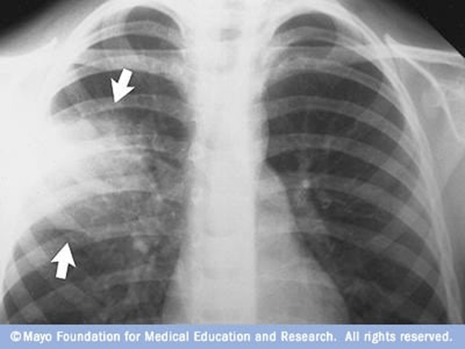
Pneumonia
PRESENTATION (Sx) | Symptoms: Cough, sputum, SOB, fever, pleuritic chest pain Signs: ↑ RR + HR, ↓BP, ↓ O2 sats, Dull to percuss, Increased tactile fremitus On auscultation: Wheezing, Coarse crackles, Bronchial breath sounds, Increased vocal resonance
DIAGNOSIS & INVESTIGATIONS (Ix) | FBC – elevated WBC Sputum culture CXR - localised/widespread consolidation, effusion, abscesses, empyema

Slide 33
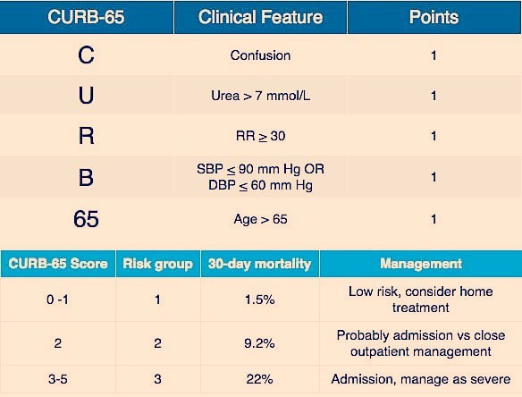
Pneumonia

Slide 34
Pneumonia - Treatment
CURB-65 Score | Management | Treatment
0-1 | Consider tx. at home | Oral amoxicillin for 5d (or macrolide if penicillin allergy)
2 | Consider hospital admission or close outpatient observation | Dual therapy with amoxicillin + macrolide (IV or oral) for 7-10d.
3-5 | Always hospital admission | IV co-amoxiclav + macrolide
• Maintaining O2 Sats between 94-98% • In COPD patients: maintain O2 sats between 88-92% • Analgesia: paracetamol or NSAIDs • IV fluids

Slide 35
MAIN DIFFERENTIAL?
A 33 y.o. lady presents with a 12 day history of left sided pleuritic chest pain. She also reports difficulty breathing and occasional cough.

Slide 36
Pleural effusion
DEFINITION, CAUSE/S & RISK FACTORS | Pleural effusion – collection of fluid between parietal and visceral pleura or in the pleural cavity of the thorax. 2 MAIN TYPES: Transudative – Fluid shifting due increase in hydrostatic pressure or oncotic pressure. Systemic causes of high blood pressure or low protein count such as Congestive HF, Fluid overload or Hypoalbuminemia (cirrhosis, nephrotic syndrome). LOW PROTEIN COUNT (<25g/l) Exudative – due to inflammation. Inflammation causes fluid + protein to leak moving across into the pleural space. Causes of inflammation = local causes + lung cancer. HIGH PROTEIN COUNT (>35g/l)
PATHOPHYSIOLOGY (IF APPLICABLE) | Transudative Exudative

Slide 37
Pleural effusion
PRESENTATION (Sx) | SOB, Cough,Stony dull percussion over effusion, Reduced breath sounds, Tracheal deviation away from the effusion if it’s a large pleural effusion.
DIAGNOSIS & INVESTIGATIONS (Ix) | • 1st line: CXR - will see ‘blunting’ of the costophrenic angles. • Pleural ultrasound • Thoracocentesis identifies and diagnoses underlying cause
TREATMENT (Tx) | Usually dependent on cause • Congestive HF – Loop diuretics • Infective – Antibiotics • Malignant - Therapeutic thoracentesis • Treatment for large effusions - CHEST DRAIN -> 5th intercostal space

Slide 38
MAIN DIFFERENTIAL?
A 22 y.o. male presents with sudden onset sharp chest pain in his left side. He has previously been diagnosed with Marfan’s and has a BMI of 20.1

Slide 39
Pneumothorax
DEFINITION, CAUSE/S & RISK FACTORS | Accumulation of air in the pleural space, causing the lungs to collapse. Types of pneumothorax: Spontaneous, Traumatic, Iatrogenic, Lung Pathology, Tension Typical patient is a tall thin young male who might have a connective tissue disorder, be a smoker or have had some kind of trauma.
PATHOPHYSIOLOGY (IF APPLICABLE) | Pleural space is usually just a vacuum containing no air. Therefore has negative intrapleural pressure. Any breach in pleura due to trauma etc. will lead to flow of air into pleural place.
PRESENTATION (Sx) | Symptoms: SOB, One sided sharp pleuritic chest pain Signs: Hyperresonant percussion note ipsilaterally, reduced breathing sounds
DIAGNOSIS & INVESTIGATIONS (Ix) | Gold standard + first line = CXR Absent lung markings Affected area much darker than normal Tracheal deviation to opposite side
TREATMENT (Tx) | Small PTX with no SOB = consider discharge and follow up CXR Larger PTX and/or SOB = needle aspiration or chest drain (more of a longer term Tx) Recurrent = surgical management - pleurodesis
Notes:
Note CXR affected area looks darker than normal due to gas accumulation

Slide 40
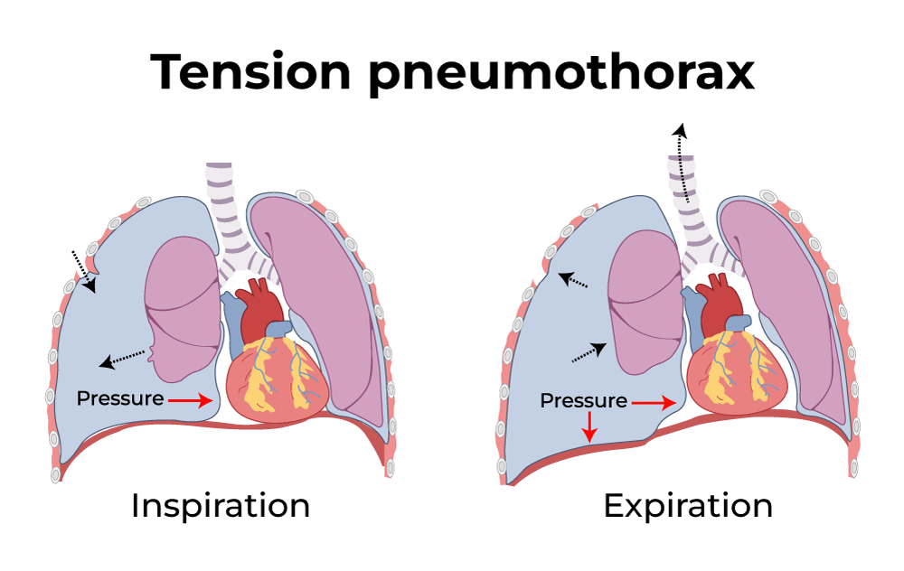
Tension Pneumothorax
THIS IS A MEDICAL EMERGENCY!!! One way valve mechanism - air can flow into the pleural space but can’t leave. With every breath the intrapleural pressure goes up Clinical presentation: Cardiopulmonary deterioration: Hypotension, Respiratory distress, Low sats,Tachycardia, Shock Severe chest pain If diagnosis is highly suspected proceed to treatment without CXR. Treatment: Insert a large bore cannula into the pleural space through the second intercostal space in the midclavicular line

Slide 41
Cystic Fibrosis
DEFINITION, CAUSE/S & RISK FACTORS | Autosomal recessive mutation on chromosome 7 - codes for the CFTR protein RFs - FHx and caucasians
PATHOPHYSIOLOGY (IF APPLICABLE) | CFTR gene normally secretes Cl- and Na+ into ductal secretions which makes them thin and watery. Due to a defect in this gene the ductal secretions are thicker with Na+ and Cl- retention. This leads to impaired mucociliary clearance = stagnation of mucus = increased infection risk, difficulty breathing.
PRESENTATION (Sx) | Respiratory Sx - recurrent infections, bronchiectasis Neonates Sx - jaundice, failure to thrive, meconium ileus (bowel obstruction) GI Sx - bowel obstruction, steatorrhea Other - male infertility, DM
DIAGNOSIS & INVESTIGATIONS (Ix) | Newborn = heel prick Older = sweat test - high chloride
TREATMENT (Tx) | MDT approach: Chest physio and postural drainage; High calorie, high fat diet; Minimise contact with other infective patients; Pancreatic supplementation
COMPLICATIONS (IF APPLICABLE) | Bronchiectasis, infections

Slide 42
Bronchiectasis
DEFINITION, CAUSE/S & RISK FACTORS | Permanent dilation of airways Causes/RFs include infection, CF and lung cancer
PATHOPHYSIOLOGY (IF APPLICABLE) | Irreversible dilation, loss of cilia and mucus hypersecretion. Increased risk of infection due to decreased mucociliary clearance
PRESENTATION (Sx) | Dyspnoea, Cough, Haemoptysis, Recurrent Cx infections
DIAGNOSIS & INVESTIGATIONS (Ix) | CXR: kerley B lines, SIGNET RING SIGN (bronchioles dilated and appear thicker than adjacent pulmonary artery) Sputum - H.influenzae most common Gold standard: HRCT (high resolution CT) = dilated thickened bronchi Spirometry = obstructive FEV1:FVC < 0.7
TREATMENT (Tx) | Non-curative Chest physio + bronchodilators + prophylactic antibiotics
Notes:
Sign seen on CT of lungs in bronchiectasis = SIGNET RING SIGN (Dilated bronchioles thicker than adjacent pul. artery)

Slide 43
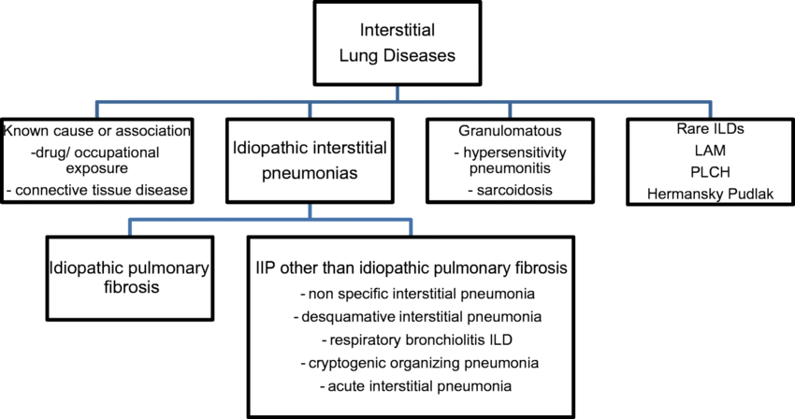
Interstitial lung diseases
Umbrella term for lung pathology that causes scarring (fibrosis) to the lungs.

Slide 44
Idiopathic pulmonary fibrosis
DEFINITION, CAUSE/S & RISK FACTORS | Formation of scar tissue in lungs with no known cause. Most common interstitial lung disease. Seen in older men (60+) who smoke RFs: smoking, occupational (e.g. dust), drugs (methotrexate), viruses (EBV,CMV)
PATHOPHYSIOLOGY (IF APPLICABLE) | Progressive scarring leading to type 1 respiratory failure
PRESENTATION (Sx) | Dyspnoea, dry cough, bibasal crackles
DIAGNOSIS & INVESTIGATIONS (Ix) | Spirometry = restrictive lung disease. FEV1:FVC > 0.7 BUT FVC is low (<0.8) Gold standard: High resolution CT = GROUND GLASS appearance of lungs
TREATMENT (Tx) | Pharmacological: Pirfenidone, nintedanib Non pharmacological: Smoking cessation, physiotherapy, vaccines up to date Lung transplantation last resort

Slide 45
Sarcoidosis
DEFINITION, CAUSE/S & RISK FACTORS | Idiopathic granulomatous disease. RFs: women, 20-40y, afro-caribbean descent
PATHOPHYSIOLOGY (IF APPLICABLE) | Immune system ‘overreacts’ causing granulomas to form in different organs of the body
PRESENTATION (Sx) | Fever, fatigue, dry cough, dyspnoea, uveitis Lupus pernio (purple rash/nodules on cheeks and shins - seen in chronic sarcoidosis)
DIAGNOSIS & INVESTIGATIONS (Ix) | Bloods - raised ACE and Ca+ CXR - bilateral hilar adenopathy + pulmonary infiltrates Diagnostic - biopsy which shows NON caseating granulomas
TREATMENT (Tx) | In early stages can be self resolving symptomatic = corticosteroids
Notes:
Good symptom of sarcoidosis is LUPUS PERNIO (purple rash, raised, on cheeks and shins in chronic sarcoid)
also in bloods raised ACE + raised Ca++ = pathognamonic for sarcoid (can ask them what you’d see instead of putting it on slide)

Slide 46
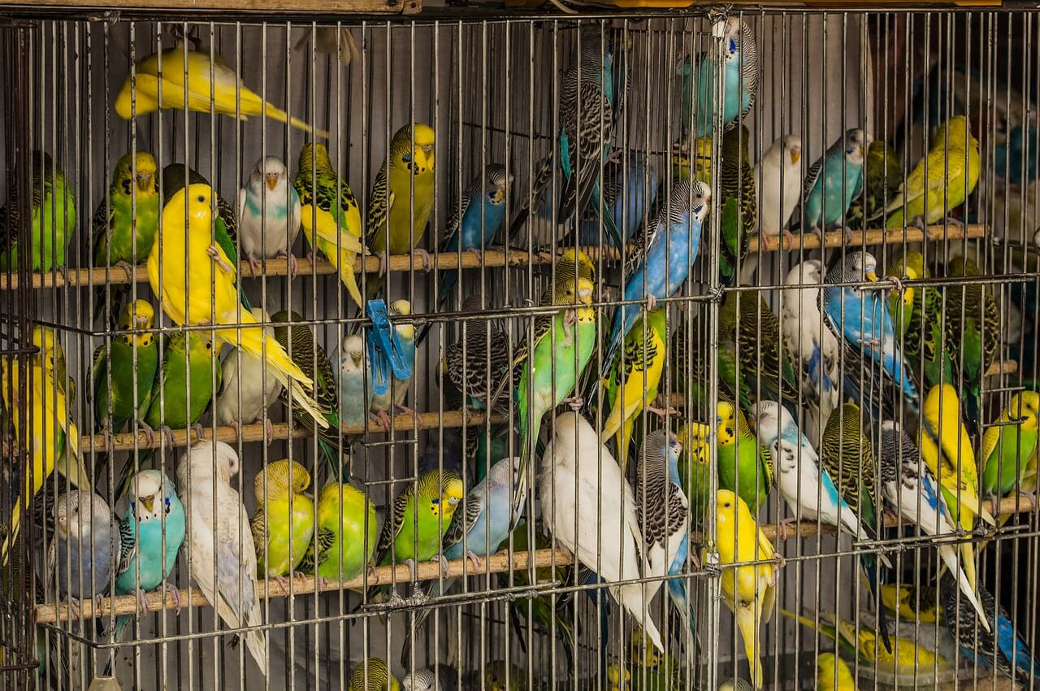
Hypersensitivity pneumonitis
DEFINITION, CAUSE/S & RISK FACTORS | Type III hypersensitivity reaction (ab-ag complex), causing alveolar and bronchial inflammation, after exposure to an inhaled allergen. RFs: occupation (e.g. farming), keeping birds
PRESENTATION (Sx) | Dyspnoea, cough, fever, malaise, weight loss.
DIAGNOSIS & INVESTIGATIONS (Ix) | Generally diagnosed through history and examination CXR: Patchy, nodular infiltrates; fibrosis in fibrotic HP.
TREATMENT (Tx) | Remove allergan, use steroids

Slide 47
Feedback
https://forms.gle/1dB25dn7m25JeUHd7
The Peer Teaching Society is not liable for false or misleading information…

Slide 48
1
A 34 year old software engineer presents to his GP with a productive cough that’s bugged him for the last 3 years or so. His grandfather had similar problems when he was 42. He has a 2 year pack history but quit 5 years ago.
What is the most likely finding on a chest CT of this patient?
Signet ring sign
Centriacinar emphysema
Empyema
Panacinar emphysema
Prominent bronchial margins

Slide 49
1
A 34 year old software engineer presents to his GP with a productive cough that’s bugged him for the last 3 years or so. His grandfather had similar problems when he was 42. He has a 2 year pack history but quit 5 years ago.
What is the most likely finding on a chest CT of this patient?
Signet ring sign
Centriacinar emphysema
Empyema
Panacinar emphysema
Prominent bronchial margins

Slide 50
2
A 67 year old male is currently in hospital for treatment of a pneumonia. He has a past medical history of cystic fibrosis and produces copious volumes of thick green phlegm. Spirometry reveals an FEV1:FVC of 0.64. What investigation is diagnostic for the most likely differential?
Chest X ray
Sputum MC & S
Bronchoscopy biopsy
Non-contrast CT chest
High resolution CT chest

Slide 51
2
A 67 year old male is currently in hospital for treatment of a pneumonia. He has a past medical history of cystic fibrosis and produces copious volumes of thick green phlegm. Spirometry reveals an FEV1:FVC of 0.64. What investigation is diagnostic for the most likely differential?
Chest X ray
Sputum MC & S
Bronchoscopy biopsy
Non-contrast CT chest
High resolution CT chest

Slide 52
3
A 65 year old chronic smoker has come in with breathing problems. Spirometry reveals a restrictive picture. Which of the following statements is incorrect?
Restrictive disease causes airway scarring
Risperidone is a first line treatment to alleviate symptoms
A chest HRCT in this patient would most likely show a ground glass appearance
The most common cause is idiopathic
The patient would most likely be suffering from a chronic dry cough

Slide 53
3
A 65 year old chronic smoker has come in with breathing problems. Spirometry reveals a restrictive picture. Which of the following statements is incorrect?
Restrictive disease causes airway scarring
Risperidone is a first line treatment to alleviate symptoms
A chest HRCT in this patient would most likely show a ground glass appearance
The most common cause is idiopathic
The patient would most likely be suffering from a chronic dry cough

Slide 54
4
A 56 year old man with a 4 month haemoptysis history has come to his GP after concerns he has gained severe amounts of weight recently while making little changes to his diet. His face appears red in complexion and his abdomen shows central obesity. On examination he has a fixed constricted pupil and a droopy eyelid on the right hand side. What is the most likely culprit?
Small cell lung cancer
Small cell lung cancer with a Pancoast tumour
Squamous cell lung cancer with a Pancoast tumour
Squamous cell lung cancer
Adenocarcinoma with a Pancoast tumour

Slide 55
4
A 56 year old man with a 4 month haemoptysis history has come to his GP after concerns he has gained severe amounts of weight recently while making little changes to his diet. His face appears red in complexion and his abdomen shows central obesity. On examination he has a fixed constricted pupil and a droopy eyelid on the right hand side. What is the most likely culprit?
Small cell lung cancer
Small cell lung cancer with a Pancoast tumour
Squamous cell lung cancer with a Pancoast tumour
Squamous cell lung cancer
Adenocarcinoma with a Pancoast tumour

Slide 56
5
A 43 year old woman with a known history of HIV presents to A&E with yellow purulent sputum production and severe dyspnoea. A chest X ray is performed and shows left lower lobe consolidation. Which of the following is true?
TB, an acid fast bacilli, is the most likely cause
Legionella pneumophila is the most likely
Mycoplasma species are the most common cause
This is most likely to be a hospital acquired pneumonia
Pneumocystitis jirovecci is the most likely cause

Slide 57
5
A 43 year old woman with a known history of HIV presents to A&E with yellow purulent sputum production and severe dyspnoea. A chest X ray is performed and shows left lower lobe consolidation. Which of the following is true?
TB, an acid fast bacilli, is the most likely cause
Legionella pneumophila is the most likely
Mycoplasma species are the most common cause
This is most likely to be a hospital acquired pneumonia
Pneumocystitis jirovecci is the most likely cause

Slide 58
6
A 15 year old girl is found by you, an F2, in what seems to be a severe asthma exacerbation. You have already administered oxygen and salbutamol and no difference has been made. A corticosteroid is also then administered and there is little change to her condition. What would you consider next?
Ipratropium bromide
IV MgSO4
Theophylline
IV Hydrocortisone
Tiotropium bromide

Slide 59
6
A 15 year old girl is found by you, an F2, in what seems to be a severe asthma exacerbation. You have already administered oxygen and salbutamol and no difference has been made. A corticosteroid is also then administered and there is little change to her condition. What would you consider next?
Ipratropium bromide
IV MgSO4
Theophylline
IV Hydrocortisone
Tiotropium bromide

Slide 60
7
Which of the following is not true regarding cystic fibrosis?
Malnutrition is a common symptom
Male infertility can occur
Family history is a RF and Afro Caribbean ethnicities are most commonly affected
Meconium ileus is a complication in paediatric cases
Steatorrhoea (fatty faeces) often occurs

Slide 61
7
Which of the following is not true regarding cystic fibrosis?
Malnutrition is a common symptom
Male infertility can occur
Family history is a RF and Afro Caribbean ethnicities are most commonly affected
Meconium ileus is a complication in paediatric cases
Steatorrhoea (fatty faeces) often occurs

