Slide 1
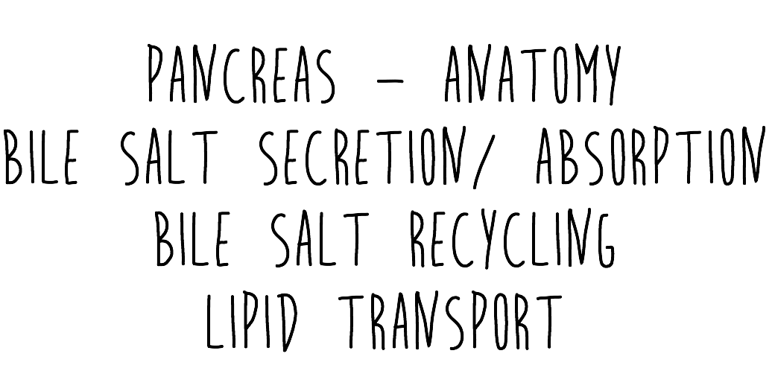
BY BARA KUBANOVA

Slide 2
THE ANATOMY OF PANCREAS
R gastric artery
Common hepatic artery
A
L gastric artery
R & L hepatic
NECK
Hepatic proper
Splenic artery
HEAD
gastroduodenal
TAIL
Superior P-D arteries
BODY
“arterial arcade”
UNCINATE
PROCESS
BLOOD SUPPLY
• anterior inferior pancreaticoduodenal artery
• posterior inferior pancreaticoduodenal artery
• anterior superior pancreaticoduodenal artery
• anterior inferior pancreaticoduodenal artery
• splenic artery (wavy)
Inferior P-D arteries
Notes:
The TAIL > attached to the spleen > intraperitoneal The BODY > can be crushed against the vertebral column during trauma
The HEAD > the bile duct is closely related to the head of the pancreas > pancreatic carcinoma can block the bile duct > OBSTRUCTIVE JAUNDICE
The Uncinate process > comes from the ventral bud (the rest of the pancreas > dorsal bud) > SMV and SMA entrapped between the uncinate process and the head of the pancreas

Slide 4
In context….
PORTAL TRIAD
D A V
DUODENUM
1 SUPERIOR (L1)
2 DESCENDING
3 INFERIOR (L3)
4 ASCENDING
Accessory pancreatic duct
1
2
4
Ampulla of Vater
3
Main pancreatic duct
Notes:
SUPERIOR > GASTRODUODENAL ARTERY > duodenal ulcer can erode into the gastroduodenal artery > haemorrhage > haematemesis

Slide 5
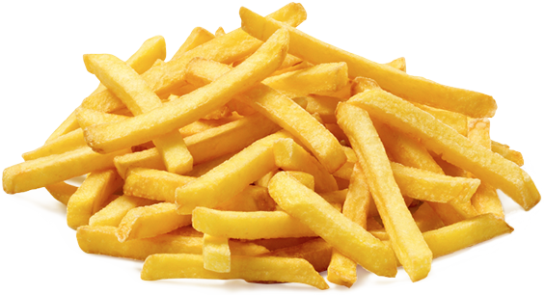
ENTEROHEPATIC CIRCULATION & BILE RECYCLING
Synthesis of new bile salts
REMEMBER:
LIVER CONTINUOUSLY PRODUCES BILE AT LOW RATES.
THE BILE IS STORED AND CONCENTRATED IN THE GALLBLADDER.
CCK STIMULATED BY THE PRESENCE OF LIPIDS IN THE DUODENUM TRIGGERS THE RELEASE OF BILE
95% OF THE BILE SALTS (~ 0.7% of bile) IS REABSORBED IN THE TERMINAL ILEUM
ONLY A SMALL PORTION OF BILE SALTS ESCAPES THE RECYCLATION AND IS EXCRETED IN FAECES
HEPATIC PORTAL VEIN
CCK
95%
RECYCLED
TERMINAL ILEUM
• secondary active Na⁺-coupled transport of bile salts
5% EXCRETED
Notes:
BILE SECRETION
About 500ml of bile produced by the liver daily > liver is continuously producing some amount of bile
Sphincter of Oddi > normally closed > the common bile duct’s opening shut > the bile shunted into the gallbladder > concentrated and stored
After meal > fatty acids enter duodenum > detected > increase in CCK > gallblader contraction + sphincter of Oddi opening >>>> bile secreted
Bile recycled in the ENTEROHEPATIC CIRCULATION >>> ONLY ABOUT 5% OF BILE SALTS ESCAPES THE RECYCLATION

Slide 6
LIPID TRANSPORT
ch
Transported in the blood stream
SKELETAL MUSCLE
Conversion of chylomicrons into:
As glycogen
Cholesterol extracted from blood
VLDLs
STORAGE OF LIPIDS
LDLs
HDLs
ADIPOSE TISSUES
As triglyceride
LYSOSOMES
PERIPHERAL TISSUES
EXCESS CHOLESTEROL
CHOLESTEROL
Notes:
Micelles > absorbed into interstitial mucosa > converted into chylomicrons
Chylomicrons > produced by epithelial enterocytes > carry absorbed lipids from GI tract into the lymph > into the blood > portal vein system > into the liver
Liver > converts the chylomicrons into the LDLs and VLDLs

Slide 7
