Slide 1
Liver Embryology
Anna Robson & Ruben Vilela

Slide 2
Primitive gut
Made from the endoderm and visceral mesoderm
Foregut: Oropharyngeal membrane → liver bud. Coeliac A.
Oesophagus, stomach, liver, biliary apparatus, pancreas & ½ duodenum
Midgut: Liver bud → 2/3rds transverse colon. SMA.
Distal ½ of duodenum jejunum, ilium, caecum, verifrom appendix, ascending colon & right 2/3rds of TC
Hindgut: 2/3rds TC → cloacal membrane. IMA.
Left 1/3rd TC ,descending colon, sigmoid colon, rectum and anal canal
Notes:
Cloacal membrane covers the cloaca (common outlet where the intestinal, urinary and genital tracts open)
It is a blind-ended tube (closed at one end)
Endoderm → epithelial lining, hepatocytes of liver & endocrine and exocrine cells of the pancreas
Mesoderm → muscle, connective tissue
SMA = superior mesenteric artery
IMA = inferior mesenteric artery

Slide 3
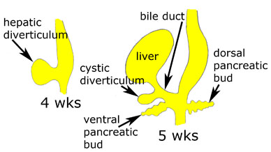
Liver bud
Hepatic diverticulum is a cellular expansion of the foregut that gives rise to the parenchyma of the liver
Notes:
The hepatic diverticulum appears in the middle of the 3rd week as an outgrowth of the endodermal epithelium at the distal end of the foregut.
The liver bud contains rapidly proliferating liver cells that penetrate the septum transversum – the bile duct forms when the connection between the liver and the foregut narrows
The ventral out growth gives rise to the gall bladder and the cystic duct

Slide 4
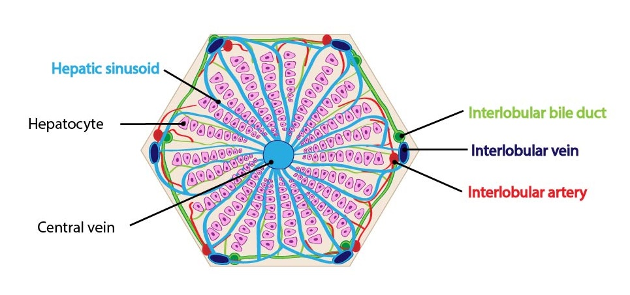
Further growth of the liver bud allows the epithelial liver cords to intermingle with the umbilical and vitelline veins, forming the Hepatic Sinusoids.
Liver cords differentiate into Hepatocytes (liver parenchyma) and form the lining of the biliary ducts.

Slide 5
Haematopoietic cells, Kupffer cells, and connective tissue cells are derived from mesoderm of the septum transversum.
Haematopoiesis: important function of the liver at this stage since it acts as the “bone marrow” in the production of white and red blood cells.

Slide 6
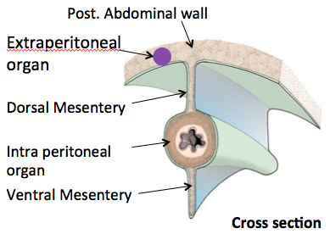
Mesenteries
Mesentery = a fold of tissue that attaches organs to the body wall
Intraperitoneal = Double layer of peritoneum that completely surrounds an organ
Retroperitoneal = The organ is only covered by the peritoneum on its anterior side
Notes:
Intra = inside
Retroperitoneal = its behind the peritoneum therefor only the front of it is covered

Slide 7
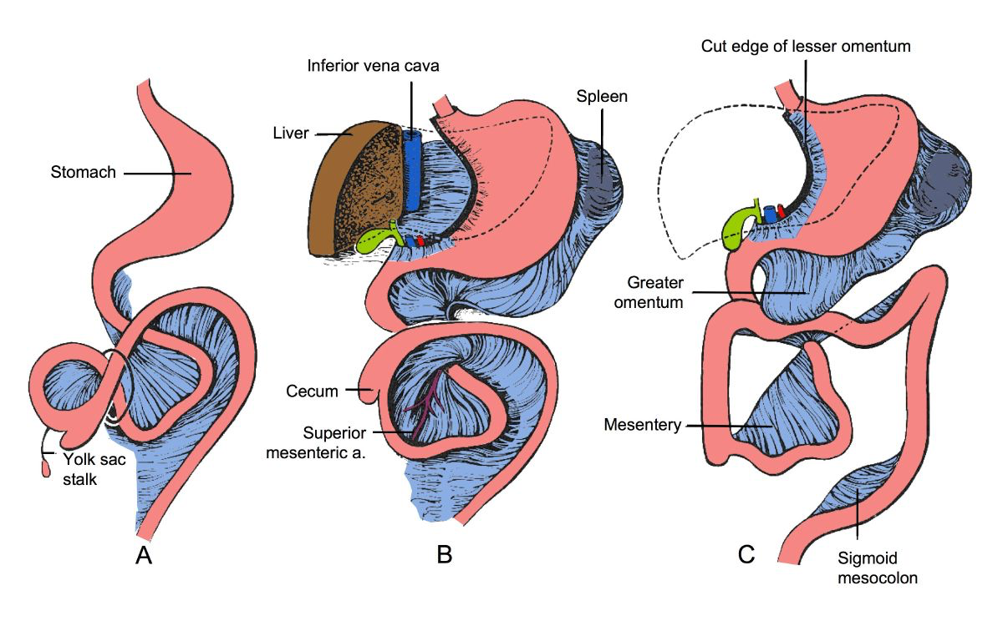

Slide 8
Ventral mesentery
Occurs only in the foregut
Derived from the septum transversum
Foregut has dorsal + ventral mesenteries
Midgut and hindgut only have a dorsal mesentery
Notes:
The septum transversum also gives the thoracic diaphragm

Slide 9
Ventral mesentery
The liver divides the ventral mesentery.
Falciform ligament to the anterior abdominal wall
Free edge contains the umbilical vein → the round ligament (ligamentum teres) after birth
Lesser omentum to the ventral borders of the stomach and the duodenum
Free edge contains hepatic artery, portal vein + bile duct
Notes:
The liver grows so rapidly that it protrudes the two layers –
It gives the falciform ligament anteriorly (this attaches it to the anterior abdominal wall) – free edge contains the umbilical vein → the round ligament after birth
And the lesser omentum (this attaches the liver to the ventral borders of the stomach and the duodenum) – free edge contains hepatic artery, portal vein + bile duct

Slide 10
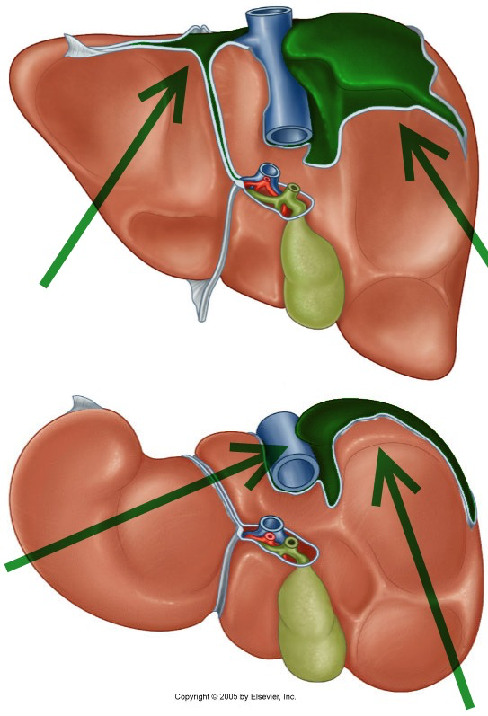
Bare area of liver
Bare area = the only area of the liver that is not covered by the ventral mesentery
Notes:
Bare of peritoneal covering – its in the name

Slide 11
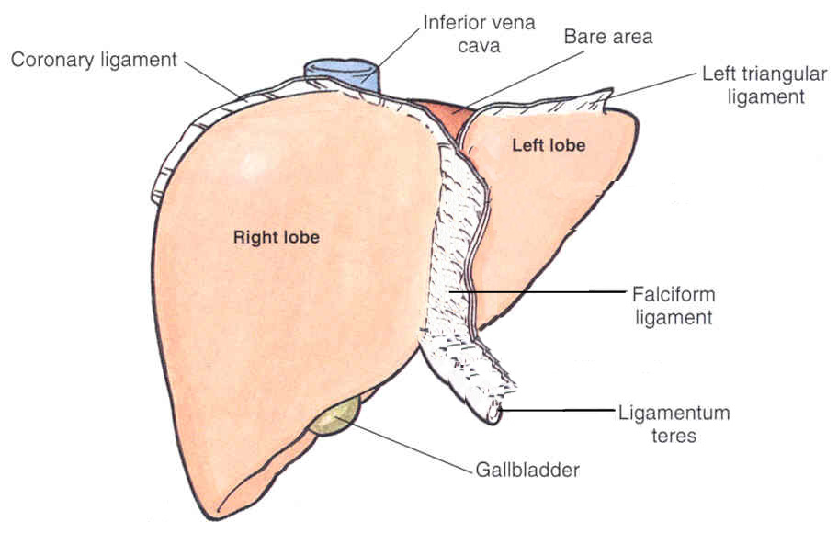
Falciform ligament

Slide 12
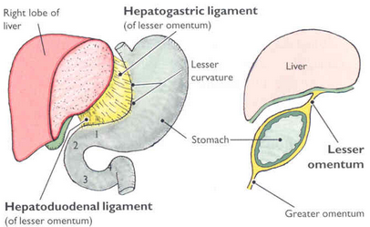
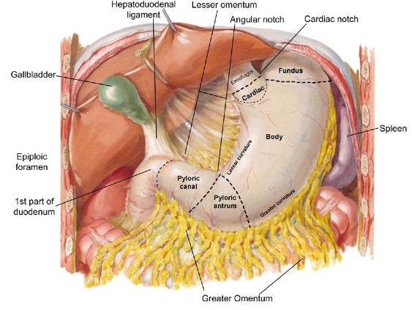
Lesser omentum

Slide 13
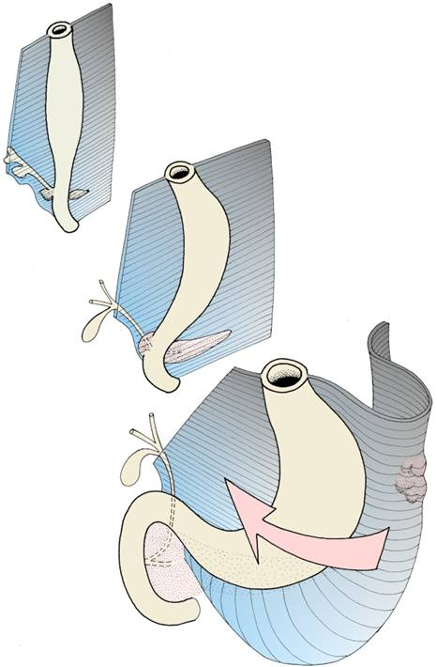
Formation of the lesser omentum
Ventral mesentery
Liver
Dorsal mesentery
Notes:
The abdominal organs are positioned here due to the rotation of the stomach
1st it rotates 90 degrees along a longitudinal axis (left now becomes anterior). The posterior wall grows quicker (now on the right side) this gives the greater curve
2nd it rotates around the anterior posterior axis – the pyloric region mores right and up and the cardiac regions moves left and down
Liver is the red triangle – look how it changes direction as the stomach rotates

Slide 14
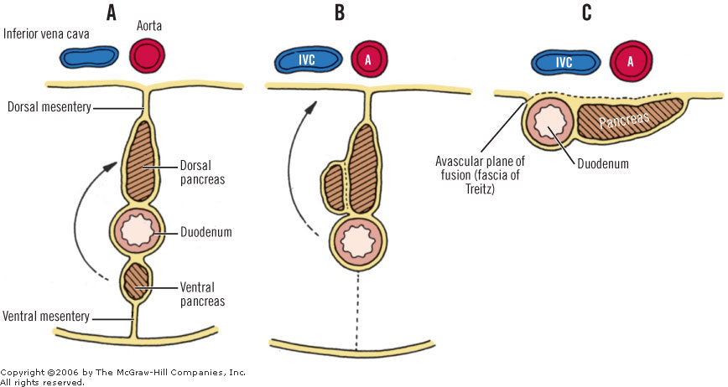
Entrance of Co. Bile duct
Co. B. D
Extrahepatic
bile duct
Co. B. D
Liver
Liver bud
Liver

Slide 15
Ligaments
Notes:
Ligaments are double layers of peritoneum that pass from one organ to another or from an organ to the body wall
This is the view as if you were looking down through a person
Spleen in latin = lien
Naming – where from and to anterior → posterior
Gastorlienal = Stomach → spleen
Lienorenal = spleen → kidney

Slide 16
The liver weight is about 10% of the total body weight. This is due to the presence of large numbers of sinusoids and involvement of the liver in haematopoietic function.
Hepatic cells start production of Bile. Since the gallbladder and cystic duct have developed, bile can enter the GI tract.

Slide 17
The haematopoietic function subsides during last 2 months of intrauterine life, which means that at birth the liver weighs about 5% that of the body weight.
After birth:
-the left umbilical vein obliterates to form ligamentum Teres hepatis
-the ductus venosus undergoes fibrosis, leaving a remnant designated ligamentum venosus.

Slide 18
Key points
3rd week: endodermal growth from Foregut
Narrowing of the connection = Bile Duct
5th week: Ventral outgrowth will form the Cystic Duct and Gallbladder
Epithelial cords + umbilical & vitelline veins = Hepatic Sinusoids
6th week: active haematopoietic function
Ventral mesentery divided by liver into Lesser Omentum and Falciform Ligament
7/8th week: Rotation of the foregut shifts entrance of bile duct to a posterior position
12th week: production of bile and its entrance to the GI tract
Left umbilical vein → Ligamentum teres hepatis
Ductus venosus → Ligamentum Venosum

Slide 19
Questions??

Slide 20
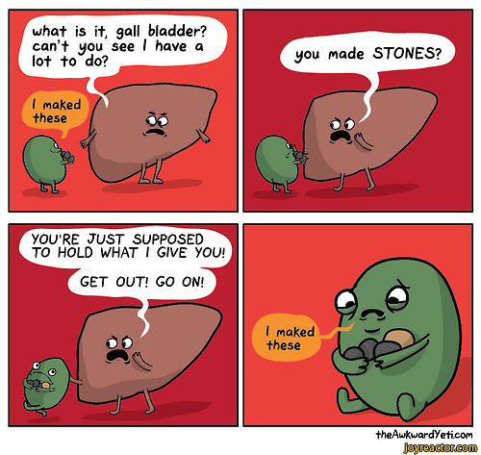
CONGRATULATIONS GUYS…
… you made it through!!! ☺
Check out “Awkward Yeti” XD

