Slide 1
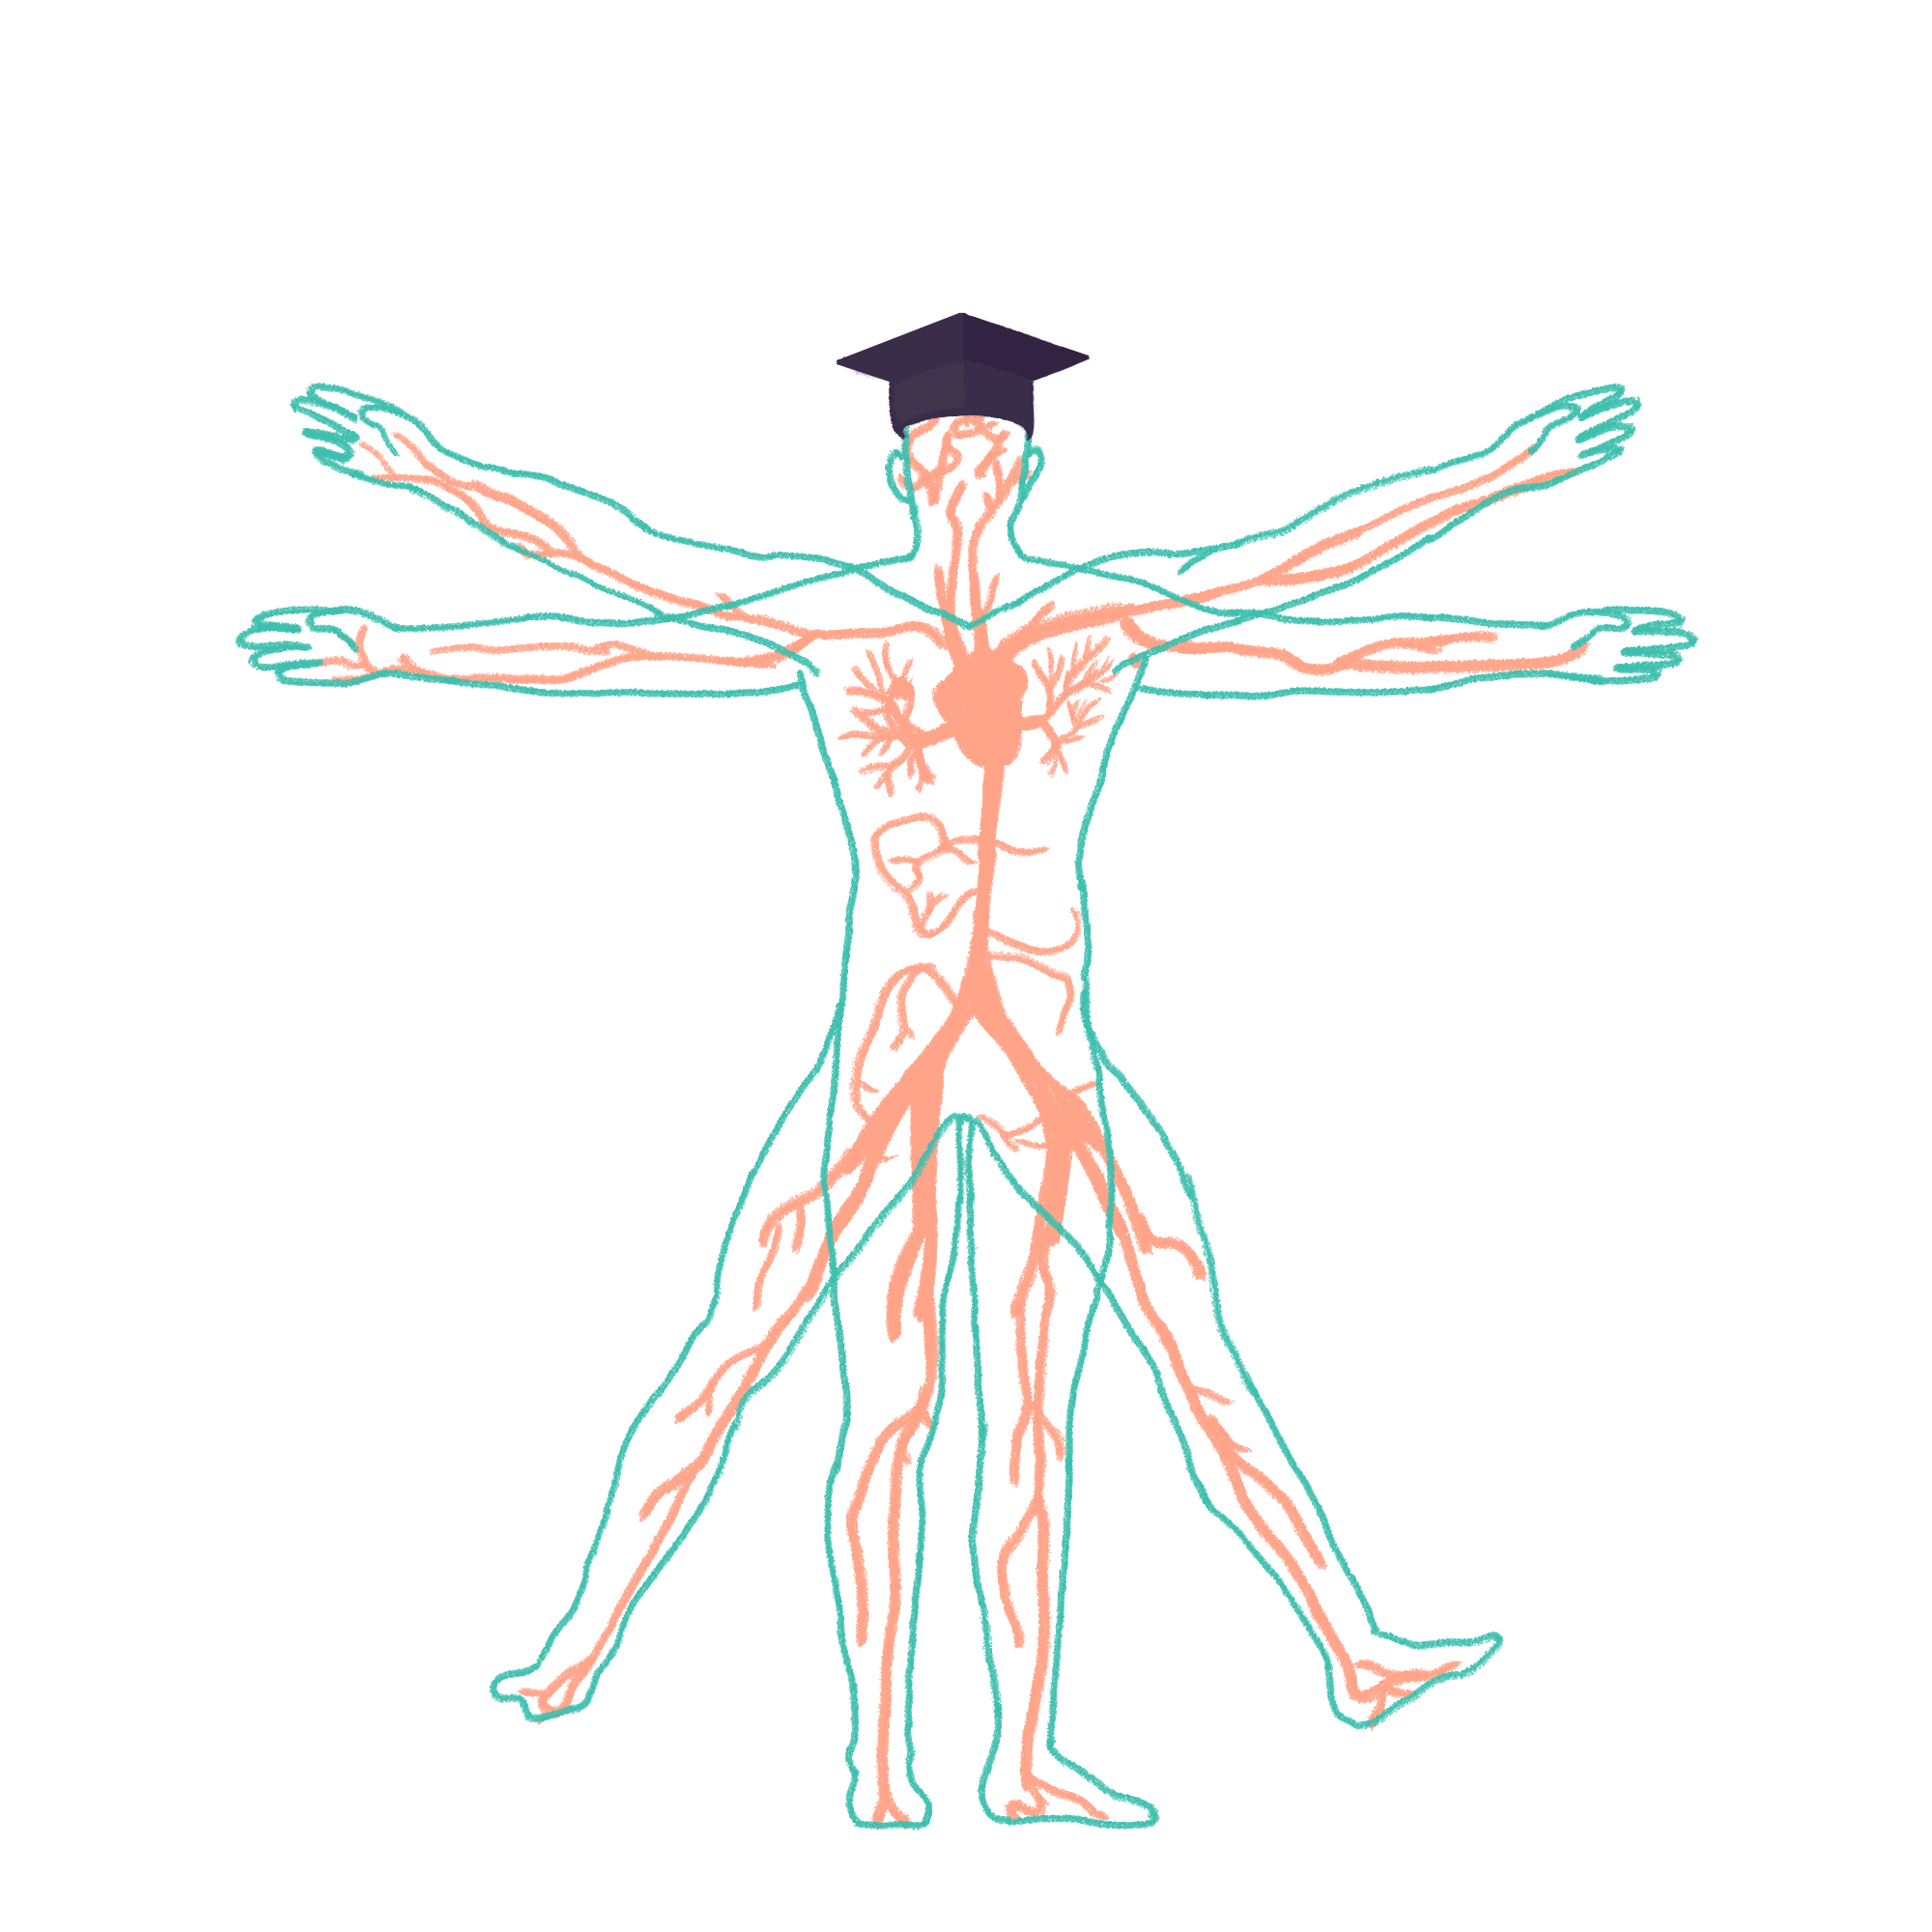
2023/2024

Slide 2
Cardio 2 Part 1: cardiac cycle and circulation
Phase 1 Revision Session
Ellie Skinner
02/11/23, 6pm
The Peer Teaching Society is not liable for false or misleading information…

Slide 3
Aims and Objectives
- To recognise and understand the different phases of the cardiac cycle and how these relate to the chambers and valves of the heart
- To understand the concept of Starling’s law and its relevance physiologically
- To understand and recognise the differences between systemic and pulmonary circulation
- To understand the factors that influence and regulate circulation
The Peer Teaching Society is not liable for false or misleading information…

Slide 4
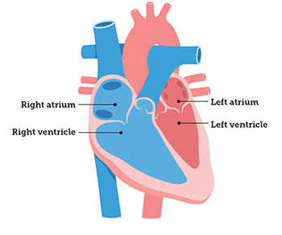
Cardiac cycle
Objective: to recognise and understand the different phases of the cardiac cycle and how these relate to the chambers and valves of the heart
Systole = contraction
Diastole = relaxation
Systole can be further divided into atrial and ventricular systole
https://www.ohsu.edu/doernbecher/understanding-pediatric-heart-conditions
The Peer Teaching Society is not liable for false or misleading information…

Slide 5
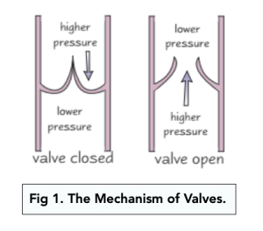
Cardiac cycle
Objective: to recognise and understand the different phases of the cardiac cycle and how these relate to the chambers and valves of the heart
Valves are like doors
They close to stop blood passing back through them
This means they must shut when the pressure in front of the valve is greater than the pressure behind the valve
https://www.ohsu.edu/doernbecher/understanding-pediatric-heart-conditions
The Peer Teaching Society is not liable for false or misleading information…

Slide 6
Cardiac cycle
Objective: to recognise and understand the different phases of the cardiac cycle and how these relate to the chambers and valves of the heart
4 phases:
Filling phase
Isovolumetric contraction
Outflow phase
Isovolumetric relaxation
The Peer Teaching Society is not liable for false or misleading information…

Slide 7
Cardiac cycle
Objective: to recognise and understand the different phases of the cardiac cycle and how these relate to the chambers and valves of the heart
Filling phase
Refers to the ventricles filling
Diastole and atrial systole
Arterial pressure > ventricular pressure = SL valves shut
AV valves start open but as atria contract and more blood goes into ventricles: ventricular pressure > atrial pressure = AV valves shut
https://www.ohsu.edu/doernbecher/understanding-pediatric-heart-conditions
The Peer Teaching Society is not liable for false or misleading information…

Slide 8
Cardiac cycle
Objective: to recognise and understand the different phases of the cardiac cycle and how these relate to the chambers and valves of the heart
Isovolumetric contraction
Isovolumetric = volume remains constant (as both SL and AV valves are shut)
Start of ventricular systole
Pressure in the ventricles is rising…. But not enough to open the SL valves
https://www.ohsu.edu/doernbecher/understanding-pediatric-heart-conditions
The Peer Teaching Society is not liable for false or misleading information…

Slide 9
Cardiac cycle
Objective: to recognise and understand the different phases of the cardiac cycle and how these relate to the chambers and valves of the heart
Outflow phase
Continued ventricular systole
Ventricular pressure > arterial pressure = SL valves open
Blood leaves the heart via the aorta and pulmonary arteries
Pressure in the arteries > ventricular pressure = SL valves shut
https://www.ohsu.edu/doernbecher/understanding-pediatric-heart-conditions
The Peer Teaching Society is not liable for false or misleading information…

Slide 10
Cardiac cycle
Objective: to recognise and understand the different phases of the cardiac cycle and how these relate to the chambers and valves of the heart
Isovolumetric relaxation
Isovolumetric = volume remains constant (as both SL and AV valves are shut)
Diastole
Ventricles relax and blood begins to flow into the atria
Atrial pressure > ventricular pressure = AV valves open
Blood flows into the ventricles and cycle begins again
https://www.ohsu.edu/doernbecher/understanding-pediatric-heart-conditions
The Peer Teaching Society is not liable for false or misleading information…

Slide 11
Starling’s Law
Objective: to understand the concept of Starling’s law and its relevance physiologically
“the more the heart chambers fill, the stronger the ventricular contraction”
Think of it like an elastic band
More preload = stronger contraction = greater stroke volume = greater cardiac output
If you overfill the ventricles they become less contractile and stroke volume decreases
https://drawittoknowit.com/course/physiology/glossary/physiological-process/frank-starling-law
The Peer Teaching Society is not liable for false or misleading information…

Slide 12
The relevance of Frank-Starling
Objective: to understand the concept of Starling’s law and its relevance physiologically
Sympathetic nervous system = fight or flight
Activation = cardiac muscle becomes more contractile and vessels constrict
More preload + greater contractility = greater stroke volume = greater cardiac output
https://drawittoknowit.com/course/physiology/glossary/physiological-process/frank-starling-law
The Peer Teaching Society is not liable for false or misleading information…

Slide 13
The relevance of Frank-Starling
Objective: to understand the concept of Starling’s law and its relevance physiologically
Parasympathetic nervous system = rest and digest
Opposite action to sympathetic
Activation = less contractile cardiac muscle and blood vessels dilate
Less preload + lower contractility = lower stroke volume = lower cardiac output
https://drawittoknowit.com/course/physiology/glossary/physiological-process/frank-starling-law
The Peer Teaching Society is not liable for false or misleading information…

Slide 14
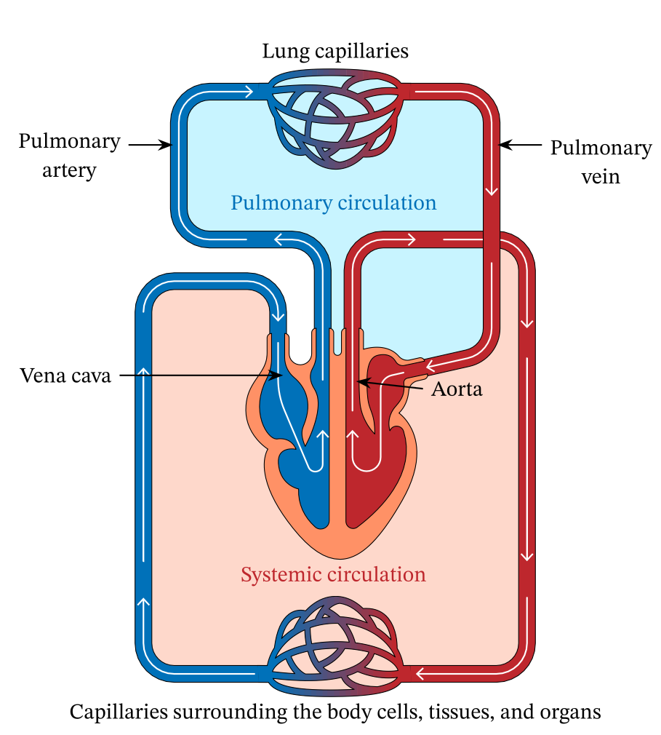
Circulation
Objective: to understand and recognise the differences between systemic and pulmonary circulation
Systemic
Carries oxygenated blood to the tissues of the body, and then returns the deoxygenated blood to the heart
Left side of heart -> aorta -> arteries -> arterioles -> metarterioles -> capillaries -> veins -> vena cava
https://www.nagwa.com/en/explainers/912123271719/
The Peer Teaching Society is not liable for false or misleading information…

Slide 15
Circulation
Objective: to understand and recognise the differences between systemic and pulmonary circulation
Pulmonary
Carries deoxygenated blood to the lungs, and then returns the newly oxygenated blood to the heart
Right side of the heart -> pulmonary arteries -> capillaries -> pulmonary veins
https://www.nagwa.com/en/explainers/912123271719/
The Peer Teaching Society is not liable for false or misleading information…

Slide 16
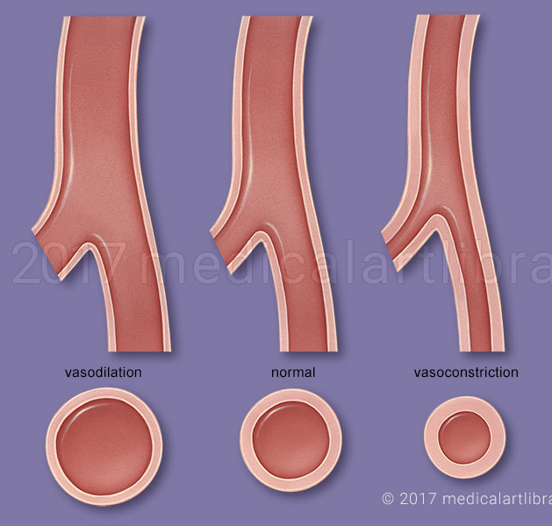
Circulation
Objective: to understand the factors that influence and regulate circulation
Total peripheral vascular resistance = the resistance to blood flow in the systemic vessels, specifically the arterioles, in the body
Increased TPR = reduced blood flow to tissues
Reduced TPR = increased blood flow to tissues
https://medicalartlibrary.com/vascular-resistance/
The Peer Teaching Society is not liable for false or misleading information…

Slide 17
Circulation
Objective: to understand the factors that influence and regulate circulation
Autonomic nervous system
Sympathetic = fight or flight = vasoconstriction = increased TPR. This action is due to noradrenaline release
Parasympathetic = rest and digest = vasodilation = reduced TPR
https://medicalartlibrary.com/vascular-resistance/
The Peer Teaching Society is not liable for false or misleading information…

Slide 18
Circulation
Objective: to understand the factors that influence and regulate circulation
Metabolites
Tissues that undergo respiration (metabolically active) release metabolites
Most important: H+, CO2, K+, adenosine, lactate
These all cause vasodilation
Metabolite build up in tissues = vasodilation = reduced TPR = more blood flow to area
https://medicalartlibrary.com/vascular-resistance/
The Peer Teaching Society is not liable for false or misleading information…

Slide 19
Circulation
Objective: to understand the factors that influence and regulate circulation
Baroreceptors
Short term changes in blood pressure can be detected by baroreceptors
Sensitive to stretching or pressure
Aortic arch: detect increased pressure
Carotid sinus: detect increased or decreased pressure
Increased/decreased pressure = increased/decreased firing rate to brain = changes in autonomic nervous system to impact heart and vessels
In chronic high blood pressure, set point changes
The Peer Teaching Society is not liable for false or misleading information…

Slide 20
Circulation
Objective: to understand the factors that influence and regulate circulation
Chemoreceptors
Detect changes in O2, CO2 and pH
Peripheral: carotid bodies and aortic bodies, mainly sensitive to O2 changes
Central: medulla, mainly sensitive to CO2 and pH changes
Reduced O2 or pH, or increased CO2 = increased firing = increased sympathetic nervous system action = vasoconstriction = increased TPR
The Peer Teaching Society is not liable for false or misleading information…

Slide 21
SBA
Noradrenaline is released by the sympathetic nervous system. How does this impact cardiac output?
A) Reduces contractility of the cardiac muscle, reduces preload, increases stroke volume, and increases cardiac output
B) Increases contractility of the cardiac muscle, increases preload, reduces stroke volume and increases cardiac output
C) Increases contractility of the cardiac muscle, increases preload, increases stroke volume and increases cardiac output
D) Reduces contractility of the cardiac muscle, increases preload, reduces stroke volume, and reduces cardiac output
The Peer Teaching Society is not liable for false or misleading information…

Slide 22
SBA
Mr Jones is suffering from ischaemic heart disease, atherosclerosis is reducing blood flow through the coronary arteries hence less oxygen is reaching the cardiac muscle. There is a build up of lactate as a result of anaerobic respiration in this tissue. How does this impact vascular resistance.
A) Lactate is a vasoconstrictor, vascular resistance rises
B) Lactate is a vasodilator, vascular resistance reduces
C) Lactate is a vasoconstrictor, vascular resistance reduces
D) Lactate is a vasodilator, vascular resistance rises
The Peer Teaching Society is not liable for false or misleading information…

Slide 23
Summary
4 phases in cardiac cycle: filling, isovolumetric contraction, outflow, and isovolumetric relaxation
If pressure in front of a valve is greater than behind a valve, the valve is closed. If the pressure in front of a valve is less than the pressure behind a valve, the valve is opened
Frank-Starling = elastic band. More stretch = bigger force (until it snaps)
Greater vascular resistance = less blood flow to tissue
Changes in blood pressure are regulated by chemo and baroreceptors
Sympathetic = fight or flight
Parasympathetic = rest and digest
The Peer Teaching Society is not liable for false or misleading information…

Slide 24
Feedback
The Peer Teaching Society is not liable for false or misleading information…

