Slide 1
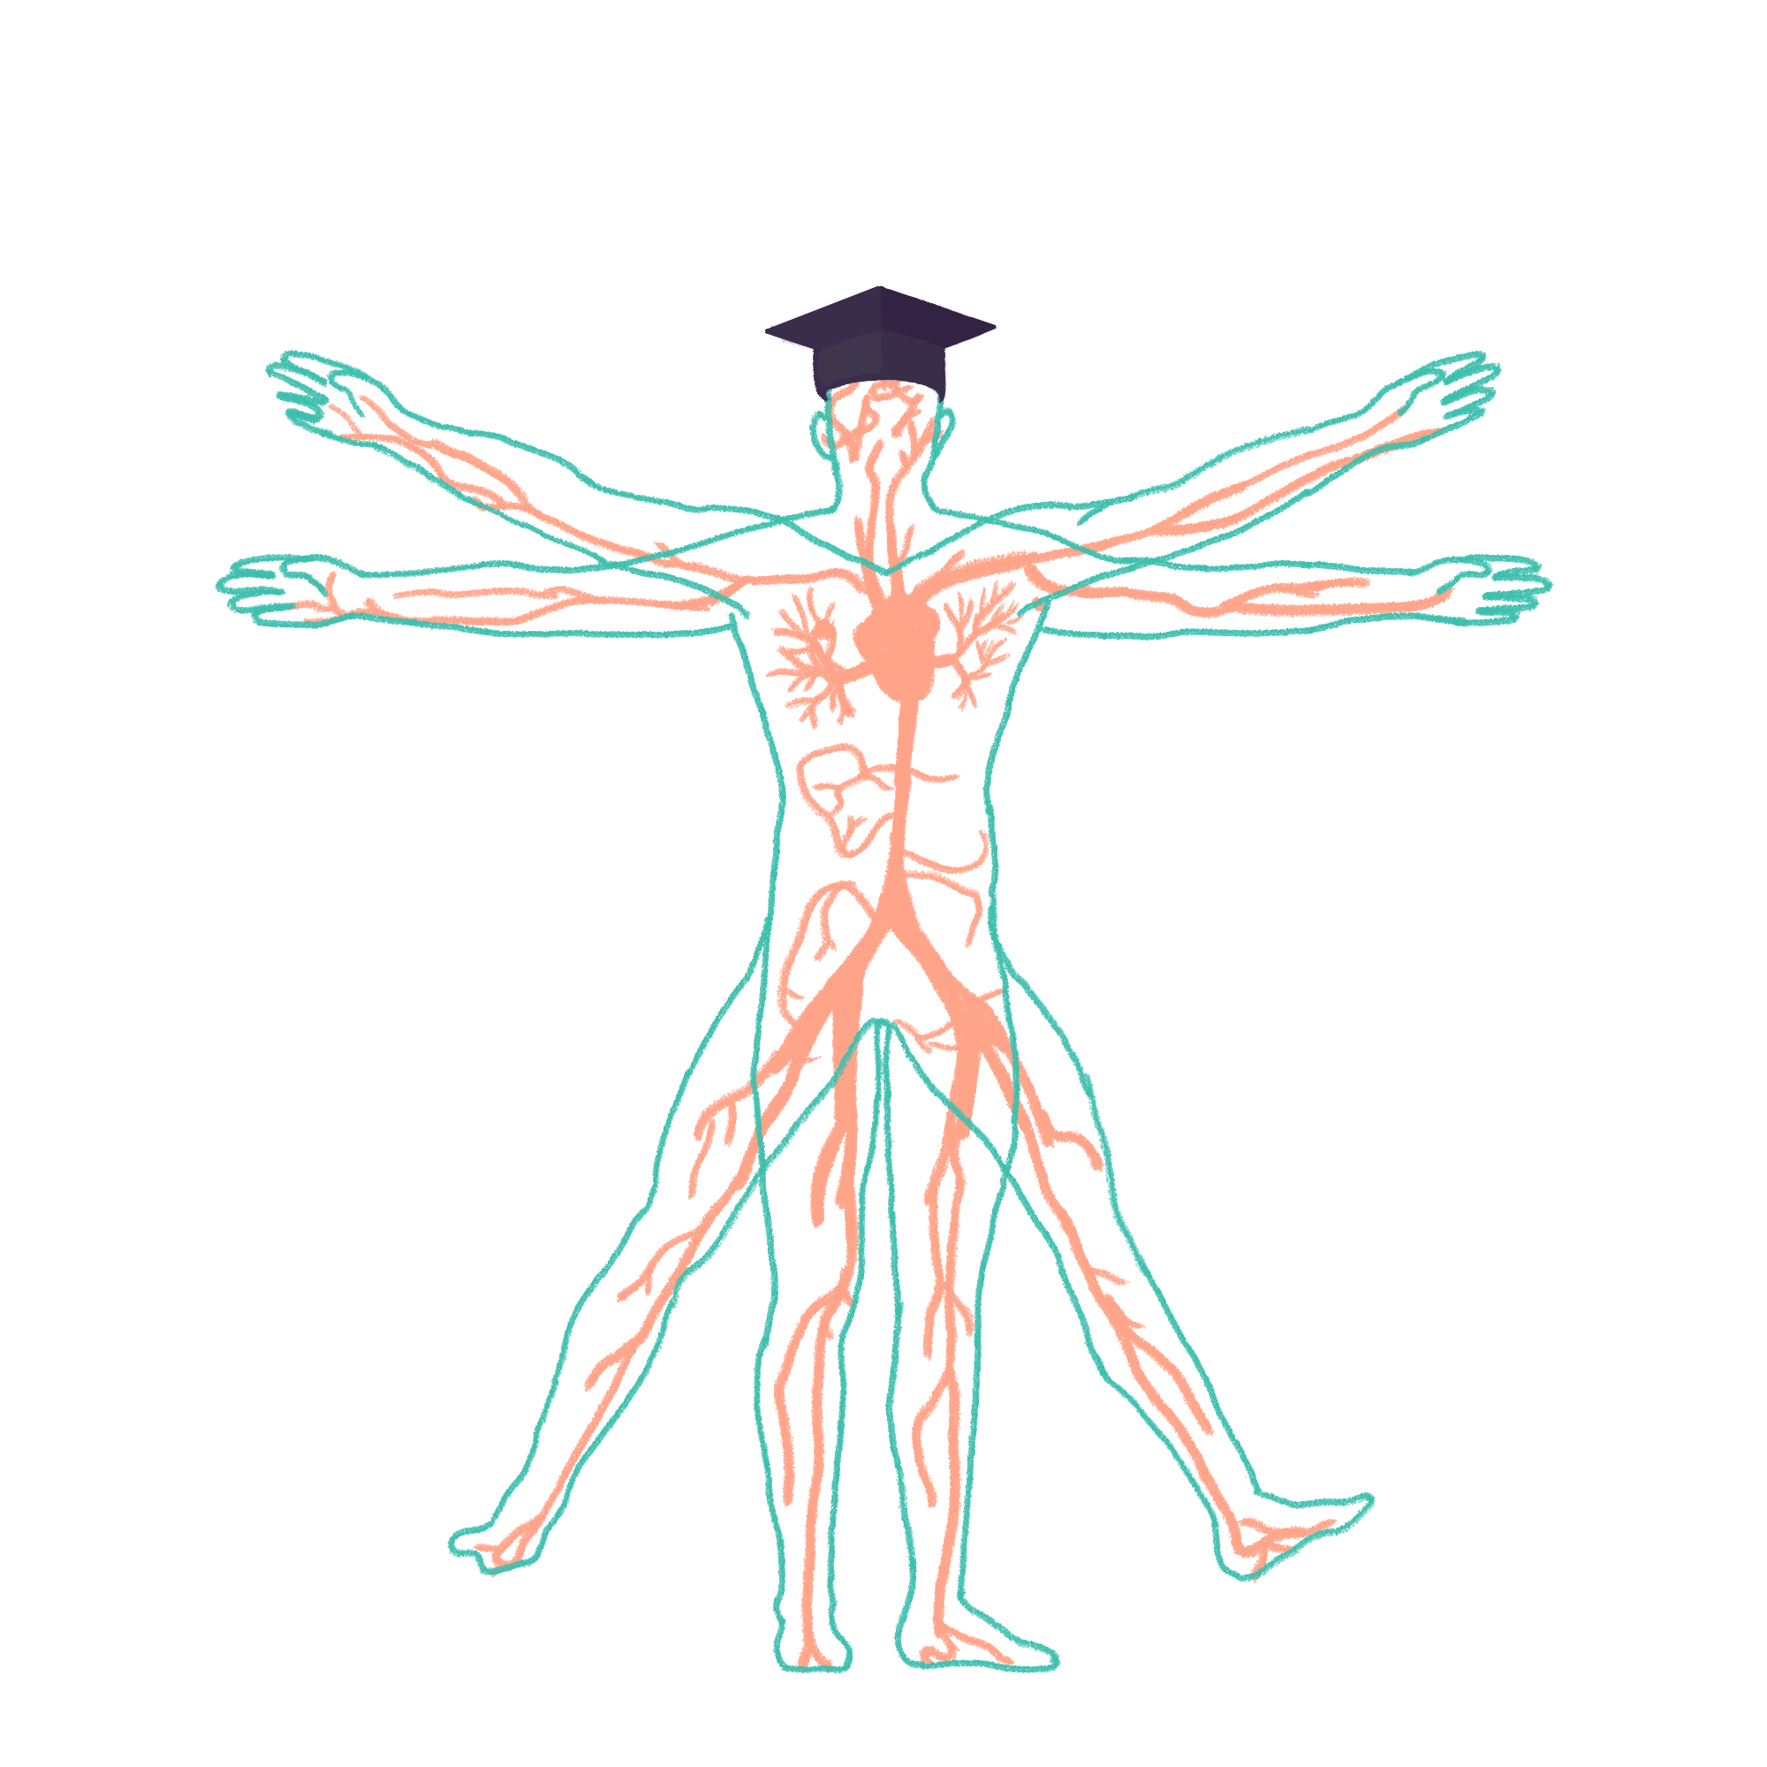
2023/2024

Slide 2
Cardio SBA/SAQ session
Phase 1 Revision Session
Joe Keane & Joe Priestley
[Date/time]
The Peer Teaching Society is not liable for false or misleading information…

Slide 3
Aims and Objectives
Familiarise the concept of SBA/SAQ style exam questions
Understand how to approach SBA/SAQ questions
Putting knowledge into practice through a series of exam style questions
The Peer Teaching Society is not liable for false or misleading information…

Slide 4
Short Answer Questions (SAQ)
Format: Requires writing concise and specific answers to open-ended questions,often asking for definitions, explanations, or comparisons.
Focus: Tests understanding of concepts and ability to articulate them clearly.
Tips:
Identify the key points the question addresses and tailor your answer accordingly.
Use clear and concise language, avoiding unnecessary jargon.
The Peer Teaching Society is not liable for false or misleading information…

Slide 5
Single Best Answer (SBA)
Format: Presents a scenario or stem followed by multiple answer choices, with only one being the most correct.
Focus: Tests knowledge recall and application to specific situations.
Tips:
Read the stem carefully to understand the context and key information.
Analyze each answer choice critically, considering its relevance and potential flaws.
Eliminate obviously incorrect options based on your knowledge.
If unsure, choose the answer that best aligns with the scenario and established principles.
The Peer Teaching Society is not liable for false or misleading information…

Slide 6
SAQ 1
A healthy 20-year-old male presents for a routine check-up. During the physical examination, you are tasked with performing cardiac auscultation.
Briefly describe the normal heart sounds (S1 & S2) in terms of their timing, location, and characteristics. (1 point)
Using anatomical landmarks, identify the four main valve areas where you would auscultate for heart sounds. (2 points)
Explain the physiological events occurring in the heart that generate each of the normal heart sounds. (2 points)
The Peer Teaching Society is not liable for false or misleading information…

Slide 7
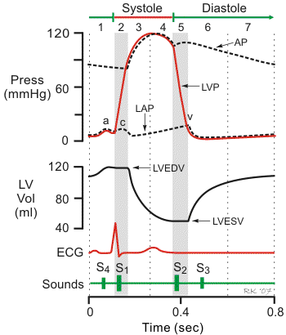
SAQ 1
S1: Low-pitched, "lub" sound; occurs at the beginning of systole (ventricular contraction); heard best at the apex.
S2: High-pitched, "dub" sound; occurs at the beginning of diastole (ventricular relaxation); heard best at the base.
The Peer Teaching Society is not liable for false or misleading information…

Slide 8
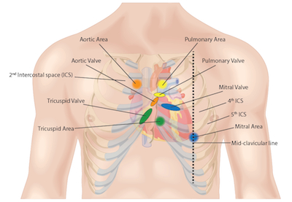
SAQ 1
Mitral area: Left sternal border, 5th intercostal space (IC space).
Tricuspid area: Lower left sternal border, 4th-5th IC space.
Pulmonary area: Left sternal border, 2nd IC space.
Aortic area: Right sternal border, 2nd IC space.
The Peer Teaching Society is not liable for false or misleading information…

Slide 9
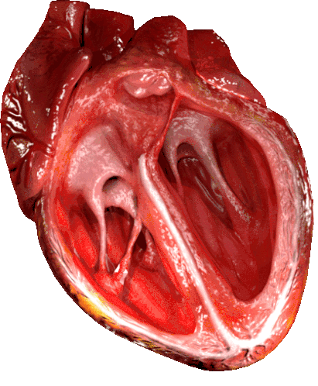
SAQ 1
S1: Closure of mitral and tricuspid valves.
S2: Closure of aortic and pulmonary valves.
The Peer Teaching Society is not liable for false or misleading information…

Slide 10
SAQ 2
A 30-year-old woman with no significant medical history presents to the emergency department with chest pain radiating down her left arm. Based on her symptoms and initial tests, you suspect a potential cardiac issue.
Describe the origin and course of the two main coronary arteries (left main and right coronary artery) arising from the aorta. (2 points)
Briefly explain the main territories supplied by the left main coronary artery and its branches. (2 points)
Why is the left main coronary artery considered the "widowmaker"? (1 point)
If the right coronary artery were blocked, which specific regions of the heart would be most likely affected? (2 points)
The Peer Teaching Society is not liable for false or misleading information…

Slide 11
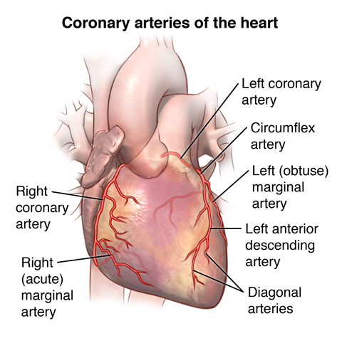
SAQ 2
Left main coronary artery: Arises from the left anterior aortic sinus, runs along the left atrioventricular groove, and divides into the left anterior descending (LAD) and circumflex arteries.
Right coronary artery: Arises from the right aortic sinus, runs along the right atrioventricular groove, and supplies the right ventricle and inferior wall of the left ventricle.
The Peer Teaching Society is not liable for false or misleading information…

Slide 12
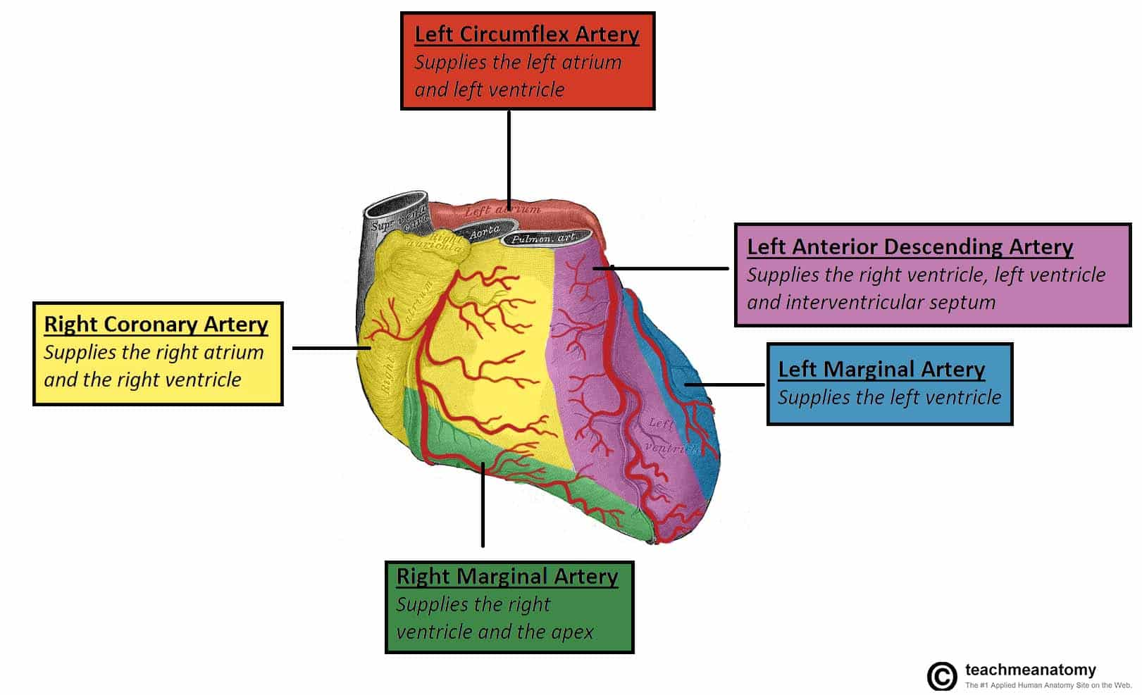
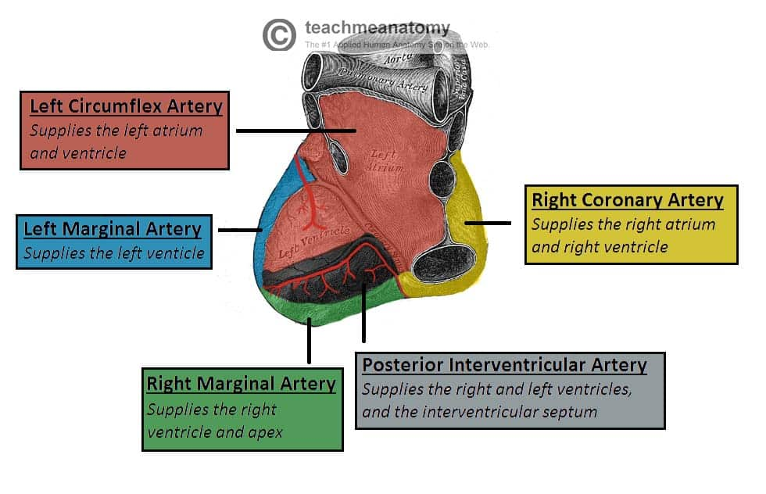
SAQ 2
Left main coronary artery: Supplies the interventricular septum, anterior and lateral walls of the left ventricle, and the left papillary muscle.
LAD: Supplies the anterior and anteroseptal walls of the left ventricle.
Circumflex: Supplies the lateral wall of the left ventricle.
The Peer Teaching Society is not liable for false or misleading information…

Slide 13
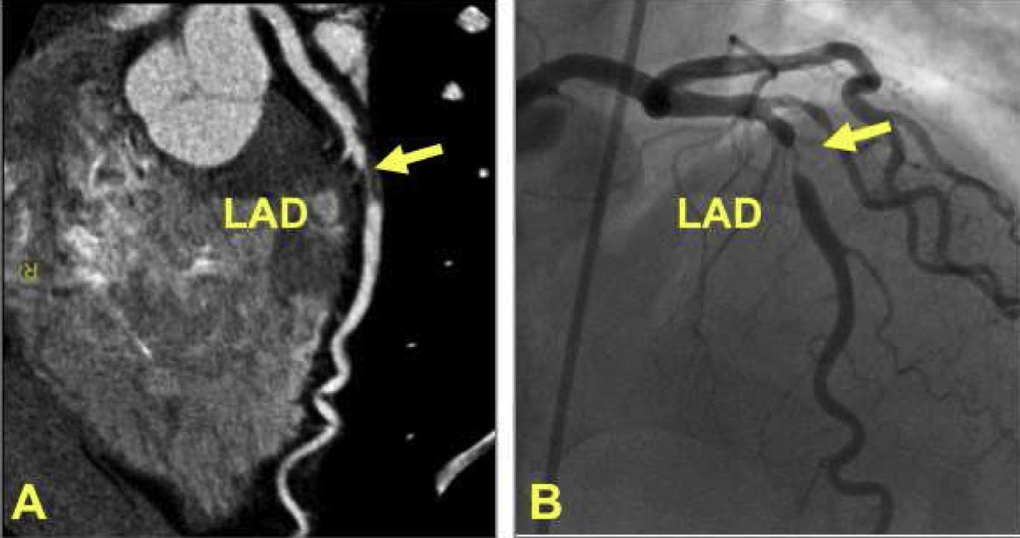
SAQ 2
Blockage of the left main coronary artery affects a large area of the left ventricle, including critical conduction pathways, leading to potentially fatal arrhythmias and heart failure.
The Peer Teaching Society is not liable for false or misleading information…

Slide 14
SAQ 2
Right coronary artery: Supplies the right ventricle, inferior wall of the left ventricle, and the sinoatrial (SA) node.
Blockage would likely affect the right ventricle and potentially cause inferior wall ischemia, but the SA node would be spared in most cases.
The Peer Teaching Society is not liable for false or misleading information…

Slide 15
SAQ 3
During a routine check-up, a 25-year-old athlete with no known medical history exhibits a slightly irregular heartbeat on your physical examination. You decide to investigate further.
Briefly describe the components of the cardiac conduction system, starting from the pacemaker to the ventricles. (2 points)
What key structures are responsible for delaying the electrical signal before ventricular contraction? Explain the physiological purpose of the delay in electrical signal conduction after the atria. (2 points)
Describe the differences in conduction velocities of different structures within the heart. (2 points)
The Peer Teaching Society is not liable for false or misleading information…

Slide 16
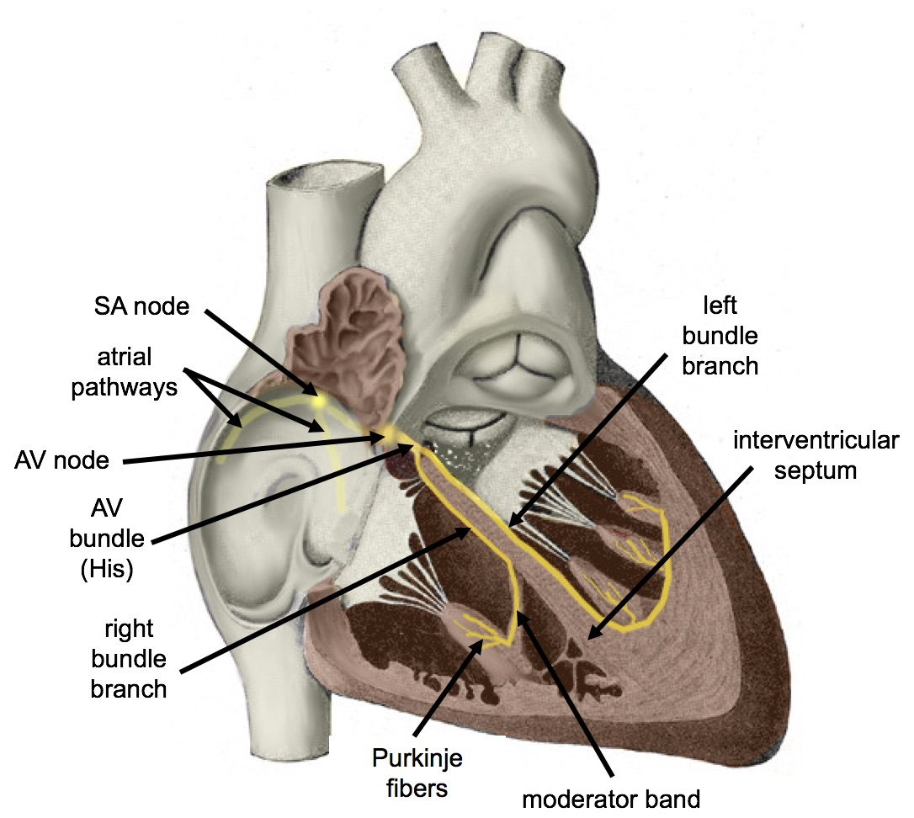
SAQ 3
Sinoatrial node (SA node) ->
Atria (depolarization) ->
AV node ->
Bundle of His ->
Right and left bundle branches ->
Purkinje fibers ->
Ventricles (depolarisation and contraction)
The Peer Teaching Society is not liable for false or misleading information…

Slide 17
SAQ 3
The atrioventricular node delays impulses by approximately 0.09s. This delay in the cardiac pulse is extremely important: It ensures that the atria have ejected their blood into the ventricles first before the ventricles contract.
Physiology:
Fewer pacemaker cells in the AV node
Fewer gap junctions
Fewer FAST Na+ channels
The Peer Teaching Society is not liable for false or misleading information…

Slide 18
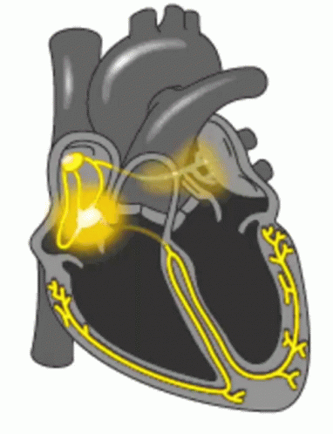
SAQ 3
Conduction velocity = speed of depolarisation through the tissue
Fastest = purkinje fibres 2-4 m/s
Allows strong ejection
Slowest = AVN 0.1-0.5 m/s
Allows adequate ventricular filling
Speed is dependent on:
Ion movement in/out
Interconnectedness – number of gap junctions
The Peer Teaching Society is not liable for false or misleading information…

Slide 19
SAQ 4
A 40-year-old patient presents with high blood pressure (150/90 mmHg) and reports experiencing occasional dizziness. You suspect changes in blood flow and pressure dynamics might be contributing to their symptoms. Based on your understanding of basic cardiovascular physiology, answer the following questions:
Briefly explain Ohm's Law (with equation) and its application to blood flow in the circulatory system. (1 point)
Define stroke volume and give its equation (1 point)
Calculate the pulse pressure for this patient using the provided blood pressure values. (1 point)
The Peer Teaching Society is not liable for false or misleading information…

Slide 20
SAQ 4
Ohm’s law – Flow (Q) = pressure gradient (ΔP) / resistance (R)
Stroke volume - The amount of blood ejected from the ventricle per beat
Stroke volume (SV) = End diastolic volume (EDV) – End systolic volume (ESV)
Pulse pressure – The difference between systolic and diastolic blood pressure
150-90 = 60mmHg
The Peer Teaching Society is not liable for false or misleading information…

Slide 21
SBA 1
A 40-year-old woman presents to the emergency department with sudden, crushing chest pain radiating down her left arm and jaw. She also reports feeling nauseous and sweating. Based on her symptoms, which of the following areas is LEAST likely to be another site of pain?
Lower back
Right shoulder blade
Left upper arm
Upper abdomen
The Peer Teaching Society is not liable for false or misleading information…

Slide 22
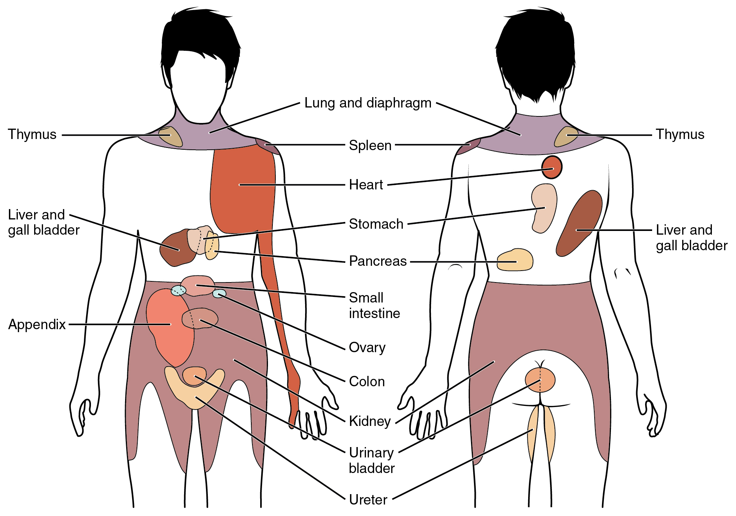
SBA 1
Answer: A) Lower back
While referred pain from the heart can be diverse, it typically does not radiate to the lower back.
More likely locations for referred pain from a cardiac event include the left arm, jaw, upper abdomen, shoulder blade, and neck.
Nerves from the heart share pathways with nerves from these other areas in the spinal cord, leading to the perception of pain in distant locations.
The Peer Teaching Society is not liable for false or misleading information…

Slide 23
SBA 2
During a routine check-up, your patient, a 30-year-old healthy woman, asks about the different blood vessels supplying her vital organs. You explain that the aorta, the largest artery in the body, has branches that deliver blood to various regions. Which of the following branches of the aorta would NOT supply blood directly to the brain?
Brachiocephalic artery
Descending thoracic aorta
Left common carotid artery
Left subclavian artery
The Peer Teaching Society is not liable for false or misleading information…

Slide 24
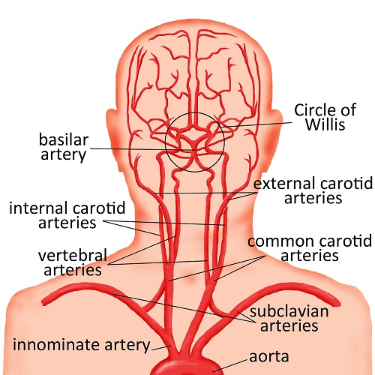
SBA 2
Brachiocephalic artery: Divides into the right common carotid artery (supplying the right side of the brain) and the right subclavian artery (supplying the right arm).
Left common carotid artery: Delivers blood directly to the left side of the brain.
Left subclavian artery: Supplies blood to the left arm and indirectly contributes to blood flow to the head through the vertebral arteries.
Descending thoracic aorta: Travels down the chest and supplies blood to organs below the diaphragm, excluding the brain.
The Peer Teaching Society is not liable for false or misleading information…

Slide 25
SBA 3
During an embryology lecture, your professor discusses the development of the aortic arches. You recall that these early embryonic structures contribute to the formation of important arteries in adults. Which of the following pairs of arteries arises from the same embryonic aortic arch?
Brachiocephalic artery and left subclavian artery
Left common carotid artery and right common carotid artery
Left subclavian artery and descending aorta
Aorta and pulmonary artery
The Peer Teaching Society is not liable for false or misleading information…

Slide 26
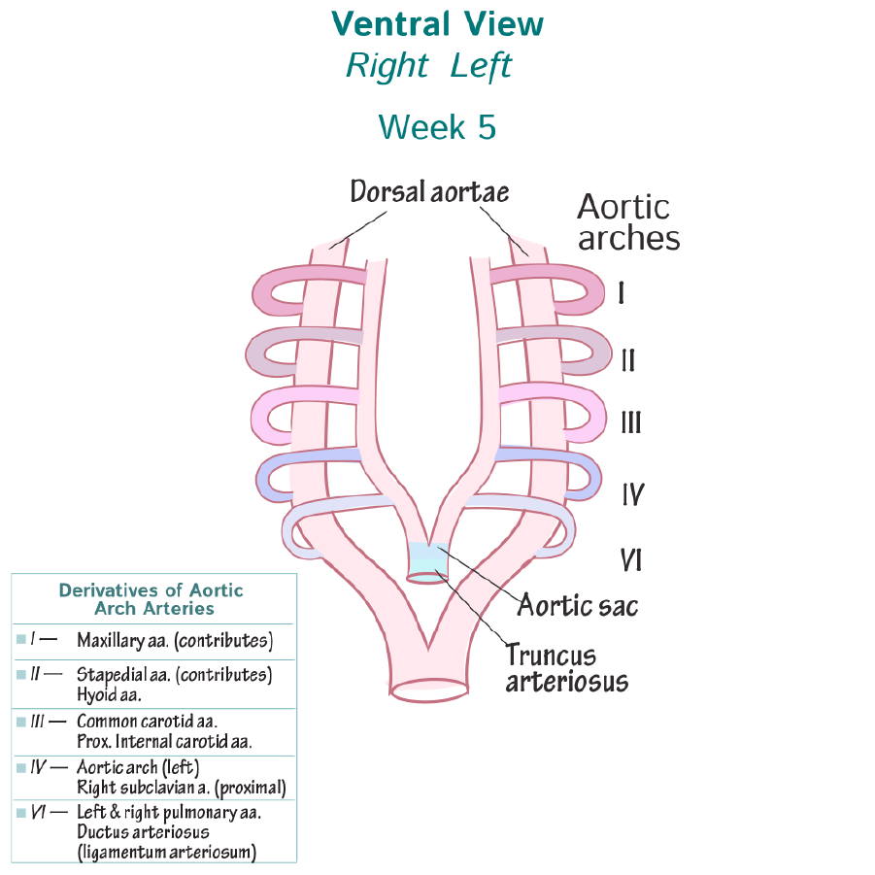
SBA 3
Option B: Correct. Both left and right common carotid arteries originate from the 3rd aortic arch.
The Peer Teaching Society is not liable for false or misleading information…

Slide 27
SBA 4
You are monitoring a healthy 30-year-old patient during an exercise stress test. You notice their heart rate increases as the intensity of the exercise increases. Which of the following events occurs DURING systole, the contraction phase of the heart cycle?
Blood flows passively from the atria into the ventricles.
The atrioventricular valves (mitral and tricuspid) open.
The pressure in the ventricles is higher than the pressure in the arteries.
The semilunar valves (aortic and pulmonary) close.
The Peer Teaching Society is not liable for false or misleading information…

Slide 28
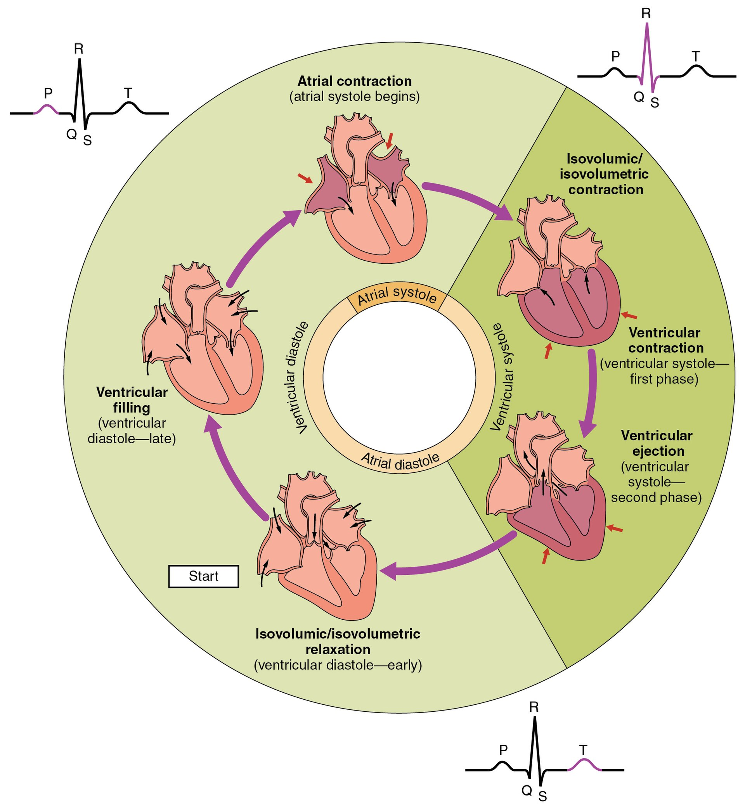
SBA 4
Answer: C) The pressure in the ventricles is higher than the pressure in the arteries.
The Peer Teaching Society is not liable for false or misleading information…

Slide 29
SBA 5
During a lecture on cardiovascular physiology, your professor discusses Starling's Law of the Heart, which explains the relationship between ventricular filling and stroke volume. You recall that increased venous return leads to increased stroke volume, up to a certain point. Which of the following factors is LEAST likely to contribute to an increased stroke volume according to Starling's Law?
Increased preload
Increased contractility of the heart muscle
Increased afterload
Increased heart rate
The Peer Teaching Society is not liable for false or misleading information…

Slide 30
SBA 5
Answer: C) Increased afterload (pressure against which the ventricles must contract)
Definitions:
Preload - the initial stretching force experienced by the heart muscle fibers (myocardium) before contraction. It directly relates to the volume of blood present in the ventricles at the end of diastole (relaxation phase).
Afterload - the force against which the heart contracts to eject blood from the ventricles. It essentially represents the resistance or pressure encountered by the heart during this process.
The Peer Teaching Society is not liable for false or misleading information…

Slide 31
SBA 5
The Frank-Starling mechanism, also known as Starling's law of the heart, describes the relationship between ventricular filling volume (preload) and stroke volume (amount of blood ejected per beat).
Simply put, it explains how stretching the heart muscle fibers before contraction can lead to a stronger and more forceful contraction, resulting in a larger volume of blood being pumped out.
Mechanism:
When more blood fills the ventricle, it stretches the individual muscle fibers (sarcomeres) within the heart wall.
This stretch triggers a phenomenon known as the Frank-Starling law of the muscle, which essentially means that a stretched muscle contracts with more force.
In the context of the heart, this stronger contraction allows the ventricle to eject a larger volume of blood during systole (contraction).
The Peer Teaching Society is not liable for false or misleading information…

Slide 32
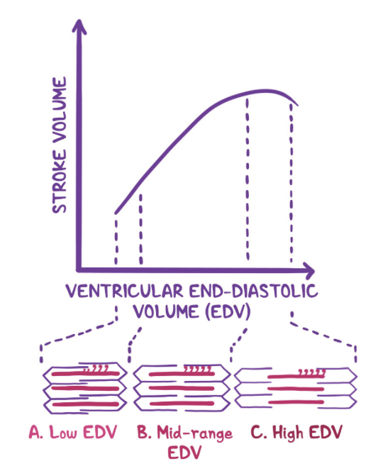
SBA 5
The Peer Teaching Society is not liable for false or misleading information…

Slide 33
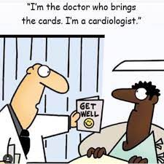
We will take a 5 min break before continuing to part 2 (Joe Priestley)
The Peer Teaching Society is not liable for false or misleading information…

Slide 34
Question 1
State Pouiselle’s equation
The Peer Teaching Society is not liable for false or misleading information…

Slide 35
Answer 1
R = 8ηl/πr 4
The Peer Teaching Society is not liable for false or misleading information…

Slide 36
Question 2
What is the equation for Mean Arterial Pressure?
The Peer Teaching Society is not liable for false or misleading information…

Slide 37
Answer 2
MAP = Diastolic pressure + 1/3 Pulse Pressure
The Peer Teaching Society is not liable for false or misleading information…

Slide 38
Question 3
Which cranial nerve monitors the carotid body and sinus chemo-
and baroreceptors?
a) Vagus
b) Accessory
c) Glossopharyngeal
d) Facial
e) Hypoglossal
The Peer Teaching Society is not liable for false or misleading information…

Slide 39
Answer 3
Which cranial nerve monitors the carotid body and sinus chemo-
and baroreceptors?
a) Vagus
b) Accessory
c) Glossopharyngeal
d) Facial
e) Hypoglossal
The Peer Teaching Society is not liable for false or misleading information…

Slide 40
Question 4
Where are central chemoreceptors located?
The Peer Teaching Society is not liable for false or misleading information…

Slide 41
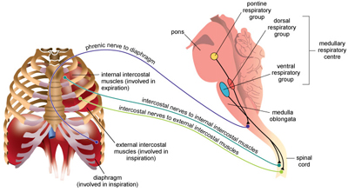
Answer 4
Medulla
The Peer Teaching Society is not liable for false or misleading information…

Slide 42
Question 5
What is the equation for calculating Heart Rate?
The Peer Teaching Society is not liable for false or misleading information…

Slide 43
Answer 5
Heart Rate = Cardiac Output / Stroke Volume
The Peer Teaching Society is not liable for false or misleading information…

Slide 44
Question 6
Describe the composition of blood.
The Peer Teaching Society is not liable for false or misleading information…

Slide 45
Answer 6
Plasma - 55%.Cellular - 45% - RBC: 44%, WBC: 1%.
The Peer Teaching Society is not liable for false or misleading information…

Slide 46
Question 7
What do the 3rd aortic arches form?
a) Minor vessels in the head
b) Left and right subclavian arteries
c) Left - aorta. Right - Right subclavian artery.
d) Left - left pulmonary artery and ductus arteriosus. Right -
right pulmonary artery.
e) The common carotid arteries
The Peer Teaching Society is not liable for false or misleading information…

Slide 47
Answer 7
What do the 3rd aortic arches form?
a) Minor vessels in the head
b) Left and right subclavian arteries
c) Left - aorta. Right - Right subclavian artery.
d) Left - left pulmonary artery and ductus arteriosus. Right -
right pulmonary artery.
e) The common carotid arteries
The Peer Teaching Society is not liable for false or misleading information…

Slide 48
Question 8
What does the T wave on ECG represent?
a) Ventricular depolarisation
b) Ventricular repolarisation
c) Atrial repolarisation
d) Atrial depolarisation
The Peer Teaching Society is not liable for false or misleading information…

Slide 49
Question 8
What does the T wave on ECG represent?
a) Ventricular depolarisation
b) Ventricular repolarisation
c) Atrial repolarisation
d) Atrial depolarisation
The Peer Teaching Society is not liable for false or misleading information…

Slide 50
Question 9
What would an absent P wave on an ECG be a sign of?
The Peer Teaching Society is not liable for false or misleading information…

Slide 51
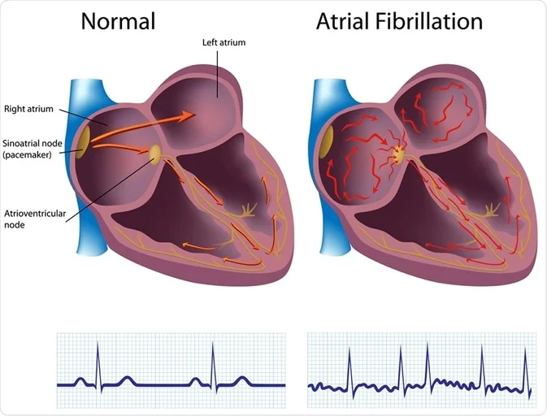
Atrial Fibrillation
Answer 9
The Peer Teaching Society is not liable for false or misleading information…

Slide 52
Question 10
What is the unique characteristic of cardiac muscle?
The Peer Teaching Society is not liable for false or misleading information…

Slide 53
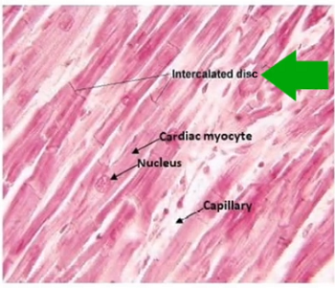
Presence of intercalated discs found between muscle fibres.
They hold adjacent
cells together by providing sites of strong adhesion.
Answer 10
The Peer Teaching Society is not liable for false or misleading information…

Slide 54
Question 11
Briefly describe foetal circulation.
The Peer Teaching Society is not liable for false or misleading information…

Slide 55
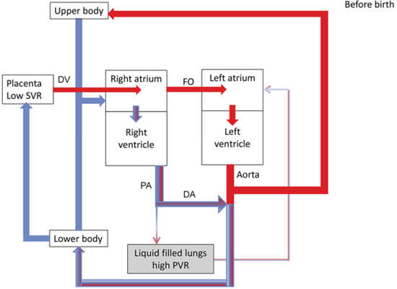
Answer 11
Maternal circulation ->
umbilical vein (oxygenated blood) ->
ductus venosus - >
IVC - >
RA ->
LA/RV ->
aorta ->
umbilical artery (deoxygenated
blood) ->
maternal circulation
The Peer Teaching Society is not liable for false or misleading information…

Slide 56
Question 12
Which of these is not a layer in the arterial wall?
a) Serosa
b) Tunica intima
c) Tunica media
d) Tunica externa/adventitia
The Peer Teaching Society is not liable for false or misleading information…

Slide 57
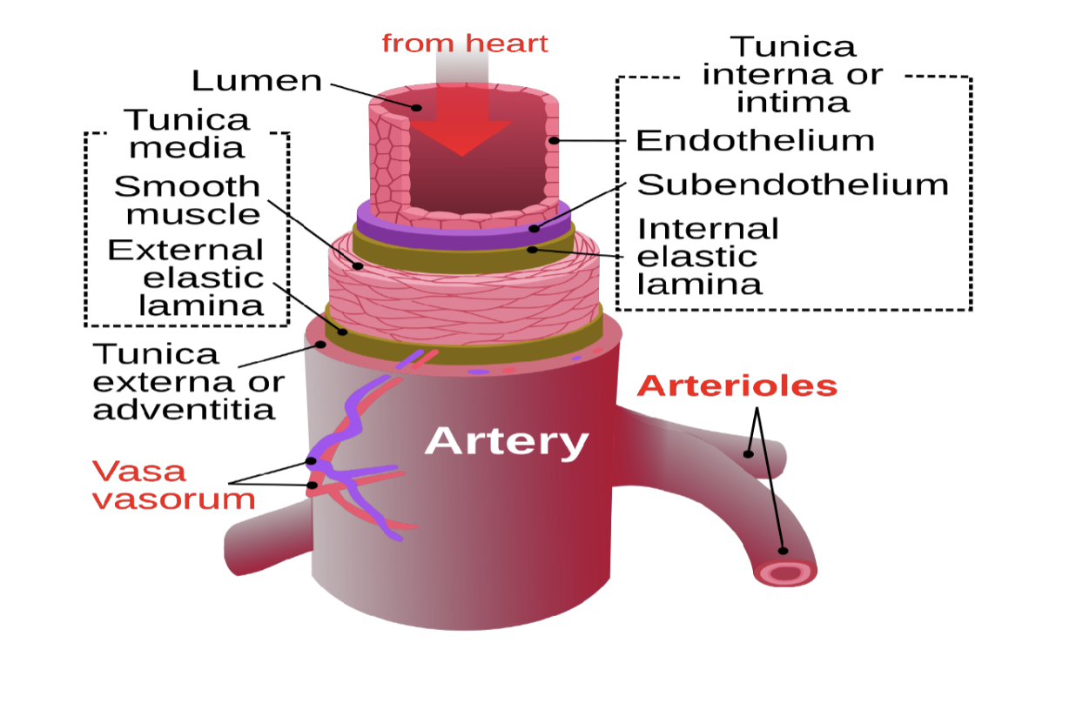
Answer 12
Answer = A (serosa)
The Peer Teaching Society is not liable for false or misleading information…

Slide 58
Question 13
A 25-year-old male sustains a deep laceration on his arm during a fall. Bleeding
is brisk, so you apply direct pressure and activate emergency services. While waiting
for the ambulance, you consider the body’s clotting mechanisms.
Which of the following factors is NOT directly involved in the intrinsic pathway of the
coagulation cascade?
A) Factor VIII (FVIII)
B) Factor IX (FIX)
C) Tissue factor (TF)
D) Contact with subendothelium
E) Activated platelet phospholipids
The Peer Teaching Society is not liable for false or misleading information…

Slide 59
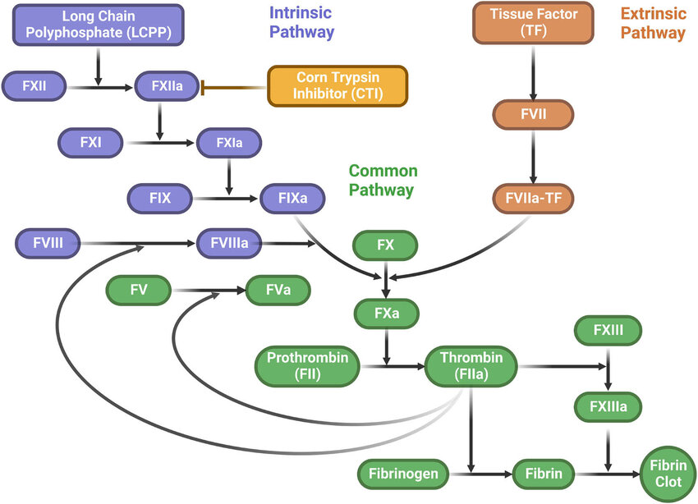
Answer = C (Tissue factor)
Answer 13
The intrinsic pathway of the coagulation cascade is activated by contact with subendothelium (exposed basement membrane) following vascular injury. This triggers a series of enzyme activations involving Factors XII, XI, IX, VIII, X, and ultimately leading to thrombin generation.
Factor VIII (FVIII) and Factor IX (FIX) are essential components of the
intrinsic pathway.
Tissue factor (TF), however, is the key initiator of the extrinsic pathway, activated by damaged tissues and not directly involved in the intrinsic cascade.
Activated platelet phospholipids play a role in amplifying both the intrinsic and extrinsic pathways, providing a surface for factor assembly and activation.
Contact with subendothelium triggers the intrinsic pathway by activating
Factor XII, the initial step in the cascade.
The Peer Teaching Society is not liable for false or misleading information…

Slide 60
Conclusion
In this session we have…
Familiarised the concepts of SBA/SAQ style exam questions
Understood how to approach SBA/SAQ questions
Applied cardio knowledge to a series of exam style questions
The Peer Teaching Society is not liable for false or misleading information…

Slide 61
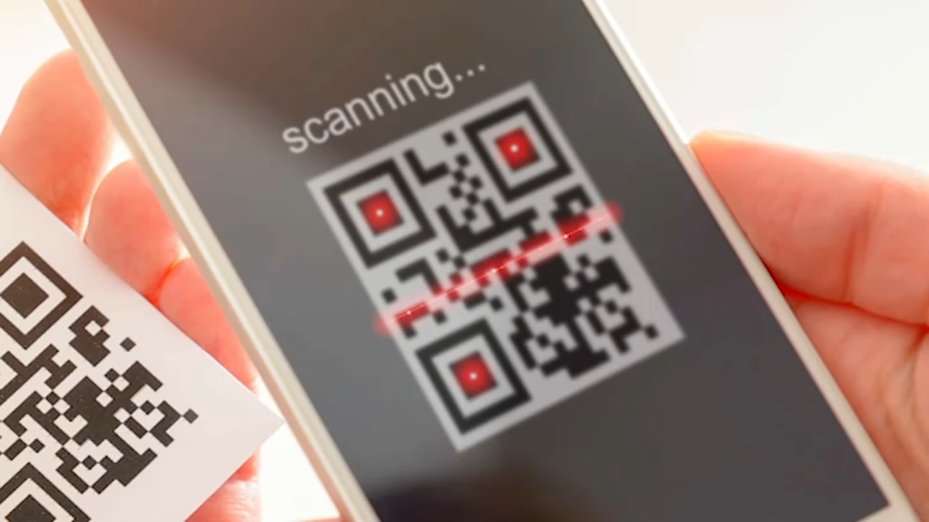
Feedback
phase reps add QR code here - QR Code Generator (the-qrcode-generator.com)
phase reps add feedback link here
The Peer Teaching Society is not liable for false or misleading information…

