Slide 1
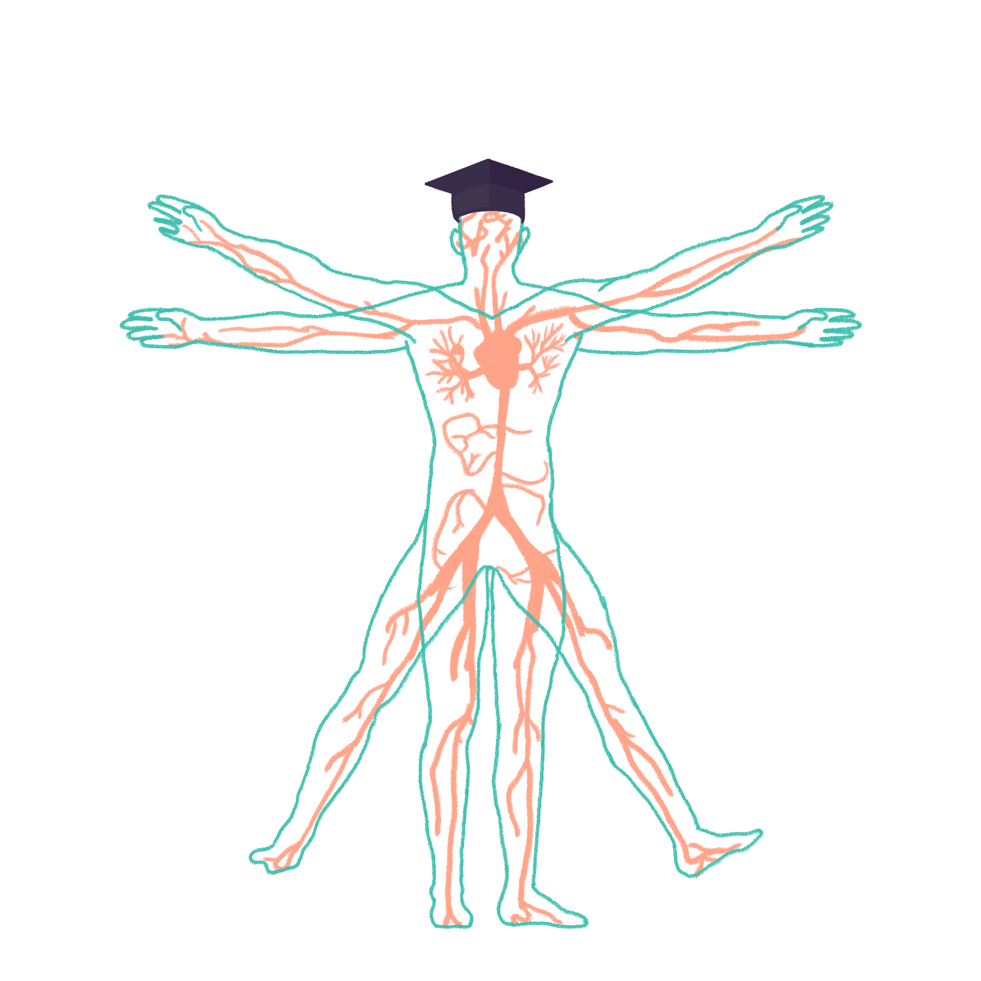
2023/2024

Slide 2
Cardio 2
Phase 1 Cardiovascular Wrap-Up Revision Session
Olivia Slaney
02/11/23
The Peer Teaching Society is not liable for false or misleading information…

Slide 3
Aims and Objectives
Objective – To have a good understanding of the key information and equations.
ECG basics – be able to identify the PQRST points on an ECG and clearly identify the apex of the heart.
Conduction – to understand and identify the primary pacemaker and the conduction of the heart.
Action potential stages – the difference between phases 0-4 and how this affects the heart.
Equations – recall equations and know what factors can affect cardiac output and stroke volume.
The Peer Teaching Society is not liable for false or misleading information…

Slide 4
ECG Basics.
What is depolarization?
The heart contracts as the membrane of the muscle cells lose charges.
What is repolarization?
The heart relaxes as the membrane of the muscle cells gains charge.
The Peer Teaching Society is not liable for false or misleading information…
Notes:
On the ECG – the height of the wave is proportional to the strength of the contraction e.g., the higher the wave, the greater the depolarisation and the stronger the contraction.

Slide 5
ECG Basics.
P Wave = Atrial Depolarization.
QRS Complex = Ventricular Depolarization.
T Wave = Ventricular Repolarization.
The Peer Teaching Society is not liable for false or misleading information…
Notes:
- The P wave is the atria contracting.
- The QRS complex is the ventricle contracting.
- The T wave os caused by the ventricles relacing.

Slide 6
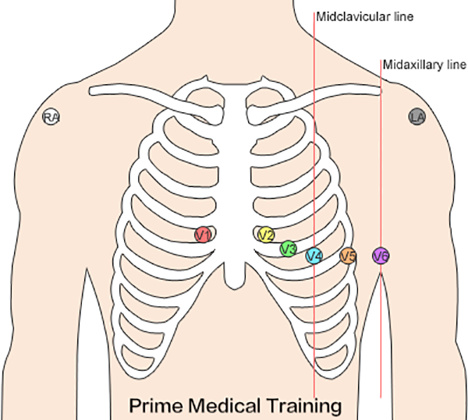
ECG Placement.
Where is the apex of the heart?
Located on the midclavicular line, in the fifth intercostal space.
The Peer Teaching Society is not liable for false or misleading information…

Slide 7
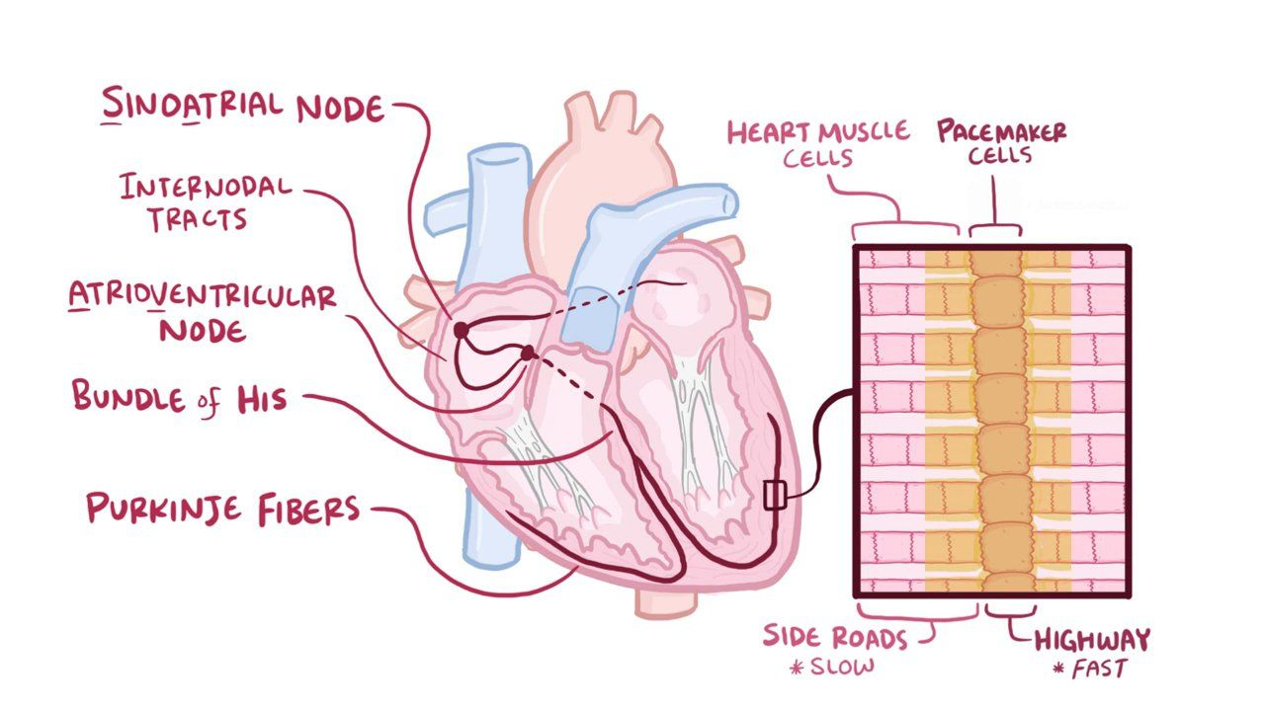
Pacemaker Cells.
The primary pacemaker is in the sinoatrial node.
Made up of cardiomyocytes.
Spontaneously generate cardiac action potentials.
Modified by the sympathetic/parasympathetic nerve fibers.
Depolarize at a rate of 60-100 per minute.
The Peer Teaching Society is not liable for false or misleading information…

Slide 8
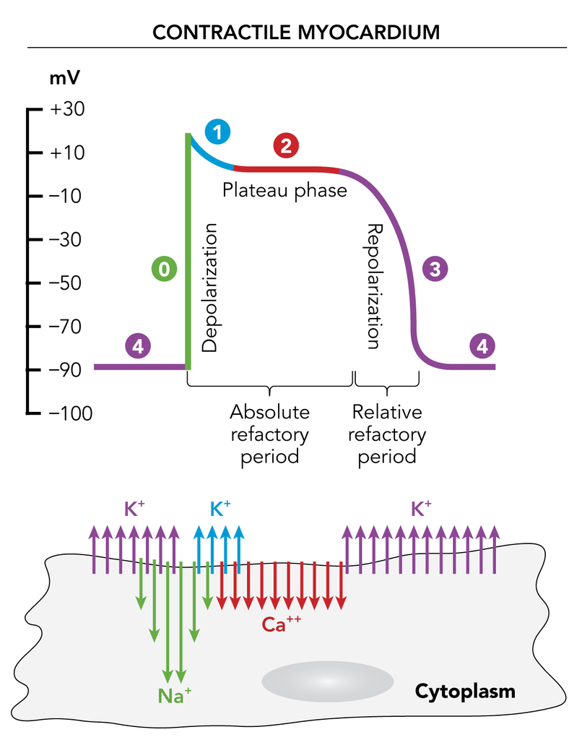
Action Potential Stages.
The Peer Teaching Society is not liable for false or misleading information…

Slide 9
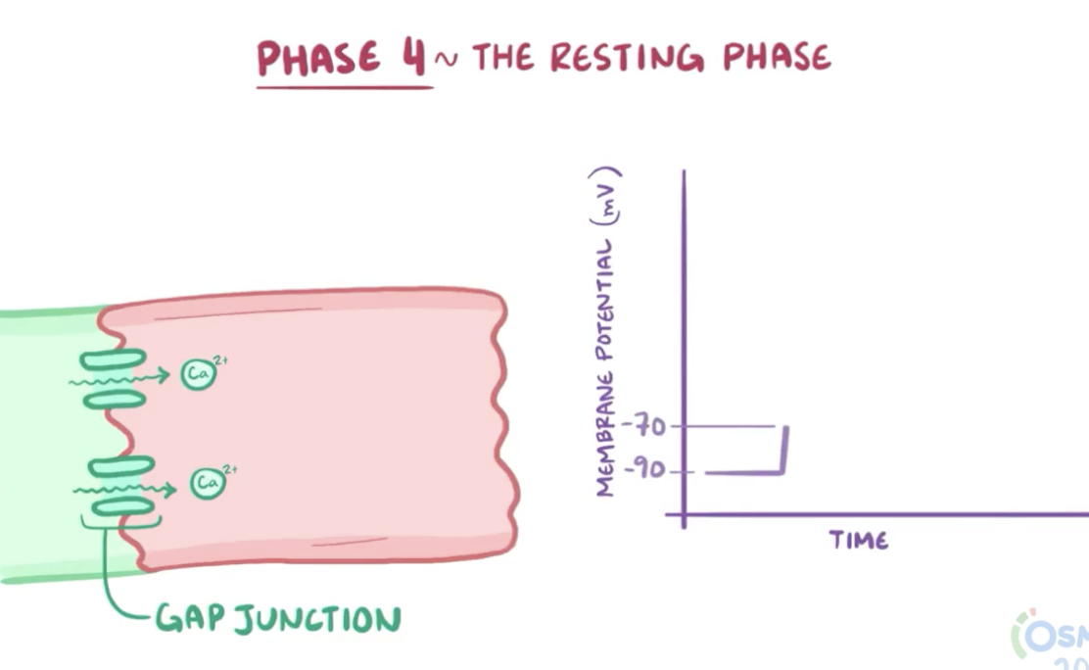
Action Potential Stages.
Resting Phase
At rest, the K+ channels are open.
The cardiac myocyte is much more permeable to K+.
The potential remains at roughly -70mV.
Maintained by Na+ and K+ ATPase pumps.
3 Na+ ions are pumped out for every 2K+ ions in.
The Peer Teaching Society is not liable for false or misleading information…
Notes:
F-type (funny) channels as unlike most voltage-gated channels, they are open when the membrane potential is negative.

Slide 10
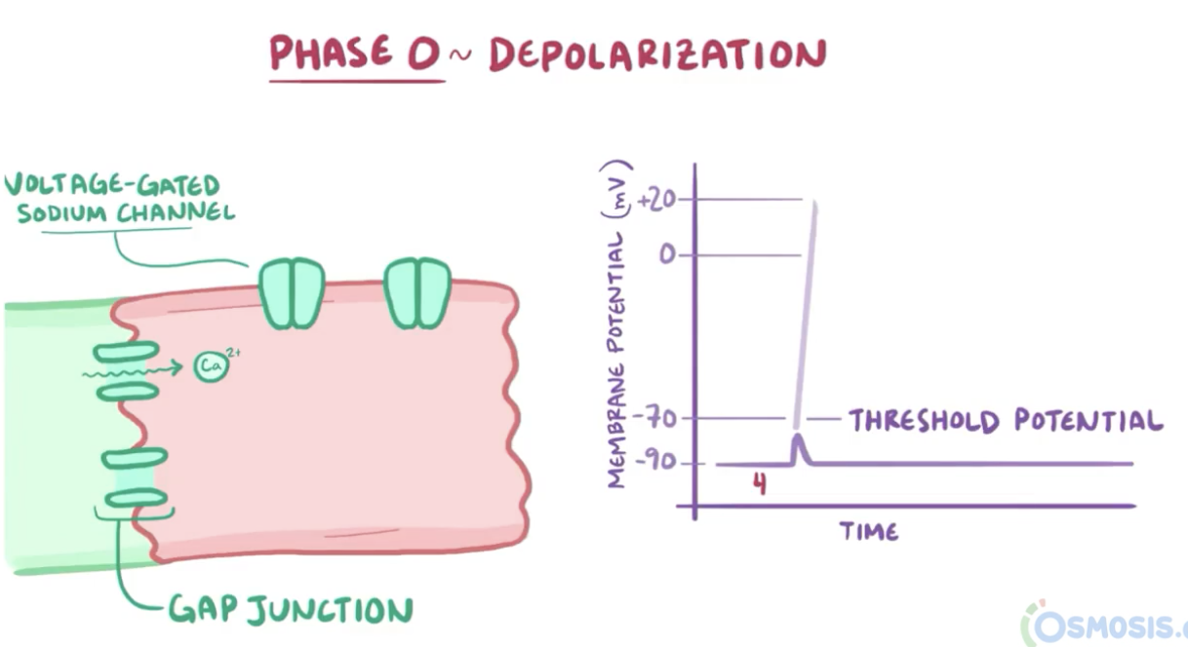
Action Potential Stages.
Depolarization.
Action potential arrives.
The Na+ channels open.
Na+ entering the cell triggers a positive feedback = more Na+ channels open and depolarizes the cell.
The Peer Teaching Society is not liable for false or misleading information…

Slide 11
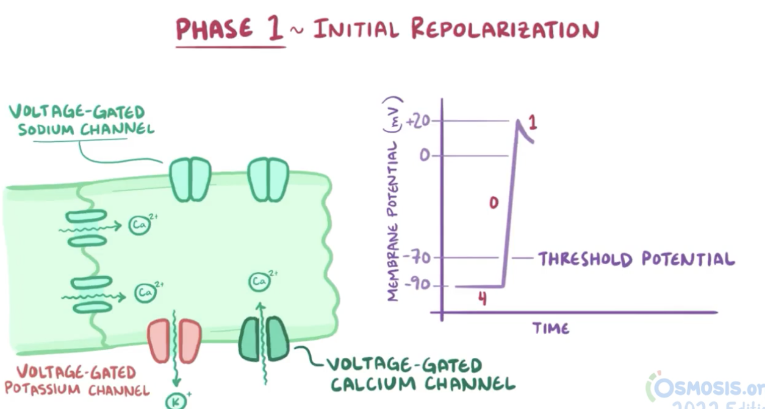
Action Potential Stages.
Initial Repolarization.
The potential in the cell is now positive.
The Na+ channels close at the same time voltage-gated K+ channels open.
This partially repolarizes the cell.
Ca2+ voltage-gated channels slowly open at the T-Tubules.
Inflow of Ca2+ into the cell.
The Peer Teaching Society is not liable for false or misleading information…
Notes:
T-Tubules are part of the sarcolemma which is part of the myocyte membrane.

Slide 12
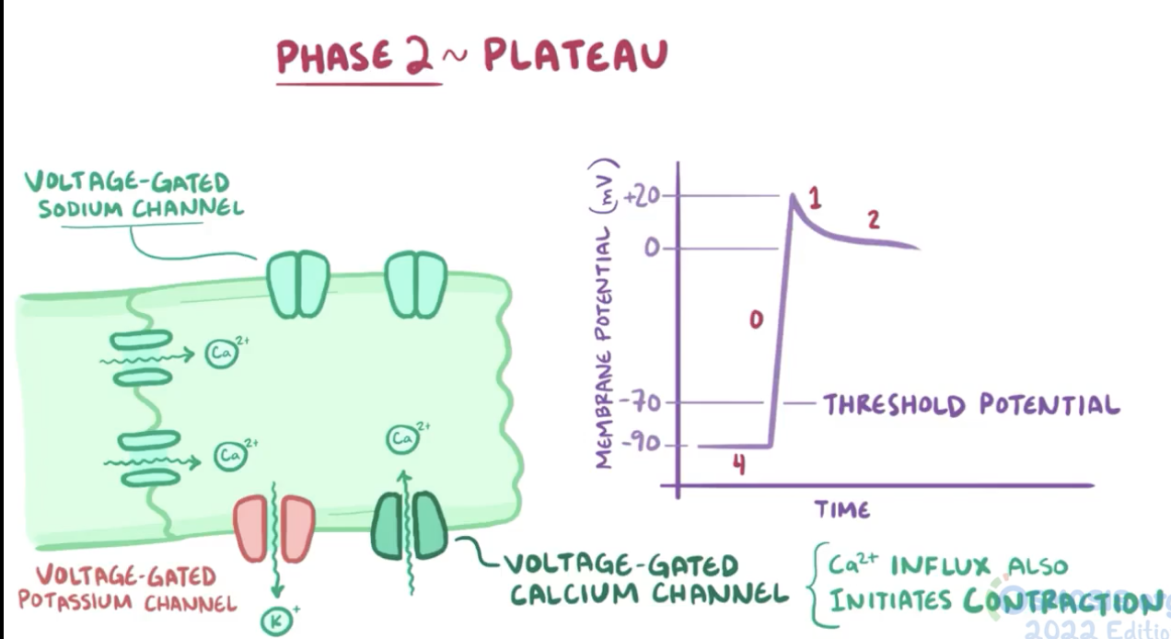
Action Potential Stages.
Plateau
Ca2+ channels are called L- type Ca2+ channels because they are long lasting and remain open for a longer time.
The flow of Ca2+ in balances out the flow of K+ out of the cell.
The membrane is depolarized at the plateau level of 0mV.
The Peer Teaching Society is not liable for false or misleading information…
Notes:
The voltage gated Ca2+ channels depolarise the membrane more slowly than Na+ channels. This means the action potential travels more slowly through the AV node.

Slide 13
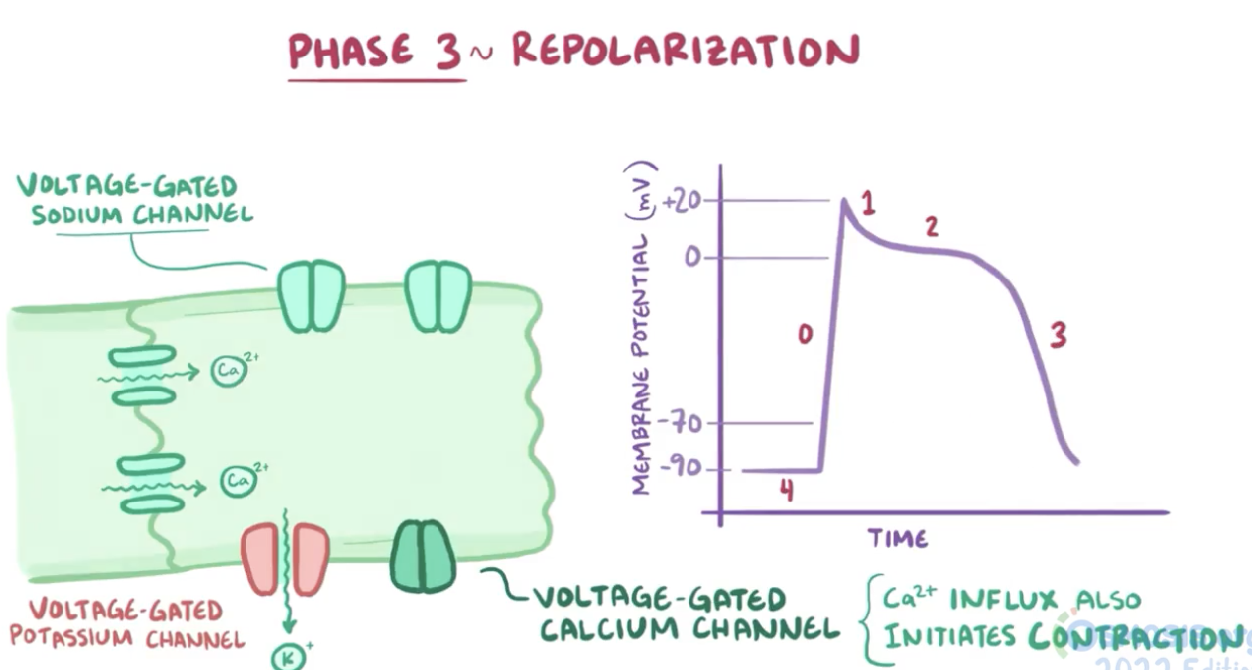
Action Potential Stages.
Repolarization.
The L-type Ca2+ channels close and the K+ channels reopen.
The K+ channels open in response to depolarization (after a delay).
Negative potential = F-type channels open.
The Peer Teaching Society is not liable for false or misleading information…

Slide 14
Action Potential Stages.
Refractory Period
Absolute.
No stimulus can depolarize the cell.
During phases 0,1 and part of 2.
Relative
Large stimulus can generate an action potential.
The Peer Teaching Society is not liable for false or misleading information…

Slide 15
Equations.
Cardiac Output (CO) = Heart Rate (HR) x Stroke Volume (SR)
Blood Pressure = CO x Total Peripheral Resistance (TPR)
Pulse Pressure (PP) = Systolic – Diastolic pressure
Mean Atrial Pressure (MAP) = Diastolic Pressure + 1/3 PP.
Stroke Volume = End-Diastolic Volume (EDV) – End Systolic Volume (ESV)
Poiseuille's Equation: Flow = Radius^4
Ohms Law: Flow = Pressure Gradient/Resistance.
The Peer Teaching Society is not liable for false or misleading information…

Slide 16
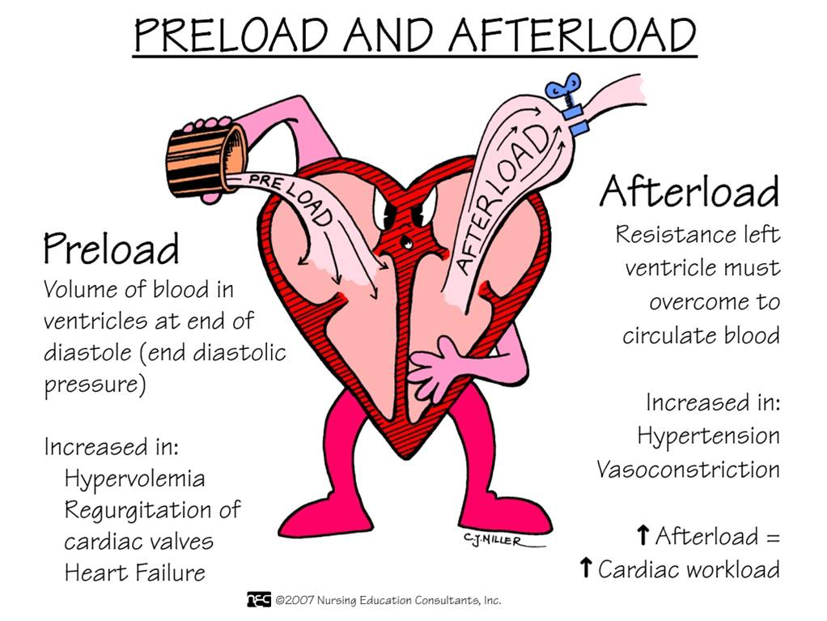
Stroke Volume
Factors affecting SV.
Preload.
Venous BP.
End-diastolic volume.
Exercise.
Pumps = respiratory and skeletal muscle.
Afterload.
Disease processes.
Hypertension.
Cardiac Contractility.
Sympathetic/parasympathetic activation.
Hypercapnia.
Heart attack.
The Peer Teaching Society is not liable for false or misleading information…

Slide 17
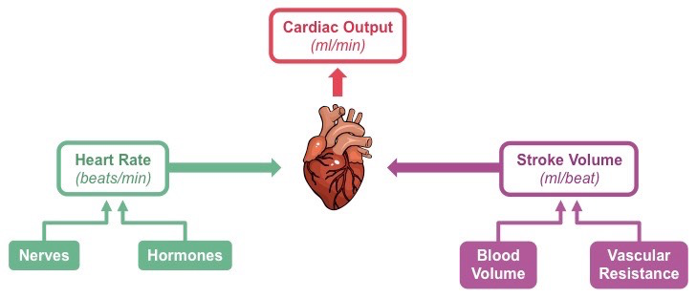
Cardiac Output
The Peer Teaching Society is not liable for false or misleading information…

Slide 18
SBA Questions
A 75-year-old man is referred to the cardiology unit for a Doppler ultrasound and ECG. Results from these investigations indicate a stroke volume of 80 millilitres (mL) and a heart rate of 75 beats per minute. What is the cardiac output for this patient?
6000L per minute
5L per minute
0.6L per minute
4L per minute
6L per minute.
The Peer Teaching Society is not liable for false or misleading information…
Notes:
5.

Slide 19
SBA Questions
Which ion channels are open during the plateau phase of the cardiac action potential?
Calcium channels and potassium channels.
Sodium channels only.
Calcium channels only.
Calcium channels and sodium channels.
Potassium channels only.
The Peer Teaching Society is not liable for false or misleading information…
Notes:
1.

Slide 20
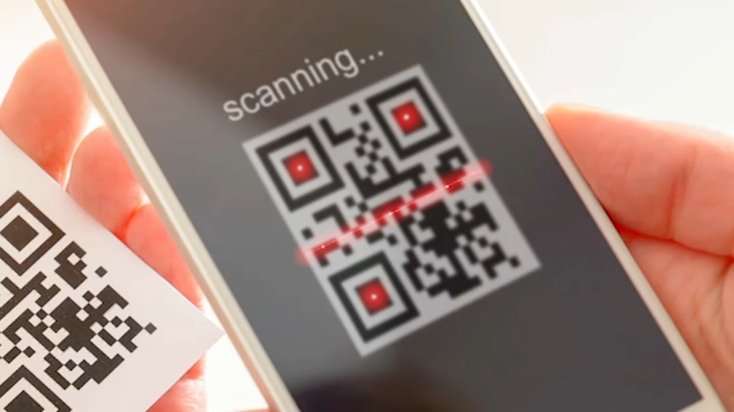
Feedback
phase reps add QR code here - QR Code Generator (the-qrcode-generator.com)
phase reps add feedback link here
The Peer Teaching Society is not liable for false or misleading information…

