Slide 1
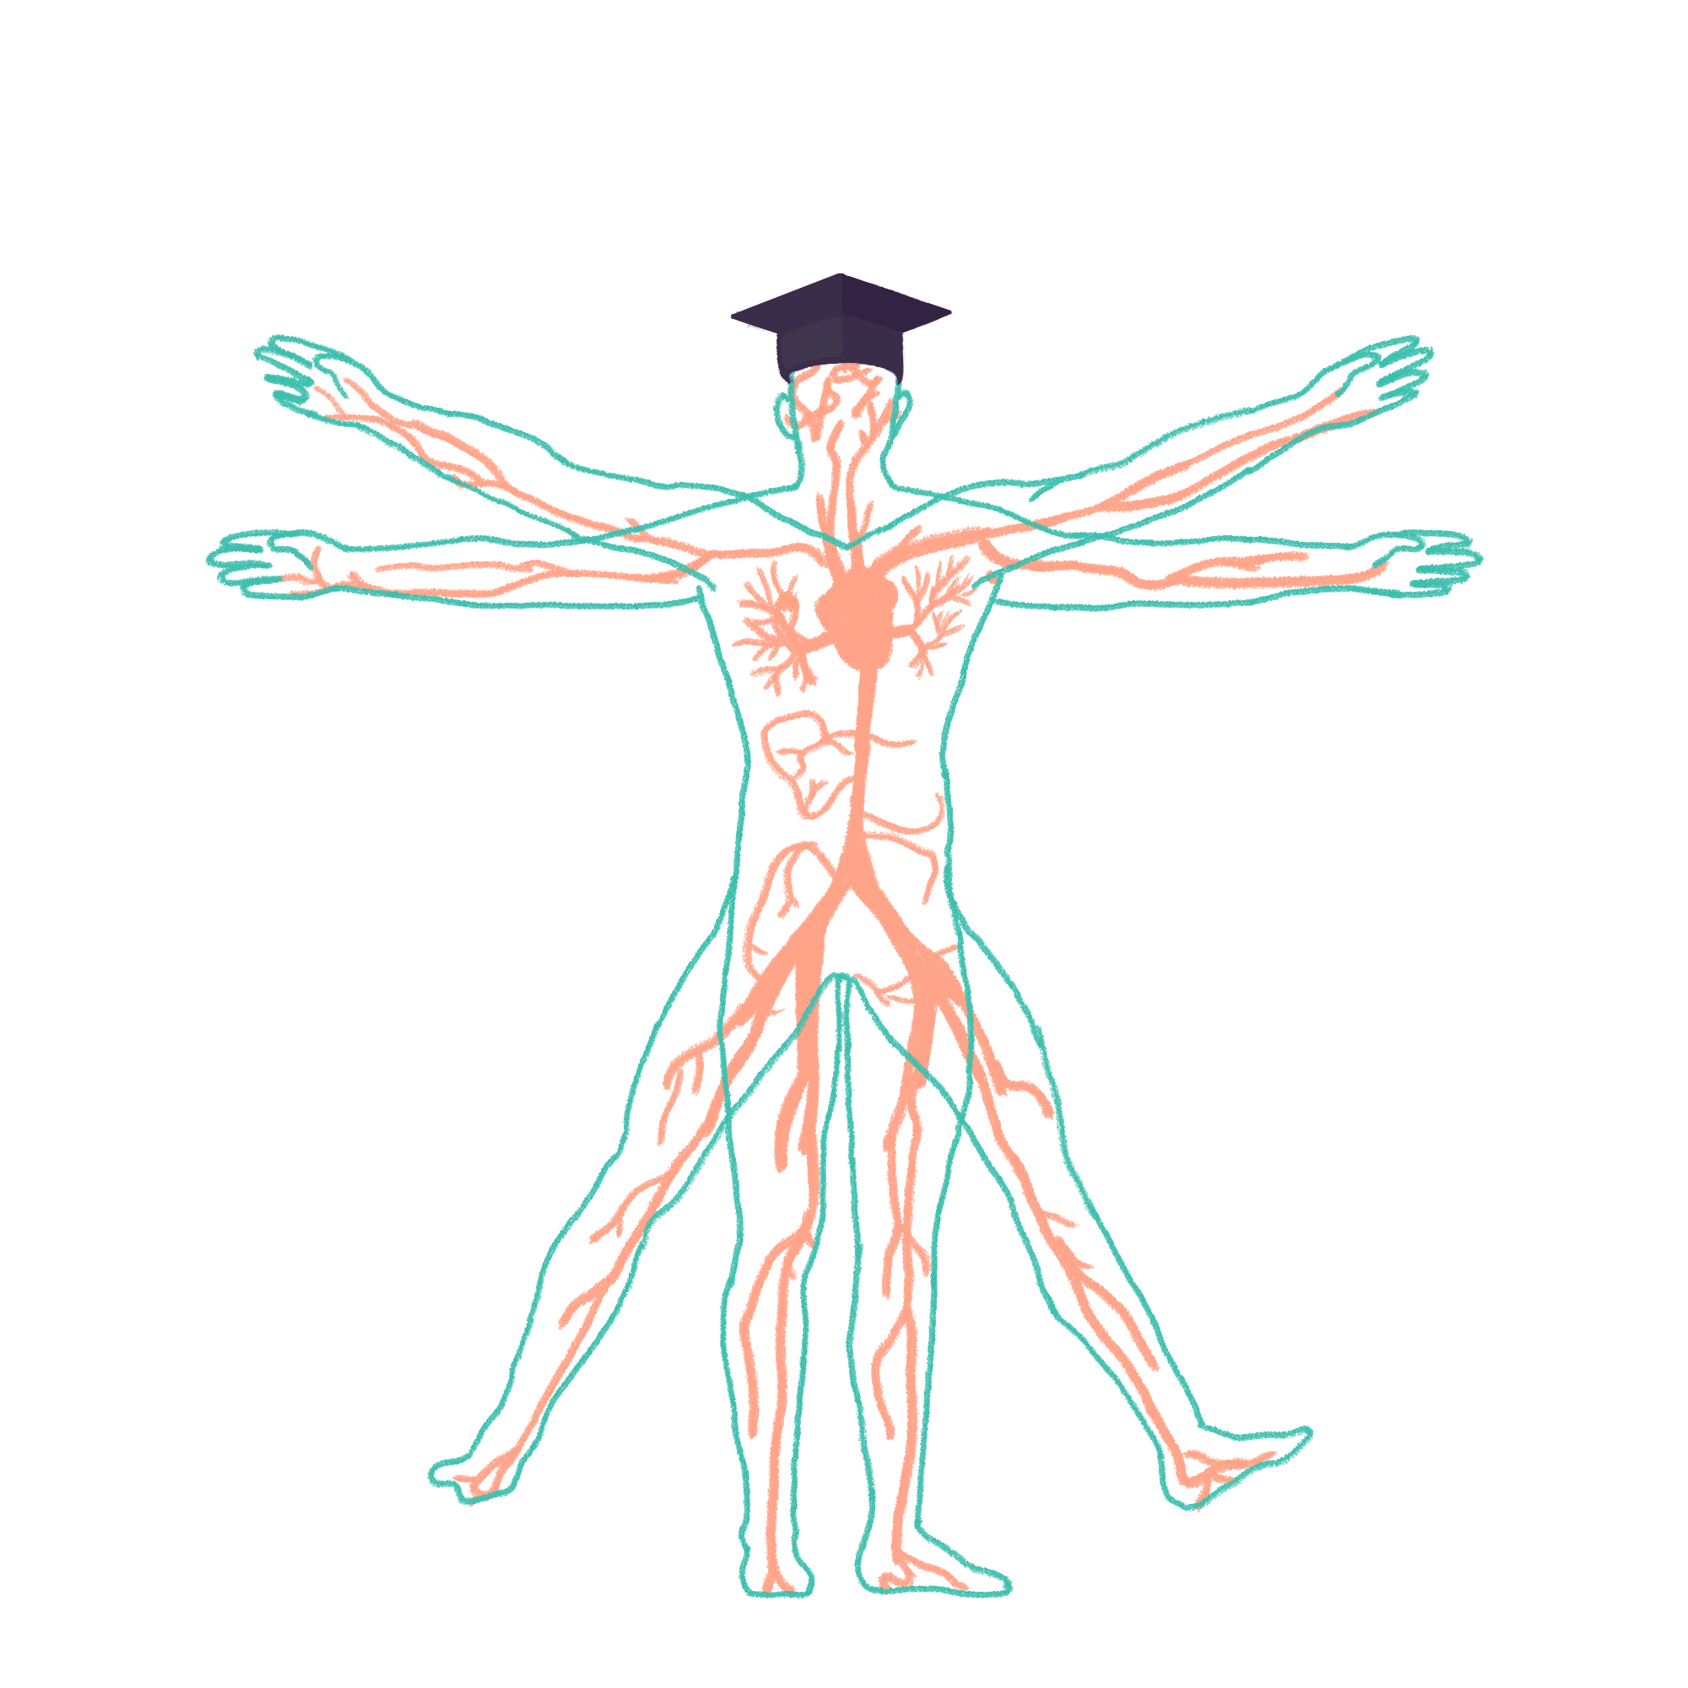
2022/2023

Slide 2
Cardio Examination
Phase 2B Revision Session
Holly Benn
Shefali Philip
12/07/22, 18:00
The Peer Teaching Society is not liable for false or misleading information…

Slide 3
Aims and Objectives
The steps of a cardio examination
How to examine each area involved
Identifiable signs associated with cardiac disease and what conditions cause them
The Peer Teaching Society is not liable for false or misleading information…

Slide 4
Introduction
Wash hands
Introduce yourself → name and role
Check the patient → name and DOB
Explain the the examination and gain consent
Expose the patients chest and legs
Ask if the patient is in any pain before starting
Ensure bed is adjusted to 45 degrees

Slide 5
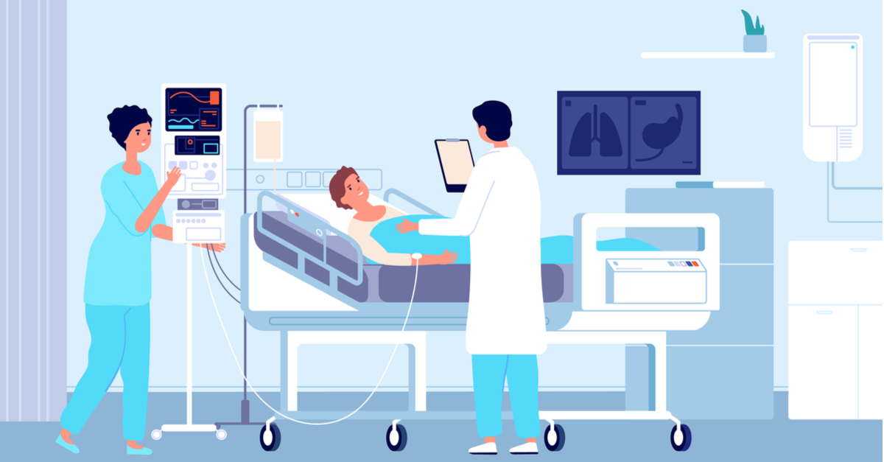
General inspection
Bedside
equipment
mobility aids
multiple pillows
medications
Patient
cyanosis
pallor
malar flush
oedema
scars
sweating, distress?
Notes:
equipment - O2, ECG, catheter, IV
multiple pillows - potentially HF
cyanosis - poor circulation, inadequate O2
pallor - anaemia, haemorrhage, chronic disease, poor perfusion
malar flush - mitral stenosis
oedema - heart failure (peripheral is RHF, pulmonary is LHF)

Slide 6
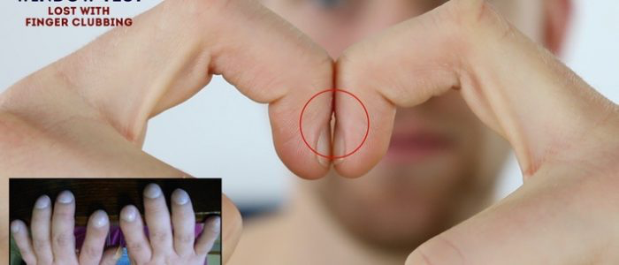
Hands
Ensure patients arms up to their elbows are exposed
Look - hold out hands, both sides
Colour → pallor, cyanosis, tar staining
Signs of disease → xanthomata, arachnodactyly, clubbing, splinter haemorrhages, janeway lesions, Oslers nodes
Feel
temperature
capillary refill
hold for 5s, should pink up within 2s
radial pulse and HR
Radio-radial delay
Image: Geeky Medics
Notes:
tar staining - smoker
xanthomata - raised yellow cholesterol spots - palms/tendons/elbows - hypercholesterolemia
arachnodactyly - spider fingers - feature of marfan syndrome - associated with valve prolapse and aortic dissection
clubbing - rounded nails - congenital cyanotic heart disease, infective endocarditis, atrial myxoma
assess by placing backs of nails together, a gap will be seen between the nails
splinter haemorrhage - local trauma, IE, sepsis, vasculitis, psoriatic nail disease
janeway lesions and oslers nodes- infective endocarditis
cool and clammy hands - potential acute coronary syndrome
radio-radial delay - caused by subclavian artery stenosis, aortic dissection, aortic coarctation

Slide 7
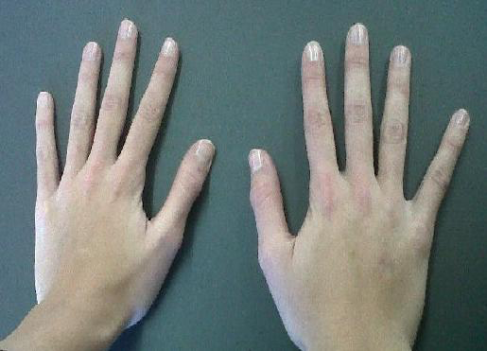
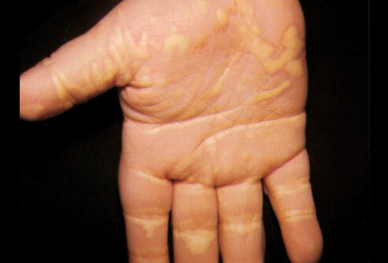
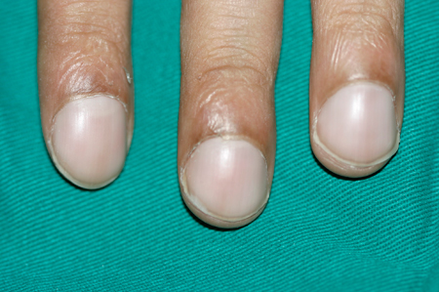
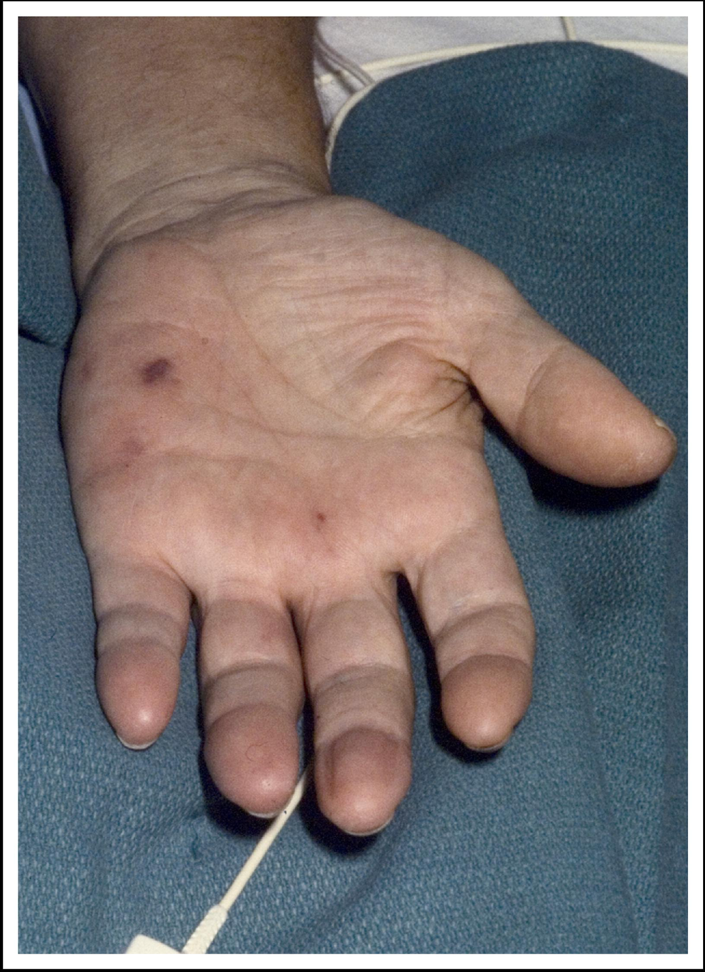
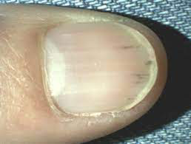
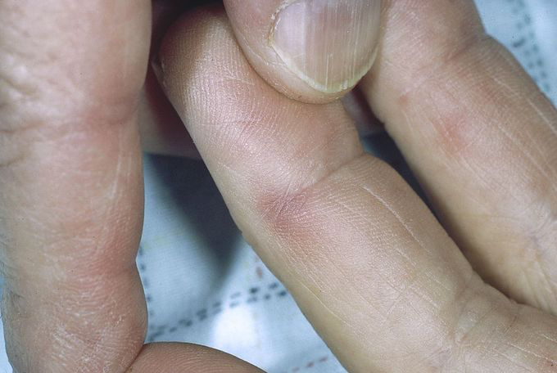
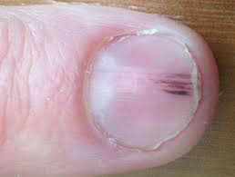
Image: wikipedia
Image: medicinenet
B
image: best practice BMJ
A
C
E
D
Image: MEDizzy
F
Images: Dermnetnz
Image: amjmed
Notes:
A - xanthomata
B - spider fingers, arachnodactyly
C - clubbing
D - splinter haemorrhage
E - janeway lesion
F - oslers node

Slide 8
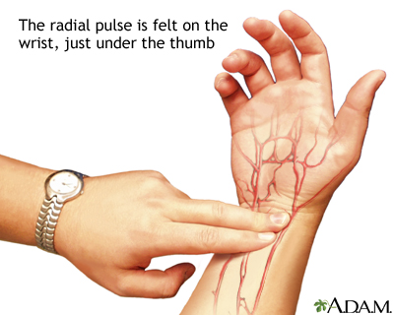
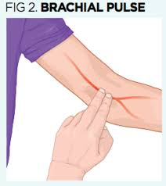
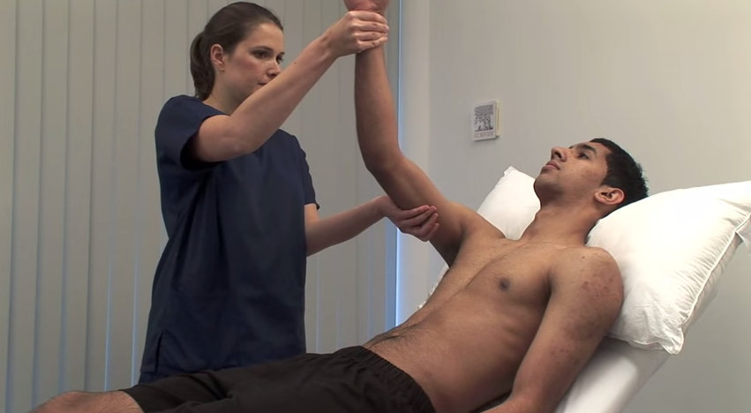
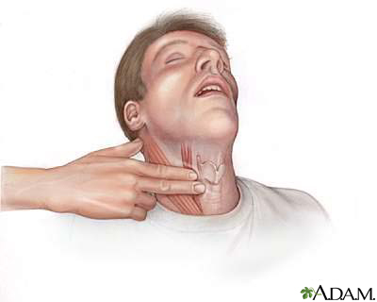
Pulses
Assessing rate, rhythm and character
Radial
assess for collapsing pulse
Brachial
slow rising
bounding
thready
carotid - auscultate before palpating
presence of bruit
ask the patient to hold their breath
Image Sources:
Medline plus
emap
Geeky medics
mount sinai
Notes:
causes of collapsing pulse - pregnancy, fever, cardiac lesions (aortic regurg, patent ductus arteriosus), high output state (anaemia, AV fistula, thyrotoxicosis)
slow rising - aortic stenosis
bounding - aortic regurg, CO2 retention
thready - hypovolaemia such as sepsis

Slide 9
Blood pressure
Should be done in both arms, lying and standing
looking for
hypertension >140/90
hypotension <90/60
narrow pulse pressure <25mmHg difference between systolic and diastolic
wide pulse pressure >100mmHg difference between systolic and diastolic
Difference between arms
postural/orthostatic hypotension - difference of 20mmHg between systolic readings when sitting and standing
This is something you do not typically carry out in the OSCE but you should state you would do this
Notes:
difference between arms suggests aortic dissection

Slide 10
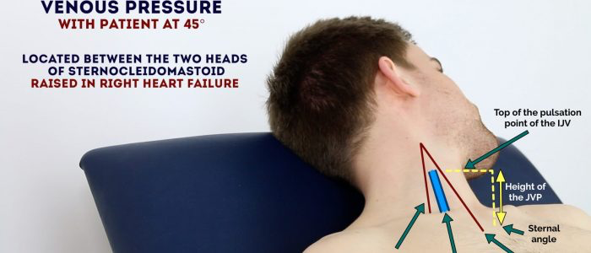
Jugular Venous Pressure
position patient lying at 45 degrees and turn the head slightly to the left
inspect the neck for JVP - located between the medial clavicle and earlobe, under the medial aspect of sternocleidomastoid
Has a double wave form pulse
‘Measure vertical distance between sternal angle and top of pulsation point of IJV’
Check for low JVP with hepatojugular reflux - press on the patients liver
JVP is normally only
visible when disease is present
Image: Geeky medics
Notes:
raised in - RHF, pulmonary hypertension from LHF, tricuspid valve regurg (IE or rheumatic heart disease), constrictive pericarditis

Slide 11
Face
Eyes
conjunctival pallor - ask patient to pull down lower eyelid
corneal arcus
xanthelasma
kayser fleischer rings
Mouth - ask patient to say ‘ahh’ and then stick out their tongue/raise it to the roof of their mouth
central cyanosis
angular stomatitis
high arch palate
dental hygiene
Face
Malar flush
Image: Geeky Medics
Notes:
conjunctival pallor - anaemia
corneal arcus, xanthelasma - hypercholestrolaemia
kayser fleischer - wilsons disease
central cyanosis - hypoxaemia (R→L shunt)
angular stomatitis - anaemia iron deficiency
high arch palate - marfans
dental hygiene - risk of IE
malar flush - mitral stenosis

Slide 12
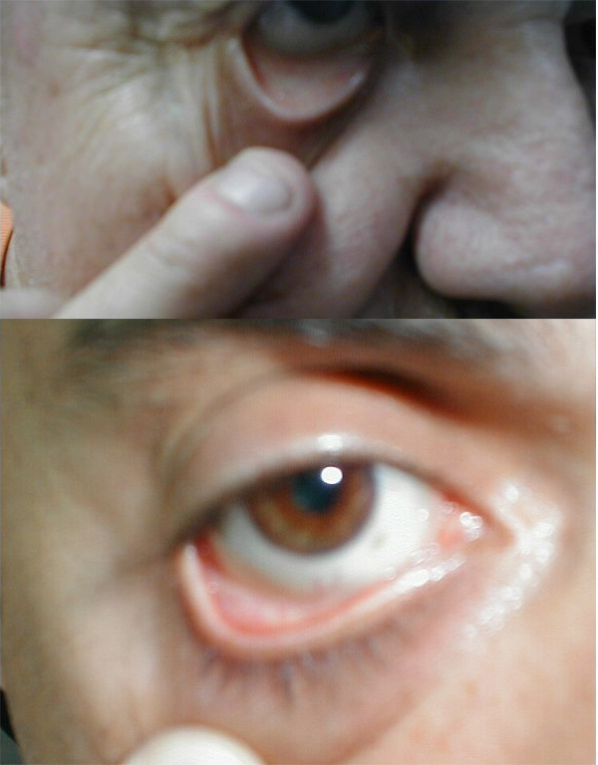
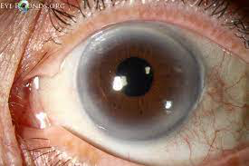
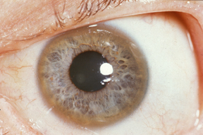
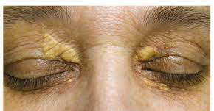
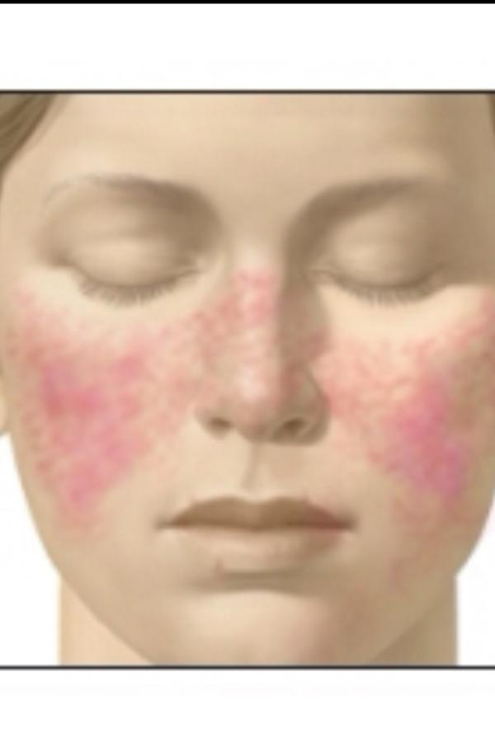
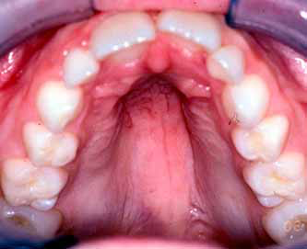
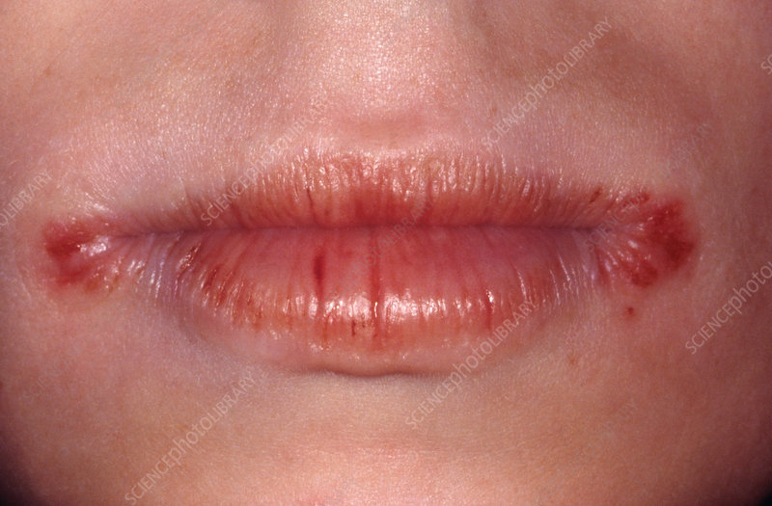
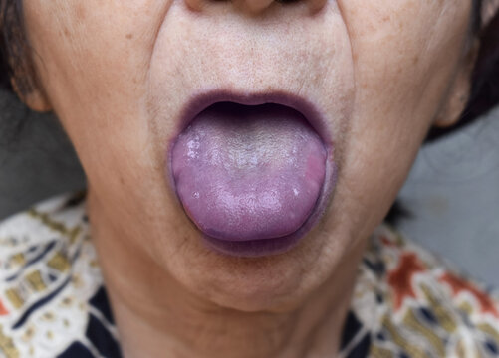
Image: Grep med
B
D
image: wikipedia
Image: eyerounds
C
A
Image: aesthetics journal
H
Image: sciencephoto
F
E
Image: Adobe stock
Image: elementsofmorphology
G
Image: Twitter
Notes:
A - conjunctival pallor
B - corneal arcus
C - xanthelasma
D - kayser fleischer
E - central cyanosis
F - angular stomatitis (also called chelitis)
G - high arched pallet
H - malar flush

Slide 13
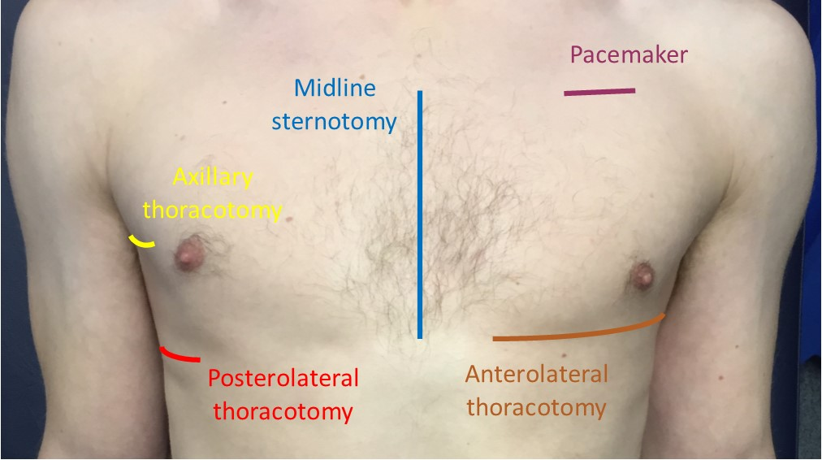
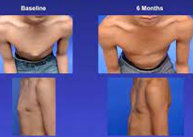
Chest Examination
Closely inspect the chest
Make sure to inspect the chest anteriorly and the axilla for:
Scars suggestive of previous surgery
Chest deformities : Pectus excavatum and pectus carinatum
Visible pulsations
Notes:
Median sternotomy scar: located in the midline of the thorax. This surgical approach is used for cardiac valve replacement and coronary artery bypass grafts (CABG).
Anterolateral thoracotomy scar: located between the lateral border of the sternum and the mid-axillary line at the 4th or 5th intercostal space. This surgical approach is used for minimally invasive cardiac valve surgery.
Infraclavicular scar: located in the infraclavicular region (on either side). This surgical approach is used for pacemaker insertion.
Axillary thoracotomy scar: Usually located at the 5th intercostal space in the anterior axillary line. Commonly due to a previous chest drain. (This is best assessed when inspecting the back).
Left mid-axillary scar: this surgical approach is used for the insertion of a subcutaneous implantable cardioverter-defibrillator (ICD).
Posterolateral thoracotomy scar: Usually located at the lateral and posterior intercostal space inferior to the tip of the scapula. Commonly due to a lobectomy or pneumonectomy. (This is best assessed when inspecting the back).
Posterolateral thoracotomy scar: Usually located at the lateral and posterior intercostal space inferior to the tip of the scapula. Commonly due to a lobectomy or pneumonectomy. (This is best assessed when inspecting the back).

Slide 14
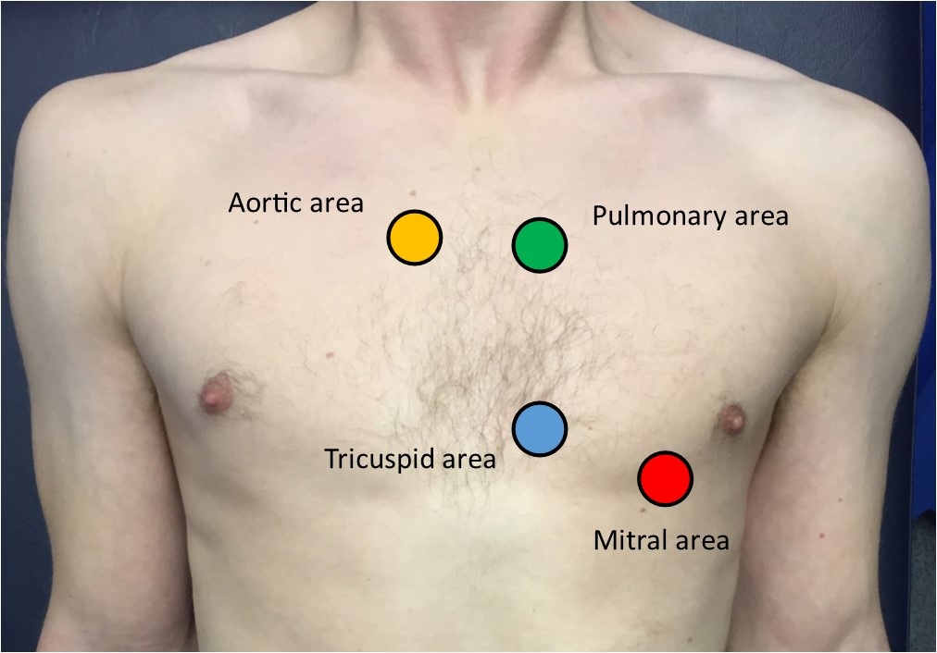
Palpation
1.. Apex Beat -> LHS 4th/5th ICS midclavicular line
2. Palpate 4 areas of the heart
Heaves
Thrills
NEXT : Before you start listening make sure the stethoscope is the right way. Tap the diaphragm before you use it
BELL VS DIAPHRAGM
Bell = more effective at detecting low frequency sounds = mitral stenosis
Diaphragm = more effect at detecting high frequency sound = aortic stenosis , aortic regurg and mitral regurg
Notes:
A displaced apex beat could be a result of ventricular hypertrophy.
HEaves = precordial impulse that can be palpated -> use heel of your hand
Thrill = palpable murmer/ vibration caused by turbulent blood flow through a heart valve = use flat of your fingers

Slide 15
Auscultation of the Anterior Chest
1st: PALPATE THE CAROTID TO DETERMINE THE FIRST HEART SOUND AND CONTINUE TO FEEL IT DURING THIS
Listen to all 4 heart areas - with the diaphragm and bell
Aortic valve: 2nd intercostal space at the right sternal edge.
Pulmonary valve: 2nd intercostal space at the left sternal edge.
Tricuspid valve: 4th or 5th intercostal space at the lower left sternal edge.
Mitral valve: 5th intercostal space in the midclavicular line
Notes:
Be sure to palpate the carotid pulse whilst doing so in order to time any audible murmurs
In the osce you get a mark for feeling the carotid while listening to the heart valves as its how you figure out if its systolic or diastolic

Slide 16
Murmurs
Aortic Regurgitation
Mitral Regurgitation
Aortic Stenosis
Mitral Stenosis
Low pitched rumbling mid-diastolic murmur , S1 snap
Ejection systolic murmur, radiates to the carotid. Slow rising pulse and narrow PP
Pansystolic murmur , radiating to the axilla
Decrescendo early diastolic murmur, austin flint murmur , collapsing pulse , wide PP
Notes:
Aortic Regurgitation = 6 mins 3 = Number 4
Austin Flint murmur: a low pitched rumbling mid-diastolic murmur heard best at the apex. This is caused by the regurgitated blood through the aortic valve mixing with blood from the left atrium, during atrial contraction
Mitral Regurgitation = 4 mins 30 = number 3 = heard loudest on exp when lying on left
Aortic Stenosis = 5 mins 12 = Number 2 -> heard loudest on expiration when patient sits forward
Mitral Stenosis = 3mins 50
Loudest at apex

Slide 17
Accentuation Maneuvers
Mitral valve -> Roll patient on their LEFT and listen DURING EXPIRATION over the valve area
M.Regurgitation - USE THE DIAPHRAGM : start at the valve area and listen, then move to the axilla to identify radiation of the murmur
M. Stenosis - USE THE BELL : Listen to the valve area
Aortic Valve - USING THE DIAPHRAGM
Aortic stenosis -> Auscultate the carotid arteries whilst the patient HOLDS THEIR BREATH = listening for radiation
Aortic regurg -> SIT PATIENT FORWARD and Auscultate the aortic area DURING EXPIRATION
IT'S IMPORTANT l that you only auscultate whilst palpating for the carotid pulse. This way you can easily determine if a murmur is systolic (in time with the pulse), or diastolic (immediately after the pulse).
Notes:
A mid-diastolic murmur due to mitral stenosis can be accentuated by asking the patient to lie down on their left side. Auscultate over the mitral area using the bell of the stethoscope.
A pansystolic murmur due to mitral regurgitation may radiate to the axilla. Therefore, whilst the patient is still lying down, auscultate the axilla using the diaphragm once again.
An early diastolic murmur due to aortic regurgitation can be accentuated by asking the patient to sit up straight. Auscultate just left of the sternal edge, rather than in the aortic area.
An ejection systolic murmur due to aortic stenosis may radiate as high as the carotid arteries. Therefore, with the patient already sat up, finish by auscultating the carotid arteries.

Slide 18
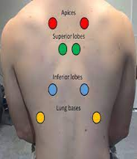
Posterior Chest and Back
Inspect the back when patient sits forwards -> scars and deformities
Auscultate the lung fields
Inspect and palpate Sacrum for sacral oedema
Notes:
COarse crackles -> Pulm oedema -> LV failure
Absent air entry / stony sullness = pleural effusion = LV failure
Pitting oedema -> HF

Slide 19
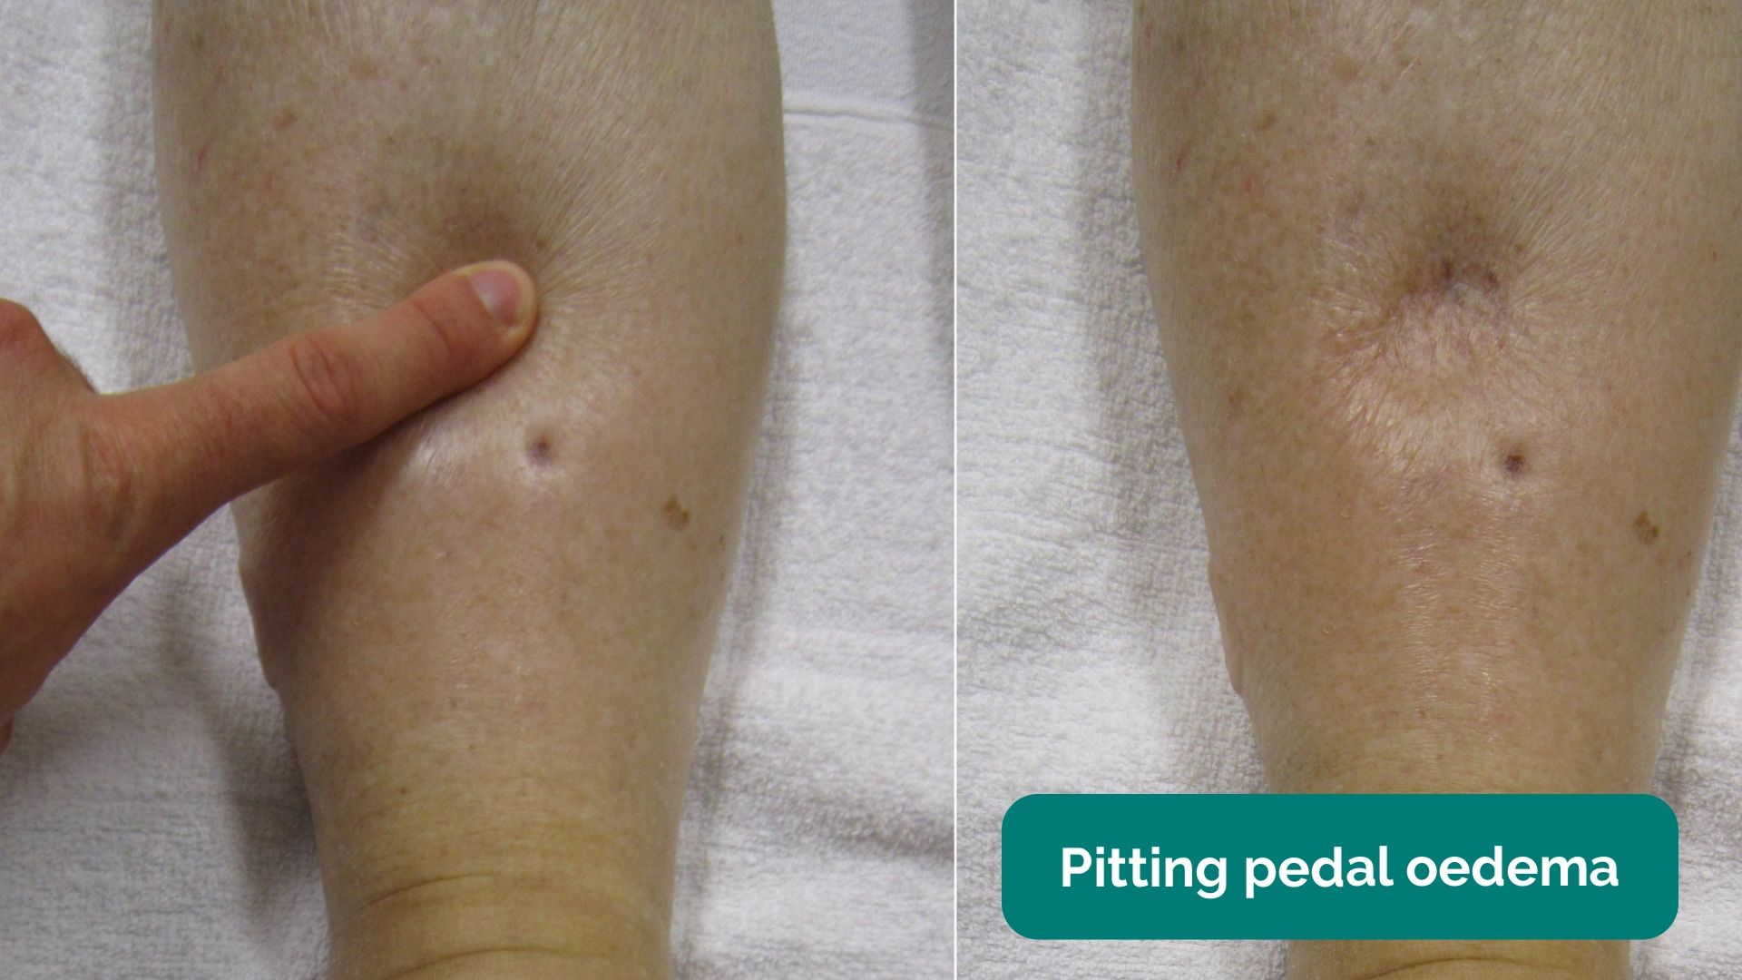
Peripheries
Inspect and palpate the patients ankles -> pitting oedema
Inspect legs for evidence of saphenous vein harvesting
Notes:
pitting oedema = RV HF
sapheous vein -> CAMG

Slide 20
Extra Test to suggest
Suggest further assessments that yu would do at the end to the examiner -> this scores you points in the OSCE
Measure BP
ECG
Urine dipstick
Perform fundoscopy
DO a peripheral vascular exam
Notes:
BP -> HTN / discrepancies
PVE -> PVD
ECG -> arrhythmias
Urine -> protienuria / haematuria
Fundoscopy -> malignant HTN , papilloedmea

Slide 21
Finish and present
Example summary TAKEN FROM GEEKY MEDICS
“Today I examined Mrs Smith, a 64-year-old female. On general inspection, the patient appeared comfortable at rest and there were no objects or medical equipment around the bed of relevance.”
“The hands had no peripheral stigmata of cardiovascular disease and were symmetrically warm, with a normal capillary refill time.”
“The pulse was regular and there was no radio-radial delay. On auscultation of the carotid arteries, there was no evidence of carotid bruits and on palpation, the carotid pulse had normal volume and character.”
“On inspection of the face, there were no stigmata of cardiovascular disease noted in the eyes or mouth and dentition was normal.”
“Assessment of the JVP did not reveal any abnormalities and the hepatojugular reflux test was negative.”
“Closer inspection of the chest did not reveal any scars or chest wall abnormalities. The apex beat was palpable in the 5th intercostal space, in the mid-clavicular line. No heaves or thrills were noted.”
“Auscultation of the praecordium revealed normal heart sounds, with no added sounds.”
“There was no evidence of peripheral oedema and lung fields were clear on auscultation.”
“In summary, these findings are consistent with a normal cardiovascular examination.”
“For completeness, I would like to perform the following further assessments and investigations.”

Slide 22
Feedback
https://forms.gle/NZsde8AYStuzdgMk7
The Peer Teaching Society is not liable for false or misleading information…

