Slide 1
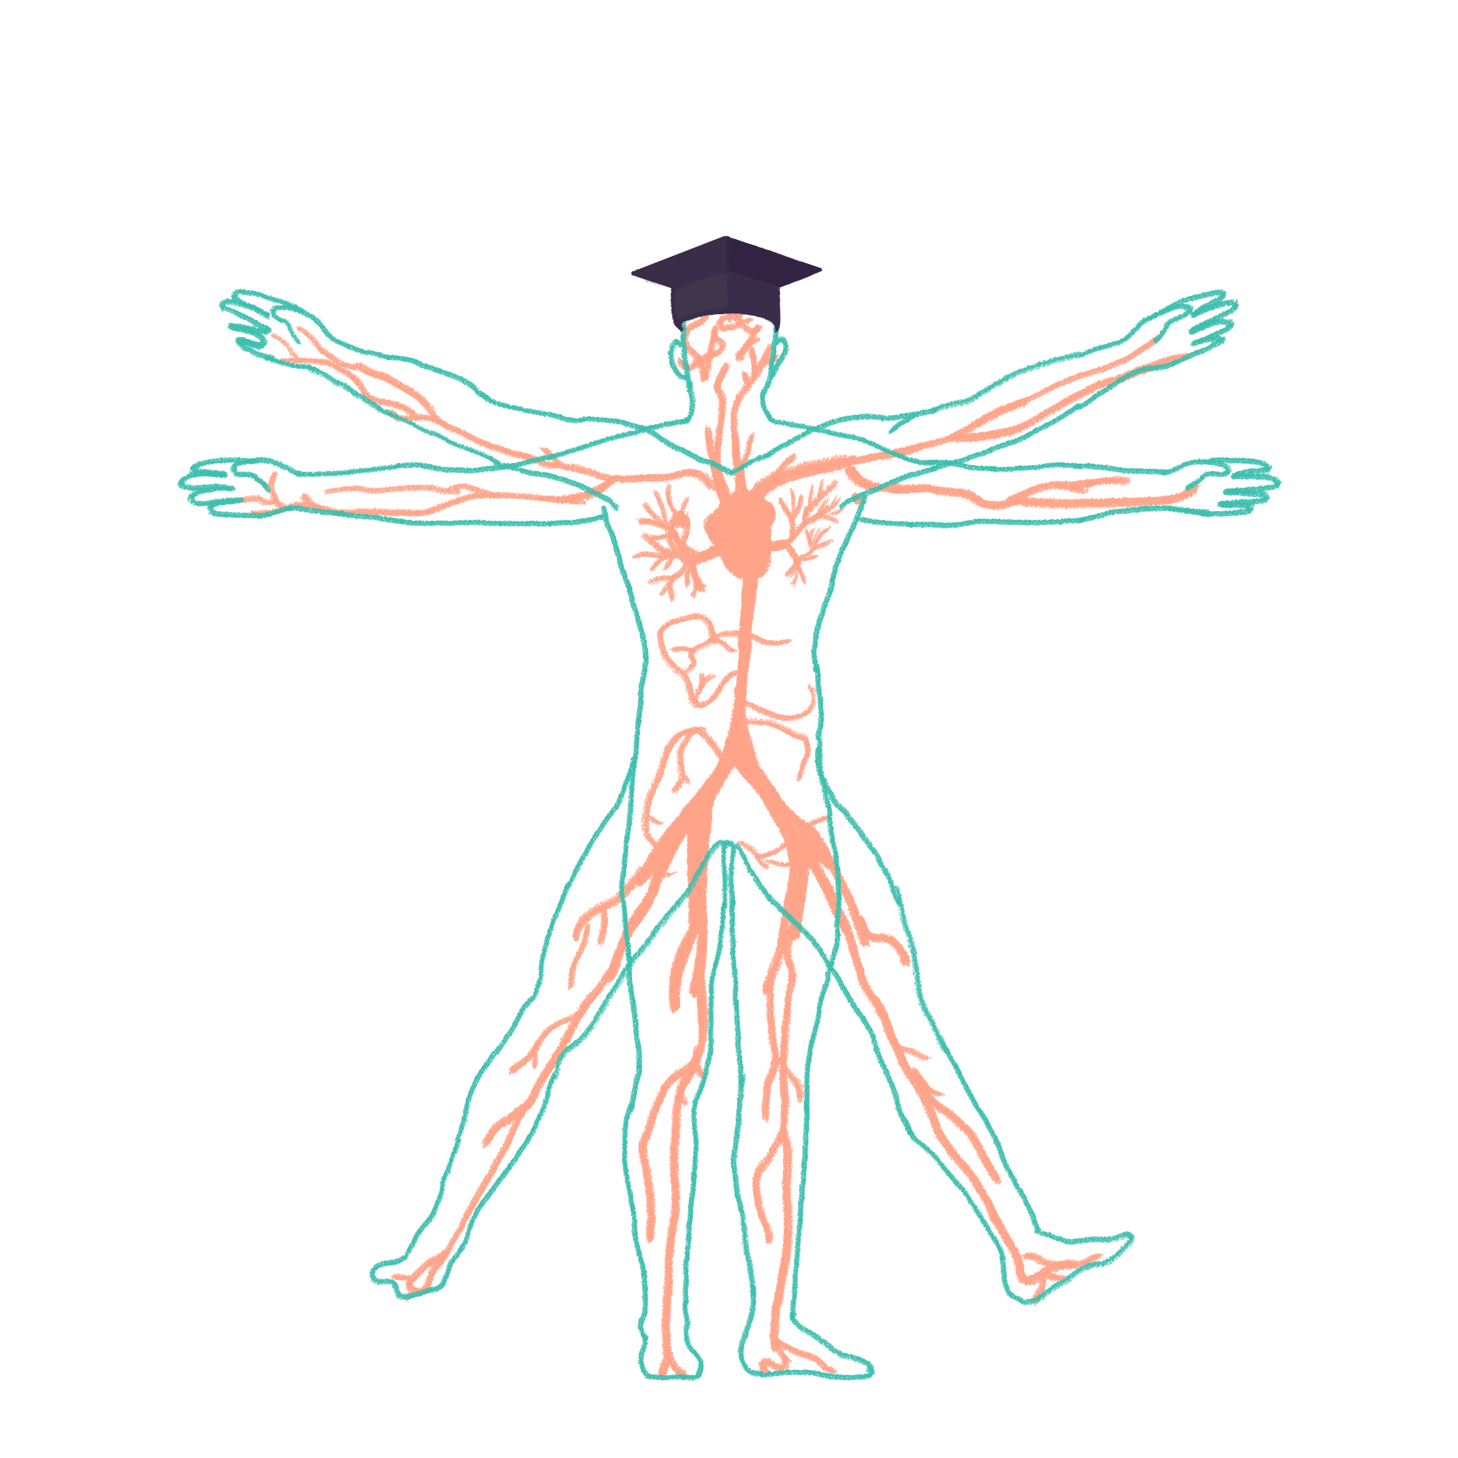
2022/2023

Slide 2
Cardiac History
Phase 2B Revision Session
Holly Benn
Molly Sellicks
11/07/22 - 18:00

Slide 3
Aims and Objectives
Cover the steps of a history in regard to cardiovascular presentations
Common symptoms and lines of questioning
The Peer Teaching Society is not liable for false or misleading information…

Slide 4
Structuring your history
Wash hands and introduce self
Identify patient
Gain consent
Presenting complaint
Past medical history
Current medications and allergies
Family history
Social history
Ideas, concerns and expectations
Complete

Slide 5
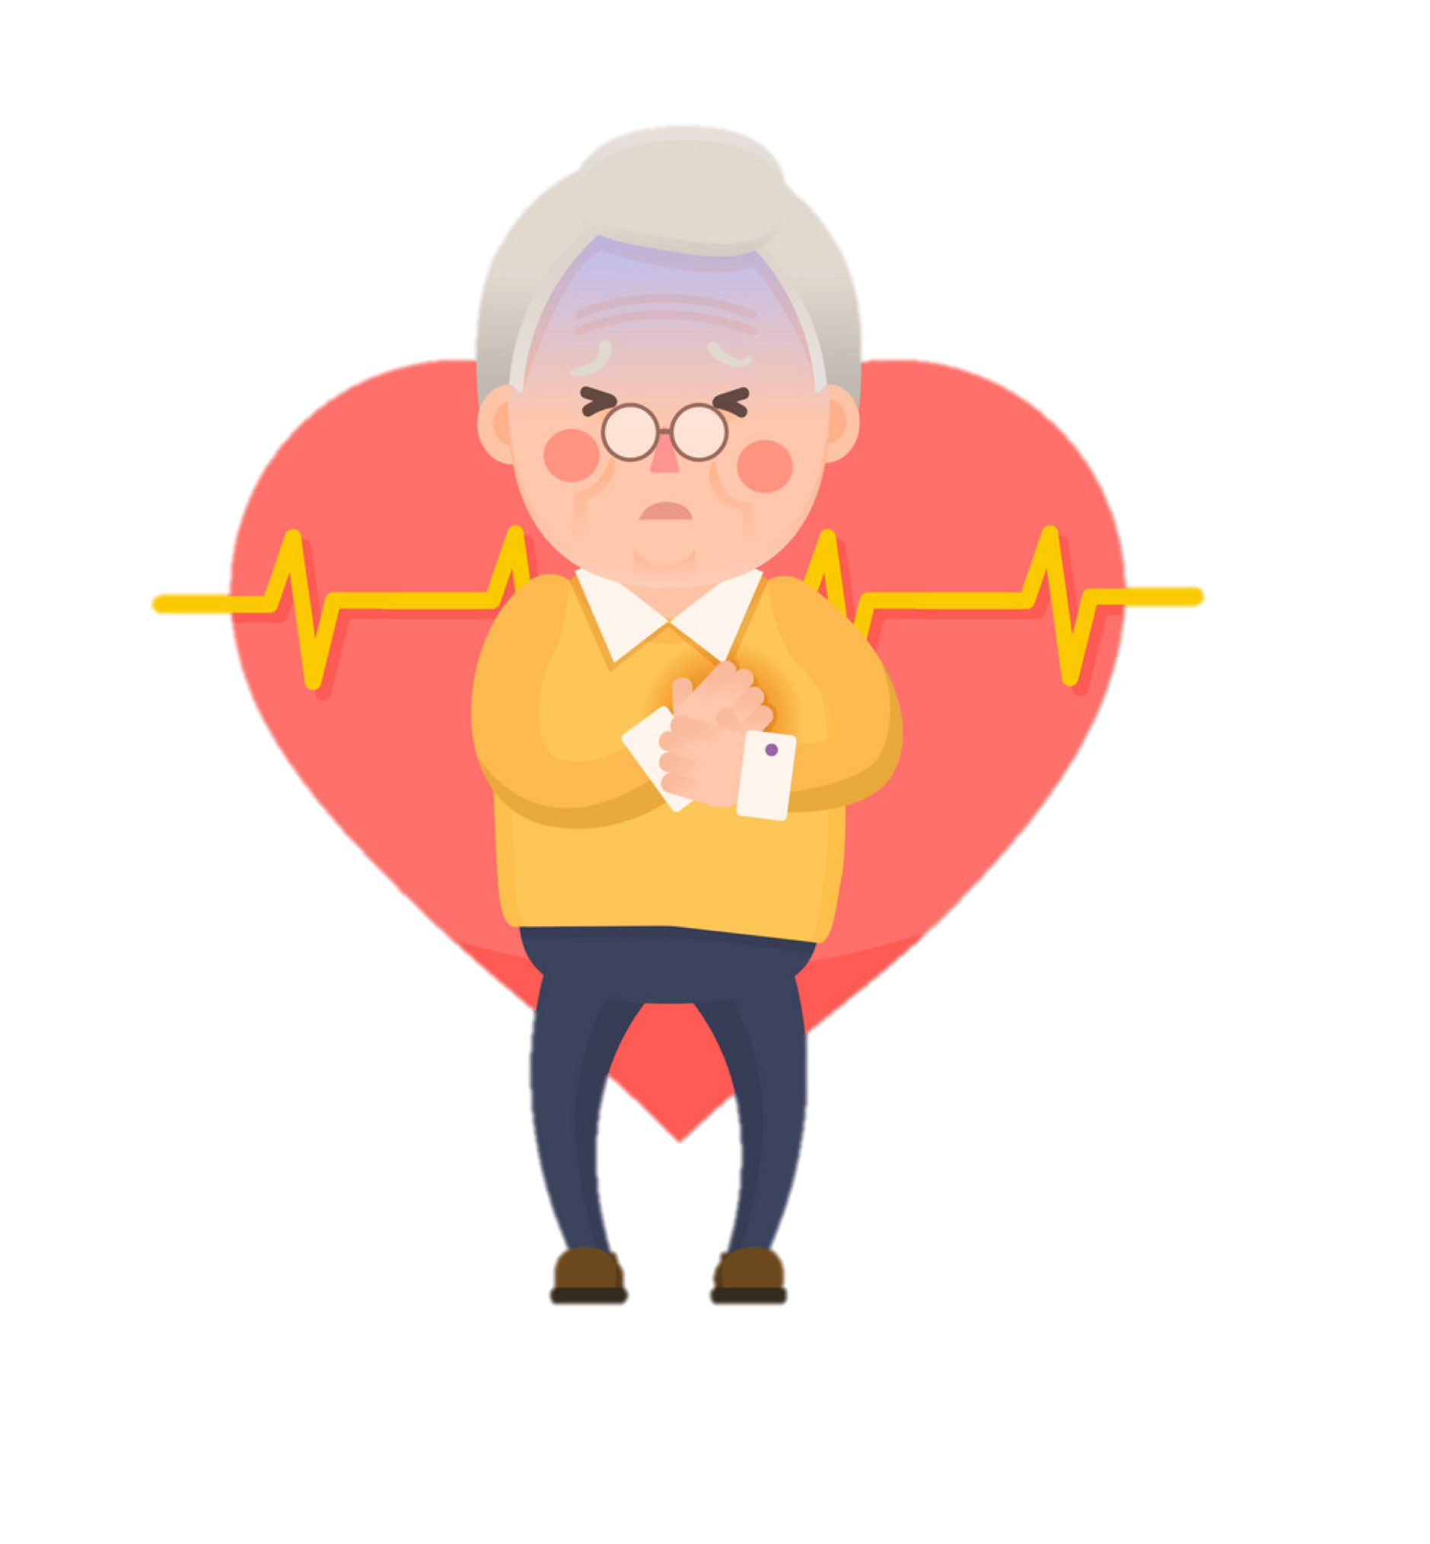
Common symptoms
chest pain
shortness of breath
orthopnoea
paroxysmal nocturnal dyspnoea
ankle oedema
cough, sputum, haemoptysis
presyncope - dizziness, lightheadedness
syncope
palpitations
nausea and sweating
claudication
fatigue
weight loss, anorexia
fever

Slide 6
Chest pain
Remember patient language and avoid using jargon when taking the history!
Site - central, midthorax, arm/shoulder, jaw, intrascapular
Onset - acute, chronicle
Character - crushing, tight, constricting, squeezing, burning, heaviness
Radiation - neck/jaw, L arm, shoulder
Associations - sweating, nausea, SOB, palpitations
Timing - on exertion, at rest
Exacerbation - exercise, excitement, stress, cold, after eating, smoking, lying flat
Alleviating factors - rest, medication, oxygen
Severity - pain scale
Notes:
Chest pain: typically central or left-sided (e.g. pericarditis) and may radiate to the left arm and jaw (e.g. acute coronary syndrome). In some cases, patients having a myocardial infarction may complain of neck pain rather than chest pain.
Dyspnoea: shortness of breath which may be exertional, related to lying down (orthopnoea) or wake the patient from sleep (paroxysmal nocturnal dyspnoea).
Palpitations: a sensation of a fast-beating, fluttering or pounding heart that may feel regular or irregular. It can be useful to ask the patient to tap out the rhythm to assess its regularity.
Syncope: rapid onset loss of consciousness (LOC) secondary to reduced cerebral perfusion. The LOC is typically short in duration with the patient recovering spontaneously. Syncope may be associated with sudden changes in posture (e.g. postural hypotension), exertion (e.g. aortic stenosis) or occur randomly (e.g. arrhythmia).
Oedema: fluid retention in the tissues which may be peripheral (e.g. pedal oedema) or central (e.g. sacral oedema). In the context of a cardiovascular history, the cause of oedema is most likely to be congestive heart failure or a side effect of medications such as amlodipine.
Intermittent claudication: muscle pain, typically in the calf, that develops during mild exertion and resolves upon resting. Intermittent claudication is caused by inadequate arterial supply secondary to peripheral vascular disease.
Systemic symptoms: these can include fatigue (e.g. congestive heart failure), fever (e.g. pericarditis, endocarditis), weight loss (e.g. endocarditis, atrial myxoma) and weight gain (e.g. congestive heart failure).

Slide 7
Factors against ischaemic pain
Knife like
sharp/stabbing pain, aggravated by breathing
Location
left submammary
left hemithorax
Exacerbations
after completion of exercise
specific body motion
Notes:
knife like, aggravated by breathing → PE

Slide 8
Risk factors for ischaemic heart disease
• Male sex
• Age
• Smoking
• Hypertension
• Diabetes mellitus
• Family history of IHD
• Hypercholesterolaemia
• Physical inactivity and obesity

Slide 9
Shortness of breath
Onset - acute, chronic, acute-on-chronic
Associations - sweating, nausea, pain, cough, sputum (watery, frothy, blood?), swollen calf or ankles, palpitations, nocturnal micturition, rapid weight gain (oedema?)
Timing - on exertion, rest, constant, at night
Exacerbating - position, number of pillows
alleviations - Rest, medications, oxygen, sitting up
severity - debilitating, impact on daily life, exercise tolerance
Hx of respiratory disease?

Slide 10
Questions for exercise tolerance
How far can you walk on the flat before needing to stop?
What limits how far you walk ( chest pain, leg pain, out of breath?)
Do you have SOB when walking up hills/stairs
How long ago did you notice this?
Has it gotten worse suddenly or gradually
What could you do previously

Slide 11
Palpitations
Have you had any palpitations? (funny feelings in your chest/heart racing/skipping a beat)
Does anything provoke this?
Does it start suddenly or build up gradually?
Does it stop suddenly or gradually, how long does it last?
Do you experience any other symptoms when this happens?
Can you describe or tap out the rhythm?

Slide 12
Dizziness and Syncope
Before → warning signs, circumstance, pre-ictal symptoms, headache?
During → duration, loss of consciousness, movement (floppy/fit), incontinence, tongue biting, complexion
After → amnesia, muscle pain/neck stiffness, fatigue, confusion, injuries
has is happened before? how frequent is it?
medication history
chest pain, palpitations, SOB/wheeze, cough, sputum, leg swelling
Notes:
cardio causes of syncope - postural hypotension (dizziness, from lying to standing), arrhythmias (palpitation, feels strange, during exercise, cardiac fhx), aortic stenosis (collapse on exertion, SOB on exertion)

Slide 13
medical history
similar episodes
previous diagnoses
treatments and response to treatment
previous surgery
hypertension
hypercholesterolemia
anaemia
diabetes
angina
MI
TIA
peripheral vascular disease
cardiac failure
rheumatic fever

Slide 14
Family history
history of…before age 65:
ischaemic heart disease
cerebrovascular event
diabetes
vascular events such as TIA, stroke
Thyroid disease, autoimmune disease

Slide 15
Drug history
Don't forget to ask about any known allergies or sensitivities
Antihypertensive drugs
Antiplatelets and anticoagulants
Over the counter medication such as aspirin, NSAIDs etc
Drugs with cardiac side effects
corticosteroids (HTN and fluid retention)
drugs causing sinus tachycardia (salbutamol, theophylline, nifedipine, thyroxine)

Slide 16
Social History
Smoking - pack years
Alcohol - units, how often
Recreational drug use
Occupation
Stress
Diet
Independance level
Notes:
alcohol can cause AF, cardiomyopathy, HTN and tachycardia

Slide 17
ICE
Ideas - does the patient have any ideas of what they think it is?
Concerns - what are the specifically worried about?
Expectations - what were they hoping to get out of the consultation today?

Slide 18
Tips
Keep a general structure to your history, but allow the patient to lead you in it
remember patient terminology, e.g. they may not class chest tightness as a pain
remember systemic enquiry and associated symptoms with each major condition to aid forming the differential diagnosis
Summarise as you go to help you stay on track, and also check you haven't missed anything at the end
Notes:
Remember that you only have 7 minutes. Some patients will be told to go off in tangents deliberately and give ‘irrelevant’ information, practice interrupting and keeping them on track. You are leading this consultation, not them.
I found it helpful to learn ‘tell tale signs’. They’re not really trying to trick you, so if you can recognise characteristic signs and symptoms of conditions it’ll make history taking and giving differentials much easier - every mark counts. Patients may throw a couple of red herrings in their histories so stay switched on and make sure to explore all differentials you can think of as a way to demonstrate your thought process and diagnose based on elimination.

Slide 19
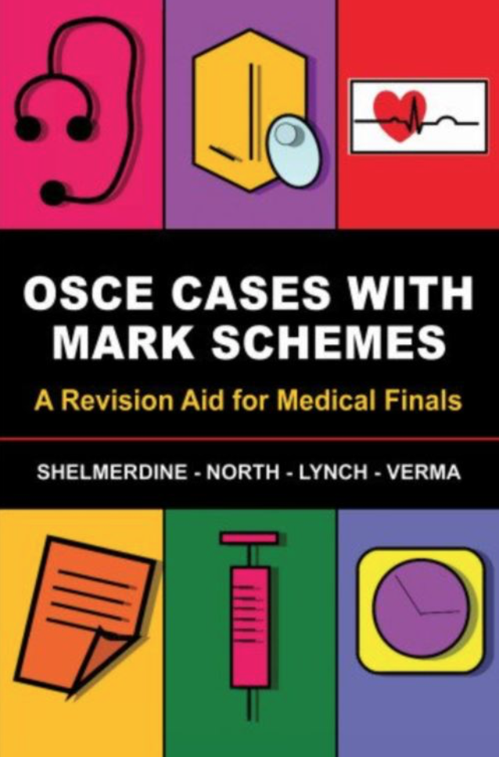
Thank you
Thank you for listening, any questions?
useful resources
Geeky medics for learning histories by system and examinations
‘almost a doctor’ website for histories by common symptom
‘OSCE cases with mark scheme’ practice book
placement and other students for practicing
OSCE stop for examinations and histories
The Peer Teaching Society is not liable for false or misleading information…

Slide 20
Feedback Form
https://forms.gle/cHG6DuxzDe1renS96
The Peer Teaching Society is not liable for false or misleading information…

