Slide 1
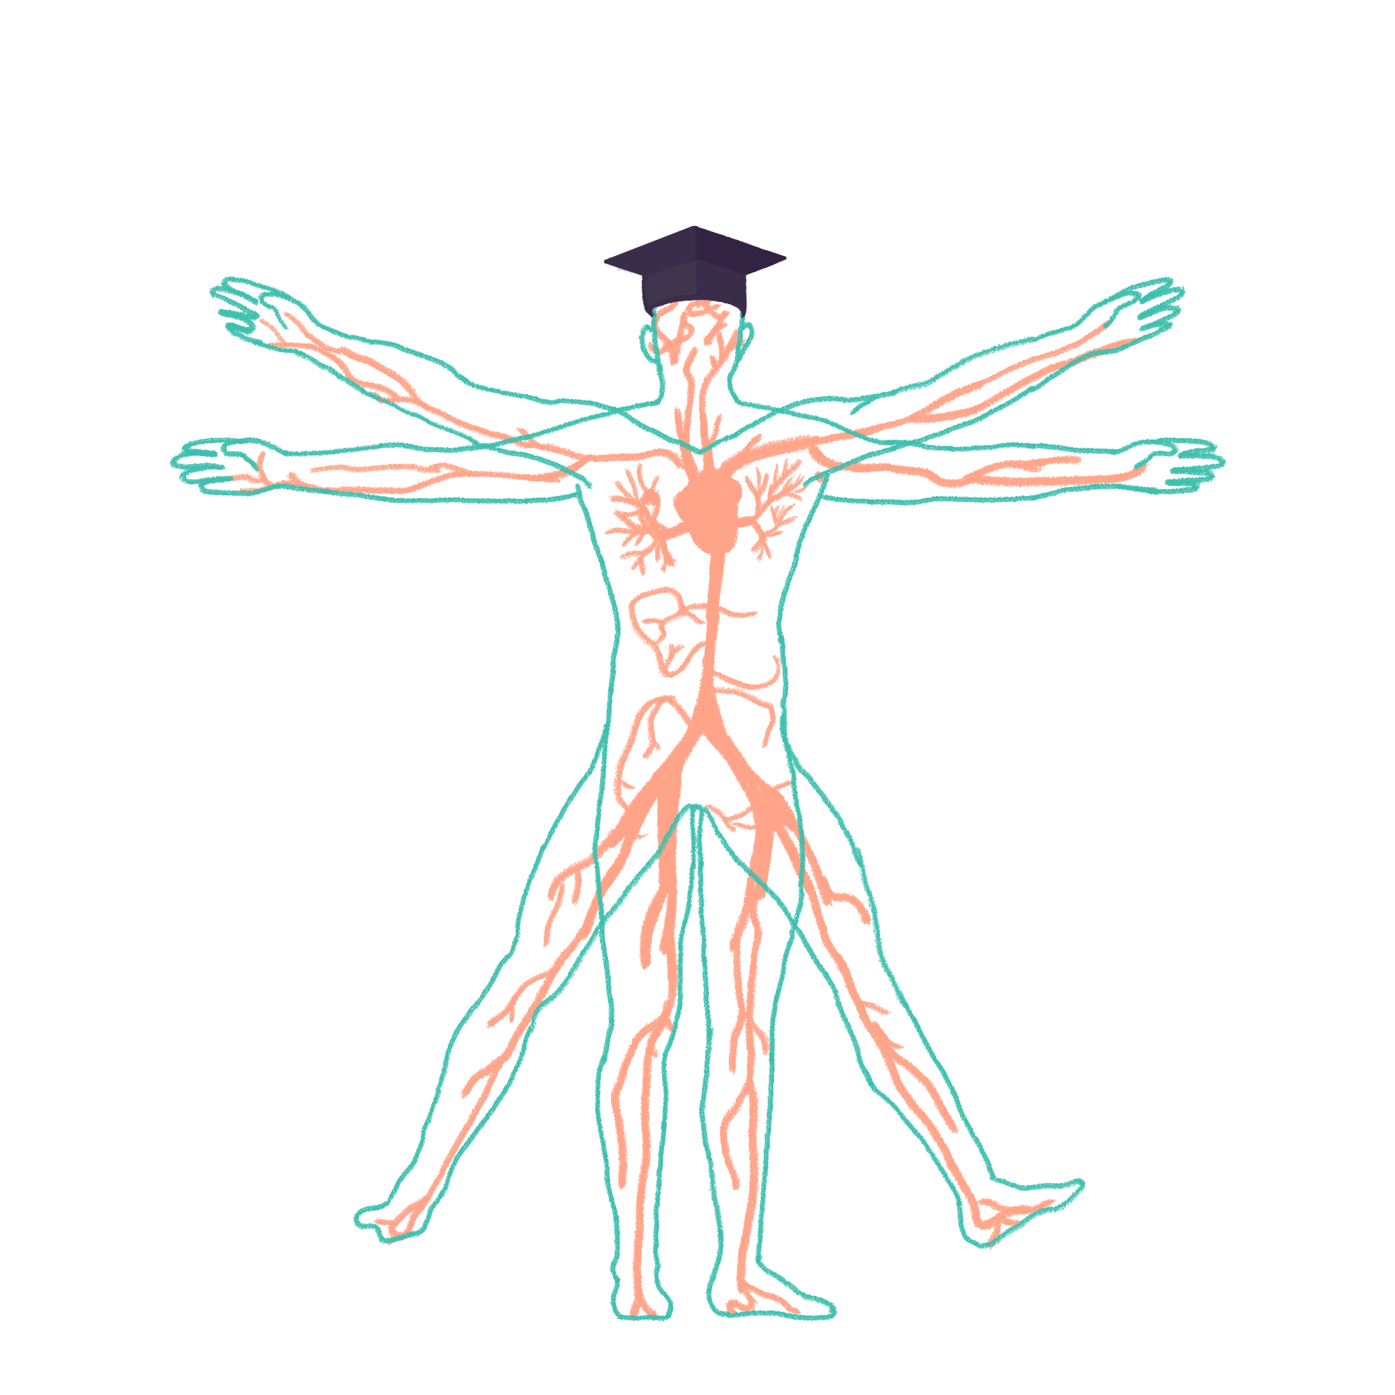
2023/2024

Slide 2
Cardio Session 1
Phase 1 Revision Session
Nicola Andrzejowska and Jemima Richenberg
26/10/23
6:30-7:30
The Peer Teaching Society is not liable for false or misleading information

Slide 3
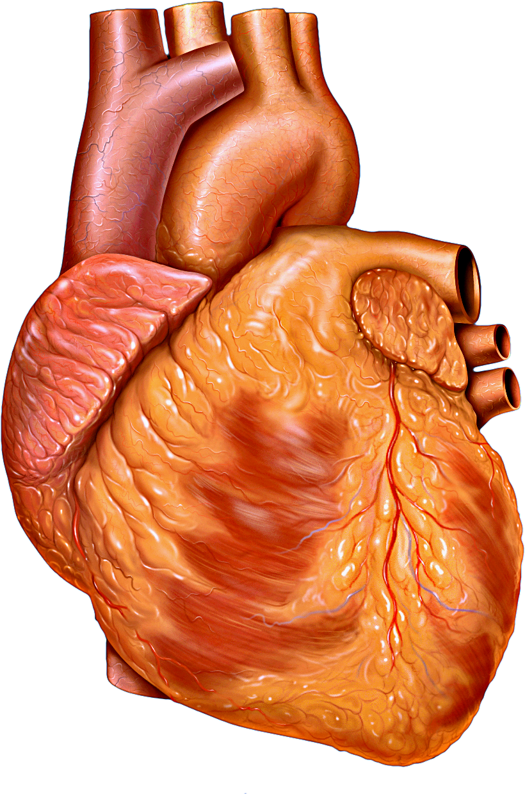
Aims and Objectives
This session aims to cover cardiovascular anatomy with relevance to blood physiology, looking at purpose, blood circulation and conducting systems.
The Peer Teaching Society is not liable for false or misleading information…

Slide 4
Anatomy:
o Thoracic cage: ribs, vertebrae, sternum and clavicles
o Pectoral muscles and serratus anterior
o Surface landmarks on the chest
o Dermatomes of the chest and innervation of the skin
o Anatomy and neurovascular supply of the breast
o Anatomy of the heart (chambers and vessels)
o Heart valves, papillary muscles, chordae tendinae
o Heart surfaces and borders
o Location of valve auscultations
o Fossa ovale and ligamentum arteriosum
o Coronary arteries and their supply territories
o Referred heart pain
o Location of conduction system (SAN, AVN ..)
o Pericardium
o Vagus and phrenic nerves and their pathways through the thorax and their diaphragm
piercings
o Aortic branches
o SVC (location and borders)
o Position of structures relative to the heart
o Aortic arches
o Venous drainage
Blood:
o Platelet biochemistry
o Clotting cascade
o Structures and functions of RBC, WBC and platelets
o Constituents of plasma proteins
o Blood groups and the Rhesus system
o Methods and alternatives to blood transfusions
Notes:
This is the section of the phase 1 syllabus we are aiming to cover and recap in order to try and provide you with a greater understanding. We will start with anatomy related to the chest with some embryology before moving onto anatomy specifically of the heart and finish with the blood physiology to try and keep the session engaging.

Slide 5
Aims and Objectives
Anatomy
Breast anatomy
Cardiovascular embryology
The passage of the vagus and phrenic nerves
Surface landmarks of the thorax
The Peer Teaching Society is not liable for false or misleading information…

Slide 6
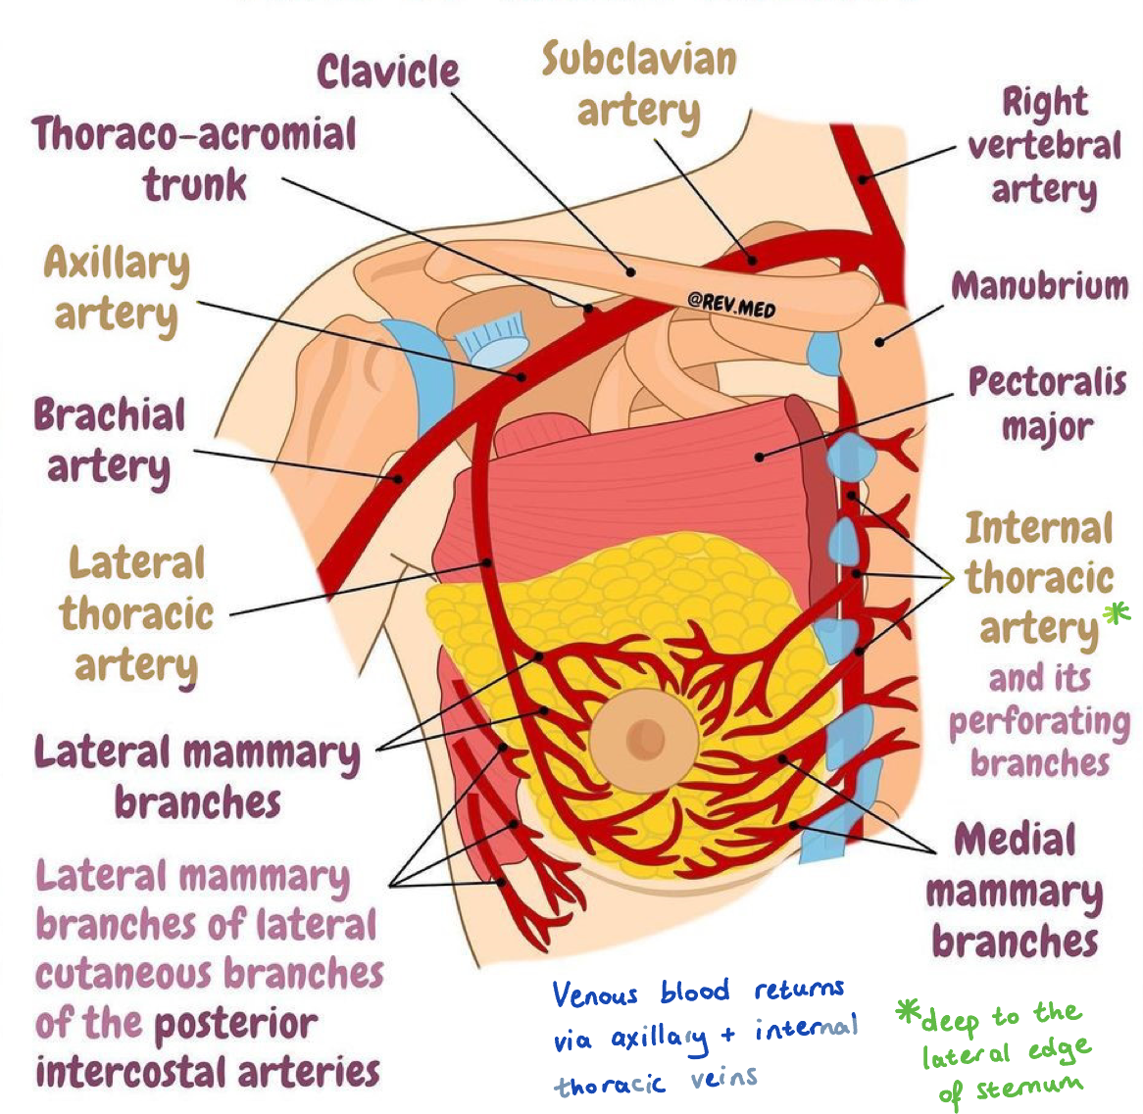
Breast anatomy: lymph nodes and blood vessels
5 axillary lymph nodes- apical receive lymph from all other nodes- usually involved in breast cancer metastasis- lymphoedema
Subclavian artery —> axillary artery —> lateral thoracic artery
Subclavian artery —> internal thoracic artery
The Peer Teaching Society is not liable for false or misleading information…
Notes:
Lymphoedema = upper limb swelling

Slide 7
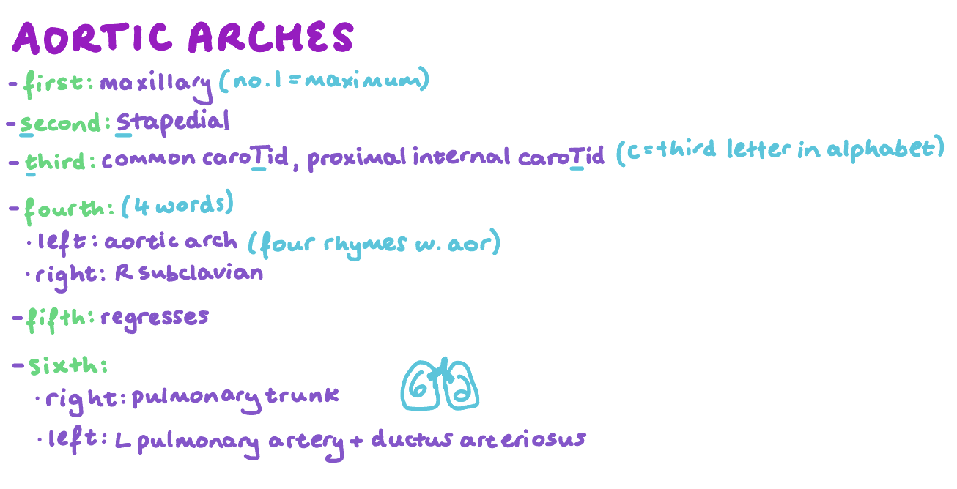
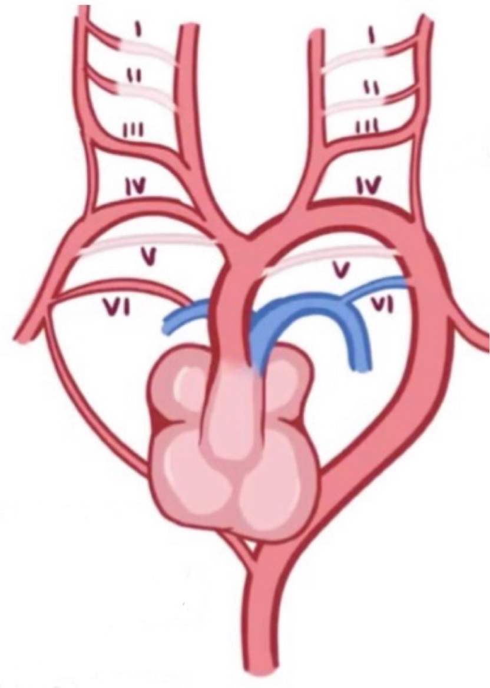
Cardiovascular embryology
The Peer Teaching Society is not liable for false or misleading information…

Slide 8
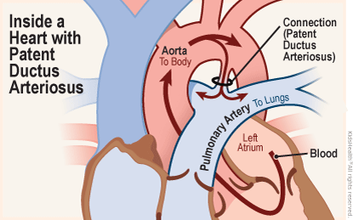
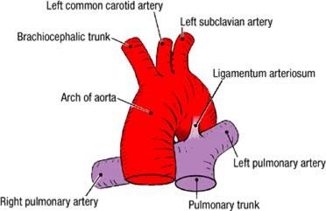
Cardiovascular embryology
The Peer Teaching Society is not liable for false or misleading information…
Notes:
1- to bypass the lungs. If it doesn’t become lig art then pulmonary hypertension- strains the right side of heart

Slide 9
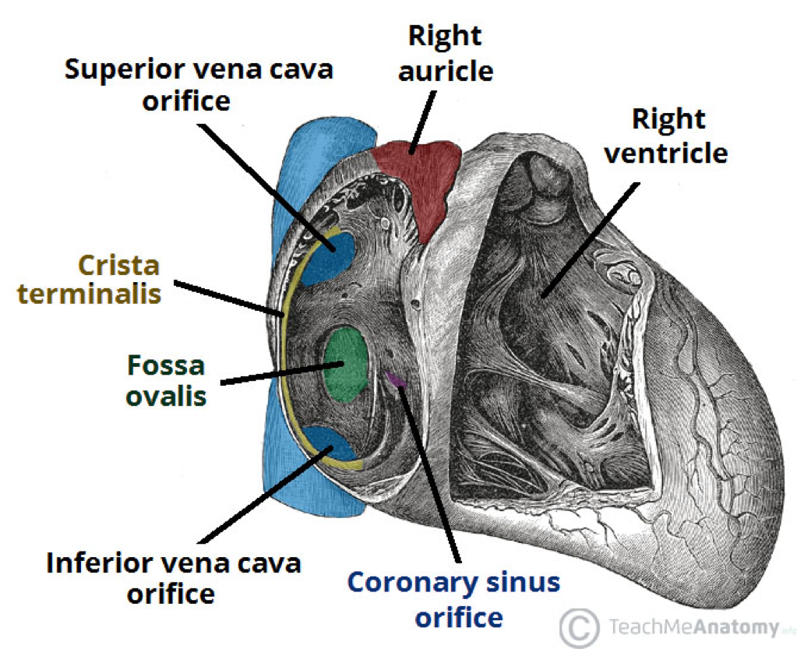
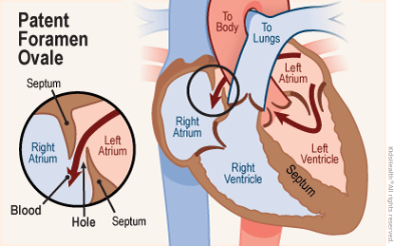
Cardiovascular embryology
The Peer Teaching Society is not liable for false or misleading information…
Notes:
1- shunts oxygenated blood from right atrium to left atrium to bypass the lungs in the foetus

Slide 10
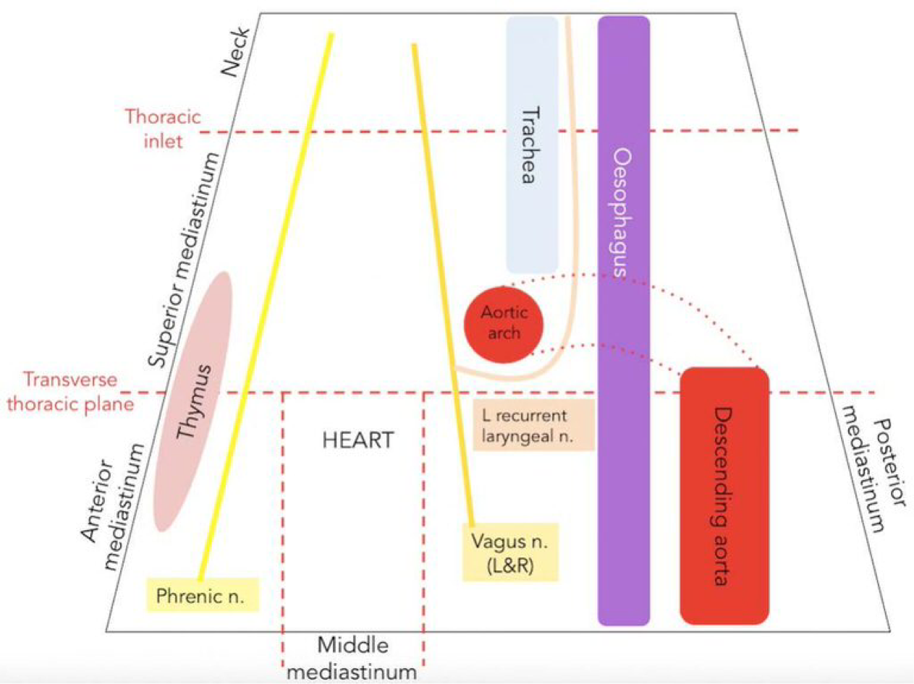
The passage of the vagus and phrenic nerves
Vagus nerve
Origin: brainstem
Descends in posterior mediastinum
Exits through diaphragm at: T10 alongside oesophagus (‘oesophaGUS = vaGUS = cranial nerve 10’)
The Peer Teaching Society is not liable for false or misleading information…

Slide 11
The passage of the vagus and phrenic nerves
Phrenic nerve
Origin: C3,4,5 (‘keeps the diaphragm alive’)
Descends in anterior mediastinum
Exits through diaphragm at:
- right: T8 alongside vena cava (‘8 letters’)
- left: separately
The Peer Teaching Society is not liable for false or misleading information…

Slide 12
Referred pain
The Peer Teaching Society is not liable for false or misleading information…

Slide 13
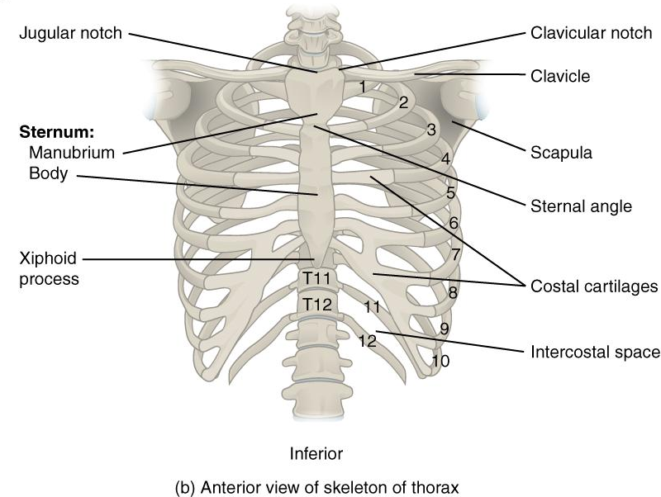
Surface landmarks of the thorax
Superior thoracic aperture: manubrium of the sternum, rib 1 and T1
Sternal angle: rib 2 attaches to the body of the sternum
Costal margin: ribs 7-10
The Peer Teaching Society is not liable for false or misleading information…

Slide 14
Anatomy practice questions
Which TWO of these are false?
A- There are 5 axillary lymph nodes
B- The fourth aortic arch regresses
C- The ductus arteriosus becomes the ligamentum arteriosum
D- The fossa ovalis becomes the foramen ovale
The Peer Teaching Society is not liable for false or misleading information…

Slide 15
Anatomy practice questions
Which TWO of these are false?
A- There are 5 axillary lymph nodes
B- The fourth fifth aortic arch regresses
C- The ductus arteriosus becomes the ligamentum arteriosum
D- The fossa ovalis becomes originates from the foramen ovale
The Peer Teaching Society is not liable for false or misleading information…

Slide 16
Anatomy practice questions
Which TWO of these are false?
A- The sternal angle is used to palpate the first rib
B- The phrenic nerve originates from C3-5
C- The phrenic nerve descends in the posterior mediastinum
D- The right phrenic nerve branch enters the diaphragm via T8 alongside the aorta
E- An ischaemic myocardium presents as chest pain
The Peer Teaching Society is not liable for false or misleading information…

Slide 17
Anatomy practice questions
Which TWO of these are false?
A- The sternal angle is used to palpate the first rib
B- The phrenic nerve originates from C3-5
C- The phrenic nerve descends in the posterior anterior mediastinum
D- The right phrenic nerve branch enters the diaphragm via T8 alongside the aorta vena cava
E- An ischaemic myocardium presents as chest pain
The Peer Teaching Society is not liable for false or misleading information…

Slide 18
Anatomy practice questions
Where does the vagus nerve:
A- originate?
B- travel- which mediastinum?
C- enter the diaphragm- spinal level and alongside what?
The Peer Teaching Society is not liable for false or misleading information…

Slide 19
Anatomy practice questions
Where does the vagus nerve:
A- originate? Brainstem- it is a cranial nerve
B- travel- which mediastinum? Posterior mediastinum
C- enter the diaphragm- spinal level and alongside what? T10 alongside the oesophagus
‘oesophaGUS = vaGUS = cranial nerve 10’
The Peer Teaching Society is not liable for false or misleading information…

Slide 20
Aims and Objectives
Anatomy
Thoracic cage: ribs, vertebrae, sternum and clavicles
Pectoral muscles and serratus anterior
Anatomy of the heart (chambers and vessels)
Heart valves, papillary muscles, chordae tendinae
Heart surfaces and borders
Location of valve auscultations
Coronary arteries and their supply territories
Location of conduction system (SAN, AVN ..)
Pericardium
SVC (location and borders)
Venous drainage

Slide 21
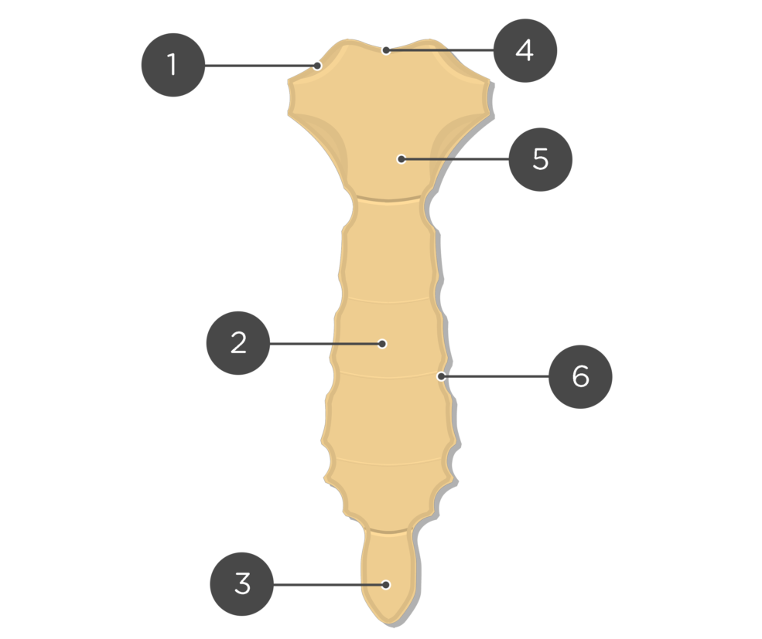
Thoracic cage: Sternum
Clavicular Notch
articulation points for the clavicle
Jugular/ Suprasternal Notch
Manubrium
Question:
What vertebral level is the Manubrosternal joint?
Bonus question:
What is the name of this angel?
Manubrosternal Joint
7
T4
Angle of Louis/ Sternal Angle
Body
Costal Notch
depressions on both sides of the sternum where the costal cartilages articulate
Xiphisternal Joint
8
Xiphoid Process (Xiphisternum)
The Peer Teaching Society is not liable for false or misleading information…
https://www.getbodysmart.com/ribs-and-sternum/sternum-bone-anatomy/
Notes:
The sternum lies anteriorly in the midline of the thoracic cage and is composed of 3 parts.
The angle of Louis is the division between superior and inferior mediastinum.

Slide 22
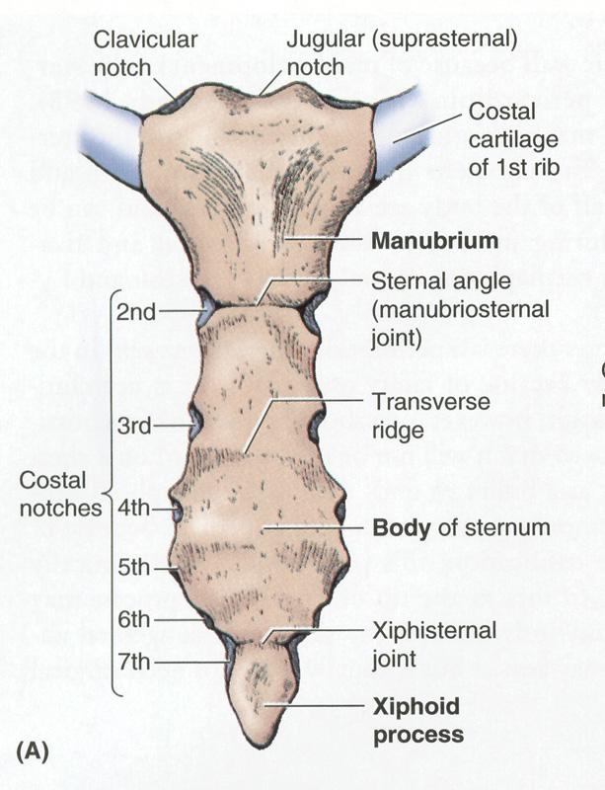
For Revision/ recap after the session:
https://wp.stu.ca/forensicscience/ribs-sternum/

Slide 23
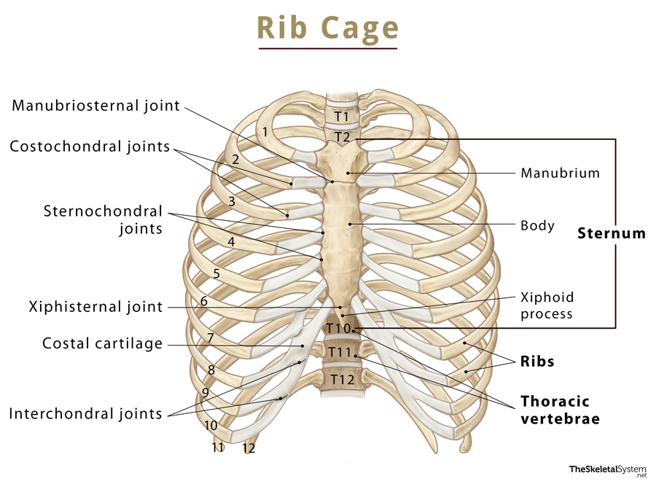
Thoracic cage: Ribs and Clavicles
How many pairs of ribs do we have?
We have 12 pairs of ribs which form the anterior, lateral and posterior wall of the thoracic cage.
3 joints associated with the anterior thoracic cage:
Sternoclavicular joint: where clavicle and sternum articulate Sternocostal Joint: where the costal cartilage of ribs 1-7 articulate directly with the sternum
Costochondral Joints: where the ribs and costal cartilage articulate
Which ribs comprise the COSTAL MARGIN?
Ribs 7-10
Which ribs are the TRUE RIBS?
Ribs 1-7
Which ribs are the FALSE RIBS?
Ribs 8-10
Which ribs are the FLOATING RIBS?
Ribs 11 and 12
The Peer Teaching Society is not liable for false or misleading information…
Notes:
The costal cartilage of ribs 7-10 are palpable and can be felt at the bottom of your rib cage.
Ribs 1-7 are the true ribs since they articulate directly with the sternum.
Ribs 8-10 unite and join with the costal cartilage of the 7th rib but do not articulate with the sternum directly, hence do not form a sternocostal joint.
Ribs 11 and 12 don’t articulate with the sternum at all.

Slide 24
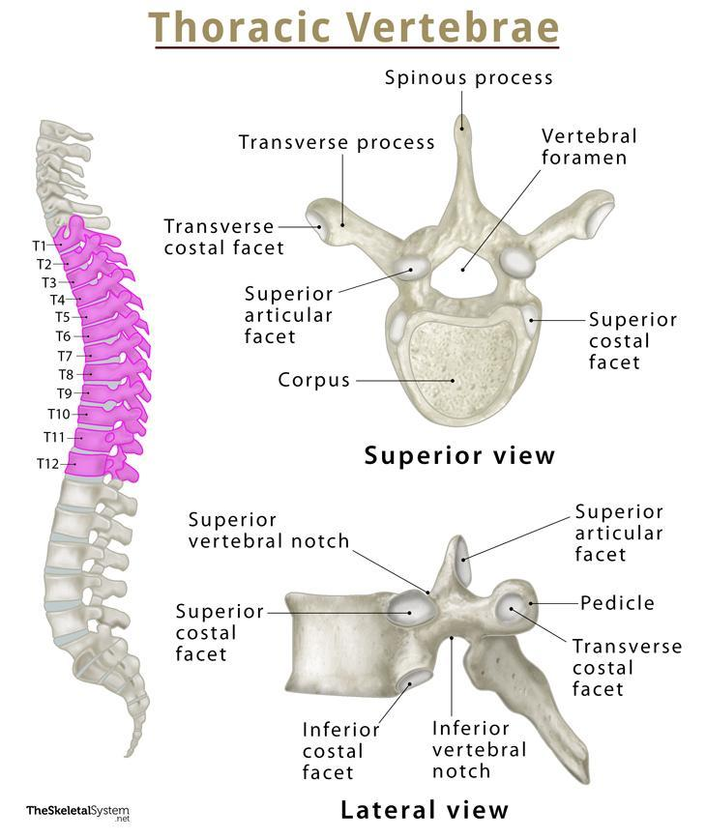
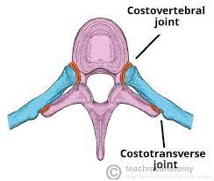
Thoracic cage: Vertebrae
What is the name of the joint between the thoracic vertebrae and the posterior part of the rib?
COSTOVERTEBRAL joint:
The HEAD of the RIB articulate with the vertebral BODY
COSTOTRANSVERSE joint:
The TUBERCLE of the rib articulate with the TRANSVERSE PROCESS of the vertebrae
T11 and T12 do not have costovertebral joints since ribs 11 and 12 are FLOATING!
Body
Transverse process
spinous process
Notes:
https://www.theskeletalsystem.net/spine-vertebral-column/thoracic-vertebrae.html
https://teachmeanatomy.info/thorax/bones/thoracic-spine/
Transverse process has a facet for the rib to articular to.

Slide 25
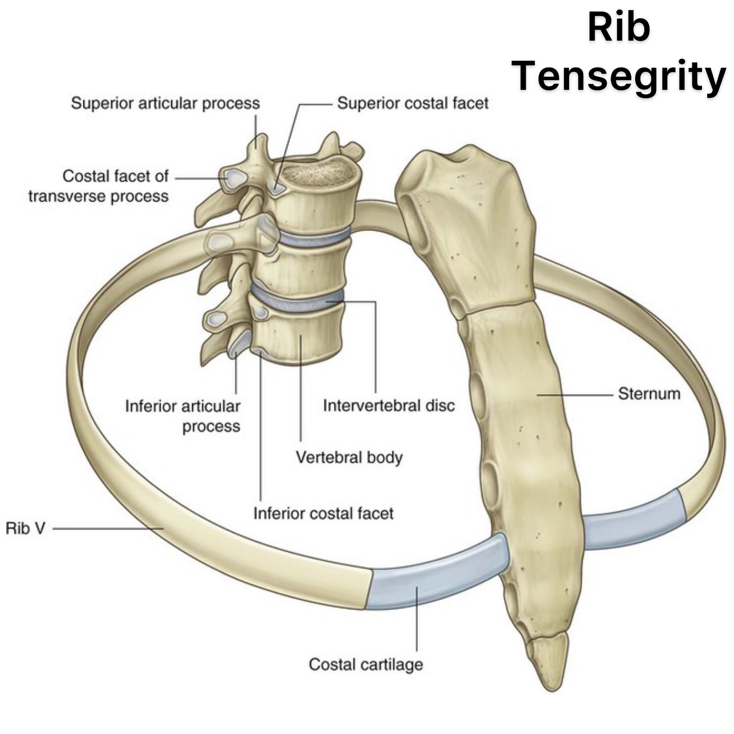
For Revision:

Slide 26
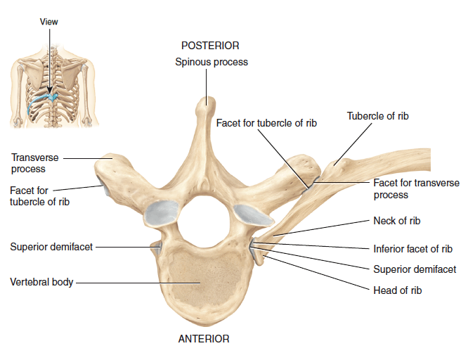
For Revision:
Notes:
https://quizlet.com/491289451/posterior-view-of-left-ribs-articulated-with-thoracic-vertebrae-and-sternum-diagram/

Slide 27
Muscles of the chest wall
In between each rib is an intercostal space. What are the 3 intercostal muscles?
External
Internal
Innermost
Superficial muscle, fibres are orientated anteroinferiorly, active during inspiration (contraction pulls ribs superiorly)
Middle layer, fibres oriented posteroinferiorly, active on expiration (contraction pulls muscles inferiorly)
Fibres oriented posteroinferiorly
Where is the neurovascular bundle found?
What comprises the neurovascular bundle?
Between the internal and innermost layer
Intercostal Vein, Intercostal Artery, Intercostal Nerve
Notes:
The neurovascular bundle is found in each intercostal space and supplies the intercostal muscles, overlying skin and underlying parietal pleura. It is along the inferior border of the rib superior in the space.

Slide 28
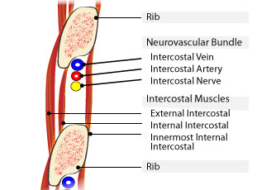
Notes:
https://csds.qld.edu.au/sdc/Provectus/Paediatric%20Trauma/Skill%20Sessions/Airway%20and%20breathing/unit-04012012124609217407/flash/paedTr_s04_m01_p50_intercostal/paedTr_s04_m01_p21_intercostal.html

Slide 29
Anterior Pectoral Girdle
For Revision as you will return to this in MSK:
Name | Origin | Insertion | Function | Innervation
Pectoralis major | Sternum Clavicle Upper 6 ribs | Intertubercular groove of humerus | Adduct & flex humerus Internal rotation | Medial pectoral Lateral pectoral
Pectoralis minor | Ribs 3-5 | Coracoid process of scapula | Protracts and depresses scapula | Lateral pectoral
Serratus anterior | Ribs 1-8 | Medial boarder of scapula | Protraction of scapula anteriorly and inferiorly | Long thoracic nerve (C5-C7) Pneumonics: [SALT] [C5, 6,7 raise your arms to heaven)
Notes:
when learning muscles learn name and what it looks like but also origin, insertion, what it does and which nerve innervates it (where relevant) as sometimes questions might be phrased as which muscle origiinates from (eg ribs 3-5)? rather than a pin in the muscle and asking which muscle it is. you will come back to this in MSK but worth familiarizing yourself now if you have time!

Slide 30
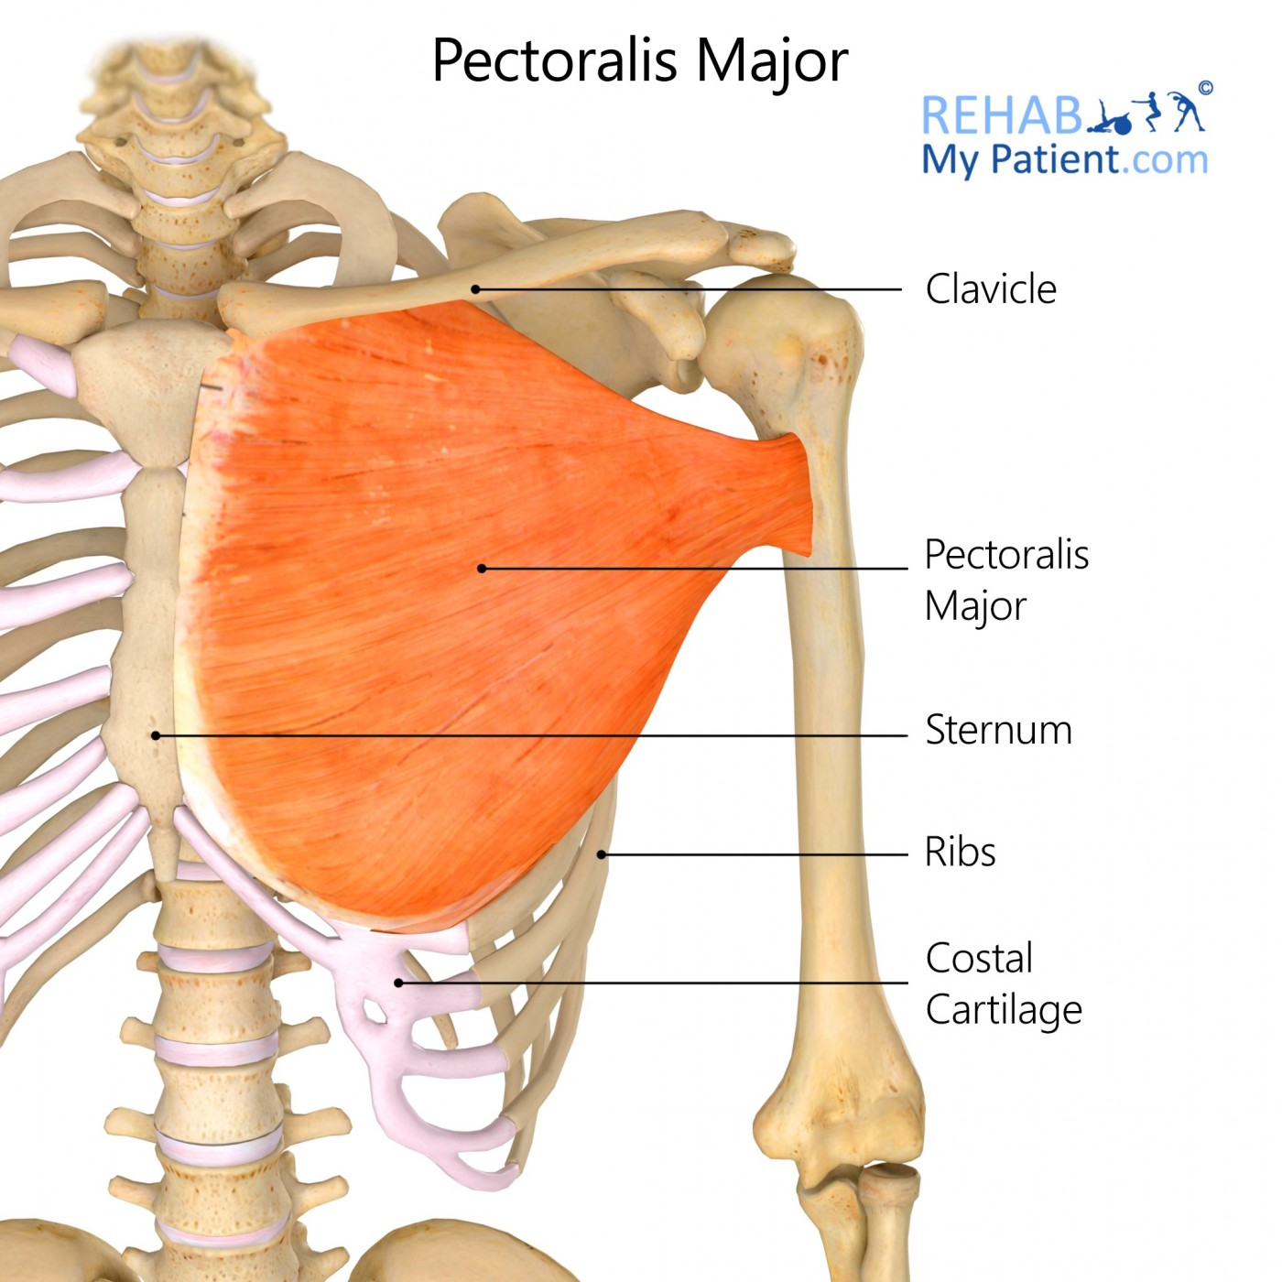
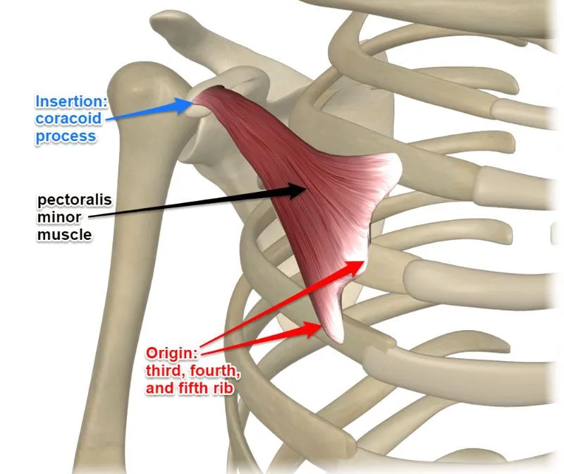
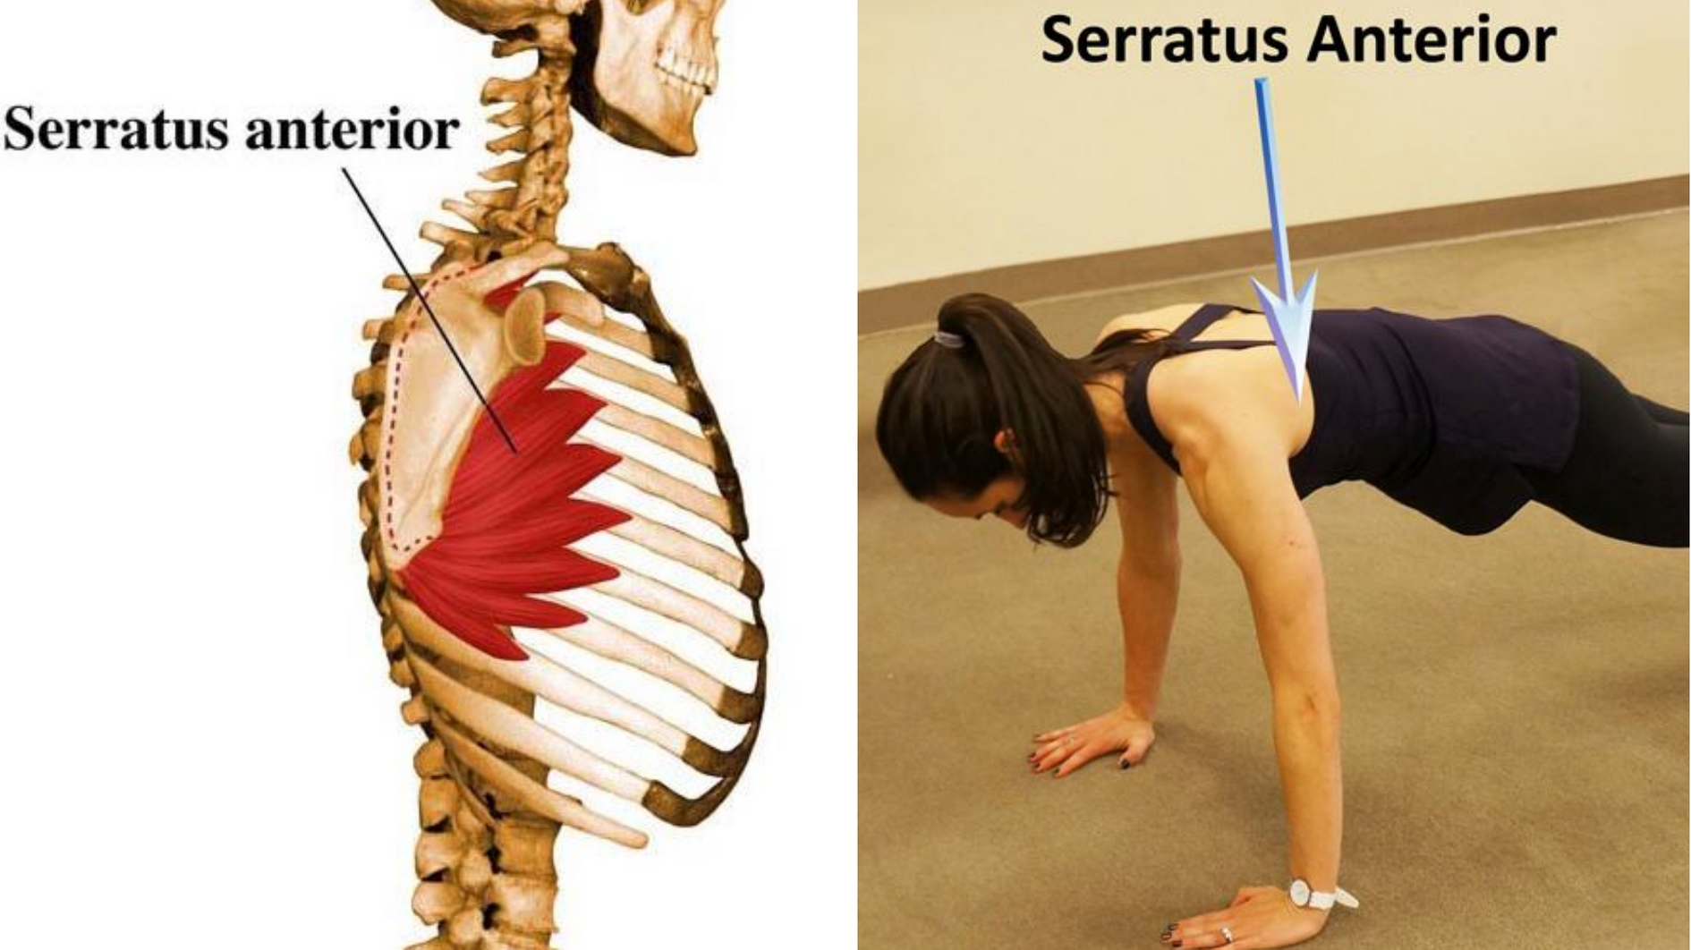
Notes:
https://www.rehabmypatient.com/shoulder/pectoralis-major
https://www.yoganatomy.com/pectoralis-minor-muscle/
https://barmethod.com/blog/the-most-neglected-muscle-during-exercise-the-serratus-anterior/

Slide 31
https://www.theskeletalsystem.net/rib-cage
Notes:
To sumarise the rib cage is made of the sternum which is composed of 3 parts. The sternum articulates with the first 7 ribs (true ribs) at the sternocostal angle but in total we have 12 ribs. The 12 thoracic vertebrae, T1-T12, articulate with the ribs at the posterior of the rib cage at the costovertebral joint, which functions to add support to the rib cage. The intercostal space between each rib is composed of 3 layers of muscle- external, internal and innermost which are involved in inhalation and exhalation. The 1st intercostal space is located between the 1st and 2nd ribs.

Slide 32
Content covered so far!!!
o Thoracic cage: ribs, vertebrae, sternum and clavicles
o Pectoral muscles and serratus anterior
o Surface landmarks on the chest
o Dermatomes of the chest and innervation of the skin
o Anatomy and neurovascular supply of the breast
o Anatomy of the heart (chambers and vessels)
o Heart valves, papillary muscles, chordae tendinae
o Heart surfaces and borders
o Location of valve auscultations
o Fossa ovale and ligamentum arteriosum
o Coronary arteries and their supply territories
o Referred heart pain
o Location of conduction system (SAN, AVN ..)
o Pericardium
o Vagus and phrenic nerves and their pathways through the thorax and their diaphragm
piercings
o Aortic branches
o SVC (location and borders)
o Position of structures relative to the heart
o Aortic arches
o Venous drainage

Slide 33
Pericardium
The outermost layer surrounding the heart, consists of the fibrous and serous pericardium which is further divided into parietal and visceral .
Fibrous sac consisting of a layer of squamous mesothelial cells resting on a thin layer of connective tissue
Parietal pericardium: layer of cells than line the inner surface of the fibrous sac containing the heart
Visceral pericardium: layer on outer surface of the heart
Pericardial space= a potential space containing approx. 10ml serous fluid
The Peer Teaching Society is not liable for false or misleading information…

Slide 34
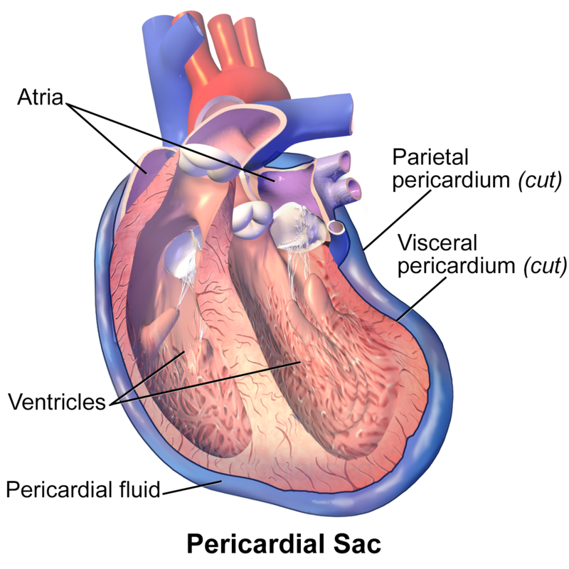
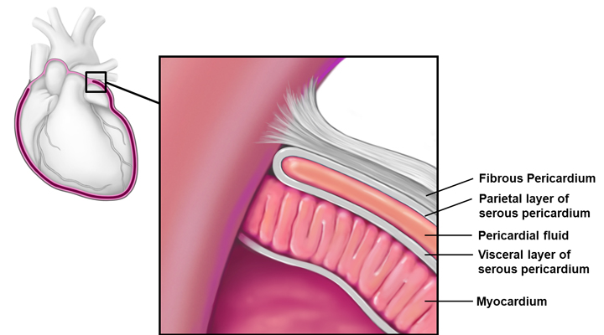
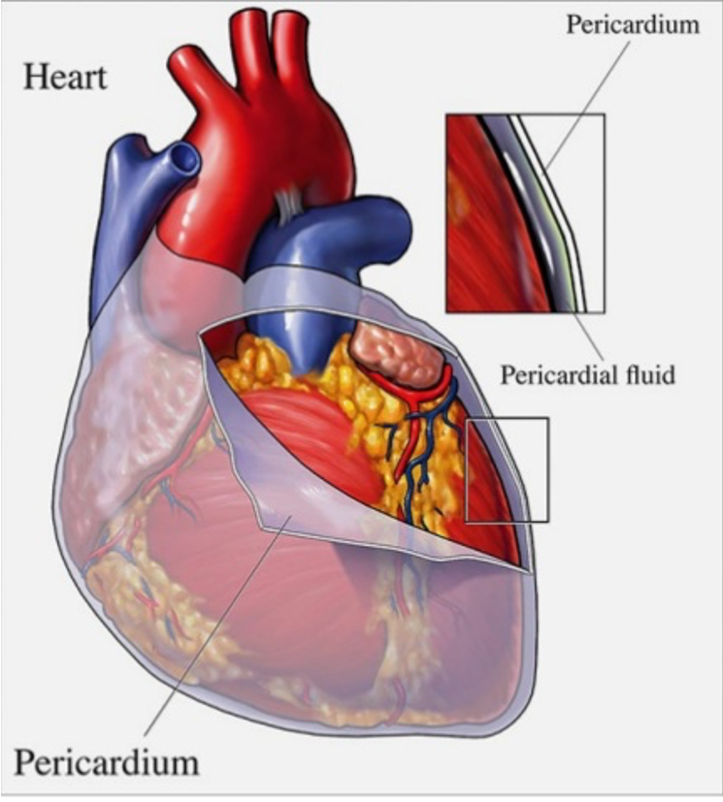
https://media.springernature.com/lw685/springer-static/image/chp%3A10.1007%2F978-3-319-71617-6_18/MediaObjects/128962_2_En_18_Fig1_HTML.jpg
https://www.cardiosurgeon.co.uk/wp-content/uploads/2021/01/Pericardium.png
https://upload.wikimedia.org/wikipedia/commons/thumb/7/78/Blausen_0724_PericardialSac.png/250px-Blausen_0724_PericardialSac.png

Slide 35
What are the other layers surrounding the heart?

Slide 36
The heart wall
Epicardium
Myocardium
Endocardium
Layer of white fatty connective tissue that contains the coronary blood vessels and nerves
thickest layer of the heart comprising of specialised cardiac muscle and where the conducting system is located
innermost layer; thin layer of fibrous connective tissue. Covers the valves.
The Peer Teaching Society is not liable for false or misleading information…

Slide 37
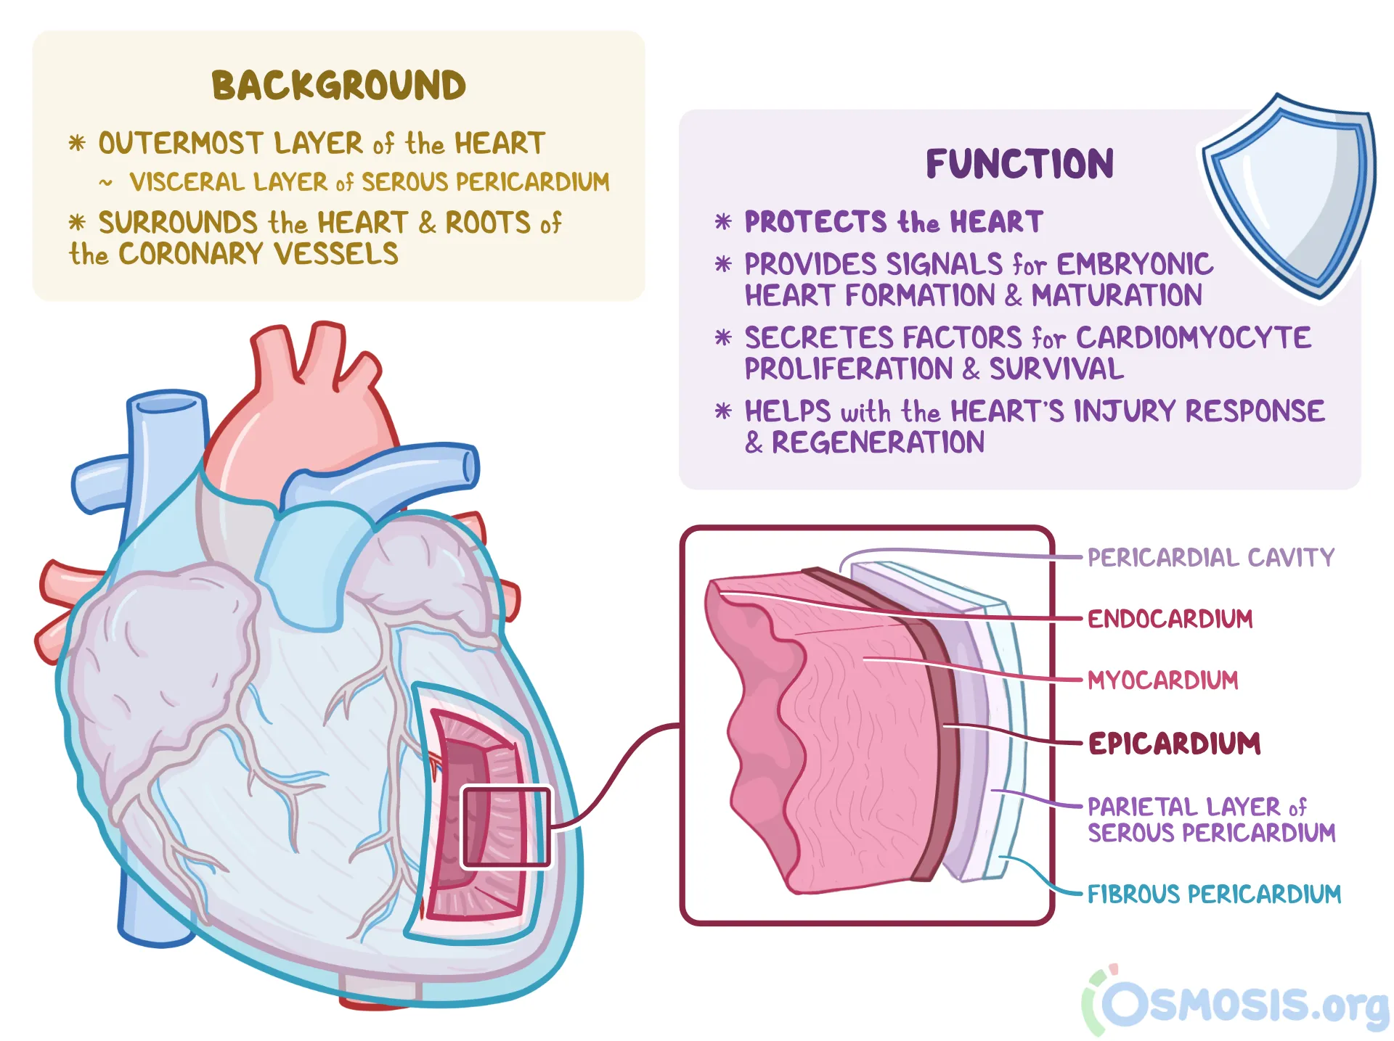
Notes:
https://www.osmosis.org/answers/epicardium

Slide 38
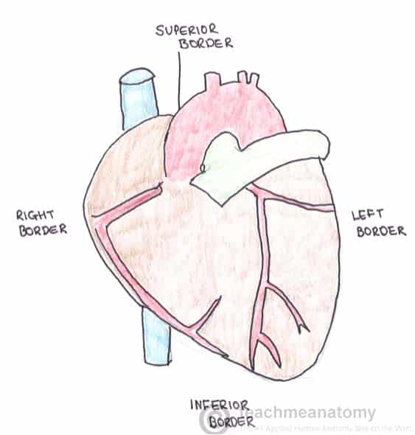
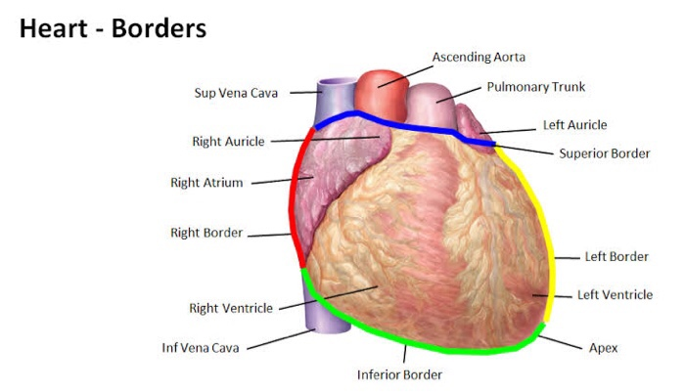
Borders of the Heart
Right border=
Left border=
inferior border=
superior border=
Right atrium
Left ventricle (and a bit of the left atrium
left and right ventricle
Right and left atrium, great vessels
The Peer Teaching Society is not liable for false or misleading information…
Notes:
Importance of understanding anatomical position of heart!!!

Slide 39
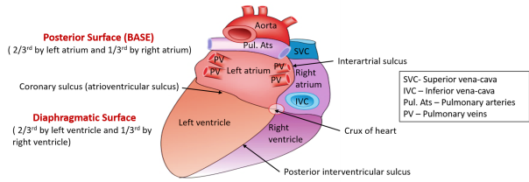
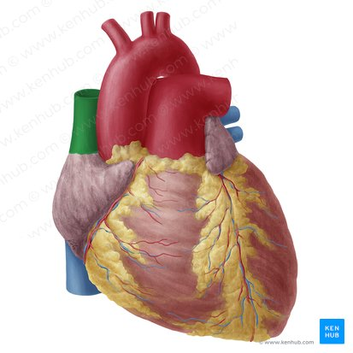
Surfaces of the Heart
The Peer Teaching Society is not liable for false or misleading information…
Notes:
Heart is described in a pyramidal shape with the apex being in an anterior-inferior direction.
In anatomical orientation there are 5 surfaces of the heart.
heart sits between lung lobes so has 2 pulmonary surfaces, and is above the diaphragm hence diaphragmatic surface

Slide 40
Q. Where is the apex of the heart located?

Slide 41
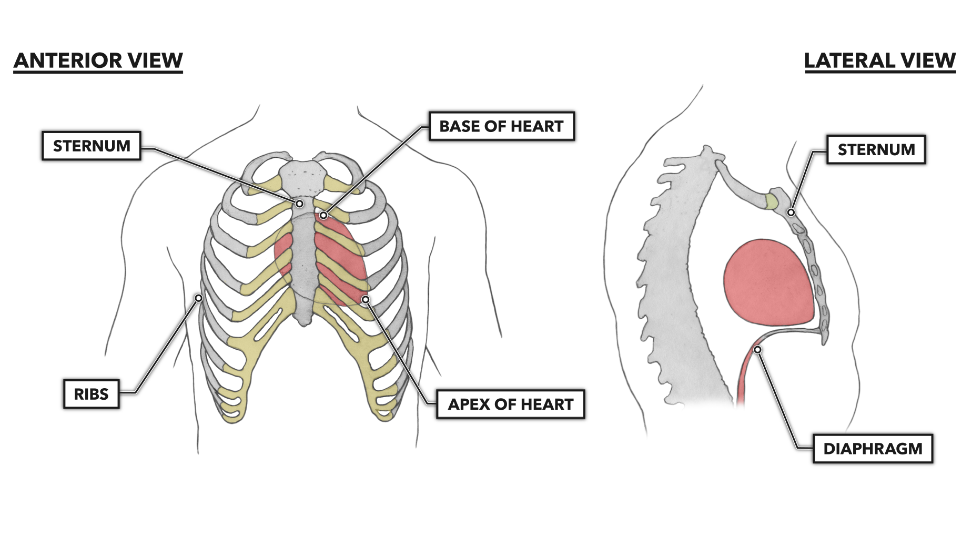
Q. Where is the apex of the heart located?
The 5th Intercostal space on the Left hand side
Notes:
https://www.crossfit.com/wp-content/uploads/2020/07/24115616/CF_Heart_Orient_front.png

Slide 42
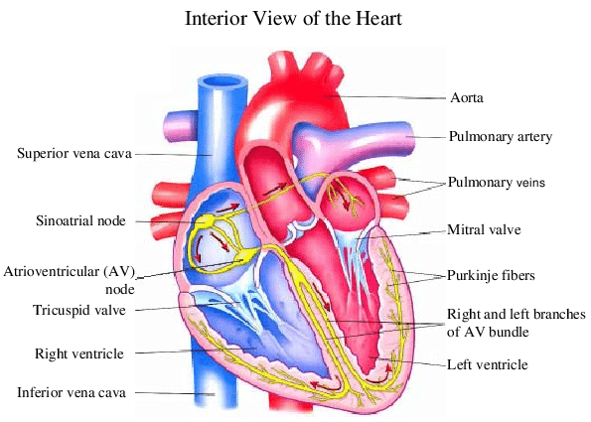
o Anatomy of the heart (chambers and vessels)
The Peer Teaching Society is not liable for false or misleading information…
Notes:
when learning anatomy, link to function, particularly with ant heart. Eg SVC come from head and neck, to RA, carry deox blood.→ know where it’s coming from, whether blood is deoxygenated or oxygenated and where it is going to
Conducting system in yellow
Vessels: SVC and IVC which bring de-oxygenated blood back to the heart to enter the right atrium
The pulmonary artery carries deoxygenate blood from the right ventricle to the lungs to be oxygenated. this oxygenated blood returns to the left atrium via the pulmonary veins to be pumped out of the left ventricle to the rest of the body via the aorta.
Mitral valve separates the left atrium from the left ventricle- also called the bicuspid valve.

Slide 43
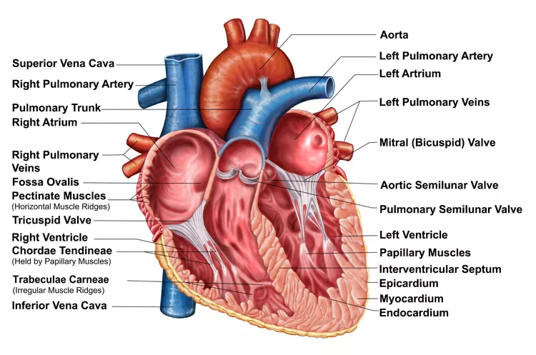
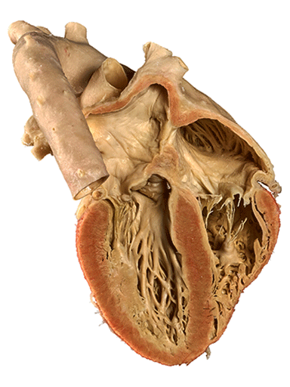
o Heart valves, papillary muscles, chordae tendinae
The Peer Teaching Society is not liable for false or misleading information…
Notes:
https://www.thoughtco.com/the-heart-wall-4022792
https://www.vonhagens-plastination.com/pages/medical-teaching-specimens/von-hagens-plastination.php/silicone-plastinates-sub-cardiovascular-system-overview
papillary muscles= within ventricles, attach to cusps of AV valves via chordae tendineae and contract to prevent prolapse of valves on systole
Trabeculae carnae= irregular muscle ridges on ventricles that contract to prevent inversion of the valves
Chordae tendinae= thread like tendons of papillary muscles that insert on AV valves

Slide 44
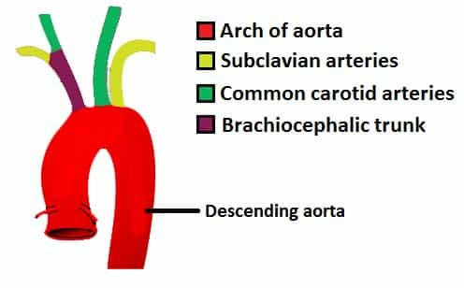
Aortic Branches
30 second challenge to draw out aortic arch and its branches!!!
At which vertebral level does the aortic arch end?
T4- angle of Louis
What is the first branch of the aortic arch?
Left and Right coronary arteries
The Peer Teaching Society is not liable for false or misleading information…

Slide 45
What are the main branches of the left and right coronary artery?
Quick thinking activity !

Slide 46
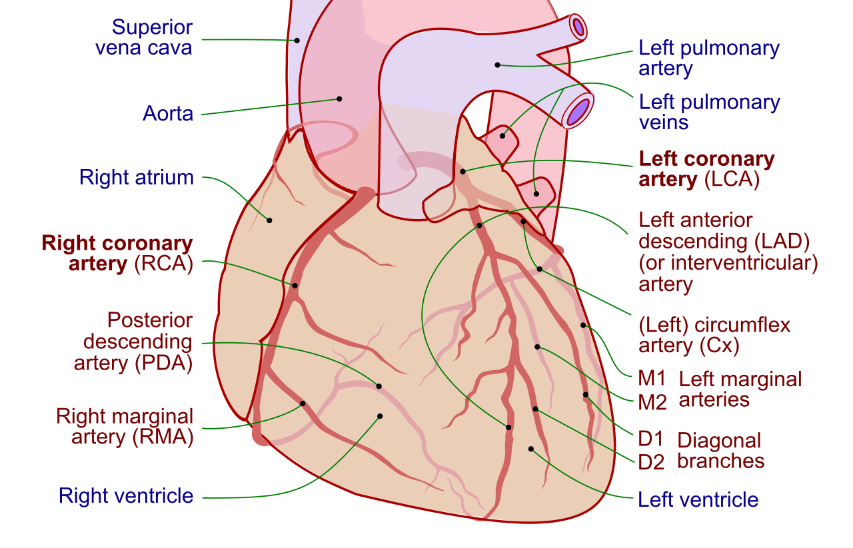
o Coronary arteries
orientate the heart; surfaces, aorta, SVC, IVC, Pulmonary veins, pulmonary arteries
Identify the LCA and RCA
Identify the branches from the coronary arteries
When thinking about coronary arteries think about their purpose and which teroties they supply!
The Peer Teaching Society is not liable for false or misleading information…
Notes:
identify anterior, diaphragmatic, base, L and R pulmonary surfaces; find the apex and place it in anatomical position (Q. identify chambers of the heart- which ones can we see here?)
Q. where is the aorta, SVC, pulmonary artery, pulmonary vein (when identifying think of where they enter/exit and what their function is)
Q. where are the LCA and RCA?
branches of LCA?
branches of RCA?

Slide 47
o Coronary arteries and their supply territories
Right Coronary artery=
R atrium and R ventricle
R marginal= R ventricle and apex of heart
PIV= posterior ⅓ interventricular septum
and AV node
Left coronary artery:
LAD
Circumflex
LAD= anterior 2/3rd interventricular septum, Right and Left ventricle
L Cx= L atrium, L ventricle
L Marginal= L ventricle
The Peer Teaching Society is not liable for false or misleading information…
Notes:
IMPORTANT TO LEARN

Slide 48
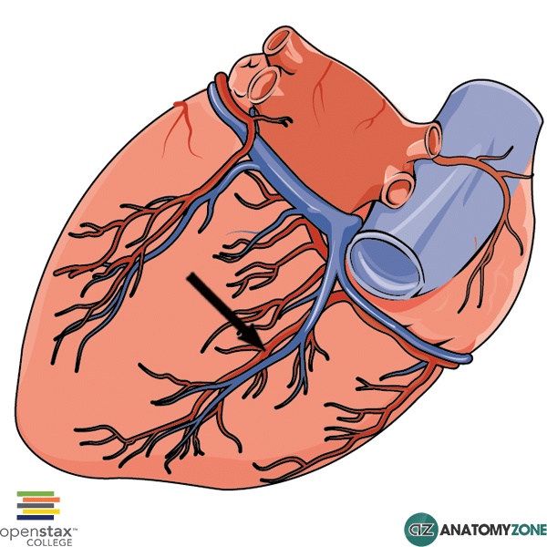
Dominance
Dominance of the heart is determined by whether the LCA or RCA supply the PIV artery, which runs along the posterior interventricular sulcus to the apex of the heart.
RCA only in 70% of people
LCA only in 10% of people
RCA and LCA in 20% people
What % of people does the RCA supply the PIV artery?
90%
The Peer Teaching Society is not liable for false or misleading information…
Notes:
https://anatomyzone.com/wp-content/uploads/2015/01/Posterior-Interventricular-Artery.png

Slide 49
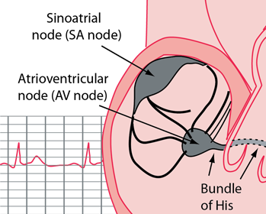
Conducting System
SAN:
60% of people=RCA
40% of people=LCA
Which artery supplies the AVN?
Posterior Interventricular Artery
SAN and AVN are both located in the right atrium. SAN is present near the opening of SCV along the sulcus terminalis and the AVN is near the tricuspid valve on the interatrial septum.
The Peer Teaching Society is not liable for false or misleading information…
Notes:
http://hyperphysics.phy-astr.gsu.edu/hbase/Biology/sanode.html
% refer to proportion of people

Slide 50
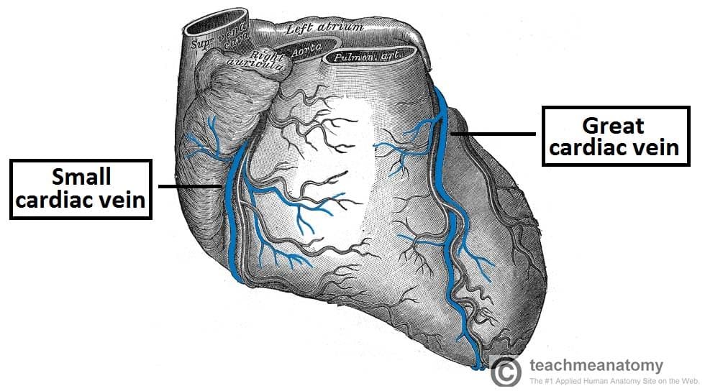
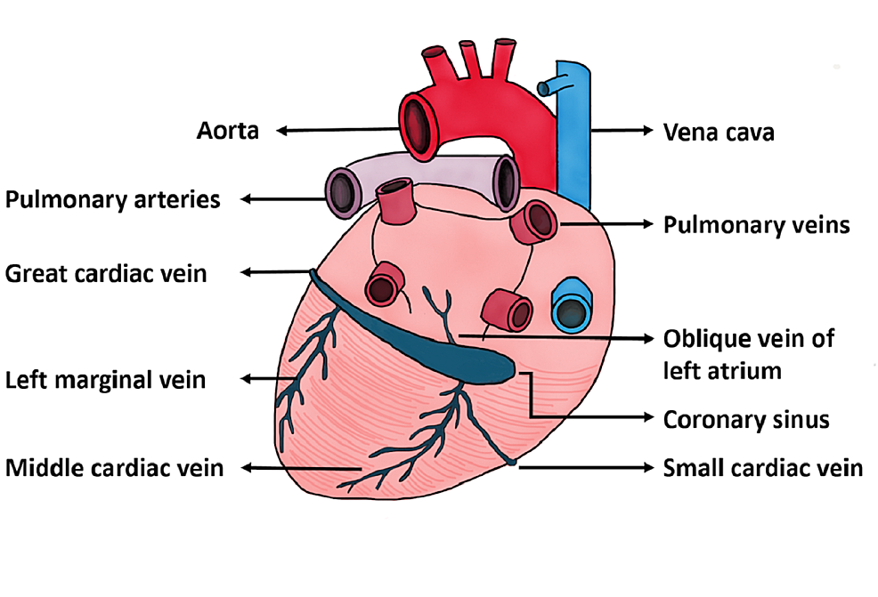
Venous drainage
The coronary sinus drains directly into the the right atrium!
The Peer Teaching Society is not liable for false or misleading information…
Notes:
Small cardiac vein/ anterior cardiac vein is to the left at the fron
Great cardiac vein is at the front
Middle cardiac vein is at the back

Slide 51
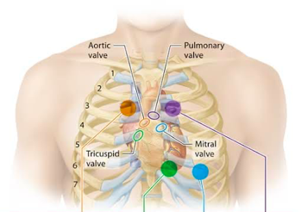
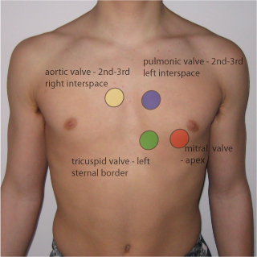
o Location of valve auscultations
For private revision:
Valve auscultations refer to the sound of the valve cusps snapping shut.
As we have 4 valves, there are 4 sites to hear heart sounds:
Think about the names of the 4 valves and where they are located?
Aortic valve:
pulmonary valve:
tricuspid valve:
mitral valve:
2nd intercostal space,right side of the sternum
2nd intercostal space, left side of the sternum
5th intercostal space, lower-left of sternum
5th intercostal space, mid-clavicular line
The Peer Teaching Society is not liable for false or misleading information…
Notes:
Think about the names of the 4 valves and where they are located?

Slide 52
Questions
Why are incisions made in the middle to lower part of the intercostal space?
The Peer Teaching Society is not liable for false or misleading information…

Slide 53
Answer
Why are incisions made in the middle to lower part of the intercostal space?
To avoid the neurovascular bundle which is found at the superior part of the intercostal space
The Peer Teaching Society is not liable for false or misleading information…

Slide 54
Questions
Which of the following is false regarding cardiac muscle?
It is striated
It has intercalated discs
It is multinucleated
Nucei are central
The Peer Teaching Society is not liable for false or misleading information…

Slide 55
Answer
Which of the following is false regarding cardiac muscle?
It is striated
It has intercalated discs= unique to cardiac muscle
It is multinucleated → only skeletal muscle!
Nuclei are central
Cardiac muscle is striated, each myocyte has one central nuclei
- Intercalated discs are specialised connections between myocytes in CARDIAC muscle, they join individual myocytes together to form long and branching chain so cardiac muscles is also branched
The Peer Teaching Society is not liable for false or misleading information…

Slide 56
Questions
An occlusion in which coronary artery is most likely to be fatal?
The Peer Teaching Society is not liable for false or misleading information…

Slide 57
Answer
An occlusion in which coronary artery is most likely to be fatal?
LCA:
Since it branches into the Cx and LAD which supplies
left output to the body
The Peer Teaching Society is not liable for false or misleading information…

Slide 58
What have we covered so far?
o Thoracic cage: ribs, vertebrae, sternum and clavicles
o Pectoral muscles and serratus anterior
o Surface landmarks on the chest
o Dermatomes of the chest and innervation of the skin
o Anatomy and neurovascular supply of the breast
o Anatomy of the heart (chambers and vessels)
o Heart valves, papillary muscles, chordae tendinae
o Heart surfaces and borders
o Location of valve auscultations
o Fossa ovale and ligamentum arteriosum
o Coronary arteries and their supply territories
o Referred heart pain
o Location of conduction system (SAN, AVN ..)
o Pericardium
o Vagus and phrenic nerves and their pathways through the thorax and their diaphragm
piercings
o Aortic branches
o SVC (location and borders)
o Position of structures relative to the heart
o Aortic arches
o Venous drainage
Blood:
o Platelet biochemistry
o Clotting cascade
o Structures and functions of RBC, WBC and platelets
o Constituents of plasma proteins
o Blood groups and the Rhesus system
o Methods and alternatives to blood transfusions

Slide 59
What are the constituents of blood?

Slide 60
5 litres in the human body
-RBC = 43%
-WBC and platelets= 1%
-Plasma= 56%

Slide 61
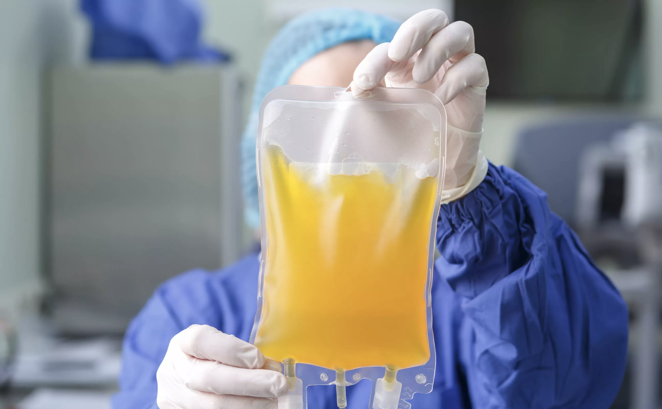
Plasma
Fluid = blood without the cells
salts
proteins: Albumin (oncotic pressure), Globilis (ImG), fibrinogen
Hormones
coagulation/clotting factors
minerals
water
Definition of blood serum?
Blood serum= Blood plasma without the clotting factors
The Peer Teaching Society is not liable for false or misleading information…
Notes:
https://centromedicoabc.com/wp-content/uploads/2022/12/plasma-sanguineo.jpg

Slide 62
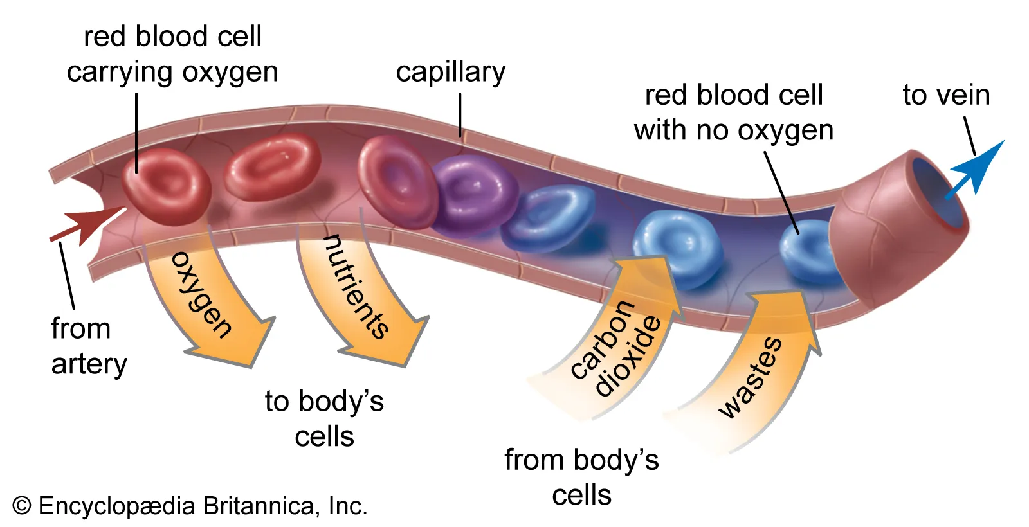
o Structures and functions of RBC
Erythrocytes:
Lifespan=
shape=
function=
protein=
produced=
destroyed=
Hormone involved in erythropoiesis=
The Peer Teaching Society is not liable for false or misleading information…
Notes:
https://cdn.britannica.com/08/92808-050-E1894C1B/Cross-section-capillary.jpg

Slide 63
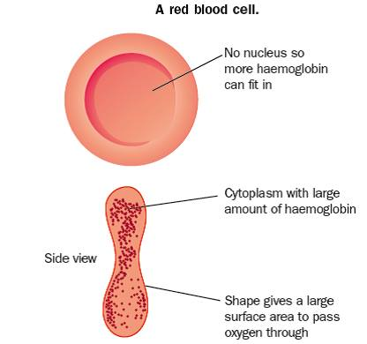
o Structures and functions of RBC
Erythrocytes:
Lifespan= 4 month
shape= anucleate, biconcave
Function= O2/CO2 carrier
protein= haemoglobin (2 beta and 2 alpha chains, Haeme, Fe2+
produced= liver in fetus, bone marrow-Adults: Erythropoiesis occurs in certain bones, including pelvis, vertebrae, ribs and breastbone, children: all bone marrow
destroyed =liver and spleen
Hormone involved in erythropoiesis= Erythropoietin
What is the word for the ratio of volume of RBCs to total volume of blood?
Haematocrit
The Peer Teaching Society is not liable for false or misleading information…
Notes:
So if someone lost 500ml blood- haematocrit level doesn't change despite there being fewer number of RBC as RBC lost in proportion to total vol
https://revisionworld.com/sites/revisionworld.com/files/imce/Blood%202.jpg

Slide 64
Structure and Function of WBC
Leucocytes:
Granulocytes= innate immune response
Agranulocytes= adaptive immune response
granulocytes → Neutrophil, Eosinophil, Basophil
Agranulocye→ lymphocytes and monocytes
Plateles- cell fragments found in bone marrow
Which WBC is the commonest?
The Peer Teaching Society is not liable for false or misleading information…

Slide 65
Granulocytes
Neutrophils: (most common)
Multi-lobed
granular cytoplasm
phagocytic
Which granulocytes increases in number in parasitic infection?
Eosinophils
Eosinophils:
tri-lobed
large, red cytoplasmic granules
phagocytic, receptor for IgE, neutralise histamine
Basophils:
bi-lobed
blue staining cytoplasmic granules containing histamine
release histamine, prevent coagulation, receptors for IgE
The Peer Teaching Society is not liable for false or misleading information…
Notes:
E makes a 3 = Tri-lobed
Bi-lobed Basophil (alliteration to remember)

Slide 66
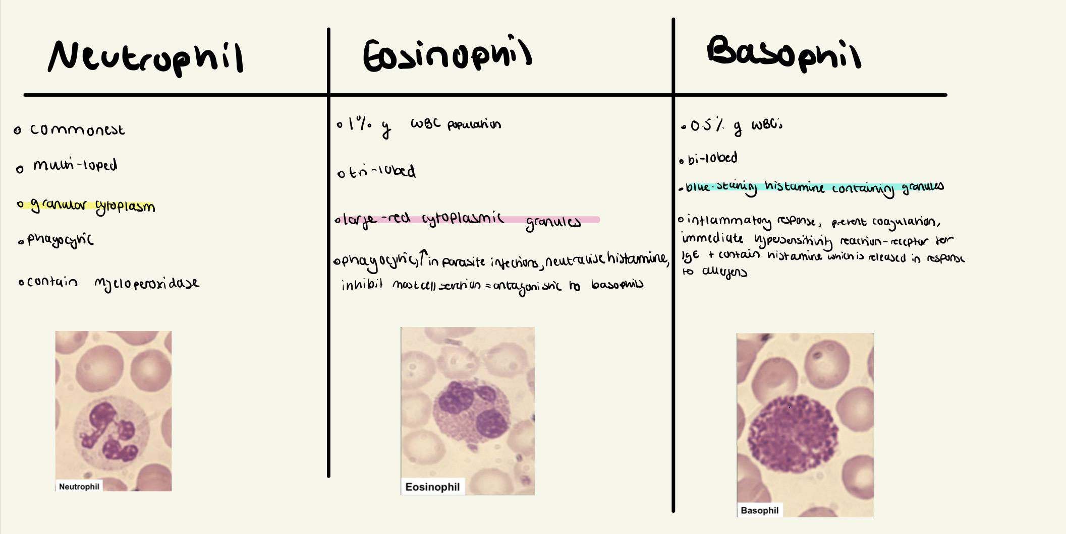

Slide 67
Agranulocytes
lymphocytes:
B cells→ become plasma cells, secret antibodies,
T cells → Helper, Cytotoxic, Suppressor, Natural Killer
Monocytes:
immature
monocyte within blood differentiates into macrophages in tissue
differentiate:
-Tissue macrophage
-Kupffer cells (Liver)
-Osteoclasts (bone)
-APC
-Alveolar macrophages (lung
The Peer Teaching Society is not liable for false or misleading information…
Notes:
T- cell-mediated immunity
B- humoural response

Slide 68
Aims and Objectives
Physiology
Platelets and haemostasis
Blood groups and the rhesus system
The Peer Teaching Society is not liable for false or misleading information…

Slide 69
Platelets and haemostasis
Size: anucleate, 2-4uM
Lifespan: 7-10 days
Origin: thrombopoesis from megakaryocytes
Activation: shape change from smooth discoid to spiculated with pseudopodia to increase surface area
Haemostasis
Primary- forms temporary platelet plug
Secondary- coagulation cascade forms permanent fibrin clot
The Peer Teaching Society is not liable for false or misleading information…

Slide 70
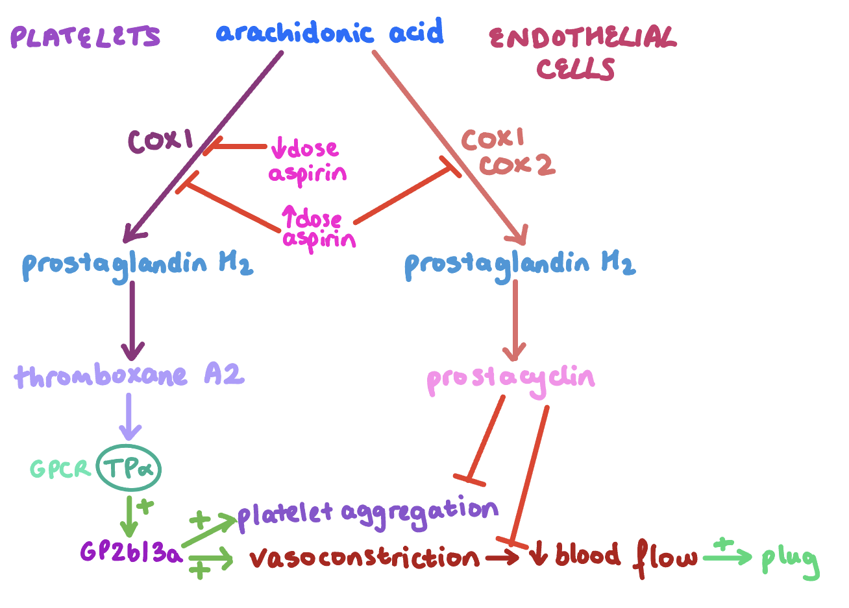
Primary haemostasis: platelet plug formation
1. Injury: vasoconstriction via endothelin release
2. Adhesion: exposed collagen-vWF-GP1b-platelet
3. Activation: pseudopodia and granule release
4. Aggregation: platelet-GP2b/3a-fibrinogen-GP2b/3a-platelet
The Peer Teaching Society is not liable for false or misleading information…

Slide 71
Secondary haemostasis: the coagulation cascade
Various proteolytic enzymes that circulate in the plasma inactive
Liver makes: prothrombin, VNF, fibrinogen, coagulation factors
Blood serum = blood plasma without clotting factors
Vitamin K dependant factors: 10, 9, 7, 2
The Peer Teaching Society is not liable for false or misleading information…

Slide 72
Blood Groups
Mendelian inheritance: A and B are co-dominant, O is recessive
The Peer Teaching Society is not liable for false or misleading information…

Slide 73
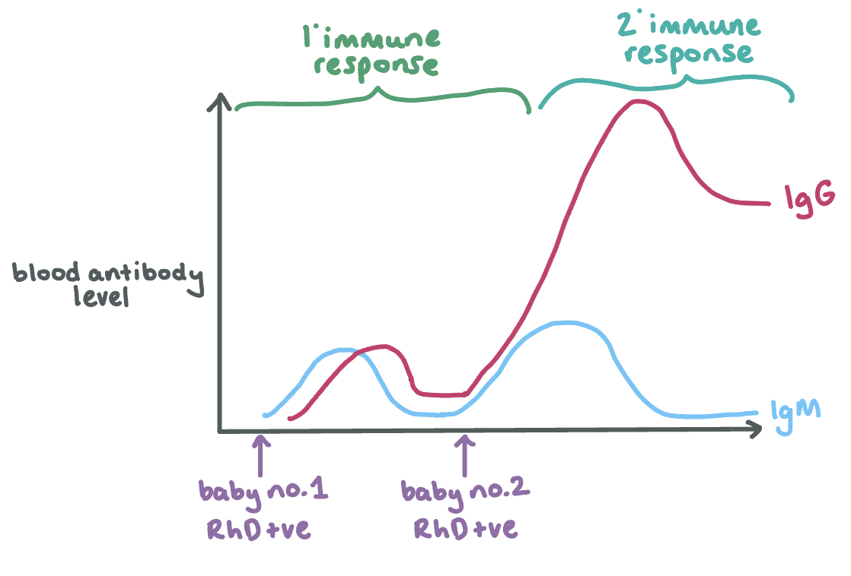
The Rhesus System
1. RhD negative mum + RhD positive dad (RhD is dominant)
2. RhD positive baby no.1 —> sensitisation- primary immune response —> mum makes IgM anti-D antibodies (can’t cross placenta)
3. RhD positive babe no.2 —> secondary immune response —> mum makes many IgG antibodies —> cross placenta- attack RhD antigens on foetal RBCs —> haemolysis —> anaemia
IgG Goes to foetus
The Peer Teaching Society is not liable for false or misleading information…
Notes:
ADD DIAGRAM OF IGG AND IGM

Slide 74
Physiology practice questions
Which of these is false?
A- platelets live for 7-10 days
B- platelet plugs are temporary
C- low dose aspirin inhibits COX2
D- vitamin K dependant factors are 10, 9, 7 and 2
The Peer Teaching Society is not liable for false or misleading information…

Slide 75
Physiology practice questions
Which of these is false?
A- platelets live for 7-10 days
B- platelet plugs are temporary
C- low dose aspirin inhibits COX2 COX1
D- vitamin K dependant factors are 10, 9, 7 and 2
The Peer Teaching Society is not liable for false or misleading information…

Slide 76
Physiology practice questions
Which of these is false?
A- universal plasma donor is AB+
B- blood type O have no antigens on RBCs
C- IgG is mostly involved in the primary immune response
D- IgG can cross the placenta
The Peer Teaching Society is not liable for false or misleading information…

Slide 77
Physiology practice questions
Which of these is false?
A- universal plasma donor is AB+
B- blood type O have no antigens on RBCs
C- IgG is mostly involved in the primary secondary immune response
D- IgG can cross the placenta
The Peer Teaching Society is not liable for false or misleading information…

Slide 78
Conclusion = covered all of this content!
Anatomy:
o Thoracic cage: ribs, vertebrae, sternum and clavicles
o Pectoral muscles and serratus anterior
o Surface landmarks on the chest
o Dermatomes of the chest and innervation of the skin
o Anatomy and neurovascular supply of the breast
o Anatomy of the heart (chambers and vessels)
o Heart valves, papillary muscles, chordae tendinae
o Heart surfaces and borders
o Location of valve auscultations
o Fossa ovale and ligamentum arteriosum
o Coronary arteries and their supply territories
o Referred heart pain
o Location of conduction system (SAN, AVN ..)
o Pericardium
o Vagus and phrenic nerves and their pathways through the thorax and their diaphragm
piercings
o Aortic branches
o SVC (location and borders)
o Position of structures relative to the heart
o Aortic arches
o Venous drainage
Blood:
o Platelet biochemistry
o Clotting cascade
o Structures and functions of RBC, WBC and platelets
o Constituents of plasma proteins
o Blood groups and the Rhesus system
o Methods and alternatives to blood transfusions

Slide 79
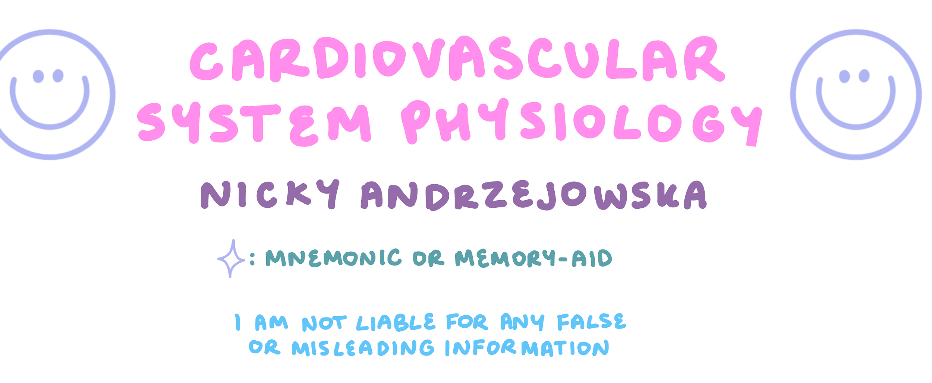
Extra Advice
Thank you for listening!
My IMMS notes are available via this link: https://drive.google.com/drive/folders/1Gad1UVtdiFMHjAu4U3Sn7w6xufmCdFcR?usp=share_link
If you want access to my cardio notes then fill out this IMMS feedback form:
https://forms.gle/V7wBYxt8qiTShGpZ7
The Peer Teaching Society is not liable for false or misleading information…

Slide 80
Extra Resources
https://quizlet.com/jrichenberg1/folders/cardiovascular?i=4old9b&x=1xqt
(Flashcards based on the lectures from phase 1 2022-2023 cardio lectures
For Anatomy youtube videos: Sam Webster
Anatomy app: Anatomy 3D atlas
Teach me anatomy/physiology
take it in bite sized chunks- use your friends/peers for study sessions, make the most of your anatomy, flashcards, mind maps on a whiteboard (really recommend getting a mini whiteboard for blurting/mind maps), practice by teaching the topics as this will highlight what you really understand and what needs a bit more work
The Peer Teaching Society is not liable for false or misleading information…

Slide 81
Key things to remember:
Don’t panic! It can feel very overwhelming and like there is way too much information to learn but remember you have lots of time and will know more than you think.
Little and often → break the information down into manageable chunks and don’t try to learn everything in one go.
When thinking about anatomy, link structures to functions, utilise your anatomy sessions and use image occlusion (if that helps you)
You are doing well and you really can do this :)
These slides will be available as a revision resource
Well done for completing this session
Thank you for attending

Slide 82
Feedback:
To have access to the powerpoint, please fill out this form!
https://docs.google.com/forms/d/e/1FAIpQLSefNBjNn8KT9xlultvx-uVnGMiYEHWxJ8Rlw1tEmCmdcqowTg/viewform?usp=sf_link
The Peer Teaching Society is not liable for false or misleading information…

