Slide 1
Cardiology

Slide 2
Cardiology
Phase 2a Revision Session
Tom Stephenson & Ruaridh Owen
8th March
The Peer Teaching Society is not liable for false or misleading information…

Slide 3
Ischaemic Heart Disease
Angina
ACS
MI
Complications of MI
The Peer Teaching Society is not liable for false or misleading information…

Slide 4
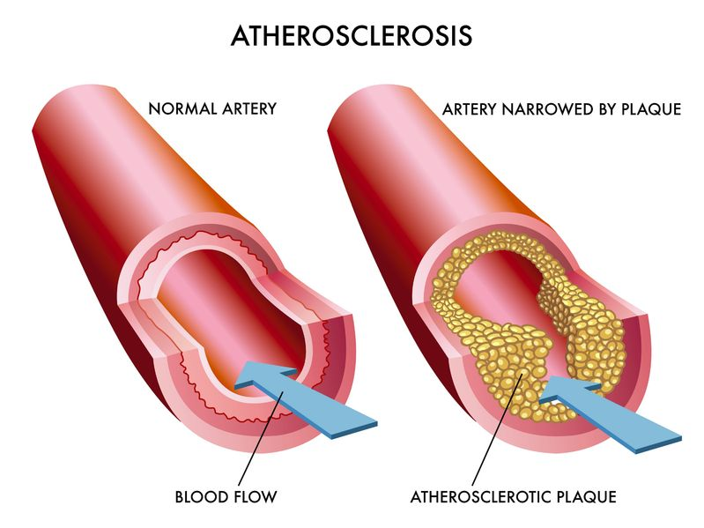
Atherosclerosis
Risk factors
Typical lesion = fatty streak
Cellular components – macrophages, smooth muscle cells, lymphocytes
Lipid core with fibrous capsule
The Peer Teaching Society is not liable for false or misleading information…
Notes:
Pathophysiology as aboce
Usual risk factors – smoking, age, low HDLs, High LDLs, obesity, male, afro-caribbean

Slide 5
Angina - Risk Factors
The Peer Teaching Society is not liable for false or misleading information…
Notes:
Risk factors – FH, smoking, DM, Metabolic syndrome, hypertension, hyperlipidaemia, obesity, lack of exercise

Slide 6
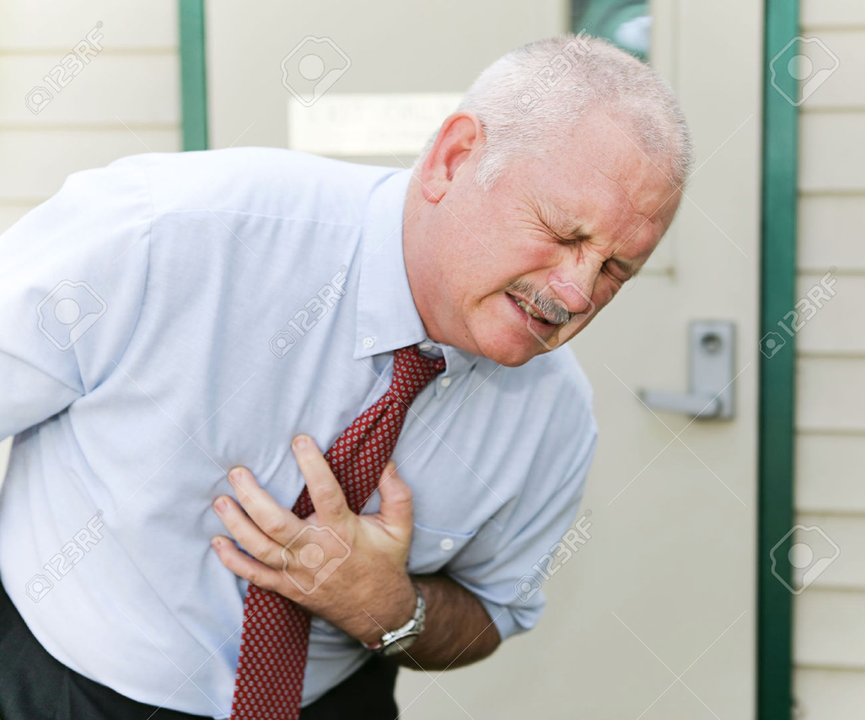
Angina - Aetiology/ Presentation
The Peer Teaching Society is not liable for false or misleading information…
Notes:
Aetiology – narrowing of the coronary artery due to atherosclerotic disease
Presentation – Chest pain on exertion, constricting discomfort in chest, neck, shoulders, jaw or arms, relieved by rest/GTN – all three = typical angina, 2 = atypical, 1 = not angina

Slide 7
Investigations
ECG
FBC
Other bloods, Kidneys, LFTs, RBG, TFTs, cholesterol, troponins
The Peer Teaching Society is not liable for false or misleading information…
Notes:
ECG – Q waves, ST/ T changes, LBBB
FBC - exclude anaemia

Slide 8
Management
Lifestyle!!
GTN – immediate
Aspirin daily
Statins
CaCb/ Beta blocker or both
Long acting nitrate
Revascularization if high risk or persistent
The Peer Teaching Society is not liable for false or misleading information…
Notes:
GTN -> wait 5 mins the again -> wait 5 mins again -> wait 5 mins then ambulance

Slide 9
ACS
STE-ACS
NSTE-ACS = NSTEMI/ unstable angina
Risk factors?
Aetiology?
Presentation?
The Peer Teaching Society is not liable for false or misleading information…
Notes:
STE-ACS – ST elevation and troponins raised
NSTE-ACS – No ST elevation (sometimes depressed T/ST) and troponins raised
Unstable Angina - Neither
Presentation – prolonged chest pain >20 mins, destabilisation of angina, SOB, doom, sweating, vomiting, fatigue, pallor, palpitations

Slide 10
Investigations
ECG
Cardiac Enzymes (at 6-12 hours)
FBC
Other bloods
Coronary angiography
The Peer Teaching Society is not liable for false or misleading information…

Slide 11
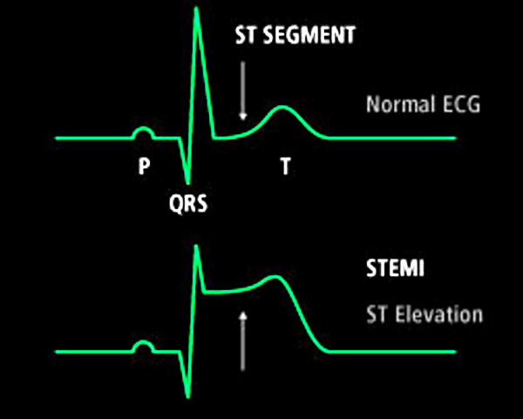
Investigations
The Peer Teaching Society is not liable for false or misleading information…

Slide 12
Management
ABCDE
MONA for suspected ACS
Aspirin and ticagrelor
Fondaparinux/LMWH
Revascularization (PCI) – failing this – streptokinase for thrombolysis
GTN, CaCB, Beta-blockers, statins, ACEi
The Peer Teaching Society is not liable for false or misleading information…
Notes:
Oxygen only if <94% sats

Slide 13
Complications
Shock
HF
Arrhythmia
The Peer Teaching Society is not liable for false or misleading information…

Slide 14
Valvular Heart Disease
Mitral Stenosis
Mitral Regurgitation
Aortic Stenosis
Aortic Regurgitation
The Peer Teaching Society is not liable for false or misleading information…

Slide 15
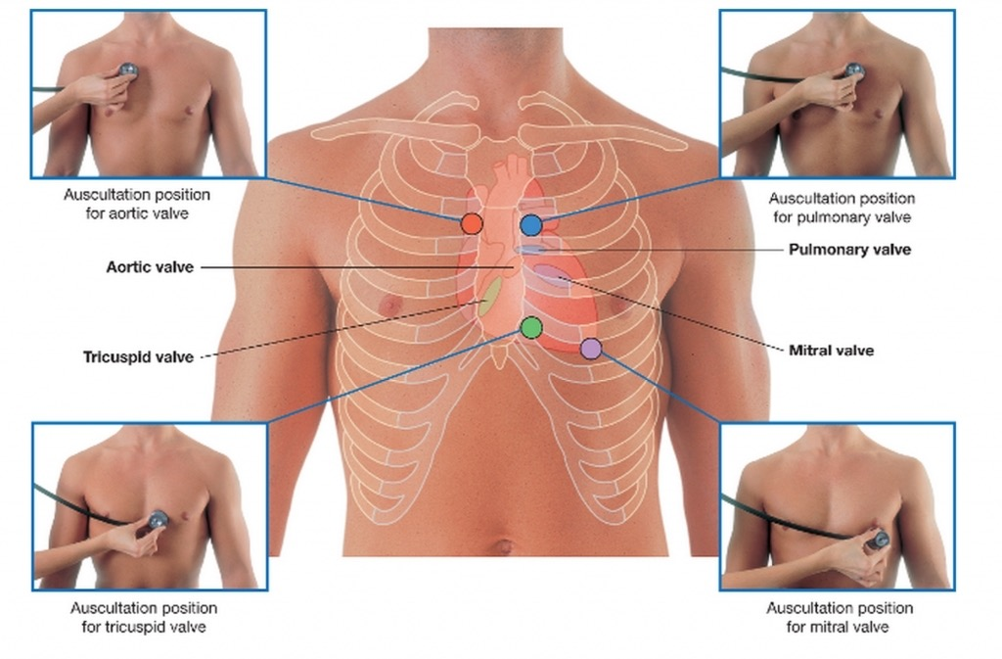
Valvular Heart Disease
The Peer Teaching Society is not liable for false or misleading information…
Notes:
Mitral valve auscultated at the apex, radiating to axilla.
Mitral valve prevents backflow of blood into left atrium during systole.
Mitral opens to allow left ventricular filling during diastole.
Aortic valve auscultated in 2nd intercostal space, left of sternum, radiating to carotids.
Aortic valve opens during systole.
Aortic valve closes during diastole to allow adequate filling of left ventricle (maximise efficiency of cardiac output)

Slide 16
1. Mitral Stenosis
Causes:
Commonest = rheumatic heart disease
Pathophysiology
Inflammation, reduction in mitral orifice area.
Valve thickening, cusp fusion, calcium deposition.
Increased LA pressure.
Pulmonary oedema, pulmonary HTN.
The Peer Teaching Society is not liable for false or misleading information…
Notes:
Commonest cause is rheumatic heart disease:
Secondary to rheumatic fever (group A strep).
Inflammation leads to commissural fusion and reduction in mitral valve orifice area.
Echo shows doming pattern.
Over years, progresses to valve thickening, cusp fusion, calcium deposition, stenotic valve.
Pathophysiology
Normal valve orifice is 4-6cm².
When it is reduced <1cm², severe MS is present.
For sufficient cardiac output, left atrial pressure increases and left atrial hypertrophy and dilatation occur.
May progress to increased pressure in pulmonary venous, pulmonary arterial and right heart.
Pulmonary oedema may occur.
Reactive pulmonary hypertension may occur.

Slide 17
1. Mitral Stenosis
SYMPTOMS:
Dyspnoea and productive cough
Right heart failure
AF
The Peer Teaching Society is not liable for false or misleading information…
Notes:
Symptoms
Severe dyspnoea
Productive cough (blood-tinged, frothy or frank haemoptysis)
Right heart failure
Weakness
Fatigue
Abdo/lower limb swelling)
Atrial fibrillation (caused by enlarged left atrium)
Palpitations
Systemic emboli (stroke)

Slide 18
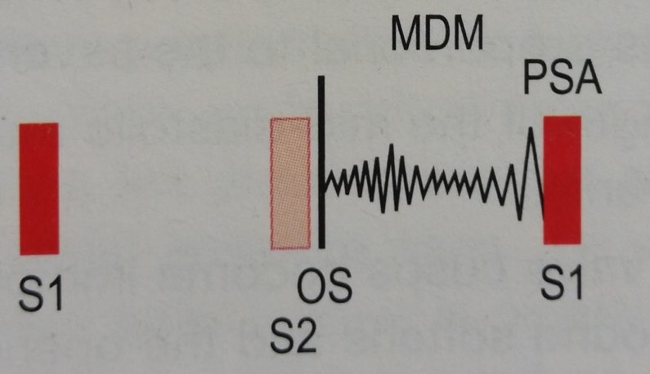
1. Mitral Stenosis
SIGNS: Murmur
Mid-diastolic rumble at apex
Opening snap
The Peer Teaching Society is not liable for false or misleading information…
Notes:
Murmur:
Mid-diastolic rumble at apex
Loud S1, loud S2, opening snap
- Opening snap: increased left atrial pressure.
- Mid-diastolic rumble: left ventricle fills, blood flows through stenosed valve.

Slide 19
1. Mitral Stenosis
Investigations
CXR
ECG
Echo
The Peer Teaching Society is not liable for false or misleading information…
Notes:
CXR
Small heart, enlarged left atrium.
Calcified mitral valve
Pulmonary oedema
ECG
Sinus rhythm
Bifid P wave (left atrial activation)
Echo
Left atrial enlargement

Slide 20
1. Mitral Stenosis
Management
Valvotomy to widen the valve
Mitral valve replacement if severe
Treat AF
Treat dyspnoea
The Peer Teaching Society is not liable for false or misleading information…
Notes:
Treat AF
Digoxin + anticoag
Treat dyspnoea
Low dose diuretics

Slide 21
2. Mitral Regurgitation
Causes:
Degenerative
Ischaemic heart disease
Rheumatic heart disease
Infective endocarditis
The Peer Teaching Society is not liable for false or misleading information…
Notes:
Also seen in:
Cardiomyopathy
SLE
Marfan’s
Ehlers-Danlos

Slide 22
2. Mitral Regurgitation
Pathophysiology
Regurg. into LA -> LA dilatation
Increased LA pressure if acute MR (pulmonary oedema, etc)
LV hypertrophy
The Peer Teaching Society is not liable for false or misleading information…
Notes:
Pathophysiology
Regurgitation into left atrium produces left atrial dilatation (but little increase in pressure if MR is long standing.
Increased left atrial pressure if acute MR (rise in pulmonary venous pressure and pulmonary oedema).
Stroke volume must increase to compensate for the regurgitation: left ventricular hypertrophy occurs.

Slide 23
2. Mitral Regurgitation
SYMPTOMS:
‘Palpitation’
Dyspnoea and orthopnoea
Fatigue and lethargy
The Peer Teaching Society is not liable for false or misleading information…
Notes:
Symptoms
Palpitation
(often felt due to increase in stroke volume)
Dyspnoea and orthopnoea
(due to secondary left ventricular failure and pulmonary hypertension)
Fatigue and lethargy
(reduced cardiac output)

Slide 24
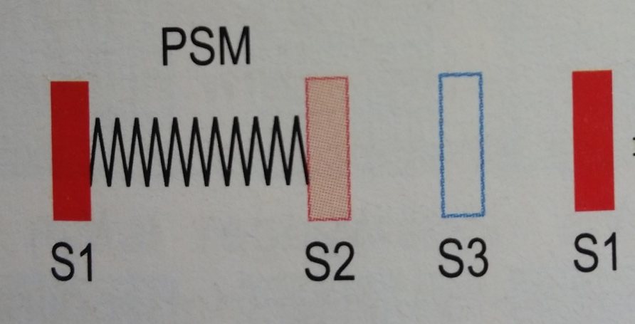
2. Mitral Regurgitation
SIGNS: Murmur
Pansystolic
Palpable thrill (if severe)
The Peer Teaching Society is not liable for false or misleading information…
Notes:
S3 heart sound:
sudden rush of blood back into the dilated left ventricle in early diastole

Slide 25
2. Mitral Regurgitation
Investigations
CXR
ECG
Echo
The Peer Teaching Society is not liable for false or misleading information…
Notes:
CXR
Left atrial and left ventricular enlargement
Calcified mitral valve
ECG
Bifid P waves (left atrial delay)
Left ventricular hypertrophy
Echo
Dilated left atrium and left ventricle

Slide 26
2. Mitral Regurgitation
Management
Prophylaxis against endocarditis
Mitral valve repair/replacement
The Peer Teaching Society is not liable for false or misleading information…

Slide 27
3. Aortic Stenosis
Causes:
Calcific Aortic Valvular Disease (CAVD)
Bicuspid Aortic Valve (BAV)
Rheumatic Fever
The Peer Teaching Society is not liable for false or misleading information…
Notes:
1. Calcific Aortic Valvular Disease (CAVD)
Commonest cause.
Mainly elderly.
Inflammatory process (T lymphocytes, macrophages) results in thickening of subendothelium with fibrosis.
Lesions contain lipoproteins that calcify.
RISK FACTORS: old age, male gender, elevated lipoprotein, low LDL, HTN, DM, smoking.
2. Bicuspid aortic valve (BAV)
Commonest congenital heart disease, 1-2% live births.
CAVD of a BAV present earlier.
Associated with aortic coarctation, root dilatation, aortic dissection.
Require regular echo.
3. Rheumatic fever
Progressive fusion and thickening of aortic valve.
Other causes:
Chronic kidney disease
Paget’s disease of bone
Previous radiation exposure
Homozygous familial hypercholesterolaemia

Slide 28
3. Aortic Stenosis
Pathophysiology
Obstructed LV emptying -> increased LV pressure
LV hypertrophy
Ischaemia of myocardium
The Peer Teaching Society is not liable for false or misleading information…
Notes:
Pathophysiology
Obstructed left ventricular emptying leads to increased left ventricular pressure and hypertrophy.
Leads to ischaemia of the left ventricular myocardium.
Angina, arrhythmias and left ventricular failure result.

Slide 29
3. Aortic Stenosis
Usually no symptoms until moderately severe disease.
Aortic orifice reduced to 1/3 normal size.
SYMPTOMS:
Exercise-induced syncope
Angina
Dyspnoea
The Peer Teaching Society is not liable for false or misleading information…
Notes:
Exercise-induced syncope
Cardiac output can’t increase with exercise due to obstructed output.
Angina (ischaemia of myocardium)
Dyspnoea (increased left ventricular pressure)

Slide 30
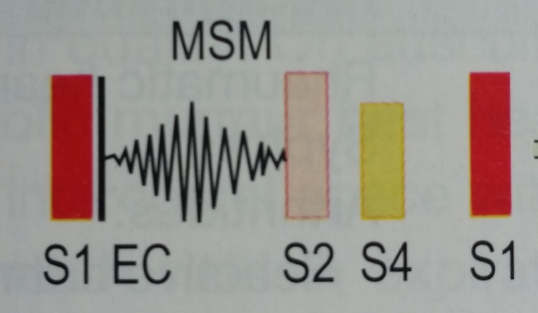
3. Aortic Stenosis
SIGNS: Murmur
Systolic, low pitched, ejection
Radiates to carotids
Ejection click
Palpable thrill
The Peer Teaching Society is not liable for false or misleading information…
Notes:
Murmur:
Systolic, low pitched, ejection
Radiating to carotids
Ejection click, soft A2, S4
Palpable systolic thrill
S4 caused by atrial contraction

Slide 31
3. Aortic Stenosis
Investigations
CXR
ECG
Echo
The Peer Teaching Society is not liable for false or misleading information…
Notes:
CXR
Relatively small heart
Prominent, dilated ascending aorta
Turbulent blood flow causes “post-stenotic dilatation”
Calcified aortic valve
ECG
Left ventricular hypertrophy
Left atrial delay
Echo
Thickened, calcified and immobile aortic valve cusps
Left ventricular hypertrophy may be used for severity

Slide 32
3. Aortic Stenosis
Management
Valve replacement
Prophylaxis for infective endocarditis
The Peer Teaching Society is not liable for false or misleading information…

Slide 33
4. Aortic Regurgitation
Causes:
Any disease affecting the aortic valve (rheumatic fever, infective endocarditis, etc)
The Peer Teaching Society is not liable for false or misleading information…
Notes:
Causes of acute AR:
Any disease affecting the aortic valve (acute rheumatic fever, infective endocarditis, aortic dissection).
Causes of chronic AR:
Rheumatic heart disease
Syphilis
Arthritides (reactive arthritis, ank spon., RA)
Severe HTN
Bicuspid aortic valve
Marfan’s
OI

Slide 34
4. Aortic Regurgitation
Pathophysiology
Blood refluxes from aorta to LV during diastole.
Stroke volume increases, LV hypertrophy.
Diastolic pressure drops.
The Peer Teaching Society is not liable for false or misleading information…
Notes:
Pathophysiology
Reflux of blood from aorta through the aortic valve, into the left ventricle, during diastole.
To maintain cardiac output, stroke volume must increase.
Left ventricular enlargement occurs.
Diastolic pressure drops (aortic runoff during diastole), decreased coronary perfusion.
Enlarged left ventricle is less efficient and demand for oxygen is greater: ischaemia occurs.

Slide 35
4. Aortic Regurgitation
Significant symptoms occur late, don’t occur until left ventricular failure.
SYMPTOMS:
Palpitations
Angina
Dyspnoea
The Peer Teaching Society is not liable for false or misleading information…
Notes:
Increased stroke volume (felt as palpitation, as in mitral regurgitation)
Angina (ischaemia of myocardium)
Dyspnoea (left ventricular dilatation and dysfunction)

Slide 36
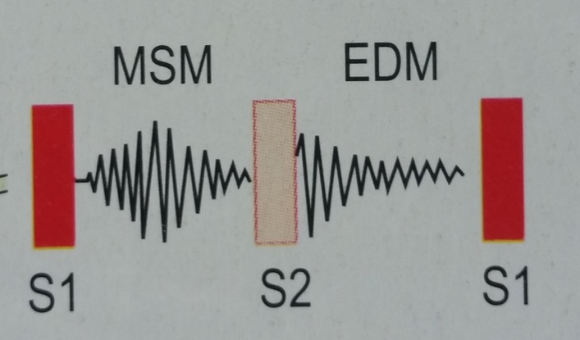
4. Aortic Regurgitation
SIGNS: Murmur
High-pitched, early diastolic
Ejection systolic
Mid-diastolic rumble
The Peer Teaching Society is not liable for false or misleading information…
Notes:
Murmur:
High-pitched, early diastolic murmur (reflux of blood)
Ejection systolic at base and into neck (volume overload)
Mid-diastolic rumble at the apex (regurgitant blood impinging on anterior mitral valve cusp)

Slide 37
4. Aortic Regurgitation
SIGNS: Hyperdynamic circulation
Bounding/collapsing pulse
Quincke’s sign (capillary pulse in nail bed)
De Musset’s sign (head nodding with heart beat)
The Peer Teaching Society is not liable for false or misleading information…

Slide 38
4. Aortic Regurgitation
Investigations
CXR
ECG
Echo
The Peer Teaching Society is not liable for false or misleading information…
Notes:
CXR
Left ventricular enlargement
Dilatation of ascending aorta
Calcified aorta (syphilis)
ECG
Left ventricular hypertrophy with volume overload
Tall R waves, deeply inverted T waves
Echo
Vigorous cardiac contraction
Dilated left ventricle
Diastolic fluttering of mitral leaflets

Slide 39
4. Aortic Regurgitation
Management
ACE inhibitors for left ventricular dysfunction
Beta-blockers to slow aortic dilatation
Operative valve replacement before symptoms occur
The Peer Teaching Society is not liable for false or misleading information…

Slide 40
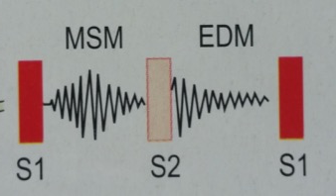
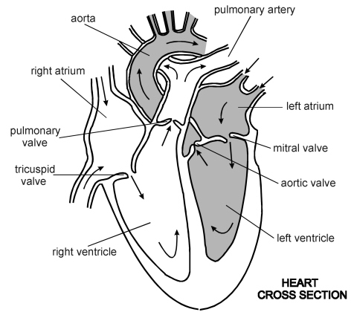
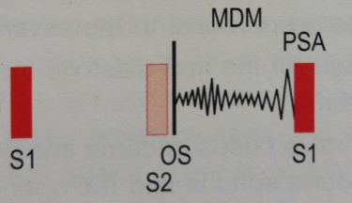
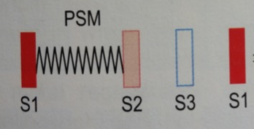
Valvular Heart Disease: Summary
Aortic Stenosis
Aortic Regurgitation
Mitral Regurgitation
Mitral Stenosis
The Peer Teaching Society is not liable for false or misleading information…

Slide 41
Infective Endocarditis
Pathophysiology
Organisms in blood (dental hygiene, IVDU).
Abnormal cardiac endothelium.
Organisms adhere to cardiac valves, endocardium, prosthetic valves, etc.
Causative Organisms
Strep. Viridans, Staph, enterococci
The Peer Teaching Society is not liable for false or misleading information…
Notes:
Endovascular infection of cardiovascular structures:
Cardiac valves
Atrial and ventricular endocardium
Intrathoracic vessels
Prosthetic heart valves, pacemaker leads
Pathophysiology
Presence of organisms in blood.
Abnormal cardiac endothelium, facilitating adherence and growth of organisms.
Bacteraemia (poor dental hygiene, IVDU, soft tissue infections).
Aortic and mitral valves mostly affected.
Right-sided lesions more common in IVDU.

Slide 42
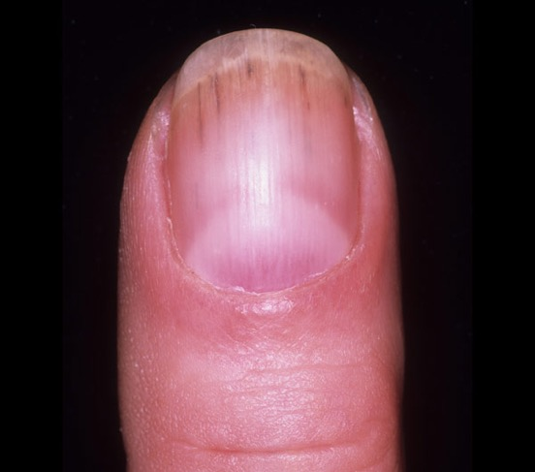
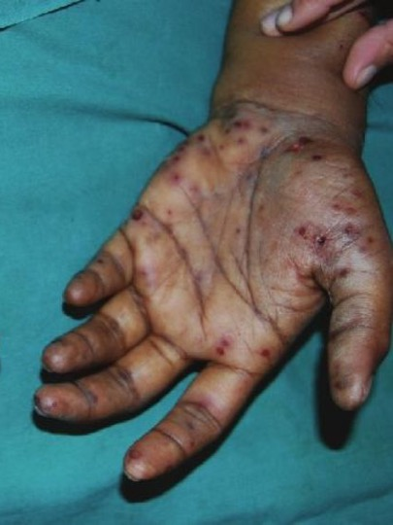
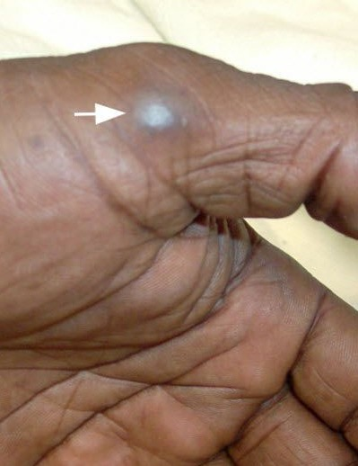
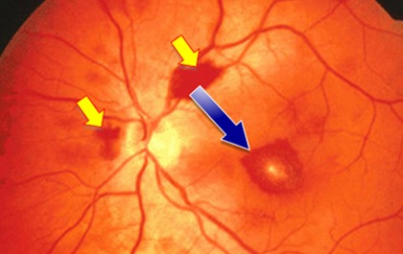
Infective Endocarditis
Clinical Presentation
The Peer Teaching Society is not liable for false or misleading information…

Slide 43
Infective Endocarditis
Duke’s Diagnostic Criteria
MAJOR
Positive blood culture (x2)
Echo
2. MINOR
Fever >38, predisposition,
vascular/immunological signs, echo (minor),
blood culture (minor)
The Peer Teaching Society is not liable for false or misleading information…
Notes:
Duke’s Criteria for Infective Endocarditis
2 major OR 1 major + 3 minor OR 5 minor
Major Criteria
Positive blood culture (x2)
Evidence on echo
Minor Criteria
Fever >38
Predisposition
Vascular/immunological signs
Blood culture (minor)
Echo (minor)
Immunological Signs
Glomerulonephritis
Osler’s nodes
Roth’s spots
Rheumatoid factor
Vascular Signs
Major arterial emboli
Septic pulmonary infarcts
Mycotic aneurysm
Intracranial haemorrhages
Conjunctival haemorrhages
Janeway’s lesions
Splinter haemorrhages

Slide 44
Infective Endocarditis
Investigations
Blood cultures, FBC, U&Es, LFTs, ESR/CRP
Urine
ECG
CXR
Echo
The Peer Teaching Society is not liable for false or misleading information…
Notes:
Blood cultures
3 sets from different sites
FBC
Low Hb, high WCC,
U&E
Increased urea and creatinine
LFTs
Increased alk. phos.
ESR/CRP
Urine
Proteinuria/haematuria
ECG
Prolonged PR
CXR
Pulmonary oedema left side, pulmonary emboli right side
Echo
Vegetations

Slide 45
Infective Endocarditis
Management
6/52 IV abx
Amoxicillin + gentamicin
The Peer Teaching Society is not liable for false or misleading information…

Slide 46
Rheumatic Fever
Disease of children/young adults (<15yrs old).
Pathophysiology
Group A Strep.
Inflammatory reaction causes symptoms.
The Peer Teaching Society is not liable for false or misleading information…
Notes:
Initial pharyngeal infection.
Clinical syndrome of rheumatic fever follows.
Autoimmune reaction, triggered by proteins on cell wall of strep. Pyogenes.
Inflammatory reaction causes the symptoms, not direct infection, nor bacterial toxins.

Slide 47
Rheumatic Fever
Jones Criteria
Major Criteria
Carditis
Polyarthritis
Chorea
Erythema marginatum
SC nodules
Minor Criteria
Fever
Arthralgia
Previous RF
Raised ESR/CRP
Leukocytosis
ECG changes
The Peer Teaching Society is not liable for false or misleading information…
Notes:
“CASES FRAPP”
Major Criteria- Carditis
- Arthritis
- Subcutaneous nodules
- Erythema marginatum
- Sydenham's chorea
Minor Criteria
- Fever
- Raised ESR or CRP
- Arthalgia
- Prolonged PR interval
Previous rheumatic fever
TO MAKE A DIAGNOSIS…
Evidence of strep infection (throat swab, Hx, elevated ASO)
2 Major criteria OR 1 major + 2 minor

Slide 48
Rheumatic Fever
Investigations
Throat swab
ASO titre
ESR/CRP
ECG, echo (carditis)
Management
Bed rest
Penicillin
The Peer Teaching Society is not liable for false or misleading information…

Slide 49
Hypertension
Primary (essential) = idiopathic
Secondary = a cause
Risk factors?
The Peer Teaching Society is not liable for false or misleading information…
Notes:
Usual plus stress and salt
Secondary causes of hypertension-
Renal (most common cause of secondary hypertension): glomerulonephritis, polyarteritis nodosa, systemic sclerosis, pyelonephritis, PKD) or renovascular disease
Preeclampsia/ pregnancy
Coarcation of the aorta
Alcohol, cocaine etc
Endocrine: Cushing’s, Conn’s, Hyperthyroidism, Phaeochromocytoma, Acromegaly, Hyperparathyroidism

Slide 50
Presentation
?
The Peer Teaching Society is not liable for false or misleading information…
Notes:
Usually asymptomatic

Slide 51
Diagnosis
Stage 1 = 140/90 in clinic, 135/85 at home or ambulatory
Stage 2 = 160/100 or 150/95
Severe = 180/110
The Peer Teaching Society is not liable for false or misleading information…
Notes:
First one is suggestive, home is diagnostic Screen every 5 years in adults as silent

Slide 52
Investigations
CVD – glucose + cholesterol
Urine dip
RFTs
ECG
Echo
USS kidneys
FBG, Cholesterol
Cortisol suppression test
Renin/ aldosterone levels
The Peer Teaching Society is not liable for false or misleading information…
Notes:
Also calcium, MRI renal arteries

Slide 53
Management
>55 or not caucasian? CaCB
<55 and caucasian? ACEi/ARB
Then combo
Then add thiazide diuretic
Then refer
LIFESTYLE + risk factors
The Peer Teaching Society is not liable for false or misleading information…
Notes:
Stage 1 – only treat if end organ damage or diabetes or QRISK >20%
Stage 2 – treat
Thiazide eg bendroflumethiazide

Slide 54
Aortic Aneurysm
Aneurysm = permanent and irreversible dilatation of blood vessel by ≥50%
Loss of elasticity, smooth muscle cells and protein
Leukocyte infiltration
Bigger = WORSE
The Peer Teaching Society is not liable for false or misleading information…
Notes:
Proteolysis, degradation of elastic lamellae and leuocyte infiltration
Abdominal (>3cm) as normal aorta 2cm or thoracic

Slide 55
Risk Factors
The Peer Teaching Society is not liable for false or misleading information…
Notes:
Marfans, Ehlers-danos, FH, trauma

Slide 56
Presentation
Asymptomatic – incidental discovery
Pulsatile mass
Back pain etc from pressure
Rupture – abdo pain -> shock->DEATH (80%)
Examination – pulsatile mass
Doesn’t work well if aneurysm small or patient fat
The Peer Teaching Society is not liable for false or misleading information…

Slide 57
Investigation
FBC, clotting, cross-match, ECG
USS or CT
CT shows ‘crescent sign’ in artery = blood in thrombus, rupture imminent
May also show inflammation or mural thrombus
The Peer Teaching Society is not liable for false or misleading information…

Slide 58
Management
3-4.4 - annual USS
4.5-5.4 - 3 monthly USS
Bigger ->surgery (open vs endovascular)
LIFESTYLE
The Peer Teaching Society is not liable for false or misleading information…

Slide 59
Heart Failure
Main Causes:
Ischaemic heart disease (35-40%)
Cardiomyopathy (30-34%)
HTN (15-20%)
The Peer Teaching Society is not liable for false or misleading information…
Notes:
Results from any structural or functional cardiac disorder that impairs ability of the heart to function as a pump, to support circulation.
Main Causes
Ischaemic heart disease
(35-40%)
Cardiomyopathy
(30-34%)
Hypertension
(15-20%)
Other Causes
Cardiomyopathy (restrictive)
Valve disease
Alcohol/drugs (chemo)
Congenital heart disease
Right heart failure
Tricuspid incompetence
Arrhythmias
Pericardial disease
Infections (Chagas’)

Slide 60
Heart Failure
Pathophysiology
Heart begins to fail: compensatory changes occur.
As heart failure progresses, compensatory changes become overwhelmed (become pathological).
The Peer Teaching Society is not liable for false or misleading information…

Slide 61
Heart Failure
Compensatory Changes:
Ventricular dilatation
Myocyte hypertrophy
Increased collagen synthesis
Salt and water retention
Sympathetic stimulation
Peripheral vasoconstriction
The Peer Teaching Society is not liable for false or misleading information…
Notes:
Pathophysiological Changes in Heart Failure
Ventricular dilatation
Myocyte hypertrophy
Increased collagen synthesis
Altered myosin gene expression
Altered sarcoplasmic Ca²⁺-ATPase density
Increased ANP secretion
Salt and water retention
Sympathetic stimulation
Peripheral vasoconstriction

Slide 62
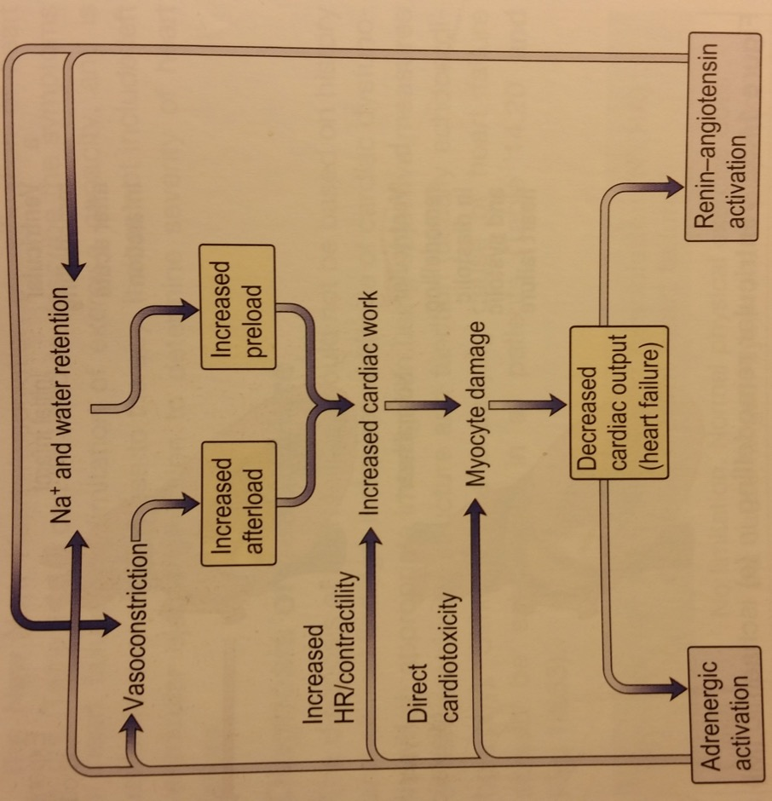
Heart Failure
Increased Preload
Myocardial contractility (sympathetic stimulation)
Salt and water retention
Myocardial remodelling
The Peer Teaching Society is not liable for false or misleading information…
Notes:
Increased Preload
Myocardial failure results in more blood left in ventricles after systole.
Results in increased venous return/preload.
Stretches myocardium, maintaining cardiac output (Starling’s law).
Dyspnoea, hepatic enlargement, ascites, oedema.
2. Myocardial contractility
Initially, sympathetic stimulation acts to maintain cardiac output.
Chronic sympathetic stimulation causes myocyte apoptosis and neurohormonal activation (salt and water retention).
3. Salt and water retention
Reduced cardiac output leads to diminished renal perfusion, activating RAAS.
Sympathetic stimulation increases salt and water retention.
4. Myocardial remodelling
In response to ischaemia, myocyte damage, etc.
Hypertrophy, loss of myocytes and increased interstitial fibrosis.

Slide 63
Heart Failure
SYMPTOMS
Exertional dyspnoea
Orthopnoea
Paroxysmal nocturnal dyspnoea
Fatigue
SIGNS
Cardiomegaly
Added heart sounds
Elevated JVP
Tachycardia
Hypotension
Bi-basal crackles
Peripheral oedema
Ascites
The Peer Teaching Society is not liable for false or misleading information…

Slide 64
Heart Failure
Investigations
FBC, LFTs, U&Es
Creatine kinase, troponin I, troponin T
CXR
ECG
Echo
Exercise testing
24h ECG
The Peer Teaching Society is not liable for false or misleading information…
Notes:
Bloods
FBC, LFTs, U&Es, BNP, TFTs
Cardiac enzymes/ proteins
Creatine kinase, troponin I, troponin T
CXR
Cardiomegaly
Pulmonary congestion
Kerley B lines
Pulmonary oedema
ECG
Ischaemia, HTN, arrhythmia
Echo
Cardiac chamber dimension
Systolic and diastolic function
Valvular disease
Cardiomyopathies
Stress echo
Dobutamine identifies contractile reserve
Angiography
Quantify ejection fraction
Exercise testing
VO₂ max
Ambulatory ECG
24hr monitoring

Slide 65
Heart Failure
Management: Lifestyle
Education
Obesity control
Diet
Smoking cessation
Cardiac rehab
Vaccination
The Peer Teaching Society is not liable for false or misleading information…
Notes:
General Lifestyle Advice
Education
Obesity control
Dietary modification (avoid large meals, salt restriction, omega-3)
Smoking cessation
Physical activity, exercise training and cardiac rehab
Vaccination
Sexual activity – avoid sildenafil (may cause profound hypotension)

Slide 66
Heart Failure
Management: Drugs
Diuretics (furosemide, metolazone)
ACE inhibitors (lisinopril)
Beta-blockers (bisoprolol)
ARB (candesartan)
Calcium glycosides (digoxin)
The Peer Teaching Society is not liable for false or misleading information…
Notes:
Pharmaceutical Management
Diuretics
Loop diuretics (furosemide, bumetanide)
Thiazide diuretics (metolazone)
Prescribed for symptomatic relief of dyspnoea and improve exercise tolerance.
ACE inhibitors
Lisinopril.
Improve ventricular function and patient wellbeing, and mortality.
Beta-Blockers
Bisoprolol, carvedilol, metoprolol.
Nb. CI in asthma, 2nd and 3rd degree heart block.
Angiotensin-II Receptor Antagonists
Candesartan, valsartan.
Prescribed if cough produced by ACE-i usage.
Aldosterone Antagonists
Spironolactone.
Nb. Risk of gynaecomastia or breast pain 1in10 men.
Calcium Glycosides
Digoxin if AF.

Slide 67
Heart Failure
Management: Other
Revascularisation (coronary artery bypass, PCI)
Valvular replacement
The Peer Teaching Society is not liable for false or misleading information…

Slide 68
Shock
‘Failure of the circulatory system to maintain adequate organ perfusion’
The Peer Teaching Society is not liable for false or misleading information…

Slide 69
Causes
Haemorrhagic – can withstand half a litre of blood loss with no ill effect
Anaphylaxis
Septic
Cardiogenic
Hypovolaemic
The Peer Teaching Society is not liable for false or misleading information…
Notes:
Haemorrhagic - bleeding, hence less circulating blood hence inadequate perfusion. Treatment = stop bleeding (surgery) and replace blood
Hypovolaemic – low circulating volume (same)
Anaphylactic – IgE mediated, releases histamine and inflammatory mediators -> capillary leakage, mucosal oedema -> shock.
Signs and symptoms of shock?
Low BP
High HR
High RR
Confusion
Pallor
Clammy
Pale peripheries
Reduced urine output

Slide 70
Anaphylactic
Signs and symptoms? Triggers?
IgE
Inflammatory mediators
Leaky vessels
Shock
The Peer Teaching Society is not liable for false or misleading information…
Notes:
S+S = itching, urticaria, angioedema, wheezing, stridor, n+v, abdominal pain, cyanosis, low BP etc.
Triggers = nuts, milk, eggs, fish

Slide 71
Management
ABCDE
Oxygen
Adrenaline (IM/IV)
The Peer Teaching Society is not liable for false or misleading information…
Notes:
Plus anti-histamines

Slide 72
Septic
Sepsis leads to a *derangement* in physiology
Abnormal coag
Endothelial cell dysfunction
Cell aptoposis
Labile sugars
Reduced steroid hormones
Cytokine release
The Peer Teaching Society is not liable for false or misleading information…

Slide 73
RF/Presentation
Risk factors?
Screening:
Low BP
High HR
Low sats
High RR
Lactate >2
Unresponsive
The Peer Teaching Society is not liable for false or misleading information…
Notes:
Risk factors – age, DM, immunocompromised, alcoholics, burns, IVDU, pregnancy, catheter
Investigations – URINE DIPSTICK, BC, FBC, glucose, ABG, clotting screen, LACTATE, LFTs, RFTs

Slide 74
Management = SEPSIS SIX
OXYGEN
FLUIDS
IV ANTIBIOTICS
Do BC and find source
Check Hb and Lactate
Measure urine out put hourly
The Peer Teaching Society is not liable for false or misleading information…

Slide 75
Cardiogenic
Reduced CO
Sustained hypotension <90mmHg, >30mins
Tissue hypoperfusion (cold peripheries, oliguria <30ml/hr, or both)
Usually due to MI
Usual presentation
Usual investigations
Treat underlying cause
The Peer Teaching Society is not liable for false or misleading information…

Slide 76
Heart Failure
Main Causes:
Ischaemic heart disease (35-40%)
Cardiomyopathy (30-34%)
HTN (15-20%)
The Peer Teaching Society is not liable for false or misleading information…
Notes:
Results from any structural or functional cardiac disorder that impairs ability of the heart to function as a pump, to support circulation.
Main Causes
Ischaemic heart disease
(35-40%)
Cardiomyopathy
(30-34%)
Hypertension
(15-20%)
Other Causes
Cardiomyopathy (restrictive)
Valve disease
Alcohol/drugs (chemo)
Congenital heart disease
Right heart failure
Tricuspid incompetence
Arrhythmias
Pericardial disease
Infections (Chagas’)

Slide 77
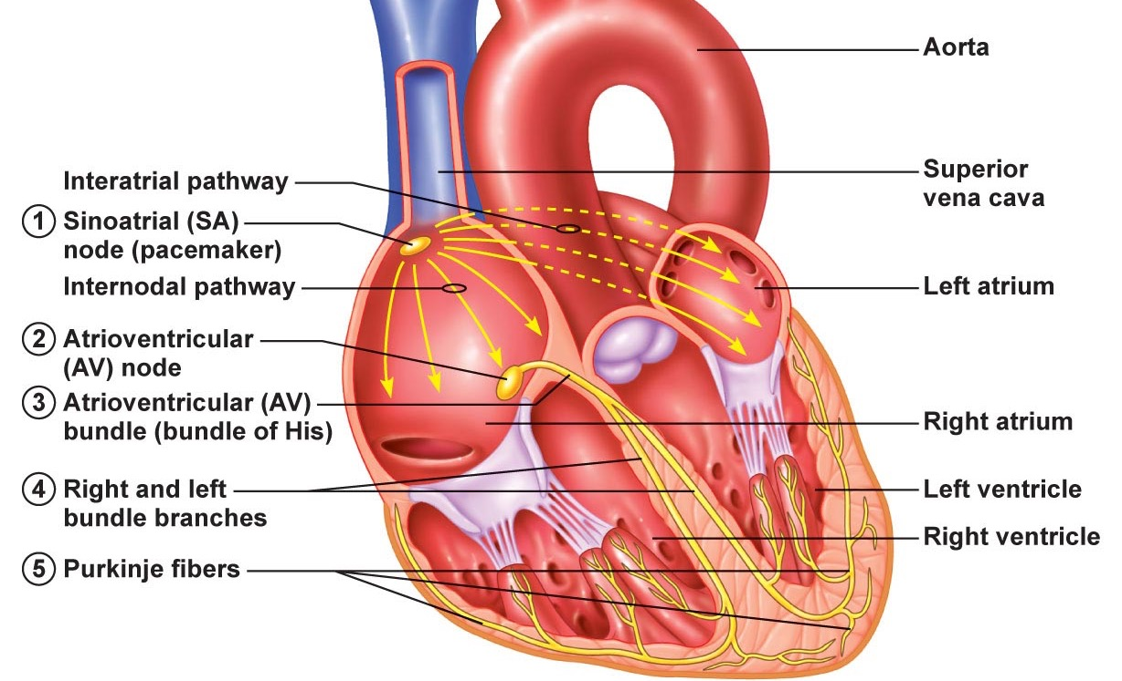
Cardiac Arrhythmias
The Peer Teaching Society is not liable for false or misleading information…

Slide 78
Cardiac Arrhythmias
Definition
Brady: <60bpm day; <50bpm night
Tachy: >100bpm
Clinical Features
Asymptomatic Syncope Heart failure
Chest pain Pre-syncope Palpitations
The Peer Teaching Society is not liable for false or misleading information…

Slide 79
Cardiac Arrhythmias
Supraventricular Tachycardia
Tachycardia arising from atrium or atrioventricular junction…
Artial fibrillation
Atrial flutter
Atrioventricular nodal re-entry tachycardia (AVNRT)
Atrioventricular reciprocating tachycardia (AVRT)
The Peer Teaching Society is not liable for false or misleading information…

Slide 80
Cardiac Arrhythmias
1. Atrial Fibrillation
Causes: conditions affecting the atrial pressure/mass
Heart failure and HTN commonest
Pathophysiology
Atrial activation 300-600/min.
Only proportion conducted to ventricles, due to refractory period of AV node.
HR 120-180bpm.
The Peer Teaching Society is not liable for false or misleading information…
Notes:
Occurs in 1-2% general population; 5-10% patients >75 years old.
Causes:
Any condition causing raised atrial pressure, increased atrial mass, atrial fibrosis, or inflammation/infiltration of the atrium.
HTN and heart failure are the commonest causes.
Also rheumatic heart disease, alcohol intoxication and thyrotoxicosis are classic causes.
Pathophysiology
Continuous, rapid (300-600/min) activation of the atria by multiple meandering re-entry wavelets.
Only a proportion of impulses conducted to the ventricles.
Refractory period.

Slide 81
Cardiac Arrhythmias
1. Atrial Fibrillation
ECG: F waves, no P waves, QRS irregularly irregular
The Peer Teaching Society is not liable for false or misleading information…
Notes:
F waves (fibrillation of the baseline)
No clear P waves
QRS is rapid and irregular (120-180bpm)
“Irregularly irregular”

Slide 82
Cardiac Arrhythmias
1. Atrial Fibrillation
Management
1. Medical
Rate control (beta-blocker, rate-limiting Ca²⁺ blocker)
Rhythm control (amiodarone)
2. Cardioversion
Electrical or pharmaceutical
The Peer Teaching Society is not liable for false or misleading information…
Notes:
Medical Management
Rhythm control
Dronedarone to maintain sinus rhythm after cardioversion
Amiodarone if left ventricular failure
Rate control
Beta-blocker (atenolol)
Rate-limiting calcium channel blocker (diltiazem)
Digoxin monotherapy in non-paroxysmal AF
Cardioversion
Electrical cardioversion if AF >48hrs
Echo may be used to guide cardioversion.
Left Atrial Ablation

Slide 83
Cardiac Arrhythmias
1. Atrial Fibrillation
Nb. CHADS₂VASc Score!
The Peer Teaching Society is not liable for false or misleading information…
Notes:
0 = No anticoagulation
1 = consider oral anticoagulation or aspirin
2 = oral anticoagulation (warfarin, rivaroxaban)
Target INR: 2.0-3.0

Slide 84
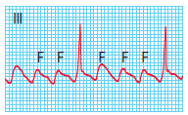
Cardiac Arrhythmias
2. Atrial Flutter
Regular counter-clockwise flutter pattern of depolarisation.
Atrial rate 250-300bpm.
The Peer Teaching Society is not liable for false or misleading information…
Notes:
ECG
Regular sawtooth-like flutter waves (F waves)
Management of Atrial Flutter
Electrical cardioversion
Anticoagulated for 3 weeks prior to cardioversion
Catheter ablation therapy for persistent flutter

Slide 85
Cardiac Arrhythmias
3. Atrioventricular nodal re-entry tachycardia (AVNRT)
Within AV node; “slow-fast” rhythm.
QRS complexes 140-240/min.
4. Atrioventricular re-entry tachycardia (AVRT)
AV node, His bundle, ventricle and fibres.
P wave seen between QRS and T wave.
Eg. Wolff-Parkinson-White syndrome.
The Peer Teaching Society is not liable for false or misleading information…
Notes:
Wolff-Parkinson-White syndrome
Pre-excited ECG (with short PR interval, wide QRS and δ waves)
History of palpitations.
Broad complex tachycardia
Atrioventricular Reciprocating Tachycardia (AVRT)
Large circuit comprising AV node, His bundle, the ventricle and an abnormal connection of myocardial fibres.
Atrial activation occurs after ventricular activation: P wave usually seen between QRS and T wave.
AV node and ventricles activated normally, giving narrow QRS.

Slide 86
Cardiac Arrhythmias
Management SVT (AVNRT, AVRT)
Vagal manoeuvres
IV adenosine
Long-term verapamil, beta-blockers, diltiazem.
The Peer Teaching Society is not liable for false or misleading information…
Notes:
Management of SVT
Vagal manoeuvres
Right carotid massage
Valsalva manoeuvre (preferred)
Facial immersion in cold water
IV adenosine
Purine nucleotide that causes complete heart block for a fraction of a second as soon as it is administered.
S/E: bronchospasm, flushing, chest pain, heaviness of the limbs, sense of impending doom.
Long-Term Management
Verapamil
Beta-blockers
Diltiazem

Slide 87
Cardiac Arrhythmias
Ventricular Tachycardia
1. Sustained ventricular tachycardia
>30s, HR120-220, rapid regular ventricular rhythm.
Broad QRS, P waves march through QRS
TREAT: DC cardioversion or amiodarone
The Peer Teaching Society is not liable for false or misleading information…
Notes:
Sustained Ventricular Tachycardia
>30 seconds.
Pre-syncope, syncope, hypotension, cardiac arrest.
HR 120-220bpm.
ECG: rapid ventricular rhythm, broad QRS.
Visible P waves which appear to march through the tachycardia.
TREAT: emergency DC cardioversion OR amiodarone if condition stable.

Slide 88
Cardiac Arrhythmias
Ventricular Tachycardia
2. Ventricular fibrillation
Rapid irregular ventricular activation.
Pulseless.
ECG: shapeless, rapid oscillations
TREAT: DC cardioversion
The Peer Teaching Society is not liable for false or misleading information…
Notes:
Ventricular Fibrillation
Rapid and irregular ventricular activation with no mechanical effect.
Patient is pulseless and becomes rapidly unconscious, and respiration ceases.
ECG: shapeless, rapid oscillations.
TREAT: electrical defibrillation.
Implantable cardioverter-defibrillators if risk of recurrence.

Slide 89
Cardiac Arrhythmias
AV Heart Block
First degree
Second degree (Mobitz I and Mobitz II)
Third degree
The Peer Teaching Society is not liable for false or misleading information…

Slide 90
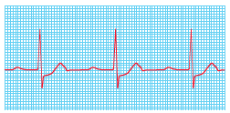
Cardiac Arrhythmias
AV Heart Block: First Degree
Prolongation of PR interval >0.22s.
Every P associated with QRS complex.
The Peer Teaching Society is not liable for false or misleading information…
Notes:
1. First-Degree AV Block
Prolongation of PR interval >0.22s.
Every atrial depolarisation is followed by conduction to the ventricles but with delay.

Slide 91
Cardiac Arrhythmias
AV Heart Block: Second Degree (Mobitz I)
Progressive PR prolongation until a P wave fails to conduct.
The Peer Teaching Society is not liable for false or misleading information…
Notes:
2. Second-Degree AV Block
Some P waves conduct, some do not.
Mobitz I Block “Wenckebach block” (block in AV node)
Progressive PR prolongation until a P wave fails to conduct.
PR interval before the blocked P wave is much longer than PR interval after blocked P wave.

Slide 92
Cardiac Arrhythmias
AV Heart Block: Second Degree (Mobitz II)
Dropped QRS complex not preceded by progressive PR interval prolongation.
The Peer Teaching Society is not liable for false or misleading information…
Notes:
2. Second-Degree AV Block
Some P waves conduct, some do not.
Mobitz II Block (block in His bundle)
Dropped QRS complex not preceded by progressive PR interval prolongation.
Usually QRS wide >0.12s.

Slide 93
Cardiac Arrhythmias
AV Heart Block: Third Degree
All atrial activity fails to progress to ventricles
Don’t really need to know this in any detail
The Peer Teaching Society is not liable for false or misleading information…

Slide 94
Peripheral Vascular Disease
The Peer Teaching Society is not liable for false or misleading information…

Slide 95
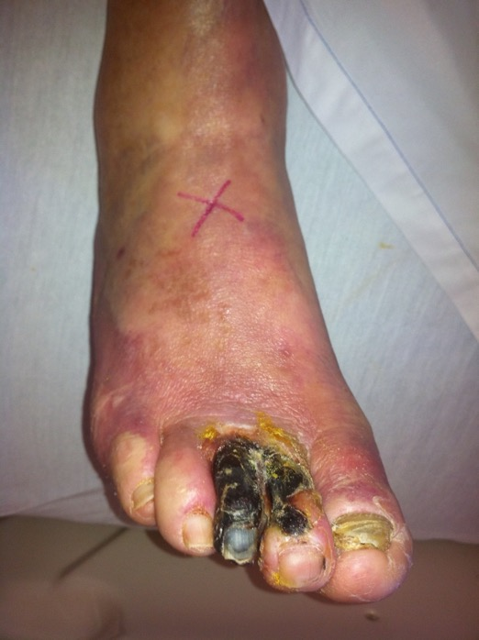
Peripheral Arterial Disease
Chronic Lower Limb Ischaemia
Symptoms (Fontaine)
Stage I: asymptomatic
Stage II: intermittent claudication
Stage III: rest pain/nocturnal pain
Stage IV: necrosis/gangrene
The Peer Teaching Society is not liable for false or misleading information…
Notes:
Clinical Features of Chronic Lower Limb Ischaemia
Symptoms
Fontaine Classification:
Stage I: asymptomatic
Stage II: intermittent claudication
Stage III: rest pain/nocturnal pain
Stage IV: necrosis/gangrene
Signs
Cold limbs
Dry skin
Lack of hair
Diminished/absent pulses
Ulceration
Discoloration

Slide 96
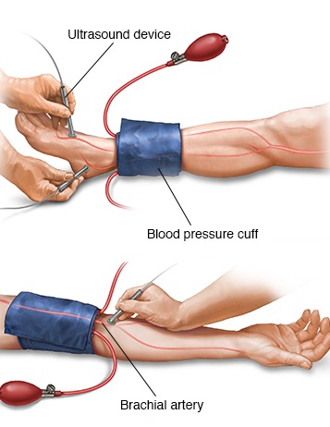
Peripheral Arterial Disease
Chronic Lower Limb Ischaemia
Risk factors: smoking, DM, high cholesterol, HTN, etc.
Ankle/brachial pressure index (ABPI)
0.5-0.9 – intermittent claudication
<0.5 – critical limb ischaemia
The Peer Teaching Society is not liable for false or misleading information…
Notes:
Investigations for Chronic Limb Ischaemia
Ankle/brachial pressure index (ABPI)
0.5-0.9 = intermittent claudication
<0.5 = critical limb ischaemia
Angiography
USS
3D contrast MR angiography or CT angiography

Slide 97
Peripheral Arterial Disease
Chronic Lower Limb Ischaemia
Management
Control risk factors
Peripheral vasodilators (naftidrofuryl oxalate)
Cilostazol for symptomatic relief
Bypass/stent
The Peer Teaching Society is not liable for false or misleading information…
Notes:
Management of Chronic Limb Ischaemia
Medical
Risk factor management
Stop smoking
DM control
Statins
Low-dose aspirin
Pharmacological management
Peripheral vasodilators (naftidrofuryl oxalate).
Cilostazol for symptomatic relief.
Surgical
Bypass surgery
Endovascular revascularisation

Slide 98
Peripheral Arterial Disease
Acute Lower Limb Ischaemia
Embolic or thrombotic disease.
Symptoms: Five Ps
Pain
Pallor
Paraesthesia
Paralysis
Perishingly cold
The Peer Teaching Society is not liable for false or misleading information…

Slide 99
Peripheral Arterial Disease
Acute Lower Limb Ischaemia
Management
LMWH, warfarin
Bypass, stent, embolectomy
The Peer Teaching Society is not liable for false or misleading information…
Notes:
Management of Acute Limb Ischaemia
Medical
Heparin
Long-term warfarin if emboli from AF/MI
Surgical
Graft thrombolysis if patient has occluded a graft
Angioplasty
Embolectomy
Bypass graft

Slide 100
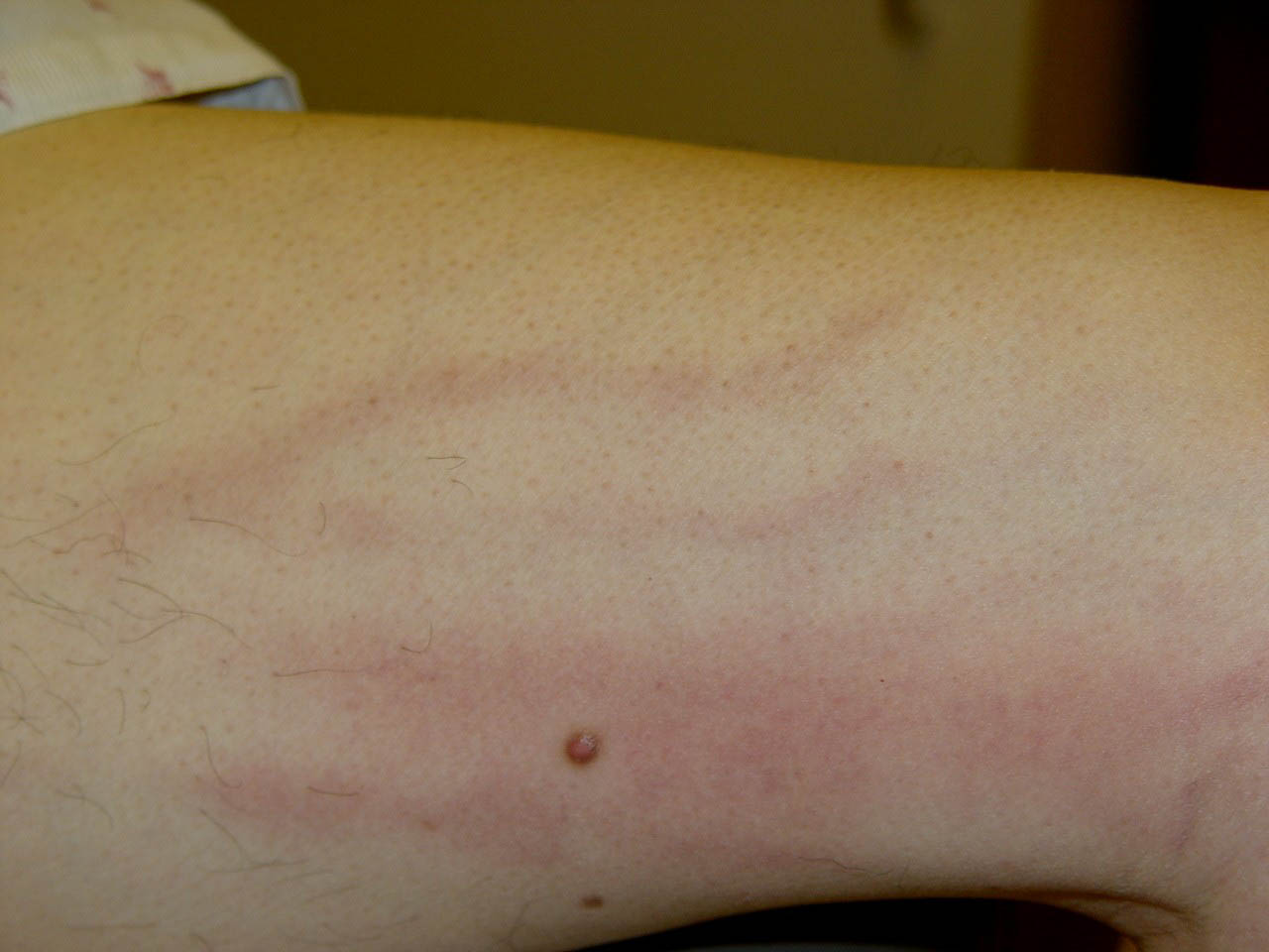
Peripheral Venous Disease
Superficial Thrombophlebitis
Inflammation, commonly saphenous veins.
The Peer Teaching Society is not liable for false or misleading information…
Notes:
Clinical Features of Superficial Thrombophlebitis
Painful
Tender
Cord-like structure in leg
Associated redness
Swelling

Slide 101
Peripheral Venous Disease
Superficial Thrombophlebitis
Management
Rest and elevation of leg
Analgesia
Subcut. Fondaparinux may reduce recurrence
The Peer Teaching Society is not liable for false or misleading information…
Notes:
Management of Superficial Thrombophlebitis
Rest and elevation of the limb
Analgesia (NSAIDs)
Subcutaneous fondaparinux to reduce rate of events

Slide 102
Peripheral Venous Disease
Deep Vein Thrombosis (DVT)
Risk factors?
Clinical Features
Calf pain, swelling and tenderness
Engorged superficial veins
Warm to touch
PE symptoms?
The Peer Teaching Society is not liable for false or misleading information…
Notes:
Risk Factors for DVT
Immobilisation
Prior hx DVT
>60 y o
Surgery
Obesity
Prolonged travel
Acute illness
Cancer
Thrombophilia
Pregnancy
Clinical Features of DVT
Calf pain
Swelling
Tenderness
Engorged superficial veins
Warm to touch
Ankle oedema
Homan’s sign (pain in calf on dorsiflexion of foot)

Slide 103
Peripheral Venous Disease
Deep Vein Thrombosis (DVT)
Investigations
D-dimer, Doppler, USS venography
Management
LMWH and warfarin (INR 2.5)
The Peer Teaching Society is not liable for false or misleading information…
Notes:
Investigations for DVT
D-dimer (Sensitivity of 80%)
Iliofemoral Thrombosis?
B mode venous compression
Ultrasonography
Doppler USS
Below Knee Thromboses
Venography (USS)
Management of DVT
Aim to prevent PE
Low-molecular weight heparin (LMWH) (short-term)
Give at the same time as warfarin.
Stop when INR is in desired range.
Warfarin (long-term – 3 months) – INR 2.5

Slide 104
Questions
5 risk factors for atherosclerosis?
Typical lesion seen in athersclerosis?
Three components?
The Peer Teaching Society is not liable for false or misleading information…
Notes:
Obesity, male, high LDLs, low HDLs, smoking, hypertension, afro-caribbean
Fatty streak
Macrophages, smooth muscle cells, lipid core, fibrous capsule, lymphocytes

Slide 105
Questions
Risk factors for MI?
Symptoms?
3) Treatment?
The Peer Teaching Society is not liable for false or misleading information…
Notes:
As per the last question plus FH, previous MI, angina etc.
Crushing central chest pain radiating to jaw, left arm, shoulder etc. SOB, impending doom, nausea, sweating, pallor…
Revascularisation (PCI), MONA, fibrinolytics

Slide 106
Questions
1) What causes pulmonary oedema in left ventricular failure?
2) What are the symptoms of LVF other than exceptional breathlessness, fatigue?
3) Give 3 mechanisms why her symptoms might be getting worse?
The Peer Teaching Society is not liable for false or misleading information…
Notes:
decreased left ventricular output, increased pulmonary hypertension, increased fluid leakage from capillaries into alveoli
Paroxysmal nocturnal dyspnea , coughing, wheezing, orthopnea
Pathological hypertrophic growth of heart, valvular incompetence, decreased alveolar surface area/ alveolar destructiom, hypervolemia, progressive atherosclerosis

Slide 107
Questions
1) Acute MI - which drug to give for thrombolysis?
Streptokinase
Warfarin
Heparin
Atenolol
Filodipine
The Peer Teaching Society is not liable for false or misleading information…

Slide 108
Questions
1) The product of which two things will equal mean arterial pressure.
2) Name two things released by endothelial cells for vascular tone
3) Four things released by tissue to increase blood flow
4) Name of the phenomenon that causes increased blood flow to area where there was previously occlusion
The Peer Teaching Society is not liable for false or misleading information…
Notes:
1) Diastolic Pressure + ⅓*Pulse Pressure
2) NO, Endothelin-1
3) Adenosine, NO, prostacyclin and K+
4) Reactive hyperaemia

