Slide 1
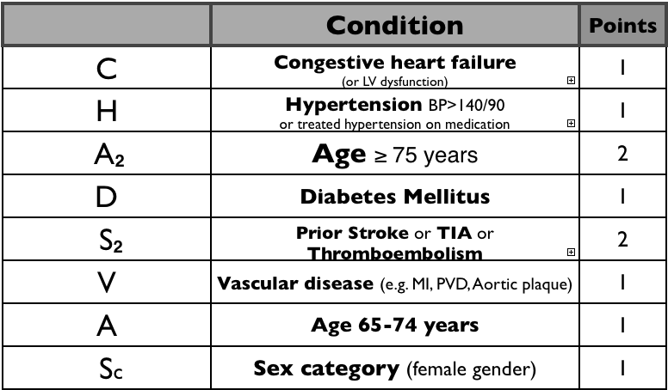
Notes:
Stroke risk for patients with AF
<1 = no anticoagulation
1 = consider anticoagulation (male), no anticoagulation (female)
>1 = anticoagulation

Slide 2
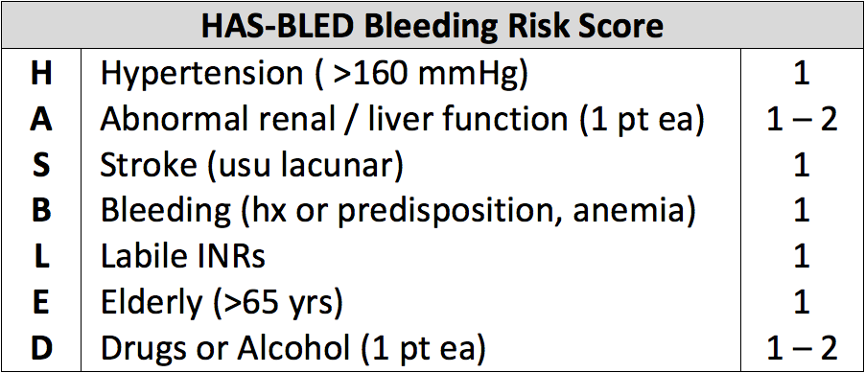
Notes:
Risk of major bleeding for patients on anticoagulation for AF
=>3 = high risk of bleeding
Alcohol (>8 drinks pw). Drugs predisposing to bleeding, e.g. NSAID, antiplatelet
Use this score in conjunction with CHADSVASC to weigh benefits and harms of anticoagulation

Slide 3
Tachycardia – Broad Complex
Regular | Irregular
Ventricular tachycardia | Ventricular fibrillation Polymorphic VT (Torsades de Pointes)

Slide 4
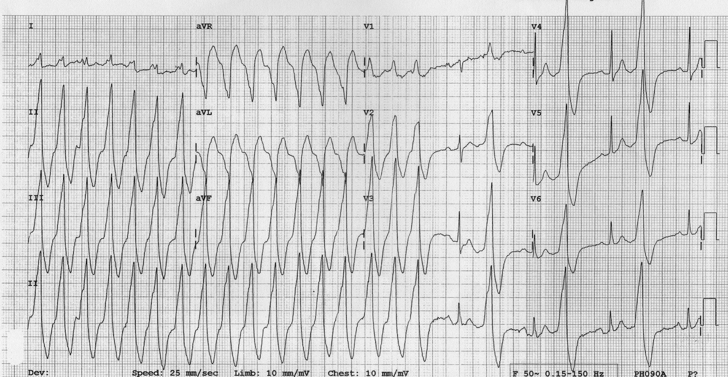
Ventricular Tachycardia
Notes:
Due to re-entrant circuit due to scarring from past ischaemia/infarction OR triggered by long QT or digoxin toxicity
Pic = Monomorphic VT = tachycardia, very broad QRS (>160bpm), positive concordance in precordial leads (dominant R waves), multiple capture beats (normal beats) in second half of tracing

Slide 5
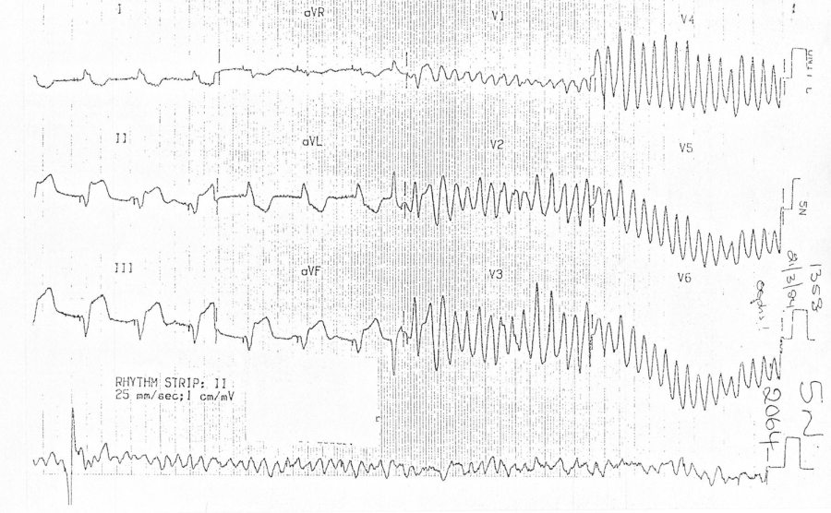
Ventricular Tachycardia -> VF
Notes:
Pic: R on T event -> Polymorphic VT -> VF
Also: inferior ST elevation, ventricular pacing spikes
[rhythm strip after individual lead strips]

Slide 6
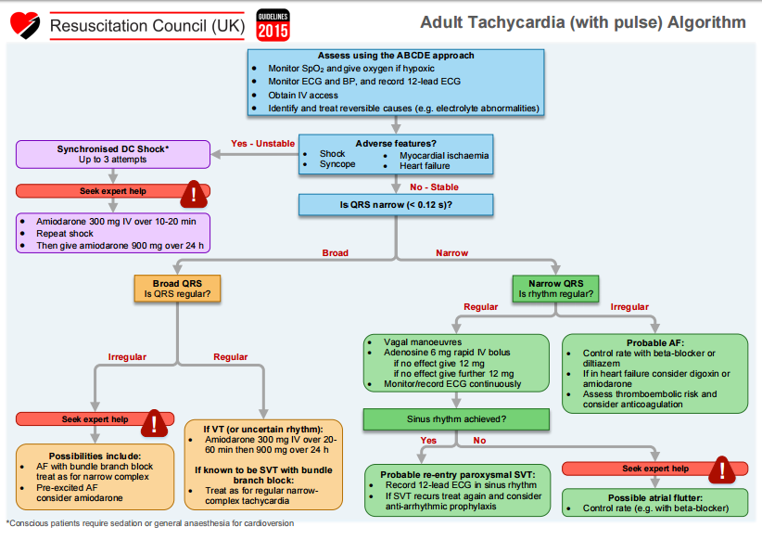

Slide 7
Ischaemic Heart Disease

Slide 8
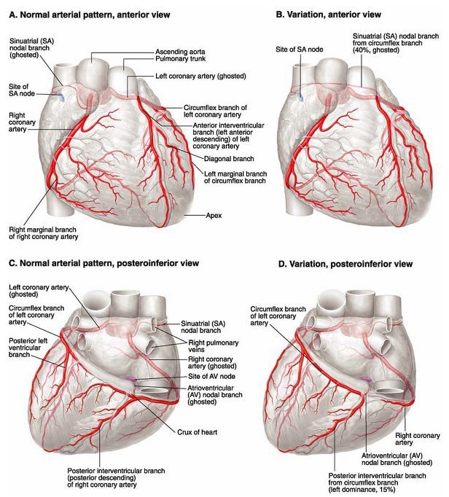
Notes:
RCA passes between pulmonary trunk and RA to lie in the atrioventricular groove. Gives off branch, Right Marginal Artery, supplies SAN in 60% cases. Winds around heart and gives off Posterior Descending Artery (PDA) in 85% cases.
LCA passes behind pulmonary trunk and left auricle to reach atrioventricular groove, divides into Circumflex and Anterior Descending Arteries. Circumflex gives off Left Marginal Artery before winding around anastomosing with RCA posteriorly. Anterior Descending (LAD) is the ‘widow maker’ (male MI) descends in interventricular septum and gives off many branches, including Diagonal Artery.
In 40% cases SAN supplied by Circumflex of LCA.
In 8% cases PDA arises from Circumflex.
In 7% cases PDA arises from RCA and Circumflex.
AVN supplied by RCA in 90% and Circumflex in 10%.

Slide 9
Stable Angina
PATH
Atherosclerosis -> coronary stenosis -> ischaemia
RF!
PREC
Emotion
Cold
Heavy Meals
Angina Chest Pain
Constricting discomfort in front of chest, neck, shoulders, jaw or arms
Precipitated by physical exertion
Relieved by rest or GTN within 5 minutes
Notes:
Other Types: Decubitus (exacerbated by lying down), Variant/Prinzmetal (coronary artery spasm during rest, transient ST elevation on ECG during pain, CCB +/- Long-Acting Nitrates)

Slide 10
Stable Angina
Mx
RF Mx
Aspirin, Statin, Glyceryl Trinitrate (SL)
BB (atenolol)/CCB (verapamil/diltiazem)
BB + CCB (nifedipine), OR monotherapy + long-acting nitrate/ivabradine/nicorandil/ranolazine
Can use BB + CCB + 3rd Drug whilst waiting for PCI/CABG
PCI
Surgery (CABG)
INV
ECG (possibly ST depression, old infarct)
Stress Echo / Coronary Angiography / Cardiac CT calcium score / Myocardial perfusion scan with SPECT

Slide 11
Acute Coronary Syndromes
PRES
Acute Central Chest Pain (>15min)
+/- N+V/ SOB/ Palpitations/ Sweating
‘silent’ in elderly/DM: Syncope/Epigastric Pain/Delirium
PATH
Plaque Rupture = Thrombosis = Inflammation
(emboli, coronary spasm, vasculitis)
ACS Types
Unstable Angina
NSTEMI ~subendocardial
STEMI ~transmural
Notes:
Occluded Arteries: LAD > RCA > Circumflex
RF: (atherosclerosis)
SIG: Anxiety, Pallor, Sweatiness, S4, HF Signs

Slide 12
ECG MI
Myocardial Infarction (MI) DEF:
Rise +/- Fall of Cardiac Troponin
One Troponin Measurement Above Upper Limit
One of:
Symptomatic
New ST-T changes, LBBB or pathological Q waves
Intracoronary thrombus (CT coronary angiography)
New loss of viable myocardium or new regional wall motion abnormality (MPS with SPECT, stress echo, stress MRI)
STEMI DEF
ST Elevation
>1mm in =>2 contiguous limb leads
>2mm in => 2 contiguous chest leads
New LBBB

Slide 13
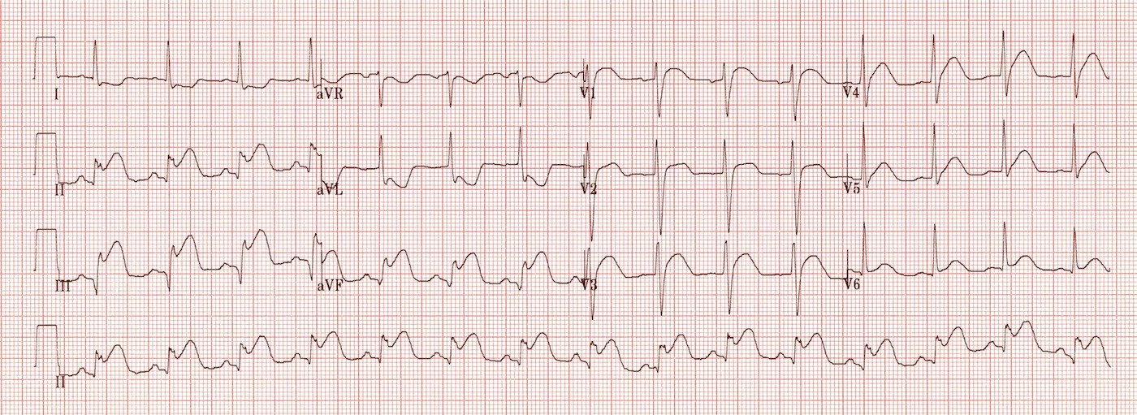
Inferior STEMI
Notes:
Pic: Inferior (RCA) MI + Right Ventricular Infarction = ST elevation II/III/AVF, ST elevation III>II, ST elevation V1+/-V2, ST depression I/AVL
40-50% of all MI’s
ASSOC: Right Ventricular Infarction (~40%), 2nd/3rd HB (~20%), Lateral MI
AE: RCA (~80%) – ST elevation III>II, ST depression I, right ventricular infarction, LCX – ST elevation III=II, absent ST depression, lateral ST elevation

Slide 14
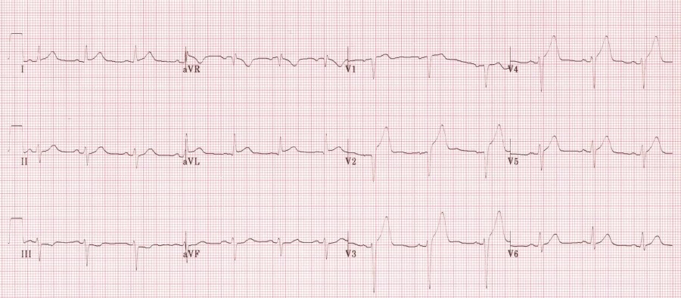
Anterior STEMI
Notes:
Anterior = Anterior STEMI (LAD), Left Main Coronary Artery Occlusion, Wellen’s Syndrome, De Winter’s T Waves
Pic = Hyperacute Anteroseptal STEMI = V1-4 ST elevation, V1-2 pathological Q waves, V2-4 hyperacute T waves, III reciprocal ST depression

Slide 15
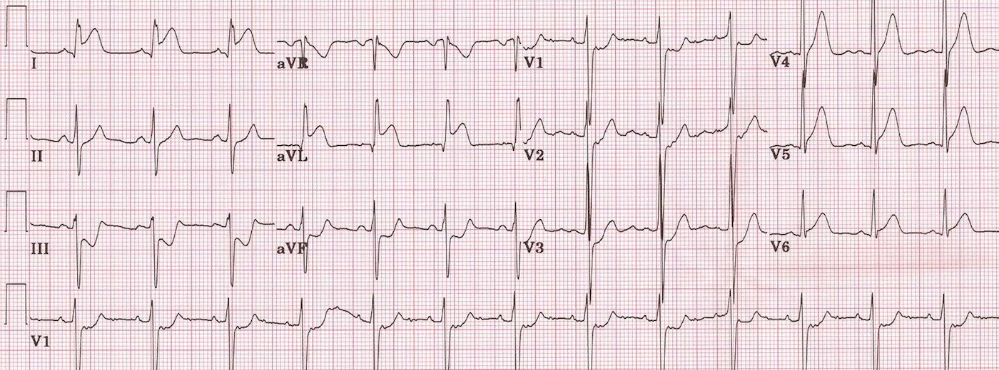
Lateral STEMI
Notes:
Anterolateral/High Lateral (I/AVL) = LAD, Inferior-Posterior-Lateral = LCX
Pic = High lateral STEMI = ST elevation I/AVL + hyperacute T waves V4-6 + ST depression III/AVF

Slide 16
Management
BOTH: (STEMI and NSTEMI)
Pre-Hospital: Aspirin 300mg and GTN
Acute (MONA)
ECG, Troponin, Other Bloods, CXR
Analgesia: GTN, Morphine (5-10mg) +/- Metoclopramide IV
Aspirin (300mg) + Clopidogrel
Heparin
O2 (only if hypoxic)
STEMI:
PCI (within 12hrs symptom onset, 90mins after thrombolysis and ST elevation not resolved), Thrombolysis (if can’t get PCI within 2hrs)
Notes:
Thrombolysis if facilities not available for PCI

Slide 17
Management
NSTEMI
Assess Risk (High = Continued Pain, ST depression, DM, Raised Troponin)
Intermediate/High:
GPIIb/IIIa Infusion (tirofiban) + Angiography (within 96hrs of admission)
Optimise Drugs (+Statin, +CCB, +ACE-i)
(continued symptoms) PCI/CABG
Notes:
Low Risk: (no further pain, flat/inverted T waves, negative troponin)
Dicharge if 12hr trop is –ve
Otherwise: Exercise Echo, Angiogram
Prescribing a statin:
QRISK2 = takes into account many factors, score > 10% indicates need for interventions, e.g. statin

Slide 18
Subsequent Management
Bed Rest
Daily Examination, Bloods, ECG
LMWH (DVT prophylaxis)
Cardiac rehab
DRUGS (BACAS)
Aspirin
Clopidogrel (or other PY12)
Beta-Blocker
ACEi
Statin

Slide 19
Complications
(short-term)
Cardiac Arrest
Cardiogenic Shock
Acute Heart Failure
Dysrhythmias (heart block, tachyarrhythmia)
Pericarditis (<48hrs)
(long-term)
Unstable Angina
Mitral Regurgitation (papillary muscle rupture)
Chronic Heart Failure
Dresslers Syndrome (2-6wks)
Left Ventricular Aneurysm (persistent ST elevation + LVF)
Notes:
Tachyarrhythmia:
Management depends on type (sinus, VT, AF, atrial flutter, VF), usually: analgesia, cardioversion (pharm/electr)
Pericarditis:
Central chest pain relieved by sitting forward. ECG (saddle-shaped ST elevation). Echo. NSAIDS
Cardiac Tamponade:
Low CO, pulsus paradoxus, raised JVP. Echo. Pericardial aspiration, Surgery.
Ruptures = 3-14days post MI
Dresslers Syndrome:
AUI. 2-10wks post MI.
SYM: Recurrent fever, chest pain
SIG: Pleural/Pericardial Rub (fibrinous), Cardiac Tamponade
M: Aspirin, NSAIDs, Steroids
Left Ventricular Aneurysm:
4-6wks post-MI.
LVF, Angina, recurrent VT, Systemic embolism.
ECG = persistent ST elevation
M: Anticoagulate, Surgical Excision

Slide 20
Pericarditis

Slide 21
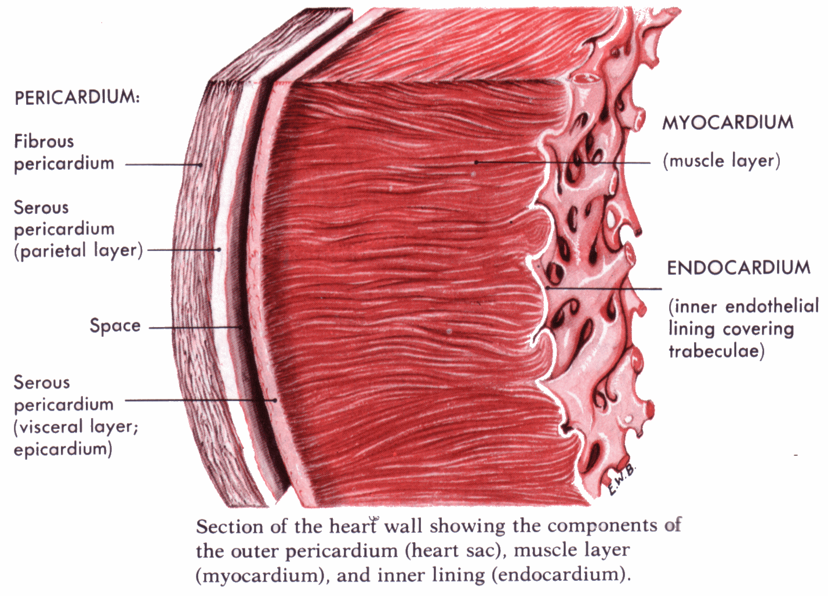
Notes:
Heart histology

