Slide 1
Acute Pericarditis
AE
Idiopathic
Virus (coxsackie, flu, EBV, mumps)
Bacteria (pneumonia, rheumatic fever, TB, staph, strep)
Post-MI / Dressler’s
AUI (SLE, RA)
PRES
Central Chest Pain (worse on inspiration or lying flat, relief by sitting forward)
Fever, SOB
Pericardial Rub, Tachypnoea, Tachyardia
INV
Bloods (troponin, FBC, U&E, viral serology, cultures)
CXR (cardiomegaly = pericardial effusion)
Echo (suspected pericardial effusion)
ECG Features
ST elevation (concave, widespread = I/II/III/AVF/AVL/V2-6)
PR depression
Sinus Tachycardia
Reciprocal ST depression + PR elevation (AVR/V1)
Mx
Analgesia (e.g. Ibuprofen), Treat Cause, Steroid/Immunosuppresant

Slide 2
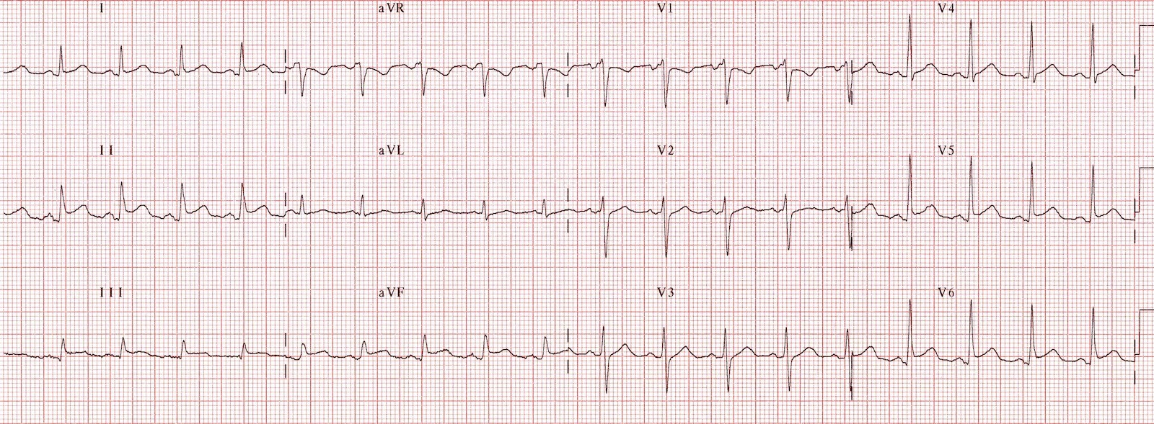
Notes:
Pic = Pericarditis = concave ST elevation + PR depression V5-6/I/II/III/AVF, reciprocal changes in AVR, spodick’s sign +ve (II/AVF/V4-6)

Slide 3
Heart Failure
Physiological: A state where the heart is unable to pump enough blood to satisfy the needs of metabolising tissues
Clinical: “A symptomatic condition where breathlessness, fluid retention and fatigue are associated with a cardiac abnormality that reduces cardiac output”
Cardiac output = HR x Stroke Volume!
The Peer Teaching Society is not liable for false or misleading information…

Slide 4
Heart Failure: Aetiology
Too much to pump: Valve disease High output state
Resistance against pump: HTN Valve disease
Cor Pulmonale
Weak muscle: MI/ CAD Connective tissue diseases Infection
Not enough filling: Pericardial disease Cardiomyopathy Arrhythmias
The Peer Teaching Society is not liable for false or misleading information…

Slide 5
Heart Failure: Mechanisms
Systolic: - Ventricle cannot contract normally
Diastolic: - Inability of ventricle to relax and fill normally.
Neurohormonal changes:
Sympathetic: increased afterload
RAAS: increased afterload + preload
Vasopressin: increased afterload + preload
The Peer Teaching Society is not liable for false or misleading information…

Slide 6
Heart Failure: Frank Starling
The Peer Teaching Society is not liable for false or misleading information…

Slide 7
Heart Failure: Symptoms
Left Sided
Exertional dyspnoea
Orthopnoea
Paroxysmal nocturnal dyspnoea (PND)
Fatigue
Nocturnal cough – pink frothy sputum
Right Sided
Peripheral oedema
Ascites
Nausea
Epistaxis
Anorexia
The Peer Teaching Society is not liable for false or misleading information…

Slide 8
Heart Failure: Signs
Left Sided
Right Sided
Cardiomegaly
Weight loss
Tachycardia
Crepitations in lung bases
Cool peripheries
Murmur
Raised JVP
Hepatomegaly
Pitting oedema
Ascites
The Peer Teaching Society is not liable for false or misleading information…

Slide 9
Heart Failure: Investigations
Chest X ray
Bloods
B-type Natriuretic Peptide
ECG
Transthoracic echocardiogram
NYHA of severity
Framingham Criteria
The Peer Teaching Society is not liable for false or misleading information…
Notes:
FBC, U&E, TFT, LFT

Slide 10
Heart Failure: Chest XR: ABCDE
The Peer Teaching Society is not liable for false or misleading information…

Slide 11
Heart Failure: Treatment
Diuretics
ACE-I / ARB
B-Blocker
Spironolactone
Digoxin
Vasodilators – Hydralazine & Isosorbide Dinitrate
The Peer Teaching Society is not liable for false or misleading information…
Notes:
FBC, U&E, TFT, LFT

Slide 12
Heart Failure: Acute Treatment
Oxygen
Diamorphine IV
Furosemide IV
GTN spray
If systolic BP >100mmHg IV nitrate
The Peer Teaching Society is not liable for false or misleading information…
Notes:
FBC, U&E, TFT, LFT

Slide 13
Shock!
The Peer Teaching Society is not liable for false or misleading information…

Slide 14
Shock!
Circulatory failure (Systolic <90)
Inadequate organ perfusion
Types: - Septic (SIRS + suspected infection + hypotension) - Anaphylactic (vasc tone, histamine, urticaria, oedema) - Cardiogenic (pump failure or inadequate filling) - Hypovolaemic (bleeding, diarrhoea, ascites, pancreatitis) - Spinal (traumatic section, iatrogenic)

Slide 15
Shock: Clinical
Patient history vital
Pallor/Mottled
Rapid but weak pulse
Trying to keep organs purfused
Low BP
Decreased capillary refill time
Chest pain/SOB, wheeze, stridor
Confusion/ reduced GCS
Oliguria
The Peer Teaching Society is not liable for false or misleading information…

Slide 16
Shock: Management
ABC
Airway
Breathing
High-flow oxygen
Circulation
Lay patient flat or head down.
IV access
Fluids FAST to raise BP
Investigations
Treat the cause
Septic shock
Blood cultures before antibiotics
The Peer Teaching Society is not liable for false or misleading information…

Slide 17
Peripheral Vascular Disease
Peripheral Arterial Disease Atherosclerotic stenosis → RFs: Same as CAD.
Symptoms: (Intermittent Claudication) - Cramp → site? Ask about distance! - Relieved by rest
- Burning pain at night → relieved? - Ulceration + gangrene
Signs: - Absent pulses - Punched out ulcers - Atrophic skin - Prolonged cap refil

Slide 18
PAD: Management
Investigations - Bloods: ESR/CRP, FBC, U&E, Lipids
- ECG - ABPI: 0.5-0.9 - USS Doppler - MR Angiography
Treatment - Reduce RFs - Clopidogrel - Exercise programmes - Angioplasty/Amputation if unresolving

Slide 19
Acute Limb Ischaemia
Emergency!
The 6 Ps:
Pale Pulseless Painful Paralysed Paraesthetic Perishingly cold
Management - Urgent surgery/angioplasty - Embolic: thrombolysis - Anticoagulation

Slide 20
Varicose Veins
Tortuous dilated superficial veins.
Incompetent valves → venous HTN.
RFs: standing, obesity, pregnancy, the Pill, fam hx
Symptoms: - Pain - Cramps - Tingling - Heaviness - Restless legs
Signs: - Oedema
- Eczema - Ulcers - Haemosiderin - Phlebitis - Lipodermatosclerosis

Slide 21
Varicose Veins: Management
Supportive: - Elevate legs, avoid standing - Support stockings - Lose weight - Regular walks
Endovascular: - Radiofrequency ablation - Laser ablation
Surgery

