Slide 1
IMMS 1 Revision (part 2)
Nick Richards & Byron Haywood-Alexander

Slide 2
Mitosis/Meiosis
S DNA Synthesis
Cell cycle
X
G0 Quiescence
G1 Growth preparation
G2 Spindle formation
M Mitosis
X

Slide 3
Mitosis
Cellular division
Two genetically identical daughter cells
6 phases
Interphase
Prophase
Prometaphase
Metaphase
Anaphase
Telophase

Slide 4
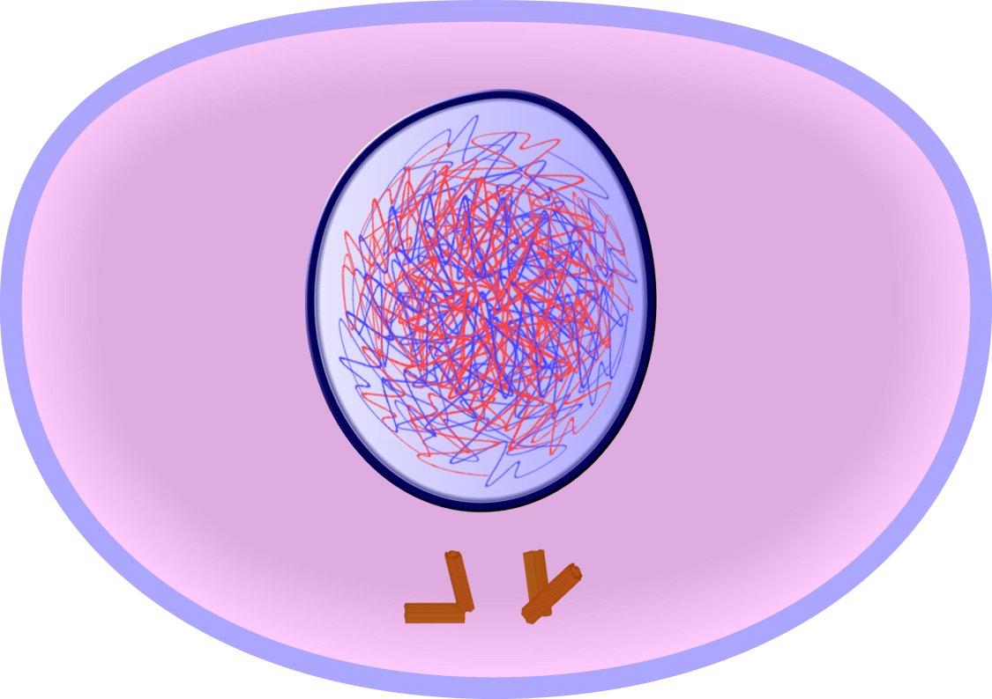
Mitosis - Interphase
Longest phase
DNA gets replicated
Nuclear membrane still intact
DNA is spread out
Centrosomes outside of the nucleus

Slide 5
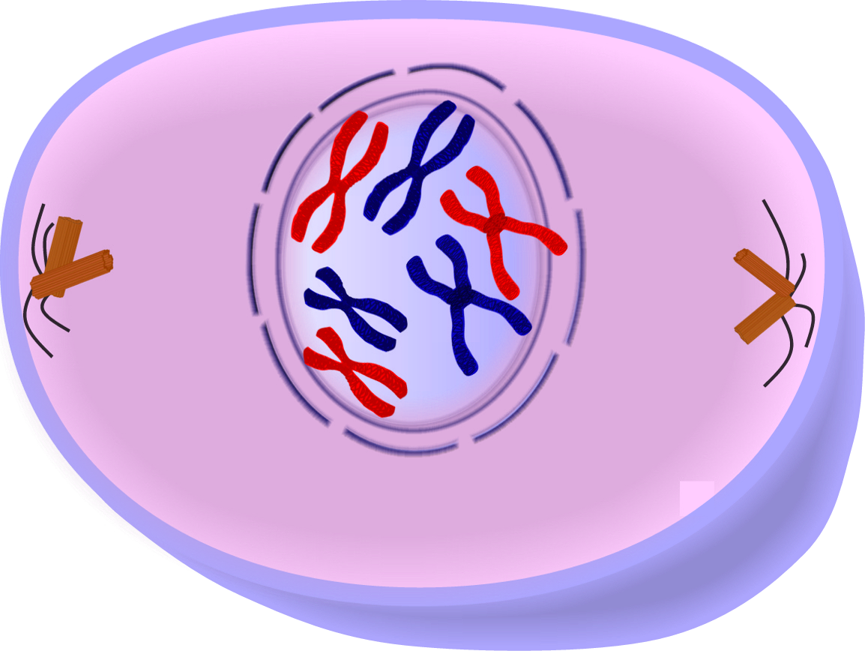
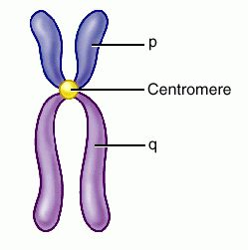
Mitosis - Prophase
DNA condenses to form visable chromosomes
Each made of 2 identical chromotids joined at a centromere
Centrosomes separate and start spindle production
Nucleus membrane starts to disappear

Slide 6
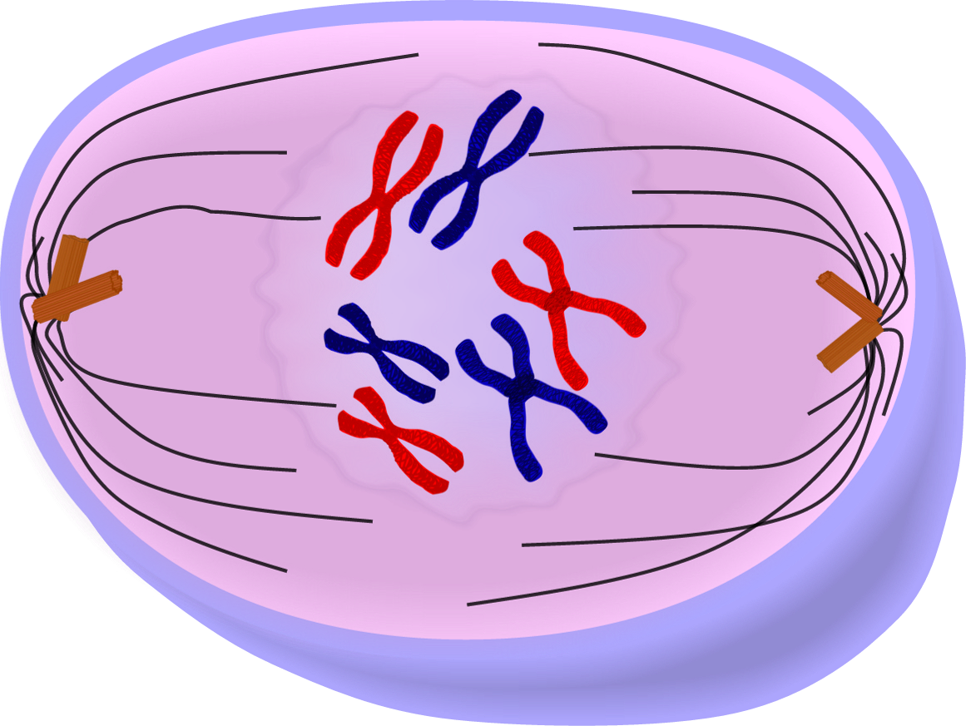
Mitosis - Prometaphase
Nucleus membrane disappears completely
Spindles grow towards the centre of the cell

Slide 7
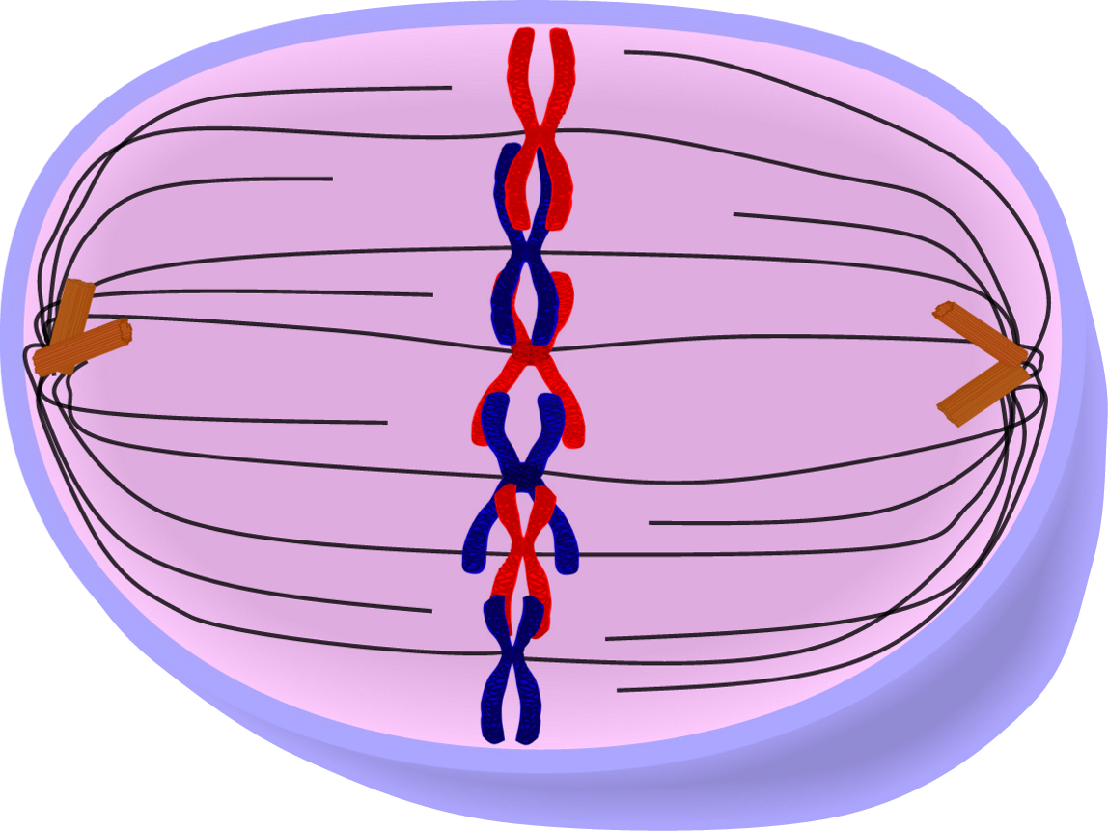
Mitosis - Metaphase
Chromosomes line up in the centre of the cell
Spindles begin to attach to the centromeres

Slide 8
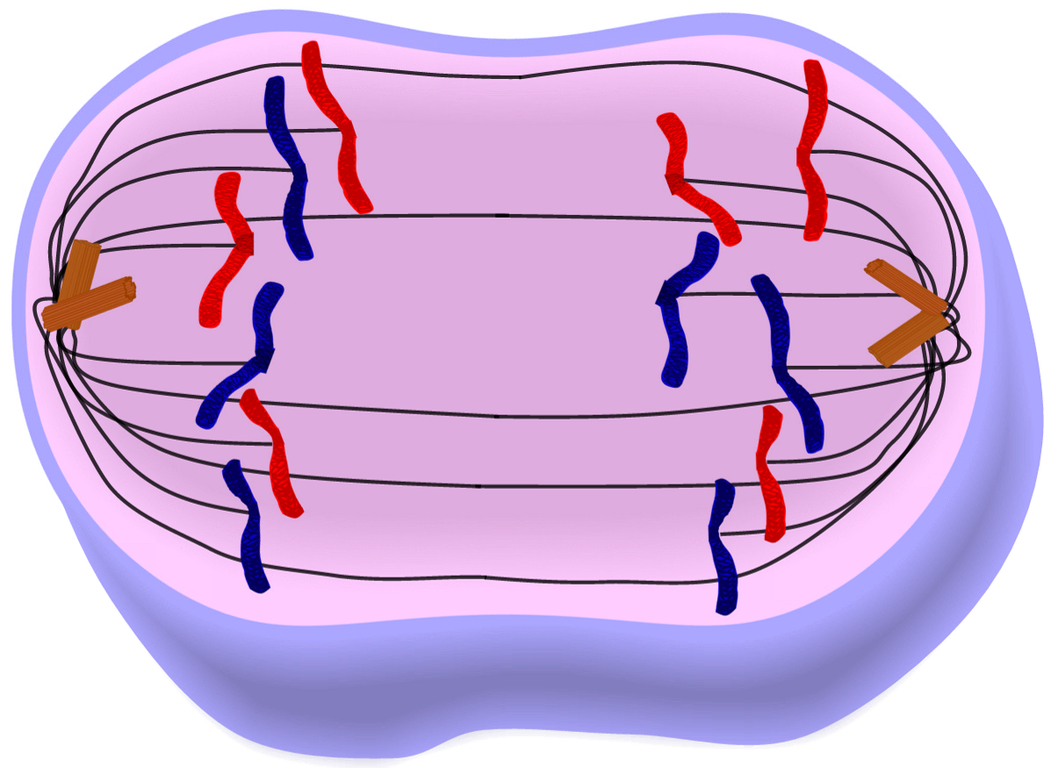
Mitosis - Anaphase
Spindles pull on the centromeres
Chromosomes split in two
Chromatids move towards the poles of the cell

Slide 9
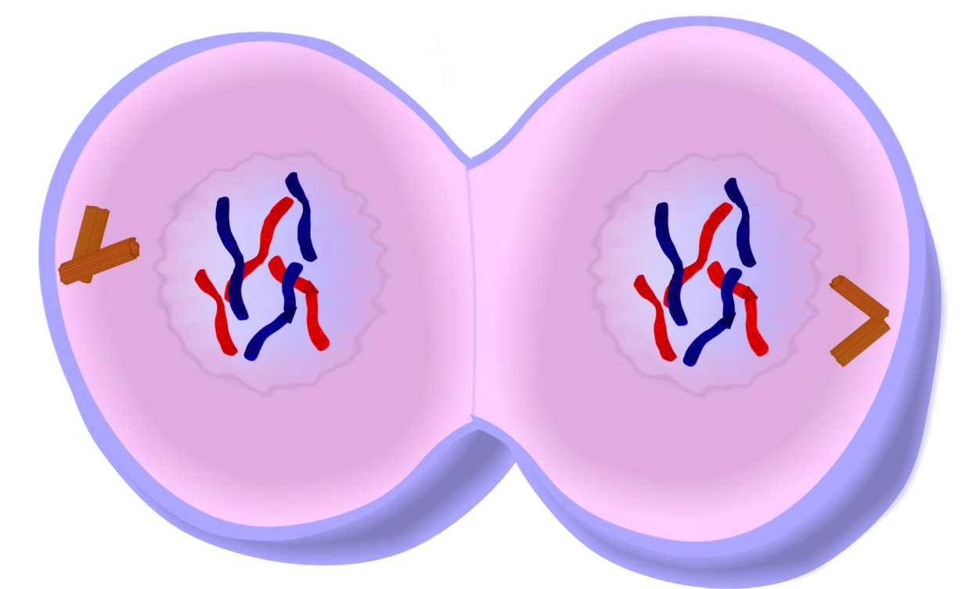
Mitosis - Telophase
Nuclear membranes begin to form
Ring of microfilaments form at the centre of the cell
Microfilament ring tightens

Slide 10
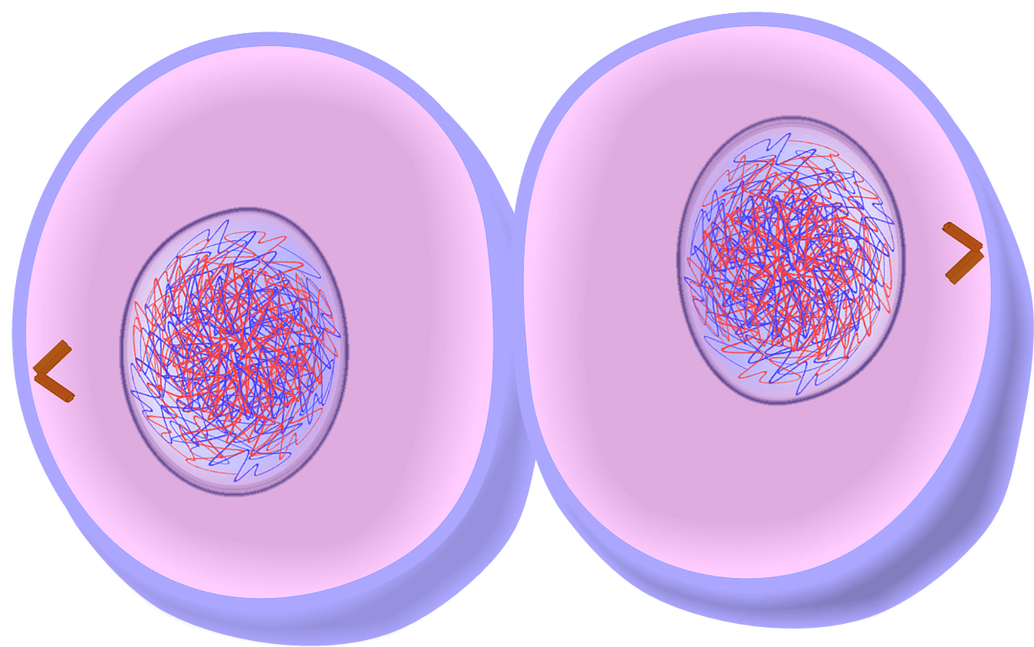
Mitosis - Cytokinesis
Ring tightens until the membranes separate
Two daughter cells
Genetically identical

Slide 11
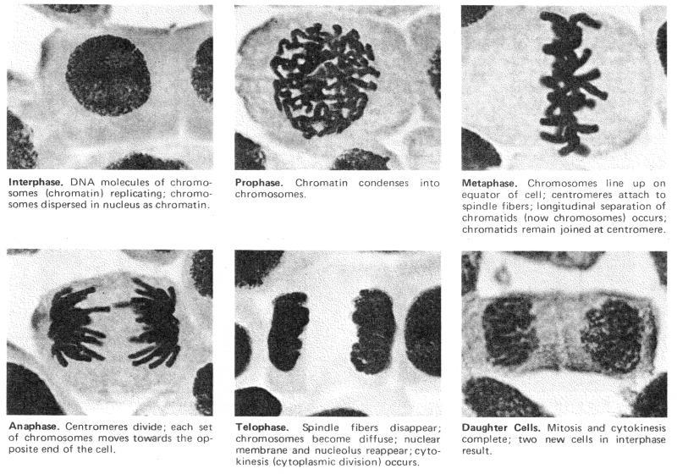

Slide 12
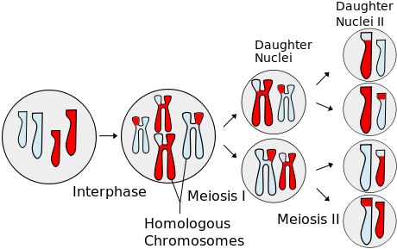
Meiosis
Cellular division
Produces 4 genetically different daughter cells
2 main phases
Meiosis I
Meiosis II

Slide 13
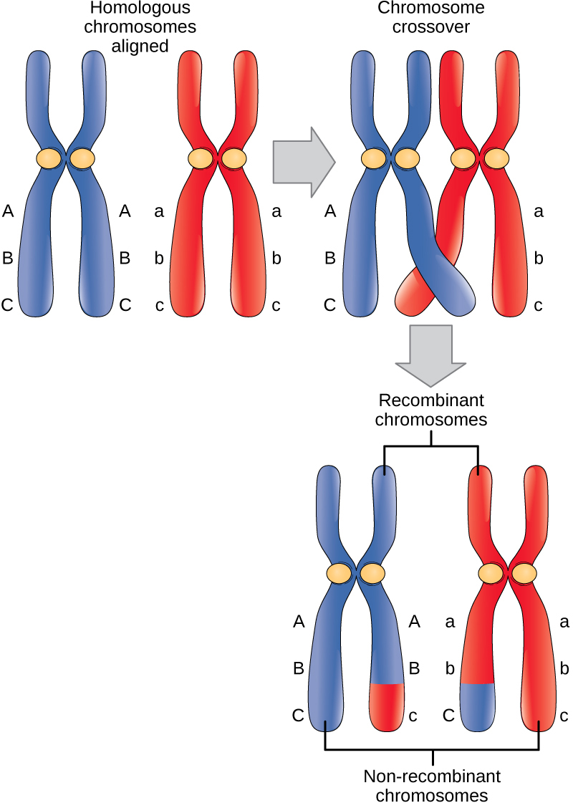
Meiosis - Prophase I
TETRAD
CHIASMA
Maternal Chromosome
Synapsis
Create new genetic combinations
Paternal Chromosome

Slide 14
Meiosis - Metaphase I
Independent assortment

Slide 15
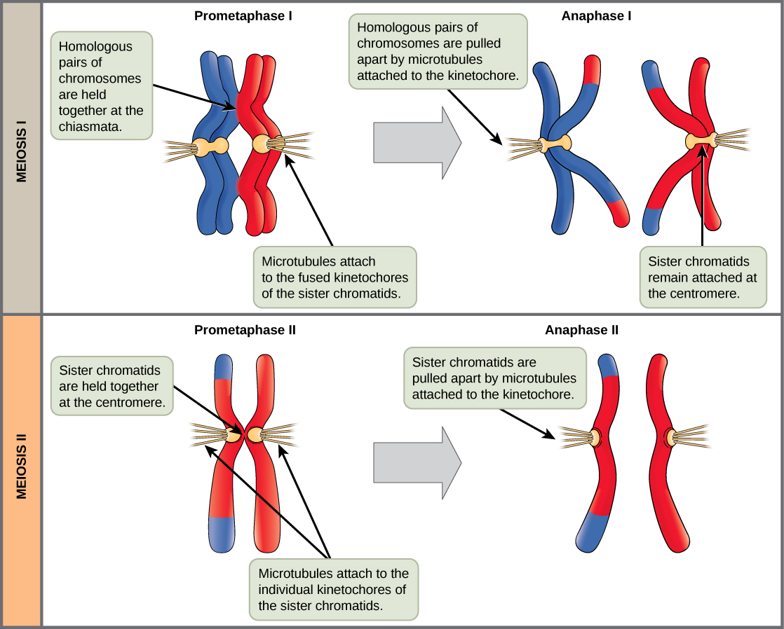
Meiosis II

Slide 16
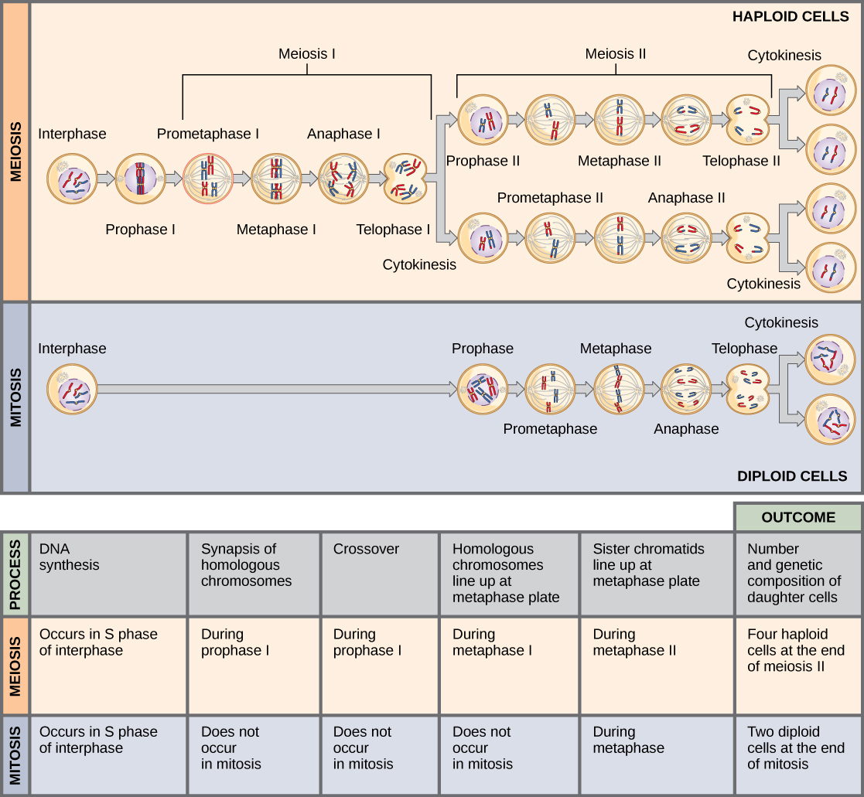

Slide 17
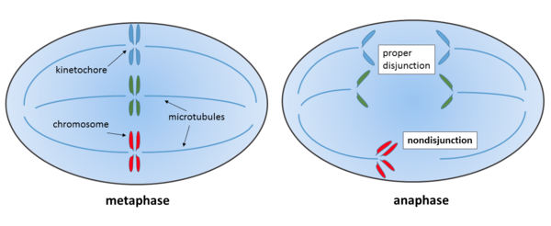
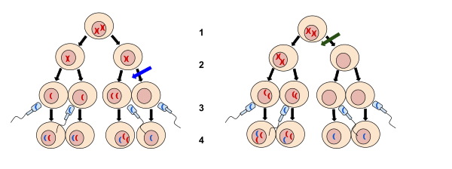
Nondisjunction
Failure of chromatids to separate

Slide 18
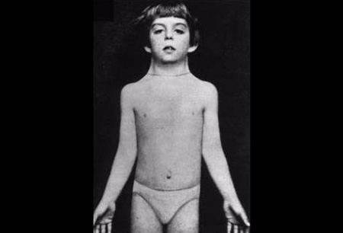
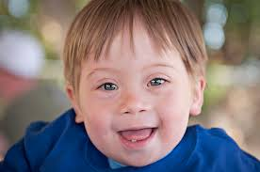
Aneuploidy
Monosomy
Turner’s syndrome
45 X - only one X chromosome
Trisomy
Down’s syndrome
3x chromosome 21
Edward’s syndrome 3x chromosome 18

Slide 19
Gonadal Mosaicism

Slide 20
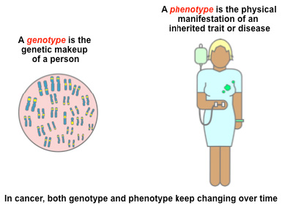
Genetics

Slide 21
Definitions:
Penetrance
Variable expression
Sex limitation

Slide 22
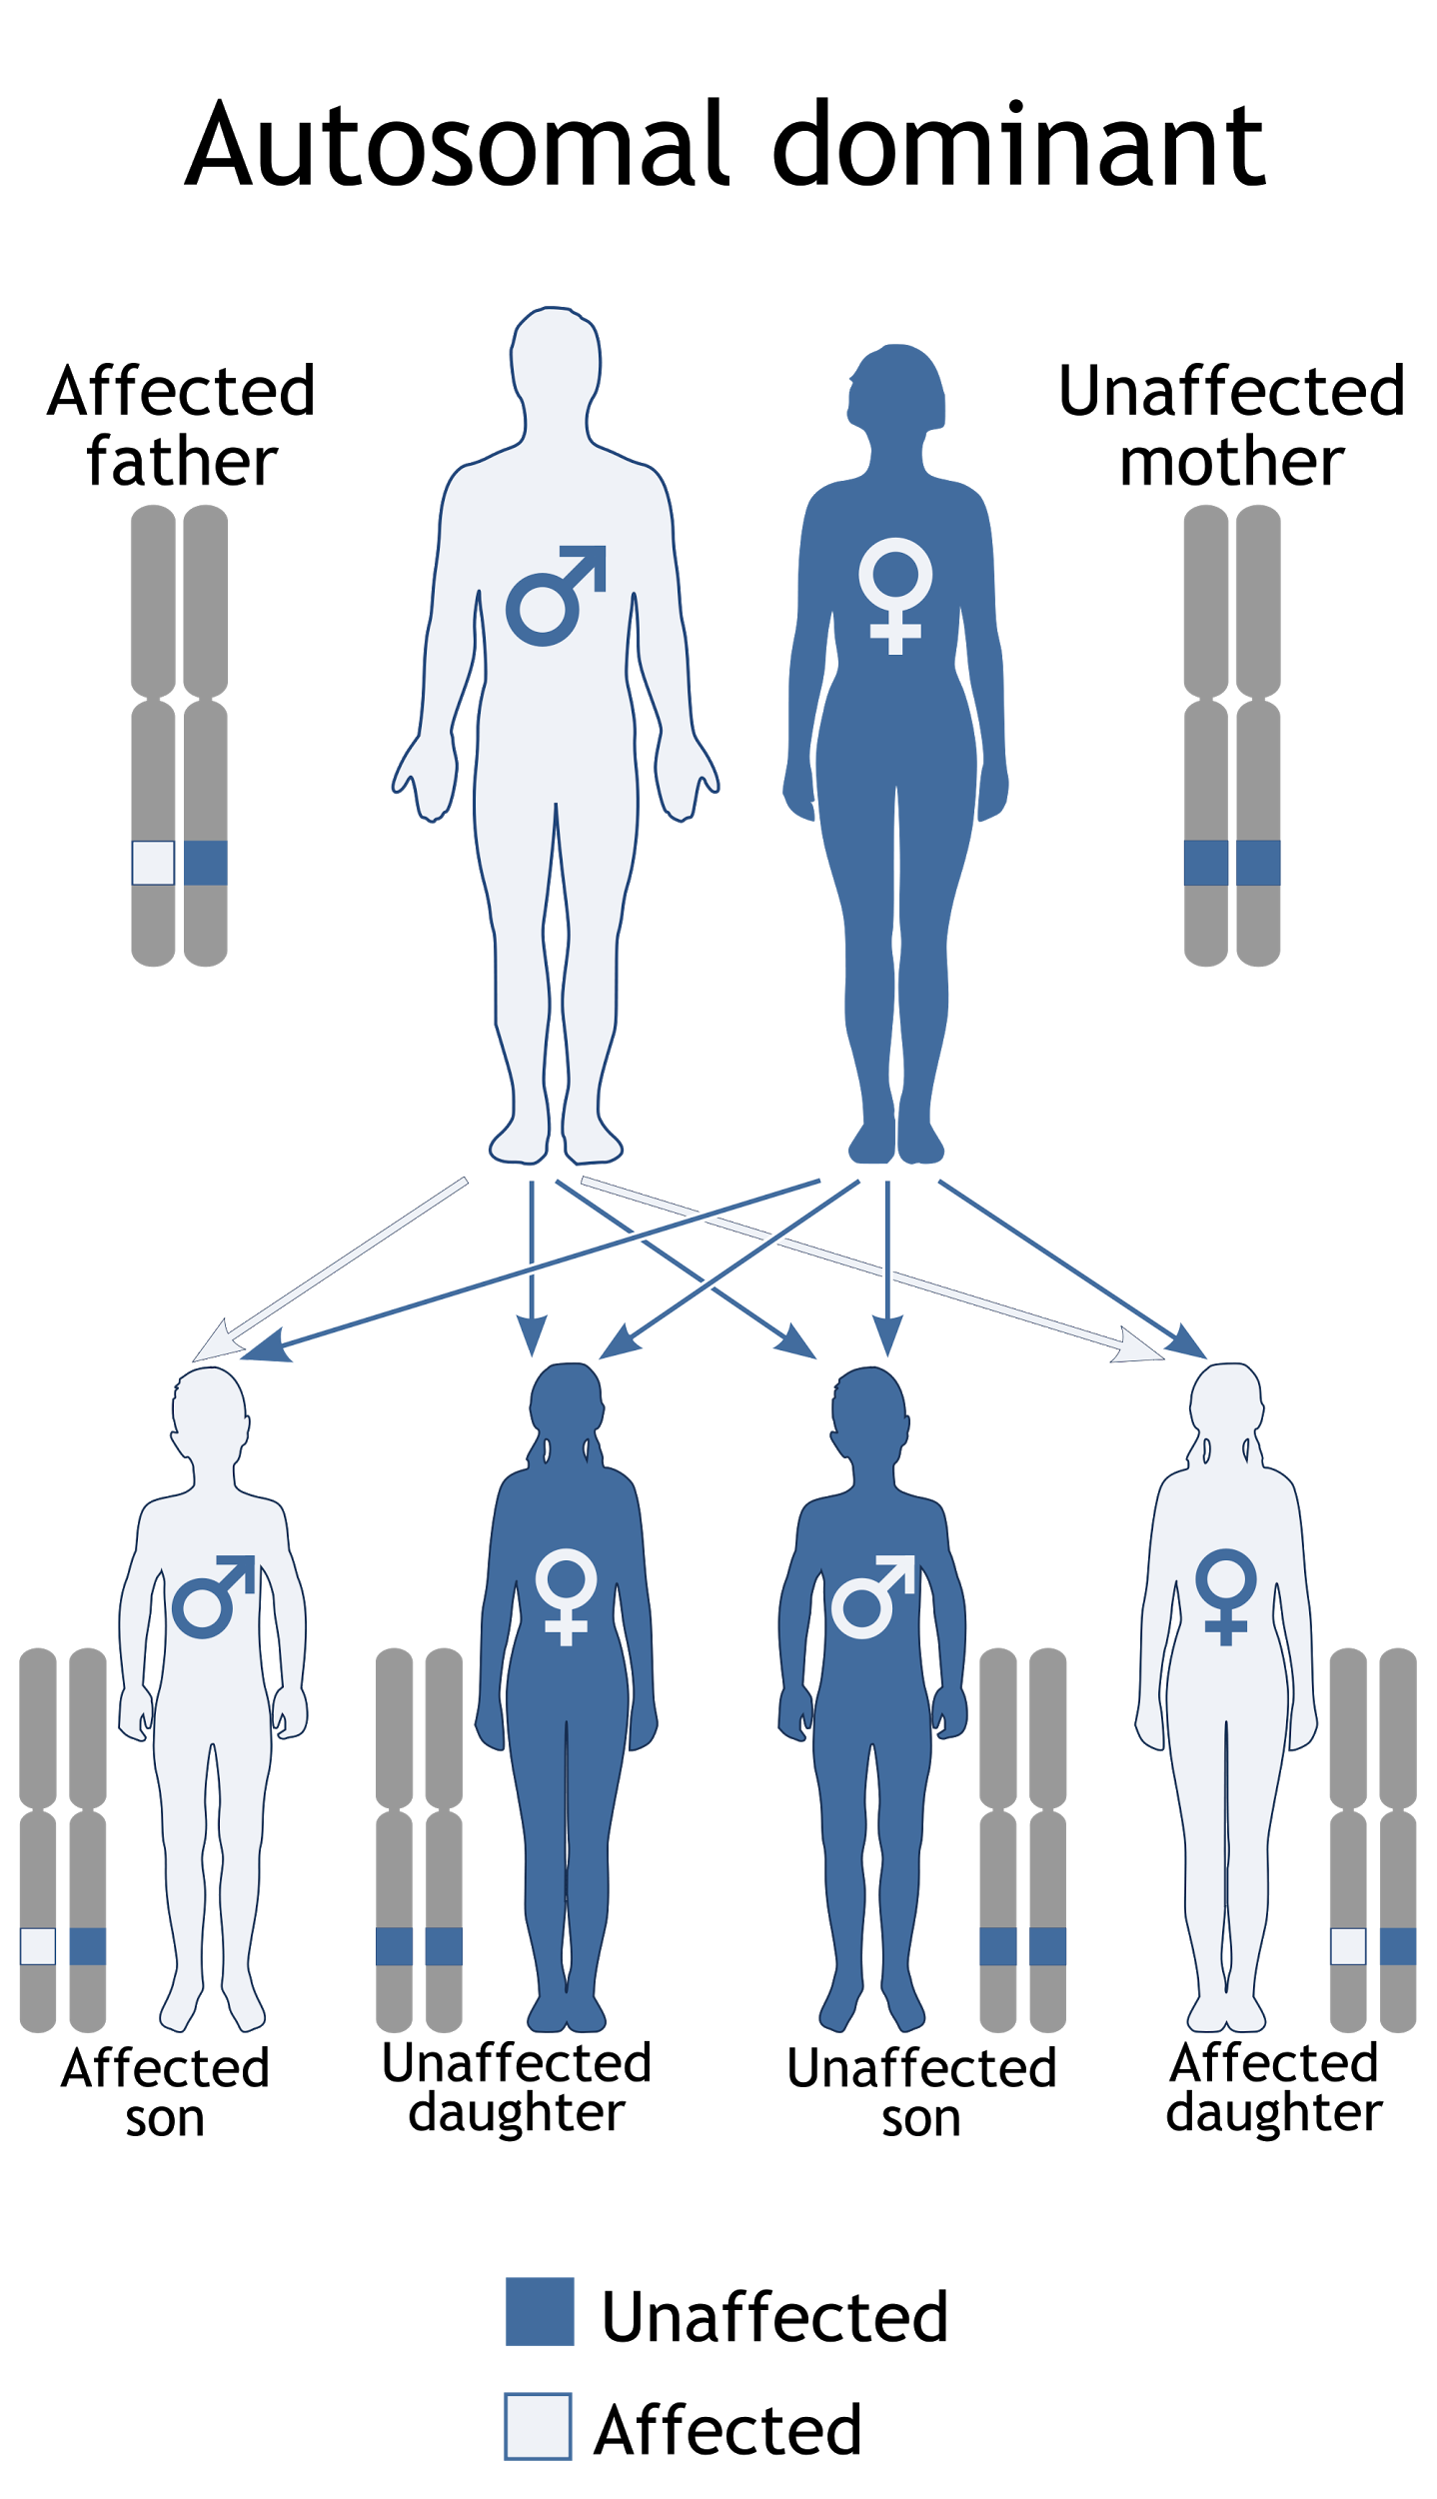
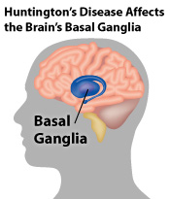
Only one defective gene needed
50% chance of offspring having condition
Examples:
Huntington’s Disease

Slide 23
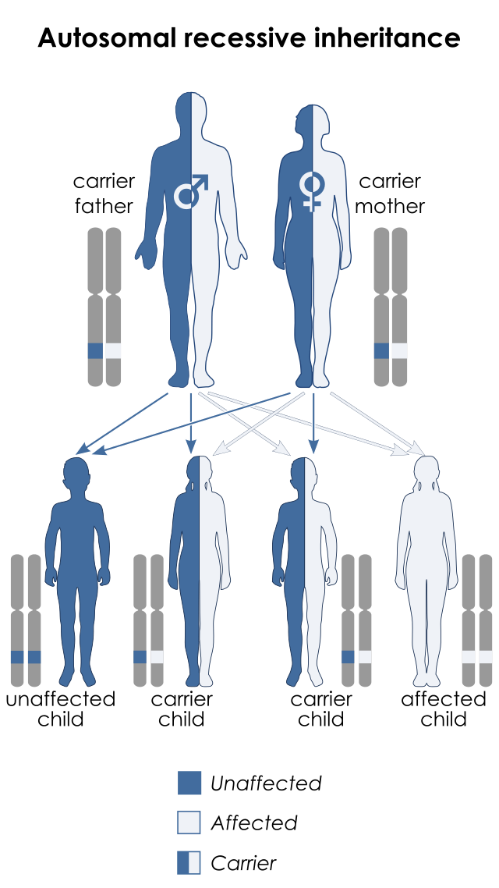
Two defective genes needed
25% chance of offspring having condition
50% chance of offspring being a carrier
Examples:
Cystic Fibrosis

Slide 24
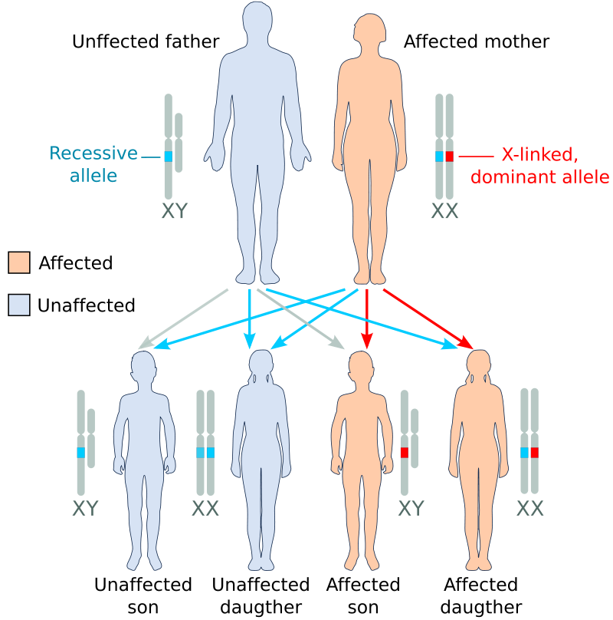
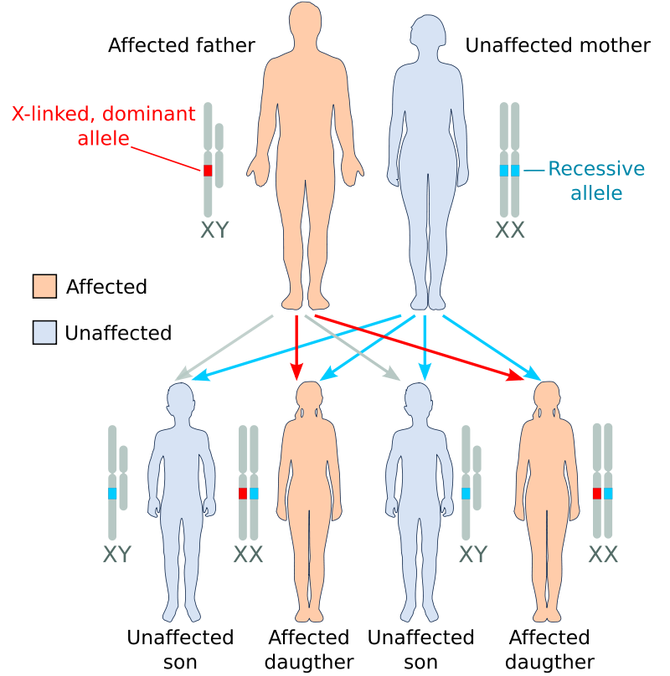
X-Linked DOMINANT
(Paternal)
X-Linked DOMINANT
(Maternal)

Slide 25
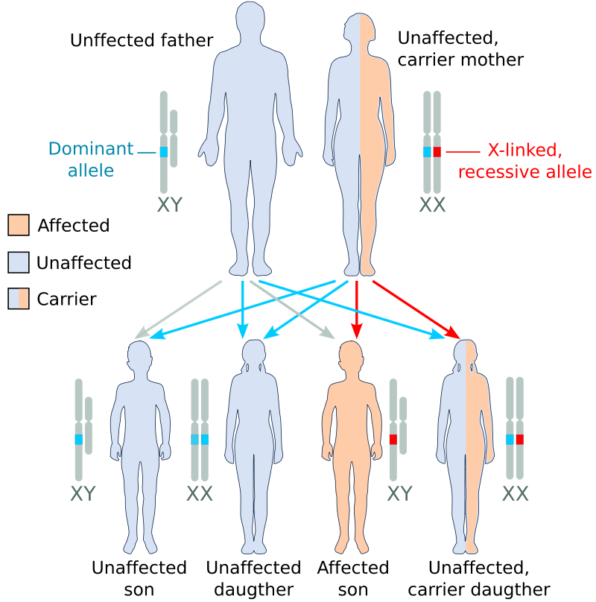
X-Linked RECESSIVE
(Maternal)
Examples:
X-linked dominant:
Alport’s syndrome (kidneys)
X-linked recessive
Duchenne’s muscular dystrophy

Slide 26
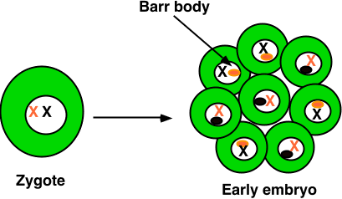
Lyon Hypothesis
X inactivation in females
Barr body

Slide 27
Knudson 2-hit hypothesis

