Slide 1
Cardiovascular Peer Teaching
Annie Evans and Alice Roberts

Slide 2
What We Are Going To Cover
Anatomy – the hard bits!
The cardiac cycle and pressure changes
Control of the cardiovascular system
Electrical conduction
Blood
Basic embryology

Slide 3
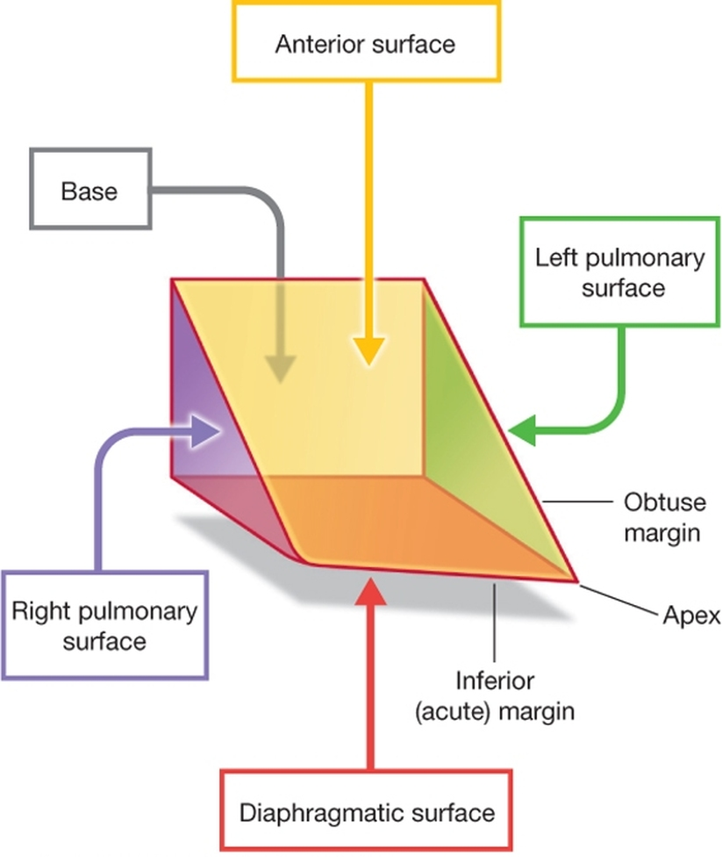
Anatomy
Heart surfaces

Slide 4
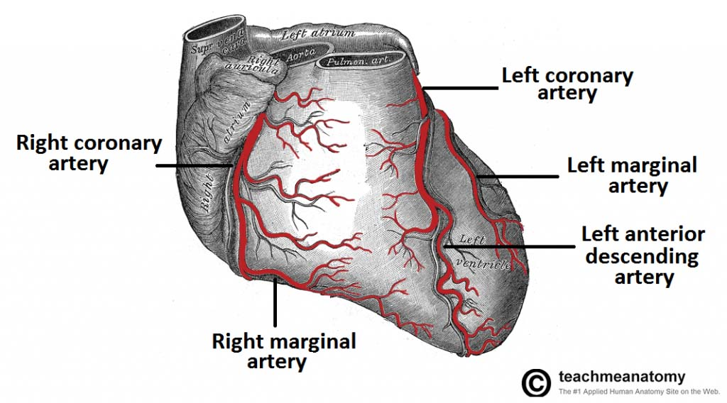
Anatomy
Coronary Arteries

Slide 5
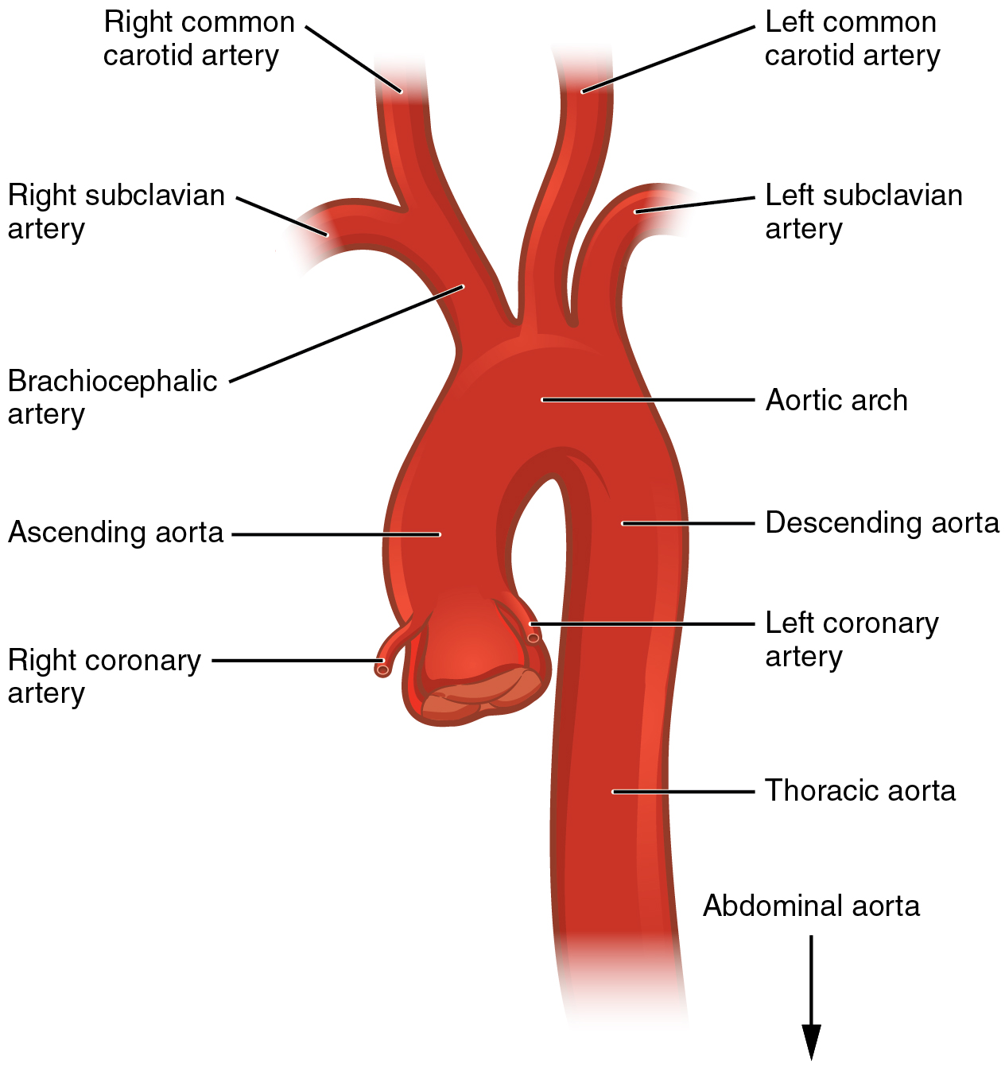
anatomy
Aortic Arch

Slide 6
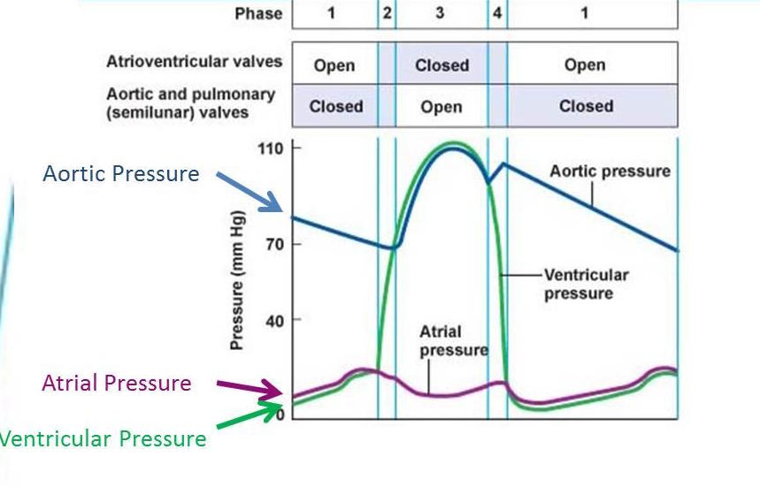
Cardiac cycle
Ventricular Pressure Changes

Slide 7
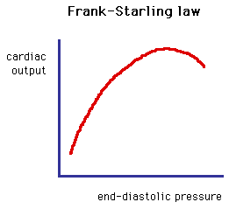
Cardiac cycle
Starling’s Law

Slide 8
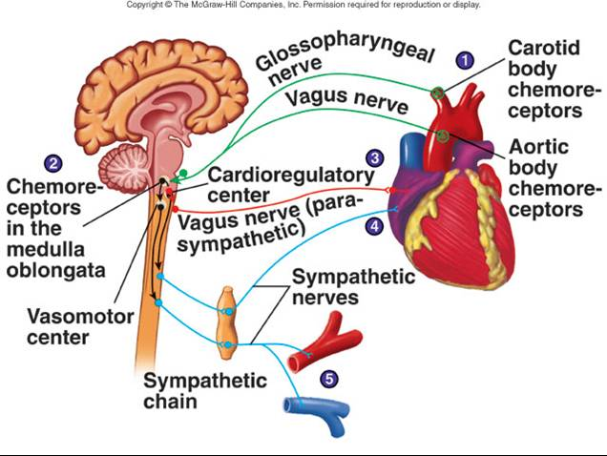
Central Control of the CVS
Chemoreceptors
Carotid Body -> Medulla -> Sino Atrial Node
Parasympathetic - Vagus nerve
Sympathetic - Sympathetic chain
pH

Slide 9
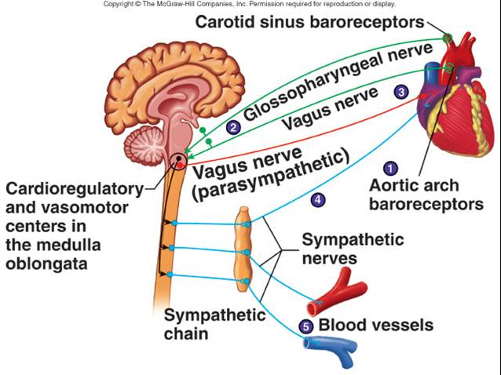
Central control of the CVS
Baroreceptors
Carotid sinus and Aortic Arch -> Medulla -> Sinoatrial Node
Parasympathetic – Vagus Nerve
Sympathetic – Sympathetic chain
Pressure

Slide 10
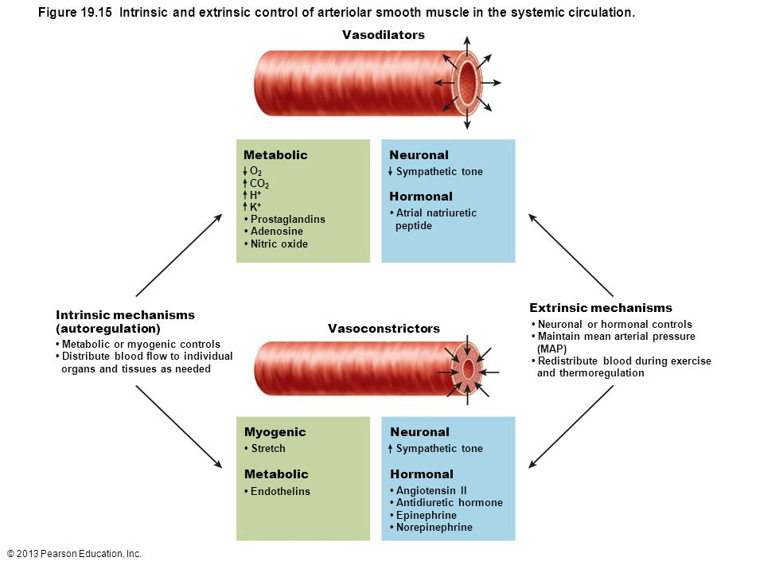
Peripheral Circulation control
Vasoconstrictors and Vasodilators

Slide 11
Electrical conduction

Slide 12
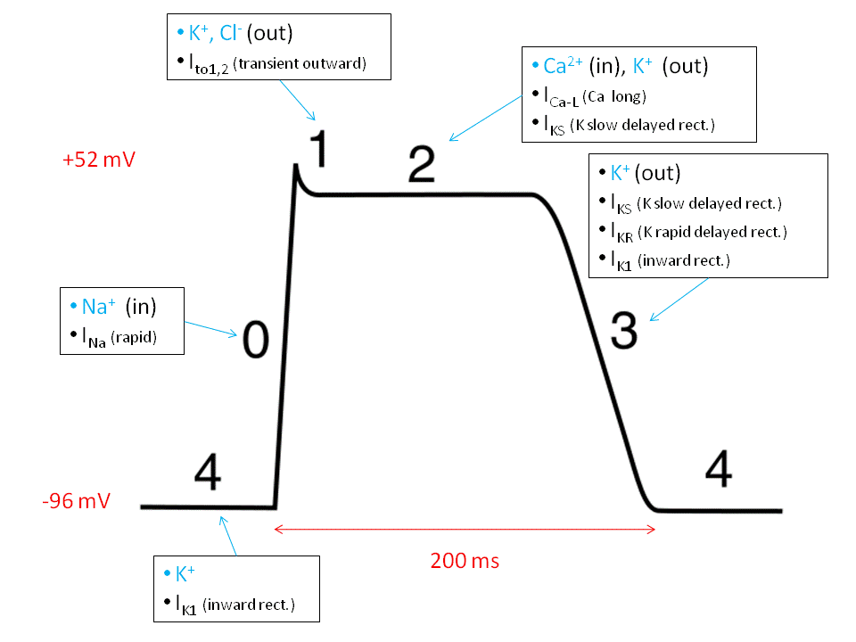
Electrical conduction
Action Potential

Slide 13
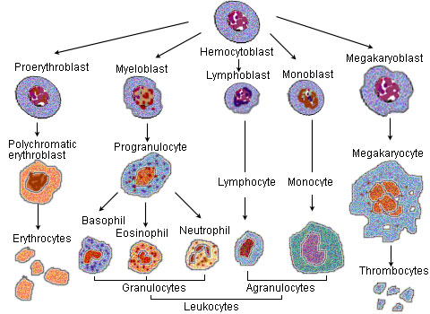
blood

Slide 14
embryology

