Slide 1
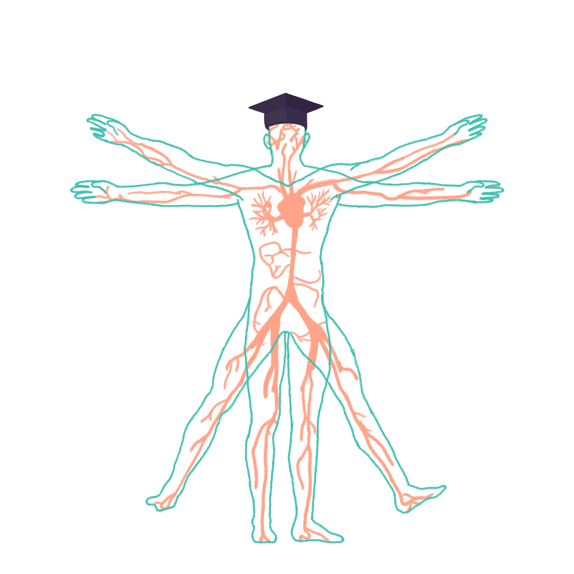
2022/2023

Slide 2
Cardiovascular 1
Phase 1 Revision Session
Raneem Alhalabi
02/11/2022
The Peer Teaching Society is not liable for false or misleading information…

Slide 3
Aims and Objectives
Anatomy of the heart
Anatomy of the coronary arteries
Phrenic and Vagus nerves
Referred cardiac pain
Embryology
Cardiac Cycle
The Peer Teaching Society is not liable for false or misleading information…

Slide 4
Anatomy

Slide 5
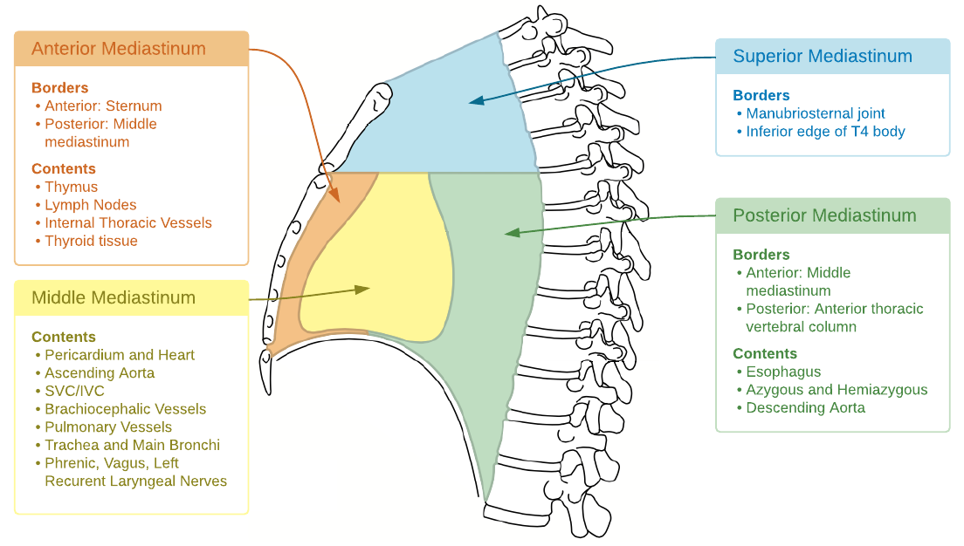
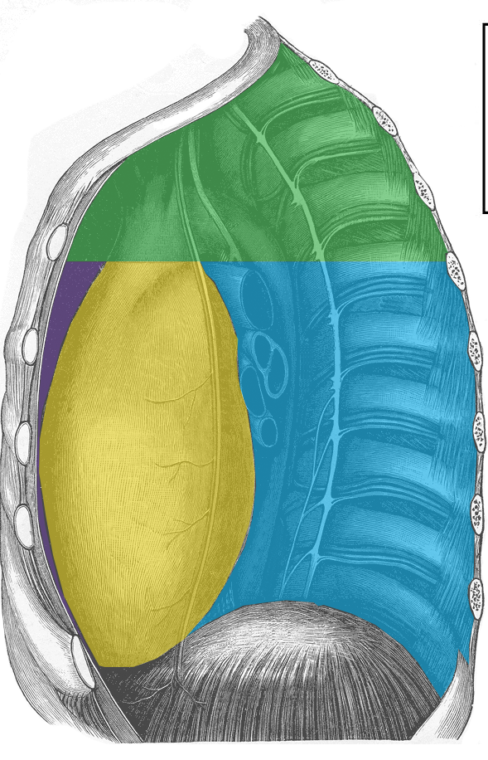
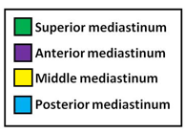
Anatomy: Mediastinum
The Peer Teaching Society is not liable for false or misleading information…
Notes:
Mediastinum; area between right and left pleura
Division between superior and inferior; plane between sternal angle and T4/5
Anterior/ middle and posterior division; pericardium

Slide 6
Anatomy: Pericardium
Anatomy: Pericardium
A fibro-serous fluid filled sac
Separates the heart and roots of the great vessels from other mediastinal structures
The Peer Teaching Society is not liable for false or misleading information…

Slide 7
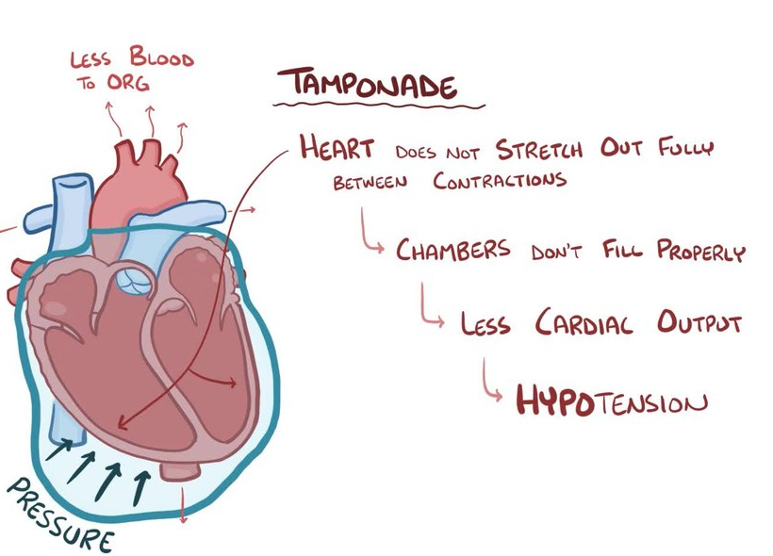
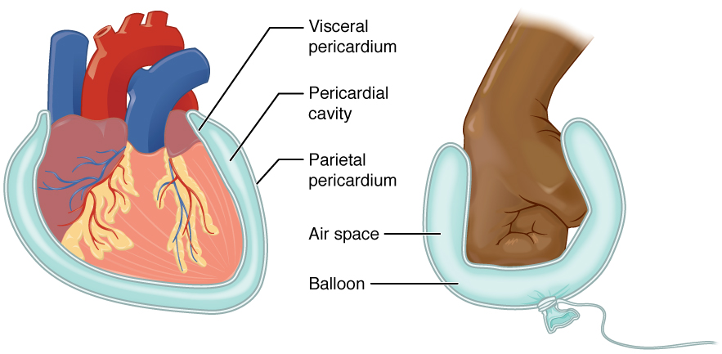
Anatomy: Pericardium
Anatomy: Pericardium
Pericardium; fibrous and serous
Serous divided into outer parietal and internal visceral (= epicardium)
Fist into balloon = 2 layers and pericardial reflections
Pericardial space/ cavity; potential space
Contains approx. 10ml serous fluid
Pleural reflection; allows drainage of pericardial fluid from left of xiphisternum
Visceral layers ALWAYS covers organs and parietal lines the walls of the body cavity
Notes:
Cardiac tamponade; rapid collection of pericardial fluid – heart is restricted and impairs filling
Pericarditis = inflammation of pericardium
- Chest pain, can cause acute cardiac tamponade due to accumulation of fluid in pericardial cavity

Slide 8
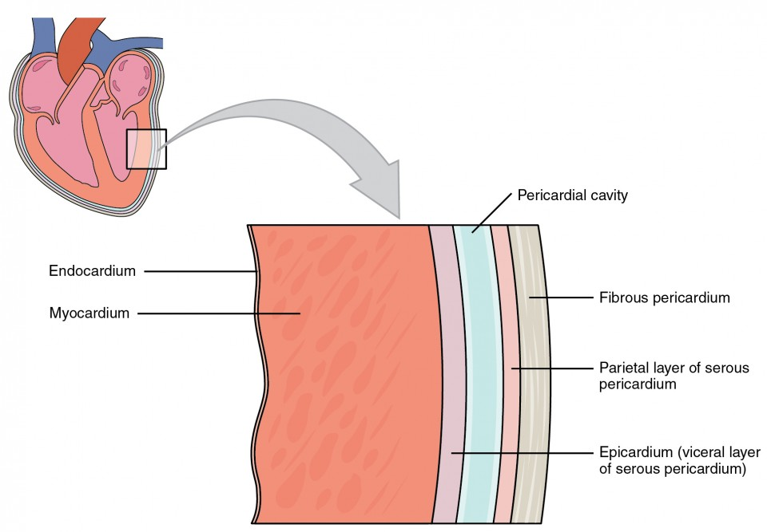
Anatomy: Interior Heart
Epicardium - Adipose tissue, vessels & nerves underlying the pericardium
Myocardium – thickest layer that contracts
Endocardium – inner layer of the heart, made of endothelial cells
The Peer Teaching Society is not liable for false or misleading information…

Slide 9
Anatomy: Interior Heart 1
1
2
3
4
11
5
10
9
6
8
7
The Peer Teaching Society is not liable for false or misleading information…
Notes:
Nb 7 = epicardium, myocardium and endocardium

Slide 10
Anatomy: Interior Heart 1
2
3
4
11
5
10
9
6
8
7
The Peer Teaching Society is not liable for false or misleading information…
Notes:
Nb 7 = epicardium, myocardium and endocardium

Slide 11
Anatomy: Interior Heart 1
3
4
11
5
10
9
6
8
7
The Peer Teaching Society is not liable for false or misleading information…
Notes:
Nb 7 = epicardium, myocardium and endocardium

Slide 12
Anatomy: Interior Heart 1
4
11
5
10
9
6
8
7
The Peer Teaching Society is not liable for false or misleading information…
Notes:
Nb 7 = epicardium, myocardium and endocardium

Slide 13
Anatomy: Interior Heart 1
11
5
10
9
6
8
7
The Peer Teaching Society is not liable for false or misleading information…
Notes:
Nb 7 = epicardium, myocardium and endocardium

Slide 14
Anatomy: Interior Heart 1
11
10
9
6
8
7
The Peer Teaching Society is not liable for false or misleading information…
Notes:
Nb 7 = epicardium, myocardium and endocardium

Slide 15
Anatomy: Interior Heart 1
11
10
9
8
7
The Peer Teaching Society is not liable for false or misleading information…
Notes:
Nb 7 = epicardium, myocardium and endocardium

Slide 16
Anatomy: Interior Heart 1
11
10
9
8
The Peer Teaching Society is not liable for false or misleading information…
Notes:
Nb 7 = epicardium, myocardium and endocardium

Slide 17
Anatomy: Interior Heart 1
11
10
9
The Peer Teaching Society is not liable for false or misleading information…
Notes:
Nb 7 = epicardium, myocardium and endocardium

Slide 18
Anatomy: Interior Heart 1
11
10
The Peer Teaching Society is not liable for false or misleading information…
Notes:
Nb 7 = epicardium, myocardium and endocardium

Slide 19
Anatomy: Interior Heart 1
11
The Peer Teaching Society is not liable for false or misleading information…
Notes:
Nb 7 = epicardium, myocardium and endocardium

Slide 20
Anatomy: Interior Heart 1
The Peer Teaching Society is not liable for false or misleading information…
Notes:
Nb 7 = epicardium, myocardium and endocardium

Slide 21
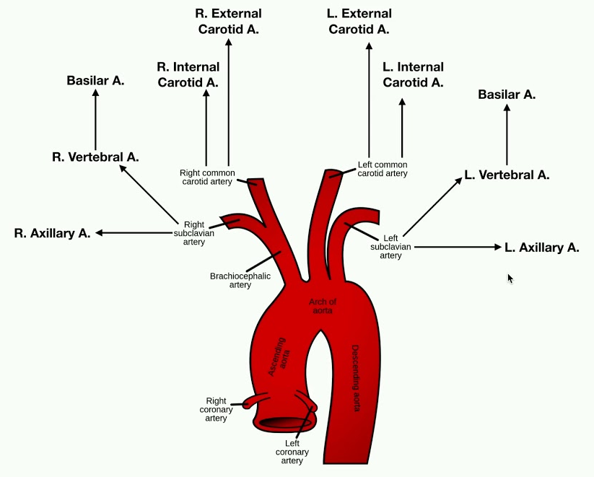
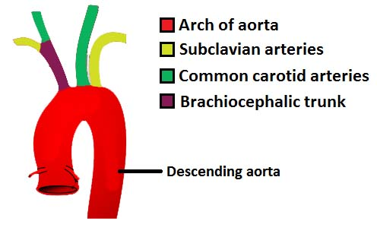
Aortic Arch and its branches
4 parts of the aorta;
Ascending, arch, thoracic/ descending, abdominal
Arch end at T4
Q:What is the 1st branch from the aorta?
Notes:
A = L and R coronary arteries; supply myocardium
- Arise from L and R aortic sinuses (in ascending aorta, at level of aortic valve)
Aorta = ELASTIC artery
Arch connected to pulomary trunk by ligamentum arteriosum (remnant of foetal ductus arteriosus)

Slide 22
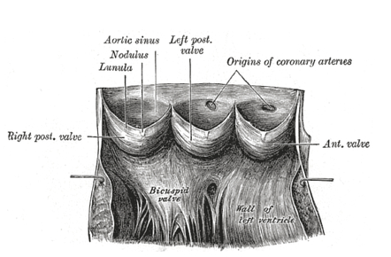
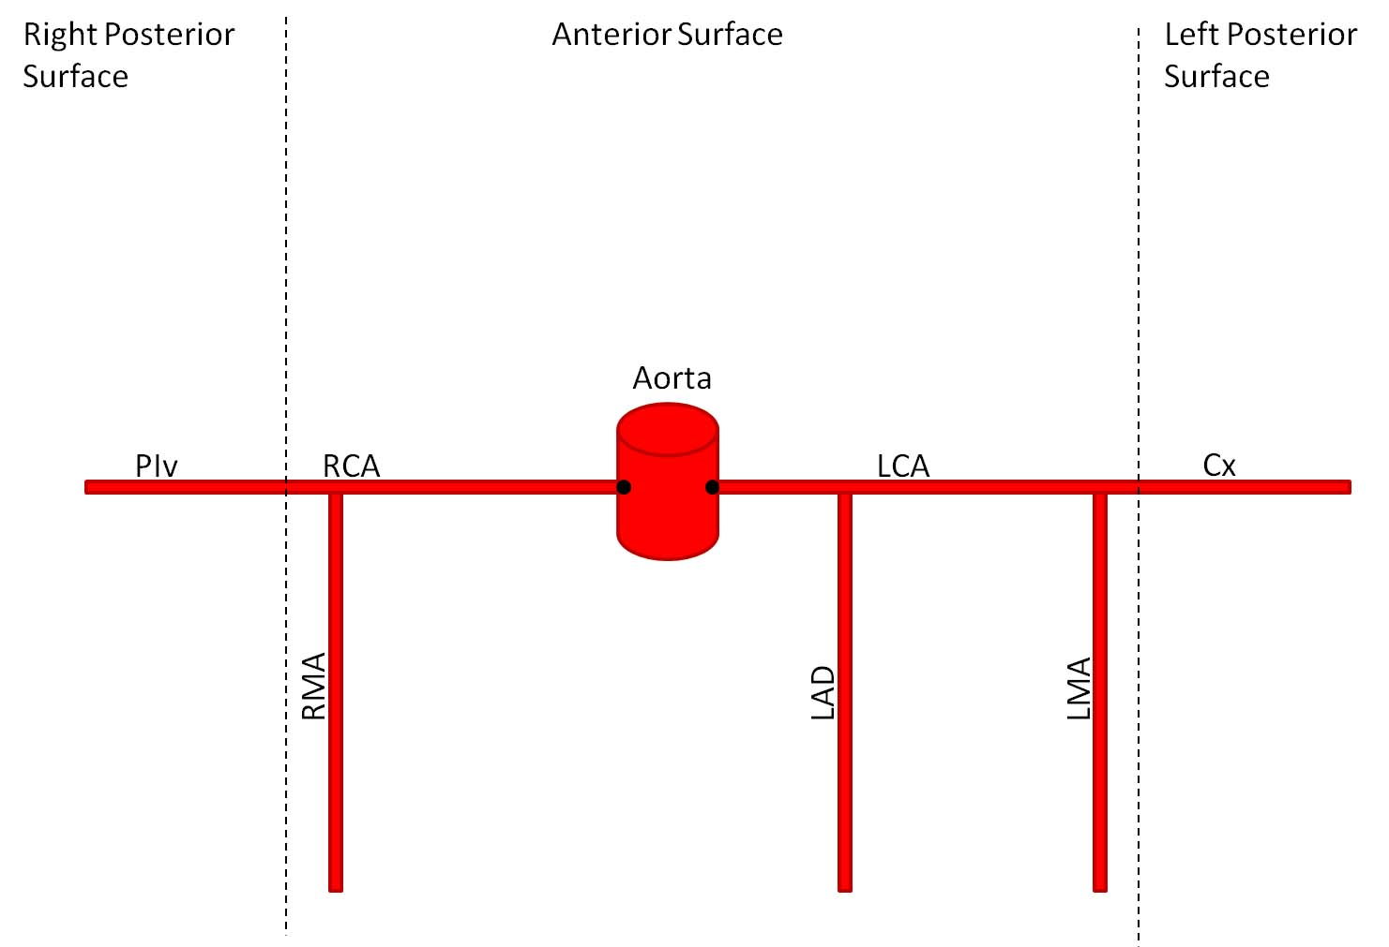
Anatomy: Coronary Arteries
Learn the main branches of the RCA&LCA
When the aortic valve closes, cusps fill with blood and RCA&LCA get this blood to supply the heart

Slide 23
Anatomy: Exterior heart
Anatomy: Exterior Heart
Borders of the heart:
- Right = R atrium
- Inferior = L & R ventricles
- Left = L ventricle & some of L atrium
- Superior = L & R atria & great vessels
1
Arterial supply to the heart
LEARN THIS LIKE YOUR LIFE DEPENDS ON IT!!!
2
3
Don’t worry too much about learning the venous drainage of the heart
4

Slide 24
Anatomy: Exterior heart
Anatomy: Exterior Heart
Borders of the heart:
- Right = R atrium
- Inferior = L & R ventricles
- Left = L ventricle & some of L atrium
- Superior = L & R atria & great vessels
Arterial supply to the heart
LEARN THIS LIKE YOUR LIFE DEPENDS ON IT!!!
2
3
Don’t worry too much about learning the venous drainage of the heart
4

Slide 25
Anatomy: Exterior heart
Anatomy: Exterior Heart
Borders of the heart:
- Right = R atrium
- Inferior = L & R ventricles
- Left = L ventricle & some of L atrium
- Superior = L & R atria & great vessels
Arterial supply to the heart
LEARN THIS LIKE YOUR LIFE DEPENDS ON IT!!!
3
Don’t worry too much about learning the venous drainage of the heart
4

Slide 26
Anatomy: Exterior heart
Anatomy: Exterior Heart
Borders of the heart:
- Right = R atrium
- Inferior = L & R ventricles
- Left = L ventricle & some of L atrium
- Superior = L & R atria & great vessels
Arterial supply to the heart
LEARN THIS LIKE YOUR LIFE DEPENDS ON IT!!!
Don’t worry too much about learning the venous drainage of the heart
4

Slide 27
Anatomy: Exterior heart
Anatomy: Exterior Heart
Borders of the heart:
- Right = R atrium
- Inferior = L & R ventricles
- Left = L ventricle & some of L atrium
- Superior = L & R atria & great vessels
Arterial supply to the heart
LEARN THIS LIKE YOUR LIFE DEPENDS ON IT!!!
Don’t worry too much about learning the venous drainage of the heart

Slide 28
Anatomy: Coronary Arteries
Right coronary artery (RCA)
> right marginal artery (RMA)
> Posterior interventricular artery (PIV)
Supply to the heart
RCA
R atrium
R ventricle
RMA
R Ventricle
Apex of heart
PIV
Posterior 1/3rd of interventricular septum
AV node
1
2
3

Slide 29
Anatomy: Coronary Arteries
Right coronary artery (RCA)
> right marginal artery (RMA)
> Posterior interventricular artery (PIV)
Supply to the heart
RCA
R atrium
R ventricle
RMA
R Ventricle
Apex of heart
PIV
Posterior 1/3rd of interventricular septum
AV node
2
3

Slide 30
Anatomy: Coronary Arteries
Right coronary artery (RCA)
> right marginal artery (RMA)
> Posterior interventricular artery (PIV)
Supply to the heart
RCA
R atrium
R ventricle
RMA
R Ventricle
Apex of heart
PIV
Posterior 1/3rd of interventricular septum
AV node
3

Slide 31
Anatomy: Coronary Arteries
Right coronary artery (RCA)
> right marginal artery (RMA)
> Posterior interventricular artery (PIV)
Supply to the heart
RCA
R atrium
R ventricle
RMA
R Ventricle
Apex of heart
PIV
Posterior 1/3rd of interventricular septum
AV node

Slide 32
Anatomy: Coronary Arteries
Left coronary artery (LCA)
> Left anterior descending artery (LAD)
> Left marginal artery (LMA)
> Circumflex artery (CA)
1
Supply to the heart
LAD
Anterior 2/3rd of interventricular septum
R & L ventricle
LMA
L ventricle
Cxr
L atrium
L ventricle
Notes:
1= 3 branches of LCA

Slide 33
Anatomy: Coronary Arteries
Left coronary artery (LCA)
> Left anterior descending artery (LAD)
> Left marginal artery (LMA)
> Circumflex artery (CA)
Supply to the heart
LAD
Anterior 2/3rd of interventricular septum
R & L ventricle
LMA
L ventricle
Cxr
L atrium
L ventricle
Notes:
1= 3 branches of LCA

Slide 34
Anatomy: Coronary Arteries
Dominance:
70% RCA only
10% LCA only
20% RCA & LCA
Question:
What percentage of people have their PIV artery branch off the RCA?
Pay attention to how they phrase the question
Don’t fall for the trick!!

Slide 35
Anatomy: Coronary Arteries
Dominance:
70% RCA only
10% LCA only
20% RCA & LCA
Question:
What percentage of people have their PIV artery branch off the RCA?
90%
Pay attention to how they phrase the question
Don’t fall for the trick!!

Slide 36
Anatomy: Coronary Arteries
SA Node supply:
60% Right coronary artery
40% Left coronary artery
AV Node supply: Always supplied by PIA
70% RCA only
20% RCA & LCA
10 LCA only
1
NB: these numbers are for what proportion of people have their nodes supplied by these arteries
Notes:
1= PIV

Slide 37
Anatomy: Coronary Arteries
AV Node supply: Always supplied by PIV
70% RCA only
20% RCA & LCA
10 LCA only
SA Node supply:
60% Right coronary artery
40% Left coronary artery
NB: these numbers are for what proportion of people have their nodes supplied by these arteries
Notes:
1= PIV

Slide 38
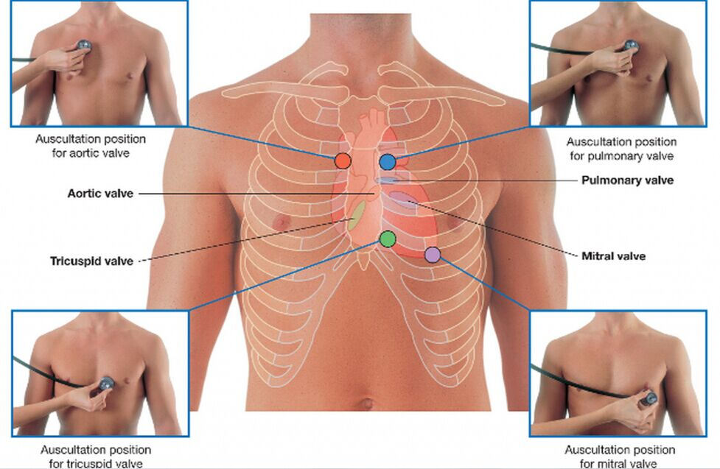
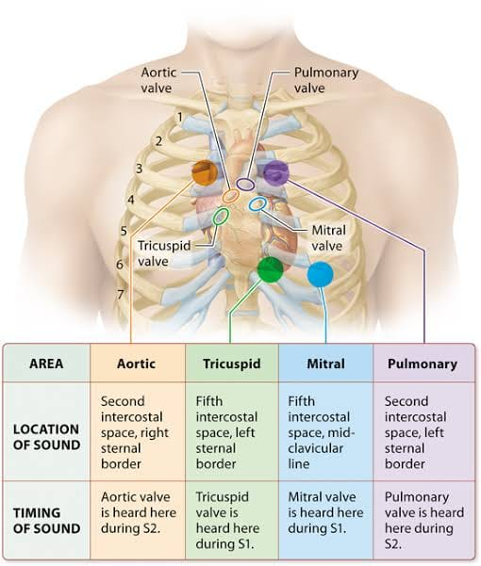
Anatomy: Valve Auscultation
Where is the APEX of the heart found?
Notes:
Apex = LEFT midclavicular line, 5th intercostal space

Slide 39
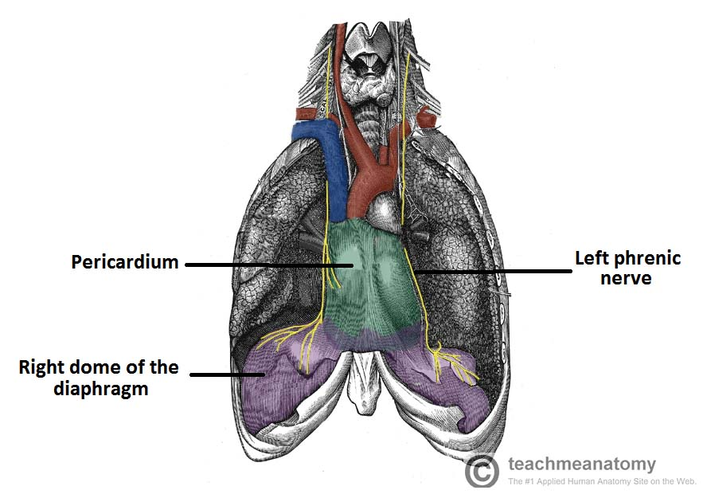
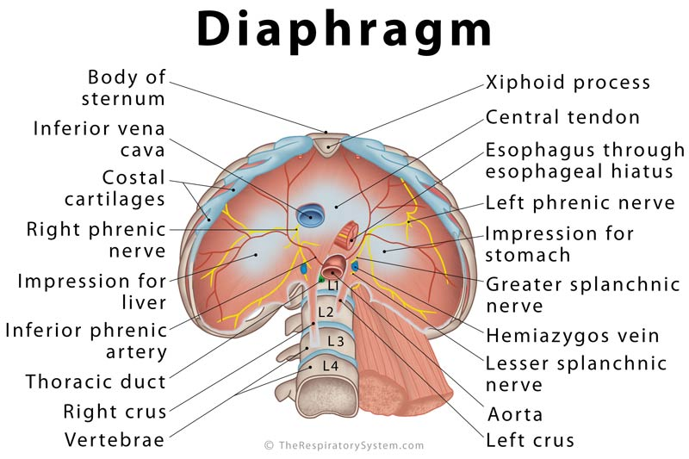
Anatomy: Phrenic Nerve
Origin C3-5
Motor AND sensory
Motor innervation to what important muscle? (hint: inspiration)
Right Phrenic nerve;
Descends ANTERIORLY (phrenic, front) along R lung root
Travels along pericardium of R atrium
Passes through diaphragm at IVC opening (T8)
Left Phrenic nerve
Descends ANTERIOR to L lung root
Crosses aortic arch, bypasses vagus nerve
Travels along pericardium of L ventricle
Passes through diaphragm separately
Notes:
Phrenic innervates diaphragm; C345 keeps the diaphragm alive
Sensory fibres from the phrenic nerve supply the central part of the diaphragm, including the surrounding pleura and peritoneum. The nerve also supplies sensation to the mediastinal pleura and the pericardium)
I 8: inferior vena cava at T8
10 eggs: oesophagus (US spelling) at T10
at 12: aorta at T12

Slide 40
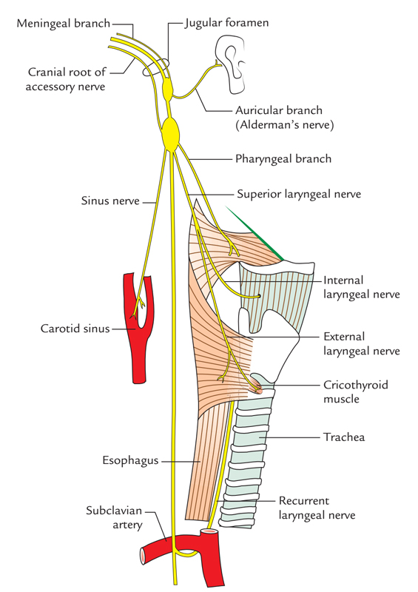
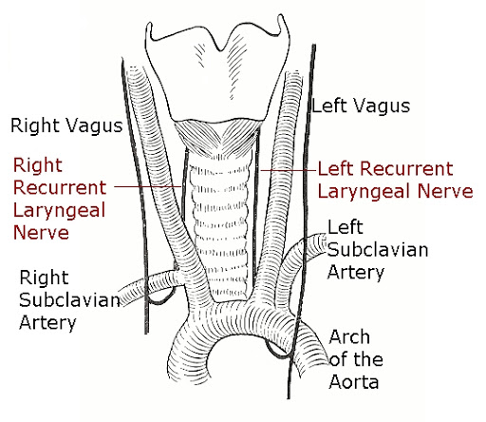
Anatomy: Vagus Nerve
Vagus = CN10
Motor and Sensory
Sympathetic AND Parasympathetic
Parasympathetic to ALL organs of thorax and abdomen
Passes BEHIND lung roots
Passe through the diaphragm at T10
Notes:
CN 10 leaves skull through jugular foramina
Parasympathetic
https://www.earthslab.com/anatomy/vagus-nerve/
Vagal stimulation decreases HR, Sympathetic stimulation increases HR.
Vagus supplies thyroid via superior laryngeal nerve

Slide 41
Referred Cardiac Pain
When pain somewhere refers to pathology somewhere else away from the pain.
Often happens in Myocardial Infarctions (heart attacks)
Pain in shoulder, jaw, neck, arms …
Be aware of this so you don’t miss catastrophic pathologies because of referred pain

Slide 42
Embryology

Slide 45
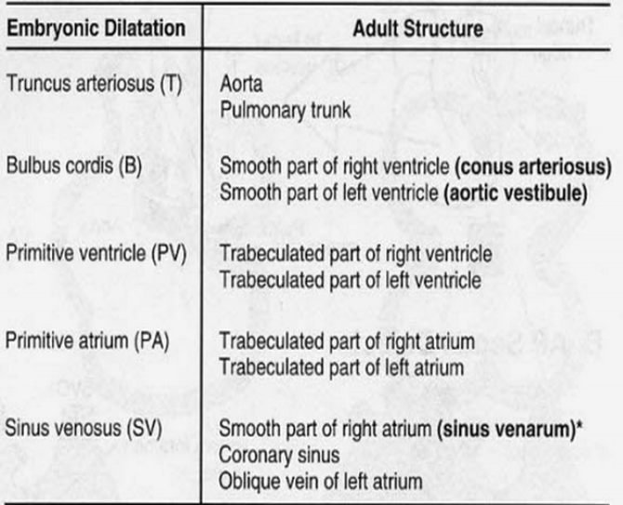

Slide 46
Stages of Cardiac embryology:
Formation of primitive heart tube
Cardiac Looping
Cardiac Septation

Slide 47
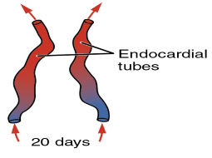
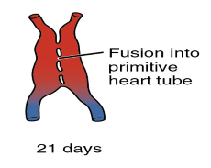
1- Formation of primitive heart tube:
Cells from the cardiogenic region form endocardial tubes
The endocardial tubes will fuse together to form the primitive heart tube

Slide 48
2- Cardiac Looping:
Bulbis cordis moves inferiorly and anteriorly
Primitive ventricle moves superiorly and posteriorly
Primitive atrium and sinus venous move superiorly and posteriorly

Slide 49
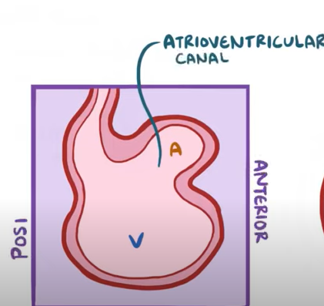
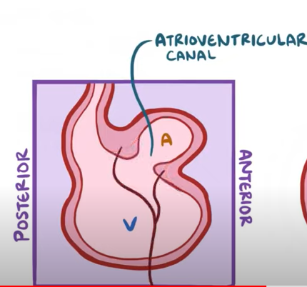
3- Cardiac Septation:
There is one atrium and one ventricle at this stage connected together by the atrioventricular canal
Endocardial cushions grow from the sides of the AV canal
The cushions eventually fuse together forming what becomes the left and right atrioventricular canals.
It helps to picture this as if you’re looking from the side

Slide 50
Aortic Arches
Arch 1
Disappears early → Maxillary artery
Arch 2
Disappears early → Stapedial artery
Arch 3
Becomes CCA and proximal ICA
NB distal ICA comes from extensions of dorsal aortae
Arch 4 (+dorsal aorta)
Both sides join with 7th intersegmental a.
Right → R subclavian artery
Left → Aortic arch
Arch 5
Regresses & doesn’t form anything
Arch 6
Right → pulmonary trunk
Left → left PA and ductus arteriosus
Notes:
Stapedial artery = inner ear
CCA = common carotid arteries
ICA = internal carotid arteries
7th segmental artery
Left → L subclavian artery
Right → part of R subclavian artery

Slide 51
Histology

Slide 52
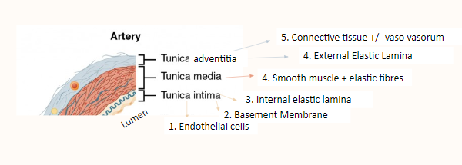
Histology: Arteries

Slide 53
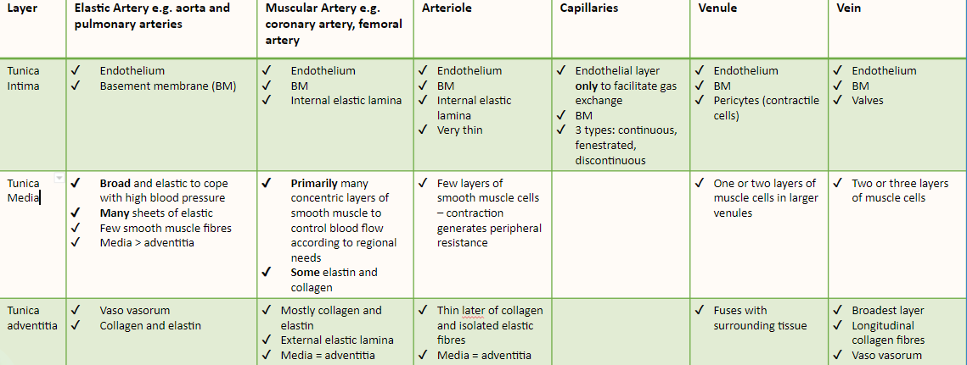
Histology: Blood vessels overview

Slide 54
Cardiac Cycle

Slide 55
Cardiac Cycle
Very very high yield and very important to understand it fully not just for your exams but for the future as well!!

Slide 56
The Cardiac cycle - keywords
`
End-diastolic volume (EDV)
Stroke Volume
Cardiac output
“Dub”
Keywords
“Lub”
End-systolic volume
Heart rate
Ejection fraction
Notes:
Stroke volume: The volume of blood ejected per beat
Cardiac output: The amount of blood pumped out the LV per mine (SV x HR)
Heart rate: the number of times the heart beats per min
EDV: the volume of blood in the ventricles at the end of diastole
ESV: the volume of blood in the ventricles at the end of systole
Ejection fraction: the proportion of the EDV that is pumped out the LV per beat, SV/EDV, provides an indication of the contractility of the heart
“Lub”: first heart sound (S1) – closing of the Atrioventricular valves
“Dub”: second heart sound (S2) – closing of the Semilunar valves

Slide 57
The cardiac cycle definitions
Cardiac Cycle:
This is a heart full of blood -
100mls = end diastolic volume (EDV)
100mls

Slide 58
The cardiac cycle definitions
Cardiac Cycle:
100mls

Slide 59
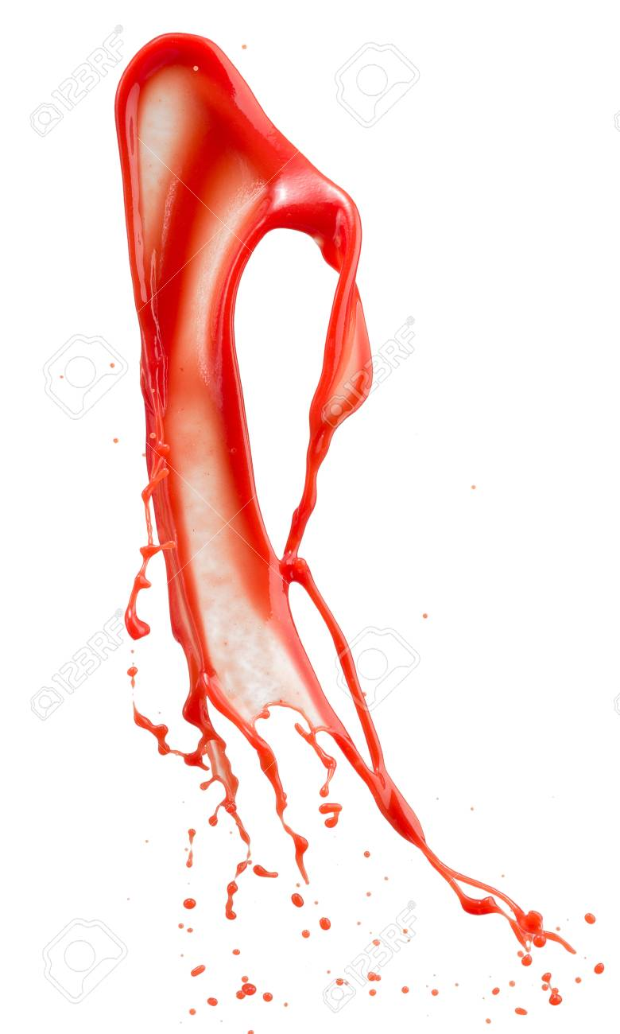
The cardiac cycle definitions
Cardiac Cycle:
70mls
30mls

Slide 60
The cardiac cycle definitions
Cardiac Cycle:
70mls
30mls
End systolic volume = 30mls
Stroke volume = 70mls

Slide 61
The cardiac cycle definitions
Cardiac Cycle:
Ejection fraction = SV/EDV
= 70/100 = 70%
70mls
30mls
End systolic volume = 30mls
Stroke volume = 70mls
(EDV - ESV)

Slide 62
Cardiac Cycle:
Divided into systole (contraction) and diastole (relaxation):
Systole:
Isovolumic contraction
Ejection
Diastole:
Isovolumic relaxation
Passive blood flow
Atrial booster

Slide 63
Cardiac Cycle: Systole
Isovolumic contraction:
AV valve closes when ventricular pressure exceeds atrial pressure
But ventricular pressure is still not high enough to cause aortic valve to open
So isovolumic contraction increases the pressure but does not affect the volume (hence it’s iso (same) volumic (volume)
This increase in pressure will cause the aortic valve to open leading to ejection
Ejection:
Aortic valve opens and ventricles contract
Only 70% of blood is pumped out (stroke volume) and 30% left (End-Systolic volume)

Slide 64
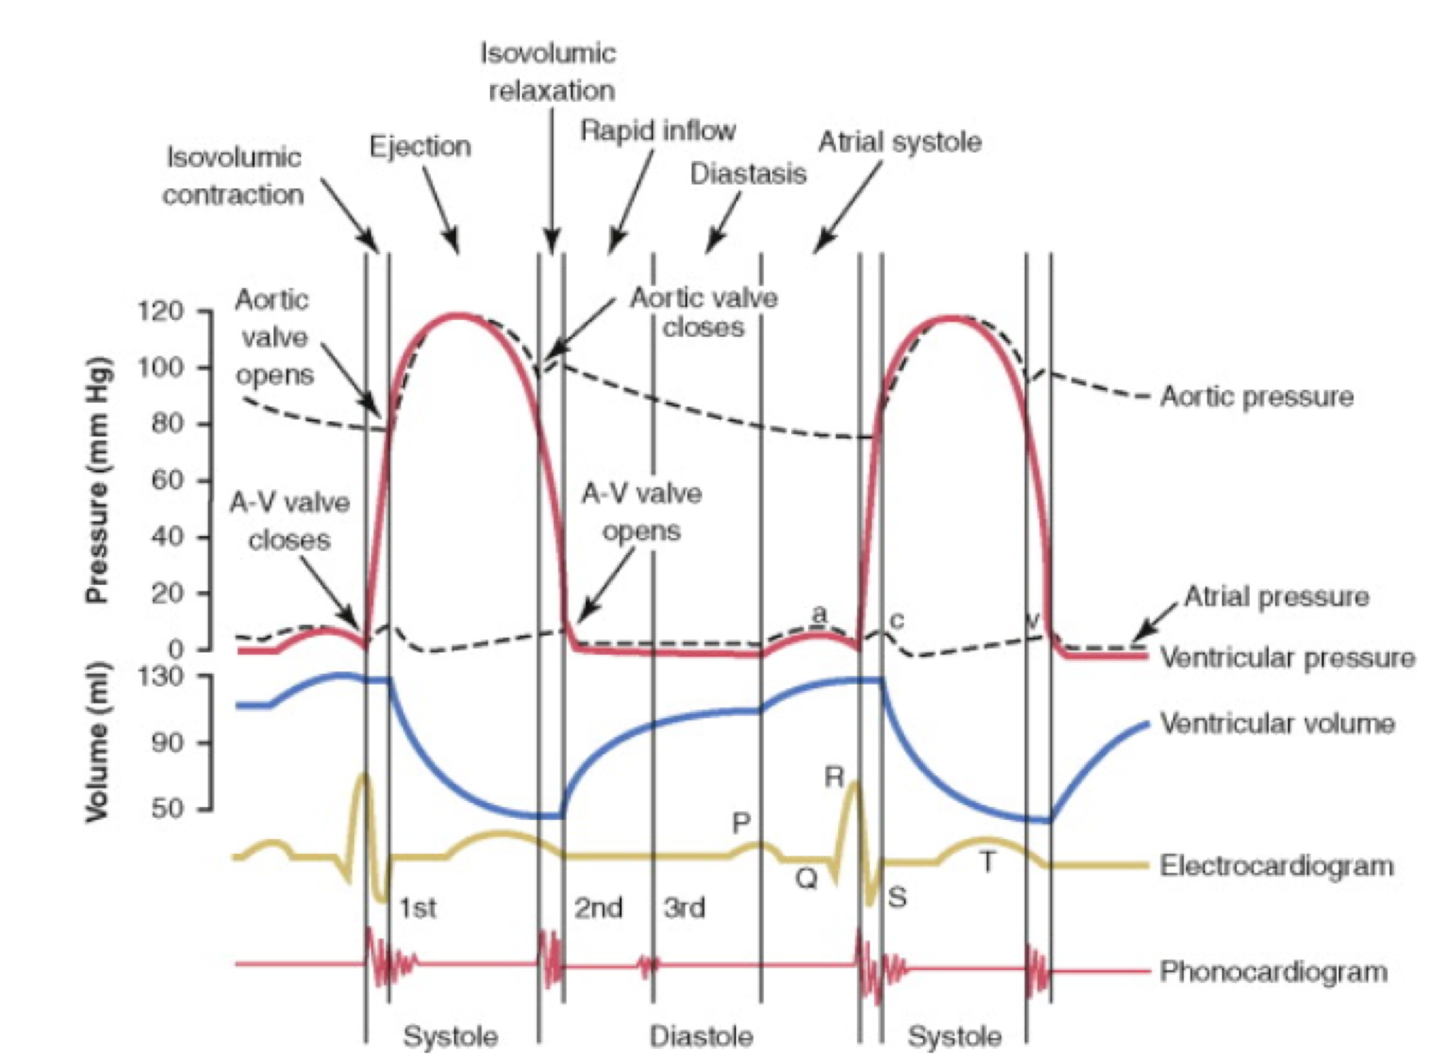
Cardiac Cycle: Systole
Isovolumic contraction:
AV valve closes when ventricular pressure exceeds atrial pressure
But ventricular pressure is still not high enough to cause aortic valve to open
So isovolumetric contraction increases the pressure but does not affect the volume (hence it’s iso (same) volumetric (volume)
This increase in pressure will cause the aortic valve to open leading to ejection
Ejection:
Aortic valve opens and ventricles contract
Only 70% of blood is pumped out (stroke volume) and 30% left (End-Systolic volume)

Slide 65
Cardiac Cycle: Diastole
Isovolumic relaxation:
All valves are closed at this point
Passive blood filling:
Rapid filling: passive ventricular filling as ventricular pressure is lower than atrial so there will be an influx of blood from atria to ventricles
Diastasis: slow filling to almost none as the pressure in the ventricles is starting to go up
Atrial booster:
Atrial walls to contract to send the last little bit of blood out to the ventricles

Slide 66
Cardiac Cycle: Diastole
Isovolumic relaxation:
All valves are closed at this point
Passive blood filling:
Rapid filling: passive ventricular filling as ventricular pressure is lower than atrial so there will be an influx of blood from atria to ventricles
Diastasis: slow filling to almost none as the pressure in the ventricles is starting to go up
Atrial booster:
Atrial walls to contract to send the last little bit of blood out to the ventricles

Slide 67
Before moving on to questions Feedback:
Please scan the QR code or follow the link posted in the chat to fill out the feedback form!!
Notes:
https://docs.google.com/forms/d/e/1FAIpQLScWKzx4ikpHkOXDyIF_jMUPqgR8vS2OeiMTYnHEeCnxANkNFA/viewform?vc=0&c=0&w=1&flr=0

Slide 68
Questions: SBA Style

Slide 69
1- The heart sounds are described as “lub-dub”. The closure of which valves correspond to the “dub”?
The ventricular valves
The atrial valves
The semilunar valves
The trilunar valves
The atrioventricular valves

Slide 70
1- The heart sounds are described as “lub-dub”. The closure of which valves correspond to the “dub”?
The ventricular valves
The atrial valves
The semilunar valves
The trilunar valves
The atrioventricular valves

Slide 71
2- Which coronary artery is often known as the “widow-maker”?
Left coronary artery
Right marginal artery
Left circumflex artery
Left anterior descending artery
Right coronary artery

Slide 72
2- Which coronary artery is often known as the “widow-maker”?
Left coronary artery
Right marginal artery
Left circumflex artery
Left anterior descending artery
Right coronary artery

Slide 73
3- During isovolumic contraction of the ventricles, ventricular pressure is lower than aortic pressure. What does this lead to?
The ventricles contract and blood is ejected through the aortic valve and pulmonary valve
The atria contract and blood is ejected through the AV valves and into the ventricles
The ventricles contract but the valves remain closed so blood is not yet ejected through the semilunar valves
The ventricles contract
The atria relax

Slide 74
3- During isovolumic contraction of the ventricles, ventricular pressure is lower than aortic pressure. What does this lead to?
The ventricles contract and blood is ejected through the aortic valve and pulmonary valve
The atria contract and blood is ejected through the AV valves and into the ventricles
The ventricles contract but the valves remain closed so blood is not yet ejected through the semilunar valves
The ventricles contract
The atria relax

Slide 75
4- A medical student collapses during the ward round and on observations she has a slow heart of 47 bpm, and a blood pressure reading of 72/33 mm/Hg. What is the cause of her fall? ?
Blood loss from a head injury sustained during the fall
Severe heart failure
Excessive sympathetic stimulation
Increase preload
Excessive parasympathetic stimulation

Slide 76
4- A medical student collapses during the ward round and on observations she has a slow heart of 47 bpm, and a blood pressure reading of 72/33 mm/Hg. What is the cause of her fall? ?
Blood loss from a head injury sustained during the fall
Severe heart failure
Excessive sympathetic stimulation
Increase preload
Excessive parasympathetic stimulation

Slide 77
Questions: Spotter-style questions

Slide 78
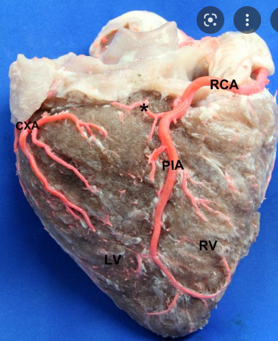
What structures are 1,2,3?
Hint: this is the posterior surface of the heart
2
1
3

Slide 79
What structures are 1,2,3?

Slide 80
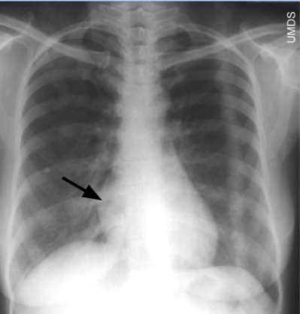
In this X-ray what structure is the arrow pointing at?
Right atrium
Right ventricle
Aortic arch
Left atrium
Pulmonary trunk

Slide 81
In this X-ray what structure is the arrow pointing at?
Right atrium
Right ventricle
Aortic arch
Left atrium
Pulmonary trunk

Slide 82
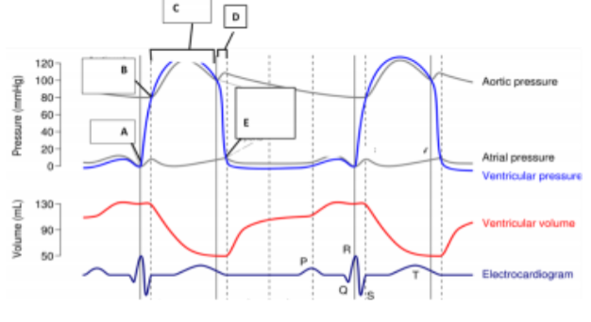
Th diagram below shows changes in blood pressure and volume in the left ventricle and arota during the cardiac cycle. Which of the following indicates the opening of the AV valves?
A
B
C
D
E

Slide 83
Th diagram below shows changes in blood pressure and volume in the left ventricle and arota during the cardiac cycle. Which of the following indicates the opening of the AV valves?
A
B
C
D
E

Slide 84
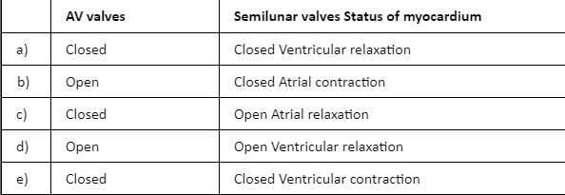
Which of the following is true about process D?

Slide 85
Which of the following is true about process D?

Slide 86
Advice!
Don’t stress too much and enjoy this year
Start revision early because you’ll be surprised by the amount you have to learn. Feb/March
Phase 1 Drive, PTS, TeachMeAnatomy and the flashcards are great
Try to figure out what works best for you soon before workload starts
Use the dissection videos for anatomy (that’s what your spotter will be)
Really focus on anatomy this year because you won’t learn it in depth after that
Good luck
If you have any questions about anything just send me an email my inbox is always open: ralhalabi1@Sheffield.ac.uk

