Slide 1
2022/2023

Slide 2
Cardiovascular 2
Phase 1 Cardiovascular Revision Session 2
Annie Walls
9th November 18:00

Slide 3
Aims and Objectives
To learn or cement understanding of the following topics:
Circulation – Pulmonary vs Systemic
Cardiac Equations – CO, SV, MAP, PP, BP
Central and Peripheral circulation control
Electrical Conduction
Blood and its constituents
Clotting cascade (sorry!)
The Peer Teaching Society is not liable for false or misleading information…

Slide 4
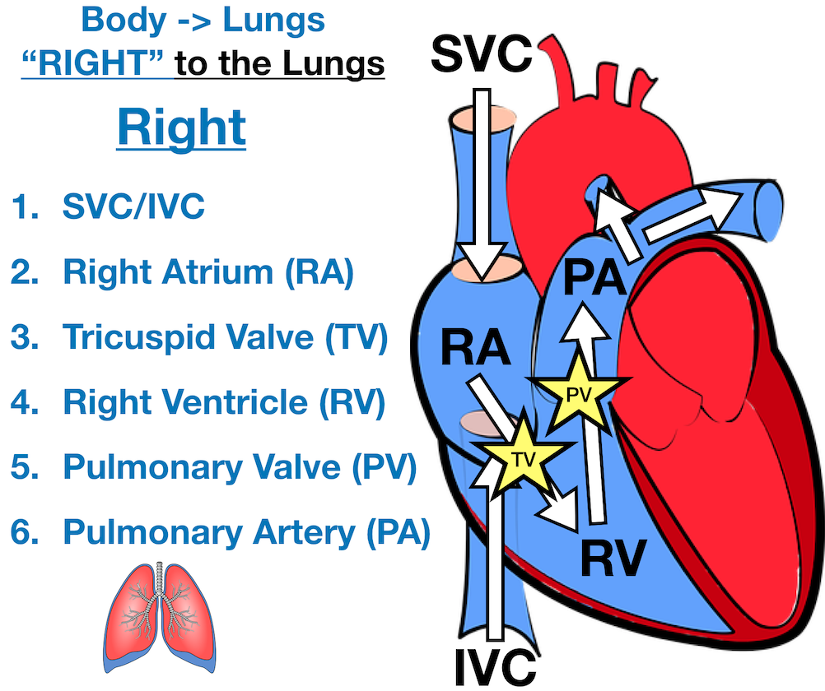
Pulmonary Circulation 1
Deoxygenated blood flows into Right Atrium via the Vena Cava (Superior and Inferior)
Right atrium pumps blood into Right Ventricle via TRICUSPID valve
Right ventricle contracts, pushing blood out of the heart through the SEMILUNAR/PULMONARY valves via the Pulmonary Artery
Pulmonary Artery/Trunk splits into Left and Right Pulmonary arteries
https://www.ezmedlearning.com/blog/heart-blood-flow-diagram

Slide 5
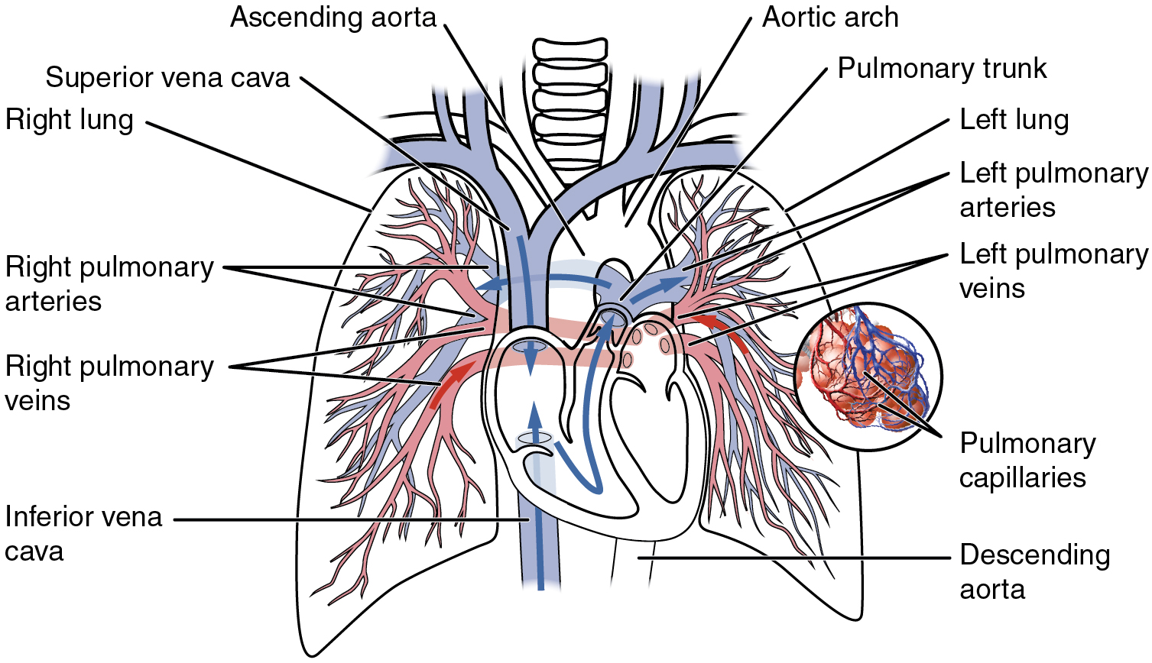
Pulmonary Circulation 2
Pulmonary arteries divide into lobar arteries supplying each lobe of the lung
Divides further into a network of capillaries which allow for gas exchange at each individual alveoli
Oxygenated blood flows from the alveoli into FOUR Pulmonary Veins
Each Pulmonary Vein drains into the Left Atrium
https://en.wikipedia.org/wiki/Pulmonary_circulation#/media/File:2119_Pulmonary_Circuit.jpg

Slide 6
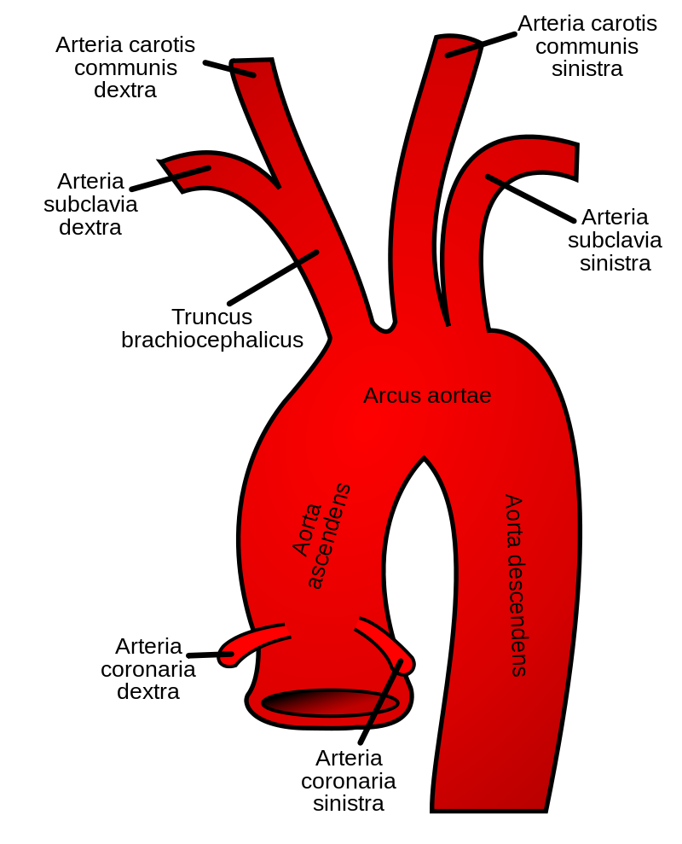
Systemic Circulation 1 - Arterial
Blood pumped out of Left Ventricle into Ascending Aorta via the SEMILUNAR/AORTIC Valve and through the Arch of Aorta
Arch of Aorta has 3 branches; Brachiocephalic trunk (which includes RS and RCC), the LCC and LS. Subclavians supply respective arms and Carotids supply respective sides of face and neck
Thoracic Aorta runs from T4 to T12 and contains paired branches which supplies bronchi, pericardium, mediastinum and oesophagus
Abdominal Aorta supplies the GI tract, liver, kidneys, bifurcates at L4 to go onto supply the lower limbs (you will learn this in GI and MSK)

Slide 7
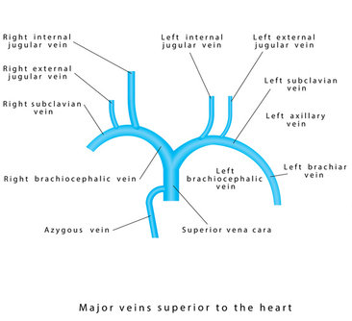
Systemic Circulation 2 - Venous
Main vein draining organs runs alongside the artery and often shares the name
Superior Vena Cava drains blood from the upper body, receiving two brachiocephalic veins which also receives subclavian and jugular veins
Azygous veins drains blood from the thorax into the Superior Vena Cava
Inferior Vena Cava drains blood from the abdomen and lower body
SVC and IVC converge to form the Vena Cava which empties into the Right Atrium

Slide 8
Equations 1
Cardiac Output = Stroke Volume x Heart Rate
Cardiac Output is amount of blood pumped per minute
Stroke Volume is the volume of blood pumped out of the heart in each contraction
Heart Rate is the number of times the heart beats per minute
Stroke Volume = End Diastolic Volume – End Systolic Volume
End diastolic volume is the volume of blood in a ventricle before the heart contracts
End systolic volume is the volume of blood in a ventricle after systole before filling

Slide 9
Equations 2
Mean Arterial Pressure = Diastolic Pressure + 1/3 (Pulse Pressure)
Mean arterial pressure is the average arterial pressure throughout one cardiac cycle
Diastolic pressure is the pressure in arteries when the heart is at rest between beats
Systolic Pressure is the pressure exerted against arterial walls when the heart beats
Pulse pressure is Systolic Pressure minus Diastolic Pressure
Blood Pressure = Cardiac Output x Total Peripheral Resistance
Blood pressure is the measure of force the heart uses to pump blood around your body
Total Peripheral Resistance is the force exerted on blood by the vascular walls

Slide 10
Peripheral Circulation Control
Myogenic Autoregulation – Increased stretch of vessels during blood flow can stimulate contraction
Local Factors
Local Vasoconstrictors – Endothelin-1 which is produced by endothelial cells, myogenic autoregulation
Local Vasodilators – Hypoxia, Adenosine and Bradykinin, Nitric Oxide released by Endothelial cells, increases in K, CO2 and H lead to dilation
Nitric Oxide is released continuously to contribute to basal vasodilation in comparison to Endothelin which is released in response to stimuli

Slide 11
Central Circulation Control
Controlled in the Medulla; particularly the dorsal and ventromedial region
Central Chemoreceptors
Located in medulla and responds to increases in PaCO2 by vasoconstricting in order to increase peripheral resistance and blood pressure
Peripheral Chemoreceptors
Located in aortic arch and carotid sinus and responds to fall in PaO2, pH and increases in PaCO2
Mainly involved in respiration control but also leads to reflex vasoconstriction
Baroreceptors
Peripheral pressure sensing receptors, Arterially in carotid sinus and aortic arch, Venously in veins, myocardium and pulmonary vessels. Influences RAAS system

Slide 12
SAQ Questions
Explain how deoxygenated blood travels from the entrance of the heart to the lungs (4 marks) Blood enters right atrium via vena cava
You have been presented with a patient that has a heart rate of 120 beats per minute and a stroke volume of 75ml. What is their cardiac output? (2 marks)
Where are central chemoreceptors located and what do they respond to? (2 marks)

Slide 13
SAQ Questions Answers
Blood enters right atrium via vena cava (1), Blood pumped into right ventricle via Tricuspid valve (1), Blood pumped through pulmonary/semi lunar valves to the pulmonary artery (1), pulmonary artery splits into left and right (1)
9000 (1) millilitres per minute (1)
Medulla (1) responds to increase in PaCO₂ (1)

Slide 14
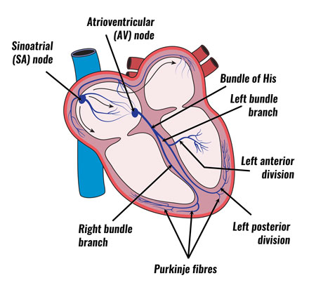
Spotter Questions
Which label is the bundle of His?
Which label has a ‘lag’ to allow for blood to flow from the atria to the ventricles?
A
C
D
B

Slide 15
Spotter Questions Answers
Which label is the bundle of His? D – Located in the interventricular septum
Which label has a ‘lag’ to allow for blood to flow from the atria to the ventricles?
A – The atrioventricular node

Slide 16
SBA Questions
1. Which valve does deoxygenated blood travel through to reach the ventricles?
Pulmonary Valve
Mitral Valve
Aortic Valve
Tricuspid Valve
2. What do peripheral receptors respond to a change in
Increase in PaCO2
Increase in PaCO2 and fall in PaO2
Increase in PaO2
Increase in PaO2 and fall in PaCO2

Slide 17
SBA Questions Answers
1. Which valve does deoxygenated blood travel through to reach the ventricles?
D – between right atria and ventricle, deoxygenated blood travels through the right side normally
2. What do peripheral receptors respond to a change in?
B – While A is technically right, SBA is ‘single best answer’ therefore B is correct as it provides the best, most in depth answer for the question

Slide 18
Thank you for listening!
Any Questions?
If you get any burning questions, don’t hesitate to get it touch with me at awalls1@sheffield.ac.uk ☺

Slide 19
Feedback
The Peer Teaching Society is not liable for false or misleading information…
Notes:
https://docs.google.com/forms/d/e/1FAIpQLSe2zgyqKuwBzN4d5qd93846ukOZ6O86lbA_jxXRy_sxj6LqGQ/viewform?vc=0&c=0&w=1&flr=0

