Slide 1
CXR interpretation
Dr Matt Kinsella

Slide 2
Aims and objectives
Use a systematic approach to CXR interpretation and presentation
Be able to recognize common CXR pathology
Be able to recommend appropriate management

Slide 3
Format
Cover technique for interpretation and presenting in OSCE
Examples of common pathology
What to do with your diagnosis

Slide 4
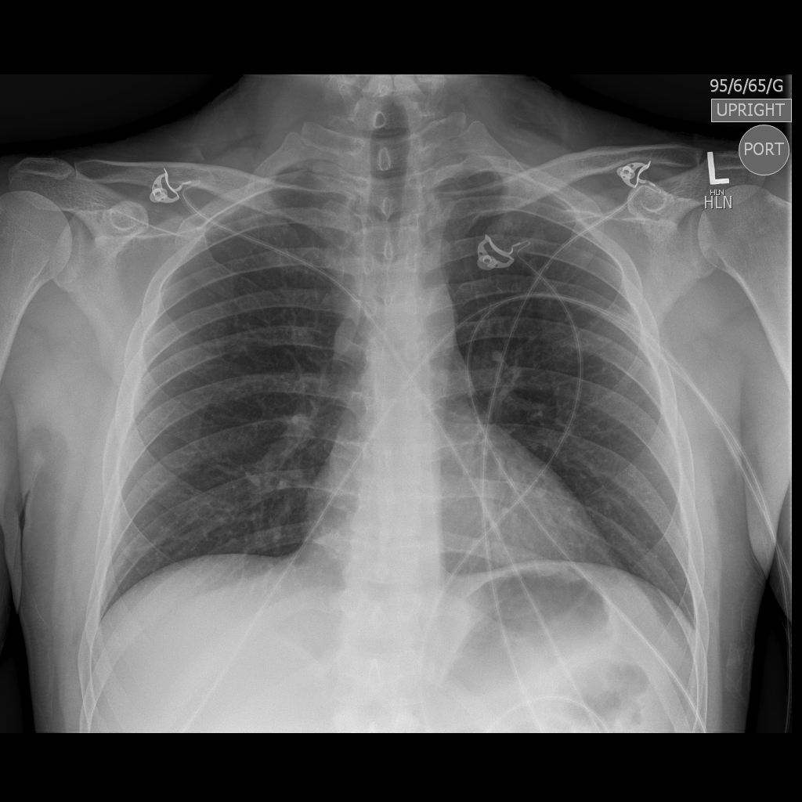

Slide 6
1
2
3
4
5
6

Slide 13
What is likely to come up in OSCE?
Consolidation
Effusion
Pulmonary oedema
Pneumothorax
Mass
?Collapse

Slide 14
Consolidation
= white area = area of increased density
DDx – Pneumonia, oedema, cancer

Slide 15
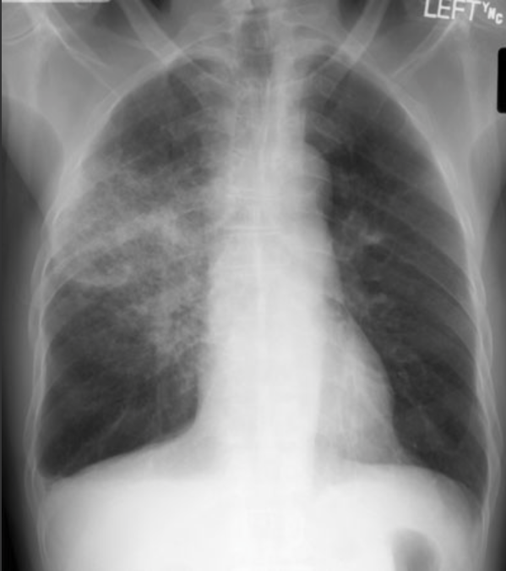

Slide 16
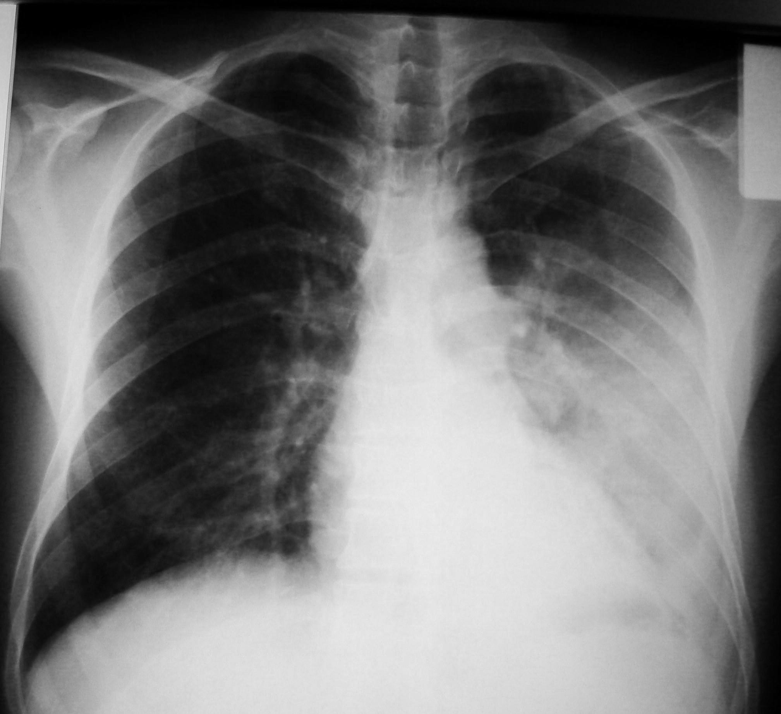

Slide 17
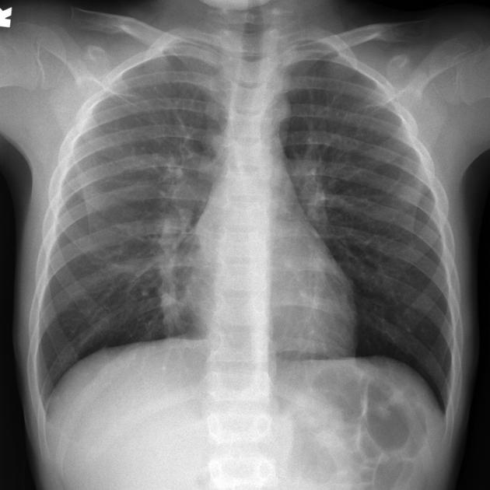
Notes:
Hiden areas- heart boarders,, diapragm, behind the heart, apex

Slide 18
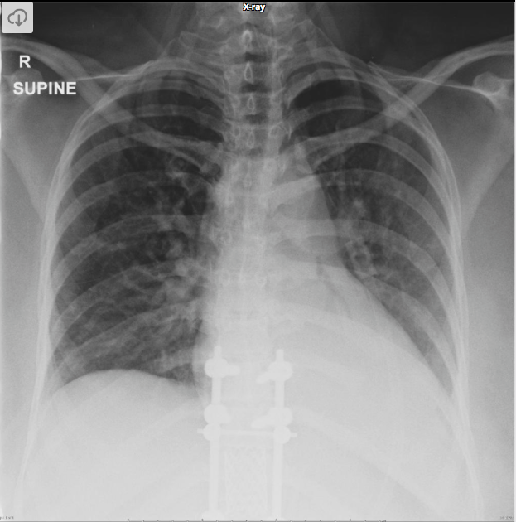

Slide 19
What to do next
Correlate with clinical hx and examination
Likely pneumonia
Treat with Abx as per trust guidelines
Repeat CXR in 6-8 weeks- Why?
Cross sectional imaging if worried about cancer

Slide 20
Pleural effusion
Dense white area
Meniscus?
Blunted CP angles
Bilateral vs unilateral
Transudate Vs Exudate

Slide 21
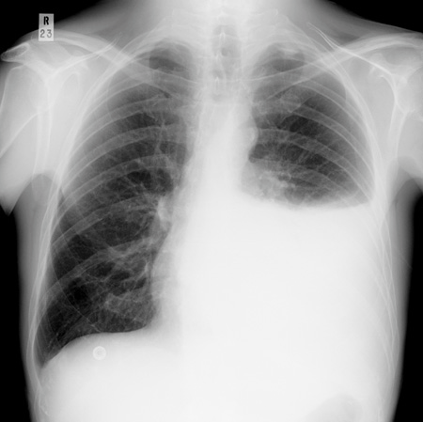

Slide 22
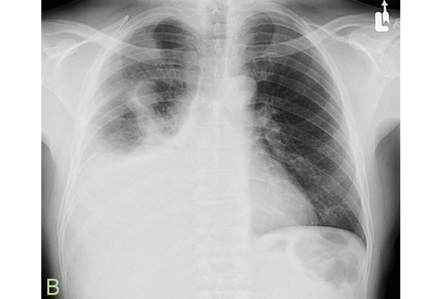

Slide 23
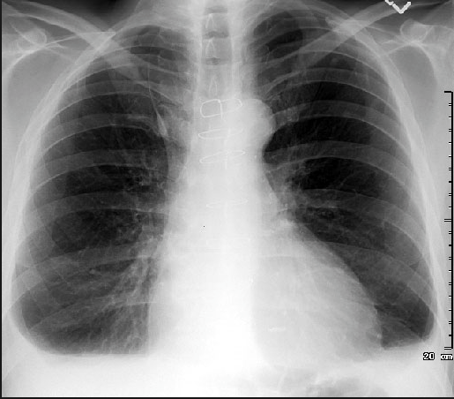

Slide 24
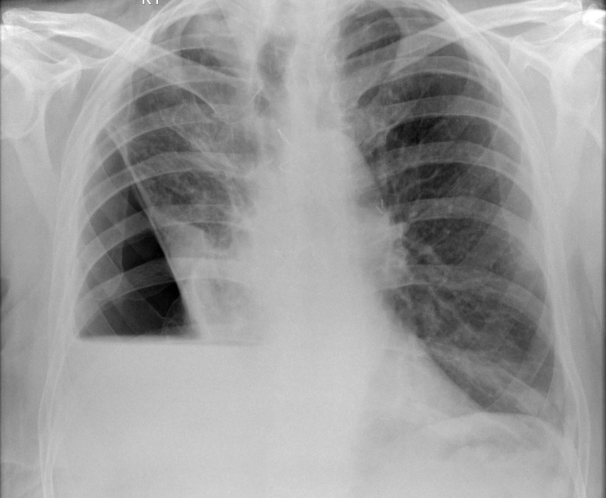

Slide 25
What next
Correlate with clinical picture
Unilateral- ? Infection, malignancy
Bilateral - ? Failures
Lights criteria
Management
Chest drain Vs therapeutic/diagnostic aspiration

Slide 26
Pulmonary oedema
Heart failure
Cardiomegally
Batwings
Blunt CP angles
?bilat effusions
Kerley B line, upper lobe diversion of vessels

Slide 27
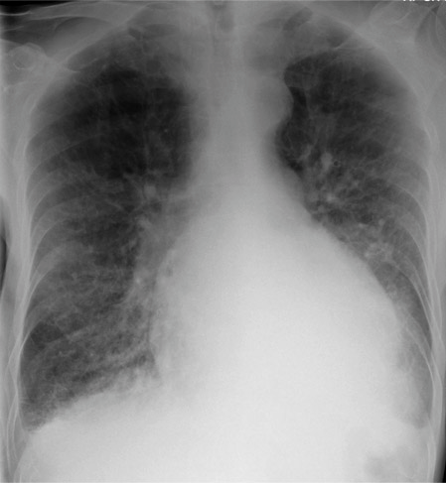

Slide 28
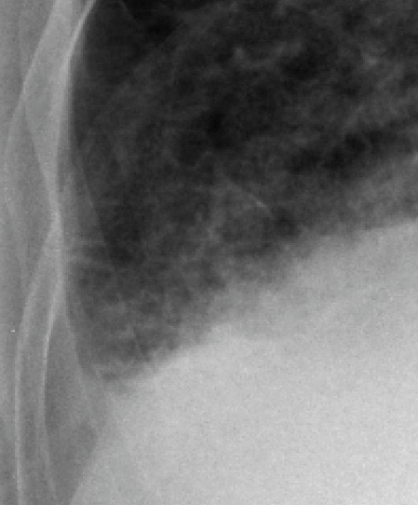

Slide 29
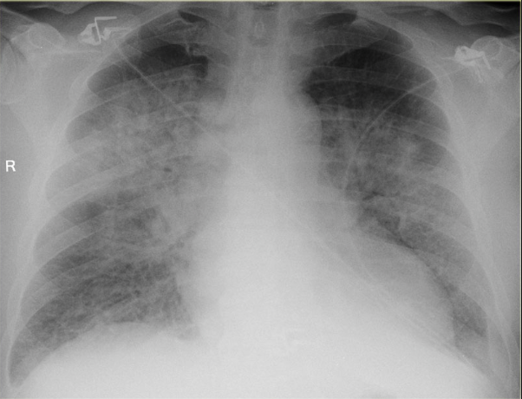

Slide 30
What next?
Acute pulmonary oedema
Sit up
O2
GTN
Morphine
Frusemide
Chronic management - needs ACE I and betablockers
ECHO + HF team

Slide 31
Pneumothorax
Darker area
Pleural edge
Trachea central?
Trauma? Vs Primary Vs Secondary

Slide 32
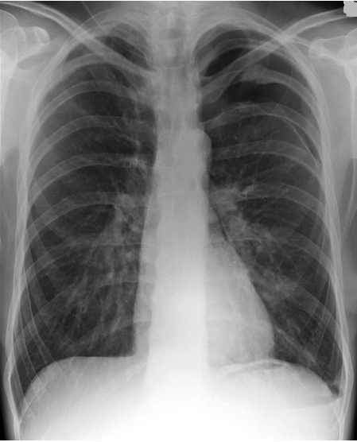

Slide 33
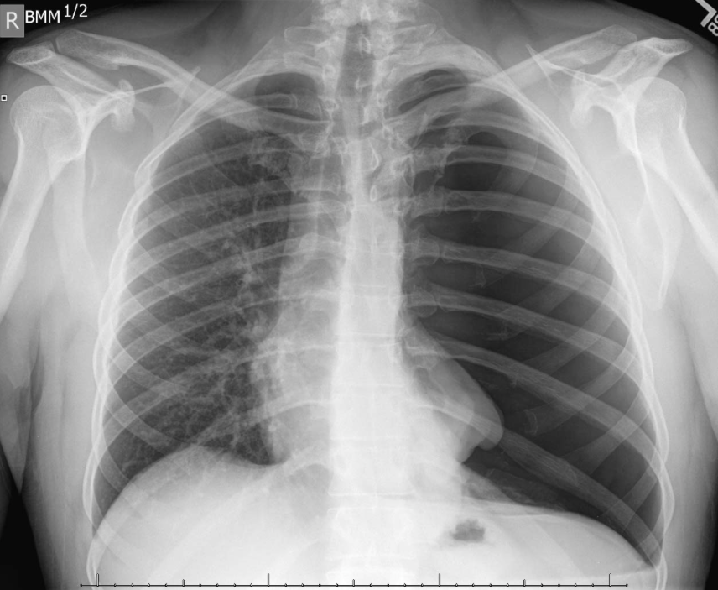

Slide 34
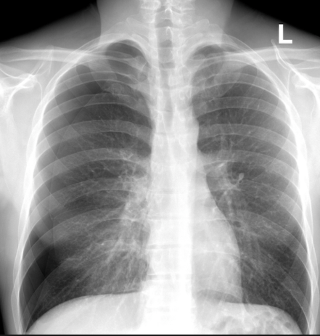

Slide 35
What now?
Tension- needle decompression + chest drain
O2 + analgesia
Aspiration
Chest drain

Slide 36
Mass
Single vs multiple
DDx- infection or malignancy
Hollow vs solid

Slide 37
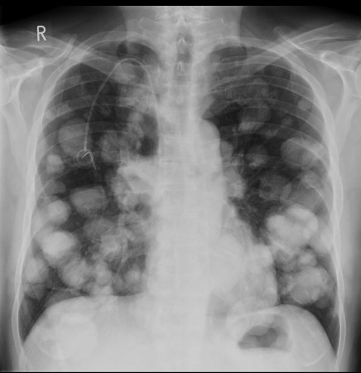

Slide 38
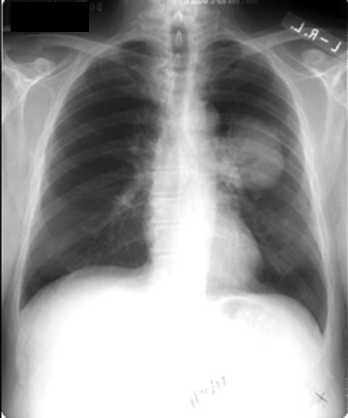

Slide 39
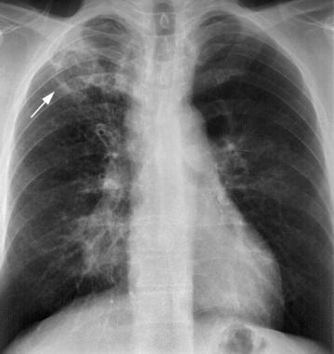

Slide 40
What next?
Correlate with clinical ? Malignancy ? TB etc
Cross sectional imaging , bronchoscopy, image guided biopsy
MDT
Treat any infection

Slide 41
Collapse
White area
Loss of volume
Collapse Vs Effusion
DDx- Infection, obstructing lesion, inhaled foreign body, mucous plugging, ?pneumonectomy

Slide 42
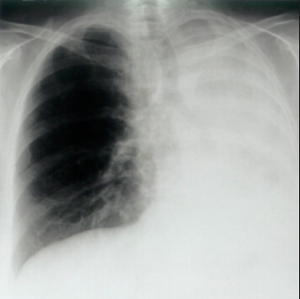

Slide 43
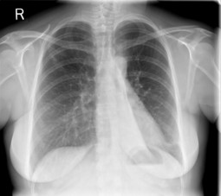

Slide 44
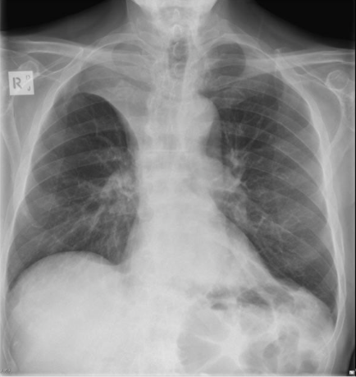

Slide 45
What now?
Depends on cause
PT to clear secretions
Cross section imaging, Bronchoscopy
?MDT

Slide 46
Medical lines and devices
NG tube- very important its in the right place
Pacemaker
ET tube
Chest drain

Slide 47
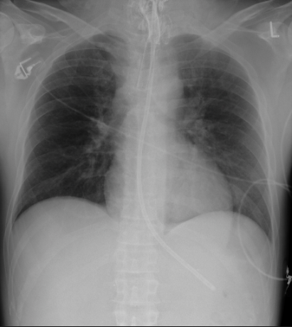

Slide 48
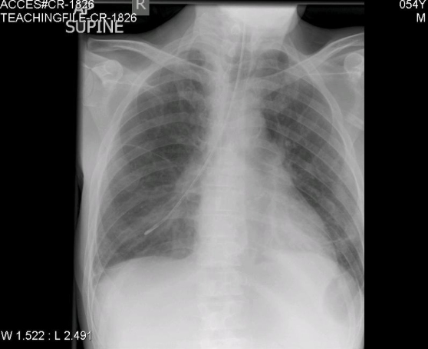

Slide 49
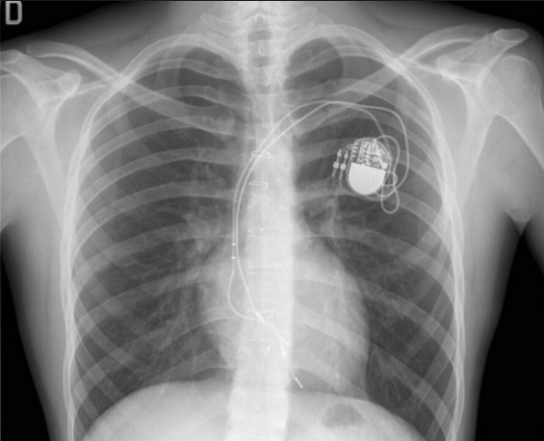

Slide 50
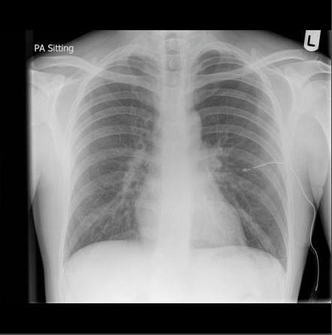

Slide 51
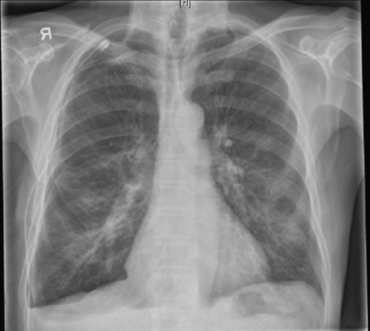

Slide 52
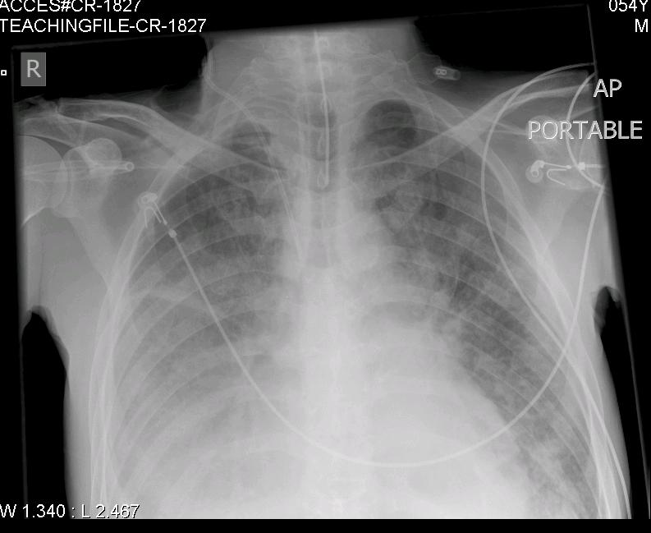

Slide 53
Quiz
10 CXR
Prize for winner

Slide 54
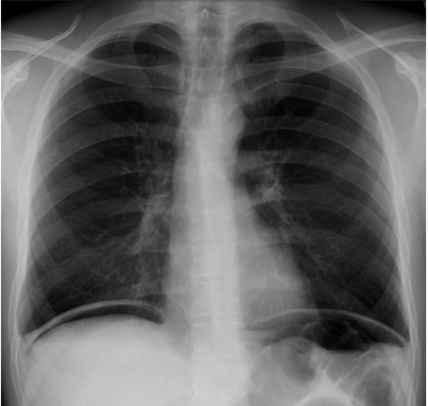
CASE 1

Slide 55
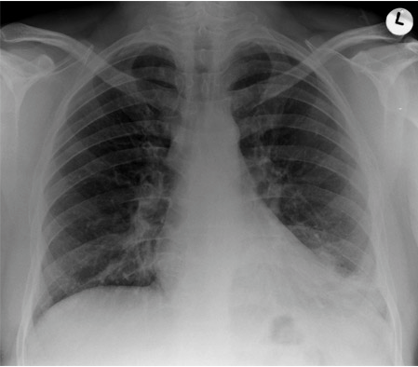
CASE 2

Slide 56
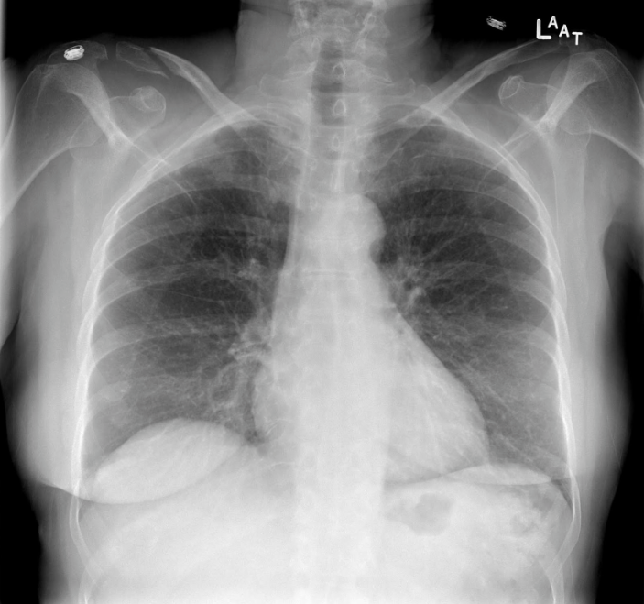
CASE 3

Slide 57
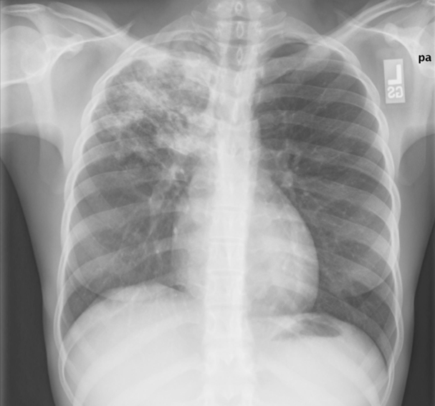
CASE 4
Notes:
R sided #s

Slide 58
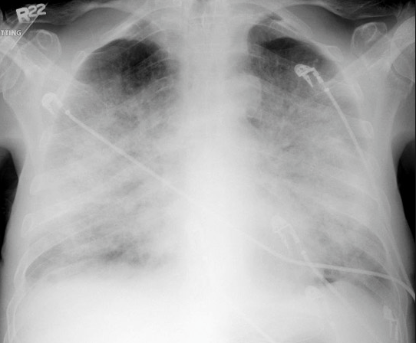
CASE 5

Slide 59
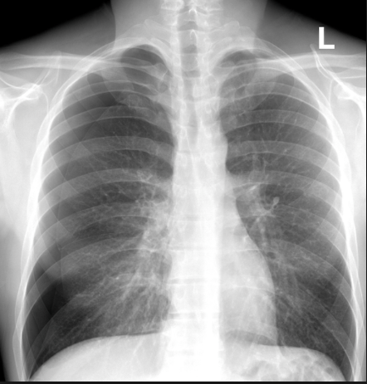
CASE 6

Slide 60
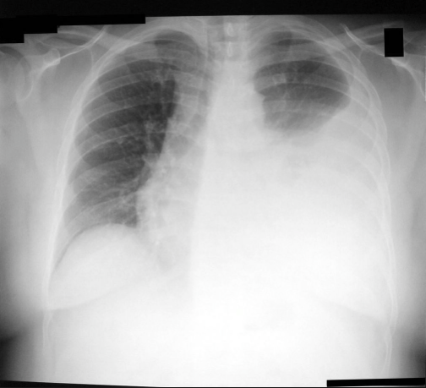
CASE 7

Slide 61
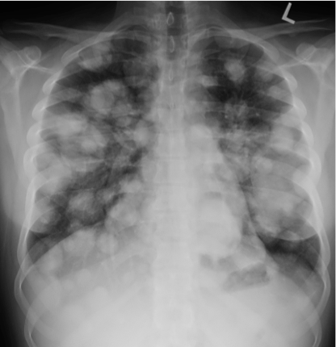
CASE 8

Slide 62
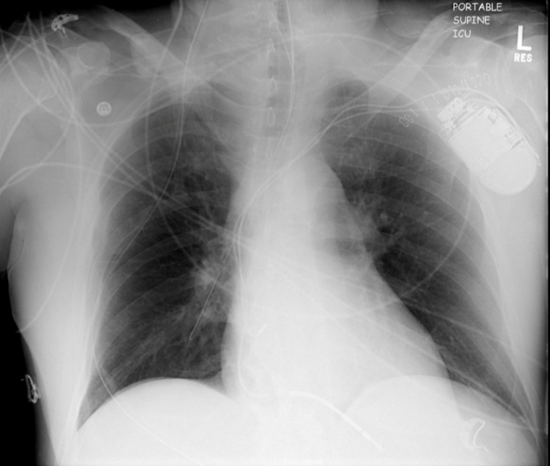
CASE 9

Slide 63
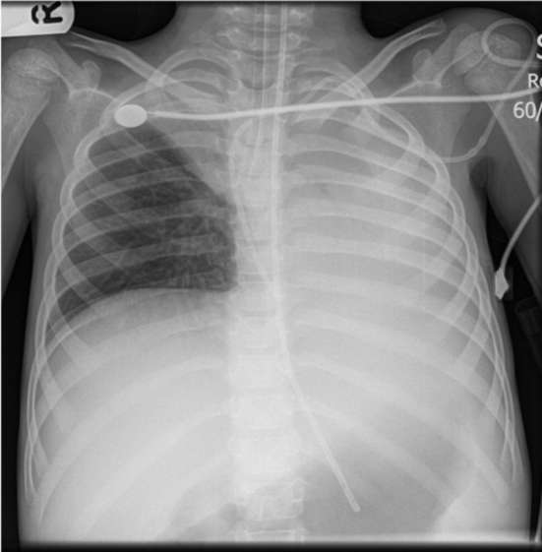
CASE 10

