Slide 1
2020/21

Slide 2
Endocrine 1
Phase 2a Revision Session
Nimisha Shaji and Junaid Patel
18/01/2021

Slide 3
Aims and Objectives
Diabetes 1 and 2 (including ketoacidosis and hyperosmolar hyperglycaemic state as complications),
Cushing’s disease and syndrome
Adrenal insufficiency
Conn’s syndrome
Hypo and hyperkalaemia
Neuroendocrine tumours
Pheochromocytoma
The Peer Teaching Society is not liable for false or misleading information…

Slide 4
Type 1 Diabetes Mellitus
Definition:
Autoimmune destruction of pancreatic beta cells leading to complete insulin deficiency.
Risk Factors:
Northern European
Family History:
HLA DR3-DQ2 or
HLA-DR4-DQ8
Epidemiology:
Usually at ages 5-15

Slide 5
Type 1 Diabetes Mellitus
Definition:
Autoimmune destruction of pancreatic beta cells leading to complete insulin deficiency.
Risk Factors:
Northern European
Family History:
HLA DR3-DQ2 or
HLA-DR4-DQ8
Other autoimmune diseases:
Autoimmune thyroid
Coeliac disease
Addison’s disease
Pernicious anaemia
Epidemiology:
Usually at ages 5-15

Slide 6
Type 1 Diabetes Mellitus
Pathophysiology
Autoimmune destruction of beta cells in the Islets of Langerhans by autoantibodies
Insulin deficiency and continued breakdown of liver glycogen
Hyperglycaemia and Glycosuria
Notes:
Abscence of insulin → increased hepatic gluconeogenesis and decreased peripheral glucose

Slide 7
Type 1 Diabetes Mellitus
Signs and Symptoms:
Polydipsia
Polyuria
Weight Loss
(Usually short history of severe symptoms)
Diagnosis:
Likely patient (but not a rule!):
Symptoms/Signs mentioned above
Young
BMI < 25
Personal and/or FHx of autoimmune disease

Slide 8
Type 1 Diabetes Mellitus
Signs and Symptoms:
Polydipsia
Polyuria
Weight Loss
(Usually short history of severe symptoms)
Diagnosis:
Likely patient (but not a rule!):
Symptoms/Signs mentioned above
Young
BMI < 25
Personal and/or FHx of autoimmune disease
Random Plasma Glucose > 11mmol/l

Slide 9
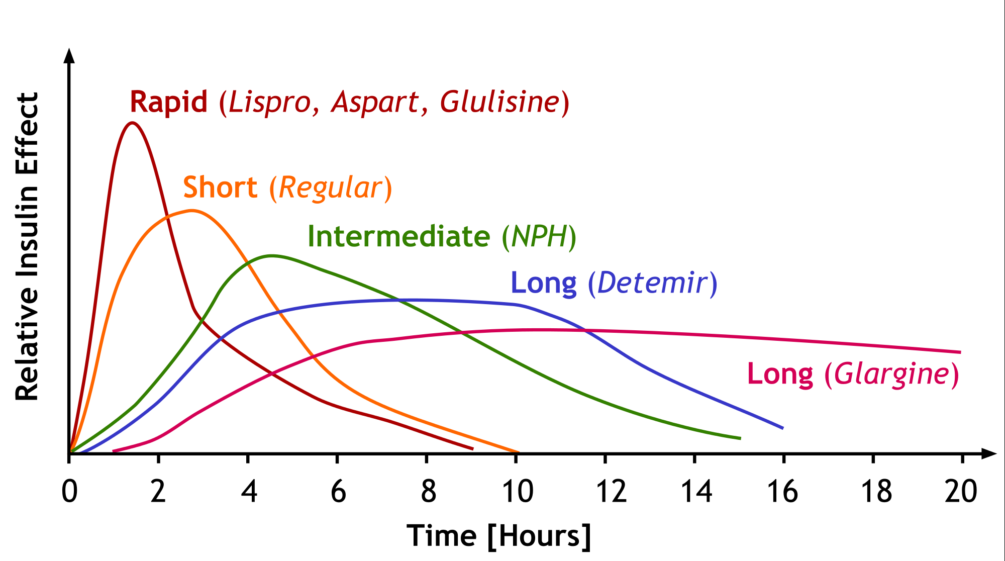
Type 1 Diabetes Mellitus
Treatment:
INSULIN
Short acting
Short acting insulin analogues
Longer acting insulins

Slide 10
Diabetic Ketoacidosis
Aetiology
Untreated T1DM
Undiagnosed DM
Infection/Illness
Pathophysiology
Complete absence of insulin unrestrained increased hepatic gluconeogenesis and decreased peripheral glucose uptake
Hyperglycaemia osmotic diuresis dehydration
Peripheral lipolysis increase FFA oxidised to Acetyl CoA ketones
= ACIDOSIS

Slide 11
Diabetic Ketoacidosis
Symptoms
Diabetes Symptoms ++
Nausea and vomiting
Weight loss
Drowsy/ Confused
Abdominal Pain
Signs:
Reduced tissue turgor
Kussmaul’s breathing
Breath smell of ketones
Hypotension
Tachycardia
Investigations
Hyperglycaemia: Random Plasma Glucose >11mmol/l
Ketonaemia: Plasma ketones > 3mmol/l
Acidosis: Blood pH < 7.35 or Bicarbonate <15mmol/l
Urine dipstick: glycosuria/ketonuria

Slide 12
Diabetic Ketoacidosis
Complications
Coma
Cerebral oedema
Thromboembolism
Aspiration Pneumonia
DEATH
Management
ABC
Replace fluid loss with 0.9% saline IV
IV insulin
Restore electrolytes e.g. K+
Notes:
Restore electrolytes question

Slide 13
Type 2 Diabetes Mellitus
Definition
Combination of peripheral insulin resistance and less severe insulin deficiency…
Risk Factors
Increase w/ age
M > F
Ethnicity: African-Carribean, Black African and South Asian
Obesity
Hypertension
Clinical Presentation
Polydipsia
Polyuria
Glycosuria
Central obesity
Slower onset
Notes:
How is the t2dm presentation different to t1dm

Slide 14
Type 2 Diabetes Mellitus
Diagnosis Random Plasma Glucose/Fasting Glucose
HbA1c: measures glycosylated glucose
 | Normal | Pre-diabetes | Diabetes
Random | <11.1 | N/A | 11.1
Fasting | <6.1 | 6.1 - 6.9 | 7.0
2h post prandial | <7.8 | 7.8 - 11.0 | 11.1
HbA1c (mmol/mol) | <42 | 42 - 47 | >47
HbA1c (%) | <6.0 | 6.0 - 6.4 | >6.4

Slide 15
Type 2 Diabetes Mellitus
Diagnosis Random Plasma Glucose/Fasting Glucose
HbA1c: measures glycosylated glucose
 | Normal | Pre-diabetes | Diabetes
Random | <11.1 | N/A | 11.1
Fasting | <6.1 | 6.1 - 6.9 | 7.0
2h post prandial | <7.8 | 7.8 - 11.0 | 11.1
HbA1c (mmol/mol) | <42 | 42 - 47 | >47
HbA1c (%) | <6.0 | 6.0 - 6.4 | >6.4

Slide 16
Type 2 Diabetes Mellitus
1. Lifestyle Modification
Diet
Weight Control
Exercise
2. 1st Line Therapy
Metformin (biguanide)
3. If HbA1c still high consider dual therapy:
Metformin + DPP4 inhibitor
Metformin + Pioglitiazone
Metformin + sulfonylureas
Metformin + SGLT-2i
4. If HbA1c still high, triple therapy
5. Insulin

Slide 17
Type 2 Diabetes Mellitus
Diabetes Pharmacology
Drug Class and Example | Mechanism of Action | Side Effects
Biguanide e.g. Metformin | Decreased gluconeogenesis in liver and increase cell sensitivity to insulin | NOT hypoglycaemia GI disturbances (anorexia, diarrhoea, nausea)
Sulfonylureas e.g. gliclazide | Promote insulin secretion | Hypoglycaemia Weight Gain

Slide 18
Hyperosmolar Hyperglycaemic
Characterised by:
Marked hyperglycaemia
Hyperosmolality
Mild/no ketosis
- Uncontrolled T2DM
Clinical Presentation
Decrease level of consciousness
Severe dehydration
Hyperglycaemia
Hyperosmolality
No ketones in blood/urine
Pathophysiology
Decreased insulin levels insufficient to inhibit hepatic glucose production but sufficient to inhibit hepatic ketogenesis.

Slide 19
Hyperosmolar Hyperglycaemic
Diagnosis
Hyperglycaemia >11mmol/l
Urine dipstick: heavy glycosuria
Plasma osmolality: high
Treatment
Fluid replacement w/ 0.9% saline
LMWH e.g. SC enoxaparin to decrease risk of thromboembolism
Restore electrolyte loss (K+)

Slide 20
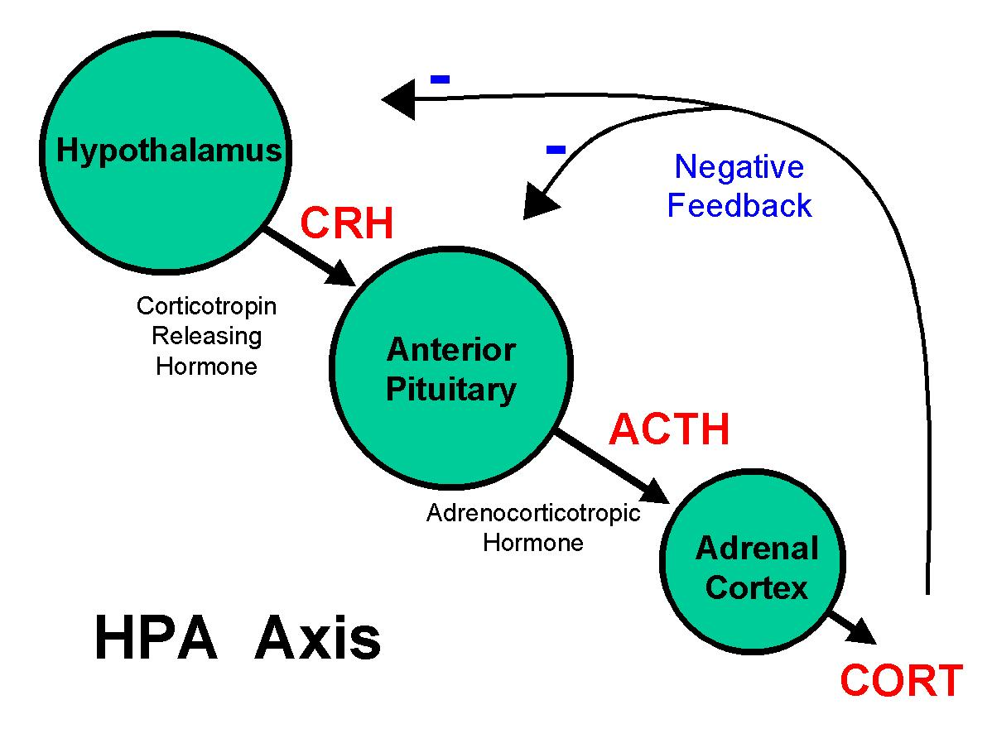
Cushing’s syndrome
Aetiology
Chronic excess of cortisol hormone released by the adrenal glands.
Notes:
Cushing’s disease vs syndrome

Slide 21
Cushing’s syndrome
ACTH dependent causes
Cushing’s disease
Most common of the ACTH-dependent causes
Caused by an ACTH secreting pituitary adenoma
Leads to bilateral adrenal hyperplasia
Ectopic ACTH production
ACTH treatment
ACTH independent causes
Adrenal adenoma
Iatrogenic

Slide 22
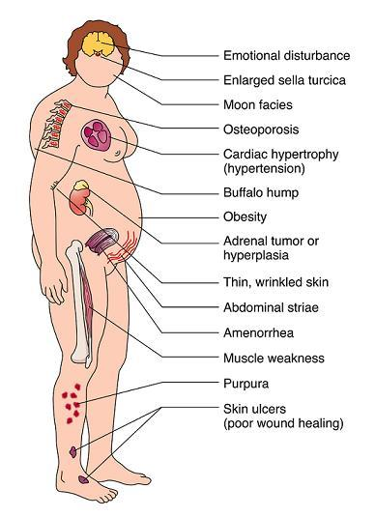
Cushing’s syndrome
Clinical presentation
Central obesity
Plethoric complexion
Moon face
Mood change
Proximal muscle weakness
Purple abdominal striae
Gastric ulcers
Osteoporosis
Hirsutism

Slide 23
Cushing’s syndrome
Diagnosis
Drug history – Cushing’s can be caused by oral steroids so first exclude this
Random plasma cortisol (screening)
Overnight dexamethasone suppression test
+ Urinary free cortisol (24hr)
If high
If positive
Test plasma ACTH

Slide 24
Cushing’s syndrome
Treatment Dependent on cause
If cause is:
Pituitary adenoma Transsphenoidal surgical resection
Adrenal adenoma Adrenalectomy
Complications
Cardiovascular disease
Hypertension
Diabetes mellitus
Osteoporosis

Slide 25
Adrenal insufficiency
Primary adrenal insufficiency
Addison's disease, or primary adrenal insufficiency, is a disorder that affects the adrenal glands, causing decreased production of adrenocortical hormones
Secondary adrenal insufficiency
Secondary adrenal insufficiency occurs in patients with pituitary or hypothalamic involvement. This results in decreased ACTH secretion, which ultimately results in adrenal failure.
Notes:
What is primary adrenal insufficiency aka

Slide 26
Adrenal insufficiency
Primary adrenal insufficiency
Addison's disease, or primary adrenal insufficiency, is a disorder that affects the adrenal glands, causing decreased production of adrenocortical hormones
Secondary adrenal insufficiency
Secondary adrenal insufficiency occurs in patients with pituitary or hypothalamic involvement. This results in decreased ACTH secretion, which ultimately results in adrenal failure.
Notes:
What is primary adrenal insufficiency aka

Slide 27
Adrenal insufficiency
Aetiology – commonest causes
In developed countries autoimmune destruction (21-hydroxylase present in 60-90% of people)
TB is one of the commonest cause in developing countries.
Pathophysiology
Destruction of the adrenal cortex results in the decreased production of the hormones.
Risk factors
Female sex
Adrenocortical antibodies
Other autoimmune diseases
Notes:
The cumulative risk, for patients with positive tests for adrenocortical autoantibodies, of developing Addison's disease is approximately 50%

Slide 28
Adrenal insufficiency
Aetiology – commonest causes
In developed countries autoimmune destruction (21-hydroxylase present in 60-90% of people)
TB is one of the commonest cause in developing countries.
Pathophysiology
Destruction of the adrenal cortex results in the decreased production of the hormones.
Risk factors
Female sex
Adrenocortical antibodies
Other autoimmune diseases
Notes:
The cumulative risk, for patients with positive tests for adrenocortical autoantibodies, of developing Addison's disease is approximately 50%

Slide 29
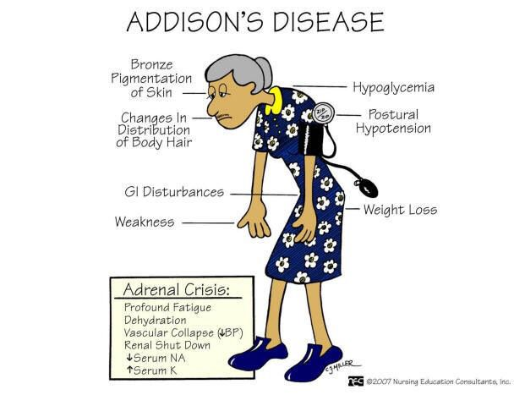
Adrenal insufficiency
Symptoms
Fatigue
Weakness
Weight loss
Signs
Hyperpigmentation – Only in Addison’s
Postural hypotension
Hypoglycaemia
Other signs of autoimmunity may be present (vitiligo, hashimoto’s etc.)

Slide 30
Adrenal insufficiency
Investigations
Serum electrolytes: ↓ Sodium ↑ Potassium
FBC: Anaemia and eosinophilia
Morning serum cortisol: Reduced
Adrenal CT or MRI
Management
Glucocorticoid + Mineralocorticoid
Aim to mimic normal physiological state
Treat underlying cause

Slide 31
Conn’s syndrome
Aetiology
Autonomous aldosterone production that exceeds the body’s requirements and is independent of the renin-angiotensin ll system.
Pathophysiology
Excess aldosterone
Increased sodium reabsorption and potassium excretion in the kidneys
Hypertension and potential hypokalaemia

Slide 32
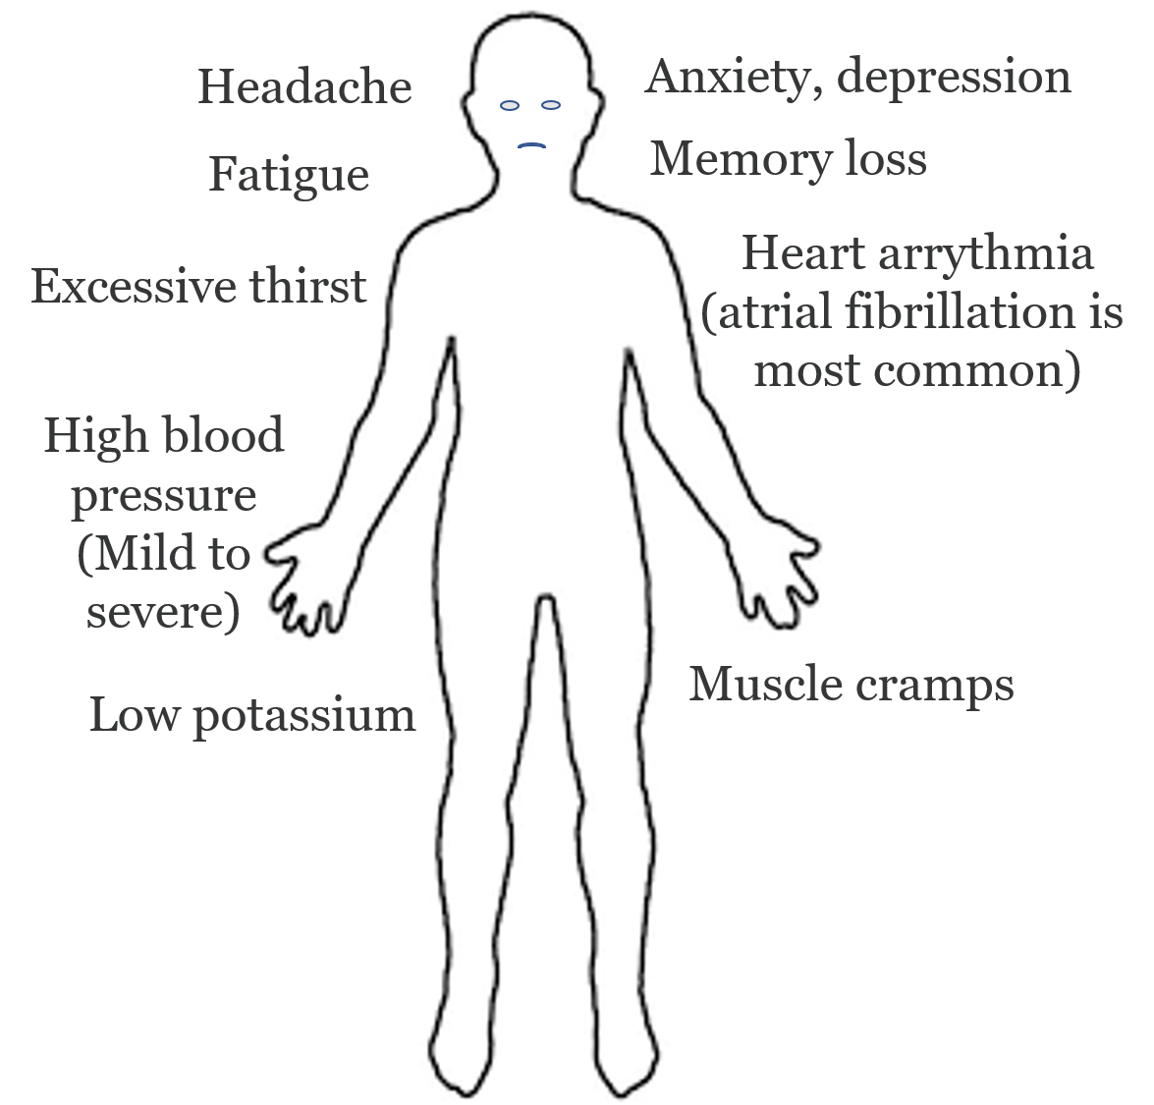
Conn’s syndrome
Clinical presentation
Hypertension
Nocturia and polyuria
Mood disturbance
Difficulty concentrating
Investigations
Plasma potassium Low
Aldosterone/renin ratio High

Slide 33
Conn’s syndrome
Treatment
Goals: Lower BP, decrease aldosterone levels and resolve any electrolyte imbalance
If the cause is a single benign adrenal tumour Unilateral adrenalectomy
If the cause is due to bilateral adrenal hyperplasia Aldosterone antagonists (spironolactone)

Slide 34
Hypokalaemia
Definition: <3.5mmol/L
Symptoms
Asymptomatic
Fatigue
Generalised weakness
Muscle cramps and pain
Palpitations
Signs
Arrhythmias
Muscle paralysis and rhabdomyolysis
Aetiology
Increased Excretion | Reduced Intake | Shift to Intracellular
Drugs e.g. thiazide, loop Renal disease GI loss Increased aldosterone | Dietary deficiency | Drugs e.g. insulin, salbutamol
The Peer Teaching Society is not liable for false or misleading information…
Notes:
GI: diarrhoea, vomiting, laxative abuse
Renal: diuretics, other drugs, mineralocorticoid excess

Slide 35
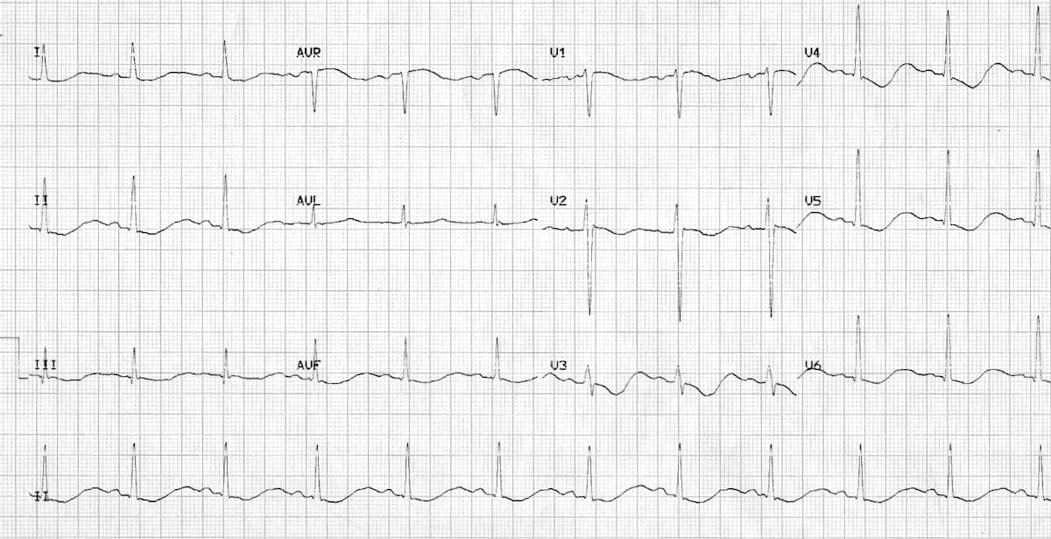
Hypokalaemia
Diagnosis
ECG: Flat T waves, ST depression, Prominent U waves, Prolonged PR
Urine osmolality, electrolytes
Bloods: FBC, U&E
The Peer Teaching Society is not liable for false or misleading information…
Notes:
GI: diarrhoea, vomiting, laxative abuse
Renal: diuretics, other drugs, mineralocorticoid excess

Slide 36
Hypokalaemia
Diagnosis
ECG: Flat T waves, ST depression, Prominent U waves, Prolonged PR
Urine osmolality, electrolytes
Bloods: FBC, U&E
Management
Potassium PO/IV
Other electrolyte replacements
Treat underlying cause
The Peer Teaching Society is not liable for false or misleading information…
Notes:
GI: diarrhoea, vomiting, laxative abuse
Renal: diuretics, other drugs, mineralocorticoid excess

Slide 37
Hyperkalaemia
Definition: >5.5mmol/L
Symptoms
Fatigue
Generalised weakness
Chest pain
Palpitations
Signs
Arrhythmias
Reduced power
Reduced reflexes
Signs of underlying cause
Aetiology
Impaired Excretion | Increased Intake | Shift to Extracellular
AKI and CKD Drug effect Renal tubular acidosis (T4) | Intravenous therapy Increased dietary intake | Metabolic acidosis Rhabdomyolysis
The Peer Teaching Society is not liable for false or misleading information…
Notes:
GI: diarrhoea, vomiting, laxative abuse
Renal: diuretics, other drugs, mineralocorticoid excess

Slide 38
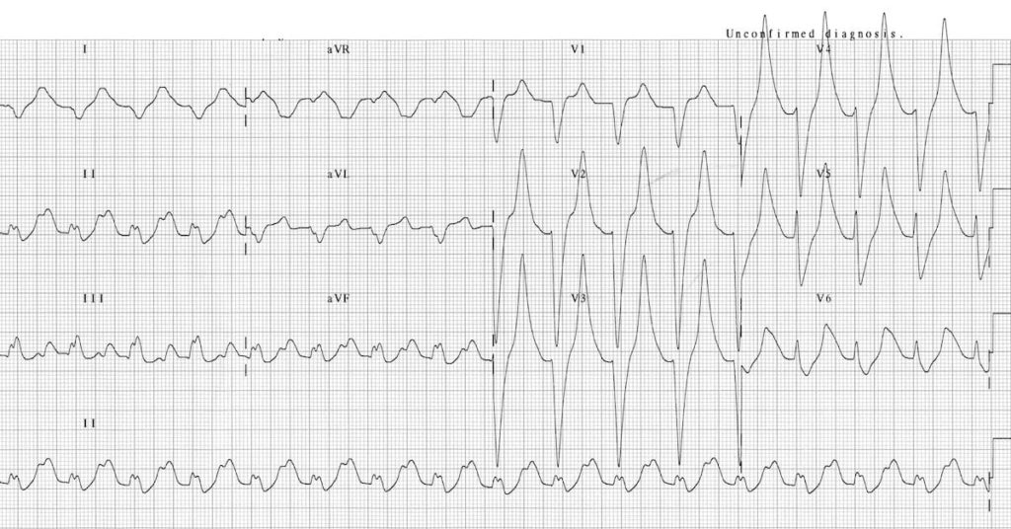
Hyperkalaemia
Diagnosis
ECG: ‘tall tented T waves’, prolonged PR interval (>200ms), widening of the QRS interval (>120ms), small/absent P waves
Urine osmolality, electrolytes
Bloods: FBC, U&E
The Peer Teaching Society is not liable for false or misleading information…
Notes:
GI: diarrhoea, vomiting, laxative abuse
Renal: diuretics, other drugs, mineralocorticoid excess

Slide 39
Hyperkalaemia
Diagnosis
ECG: ‘tall tented T waves’, prolonged PR interval (>200ms), widening of the QRS interval (>120ms), small/absent P waves
Urine osmolality, electrolytes
Bloods: FBC, U&E
Management
ABC assessment
Consider cardiac monitoring
1. Protect myocardium: 10ml, 10% calcium gluconate
2. Drive K+ intracellularly: Insulin/Dextrose, Nebulised Salbutamol
The Peer Teaching Society is not liable for false or misleading information…
Notes:
GI: diarrhoea, vomiting, laxative abuse
Renal: diuretics, other drugs, mineralocorticoid excess

Slide 40
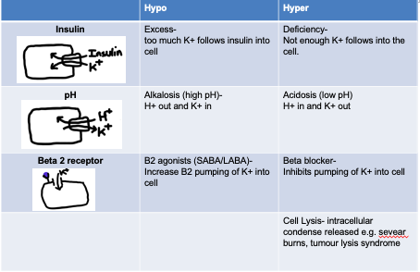
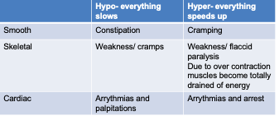
HyPER vs HyPO - kalaemia

Slide 41
Phaeochromocytomas
Adrenal medullary tumour that secretes catecholamines.
Very rare
Aetiology
Phaeochromocytomas occur in certain familial syndromes:
Multiple endocrine neoplasia (MEN) syndrome
Neurofibromatosis
Von-Hippel Lindau Disease

Slide 42
Phaeochromocytomas
Symptoms
Headache, Profuse Sweating, Palpitations, Tremor etc.
Signs
Hypertension, Postural hypotension, tremor, hypertensive retinopathy, pallor
Investigations
Plasma metanephrines and normetanephrines
24 hour urinary total catecholamines
CT – look for tumour

Slide 43
Phaeochromocytomas
Treatment
Without HTN crisis:
1st Line: Alpha blockers: phenoxybenzamine
Most patients will eventually get the tumour removed and then managed medically.
With HTN crisis:
1st Line: Antihypertensive agents: phentolamine

Slide 44
Carcinoid Syndrome
Groups of symptoms due to release of serotonin and other vasoactive peptides into the systemic circulation from a carcinoid tumour.
Symptoms
Diarrhoea
Flushing
Signs
Palpitations
Abdominal cramps
Signs of right heart failure
Bronchospasm
Tend to express somatostatin receptors.
Affects lung, bowel, stomach, mets to liver

Slide 45
Carcinoid Syndrome
Investigations
High volume of 5-hydroxyindoleacetic acid (breakdown product of serotonin)
Metabolic panel and LFTs
Liver ultrasound: confirm metastases
Treatments
Local disease: surgical resection + peri-operative octreotide infusion
Metastases: above + additional radiofrequency ablation

Slide 46
Case 1
A 48-year-old man has a 4-month history of increasing fatigue and anorexia. He has lost 5.5 kg and noticed increased skin pigmentation. He has been otherwise healthy. His mother has Hashimoto's thyroiditis and one of his sisters has type 1 diabetes. His blood pressure is 110/85 mmHg (supine) and 92/60 mmHg (sitting). His face shows signs of wasting and his skin has diffuse hyperpigmentation, which is more pronounced in the oral mucosa, palmar creases, and knuckles.
What condition does this man likely have?
Conn’s syndrome
Type 1 diabetes
Addison’s disease

Slide 47
Case 1
A 48-year-old man has a 4-month history of increasing fatigue and anorexia. He has lost 5.5 kg and noticed increased skin pigmentation. He has been otherwise healthy. His mother has Hashimoto's thyroiditis and one of his sisters has type 1 diabetes. His blood pressure is 110/85 mmHg (supine) and 92/60 mmHg (sitting). His face shows signs of wasting and his skin has diffuse hyperpigmentation, which is more pronounced in the oral mucosa, palmar creases, and knuckles.
What condition does this man likely have?
Conn’s syndrome
Type 1 diabetes
Addison’s disease

Slide 48
Case 2
A 12-year-old girl is brought to the emergency department by her parents due to 12 hours of rapidly worsening nausea, vomiting, abdominal pain, and lethargy. Over the last week she has felt excessively thirsty and has been urinating a lot. Physical examination reveals a lean, dehydrated girl with deep rapid respirations, tachycardia, and no response to verbal commands.
What is the most likely condition she is suffering from?
Hyperosmolar-hyperglycaemic state
Diabetic Ketoacidosis
Adrenal crisis
Anaphylactic shock

Slide 49
Case 2
A 12-year-old girl is brought to the emergency department by her parents due to 12 hours of rapidly worsening nausea, vomiting, abdominal pain, and lethargy. Over the last week she has felt excessively thirsty and has been urinating a lot. Physical examination reveals a lean, dehydrated girl with deep rapid respirations, tachycardia, and no response to verbal commands.
What is the most likely condition she is suffering from?
Hyperosmolar-hyperglycaemic state
Diabetic Ketoacidosis
Adrenal crisis
Anaphylactic shock

Slide 50
Case 3
A 34-year-old woman presents with complaints of weight gain and irregular menses for the last several years. She has gained 20 kg over the past 3 years and feels that most of the weight gain is in her abdomen and face. She notes bruising without significant trauma, difficulty rising from a chair, and proximal muscle wasting. She was diagnosed with type 2 diabetes and hypertension 1 year ago.
What is the most likely condition she is suffering from?
Addison’s disease
Cushing syndrome
Pheochromocytoma
Polycystic Ovary Syndrome

Slide 51
Case 3
A 34-year-old woman presents with complaints of weight gain and irregular menses for the last several years. She has gained 20 kg over the past 3 years and feels that most of the weight gain is in her abdomen and face. She notes bruising without significant trauma, difficulty rising from a chair, and proximal muscle wasting. She was diagnosed with type 2 diabetes and hypertension 1 year ago.
What is the most likely condition she is suffering from?
Addison’s disease
Cushing syndrome
Pheochromocytoma
Polycystic Ovary Syndrome

Slide 52
Conclusion
Diabetes mellitus almost always comes up in exams so be sure to learn it in-depth.
For the less commonly asked about conditions such as pheochromocytoma and carcinoid syndrome, you don’t have to learn everything about them – just typical presentation, pathophysiology, 1st line investigation and 1st line management is fine.
The Peer Teaching Society is not liable for false or misleading information…

