Slide 1
GEM SBA-Style Revision Series
2022/23

Slide 2
Reproductive Physiology
Phase 1 Content GEM SBA Revision Session
[Jess and Adam]
[12/10/2022/6:30– 8:00]

Slide 3
Aims and Objectives
Reproduction
SRY gene and its importance
Meiosis (already done in IMMS)
Oogenesis, spermatogenesis
Spermiogenesis – know the difference between spermiogenesis and spermatogenesis
→ Little bit about Histology
Pregnancy and menstrual cycle
Stages of menstrual cycle – hormones involved, changes to the lining, etc.
Be able to identify hormones involved in the menstrual cycle off of a graph (based on levels in certain
Fertilization and implantation
Follicular development
Layers of the uterus and cervical ripening
Maternal adaptations during pregnancy
Stages of labour & hormones involved in its initiation
Placenta: hormones, function, structure

Slide 4
Question 1
Where does fertilisation of the egg cell occur?
A – In the ampulla of the fallopian tube
B – In the endocervix
C – In the body of the uterus
D – In the abdominal cavity
E – In the urethra

Slide 5
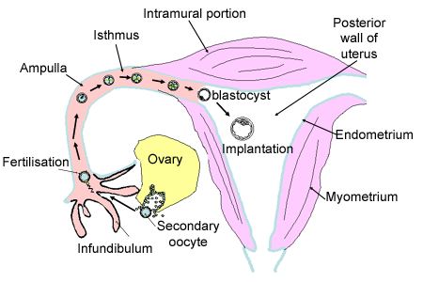
Question 1 Answer
Where does fertilisation of the egg cell occur?
A – In the ampulla of the fallopian tube
B – In the endocervix
C – In the body of the uterus
D – In the abdominal cavity
E – In the urethra

Slide 6
Question 2
The SRY gene codes for the production of testis determining factor, a protein which is essential for the development of the testes. Which of the following is the correct pathway regarding male embryonic development?
A – No Sertoli cells → no Mullerian-inhibiting factor secreted → degeneration of Wolffian ducts → male genitalia
B – Sertoli cells secrete Mullerian-inhibiting factor → development of Mullerian ducts → male genitalia
C – Sertoli cells secrete testosterone → development of Wolffian ducts → male genitalia
D – Leydig cells secrete testosterone → development of Wolffian ducts → male genitalia
E – Leydig cells secrete testosterone → development of Mullerian ducts → male genitalia
Notes:
Sex determining gene on the Y chromosome
Mesenephric = wolffian
Paramesenephric = Mullerian

Slide 7
Question 2 Answer
The SRY gene codes for the production of testis determining factor, a protein which is essential for the development of the testes. Which of the following is the correct pathway regarding male embryonic development?
A – No Sertoli cells → no Mullerian-inhibiting factor secreted → degeneration of Wolffian ducts → male genitalia
B – Sertoli cells secrete Mullerian-inhibiting factor → development of Mullerian ducts → male genitalia
C – Sertoli cells secrete testosterone → development of Wolffian ducts → male genitalia
D – Leydig cells secrete testosterone → development of Wolffian ducts → male genitalia
E – Leydig cells secrete testosterone → development of Mullerian ducts → male genitalia
Notes:
Sex determining gene on the Y chromosome
Mesenephric = wolffian
Paramesenephric = Mullerian

Slide 8
Question 2 Explanation
Male Development
1) XY chromosome
2) Y chromosome has SRY gene which codes for testis determining factor
3) Genital ride develops into testes
Leydig cells → testosterone → Wolffian/mesonephric duct development → epididymis, vas deferens, seminal vesicle and ejaculatory ducts
Sertoli cells → Mullerian-inhibiting factor → Mullerian/paramesonephric duct degeneration
Female Development
1) XX chromosome
2) No Y chromosome so no SRY gene and no testis determining factor
3) Genital ridge develops into ovaries by default
No Leydig cells → no testosterone → Wolffian/mesonephric duct degeneration
No Sertoli cells → no Mullerian-inhibiting factor → Mullerian/paramesonephric duct development → fallopian tubes, uterus, cervix and upper 2/3 of vagina
Notes:
Sex determining gene on the Y chromosome
Mesenephric = wolffian
Paramesenephric = Mullerian

Slide 9
Question 2 Explanation
Notes:
Sex determining gene on the Y chromosome
Mesenephric = wolffian
Paramesenephric = Mullerian

Slide 10
Question 3
Which of the following is correct regarding oogenesis and spermiogenesis?
A – Oogenesis is promoted by LH whilst spermiogenesis is promoted by FSH
B – Spermiogenesis is promoted by LH whilst oogenesis is promoted by FSH
C – They both cease after menopause
D – They both occur after puberty
E – Oogenesis occurs before birth while spermiogenesis begins at puberty and continues throughout life

Slide 11
Question 3 Answer
Which of the following could be accurately said of oogenesis and spermiogenesis?
A – Oogenesis is promoted by LH whilst spermiogenesis is promoted by FSH
B – Spermiogenesis is promoted by LH whilst oogenesis is promoted by FSH
C – They both cease after menopause
D – They both occur after puberty
E – Oogenesis occurs before birth while spermiogenesis begins at puberty and continues throughout life
Notes:
Spermiogenesis is the maturation of spermatids into sperm cells vs spermatogenesis is the formation of sperm cells

Slide 12
Question 4
Which of the following is the correct pathway that sperm travels from the seminiferous tubules to the penile urethra?
A – Seminiferous tubules → rete testis → efferent ducts → epididymis → vas deferens → ejaculatory duct → urethra → penile urethra
B – Seminiferous tubules → efferent ducts → rete testis → epididymis → vas deferens → ejaculatory duct → urethra → penile urethra
C – Seminiferous tubules → epididymis → rete testis → efferent ducts → urethra → ejaculatory duct → penile urethra
D – Seminiferous tubules → ejaculatory duct → epididymis → efferent ducts → rete testis → vas deferens → urethra → penile urethra
E – Epididymis → seminiferous tubules → rete testis → efferent ducts → vas deferens → ejaculatory duct --> urethra → penile urethra

Slide 13
Question 4 Answer
Which of the following is the correct pathway that sperm travels from the seminiferous tubules to the penile urethra?
A – Seminiferous tubules → rete testis → efferent ducts → epididymis → vas deferens → ejaculatory duct → urethra → penile urethra
B – Seminiferous tubules → efferent ducts → rete testis → epididymis → vas deferens → ejaculatory duct → urethra → penile urethra
C – Seminiferous tubules → epididymis → rete testis → efferent ducts → urethra → ejaculatory duct → penile urethra
D – Seminiferous tubules → ejaculatory duct → epididymis → efferent ducts → rete testis → vas deferens → urethra → penile urethra
E – Epididymis → seminiferous tubules → rete testis → efferent ducts → vas deferens → ejaculatory duct --> urethra → penile urethra

Slide 14
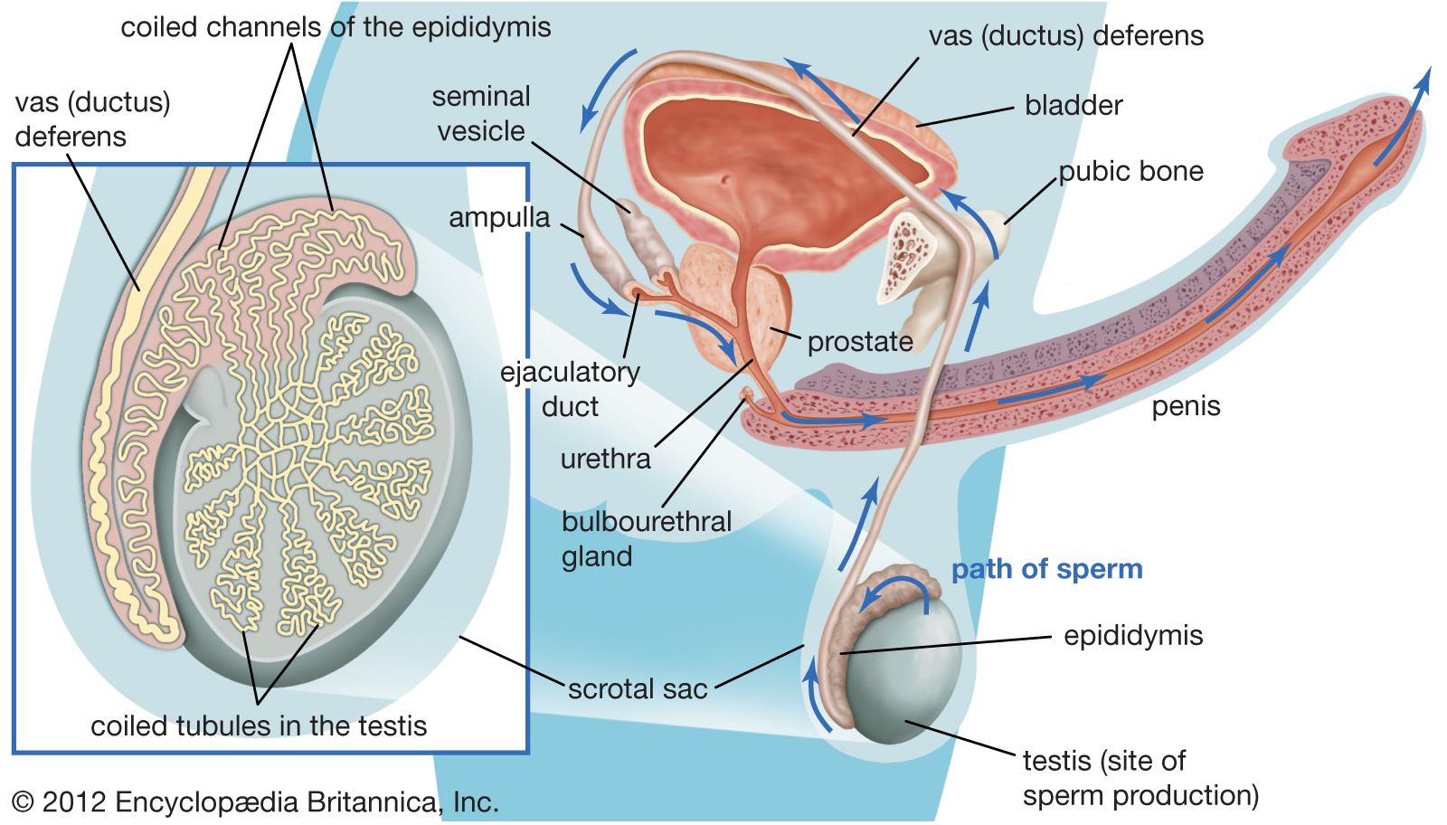
Question 4 Explanation
Remember SREEVEN UP:
S – Seminiferous tubules
R – Rete testis
E – Efferent ducts
E – Epididymis
V – Vas deferens
E – Ejaculatory duct
N – Nothing
U – Urethra
P – Penile urethra

Slide 15
Question 5
Which of the following is true regarding regarding the menstrual cycle?
A – Ovulation usually occurs on day 5 of the menstrual cycle
B – Ovulation is stimulated by a surge in FSH
C – The 3 phases of the ovarian cycle are the period phase, proliferative phase and secretory phase
D – The corpus luteum secretes progesterone which inhibits FSH and LH, this helps to maintain the endometrium
E – Human chorionic gonadotrophin (hCG) causes degeneration of the corpus luteum

Slide 16
Question 5 Answer
Which of the following is true regarding regarding the menstrual cycle?
A – Ovulation usually occurs on day 5 of the menstrual cycle (Day 14)
B – Ovulation is stimulated by a surge in FSH (Surge in LH)
C – The 3 phases of the ovarian cycle are the period phase, proliferative phase and secretory phase (These are the 3 phases of the uterine cycle)
D – The corpus luteum secretes progesterone which inhibits FSH and LH, this helps to maintain the endometrium
E – Human chorionic gonadotrophin (hCG) causes degeneration of the corpus luteum (hCG helps maintain the corpus luteum)

Slide 17
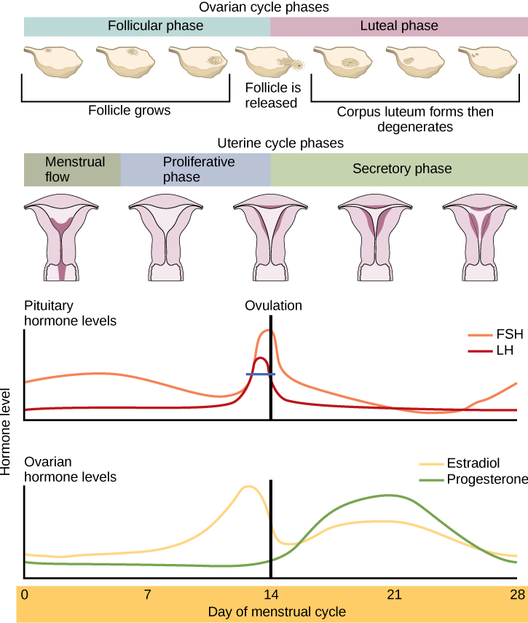
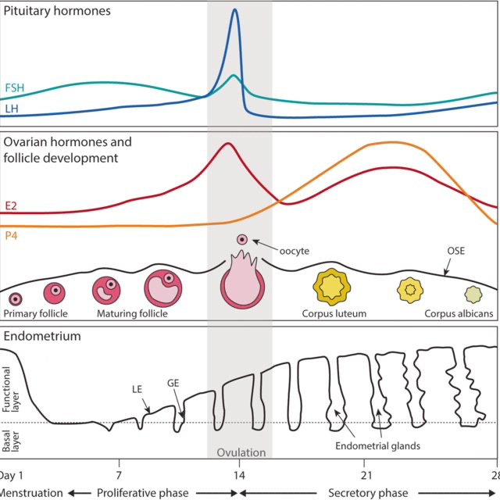
Question 5 Explanation

Slide 18
Question 6
What type of epithelium lines the vagina?
A – Pseudostratified columnar epithelium with goblet cells and cilia
B – Keratinised stratified squamous epithelium
C – Non-keratinised stratified squamous epithelium
D – Urothelium
E – Stratified columnar epithelium

Slide 19
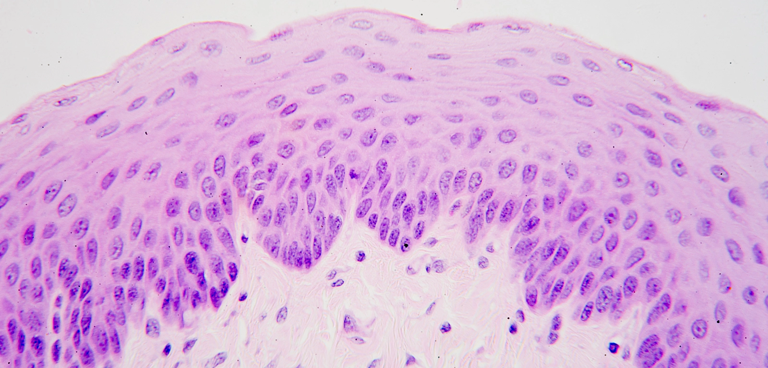
Question 6 Answer
What type of epithelium lines the vagina?
A – Pseudostratified columnar epithelium with goblet cells and cilia (Resp Tract)
B – Keratinised stratified squamous epithelium (epidermis of skin)
C – Non-keratinised stratified squamous epithelium (also lips, rectum)
D- Urothelium (bladder, urinary tract)
E – Stratified columnar epithelium (eyelids)
Notes:
mucous membrane (conjunctiva) lining your eyelids

Slide 20
Question 7
Where in the body is gonadotrophin releasing hormone (GnRH) produced?
A – Hypothalamus
B – Anterior pituitary gland
C – Posterior pituitary gland
D – Zona reticularis of the adrenal cortex
E – Adrenal medulla

Slide 21
Question 7 Answer
Where in the body is gonadotrophin releasing hormone (GnRH) produced?
A – Hypothalamus
B – Anterior pituitary gland
C – Posterior pituitary gland
D – Zona reticularis of the adrenal cortex
E – Adrenal medulla

Slide 22
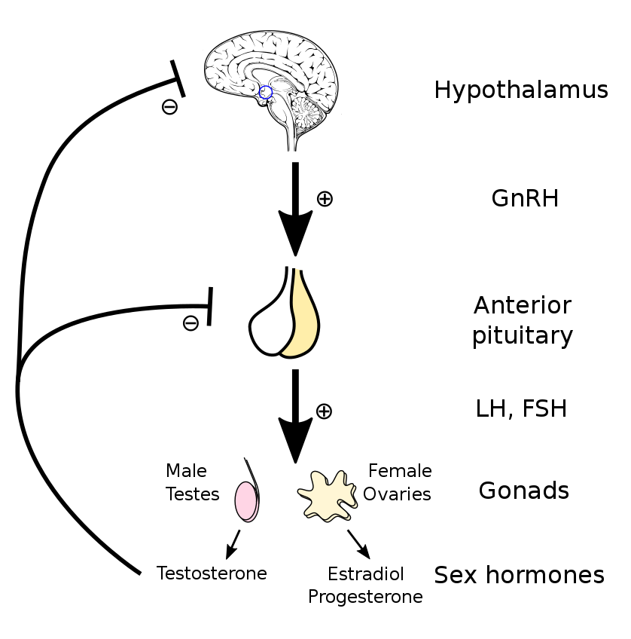
Question 7 Explanation
Hypothalamic-pituitary-testicular axis
LH → Leydig cells → testosterone release
FSH → Sertoli cells → spermatogenesis
Testosterone → negative feedback effect on hypothalamus and anterior pituitary gland
Hypothalamic-pituitary-ovarian axis
LH → theca cells → androgen release
Androgens diffuse from theca cells to granulosa cells
FSH → granulosa cells → convert androgen to oestrogen

Slide 23
Question 8
Which of the following is NOT found within the spermatic cord?
A – Testicular artery
B – Vein of the Vas
C – Genital branch of the genitofemoral nerve
D – Vas deferens
E – Inguinal ligament

Slide 24
Question 8 Answer
Which of the following is NOT found within the spermatic cord?
A – Testicular artery
B – Vein of the Vas
C – Genital branch of the genitofemoral nerve
D – Vas deferens
E – Inguinal ligament

Slide 25
Question 8 Explanation
Contents of the spermatic cord:
3 Arteries | 3 Veins | 3 Nerves | 3 Other Structures
Testicular artery | Testicular vein | Genital branch of genitofemoral nerve | Vas deferens
Artery of the Vas | Vein of the Vas | Inguinal branch of ilioinguinal nerve | Lymphatics
Cremesteric artery | Cremesteric vein | Sympathetic nerves to the vas and testis | Processus vaginalis

Slide 26
Question 9
What forms the blood-testis barrier?
A – Tight junctions between Leydig cells
B – Tight junctions between Sertoli cells
C – Tight junctions between Theca cells
D – Tight junctions between Granulosa cells
E – Desmosomes between Leydig and Sertoli cells

Slide 27
Question 9 Answer
What forms the blood-testis barrier?
A – Tight junctions between Leydig cells
B – Tight junctions between Sertoli cells
C – Tight junctions between Theca cells
D – Tight junctions between Granulosa cells
E – Desmosomes between Leydig and Sertoli cells
Remember S for Supporting!

Slide 28
Question 10
Spermatogenesis involves the production and development of immature germ cells to mature spermatozoa. Which of the following is true regarding spermatogenesis?
A – Spermatogenesis occurs in the epidydymis
B – Type A sperm cells go onto form mature sperm whilst Type B sperm cells replenish pool of immature spermatogonia
C – Meiosis I produces secondary spermatocytes
D – Meiosis II produces tertiary spermatocytes
E – Final maturation of sperm occurs in the vas deferens

Slide 29
Question 10 Answer
Spermatogenesis involves the production and development of immature germ cells to mature spermatozoa. Which of the following is true regarding spermatogenesis?
A – Spermatogenesis occurs in the epidydymis
B – Type A sperm cells go onto form mature sperm whilst Type B sperm cells replenish pool of immature spermatogonia
C – Meiosis I produces secondary spermatocytes
D – Meiosis II produces tertiary spermatocytes
E – Final maturation of sperm occurs in the vas deferens

Slide 30
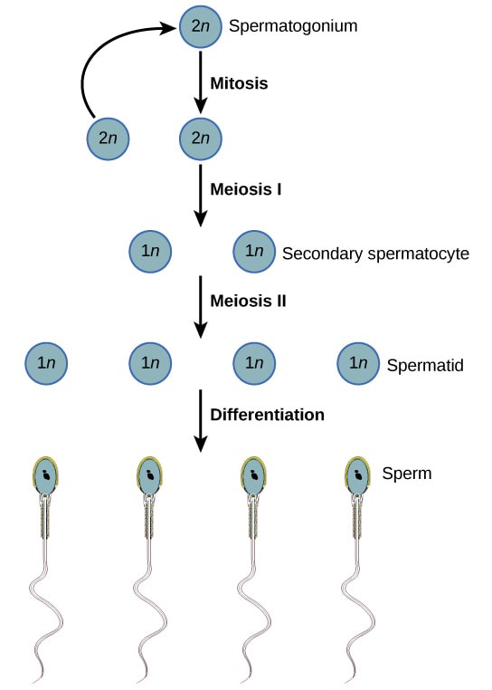
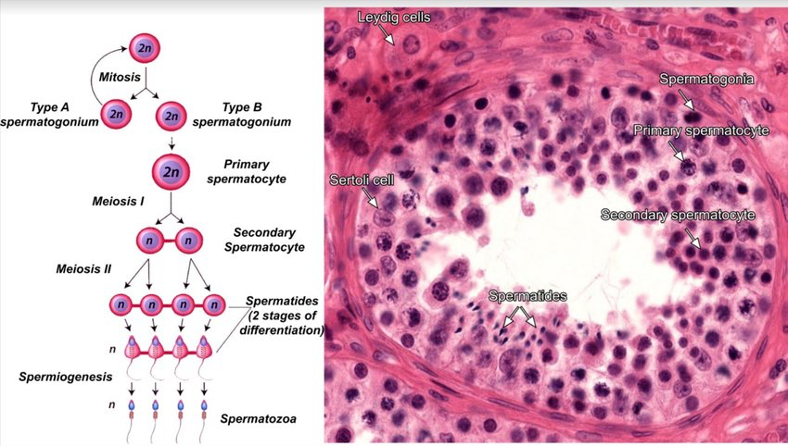
Question 10 Explanation

Slide 31
Question 11
What is the first physical sign of puberty in majority of females?
A – Menarche
B – Breast development
C – Hair growth in the axilla and genitals
D – Increase in height and weight
E – Ovaries grow larger and start producing more oestrogen and progesterone

Slide 32
Question 11 Answer
What is the first physical sign of puberty in majority of females?
A – Menarche
B – Breast development
C – Hair growth in the axilla and genitals
D – Increase in height and weight
E – Ovaries grow larger and start producing more oestrogen and progesterone
The first sign of puberty in males is testicular enlargement

Slide 33
Question 12
Which hormone initiates labour?
A – Prolactin
B – Relaxin
C – hCG
D – Prostaglandins
E – Oxytocin

Slide 34
Question 12 Answer
Which hormone primarily initiates labour?
A – Prolactin
B – Relaxin
C – hCG
D – Prostaglandin (Released in response to oxytocin, also has a role in labour)
E – Oxytocin (Responsible for uterine contractions in pregnancy and labour)

Slide 35
Question 13
Following fertilisation of the egg cell in the ampulla of the fallopian tube, syngamy occurs. What does syngamy involve?
A – Fusion of the male and female pronuclei
B – Duplication of the egg cell
C – Egg cell attaches to the epithelium of the fimbrial epithelium
D – Increase in size of the egg cell
E – Differentiation of the egg cell

Slide 36
Question 13 Answer
Following fertilisation of the egg cell in the ampulla of the fallopian tube, syngamy occurs. What does syngamy involve?
A – Fusion of the male and female pronuclei
B – Duplication of the egg cell
C – Egg cell attaches to the epithelium of the fimbrial epithelium
D – Increase in size of the egg cell
E – Differentiation of the egg cell

Slide 37
Question 13 Answer
Capacitation
Fertilisation
Fertilised egg undergoes Meiosis 2 (4-7hrs)
Cleavage (day 2-3)
Compaction (day 4)
Cavitation and Differentiation (day 5)
Expansion (day 5-6)
Hatching (day 6+)
Notes:
Cap – spermatozoa matures in the female genital tract to gain ability to fertilise oocyte
Fert – egg must be fertilised with 24-48 hrs of ovulation
Cleavage – number of mitotic cell divisions occur (totipotent)
Compaction – cells flatten + maximise intracellular contacts
Cavitation + Differentiation – Blastocyst is formed (greater than 80 cells)
Expanision – Blastocyst diameter increases
Hatching – Blastocyst expands + embryo hatches from zona pellucida

Slide 38
Question 14
The developing embryo reaches the uterus 5/6 days following fertilisation. What is the correct order of the stages of implantation?
A – Attachment → maternal recognition → invasion → trophoblast differentiation → apposition
B – Apposition → attachment → maternal recognition → invasion → trophoblast differentiation
C – Apposition → attachment → invasion → trophoblast differentiation → maternal recognition
D – Attachment → apposition → trophoblast differentiation → invasion → maternal recognition
E – Apposition → attachment → trophoblast differentiation → invasion → maternal recognition

Slide 39
Question 14
The developing embryo reaches the uterus 5/6 days following fertilisation. What is the correct order of the stages of implantation?
A – Attachment → maternal recognition → invasion → trophoblast differentiation → apposition
B – Apposition → attachment → maternal recognition → invasion → trophoblast differentiation
C – Apposition → attachment → invasion → trophoblast differentiation → maternal recognition
D – Attachment → apposition → trophoblast differentiation → invasion → maternal recognition
E – Apposition → attachment → trophoblast differentiation → invasion → maternal recognition

Slide 40
Question 14 Explanation
Stages of Implantation:
1) Apposition – unstable adherence of blastocyst to uterine lining
2) Attachment – endometrial epithelial cells and trophoblast cells connect via integrins, causing a strong adhesion
3) Trophoblast differentiation – differentiates into cytotrophoblast and syncytiotrophoblast, this invades the wall of the uterus
4) Invasion
5) Maternal recognition

Slide 41
Question 15
Crossing over during meiosis allows for new allelic combinations and genetic variation between daughter cells. When does crossing over occur in meiosis?
A – Prophase I
B – Prophase II
C – Metaphase
D – Anaphase
E – Telophase

Slide 42
Question 15 Answer
Crossing over during meiosis allows for new allelic combinations and genetic variation between daughter cells. When does crossing over occur in meiosis?
A – Prophase I
B – Prophase II
C – Metaphase
D – Anaphase
E – Telophase

Slide 43
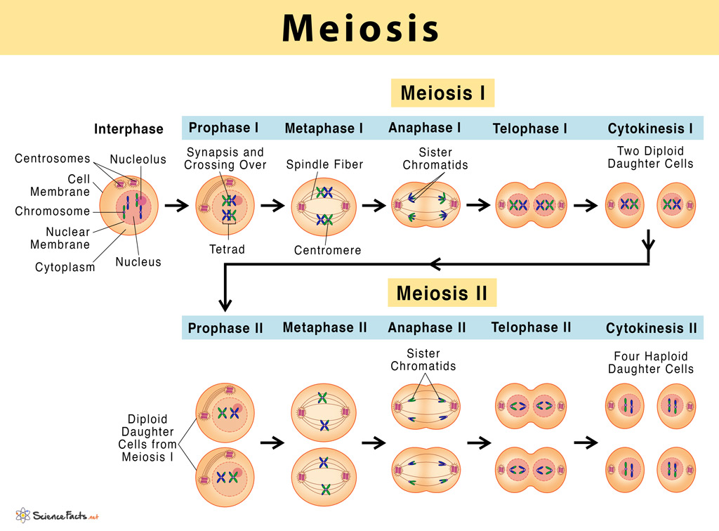
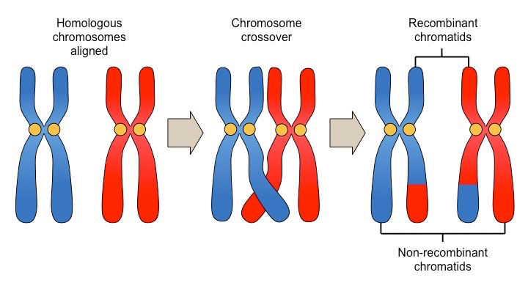
Question 15 Explanation

Slide 44
Question 16
Dihydrotestosterone is a male androgen derived from testosterone and is involved in the development of the external genitalia, hair follicles and prostate. What converts testosterone to dihydrotestosterone?
A – Growth hormone
B – 5-alpha reductase
C – 4-alpha reductase
D – LH
E – FSH
Notes:
Testosterone is the primary male androgen, involved in sexual development, fertility, muscle formation, body composition, bone health and cognitive function.
Dihydrotestosterone is an androgen hormone that stimulates the development of male characteristics. It is formed from testosterone via 5-alpha-reductase.

Slide 45
Question 16 Answer
Dihydrotestosterone is a male androgen derived from testosterone and is involved in the development of the external genitalia, hair follicles and prostate. What converts testosterone to dihydrotestosterone?
A – Growth hormone
B – 5-alpha reductase
C – 4-alpha reductase (Doesn’t exist)
D – LH
E – FSH
Notes:
Testosterone is the primary male androgen, involved in sexual development, fertility, muscle formation, body composition, bone health and cognitive function.
Dihydrotestosterone is an androgen hormone that stimulates the development of male characteristics. It is formed from testosterone via 5-alpha-reductase.

Slide 46
Question 17
Which of the following is true regarding oogenesis?
A – Oogonia undergo meiosis to produce primary oocytes
B – Primary oocytes undergo meiotic arrest at metaphase I until puberty
C – Primary oocytes complete meiosis to form 1 secondary oocyte and 2 polar bodies
D – Theca cells form a follicle around the ovum
E – Granulosa cells inside the follicle provide nutrition to the maturing ovum

Slide 47
Question 17 Answer
Which of the following is true regarding oogenesis?
A – Oogonia undergo meiosis to produce primary oocytes
B – Primary oocytes undergo meiotic arrest at metaphase I until puberty
C – Primary oocytes complete meiosis to form 1 secondary oocyte and 2 polar bodies
D – Theca cells form a follicle around the ovum
E – Granulosa cells inside the follicle provide nutrition to the maturing ovum
Notes:
3 polar bodies

Slide 48
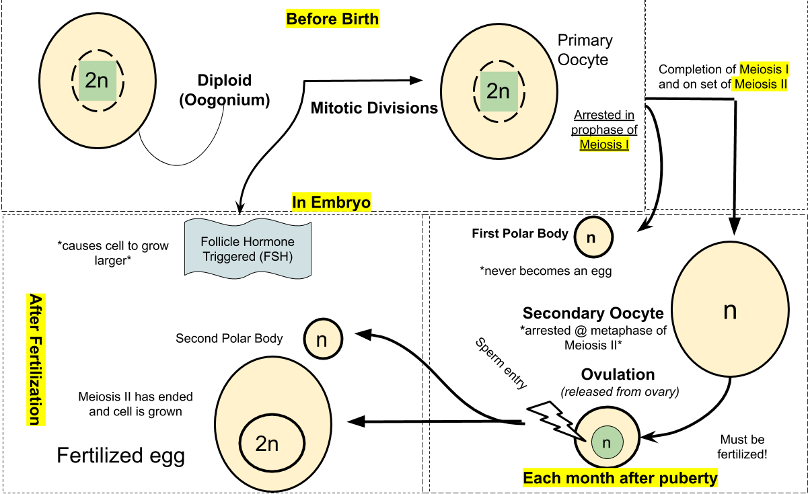
Question 17 Explanation

Slide 49
Question 18
Which of the following is correct regarding the placenta?
A – It produces prolactin which supports the corpus luteum
B – Its only purpose is to provide nutrition to the developing foetus
C – It develops from the blastocyst
D – It is unable to produce its own oestrogen and progesterone, relying on the corpus luteum to produce these hormones
E –

Slide 50
Question 18 Answer
Which of the following is correct regarding the placenta?
A – It produces prolactin which supports the corpus luteum (It produces hCG which supports the corpus luteum)
B – Its only purpose is to provide nutrition to the developing foetus (Also involved in gas exchange, water removal and endocrine and immune support)
C – It develops from the blastocyst
D – It is unable to produce its own oestrogen and progesterone, relying on the corpus luteum to produce these hormones (Corpus luteum degenerates at week 12, the placenta will maintain the pregnancy through oestrogen and progesterone secretion)
E –

Slide 51
Question 19
What is the role of progesterone during pregnancy?
A – Induces synthesis of receptors for oxytocin
B – Can be used to induce labour
C – Softens the cervix and involved in cervical ripening
D – Inhibits uterine contractions so the foetus is not expelled prematurely
E – Stimulates milk production

Slide 52
Question 19 Answer
What is the role of progesterone during pregnancy?
A – Induces synthesis of receptors for oxytocin (Oestrogen)
B – Can be used as a drug to induce labour (Oxytocin)
C – Softens the cervix and involved in cervical ripening (Relaxin)
D – Inhibits uterine contractions so the foetus is not expelled prematurely
E – Stimulates milk production (Prolactin)

Slide 53
Question 20
Cardiovascular changes occur during pregnancy to help support the wellbeing of both the mother and child. Which of the following is correct?
A – Increased systemic blood vessel vasoconstriction
B – Increased total peripheral resistance
C – Increased uterine blood flow
D – Decreased blood volume
E – Decreased cardiac output

Slide 54
Question 20 Answer
Cardiovascular changes occur during pregnancy to help support the wellbeing of both the mother and child. Which of the following is correct?
A – Increased systemic blood vessel vasoconstriction (Increased systemic blood vessel vasodilation)
B – Increased total peripheral resistance (Decreased total peripheral resistance)
C – Increased uterine blood flow
D – Decreased blood volume (Increased blood volume)
E – Decreased cardiac output (Increased cardiac output)

Slide 55
Conclusion
- Don’t panic, you don’t need too much detail
- Just know the basic principles!
- You’ll go over the bits you need in other years.

Slide 56
Feedback
Notes:
https://docs.google.com/forms/d/e/1FAIpQLSfc8O5LXCZaH3ZnqsKi-DlVt7QDBx4tOgbtYJcj6WeiU7fIFA/viewform?vc=0&c=0&w=1&flr=0

