Slide 1
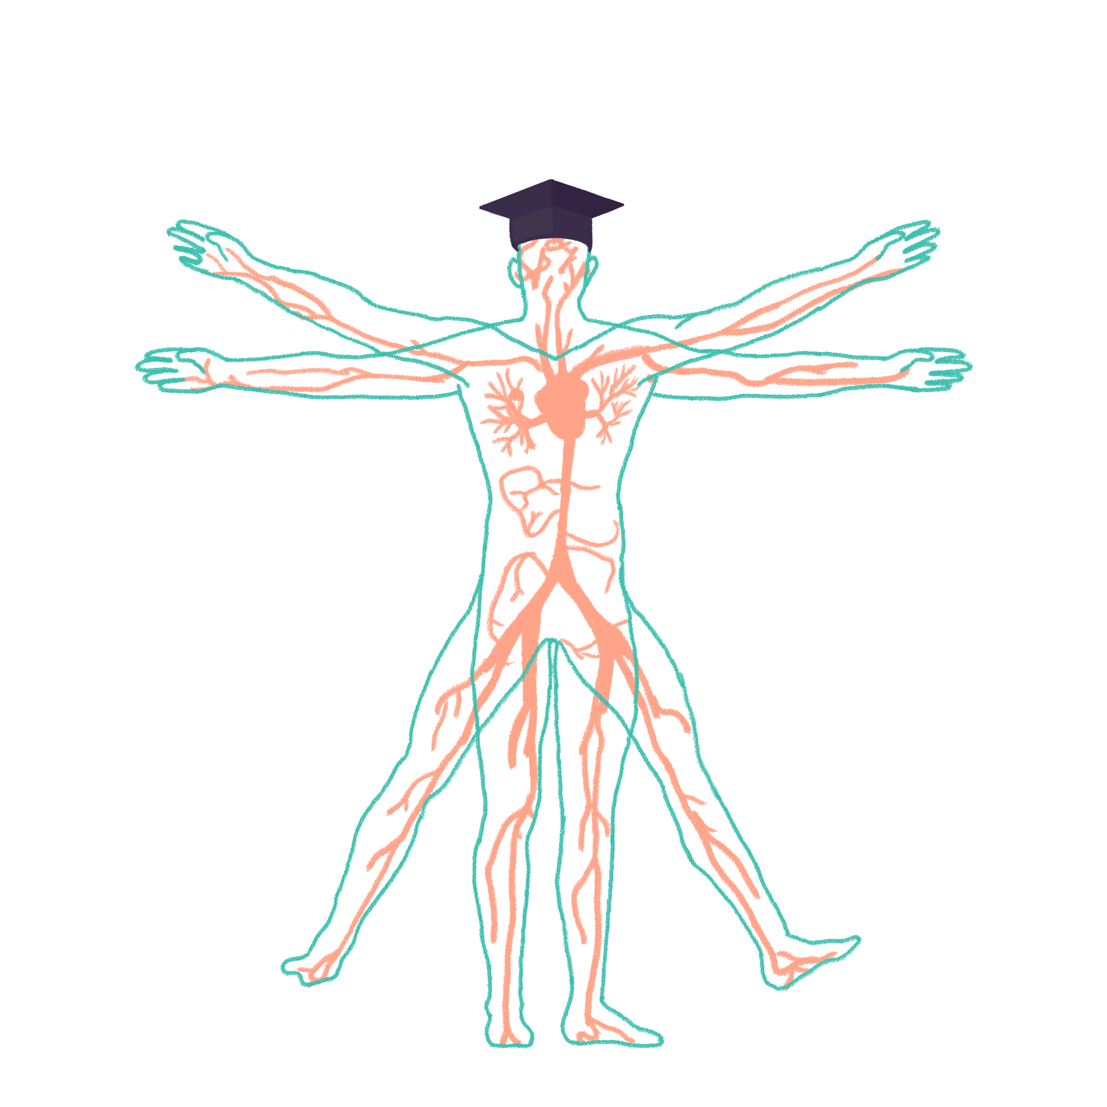
2022/2023

Slide 2
Geriatrics
Phase 3a Revision Session
Emily Fothergill
07/11/2023 7pm
The Peer Teaching Society is not liable for false or misleading information…

Slide 3
Aims and Objectives
Revision of the main topics/conditions in geriatrics
Start applying this to clinical cases
Stroke
Benign paroxysmal positional vertigo
Delirium
Dementias
Parkinson’s disease
Falls
Frailty
Osteoporosis
Constipation
Urinary incontinence
Malnutrition
Medicolegal/Polypharmacy
Pressure sores
The Peer Teaching Society is not liable for false or misleading information…
Notes:
Most of the list other than: fractures, HF, non accidental injury, hyperthermia, hypothermia, squamous cell carcinoma
Images:

Slide 4
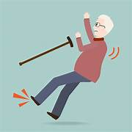
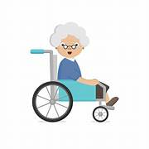
Geriatric Giants
The 4 I’s:
Instability (falls)
Immobility
Intellectual impairment (confusion)
Incontinence
The Peer Teaching Society is not liable for false or misleading information…
Notes:
These things are not diagnoses, but more general/vague things that the patient presents with. Usually an indicator of underlying problems
Pictures: https://tse1.mm.bing.net/th?id=OIP.BRqfv2Ccl9sbwTzGaynHhQHaHa&pid=Api&P=0&h=180
https://tse3.mm.bing.net/th?id=OIP.2Qn46_VoXYEhmN1ZsELYiwHaHa&pid=Api&P=0&h=180

Slide 5
Comprehensive Geriatric Assessment
Medical: Problem List, Co-morbid conditions & Disease Severity, Medication Review, Nutritional Status
Mental Health: Cognition, Mood & Anxiety (Depression screen), Fears
Functional Capacity: Activities of Daily Living, Gait & Balance, Activity/Exercise Status
Social & Environmental Assessment: Informal support from friends & family, Social network (visitors & daytime activities), Care resource eligibility, Home safety & facilities,Transport facilities
The Peer Teaching Society is not liable for false or misleading information…
Notes:
Is not one form!!

Slide 6
Types of Dementia
Alzheimer’s | Vascular | Frontotemporal | Lewy Body/ Parkinson’s
Most common form of dementia in the UK. Onset may be from 40 years or earlier. Abnormal phosphorylation of tau protein leads to build-up as B-amyloid plaques in the neural cortex (neuritic plaques) and vessel walls (amyloid angiopathy). Tau protein would usually protect the neurones against calcium influx. Neurofibrillary Tangles cause necrosis to neural tissue. A deficit of acetylcholine develops, due to damage to the forebrain. | Caused by vascular damage to the brain, so should be suspected in patients with signs of cerebrovascular disease e.g. hypertension, IHD and PVD. Often starts suddenly, following a TIA/ CVA. Similar to Alzheimer’s, but there are also focal neurological signs e.g. aphasia or weakness. Can be static, or have a step-wise deterioration. | Also known as ‘Pick’s Disease’. It is mainly early-onset and 10% is familial. Involves atrophy of the frontal and temporal lobes. Neurones in this area have abnormal swelling: Pick’s bodies – due to a mutation in the tau gene of the microtubules. Causes early changes in personality and behaviour. Relative preservation of memory and visuo-spatial functioning. Stereotypical, repetitive and compulsive behaviour; emotional blunting; abnormal eating; language problems. | If dementia symptoms 12-months before motor symptoms = Lewy Body Dementia. Accounts for >0-15% of dementias. Caused by alpha-synuclein protein deposits in the brainstem and neocortex, known as ‘Lewy bodies’. Lewy bodies lead to reduced levels of acetylcholine and dopamine in the brain. These patients may also have tangles and plaques present on histology. Fluctuating cognitive impairment. Classically, there are visual hallucinations, gait and sleep disturbances. Patients may be restless at night.
The Peer Teaching Society is not liable for false or misleading information…
Notes:
Read through in your own time

Slide 7
Dementia Continued
How would you define dementia?
Syndrome of progressive and global intellectual deterioration without impairment of consciousness
How does dementia commonly present?
Memory loss – first symptom
4As of Alzheimer’s: Amnesia, Aphasia, Agnosia, Apraxia
How can dementia be managed?
Exclude treatable and manage exacerbating factors
Support – psychological work, promote independence, relative support
Manage RF (vascular dementia)
Alzheimer’s Disease Medications: Acetylcholinesterase inhibitors - Donepezil (1st line,) Rivastigmine (better for hallucinations) AND NMDA receptor antagonist - Memantine
The Peer Teaching Society is not liable for false or misleading information…

Slide 8
Frontal Lobe Syndrome
Aetiology
Head injury, Cerebrovascular event, Infection, Neoplasm, Degenerative Disorders (e.g., Pick’s disease)
Presentation
"He's not the father I know"
Symptoms: Decreased lack of spontaneous activity, Loss of attention, Perseveration
Signs: Neglect (right-sided brain lesions typically neglect the left hemispace)
Investigations
Bloods – B12 levels, TFTs, serology for syphilis and antinuclear antibodies
Consider MRI/CT scanning
Treatment
General supportive care sharing some principles with dementia care
The Peer Teaching Society is not liable for false or misleading information…

Slide 9
Case 1
Patient Presentation: 74-year-old female, daughter describes her as becoming more forgetful on her most recent visit. When taking a history from a patient she responds mainly with “don’t know” answers.
What investigations would you like to do?
Objective test of memory: e.g. AMT 10
Confusion screen:
Imaging: CT/MRI
Give some differential diagnoses?
Dementia
Pseudodementia
depression
What is the most likely diagnosis usually secondary to?
mental illness- Most commonly depression
Pseudodementia:
Cognitive Impairment secondary to mental illness- Most commonly depression
“Don’t know” answers
Impairments in executive functioning and attention
The Peer Teaching Society is not liable for false or misleading information…
Notes:
What may be seen on the MRI scan in pseudodementia
Frontal lobe changes
White matter hyperintensities on MRI
Confusion screen (https://geekymedics.com/delirium-acute-confusional-states/)
Blood tests:
FBC (e.g. infection, anaemia, malignancy)
U&Es (e.g. hyponatraemia, hypernatraemia)
LFTs (e.g. liver failure with secondary encephalopathy)
Coagulation/INR (e.g. intracranial bleeding)
TFTs (e.g. hypothyroidism)
Calcium (e.g. hypercalcaemia)
B12 + folate/haematinics (e.g. B12/folate deficiency)
Glucose (e.g. hypoglycaemia/hyperglycaemia)
Blood cultures (e.g. sepsis)
Urinalysis:
UTI is a very common cause of delirium in the elderly.
A positive urine dipstick without clinical signs is NOT satisfactory to diagnose urinary tract infection as a cause of delirium.^{2, 3}
Look for other evidence supporting the diagnosis (WCC↑/supra-pubic tenderness/dysuria/offensive urine/positive urine culture).
Imaging:
CT head: if there is concern about intracranial pathology (bleeding, ischaemic stroke, abscess)
Chest X-ray: may be performed if there is concern about lung pathology (e.g. pneumonia, pulmonary oedema)

Slide 10
Delirium
Delirium is a clinical syndrome of confusion, variable degree of clouding of consciousness, visual illusions and/or visual hallucinations, lability of affect, and disorientation
Risk factors: Post-op, elderly, very young
Precipitating factors: Infection: particularly urinary tract infections, Metabolic: e.g., Hypercalcaemia, hypoglycaemia, hyperglycaemia, dehydration, Change of environment, Constipation, Medication/Drugs: benzodiazepines, opiates, alcohol , Hypoxia
Presentation: Fluctuating, impaired consciousness with onset over hours or days, or a rapid deterioration in pre-existing cognitive function with associated behavioural changes
Investigations:
Delirium Screen Bloods
Abbreviated Mental Test (AMT)
Non-invasive – CXR, ECG, Urine dipstick
Management:
Holistic approach – Treat cause, Avoid sedation, Optimise surroundings
Haloperidol (0.5 mg) – first-line sedative, NO Haloperidol in Parkinson’s – Lorazepam
The Peer Teaching Society is not liable for false or misleading information…
Notes:
Differential diagnosis:
Withdrawal, Mania, Post-ictal, Psychosis, Anxiety, Dementia

Slide 11
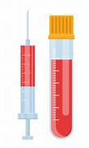
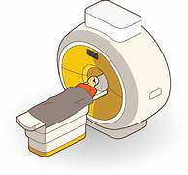
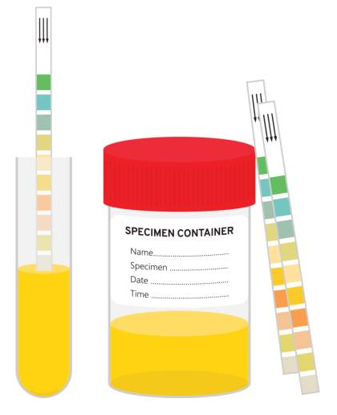
Confusion Screen
FBC (e.g. infection, anaemia, malignancy)
U&Es (e.g. hyponatraemia, hypernatraemia)
LFTs (e.g. liver failure with secondary encephalopathy)
Coagulation/INR (e.g. intracranial bleeding)
TFTs (e.g. hypothyroidism)
Calcium (e.g. hypercalcaemia)
B12 + folate/haematinics (e.g. B12/folate deficiency)
Glucose (e.g. hypoglycaemia/hyperglycaemia)
Blood cultures (e.g. sepsis)
CT head: if there is concern about intracranial pathology (bleeding, ischaemic stroke, abscess)
Chest X-ray: may be performed if there is concern about lung pathology (e.g. pneumonia, pulmonary oedema)
UTI is a very common cause of delirium in the elderly.
A positive urine dipstick without clinical signs is NOT satisfactory to diagnose urinary tract infection as a cause of delirium.
Look for other evidence supporting the diagnosis (WCC↑/supra-pubic tenderness/dysuria/offensive urine/positive urine culture).
The Peer Teaching Society is not liable for false or misleading information…
Notes:
Pictures:
https://tse4.mm.bing.net/th?id=OIP.JZAJimao05mlC_rZTJ1tJQHaHa&pid=Api&P=0&h=180
https://media.istockphoto.com/vectors/sample-of-urine-vector-id696322912?k=6&m=696322912&s=612x612&w=0&h=CaifJkDNeaKxADxdX1crfKXuiqaRIKS7IXTY1_RF9SE=https://media.istockphoto.com/vectors/sample-of-urine-vector-id696322912?k=6&m=696322912&s=612x612&w=0&h=CaifJkDNeaKxADxdX1crfKXuiqaRIKS7IXTY1_RF9SE= https://tse4.mm.bing.net/th?id=OIP.c5qYKcI-2EcO0KpoVCRYRQHaG3&pid=Api&P=0&h=180

Slide 12
Types of Delirium
Features of Hypoactive delirium?
Often missed!!
Lethargy
Apathy
Excessive sleeping
Inattention
Withdrawn
Motor retardation
Drowsy
Unrousable
Features Hyperactive delirium?
Agitation
Aggression
Restlessness
Rapidly distracted
Wandering
Delusions
Hallucinations
Mixed
The Peer Teaching Society is not liable for false or misleading information…

Slide 13
Delirium Vs Dementia (summary)
 | Acute (delirium) | Chronic (dementia)
Degenerative | - | Alzheimer’s; Huntington’s; Lewy-body, CJD and Pick’s
Other CNS | Cerebral tumour or abscess; subdural haematoma; epilepsy; acute post-trauma psychosis | Tumours; subdural haematoma; multiple sclerosis; Parkinson’s; normal pressure hydrocephalus
Infective | Meningoencephalitis; septicaemia; cerebral malaria; trypanosomiasis | Late syphilis; chronic or subacute encephalitis; CNS cysticercosis; cryptococcosis; HIV
Vascular | Stroke (or TIA); hypertensive encephalopathy; SLE | Thromboembolic multi-infarct (arteriosclerotic) dementia
Metabolic | U&E↓↑; hypoxia; liver and kidney failure; non-metastatic cancer; porphyria; alcohol withdrawal | Liver and kidney failure; non-metastatic or metastatic cancer
Endocrine | Addisonian or hyperthyroid crisis; diabetic pre-coma; hypoglycaemia; hypo/hyperparathyroidism | T4↓; Addison’s; hypoglycaemia; hypopituitarism; hypo/hyperparathyroidism
Toxic | Alcohol; many drugs; lead; arsenic; mercery | ‘Alcohol dementia’; barbiturate abuse; too much manganese or carbon disulphide
Deficiency | Thiamine; B12; folate; nicotinic acid | Thiamine; B12; folate; nicotinic acid
The Peer Teaching Society is not liable for false or misleading information…

Slide 14
Stroke
RF for ischaemic stroke:
HYPERTENSION
Hypercholesterolaemia, Diabetes, Smoking, Atrial fibrillation, Previous TIA, Carotid stenosis
RF for haemorrhagic stroke:
Hypertension – often causes bleeds in the basal ganglia, AVM, Aneurysm , If taking anticoagulants, Recreational drugs/substance abuse
Common presentations:
Unilateral weakness – often in arms and face, Slurred speech (dysarthria), Dysphasia (unable to understand words or communicate what they mean), MCA stroke – leg sparing
What is a TIA:
Symptoms for less than 24h (usually less than 60 mins)
The Peer Teaching Society is not liable for false or misleading information…

Slide 15
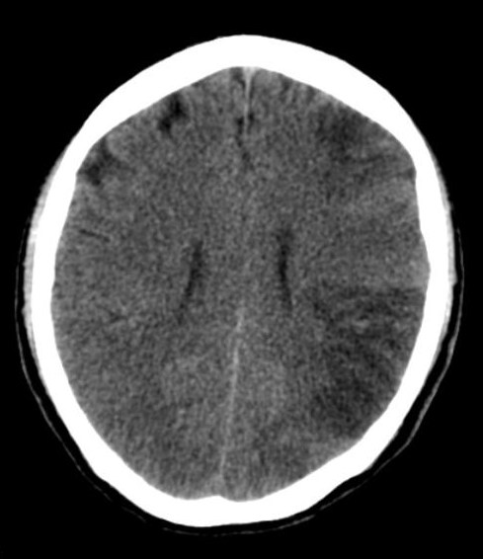
Stroke
What investigations would you do if you suspect a stroke?
CT
Initial management ischaemic stroke?
Aspirin – 300mg for 2 weeks,
Potential for thrombolysis – alteplase, cut off time 4.5h,
Control BP
Initial management haemorrhagic stroke?
Control bleeding & Control blood pressure
Primary prevention for stroke?
Smoking cessation, Control hypertension – medications and diet (reduce salt intake), Control hypercholesterolaemia (diet and medications) , Control diabetes (diet and medications) , Encourage active lifestyle and weightloss, Reduce alcohol intake
Secondary prevention for stroke?
Investigations – 72 hour ECG to look for paroxysmal AF, carotid doppler to look for carotid stenosis, BP, echo (to look for patent foramen ovale or endocarditis – can throw clots), if neck pain – investigate for dissectinon with CTA/MRA
Drugs – aspirin, clopidogrel, antihypertensives, statins, dietary control and diabetes management
How to assess for risk of stroke in AF?
CHADSVASC: Congestive heart failure – 1, Hypertension – 1, Age > 75 – 2, Previous stroke/TIA/VTE – 2 , Vascular disease – 1, Age > 65, Sex category female – 1
The Peer Teaching Society is not liable for false or misleading information…
Notes:
Picture: https://prod-images-static.radiopaedia.org/images/5579427/383f6b19c4a4a3a9da48eafdae8f0b_thumb.jpg

Slide 16
Stroke – Oxford/Bamford Classification
Total anterior circulation infarcts (TACI, c. 15%) | Partial anterior circulation infarcts (PACI, c. 25%) | Lacunar infarcts (LACI, c. 25%) | Posterior circulation infarcts (POCI, c. 25%) | Lateral medullary syndrome (posterior inferior cerebellar artery) aka Wallenberg's syndrome | Weber's syndrome | Basilar artery
Involves middle and anterior cerebral arteries All 3 of: unilateral hemiparesis and/or hemisensory loss of the face, arm & leg homonymous hemianopia higher cognitive dysfunction | Involves smaller arteries of anterior circulation e.g. upper or lower division of middle cerebral artery 2 of: unilateral hemiparesis and/or hemisensory loss of the face, arm & leg homonymous hemianopia higher cognitive dysfunction | involves perforating arteries around the internal capsule, thalamus and basal ganglia presents with 1 of the following: unilateral weakness (and/or sensory deficit) of face and arm, arm and leg or all three. pure sensory stroke. ataxic hemiparesis | involves vertebrobasilar arteries presents with 1 of the following: cerebellar or brainstem syndromes loss of consciousness isolated homonymous hemianopia | ipsilateral: ataxia, nystagmus, dysphagia, facial numbness, cranial nerve palsy e.g. Horner's contralateral: limb sensory loss | ipsilateral III palsy contralateral weakness | “locked in” syndrome
The Peer Teaching Society is not liable for false or misleading information…
Notes:
Read in your own time

Slide 17
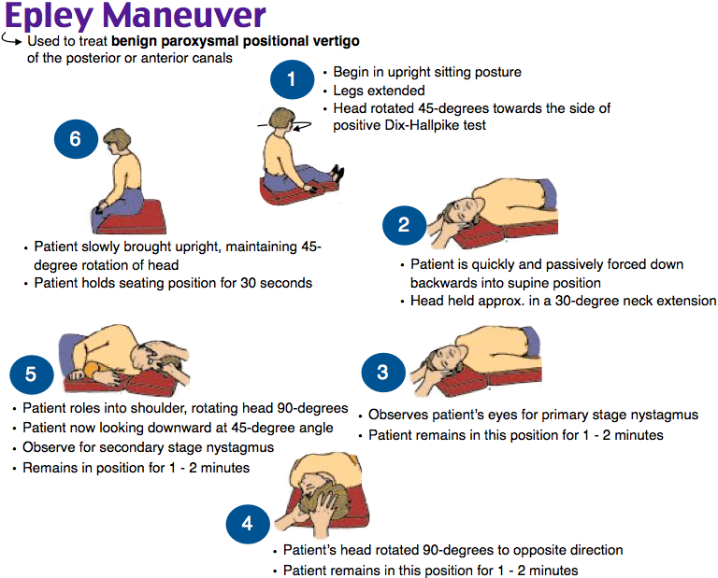
Benign Paroxysmal Positional Vertigo
Benign paroxysmal positional vertigo (BPPV) is one of the most common causes of vertigo encountered. It is characterised by the sudden onset of dizziness and vertigo triggered by changes in head position. The average age of onset is 55 years and it is less common in younger patients. Features:
vertigo triggered by change in head position (e.g. rolling over in bed or gazing upwards)
may be associated with nausea
each episode typically lasts 10-20 seconds
positive Dix-Hallpike manoeuvre, indicated by: patient experiences vertigo, rotatory nystagmus
Symptomatic relief
Epley manoeuvre (successful in around 80% of cases)
teaching the patient exercises they can do themselves at home, termed vestibular rehabilitation, for example Brandt-Daroff exercises
Medication is often prescribed (e.g. Betahistine) but it tends to be of limited value.
Around half of people with BPPV will have a recurrence of symptoms 3–5 years after their diagnosis
The Peer Teaching Society is not liable for false or misleading information…
Notes:
Picture: https://i.pinimg.com/originals/f5/ed/6f/f5ed6fb9f35c46817f373a95a1ba7be6.png

Slide 18
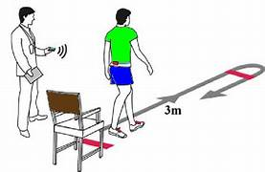
Case 2
You review a 65-year old patient in clinic who has recently had a fall. She tripped over her rug and fell onto her chair, then rolled onto the floor. Three months ago she fell trying to reach the toilet quickly. She did not sustain any serious injuries and has been referred to see you to investigate the causes of her falls
1) Give some risk factors for a fall that may have been present
Previous fall, Lower limb muscle weakness, Vision problems, Balance/gait disturbances (DM, RA, PD etc), Polypharmacy (4+ medications), Incontinence, >65, Have a fear of falling, Depression, Postural hypotension, Arthritis in lower limbs, Psychoactive drugs, Cognitive impairment
2) What physical tests may you want to perform?
'Turn 180° test' or the 'Timed up and Go test’
Also: vital signs, muscle tone, check for injuries/ deformities, vision assessment, dementia screen
3) What medications are particularly relevant to this case?
medications causing postural hypotension: Nitrates, Diuretics, Anticholinergic medications, Antidepressants, Beta-blockers, L-Dopa, Angiotensin-converting enzyme inhibitors - (ACE) inhibitors
other medications associated with falls: Benzodiazepines, Antipsychotics, Opiates, Anticonvulsants, Codeine, Digoxin, Other sedative agents
4) You think postural hypotension may have contributed to this lady’s fall, how would you diagnose this?
A drop in systolic BP of 20mmHg or more (with or without symptoms)
A drop to below 90mmHg on standing even if the drop is less than 20mmHg (with or without symptoms)
A drop in diastolic BP of 10mmHg with symptoms (although clinically much less significant than a drop in systolic BP).
The Peer Teaching Society is not liable for false or misleading information…
Notes:
WHAT DOES BLURRY/YELLOW VISION SUGGEST
Digoxin toxicity
COMPLICATIONS OF A LONG LIE?
Pressure ulcers, Dehydration, Rhabdomyolysis , Hypothermia
Pictures:
https://tse1.mm.bing.net/th?id=OIP.q33-1jmLkaqmysP77RlEngHaEz&pid=Api&P=0&h=180
https://tse2.mm.bing.net/th?id=OIP.OVTVFopEmA7JMiVB_0FbewHaFW&pid=Api&P=0&h=180

Slide 19
Frailty
=State of increased vulnerability resulting from ageing-associated decline in functional reserve, Across multiple physiological systems, Resulting in compromised ability to cope with everyday or acute stressors
Assessment:
gait speed
self-reported health status
PRISMA-7 questionnaire
The Peer Teaching Society is not liable for false or misleading information…
Notes:
Pictures: https://www.cgakit.com/_files/ugd/2a1cfa_917397e853c644f1bb499fc91b83e2f4.pdf

Slide 20
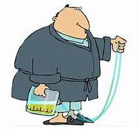
Urinary Incontinence
Common causes:
Age-related changed: reduced total bladder capacity, reduced bladder contractile function, reduced ability to postpone voiding, atrophy of vagina and urethra, loss of pelvic floor and urethral sphincter musculature, hypertrophy of prostate
Comorbidity: reduced mobility, medication, constipation, impaired cognition
Reversible: UTI, delirium, drugs, constipation, polyuria, urethral irritability, prolapse, bladder stones and tumours
Environmental: Bed Bound, Toilet Too Far/Hard To Access
Investigations:
Symptoms (stress, urgency, obstructive), bladder diary
Examination: vaginal, rectal, neuro
Urinalysis and midstream urine
Management:
Depends on cause
Bladder retraining, regular toileting, pelvic floor exercises. Overactive bladder->oxybutynin, BPH-> finasteride/tamsulosin
Indications For Catheters:
Sx urinary retention, obstructed outflow and deteriorating renal function, acute renal failure, intensive care
Complications Catheterisation:
Blockage, bypassing, infection
The Peer Teaching Society is not liable for false or misleading information…
Notes:
Pictures: https://tse1.mm.bing.net/th?id=OIP.nryt4gdtpXpKtET-J_pRHQHaD4&pid=Api&P=0&h=180

Slide 21
Faecal Incontinence
Continence mechanisms:
sigmo-rectal sphincter
ano-rectal angle, anal sphincters
ano-rectal sensation
Cause:
most commonly faecal impaction or neurogenic. Others include haemorrhoids, rectal prolapse, tumours, IBD, drugs
Management:
Treat constipation
Neurological: toilet at appropriate time, planned evacuation (loperamide)
Overflow incontinence: rehydrate, enema (phosphate agent), complete colonic washout, manual evacuation, laxatives
Prevention: once or twice weekly enema
The Peer Teaching Society is not liable for false or misleading information…

Slide 22
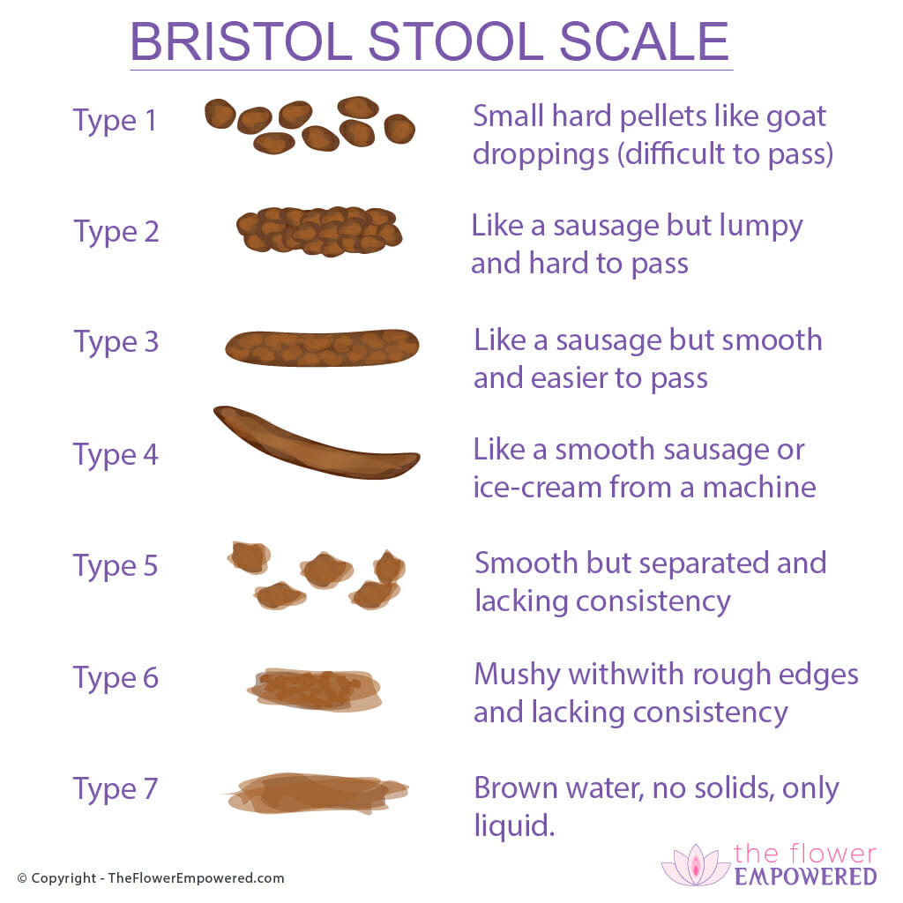
Constipation
Risk factors: Advanced age, inactivity, Low calorie intake, Low fibre diet, Medications, Female sexBristol stool chart
The Bristol stool chart can be useful in documenting stool frequency and consistency over a period (e.g. 7-14 days). Constipation typically manifests with mostly type 1 or 2 stool. There may be type 7 if overflow is present.
Symptoms and signs: infrequent bowel motions (<3 per week), difficultly passing bowel motions, tenesmus, excessive straining, abdominal distension, abdominal mass felt at the left or right lower quadrants (stool), rectal bleeding, anal fissures, haemorrhoids, presence of hard stool or impaction on digital rectal examination
Causes:
Dietary e.g. inadequate fibre intake, inadequate fluid intake
Behavioural e.g. inactivity, avoidance of defecation
Electrolyte disturbance e.g. hypercalcaemia
Drugs, particularly opiates, calcium channel blockers and some antipsychotics
Neurological disorders e.g. spinal cord lesions, Parkinson's disease, diabetic neuropathy
Endocrine disorders e.g. hypothyroidism
Colon disease e.g. stricture, malignancy
Anal disease e.g. anal fissure, proctitis
Management: Depends on cause – lifestyle, laxatives (Bulk=ispaghula husk, methylcellulose, Stool softeners= docusate sodium, Osmotic laxative=lactulose, macrogol, Stimulant laxatives=senna, bisacodyl
The Peer Teaching Society is not liable for false or misleading information…
Notes:
Constipation may include any or all of the following (Rome IV criteria):
Fewer than three bowel movements per week
Hard stool in >25% of bowel movements
Tenesmus (sense of incomplete evacuation) in >25% of bowel movements
Excessive straining in >25% of bowel movements
A need for digital evacuation of bowel movements
Primary constipation: no organic cause, thought to be due to dysregulation of the function of the colon or anorectal muscles
Secondary constipation: due to e.g diet, drugs, metabolic, endocrine or neurological disorder or obstruction
Alarm features-may indicate gastrointestinal malignancy
Weight loss
Loss of appetite
Abdominal mass
Dark stool
Investigations: Depending on history and examination findings
Full blood count, electrolytes, thyroid function, blood glucose, abdominal x-ray if suspicious of secondary cause of constipation, barium enema if suspicious of impaction or rectal mass, colonoscopy if suspicious of lower gi malignancy
Management
Exclude underlying causes including colorectal cancer
Lifestyle modification e.g. dietary improvements, increase exercise
Enemas if impaction present e.g. sodium citrate
Suppositories e.g. glycerol
Bulk laxatives e.g. ispaghula husk, methylcellulose
Stool softeners e.g. docusate sodium
Osmotic laxative e.g. lactulose, macrogol
Stimulant laxatives e.g. senna, bisacodyl
If laxatives fail to resolve symptoms, referral to specialist centre for evaluation of gut motility.
Pictures: https://tse3.mm.bing.net/th?id=OIP.f-w02u4asESDcT4MLPIZ1AHaHa&pid=Api&P=0&h=180

Slide 23
Case 3
An elderly lady has come to see you in the metabolic bone clinic as she recently had a fall from standing and fractured her wrist. She has been treated by orthopaedics; however she has been referred to you as they were worried that a reduced bone density may have contributed to her injuries.
Give some risk factors for this condition
Smoking, Early menopause, Steroid use, Underweight, Inactivity, Alcohol, ALL ELDERLY PEOPLE
What scoring system can you use to assess her risk?
FRAXX
Give some components of this scoring system
Parent hip fracture, Height and weight (BMI), Smoking, Alcohol >3 units a day , Steroids, Previous hip fracture, Femoral neck bone mineral density , Female gender, Age, RA, Secondary osteoporosis
This lady’s risk assessment score result is high risk, what investigations and initial management would you recommend
DEXA scan and treat with bisphosphonates (zoledronate, alendronate) dependent on the result
Serum biochemistry – calcium, phosphate, alkaline phosphatase (normal)
Vit D/calcium supplements
The Peer Teaching Society is not liable for false or misleading information…
Notes:
DEFINITION = Decreased bone mineral density due to imbalance between remodelling and resorption
DEXA scan: -1 to +1 = healthy , - 1 to -2.5 = osteopenia, ≤ -2.5 = osteoporosis, ≤ 2.5 and a current fragility fracture = severe osteoporosis
COMMON SITES FOR OSTEOPOROTIC FRACTURES= Thoracic vertebrae – fractures here may lead to kyphosis and loss of height, Lumbar vertebrae , Proximal femur, Distal radius (Colles’ fracture)
Pictures: https://tse2.mm.bing.net/th?id=OIP.KpoQ6p3mTIne-gZ32BqEwAHaD0&pid=Api&P=0&h=180

Slide 24
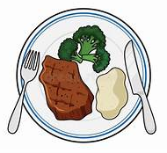
Malnutrition
=State in which a deficiency of energy, protein, and/or other nutrients causes measurable adverse effects on the body’s form, composition, function and clinical outcome.
Causes:
Decreased nutrient intake (starvation), Increased nutrient requirements (sepsis or injury), Inability to utilise ingested nutrients (malabsorption)
Diagnosis:
BMI <18.5kg/m2, Unintentional weight loss >10% last 3-6mths , BMI <20kg/m2 AND unintentional weight loss >5% within last 3-6mths
Refeeding syndrome= Metabolic disturbances as a result of reintroduction of nutrition to patients who are starved/severely malnourished
Biochemical Features: Hypophosphataemia, Hypokalaemia, Thiamine deficiency, Abnormal glucose metabolism
Complications: Cardiac arrhythmias, Coma, Convulsions, Cardiac failure
Management: Monitor blood biochemistry, Commence re-feeding with guidelines , Recognise electrolytes (phosphate, K+, Mg), Monitor glucose and Na levels, Supportive care, Refer to nutritional support team/dietician
The Peer Teaching Society is not liable for false or misleading information…
Notes:
Pictures: https://tse2.mm.bing.net/th?id=OIP.2EqAvHgPn7TmIvcUljro2wHaHa&pid=Api&P=0&h=180
https://tse2.mm.bing.net/th?id=OIP.nXEB6G4dnIzZHZ8TqKIsMQHaFu&pid=Api&P=0&h=180

Slide 25
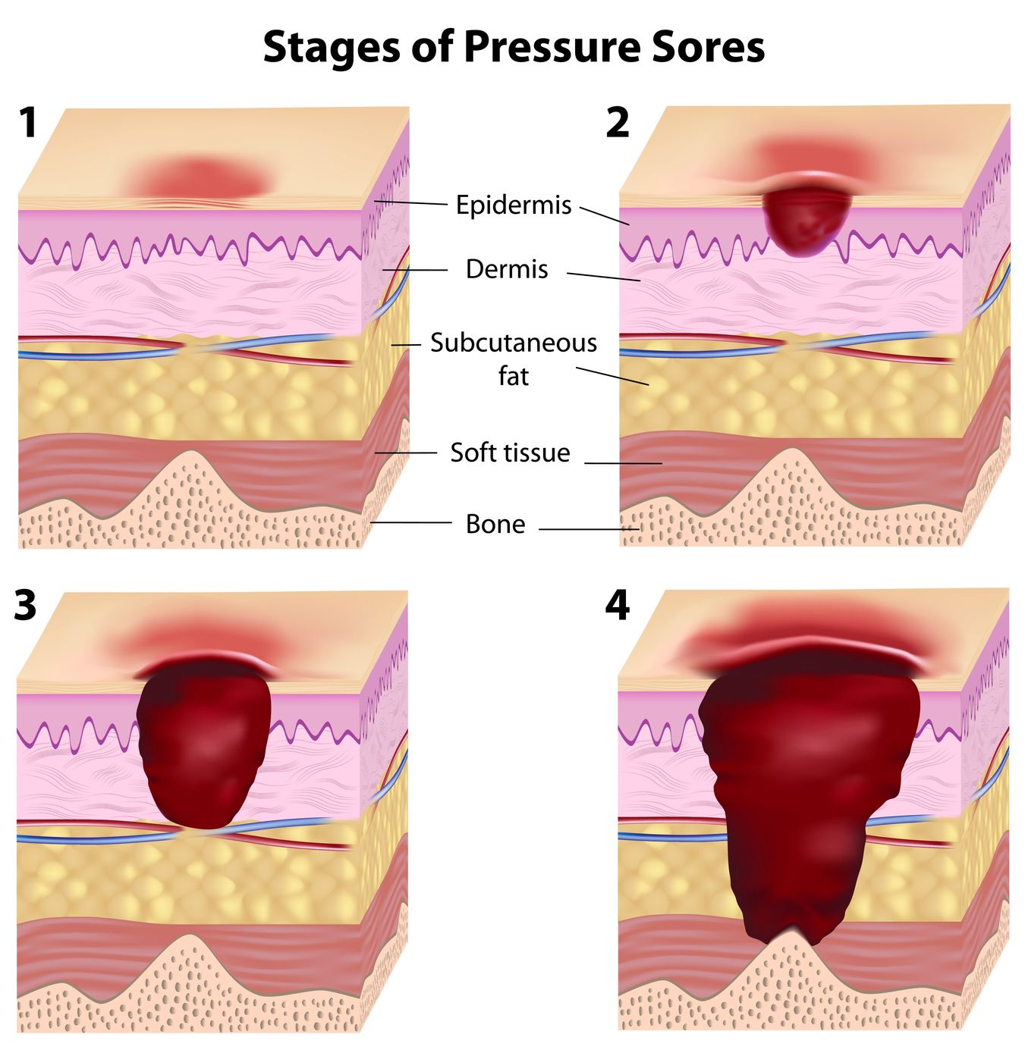
Pressure Sores
Risk Factors: Malnourishment, Incontinence, Lack of mobility, Pain (leads to a reduction in mobility)
Assessing risk: Waterlow score: includes a number of factors including body mass index, nutritional status, skin type, mobility and continence
Prevention:
Barrier creams
Pressure redistribution
Repositioning
Regular skin assessment
Management:
Moist wound environment encourages ulcer healing: Hydrocolloid dressings and hydrogels
Surgical debridement
antibiotics only if there are signs of infection
Classification:
Grade 1 – non-blanching erythema with intact skin
Grade 2 – partial thickness skin loss involving epidermis, dermis or both (abrasion/blister)
Grade 3 – full-thickness skin loss involving damage/necrosis of sub-cut tissue
Grade 4 – extensive loss, destruction/necrosis of muscle, bone or support structures
Unstageable – depth unknown, base of ulcer covered by debris
The Peer Teaching Society is not liable for false or misleading information…
Notes:
Pictures: http://www.counseloroffices.net/wp-content/uploads/2015/04/StagesofPressureSores.jpg

Slide 26
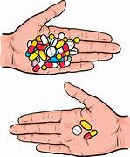
Polypharmacy
=4+ medications
START tool: Suggests medications that may provide additional benefits i.e., proton pump inhibitors for gastroprotection in patients on medications increasing bleeding risk
STOPP tool: Used to assess which drugs can be potentially discontinued in elderly patients undergoing polypharmacy
The Peer Teaching Society is not liable for false or misleading information…
Notes:
Pictures: https://tse3.mm.bing.net/th?id=OIP.8jZkEU_CC7-IuR2TgRGIYQHaF0&pid=Api&P=0&h=180
https://tse1.mm.bing.net/th?id=OIP.PyW1YAuwvfd_U_UyygfOgAHaI5&pid=Api&P=0&h=180

Slide 27
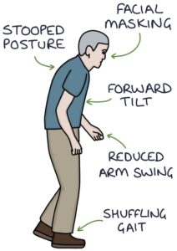
Case 4
A 70-year-old man presents to you with progressive symptoms including a tremor that is worse at rest, difficulty getting to sleep and low mood. His son is with him and has said he has noticed he seems to be moving slowly and ‘shuffling’
Describe the pathophysiology of the most likely cause of his symptoms.
progressive reduction of dopamine in the basal ganglia of the brain
What is the classic triad of symptoms associated with this condition?
Resting tremor (pill rolling, unilateral), Rigidity (cogwheel), Bradykinesia
(other: Depression, Sleep disturbance and insomnia, Loss of the sense of smell (anosmia), Postural instability, Cognitive impairment and memory problems)
How can this condition be managed? Give one example of medication used.
Levodopa: less effective over time, SE=dyskinesias
COMT Inhibitors e.g. entacapone
Dopamine Agonists e.g. bromocryptine. SE=pulmonary fibrosis
The Peer Teaching Society is not liable for false or misleading information…
Notes:
This is parkinsons disease!!
Pictures:https://zerotofinals.com/wp-content/uploads/Parkinsons-Disease-212x300.jpg

Slide 28
Parkinson’s Plus Syndromes
Progressive supranuclear palsy: Parkinisonism and vertical gaze palsy.
Multiple system atrophy: Parkinisonism and early autonomic clinical features such as: postural hypotension, incontinence, and impotence.
Cortico-basal degeneration: Parkinisonism and involves spontaneous activity by an affected limb, or akinetic rigidity of that limb.
Lewy body dementia: Parkinisonism and fluctuations in cognitive impairment and visual hallucinations, often before Parkinsonian features occur.
The Peer Teaching Society is not liable for false or misleading information…
Notes:
Parkinson-plus syndromes (PPS) are a group of neurodegenerative diseases featuring the classical features of Parkinson's disease (tremor, rigidity, akinesia/bradykinesia, and postural instability) with additional features that distinguish them from simple idiopathic Parkinson's disease (PD)

Slide 29
Capacity
How is capacity assessed?
Ability to understand the information relevant to the decision, Retain the information , Weigh up the information, Communicate the decision
What are the key parts of the mental capacity act?
Assume capacity – person assumed to have capacity until proven otherwise
Maximise decision-making capacity – all practical support to help a person make a decision should be given
Freedom to make seemingly unwise decisions
Best interests – all decisions taken on behalf of the person must be in their best interests
Least restrictive option – when making a decision on another person’s behalf, the alternative that achieves the necessary goal and interferes the least with the person’s rights and freedom of action must be chosen
The Peer Teaching Society is not liable for false or misleading information…

Slide 30
Other Ethics
Deprivation Of Liberty: occurs when a person does not consent to care or treatment, for example, a person with dementia who is not free to leave a care home and lacks capacity to consent to this
Lasting Power Of Attorney: A document which a person can nominate someone else to make certain decision on their behalf (for example on finances, health and personal welfare) when they are unable to do so themselves. To be valid, it needs to be registered with the Office of the Public Guardian
Independent Mental Capacity Advocate (Imca) Role: support and represent people who lack capacity and they do not have anyone else to represent them in decisions about changes in long-term accommodation or serious medical treatment. They can also be present for decisions regarding care reviews or adult protection.
Best Interests
Consider:
Whether the person is likely to regain capacity and can the decision wait
How to encourage and optimise the participation of the person in the decision
The past and present wishes, feelings, beliefs, values of the person and any other relevant factors
Views of other relevant people
Advanced directives
Used to authorise or request specific procedures and refuse treatment in a predefined future situation (advance directive)
Advance refusals of treatment are legally binding if: The person is an adult, Was competent and fully informed when making the decision, The decision is clearly applicable to current circumstances, and There is no reason to believe that they have since changed their mind
The Peer Teaching Society is not liable for false or misleading information…

Slide 31
Conclusion
Learning objectives (hopefully) covered today:
Revision of the main topics/conditions in geriatrics
Start applying this to clinical cases
The Peer Teaching Society is not liable for false or misleading information…
Notes:
Time for qs

Slide 32
References/Useful Resources
0 to finals: https://zerotofinals.com/
Oxford Handbooks: Oxford handbook of clinical medicine, Oxford handbook of geriatric medicine, Oxford handbook of general practice
(all available online through star plus)
Passmedicine/quesmed textbooks (not essential)
The Peer Teaching Society is not liable for false or misleading information…
Notes:
Time for qs

Slide 33
Feedback
The Peer Teaching Society is not liable for false or misleading information…

