Slide 1
GEM SBA-Style Revision Series
2022/23

Slide 2
GI/Liver
Phase 1 Content GEM SBA Revision Session
Areesha Aziz
04/10/2022

Slide 3
Aims and Objectives
Swallowing; gag reflex
Salivary glands
Gastric physiology
Intestinal physiology
Digestion and absorption of macromolecules
Vitamin and ion absorption
Liver detoxification (phase 1 & 2 reactions, CYP450, alcohol metabolism)
Bilirubin metabolism

Slide 4
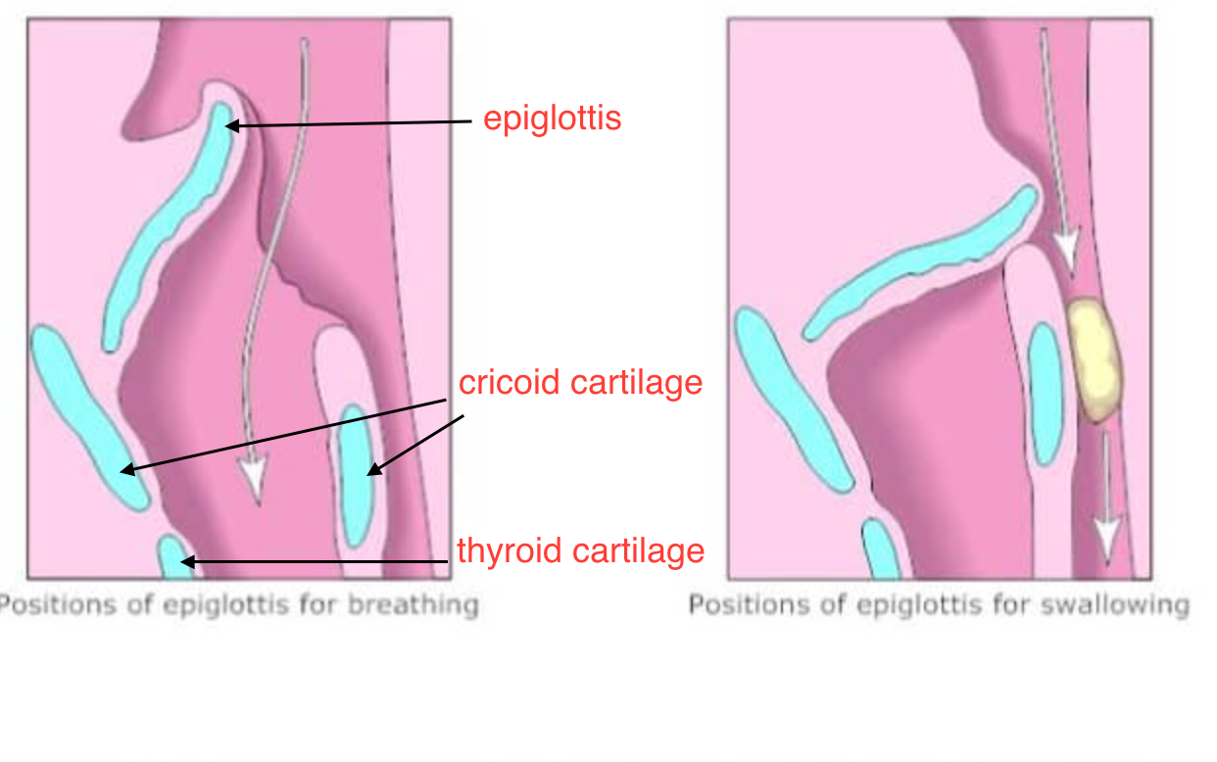
Stages of swallowing
1.Voluntary (oral)
Mastication forms a bolus
Bolus moves to oropharynx
Pressure receptors in oropharynx stimulated 🡪 action potentials via afferent glossopharyngeal nerve (CN IX) sent to brainstem 🡪 swallowing reflex initiated
2. Involuntary (pharyngeal)
- Elevation of soft palate seals off nasopharynx
- Pharynx shortens and widens
- Elevation of hyoid bone
- Glottis closes and epiglottis tilts over closed glottis to prevent aspiration of bolus

Slide 5
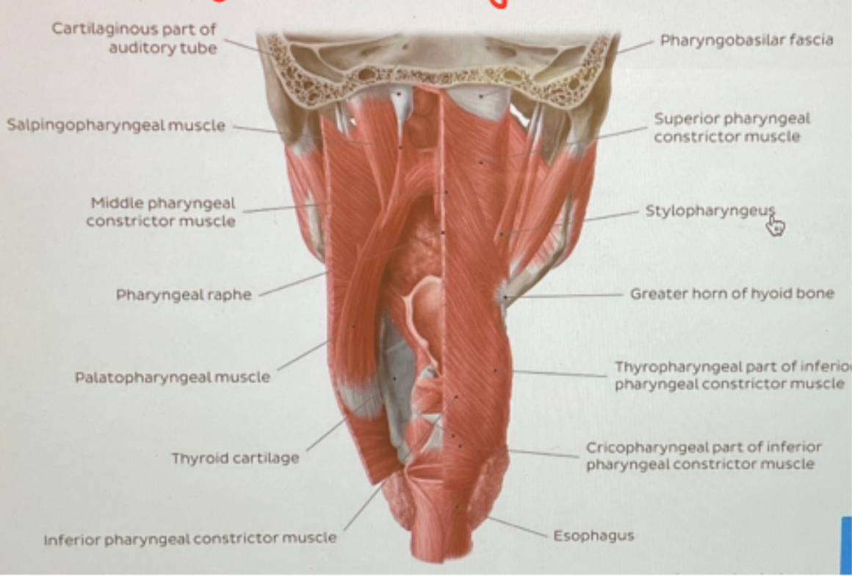
Stages of swallowing continues
3. Involuntary
- UES (upper oeosphageal sphincter) opens🡪 bolus can enter oesophagus
- Circular pharyngeal constrictor muscles sequentially contract to propel bolus into oesophagus
- LES opens and remains open during swallowing
- Hyoid bone depresses
- Nasopharynx reopens
Circular pharyngeal muscles (constrictors)
Longitudinal pharyngeal muscles

Slide 6
Muscles involved in swallowing & Gag reflex
Suprahyoid muscles (mylohyoid, geniohyoid, digastric, stylohyoid) elevate hyoid bone [2]
Longitudinal pharyngeal muscles (stylo-,palato-salpingopharyngeus) shorten and widen pharynx [2]
Infrahyoid/strap muscles (sternohyoid, thyrohyoid, sternohyoid, omohyoid) depress hyoid bone [3]
Pharyngeal constrictors (circular pharyngeal muscles)
Gag reflex
= reflex elevation of pharynx stimulated by oropharynx irritation, often accompanied by vomiting
Afferent limb = glossopharyngeal nerve (CN IX)
Efferent limb = vagus nerve (CN X)

Slide 7
Saliva
Functions of saliva
Lubricant for mastication
Maintains oral pH 6.2-7.4 using bicarbonate (HCO3-) buffer system
Digestion- contains lingual lipase & alpha-amylase (amylose🡪 maltose + glucose)
Aqueous solvent needed for taste
Oral hygiene- washes away food particles which microbes use as respiratory substrate
Immune function- contains lysozyme

Slide 8
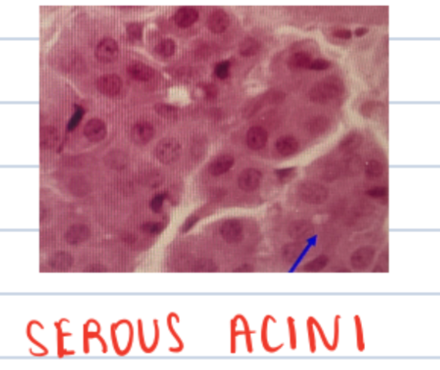
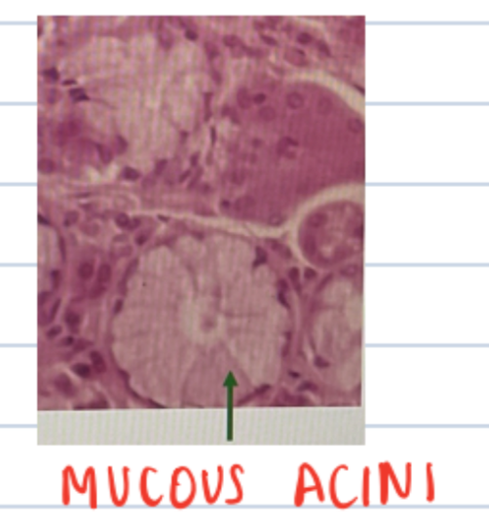
Saliva
 | Serous secretion | Mucous secretion
Components | H20 & alpha amylase | Mucus (for lubrication) = viscoelastic gel of water and glycoproteins
Examples of glands | Parotid NOTE: Von Ebner’s gland is the only serous minor gland | Sublingual gland All other minor glands
Histological appearance | Dark-staining nucleus in basal 1/3 of cells Small central ducts | pale-staining and foamy appearance Large central duct

Slide 9
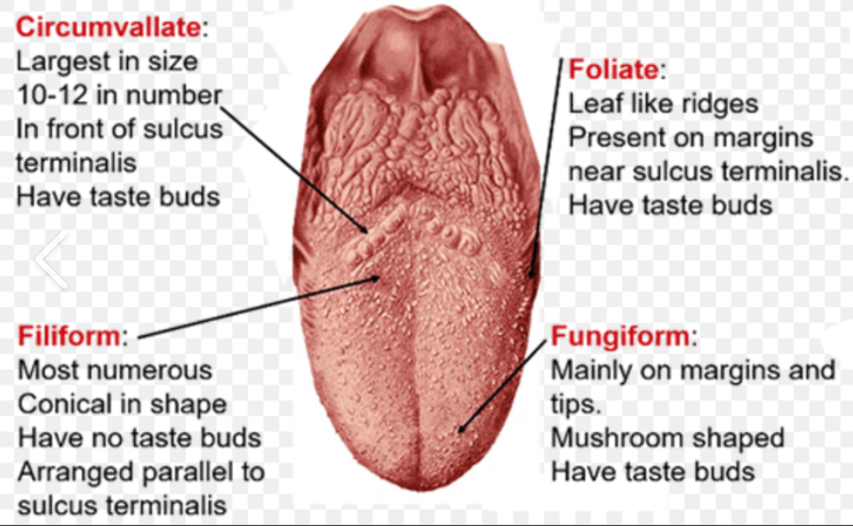
Parotid & von Ebner’s gland
Parotid gland
Serous gland
Facial nerve passes through but does not innervate it. Parasympathetic innervation by glossopharyngeal nerve (CN IX).
3 structures pass through: facial nerve (CN VII), external carotid artery, retromandibular vein
Facial nerve splits into 5 terminal branches in the parotid which innervate muscles of facial expression
Empties secretions via Stensen’s duct which traverses masseter muscle, turns 90 degrees to pierce buccinator and enter mouth adjacent to 2nd upper molar
Von Ebner’s gland
the ONLY minor salivary gland producing serous secretion
@ beneath the circumvallate papillae

Slide 10
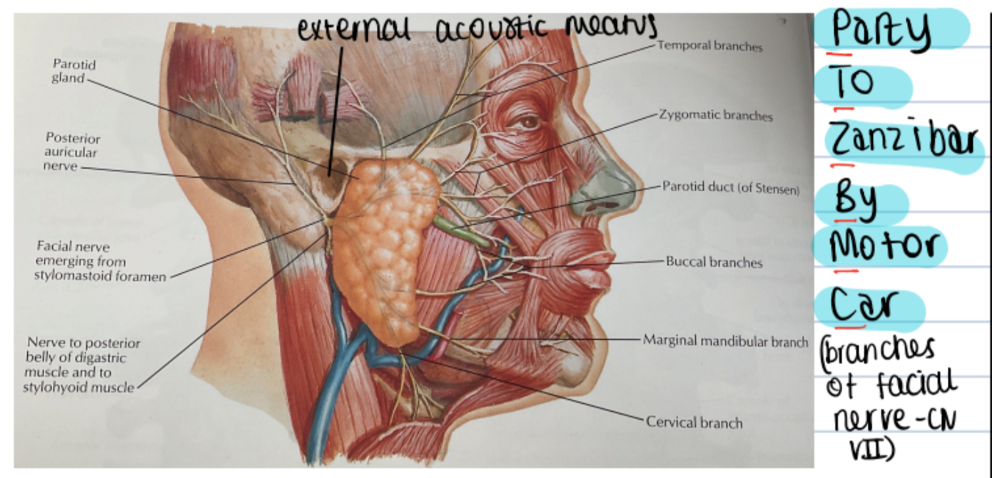
Parotid gland anatomy

Slide 11
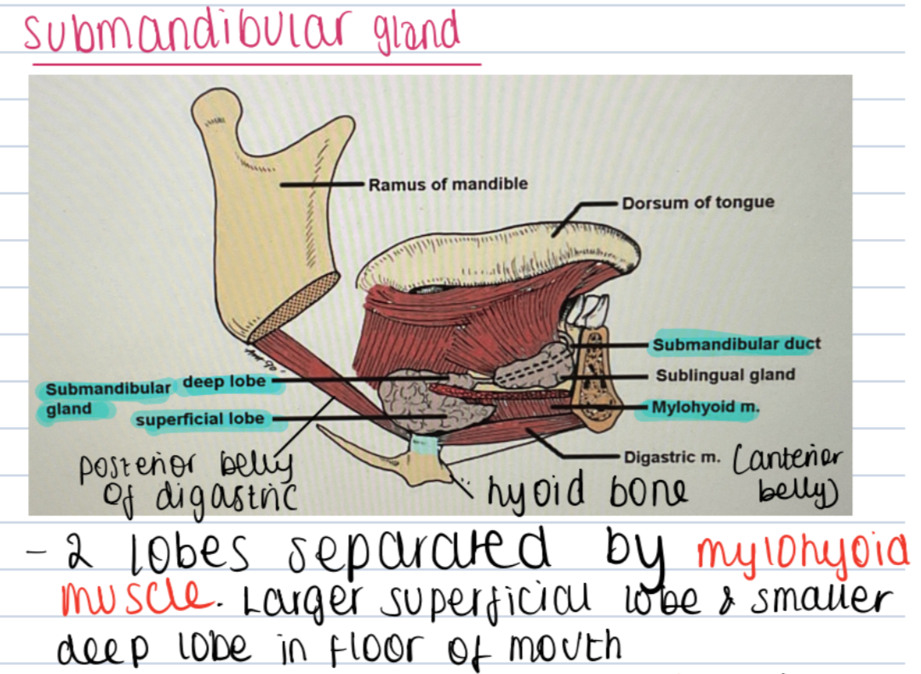
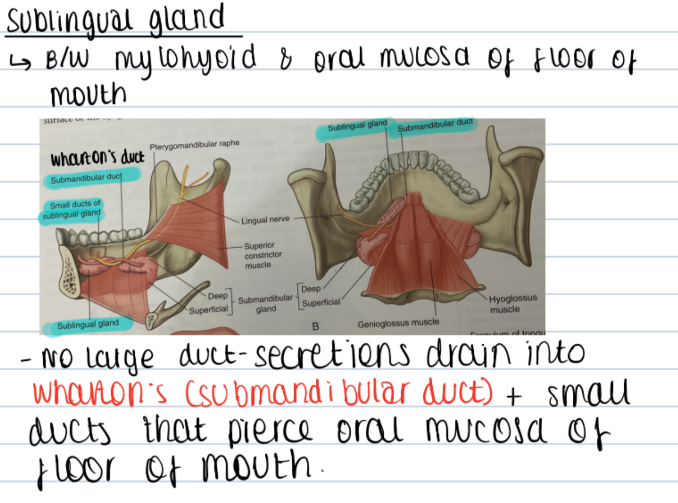
SMG & sublingual gland anatomy

Slide 12
SMG and sublingual gland
BOTH innervated by (chorda tympani branch of) facial nerve (CN VII).
Submandibular gland is a mixed gland.
Sublingual is a mucous gland.
SMG empties secretions into mouth via Wharton’s duct which wraps around mylohyoid and pierces oral mucosa @ sublingual papillae.
Sublingual gland also empties secretions into Wharton’s duct & via series of smaller ducts that pierce the oral mucosa.

Slide 13
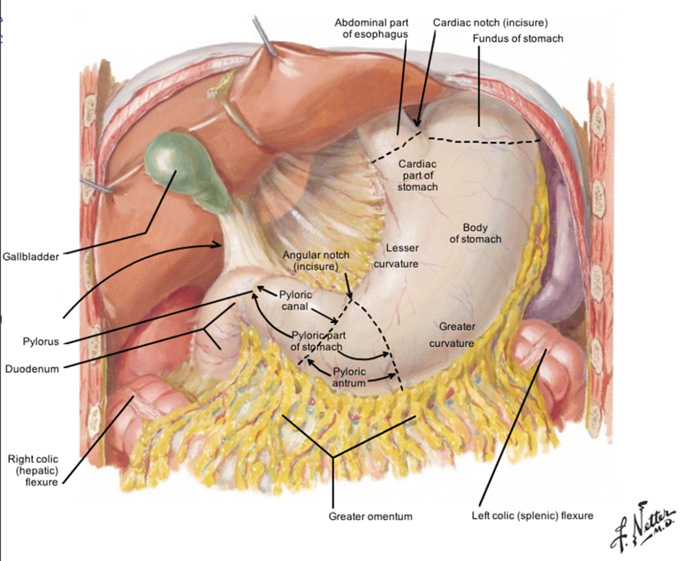
Gastric physiology 1
Functions of stomach
• Stores and mix food (receptive relaxation)
• Dissolve & continue digestion (chief cells release gastric lipase and pepsinogen, a zymogen)
• Regulate emptying into the duodenum
• Kill some microbes
• Secrete protease (intracellular inactive precursor to pepsin, pepsinogen, secreted by chief cells)
• Secrete intrinsic factor (binds to cobalamin AKA vitamin B12 to enable its absorption in the terminal ileum, secreted by parietal cells)
• Activate proteases (low luminal pH activates pepsinogen, causing its conversion into pepsin)
• Lubrication of ingested food (mucus secreted by cells at surface of gastric mucosa)
• Mucosal protection

Slide 14
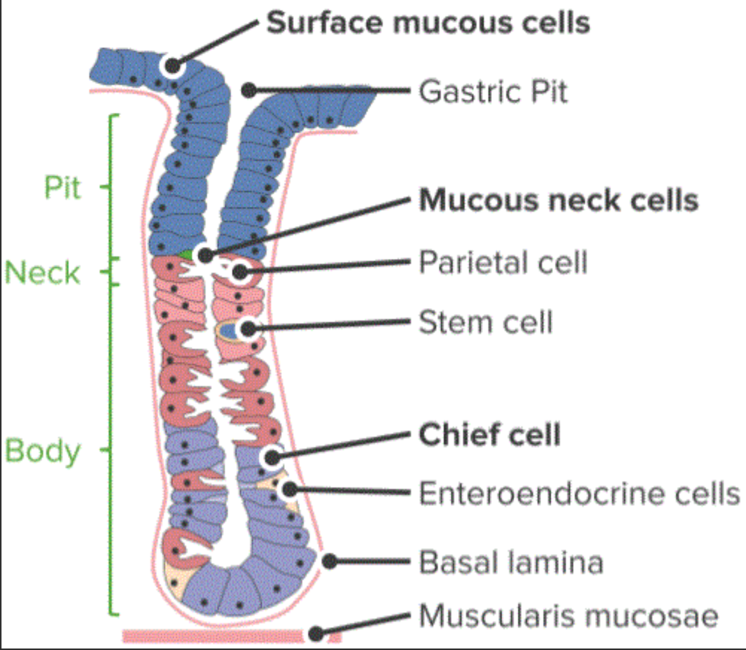
Gastric physiology 1
Cell types within the stomach
Cell type | Function | Location
Chief cells | Pepsinogen (zymogen) & gastric lipase | Fundus and body
Parietal cells | HCl & intrinsic factor | Fundus and body, little HCl produced @ antrum
Enterochromaffin-like (ECL) cells | Histamine
G cells | Gastrin | Antrum
D cells | Somatostatin
Mucous neck cells & foveolar cells | Secrete alkaline HCO3- rich mucus

Slide 15
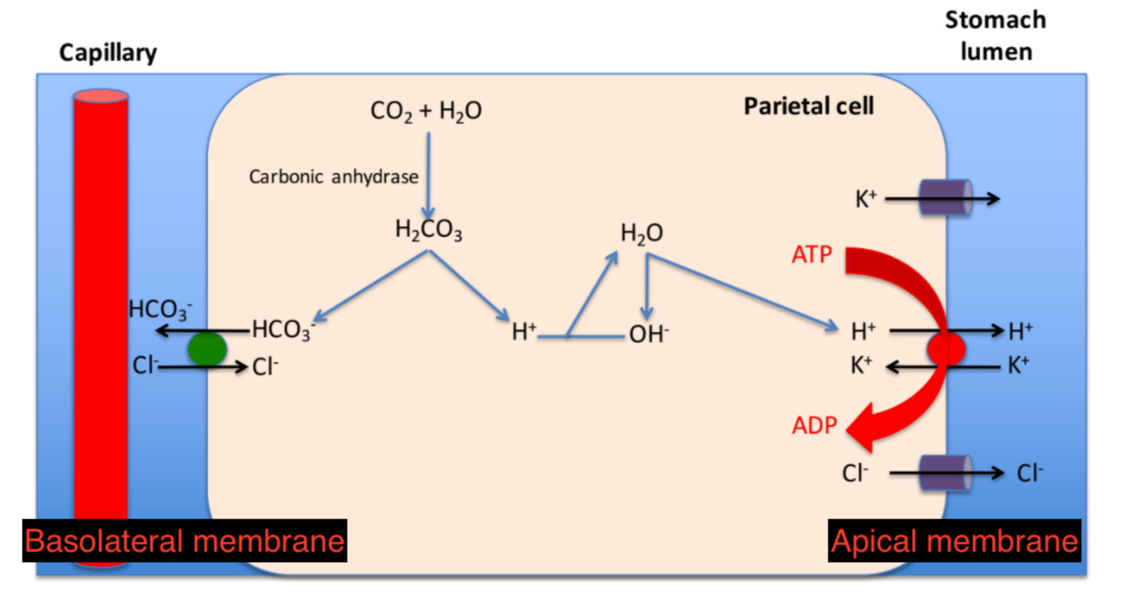
Gastric physiology 1
• 1 H+ derived from bicarbonate buffer system is pumped out of the parietal cell into the gastric lumen via apical H+/K+ ATPase pumps in exchange for 1 K+
• HCO3- is removed into the capillaries in exchange for Cl- via a HCO3-/Cl- exchanger.
•Cl- diffuses from parietal cells into gastric lumen
• H+ + Cl- 🡪 HCl
Mechanism of gastric acid production
Gastric acid production
• pH= 2
•[H+] > 150mM
• 2L/day
CO2 +H20
Carbonic anyhdrase
H2CO3
Cl-
K+
HCO3- + H+
No. of H+/K+ ATPase pumps in apical membrane of parietal cells can be up/downregulated by 4 key mediators to increase/decrease gastric acid production.
ACh (parasympathetic neurotransmitter)
Histamine (paracrine agent)
Gastrin ( hormone)
Somatostatin (paracrine agent)
Parietal cell

Slide 16
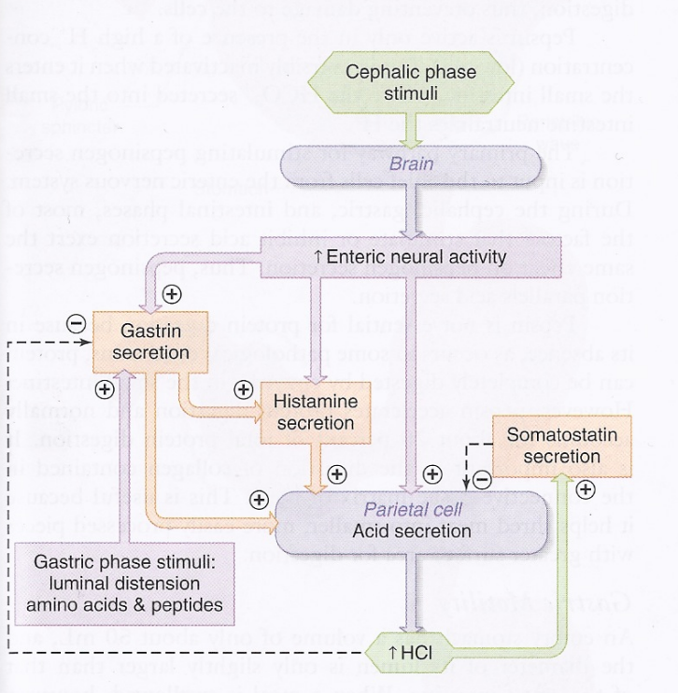
Gastric physiology 1
Cephalic phase (↑ acid production)
• Stimulus: thought, sight, taste & smell of food
• Ach released from parasympathetic vagal efferents mediates histamine release from ECL cells and gastrin release from G cells
• All 3 upregulate expression of H+/K+ ATPase pumps in apical membrane of parietal cells🡪 more gastric acid secretion
Gastric phase (↑ acid production)
• Stimulus: gastric distension & presence of peptides & AAs in gastric lumen
• Proteins in stomach directly stimulates gastrin release from G cells
• Proteins buffer gastric contents by binding H+ 🡪 luminal pH decreases🡪 somatostatin release inhibited 🡪 more acid production from parietal cells

Slide 17
Gastric physiology 1
Gastric phase ↓ acid production
•Stimulus: too much HCl/low luminal pH
• low luminal pH🡪 somatostatin release🡪 inhibits parietal cell acid production (-ve feedback)
• low luminal pH directly inhibits gastrin release
Intestinal phase ↓ acid production
• Stimulus: presence of duodenal fats, AA, decrease in duodenal pH, increase in duodenal osmolality
• Secretin (S cells) & cholecystokinin (I cells) released in duodenal mucosa inhibit gastric emptying.
• Secretin 🡪 somatostatin release🡪 inhibits acid production

Slide 18
Gastric physiology 1
Defence against acid production
Feedback loops
Tight junctions b/w simple columnar epithelial cells
Bicarbonate-rich alkaline mucus
Replacement of damaged cells- stem cells deep in gastric pit replace damaged cells
Causes of peptic ulcers
Cause | How?
NSAIDs e.g. aspirin, ibuprofen | NSAIDs inhibit COX-1 needed for prostaglandin synthesis. Prostaglandins mediate inflammation but also stimulate mucus secretion ∴ NSAIDs reduce mucus secretion.
Helicobacter Pylori infection | Resides in alkaline gastric mucus. Secretes NH4+ which together with vacuolating cytotoxin A and phospholipase, causes inflammatory response in gastric epithelial cells leading to reduced mucosal defence.
Chemical irritants | Duodeno-gastric reflux: bile salts enter stomach and strip away protective mucus layer.
Gastrinoma | Rare tumour of G cells causing gastrin hypersecretion🡪 unregulated acid production
Treatment for peptic ulcers
- Proton pump inhibitors e.g. Omeprazole, Lansaprazole
H2 receptor antagonists
- Prostaglandin analogues
↓ acid production
Does NOT ↓ acid production, ↑ mucus secretion

Slide 19
Gastric physiology 2
Peristalsis
Property of GI tract
Peristaltic waves begin in body of stomach and progress distally towards antrum. As peristaltic wave approaches the pyloric sphincter, it contracts so most antral contents are RETROPULSED for further mixing with pepsin and HCl. This prevents overfilling of duodenum with a hypertonic solution.
GORD is prevented by competent LES
Interstitial cells of Cajal = pacemaker cells in outer longitudinal layer of muscularis propria. Set basic electrical rhythm of 3 contractions/min.
Stimuli causing ↑ strength of peristaltic contractions | Stimuli causing ↓ strength of peristaltic contractions
Gastrin Gastric distension i.e. during the gastric phase of digestion (food in stomach) Parasympathetic stimulation (rest and digest) | Increase in duodenal fats Increase in duodenal osmolality Decrease in duodenal pH Duodenal distension Sympathetic stimulation

Slide 20
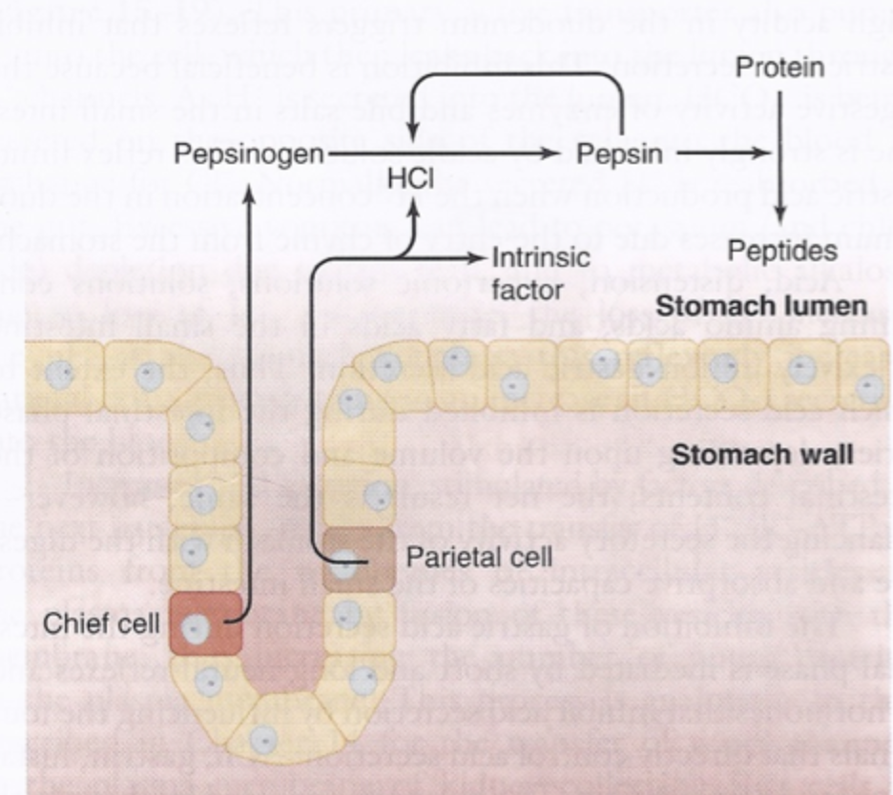
Gastric physiology 2
Pepsin
Accelerates but NOT essential for protein digestion
Digests connective tissue in meat
Pepsin production
Chief cells secrete pepsinogen- a zymogen (inactive enzyme precursor) to protect themselves from proteolytic damage
Pepsinogen is cleaved to pepsin in the gastric lumen by HCl. Pepsin also acts as an autocatalyst and stimulates its own production. This is +ve feedback.
Conversion of pepsinogen to pepsin is pH dependent. The activation of pepsinogen is most efficient when pH<2.
Pepsin irreversibly denatures in duodenum because duodenal chyme contains HCO3- ions which bind H+ ions, so pH increases.

Slide 21
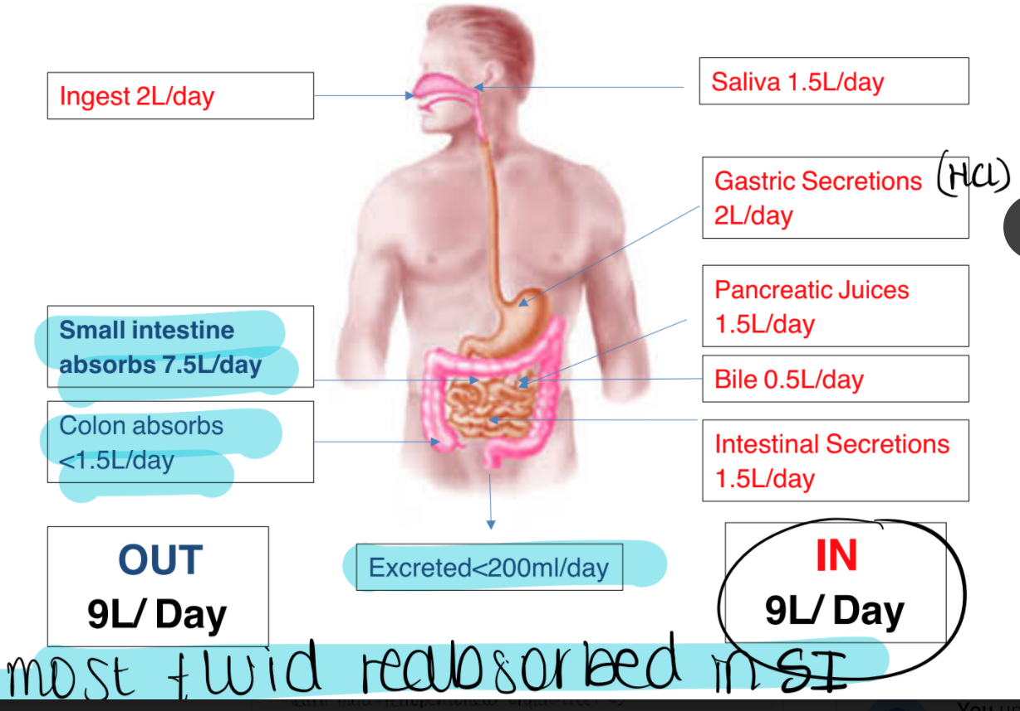
Intestinal physiology
Water distribution

Slide 22
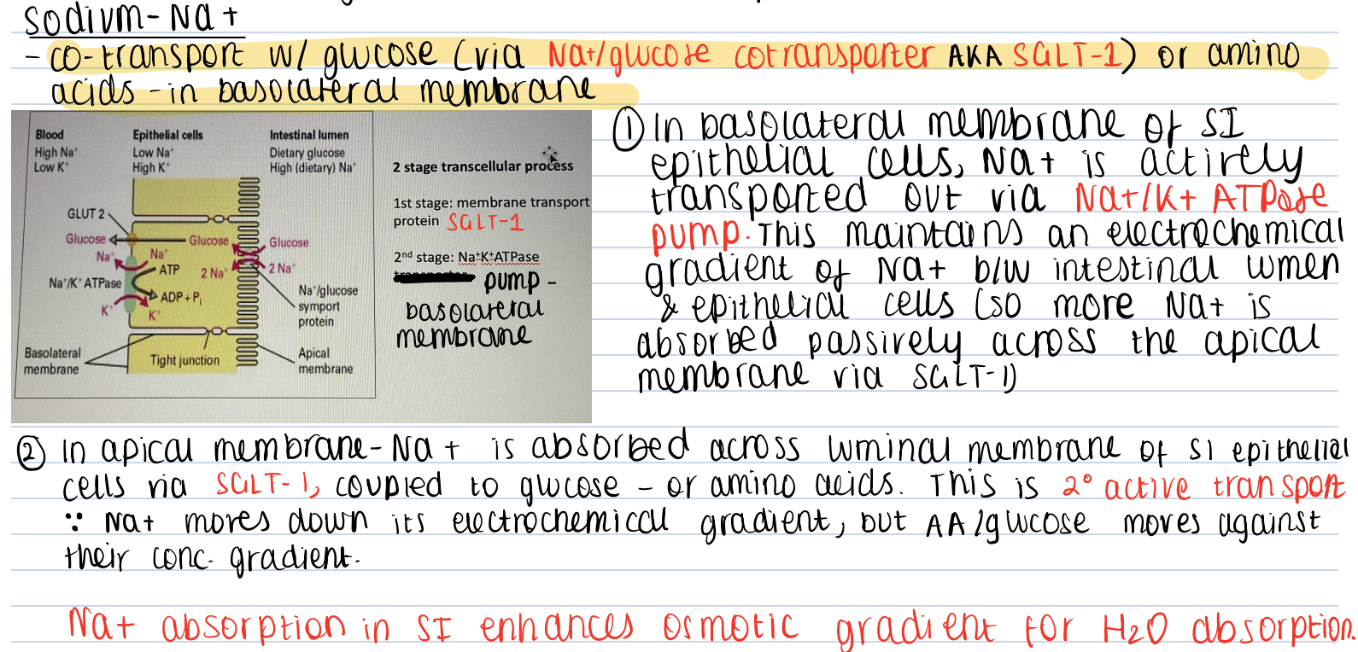
Ion transport & absorption
Water moves down osmotic gradient. Ions move down electrochemical gradient. Movement of ion creates osmotic gradients.
Na+ = most abundant solute in chyme so movement of sodium CAUSES osmosis

Slide 23
Ion transport
Na+ transport continued …

Slide 24
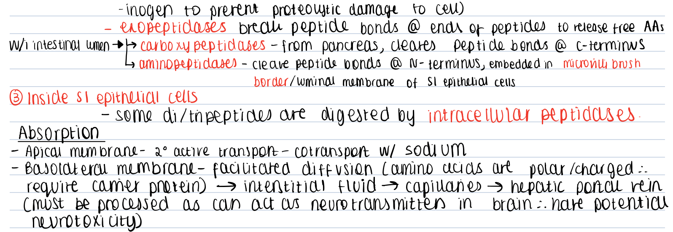
Digestion and absorption: protein

Slide 25
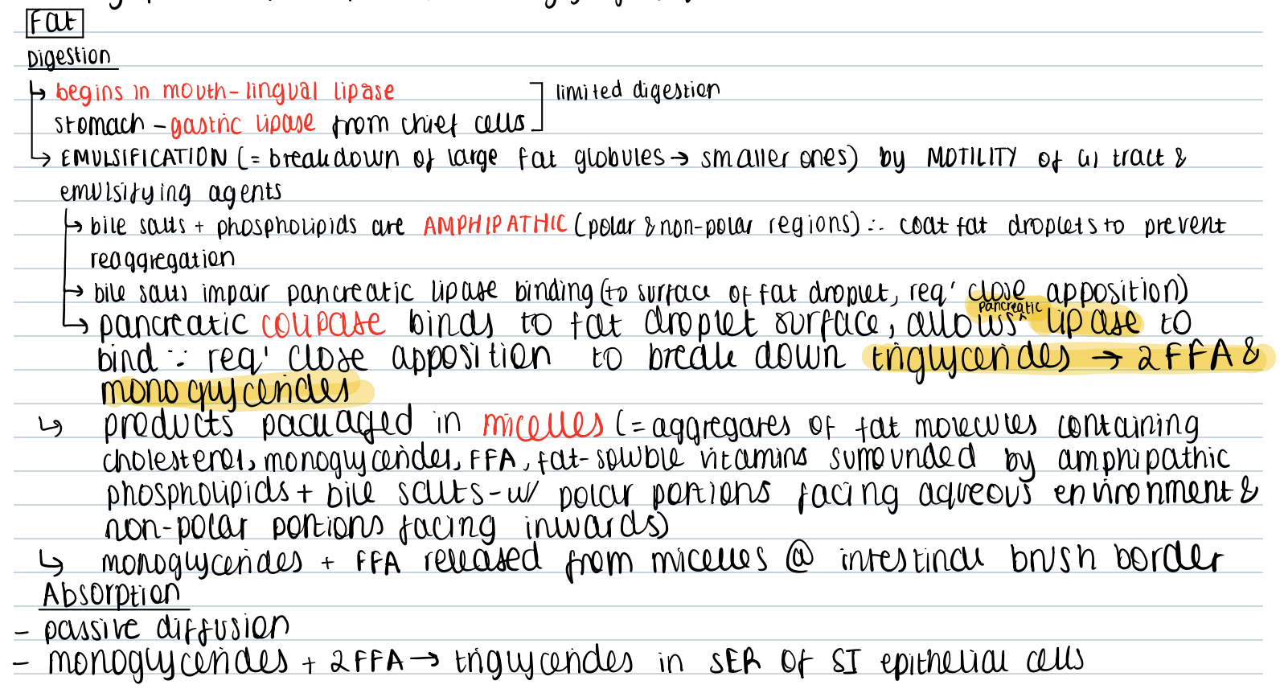
Digestion and absorption: fats
Fat globule
Hydrophilic PO4 3- ‘head’
Hydrophobic fatty acid ‘tail’

Slide 26
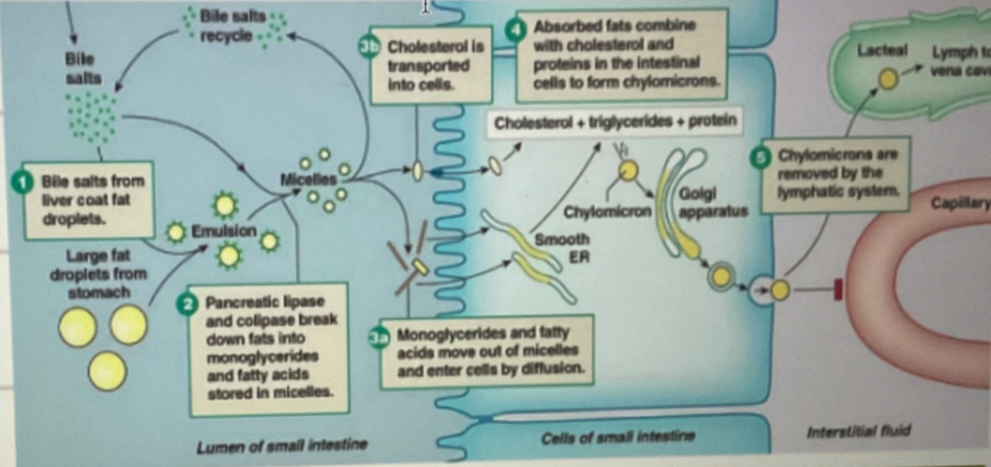
Digestion and absorption: fats

Slide 27
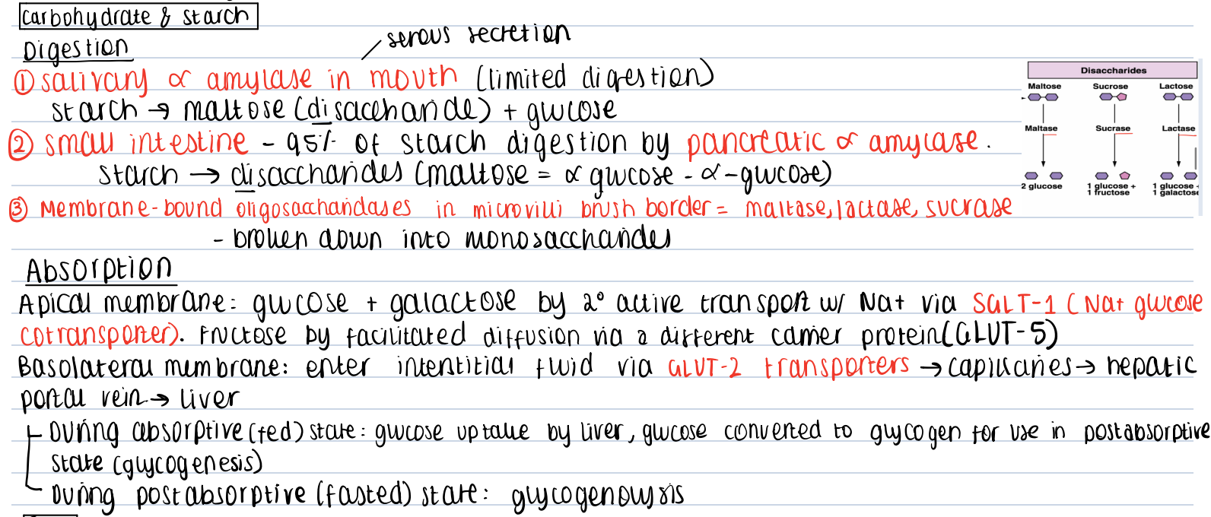
Digestion and absorption: carbs

Slide 28
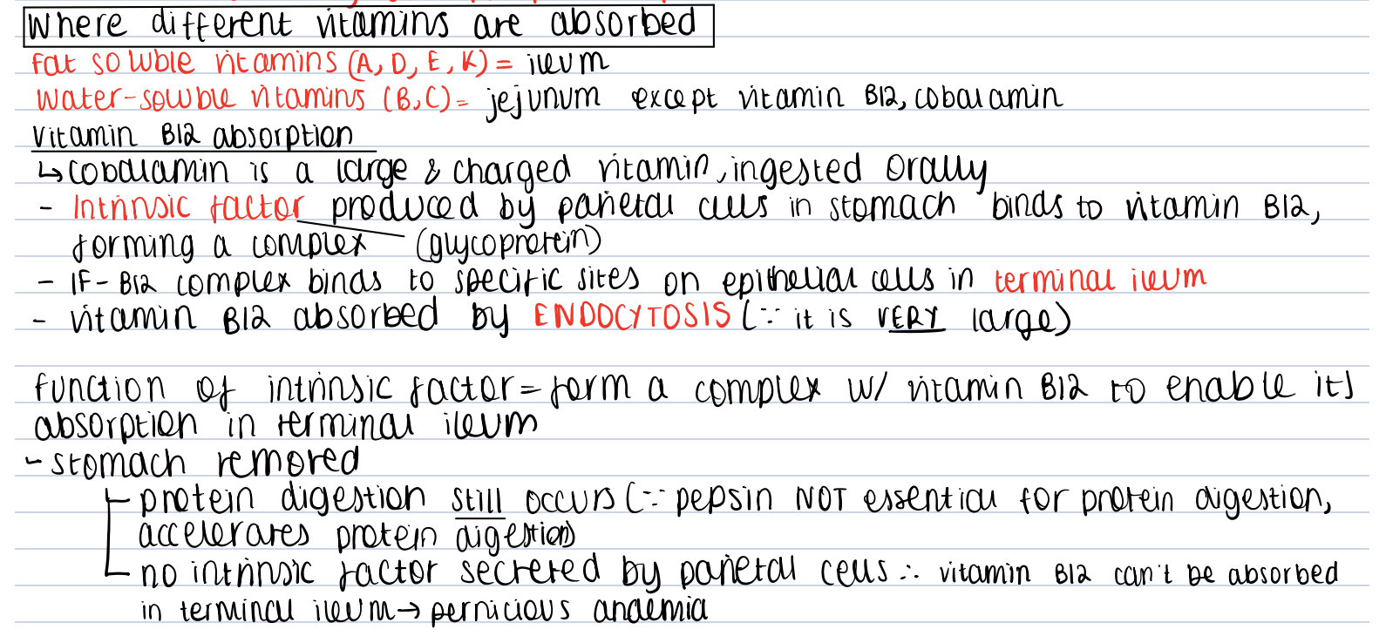
Vitamin absorption

Slide 29
Liver detoxification
Xenobiotic: foreign substances not normally found or produced in the body (exogenous) that can’t be used for energy requirements e.g. drugs, food additives
Pharmacologically active compounds are:
Lipophilic (so can diffuse across plasma membranes to reach the metabolising enzyme)
Bound to plasma proteins for transport in blood
Non-ionized at pH 7.4
Generally, drugs need to be made more hydrophilic prior to renal excretion in urine. This is done by xenobiotic transformation reactions i.e. Phase I and Phase II which are sequential.

Slide 30
Liver detoxification
Phase 1 reactions | Phase 2 reactions
Small ↑ in hydrophilicity & LARGE ↑ in reactivity (for sequential phase II reactions) Involves functionalization- functional groups are introduced/exposed which serve as ‘attack points’ for sequential conjugation with endogenous molecules in phase II reactions. Non-synthetic catabolic Involves oxidation, reduction and hydrolysis Mainly catalyzed by CYP450 – a microsomal enzyme | LARGE ↑ in hydrophilicity for renal excretion Involves conjugation w/ endogenous molecules e.g. glucuronic acid, amino acid, sulphate, methyl group, acetyl group Catalyzed by transferases All catalyzed by non-microsomal enzymes EXCEPT glucuronidation which is catalyzed by a microsomal enzyme.
Microsomal enzymes are located in smooth ER of mainly liver hepatocytes & are inducible (certain drugs, dietary components can ↑ activity). Non-microsomal enzymes are found in cytoplasm and mitochondria

Slide 31
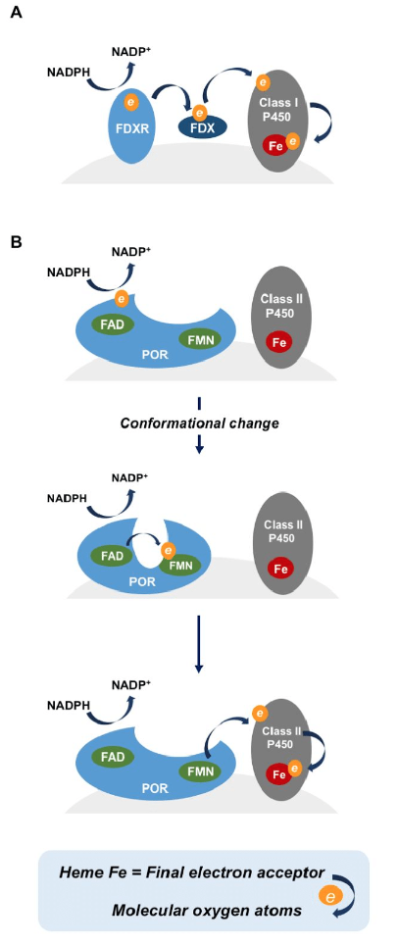
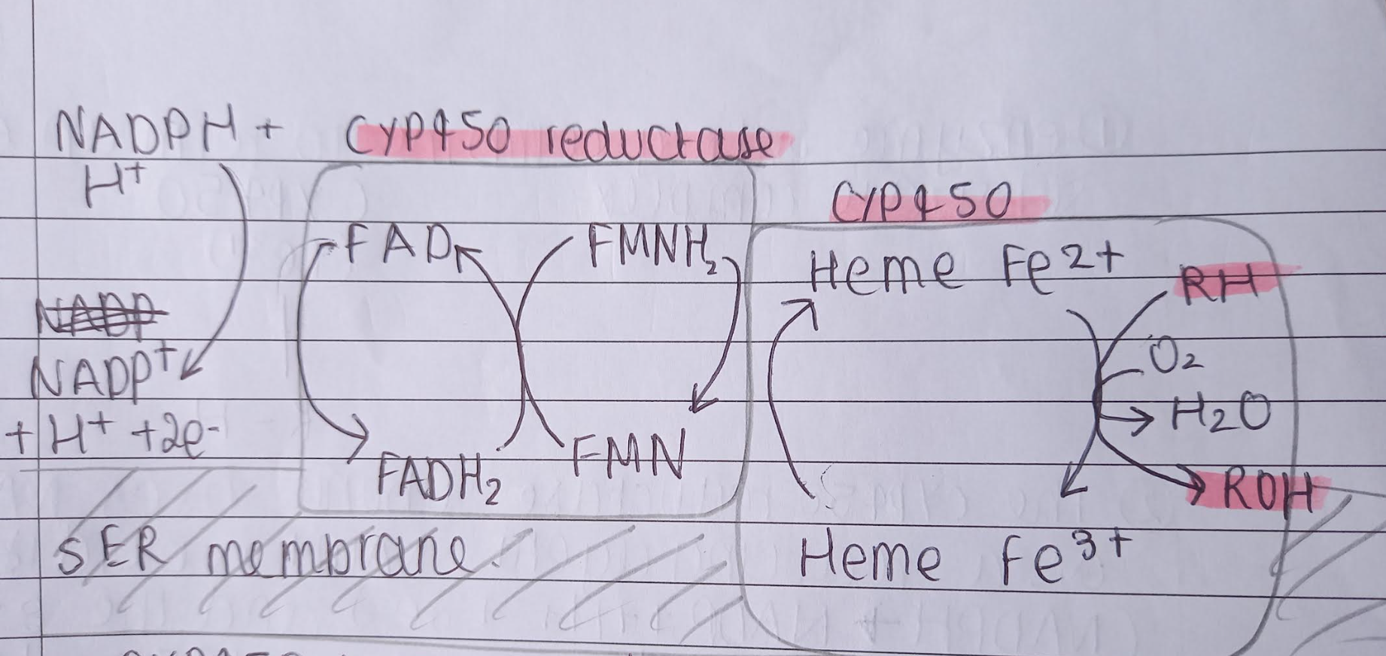
CYP450
- CYP450 is a microsomal enzyme bound to phospholipid membrane of smooth ER. CYP3A4 is an isoenzyme involved in metabolism of 50% of clinically prescribed drugs.
Uses Haem group to OXIDISE the substrate ( and thus reduce O2 to H20 in a redox reaction)
Has a reductase subunit attached which uses NADPH as a reducing agent. NADPH donates electrons to flavoprotein which consists of FAD & FMNH. FAD and FMN are sequentially reduced and oxidized; the final electron acceptor is Haem.
Overall equation: RH +O2🡪 ROH + H20
This increases hydrophilicty of drug for renal excretion. The substrate has been functionalised as ‘OH’ group has been introduced which can serve as an attack point for subsequent phase 2 conjugation.

Slide 32
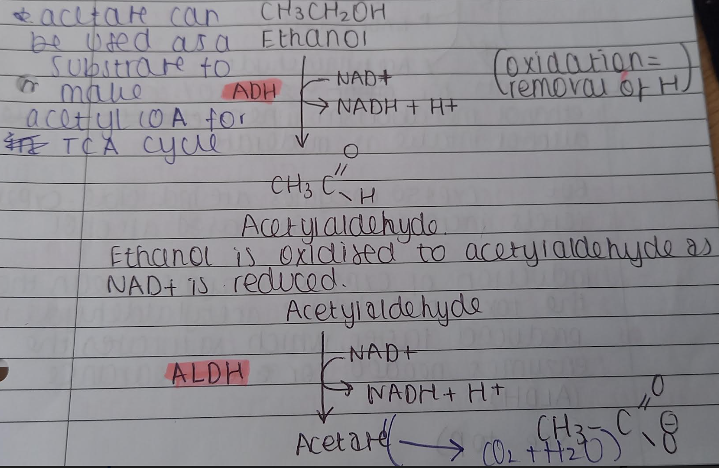
Alcohol metabolism
Doesn’t fit into phase 1 or 2 reactions. Doesn’t require conjugation.
Not a xenobiotic. Provides 7kCal/g
Major route is:
Alcohol dehydrogenase
Aldehyde dehydrogenase

Slide 33
Glucuronidation
The only phase II reaction catalysed by a microsomal enzyme
Substrate is conjugated with glucuronic acid (covalent bonds formed) to increase hydrophilicity
Catalysed by glucuronosyl transferase (UGT)
UDGPA is the essential coenzyme (organic non-protein compound that binds to enzyme to enable it to catalyse a reaction)
UDGPA + Drug 🡪 uridine phosphate + conjugated drug

Slide 34
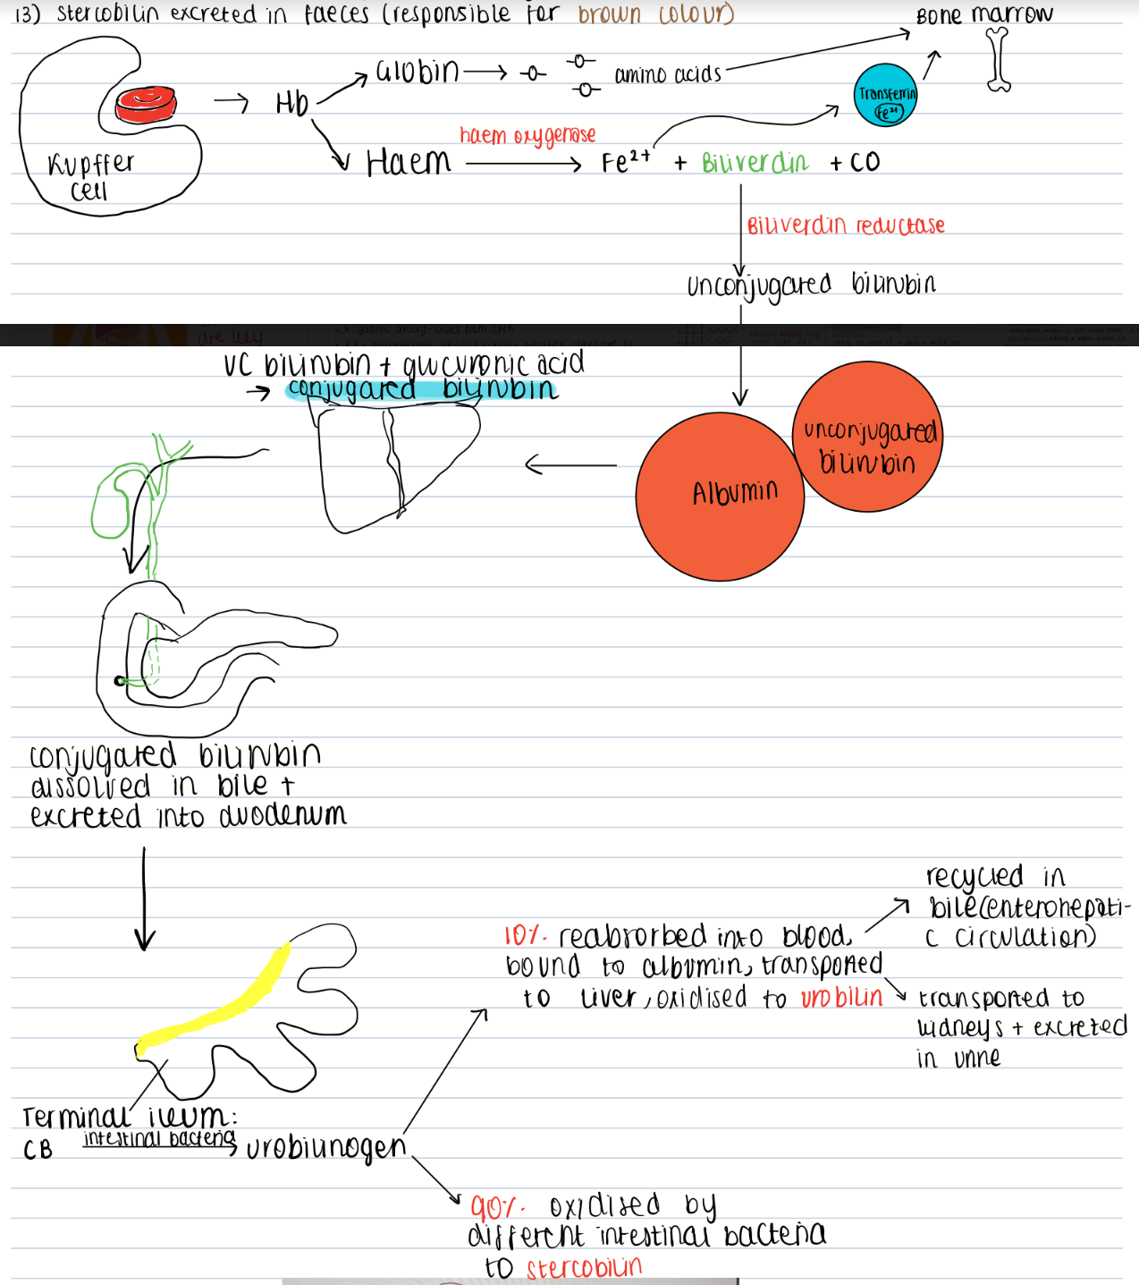
Bilirubin metabolism
Sensecent (>120 day old) RBCs are phagocytosed by macrophages in spleen & bone marrow, and Kupffer cells in liver. Part of reticuloendothelial system
Hb🡪 Haem + globin
Globin 🡪 amino acids which are recycled for protein synthesis. Haem🡪 biliverdin, Fe2+ +CO. Catalysed by haem oxygenase.
Biliverdin is reduced to unconjugated bilirubin by biliverdin reductase.
UC bilirubin is hydrophobic so binds to albumin for transport in blood to liver.
In the liver, UC bilirubin undergoes glucuronidation by UDP glucurnoyl-transferase, forming conjugated bilirubin which is hydrophilic and excreted in bile.
In the terminal ileum, intestinal bacteria reduce CB to urobilinogen. 90% is oxidized by different intestinal bacteria to stercobilin for excretion is faces. 10% of urobilinogen is reabsorbed into the blood and transported to the liver for oxidation to urobilin; this urobilin is either recycled in bile or renally excreted.

Slide 35
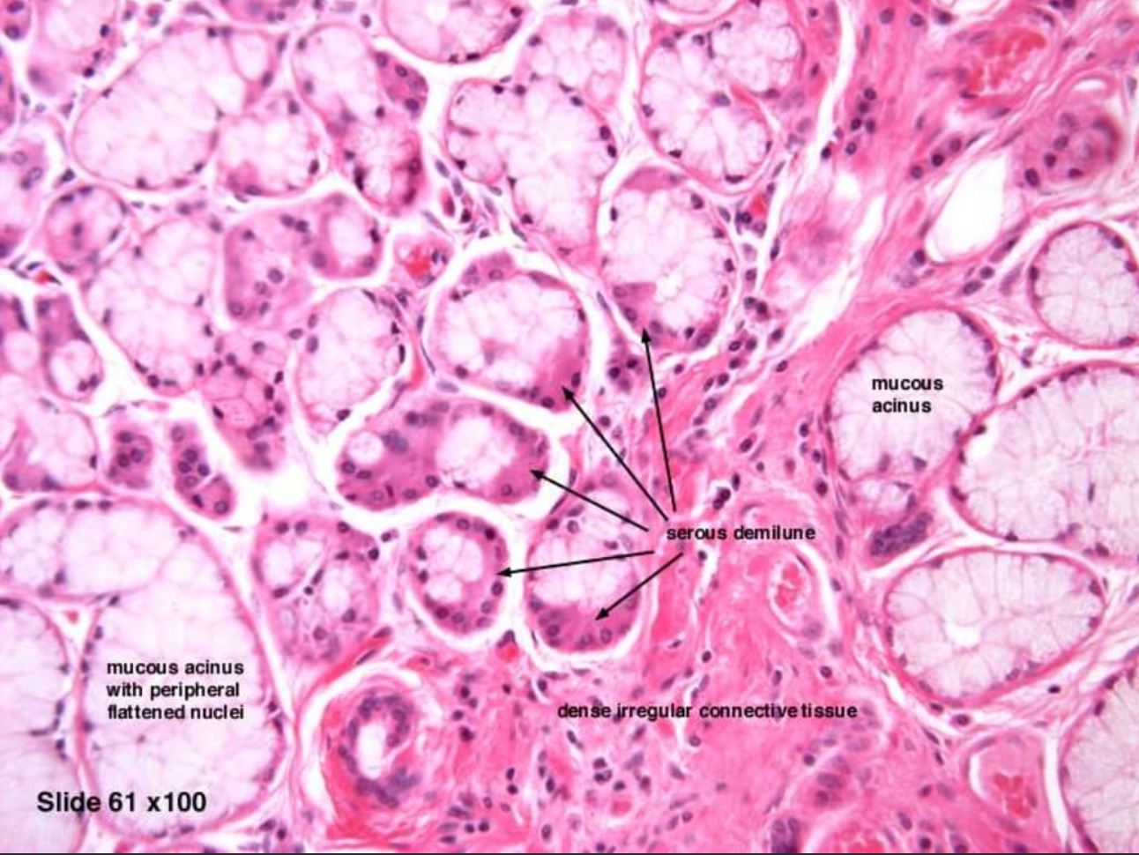
Question 1
From which of the following salivary glands is the following histology slide taken from?
Parotid gland
Sublingual gland
Submandibular gland
Von Ebner’s gland
Other unnamed glands in oral mucosa

Slide 36
Question 1
From which of the following salivary glands is the following histology slide taken from?
Parotid gland
Sublingual gland
Submandibular gland
Von Ebner’s gland
Other unnamed glands in oral mucosa
Submandibular gland is a MIXED gland so contains both serous and mucous acini. The presence of serous demilunes(serous acini which ’cap’ mucous acini) confirms that this is SMG.

Slide 37
Question 2
Which of these is a paracrine agent that inhibits gastric acid production and where is It released from in the stomach?
Gastrin from G cells
Histamine from ECL cells
Ach from the vagus nerve
Somatostatin from D cells
Secretin from S cells in the duodenal mucosa

Slide 38
Question 2
Which of these is a paracrine agent that inhibits gastric acid production and where is It released from in the stomach?
Gastrin from G cells
Histamine from ECL cells
Ach from the vagus nerve
Somatostatin from D cells
Secretin from S cells in the duodenal mucosa
Secretin is a hormone released from S cells in the duodenal mucosa. It inhibits gastric acid production by inhibiting the release of gastrin from G cells, which indirectly inhibits histamine release from ECL cells. So E is not the SBA!

Slide 39
Question 3
Which conjugation reaction does unconjugated bilirubin undergo in the liver to make it more hydrophilic?
a) sulphation
b) Acetylation
c) methylation
d) Amino acid conjugation
e) Glucuronidation

Slide 40
Question 3
Which conjugation reaction does unconjugated bilirubin undergo in the liver to make it more hydrophilic?
a) sulphation
b) Acetylation
c) methylation
d) Amino acid conjugation
e) Glucuronidation
Conjugation with glucuronic acid by UDP glucuronyl-transferase which is a microsomal enzyme found in smooth ER of predominantly liver hepatocytes. This is a phase II reaction.

Slide 41
Question 4
Which of the following is not a zymogen?
Pepsinogen
Pepsin
Chymotrypsinogen
Trypsinogen

Slide 42
Question 4
Which of the following is not a zymogen?
Pepsinogen
Pepsin
Chymotrypsinogen
Trypsinogen
Zymogens are inactive enzyme precursors which are subsequently activated to form digestive enzymes- protects cell from proteolytic damage.
Chymotrypsinogen🡪 chymotrypsin
Trypsinogen 🡪 trypsin
Both chymotrypsinogen and trypsinogen are pancreatic zymogens which when activated in the duodenum, act as endopeptidases.

Slide 43
Question 5
Where is vitamin B12 absorbed?
Duodenum
Ileum
Terminal ileum
Jeujunum
Colon (large intestine)

Slide 44
Question 5
Where is vitamin B12 absorbed?
Duodenum
Ileum
Terminal ileum
Jeujunum
Colon (large intestine)

Slide 45
Question 6
What would removal of the stomach lead to?
Pernicious anameia
Inability to digest protein
Inability to digest fat
No peristalsis

Slide 46
Question 6
What would removal of the stomach lead to?
Pernicious anameia
Inability to digest protein
Inability to digest fat
No peristalsis
- Lack of parietal cells = no intrinsic factor secreted = vitamin B12/cobalamin deficiency
- No stomach = no pepsin- protease. Since this accelerates but is not essential for protein digestion, protein digestion would still occur.
- No stomach = no chief cells = no gastric lipase. But motility of GI tract (peristaltic waves) on addition to amphipathic agents like bile salts would emulsify fats, allowing subsequent digestion.
- Peristalsis occurs throughout the entire GI tract- smooth muscle in muscularis propria/externa contracts sequentially to propel food.

Slide 47
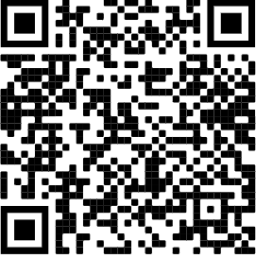
Feedback
My email is : aaziz4@sheffield.ac.uk
Feel free to ask/email me any questions you have and I will do my best to help!
I would appreciate it if you could fill out the feedback form please:

Slide 48
