Slide 1
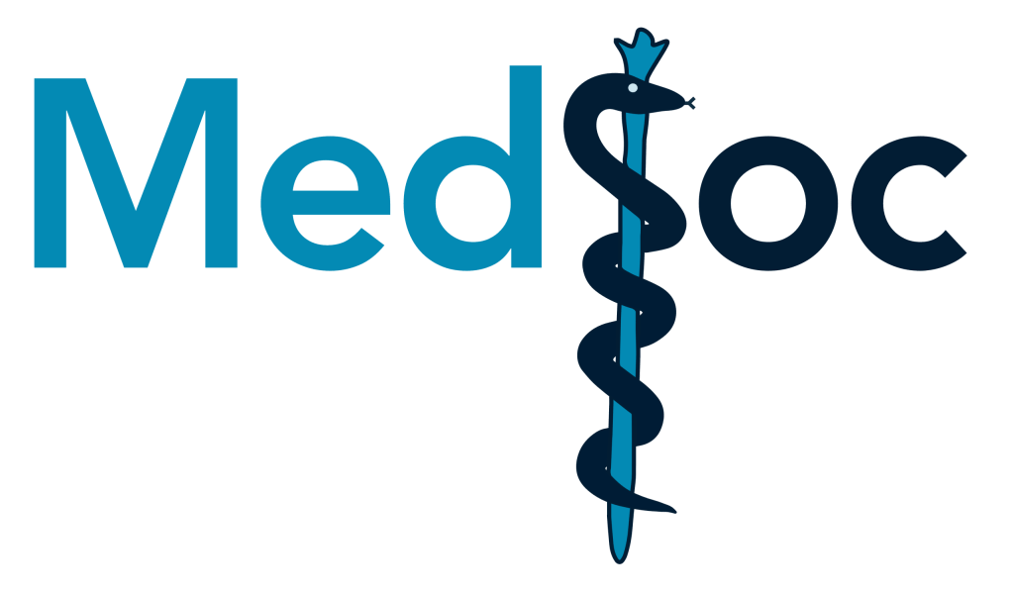
GEM Revision Series
2022/23

Slide 2
GI, Liver & Friends
GEM SBA Revision Session
Jennifer Quinn
11th October 2022

Slide 3
Aims and Objectives
What topics will we cover?
Innervation of the GI tract
GI anatomy
Liver storage and detox
Hormonal regulation of gastric secretion
Practice SBA questions
*images from Moore’s Clinical Anatomy unless specified

Slide 4
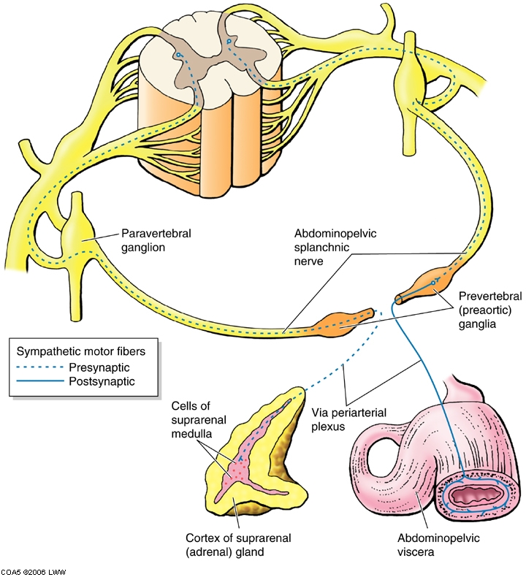
Innervation of the GI tract

Slide 5
Nervous system recap
Somatic – skeletal muscle
Autonomic:
- Parasympathetic
- Sympathetic
Referred pain
Enteric nervous system

Slide 6
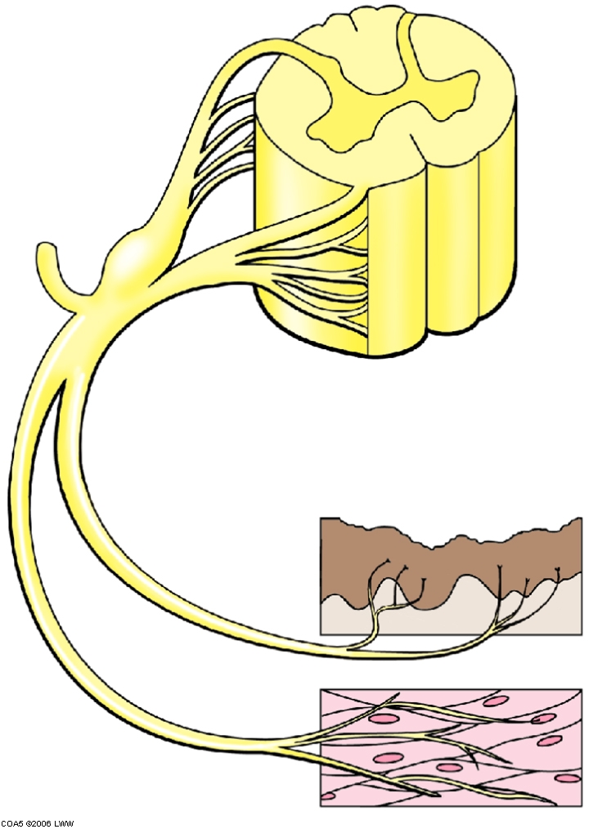
spinal cord
spinal nerves
sensory
motor

Slide 7
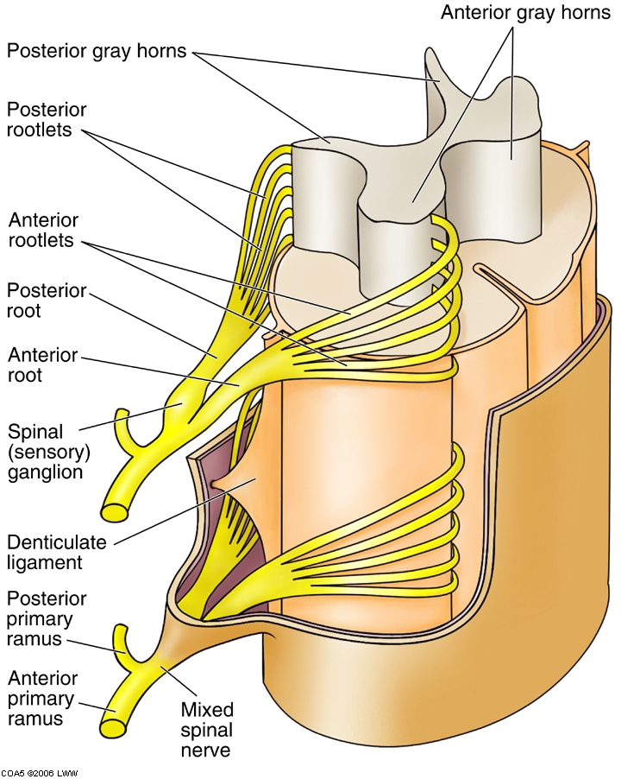
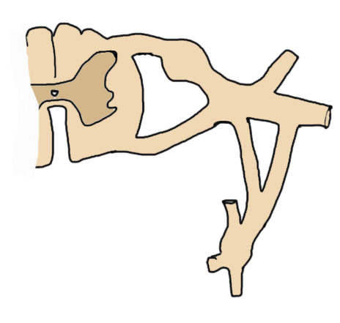
posterior = dorsal, anterior = ventral
dorsal ramus to posterior body wall contains somatic motor, somatic sensory and sympathetic fibres
PR
spinal nerve
AR
ventral ramus to anterior + lateral body wall, and limbs; contains somatic motor, somatic sensory and sympathetic fibres

Slide 8
Autonomic nervous system (ANS)
Viscera, glands and blood vessels
Smooth muscle, influences cardiac muscle
Non-conscious control
Motor and sensory
Sympathetic and parasympathetic divisions

Slide 9
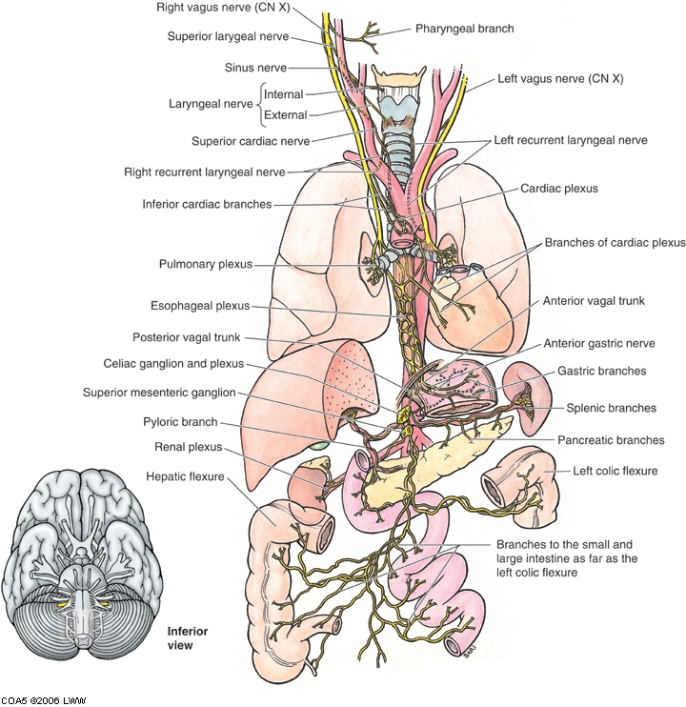
Parasympathetic – stimulates the GI tract
Cranial and sacral
‘Rest and digest’
Cranial nerves III, VII, IX, X
Sacral – via pelvic splanchnic nerves (hindgut)
Vagus CN X = visceral motor fibres to heart, lungs and abdominal viscera
Also visceral sensory

Slide 10
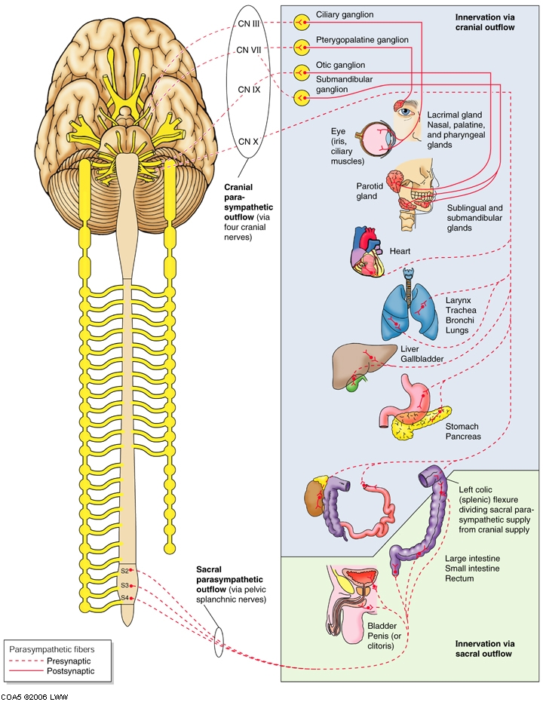
Parasympathetic motor and sensory
Visceral sensory mostly CN IX, X and S2-4
CN IX = chemoreceptors and baroreceptors in neck arteries and receptors in pharynx
CN X = cervical viscera and vessels + viscera in thorax and abdomen
Visceral sensory from pelvic viscera and distal colon carried in S2-4
Monitor normal physiological processes and reflex activities

Slide 11
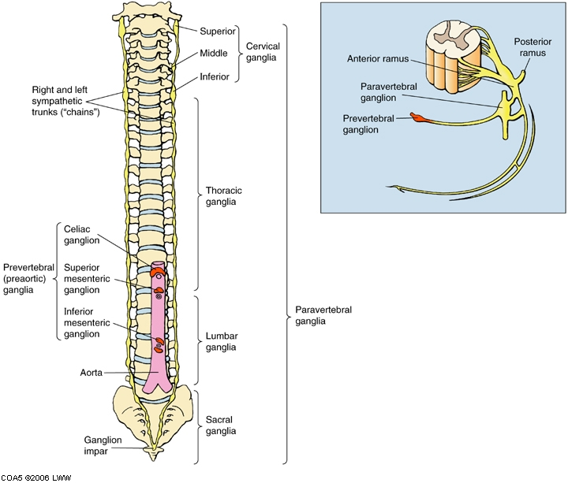
Sympathetic innervation of the GI tract – inhibitory effect
Fight and flight
Cell bodies in lateral horn of spinal cord only between T1 and L1/L2
Sympathetic supply needed to body wall and to limbs – i.e. areas beyond T1-L1/L2 still have sweat glands and blood vessels
Need a way to pass sympathetic fibres beyond the thorax – the sympathetic chain of ganglia

Slide 12
Sympathetic fibres form plexi on arterial vessels to pass to target organs

Slide 13
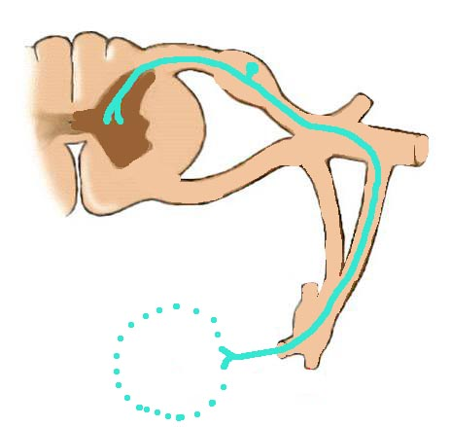
Referred pain
‘pain’ signals from viscera via sympathetic afferent
Caused by stretch or lack of oxygen (ischaemia)
Visceral pain is not well-localised.
Nerve fibres from different tissues converge at the same spinal cord level - brain interprets pain as from the spinal segment – i.e. the body wall not the viscus
spinal nerve
passes into spinal nerve
= REFERRED PAIN
viscera

Slide 14
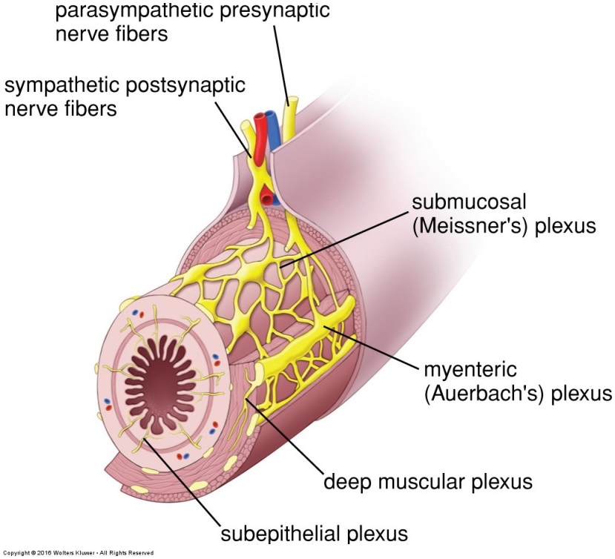
The Enteric Nervous System
The enteric nervous system comprises two plexi, the Myenteric (Auerbach’s) plexus and submucosal (Meissner’s). They govern peristalsis.
Excitation/contraction mediated by: Parasympathetic NS - Vagus (CN X) Acetylcholine (main neurotransmitter)
causes increased:
Gut tone
Contraction rate / intensity
Excitatory wave conduction speed
Inhibitory function – sympathetic NS
Vasoactive Intestinal Peptide (VIP)
nitrous oxide (NO), and ATP
Relaxes smooth muscle
Reduced sphincter tone
Myenteric (Auerbach’s) plexus
regulates gut motility
located between circular and longitudinal smooth muscle layers.
Submucosal (Meissner’s) plexus
regulates gut secretion/local blood flow
Notes:
‘Sensory (afferent ) neurons monitor luminal activity, including distention (i.e., smooth-muscle tension), chemistry (e.g., pH, osmolality, levels of specific nutrients), and mechanical stimulation. These sensory neurons activate interneurons, which relay signals, activating efferent secretomotor neurons that in turn stimulate or inhibit a wide range of effector cells: smooth-muscle cells, epithelial cells that secrete or absorb fluid and electrolytes, submucosal blood vessels, and enteric endocrine cells’ – Boulpaep, Medical Physiology

Slide 15
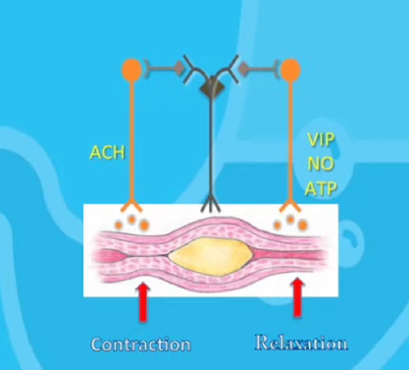
Example of nervous control of peristalsis moving waste
Distention of gut wall stimulates reflex arc:
Sensory neurones behind the bolus synapse with interneurons → synapsing with cholinergic excitatory motor neurons, releasing Ach → causing contraction of smooth muscle
Sensory neurones after the bolus synapse with interneurons → synapsing with inhibitory motor neurons → release VIP, NO, and ATP → cause relaxation of smooth muscle → bolus can pass along

Slide 16
Any questions?

Slide 17
GI anatomy recap
Foregut, Midgut, Hindgut
Contents
Vasculature
- veins
- arteries
- nerves

Slide 18
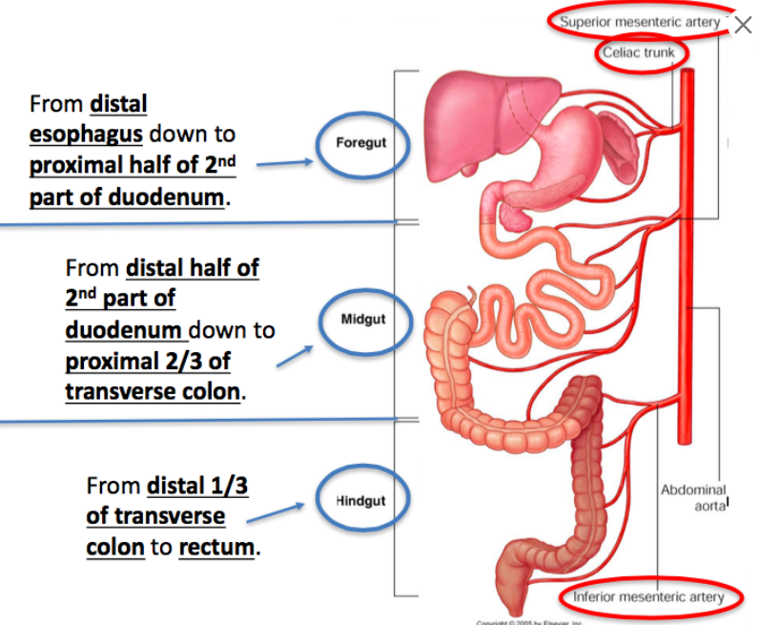
Nerve supply
Coeliac plexus
Greater splanchnic nerve, T5-T9
Parasympathetic from vagal trunks (coeliac plexus)
Superior mesenteric plexus
Lesser splanchnic nerve, T10-T11
Parasympathetic from vagal trunks (superior mesenteric plexus)
Inferior mesenteric plexus
least splanchnic nerve (T12)
parasympathetic from sacral outflow/pelvic splanchnic
T12
L1
L3

Slide 19
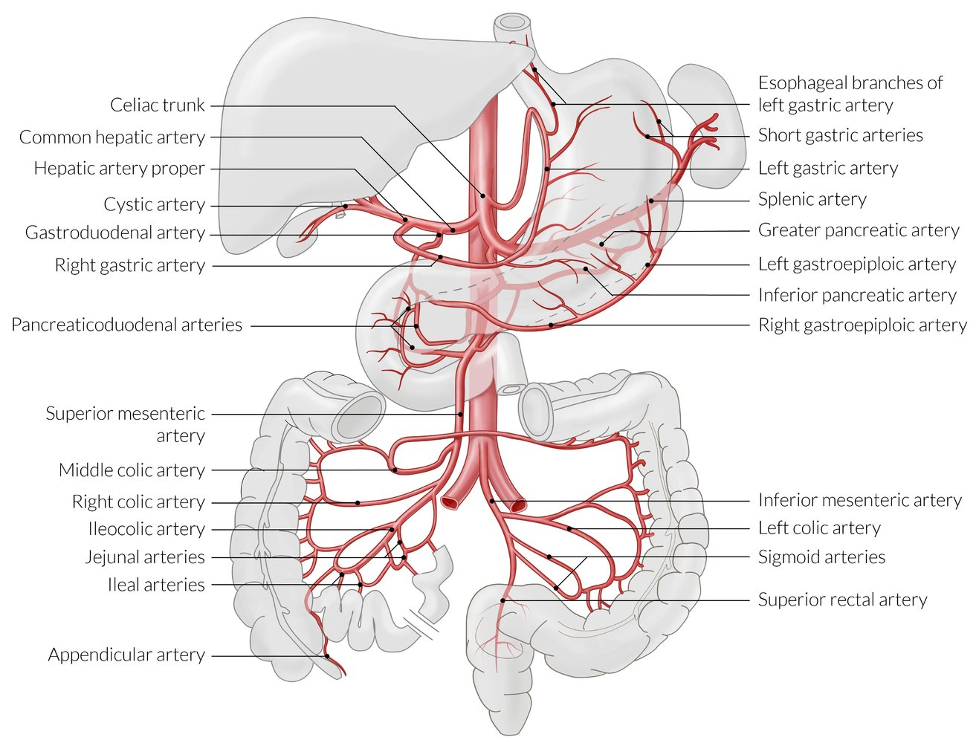
Notes:
From AMBOSS GI education

Slide 20
Foregut
Distal oesophagus, stomach, liver, spleen, proximal duodenum, part of pancreas
Blood supplied by branches of the coeliac axis (aorta T12)
Blood drains to portal vein
Nerves from coeliac plexus – pain to epigastric region
Parasympathetic from anterior and posterior vagal trunks (posterior trunk to coeliac plexus)
Sympathetic fibres carried by the greater splanchnic nerve (T5-T9) to the coeliac plexus
Lymph to pre-aortic nodes at T12 (coeliac nodes)
liver
spleen
gallbladder
stomach
duodenum
NB. Digestive system starts in the oral cavity

Slide 21
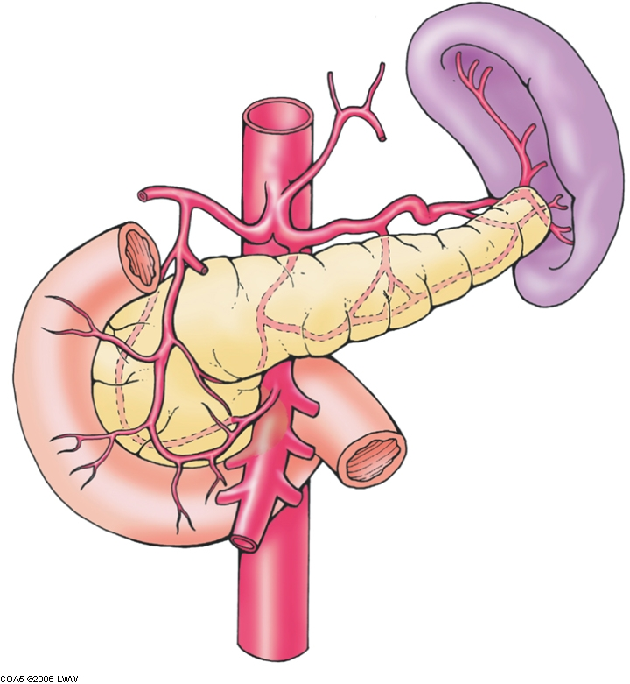
left gastric
common hepatic
left gastric
splenic
gastroduodenal
right gastric
superior pancreaticoduodenal
aorta
coeliac axis (T12)
R&L gastro-epiploic (omental)

Slide 22
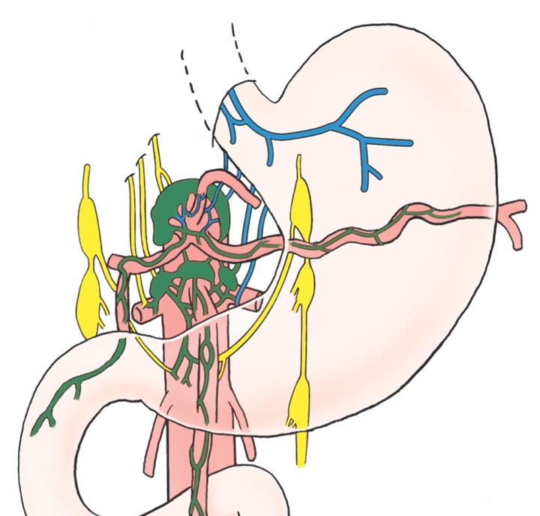
Stomach - nerves
coeliac ganglion and plexus
vagal trunks
Autonomic – coeliac plexus (at T12):
Parasympathetic from anterior and posterior vagal trunks (posterior trunk to coeliac plexus)
Sympathetic fibres carried by the greater splanchnic nerve to the coeliac plexus
splanchnic nerves
sympathetic chain

Slide 23
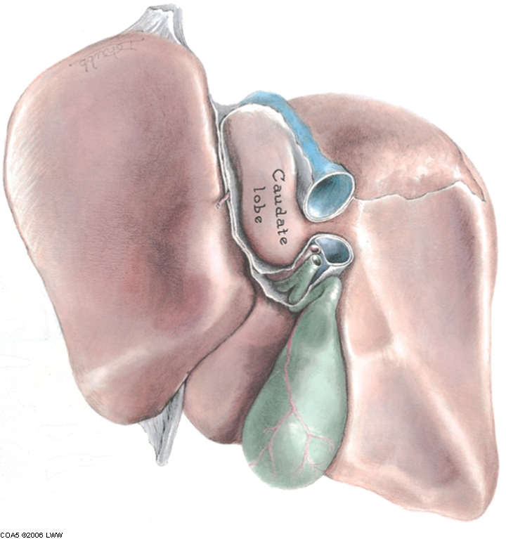
inferior vena cava
Liver
R & L hepatic arteries, from coeliac axis @ T12,
R&L hepatic veins (often 4 in total) directly into the inferior vena cava (IVC);
portal vein into IVC
Gallbladder
Stores and concentrates bile
Cystic artery from R hepatic artery, cystic vein into portal vein
Lymph to cystic node then hepatic then coeliac
cystic duct
bile duct
portal vein
hepatic artery
gall bladder
Porta hepatis post.
anterior view
coeliac axis (T12)

Slide 24
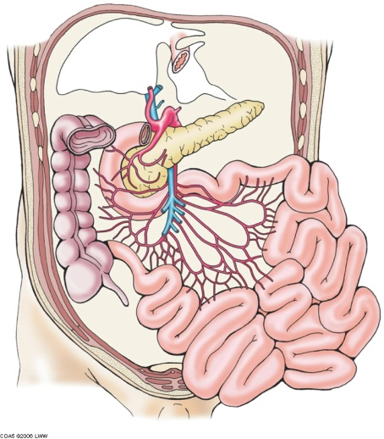
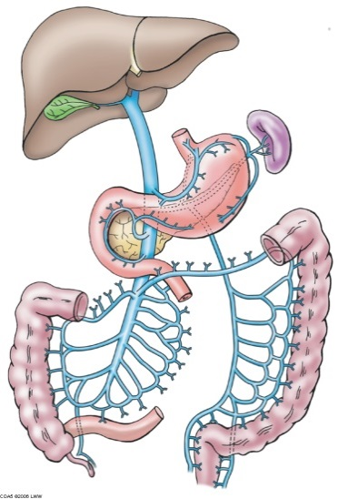
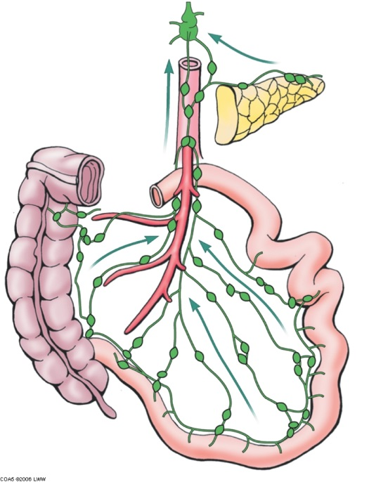
Midgut
Arterial supply from jejunal and ileal branches of the superior mesenteric artery (L1) (branches from L side and run in mesentery)
Anastomose to form arcades, lower parts of ileum also supplied by ileocolic artery
Veins drain into superior mesenteric veins
Lymph travels to mesenteric nodes and then to pre-aortic nodes around the superior mesenteric artery (L1)
Nerves = ANS superior mesenteric plexus, pain referred to umbilical region
Sympathetic fibres carried by the lesser splanchnic nerve (T10-T11) to the plexus
Clinical relevance? Appendicitis – often presents with umbilical pain
24

Slide 25
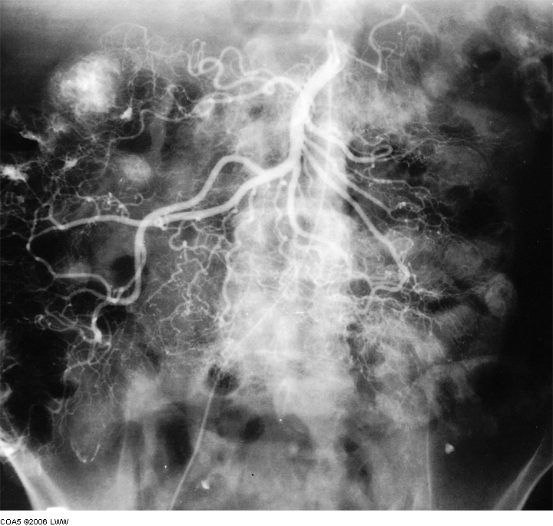
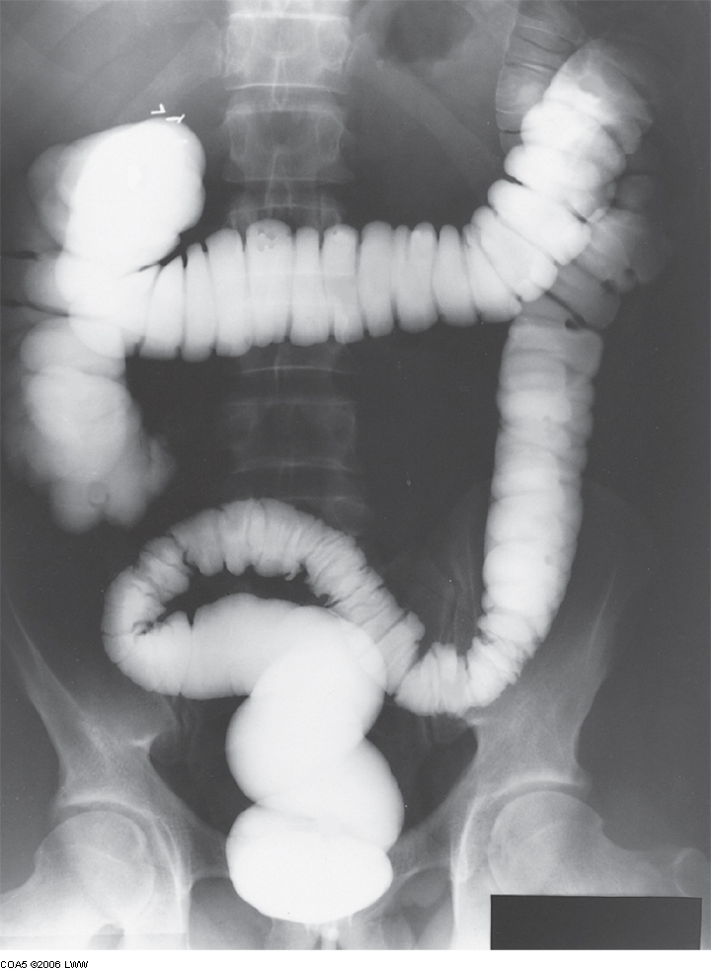
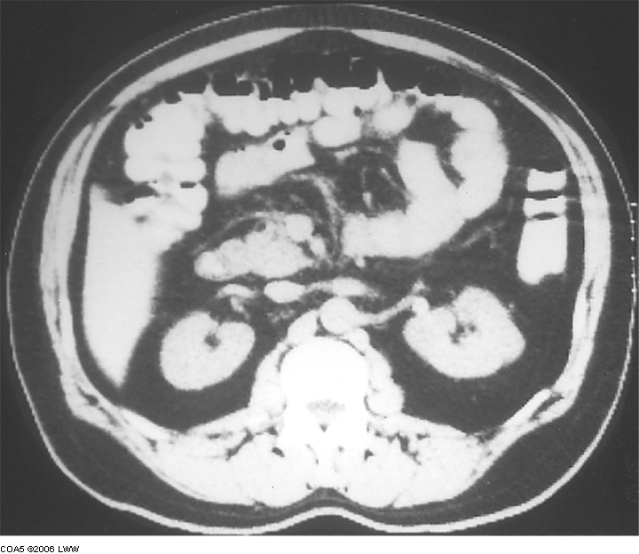
midgut and hindgut structure
jejunal and ileal branches of the superior mesenteric artery

Slide 26
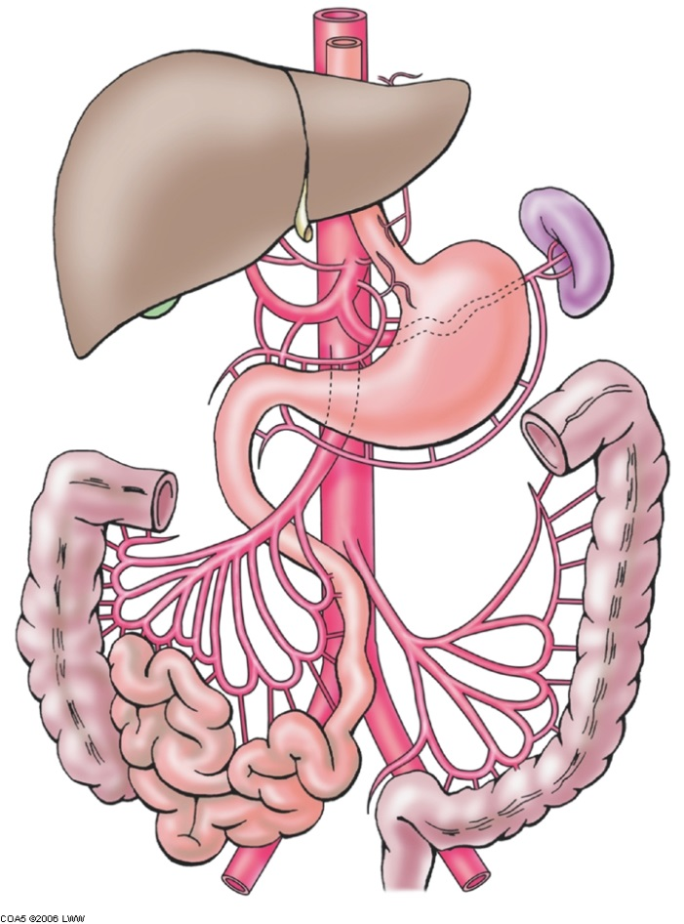
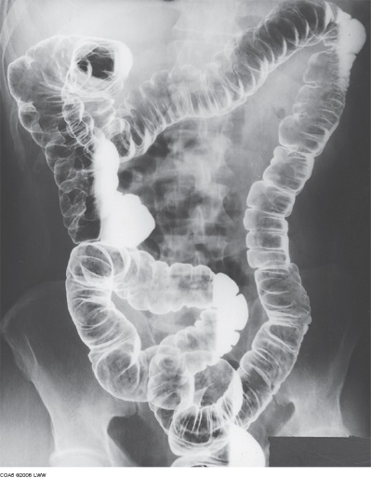
Hindgut
Transverse colon
Nerves ANS from sup. and inf. mesenteric plexuses.
Vagus to prox 2/3rds, distal 1/3rd parasympathetic from pelvis
junction midgut to hindgut
@25cm long from L colic flexure to pelvic brim where it becomes the sigmoid colon
Retroperitoneal
Left colic (LC) and sigmoid (S) arteries (from IMA L3)
Veins to inferior mesenteric vein
Lymph to inferior mesenteric pre-aortic nodes (L3)
Nerves = from inferior mesenteric plexus – sympathetic, least splanchnic nerve (T12) and parasympathetic from sacral outflow/pelvic splanchnic
Descending colon
LC
S

Slide 27
Any questions?

Slide 28
Liver
Dual blood supply (arterial, and portal venous)
Single drainage route – central venous
~30% blood from hepatic artery, ~70% from portal vein
Arterial oxygenated, portal rich in nutrients
Arterial and venous blood conducted to central vein of each liver lobule by sinusoids
Central veins drain into R&L hepatic veins (often 4 in total) directly into the inferior vena cava (IVC)

Slide 29
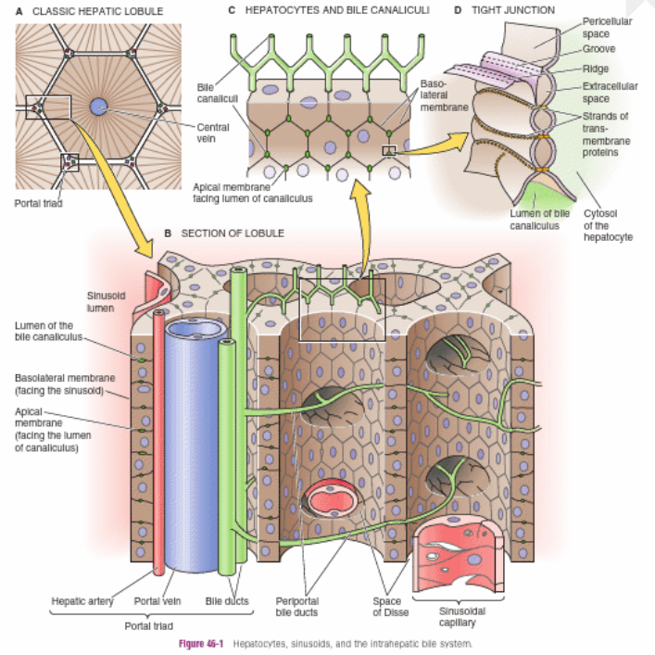
The main cells of the liver are the hepatocytes. They form what appear in sections to be cords of liver cells, but in fact are plates or sheets of cells with spaces in between for blood to flow through. These blood channels are called sinusoids.
The sinusoids are lined by endothelial cells, and there is a narrow space between them and the hepatocytes called the space of Disse.
The sinusoids endothelium = fenestrated - the liquid component of the blood generally has free access to hepatocytes, but blood cells do not.
Scattered within the sinusoids are resident macrophages called Kupffer cells. These cells remove particulate matter from the blood and help remove worn out RBCs.
Stellate (Ito) cells - are in the space of Disse. They also store vitamin A within fat droplets in their cytoplasm. In some pathological conditions (e.g. cirrhosis) they transform into myofibroblasts and produce scar tissue in the liver.
Notes:
From

Slide 30
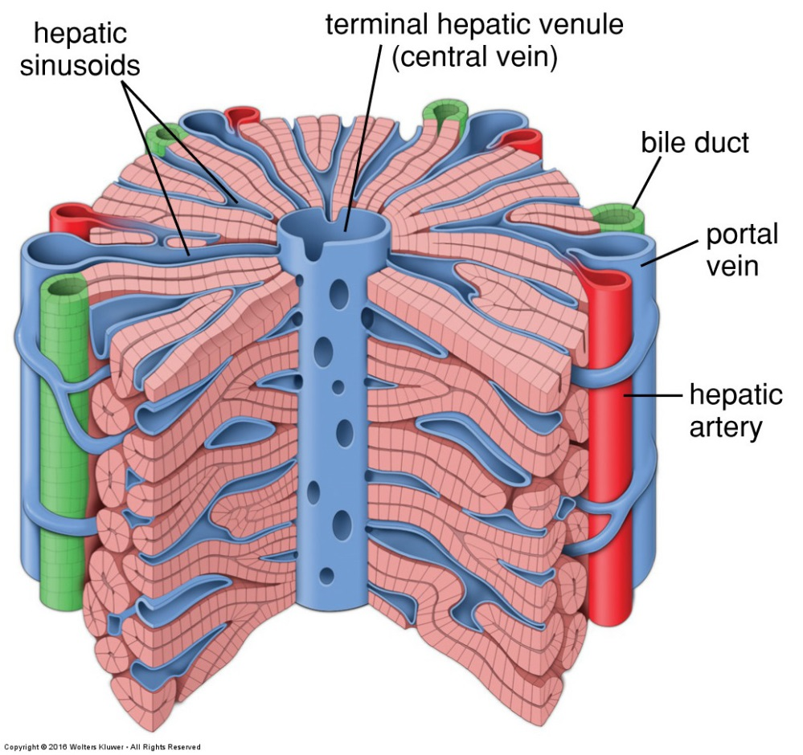
Another way to assess the liver’s function is to view the hepatic acinus, shown below, which is split into three zones.
Zone 1 (in purple): closest to the portal triads, oxygen-rich, site of majority of metabolic activity, susceptible to hepatic toxicity as first port of call from bloodstream
Zone 2 (green)
Zone 3 (yellow): closest to the central vein, lowest oxygen levels, area most affected by paracetamol overdose - carries out glycolysis, lipogenesis and cytochrome P-450 based drug detoxification
The liver has classically been viewed as made up of segments called lobules. Each lobule is approximately hexagonal and has a branch of the hepatic vein called the centrolobular vein (or central vein) at its centre and portal triads at each corner.
Zone 3: lower oxygen tension,. Zone 1 preferentially damaged in iron overload due to higher exposure level and more oxygen present.

Slide 31
Liver metabolism
Xenobiotic metabolism – anything that is not naturally produced
Phase 1 & Phase 2 – Cytochrome P450 – group of enzymes crucial to metabolism – by oxidation, reduction, hydrolysis in smooth ER
Taken across hepatic portal system to liver – hydrophobic – H- transformed in hepatocytes
CYP450 - oxidases – insert/add on an oxygen to the drug – becomes OH, more polar
CYP 3A4 metabolises almost 50% of all available drugs
CYP 2D6 – can cause significant drug reaction - turns codeine into morphine
- can see polymorphisms in genetic expression of this enzyme – slow or rapid metabolisers
- rapid metabolisers can turn into morphine at dangerous rate/levels
Phase 2 – conjugation – made even more polar by enzymes such as UDP glucuronosyltransferase (UGT), very polarised, become soluble in blood plasma, urine etc
Phase 3 – secretion/excretion Once made more polar, it has to be excreted – urine, blood plasma, bile
L

Slide 32
Hepatocytes Smooth ER
OH
H
OH
UGT
More polar
Non-polar
(hydrophobic)
G
Glucuronate – highly polar
O
CYP 450
PHASE I
PHASE II
(CONJUGATION REACTIONS)
G
O
PHASE III
(SECRETION/EXCRETION)
Urine
Bile
Blood
Notes:
Xenobiotic metabolism – anything that is not naturally produced
Phase 1 & Phase 2 – Cytochrome P450 – group of enzymes crucial to metabolism – by oxidation, reduction, hydrolysis in smooth ER
Taken across hepatic portal system to liver – hydrophobic – H- orgs transformed in hepatocytes
CYP450 oxidise – inert/add on an oxygen to the drug – becomes OH, very polarised, become soluble in blood plasma, urine etc
CYP 3A4 metabolises almost 50% of all available drugs
CYP 2D6 – can cause significant drug reaction - turns codeine into morphine
- can see polymorphisms in genetic expression of this enzyme – slow or rapid metabolisers
- rapid metabolisers can turn into morphine at dangerous rate/levels
Phase 2 – conjugation – made even more polar
Phase 3 – secretion/excretion Once made more polar, it has to be excreted – urine, blood plasma, bile

Slide 33
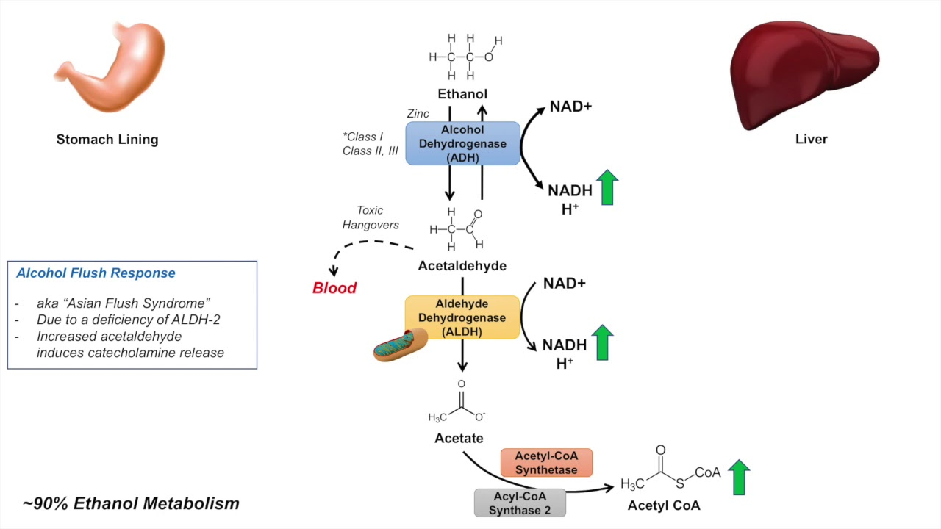
Alcohol metabolism
Absorbed across stomach/GI tract, taken to liver across hepatic portal system
Again, in smooth ER
converts ETOH to acetaldehyde by enzymatic reactions:
CYP 2E1
Alcohol dehydrogenase
Catalase
This generates reactive O2 species – toxic – cause DNA + protein damage
NAD+ reacts with alcohol, producing NADH – recap Krebs Cycle….leads to increased fatty acid synthesis→ stored in liver, leading to fatty liver
Acetaldehyde can also form adducts with other cells, presenting on cell membranes and activate the immune system
Protective mechanisms?
Glutathione in liver can convert reactive O2 species into less toxic forms
a

Slide 34
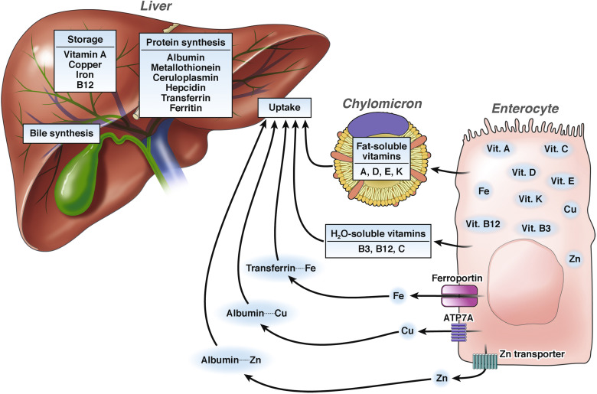
Liver storage – Vitamins & minerals
The liver stores vitamin A, D, E, K (fat-soluble) and B12 (water soluble).
Being fat soluble makes bile essential for their absorption. If bile production is compromised by liver damage, the proper absorption of these vitamins may be affected.
Vitamin A: 50-70% total; stored in stellate cells
Vitamin D: minor site (most of it is in adipose tissue); stored in hepatocytes
Vitamin E: 1/3 of the total - in hepatocyte mitochondria
Vitamin K: mostly stored in the liver; small reserve, rapidly depleted (over days);
Vitamin B12: 50% of the total body stores is in hepatocytes
Iron – usually stored in hepatocytes as ferritin) (in excess) as haemosiderin
Copper ~1/3 of the total body reserve is stored in hepatocytes as complexes with proteins
Notes:
From https://www.cmghjournal.org/article/S2352-345X(18)30117-6/fulltext

Slide 35
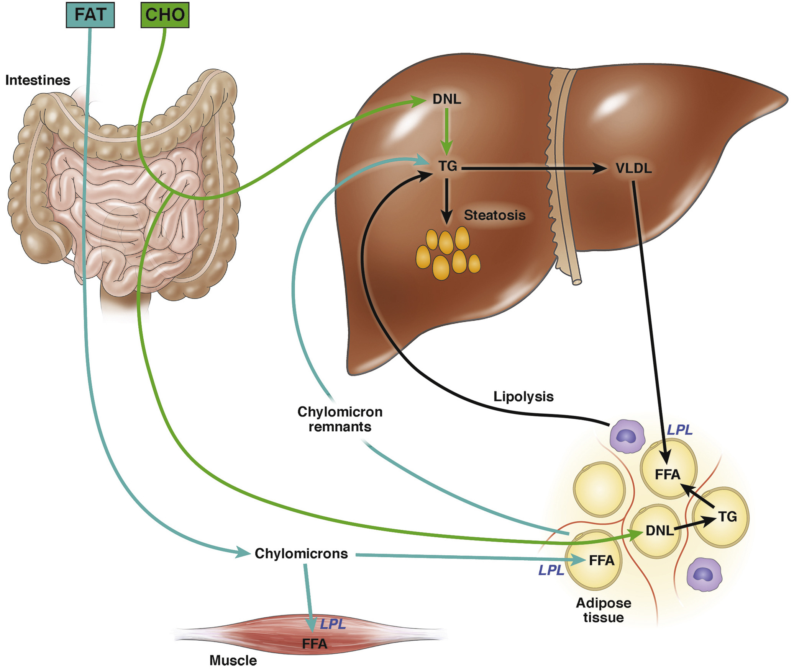
Liver storage – fat
Triglyceride – created from excess glucose when carbohydrate intake exceeds normal glycogen storage capacity
*in impaired lipid metabolism, excess fat intake and obesity, excess fat is stored in hepatocytes’ cytoplasm – leading to fatty liver, hepatic steatosis, non-alcoholic fatty liver disease, insulin resistance, cirrhosis, and hepatocellular carcinoma

Slide 36
Any questions?

Slide 37
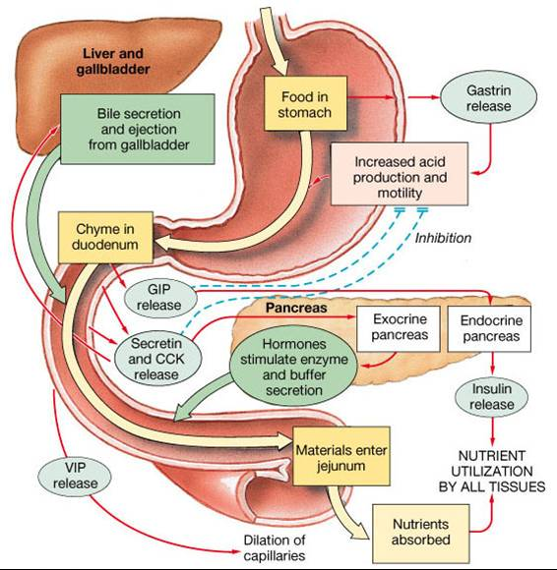
Hormonal regulation of GI secretion

Slide 38
GI secretion
Cephalic stage – 1/3 of secretions – sight, thought, smell, and taste of food
- stimulates structures in cerebral cortex - via efferent vagus fibres, stimulate secretion of HCl and pepsinogen from parietal and chief cells
- if symp. system is activated, it inhibits parasymp effects, and decreases secretion of HCL and pepsin
Gastric stage - 2/3 of all secretion caused by:
distention (stretch) – receptors all around the stomach, stimulate vagus nerve to stimulate secretion of HCl and pepsinogen;
partially digested proteins stimulate release of gastrin
Intestinal stage – secretion of intestinal gastrin → stimulate secretion of HCl and pepsinogen

Slide 39
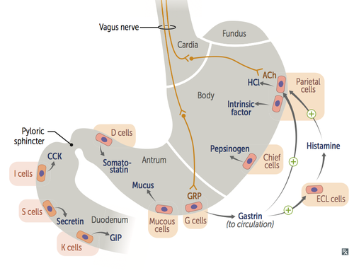
Gastrin
Hormone secreted by antral G cells in gastric glands – in response to proteins, gut distension, gastrin-releasing peptide (vagal stimulation
How does gastrin work?
travels in blood stream to parietal cells, causing H+ secretion
it binds to CCK-2 receptors on parietal cells, activating, and inducing insertion of the H+/K+ ATPases. These pump out H+ into the stomach lumen in exchange for K+ (‘Proton pumps’)
it binds to CCK-1 receptors on chief cells, causing release of pepsinogen into stomach lumen → converted into pepsin in presence of H+
Binds to smooth muscle receptors to increase stomach motility during digestion
INHIBITED by Symp NS, CCK, secretin, and somatostatin (in v low pH/high H+)

Slide 40
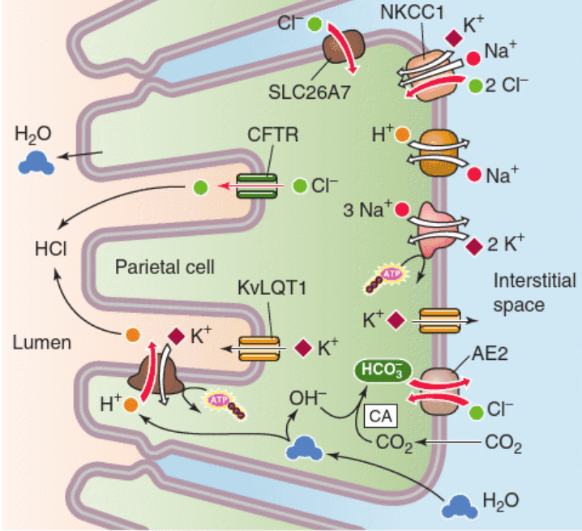
Parietal cell HCl production
Notes:
From Medical Physiology, Boulpaep et al.

Slide 41
Clinical relevance?
Peptic ulcers are a common presentation in clinical practice.
A frequently prescribed medication is omeprazole – a proton pump inhibitor – which works (as stated!) by inhibiting proton pumps – the H+/K+-ATPases in parietal cells
Taking omeprazole for more than a year may increase certain side effects, including: bone fractures, gut infections, vitamin B12 deficiency – symptoms include feeling very tired, a sore and red tongue, mouth ulcers and pins and needles.
Why B12 deficiency? Potential to damage parietal cells → Reduced secretion of intrinsic factor, which is needed for B12 absorption in the terminal ileum.

Slide 42
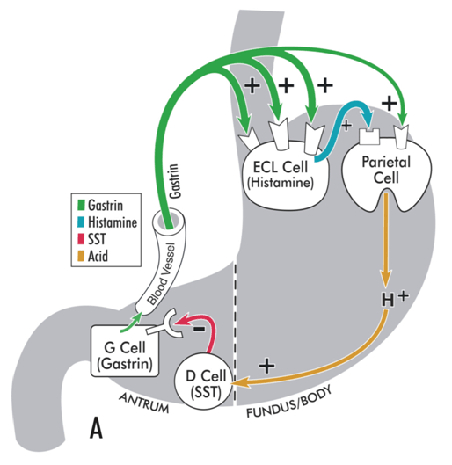
Somatostatin
released from antral D cells – they are chemoreceptors, which detect when stomach pH is very low (high H+ levels) and secrete somatostatin.
Somatostatin binds with receptors on antral G cells and INHIBITS secretion of gastrin;
- Binds to SST receptors on parietal cells and inhibits proton pumps
Clinical relevance? Studies show that low SST levels found in H.pylori infections = raised acid production

Slide 43
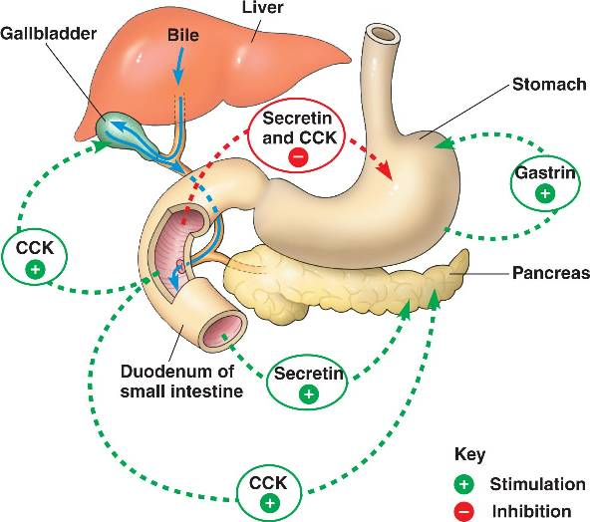
CCK – cholecystokinin
*Think ‘gallbladder’!*
Secreted by duodenal I-cells in response to high chyme conc. of fats, proteins, and glucose.
Binds with receptors on parietal cells, INHIBITING proton pump → reduced H+ release
Stimulates contraction of gallbladder → ejects out concentrated bile
Stimulates secretion of pancreatic enzymes
Enhances effect of secretin by binding to liver – bile synthesis
Stimulates Sphincter of Oddi to relax → bile, bicarb etc flow into duodenum
Relaxes stomach muscles/delays gastric emptying – paces release of chyme into the duodenum
CCK also acts on D cells – indirectly inhibits gastrin by stimulating somatostatin production

Slide 44
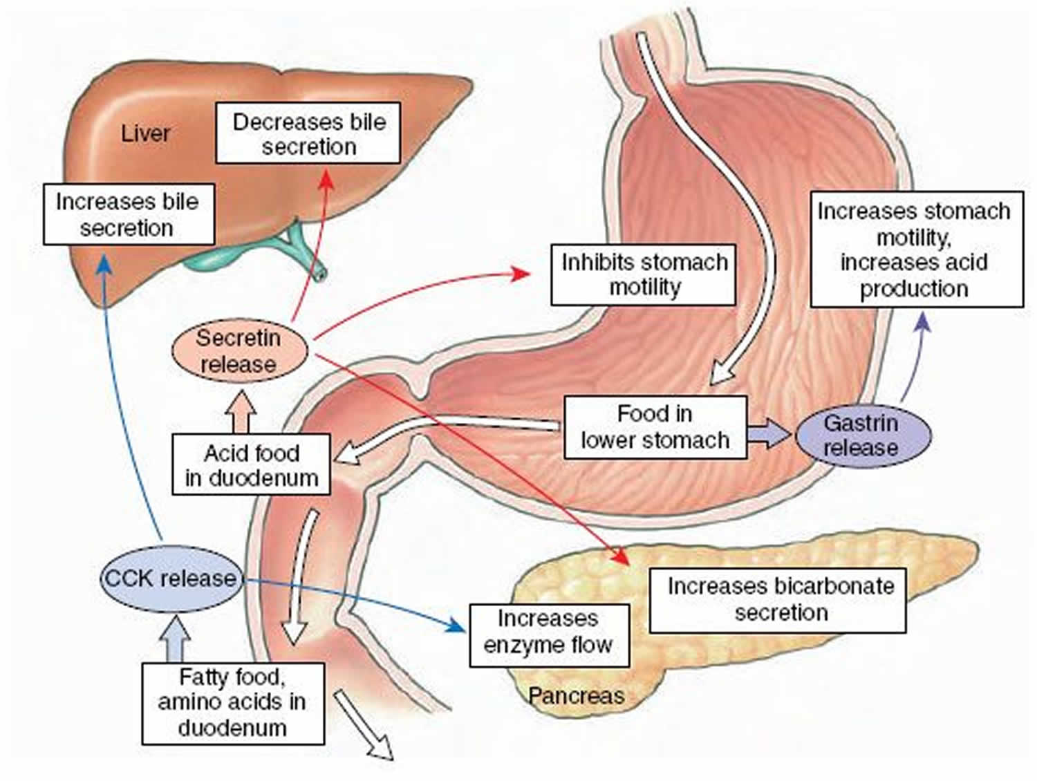
Secretin
Released by duodenal S-cells in response to partially digested proteins in chyme
Inhibits secretion of gastrin by antral G cells
Stimulates pancreas to release bicarbonate
Stimulates liver to convert cholesterol to bile acids

Slide 45
Any questions?

Slide 46
Practice SBA Questions

Slide 47
1. Hepatic acini can be split into three zones. Which of the following statements is true?
A. Zone 1 is the most susceptible to ischemic injury (due to lack of oxygen)
B. Zone 2 is where most of gluconeogenesis takes place
C. Zone 3 is the most highly oxygenated zone
D. Zone 1 is the most susceptible to infection
E. Zone 2 is the most highly oxygenated zone

Slide 48
1. Hepatic acini can be split into three zones. Which of the following statements is true?
A. Zone 1 is the most susceptible to ischemic injury (due to lack of oxygen)
B. Zone 2 is where most of gluconeogenesis takes place
C. Zone 3 is the most highly oxygenated zone
D. Zone 1 is the most susceptible to infection
E. Zone 2 is the most highly oxygenated zone
Hepatic acini have a central vein surrounded by small portal triads (each consisting of a bile duct, a portal vein, and a hepatic artery)
Arteries carry oxygenated blood - Zone 1 is closest, and the most oxygenated = least susceptible to ischemic injury. The large amounts of oxygen also make Zone 1 the area that performs most of the gluconeogenesis.
Zone 1 is where blood first enters the acinus, carrying the “most dirty” blood, and therefore, is the most susceptible to infection.

Slide 49
2. A 24-year-old woman had an endoscopy for suspected gastritis. The endoscopy reached the gastro oesophageal junction (GOJ) and entered the stomach. Which of the regions of the stomach is closest to the GOJ?
A. Body
B. Fundus
C. Cardia
D. Pyloric antrum
E. Pyloric canal

Slide 50
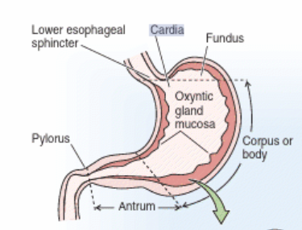
2. A 24-year-old woman underwent endoscopy for suspected gastritis. The endoscopy reached the gastro oesophageal junction (GOJ) and entered the stomach. Which of the regions of the stomach is closest to the GOJ?
A. Body
B. Fundus
C. Cardia
D. Pyloric antrum
E. Pyloric canal
Notes:
Image – Boulpaep, Medical Physiology

Slide 51
3. Which of these surface markings coincides with the position of the appendix?
a) Umbilicus
b) Transpyloric plane of Addison
c) Midaxillary line
d) McBurney’s point
e) Subcostal plane

Slide 52
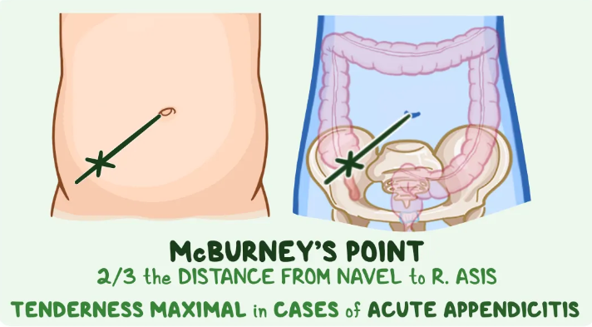
3. Which of these surface markings coincides with the position of the appendix?
a) Umbilicus
b) Transpyloric plane of Addison
c) Midaxillary line
d) McBurney’s point
e) Subcostal plane
Explanation:
The appendix lies at McBurney’s point, which is 2/3rds of the distance from the umbilicus to the right anterior superior iliac spine
Notes:
Image copyright: https://www.osmosis.org/answers/mcburneys-point

Slide 53
4. What hormone stimulates the release of bile from the gallbladder?
A. Gastrin
B. Somastatin
C. CCK
D. Glucagon
E. Testosterone

Slide 54
4. What hormone stimulates the release of bile from the gallbladder?
A. Gastrin
B. Somastatin
C. CCK
D. Glucagon
E. Testosterone

Slide 55
5. Which of the following would most likely be found in the oesophagus of a patient suffering from gastrooesophageal reflux disease?
A. Pepsin
B. Trypsin
C. Chymotrypsin
D. Carboxypeptidase
E. Peyers patches

Slide 56
5. Which of the following would most likely be found in the oesophagus of a patient suffering from gastrooesophageal reflux disease?
A. Pepsin
B. Trypsin
C. Chymotrypsin
D. Carboxypeptidase
E. Peyers patches
Explanation:
Gastrooesophageal reflux disease is also known as acid reflux, due to the acidity of the stomach contents.
Pepsin is the most likely find, as it is secreted in the stomach by chief cells (as pepsinogen), while the other options are secreted into the small intestine. Peyer’s patches are gut-associated lymphoid tissue in the ileum.

Slide 57
6. Increased stomach pH is the consequence of which of the following?
A. Damage to the mucous cells
B. Increased G cell activity
C. Inhibition of parietal cells
D. Overexpression by chief cells
E. Overexpression of parietal cells

Slide 58
6. Increased stomach pH is the consequence of which of the following?
A. Damage to the mucous cells
B. Increased G cell activity
C. Inhibition of parietal cells
D. Overexpression by chief cells
E. Overexpression of parietal cells
Explanation:
pH increases as a solution becomes less acidic and more basic/alkaline.
Mucous helps protect the stomach from acid damage, but does not change the pH.
Parietal cells secrete hydrochloric acid, which increases the [H+] of the stomach. Inhibiting these cells would increase the pH.

Slide 59
7. A patient presents with abdominal pain. Their test results come back showing normal levels of pancreatic enzymes and pepsinogen. Stomach and gall bladder motility are also normal, but they have a very acidic small intestine environment. Which hormone is out of balance?
A. Leptin
B. Cholecystokinin
C. Gastrin
D. Secretin
E. Oestrogen

Slide 60
7. A patient presents with abdominal pain. Their test results come back showing normal levels of pancreatic enzymes and pepsinogen. Stomach and gall bladder motility are also normal, but they have a very acidic small intestine environment. Which hormone is out of balance?
A. Leptin
B. Cholecystokinin
C. Gastrin
D. Secretin
E. Oestrogen
Explanation:
The digestive system is controlled by a cascade of hormones that either trigger or inhibit each other, controlling digestion.
Gastrin is secreted in the stomach and has a number of functions, including: stimulation of parietal cells, stomach motility and cholecystokinin release, among others.
Secretin triggers the release of pancreatic bicarbonate, which protects the small intestine from the acidity of the stomach contents.
If the chyme in the small intestine remains acidic, secretin must not be functioning at normal levels, so is out of balance.

Slide 61
Any final questions?

Slide 62
Conclusion
Today, we looked at:
Innervation of the GI tract
GI anatomy
Liver storage and detox
Hormonal regulation of gastric secretion

Slide 63
Feedback
Please scan the QR code to fill out the feedback form
Notes:
https://docs.google.com/forms/d/1DxQDBhxDGZdny6zrbTD8AeiEt5pZi21sD9dPf-rdos0/edit

Slide 64
