Slide 1
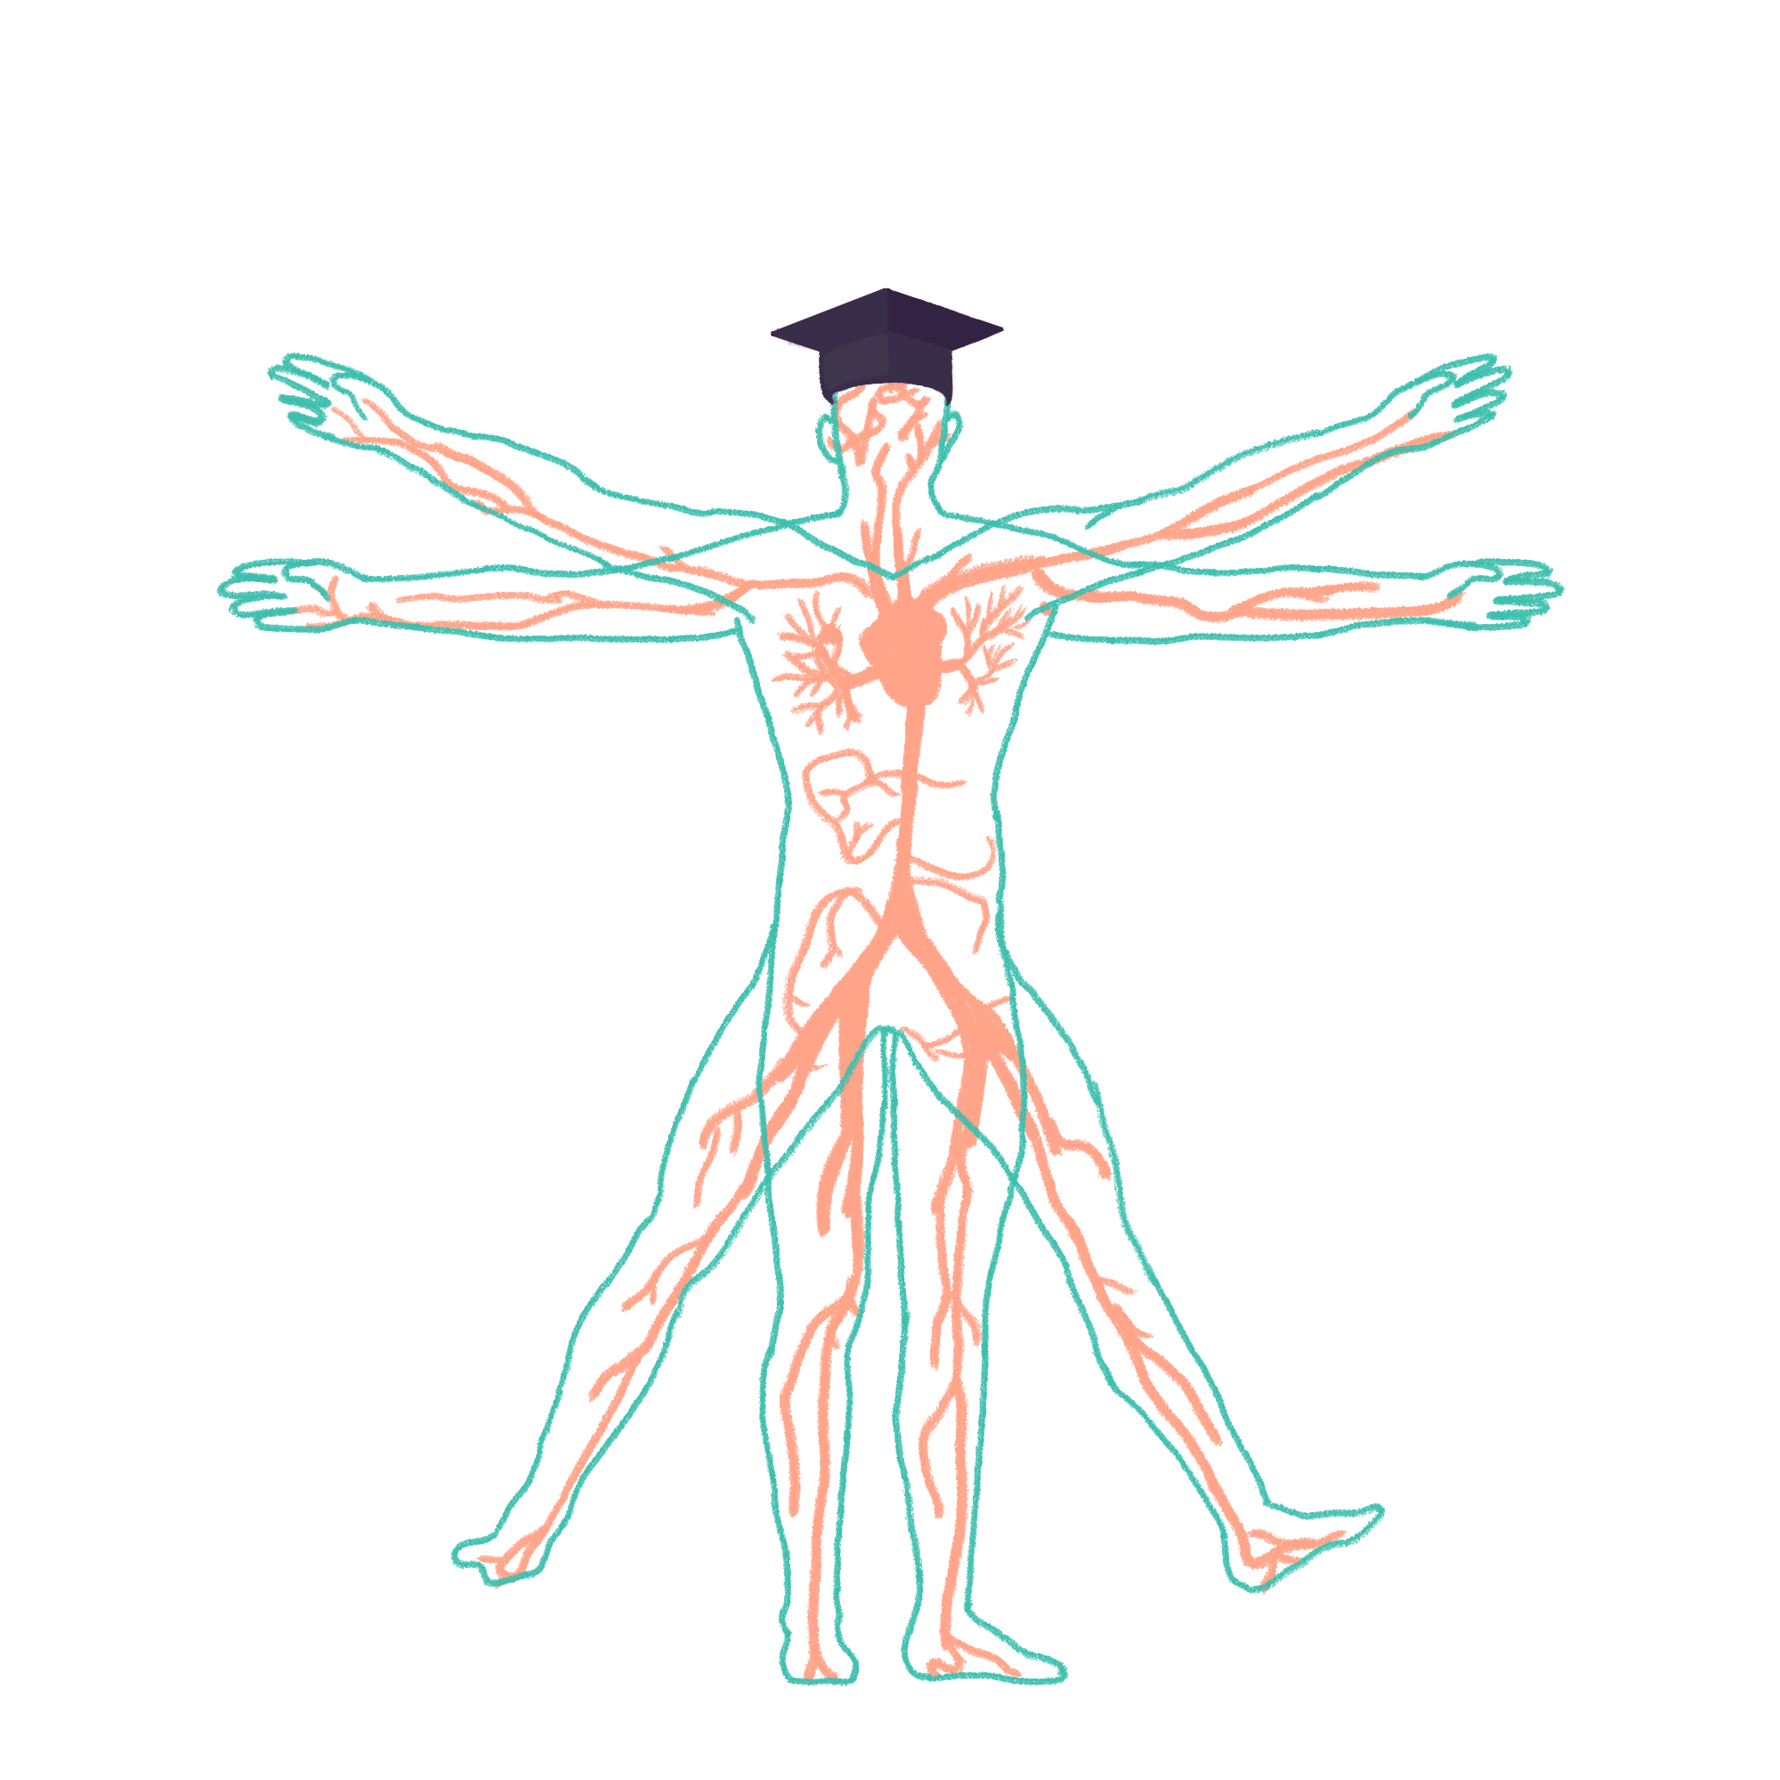
2022/2023

Slide 2
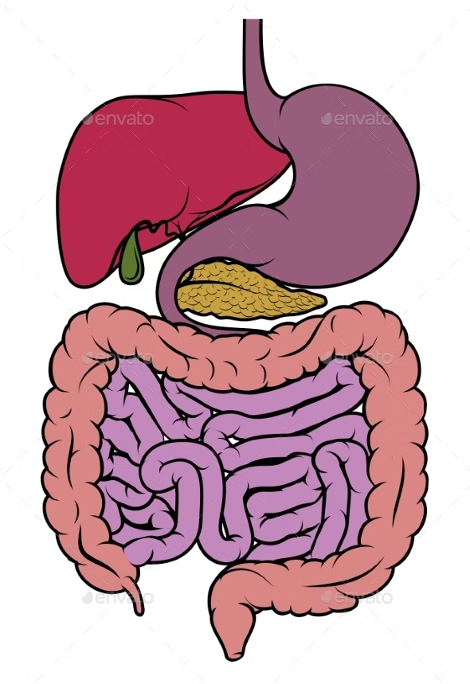
GI examination
Phase 2b Revision Session
Adya Ranjan and Priyanka Bhakta
21/7/22 6pm
The Peer Teaching Society is not liable for false or misleading information…

Slide 3
Aims and Objectives
To go through the GI Examination in a step-by-step manner
Introduction
End-of-bed Inspection
Hands
Forearm and Axila
Face
Neck
7. Chest
8. Abdomen
9. Legs
10.Completing the examination(ISHRUG)
11. Tips
The Peer Teaching Society is not liable for false or misleading information…

Slide 4
Introduction(Applies to most examinations)
Wash hand and clean stethoscope(1 mark)
Hello, My name is X and I am X yr medical student. I have been asked to do an examination of your abdomen today.
Can I confirm your name, DOB and how old does that make you?
This will involve me having a general look at you, having a press of your stomach and hearing your bowel sounds. Does that sound ok with you?
For this examination, I would need you to remove your shirt and expose yourself. Would you want a chaperone?
If at any point during this examination, you feel any pain or would like to stop, feel free to let me know and we will stop.
The Peer Teaching Society is not liable for false or misleading information…
Notes:
For any examination, its important to have a good, slick introduction

Slide 5
Bedside Inspection
Look around bedside for:
Medical Equipment: Stoma bag, feeding tube, monitors, mobility aids
Medication: Inhalers, steroids, any other meds
General inspection of patient:
Body habitus(Build, wasting, obesity)
Scars
Colour(Jaundice,pallor-anaemia)
Perspiration
Abdominal Distension
Masses
Discomfort
Breathing(rate, diaphragmatic or chest wall breathing)
Consciousness level
The Peer Deaching Society is not liable for false or misleading information…

Slide 6
Hands
HANDS:
Colour
Capillary Refill Time
Palmar Erythema and pallor of palmar creases
Temperature
Clubbing
Nails: Koilonychia, Leukonychia
Pulse(Radial)- can say BP to complete
Dupuytren’s contracture
Asterixis
The Peer Teaching Society is not liable for false or misleading information…
Notes:
go down for temp.
question: if you have asterixis, what condition is that indicative of? CO2 retention(liver failure)

Slide 7
Forearm and Axilla
Look at forearms for muscle wasting and signs of itching
Axilla:
Acanthosis Nigricans
Lymphadenopathy
Arm:
Bruising
Scratch marks
Needle track marks
The Peer Teaching Society is not liable for false or misleading information…
Notes:
-pic coming up for Acanthosis Nigricans.
what is Acanthosis Nigricans indicative of? T2DM

Slide 8
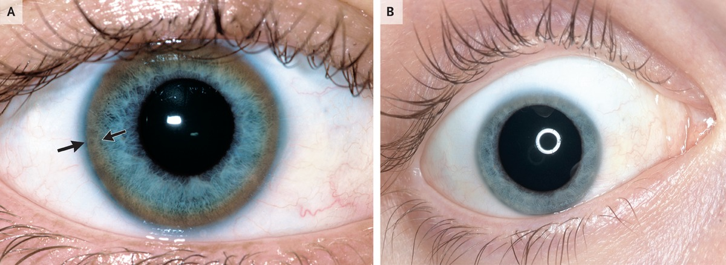
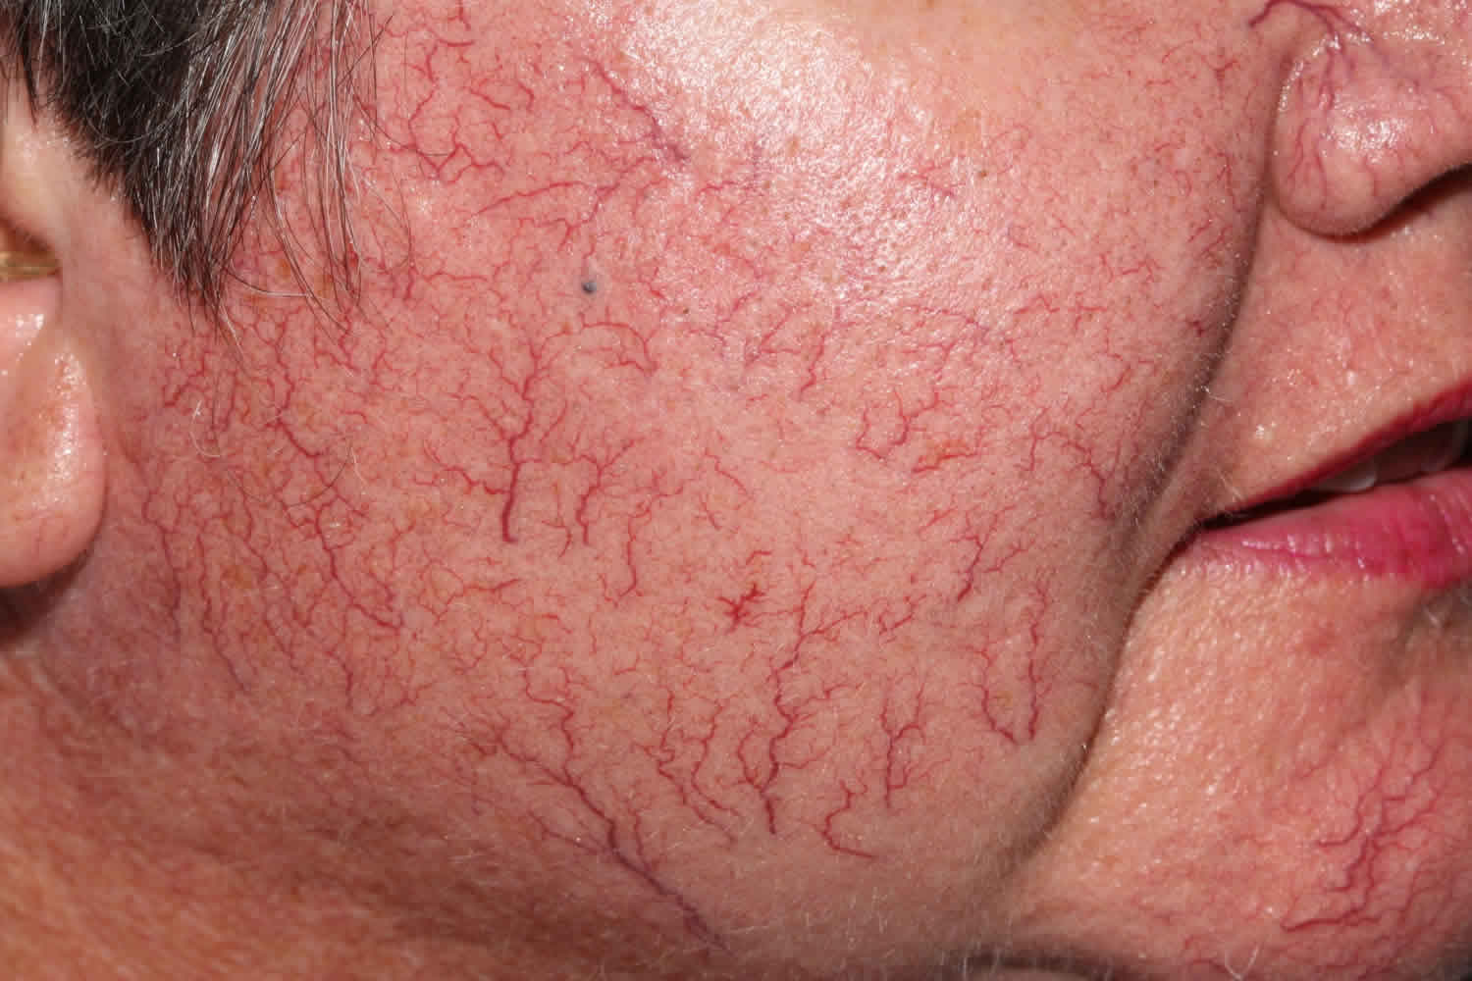
Face
Eyes: Pallor, Kayser-Fleischer rings, Corneal Arcus, Xanthelasma, Jaundice
Mouth: Angular Stomatitis, Glossitis, Oral Candidiasis, Ulcers
General Face Appearance check for:
Telangiectasia
Dehydration
Pigmentation
Halitosis(bad breath)
Ulcers
The Peer Teaching Society is not liable for false or misleading information…
Notes:
which condition is Kayser-Fleischer rings associated with? Wilson’s Disease (excess copper in liver)
-Telangiectasia(spider like veins)

Slide 9
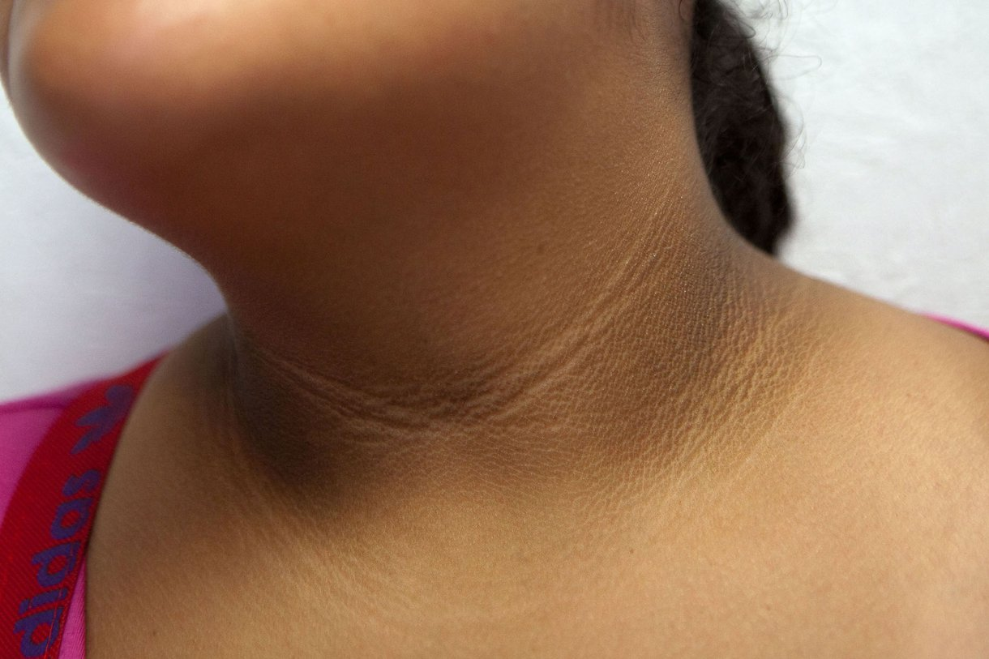
NECK + CHEST
Neck:
Inspection
Acanthosis Nigricans
Palpation
Cervical lymphadenopathy
Virchow’s node - left supraclavicular node
Chest:
Inspection
Spider naevi
Gynaecomastia
Scars
Breathing
Shape and symmetry
The Peer Teaching Society is not liable for false or misleading information…
Notes:
Troisier’s sign is an enlarged left supraclavicular lymph node (Virchow’s node) due to a metastasis from an intra-abdominal malignancy)
gynaecomastia = male breast development may be due to increased oestrogen in liver failure

Slide 10
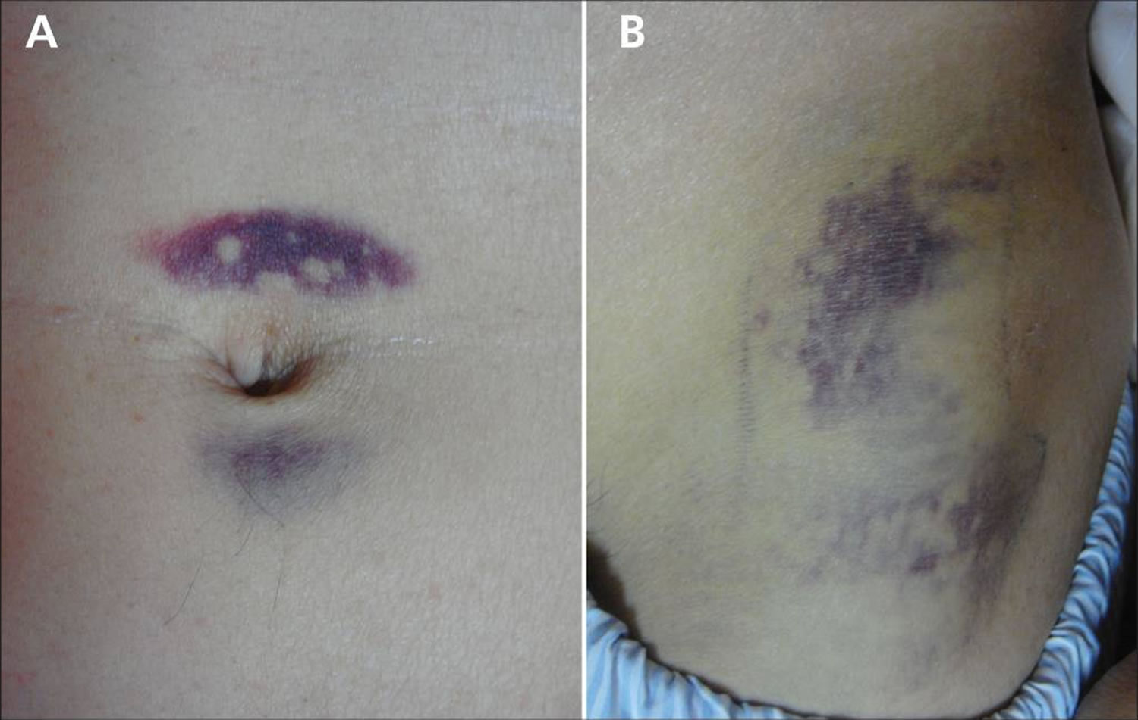
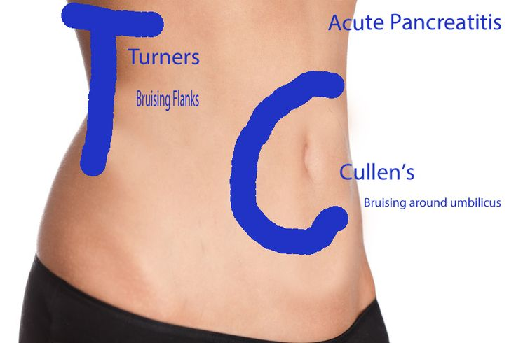
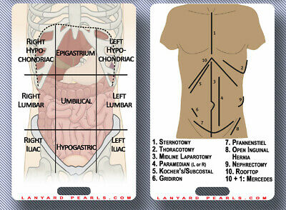
ABDOMEN
Inspection:
Stomas (location, Contents, Consistency, Spout)
Visible swellings or masses
Surgical scars
Striae
Ascites
Caput medusae
Cullen’s sign + Grey Turners Sign
Hernias
5Fs of Abdominal Distension – Flatus, Fluid, Faeces, Fetus, Fat
The Peer Teaching Society is not liable for false or misleading information…
Notes:
striae - sudden weight loss?
Caput medusae is the name for a cluster of swollen veins in your abdomen
Fluid (ascites), Faeces (constipation), Flatus (subacute intestinal obstruction), Foetus (pregnancy), Fat (obesity)
left iliac fossa pain → diverticular disease

Slide 11
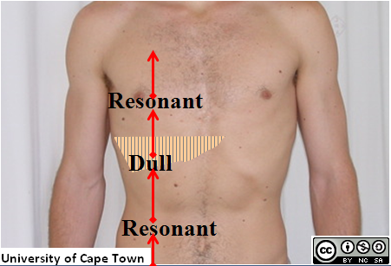
ABDOMEN
Palpation:
Light palpation of 9 regions
Always watch face
Tenderness
Rigidity
Guarding
Deeper palpation
Masses
If the stomach appears distended → succussion splash
Organs
Liver
Spleen
Kidneys
Bladder
Aorta
Murphy’s sign
Percussion:
Liver
Spleen
Bladder
Shifting dullness
Auscultation:
Bowel sounds
Present but abnormal (e.g. tinkling in small intestinal obstruction)
Absent (paralytic ileus e.g. in peritonitis)?
Aortic bruit
The Peer Teaching Society is not liable for false or misleading information…
Notes:
Assess size, surface, shape, edge, consistency, tenderness of any masses
succussion splash (shake the stomach briskly from side to side whilst listening for a sloshing sound)
Murphy's sign is elicited in patients with acute cholecystitis by asking the patient to take in and hold a deep breath while palpating the right subcostal area. If pain occurs on inspiration, when the inflamed gallbladder comes into contact with the examiner's hand, Murphy's sign is positive
An abdominal bruit (palpable murmur) is a swishing, or washing machine like sound heard when the diaphragm of stethoscope is placed over the spleen, renal arteries, or abdominal aorta. It is often indicative of partial occlusion of a vessel, as can be observed in renal artery stenosis or atherosclerosis of the abdominal vasculature.

Slide 12
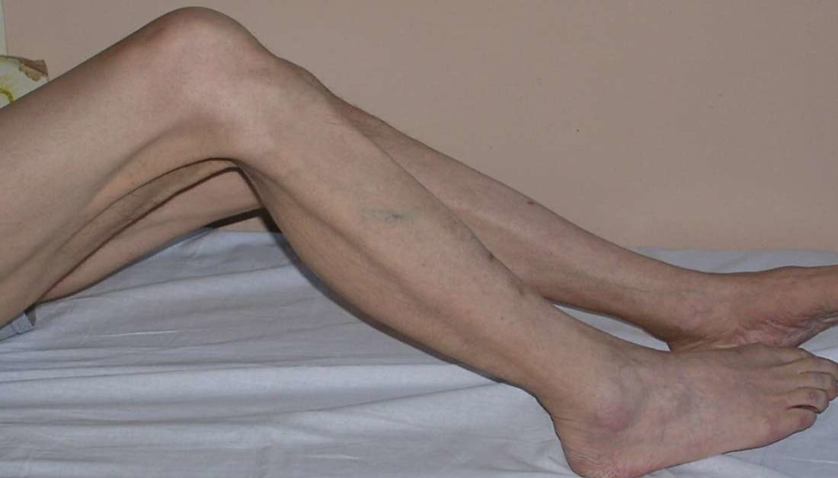
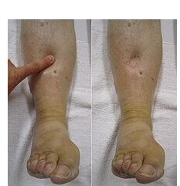
ABDOMEN + LEGS
ABDOMEN
Inspect the back
Scars
Swellings
LEGS
Muscle wastage
Pitting oedema
The Peer Teaching Society is not liable for false or misleading information…

Slide 13
ISHRUG + end remarks
Inguinal lymph nodes
Stools
Hernial orifices (femoral and inguinal)
Rectal examination
Urinalysis
Genitalia
End remarks:
Always thank the patient and ask if they need any help redressing
The Peer Teaching Society is not liable for false or misleading information…
Notes:
always say what you need to complete if not prompted and even if you run out of time, state what you missed

Slide 14
Presenting
ABDOMINAL:
I performed an abdominal examination on ___ who is a ___ year old male/female.
On general inspection, he/she appeared comfortable at rest.
There was no peripheral stigmata of gastrointestinal pathology.
Abdomen was soft and non tender
No evidence of Organomegaly
Bowel sounds were present and normal
In summary, this was a normal abdominal examination.
The Peer Teaching Society is not liable for false or misleading information…

Slide 15
Conclusion
Introduction
End-of-bed Inspection
Hands + Forearm
Face (Eyes + Mouth)
Neck + Chest
Abdomen + Back
Legs (Pitting oedema)
ISHRUG
The Peer Teaching Society is not liable for false or misleading information…

Slide 16
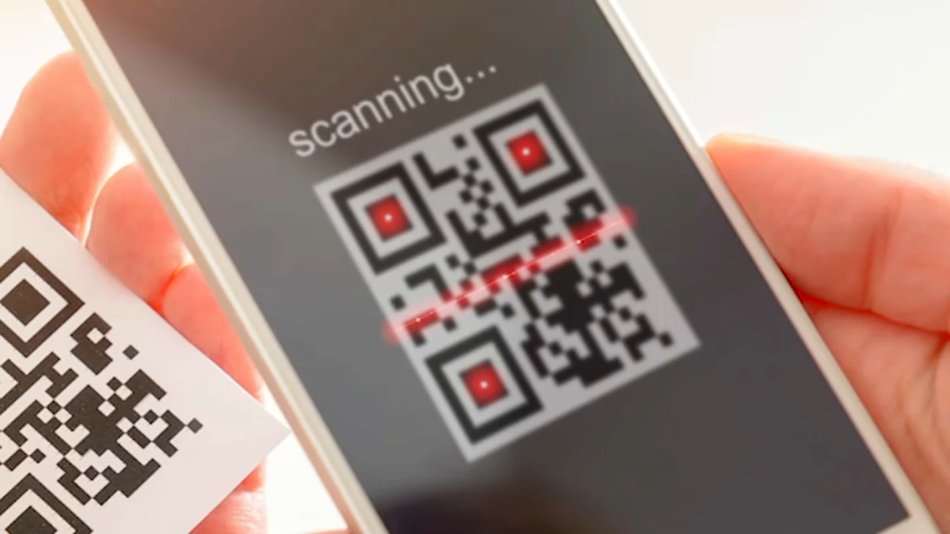
Feedback
https://forms.gle/BDfRAZjWvPgJWJoi9
The Peer Teaching Society is not liable for false or misleading information…

