Slide 1
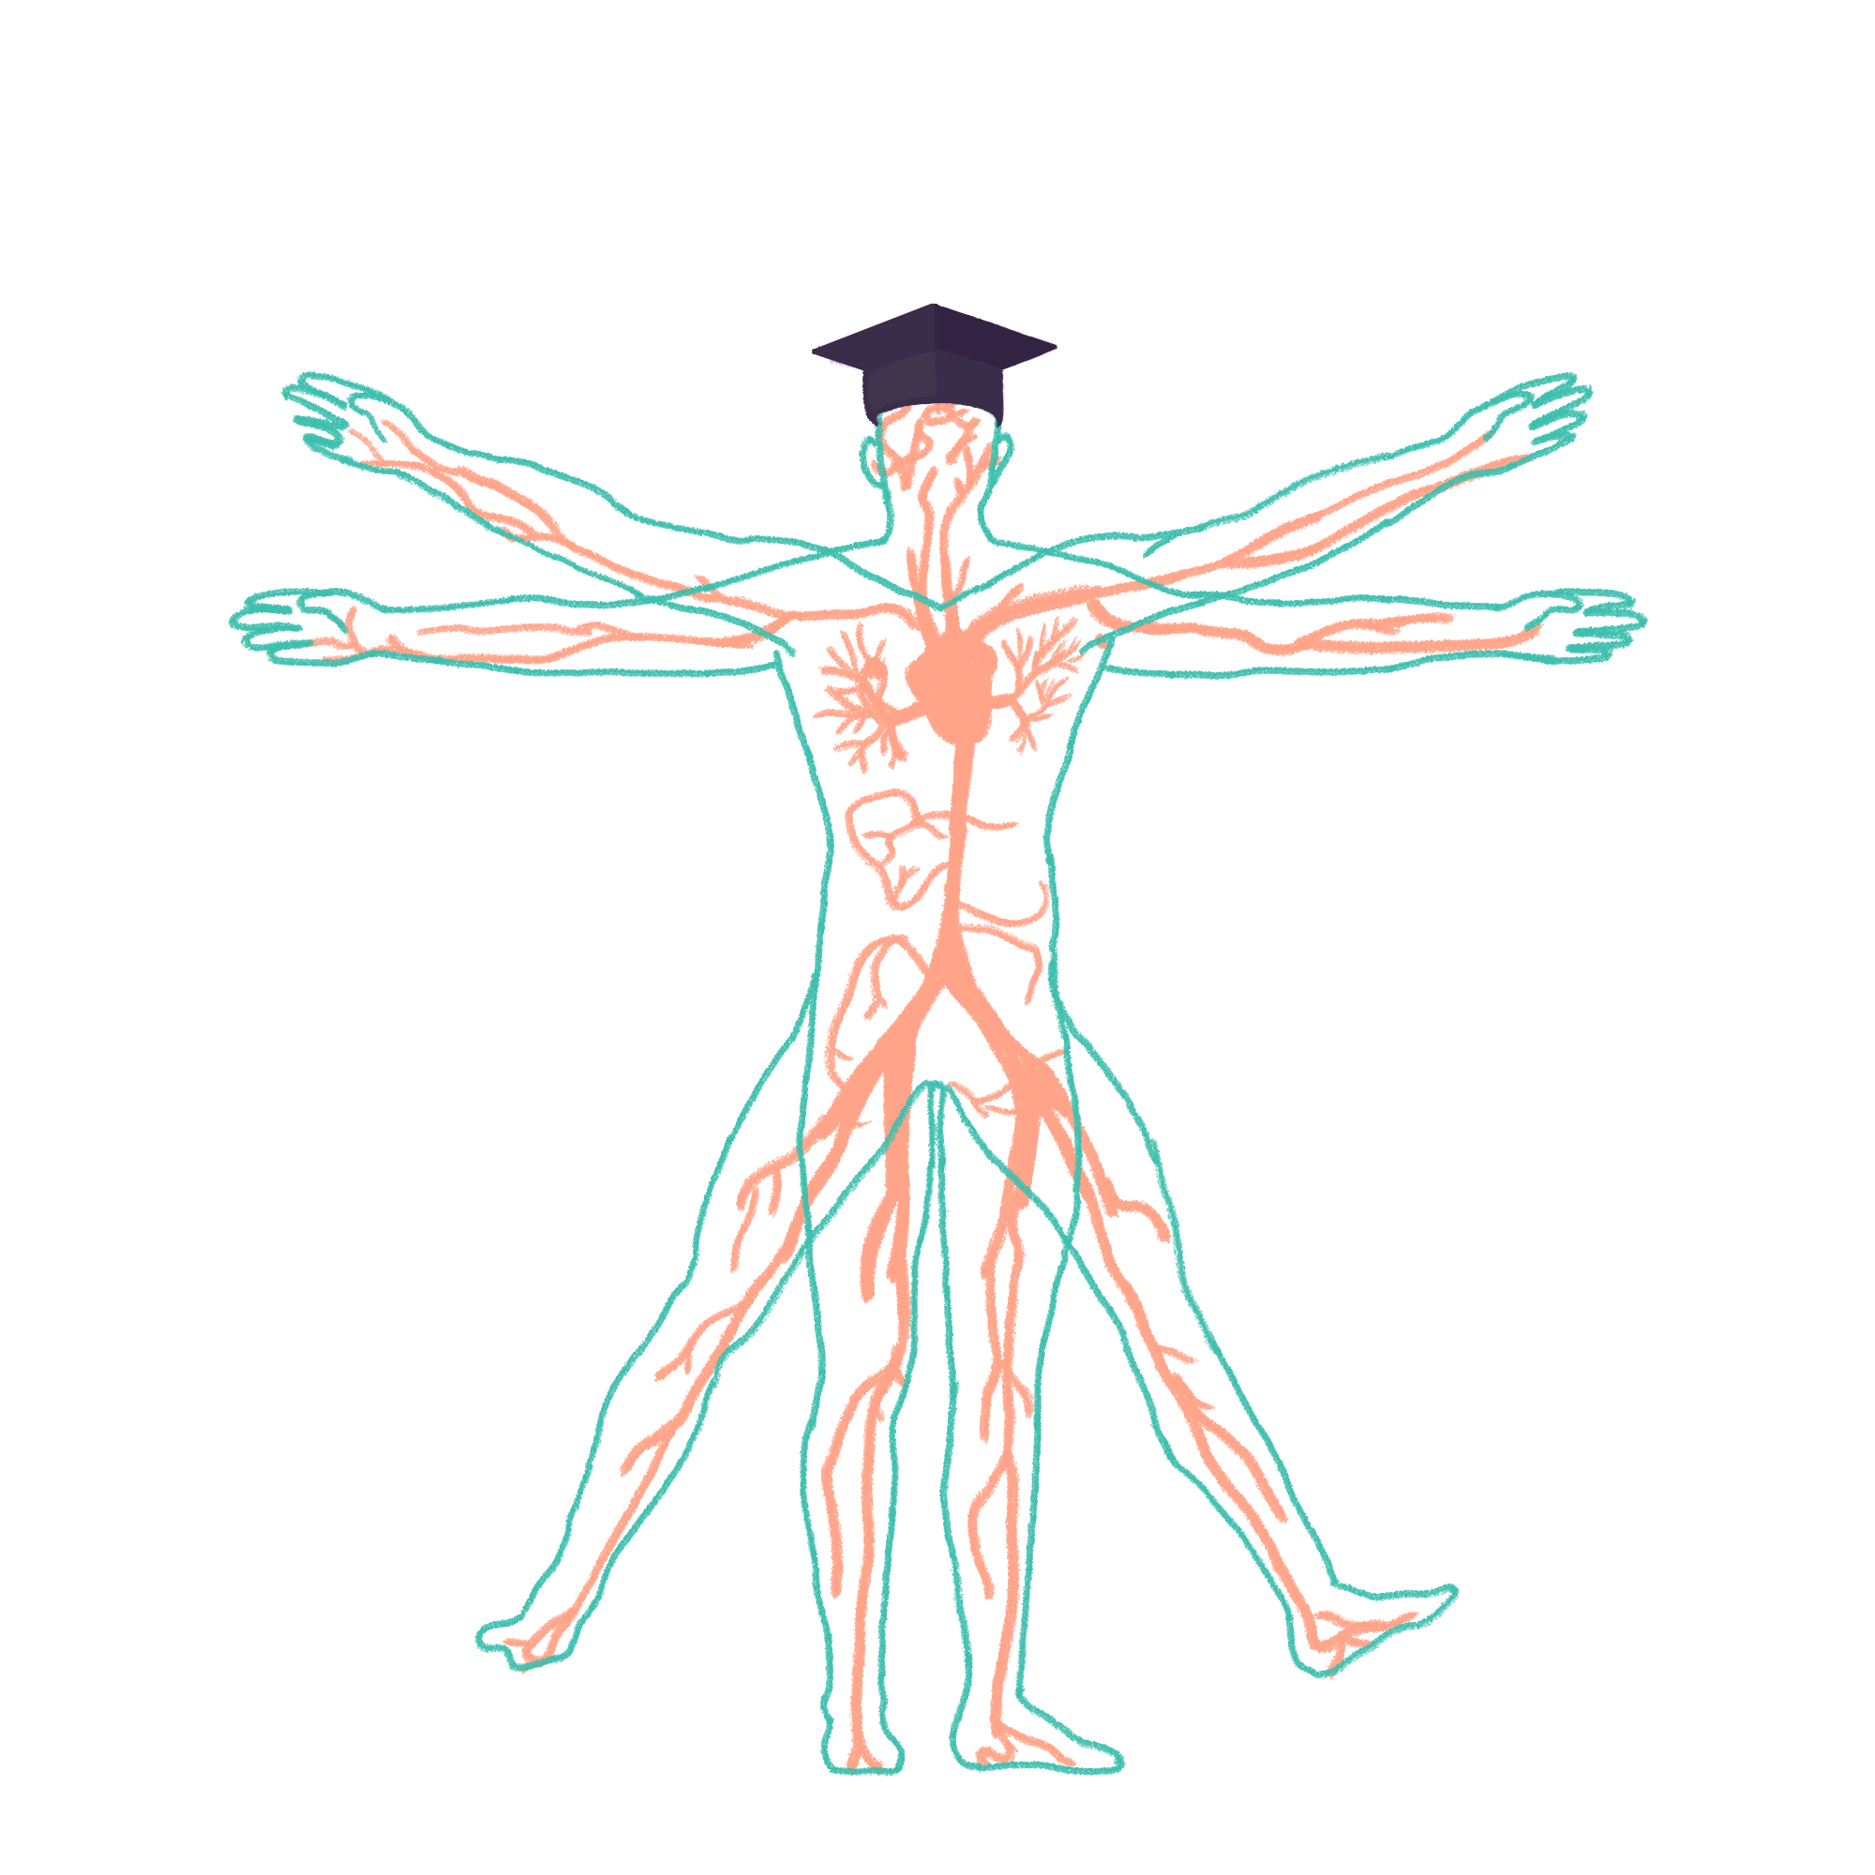
2022/2023

Slide 2
GI Wrap-Up 1
Phase 1 Revision Session
Omar Al-Rubaie
Special thanks to Beth Richards
8/12/2022 / 18:00 – 19:30
The Peer Teaching Society is not liable for false or misleading information…

Slide 3
Aims and Objectives
Anatomy – the structure of the gut, e.g. foregut, midgut, hindgut, blood, and nervous supply, etc.
Swallowing – swallowing reflex, structures, etc.
Anatomy of the abdominal wall
Saliva and Salivary Glands – serous and mucous salivary glands, components of saliva, etc.
The Peer Teaching Society is not liable for false or misleading information…

Slide 4
Anatomy Overview
The GI system is made up of three main sections with blood and nervous supply:
Foregut (coeliac plexus).
Midgut (sup. mesenteric plexus).
Hindgut (inf. mesenteric plexus).
The Peer Teaching Society is not liable for false or misleading information…
Notes:
Coeliac plexus
Greater splanchnic nerve, T5-T9
Parasympathetic from vagal trunks (coeliac plexus)
Superior mesenteric plexus
Lesser splanchnic nerve, T10-T11
Parasympathetic from vagal trunks (superior mesenteric plexus)
Inferior mesenteric plexus
Least splanchnic nerve (T12)
Parasympathetic from sacral outflow/pelvic splanchnic

Slide 5
Anatomy: Foregut
Composed of the:
Mouth.
Oesophagus.
Stomach.
Duodenum.
Lower blood supply via the coeliac trunk.
Nervous supply by the coeliac plexus.
The Peer Teaching Society is not liable for false or misleading information…
Notes:
Coeliac plexus
Greater splanchnic nerve, T5-T9
Parasympathetic from vagal trunks (coeliac plexus)

Slide 6
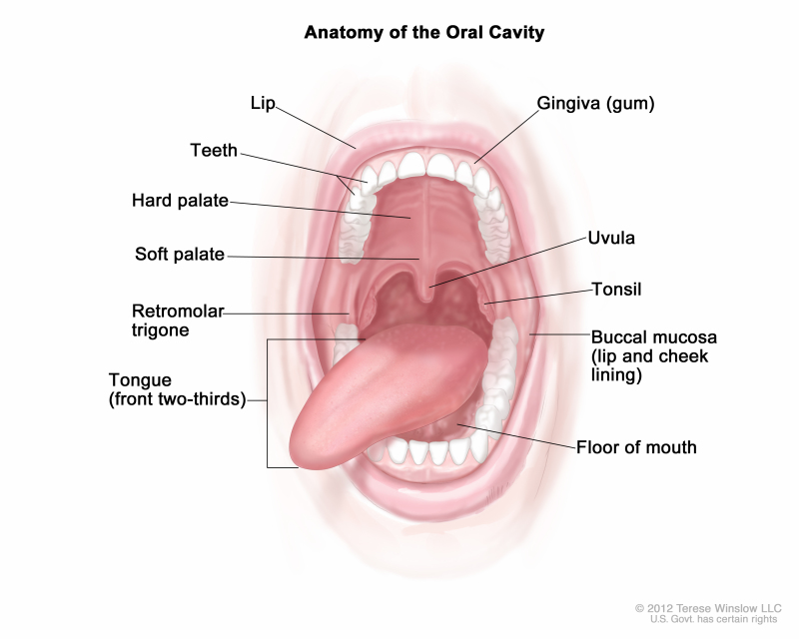
Anatomy: Mouth
The mouth or oral cavity is where mastication and bolus formation occurs.
Food is mixed with saliva and digestion starts.
The Peer Teaching Society is not liable for false or misleading information…

Slide 7
Anatomy: Oesophagus
Connects the pharynx to the stomach, a bolus of food is moved down it either via gravity or through peristaltic waves.
Made up of stratified squamous epithelium.
The Peer Teaching Society is not liable for false or misleading information…

Slide 8
Anatomy: Stomach
Stomach structures can be seen to the right.
Nervous supply:
Parasympathetic (anterior and posterior vagal trunks).
Sympathetic (greater splanchnic nerve).
The Peer Teaching Society is not liable for false or misleading information…

Slide 9
Anatomy: Duodenum
The foregut includes the first part of the duodenum up to the major duodenal papilla.
The duodenum is C-shaped and has 4 parts.
The mucosa is initially smooth, whereas in the rest has plicae circulares.
The Peer Teaching Society is not liable for false or misleading information…
Notes:
The major duodenal papilla is a small opening that enters into the first portion of the small intestine, known as the duodenum. It is the spot where the pancreatic and bile ducts release their secretions into the intestines. The flow is controlled by the sphincter of Oddi. Plicae circulares are present throughout the small intestine except in the first portion, or bulb, of the duodenum.

Slide 10
Anatomy: Midgut
The midgut is composed of the rest of the duodenum up to part way through the transverse colon.
The blood supply is through the superior mesenteric artery and vein. Nerve supply via the superior mesenteric plexus and sympathetic innervation through the lesser splanchnic nerve.
The Peer Teaching Society is not liable for false or misleading information…

Slide 11
Anatomy: Jejunum
The jejunum is the middle part of the small intestines and its primary function is to absorb sugar, amino acids, and fatty acids.
Its mucosa is lined with simple columnar epithelium with crypts of Lieberkühn (glands) and villi.
The Peer Teaching Society is not liable for false or misleading information…
Notes:
Crypts of Lieberkühn are glands that secrete intestinal juices.

Slide 12
Anatomy: Ileum
The ileum is the last part of the small intestines and connects to the cecum. It absorbs any final nutrients, especially vitamin B12 and bile acids.
It is composed of simple columnar epithelium and the highest concentration of Peyers patches.
The Peer Teaching Society is not liable for false or misleading information…
Notes:
Peyer's patches are small masses of lymphatic tissue found throughout the ileum region of the small intestine. Also known as aggregated lymphoid nodules, they form an important part of the immune system by monitoring intestinal bacteria populations and preventing the growth of pathogenic bacteria in the intestines.
Jejunal arteries tend to be slightly larger than ileal, but the number of arterial arcades in the ileum is greater. Ileal arteriae/vasa recta are more numerous, shorter and narrower than in the jejunum.

Slide 13
Anatomy: Cecum
The cecum is the first part of the large intestines and it connects the large intestines to the small intestines.
It is supplied by the cecal artery which is a branch of the ileocolic artery (still a branch of the superior mesenteric artery).
The Peer Teaching Society is not liable for false or misleading information…

Slide 14
Anatomy: Appendix
The appendix is different from the rest of the colon in that it lacks:
Taeniae.
Haustra.
Semilunar folds.
Appendices epiploicae.
The Peer Teaching Society is not liable for false or misleading information…
Notes:
Teniae coli are three approximately 8-mm-wide longitudinal smooth muscle bands in the colon wall.
The haustra of the colon (singular haustrum) are the small pouches caused by sacculation, which give the colon its segmented appearance.
Semilunar folds arise in the inner surface through muscle contractions. These are merely caused functionally and therefore movable. These folds form pouches on the external surface (haustra).
Appendices epiploicae are adipose structures protruding from the serosal (outside) surface of the colon.

Slide 15
Anatomy: Colon
The ascending and and proximal 2/3 of the transverse colon are part of the midgut. Its function is to absorb water and electrolytes.
The colon is supported by peritoneal folds called mesentery.
Right\Middle colic arteries.
The Peer Teaching Society is not liable for false or misleading information…

Slide 16
Anatomy: Hindgut
The hindgut is the final part of the GI tract. Its blood supply is via the left colic and sigmoid artery branches of the inferior mesenteric artery. Ends with the rectum.
Its sympathetic nervous supply is via the least splanchnic nerve (inferior mesenteric plexus).
The Peer Teaching Society is not liable for false or misleading information…
Notes:
Parasympathetic from sacral outflow/pelvic splanchnic.
The rectum is continuous with the sigmoid colon and extends 13 to 15 cm (5 to 6 inches) to the anus. A muscular sheet called the pelvic diaphragm runs perpendicular to the juncture of the rectum and anal canal and maintains a constriction between these two segments of the large intestine.

Slide 17
Anatomy: Peritoneal
The Peer Teaching Society is not liable for false or misleading information…

Slide 18
Anatomy: Q1
What nerve supplies sympathetic innervation to the ileum?
Superior mesenteric.
Inferior mesenteric.
Lesser splanchnic.
Coracoid plexus.
The Peer Teaching Society is not liable for false or misleading information…

Slide 19
Anatomy: Q1 Answer
What nerve supplies sympathetic innervation to the ileum?
Superior mesenteric.
Inferior mesenteric.
Lesser splanchnic.
Coracoid plexus.
The Peer Teaching Society is not liable for false or misleading information…

Slide 20
Anatomy: Q2
What structure is considered to mark the end of the foregut?
Cystic Artery.
Jejunum.
Major duodenal papilla.
Plicae Circularis.
The Peer Teaching Society is not liable for false or misleading information…

Slide 21
Anatomy: Q2 Answer
What structure is considered to mark the end of the foregut?
Cystic Artery.
Jejunum.
Major duodenal papilla.
Plicae Circularis.
The Peer Teaching Society is not liable for false or misleading information…

Slide 22
Anatomy: Q3
Which of the following is a retroperitoneal organ?
Stomach.
Transverse colon.
Appendix.
Descending colon.
The Peer Teaching Society is not liable for false or misleading information…

Slide 23
Anatomy: Q3 Answer
Which of the following is a retroperitoneal organ?
Stomach.
Transverse colon.
Appendix.
Descending colon.
The Peer Teaching Society is not liable for false or misleading information…

Slide 24
Anatomy: Q4
What artery supplies the main blood supply to the hindgut?
Inferior mesenteric artery.
Superior mesentery artery.
Left colic artery.
Celiac artery.
The Peer Teaching Society is not liable for false or misleading information…

Slide 25
Anatomy: Q4 Answer
What artery supplies the main blood supply to the hindgut?
Inferior mesenteric artery.
Superior mesentery artery.
Left colic artery.
Celiac artery.
The Peer Teaching Society is not liable for false or misleading information…

Slide 26
Swallowing Overview
The swallowing reflex is composed of a serious of tongue, pharyngeal, and laryngeal muscles.
It is necessary to allow the movement of a bolus of food from the oral cavity to the oesophagus without aspiration.
The Peer Teaching Society is not liable for false or misleading information…

Slide 27
Swallowing: Physiology
The swallowing reflux is made up of 3 phases:
Oral (voluntary)
Pharyngeal (involuntary)
Oesophageal (involuntary)
The Peer Teaching Society is not liable for false or misleading information…

Slide 28
Swallowing: Phase 1
The oral phase has two sub-phases:
1. The preparatory phase (chewing, mastication, and sucking). Food also mixes with salvia forming a bolus.
2. The transfer phase where:
The tip of the tongue contracts against the hard palate pushing food to the oropharynx.
The soft palate elevates blocking off the nasopharynx.
The posterior phalangeal wall contracts downwards along with the soft palate.
The tongue contracts closing off the mouth, pushing the bolos fully into the oropharynx.
The Peer Teaching Society is not liable for false or misleading information…

Slide 29
Swallowing: Phase 2
The pharyngeal phase is the first irreversible step:
The airways are sealed off (epiglottis swings down, vocal cords and arytenoids close off larynx).
The larynx moves upwards and outwards, the pharynx widens and shortens.
The upper oesophageal sphincter elevates.
d) Food is quickly pushed into the oesophagus by a wave of muscle contractions (pharyngeal peristalsis).
The Peer Teaching Society is not liable for false or misleading information…

Slide 30
Swallowing: Phase 3
The oesophageal phase starts with the relaxation of the oesophagus and lower oesophageal sphincter.
This enables the bolus to enter the oesophagus then partly enter the stomach via gravity.
Any residual bolus is moved by further peristaltic waves. This is normally the case and takes 1-5 seconds (ph2-3).
The Peer Teaching Society is not liable for false or misleading information…

Slide 31
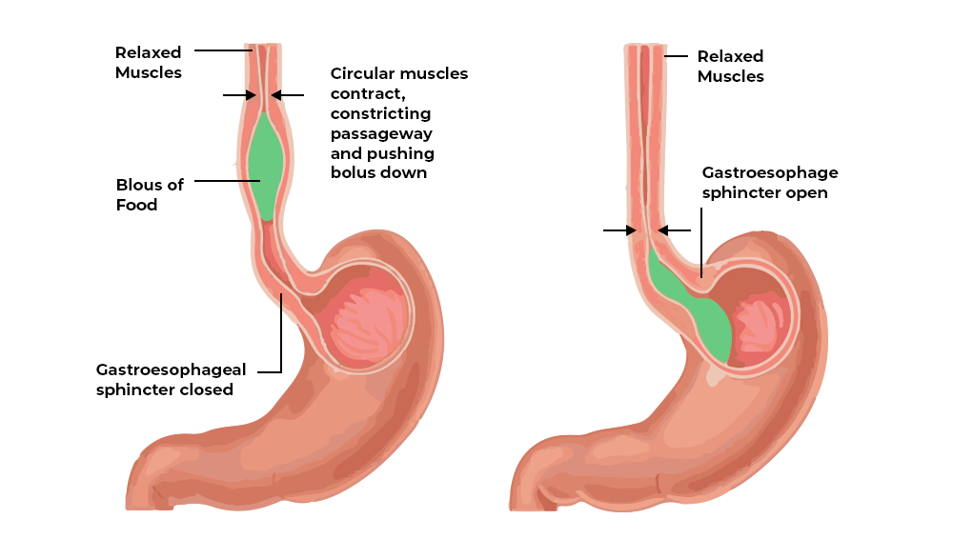
Swallowing: Structures
The Peer Teaching Society is not liable for false or misleading information…

Slide 32
Swallowing: Q1
What are the three physiological phases of swallowing?
a) Oral, Pharyngeal, and Peristaltic.
b) Oral, Pharyngeal, and Oesophageal.
c) Oral, Peristaltic, and Oesophageal.
d) Nasal, Pharyngeal, and Oesophageal
The Peer Teaching Society is not liable for false or misleading information…

Slide 33
Swallowing: Q1 Answer
What are the three physiological phases of swallowing?
a) Oral, Pharyngeal, and Peristaltic.
b) Oral, Pharyngeal, and Oesophageal.
c) Oral, Peristaltic, and Oesophageal.
d) Nasal, Pharyngeal, and Oesophageal
The Peer Teaching Society is not liable for false or misleading information…

Slide 34
Swallowing: Q2
After the oral phase, how long does it take a bolus of food to travel from the oropharynx to the stomach
a) 1-2 seconds.
b) 5-10 seconds.
c) 1-5 seconds.
d) 30-40 seconds.
The Peer Teaching Society is not liable for false or misleading information…

Slide 35
Swallowing: Q2 Answer
After the oral phase, how long does it take a bolus of food to travel from the oropharynx to the stomach
a) 1-2 seconds.
b) 5-10 seconds.
c) 1-5 seconds.
d) 30-40 seconds.
The Peer Teaching Society is not liable for false or misleading information…

Slide 36
Swallowing: Q3
What occurs at the very start of the Oesophageal phase?
a) Peristaltic waves propel the bolus down.
b) The oesophagus and lower oesophageal sphincter relax.
c) The bolus moves via gravity.
d) The stomach begins digesting the food.
The Peer Teaching Society is not liable for false or misleading information…

Slide 37
Swallowing: Q3 Answer
What occurs at the very start of the Oesophageal phase?
a) Peristaltic waves propel the bolus down.
b) The oesophagus and lower oesophageal sphincter relax.
c) The bolus moves via gravity.
d) The stomach begins digesting the food.
The Peer Teaching Society is not liable for false or misleading information…

Slide 38
Swallowing: Q4
What phase of swallowing is voluntary?
a) Oral.
b) Oesophageal.
c) Pharyngeal.
d) Gastric.
The Peer Teaching Society is not liable for false or misleading information…

Slide 39
Swallowing: Q4 Answer
What phase of swallowing is voluntary?
a) Oral.
b) Oesophageal.
c) Pharyngeal.
d) Gastric.
The Peer Teaching Society is not liable for false or misleading information…

Slide 40
Raise hands for a break?
The Peer Teaching Society is not liable for false or misleading information…

Slide 41
GI Wrap-Up 1
Phase 1 Revision Session
Raneem Alhalabi
Part II
The Peer Teaching Society is not liable for false or misleading information…

Slide 42
Abdominal Wall muscles:
3 muscles in the abdominal wall:
What are they? Superficial to deep?
And which of them form an aponeurosis? What is it called?
The Peer Teaching Society is not liable for false or misleading information…

Slide 43
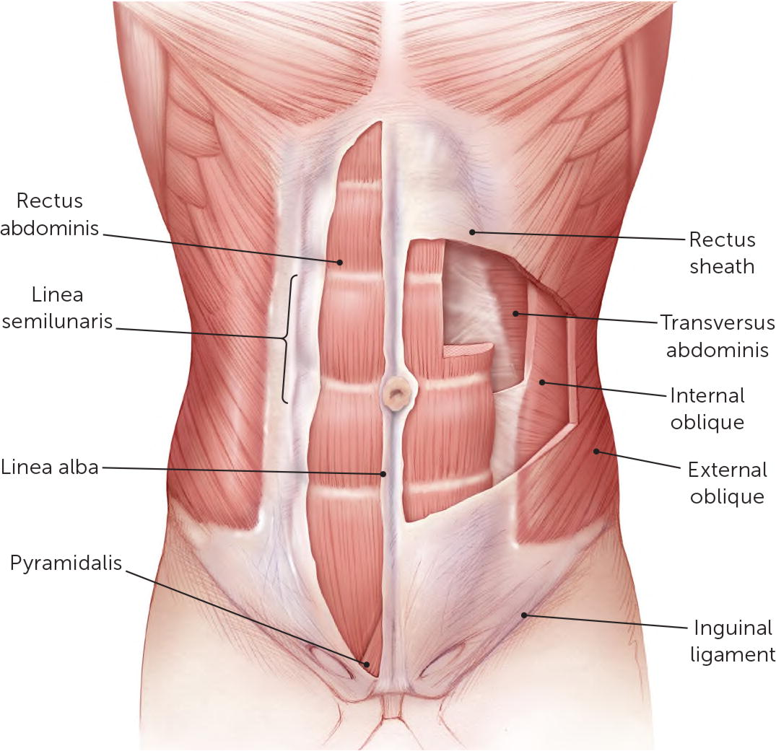
Abdominal wall muscles:
External Oblique:
Fibres run inferiomedially (putting your hand in your pocket)
Internal oblique:
Fibres run superomedially
Transversus abdominis
The Peer Teaching Society is not liable for false or misleading information…

Slide 44
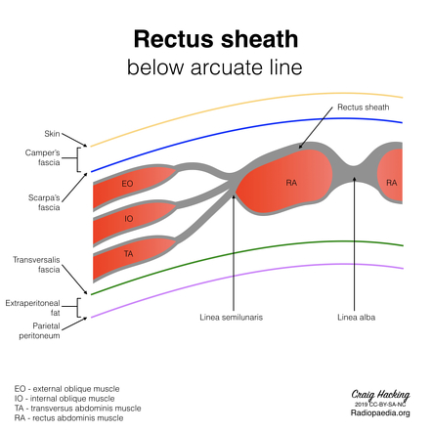
Abdominal wall muscles:
External Oblique:
Fibres run inferiomedially (putting your hand in your pocket)
Internal oblique:
Fibres run superomedially
Transversus abominus
The Peer Teaching Society is not liable for false or misleading information…

Slide 45
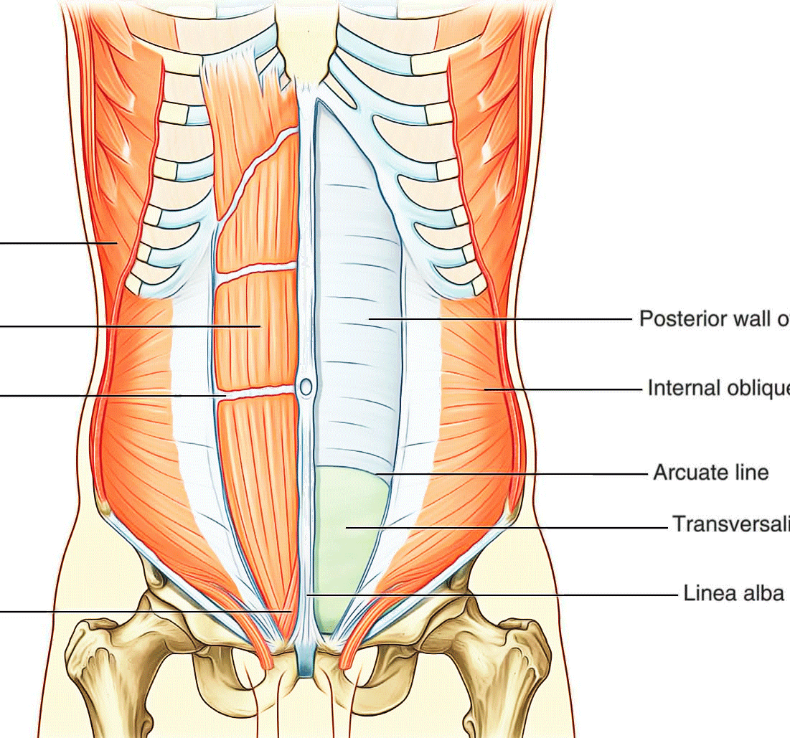
VERY COMMON EXAM QUESTION:
The aponeurosis above and below the arcuate line??
The Peer Teaching Society is not liable for false or misleading information…

Slide 46
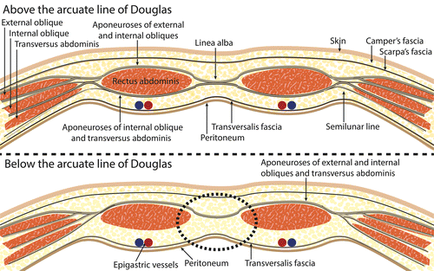
VERY COMMON EXAM QUESTION:
Above arcuate line:
Anterior: external oblique and some of internal oblique
Posterior: some of internal oblique and transversus abdominus
Below the arcuate line:
All fascia lies in front
The Peer Teaching Society is not liable for false or misleading information…

Slide 47
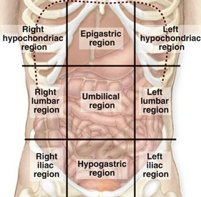
Surface anatomy of the abdomen:
Dividing lines
Vertical
Midclavicular lines
Horizontal
Superior = subcostal plane
Inferior = intercristal plane
The Peer Teaching Society is not liable for false or misleading information…

Slide 48
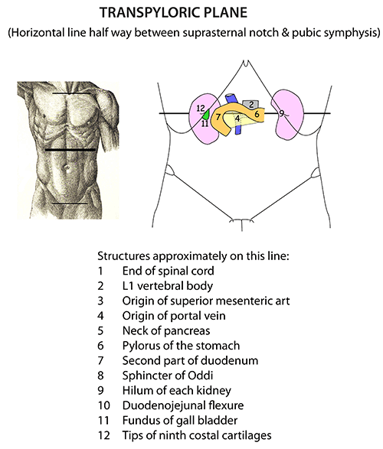
Surface anatomy of the abdomen:
The Peer Teaching Society is not liable for false or misleading information…

Slide 49
Where is McBurney’s point found?
The Peer Teaching Society is not liable for false or misleading information…

Slide 50
Where is McBurney’s point found?
2/3 of the way from the umbilicus to the ASIS. It’s where the appendix is found and where pain is usually felt when it’s severe inflammation.
Remember visceral and parietal!!
The Peer Teaching Society is not liable for false or misleading information…

Slide 51
Saliva and Salivary glands:
Functions:
Lubricant – for mastication
Maintaining oral pH
Begin starch digestion – alpha amylase
Anti-bacterial – Lysozymes
What is the normal pH of the mouth?
The Peer Teaching Society is not liable for false or misleading information…
Notes:
6.2-7.6

Slide 52
Secretions of saliva:
Mucous: mucins for lubrication
Serous: alpha amylase for starch digestion
The Peer Teaching Society is not liable for false or misleading information…

Slide 53
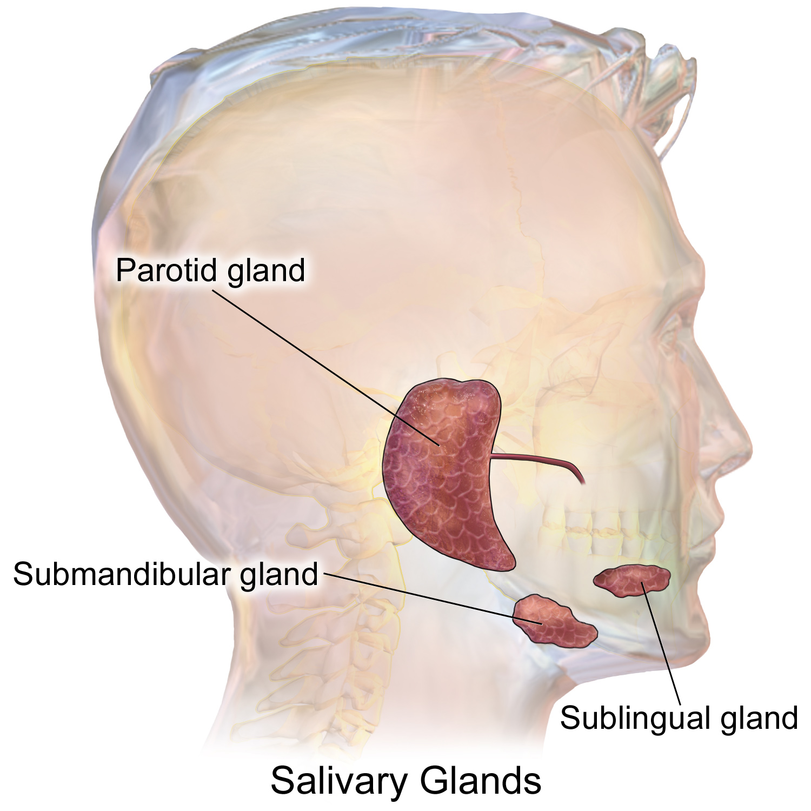
Salivary glands:
1
2
3
The Peer Teaching Society is not liable for false or misleading information…

Slide 54
Salivary glands:
The Peer Teaching Society is not liable for false or misleading information…

Slide 55
Salivary gland secretions:
Parotid gland:
Serous secretion
Submandibular gland:
Mixed secretion
Sublingual glands:
Mucous secretion
The Peer Teaching Society is not liable for false or misleading information…

Slide 56
Salivary gland innervation:
Parasympathetic stimulates saliva production
Sympathetic inhibits saliva production (when you’re anxious you get dry mouth!!)
Parotid: CNIX (glossopharyngeal)
Submandibular: CNVII (facial)
Sublingual: CNVII (facial)
The Peer Teaching Society is not liable for false or misleading information…

Slide 57
Before we move on to the last couple of questions fill out to the feedback form please!!
The Peer Teaching Society is not liable for false or misleading information…
Notes:
https://docs.google.com/forms/d/e/1FAIpQLSfeZjoYjAAwT_U0oXoWD8MeeOvwIJh4_Q9L6bJa0LBlgDBZtQ/viewform?usp=sf_link

Slide 58
Questions:
Which salivary gland has a mainly serous secretion and which nerve innervates it?
The Peer Teaching Society is not liable for false or misleading information…

Slide 59
Questions:
Which salivary gland has a mainly serous secretion and which nerve innervates it?
Parotid gland CN IX
The Peer Teaching Society is not liable for false or misleading information…

Slide 60
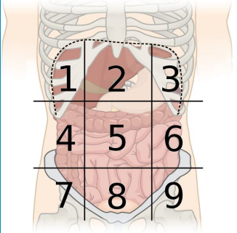
Questions:
What is 1 and 6?
The Peer Teaching Society is not liable for false or misleading information…

Slide 61
Questions:
What is 1 and 6?
1= right hypochondrium (RUQ)
6= left flank
The Peer Teaching Society is not liable for false or misleading information…

Slide 62
Which of these separate the right iliac fossa from the suprapubic area?
a- Midline
b- Midclavicular line
c- Anterior axillary line
d- Posterior axillary line
e- Mid-axillary line
The Peer Teaching Society is not liable for false or misleading information…

Slide 63
Which of these separate the right iliac fossa from the suprapubic area?
a- Midline
b- Midclavicular line
c- Anterior axillary line
d- Posterior axillary line
e- Mid-axillary line
The Peer Teaching Society is not liable for false or misleading information…

Slide 64
If a patient’s gallbladder is inflamed, where will the initial delocalized pain be felt, and which nerve supplies the section of the gut that includes the gallbladder?
Supplied by greater splanchnic nerve, pain felt in the umbilical region
Supplied by least splanchnic nerve, pain felt in left and right flank regions
Supplied by greater splanchnic nerve, pain felt in epigastrium
Supplied by lesser splanchnic nerve, pain felt in suprapubic area
None of the above
The Peer Teaching Society is not liable for false or misleading information…

Slide 65
If a patient’s gallbladder is inflamed, where will the initial delocalized pain be felt, and which nerve supplies the section of the gut that includes the gallbladder?
Supplied by greater splanchnic nerve, pain felt in the umbilical region
Supplied by least splanchnic nerve, pain felt in left and right flank regions
Supplied by greater splanchnic nerve, pain felt in epigastrium
Supplied by lesser splanchnic nerve, pain felt in suprapubic area
None of the above
The Peer Teaching Society is not liable for false or misleading information…

Slide 66
Helpful Summaries:
Here are some helpful summaries to come back to for last minute revision!!
The Peer Teaching Society is not liable for false or misleading information…

Slide 67
GI tract
GI tract:
Midgut
Distal ½ of duodenum
Jejunum
Ileum
Caecum & appendix
Ascending colon
Right $2/3$ of transverse colon
Blood supply:
Superior mesenteric artery
Nerve supply:
Lesser splanchnic nerve, T10-T11
Hindgut
Left $2/3$ of transverse colon
Descending colon
Sigmoid colon
Rectum
Anal canal
Blood supply:
Inferior mesenteric artery
Nerve supply:
Least splanchnic nerve, T12
Foregut
Pharynx
Oesophagus
Stomach
Proximal ½ of duodenum
Blood supply:
Coeliac trunk/axis
Nerve supply:
Greater splanchnic nerve, T5-T9

Slide 68
Small intestine vs Large intestine
SMALL INTESTINE | LARGE INTESTINE
With exception of D1, mobile | AC and DC are fixed; rest are mobile
Smaller | Larger
Longitudinal muscle layer in wall is continuous | Longitudinal muscle s NOT continuous but is 3 muscles called TENAE COLI (except appendix)
No appendices epiploicae | Has appendices epiploicae
Wall smooth | Sacculated (haustrations)
Internal membrane has plicae | No plicae
Mucos membrane has villi | No villi
Peyers patches | No peyers patches
No haustrations | Has haustrations

Slide 69
Jejunum vs Ileum
Category | Jejunum | Ileum
Length | 2/5 | 3/5
Diameter | Wider | Less
Wall | Thick & double | Thin
Colour | Deep red | Pale pink
Peyer’s patches | Very few | Many
Blood supply | Long arteries & few vasa rectae | Short arteries & many vasa rectae
Mesentery | Less fat | More fat
Crypts of Lieberkuhn | Shallow crypts | Normal depth
Villi | Long & narrow | Short & wide

Slide 70
Topics covered next session:
Histology
Physiology of the stomach
Intestinal physiology
Digestion and absorption
The Peer Teaching Society is not liable for false or misleading information…

Slide 71
Topics not covered:
Embryology!!!
The Peer Teaching Society is not liable for false or misleading information…

Slide 72
Any questions!!
If you have any questions feel free to email me: ralhalabi1@sheffield.ac.uk
The Peer Teaching Society is not liable for false or misleading information…

