Slide 1
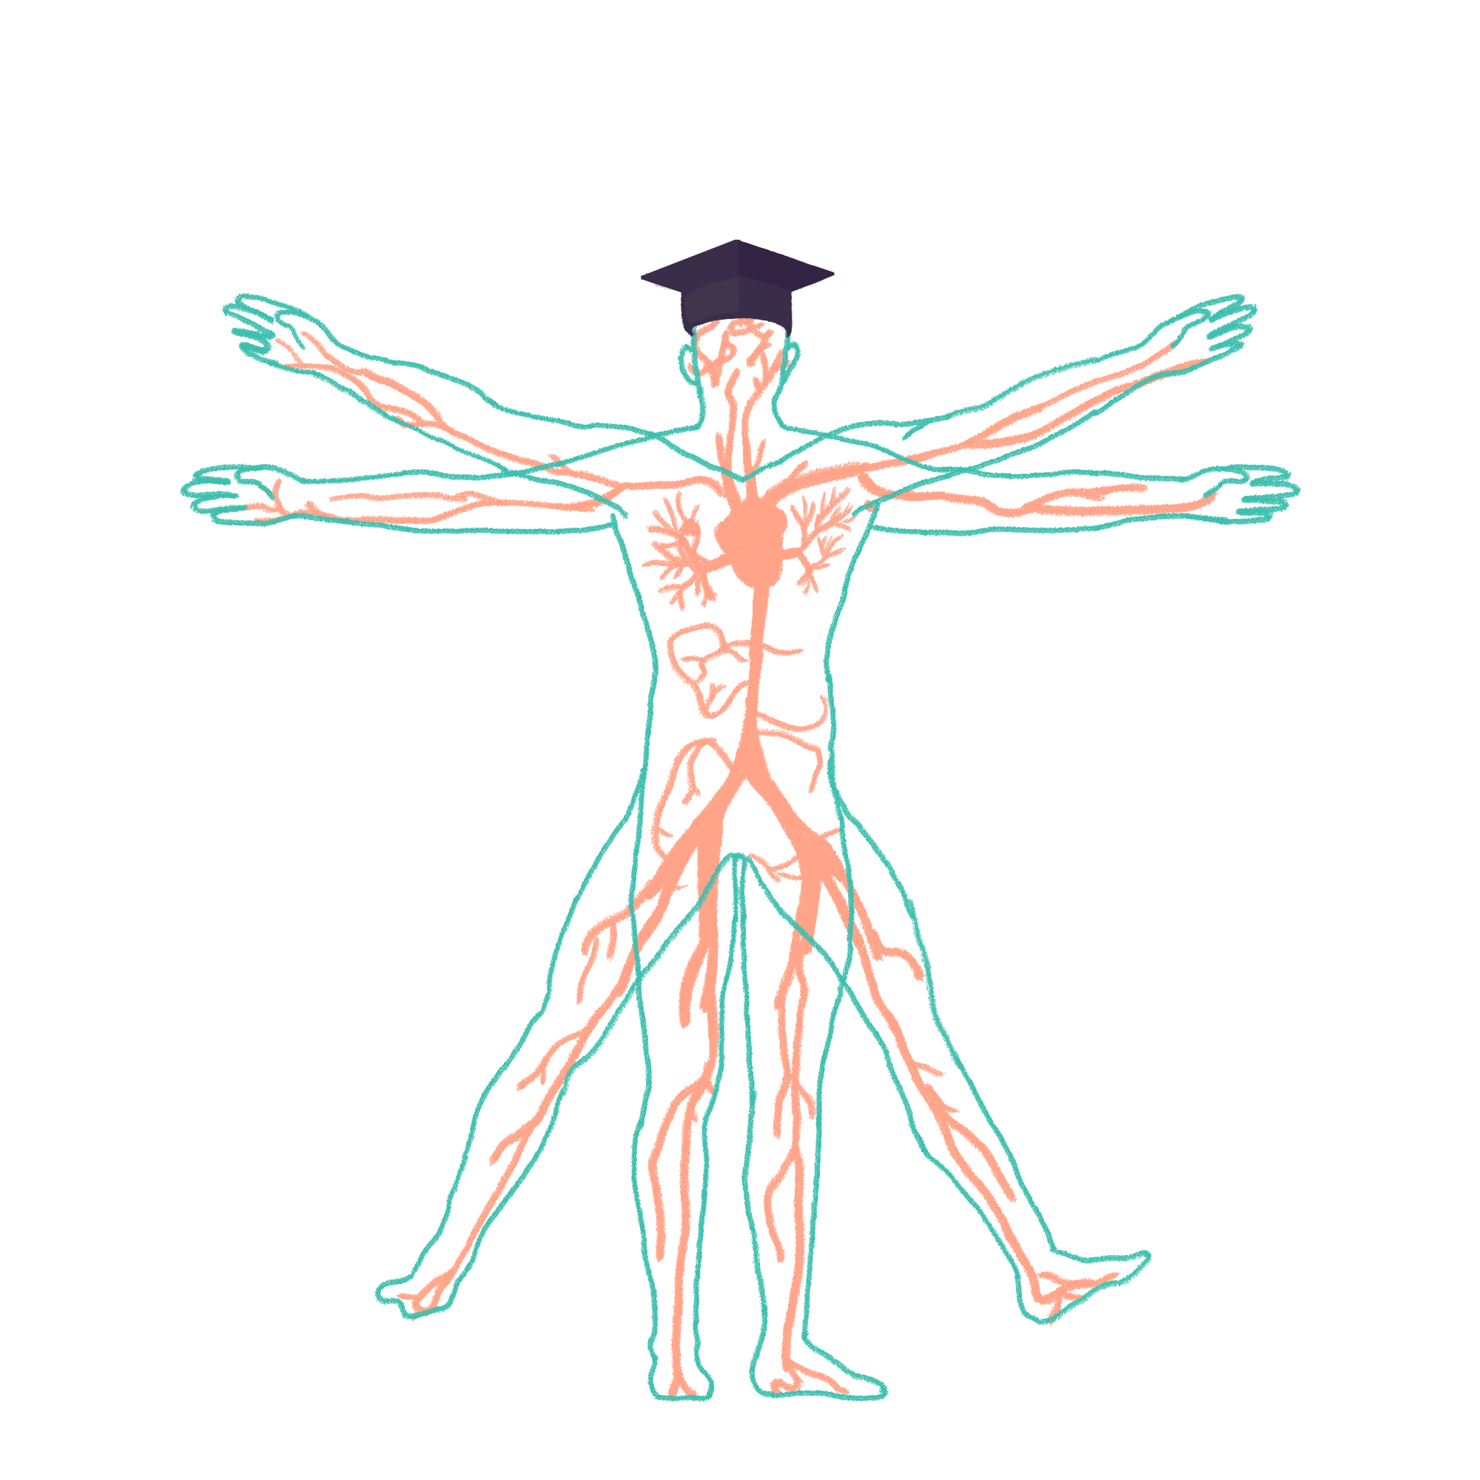
2022/2023

Slide 2
GI Session 1
Phase 1 Revision Session
[Hannah Peachey]
[11/12/22]
The Peer Teaching Society is not liable for false or misleading information…

Slide 3
Aims and Objectives
Histology
Physiology of the stomach
Intestinal physiology
Digestion and absorption
The Peer Teaching Society is not liable for false or misleading information…

Slide 4
Histology
Mouth
Oesophagus
Stomach
Small intestine (duodenum, jejunum, illium)
Large intestine
Anal canal
The Peer Teaching Society is not liable for false or misleading information…

Slide 5
Mouth
The mouth is lined by oral mucosa. This is stratified squamous epithelium.
This is not keratinised in mobile areas such as the soft palate, cheek and lips.
This is keratinised in areas such as the upper surface of the tongue, gums and hard palate.
The Peer Teaching Society is not liable for false or misleading information…

Slide 6
Mouth
The Peer Teaching Society is not liable for false or misleading information…

Slide 7
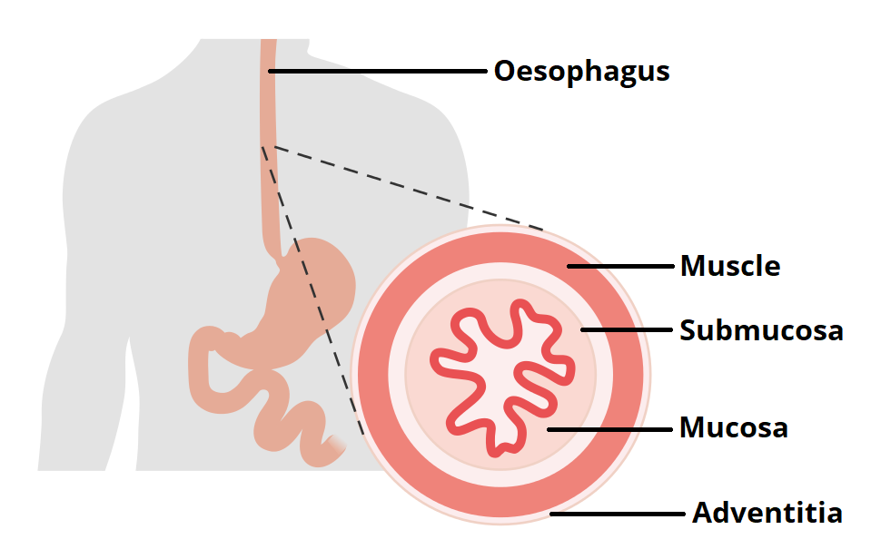
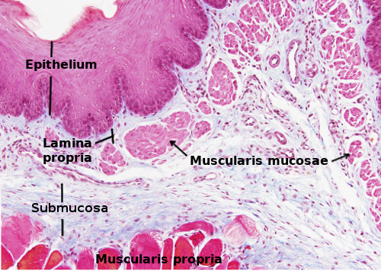
Oesophagus
From external to internal;
Adventitia,
Muscle layer (upper 1/3 is voluntary striated, middle 1/3 is voluntary striated and smooth muscle, lower 1/3 is smooth muscle)
Submucosa,
Mucosa (non-keratinized stratified squamous epithelium)
The Peer Teaching Society is not liable for false or misleading information…

Slide 8
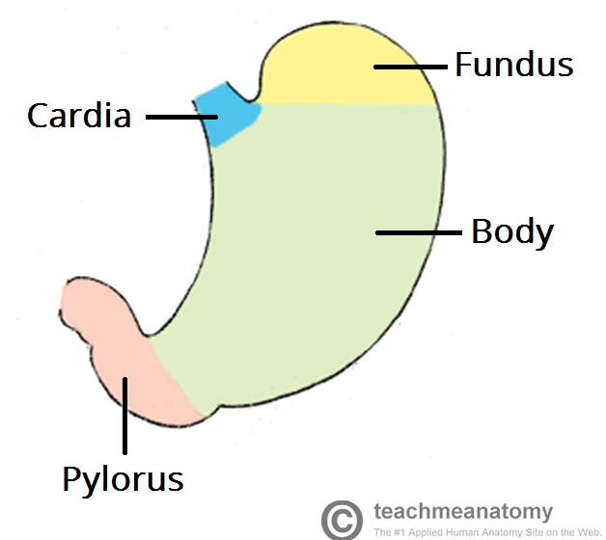
Stomach
The zones of the stomach are;
Cardia
Fundus
Body
Antrum
Pylorus
The Peer Teaching Society is not liable for false or misleading information…

Slide 9
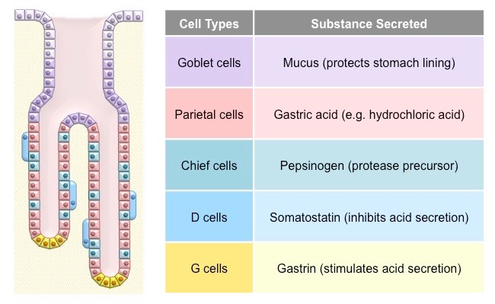
Stomach
The Peer Teaching Society is not liable for false or misleading information…

Slide 10
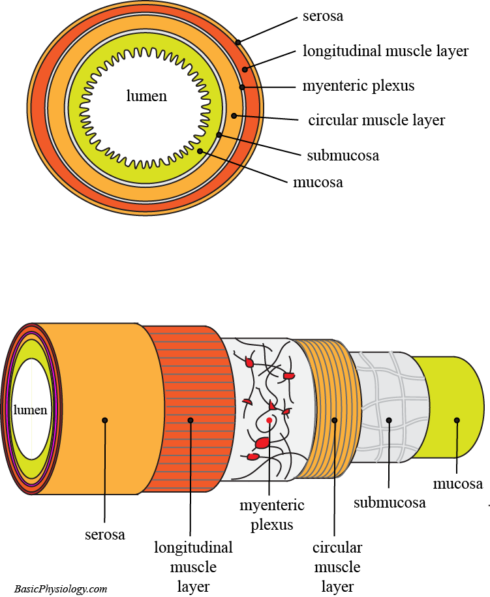
Small intestine
The layers of the small intestine are;
Serosa,
Muscularis mucosa (outer longitudinal, inner circular. This is also true for the stomach)
Submocosa
Mucosa (this is simple columnar epithelium)
The Peer Teaching Society is not liable for false or misleading information…

Slide 11
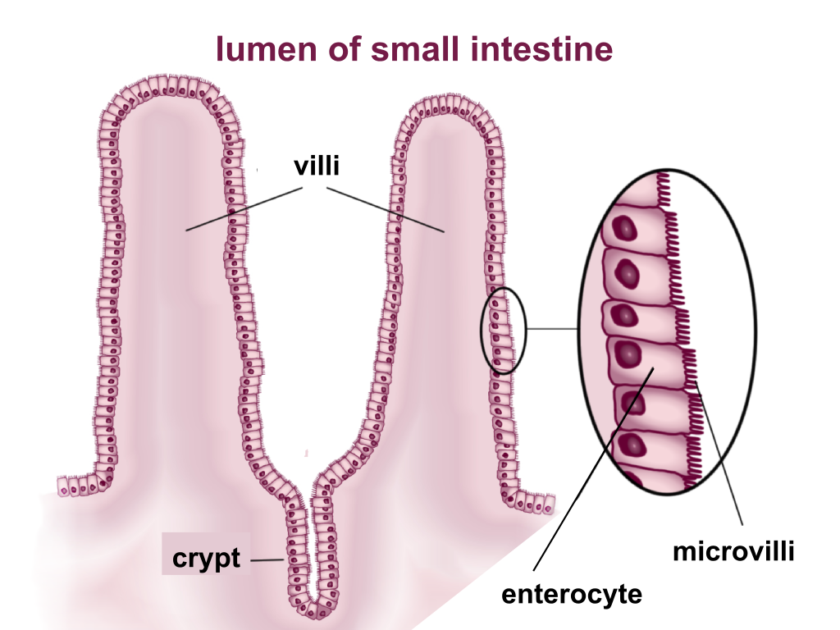
Small intestine cells
Enterocytes – tall, columnar, contain brush border enzymes. These have an absorptive function. These have villi and microvilli.
Goblet cells – secrete mucus
Crypts of lieberkuhn – contain stem cells to replenish cells lost during abrasion.
The Peer Teaching Society is not liable for false or misleading information…

Slide 12
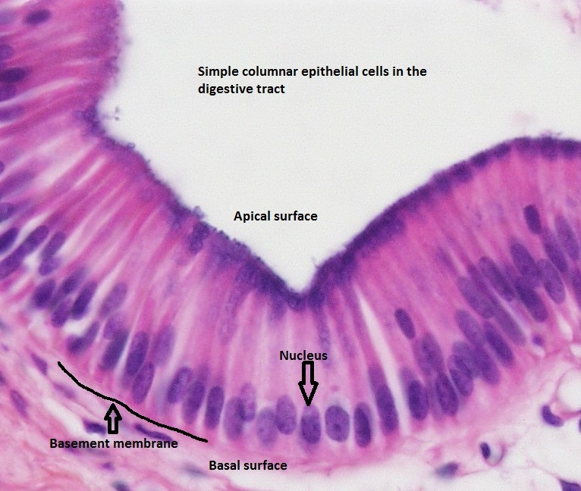
Large intestine
Same layers as the small intestine!!!
Also lined with simple columnar cells.
The Peer Teaching Society is not liable for false or misleading information…

Slide 13
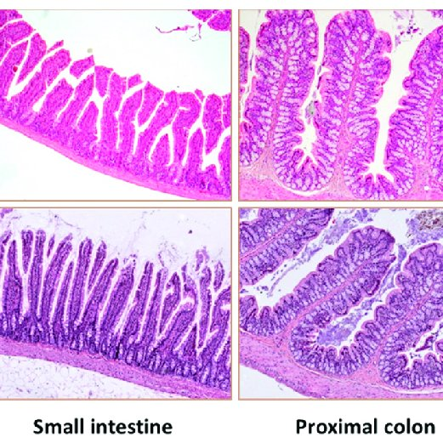
Small VS Large intestine
Small intestine – contains villi and microvilli, pilcae circularis and Paneth cells. The large intestine does not
Large intestine – contains a thicker mucosa layer, deeper crypts of liberkuhn and goblet cells are more abundant.
The Peer Teaching Society is not liable for false or misleading information…

Slide 14
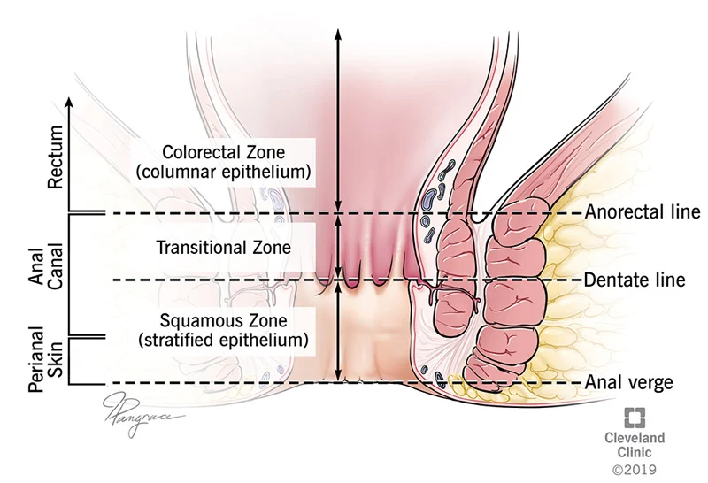
Anal Canal
The Peer Teaching Society is not liable for false or misleading information…

Slide 15
Stomach Physiology
Gastric Acid Production
Appetite
The Peer Teaching Society is not liable for false or misleading information…

Slide 16
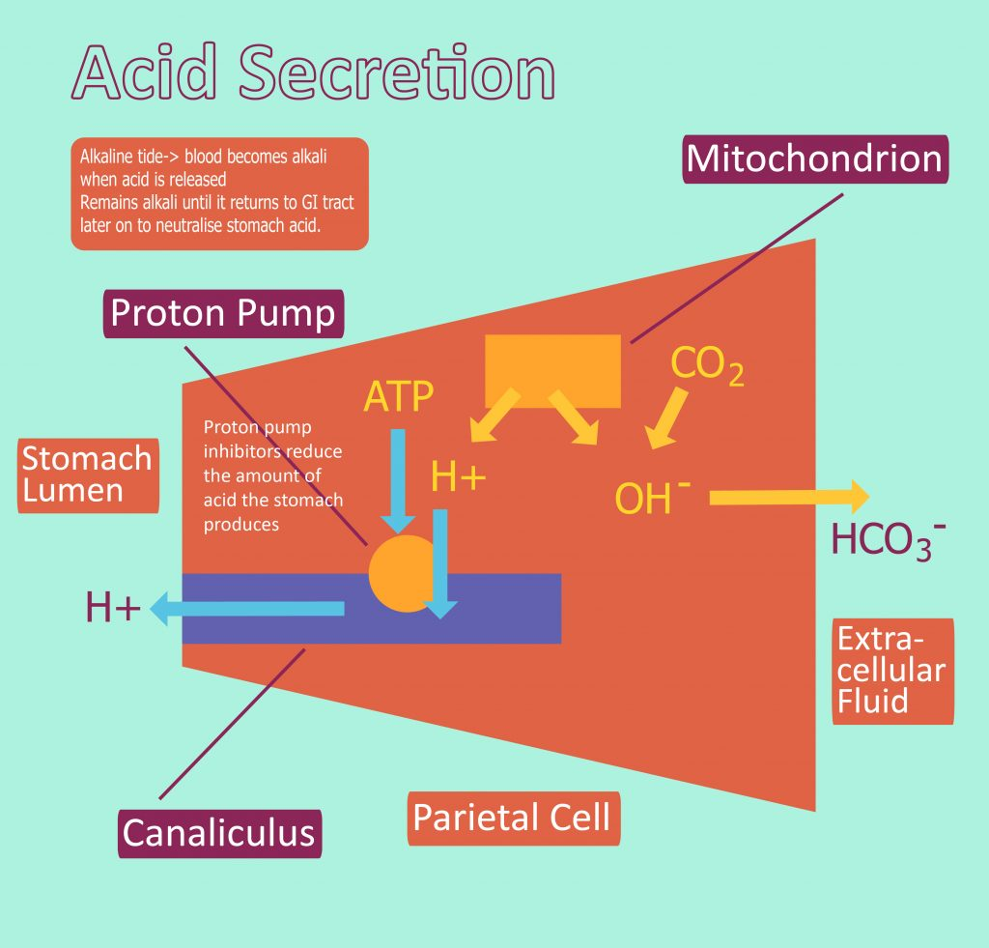
Gastric Acid Production
PH is between 1.5 and 3.5
HCL is produced from parietal cells
The Peer Teaching Society is not liable for false or misleading information…

Slide 17
Gastric Acid Production
Water and carbon dioxide react to form carbonic acid in parietal cells. This is catalysed by carbonic anhydrase. This then dissociates into a hydrogen ion and a bicarbonate ion.
The hydrogen ion is transported into the lumen of the stomach via the H+ K+ ATPase ion pump.
The Bicarbonate ion is transported out of the blood via the anion exchanger. This transports Cl- into the parietal cell.
The chloride ion is transported into stomach lumen via chloride channels.
In the stomach, the H+ and Cl- ions combine to form HCl. This is stomach acid!!!!!!!!!!!
The Peer Teaching Society is not liable for false or misleading information…

Slide 18
Increasing Gastric Acid Production
This can be done in 3 ways;
ACh is released from the vagus nerve in the cephalic phase of digestion when seeing or chewing food. This directly stimulates the parietal cells to increase gastric acid production
Gastrin is released from G cells in the stomach. These can be activated by the vagus nerve. This binds to CCK receptors on the parietal cells which increases calcium levels causing increased vesicular fusion.
Enterochromaffin like cells secrete histamine which binds to H2 recpetors on the parietal cells. This increases vesicular fusion via the cAMP secondary messenger.
The Peer Teaching Society is not liable for false or misleading information…

Slide 19
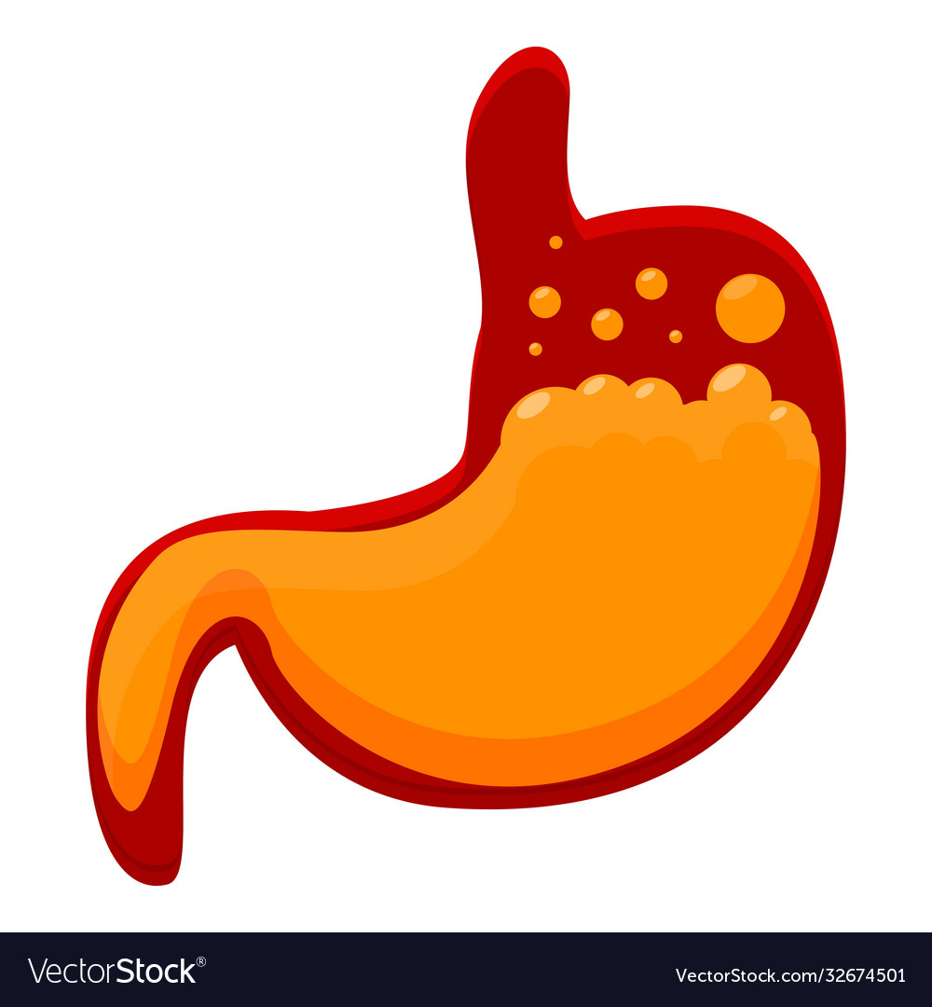
Decreasing Gastric Acid Production
A decrease in stomach PH stimulates D cells to produce somatostatin. This inhibits gastrin secretion
When chyme enters the duodenum, it triggers the enterogastric reflex. This sends inhibitory signals to the stomach via the enterogastric reflex.
Duodenal distention also triggers the enteroendocrine cells to release cholecystokinin and secretin. These inhibit gastric acid secretion.
The Peer Teaching Society is not liable for false or misleading information…

Slide 20
Appetite
Appetite is controlled by the arcuate nucleus in the hypothalamus.
Ghrelin – produced in the pancreas and released from the stomach wall. This is excitatory and stimulates appetite. When the stomach is full, ghrelin release is inhibited.
PPY (peptide tyrosine tyrosine) – released from the ileum and the colon in response to feeding. This suppresses appetite.
Leptin – released by adipocytes. This is inhibitory and suppresses appetite.
Insulin – this is released from beta cells in the islets of Langerhans. It suppresses appetite.
The Peer Teaching Society is not liable for false or misleading information…

Slide 21
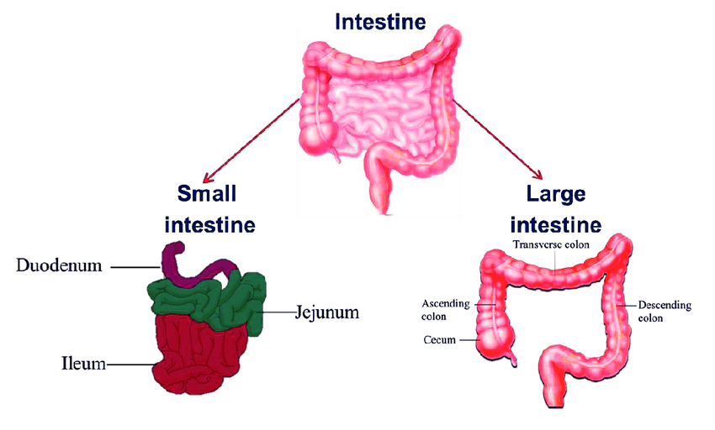
Intestinal Physiology
The small intestine is mostly responsible for absorbing nutrients and most of the water
The large intestine is mostly responsible for absorbing the rest of the water, some ions and it forms and stores faeces.
The Peer Teaching Society is not liable for false or misleading information…

Slide 22
Carbohydrate digestion and absorption
Starch begins to be digested in the mouth by salivary amylase.
Most digestion happens in the small intestine by pancreatic amylase. This produces disaccharides which are then broken down into monosaccharides by brush border enzymes.
The final monosaccharides produced are glucose, galactose and fructose.
Glucose and galactose are absorbed by secondary active transport through sodium-glucose cotransporters.
Fructose enters the enterocytes via facilitated diffusion.
The Peer Teaching Society is not liable for false or misleading information…

Slide 23
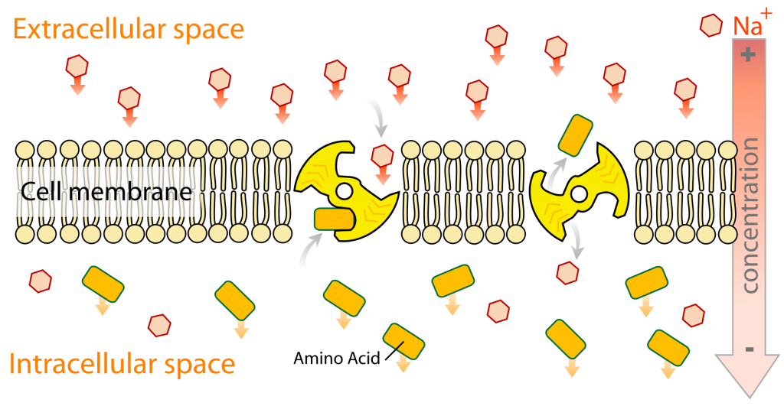
Protein digestion and absorption
Protein digestion begins in the stomach with pepsin.
This is completed by brush border enzymes in the small intestine.
Amino acids are absorbed via facilitated diffusion via sodium co-transporters.
The Peer Teaching Society is not liable for false or misleading information…

Slide 24
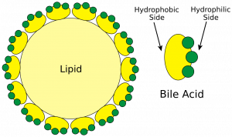
lipid digestion and absorption
Some Lipids are digested by lingual and gastric lipase.
Most lipids are digested in the small intestine by bile acids. These emulsify fates to produce micelles.
Pancreatic lipases then hydrolyse the micelles and break them down into fatty acids, monoglycetides, cholesterol and lysolecithin.
The digested products then diffuse into the enterocyte where they reform in to the original lipid.
The Peer Teaching Society is not liable for false or misleading information…

Slide 25
Large intestine absorption
The colon is responsible for absorbing water and forming faeces.
It has lots of crypts of lieberkuhn containing goblet cells. These produce mucus which helps to protect the colon from abrasive faeces.
The faeces is concentrated when it reaches the large intestine, so water reabsorption is dependent on ion reabsorption. WHERE SODIUM GOES WATER FLOWS.
Sodium can be absorbed by; sodium hydrogen antiporters on the luminal membrane or epithelial sodium channels
Potassium chloride ions are reabsorbed in the large intestine.
The Peer Teaching Society is not liable for false or misleading information…

Slide 26
Conclusion
The Peer Teaching Society is not liable for false or misleading information…

Slide 27
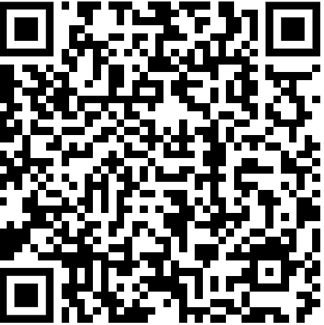
Feedback
The Peer Teaching Society is not liable for false or misleading information…
Notes:
https://docs.google.com/forms/d/e/1FAIpQLSc_wMIVd3qiRbOGH6rmhAV_sxQSgwJiPgpznMOD5syHkQ4KeA/viewform?usp=sf_link

