Slide 1
G.I. (Part I) Peer Teaching for Phase 2a
Seb van der Linden and Ketan Dhital

Slide 2
Gastroesophageal Reflux Disease (GORD)
WHAT: Reflux of gastric contents into oesophagus
CAUSES: Hiatus Hernia, Tracheoesophageal Fistula - insufficiency of Lower Oesophageal Sphincter. May occur spontaneously.
CLINICAL FEATURES: Heartburn - made worse by bending/stooping/lying flat. May be a cough, nocturnal asthma (due to aspiration)
INVESTIGATIONS: diagnosis is usually clinical (no need in patients under 45 unless there is weight loss, dysphagia or anaemia) - Oesophagoscopy - shows oesophagitis - Barium Swallow - may show ulceration in lower oesophagus/hernia - 24-hour pH monitoring
Rx: Weight loss, reduce alcohol intake, stop smoking, antacids (H2–receptor antagonist e.g. ranitidine, Proton Pump Inhibitor e.g. lansoprazole/omeprazole endoscopic therapy, surgery in extreme cases.

Slide 3
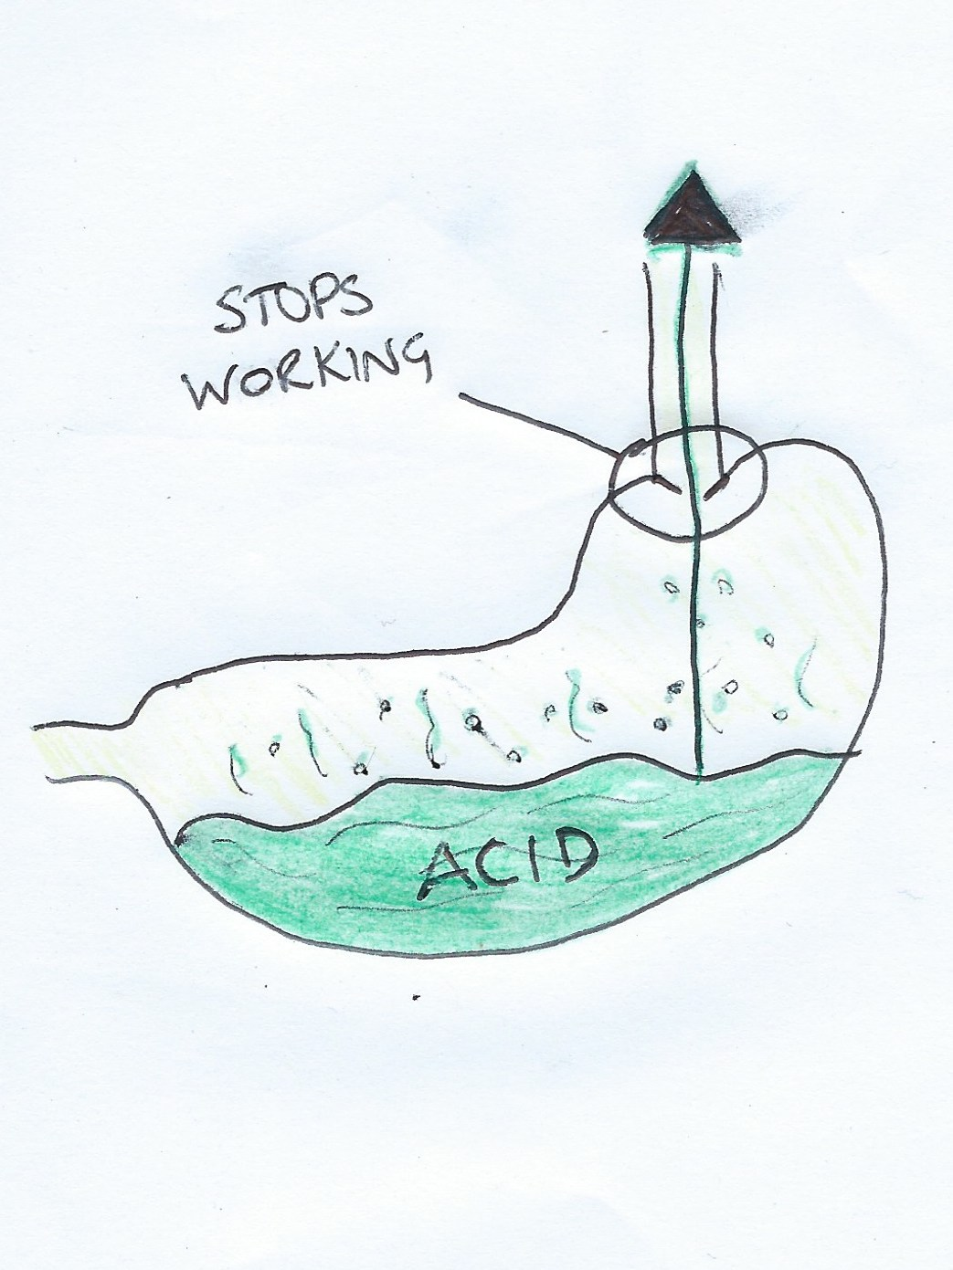
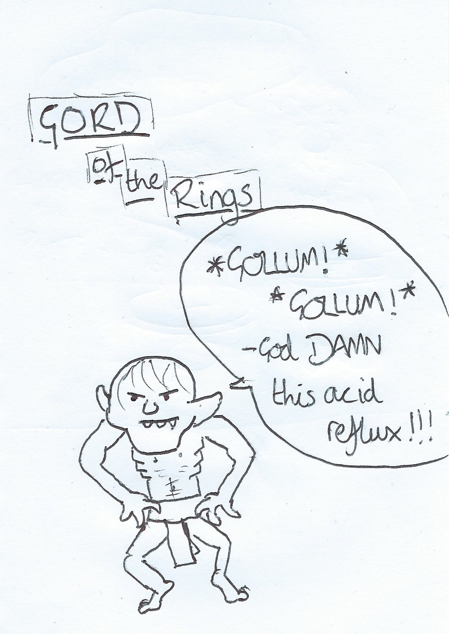
COMPLICATIONS: - Stricture formation (this would present with dysphagia) - Long term may lead to metaplasia (squamous columnar) = Barrett’s oesophagus - this is a premalignant condition

Slide 4
Mallory Weiss Syndrome
WHAT: Haematemesis from a tear in the oesophagus. It is suggested by a history of normal vomiting before the haematemesis
CAUSES: Excessive alcohol, aspirin, hiatus hernia (due to higher pressure on retching/ vomiting), straining/ hiccuping/ coughing/ Blunt abdominal trauma/ CPR, gastroenteritis, gastric outlet obstruction, malrotation, volvulus, hepatitis, drugs, severe DKA.
INVESTIGATIONS: Endoscopy!!! ASAP!!! Use the Rockall Score for the extent of a Upper GI bleed. Also take a FBC
TREATMENT: the tear may heal itself, but treatment at endoscopy e.g. Injection therapy is first line

Slide 5
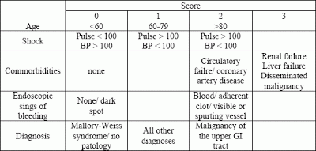
Rockall Score for G.I. Bleeds
According to OHCM, the Rockall Score is a prediction of the risk of rebreeding and mortality after an Upper GI bleed. An initial score >6 is said to be an indication for surgery. The initial score is added to after an endoscopy to give a total Rockall Score.
http://gastroenterologymaster.blogspot.co.uk/2012/11/rockall-score.html

Slide 6
Peptic Ulcer
WHAT: Ulcer of acid-bearing area (stomach/proximal duodenum)
CAUSE: Unclear, though thought that H. pylori plays a central role; There may be a genetic aspect; Aspirin and NSAIDs; also seen in hyperparathyroidism and Zollinger-Ellison syndrome.
CLINICAL FEATURES: Epigastric pain (usually relieved by antacids). - Duodenal Ulcer painful when pt. is HUNGRY (and classically occurs at night) - Gastric Ulcer painful AFTER EATING May also be nausea, heartburn, flatulence. May only present with features of a complication (coming up..), or a painless upper GI bleed
INVESTIGATIONS: Screen for H. pylori infection (serology, breath test, stool test); Patients >45 need endoscopy with biopsies of the ulcer; Barium meal for suspected gastric outlet obstruction.

Slide 7
PEPTIC ULCER TREATMENT: - H. pylori +ve: Eradicate* the Helicobacter, and prevent reoccurrence by avoiding risk factors. *Triple therapy: Metronidazole, Clarithromycin/Amoxicillin + PPI (eg Omeprazole) - H. pylori -ve: Mostly associated with NSAIDs, so stop these, and supplement with acid-suppression drug (e.g. PPI or H2-receptor antagonist)
COMPLICATIONS: Perforation! Duodenal more likely to perforate (usually into peritoneal cavity). Treatment is surgical for visceral closure with drainage of the peritoneal cavity, followed by H. pylori eradication. - Outflow obstruction: due to scarring or oedema. Main symptom = projectile vomiting. Treatment is nasogastric suction and fluid/electrolyte rebalancing. - Haemorrhage

Slide 8
Oesophago-gastric varices
WHAT: Dilated veins at junction between systemic and portal venous systems. Most commonly affected in distal oesophagus. The majority of patients have chronic liver disease. Bleeding is usually severe and may be life-threatening - Their size and tendency to bleed depends on portal pressure
CAUSES: (anything that increases Portal Pressure basically) - (PRE-HEPATIC): Portal Vein Thrombosis, Portal Vein Obstruction, Increased Portal blood flow, Increasd Splenic flow - (INTRA-HEPATIC): Cirrhosis, Idiopathic Portal HTN, Acute Hepatitis (especially Alcoholic), Schistosomiasis - (POST-HEPATIC): Compression (e.g. Tumour), Budd-Chiari syndrome, Constrictive Pericarditis, Right Heart Failure (rarely)
RISK FACTORS (for Portal HTN): Worsening liver disease, malnourishment, alcohol intake, increased intra-abdo pressure, aspirin and NSAIDs, bacterial infection

Slide 9
CLINICAL FEATURES OF VARICES: Haematemesis, melaena, abdominal pain, liver disease features, painful swallowing, pallor, may be in shock
INVESTIGATIONS: Endoscopy! Bloods (LFTs and U+Es), CXR, and investigate cause of the Portal Hypertension. - Rockall Score
TREATMENT: Terlipressin until haemostatic, antibiotics. - If Oesophageal: Band ligation, TIPS*, stenting (last resort) - If Gastric: Endoscopic Injection, TIPS* *TIPS: Transjugular Intrahepatic Portosystemic Shunt - interventional radiologists create an artificial channel in the liver to lower portal pressure

Slide 10
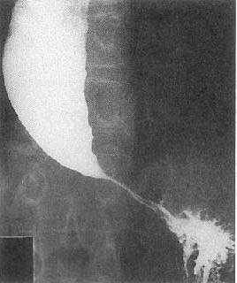
Oesophageal Motility Disorders: Achalasia
Unknown cause. Aperistalsis and non-propulsive oesophagus contractions with failure to relax of Lower Oesophageal Sphincter
Presents any age (children rare) with long history Dysphagia of BOTH solids and liquids with regurgitation. May be retrosternal chest pain
INVESTIGATIONS: Barium swallow - dilated oesophagus with tapering lower end (“beak” deformity) - Oesophagoscopy to exclude carcinoma - CXR
TREATMENT: Endoscopic dilatation of Lower oesophageal sphincter (LOS) - Injection of botox into LOS - Surgical division of LOS (Heller’s Cardiomyotomy)
REGARDLESS OF TREATMENT, THIS INCREASES RISK OF OESOPHAGEAL CANCER

Slide 11
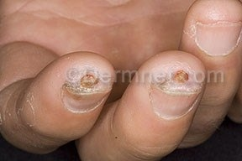
Oesophageal Motility Disorders: Scleroderma
WHAT: Chronic multisystem disease, mainly affects the skin.
CAUSE: unknown, though cellular and humoral immune systems abnormal
Increase in dermal collagen, and decreased elastic tissue, leading to thickening and immobility
In the oesophagus: This leads to decreased motility and therefore impaired peristalsis. This in turn results in reflux and eventual stricture formation
TREATMENT: As above - treatment as for any oesophageal stricture

Slide 12
Gastritis
Commonest cause = Helicobacter pylori - Other causes include: Automimmune gastritis - cause of pernicious anaemia (associated with antibodies to parietal cells (intrinsic factor)); Viruses; Duodeno-gastric reflux
Diagnosis is usually histological, often incidental diagnosis after endoscopy, and may be acute or chronic
CLINICAL FEATURES: Often asymptomatic, may be dyspepsia
INVESTIGATIONS: Urease test, Histology, Gram Stain and Culture, Urea breath test, serology, stool tests
TREATMENT: Eradication of H. pylori (triple therapy)

Slide 13
Malabsorption
Small Intestinal disorders causing malabsorption:
Coeliac disease
Dermatitis herpetiformis - closely related to Coeliac; a skin disorder with an associative gluten-sensitive enteropathy
Tropical Sprue
(Also maybe worth knowing causes e.g. Whipple’s disease, Radiation enteritis, Parasitic infection, Intestinal resection)

Slide 14
Coeliac Disease
WHAT: Gluten-sensitive enteropathy - inflammation of jejunal mucosa; Subtotal villous atrophy of the small bowel
CLINICAL FEATURES: presents any age - most common in 5th decade. Variable symptoms include: malaise with associated anaemia. There may be diarrhoea, steatorrhoea, abdominal discomfort, bloating, pain, weight loss - There may be mouth ulcers and/or angular stomatitis - Osteoporosis is very common - Increased incidence of atopy and autoimmune disease
INVESTIGATIONS: Biopsy of jejunal mucosa (via endoscope), serum antibodies (Endomysial ABs and Tissue Transglutaminase ABs), FBC to assess anaemia, radiology to show dilated bowel with thickened folds, bone densitometry to assess risk of osteoporosis
TREATMENT: Diet control - lifelong gluten free
COMPLICATIONS: Increased risk of malignancy (intestinal lymphoma especially)

Slide 15
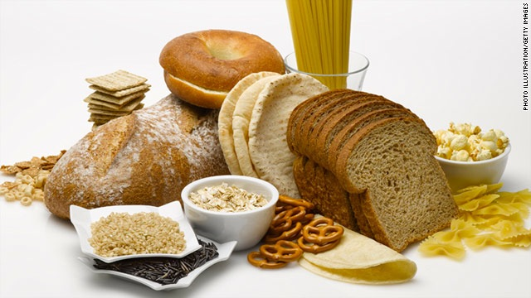
AN EXAMPLE OF GLUTEN-CONTAINING FOODS
(In case you didn’t know..)

Slide 16
Tropical Sprue
WHAT: Progressive small bowel problem. A partial villous atrophy affecting the whole small bowel. Presents with malabsorption in visitors to tropical areas (where the disease is endemic) - i.e. Asia, Caribbean, Puerto Rico, parts of South America
CAUSE: ?Infections
CLINICAL FEATURES: May present years after visit to the tropics - diarrhoea, anorexia, abdominal distention. Nutritional deficiencies develop over time
INVESTIGATIONS: Demonstrate malabsorption (especially of fat and Vitamin B12)
TREATMENT: Folic acid + Tetracycline; Correct nutritional deficiencies

Slide 17
INFLAMMATORY BOWEL DISEASE
Let’s face it - if one thing from G.I. is guaranteed to come up - THIS IS IT!!

Slide 18
Crohn’s Disease
WHAT: - chronic inflammatory GI disease - transmural granulomatous inflammation. Favours Terminal Ileum. Often unaffected areas of bowel between lesions (skip lesions). Smoking increases risk and NSAIDs may exacerbate
CLINICAL FEATURES: Diarrhoea, abdo pain, weight loss all common, fever, malaise, anorexia. EXTRA-INTESTINAL SIGNS: Clubbing, mouth ulcers, erythema nodosum, pyoderma gangrenosum, conjunctivitis, episcleritis, iritis, large joint arthritis, Seronegative Spondyloarthropathies (sacroiliitis, ankylosing spondylitis)
INVESTIGATIONS: Sigmoidoscopy and Rectal Biopsy. Blood tests to exclude infective diarrhoea
TREATMENT: Steroids for acute attacks (Prednisolone/Hydrocortisone); Additional Therapy = Azathioprine (steroid alternative), Sulfasalazine (5-ASA), Methotrexate (DMARD), TNF-alpha inhibitors e.g. Infliximab

Slide 19
Ulcerative Colitis
WHAT: Relapsing and remitting inflammation of colon. May just affect the rectum
CAUSE: Unknown. Link with HLA-B27 (Seronegative Spondyloarthropathies) - as with Crohn’s. NOT-smoking is a risk factor
CLINICAL FEATURES: Gradual onset diarrhoea ± blood and mucus. Abdo cramps common. Bowel frequency indicates severity of disease (more motions per day = more severe). May be malaise, fever, anorexia and weight loss. Urgency and tenesmus in rectal disease. - Signs include: Clubbing, tender abdomen, tachycardia, spondyloarthropathies (see slide on Crohn’s)
INVESTIGATIONS: Sigmoidoscopy and Rectal Biopsy. Blood tests, stool sampling to exclude infection. Abdo X-ray shows colon dilation, no faecal shadows and mucosal thickening
TREATMENT: Severe UC = Hydrocortisone in acute attacks, with Sulfasalazine + Prednisolone to maintain remission. Consider Infliximab/Ciclosporin. Surgery if perforation, massive haemorrhage, toxic dilatation, or failure to respond to medical therapy

Slide 20
Crohn’s | Ulcerative Colitis
Transmural Inflammation | Mucosal Inflammation
Right colon > Left colon | Left colon > Right colon
Patchy Bowel Involvement | Continuous Bowel Involvement
Granulomas Common | Granulomas Rare
Goblet Cells Present | Goblet Cells Depleted
Some Crypt Abscesses | Many Crypt Abscesses
Anywhere Mouth-Anus | Restricted to Large Bowel
Strictures Common | Strictures Less Common
Smoking Increases Risk | Smoking is Protective

Slide 21
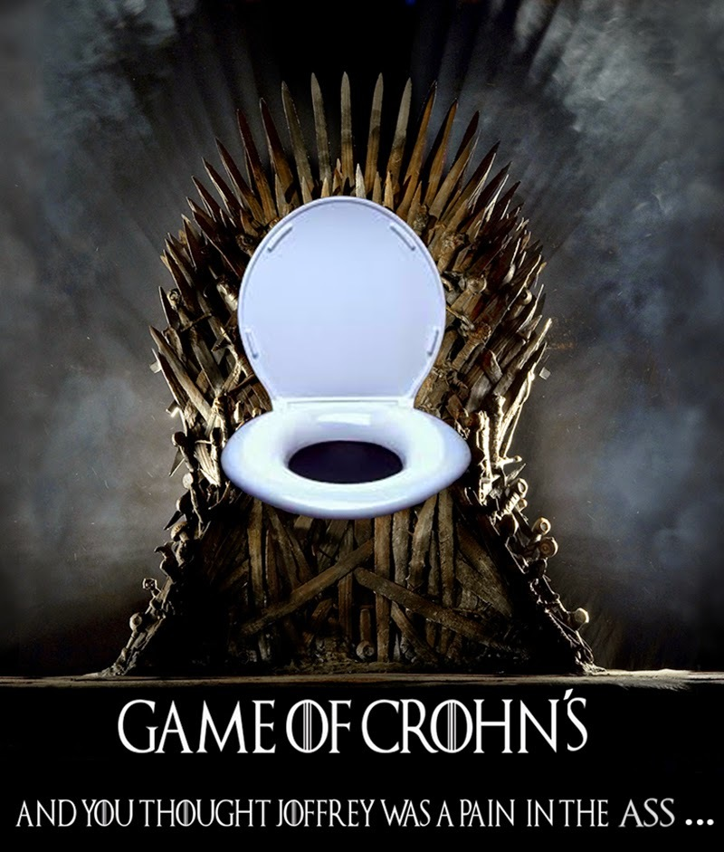

Slide 22
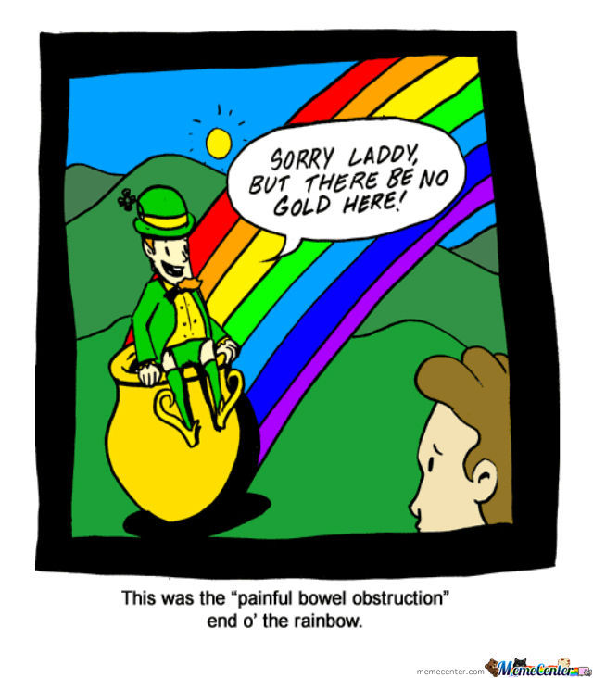
INTESTINAL OBSTRUCTIONS
A partial or total blockage of the small or large intestine, preventing the passage of food, fluid and gases. Ileus refers to when this blockage is not mechanically caused. Presents with intense colicky abdominal pain, nausea, vomiting, dysphagia and failure to pass bowel movements.

Slide 23
SMALL BOWEL OBSTRUCTION
What – The quicker symptoms develop, the more proximal the obstruction. The majority (60%) are caused by post-surgical adhesions, followed by malignancy, Crohn’s disease, and hernias. Colicky abdominal pain is often accompanied by bilious or (if God has deserted you) faeculant vomiting. May be accompanied by diarrhoea initially, progressing to constipation. Fever + tachycardia indicates there may be a strangulation, leading to ischaemia, sepsis and necrosis.
Investigations – Rectal and abdominal exams mandatory. Plain X-ray should show dilated small-bowel loops, absent or minimal colonic gas. CT scan should always be done if strangulation suspected.
Management – Fluid resuscitation, gastric decompression via NG tube. Laparoscopy to release the bowel if a mechanical obstruction or risk of strangulation.

Slide 24
Large bowel obstruction
What – Emergency mechanical obstruction, needs to be distinguished from ileus. Most likely to be due to colo-recctal malignancy – ask about bowel changes. Abrupt onset indicates an acute obstructive event (eg volvulus), whilst chronic constipation and straining are more suggestive of diverticulitis or carcinoma. Try and distinguish between a complete blockage and a partial blockage from a history of obstipation (no gas/bowel movements).
Investigations – As with small bowel, rectal + abdominal exams – check for bowel sounds (diminished), examine inguinal + femoral regions for incarcerated hernias. The lower the lesion, the more abdominal distension + hyper-resonance there will be. Plain X-rays are also required, CT if serious pathology suspected.
Management – Fluid resuscitation for dehydration, surgical intervention if required.

Slide 25
Ileus/pseudo-obstruction
What – Bowel obstruction caused by a loss in peristaltic function, normally because of dilatation of the colon due to sympathetic over-activity, classically in the elderly with numerous co-morbidities. Other causes include opiate analgesia, chest infections and MI, can occur post-operatively. There is complete obstipation with loss of bowel sounds. Pseudo-obstruction refers specifically to the large bowel, and is more likely in the elderly, whereas ileus is the entire intestinal system and is classically post-operative.
Investigations – Plain X-ray will show gas-filled large bowel with no obvious obstruction.
Management – Can respond spontaneously within 2-3 days. Stop medication that impairs bowel motility, fluid resuscitation and monitor.

Slide 26
Ischaemic colitis
What – Occlusion of superior or inferior mesenteric arteries, causing bowel ischaemia. Bad news – 80% of bowel occlusions lead to deathy death. Normally caused by thrombosis or occlusion.
Clinical features – Triad of acute abdominal pain, no abdominal signs, rapid hypovolaemia leading to shock. They will look very very very ill!
Investigations – “Gas-less” colon on abdo X-ray. Arteriography may help but most diagnoses made at laparotomy.
Management – Complications are septic peritonitis and MODS. Fluid resuscitation, antibiotics and anticoagulants. Surgery ASAP!

Slide 27
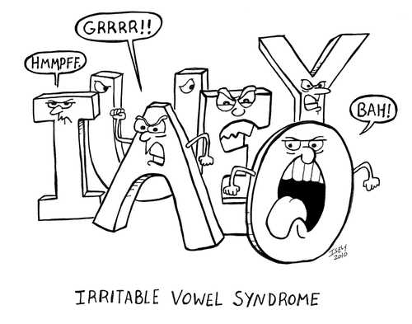
Irritable vowel syndrome (IVS)

Slide 28
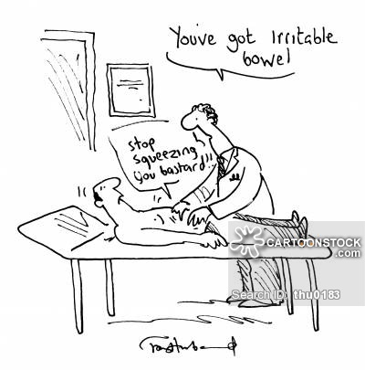
Irritable bowel syndrome (IBS)
IT’S ALL SO VAGUE!
20% have it in some form or another (and good golly there are a lot of forms) – half of these see a GP about it, 30% of these end up seeing a specialist.
NOT A JOKE
IGNORE THIS JOKE➔

Slide 29
Irritable bowel syndrome
Diagnostic criteria: In previous 12 months, at least 12 consecutive weeks of abdominal pain and discomfort which has at least two features from:
Relief by defecation
Change in frequency of stool
Change in form of stool
But there are loads of other symptoms: more than 3 poos a day; less than 3 poos a week; passage of mucus; bloating; dysmenorrhoea; urinary symptoms; back pain, headaches; halitosis…the list is long.

Slide 30
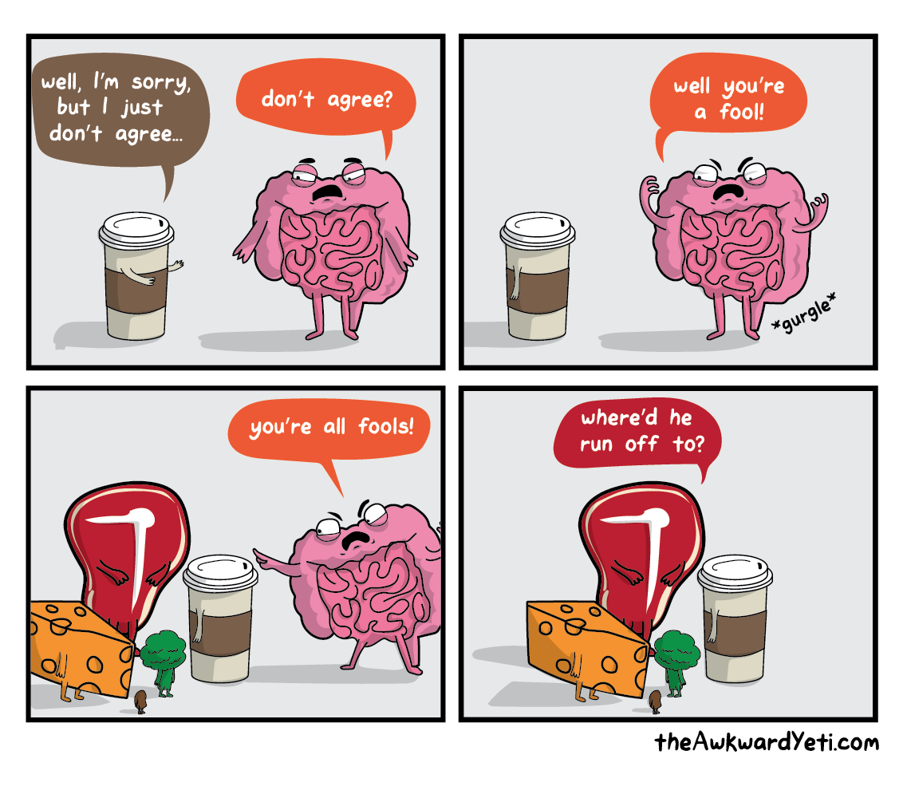
IBS - treatment
Explore the triggers
High fibre diet
Anti-diarrhoeal medication (eg loperamide, codeine phosphate, co-phenotrope)

Slide 31
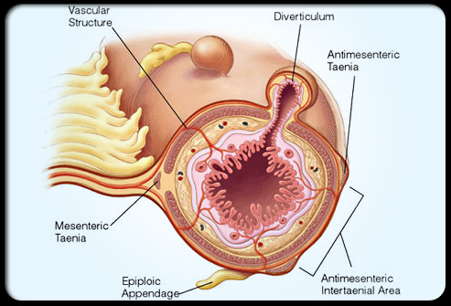
Diverticular disease
What – a spectrum of disease, from asymptomatic to acute inflammation of multiple diverticula. A diverticulum is a small pouch created by herniation of the mucosa into the wall of the colon. It is generally considered a disease of the elderly, but 20% of patients are under 50!

Slide 32
Diverticulitis
Clinical features – depends on site, but generally presents with left lower quadrant pain, change in bowel habit, nausea + vomiting and bloating. On examination, the patient is pyrexic, with tenderness over affected area. Perforation of the bowel wall will lead to peritonitis, with rebound tenderness and guarding.
Investigations – Increased WCC, CT scan will help to confirm. Contrast enemas are also helpful.
Management – Patients with mild disease can be treated with liquid diet and broad-spectrum Abx. If more serious, inpatient treatment with ‘bowel rest’. Surgical intervention to drain large abscesses.

Slide 33
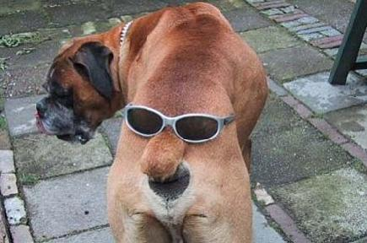
BUM STUFF!

Slide 34
Haemorrhoids
What – Swollen blood vessels in the lower rectum. Ridiculously common, but lots of people too embarrassed to see a doctor – be sympathetic! They are clusters of vascular tissue which bleed freely when irritated. Depending on whether the cushion starts above or below the dentate line (2cm above anal verge) they are classified as internal or external. Constipated patients or those who strain are more at risk, as is anyone with increase abdominal pressure. It’s important to distinguish from other anorectal disorders – thorough history!
Clinical features – Rectal bleeding (make sure its fresh), on toilet paper or in bowl. Higher grade internal haemorrhoids prolapse on straining, or are permanently prolapsed. External haemorrhoids may be painful and itchy. Strangulated haemorrhoids may be acutely painful.
Investigations – Rectal exam necessary. Proctoscopy will show pink mucus
Management – Analgesia; topical corticosteroids; rubber band ligation; injection scleropathy; haemorroidectomy.

Slide 35
Anorectal abscess
What – Collection of pus in the anal/rectal region – may be caused by an infected anal fissure, an STI or blocked anal glands. Most commonly perianally, but can be found ischio-rectally, or inter-sphicterally. Patients at risk are diabetics, the immuno-compromised, and those who receive anal sex. Can also be due to inflammatory bowel diseases or diverticulitis.
Clinical features - Painful, hardened tissue perianally; fever, constipation or pain associated with passing stools; discharge of pus from the rectum; tender lumps/nodules.
Investigations – Digital rectal exam is usually enough to diagnose. Screen for STIs, IBD. Procto-sigmoidoscopy to examine extent.
Management – May develop on fistula in ano (get excited for the next slide!). Prompt surgical drainage is necessary, analgesia, antibiotics if immunocompromised.

Slide 36
Fistula in ano
What – An abnormal tract with the external opening in the perianal area which communicates with the anal canal.40% of anorectal abscesses progress to a fistula in ano as a result of chronic inflammation. They may also be associated with diverticular disease, IBD and malignancy.
Clinical features – A hole? Perianal discharge, pain, swelling bleeding…sounds sad ☹ Physical examination is really important. Investigations not normally necessary.
Management – None necessary if found routinely, only if symptomatic. Surgical replacement if not.

Slide 37
Pilonoidal sinus
What – Abnormal pocket in the skin around the tailbone, which fills with hair and skin debris. Typically occur after hair punctures the skin – can become infected and extremely painful. Young males are more susceptible, as are those who sit for long periods eg. Lorry drivers, and the obese.
Clinical findings – Will be acutely tender, red and warm over the sinus tract. Loose hair may be seen sticking out. No further investigations needed.
Management – If abscess is painful, incision and drainage may be required.

Slide 38
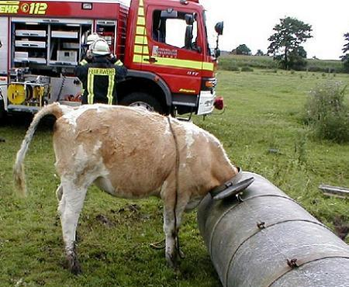
How not to proctoscopy

Slide 39
QUIZ TIME!
1) You see a 47-year-old man in clinic with a three-month history of epigastric dull abdominal pain. He states that the pain is worse in the mornings and is relieved after meals. On direct questioning, there is no history of weight loss and the patient’s bowel habits are normal. On examination, his abdomen is soft and experiences moderate discomfort on palpation of the epigastric region. The most likely diagnosis is:
A. Gastric ulcer
B. Gastro-oesophageal reflux disease (GORD)
C. Duodenal ulcer
D. Gastric carcinoma
E. Gastritis

Slide 40
QUIZTASTIC ANSWER
C Although all of the answers may present with abdominal pain, the key to the answer is in the history. Duodenal ulcers (C), which are four times more common than gastric ulcers, classically present with abdominal pain which is usually relieved after meals or drinking milk. Gastric ulcers (A) on the other hand present with abdominal pain which tends to worsen after meals. In either duodenal/gastric ulcers, weight loss may be an associated symptom, but this is usually more common in gastric ulcers. Patients who suffer from GORD (B) usually experience retrosternal discomfort (‘heartburn’) after meals and on lying flat. In addition, abdominal discomfort and pain in patients with gastritis (E) usually occurs after meals. Gastric carcinomas (D)tend to present with abdominal pain and drastic weight loss (e.g. 2–3 stone weight loss in the space of three months).

Slide 41
QUIZLAMIC EXTREMISM
2) You see a 40-year-old woman who was diagnosed with Crohn’s disease ten years ago. Due to a severe attack of Crohn’s which failed to respond to medical therapy, she had a small bowel resection. Your registrar tells you that she is at risk of developing vitamin B12 deficiency as a result of her surgery. Which part of the small bowel is responsible for the absorption of vitamin B12?
A. Jejunum
B. Proximal ileum
C. Duodenum
D. Terminal ileum
E. None of the above

Slide 42
HOGWARTS SCHOOL OF WITCHCRAFT AND QUIZZARDRY
D The terminal ileum is responsible for the absorption of vitamin B12. If this vitamin is not supplemented, the patient will experience symptoms of glossitis, neuropathy, macrocytic anaemia. The proximal ileum is responsible for absorption of vitamin B2 and vitamin C. The jejunum is responsible for the absorption of vitamin D folic acid and nicotinamide. The duodenum is responsible for the absorption of the minerals calcium and iron.

Slide 43
QUIZ ME WITH YOUR RHYTHM STICK
3) A 28-year-old man undergoes a sigmoidoscopy for longstanding diarrhoea and weight loss. On visualization of the rectum, the mucosa appears inflamed and friable. A rectal biopsy is taken and the histology shows mucosal ulcers with inflammatory infiltrate, crypt abscesses with goblet cell depletion. From the list of answers below, which is the most likely diagnosis describing the histology report?
A. Crohn’s disease
B. Pseudomembranous colitis
C. Irritable bowel syndrome
D. Ulcerative colitis
E. No diagnosis – the report is inconclusive

Slide 44
QUIZTERICAL
D The most likely diagnosis is ulcerative colitis (UC) (D) based on the histological results of the rectal biopsy. The findings of inflammatory infiltrates coupled with mucosal ulcers, goblet cell depletion and crypt abscesses are highly suggestive of a diagnosis of UC. UC is described as a relapsing and remitting inflammatory bowel disorder of the colonic mucosa. The condition usually starts at the rectum (proctitis in 50 per cent) and spreads proximally, in a continuous fashion, to affect parts of the colon (e.g. left-sided colitis in 30 per cent) or the entire colonic tract (pancolitis in 20 per cent). UC tends not to spread beyond the ileocaecal valve but may cause a condition called ‘backwash ileitis’. Histologically, Crohn’s disease (A) is characterized by transmural, non-caseating, granulomatous inflammation, coupled with fissuring ulcers, lymphoid aggregates and neutrophil infiltrates. Crohn’s disease can affect any part of the GI tract from the mouth to the anus (but favours the terminal ileum in 50 per cent) and is also characterized by skip lesions (unaffected bowel between areas of active disease) whereas in UC, disease spreads from the rectum to the ileocaecal valve in a continuous fashion depending on the stage of disease. Pseudomembranous colitis (PC) (B) is characterized by the formation of an adherent inflammatory membrane (the pseudomembrane) overlying sites of muscosal injury within the colon. The histology of PC is described as small surface erosions of the superficial colonic crypts coupled with overlying accumulation of neutrophils, fibrin, mucus and necrotic epithelial cells forming a ‘summit lesion’. The toxins (toxin A and B) produced by the gram-positive anaerobic bacillus, Clostridum difficile, are meant to be the cause of PC. There is normal histology of the bowel in irritable bowel syndrome (C).

