Slide 1
GU - Part 2
Emily Finbow and Emma Partington - Peer Teaching Society
15th March 2021- 6:30pm

Slide 2
Plan
Go through the key things that give away each disease

Slide 3
Top Tips:
Imaging - USS generally generates good diagnostic images of urinary tract (kidney + bladder), may miss small things so CT KUB sometimes indicated (stones)
Look for key clues in questions - eg painter + painless visible haematuria = bladder ca

Slide 4
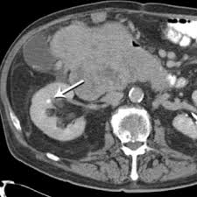

Slide 5
Nephrolithiasis (Stones)
Presentation:
Renal colic = severe unilateral abdominal pain starting in loin + radiating to ipsilateral groin/ testicle/ labia, classically sudden onset early in morning
Restlessness, nausea + vomiting, haematuria, dysuria
Basics:
Very common, slightly more common in men (testosterone -> increased oxalate)
80-85% = calcium oxalate (radio-opaque), 5-10% = uric acid (radio-lucent), 2-20% = struvite (radio-opaque) + 1% = cystine
RF = chronic dehydration, obesity, high protein/ salt diet, recurrent UTIs, hyperparathyroidism (hypercalciuria), congenital abnormalities
Investigations:
Dipstick: haematuria, leucocytes, nitrites
Bloods: FBC, CRP, U&Es
Gold standard = non-contrast CT KUB, USS KUB in pregnancy (can only see radiopaque stones with USS)
Management:
Symptomatic relief - hydration, NSAIDs/ opioids
Small enough stones pass on spontaneously (<5mm)
Elective treatment if too big - ESWL (break stone into smaller fragments using shockwaves), ureteroscopy, PCNL (percutaneous access, use nephroscope to remove stone)
Immediate treatment: intolerable pain/ vomiting, signs of obstruction/ infection, AKI (+ hyperkalaemia)
Lifestyle: decrease sodium + protein intake, increased citrus fruit, adequate fluid intake
Recurrence is common

Slide 6
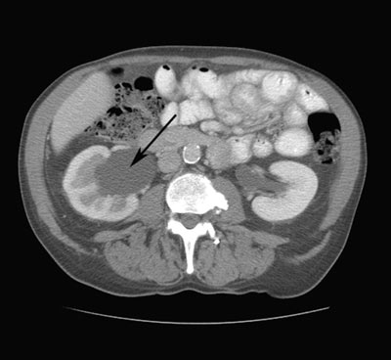
Obstructive Uropathy
Basics:
= blockage of urinary flow, can affect one or both kidneys depending on level of obstruction
If only one kidney affected, urinary output may be unchanged + serum creatinine can be normal, when kidney function affected = ‘obstructive nephropathy’
Hydronephrosis = dilation of the renal pelvis (due to build-up of fluid + increased pressure)
Most common causes = stones + BPH
Prone to infection
Treatment:
Initial treatment directed at relieving pressure on the kidneys to prevent obstructive nephropathy + irreversible renal damage - urethral catheter, ureteric stent or nephrostomy tube depending on level + cause of obstruction
Then focus on managing the underlying cause (see stone/ BPH treatment)
Infection must be treated promptly

Slide 7
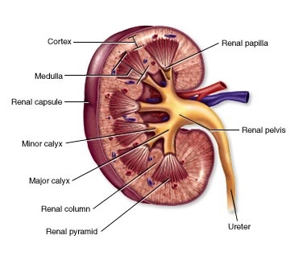
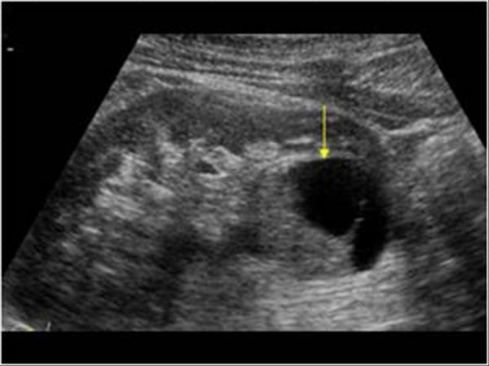

Slide 8
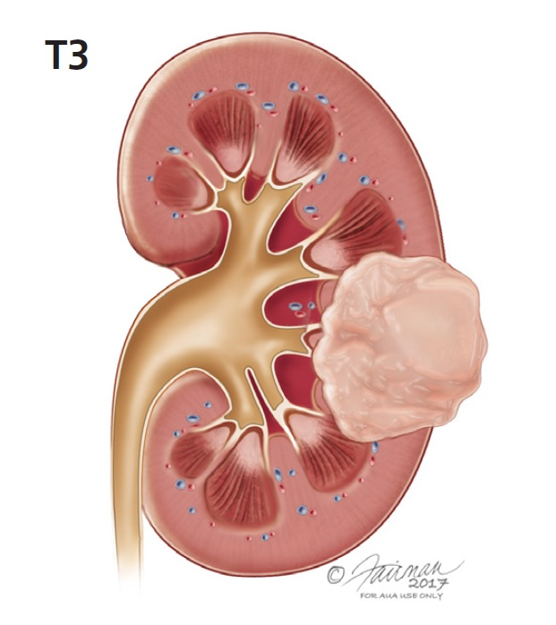
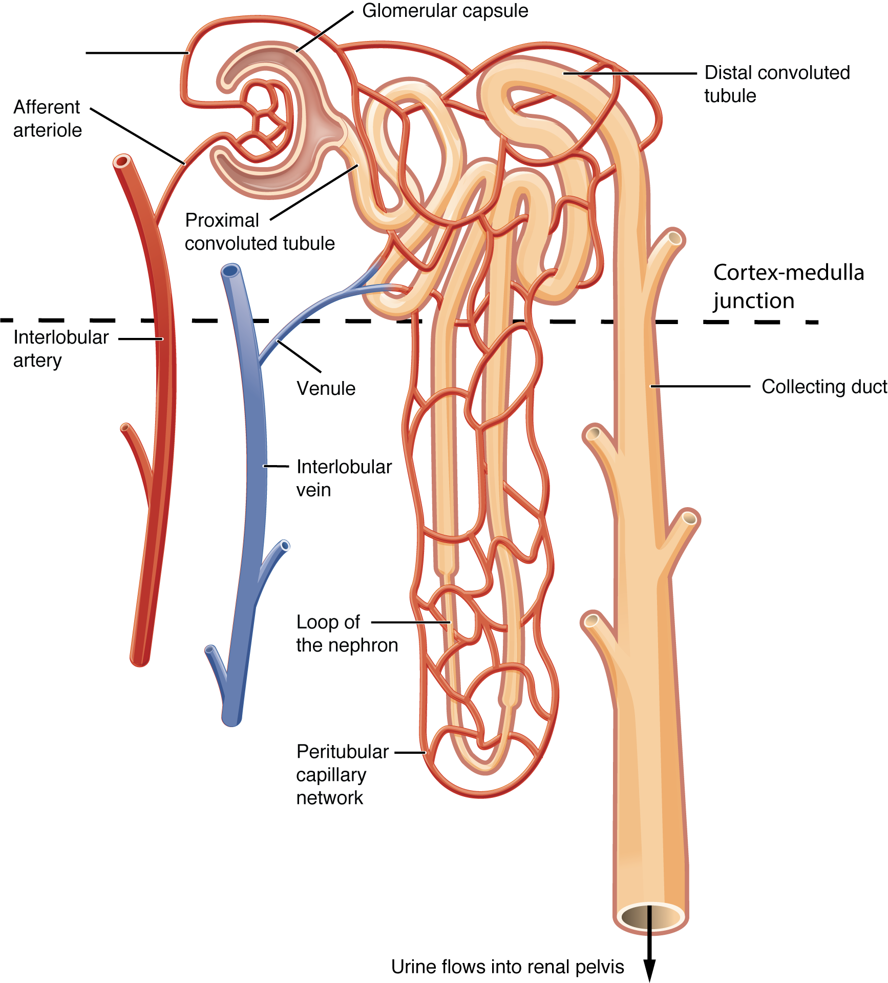
Kidney Cancer
Does not come up very often!
Basics:
Most common type is RCC = malignant cancer of proximal convoluted tubular epithelium
Often asymptomatic and discovered incidentally - 25% have metastasis at presentation
Presentation:
Classic cancer symptoms, vague loin pain, haematuria, abdominal mass, may present with varicocele - invasion of left renal vein leads to compression of left testicular vein
Investigations:
USS (1st line)
CT chest/abdo/pelvis (more sensitive than USS)
Renal biopsy = diagnostic
Management:
1st line = nephrectomy/partial nephrectomy if bilateral
Complications:
Paraneoplastic changes - polycythaemia, HTN, hypercalcaemia, Cushing’s

Slide 9
Painless haematuria

Slide 10
Bladder Cancer
Presentation:
Painless visible haematuria (can be non-visible)
Urgency
Suprapubic/ pelvic mass/ pain
Recurrent UTI
Symptoms of systemic spread - bone pain, weight loss etc
Basics:
Most common subtype = transitional cell carcinoma of the bladder
Incidence increases with age, average age of diagnosis = 73
Most common sites of metastasis = lymph nodes, bones, lung, liver
Investigations:
Haematuria clinic: bloods, urine sample for microscopy + culture, ultrasound + flexible cystoscopy
Risk Factors:
Age 50-80, male, caucasian
Exposure to dyes/ rubber/ leather/ textiles + paint - hairdresser, painter etc
Cyclophosphamide (RA/ chemotherapy) + previous pelvic radiotherapy
Smoking
Management:
Psychosocial factors: cancer specialist nurse support, Macmillan support
Medical: radiotherapy, chemotherapy (intravesical therapy or systemic) + symptomatic relief
Surgical: transurethral resection of bladder tumour ‘TURBT’, cystodiathermy, cystectomy

Slide 12
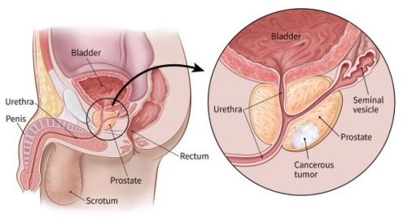
Prostate Cancer
Basics:
Most common male malignancy
Most are slow growing but some can be very aggressive and malignant
Risk factors:
Afro-Caribbean, family history/genetics, increasing age, anabolic steroids
Presentation:
LUTS, weight loss, fatigue, night sweats, bone pain
Common metastasis to bone (sclerotic bony lesions), brain, liver and lung
Investigations:
DRE and PSA are done in community, Transrectal USS and biopsy = DIAGNOSTIC
Gleason grading system - higher the score the worse the prognosis
Management:
If local - prostatectomy (<70), active surveillance (>70 and low risk), radiotherapy
If metastatic - chemotherapy, radiotherapy, bilateral orchidectomy (gold standard hormonal treatment), Goserelin (LHRH receptor blocker), palliative treatments focus on relieving symptoms e.g. TURP
Most hormone sensitive malignancy

Slide 13
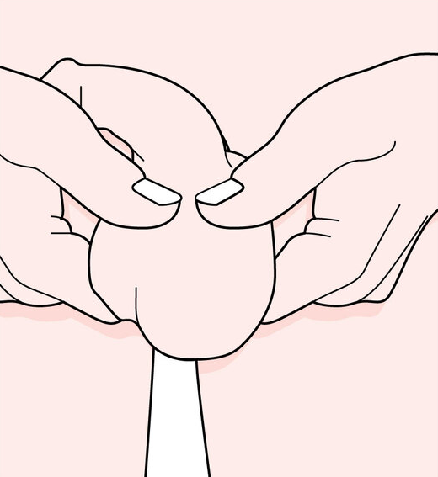

Slide 14
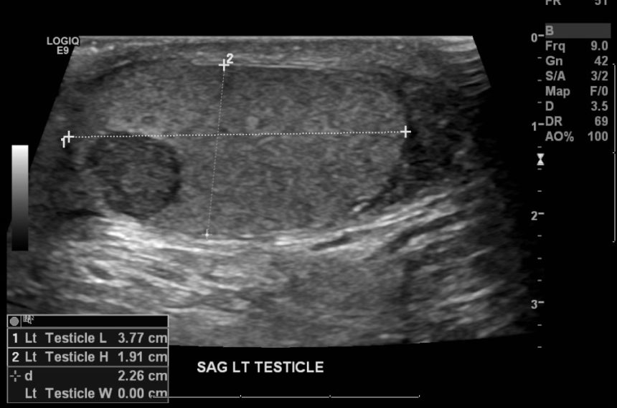
Testicular Cancer
Basics:
Most common solid tumour in men aged 20-45
Good survival rate (98% 5-year survival)
Categorised by their cell type - 90% are germ cell tumours (seminomas, teratoma, choriocarcinoma), others are non-germ cell tumours (sertoli, leydig, lymphoma, mesenchymal)
Risk factors:
Age 20-45, caucasian, cryptorchidism, previous testicular cancer, HIV, family history
Investigations:
Urgent USS of the testes
CXR if symptomatic for pulmonary mets
Tumour markers (not always raised, not diagnostic, can be useful to check response before + after surgery) - alpha fetoprotein, hCG, LDH
Management:
Urgent radical inguinal orchidectomy +/- testicular prosthesis
Semen cryopreservation
Treatment for metastatic disease - retroperitoneal lymph node dissection if tumour has metastasised to lymph nodes, chemotherapy, radiotherapy
Presentation:
Palpable lump within the testis
Non-transilluminable (light can’t get through tumour)
May be painful/ painless
Often found on self-examination
Haematospermia

Slide 15
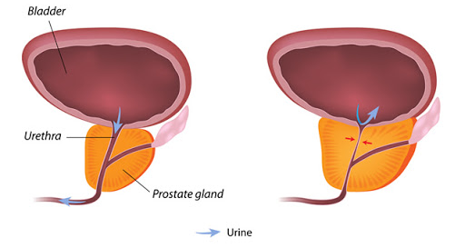

Slide 16
BPH
Investigations:
Digital rectal exam - show smooth but enlarged prostate
PSA - not overly accurate but usually done for completion (remember you can’t do this at the same time as DRE)
Bladder diaries etc.
Basics:
Hyperplasia of the inner transitional
zone of prostate gland which partially
blocks the urethra = BPH
This is a normal part of ageing for men
Management:
Lifestyle - reduce caffeine/alcohol intake, relax when voiding
1st line = alpha blockers e.g. tamsulosin
Relaxes smooth muscle in bladder neck and prostate
2nd line = 5-alpha reductase inhibitors e.g. finasteride
Blocks conversion of testosterone to dihydrotesterone which decreases prostate size
If does not respond to medication consider surgery:
TURP = GOLD STANDARD
Required if there is acute urinary retention, gross haematuria or spreads to kidneys
Presentation = LUTS
Storage | Voiding
Frequency | Poor/intermittent stream
Urgency | Post-micturition dribbling
Nocturia | Straining
Urgency incontinence | Incomplete emptying
 | Hesitancy

Slide 17
Loin Pain
Fever
Pyuria

Slide 18
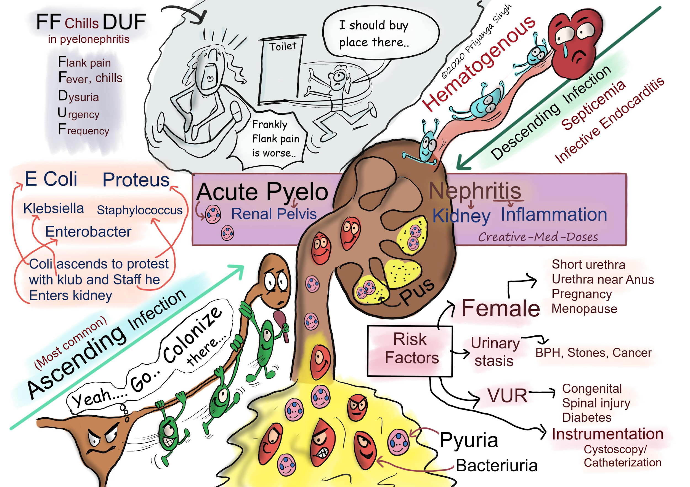
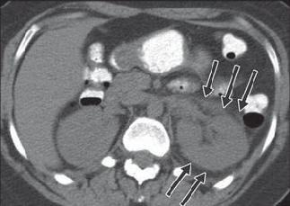
Pyelonephritis
Basics:
Infection of the kidneys/upper ureter
Most commonly acquired via ascending transurethral spread
but can be via blood or lymphatics
Majority are caused by UPEC
Presentation:
Triad of loin pain, fever and pyuria
May also have back pain, severe headache, nausea and vomiting, associated cystitis symptoms
Investigations:
Urine dipstick (1st line)
Mid-stream urine MC+S (GOLD STANDARD)
Urgent USS to detect stones, obstruction or incomplete bladder emptying
Management:
Analgesia
Abx (cipro/co-amoxiclav, may require IV if severe)

Slide 19
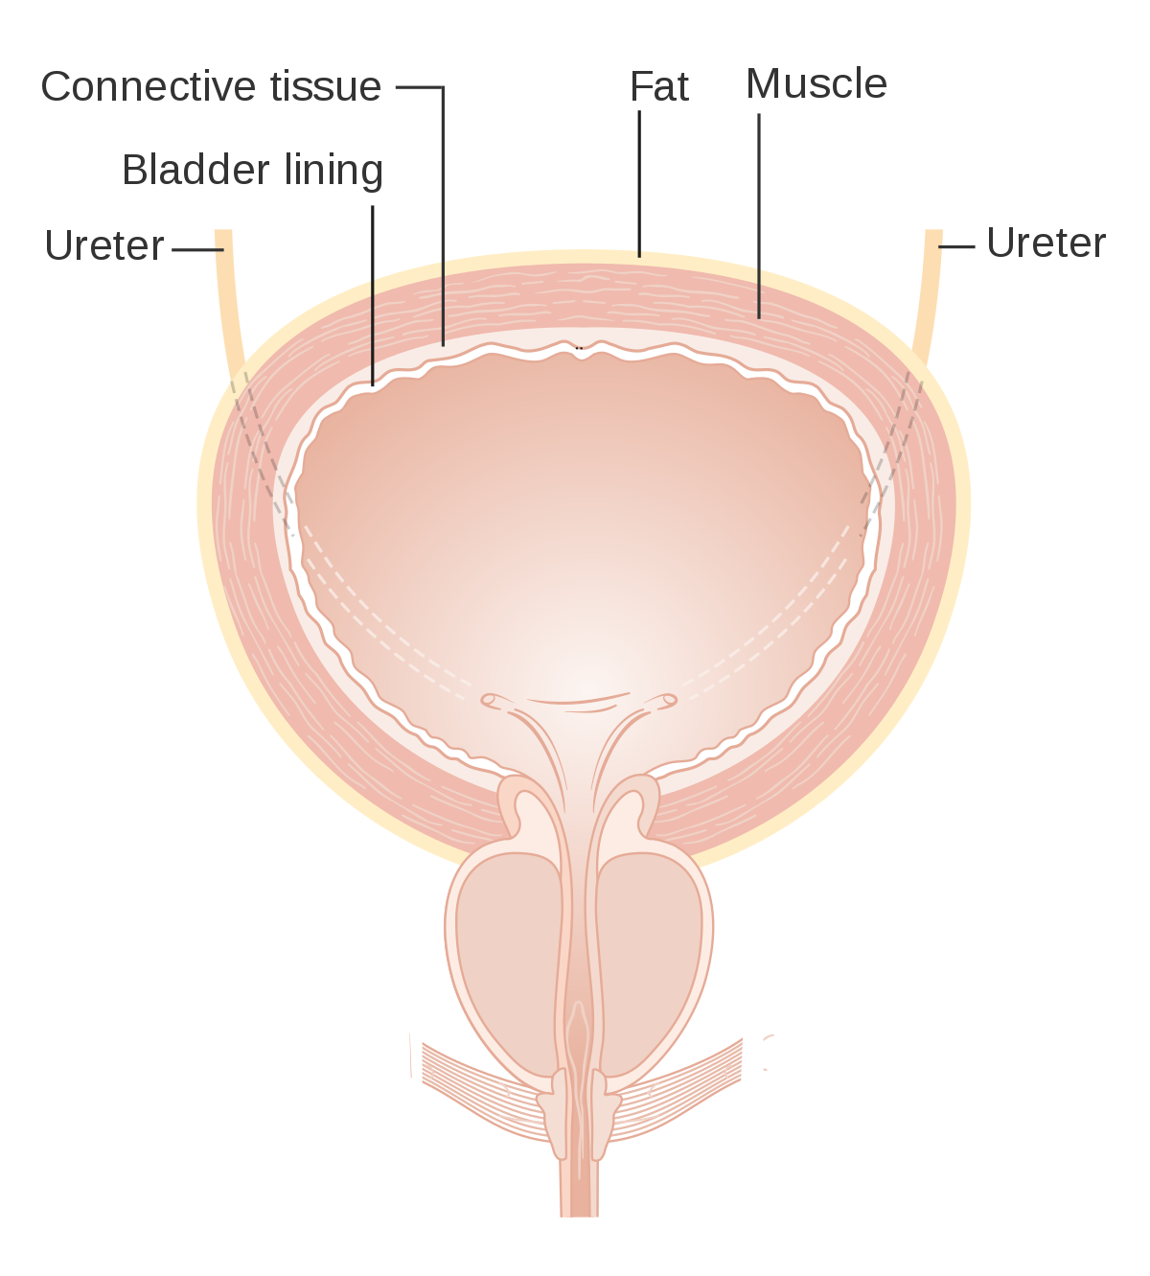
E.coli
E.coli
E.coli
E.coli
E.coli

Slide 20
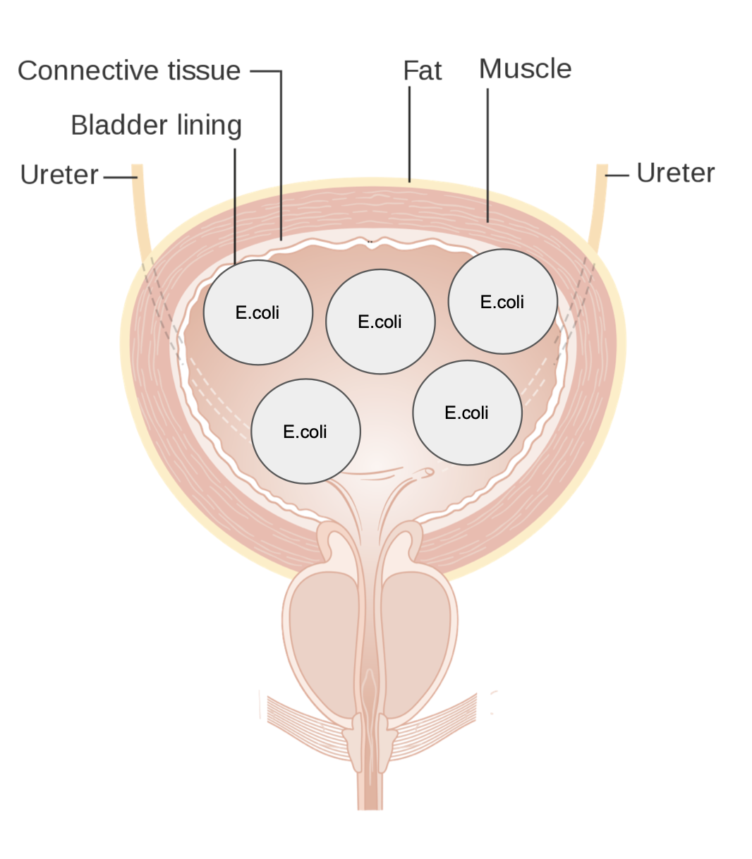
Cystitis
Basics:
Infection of the bladder
Occurs in children, females, pregnancy and those with catheters
Women are more susceptible due to shorter urethra and short proximity to anus which allows bacteria transfer
KEEPS - Klebsiella, E.coli (most common), Enterococci, Proteus species, Staph aureus/saprophyticus
Presentation:
Dysuria, frequency, urgency, suprapubic pain, haematuria and polyuria, incontinence, confusion (in elderly)
Investigations:
1st line = urine dipstick = + leukocytes/blood/nitrates
GOLD STANDARD = mid-stream MC+S
Management:
Trimethoprim/nitrofurantoin (3 day course for women, 7 day for men/complicated women)
In pregnancy = trimethoprim cannot be used in 1st trimester (inhibits folate synthesis), nitrofurantoin cannot be used in 3rd trimester - amoxicillin, cefalexin can both be used

Slide 21
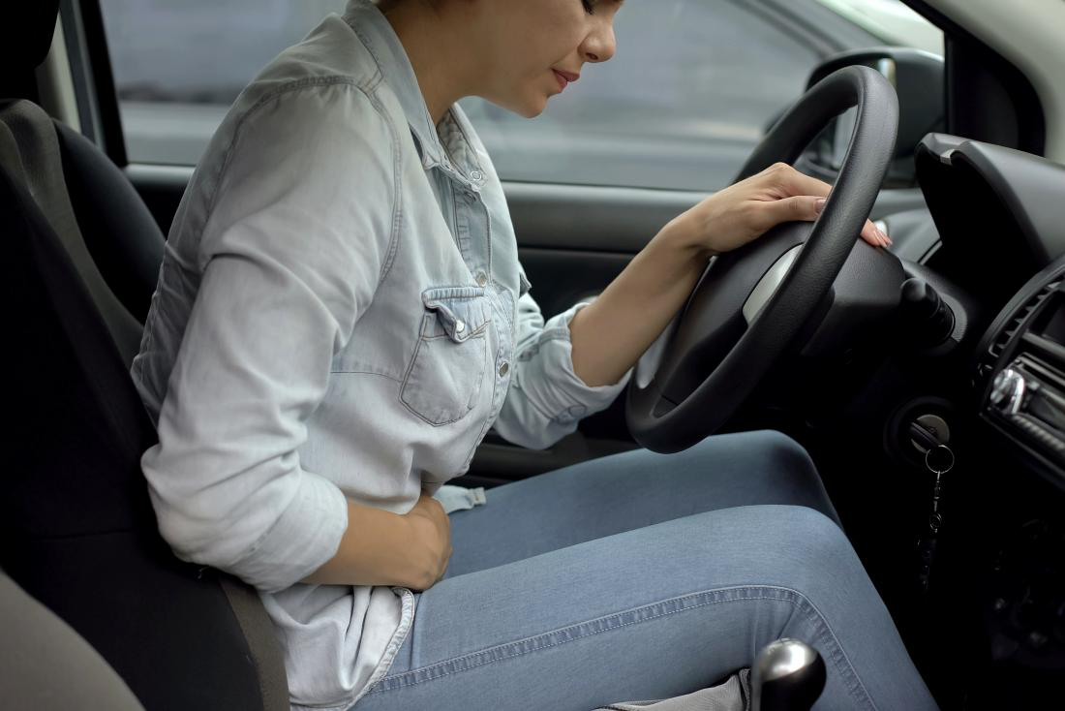
Gonorrhoea
Cystoscopy
Catheterisation

Slide 22
Urethritis
Basics:
Urethral inflammation due to infectious or non-infectious cause
Non-gonococcal urethritis > gonococcal urethritis
Causes:
N.gonorrhoea
Chlamydia, mycoplasma genitalium, ureaplasma urealyticum, trichomonas vaginalis - do not waste your time learning these!
Trauma (inc iatrogenic instrumentation), urethral stricture, irritation, urinary calculi
Presentation:
Skin lesion
Dysuria +/- discharge (blood/ pus)
Urethral pain
Penile discomfort/ pruritus
Investigations:
STI testing
Microscopy + culture of urethral discharge
Blood cultures
Urine dipstick to exclude UTI
Urethral smear
? flexible cystoscopy
Management:
Management of underlying cause - antibiotics, partner notification
Reactive arthritis = triad of conjunctivitis, urethritis + arthritis “can’t see, can’t pee, can’t climb a tree”

Slide 23
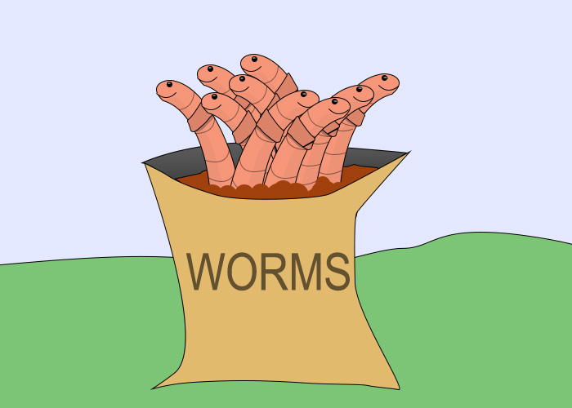

Slide 24
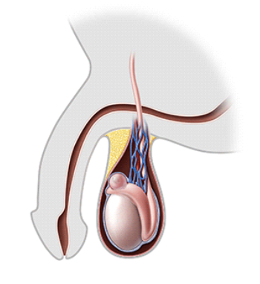
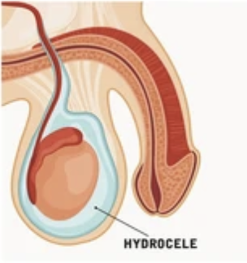
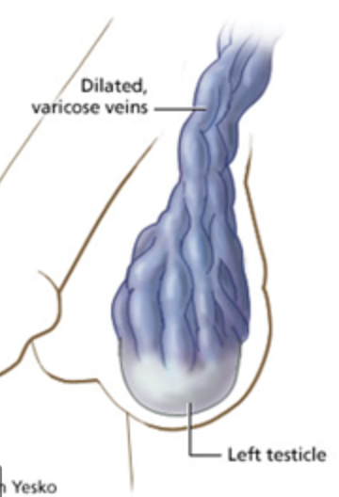
Scrotal Disease
Epididymal cyst
Smooth extra testicular spherical cyst at the epididymis (top of the testicle)
Contains clear and milky fluid
May be multiple and bilateral
When they get large can be painful
TRANSLUMINATES (fluid filled)
Can palpate the cyst and the testis separately
Not treatment is necessary usually
Hydrocele
Abnormal collection of fluid in the tunica vaginalis
Simple = overproduction of fluid
Communicating = peritoneal
fluid and scrotum are connected
Non-tender smooth cystic swelling
Painless unless infected
TRANSLUMINATES
Most resolve spontaneously
Most similar to testicular cancer so rule this out
Varicocele
Abnormal dilation of testicular veins in pampiniform venous plexus
Left side more commonly affected (angle that left testicular vein enters left renal vein)
Presentation = feels like a bag of worms, dragging/soreness/heaviness of scrotum
Surgical repair if there is pain,
infertility or testicular atrophy

Slide 25
Questions?
Kahoot

Slide 26
Quiz Questions Ideas:
Amy, 26F. On dipstick you find she is positive for leukocytes and nitrites, with a slight trace of blood. She complains of dysuria and is slightly febrile. First line drug? What about if she was 6 weeks pregnant?

Slide 27
Stones
Who needs urgent treatment?
Paul, 66M, imaging showed 3mm stone, complaining of severe discomfort and can’t sit still
Jane, 54F, imaging showed a unilateral 15mm stone, describes the pain as worse than childbirth, afebrile
Mike, 36M, imaging showed a 8mm stone, bloods show high WCC, elevated creatinine, urea and potassium

Slide 28
Stones
Should be small enough to pass spontaneously
Who needs urgent treatment?
Paul, 66M, imaging showed 3mm stone, complaining of severe discomfort and can’t sit still
Jane, 54F, imaging showed a unilateral 15mm stone, describes the pain as worse than childbirth, afebrile
Mike, 36M, imaging showed a 8mm stone, bloods show high WCC, elevated creatinine, urea and potassium
Likely too big to pass spontaneously but not urgent - elective
Signs of infection + AKI

Slide 29
Bladder Cancer
Martin is a 76 year old retired painter who pays a visit to the haematuria outpatient clinic with suspected bladder cancer. Which of these is not a routine investigation within this clinic?
CT urogram
Flexible cystoscopy
Ultrasound
Urine microscopy + culture

Slide 30
Bladder Cancer
Martin is a 76 year old retired painter who pays a visit to the haematuria outpatient clinic with suspected bladder cancer. Which of these is not a routine investigation within this clinic?
CT urogram
Flexible cystoscopy
Ultrasound
Urine microscopy + culture

