Slide 1
Gynaecology
Phase 3A
Rosie O’Donoghue and Lizzy Stedman
The Peer Teaching Society is not liable for false or misleading information.

Slide 2
Introduction
Menstrual disorders
Amenorrhea
Prolapse and urinary problems
Menopause
Gynaecological cancers
The Peer Teaching Society is not liable for false or misleading information.

Slide 3
Menstrual Disorders – Dysmenorrhea
Primary dysmenorrhoea
No organ pathology, starting at menarche, spasmodic type pain
Present to some extent in most women
Management – explanation of symptoms, simple OTC analgesics or PG inhibitors e.g. mefenamic acid, COCP to prevent ovulation, can tricycle the pill back to back if symptoms severe or very disruptive
The Peer Teaching Society is not liable for false or misleading information.

Slide 4
Secondary Dysmenorrhea
Common causes
- Endometriosis
- PID
- Fibroids
Less common causes
- Adenomysosis
Ashermans Syndrome
Adhesions
The Peer Teaching Society is not liable for false or misleading information.

Slide 5
Endometriosis
Presence of ectopic endometrial tissue outside the uterus – most commonly in pelvic peritoneum
Aetiology unknown but commonly accepted theory is retrograde menstruation – Sampson’s theory
Pelvic deposits thicken cyclicallly causing inflammatory response and pain leading to chronic inflammation and formation of adhesions

Slide 6
Symptoms
Dysmenorrhoea (normally worst leading up to or just prior to menstruation)
Pelvic pain (chronic)
Deep dyspareunia
Subfertility
Dysuria
Dyschezia
Rectal bleeding
Haematuria

Slide 7
Signs
Tenderness in Iliac fossa
Adnexal/posterior fornix tenderness on examination
Mass in iliac fossa - Endometrioma
Fixed pelvic organs
Nodules on PV in pouch of douglas
Nodules in rectovaginal septum on PR examination

Slide 8
Diagnosis
Diagnostic laparoscopy gold standard – presecence of chocolate cysts, endometriotic plaques, powder burn appearance
Diagnosis confirmed by biopsy of lesions/chocolate cyst – presence of endometrial stroma and glandular tissue
CA125 not useful in diagnosis

Slide 9
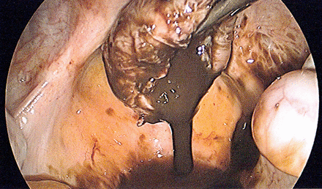

Slide 10
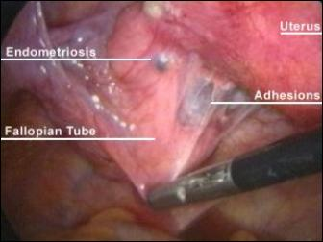

Slide 11
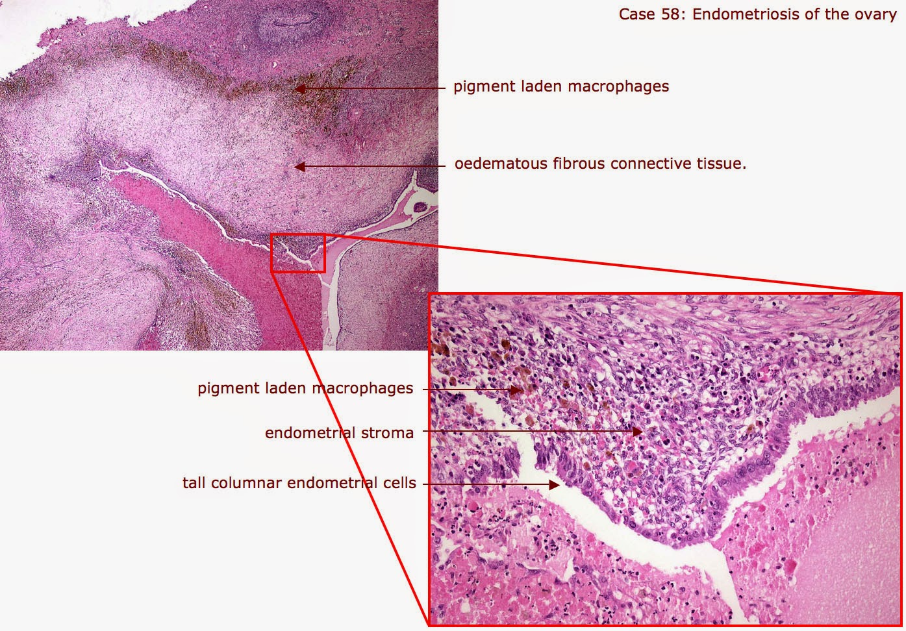

Slide 12
Management
Symptom relief – analgesia, may require weak opioids
Medical treatment
- Inhibition of ovarian hormones
COCP
Prostestogens such as depo provera or implant
Mirena coil
GnRH analogues eg. zoladex leading to medical menopause
Role of aromatse inhibitors being considered
Surgical treatment
– Excision of endometrial deposits and adhesiolysis using diathermy or laser (only option for subfertility)

Slide 13
Pelvic Inflammatory disease
infection of the upper female genital tract, including the uterus, Fallopian tubes, and ovaries.
can damage the Fallopian tubes and tissues in and near the uterus and ovaries. Untreated PID can lead to serious complications, including infertility, ectopic pregnancy, abscess formation and chronic pelvic pain.

Slide 14
Presentation
Acute bilateral pelvic pain
Deep dyspareunia
Abnormal vaginal bleeding
Vaginal or cervical discharge that is purulent
Signs
Lower abdominal tenderness
Right UQ pain - fitz-hugh-curtis syndrome
Mucopurulent cervical discharge and cervicitis on speculum examination
Cervical motion tenderness and adnexal tenderness on bimanual examination.
Fever (but may be apyrexial).

Slide 15
Diagnosis
Pain history
Sexual history
PMH
Investigations – FBC, U + E, LFT, BHCG, ESR, CRP, urinalysis, Pelvic and TV US
Cervical and high vaginal swabs
Laparoscopy gold standard for diagnosis

Slide 16
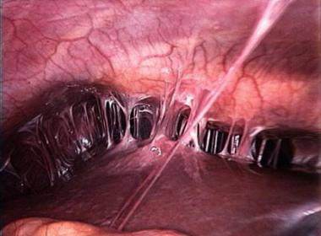

Slide 17
Treatment
outpatient treatment
ceftriaxone 500 mg as a single IM dose, followed by doxycycline 100 mg orally twice daily and metronidazole 400 mg twice daily for 14 days.
severely ill patients is:
IV doxycycline, single-dose IV ceftriaxone and IV metronidazole, then change to oral doxycycline and metronidazole to complete 14 days of treatment.

Slide 18
Fibroids (leiomyoma)
Benign tumours of uterine smooth muscle
Can cause abdominal and pelvic pain due to pressure effects and red degeneration
Menorrhagia – increased surface area in uterine cavity for bleeding to occur from and disruption to SM reduces contracting ability which can increase blood loss.
Can be subserosal, submucosal intramural and intracavity
More common in women of Afro – Caribbean descent

Slide 19
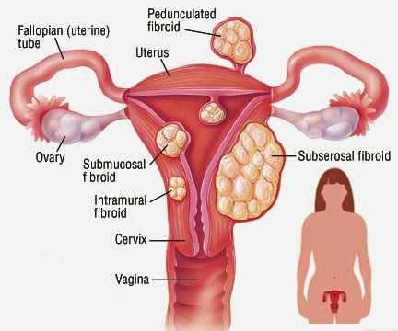

Slide 20
Diagnosis
Exclude IMB/PCB and other red flags related to malignancy
Abdo exam, speculum exam and bimanual exam
Fibroid uterus feels bulky on examination, with uterine enlargement.
Investigations – FBC, BHCG, pelvic and TV USS, hysteroscopy.
Endometrial pipelle biopsy if over 45, have IMB or are treatment resistant to exclude endometrial carcinoma

Slide 21
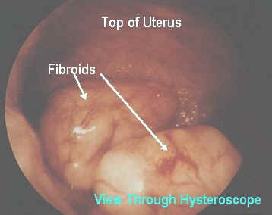

Slide 22
Treat if symptomatic
Medical management
- use of NSAIDS and tranexamic acid to reduce bleeding
Mirena coil can reduce uterine size and reduce bleeding
GnRH analogues and Ulipristal acetate can be used as pre surgery treatment to reduce uterine size

Slide 23
Surgical management
Surgery is indicated when:
There is excessively enlarged uterine size.
Pressure symptoms are present.
Medical management is not sufficient to control symptoms.
The fibroid is submucous and fertility is reduced.

Slide 24
Surgical options
Abdominal Myomectomy- patient can maintain reproductive potential or keep their uterus
4-17% of women will later go on to have a hysterectomy.
Laparoscopic Myomectomy - best treatment option for symptomatic women with symptomatic subserous fibroids, who wish to maintain their fertility
Total hysterectomy – formerly mainstay of treatment, now reserved for women who have completed their family, or have many fibroids too complicated for myomectomy.

Slide 25
Adenomyosis – prescence of ectopic endometrial tissue within the wall of the myometrium. Similar medical management to that of endometriosis
Ashermans syndrome – intrauterine adhesions causing dysmenorrhea. Associated with previous dilation and curettage. Diagnosed on hysteroscopy as gold standard, treated by surgical removal of adhesions with varying prognostic outcomes.

Slide 26
Amenorrhea
Absence of menstruation
Primary amenorrhoea -menses have not occurred by the time of the expected menarche.
age 14 years in the absence of secondary sexual characteristics, but 16 years if other features are developing normally.
The Peer Teaching Society is not liable for false or misleading information.

Slide 27
Secondary amenorrhoea with no signs of androgen excess
PREGNANCY!
Premature ovarian failure
Weight loss – athletes, anorexia nervosa
Pituitary disease such as a prolactinoma or sheehans syndrome - the pituitary may be damaged by tumours, trauma, cranial irradiation, sarcoidosis or tuberculosis.
Post pill or other hormonal contraceptive

Slide 28
Secondary amenorrhea with signs of androgen excess
PCOS
Cushings syndrome
Late onset congenital hyperplasia
Adrenal or ovarian carcinoma producing androgens

Slide 29
Polycystic Ovarian Syndrome
Presentation
Patient in teens or 20’s
Oligomenorrhoea - <9 periods per year
subfertility
Acne
Hirsutism
Alopecia
Obesity or difficulty losing weight
mood swings, depression, anxiety, poor self-esteem

Slide 30
Signs
Hirsutism - often on the upper lip, chin, around the nipples and in a line beneath the umbilicus
Male-pattern balding, alopecia
Obesity - usually central
Acanthosis nigricans – think insulin resistance

Slide 31
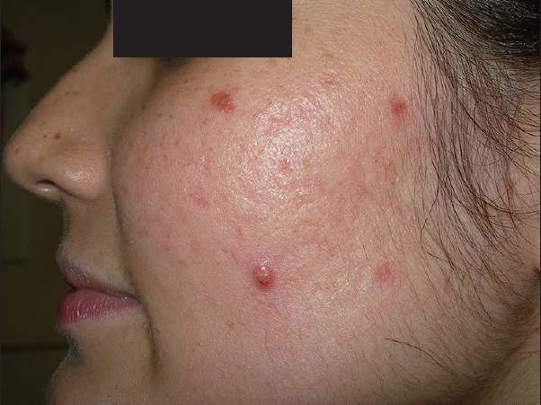

Slide 32
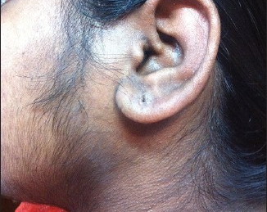

Slide 33
Investigations
Pelvic ultrasound – string of pearls appearance
Testosterone binding hormone, free androgen index, oestradiol, LH and FSH on days 1- 3, TSH, TFT, Prolactin, OGTT if BMI over 30
May show increased LH with increased LH:FSH ratios and a normal FSH

Slide 34
Rotterdam criteria
Two of the three following criteria are diagnostic of the condition
Polycystic ovaries (either 12 or more peripheral follicles or increased ovarian volume (greater than 10 cm3)
Oligo-ovulation or anovulation
Clinical and/or biochemical signs of hyperandrogenism

Slide 35
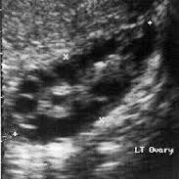

Slide 36
Treatments
Co-cyprindrol: treating hirsutism and acne, although not specifically in PCOS.
Combined oral contraceptive pill (COCP): is also used to control menstrual irregularity. If risk factors deem women ineligible, progesterones may be used.
Metformin: has been increasingly used off-licence for PCOS; side effects may outweigh benefits!
Eflornithine: may be used for hirsutism, as can cosmetic treatments (electrolysis, laser, waxing, bleaching).
Orlistat: can help with weight loss in women with PCOS and may improve insulin sensitivit

Slide 37
For women wishing to concieve
Clomifene - induces ovulation and has been proven to improve pregnancy rates. It should not be used for more than six months and, as it is associated with a risk of multiple pregnancy, women should have ultrasound monitoring during treatment.
Metformin: may be used instead of or together with clomifene to improve pregnancy rates
Laparoscopic ovarian drilling or gonadotrophins: are second-line treatments for those who are resistant to medical treatment.

