Slide 1
Hepatopancreatobiliary
Tom Drake and Fran Young

Slide 2
The Bilirubin Cycle

Slide 3
Liver Function Tests
Notes:
-Pre
-Hep
-Post

Slide 4
Hepatotoxicity
ALP- Cholestasis
ALT-Hepatocyte damage
yGT-Cholestasis

Slide 5
Synthetic Liver Function
Albumin
PT- Prolonged in almost all liver problems- Cholestasis to do with Vit K
INR
Protein/Globulin

Slide 6
Clinical Examination

Slide 7
Clinical Examination
Gynaecomastia
Spider Naevi
Palmar erythema
Caput medusae
Bleeding
Jaundice
Bruising
Encephalopathy
Murmurs (Cruveilhier-Baumgarten)

Slide 8
Ascites
Notes:
Transudate, Exudate
Up to 35L of
Portal HTN

Slide 9
Jaundice

Slide 10
Pre-Hepatic Causes
Haemolysis
Genetic
Symptoms?

Slide 11
Hepatic Causes
Hepatitis
Drug Toxicity
Liver disease (Cirrhosis, NAFLD)
Infections
Symptoms?
Notes:
Conjugated itchy!!!

Slide 12
Post-Hepatic Causes
Any obstruction of the biliary tree
Causes
Symptoms?

Slide 13
Liver
Hepatitis
Cirrhosis
Malignancy

Slide 14
Hepatitis
Viral
Autoimmune
Drug-induced
NAFLD
Ischaemic

Slide 15
Viral Hepatitis
A, B, C, D, E
B and D
High-risk group
Investigation

Slide 16
Viral Hepatitis
A, B, C, D, E
B and D
High-risk groups
Investigation

Slide 17
Viral Hepatitis
Acute phase Nausea, vomiting, appetite, jaundice Hep C
Chronic phase
Outcomes -50% of Hepatocellular Carcinoma -Liver failure

Slide 18
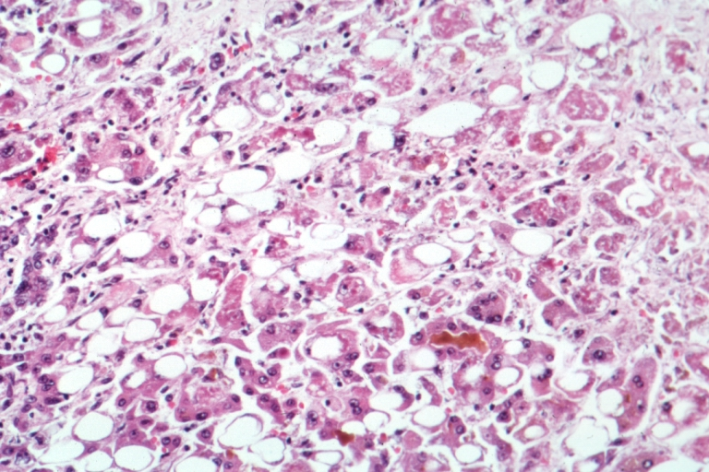
Alcoholic Hepatitis and NAFLD
Notes:
Mallory bodies and steatosis

Slide 19
Cirrhosis
Replacement of liver tissue by fibrosis and regenerative nodules
End stage liver disease
Irreversible loss of liver function
Decompensated Cirrhosis
Notes:
Mallory bodies

Slide 20
Biliary Tree
Cholecystitis
Ascending Cholangitis
Primary Biliary Sclerosis

Slide 21
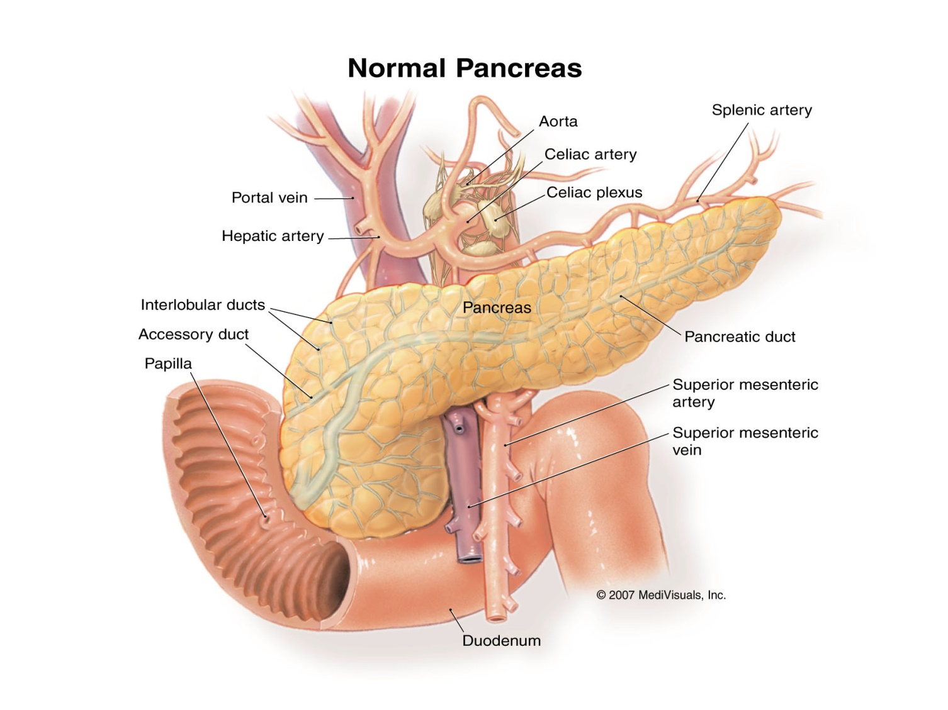
Acute Pancreatitis
Causes
Investigation
Glasgow and VAPOR
Treatment -Fluids -Pain Relief -?Antibiotics
Notes:
Lipase, cultures, MRCP, CT

Slide 22
Acute Pancreatitis
Causes
Investigation
Glasgow and VAPOR
Treatment -Fluids -Pain Relief -?Antibiotics
Notes:
Lipase, cultures, MRCP, CT

Slide 23
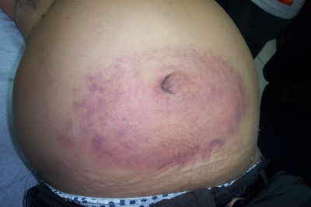
Acute Pancreatitis
Notes:
Lipase, cultures, MRCP, CT

Slide 24
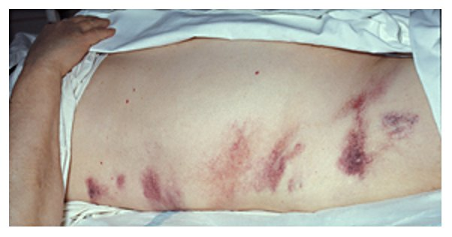
Acute Pancreatitis
Notes:
Lipase, cultures, MRCP, CT

Slide 25
Chronic Pancreatitis
Causes
Investigation
Treatment
Pancreatic insufficiency
Notes:
Similar causes as to acute
Gold standard investigation is serum secretin test

Slide 26
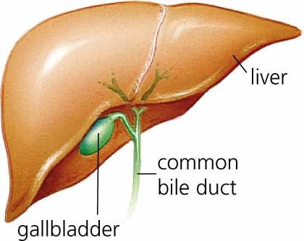
Cholecystitis

Slide 27
Cholecystitis
Symptoms
Causes
Examination
Investigation
Notes:
Caused by gallstone, infection, cholangitis

Slide 28
Choledocholithiasis /Cholecystitis
What is says on the tin.
ERCP/MRCP
“Hot” Lap-chole
Fluids and antibiotics
Notes:
Ursodeoxy, ERCP, Shockwave

Slide 29
Ascending Cholangitis
Causes
Symptoms- Charcot’s Triad
Investigation
Treatment
Notes:
EMERGENCY- Resus and antibiotics
Cholecystectomy/obstruction… Fever RUQpain and jaundice
Raise across all and elevated bili

Slide 30
Pancreatic Cancer
Bad.
Risk Factors
Causes
Types

Slide 31
Pancreatic Cancer
Symptoms
Signs
Investigation
Treatment
Prognosis
Notes:
-

Slide 32
Questions

