Slide 1
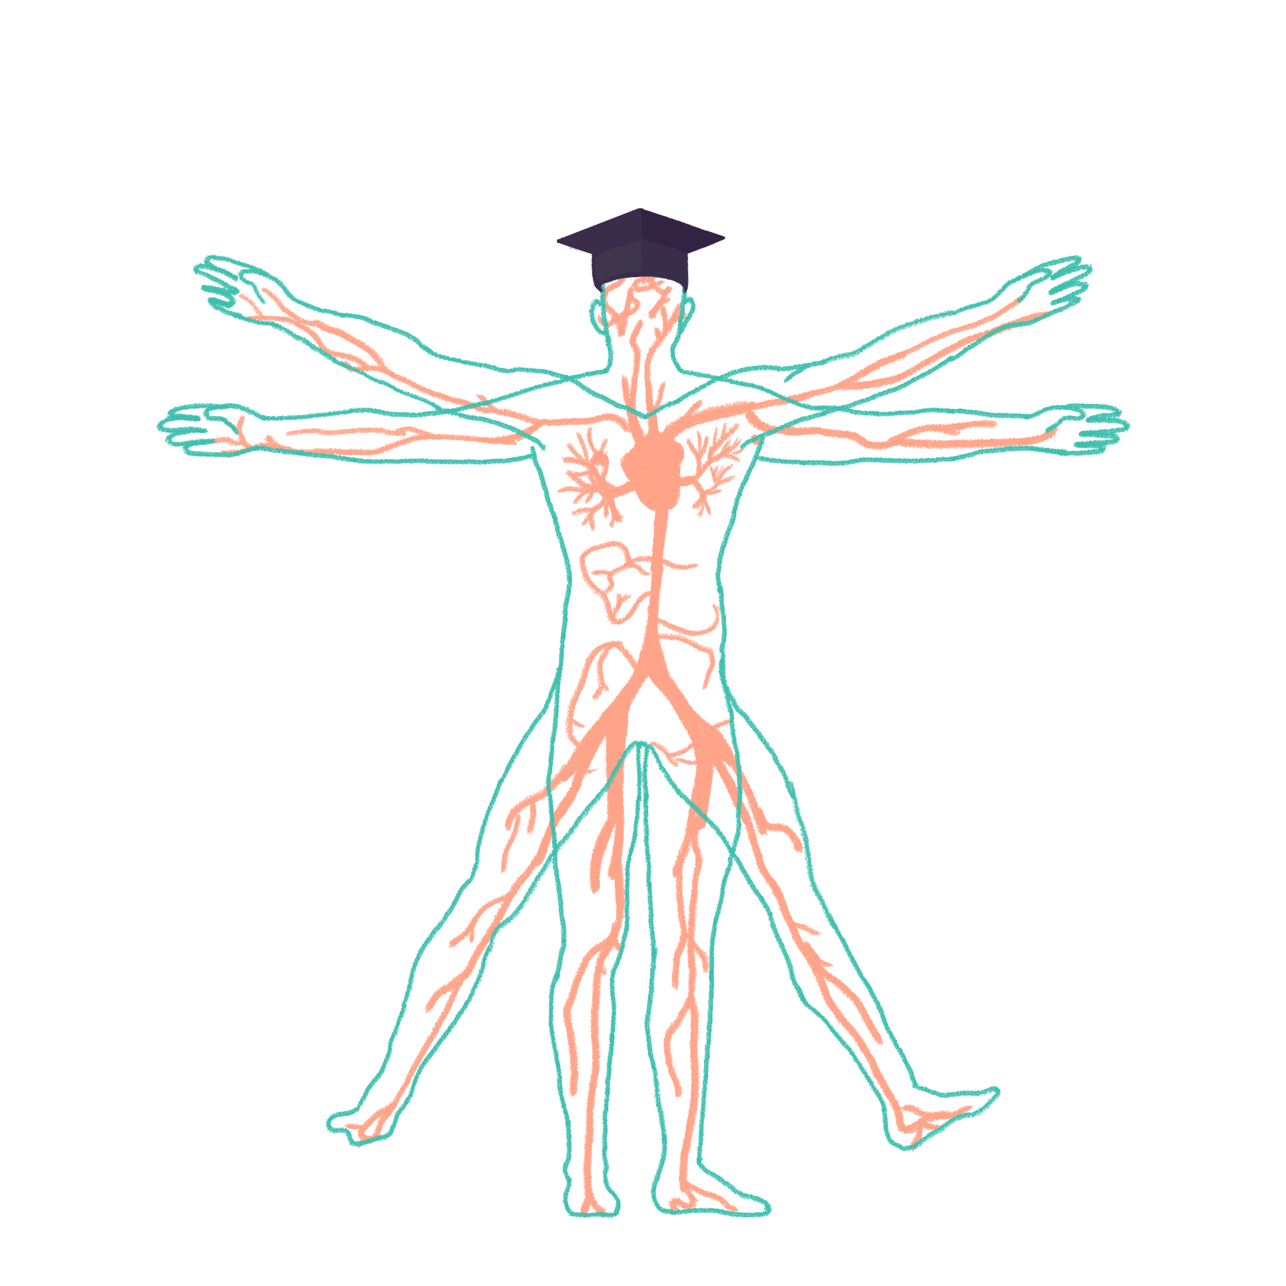
2022/2023

Slide 2
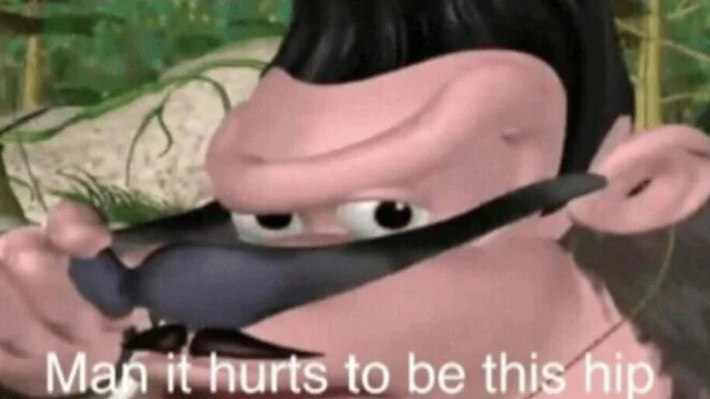
Hip and Knee Examination
Phase 2b Revision Session
Josh Palmer + Jeremy Maganji
jpgjimmyedwinpalmer1@sheffield.ac.uk
sjmaganji1@sheffield.ac.uk
02/08/22 6pm
The Peer Teaching Society is not liable for false or misleading information…

Slide 3
Aims and Objectives
Detailed steps on the hip examination.
Performance of the hip exam.
Detailed steps on the knee examination.
Performance of the knee exam.
General tips and advice.
The Peer Teaching Society is not liable for false or misleading information…

Slide 4
MSK Examinations in general…..
Introduction
Some Questions
Inspection (LOOK)
Palpation (FEEL)
Movement (MOVE)
Passive
Active
Special Tests
Conclusion
The Peer Teaching Society is not liable for false or misleading information…

Slide 5
Hip Exam Introduction
WIPE
Wash your hands
Introduce oneself
Patient Details and Permission
Explain and Expose Adequately
Remove trousers, socks and shoes.
OFFER CHAPERONE
Ask for any pain or discomfort anywhere
The Peer Teaching Society is not liable for false or misleading information…

Slide 6
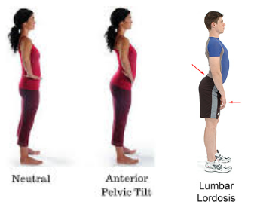
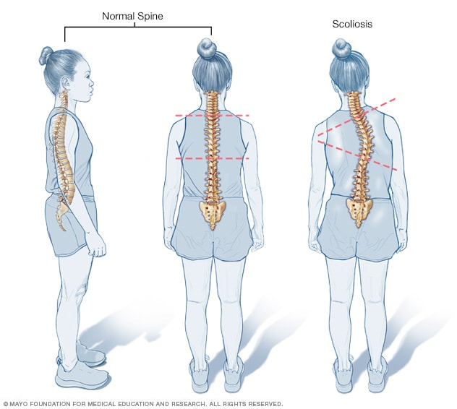
INSPECTION - Standing
Ask the patient to stand and inspect anteriorly:
Pelvic Tilt
Joint deformities -> fixed flexion
Wasting of the quadriceps muscle
Inspect side:
Exaggerated lumbar lordosis
Fixed Flexion deformity of the hip
Inspect back:
Wasting of the gluteal muscles
Scoliosis
Pelvic Tilt?
The Peer Teaching Society is not liable for false or misleading information…

Slide 7
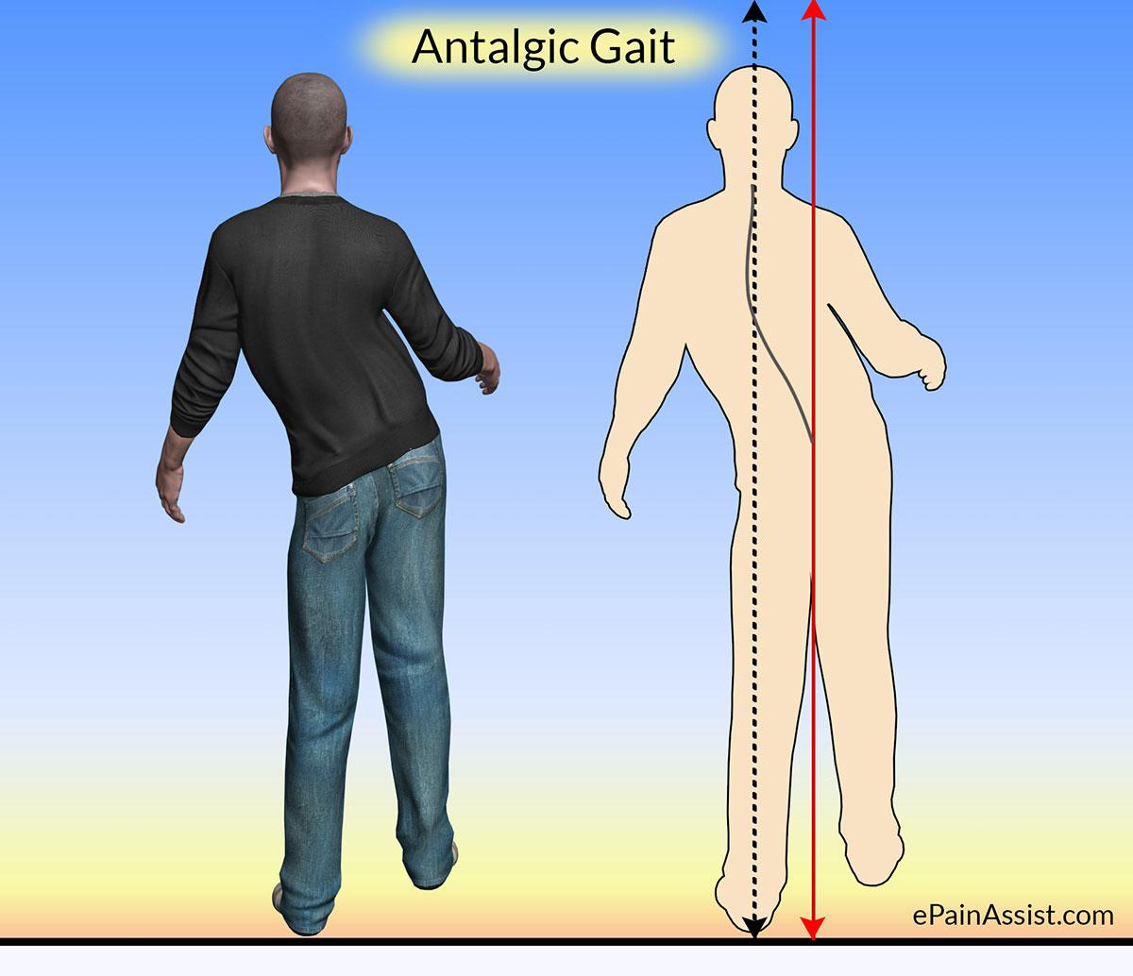
*GAIT – SPECIAL TEST
Look at from every angle
Assess footwear
Speed?
Waddling gait
Hip Pain or Proximal Muscle Weakness
Antalgic gait
Pain on weight bearing
The Peer Teaching Society is not liable for false or misleading information…

Slide 8
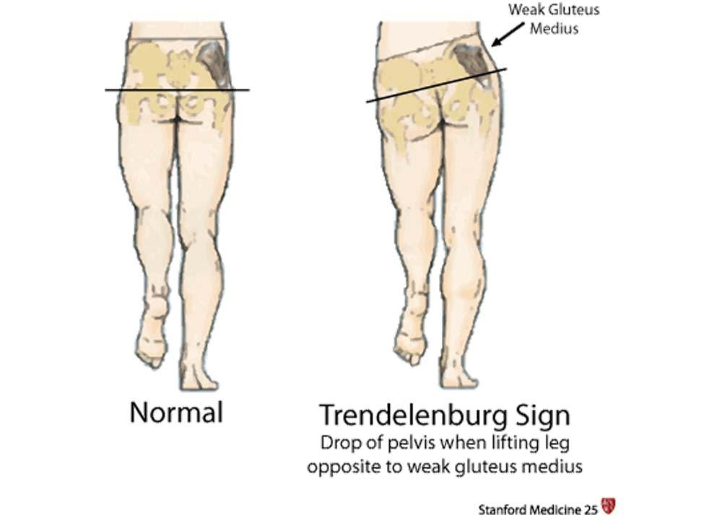
*Trendelenburg’s – SPECIAL TEST
Place hands on each side of the pelvis on iliac crests
Ask the patient to stand on one leg
Positive sign – The pelvis will drop on the contralateral leg
Weak hip abductors
What muscles???
The Peer Teaching Society is not liable for false or misleading information…
Notes:
Gluteus medius and minimus and tensor fasciae latae

Slide 9
INSPECTION - Supine
Inspect for scars in the groin, anterior and lateral thighs.
ROLL PATIENT IF NEEDED
ASSESS SYMMETRY -> Leg Length Discrepancy – use tape measure
Apparent Leg Length:
Xiphisternum -> Medial Malleolus of each leg
Note down measurements.
Influenced by pelvic tilt and spinal pathologies.
The Peer Teaching Society is not liable for false or misleading information…

Slide 10
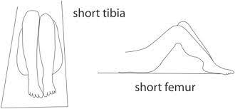
INSPECTION - Supine
True Leg Length:
ASIS -> Medial Malleolus of each leg
Note down measurements.
Tibia or Femur shortening??
Position patient with knees bent to a right angle + heels flat on bed.
Inspect from side.
Place hand across both tibial tuberosities, in femoral shortening hand will dip down towards the shortened side.
Place hand across both suprapatellar regions, in tibial shortening hand will dip down towards the shortened side.
The Peer Teaching Society is not liable for false or misleading information…

Slide 11
PALPATION
Ask for any pain or tenderness in hips.
Assess temperature using the back of the hand.
both sides!
Palpate the greater trochanter for trochanteric bursitis.
The Peer Teaching Society is not liable for false or misleading information…

Slide 12
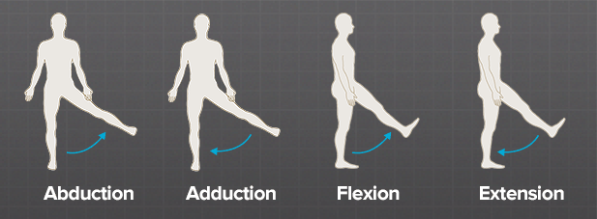
MOVEMENT - Active
40-50°
15-25°
115-125°
Internal and External Rotation -> Passive
30-40 degrees
The Peer Teaching Society is not liable for false or misleading information…

Slide 13
MOVEMENT - Active
Do the same movements with assistance.
Assess degree whilst stabilising the hip.
Feel for any crepitations.
Just watch us.
Examine patient’s face for any pain.
The Peer Teaching Society is not liable for false or misleading information…

Slide 14
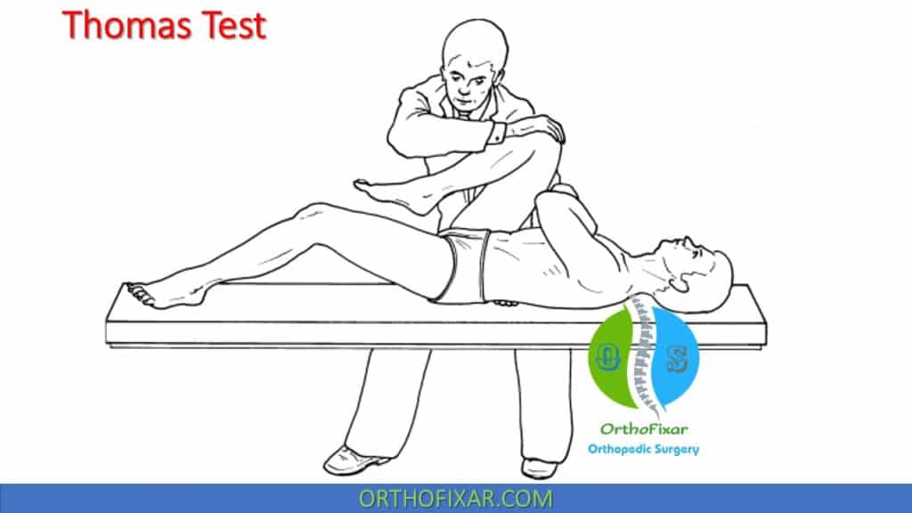
SPECIAL TESTS – Thomas’ Test
Fixed Flexion Deformity
Contralateral raise of thigh
The Peer Teaching Society is not liable for false or misleading information…

Slide 15
COMPLETION
Summarise Findings
Examine above and below the joint
Lumbar Spine and the Ipsilateral Knee joint.
Full neuro and vascular exam of the lower limb.
Thank the patient and request to redress.
The Peer Teaching Society is not liable for false or misleading information…

Slide 16
DEMONSTRATION
The Peer Teaching Society is not liable for false or misleading information…

Slide 17
QUESTIONS?
The Peer Teaching Society is not liable for false or misleading information…

Slide 18
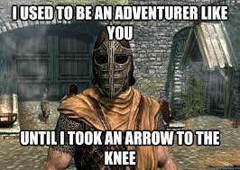
Knee Exam Introduction
WIPE
Wash your hands
Introduce oneself
Patient Details and Permission
Explain and Expose Adequately
Remove trousers, socks and shoes.
Need to see upper thigh for quadriceps
OFFER CHAPERONE
Ask for any pain or discomfort anywhere
The Peer Teaching Society is not liable for false or misleading information…

Slide 19
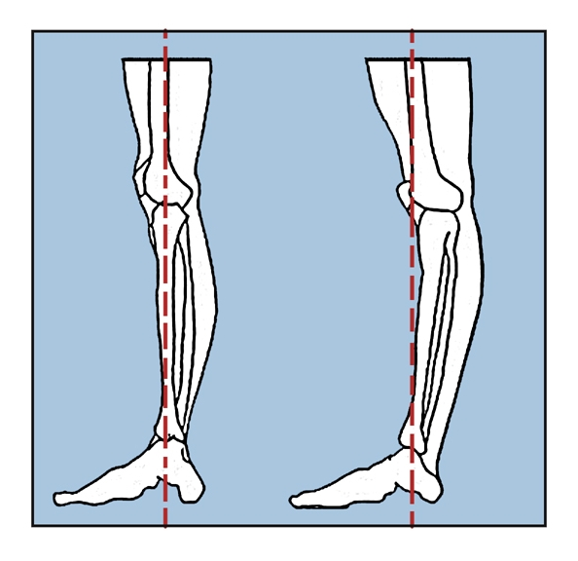
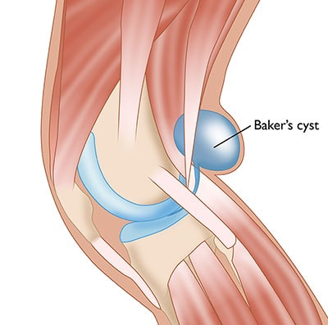
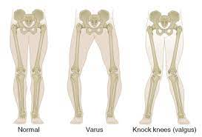
INSPECTION
Bedside:
Mobility aids
Walking stick or Wheelchair
Side:
Knee Hyperextension
Flexion deformity
Anteriorly:
Scars -> previous surgery?
Swelling -> Septic Arthritis?
Asymmetry?
Valgus + Varus Deformity
Muscle Wasting
Posterior:
Popliteal Fossa swellings:
Baker’s Cyst
Popliteal aneurysm
GAIT!
The Peer Teaching Society is not liable for false or misleading information…

Slide 20
PALPATION
Temperature:
Mid-Thigh
Patella
Upper Tibia
When Extended:
Knee
Quadriceps tendon
Patella
When Flexed:
Knee
Patella tendon
Joint line
Head of fibula
Medial + lateral collateral ligaments
Popliteal Fossa
The Peer Teaching Society is not liable for false or misleading information…

Slide 21
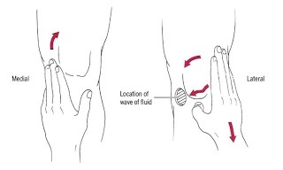
Checking for Effusion
The bulge test (cross-fluctuation).
The patellar tap.
The Peer Teaching Society is not liable for false or misleading information…
Notes:
Bulge test
This test is particularly sensitive in picking up a small effusion. Sweep the hand firmly up the medial fossa, over the suprapatellar pouch and down the lateral fossa. The medial fossa may refill, producing a bulge of fluid
Patella tap
With one hand, compress the suprapatellar pouch to empty it. Use 2 or 3 fingers of the other hand to ‘bounce’ the patella against the femur.

Slide 22
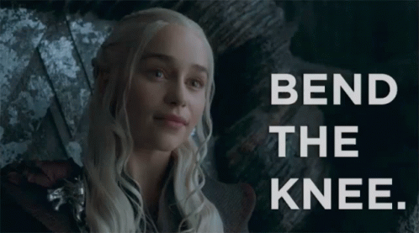
MOVEMENT
Ask the patient to actively flex and extend his knee (normal range of flexion = 135°, normal range of extension = 0°).
Assess passive movement by placing one hand on the patient’s knee and flexing the knee as far as possible with your other hand.
Palpate for crepitus during passive flexion and extension.
The Peer Teaching Society is not liable for false or misleading information…

Slide 23
SPECIAL TESTS
Anterior Draw Test
Posterior Sag Test
Lateral + Medial Collateral Ligament Test
McMurray’s Test
The Peer Teaching Society is not liable for false or misleading information…

Slide 24
COMPLETION
Summarise Findings
Examine above and below the joint
Ipsilateral Hip and Ankle
Full neuro and vascular exam of the lower limb.
Thank the patient and request to redress.
The Peer Teaching Society is not liable for false or misleading information…

Slide 25
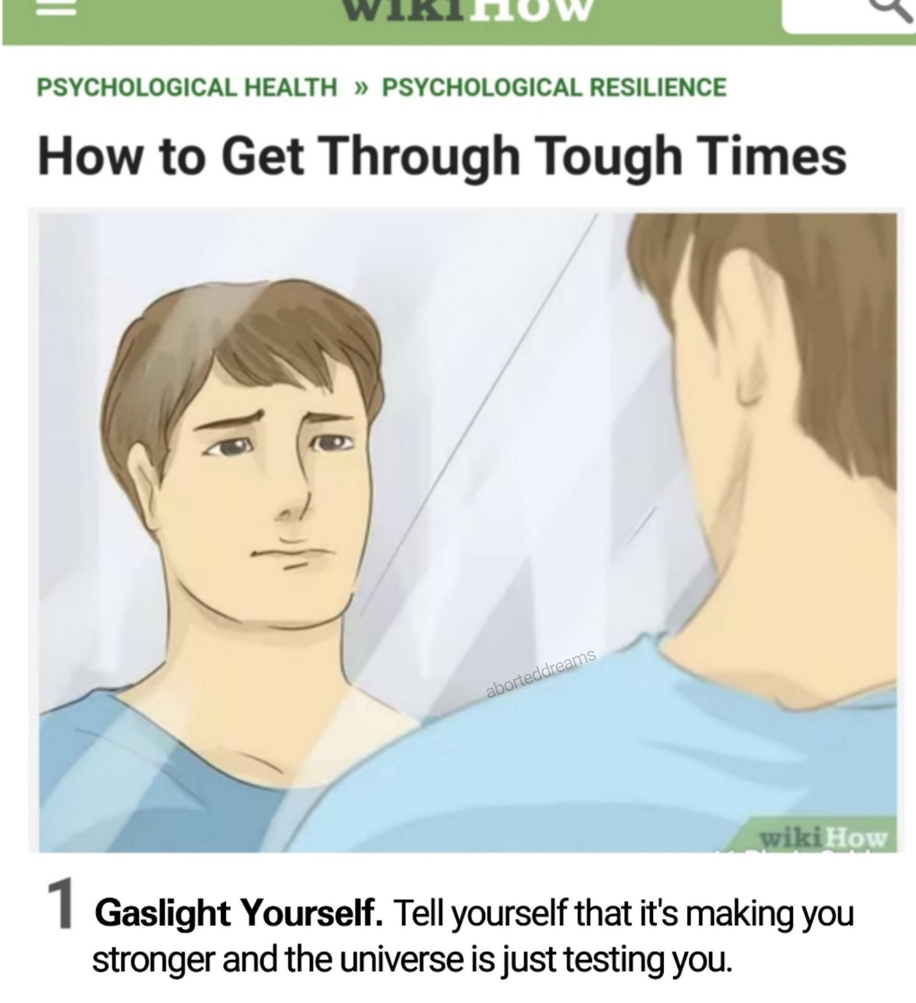
DEMONSTRATION
The Peer Teaching Society is not liable for false or misleading information…

Slide 26
QUESTIONS?
The Peer Teaching Society is not liable for false or misleading information…

Slide 27
Tips and Tricks
Clinical Examination Handbook is your best friend.
Keep practicing until you have the dance memorised.
Buy a teddy.
Geeky Medics Videos.
Alternative Methods are fine if you explain to the examiner.
Time yourself
Don’t forget to revise pathologies!
The Peer Teaching Society is not liable for false or misleading information…

Slide 28
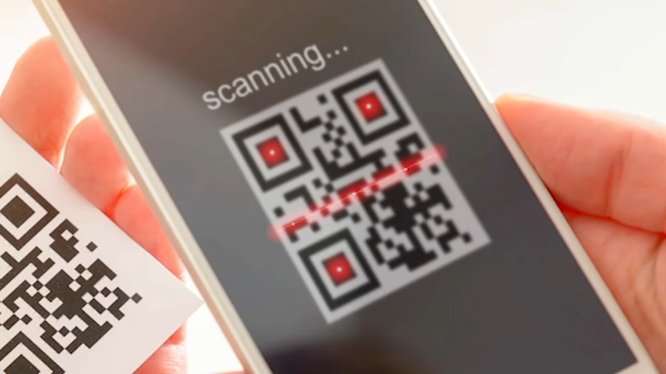
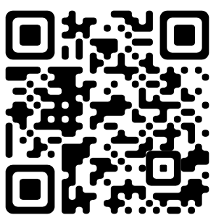
Feedback
https://forms.gle/2k6gZg9XS7odJccR6
The Peer Teaching Society is not liable for false or misleading information…

