Slide 1
Peer teaching PowerPoint brief
Thank you for signing up to deliver a Peer Teaching Society teaching session. We appreciate you taking the time to teach our members. PLEASE DELETE THIS SLIDE BEFORE THE SESSION!
We have upgraded our teaching powerpoint to make it more accessible and friendly for all students. Please use this powerpoint template. Ways to make your teaching more accessible:
Please DO NOT use red and green colours to differentiate between information.
Have the pale background colour that is currently set
When adding labels use a contrasting colour so that it can be easily seen
Don’t have large amounts of text on the pages
Use lots of images
Include the information within the notes box so that students can refer back to the information
Complete your teaching through your allocated blackboard link and if possible please record it for students with learning difficulties
Include a link for teaching feedback as a QR code if you are giving a one-off lecture to receive your feedback.

Slide 2
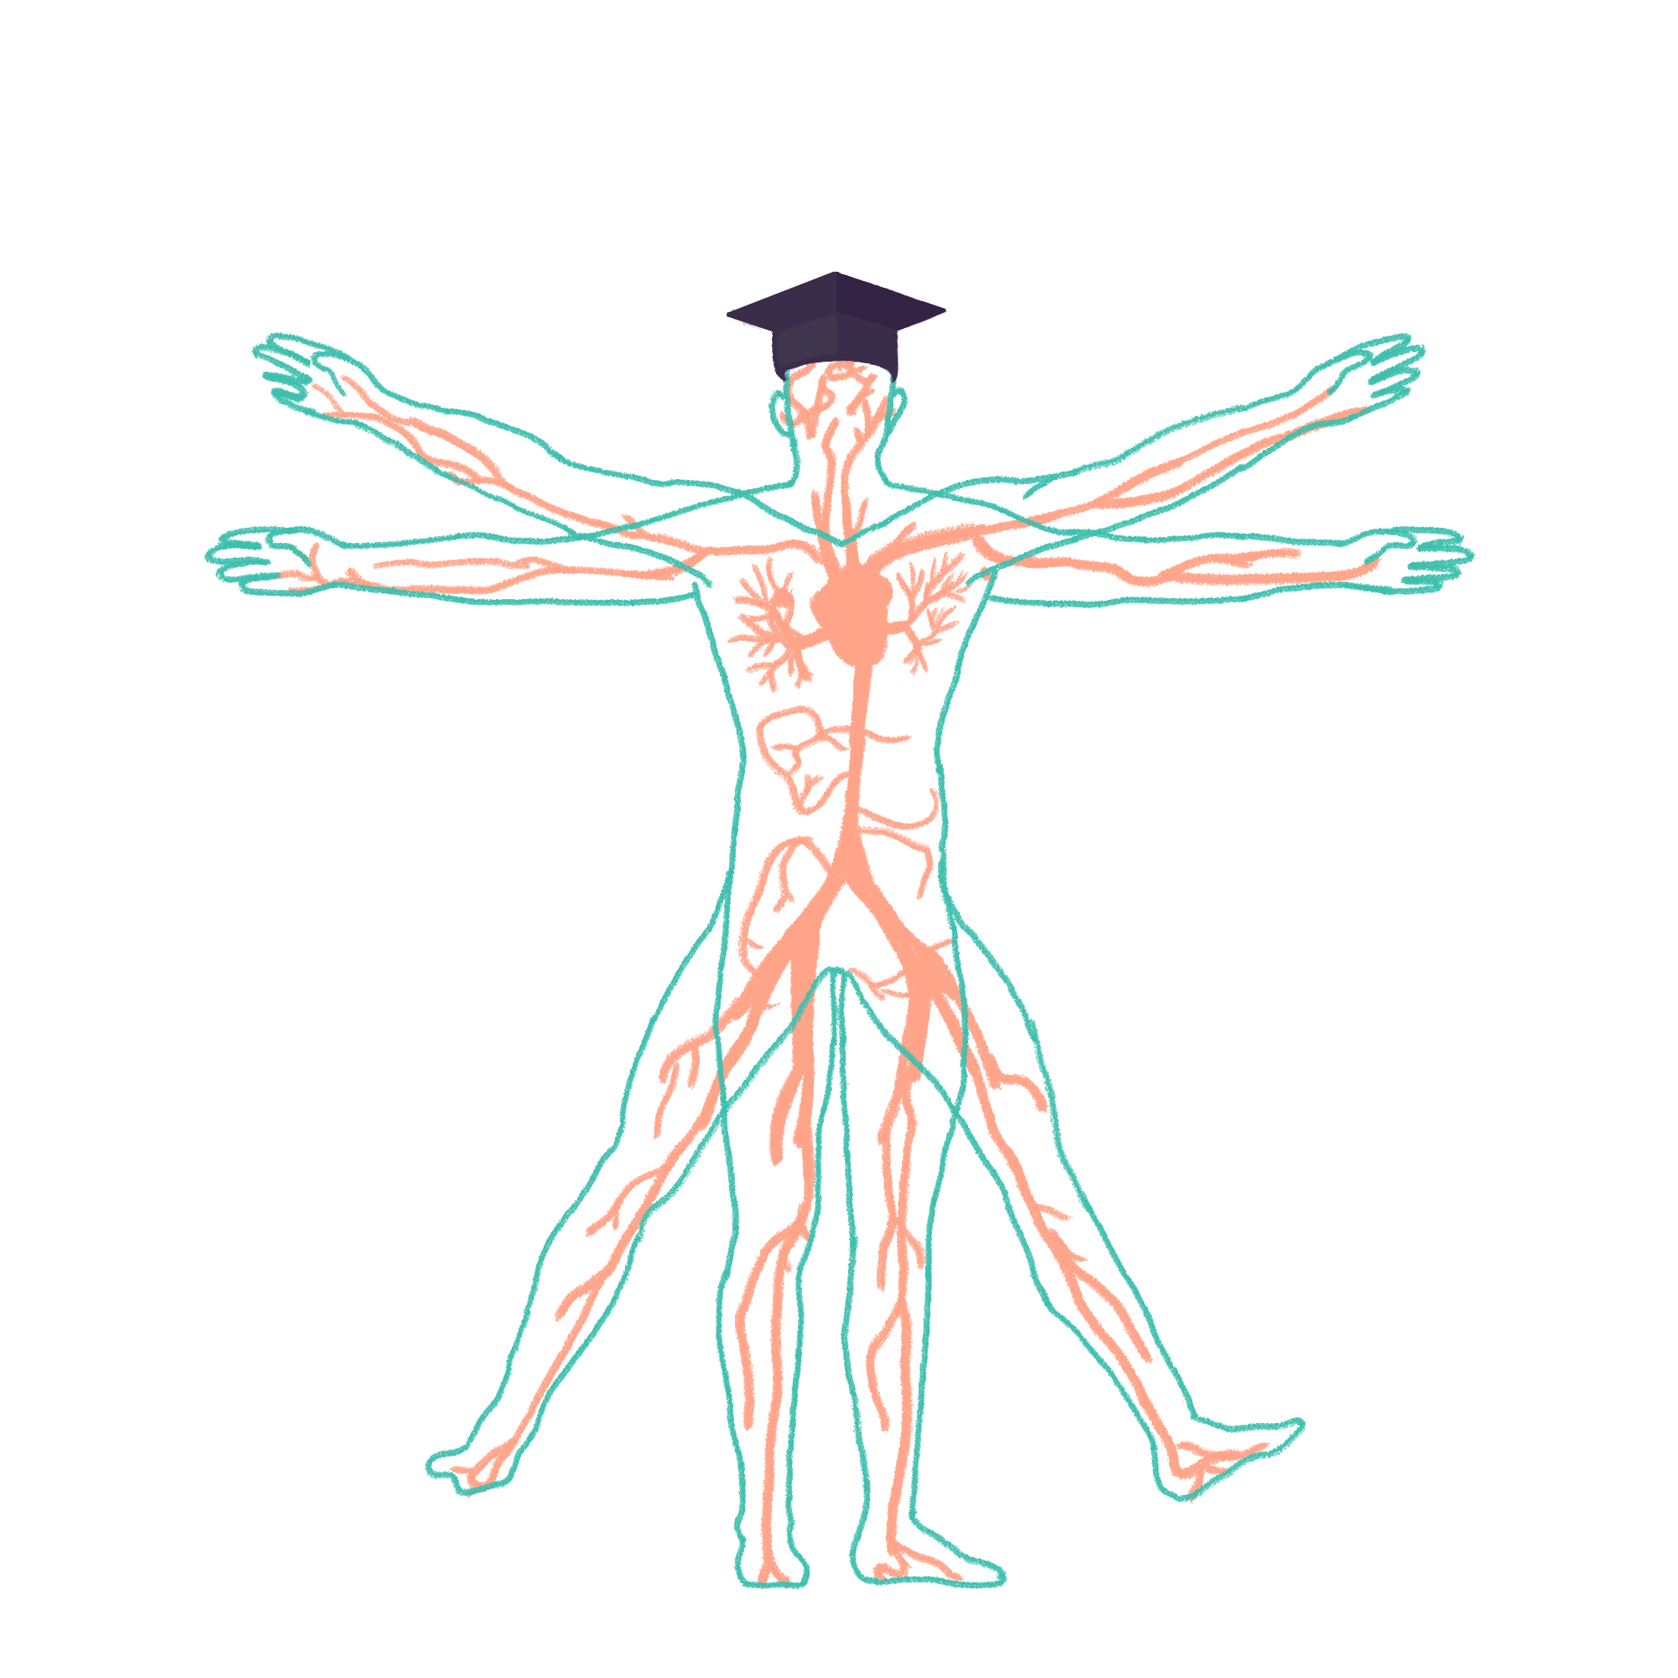
2022/2023

Slide 3
ICS
Phase 2a Revision Session
Yusuf Sanni & Anna McCarthy-Totton
09/11/2023
The Peer Teaching Society is not liable for false or misleading information…

Slide 4
Aims and Objectives
We will be going over ICS.
By the end of this session you should be able to know:
What Inflammation is
Atherosclerosis
Virchow’s triad and Coagulation
Hallmarks of Cancer
Cell morphologies
The Peer Teaching Society is not liable for false or misleading information…

Slide 5
Content
Include your teaching – remember to add lots of pictures and don’t include too much information per page.
Inflammation
Atherosclerosis
Thrombi and Emboli
Virchow’s triad
Then say the main things as one of them is cancer state
Move on to Cancer Pathology
However not all abnormal growth is cancer
Cell Definitions
The Peer Teaching Society is not liable for false or misleading information…

Slide 6
Inflammation
Acute and chronic cells involved
The ‘5 cardinal signs’
Stages of inflammation - increased vessel permeability, fluid exudate, cellular exudate
Neutrophil action - margination, adhesion, emigration and diapedesis
Outcomes of inflammation - resolution, supporation, organisation, progression
Granulomas; definition, which conditions you may see them in (NB - granulomas all secrete ACE as a blood marker) #

Slide 7
Inflammation
Local, physiological response to tissue injury.
Beneficial effects → destruction of invading microorganisms, walling off an abscess cavity
Negative effects → abscess forming a space occupying lesion in the brain.
Acute inflammation: initial and transient series of tissue reactions to injury.
Chronic inflammation: subsequent and often prolonged tissue reaction following the initial response.

Slide 8
Inflammation
Chronic Inflammation
> Lymphocytes, plasma cells, macrophages
Acute Inflammation:
> Dilation of vessels
> Vascular leakage
> Neutrophil polymorph recruited
> Outcomes: resolution, abscess, organisation, progression to chronic inflammation
Stages of inflammation:
changes in vessel calibre & flow
Increased vascular permeability and fluid exudate formation
Formation of cellular exudate - emigration of neutrophil polymorphs into extravascular space.
The Peer Teaching Society is not liable for false or misleading information…
Notes:
Changes in vessel calibre - microcirculation are the small capillaries. The smooth muscle arteriolar walls form precapillary sphincters to regulate blood flow through the capillary bed.
Increased vascular permeability - capillary hydrostatic pressure increased, and there is escape of plasma proteins into extravascular space - increasing colloid osmotic pressure. So more fluid leaves the vessels than is returned to them. The net escape of protein-rich fluid is called exudation → fluid exudate. This contains proteins, immunoglobulins, coagulation factors etc.
Cellular exudate → accumulation of neutrophil polymorphs.

Slide 9
Inflammation
Outcomes of acute inflammation:
Resolution - complete restoration of tissues to normal. Acute lobar pneumonia.
Suppuration - formation of pus (mixture of living & dead neutrophils & bacteria, cellular debris). This can then form an abscess.
Organisation - replacement of tissues by granulation tissue. Results in fibrosis, and possibly scar formation.
Progression - agent causing acute inflammation not removed → progress to chronic stage. Cellular exudate changes, lymphocytes, plasma cells and macrophages replace neutrophil polymorphs.
Neutrophil action:
Margination - neutrophils flow close to the endothelium.
Adhesion - neutrophils adhere to endothelium.
Emigration - migration through the walls of venules and small veins
Diapedesis - passive movement of red blood cells leaving the vessels.
The Peer Teaching Society is not liable for false or misleading information…
Notes:
Normal circulation: blood cells flow in the “central stream” in blood vessels, and don’t flow near the endothelium. Loss of intravascular fluid and increase in plasma viscosity + slowing of flow → neutrophils flow in this plasmatic zone.
‘pavementing of neutrophils’.
Emigration - active movement through walls (venules and small veins.
Outcomes of inflammation depends on the acute of the inflammation 0- type of tissue and amount of tissue destruction.
Suppuration - pus accumulates, surrounded by pyogenic membrane, then there’s granulation tissue and scarring. this is an abscess, bacteria within the abscess are difficult to treat (inaccessible to antibiotics and antibodies).
Organisation happens when large amounts of fibrin are formed which can’t be completely removed. substantial volumes of tissue become necrotic or if the dead tissue is not easily diggested. exudate and debris cannot be removed or discarhged.

Slide 10
Inflammation
5 cardinal signs…
Rubor (Redness)
Calor (Heat)
Tumor (Swelling)
Dolor (Pain)
Loss of Function
The Peer Teaching Society is not liable for false or misleading information…
Notes:
Rubor - acutely inflamed tissue appears red, due to dilatation of small blood vessels in the damaged area.
Calor - increase in temperature due to increased blood flow through the region, systemic fever can also contribute to local temperature.
Tumor - swelling from oedema, accumulation of fluid in the extravascular space.
Dolor - stretching & distortion of tissues, and pus under pressure. Also chemical mediators (bradykinin, prostaglands, serotonin) can all induce pain
Loss of function -

Slide 11
Granulomas
Causes:
Specific infections - mycobacteria (TB, leprosy), fungi, parasites, syphilis
Materials that resist digestion - Endogenous (keratin, necrotic bone), exogenous (silica, oils)
Specific chemicals (beryllium)
Drugs (hepatic granulomas due to allopurinol, phenylbutazone)
Unknown: crohn’s sarcoidosis, Wegener’s granulomatosis.
Aggregate of epithelioid histiocytes.
Can also contain lymphocytes & histiocytic giant cells.
One product is angiotensin converting enzyme. Measurement of the activity of this enzyme in the blood can act as a marker for systemic granulomatous disease.
Common feature of the many stimuli that can induce granulomatous inflammation is the indigestibiltiy of particulate matter by macrophages.
sarcoidosis
Tuberculosis (Granulomas + caseous necrosis)
leprosy
Parasitic infection (granulomas + eosinophils)

Slide 12
Atherosclerosis
The Peer Teaching Society is not liable for false or misleading information…

Slide 13
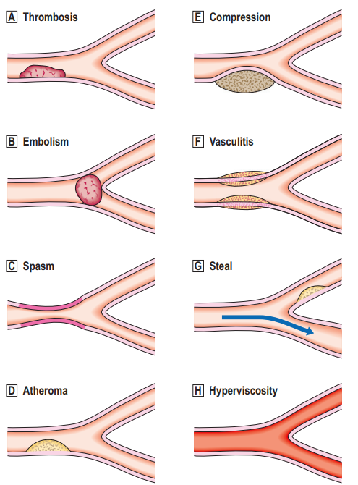
Thrombosis vs Embolism
Stuff
The Peer Teaching Society is not liable for false or misleading information…

Slide 14
Questions on Inflammation
Stuff
The Peer Teaching Society is not liable for false or misleading information…

Slide 15
Virchows Triad
Stuff
The Peer Teaching Society is not liable for false or misleading information…

Slide 16
Apoptosis vs necrosis
Apoptosis vs necrosis Mechanisms of apoptosis → Intrinsic, extrinsic, cytotoxic Cell Definitions Hypertrophy Hyperplasia Atrophy Metaplasia Dysplasia Ischemia Infarction Cancer Pathology Definition of a neoplasm (and of a tumour) Tumour classification - behaviour (benign vs malignant) Tumour classification - histogenesis (nomenclature of carcinomas and sarcomas)

Slide 17
Apoptosis vs necrosis
 | Apoptosis | Necrosis
Induction | induced by physiological or pathological stimuli | pathological injury
Extent | Single cells | Cell groups
Inflammatory response | None | Usual response
Apoptosis pathways
Intrinsic
Bcl-2 inhibits apoptosis, Bax enhances apoptotic stimuli.
Bax acts a ‘molecular switch’
responds to stimuli such as growth factors & biochemical stress (DNA damage).
P53 induces cell cycle arrest & initiates DNA damaage repair but also induces apoptosis.
Notes:
Apoptosis is programmed cell death. a sequence of events which leads to the removal of a cell without the release of products harmful to surrounding cells. This ensures continuous renewal of cells (in conjunction with mitosis)
Necrosis is unintended cell death in response to cellular injury.

Slide 18
Apoptosis
Extrinsic pathway
ligand-binding to “death receptors”
Tumour necrosis factor receptor (TNFR)
Immune system uses this pathway to eliminate lymphocytes that would produce self-antigens
Cytotoxic

Slide 19
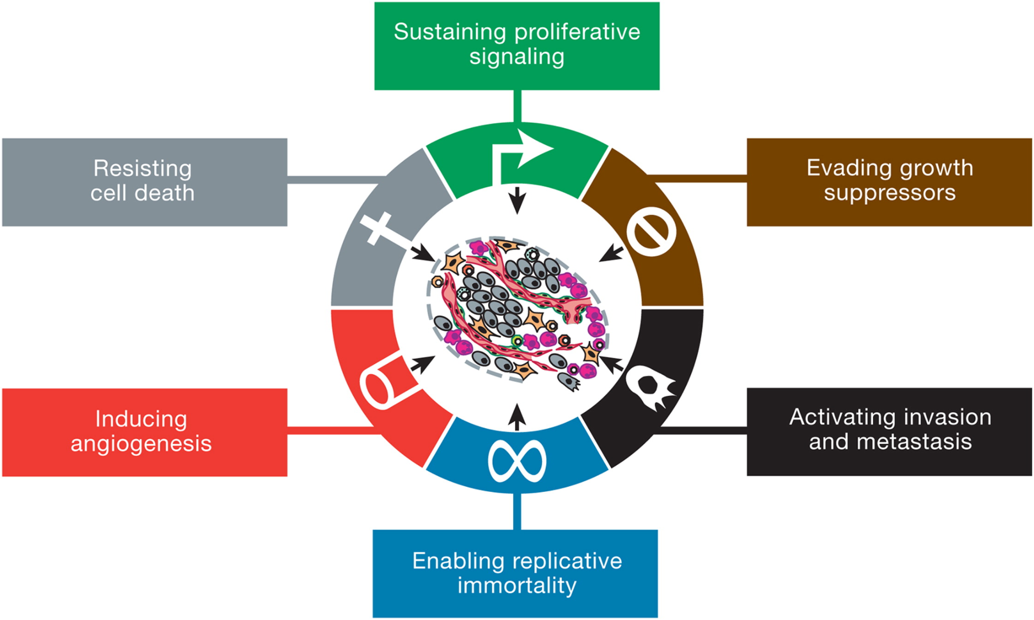
Cancer Pathology
Neoplasm/Tumour - lesion resulting from the abnormal growth of cells that persists in the absence of the initiating stimulus.
transformation requires genetic alterations and epigenetic changes.
Benign tumour - grow slowly & have distinct borders, don’t invade surrounding tissue, don’t invade other organs.
Malignant tumour - can grow quickly and have irregular borders, invade surrounding tissues, spread via metastasis.
The Peer Teaching Society is not liable for false or misleading information…
Notes:
neoplasm is less ambiguous than tumour.

Slide 20
Tumour classifications, histogenesis (nomenclature of carcinomas & sarcomas )
Behavioural classification - benign or malignant (invasion)
Histogenic classification - cell or tissue of origin
Epithelial cells → carcinomas
connective tissue → sarcomas
lymphoid/haemopoetic organs → lymphomas/leukaemias
suffix -oma
benign epithelial tumours are either papillomas or adenomas
benign connective tissue tumours have prefix denoting cell of origin.
malignant epithelial tumours = carcinomas
malignant connective tissue tumours = sarcomas
Benign epithelial tumours
papillomas (benign tumour of non-glandular origin)
adenomas (benign tumour of glandular epithelium)
malignant epithelial tumours
Carcinomas
non-glandular epithelium = prefixed by epithelial cell type
glandular epithelium = adenocarcinomas + tissue of origin.
Benign connective tissue & mesenchymal tumours
cell of origin + oma
malignant connective tissue & mesenchymal tumours
cell of origin + sarcoma
Notes:
Benign tumours don’t invade surrounding tissue, and are often encapsulated. can resemble parent tissue. cause problems by
pressure on adjacent tissue. obstruction to the flow of fluid. production of a hormone. transforamation into a malignant neoplasm. anxiety.
Malignant tumours often ahve central necrosis because of inadequate vascular perfusion. pressure & destruction of adjacent tissue. formation of metastasis. blood loss from ulcerated surfaces. obstruction of flow. production of hormone (ACTH and ADH from lung tumours). paraneoplastic effects (Weight loss & debility). anxiety & pain.
There’s always exceptions!!!
teratomas = germ cells from all 3 germ cell layers - contain teeth, hair, muscle, cartilage

Slide 21
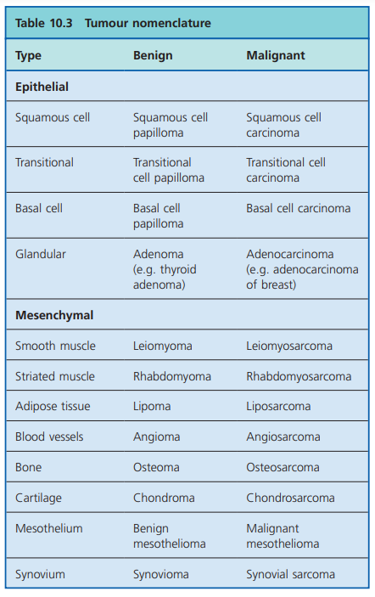

Slide 22
mode of tumour spread
Invasion - reduced cellular cohesion, production of proteolytic enzymes, abnormal cell motility
metastasis is the process of formation of distant secondary tumours.
Lymphatic, blood vessels, body cavities.
carcinomas prefer lymphatic spread
sarcomas prefer haematogenous spread.
Which tumours metastasise to bone? BLT-KP
breast
lung
prostate
kidney
thyroid

Slide 23
Risk factors for cancers (carcinogens, inherited predispositions e.g. FAP and HNPCC in colorectal cancer) Which cancers are screened for in the UK and how they’re screened (colorectal, breast, cervical) NB: Cancer screening is a form of secondary prevention
Carcinogenesis - the process that results in the transformation of normal cells to neoplastic cells by causing permanent genetic alterations.
carcinogen = environmental agent
chemicals (smoking - lung cancer. painters - bladder cancer.
virsuses (HPV 16 and 18 - cervical carcinoma). hepatitis B and C - hepatocellular carcinoma
ionising & non-ionising radiation
exogenous hormones (oestrogen and endometrial carcinomas.
bacteria, fungi, parasites (h.pylori in gastric MALT lymphomas), gastric adenocarcinoma.
miscellaneous agents (asbetstos - mesothelioma)
Inherited predisposition
FAP (familial adenomatous polyposis coli) - colorectal adenomas & adenocarcinomas. >100 adenomaatous polyps. autosomal dominant
Hereditary non-polyposis colorectal cancer (lynch syndrome) - colorectal carcinoma & other tumours (endometrial, ovarian, stomach, intestine, skin). autosomal dominant.

Slide 24
Which cancers are screened for in the UK and how they’re screened (colorectal, breast, cervical) NB: Cancer screening is a form of secondary prevention
Colorectal cancer
Breast cancer
Cervical cancer
secondary prevention - measures that lead to an early diagnosis & prompt treatment.

Slide 25
Cell Definitions
Hypertrophy - Increase in cell size without cell division
Hyperplasia - increase in cell number by mitosis
Atrophy - decrease in size of an organ or cell
Metaplasia - transformation of one type of differentiated cell into another fully differentiated cell.
Dysplasia - neoplastic epithelial alteration without invasive growth.
Ischemia - insufficient vascular perfusion → lack of oxygen to tissue. Reversible(ish).
Infarction - necrosis of tissue as a result of ischaemia. Irreversible.
The Peer Teaching Society is not liable for false or misleading information…
Notes:
atrophy - organ atrophy may be due to reduction in cell size or number. may be mediated by apoptosis. maay be physiolgoical (post-menopasual atrophy of uterus). pathological atrophy may be due to decreased function (immbolisated limb), loss of innvervation, reduced blood/oxygen supply, nutritional impairment or hormone insufficiency
metaplasia - response to altered cellular environment. affects epithelial or mesenchymal cells. often associated with increased risk of malignancy.
Metaplasia: transforms cell from one form to another, caused by external stimulus, can be reversible, less likely to lead to cancer.
dysplasia - transforms a cell into an abnormal version of itself, caused by an internal stimulus, is not reversible, more likely to lead to cancer.

Slide 26
End Questions
Stuff
Put in some histology photos
The Peer Teaching Society is not liable for false or misleading information…

Slide 27
Conclusion
Put in the definition for:
Inflammation
Atherosclerosis (Plus RF)
Virchow's Triad
Hallmarks of Cancer
Cell definitons - histology
The Peer Teaching Society is not liable for false or misleading information…

Slide 28
Feedback
https://docs.google.com/forms/d/e/1FAIpQLSfc9haX5-Z-cBE4w9nmsHXreRYJznphPBymdF5qEoUNH7-rWw/viewform?usp=sf_link
The Peer Teaching Society is not liable for false or misleading information…

