Slide 1
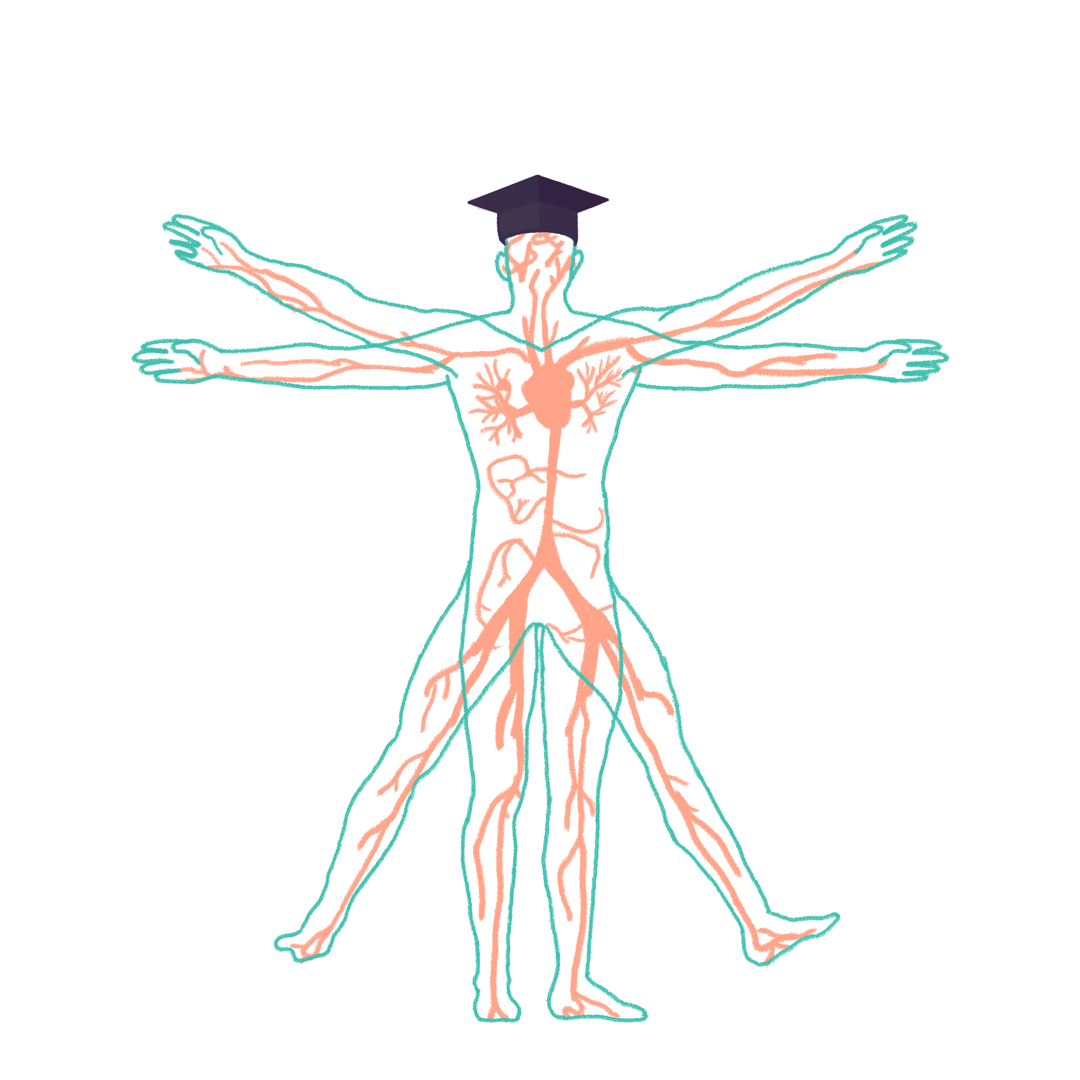
2022/2023

Slide 2
IMMS Teaching
Phase One IMMS Part 1 Wrap-Up Session
Kate Lachlan
26/10/2022

Slide 3
Aims and objectives
Cells
Organelles
Cell membranes
Structure and function
Membrane protein types
Movement across membranes
Homeostasis
Autocrine, paracrine, and endocrine signalling
Simple feedback loop
Different hormones
Steroid and peptide
Types of homeostasis
Water
Sodium
Potassium
Calcium
Water distribution
Water excess and dehydration consequences
Molecular building blocks
Bonds
Amino acids
Protein structure
Primary
Secondary
Tertiary
Enzymes
The Peer Teaching Society is not liable for false or misleading information…

Slide 4
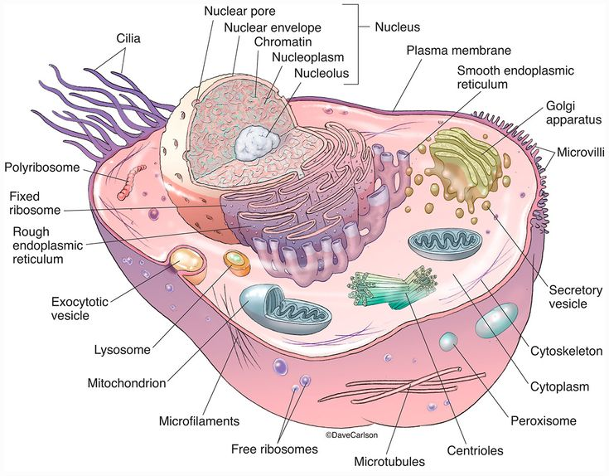
Cells
2
1
17
3
5
4
6
7
16
15
8
14
9
10
13
12
11
The Peer Teaching Society is not liable for false or misleading information…
Notes:
1 – nucleus 2 – nuclear pore 3 – nuclear envelope 4 – nucleolus 5 – plasma membrane 6 – smooth ER 7 – Golgi apparatus 8 – cytoskeleton 9 – cytoplasm 10 – peroxisome 11 – centrioles 12 – microtubules 13 – ribosomes 14 – mitochondria 15 – lysosome 16 – rough ER 17 - cilia

Slide 5
Cells
The Peer Teaching Society is not liable for false or misleading information…

Slide 6
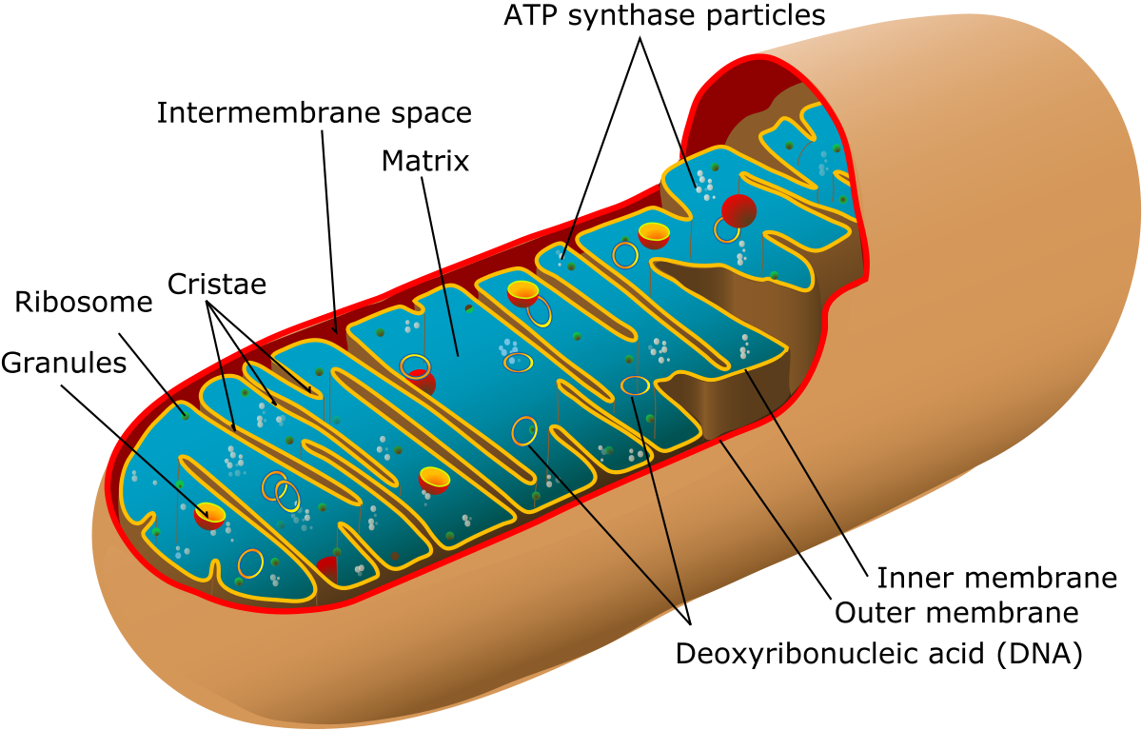
Mitochondria
Structure | Function
Matrix | Site of Krebs cycle
Cristae | Site of electron transport chain and chemiosmosis
Inner membrane | ATP synthase embedded Allows flow of H+ from ETC for ATP synthesis
The Peer Teaching Society is not liable for false or misleading information…

Slide 7
Organelle structure and function
Structure | Function
Mitochondria | Site of respiration and ATP formation
Ribosomes | Site of protein synthesis
Rough ER | Synthesis and processing of proteins
Smooth ER | Contains enzymes for lipid synthesis
Golgi apparatus | Processing and packaging proteins
Cytoskeleton | Structural support and movement of materials
Nucleus | Contains genetic information and assembles ribosome subunits
Lysosomes | Contains acid hydrolases for digestion and recycling
Peroxisomes | Fatty acid and ethanol oxidation, contains catalase
The Peer Teaching Society is not liable for false or misleading information…

Slide 8
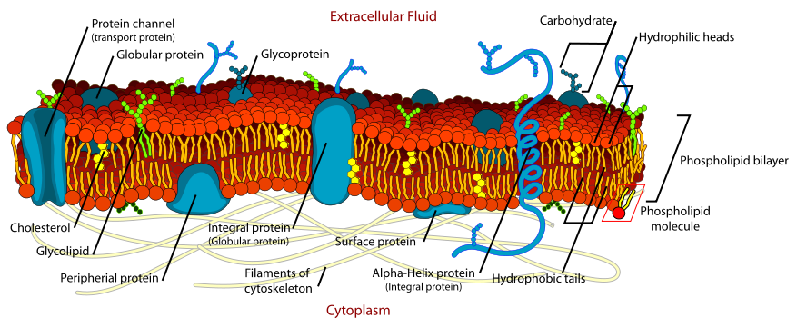
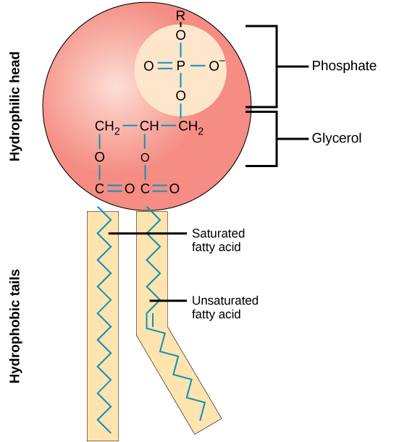
Cell membrane
Phospholipid bilayer with a fluid mosaic model
Contains:
Cholesterol – binds together phospholipids
Proteins – transporters
Glycolipids and glycoproteins – cell signalling
Functions
Partially permeable membrane
Site of membrane receptors
Regulates what enters and exits cell
Barrier to separate intracellular contents from extracellular contents
Phospholipid
Hydrophilic polar head
Hydrophobic non-polar fatty acid tail
The Peer Teaching Society is not liable for false or misleading information…

Slide 9
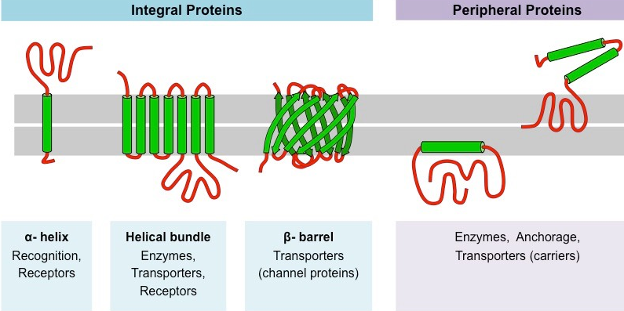
Membrane protein types
A cell membrane consists of around 60% protein
Two main categories, integral and peripheral
The Peer Teaching Society is not liable for false or misleading information…

Slide 10
Movement across membranes
Transport and receptor proteins on the phospholipid bilayer are selectively permeable to maintain the intracellular environment.
Simple diffusion
Passive movement of particles from a region of high concentration to a region of low concentration through a partially permeable membrane
Used to transport small, non-polar molecules
Facilitated diffusion
Transport of particles through a partially permeable membrane down a concentration gradient by means of a carrier molecule
Used to transport large, polar molecules
Active transport
Transport of particles against the concentration gradient, requiring ATP
Used to transport molecules such as nutrients and waste e.g. proteins, ions, complex sugars
The Peer Teaching Society is not liable for false or misleading information…

Slide 11
Homeostasis
Maintenance of a constant internal environment
Requires cellular communication
Endocrine system – hormones
Nervous system – neurotransmitters
Immune system – antibodies, cytokines
Maintained by feedback loops
Positive feedback – amplification of the signal
Negative feedback – bringing back to equilibrium
The Peer Teaching Society is not liable for false or misleading information…

Slide 12
Autocrine, paracrine, endocrine, exocrine signalling
Autocrine
A chemical is released from the cell into the extracellular fluid (ECF) and acts upon itself
Paracrine
Local cellular communication, short distance signalling e.g. ACh at NMJ
Paracrine chemical messengers travel in ECF
Endocrine
Secretion into blood
Long distance signalling e.g. HPA axis
Exocrine
Secretion via ducts into organs e.g. salivary and sweat glands
The Peer Teaching Society is not liable for false or misleading information…

Slide 13
Simple feedback loop
Feedback loops contain:
Signal – e.g. body temperature
Sensor – e.g. nerve cells with endings in the skin
Controller – e.g. temperature regulatory centre
Effector – e.g. sweat glands
If the response by the effector opposes the initial disturbance, it is a negative feedback loop
If the response by the effector is in the same direction as the initial disturbance, it is a positive feedback loop
Negative feedback loops are very common and used for maintaining homeostasis
Positive feedback loops are less common
E.G. oxytocin in childbirth, clotting factors in coagulation
Negative – homeostasis, positive – haemostasis
Controller
Effector
Signal
Sensor
The Peer Teaching Society is not liable for false or misleading information…

Slide 14
Hormones
Steroid hormones
Derived from cholesterol and lipid-soluble e.g. cortisol
Formed on an as-needed basis and not stored
Slower acting
Bound to plasma proteins and less easily metabolised and excreted
Peptide hormones
Composed of chains of amino acids 3-20 in length and water-soluble e.g. insulin
Stored in secretory vesicles enabling rapid secretion when required
Faster acting
Easily degraded by enzymes in the blood and excreted very quickly
The Peer Teaching Society is not liable for false or misleading information…

Slide 15
Water homeostasis
Water
Four mechanisms – ADH, thirst, aldosterone, sympathetic nervous system
ADH increases water reabsorption in the collecting ducts in the nephrons of the kidney
Water loss → more ADH released from the posterior pituitary gland into the blood
Stimulation of the thirst centre in the hypothalamus makes you want to drink water
Osmoreceptors, impulses from a dry mouth, and angiotensin II release due to low blood pressure stimulate the thirst centre
Low blood pressure triggers renin release from the kidneys, which triggers aldosterone release from the adrenal gland. Aldosterone allows sodium to move into the blood and increase blood volume.
If ADH is present with aldosterone, water is reabsorbed at the kidney, stabilising blood volume and pressure until water is drunk
Neurotransmitters from sympathetic nerves in the kidney stimulates smooth muscle in the afferent arteriole to constrict → less urine formation and less water leaving the body
Sympathetic stimulation also causes renin release
The Peer Teaching Society is not liable for false or misleading information…

Slide 16
Sodium, potassium, calcium homeostasis
Sodium
Normal levels: 135-145 mEq/L
Sodium is filtered out at the glomerulus in the kidney
85-90% is reabsorbed at the proximal convoluted tubule and Loop of Henle
When aldosterone is absent, sodium will remain in the filtrate and end up in urine. If it is present, the remaining sodium will be reabsorbed at the collecting ducts and late distal convoluted tubule.
Potassium
Normal levels: 3.5-5.1 mEq/L
Potassium is filtered out at the glomerulus in the kidney
About 90% is reabsorbed in the PCT and Loop of Henle. The remaining potassium will always be excreted
In the presence of aldosterone, more potassium is excreted
There is no mechanism to compensate for renal loss of potassium
Calcium
Normal levels: 9-11 mg/dL
Calcitonin decreases blood calcium
PTH and calcitriol increase blood calcium
The Peer Teaching Society is not liable for false or misleading information…

Slide 17
Water distribution
Based on an average 70kg male, total water is around 60% of the total weight (42L)
Total body water 42L
Plasma 3L
ICF 28L
ECF 14L
Interstitial fluid 11L
The Peer Teaching Society is not liable for false or misleading information…

Slide 18
Water excess and dehydration consequences
Overhydration
Body fluids become hypotonic
Cells will swell due to osmotic movement → cell lysis and tissue damage
Excessive volumes of clear urine produced
Headaches and disrupted nerve function in mild cases
Blurred vision, seizures, coma, death in severe cases
Vomiting and diarrhoea
Dehydration
Body fluids become hypertonic
Thirst and small volumes of heavily concentrated urine
BP drop and HR increase to compensate
Lethargic
Seizures, brain damage, death in severe cases
Both cause headaches
 | Water and solute | Water only
Gain | Hypervolaemia | Overhydration
loss | Hypovolaemia | Dehydration
The Peer Teaching Society is not liable for false or misleading information…

Slide 19
Glycosidic and peptide bonds
Glycosidic bond
Covalent bond
A carbohydrate molecule and another group go through a condensation reaction to produce a glycoside and a molecule of water
Glucose + glucose → maltose
Glucose + fructose → sucrose
Glucose + galactose → lactose
Peptide bond
Covalent bond
The amino group of amino acid reacts with the carboxyl group of another amino acid to produce a dipeptide and a molecule of water
The Peer Teaching Society is not liable for false or misleading information…

Slide 20
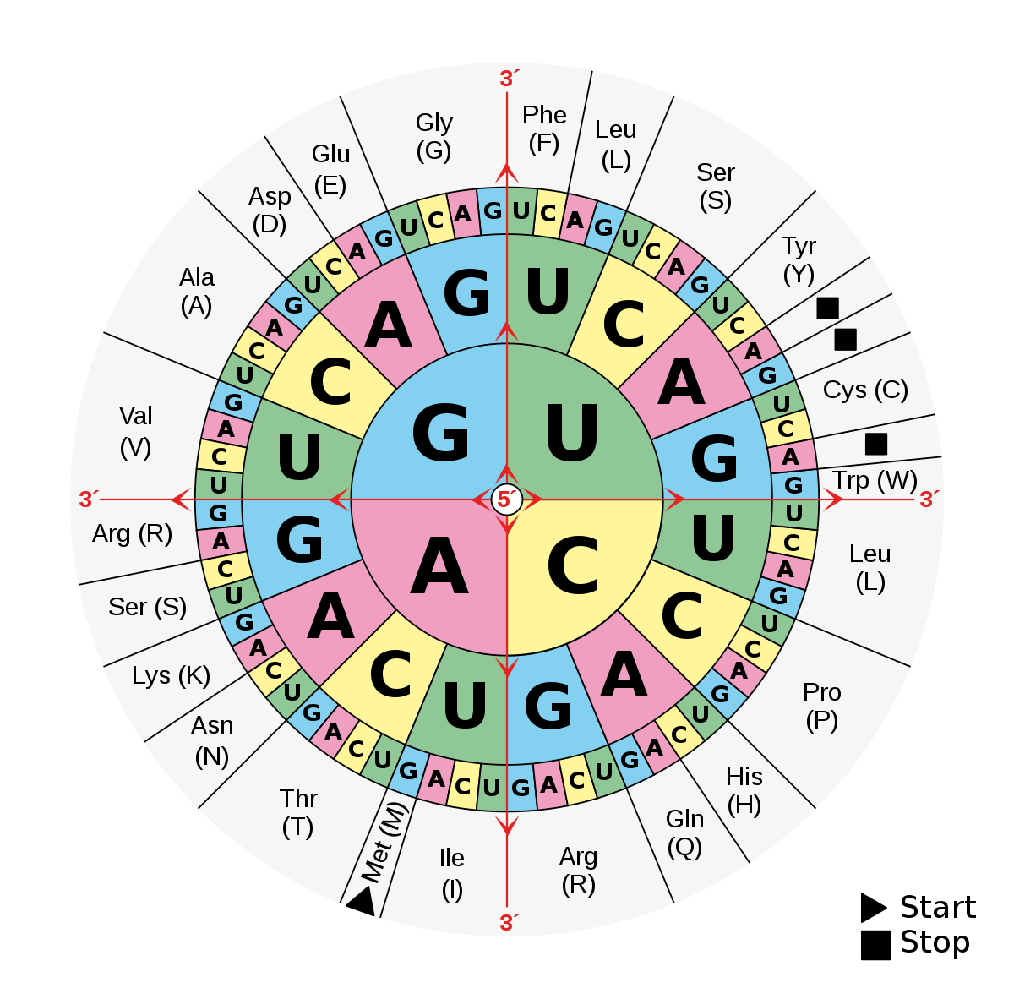
Amino Acids
Building blocks of proteins
20 total
General structure:
Carboxyl +ve
Amino –ve
Joined by peptide bonds via a condensation reaction
Cleaved by proteolytic enzymes i.e. proteases
The Peer Teaching Society is not liable for false or misleading information…

Slide 21
Protein Structure
Primary
Sequence of amino acids
Secondary
Local folding – alpha helix or beta pleated sheet
Tertiary
3D folding pattern due to chain interactions
Quaternary
Protein with more than one amino acid chain, may have prosthetic groups added
Enzymes
Can be tertiary or quaternary
Very specific shape gives the “lock and key” effect
The Peer Teaching Society is not liable for false or misleading information…

Slide 22
Questions
Where does the electron transport chain take place?
What is the function of the Golgi apparatus?
Describe a phospholipid’s properties.
How are large, polar molecules transported across membranes?
What kind of signalling is used in long distance signalling?
Name a mechanism for water homeostasis.
What is the effect of aldosterone on sodium and potassium?
How many amino acids are there?

Slide 23
Answers
Mitochondrial cristae
Processing and packaging proteins
Polar, hydrophilic head and a non-polar hydrophobic tail
Facilitated diffusion
Endocrine
ADH, thirst, aldosterone, sympathetic nervous system
Increased reabsorption of sodium, increased excretion of potassium
20

Slide 24
Thank you for listening!
Any questions?

