Slide 1
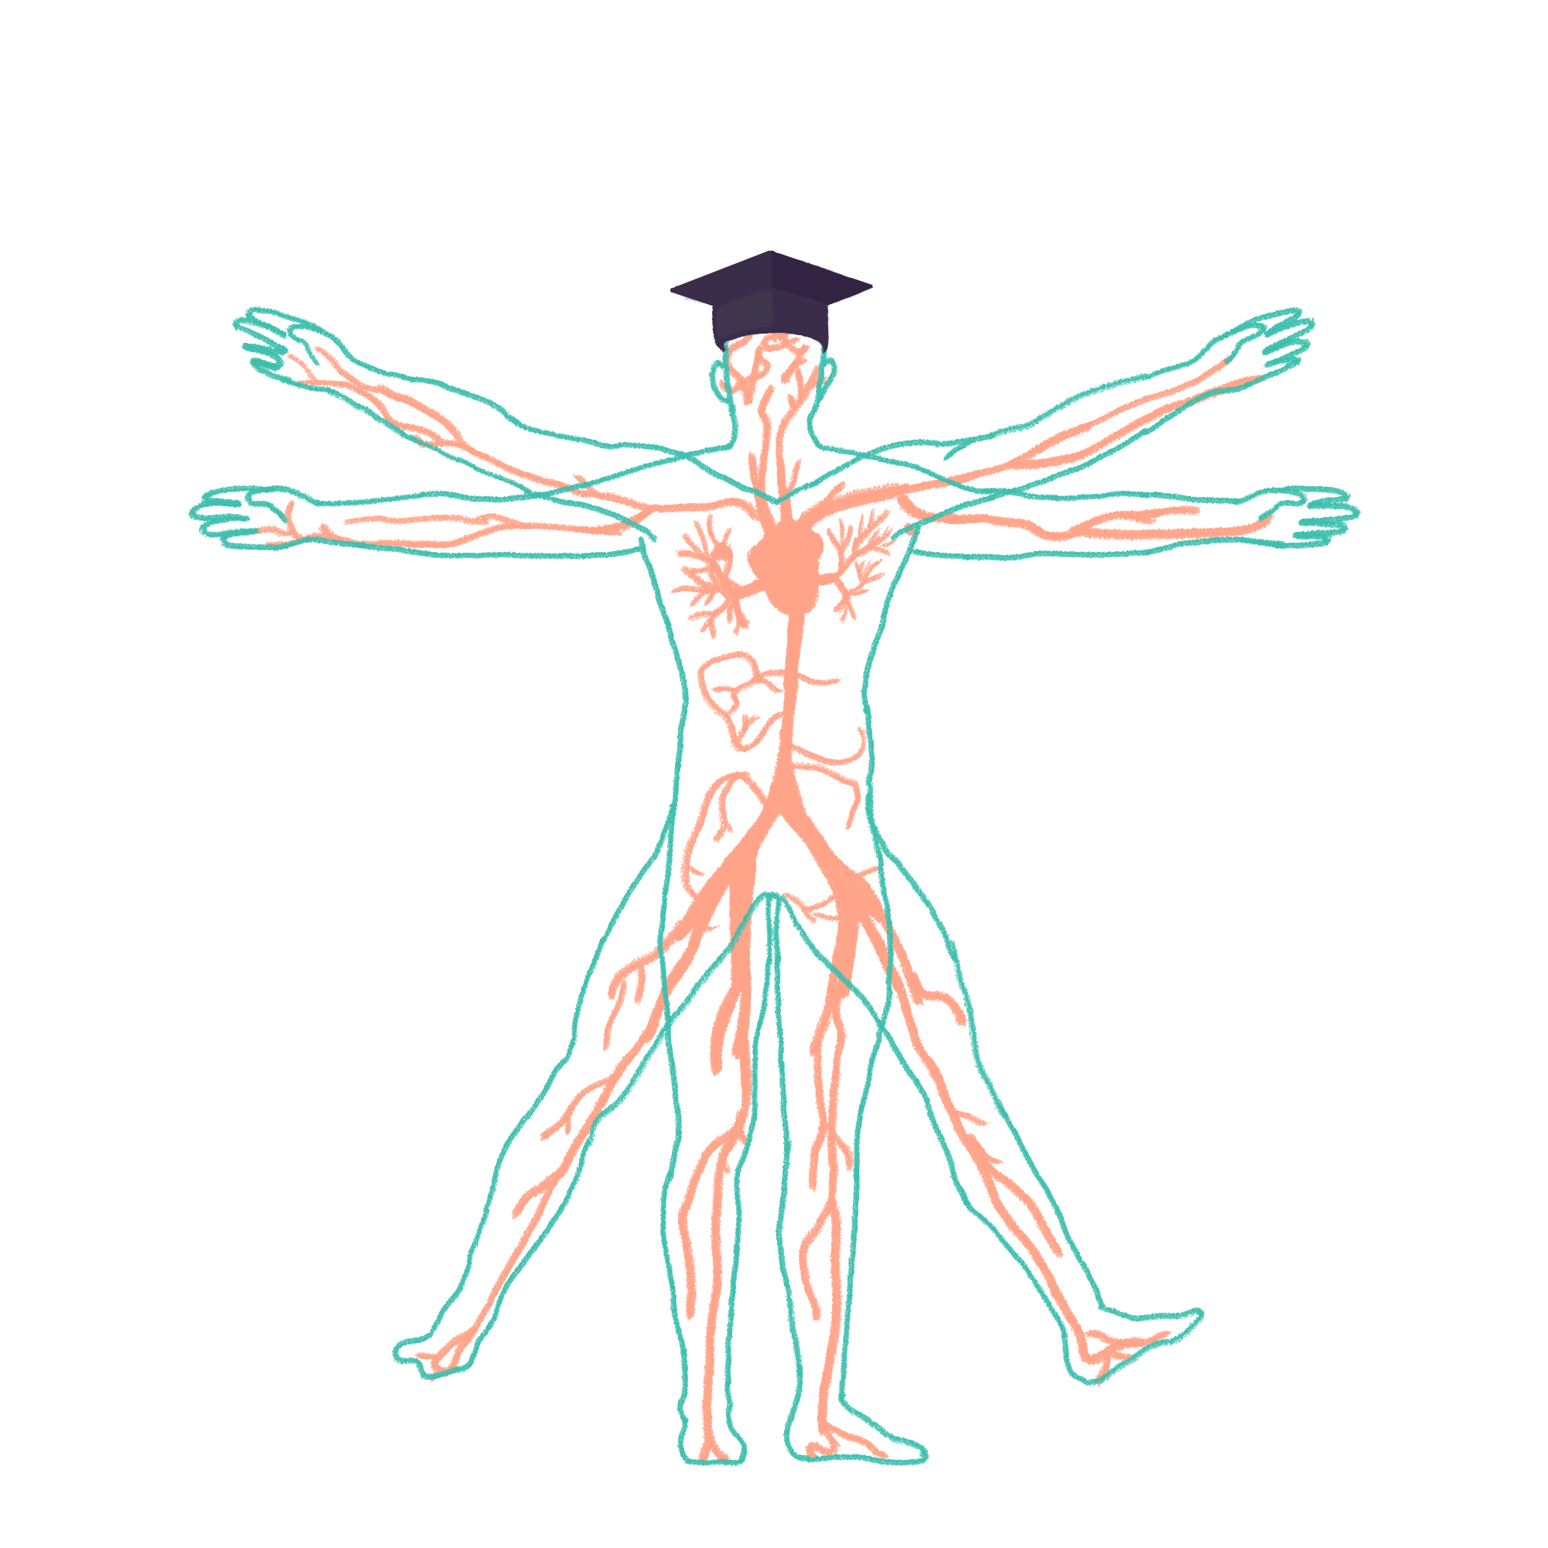
2022/2023

Slide 2
IMMS Teaching
Phase One IMMS Part 2 Wrap-Up Session
Kate Lachlan
26/10/2022

Slide 3
Aims and objectives
Biochemistry
Energy sources in diet and BMR
Aerobic and anaerobic glycolysis
Krebs’ cycle and regulations
Fatty acid oxidation
Ketones
Genetics
Structure and components of DNA
DNA mutation
DNA vs RNA
DNA transcription
Mitosis and meiosis
Male vs female sex cell production
Down syndrome mutation
Gonadal mosaicism
Chromosomal abnormalities
Genotype and phenotype
Inheritance
Lyonisation
Multifactorial inheritance
Definitions
The Peer Teaching Society is not liable for false or misleading information…

Slide 4
Energy sources in diet and BMR
Dietary energy sources
Carbohydrates – 4 kcal/g
Protein – 4 kcal/g
Alcohol – 7 kcal/g
Lipid – 9 kcal/g
BMR
Amount of energy needed to keep the body alive at rest
1 kcal/kg body mass/hr
Changing BMR
Increase BMR | Decrease BMR
High BMI Hyperthyroidism Fever/infection Pregnancy Exercise | Ageing Female Starvation Hypothyroidism
The Peer Teaching Society is not liable for false or misleading information…

Slide 5
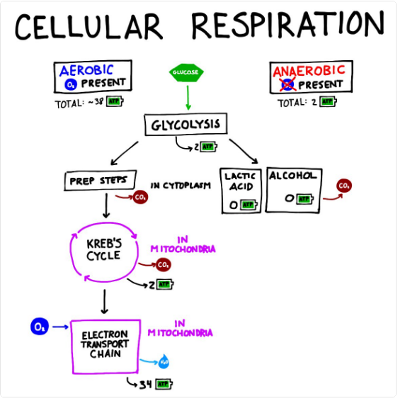
Aerobic and anaerobic glycolysis
Glycolysis: breaking down glucose to release energy
Takes place in the cytosol
Glucose + 2ADP + 2Pi + 2NAD⁺ → 2 Pyruvate + 2ATP + 2NADH + 2H ⁺ + 2H₂O
In aerobic conditions, pyruvate will enter the citric acid cycle and undergo oxidative phosphorylation
In anaerobic conditions, pyruvate will convert to lactate and the lactate will undergo lactic acid fermentation
Aerobic will produce around 38 ATP, anaerobic will produce around 2 ATP
The Peer Teaching Society is not liable for false or misleading information…

Slide 6
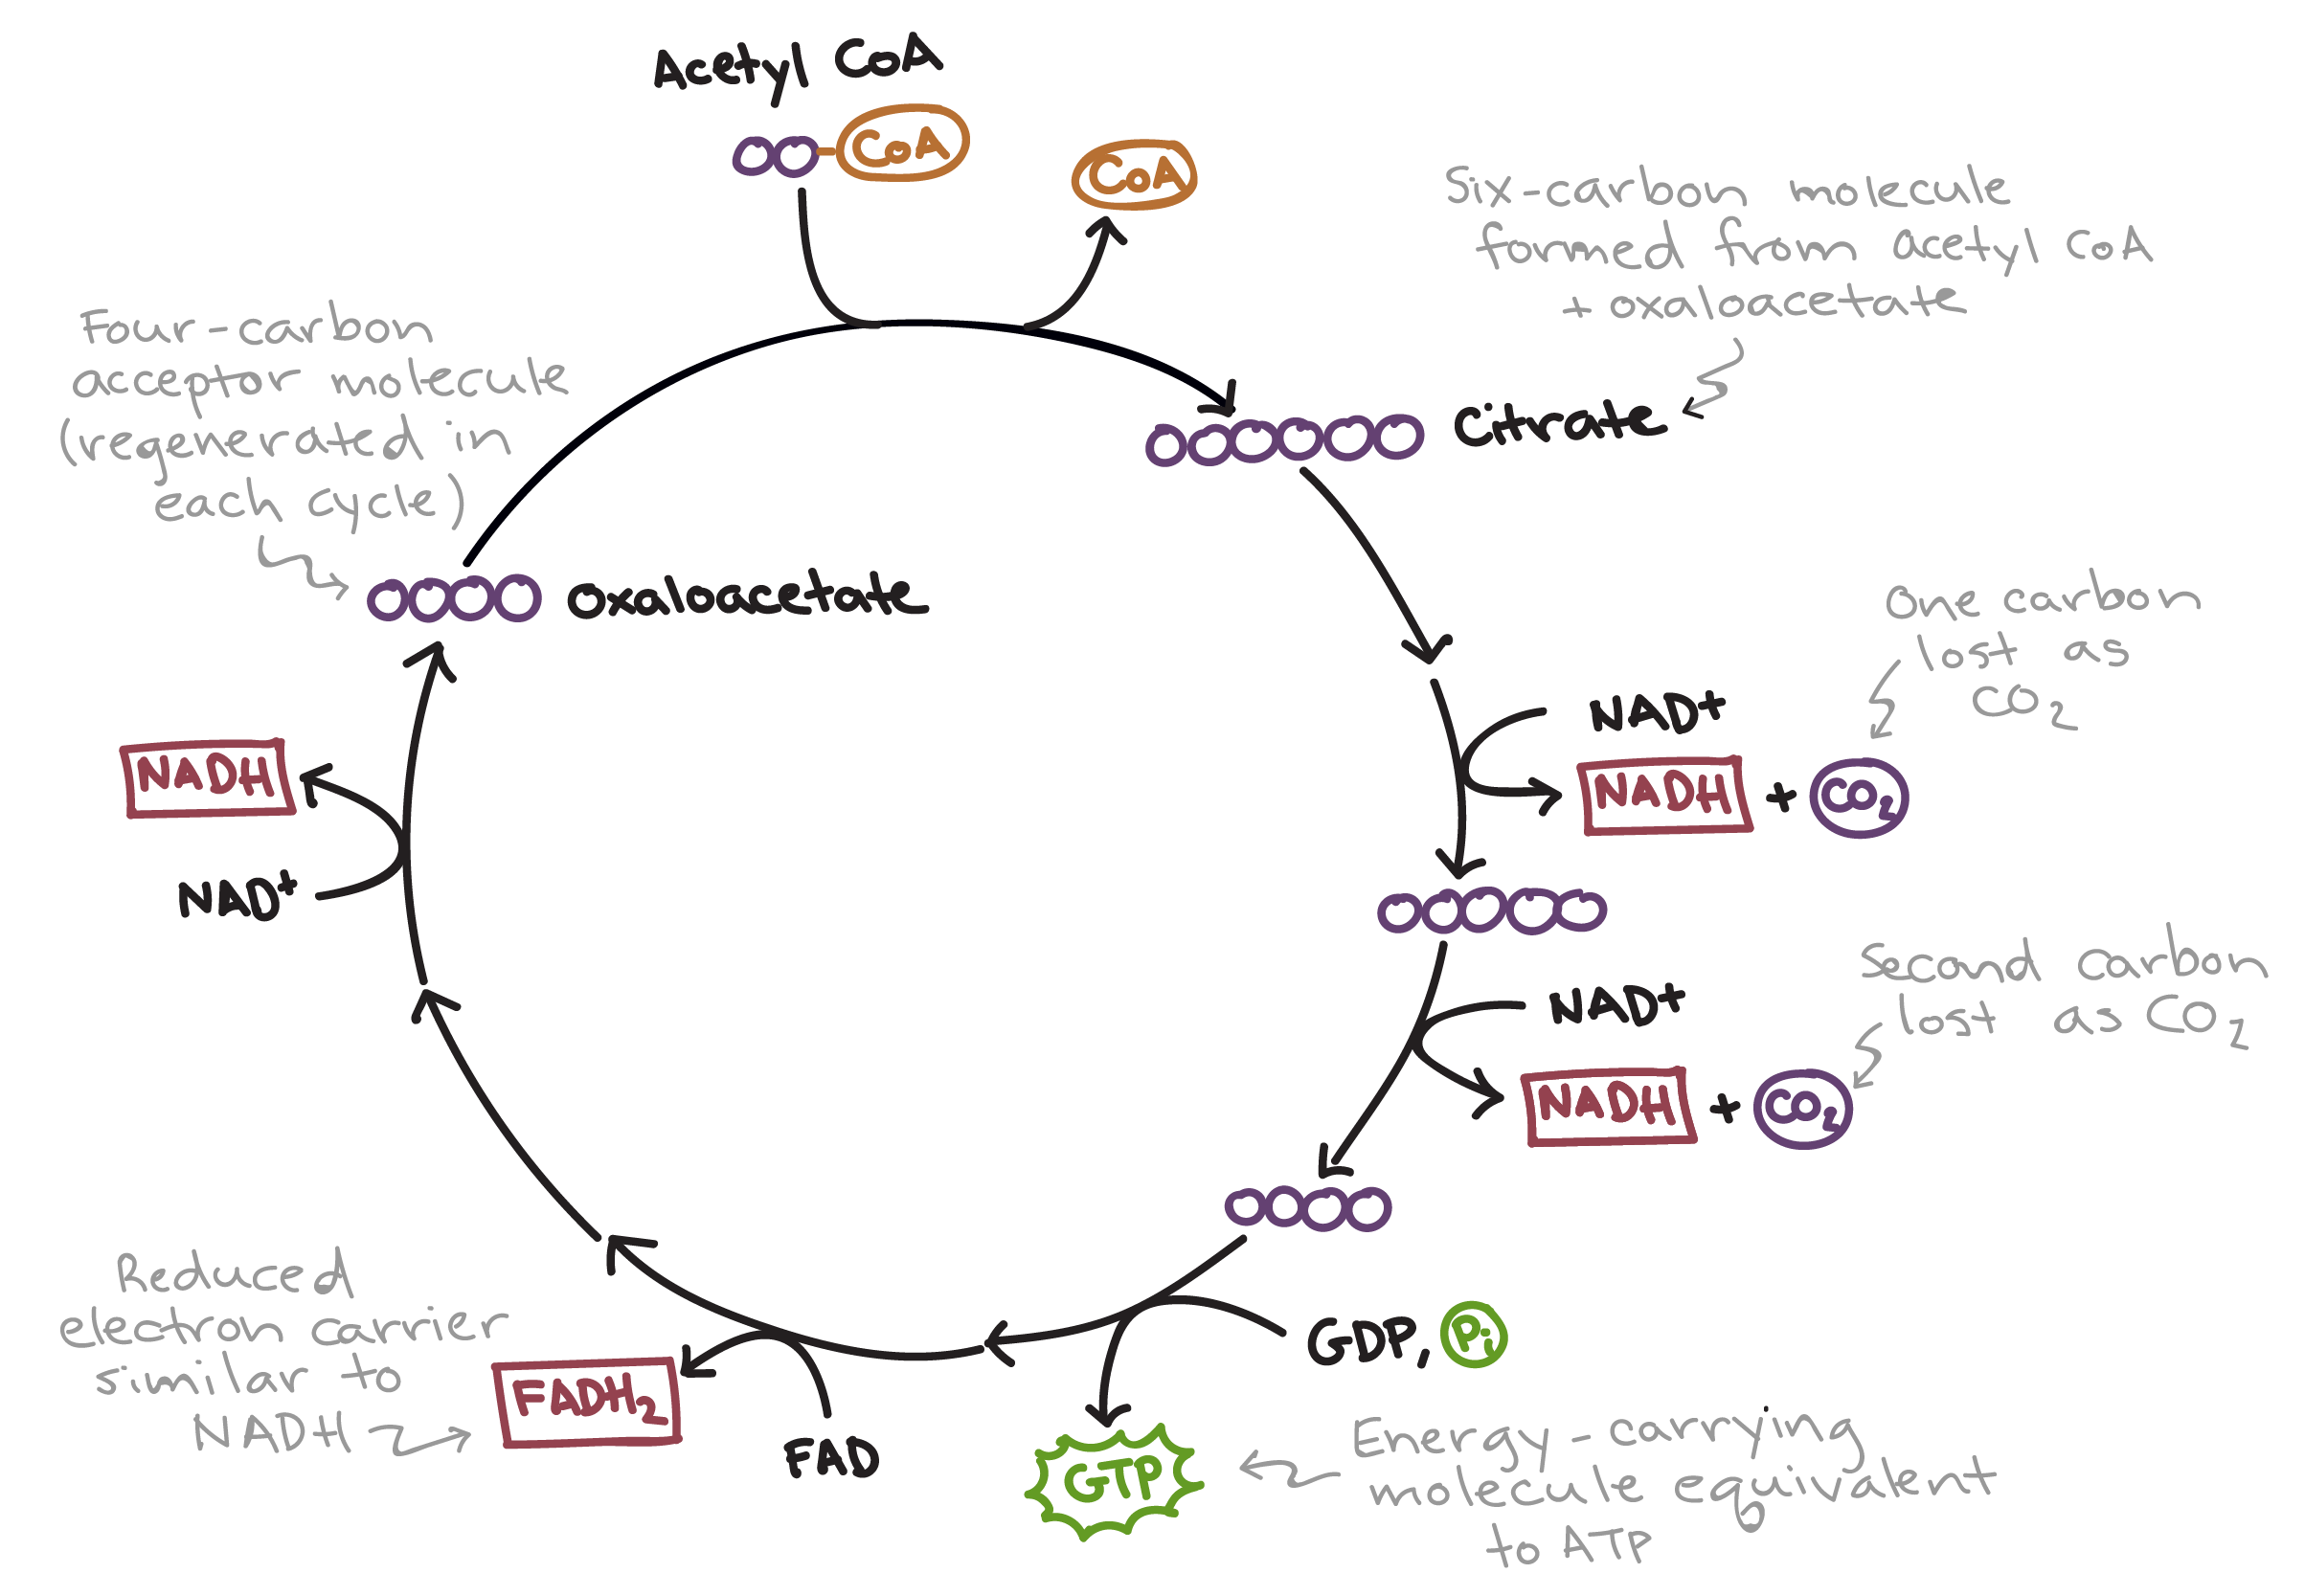
Krebs’ cycle and regulation
AKA citric acid cycle AKA tricarboxylic acid cycle
Takes place in the mitochondrial matrix
Regulated by availability of NAD+ and FAD and inhibited by high concentrations of NADH
Pyruvate from glycolysis is converted into Acetyl Coenzyme A
The Peer Teaching Society is not liable for false or misleading information…

Slide 7
Fatty acid oxidation
AKA beta oxidation
Involves peroxisomes to break down fatty acids into two carbon fragments
Dependant on oxygen, good blood supply and mitochondria numbers
The Peer Teaching Society is not liable for false or misleading information…

Slide 8
Ketones
Large amounts of acetyl-CoA are generated during high rates of fatty acid oxidation which exceed the capacity of the Krebs cycle
Ketogenesis – ketone bodies are synthesised in the mitochondrial matrix from acetyl-CoA generated in beta oxidation
Examples – acetone, acetoacetate, B-hydroxybutyrate
Removal
Acetoacetate and B-hydroxybutyrate can enter the blood
Acetone is expired by the lungs
Skeletal muscles can use ketones as fuel but the liver cannot
The Peer Teaching Society is not liable for false or misleading information…

Slide 9
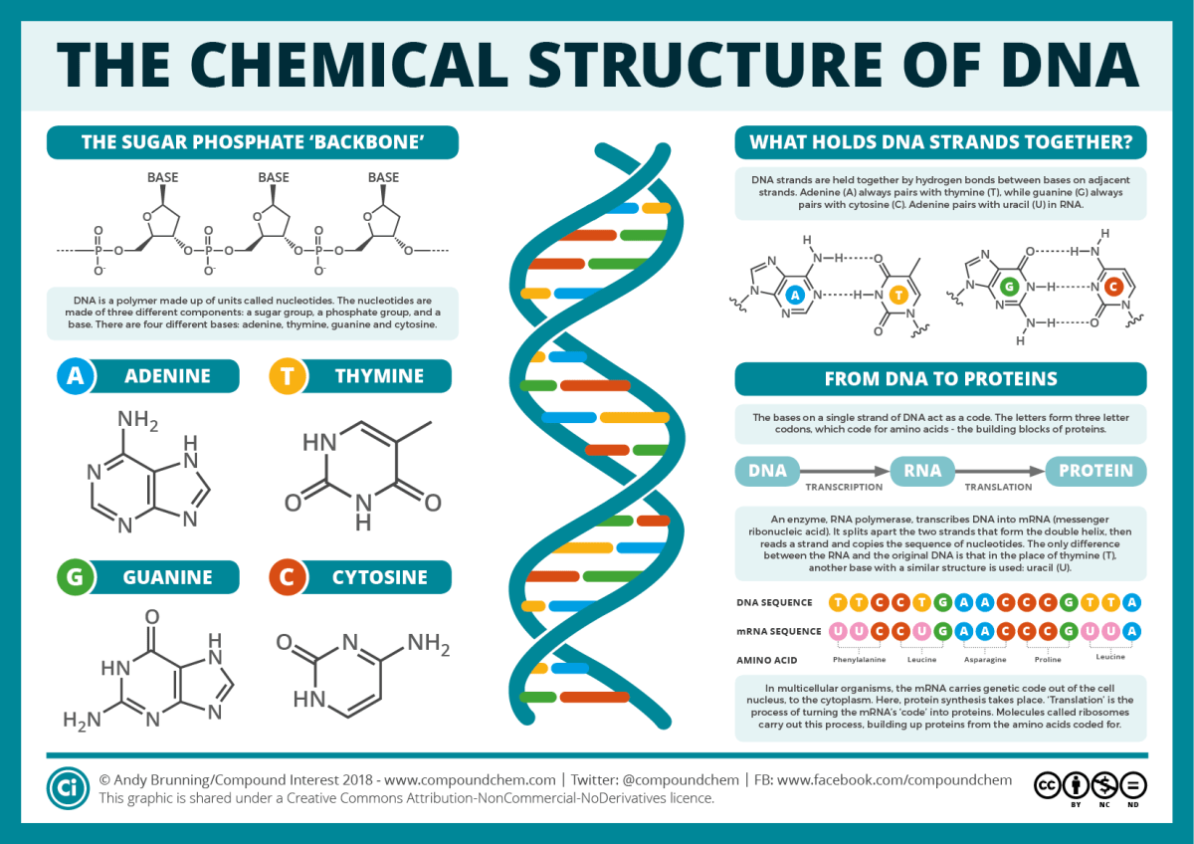
Structure and components of DNA
Structure
Double helix structure
Nucleotides
Nitrogenous base + sugar + phosphate
Nitrogenous base can be purine – two carbon-nitrogen rings e.g. adenine, guanine or pyrimidine - one carbon-nitrogen ring e.g. thymine, cytosine
Sugar is ribose (RNA) or deoxyribose (DNA)
The Peer Teaching Society is not liable for false or misleading information…

Slide 10
DNA mutation
Exon – coding section of the gene
Duplication
Part of a base or a whole gene is duplicated
Deletion
Can be the whole gene or just some exons
Out of frame – one base is deleted which shifts the sequence to the right. Can be catastrophic
In frame – complete codon is deleted. Leads to milder disease
Damage
E.g. from chemicals, UV, radiation
Missense
Single nucleotide change results in codon coding for a different amino acid. Can result in a silent mutation
Nonsense
Point mutation produces a stop codon resulting in an incomplete usually non-functional protein
Expansion of tri-nucleotide repeat
e.g. Huntington’s disease
Triple repeat is repeated several times in the first part of the coding sequence
Normal range 15-20
>36 → Huntington’s, the more the repeats, the earlier the onset of disease
The Peer Teaching Society is not liable for false or misleading information…

Slide 11
DNA vs RNA
 | DNA | RNA
Function | Replicates and stores genetic information | Convert DNA’s genetic information to a protein building format and move to ribosomes
Structure | Two strands in a double helix | One strand
Length | Longer | Shorter
Sugar | Deoxyribose | Ribose
Bases | Adenine, thymine, guanine, cytosine | Adenine, uracil, guanine, cytosine
Location | Nucleus with a small amount in mitochondria | Forms in nucleolus, moves to cytoplasm
Reactivity | More stable | Less stable
UV sensitivity | Vulnerable to UV damage | More resistant to UV damage
3 types of RNA
Messenger – mRNA
Ribosomal – rRNA
Transfer - tRNA
The Peer Teaching Society is not liable for false or misleading information…

Slide 12
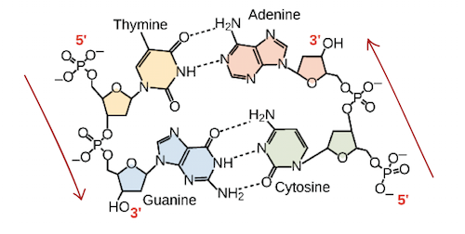
DNA transcription
Initiation
RNA polymerase attaches to the DNA and moves along until it binds to a promotor sequence
Once bound, RNA polymerase unwinds a portion of the double helix
Elongation
The template strand is read 3’ to 5’ and provides the template for mRNA
The other strand is the coding strand and is identical to the new mRNA except for T instead of U
The strand elongates in a 5’ to 3’ direction using incoming ribonucleotides
Termination
Elongation continues until RNA polymerase encounters a stop sequence
Transcription stops and the RNA polymerase releases the DNA template
The Peer Teaching Society is not liable for false or misleading information…

Slide 13
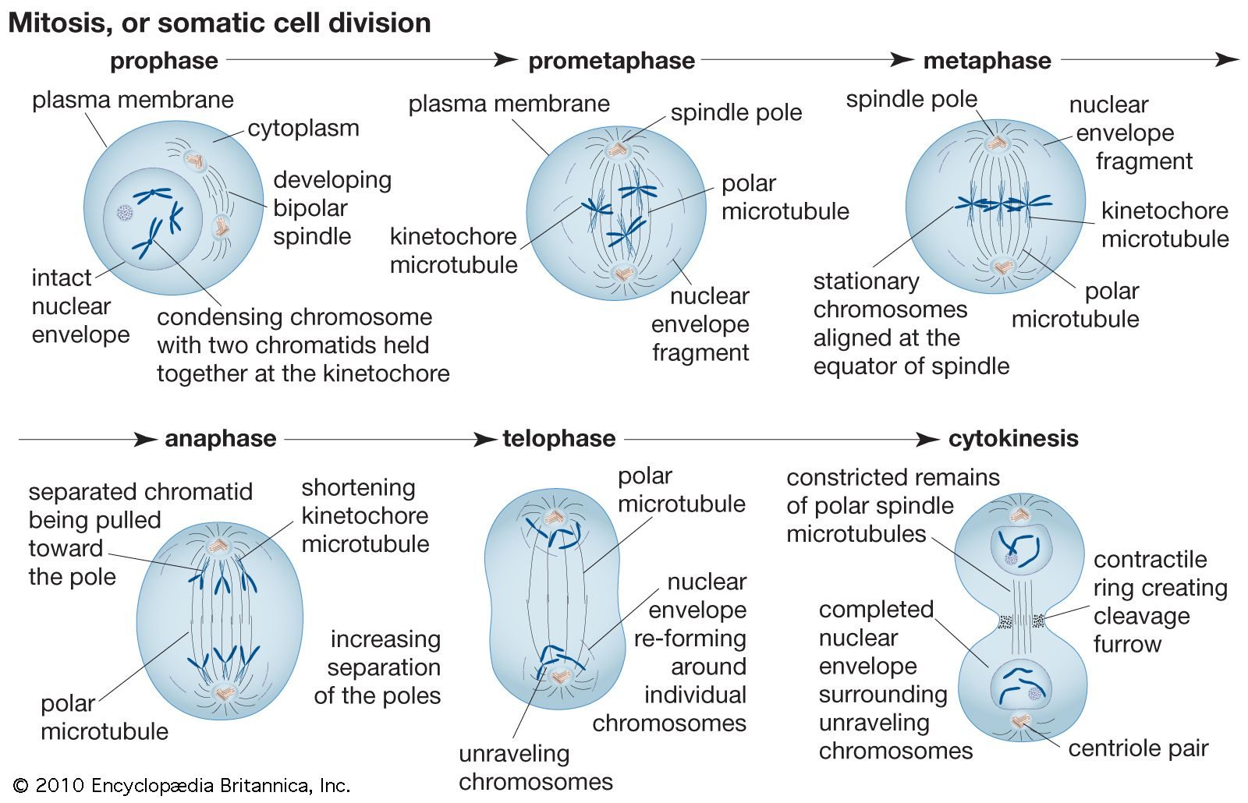
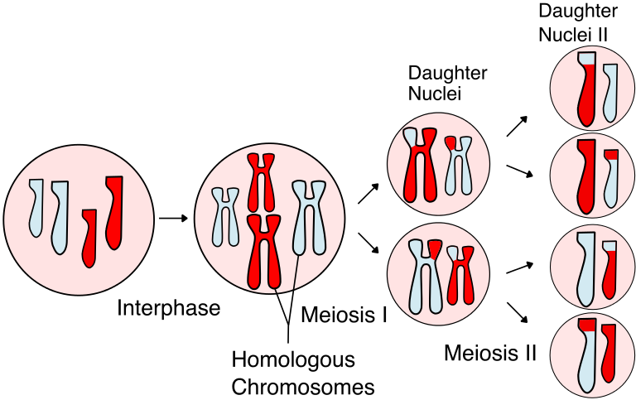
Mitosis and meiosis
Mitosis – division of one cell into two identical daughter cells
Prophase
Mitotic spindles begin to form and attach to the centrosome. The centrosomes begin to move in opposite directions
Metaphase
Chromosomes line up along the metaphase plate
The centrosomes are at opposite ends of the cell
Anaphase
Sister chromatids are pulled to opposite ends of the cell
The cell elongates to prepare for division
Telophase
The cell has elongated
Nuclei reform, one for each new cell
Chromosomes decondense
Meiosis
Prophase 1
Nuclear envelope disintegrates, chromosomes condense. Spindle fibres appear and attach to chromosomes. Crossing over occurs
Metaphase 1
Homologous chromosomes align along the equator of the cell and align themselves randomly on either side of the metaphase plate (independent assortment)
Anaphase 1
Each homologous chromosome gets pulled toward opposite poles
Telophase 1
Nuclear envelope reforms and spindle fibres disappear. Results in two haploid cell
Prophase 2
Prophase 1
Metaphase 2
Chromosomes line up single file on equator
Anaphase 2
Sister chromatids pulled to opposite poles
Telophase 2
Telophase 1
The Peer Teaching Society is not liable for false or misleading information…

Slide 14
Gametogenesis
Gametogenesis – haploid cell is formed from a diploid cell through meiosis
Spermatogenesis produces spermatozoa, oogenesis produces ova
Spermatogenesis
Starts with spermatogonia, pool of diploid cells. Constantly being replenished
Meiosis 1 produces two haploid cells – secondary spermatocytes
Meiosis 2 produces four haploid cells - spermatids
Takes approx. 70 days so multiple spermatogenic processes occurring simultaneously
Oogenesis
Primordial germ cells begin before birth
Meiosis 1 begins before birth to form primary oocytes. Around 40,000 left at puberty
LH surge during menstrual cycle induces the pre-ovulatory stage and meiosis 1 is complete. Forms 2 unequally sized haploid cells – one secondary oocyte and one polar body
Polar body undergoes meiosis 2 to form two polar bodies
Secondary oocyte arrests in metaphase of meiosis 2 3 hours prior to ovulation
Meiosis 2 will only complete following fertilisation. If not fertilised, oocyte degenerates.
The Peer Teaching Society is not liable for false or misleading information…

Slide 15
Down syndrome mutation
Down syndrome has an extra copy of chromosome 21 so is known as trisomy 21
Occurs when there is failure of chromosome pairs to separate in meiosis 1 or sister chromatids to separate properly in meiosis 2
Likelihood increases with age of both parents
The Peer Teaching Society is not liable for false or misleading information…

Slide 16
Gonadal mosaicism
Gonadal mosaicism – genetic mosaicism where more than one set of genetic information is found in the gamete cells
Occurs when precursor germline cells to sperm/egg are a mixture of 1 or more genetically different cell lines – error in mitosis
Incidence increases with older father
The Peer Teaching Society is not liable for false or misleading information…

Slide 17
Chromosomal abnormalities
Numerical
There is a different number of chromosomes in the cells of the body e.g. 45 or 47 chromosomes
Structural
Part of a chromosome is missing or extra, or has switched place with another part
The Peer Teaching Society is not liable for false or misleading information…

Slide 18
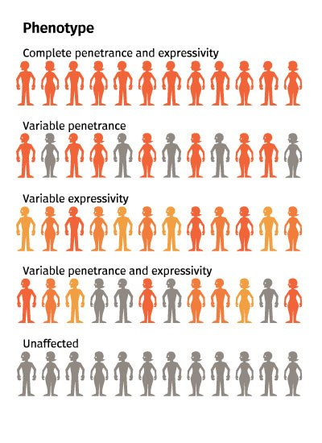
Phenotype and genotype
Genotype – unique sequence of DNA
Phenotype – expression of genotype
Disparity between these due to…
Reduced penetrance
Variable expressivity
The Peer Teaching Society is not liable for false or misleading information…

Slide 19
Inheritance
Autosomal dominant
One altered copy of the gene in each cell is sufficient for someone to be affected
e.g. Huntington disease, Marfan syndrome
Autosomal recessive
Both copies of the gene in each cell must be altered for someone to be affected
e.g. cystic fibrosis, sickle cell disease
X-linked dominant
Variation on the X chromosome. One copy is sufficient for someone to be affected therefore males always affected and one copy in females sufficient
e.g. fragile X syndrome
X-linked recessive
Variation on the X chromosome. One altered copy in each cell sufficient in males as only one X chromosome, two altered copies needed in females
e.g. haemophilia
The Peer Teaching Society is not liable for false or misleading information…

Slide 20
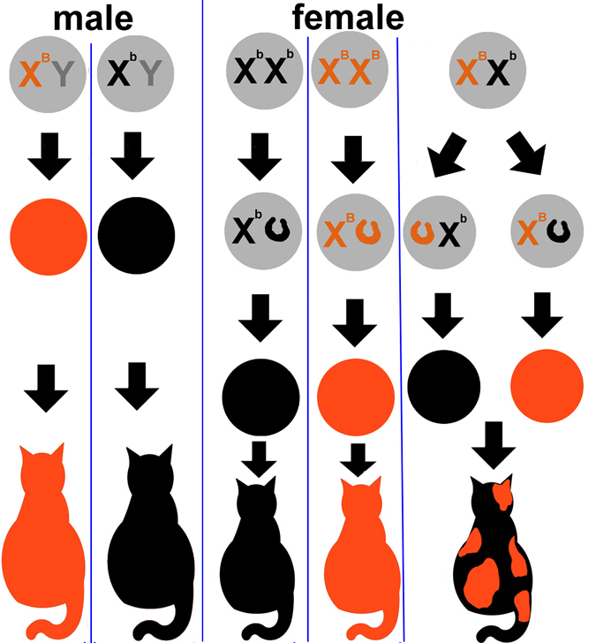
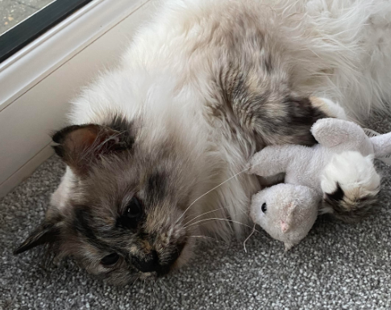
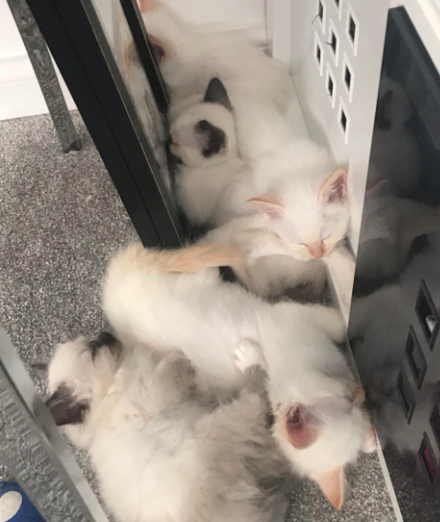
Lyonisation
AKA X-inactivation
One of the two X chromosomes is randomly and permanently inactivated in cells other than egg cells
It is present in all cells with the maternal or paternal X chromosome being inactivated
e.g. tortoiseshell cats -
The Peer Teaching Society is not liable for false or misleading information…
Notes:
Charlie is a tortoiseshell cat who had 5 male kittens, all either ginger or grey

Slide 21
Multifactorial inheritance
Multifactorial inheritance – more than 1 factor causes a trait or health problem
Examples:
Cleft palate
Hip dysplasia
Spina bifida
Diabetes
The Peer Teaching Society is not liable for false or misleading information…

Slide 22
Misc. definitions
Term | Definition
Autosomes | Any chromosome which is not a sex chromosome
Vertical transmission | Generational transmission from parent to child
Recurrence risk | The likelihood that a hereditary trait or disorder in one family member will occur again in other family members
Variable expression | The range of signs and symptoms that can occur in different people with the same genetic condition
Reduced penetrance | A lower proportion of people with a gene mutation who exhibit signs and symptoms of a genetic disorder
Anticipation | Signs and symptoms of a genetic condition become more severe and/or appear at an earlier age as the disorder is passed from one generation to the next
Sex limitation | Genes that are present in both sexes but are expressed in only one
Assortative mating | The tendency for people to choose people who are more/less similar to themselves in phenotype characteristics
The Peer Teaching Society is not liable for false or misleading information…

Slide 23
Questions
What dietary energy source has the most kcal/g?
What is the product of glycolysis?
Where does the Krebs cycle occur?
All tissues can use ketones as fuel. T/F?
Which type of DNA mutation causes Huntington’s disease?
Which nucleotide base is not present in RNA?
Meiosis 2 in the ova is complete before fertilisation. T/F?

Slide 24
Answers
Lipid
Pyruvate
Mitochondrial matrix
False
Expansion of trinucleotide repeat
Thymine
False

Slide 25
Thank you for listening!
Any questions?

