Slide 1
IMMS revision
Asha and Sophie

Slide 2
Cells
Organelle structure and function
Membranes
Cell junctions
Notes:
Mitochondria
Ribosomes
Microtubules
Nucelolus
Golgi Apparatus

Slide 4
Cell → organelle structure and function
Cytosol: fluid matrix of the cell (not held in any organelles)
Nucleus: contains cellular DNA and nucleolus
> nuclear membrane = double membrane, perforated with pores
> nuclear DNA: euchromatin is actively transcribing chromatin, heterochromatin in less active
> nucleolus: forms the rRNA
Mitochondria: site of oxidative phosphorylation
> contains mtDNA
> double membrane: outer is smooth, inner has cristae

Slide 5
Rough endoplasmic reticulum: site of protein synthesis.
Smooth endoplasmic reticulum: lipid production
Golgi apparatus: processing and modification of proteins:
> parallel stacks of membranes
> cis face: receives vesicles from SER.
> medial face: forms complex oligosaccharides
> trans face: proteolysis
Vesicles: cell derived pinocytic and phagocytic vesicles, golgi derived, ER derived, lysosomes, perioxisomes
> lysosomes: contain hydrolytic enzymes.

Slide 6
Cytoskeleton
Microfilaments: smallest (5nm). Actin
Intermediate: 10nm. Anchored to transmembrane proteins, spreads tensile forces. 6 types:
> cytokeratin, desmin, glial fibrillary acidic, neurofilament, laminin, vimentin
Microtubules: largest (25nm). Tubule proteins

Slide 7
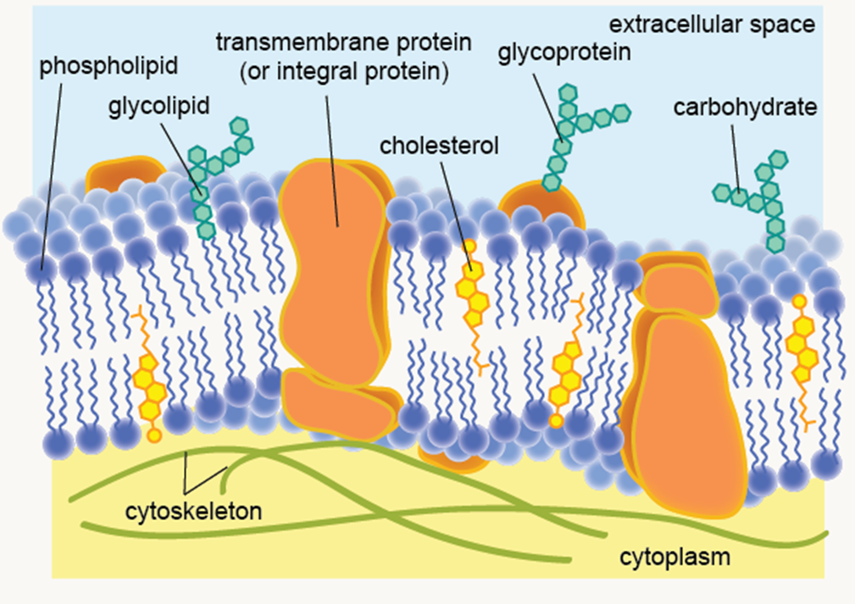
Cell Membrane
Phospholipid bilayer
> hydrophilic head and hydrophobic
tail
> consist of a glycerol molecule, two
fatty acids and a phosphate group
Fluid mosaic model: due to intrinsic/extrinsic proteins
Contains: cholesterol (supports fluidity), proteins (transporters), glycolipids and glycoproteins (cell signaling)
Functions: semi permeable membrane, hosts cell membrane receptors, regulates what goes in and out of the cell, separate intracellular cell contents from extracellular cell contents
Notes:
Cell membrane proteins: intrinsic and extrinsic, receptors, ATP driven transporters, ion channels, transporters, adhesion
Molecules cross cell membranes via simple diffusion, facilitated diffusion, primary active transport, secondary active transport, ion channels, endocytosis, exocytosis, osmosis

Slide 8
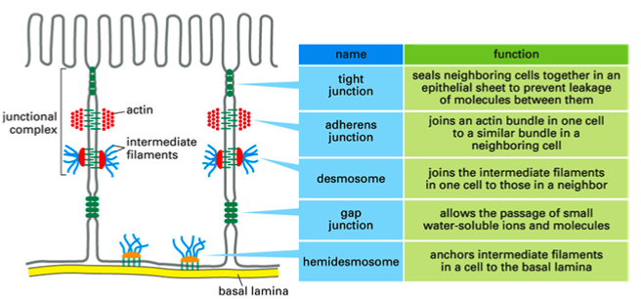
Cell Junctions:
Notes:
Tight junctions are occluding: help seal cells together
Adherens junction are anchoring filaments, as are desmosomes and hemidesmosomes
Communicating are gap junctions

Slide 9
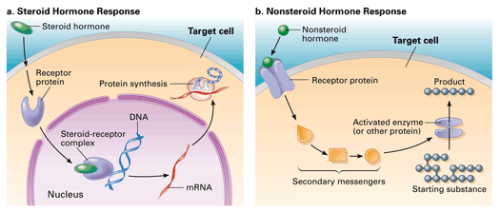
Homeostasis:
Hormones: peptide vs steroid:
peptide: fast response (eg, insulin). Can’t enter the cell, uses secondary messengers
Steroid: derived from cholesterol. Can enter the cell. Slow response (testosterone, oestrogen = sex hormones)
Cell communication methods
Water balance
Feedback mechanisms
Hormones serve as chemical messengers and help maintain homeostasis. Go to target cells, in the blood stream, via the endocrine system.
Notes:
- Steroid hormones are insoluble in water and are carried by transport proteins in the blood. Thus they remain in circulation longer than peptide hormones. Peptides are stored in vescilres ready for relase, and steroid hormones and made and released when needed

Slide 10
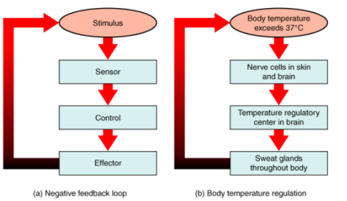
Homeostasis and signaling
‘The maintenance of a constant internal environment’
> There is a set point at which the normal range fluctuates
> maintained via feedback loops.
> hypothalamus primarily controls
Signaling:
> autocrine
> paracrine
> endocrine
> exocrine
Notes:
Positive feedback: clotting cascade (rate increases as conc of product increases), negative feedback, temperature, blood glucose regulation (Rate of process decreases as the conc of the product increases)
autocrine: cell releases signals that acts on self
Paracrine: signals to nearby cells
Endocrine: signaling via blood stream via hormones

Slide 11
Water distribution → LEARN THIS
Water distribution in the body:
> 2/3 intracellular: 28L
> 1/3 extracellular: 14L --> 3L (plasma), 1L (transcellular), 10L (interstitial)
ECF: contains glucose, urea, Cl- and HCO3-. Main cation is Na+
ICF: main cation is K+
Fluid losses can be sensible (measured, eg: urine) or insensible (cannot be measured, eg: evaporation)

Slide 12
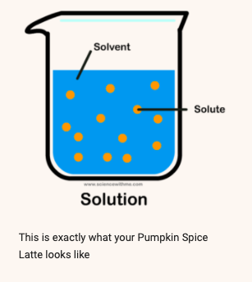
Definitions: water
Osmolality; concentration of solutes in plasma per kilogram of solvent
Osmolarity: concentration of solutes in plasma per litre of solution
Osmotic pressure: how easily a solution can take in
water.
Oncotic pressure: specific type of osmotic pressure concerning blood proteins (albumin)
Oedma: increased fluid movement from plasma to
interstitial space
Notes:
Solvent is a substance that dissolves a solute. Eg, coffee is a solvent and sugar would be the solute. When mixed together, a solution is made
Solvent measured in weight or volume, and solute measured in weight
Using the coffee analogy: osmolality is the measure of sugar dissolved in a kilogram of coffee. Osmolarity is dissolving grams of sugar into a liter of coffee. Comes down to solvents being measured by weight or volume.
Serum osmolarity is controlled by varopressin. If it increases (too much Na+), ADH released and makes you thirsty. This ‘dilutes’ you
Osmotic pressure is the minimum pressure which needs to be applied to a solution to prevent inward flow across a semipermeable membrane. Oncotic pressure is a type of this, specific to albumin.
Four types of oedma: lymphatic, hypoalbuminic, venous, inflammatory

Slide 13
Molecular building blocks
Carbohydrates/lipids/nucleotides/proteins
Enzymes (function, co-enzymes)
Forces (hydrogen, van der Waals)
Macromolecules: simple molecules like sugars, lipids and amino acids

Slide 14
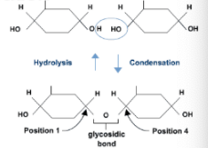
Carbohydrates:
Cn(H2O)n
Monosaccharide: any sugar that can not be hydrolysed. Smallest unit. Eg, Glucose
Oligosaccharide: substance made up of 3-10 monosaccharides
Polysaccharide: a complex carbohydrate composed of more than 10 monosaccharides, joined via glycosidic bonds. Eg, proteoglycans are long polysaccharides from a core protein. Eg2, glycogen
Glycosidic bonds: form from condensation reaction of two monosaccharides, with water as byproduct
Notes:
Disaccharides are also made by joining together of monosaccharides. For example, sucrose is formed from glucose and fructose (two different monosaccharides)
Oligiosaccharides can be part of polysaccharide digestion, or part of protein/lipid complex
Glycogen having 1,6 and 1,4 bonds means it has lots of terminal end points for hydrolysis
Glycosidic bonds: two different types: alpha 1,4 glycosidic bond and alpha 1,4 glycosidic bond. Dependent on what number carbon in the ring. 1,4 is the main linking bond, and 1,6 leads to branching linkage
Carbohydrates are integral to body metabolism. Enter glycolysis.

Slide 15
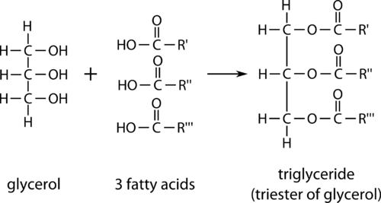
Lipids:
Important for structural support for the cell, energy storage and cell signaling. Non polar in nature and do not interact with water (hydrophobic)
Macromolecules made of fatty acid monomers.
Fatty acid: straight chain even number of carbons, with methyl at one end (CH3) and a carboxyl group at the other end (COOH)
Saturated or unsaturated (dependent on presence of double carbon bond).
Triglyceride: 3 fatty acids bound to 1 glycerol
Phospholipid: glycerol molecule, two
fatty acids and a phosphate group
Lipid metabolism is covered in GI!
Notes:
If the straight chain has a double bond in it, becomes unsaturated, and rigidity is increased.
Can anyone remember the 3 structural components of a phospholipid? Was mentioned a few slides ago in relation to CSM!

Slide 16
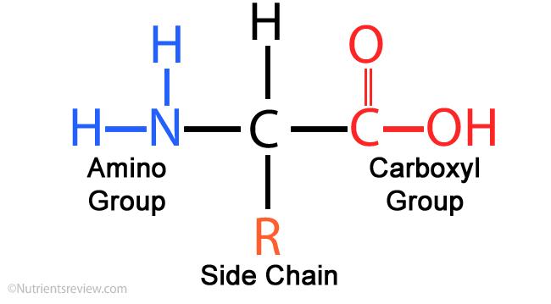
Amino acids:
Building blocks of proteins
AA have an amino group (NH2), a variable R group, a carboxyl group (COOH) and a hydrogen
AA from polypeptides via peptide bonds. These can be cleaved by proteases or peptidases. They are formed in condensation reactions.
Notes:
The side chain determines polarity and further protein structure

Slide 17
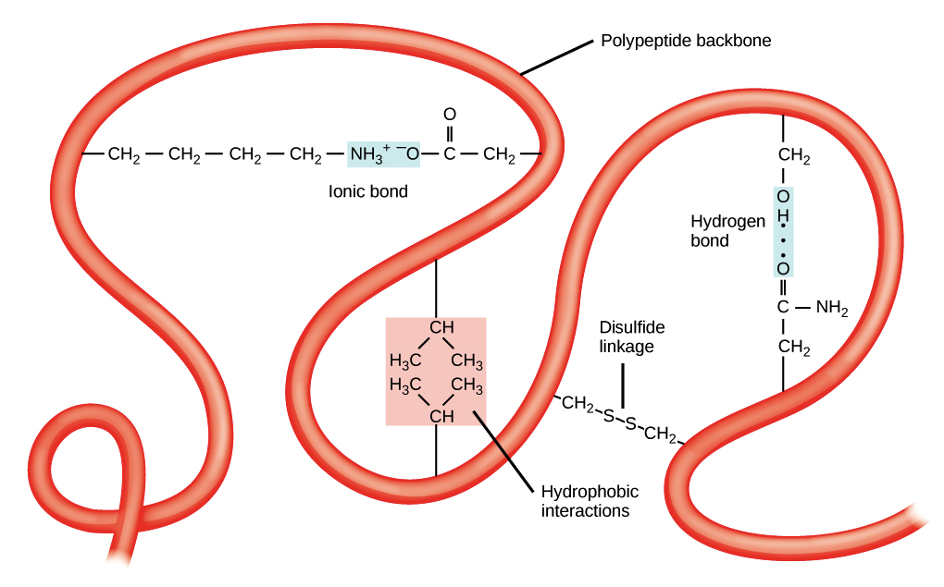
Protein structure
Primary: sequence of linear amino acids with peptide bonds
Secondary: alpha helix/ beta pleated sheet. Hydrogen bonds.
> super secondary: helix turn helix, beta alpha beta, zinc fingers, leucine zip
Tertiary: folding into a 3D shape. Involves disulphide bridges, hydrogen bonds, ionic bonds, hydrophobic bonds.
Quaternary: multiple tertiary proteins working together. Eg, haemaglobin: x4 polypeptide chains, with a prosethic Fe2+ ion
Van der Waals are the weakest forces, ionic are the strongest
Notes:
Secondary: this folding is just due to the backbone. No involvement of the R group
Tertiary: due to the R group. Disuphide bonds are covalent bonds between x2 cysteine AA.

Slide 18
Enzymes:
Biological catalysts
Isoenzymes: different structure but do the same function. Eg, LDH. Example of enzyme as disease marker
Coenzymes: form covalent bonds with the enzyme to maximise activity
Action can be affected by pH and temperature → denatured
Rate of reaction is affected by temperature, surface area, pressure/concentration, and presence of enzyme
Notes:
LDH is given out from tissue damage, but there are different types depending on where the damage is

Slide 19
Examples of proteins:
Haemoglobin:
- x2 alpha chains and x2 beta chains, with prosthetic Fe2+ ion
- sickle cell anaemia occurs when erythrocytes are sickle shaped and rigid due to glutamic acid being subbed for lysine. Causes a hydrophobic patch and haemoglobin clumps together. Example of co-dominant genetic disorder
Immunoglobulins
- proteins that counteract pathogens. Complementary shape to antigens

Slide 20
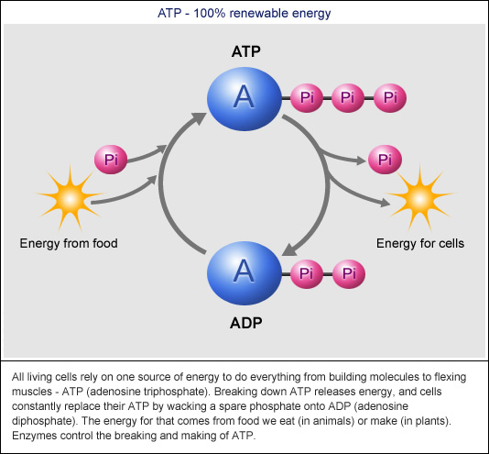
ATP—ADP cycle
ATP is the universal energy source
ADP is formed from ATP, as phosphates are released.
ATP+water -> ADP +phosphate + H+
ATP is produced via the oxidation of lipids/proteins/carbs
Notes:
The production of ADP is an energetically favorable reaction. The ATP molecule has 2 phosphoanhydride bonds that are relatively weak, and require little energy to break. Therefore, requires less energy to break the bonds than what is released
ATP is used commonly in the body for muscle contraction and biosynthesis

Slide 21
Metabolism
‘Chemical reactions that occur in a living organism’
Basal Metabolic Rate: the measure of energy required to maintain non-exercise bodily function
> affected by factors such as gender/age/diet
> eg, respiration/biosynthesis.
4 ways components are synthesized in the body
> storage (anabolic)
> biosynthesis (anabolic)
> waste disposal (catabolic)
> oxidation (catabolic)
Notes:
Respiration/biosynthesis can only be measured if not eaten in the past 12 hours, and at a controlled temperature

Slide 22
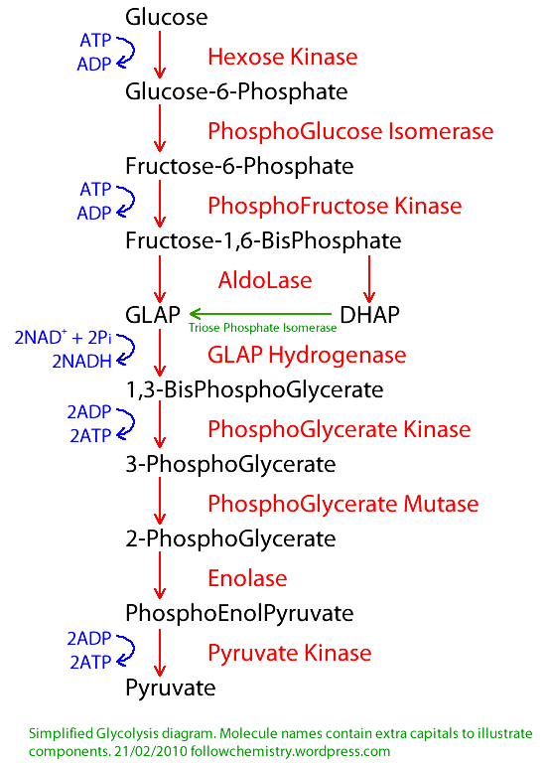
Glycolysis
LEARN THE STEPS WHICH USE ATP AND RELEASE ATP
Occurs in the cytoplasm of the cell
Produces 2x NADH, (net) x2 ATP, x2 pyruvate
Phosphofructokinase is the rate limiting step. High ATP limits.
Pyruvate then continue to the Krebs cycle
Notes:
Acronym for the enzymes: hungry pirates pick all the greatest pickled pumpkins ever picked

Slide 23
Krebs cycle:
Occurs in the mitochondrial matrix
One pyruvate molecule produces 1x ATP molecules, 3x NADH molecules, and 1x FADH₂ molecules. Released 2x CO₂
Isocitrate dehydrogenase is the rate limiting enzyme
Krebs is inhibited by NADH
Notes:
Acronym: can I keep selling socks for money officer?

Slide 25
Oxidative Phosphorylation
Total ATP from one molecule of glucose is 34 ATP
One molecule of NADH = 3 ATP
One molecule of FADH= 2 ATP
Electron transport chain
Inner mitochondrial membrane
NADH and FADH oxidize to deliver electrons to power the proton pumps
Work via electrochemical gradient. H+ pumped into the intermembrane space, build up this gradient. H+ ions then flow down the gradient, through ATP synthase to form ATP
Electrons then transferred to O2 (acts as the final electron acceptor) to split to form water

Slide 27
Fatty acid (beta) oxidation
Production of ATP from fat consumption. Occur in the mitochondria.
Rate increases when there is not enough glucose to produce Acetyl CoA
Acetyl CoA can be derived from beta oxidation of fatty acids (for Krebs)
Fatty acids are activated: form acyl-CoA. Then enter the mitochondria via carnitine shuttle.
Pathology- diabetic ketoacidosis
Complication of type 1 diabetes. When high blood sugar. Ketones build up.
Notes:
Do not act as a fuel source to the nervous system as they cannot get through the blood brain barrier.
Catabolic process
Can’t just diffuse through because bigger than 12 carbons. Carnitine acyltransferase 1 on outer mitochondrial membrane removes coA from Acyl CoA, adds a carnitine – becomes acyl carnitine
Acyl carnitine is transported into the mitochondria, through the outer mitochondrial membrane
Carnitine acyltransferase 2 removes carnitine and adds coA again – present inside the mitochondria
Acyl coA is oxidised – forms acetyl CoA
Each round produces:
1NADH, 1FADH2, 1 Acetyl-CoA (krebs)
- Other two for oxidative phosphorylation
In diabetic ketoacidosis, too much acetyl coa production, overwhelms krebs cycle and leads to ketone body formation

Slide 28
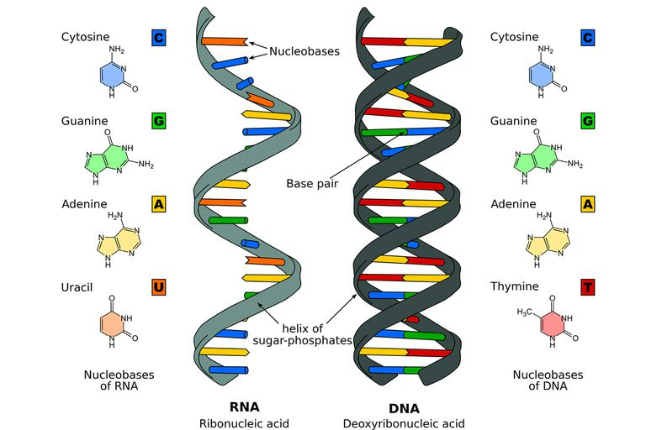
DNA/RNA
Structure
Replication
Transcription/ translation
DNA coils to nucleosomes → supercoils → chromosomes
DNA wraps around histones
Double helix anti- parallel structure
Complementary base pairing; A&T (2 H bonds), G&C (3 H bonds)
Notes:
nucleotides: nitrogenic base (purine or pyrimidine), phosphate, pentose sugar
Nucleotides are connected via phosphodiester bonds

Slide 29
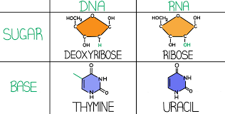
DNA vs RNA
DNA | RNA
Found in the nucleus | Found in the cytoplasm
Deoxyribose sugar | Ribose sugar
Double stranded | Single stranded
Adenine, Guanine, Thymine and Cytosine | Adenine, Uracil, Guanine, Thymine and Cytosine

Slide 30
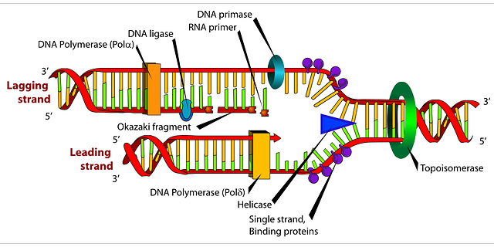
DNA replication
Semi conservative replication
In the S phase of the cell cycle
Topoisomerase: unwinds supercoils. Breaks phosphodiester bonds
Helicase: breaks hydrogen bonds between bases
DNA polymerase: reads strands 3’ to 5’, prints 5’ to 3’.
Leading and lagging strand. Lagging because of DNA polymerase only reading and printing in one direction. Results in Okazaki fragments. Joined by DNA ligase.
Occurs in replication fork
Results in identical DNA: one new strand, one parent strand.

Slide 31
Protein synthesis: transcription and translation
Transcription: DNA to mRNA
> in the nucleus
> via topoisomerase and RNA polymerase
> mRNA moves out via nuclear pores
Translation: mRNA to polypeptide
> occurs on ribosomes
> tRNA carries a specific anticodon to the corresponding codon on mRNA
> produces a chain on amino acids, until stop codon reached

Slide 32
Mitosis/ meiosis
Stages
Cell cycle
Light microscopy
Abnormalities
Mendel’s second law
Gonadal Mosaicism
Law of independent assortment
During gamete formation
Creates variation

Slide 33
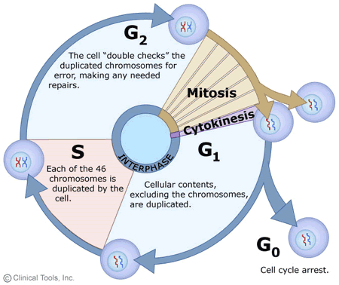
The cell cycle:
G1, S, G2, M
Required for growth and repair
Checkpoints in G1, G2, and mitosis
Takes 24 hours: G1 =11 hours, S= 8 hours, G2= 4 hours
Notes:
G1: enters cell cycle. Organelles are produced, cell becomes larger. Needs to contain components for x2 cells
S: semi conservative replication
G2: organelles and energy stores grow

Slide 34
Mitosis
Interphase DNA and organelles replicate, nuclear membrane disappears
Prophase Chromatin condenses into chromosomes
Metaphase Chromosomes line up at the equator and centromeres attach to the spindle fibres
Anaphase Chromosomes divide at centromere to opposite poles of the cell
Telophase Nuclear membrane reforms and spindle fibres disintegrate
Cytokinesis Cell forms a cleavage and splits into two – forms two identical daughter cells

Slide 35
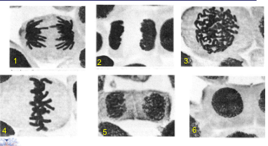
Can you identify which stage of mitosis these cells are in?

Slide 36
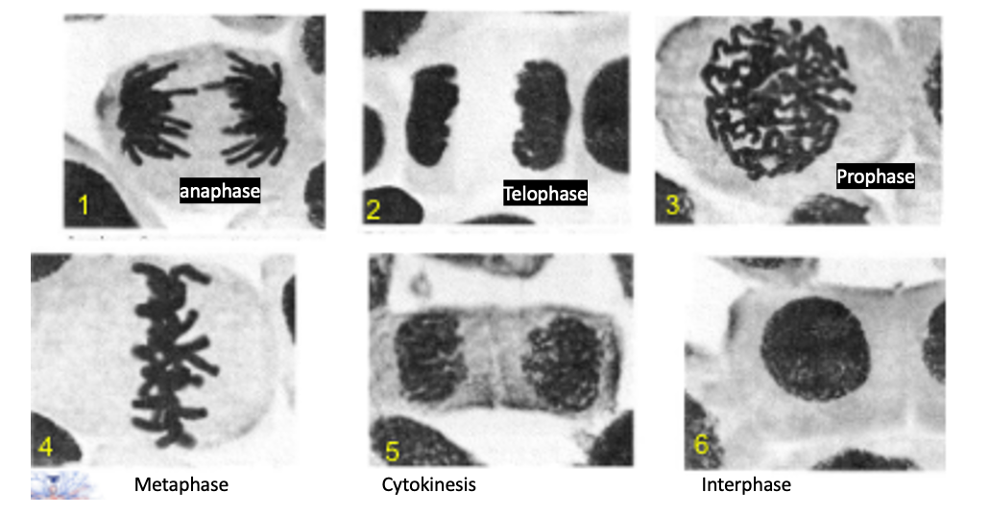

Slide 37
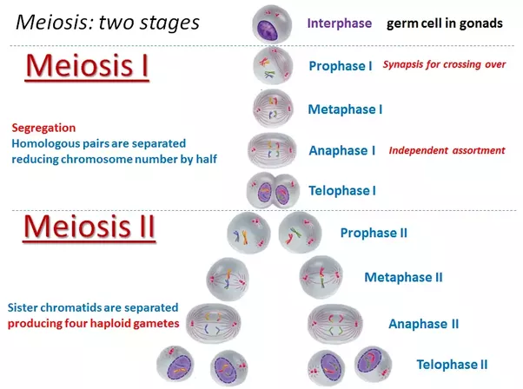
Meiosis
One parent cell creates x4 cells that are not identical
Not a cycle. Has a start and end
Variation created as half of material is from the other, half from father
Crossing over (P1) and Independent Assortment (M1 and M2)
Two divisions
Which of Mendel’s laws creates this variation?
Notes:
Meiosis I = same as mitosis apart from crossing over in prophase I and independent assortment during anaphase I

Slide 38
Abnormalities:
Numerical vs structural chromosomal abnormalities
Non disjunction: failure of the chromosomes to separate. Either too many or too few chromosomes.
Translocation: one part of a chromosome is transferred to another
Aneuploidy: abnormal number of chromosomes
Klinefelters: XXY. 47 Chromosomes
Turners: X. 45 chromosomes
Type of genetic mosaicism where there is more than 1 set of genetic information found in gamete cells: one healthy and one mutated line
Gonadal Mosaicism:
Notes:
Translocation: Robertsonian (some genetic material joins another chromosome). Reciprocal: swap
Klinefeleters: due to non disjunction. Shunted development, learning problems, tall, low sex drive, infertility, broad hips
Turners: shorter than averafe. Underdeveloped ovaries. Can lead to infertility.

Slide 39
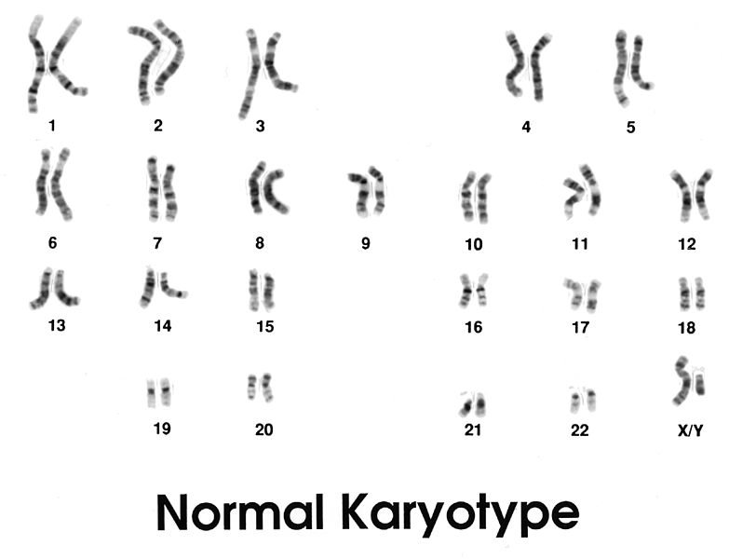
Genetic diseases:
Phenotype vs genotype
Karyotypes
Pedigrees
inheritance
Notes:
Genotype: genetic makeup of an individual
Phenotype: observable characteristics of an individual
Karyotype: appearance of chromosomes in nucleus. Use a chemical such as colchicine to halt the cell cycle so can observe the chromosomes.

Slide 40
Genetic diseases:
Autosomal dominant Non sex-linked, presents in the heterozygous state eg. Huntington’s disease
Autosomal recessive Non sex-linked, condition presents only in the homozygous state eg. Cystic fibrosis
Sex linked Gene carried on the maternal X chromosome eg. Haemophilia
Diseases can be genetic, multifactorial or environmental.

Slide 41
Recessive Pedigree
Notes:
Skips a generation. Affects all sex equally
Circles: women, square, men. Black: effected.

Slide 42
Dominant Pedigree

Slide 43
Sex linked pedigree
Notes:
Eg, haemophilia

Slide 44
SBA quiz!

Slide 45
1. In which cell are you most likely to find a perinuclear hof?
a) basophil
b) eosinophil
c) plasma cell
d) T helper cell
e) Megakaryocyte
Notes:
C

Slide 46
2. What is the Na+/K+ ATPase pump an example of?
a) primary active transport
b) secondary active transport
c) tertiary active transport
d) facilitated diffusion
e) simple diffusion

Slide 47
3. Which enzyme unwinds the DNA double helix in replication, relieving supercoiling?
a) DNA helicase
b) DNA Topoisomerase
c) DNA Ligase
d) Okazaki fragments
e) DNA primase

Slide 48
4. What type of protein structure would zinc fingers, helix-turn-helix and beta-alpha-beta be classed as?
a) primary
b) secondary
c) tertiary
d) quaternary
e) super-secondary

Slide 49
5. In a 70kg male, how many litres of total body water distribution are accounted for by interstitial fluid?
a) 11L
b) 3L
c) 28L
d) 14L
e) 42L

Slide 50
6. What is an example of type 4 collagen?
a) Placenta
b) Cartilage
c) Bone, skin, teeth
d) Basement membranes
e) Arteries, liver, kidneys, spleen, uterus

Slide 51
7. How much energy does alcohol provide?
a) 9kcal/g
b) 4kcal/g
c) 7kcal/g
d) 3kcal/g
e) 5kcal/g

Slide 52
8) Which of these is not a way ATP is produced?
a) Krebs cycle
b) Glycolysis
c) Link Reaction
d) Oxidative phosphorylation
e) substrate level phosphorylation

Slide 53
9) what is a cause of hyponatremia?
a) hyperparathyroidism
b) water deficit
c) acidosis
d) renal failure
e) excess water due to IV fluids, diuretics

Slide 54
10) what is the function of gap junctions?
a) binds cells together to prevent leakage of molecules
b) conduct electrical signals
c) attaches cells via intermediate filaments
d) regulates what goes into and out of the cell
e) joins an actin bundle in one cell to a similar bundle on a neighboring cell

Slide 55
Thank you!

