Slide 1
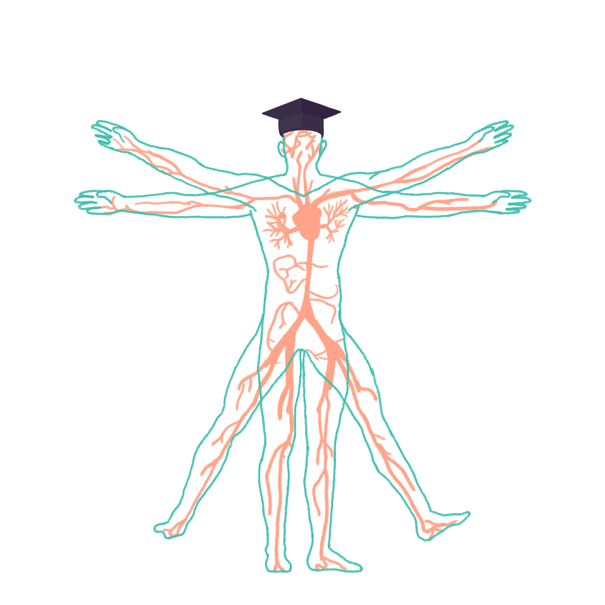
2023/2024

Slide 2
IMMS Wrap-up
Phase 1 Revision Session
IMMS 1 - Joe Keane
IMMS 2 - Joe Priestley
30/11/2023
18:30
The Peer Teaching Society is not liable for false or misleading information…

Slide 3
IMMS 1 - Aims and Objectives
1 - Cells:
Organelles
Cell (plasma) membrane (proteins and movement)
2 - Homeostasis:
Signalling
Feedback loops
Hormones
Water distribution
Homeostasis
3 - Energy:
Metabolism and BMR
Glycolysis and Krebs
Fatty acid oxidation
Ketones
The Peer Teaching Society is not liable for false or misleading information…

Slide 4
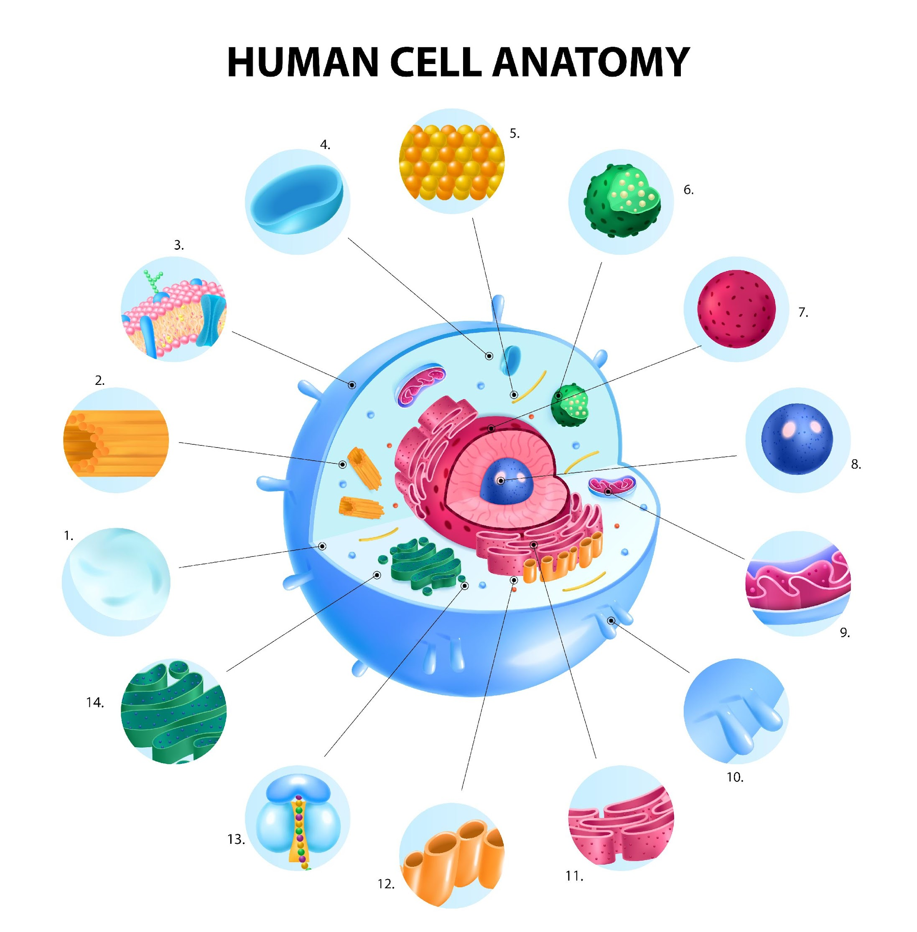
Organelles – Cell structure
The Peer Teaching Society is not liable for false or misleading information…
Link: Image by macrovector on Freepik

Slide 5
Organelles – Cell structure
1 – Cytoplasm
2 – microtubules
3 – Plasma membrane
4 – Vacuole
5 – Centrioles
6 – Lysosomes
7 - Nucleus
8 – Nucleolus
9 – Mitochondria
10 – Microvilli
11 – Rough Endoplasmic reticulum
12 – Smooth endoplasmic reticulum
13 – Ribosome
14 – Golgi complex
The Peer Teaching Society is not liable for false or misleading information…
Link: Image by macrovector on Freepik

Slide 6
Organelles - Function
Nucleolus: Ribosomal RNA synthesis, ribosome assembly
Nucleus: Storage and transcription of DNA
Mitochondria: Respiration and ATP formation
Lysosomes: Contain digestive enzymes, waste disposal system
Ribosomes: Protein synthesis
Important organelles
Cytoskeleton: Structural support and substance movement
Rough ER: Synthesis and processing proteins
Golgi apparatus: Processes and modifies ER products
Smooth ER: Lipid synthesis
The Peer Teaching Society is not liable for false or misleading information…

Slide 7
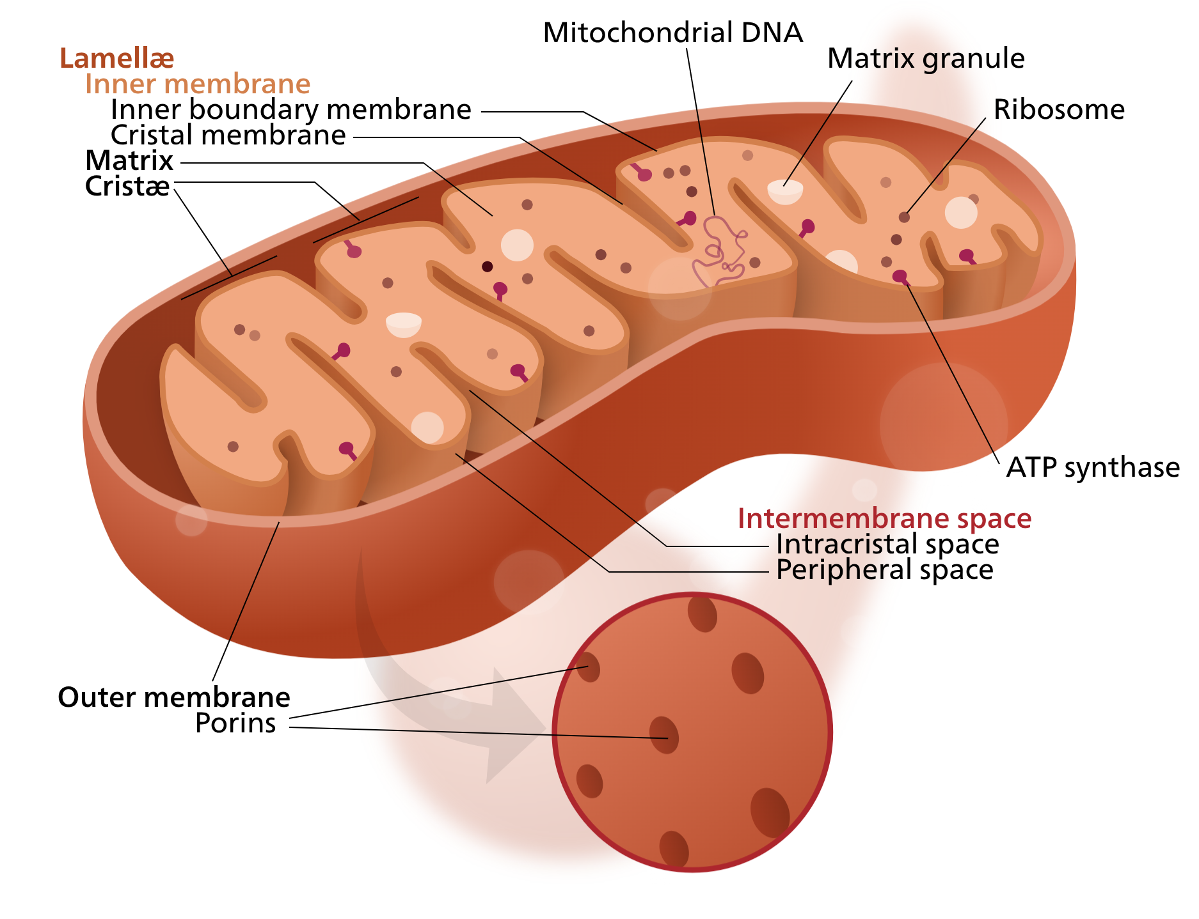
Organelles - Mitochondria
Outer membrane: Separates organelle from rest of cell + regulates molecule/ion movement
Intermembranous space: Storage of H+ to maintain an electrochemical gradient
Inner membrane: Folded into cristae, contains proteins for Electron Transport Chain and ATP synthesis
Matrix: Enzymes for Krebs
The Peer Teaching Society is not liable for false or misleading information…
Link: Wikimedia Commons

Slide 8
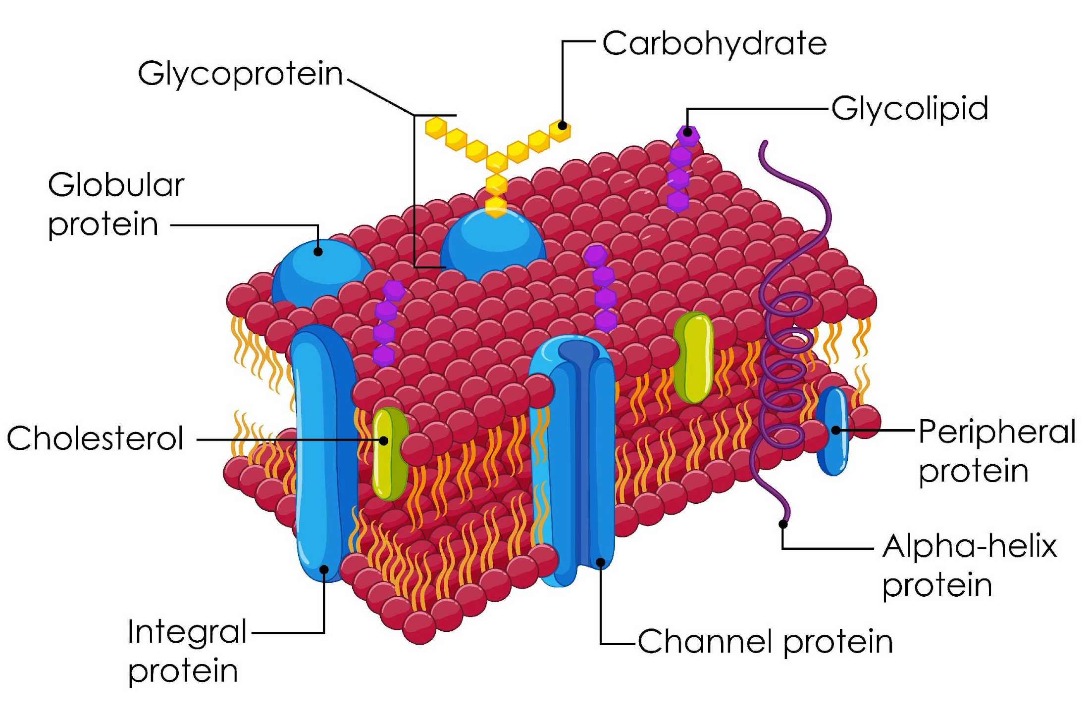
Cell (plasma) membrane – Structure
Double layer of phospholipids (bilayer)
Phospholipids: Hydrophobic head (out), hydrophilic tails (in)
Cholesterol: Integrity
Proteins, glycoproteins, lipoproteins: Signalling, cell-cell adhesion, receptors, recognition
The Peer Teaching Society is not liable for false or misleading information…
Link: Image by brgf on Freepik

Slide 9
Cell (plasma) membrane - functions
Function:
Physical barrier
Endo/exocytosis
Cell signalling
Control of passage for various molecules (selectively permeable)
Hydrophobic fatty acid tails of phospholipids form a barrier against most water-soluble molecules
Vesicles are also made of phospholipids so can be incorporated in the membrane for endocytosis or used to form them for exocytosis
Receptor proteins, lipoproteins, glycoproteins that bind to signalling molecules such as hormones or neurotransmitters
Proteins in the membrane that can act as channels or carriers to facilitate the passage of specific molecules
The Peer Teaching Society is not liable for false or misleading information…

Slide 10
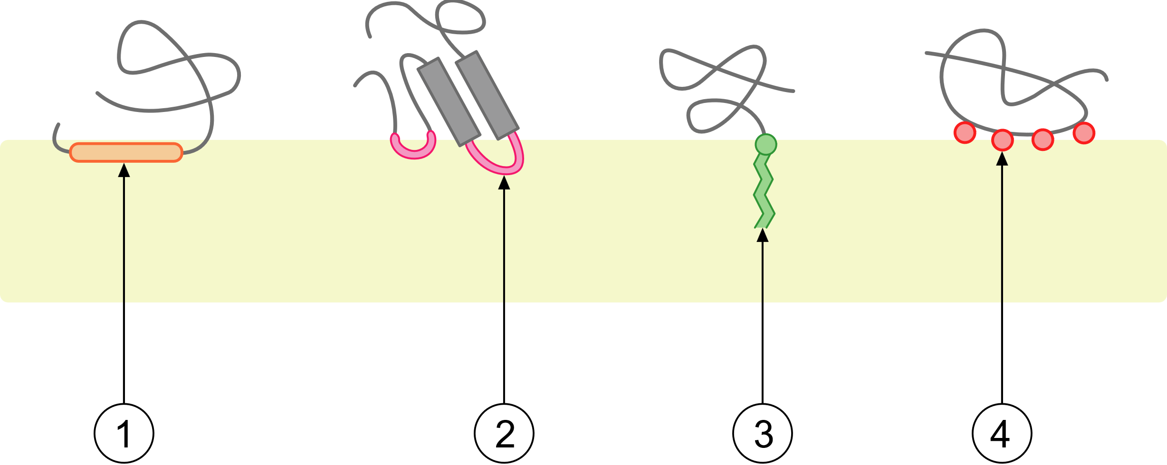
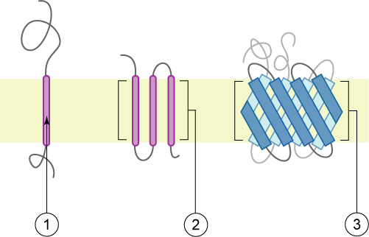
Cell (plasma) membranes - proteins
Proteins make up around 50% mass of the cell membrane
Two main types:
Peripheral
Integral
PLASMA MEMBRANE
The Peer Teaching Society is not liable for false or misleading information…
By Foobar - Own work, CC BY 2.5, https://commons.wikimedia.org/w/index.php?curid=3856212

Slide 11
Cell (plasma) membranes - movement
Transport proteins in the phospholipid bilayer are selectively permeable to maintain an intracellular environment
Simple diffusion: The passive movement of substances across a selectively permeable membrane from an area of higher to lower concentration directly through the bilayer.
Facilitated diffusion: The passive movement of substances from an area of higher to lower concentration with the assistance of specific transport proteins.
Active transport: An energy-requiring process that moves molecules or ions against their concentration gradient from an area of lower to higher concentration via specific transport proteins, utilising energy from ATP.
The Peer Teaching Society is not liable for false or misleading information…

Slide 12
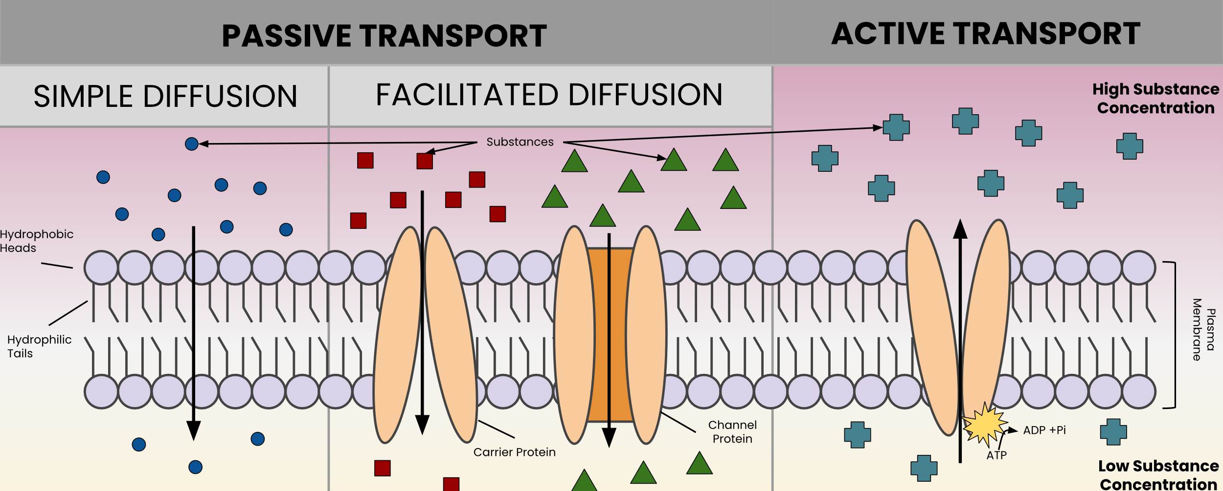
Cell (plasma) membranes - movement
Transport proteins in the phospholipid bilayer are selectively permeable to maintain an intracellular environment
The Peer Teaching Society is not liable for false or misleading information…
By LSumi - Own work, CC BY-SA 4.0, https://commons.wikimedia.org/w/index.php?curid=118132547

Slide 13
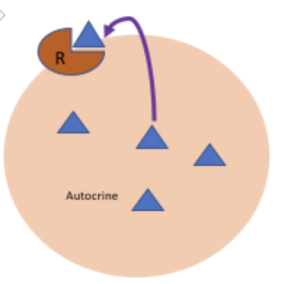
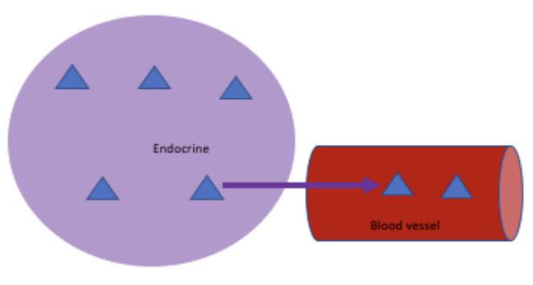
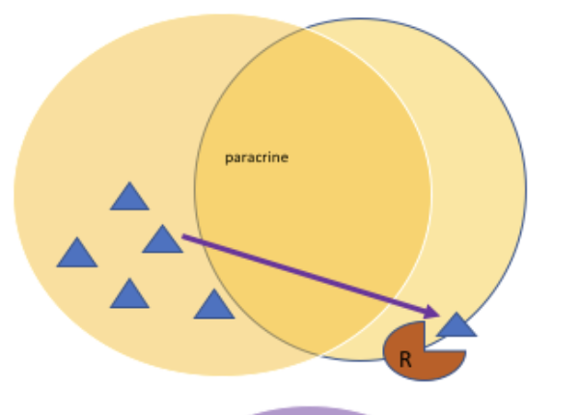
Homeostasis: Signalling
There are 3 main types of signalling
Autocrine: Messenger molecules bind with receptors in the cell where they are produced
Paracrine: Messenger molecules between cells in close-proximity through the ECF
Endocrine: Secretions of messenger molecules into the blood to act on cells in other parts of the body
The Peer Teaching Society is not liable for false or misleading information…
By Anon490 - Own work, CC BY-SA 4.0, https://commons.wikimedia.org/w/index.php?curid=69014995

Slide 14
Homeostasis – simple feedback
Sensor
e.g. nerve cells with endings in skin
Signal
e.g. body temp
Controller
e.g. temp regulatory centre in the CNS
Effector
e.g. sweat glands
The Peer Teaching Society is not liable for false or misleading information…

Slide 15
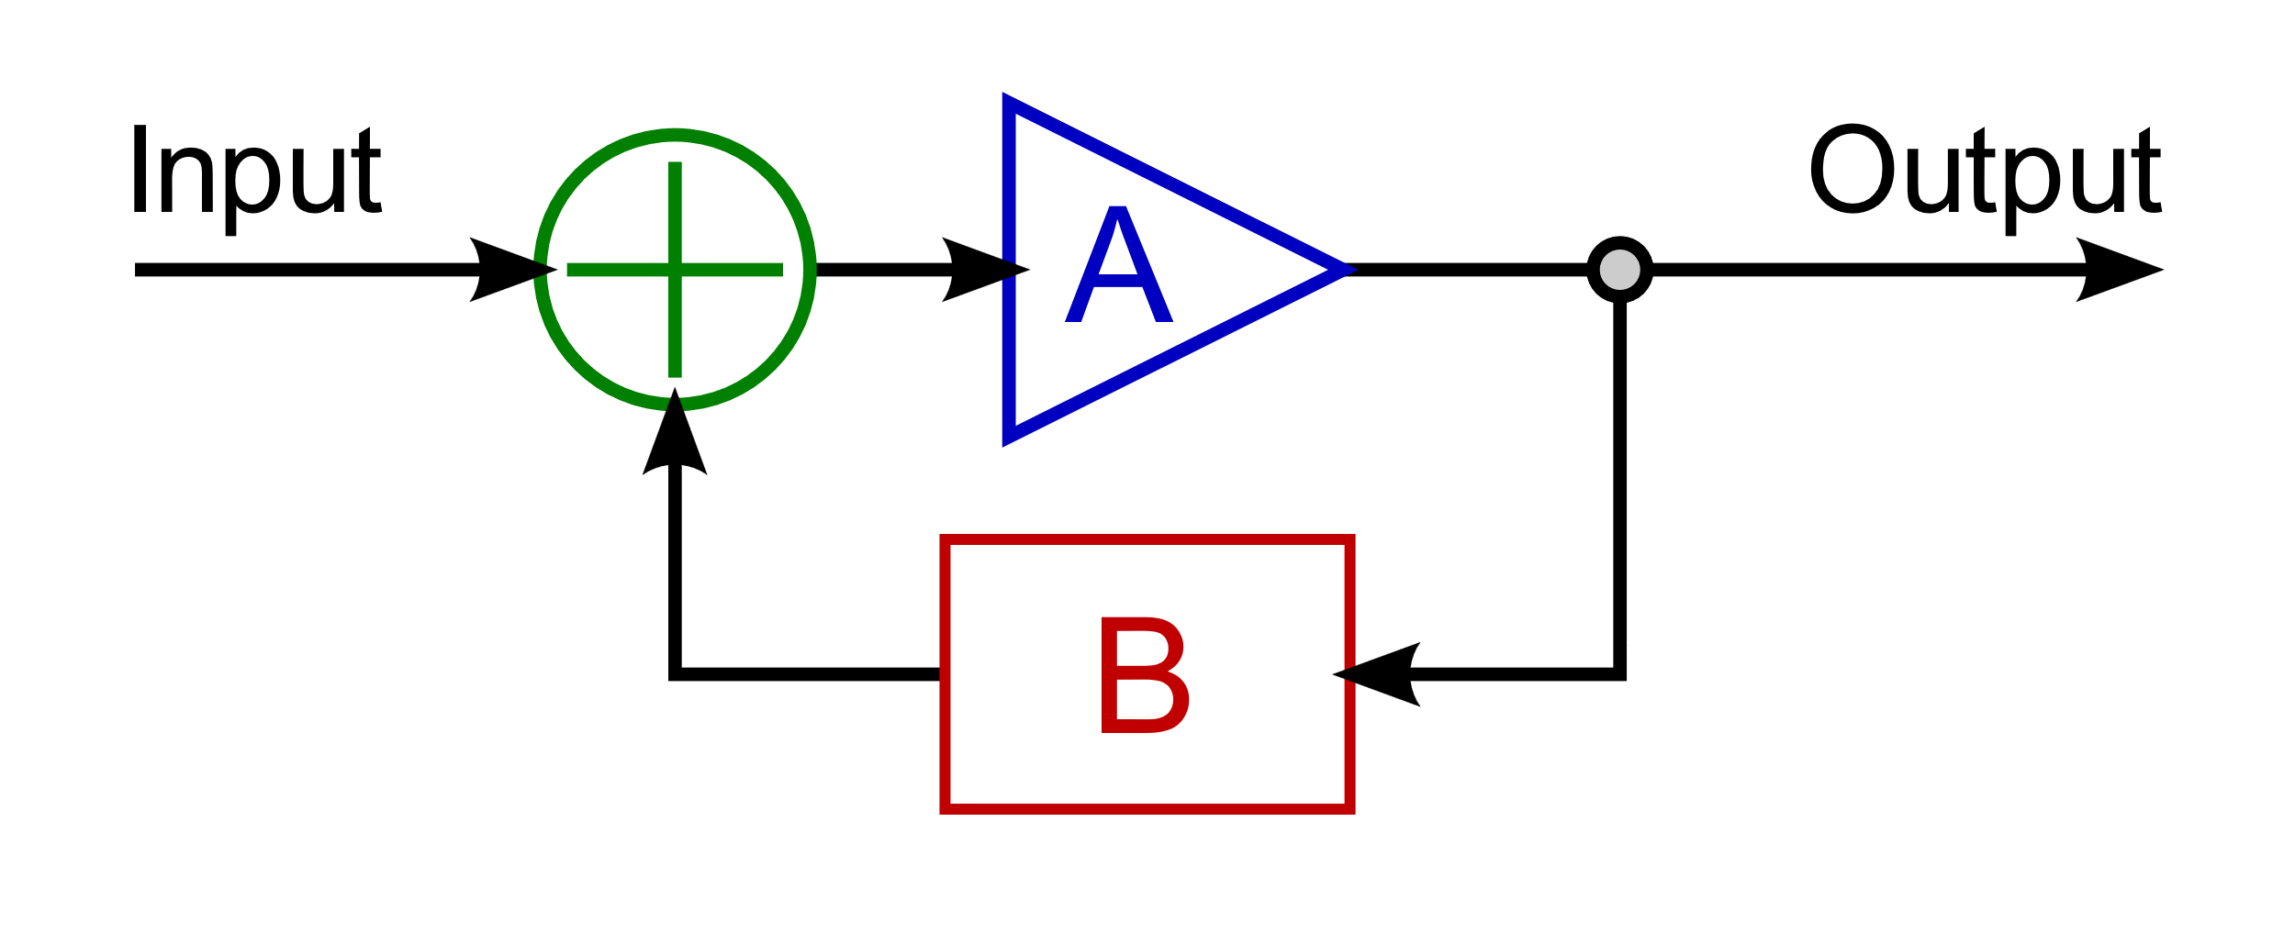
Homeostasis – feedback loops
Two types of feedback loops
Positive feedback: The output of a system amplifies the signal of the input e,g. clotting cascade
Negative feedback: Regulatory mechanism in which the output of a system opposes the signal of the input e.g. the majority of endocrine hormones
-
-
-
-
-
+ + + + +
The Peer Teaching Society is not liable for false or misleading information…
By Me (Intgr) - Own work, Public Domain, https://commons.wikimedia.org/w/index.php?curid=2836622
By OpenStax - https://cnx.org/contents/FPtK1zmh@8.25:fEI3C8Ot@10/Preface, CC BY 4.0, https://commons.wikimedia.org/w/index.php?curid=30131132

Slide 16
Homeostasis - hormones
Made from short-chains of amino acids
Stored in cell and released when signalled
Requires transport proteins in blood
Intracellular receptor target
Synthesised from tyrosine
Acts same way as peptide hormone
Binds to membrane receptor
Peptide
Directly affects transcription of DNA
Amino-acid derivative
Steroid
Examples: testosterone, oestrogen and cortisol
Example: Insulin, growth hormone, TSH, ADH
Quick response produced via secondary messenger cascade
Made from cholesterol – water insoluble, lipid soluble
Examples: adrenaline, thyroid hormones (T3 and 4)
Made by cell and diffuses out when made (not stored)
The Peer Teaching Society is not liable for false or misleading information…

Slide 17
Homeostasis - water definitions
Osmosis: Net movement of solvent molecules through a selectively permeable membrane from a solution of lower to higher solute concentration
Osmolarity: Concentration of solutes in plasma per kg of solution
Osmolality: Concentration of solutes in plasma per kg of solvent
Osmotic pressure: Pressure applied to a solution, by a pure solvent, required to prevent inward osmosis through a selectively permeable membrane
Oncotic pressure: Form of osmotic pressure exerted by a protein that tends to pull fluid into its solution
Hydrostatic pressure: Pressure difference between capillary blood (plasma) and interstitial fluid
The Peer Teaching Society is not liable for false or misleading information…

Slide 18
Homeostasis – water distribution
Fluid compartments in the body are in osmotic equilibrium
Osmotically active substances (solutes) in the ICF and ECF can create an osmotic gradient across the cell membranes
The Peer Teaching Society is not liable for false or misleading information…

Slide 19
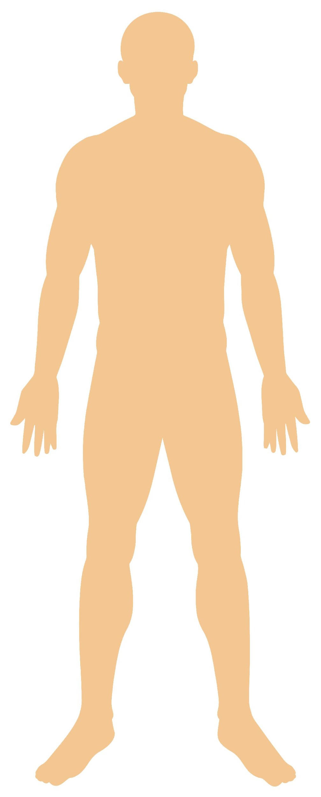
Homeostasis – water balance
Water intake:
Drink
Diet
IV fluid
Water loss:
Sensible (measurable):
Urination
Insensible (not measurable):
Sweat
Breath
Vomiting
Faeces
The Peer Teaching Society is not liable for false or misleading information…
Link: Image by brgfx on Freepik

Slide 20
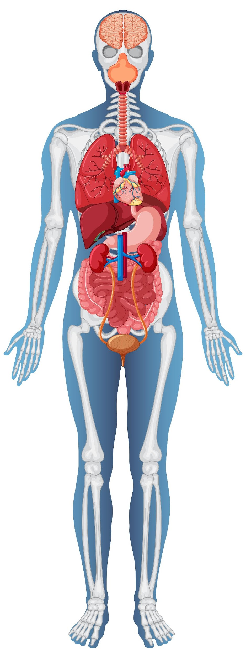
Homeostasis – water balance
Stimulation of the thirst centre in the hypothalamus increases desire to drink water, osmoreceptors, impulses from dry mouth and angiotensin II (low blood pressure) stimulate this.
Water loss causes ADH release from the posterior pituitary gland to increase water reabsorption in the collecting ducts in nephrons of the kidney
Low blood pressure triggers renin release from the kidneys, triggering aldosterone release from the adrenal gland which allows sodium to move into the blood to increase its volume
Neurotransmitters from sympathetic nerves in the kidney stimulate smooth muscle in the afferent arteriole to constrict and so less urine formation (also causes renin release
The Peer Teaching Society is not liable for false or misleading information…
Link: Image by brgfx on Freepik

Slide 21
Homeostasis – sodium, potassium, calcium
Sodium:
Filtered out glomerulus in kidney
80-90% reabsorbed at proximal convoluted tubule (PCT) and loop of Henle
Absence of aldosterone = sodium remains in filtrate and ends up in urine
Potassium:
Filtered out glomerulus in kidney
90% reabsorbed in PCT and loop of Henle
Presence of aldosterone = higher potassium excretion
Calcium:
Calcitonin decreases blood calcium
PTH and calcitriol increase blood calcium
The Peer Teaching Society is not liable for false or misleading information…

Slide 22
Energy - Metabolism
Carbohydrates – 4 kcal/g
Protein – 4 kcal/g
Alcohol – 7 kcal/g
Lipid – 9 kcal/g
The Peer Teaching Society is not liable for false or misleading information…

Slide 23
Energy - BMR
BMR: Amount of energy needed to keep the body alive at rest = 1 kcal/kg body mass/hr
High BMI
Hyperthyroidism
Fever/infection
Pregnancy
Exercise
Ageing
Female
Starvation
Hypothyroidism
The Peer Teaching Society is not liable for false or misleading information…

Slide 24
Energy - glycolysis
What?
Breaking down glucose to release energy
Where?
Cytosol
Aerobic conditions:
Pyruvate enters citric acid cycle for oxidative phosphorylation
Aerobic respiration = 38 ATP
Anaerobic = 2 ATP
Anaerobic conditions:
Pyruvate is converted to lactate which undergoes fermentation
Glycolysis
Equation:
Glucose + 2ADP +2Pi + 2NAD+ -> 2ATP +2NADH + 2H+ + 2H₂O
The Peer Teaching Society is not liable for false or misleading information…

Slide 25
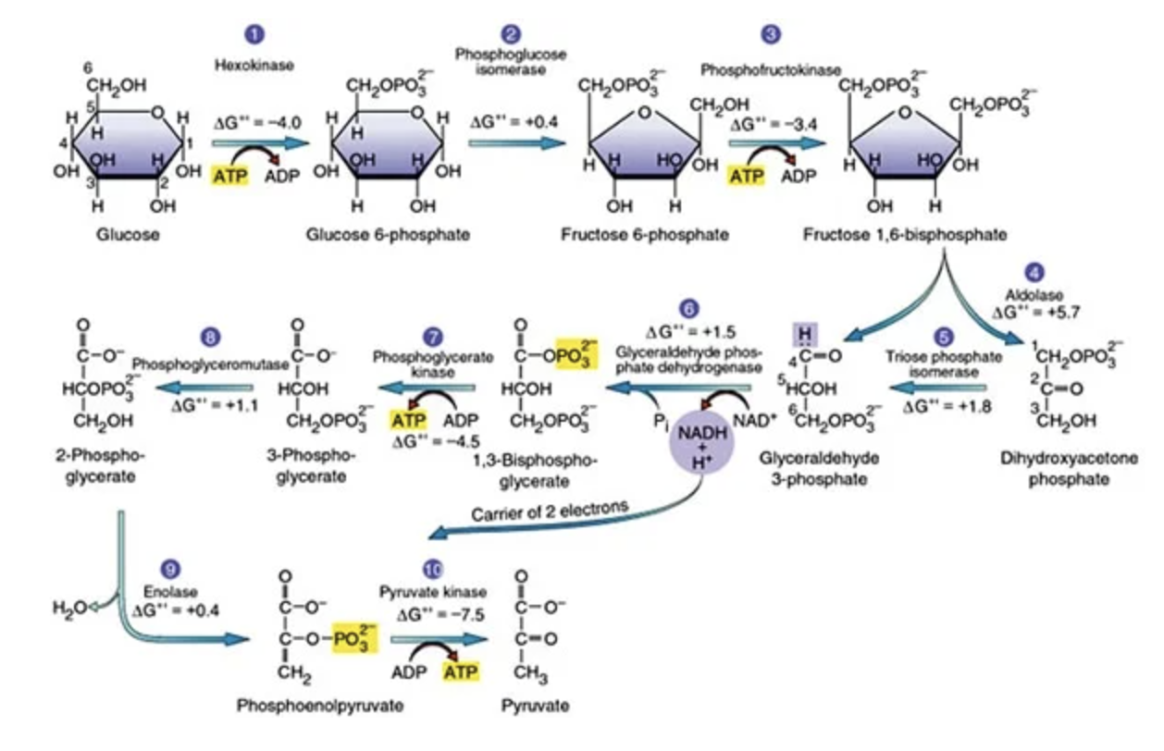
Energy - glycolysis
Rate limiting enzyme:
Phosphofructokinase - 1
The Peer Teaching Society is not liable for false or misleading information…
https://microbiologyinfo.com/glycolysis-10-steps-explained-steps-by-steps-with-diagram/

Slide 26
Energy – citric acid cycle (Krebs)
Takes place in mitochondrial matrix
Depends on the availability of NAD+ and FAD
Inhibited by high concentrations of NADH
Prior to the cycle, pyruvate is converted into Acetyl Coenzyme A
The Peer Teaching Society is not liable for false or misleading information…

Slide 27
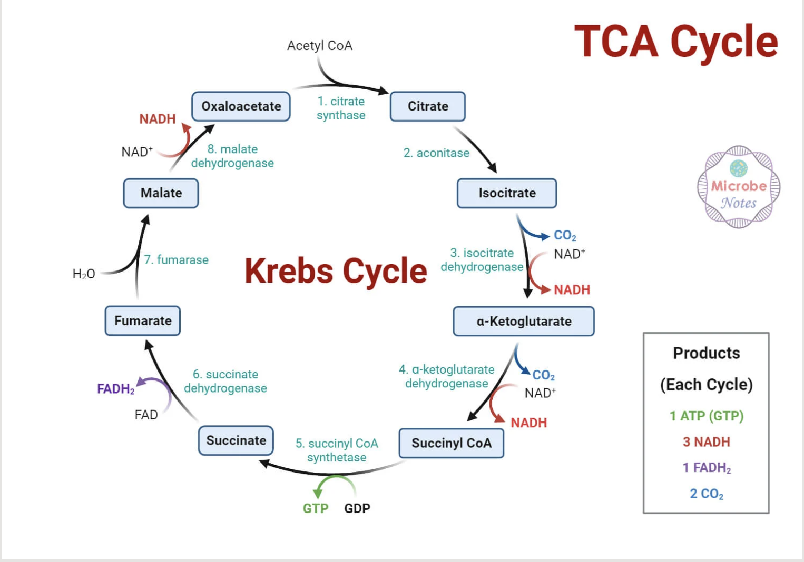
Energy – citric acid cycle (Krebs)
2 x for every glucose
The Peer Teaching Society is not liable for false or misleading information…

Slide 28
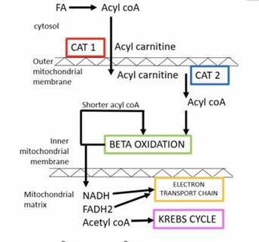
Energy - Beta oxidation
Also known as fatty acid oxidation
Occurs in mitochondria
Method of breaking down fatty acids to produce energy
Occurs in response to decreased blood glucose and high glucagon
Fatty acids are first converted into acyl CoA to cross the mitochondrial membrane and undergo oxidation
The Peer Teaching Society is not liable for false or misleading information…
= ENERGY!!!

Slide 29
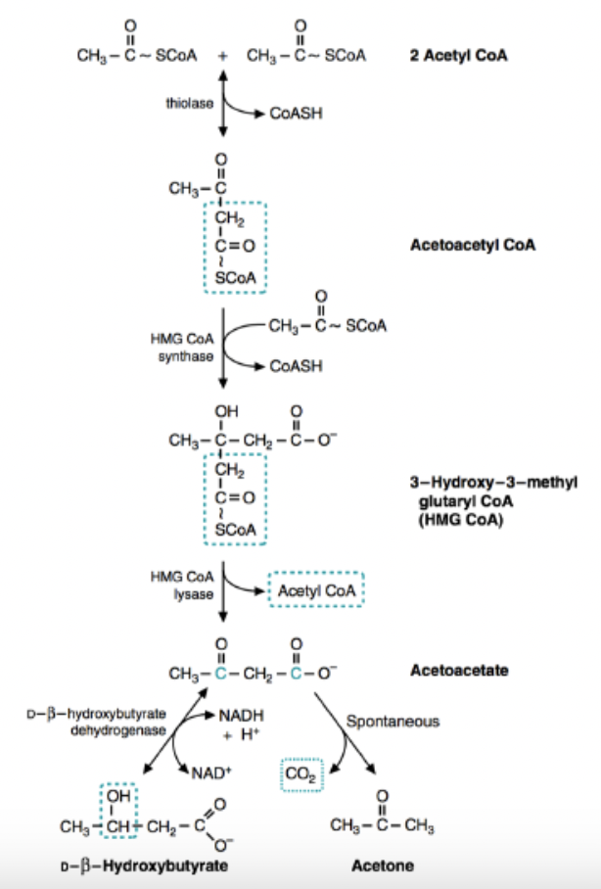
Energy – beta oxidation
Krebs or Ketogenesis
The Peer Teaching Society is not liable for false or misleading information…

Slide 30
Energy – Ketones
Large amounts of acetyl-CoA are generated from high rates of fatty acid oxidation, this exceeds Krebs cycle capacity
Ketogenesis – Biochemical process by which ketone bodies are produced in the liver from fatty acids, occurs when the supply of glucose is limited.
Skeletal muscles can use ketones for fuel
Ketones
The Peer Teaching Society is not liable for false or misleading information…

Slide 31
Summary
1 - Cells:
Organelles
Cell (plasma) membrane (proteins and movement)
2 - Homeostasis:
Signalling
Feedback loops
Hormones
Water distribution
Homeostasis
3 - Energy:
Metabolism and BMR
Glycolysis and Krebs
Fatty acid oxidation
Ketones
The Peer Teaching Society is not liable for false or misleading information…

Slide 32
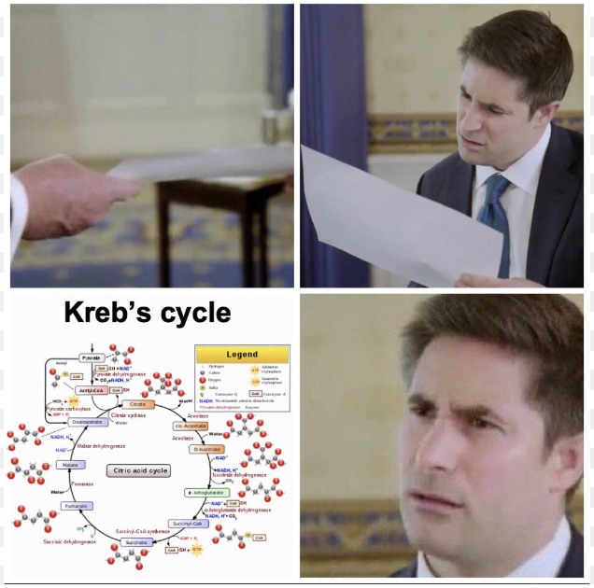
Break – 5 mins
We will take a 5 min break and then…
IMMS 2!
The Peer Teaching Society is not liable for false or misleading information…

Slide 33
IMMS 2 - Aims and Objectives
4 – Molecular building blocks
Bonds
Amino acids
Protein structure
Enzymes and their function
5 - Genetics
DNA and RNA
Transcription and translation
Mitosis and meiosis
Inheritance
The Peer Teaching Society is not liable for false or misleading information…

Slide 34
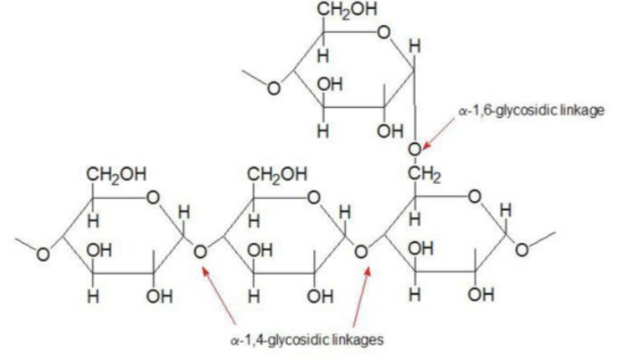
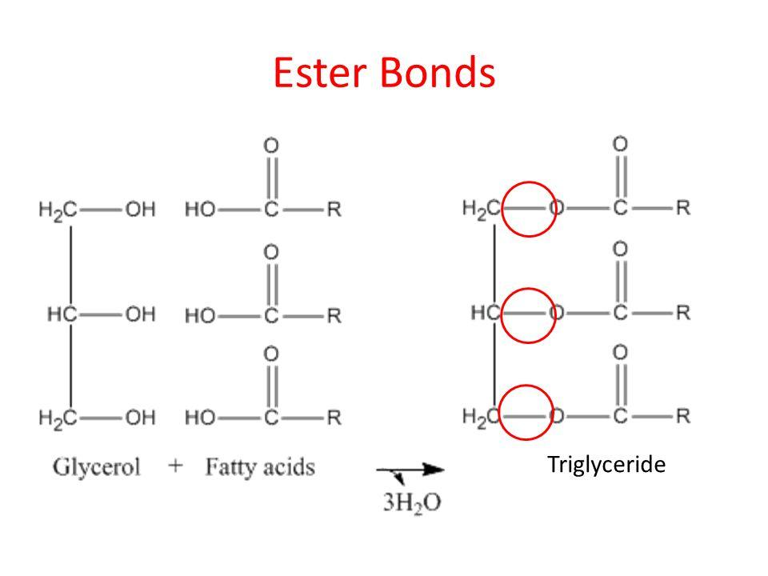
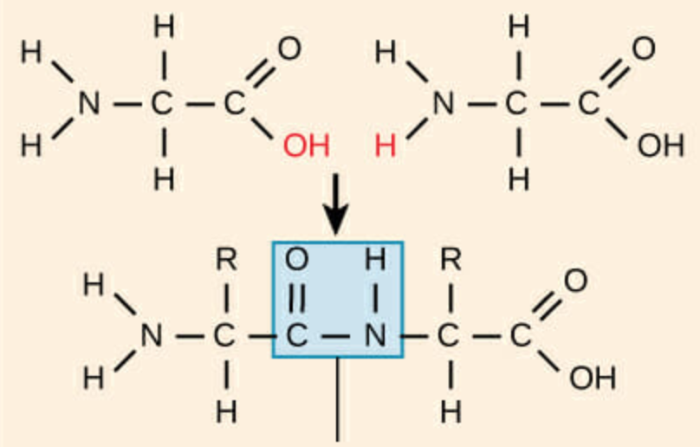
Bonds
Glycosidic bonds
The hydroxyl group of a monosaccharide can react with an OH or an NH group to form a glycosidic bond.
O-glycosidic bonds form disaccharides, oligosaccharides and polysaccharides.
N-glycosidic bonds are found in nucleotides in DNA
Ester bonds
Between glycerol and fatty acids (in lipids)
Formed by condensation reaction
Peptide bonds
Between amino acids
Formed by condensation reaction
The Peer Teaching Society is not liable for false or misleading information…

Slide 35
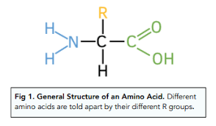
Amino Acids
20 total
Carboxyl +ve
Amino –ve
Joined by peptide bonds via a condensation reaction
Cleaved by proteolytic enzymes i.e. proteases
The Peer Teaching Society is not liable for false or misleading information…

Slide 36
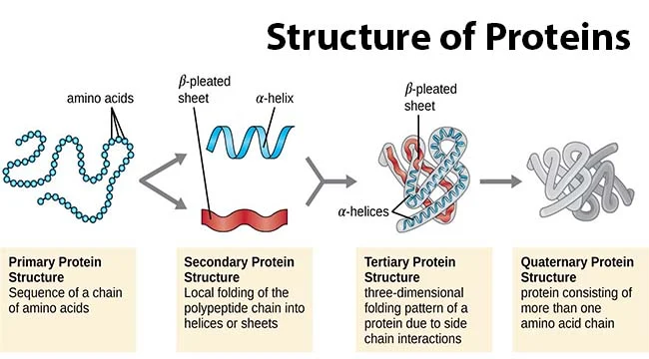
Protein structure
The Peer Teaching Society is not liable for false or misleading information…

Slide 37
Enzymes
Catalysts = Provide an alternative reaction pathway with a lower activation energy
Enable reactions to occur that otherwise would not be able to occur at physiological (body) temperatures and conditions.
Bind to the reactants and convert them to products – then release the products and return to their original form
Speed up reactions and provide a way to regulate the rate of reactions
Enzymes can be tertiary or quaternary proteins
The Peer Teaching Society is not liable for false or misleading information…

Slide 38
Enzymes
Regulation
Altering concentration of substrates, products, inhibitors or activators, can also be regulated by modifying the enzyme itself by phosphorylation
Isoenzyme: enzymes that have a different structure and sequence but catalyze the same reaction
Coenzyme: cannot in themselves catalyze a reaction but can help enzymes to do so. Bind with the enzyme protein molecules to form active enzymes.
The Peer Teaching Society is not liable for false or misleading information…

Slide 39
Molecular building blocks - Conclusion
Glycosidic bonds in carbohydrates, ester bonds in lipids and peptide bonds in protein all formed via condensation reactions
Primary protein structure = amino acid sequence, secondary = local folding – alpha helix or beta pleated sheet, tertiary = 3D folding pattern due to chain interactions and quaternary = protein with more than one amino acid chain (may have prosthetic groups added)
Enzymes are biological catalysts, providing an alternate reaction pathway with lower activation energy
The Peer Teaching Society is not liable for false or misleading information…

Slide 40
Molecular building blocks - Question 1
What type of bond is between monosaccharides?
Peptide
Ester
Metallic
Glycosidic
The Peer Teaching Society is not liable for false or misleading information…

Slide 41
Molecular building blocks - Question 2
Beta pleated sheets and alpha helices are examples of what protein structure?
Primary
Secondary
Tertiary
Quaternary
The Peer Teaching Society is not liable for false or misleading information…

Slide 42
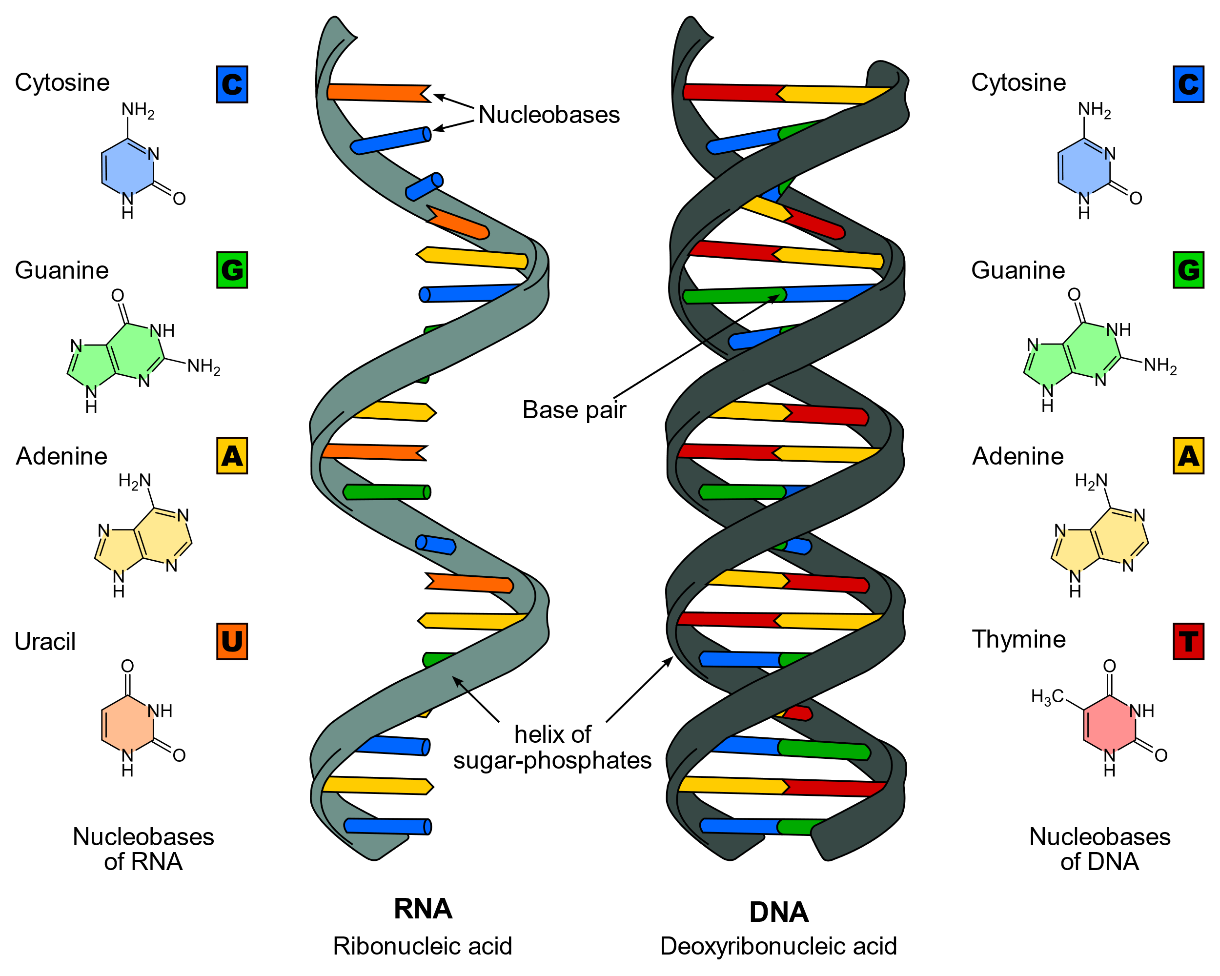
DNA
Found in nucleus and mitochondria (DNA found in mitochondria is purely maternal DNA)
Arranged in a double helix with complimentary base pairing
DNA coils around proteins (histones) and form nucleosomes > supercoils > chromosomes
46 Chromosomes, 22 Pairs (autosomes – anything not sex-determined) and a pair of sex chromosomes (XY- Male, XX – Female)
Each chromosome is made of 2 identical strands of chromatids joined in the center (centromere).
Karyotype: number and appearance of chromosomes in a cell
The Peer Teaching Society is not liable for false or misleading information…

Slide 43
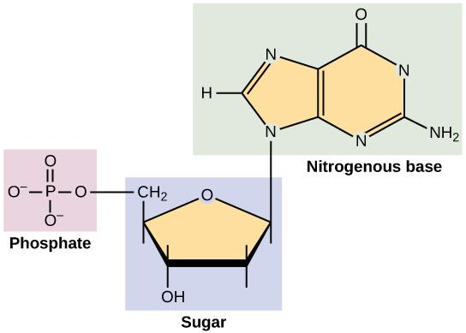
DNA
Functions:
Storage and transfer of genetic information
Template and regulator for transcription and protein synthesis
Structural basic of hereditary and genetic diseases
Structure of a nucleotide:
The Peer Teaching Society is not liable for false or misleading information…
Notes:
Structural basic of hereditary and genetic diseases (as is the genetic material)

Slide 44
DNA - Question 1
How many pairs of autosomes do we have?
a) 23
b) 22
c) 46
D) 44
The Peer Teaching Society is not liable for false or misleading information…

Slide 45
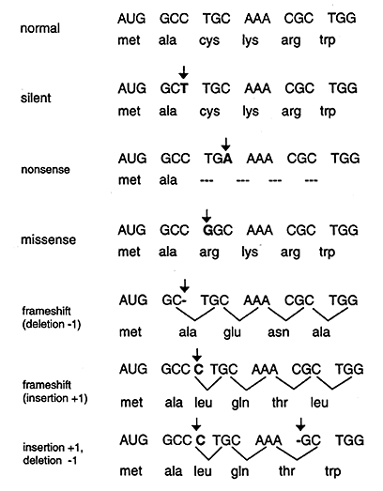
Mutations
Duplications - sections repeating, incorrect protein generated
Deletions
Out of frame – sequence shifts meaning the reading frame of the gene is changed (reading frame completely disrupted)
In frame – whereby one codon is removed thus only one amino acid is lost. Reading frame is not changed
Mutations of regulatory sequence – coding sequence still intact, but gene itself is switched on or off etc.
DNA damage – from chemicals, UV and radiation
DNA repair issues - base or nucleotide excision, mismatch repair or transcription-couples repair
The Peer Teaching Society is not liable for false or misleading information…

Slide 46
Mutations
Non – sense - Point mutation that produces a stop codon - results in an incomplete, usually non-functional protein. E.g. Duchenne’s muscular dystrophy
Mis-sense mutation - A point mutation in which a single nucleotide change results in a codon that codes for a different amino acid (substitution). This can have a varied affect and can result in a silent mutation and a non functional protein E.g Sickle cell disease where CAG was replaced with CTG
Spice site mutation – affects the accurate removal of an intron
Expansion of tri-nucleotide repeat - Huntington's disease : CAG. Triple repeat is repeated several times in the first part of the coding sequence If > 36, the patient will develop Huntington’s- Anticipation: in diseases such as Huntington’s, repeats get bigger when they are transmitted to the next generation resulting in earlier symptoms of greater severity (anticipation)
The Peer Teaching Society is not liable for false or misleading information…

Slide 47
Transcription
1. Preparation
Topoisomerase unwinds the double helix by relieving the supercoils.
DNA helicase then separates the DNA apart exposing the nucleotides.
Single stranded binding proteins (SSBP’s) coat the single DNA strands to prevent DNA re-annealing.
2. Production
TATA sequence is the recognition signal for starting
AUG is the start codon – codes for methionine
Free mRNA nucleotides line up next to their complementary bases on the template strand/ antisense strand of DNA (U-T & C-G)
Coding strand runs 5’ to 3’, template strand runs 3’ to 5’
The Peer Teaching Society is not liable for false or misleading information…

Slide 48
Transcription
3. Termination
RNA polymerase (specifically RNA polymerase 2) joins the mRNA nucleotides (catalysing phosphodiester bonds between them)
Forms antiparallel mRNA strand (with a 5’CAP head and a 3’Poly A tail) - starting at a promoter (specific sequence that RNA polymerase binds to - initiation of transcription.
Transcription is stopped at the stop codon – UAA/UAG/UGA
4. Modification (splicing)
The removal of introns, leaving just exons – the coding part (eXons eXit)
mRNA leaves the nucleus through the nuclear pores
The Peer Teaching Society is not liable for false or misleading information…

Slide 49
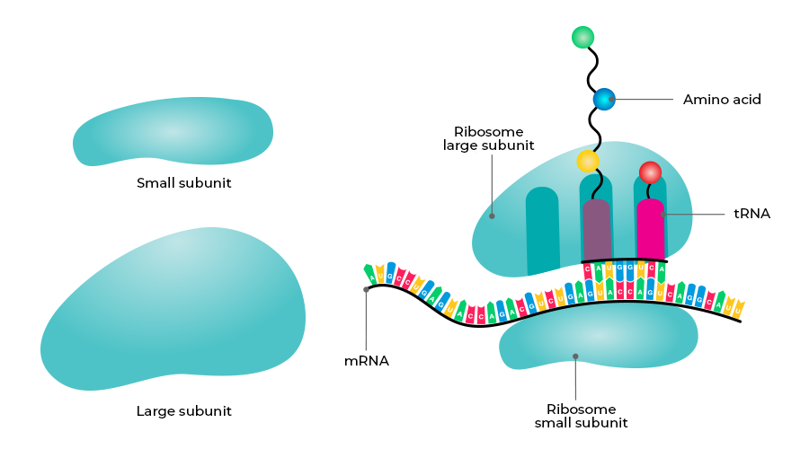
Translation
mRNA attaches to an 80s ribosome with large and small subunits
APE section in large subunit – A at the 5’ end of mRNA strand
Strand read 5’ to 3’
At ribosome the mRNA (bases on mRNA are read in 3’s - codons) sequence is used as a template to bind to complementary tRNA molecules at their anticodon (3 bases complementary to codon on mRNA).
tRNA molecules are attached to specific amino acids
Enzymes remove amino acid from tRNA and amino acids are linked together by a peptide bond (created by a condensation reaction), creating a polypeptide chain
The Peer Teaching Society is not liable for false or misleading information…

Slide 50
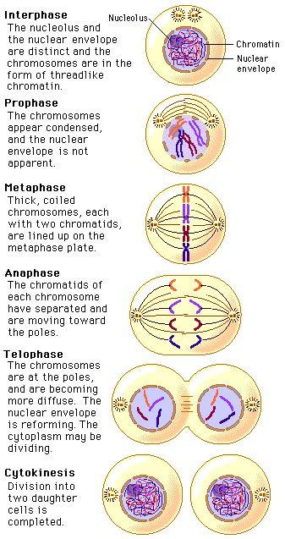
Mitosis
Prophase
Nuclear membrane disintegrates and chromatins condenses into chromosomes
Centrosomes nucleate microtubules and move to opposite poles and nucleus
Prometaphase
Nuclear membrane breaks down and microtubules invade nuclear space. Chromatids attach to microtubules and the cell no longer had a nucleus
Chromosomes attach to spindle via centromere
Metaphase
Chromosomes line up along metaphase plate
The Peer Teaching Society is not liable for false or misleading information…

Slide 51
Mitosis
Anaphase
Sister Chromatids separate and are pushed to opposite poles of the cell, centromere first, as spindle fibers contract
Telophase
Nuclear membrane reforms and chromosomes unfold into chromatin
Cytokinesis begin
Cytokinesis
Cell organelles become evenly distributed around each nucleus and the cell divides into two daughter cells with a nucleus in each.
The Peer Teaching Society is not liable for false or misleading information…

Slide 52
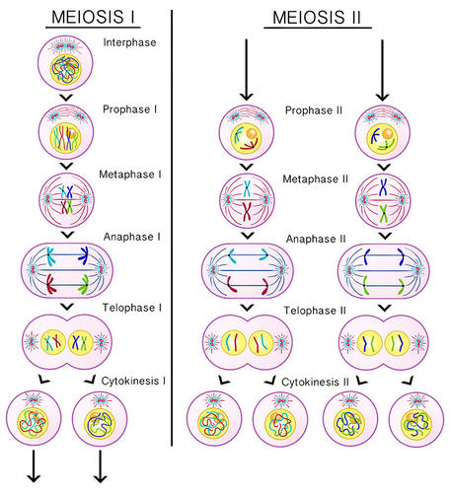
Meiosis
Meiosis can be broken down into two main stages: meiosis I and meiosis II. During meiosis I, homologous chromosomes (pairs of chromosomes with the same genes) are separated, while during meiosis II, the chromatids (each half of a duplicated chromosome) are separated.
Causes of genetic diversity:
Prophase I – crossing occurs between non-sister chromatids. Results in genetic diversity
Metaphase I – random assortment occurs on the metaphase plate. This also produces genetic diversity
Meiosis II – sister chromatids separate. Haploid cells are produced
The Peer Teaching Society is not liable for false or misleading information…

Slide 53
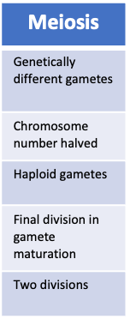
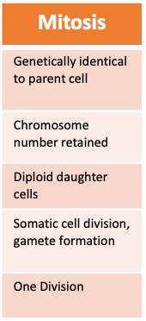
Mitosis vs Meiosis
The Peer Teaching Society is not liable for false or misleading information…

Slide 54
DNA - Question 2
What is the order of stages in mitosis?
Prophase, prometaphase, metaphase, anaphase, telophase, cytoplasmis
Prophase, metaphase, anaphase, telophase, cytokinesis
Prophase, prometaphase, metaphase, anaphase, telophase, cytokinesis
Prophase, prometaphase, metaphase, anaphase, cytokinesis, telophase
The Peer Teaching Society is not liable for false or misleading information…

Slide 55
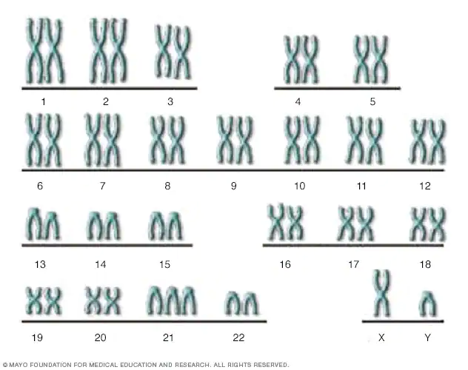
Chromosomal abnormalities
Failure of chromosomes to separate (nondisjunction)
Genetic cause of disease
Aneuploidy: the condition of having an abnormal number of chromosomes in a haploid set
Polyploidy: Polyploidy is the heritable condition of possessing more than two complete sets of chromosomes
Trisomy 21 aka Down’s Syndrome
The Peer Teaching Society is not liable for false or misleading information…

Slide 56
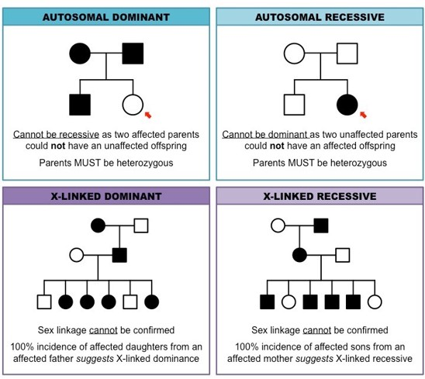
Inheritance
Autosomal Recessive
Disease manifests in homozygous state
Requires 2 defected genes
Chance having disease = 25%
Chance of being a carrier = 50%
Chance of affected child’s sibling being a carrier = 66.6%
Males/females are equally affected
Affected individuals are in single generation
E.g. Cystic Fibrosis
The Peer Teaching Society is not liable for false or misleading information…

Slide 57
Inheritance
Autosomal dominant
Disease manifests in heterozygous state
Males/females affected equally
Affects multiple generations
Transmission from both sexes to both sexes
Both parents can sometimes be unaffected E.g.
Gonadal mosaicism (don’t have genes for it)
Mother has reduced penetrance (the proportion of people with a gene who show the expected phenotype)
Mother has variable expression
Only one defected gene needed = 50% chance offspring affected
E.g. Huntington’s Disease
Gonadal mosaicism: some sperm or eggs have a gene mutation that may not be present in other tissues of the body.
The Peer Teaching Society is not liable for false or misleading information…

Slide 58
Inheritance
X-linked
Caused by mutation on the X chromosome
Never male to male – sons always get X chromosome from mother
All daughters from affected males are carriers
Transmitted usually through unaffected female
Can be recessive (Duchenne’s muscular dystrophy) or dominant (Alport’s Syndrome)
The Peer Teaching Society is not liable for false or misleading information…
Notes:
Alport syndrome is a genetic condition characterized by kidney disease, loss of hearing, and eye abnormalities.
Duchenne muscular dystrophy (DMD) is a genetic disorder characterized by progressive muscle degeneration and weakness due to the alterations of a protein called dystrophin that helps keep muscle cells intact

Slide 59
DNA - Question 3
Which one of these is an example of an autosomal dominant condition?
Alport’s Syndrome
Huntington’s Disease
Duchenne’s muscular dystrophy
Cystic fibrosis
The Peer Teaching Society is not liable for false or misleading information…

Slide 60
DNA - Question 4
Which of these is an example of an X-linked recessive condition?
Alport’s Syndrome
Huntington’s Disease
Duchenne’s muscular dystrophy
Cystic fibrosis
The Peer Teaching Society is not liable for false or misleading information…

Slide 61
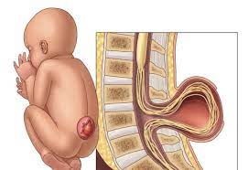
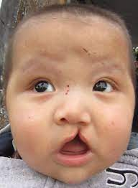
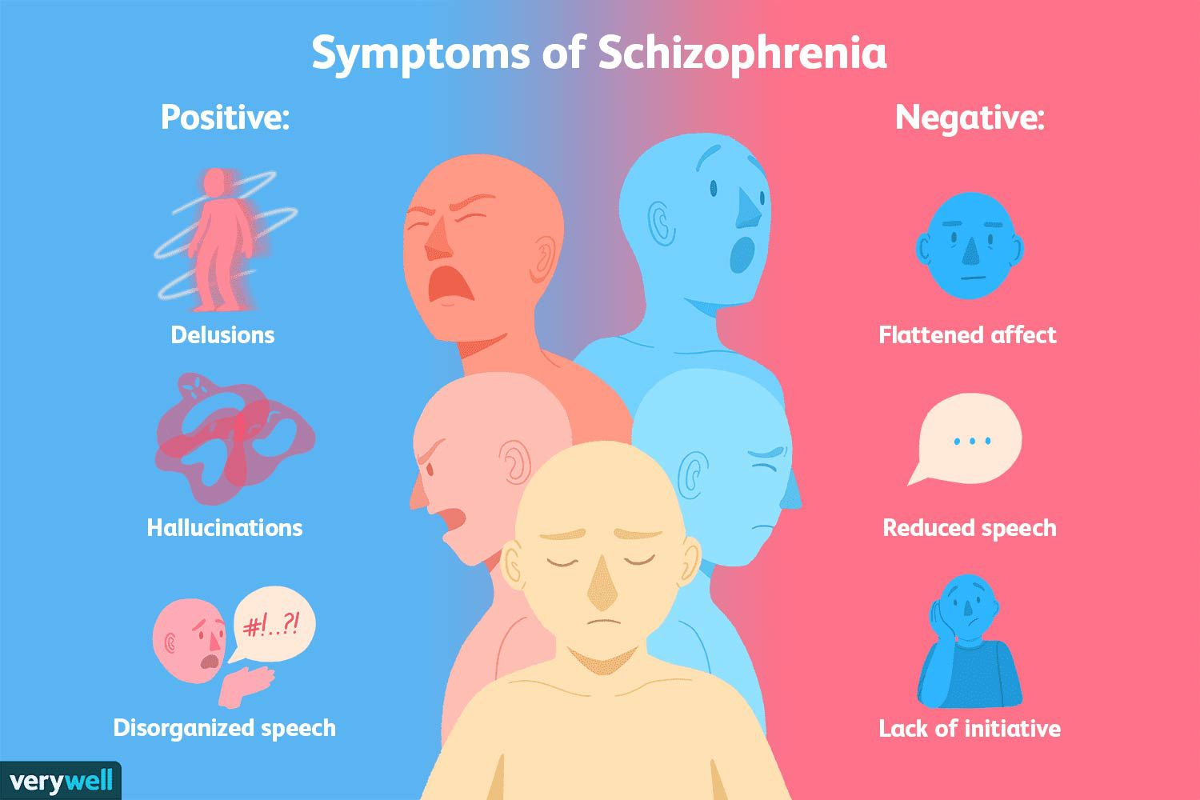
Multifactorial inheritance
Combination of genetic and environmental. Main cause of disease in developed countries
Eg: Spina bifida, Cleft palate, Diabetes, Schizophrenia
The Peer Teaching Society is not liable for false or misleading information…

Slide 62
Definitions
Phenotype: the set of observable characteristics of an individual resulting from the interaction of its genotype with the environment
Genotype: genetic constitution of an individual Vertical transmission: the passage of a pathogen from mother to baby during the period immediately before and after birth
Recurrence risk: a statistic that estimates the probability that a condition present in one or more family members will recur in another relative in the same or future generations
Variable expression: variation in clinical features of a genetic disorder between individuals with the same gene alteration
The Peer Teaching Society is not liable for false or misleading information…

Slide 63
Definitions
Penetrance: The proportion of people with a gene who show the expected phenotype
Anticipation: when a child shows a phenotype for a disease younger than their father/mother does
Sex limitation: when both sexes have a gene but its expression is limited to only one of the sexes and it is turned off in the other Assortative mating: a mating pattern and a form of sexual selection in which individuals with similar phenotypes or genotypes mate with one another more frequently than would be expected under a random mating pattern Allelic heterogeneity: If different mutations at the same locus produce the same phenotype, a disease has allelic heterogeneity
Locus heterogeneity: describes mutations in different genes whereby any one mutation generates the same disorder
The Peer Teaching Society is not liable for false or misleading information…

Slide 64
DNA - Conclusion
DNA is found in the cell nucleus and mitochondria (22 autosomal pairs and 1 pair of sex chromosomes)
Mitosis (PMAT)
Meiosis causes genetic diversity (independent assortment, crossing over)
Nondisjunction/chromosomal abnormalities can cause conditions such as Down’s syndrome
Recessive genetic conditions manifest in the homozygous state
Dominant conditions manifest in the heterozygous state
X-linked inheritance is never male to male, all daughters from affected males are carriers and recessive x-linked conditions are usually transmitted through an unaffected female to her son
The Peer Teaching Society is not liable for false or misleading information…

Slide 65
Feedback
Link:https://docs.google.com/forms/d/e/1FAIpQLSf6j5hKgciWefsV8II_1pOLqW8dvAKt_JklvsGEdFGg1stFug/viewform?usp=sf_link
The Peer Teaching Society is not liable for false or misleading information…

