Slide 1
Liver and Friends
Phase 1
Louise Caldwell & Jess Gray
The Peer Teaching Society is not liable for false or misleading information…

Slide 2
Aims
Anatomy of liver, pancreas and gall bladder
Embryology
Liver physiology
Biliary secretion
Exocrine pancreas
Histology
The Peer Teaching Society is not liable for false or misleading information…

Slide 3
Anatomy of liver
The Peer Teaching Society is not liable for false or misleading information…

Slide 4
Anatomy of liver
The Peer Teaching Society is not liable for false or misleading information…

Slide 5
Anatomy of pancreas
The Peer Teaching Society is not liable for false or misleading information…

Slide 6
Anatomy of biliary tree
The Peer Teaching Society is not liable for false or misleading information…

Slide 7
Liver Physiology
Functions of liver:
Detoxification
1:modification – cytochrome P450, usually oxidation
2:conjugation – with charged species so more hydrophilic, greater weight and less active
3:excretion – -ve groups bind to membrane transporters
Storage
BAD IRON, glycogen
vitB12 binds to intrinsic factor for absorption. Essential for action of folate.
The Peer Teaching Society is not liable for false or misleading information…

Slide 8
Liver Physiology
Metabolism of lipid
Regulated by adrenals, pancreas, thyroid and NS
-hepatic lipase allows FA uptake into hepatocytes
-fatty acids then oxidized or esterified to triglycerides for storage
4. Protein and amino acid synthesis
Liver synthesises all proteins apart from Ig
Albumin + clotting factors

Slide 9
Liver Physiology
5. Amino acid metabolism
-in periportal cells
-consumes 3 ATP equivalents
Arginine from diet/protein breakdown
Urea and water released into blood and transported to kidney for filtration.
The Peer Teaching Society is not liable for false or misleading information…

Slide 10
Embryology
Where? | Blood Supply? | Becomes..
FOREGUT | CELIAC ARTERY | Pharynx, Oesophagus, Stomach, Prox. ½ of Duodenum and derivatives (Liver, Biliary Apparatus and Pancreas)
MIDGUT | SUPERIOR MESENTERIC ARTERY | Distal ½ of Duodenum, Caecum, Vermiform Appendix, Asc. Colon, R. 2/3 of Transverse Colon
HINDGUT | INFERIOR MESENTERIC ARTERY | L. 1/3 of Transverse Colon, Desc. Colon, Sigmoid Colon, Rectum, Anal Canal
The Peer Teaching Society is not liable for false or misleading information…

Slide 11
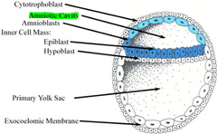
Embryology
Morula (solid ball of cells)
Blastocyst
inner cell mass => EMBRYOBLAST
- consists of epiblast and hypoblast that forms the bilaminar disc)
outer cell mass => TROPHOBLAST
- consists of cytotrophoblast and syncytium (this penetrates the endometrium)
The Peer Teaching Society is not liable for false or misleading information…

Slide 12
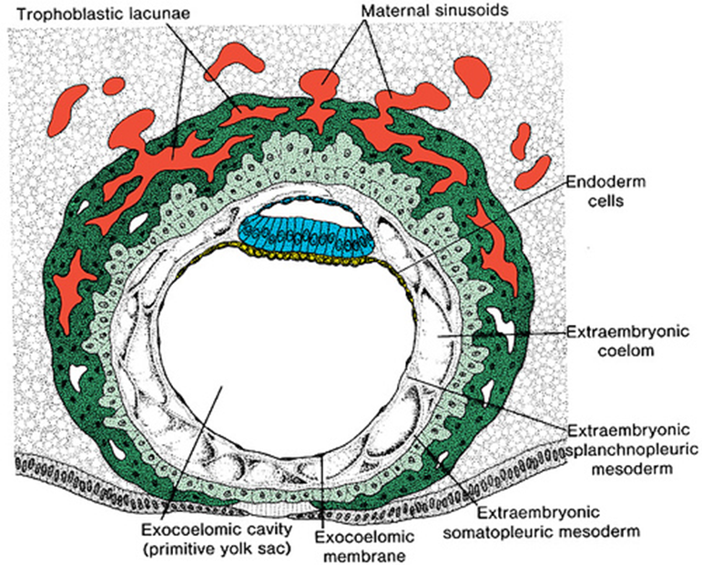
Embryology
The Peer Teaching Society is not liable for false or misleading information…

Slide 13
Embryology
EPIBLAST : gives rise to amnioblasts
HYPOBLAST: cells migrate and form the exocoelomic membrane (forms the extraembryonic cavity and secondary yolk sac)
THEN….
Gastrulation occurs (around 3rd week)
TRILAMINAR DISC (consists of ecto-, meso-, and endoderm)
First signs also include primitive streak and node forming on the epliblast
The Peer Teaching Society is not liable for false or misleading information…

Slide 14
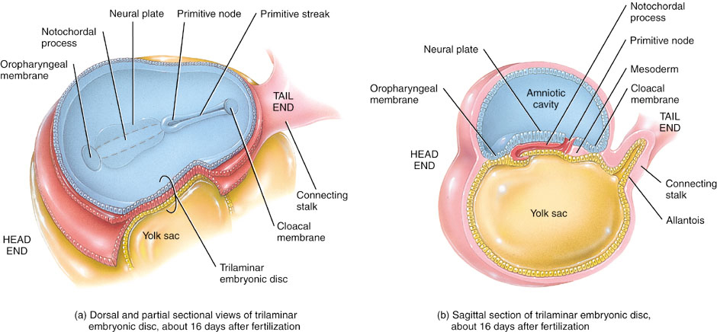

Slide 15
Embryology
But lets skip to the more important bits…
ENDODERM
Epithelial lining of Digestive Tract, Hepatocytes and Endo- + Exocrine cells of Pancreas
MESODERM
Conn. tissue for glands and muscle, conn. tissue + peritoneal components of the gut wall
Now … FOREGUT
Oropharyngeal Membrane → Liver Bud aka Hepatic Diverticulum

Slide 16
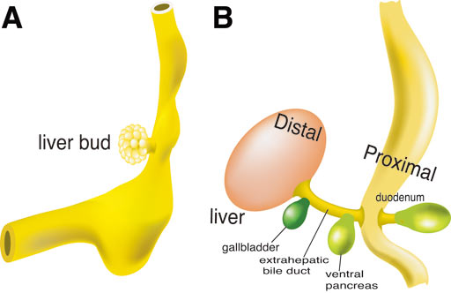
Embryology
By the 5th week, the lower part of the foregut (+ onwards) is suspended from posterior abdominal wall by DORSAL mesentery
HEPATIC DIVERTICULUM is a bud (arises ventrally) at the junction of the foregut and midgut.

Slide 17
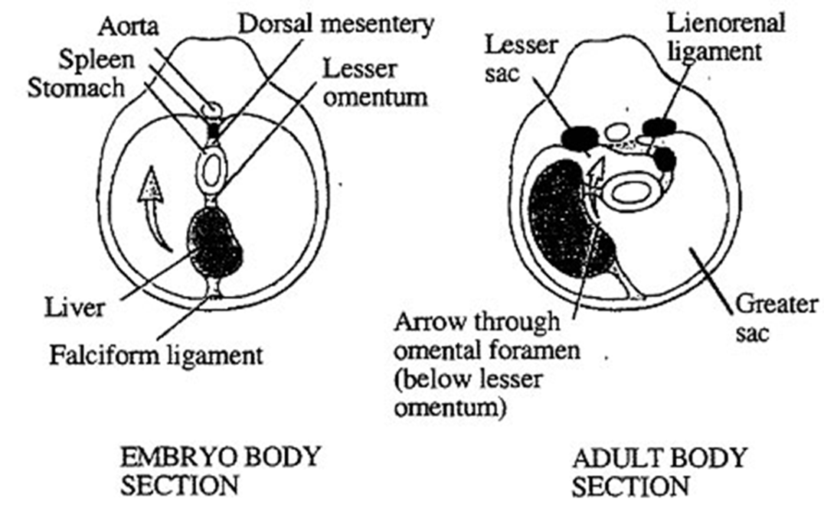
The bud goes through the Septum Transversum, which becomes the ventral mesentery (that will give rise to the lesser omentum and the falciform ligament)
Bud enlarges into PARS HEPATICA and PARS CYSTICA
| |
R. + L. lobes of liver Gall bladder
- Connection between liver and duodenum narrows => Bile Duct
Spleen develops (as a mesodermal proliferation) in the left/dorsal mesentery

Slide 18
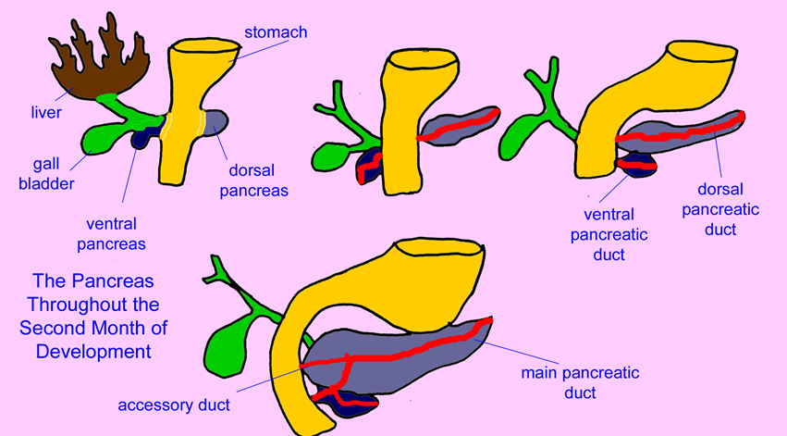
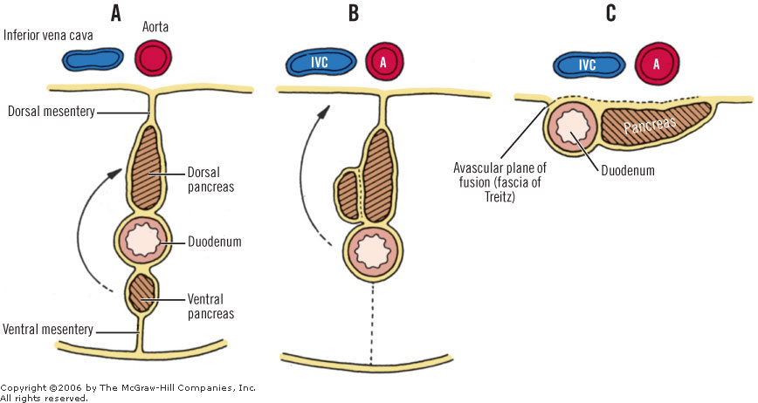
And from the MIDGUT, Pancreas is formed from two endodermal buds..
<--Due to different growth rates so becomes retroperitoneal (considered to be secondarily retroperitoneal)

Slide 19
Exocrine Pancreas
Produces:
Digestive Enzymes
- active and precursor forms
Bicarbonate
- enter duodenum via Sphincter of Oddi and protects its mucosa from gastric acid

Slide 20
Pancreatic Digestive Enzymes
Active
Alpha-Amylase: Starch -> Maltose (glucose dissacharide)
Lipase: Triglycerides -> Monoglyceride and Fatty Acids
Precursors (mainly Pancreatic Proteases)
Main ones:
Trypsinogen (activated by Enterokinase into Trypsin)
Chymotrypsinogen (activated by Trypsin into Chymotrypsin
AND Phospholipase A2 is also secreted (REMEMBER: start of process to make prostaglandins!)

Slide 21
Liver Histology
Liver Lobule
-Polygonal cells
-Central hepatic venule in the middle and does anybody know what branches are in the PORTAL TRIAD in the corners?
Hepatic Artery, Hepatic Portal Vein and Bile Ductule
Note: inside area surrounding central hepatic venule more likely to become damaged either congestion or low oxygen
Hepatocytes are the principal cell
Appear granular due to LOTS of mitochondria – why? Protein synthesis!
Larger central spherical nuclei
Arranged in cords alongside sinusoids
Space of Disse (between endothelium and hepatocytes)

Slide 22
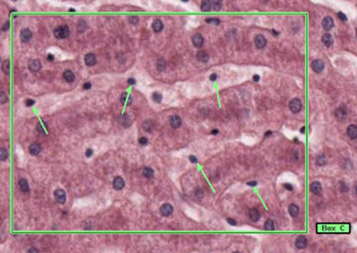
Liver Histology
Sinusoids
Specialised blood vessels
Fenestrated endothelium
Reticulin keeps structure
Scattered Kuppfer cells
- phagocytic
- can look blue with Pearl’s Prussian Blue when there is excess iron (because there’s no way of excreting it)
Kuppfer cells are very important for the portal vein circulation- what about when you strain to poo!?

Slide 23
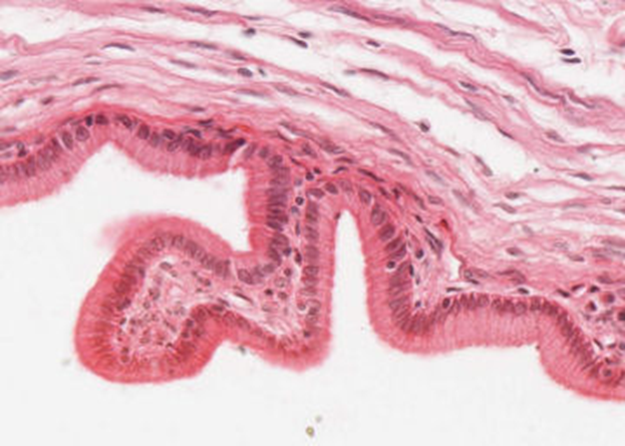
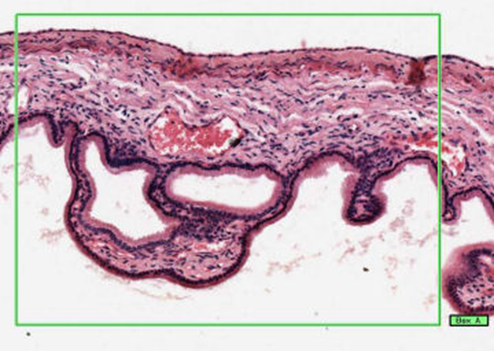
Biliary Tree Histology
From Cuboidal to Columnar in the Gall Bladder…
Mucosa is thrown into folds NOT villi (no lymphatic or circulatory system)

Slide 24
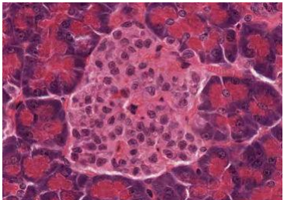
Pancreas Histology
Endocrine Pancreas
This shows an islet of Langerhans
Endocrine because secretes directly into blood flow
Cell types inc. :
Alpha => Glucagon
Beta => Insulin
Delta => Somatostatin (inhibitory)
PP / Gamma => Pancreatic Peptides
Epsilon => Ghrelin (hunger-stimulator)

Slide 25
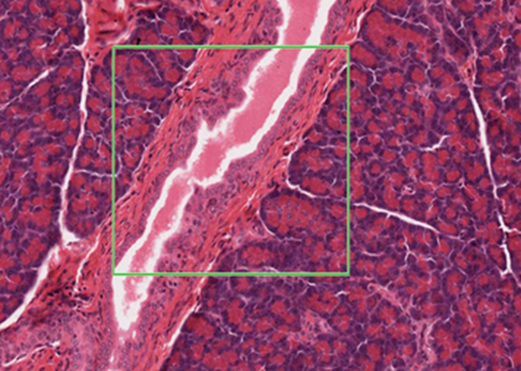
Pancreas Histology
Exocrine Pancreas
- Shows clumps of secretory cells (acini)
- Arrows pointing at centro-acinar cells
Pancreatic Duct
Lined by simple cuboidal epithelium
Surrounded by acinar tissue

