Slide 1
Gynecology
Phase 3B
Bukky Olaitan and Rolla Ibrahim
The Peer Teaching Society is not liable for false or misleading information…

Slide 2
Aims
Menstruation
Basic physiology
Dysmenorrhoea
Amenorrhoea
Infertility
Contraception
Menopause
The Peer Teaching Society is not liable for false or misleading information…

Slide 3
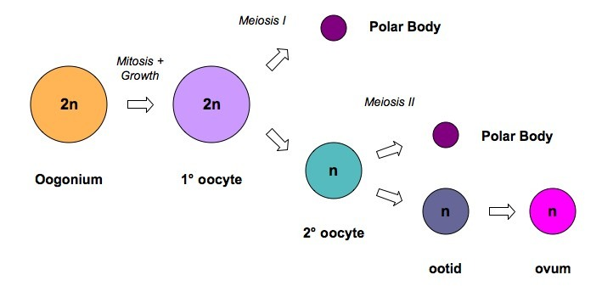
Oogenesis
The Peer Teaching Society is not liable for false or misleading information…
Notes:
Oogenesis
In utero, the primitive germ cell – oogonia – undergoes numerous mitotic divisions. Around 3mo., they stop proliferating.
The oogonia then develop into Primary oocytes, which begins the first meiotid division by replicating their DNA. They stop here under meiotic arrest, and the eggs have 46 chromosomes each with two sister chromatids.
Puberty: the egg divides to form the Second Oocyte and the first polar body, which have 23 choromosomes each.
The next division only happens after fertilization in the uterine tubes, producing the Ovum.

Slide 4
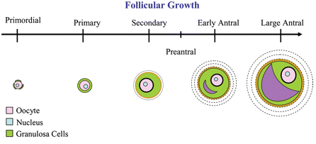
Follicle Growth
The Peer Teaching Society is not liable for false or misleading information…
Notes:
While the eggs are in the ovary they are surrounded by follicles which start out as the Primordial Follicles. This is a primary oocyte surrounded by granulosa cells.
The oocyte grows and the granulosa cells proliferate into multiple layers. The Zona Pellucida forms, which is a thick layer between the granulose and oocyte.
Granuolsa cells still stay connected by forming gap junctions to the oocyte, allowing passage of nutrients and chemical messengers.
Granulosa Cells proliferate and form the outer layer Theca, which secretes estrogen.
As the granulosa cells produce fluid, the Antrum forms when the primary oocyte reaches full capacity.
At the beginning of menstration, 10-20 preantral and early antral follicles begin to develop and enlarge. One becomes the Dominant Follicle and the rest undergo degeneration called Atresia.
The Antrum continues to grow and the granulosa cells produce the Culumus Oophorous, thick layer holding the egg.
As ovulation approaches, it divides forming the secondary oocyte. The culumus separates and the egg is free floating. This Mature Follicle, balloonings on the surface of the ovary.
Ovulation – the rupture of the ovary from the follicle.

Slide 5
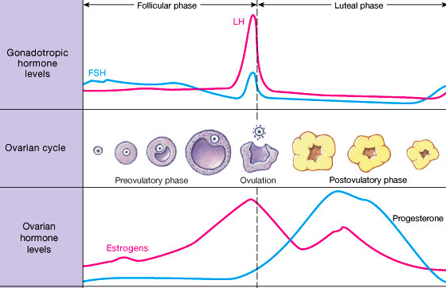
Menstrual Cycle
The Peer Teaching Society is not liable for false or misleading information…

Slide 6
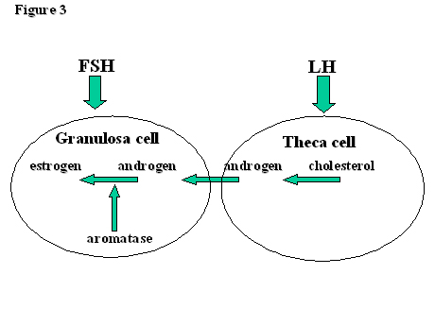
FSH and LH
The Peer Teaching Society is not liable for false or misleading information…

Slide 7
FSH and LH
FSH
Follicle Stimulating Hormone
Stimulates granulosa cells
Slightly elevated at the beginning
Decreases throughout phase
Small peak mid-cycle
The Peer Teaching Society is not liable for false or misleading information…

Slide 8
FSH and LH
LH
Luteinizing Hormone
Stimulates Theca cells
Constant until 18 hours before ovulation
LH surge → ovulation
The Peer Teaching Society is not liable for false or misleading information…

Slide 9
Oestogen
Initially secreted in low amounts from granulosa cells
Some diffuses into plasma and continues cell growth with FSH
Increases before ovulation because secreted from dominant follicle
Negative Feedback
When in small concentrations
Act on hypothalamus to decrease GnRH pulses → Decreasing FSH/LH
Positive Feedback
At high concentrations
Increase gonadotropin → LH surge
The Peer Teaching Society is not liable for false or misleading information…

Slide 10
Oestrogen
Estrone
Predominant during menopause
Made from testosterone in fat cells
Estradiol
Predominant during reproductive years
Strongest potency 80x
Made from testosterone in ovary
Estriol
Predominant during pregnancy
Most in quantity, but weakest
The Peer Teaching Society is not liable for false or misleading information…

Slide 11
Progesterone
Secreted in little amounts from the ovary
After ovulation, high amounts from the corpus luteum
Function
Prepares uterus’ endometrium for implantation
Proliferation, vascularization, and differentiation
The Peer Teaching Society is not liable for false or misleading information…

Slide 12
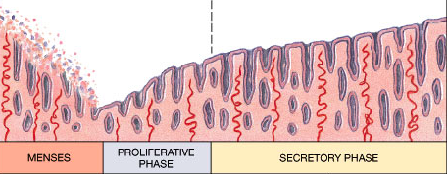
Uterine Cycle
Changes caused by oestrogen and progesterone
Decrease in these cause menstrual phase
Basal layer stays
Prostaglandins
Vasoconstriction and uterine contraction
Overproduction →Dysmenorrhea
Smooth muscles throughout body e.g. nausea, vomiting
Constriction of uterine blood vessels → decrease O2 → Disintegrate → Arterial dilation → Hemorrhage
The Peer Teaching Society is not liable for false or misleading information…

Slide 13
Question 1
Which of the following are functions of LH?
Formation & Maintenance of the corpus luteum
Stimulation of the follicle development
Stimulation of GnRH production
ANS: Formation and maintenance of the corpus luteum
The Peer Teaching Society is not liable for false or misleading information…

Slide 14
Question 2
Which hormone is the Corpus Luteum responsible for producing?
Oestrogen
Progesterone
FSH
LH
ANS: Progesterone
The Peer Teaching Society is not liable for false or misleading information…

Slide 15
Question 3
Which of the following indicates that a women is about to ovulate?
Decrease in basal body temperature
Increase in basal body temperature
Thickening of the cervical mucous
Thinning of the cervical mucous
ANS:
Increase in basal body temp
Thinning of the cervical mucous
The Peer Teaching Society is not liable for false or misleading information…

Slide 16
Question 4
At which stage of the cycle is the secretory phase?
Days 1-5
Days 5-14
Days 14-28
ANS: Days 14-28
The Peer Teaching Society is not liable for false or misleading information…

Slide 17
Question 5
Which of the following are functions of the progesterone?
Inhibition of oestrogen production
Stimulation of oestrogen production
Initiation of the secretory phase of the endometrium
Increased in basal body temperature
Inhibition of LH & FSH
Ans: 2-5
The Peer Teaching Society is not liable for false or misleading information…

Slide 18
Question 6
Where are the LH & FSH produced?
Hypothalamus
Anterior pituitary
Posterior pituitary
Adrenal glands
ANS: Anterior pituitary
The Peer Teaching Society is not liable for false or misleading information…

Slide 19
Question 7
At which point in the menstrual cycle is a women most fertile?
Days 1-5
Days 9-16
Days 17-21
Days 22-28
ANS Days 9-16
The Peer Teaching Society is not liable for false or misleading information…

Slide 20
Dysmenorrhoea
Excessive pain during periods
Primary
No underlying pathology
Affects 50% (probably more) of women
Cause? → excessive endometrial prostaglandins
Features
Pain before or within a few hours of periods
May radiate to back or down thighs
Management
First line: NSAIDs → Ibuprofin or mefenamic acid. Stop prostaglandin production
Second line: COCP
The Peer Teaching Society is not liable for false or misleading information…

Slide 21
Amenorrhoea
Primary Amenorrhoea
Lack of menstruation by age 16
Secondary amenorrhoea
Absence of menstruation by 6 months
The Peer Teaching Society is not liable for false or misleading information…

Slide 22
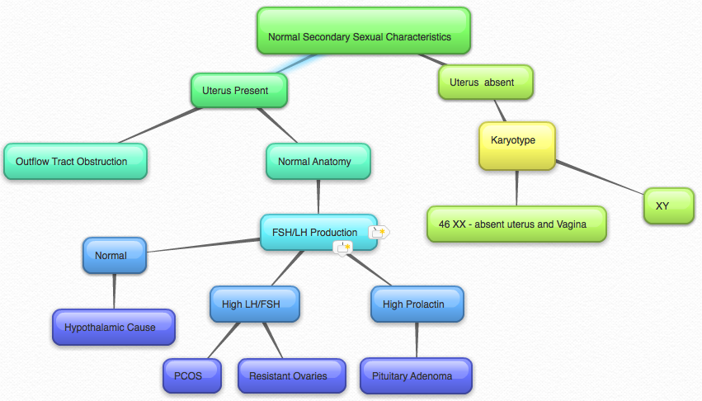
Primary Amenorrhoea
The Peer Teaching Society is not liable for false or misleading information…

Slide 23
Primary with 2ndary
Constitutional delay
No abnormalities, just later than peers
Genitourinary malformation
Imperforated hymen
Cervical stenosis
Asherman’s syndrome → Uterine adhesions
The Peer Teaching Society is not liable for false or misleading information…

Slide 24
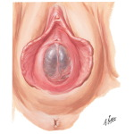
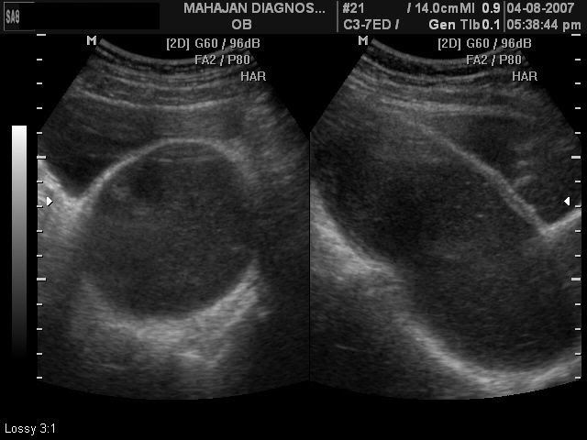
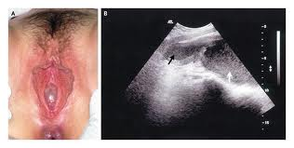

Slide 25
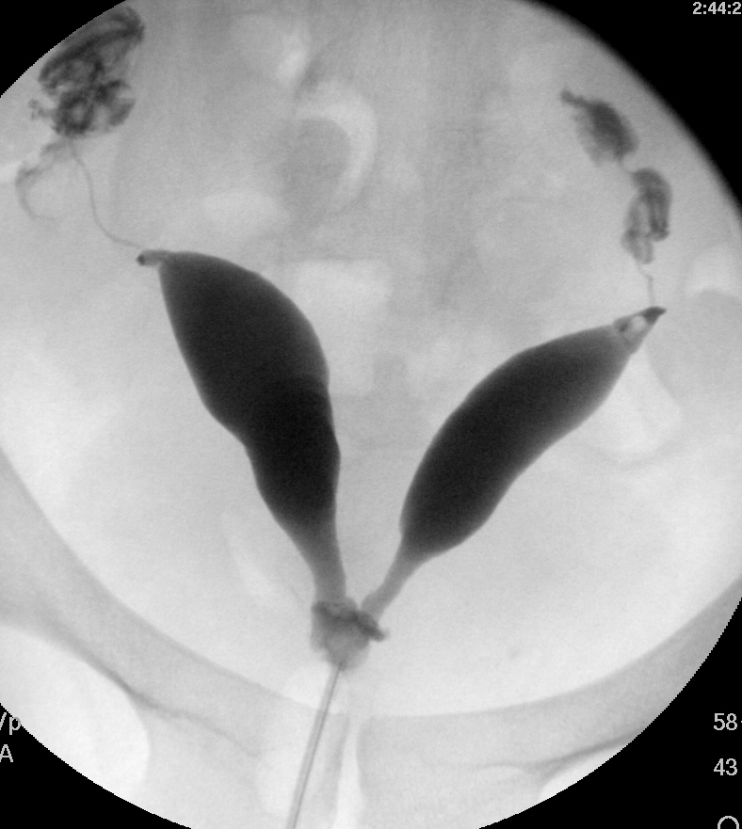

Slide 26
Primary with 2ndary
Testicular feminisation – Androgen resistance syndrome
XY karyotype
External appearance of a girl, no internal female parts
Y chromosome in a male fetus controls internal organ change
Testosterone controls outer
So if not enough testosterone, or resistance, the fetus gets female parts externally
The Peer Teaching Society is not liable for false or misleading information…

Slide 27
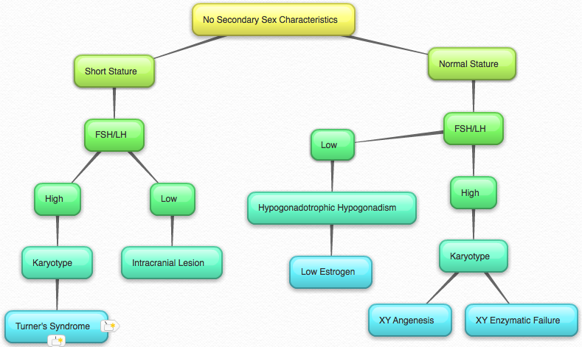
Primary Amenorrhoea
The Peer Teaching Society is not liable for false or misleading information…

Slide 28
Primary without 2ndary
Hypothalamic Failure
Functional → stress, anorexia, exercise
Non-Functional → SOL, Kallman’s, Surgery
Kallman’s Syndrome
Primary GnRH deficiency. Lack of smell
Cause: tumours, hydrocephalus
Hyperprolactinemia
Gonadal failure
Premature ovarian failure – usually Turner’s
The Peer Teaching Society is not liable for false or misleading information…

Slide 29
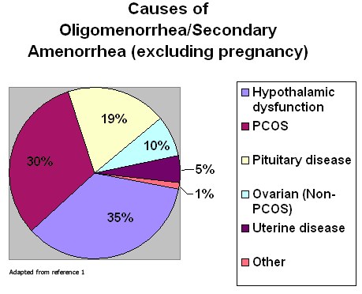
Secondary Amenorrhoea
Signs of androgen excess
No signs of androgen excess
The Peer Teaching Society is not liable for false or misleading information…

Slide 30
2ndary with Androgen
PCOS
30% of amenorrhoea. LH > FSH
Patient usually overweight
More on this to come!! ☺
Cushing’s Syndrome
Adrenal or ovarian carcinoma
The Peer Teaching Society is not liable for false or misleading information…

Slide 31
2ndary without androgen
Physiological cause
PREGNANCY!! Menopause, lactation
Depot/implant
Premature ovarian failure
May resume again spontaneously
Radiotherapy? Familial
Weight loss (BMI >19)
Hyperprolactinaemia
The Peer Teaching Society is not liable for false or misleading information…

Slide 32
2ndary without androgen
Sheehan’s Syndrome
Secondary panhypopituitarism
Caused by severe post-partum hemorrhage → pituitary necrosis
Posterior not affected → arterial blood supply
Anterior → low pressure venous sytem
Hyperplasia & Hypertrophy of lactotrophes
Bigger but no increase in blood supply
Ischemia with PPH
The Peer Teaching Society is not liable for false or misleading information…

Slide 33
2ndary without androgen
Asherman’s syndrome
MC anatomical abnormality to cause 2ndary amenorrhea
Adhesions and/or fibriosis of the endometrium
Uterine adhesions
“cob-webs”
Causes
Trauma to the endometrium
After miscarriage, abortion
Endometrial insensitivity to estrogen
The Peer Teaching Society is not liable for false or misleading information…

Slide 34
Question 8
A 20 year old woman who has never been pregnant presents for the evaluation of 3 months of amenorrhea. Her menstrual cycles have been regular up till now. She complains of fatigue, nausea, and breast tenderness. What is the first test you will do?
ANS – Pregnancy test
The Peer Teaching Society is not liable for false or misleading information…

Slide 35
Question 9
What measurements can help differentiate hypothalamic-pituitary amenorrhea from ovarian failure?
Testosterone levels
FSH levels
hCG levels
Serum estradiol levels
ANS: FSH levels
The Peer Teaching Society is not liable for false or misleading information…

Slide 36
Question 10
FSH and LH levels can help determine the difference between hypothalamic amenorrhea and pituitary amenorrhea
True
False
ANS: False
FSH and LH levels will be low in both
The Peer Teaching Society is not liable for false or misleading information…

Slide 37
Question 11
What is oligomenorrhea?
Prolonged or excessive uterine bleeding that occurs at regular intervals
Irregular mentrual bleeding
Regular bleeing that occurs more frequently than 21 days
Menstrual cycle length greater than 35 days
ANS: Mentrual cycle >35 days
Ans 3 → polymenorrhea
The Peer Teaching Society is not liable for false or misleading information…

Slide 38
Subfertility
Definition – Conception not occurred after 1 year of regular unprotected sex
Primary – Female partner never conceived
Secondary – Female partner has previous conceived (regardless of outcome of pregnancy)
The Peer Teaching Society is not liable for false or misleading information…

Slide 39
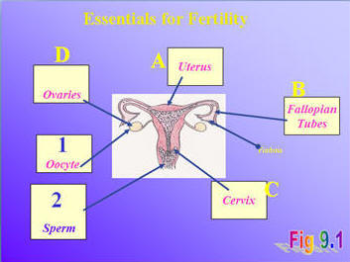
Conditions for pregnancy
Egg must be produced (failure = anovulation – 30%)
Adequate sperm must be released (problem = male factor – 25%)
Sperm must reach egg.
Tubal damage (25%)
Sexual (5%)
Cervical (<5%)
Embryo must implant (incidence defective implantation unknown)
The Peer Teaching Society is not liable for false or misleading information…

Slide 40
Contributors to subfertility
Ovulatory problems – 30%
Male Factors – 25%
Tubal Problems – 25%
Coital problems – 5%
Cervical problems - <5%
Unexplained – 30%
The Peer Teaching Society is not liable for false or misleading information…
Notes:
Total % as >100 as more than one cause may be present

Slide 41
Disorders of ovulation (30%)
NB - Fertility decreases with increasing age in females due to decreased genetic quality of remaining oocytes rather than ovulatory problems.
The Peer Teaching Society is not liable for false or misleading information…

Slide 42
Physiology of Ovulation – brief recap
The Peer Teaching Society is not liable for false or misleading information…

Slide 43
Detection of Ovulation
History – If cycles are regular most likely to be ovulating
Examination (not recommended)
Temperature pattern, looking at cervical mucus under microscope (fern like pattern)
The Peer Teaching Society is not liable for false or misleading information…

Slide 44
Detection of Ovulation
Investigations
Elevated serum progesterone levels in mid-luteal phase indicate ovulation has occurred. Levels measured 7 days before subsequent menstruation (so day 21 of 28 day cycle)
Ultrasound scan to serially measure follicular growth – too time consuming
Over the Counter urine prediction kits indicate if LH surge has taken place
The Peer Teaching Society is not liable for false or misleading information…

Slide 45
Causes of Anovulation
Hypothalamic
Hypothalamic Hypogonadism
Kallman’s syndrome
Pituitary Causes
Hyperprolactinaemia
Pituitary damage
Ovarian Causes
PCOS
Premature Ovarian failure
Gonadal Dysgenesis
Luteinized unruptured follicle syndrome
Other causes
Hypo or Hyperthyroidism
Androgen secreting tumours
PREGNANCY!!!
The Peer Teaching Society is not liable for false or misleading information…
Notes:
Kallman’s syndrome – GnRH secreting neurones fail to develop. Exogenous gonadotrophins or GnRH pump will induce ovulation

Slide 46
Causes of Anovulation - Pituitary
Pituitary damage
Decreased FSH and LH release
Pressure from tumours or Sheehan’s syndrome
Hyperprolactinaemia
Excess prolactin -> Decreased GnRH release
Usually adenomas or hyperplasia of pituitary cells.
Also associated with PCOS, hypothyroidism and psychotropic drugs.
Symptoms
Oligomnorrhoea, Amennorhoea, Galactorrhoea, headaches, bitemporal hemianopia
The Peer Teaching Society is not liable for false or misleading information…
Notes:
Pituitary damage – GnRH production normal but due to pituitary damage FSH and LH release is decreased.
Due to pressure from tumours or Sheehan’s syndrome (aka postpartum hypopituitarism which is infarction following sever postpartum haemorrhage)
Pathophysiology - Hypertrophy and hyperplasia of lactotrophs during pregnancy results in the enlargement of the anterior pituitary, without a corresponding increase in blood supply.
Secondly, the anterior pituitary is supplied by a low pressure portal venous system.[7]
These vulnerabilities, when affected by major hemorrhage or hypotension during the peripartum period, can result in ischaemia of the affected pituitary regions leading to necrosis.
The posterior pituitary is usually not affected due to its direct arterial supply

Slide 47
Hyperprolactinaemia
Investigations
Elevated prolactin
CT if neurological symptoms
Treatment
Dopamine Agonist e.g Bromocriptine or Cabergoline
Surgery if medical treatment fails or symptoms warrant it
The Peer Teaching Society is not liable for false or misleading information…

Slide 48
Causes of Anovulation - Ovarian
PCOS (Polycystic Ovarian Syndrome)
Premature ovarian failure
Gonadal dysgenesis
Rare conditions
Usually present with primary amenorrhoea
Luteinized unruptured follicle syndrome
Follicle develops but egg not released
Doesn’t occur every month so not persistent problem.
The Peer Teaching Society is not liable for false or misleading information…

Slide 49
Premature Ovarian Failure
No ovarian follicles
Requires donor eggs
Bone protection with HRT or COCP
Investigations – FSH and LH levels will be increased as no oestrogen or inhibin to inhibit their release.
The Peer Teaching Society is not liable for false or misleading information…

Slide 50
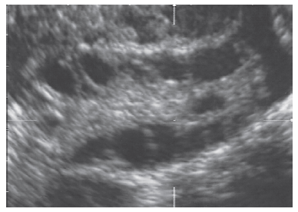
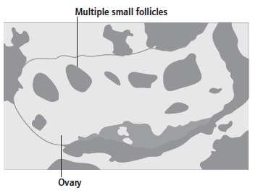
Polycystic Ovarian Syndrome (PCOS)
Polycystic Ovaries – Transvaginal ultrasound appearance of multiple (12 or more) small (2-8mm) follicles in an enlarged (<10ml volume) ovary.
Present in 20% of women, majority of whom have regular cycles
The Peer Teaching Society is not liable for false or misleading information…

Slide 51
PCOS
Weight gain causes development of the syndrome
5% of women
2 out of 3 criteria
PCO on Ultrasound
Irregular periods
Hirsutism
Clinical – acne or excess body hair
Biochemical – Increased serum testosterone
The Peer Teaching Society is not liable for false or misleading information…
Notes:
Irregular periods are defined as being more than 35 days apart

Slide 52
PCOS – Pathology/Aetiology
The Peer Teaching Society is not liable for false or misleading information…
Notes:
Genetic
Disordered LH production and peripheral insulin resistant with compensatory hyperinsulinaemia
Increased LH and insulin act on Polycystic ovaries which causes ovary to produce increased androgens
Increased insulin, increased adrenal androgen production and decreased hepatic production od SHBG => increased free androgen levels
Increased intraovarian androgens disrupt folliculogenesis causing excess small ovarian follicles (and PCO picture) and absent or irregular ovulation.
Raised peripheral androgens cause hirsutism
Increased body weight causes raised insulin and consequently androgen levels
Many have Family history of type 2 DM

Slide 53
The Peer Teaching Society is not liable for false or misleading information…

Slide 54
PCOS Clinical Features
PCO without syndrome – no symptoms
Miscarriage more common in PCOS
The Peer Teaching Society is not liable for false or misleading information…

Slide 55
PCOS Investigations
Diagnosis of exclusion
Blood Tests:
FSH ( in ovarian failure, ⬇ in hypothalamic dx, normal in PCOS), Prolactin and TSH
Hirsutism – Serum testosterone levels
LH often raised in PCOS, but not diagnostic
Ultrasound to look for PCO
Other – Screen for diabetes, abnormal lipids especially if positive FH
The Peer Teaching Society is not liable for false or misleading information…
Notes:
If serum testosterone levels markedly increased – possiblilty of androgen secreting tumour or CAH

Slide 56
PCOS Complications
Up to 50% develop Type 2 DM later in life
30% develop gestational diabetes
Increased risk of endometrial carcinoma
The Peer Teaching Society is not liable for false or misleading information…
Notes:
Endometrial carcinoma – due to unopposed oestrogen action from many years of amenorrhoea

Slide 57
The Peer Teaching Society is not liable for false or misleading information…

Slide 58
Symptomatic Treatment
Diet and Exercise advice – weight loss
Combined oral contraceptive pill
If fertility not required
Regulates menstruation and treats hirsutism
Antiandrogens or spironolactone
Effective for hirsutism
Metformin to decrease insulin levels
Eflornithine – topical antiandrogen for facial hirsutism
The Peer Teaching Society is not liable for false or misleading information…
Notes:
Weight loss should decrease insulin levels and improve all PCOS symptoms
At least 3-4 bleeds per year to protect endometrium
Antiandrogens or spironolactone – MUST AVOID CONCENPTION

Slide 59
PCOS Treatment
1st Line
Clomifene
antioestrogen
Day 2 – 6 of cycle
Initiates process of follicular maturation
Ultrasound monitoring
The Peer Teaching Society is not liable for false or misleading information…
Notes:
Clomifene – 1st line induction drug in PCOS
Limited to 6 months use
60% ovulation and 40% ivebirth rates
Antioestrogen – blocks oestrogen receptors in hypothalamus and pituitary which causes increased FSH and LH production
Given on days 2-6 of cycle
Initiates process of follicular maturation which is thereafter self-perpertuating for that cycles
Monitor clomifene cycles by transvaginal ultrasound – to assess ovarian response and endometrial thickness
Dose initiall 50mg/day if no response can be increased to 100 and then max of 150mg/day
If 3 or more follicles develop, cycle cancellation indicated to decrease risk of multiple preganancy
Antrioestrogen means that it has negative effects on endometrium therefore higher doses can cause thin (<7mm) endometrium

Slide 60
PCOS treatment
2nd Line
Metformin
Insulin sensitizing drug
Can be used with clomifene in clomifene resistant women
Treats hirsutism
Laparoscopic ovarian diathermy
Effective as gonadotrophins with lower multiple pregancy rate
Risks – periovarian adhesion formation, ovarian failure (rare)
Gonadotrophins
Used when clomifene fails and in hypothalamic hypogonadism if weight normal
Used to stimulate follicular growth
Low dose step up in PCOS
FSH to stimulate follicular growth, then when big enough, recombinant LH to stimulate ovulation
The Peer Teaching Society is not liable for false or misleading information…
Notes:
Metformin
Insulin sensitizing drug
No risk multiple pregnancy therefore no need for scan monitoring
Lower live birth rate compared to clominfene
Can be used with clomifene as increases effectiveness of clomifene in clomifene resistant women
Treats hirsutism – so ideal for anovulatory women who want hirsutism treated and to avoid multiple pregnancy
Laparoscopic ovarian diathermy
Effective as Gonadotrophins – with lower multiple pregnancy rate
Can also test for tubal patency (methylene blue insufflation) and treat any comorbidities such as endometriosis or adhesions at same time as doing diathermy process.
If successful – regular ovulations continue for years
Risks – periovarian adhesion formation, ovarian failure
Gonadotrophins
Used when clomifene fails and in hypothalamic hypogonadism if weight normal
Exogenous FSH +/- LH administered SC daily – used as substitute for normal pituitary production – used to stimulate follicular growth
Often leads to maturation of more than 1 follicle
If PCOS – low dose step up – Gonadotrophin dose increased in small increments every 5-7 days until ovaries begine to respond. This decreases multiple pregnancy to <10%
Monitor follicular development with US
Once follicle is of size adequate for ovulation (about 17 mm) process can be artificially stimulated by hCG (structurally similar to LH) or recombinant LH
Alternative to Gonadotrophin induction – Continuous GnRH pump. Stimulates FSH and LH production from pituitary in physiological manner and achieves normal pregnancy and multiple pregnancy rates. Need to wear pump limits acceptability

Slide 61
Ovulation Induction - SE
Multiple pregnancy
More likely with clomifene or gonadotrophins
Ovarian Hyperstimulation Syndrome (OHSS)
Main gonadotrophins
Overstimulated follicles become v. large and painful
Risk factors – Gonadotrophin, age <35, previous OHSS, PCO on Ultrasound scan
Prevention – lowest effective doses, ultrasound monitoring, coasting or cancellation of cycle
The Peer Teaching Society is not liable for false or misleading information…
Notes:
OHSS
Mainly gonadotrophins – overstimulate follicles which become very large and painful. More common during IVF.
Risk factors – Gonadotrophin stimulation, age <35, previous OHSS and ovaries of polycystic morphology on USS
Prevention – Use lowest effective gonadotrophin doses
US monitoring of follicular growth
Coasting (Withdrawal of gonadotrophins for a few days) or cancellation of IVF cycle
Severe cases Of OHSS
Hypovolaemia, electrolyte disturbances, ascites, thromboembolism and pulmonary oedeme may develop.
Hospitalisation require for these cases

Slide 62
Male factors (25%)
About 70 days for sperm to develop fully.
The Peer Teaching Society is not liable for false or misleading information…

Slide 63
Semen Analysis
If normal – excludes male factors
Sample should be produced at least 2-7 days after last ejaculation
Analyse sample within 1-2 hours of production
If abnormal repeat after 12 weeks
If persistently abnormal then examine and investigate male
The Peer Teaching Society is not liable for false or misleading information…
Notes:
Other causes of abnormal semen analysis
Antisperm antibodies – common after vasectomy reversal
Varocolcele – Varicosities of pampiniform venous plexus, usually left side. Pathophysiology unknown
Infections – e.g epididymitis, mumps orchitis
Testicular abnormalities e.g Klinefelters (XXY)
Cystic fibrosis – congenital absence of vas deferens causes obstruction to delivery
Hypothalamic Problems
Kallman;s syndrome
Hyperprolactinaemia
Retrograde ejaculation (eg due to neurological disease secondary to diabetes or TURP)

Slide 64
Further Investigation
Azoospermia
Blood test for: FSH, LH, testosterone, prolactin and TSH. Find treatable causes (not common)
High FSH and LH with low testosterone suggests primary testicular failure – may be associated with cyptorchidism or due to surgery, radiochemotherapy or unknown
Serum Karyotype
Absent Vas deferens – Test for CF
The Peer Teaching Society is not liable for false or misleading information…

Slide 65
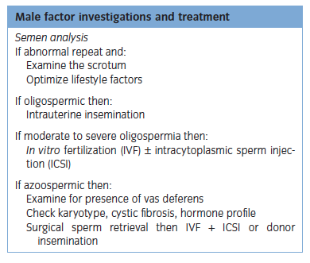
Male factors Mx
Specific Measures
Hypogonadotrophic hypogonadism – Twice weekly SC FSH and LH injections for 6-12 months
The Peer Teaching Society is not liable for false or misleading information…
Notes:
General Advice – lifestyle changes and drug exposures addressed. Wear loose clothing, testicular cooling.
Specific measures – as above
Assisted conception techniques
IUI – mild to moderate sperm dysfn
IVF – if more sever oligospermia
ICSI – V sever oligospermia
SSR – Surgical sperm retrieval – azoospermia, sperm can then be used for ICSI, IVF. Donor sperm may be used after adequate counselling

Slide 66
Disorders of Fertilization
Can be due to
Tubal damage (25%)
Infection – PID especially STDs
Salpingostomy – Increases ectopic pregnancy rates
Detect - laparoscopy and methylene blue insufflation (look for spill) or Hysterosalpingogram (fill and spill)
The Peer Teaching Society is not liable for false or misleading information…

Slide 67
Disorders of Fertilization
Endometriosis
Mechanism poorly understood
Laparoscopic surgery to remove endometriotic deposits improves fertility
Previous surgery/sterilization
Causes adhesions
Cervical problems
Rare
Antibody production which kill sperm, cone biopsy, infection
Intrauterine Insemination
Sexual problems – Impotence, ignorance or discomfort
The Peer Teaching Society is not liable for false or misleading information…

Slide 68
Assisted Conception
The Peer Teaching Society is not liable for false or misleading information…
Notes:
IUI, IVF (stages), ICSI, oocyte donation, PGD (Preimplantation Genetic Diagnosis), Surrogacy, Fertility preservation (freeze sperm, eggs or embryos (to thaw embryo both must agree otherwise destroyed))

Slide 69
Contraception
The Peer Teaching Society is not liable for false or misleading information…

Slide 70
Question 1
What does the Fraser Guideline state?
the young person understands the professional's advice
the young person cannot be persuaded to inform their parents
the young person is likely to begin, or to continue having, sexual intercourse with or without contraceptive treatment
unless the young person receives contraceptive treatment, their physical or mental health, or both, are likely to suffer
the young person's best interests require them to receive contraceptive advice or treatment with or without parental consent
The Peer Teaching Society is not liable for false or misleading information…

Slide 71
Question 2
Which one of the following is less common in women who take the combined oral contraceptive pill?
Stroke
Endometrial Cancer
Pulmonary embolism
Cervical cancer
Ischemic heart disease
ANS: Endometrial Cancer
COCP
Protective against ovarian and endometrial cancer
Increased risk of breast and cervical cancer
The Peer Teaching Society is not liable for false or misleading information…

Slide 72
COCP
Estrogen (ethinylestradiol) and progesterone
Take for 3 weeks, withdrawl bleeding 1 week
Effectiveness
0.2-3 pregnancies per 100 woman years
Mode of action
Inhibits ovulation
thickens cervical mucous
thins endometrial lining
The Peer Teaching Society is not liable for false or misleading information…

Slide 73
COCP
Disadvantages
Advantages
Increase risk of breast cancer
Increased risk of cervical caner
Thromboembolic risk
Due to oestrogen’s affect on clotting factors and arterial disease
Potential drug interactions
Protective for endometrial and ovarian cancer
Decrease menorrhagia and dysmenorrhea
Decrease risk of PID
May help with acne
Reversible when stopping
The Peer Teaching Society is not liable for false or misleading information…

Slide 74
Question 3
Which one of the following is not an absolute contraindication to combined oral contraceptive pill use?
Blood pressure > 160/100 (confirmed)
Continuous use before and after a total knee replacement
Breast feeding a 10 week baby
DVT 9 months ago
39 year old smoking 20/day
Ans: breast feeding
The Peer Teaching Society is not liable for false or misleading information…

Slide 75
COCP
Absolute
Disadvantages > Benefit
More than 35 years of age and smoking >15/day
Migrane with aura
History of thromboembolic disease
History of stroke or ischemic heart disease
Uncontrolled HTN
Breast cancer
Major immobility
Overweight >35BMI
FHx thromboembolic disease in first degree relative <45yrs
Controlled HTN
Breast feeding
The Peer Teaching Society is not liable for false or misleading information…

Slide 76
POP
Stops ovulation 15-40%
Cerazette – different type of progesterone. Stops ovulation up to 99%
Take once a day at the same time
Types
POP, Injectable, implant, IUS
Mode of action
Thickens cervical mucus
Things endometrium
The Peer Teaching Society is not liable for false or misleading information…

Slide 77
Question 4
What is the most common adverse effect experienced by women taking the progestogen only pill?
Acne
Irregular bleeding pattern
Mood swings
Weight gain
Reduced libido
ANS: Irregular bleeding pattern
The Peer Teaching Society is not liable for false or misleading information…

Slide 78
POP
Advantages
Disadvantages
Can use for obese patients
Can use for >35 yrs and smokers
Can use for all contraindication of COCP e.g. thrombo-embolism hx
DMPA – protective against endometrial cancer
Less cost effective
3 hour window for missed pill. 12 hour window for Cerezette
Irregular bleeding
DMPA
Delayed return to fertility
Increase weight
Bone loss
Hypo-estrogenism with longterm use
The Peer Teaching Society is not liable for false or misleading information…

Slide 79
Question 5
What is the main mechanism of action of Nexplanon (etonogestrel contraceptive implant)?
Thickens the cervical mucus
Thins endometrial lining
Inhibition of ovulatin
Causes fallopian tube dysfunction
Prevents implantation
ANS: Inhibits ovulation
The Peer Teaching Society is not liable for false or misleading information…

Slide 80
Question 6
A woman presents to have Nexplanon (etonogestrel) insert. Where is the most appropriate place to insert the implant?
Subcutaneous buttock
Subdermal, non-dominant arm
Subcutaneous, non-dominant arm
Intradermal, non-dominant arm
Subdermal, buttock
ANS: Subdermal, non-dominant arm
The Peer Teaching Society is not liable for false or misleading information…

Slide 81
Implant
Highly effective: failure rate 0.07/100 woman years
Long acting → 3 years
Doesn’t contain oestrogen
Can be used immediately after TOP
Adverse effect
Irregular bleeding
Progestogen effects → headache, nausea, breast pain
Contraindications
Current breast cancer
The Peer Teaching Society is not liable for false or misleading information…

Slide 82
Question 7
Which one of the following statements regarding the link between intrauterine devices (IUDs) and ectopic pregnancies is correct?
The proportion of pregnancies that are ectopic is increased and the absolute number is increased
The proportion of pregnancies that are ectopic is increased but the absolute number is decreased
Having an IUD has no effect on rate of ectopic pregnancies
The proportion of pregnancies that are ectopic is decreased and the absolute number is decreased
The proportion of pregnancies that are ectopic is decreased but the absolute number is increased
ANS: 2
The Peer Teaching Society is not liable for false or misleading information…

Slide 83
IUD and IUS
Copper coil with plastic frame. IUS/Mirina has progesterone
Highly effective
Mode of action
IUD → coper ions → decreased sperm motility and survival → decreased fertilization
IUS → Prevents endometrial proliferation and cervical mucous thickening
IUD effective immediately. IUS 7 days extra protection
The Peer Teaching Society is not liable for false or misleading information…

Slide 84
IUD and IUS
Advantages
Disadvantages
Long term, 5 years
99% effective
IUD effective immediately and used as emergency contraception
If inserted after 40, can leave until after menopuase
Risk of perforation on insertion 2/1000
Increased proportion of ectopic pregnancies
Infection
IUD
Can cause menorrhagia and dysmenorrhagia
IUS
Initial frequent uterine bleeding and spotting
The Peer Teaching Society is not liable for false or misleading information…

Slide 85
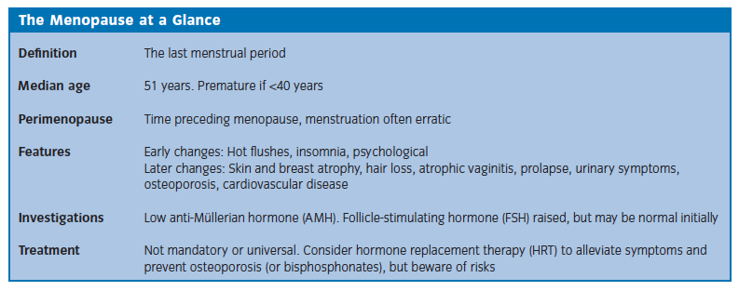
Menopause
The Peer Teaching Society is not liable for false or misleading information…

Slide 86
Menopause
The Peer Teaching Society is not liable for false or misleading information…

Slide 87
Premature Menopause
Menopause under 40
1% women
Idiopathic in most
Surgical – following bilateral oopherectomy
Infection, autoimmune disorders, chemo, ovarian dysgenesis, metabolic disease
HRT until 50
Oocyte donation for fertility
The Peer Teaching Society is not liable for false or misleading information…

Slide 88
Post Menopausal Bleeding
Vaginal bleeding after menopause
Causes
Endometrial carcinoma, endometrial hyperpplasia +/- atypia and polyps, cervical carcinoma, atrophic vaginitis, cervitis, ovarian carcinoma, cervical polyps
Investigation – Bimanual and speculum examination, cervical smear, transvaginal ultrasound (measure endometrial thickness) and
The Peer Teaching Society is not liable for false or misleading information…

Slide 89
The Peer Teaching Society is not liable for false or misleading information…

Slide 90
Thank you!
Rolla.ibrahim@hotmail.com
oolaitan1@sheffield.ac.uk
The Peer Teaching Society is not liable for false or misleading information…

