Slide 1
Microbiology
Phase 2a
By Laura MacKenzie & Emma Wynne
The Peer Teaching Society is not liable for false or misleading information…

Slide 2
Bacterial identification
How do you identify bacteria?
COLOUR
Purple (gram positive)
Pink (gram negative)
SHAPE
Cocci:
Diplococci
Chains
Clusters
Bacilli:
Chains
Branching
Notes:
Why do gram positive bacteria stain purple?
- Because these bacteria have a thicker peptidoglycan cell wall

Slide 3
Gram stain
Fixation
Crystal violet
Iodine treatment
Discolourisation
Counter stain with safranin

Slide 4
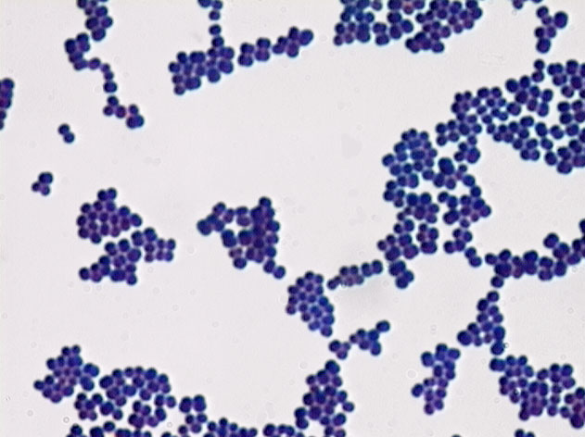
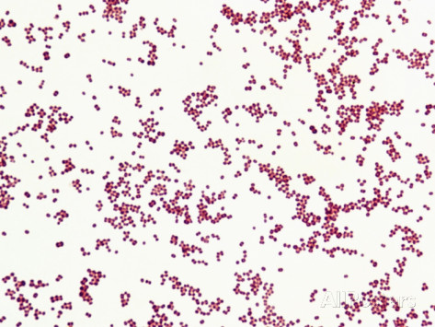
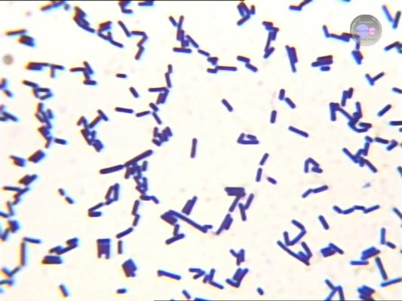
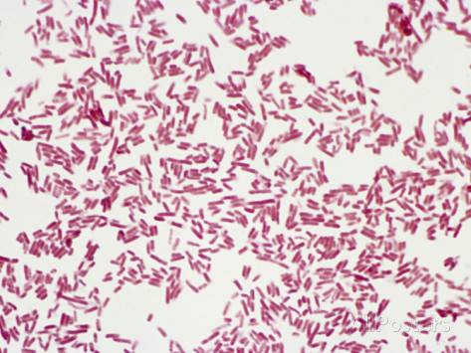
Gram positive cocci
Gram negative cocci
Gram positive bacilli
Gram negative bacilli

Slide 5
Gram Positive Cocci
What are the 2 main groups?
Staphylococcus (clusters)
Streptococcus (chains)
What is this test to differentiate between the two?
catalase
Staphylococcus Streptococcus
+ve
-ve

Slide 6
Streptococcus
Haemolysis on blood agar
Alpha Beta
(greening around colonies) (clearing around colonies)
Optochin test Lancefield group
How do you differentiate between the different subtypes of streptococci?
A, B, C, D
A =s.pyogenes
Sensitive
=s.pneumoniae
Resistant =s.viridans

Slide 7
Staphylococcus
How do you differentiate between the different subtypes of staphylococci?
Coagulase
test
coagulase –ve
staphylococcus: s.aureus
- s.epidermidis
- s.saprophiticus (honeymoon cystitis!)
-ve
+ve

Slide 8
Gram positive bacilli
There are 2 groups:
Aerobic e.g. listeria monocytogenes
Anaerobic e.g. clostridium difficile

Slide 9
Gram negative cocci
Neisseria
N.gonorrhoea
N.meningitidis
Nb. Learn about signs/symptoms of meningitis

Slide 10
Gram negative bacilli
how do you differentiate between the different types?
- Appearance on MacConkey plate
MacConkey plate
(simple growth requirements)
Lactose fermenters (pink): Non-lactose fermenters (pale): E. coli
Klebsiella pneumoniae oxidase test
enterobacteria: pseudomonas:
salmonella enterica p.aeruginosa
shigella dysenteriae
proteus mirabillis
-ve
+ve
(XLD differentiates these 2)

Slide 11
Gram negative bacilli
Other important examples…
Simple growth requirements:
Pseudomonas e.g. p.aeruginosa
Vibrio e.g. v.cholerae
Fastidious growth requirements
Helicobacter e.g. h.pylori
Campylobacter jejuni
Legionella pneumophilia

Slide 12
Antibiotics
Antibiotics which inhibit cell wall synthesis:
Glycopeptides → vancomycin
Beta lactams:
Penicillins → benzypenicillin, flucloxacillin, amoxicillin
Cephalosporins → cephalexin, cefuroxime, ceftazimide
Carbapenems → imipenem, ertapenem
Antibiotics which inhibit nucleic acid synthesis:
Inhibit folate synthesis → trimethoprim
Inhibit DNA gyrase → fluroquiolones
Binds to RNA polymerase → rifampicin
DNA strand breaks → metronidazole
Antibiotics which inhibit protein synthesis:
Macrolides → clarithromycin, erythrmoycin
Aminoglycosides → gentamycin

Slide 13
Case studies…

Slide 14
Case 1
A 90 year old female, Mrs E Windsor presents to her GP. She is normally fit and active and enjoys walking her corgis and attending frequent public events (especially when her Grandson is unavailable skiing…) She complains of feeling hot and cold, has pain when breathing in and has reported coughing up green sputum for the last 4 days. She has not been abroad recently. PMH: hypertension and OA of hand.
A) What is the diagnosis?
B) Sputum sample reveals a gram positive alpha haemolytic cocci, which is sensitive to optochin. What is the likely bacteria?
C) Name another common cause of community-acquired pneumonia?
D) Which scoring system is used to determine severity of a pneumonia?
E) Name a suitable antibiotic we could prescribe for this lady?
community-acquired pneumonia
s.pneumonia
h.influenzae
CURB65
Amoxicillin

Slide 15
CURB65
Score 0-1 :
Mild
Treat as outpatient
Score 2:
Moderate
Admit to hospital
Score ≥3:
Severe
May require ITU

Slide 16
Specific forms of pneumonia
Pneumocyctis jiroveci
AIDS defining condition
Staphylococcus aureus
After influenza viral infection
Haemophilus influenza
COPD
Pseudomonas aeruginosa
Immunocompromised
Cystic fibrosis
Legionella pneumophilia
Travel related
Contamination of water distribution system in hotels

Slide 17
Case 2
A 36 year old female, Miss K Kardashian, has been having lots of ‘fun’ with her husband Kanye lately… She presents to her GP with increased frequency, pain on urination and offensive smelling urine. She is normally fit and well.
A) What is the most likely diagnosis?
B) MC&S has shown a lactose fermenting gram
negative bacilli. What is the most likely bacteria?
C) How would you treat the infection?
D) If the infection spread upwards and Kim complained of loin-to-groin pain, what pathology would you be most worried about?
Urinary tract infection
e.coli or klebsiella spp.
Trimethoprim or nitrofurantroin
Pyelonephritis

Slide 18
Case 3
A 70 yr old male, Mr D Trump, presents to A&E with a large open wound to his right leg after falling down the White House stairs after a rapid exit from a press conference yesterday. His leg is painful, red, hot and swollen. He is pyrexial.
What is the most likely diagnosis?
B) A swab of the wound has shown a gram positive ,beta haemolytic, group A coccus. What is the offending organism?
C) What is another common causative organism of cellulitis?
D) What antibiotics would you use to treat the above
organisms?
Cellulitis
s.pyogenes
s.aureus
Flucloxacillin

Slide 19
Case 3 continued
Mr Trump deteriorates overnight. He continues to spike a temperature, his sats drop, he is shivering and has not passed urine for 24hrs.
A) What systemic condition are you most worried about?
B) What investigations would you like to
carry out?
C) What immediate treatment would you give this patient?
Sepsis
Blood cultures
Urine output
Lactate
None, just let trump die….
15L oxygen
Fluids
Broad spec antibiotics

Slide 20
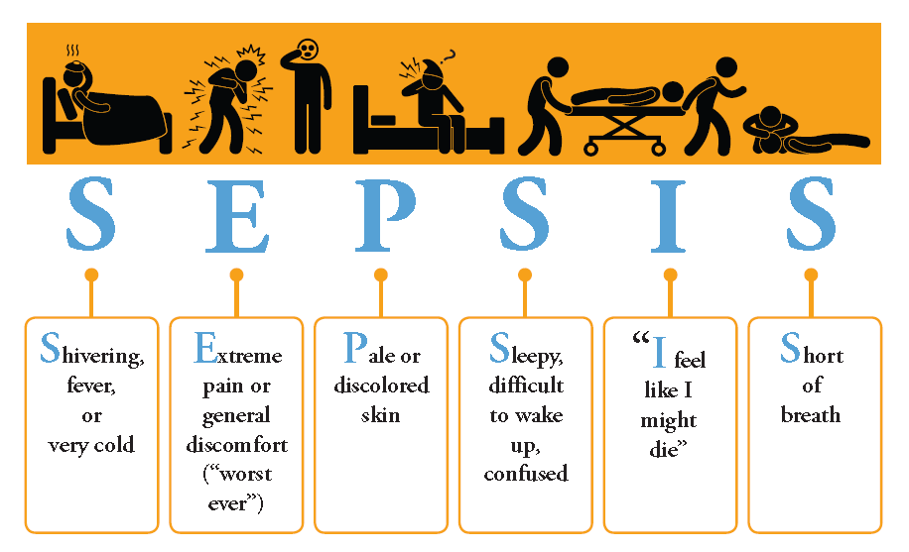
Sepsis

Slide 21
Case 4
An 18 yr old male, Mr B Beckham is a new fresher at Sheffield University. He presents to the walk-in centre with profuse diarrhoea, abdominal pain and feeling generally unwell for the past 24hrs. He was known to have visited Balti King 2 nights ago after poptarts…
What is the diagnosis?
B) A stool sample shows a gram negative
bacilli, which is non-lactose fermenting
and negative to oxidase test. What is the causative organism?
C) What is the incubation period for this organism?
D) How would you manage this patient?
Food poisoning
Salmonella spp.
12-48hrs
Supportive treatment
Encourage fluid oral intake
Anti-emetic (prochlorperazine)
Anti-diarrhoeals (loperamide)

Slide 22
Food poisoning
Organism | Incubation Period | Related Foods | Symptoms
Salmonella spp. | 12-48 hrs | Poultry, Eggs | Diarrhoea, abdo. pain
Campylobacter spp. | 24-72 hrs | Meat products | Profuse diarrhoea (bloody), severe abdo. pain
C. perfringens | 12-24 hrs | Cooked Meats | Diarrhoea, severe vomiting, fever
Staph. aureus | 1-6 hrs | Finger food | Profuse vomiting
Bacillus cereus | 1-6 hrs | Rice | Vomiting and diarrhoea

Slide 23
Case 5
A 30 year old female, Miss L Lohan was admitted to hospital with a
fever and profuse sweating after spending the weekend alone watching
Mean Girls on repeat...On examination a new onset murmur was detected and a mass in her LUQ was palpated. She is a known IVDU.
What is the most likely diagnosis?
B) Microbiology has reported growth of a alpha haemolytic, gram positive cocci, which is resistant to optochin testing. Which organism is responsible?
C) Which antibiotic combination would you give this patient?
.
D) Name some other findings on examination that would support your diagnosis.
E) Which heart valve is most commonly affected in IVDU?
F) What are other predisposing factors to this condition?
Infective endocarditis
S. viridans
Amoxicillin and gentamicin
- Roth spots
-Splinter Haemorrhages
Osler’s nodes
Janeways lesions
Tricuspid valve
-Prosthetic heart valve
-Recent dental work

Slide 24
Case 6
A 76 year old male, Mr T Jones is admitted to A&E following a 2 day history of profuse diarrhoea and vomiting after taking a leave of absence from The Voice UK. PMH: COPD, rheumatoid arthritis and hypertension. He has recently completed a full course of antibiotics to treat a chest infection.
A stool sample is obtained and reveals gram positive bacilli . What is the causative organism of this patients D+V?
B) What condition does she have?
C) From this history, what do you think is the cause of this presenting complaint?
D) List some other causes:
E) How would you manage this patient?
c.difficile
Pseudomembranous colitis
His recent course of antibiotics
The 5Cs of c.diff..
co-amoxiclav - ciprofloxacin
Clindomycin - carbapenems
cephaslosporins
Oral vancomycin/metranidazole

Slide 25
Risk factors for c.diff
>65 years old
Immunocompromised
Previous c.diff infection
PPIs
Being in nursing/residential homes
Cruise ships

Slide 26
Case 7
A 58 year old male, Mr L Henry presents to his GP with a 4month history of a productive cough with bloodstained sputum. He reports feeling more tired than usual, he has had night sweats and has lost 10lb without intention. He has travelled to Nigeria 6 months ago on a Red Nose day charity visit. On examination of his neck you palpate enlarged lymph nodes. Sputum sample reveals a growth of acid fast bacilli.
What is the diagnosis?
What stain would you use to determine the causative organism obtained from a sputum sample?
Why?
What is the causative organism?
How would you treat this patient?
Tuberculosis
Ziehl-Neelsen stain
Acid fast bacilli cannot be stained with gram stain as their lipopolysaccharide cell wall is too thick
Mycobacterium tuberculosis
-Rifampicin
-Isoniazid
-Pyrazinamide
-Ethambutol

Slide 27
Anti-TB drugs
Rifampicin
Isoniazid
Pyrazinamide
Ethambutol
stains urine pink/orange
Polyneuropathy
Give pyridoxine
Athralgia
Gout
Optic Neuritis

Slide 28
Topics we’ve not covered
HIV
Learn AIDs defining illnesses
Markers eg CD4 count
Transmission
Malaria
Transmission
Investigations
Pathophysiology
Septic Arthritis (See Rheum)
Hepatitis
-Difference between subtypes
Presentation
Transmission

Slide 29
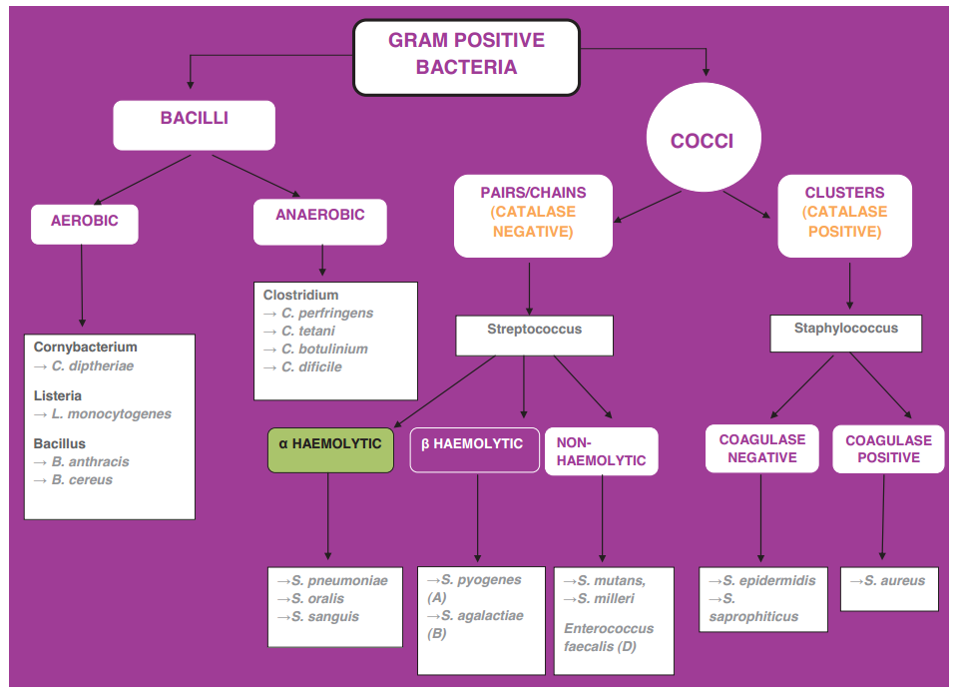
Learn this….

Slide 30
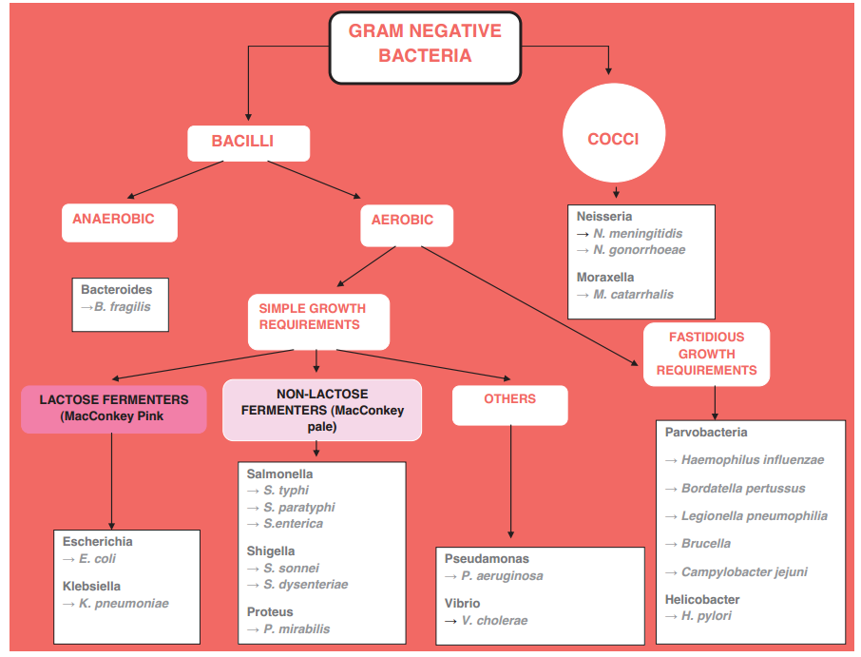
And this..

Slide 31
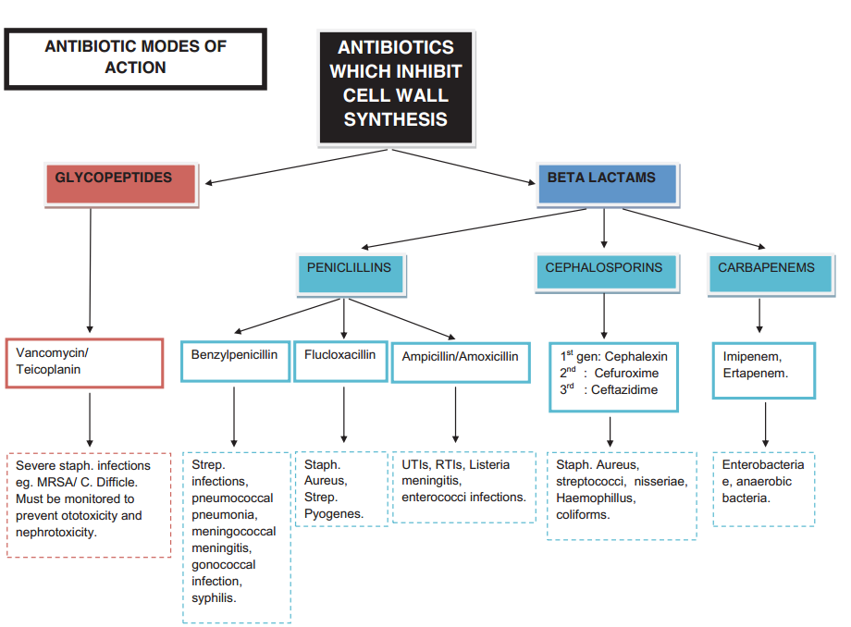
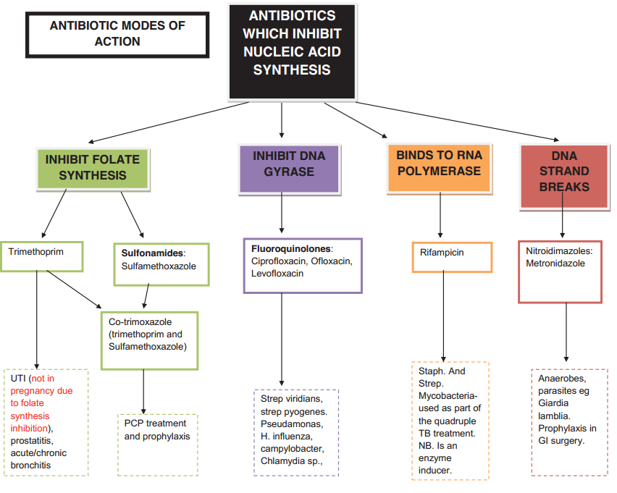
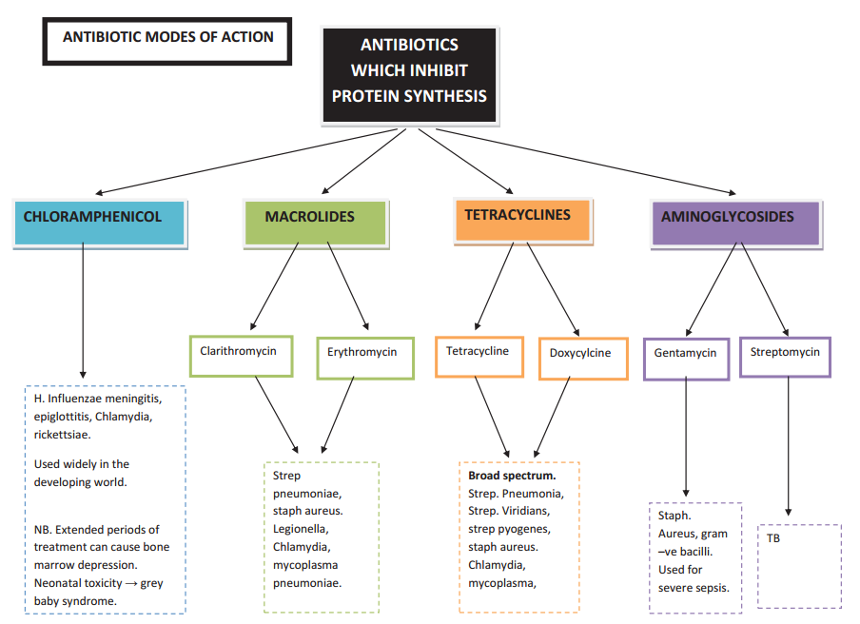
And these…

Slide 32
Thank you!

