Slide 1
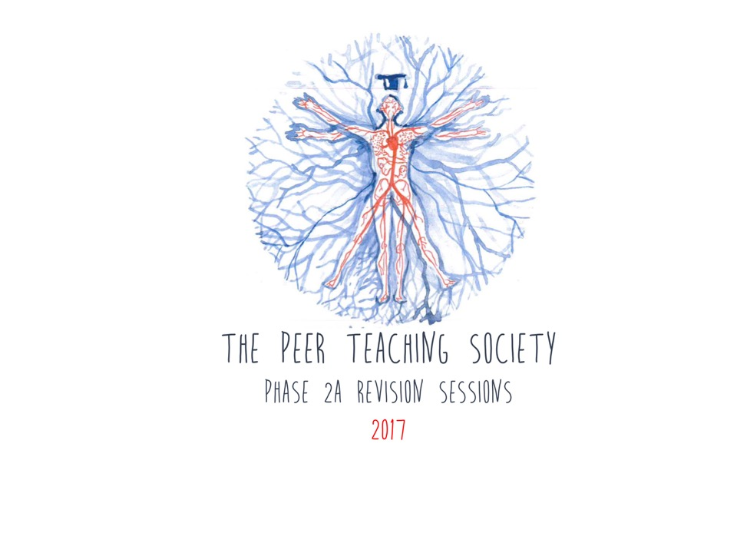
Miscellaneous (but important…)

Slide 2
Miscellaneous
Ellie Rosario
Laura Horseman
Phase 3b
26/04/2017

Slide 3
What we’re going to cover
Infectious Diseases (tropical diseases, HIV/AIDS)
Amyloidosis
Poisoning
Diseases of the breast
Lymphoedema
Sarcoma
Medical ethics and law (mental capacity act, principles of informed consent)

Slide 4
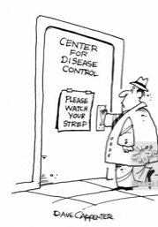
Infectious Diseases
HIV/AIDS
TB
Helminths
Tropical Medicine
Haemorrhagic fevers
African sleeping sickness
Chaga’s disease

Slide 5
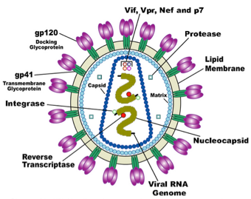
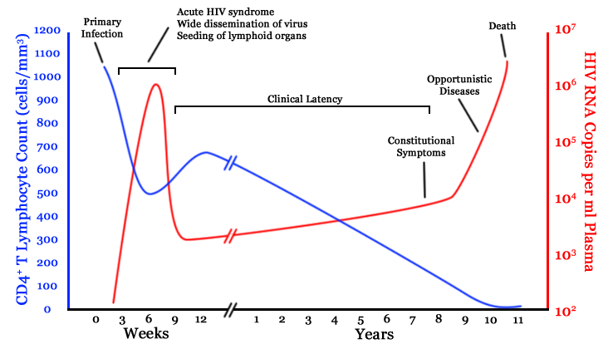
HIV/AIDS
What type of virus is it?
RNA RETROVIRUS
3 main enzymes? What do they do?
Reverse transcriptase
Integrase
Protease
How is it transmitted?
Blood/sex/vertical
Which cells are most affected?
CD4 T-cells (T helpers)
Opportunistic infections
begin to appear at about
CD4 350
AIDS at CD4 count < 200
Notes:
Reverse transcriptase produces DNA from RNA
Integrase transfers DNA into host cell genome
Protease processes proteins produced by host cell

Slide 6
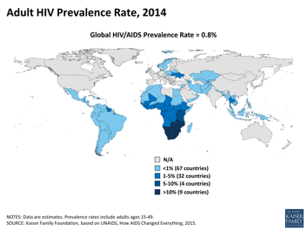
HIV/AIDS
Prevention
Maternal ARVs/C-section/no breastfeeding
Post exposure prophylaxis
Needle exchange, screen blood products
Sex education, condom use
Highly active antiretroviral therapy (HAART) adherence
Risk factors?
Multiple partners, no condom use
High prevalence communities, mother-to-child
Sex workers
Needle sharing
MSM
Where is it most prevalent?
Sub Saharan Africa
Screening
Venous blood, saliva, fingerprick blood
CONTACT TRACING. Deliberate transmission is criminalised. Break confidentiality

Slide 7
HIV/AIDS treatment
Progression to AIDS in 5-10 years without treatment
What markers do we monitor?
CD4 count
Viral load
Name some AIDS defining illnesses
Lung candidiasis, Non-pulmonary TB, Kaposi’s sarcoma, HIV dementia, wasting
Types of HAART
Reverse transcriptase inhibitors (NRTI, NNRTI)
Protease inhibitors
Membrane fusion inhibitors
3 drug regimen. Adherence ESSENTIAL to effectively treat and avoid resistance

Slide 8
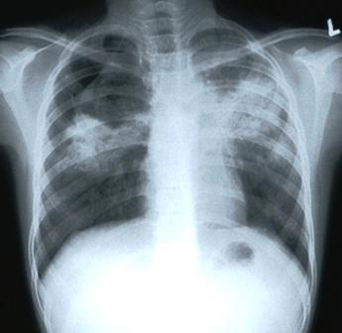
TB
What type of pathogen is it?
Mycobacteria (mycobacterium tuberculosis)
Caseating granulomatous disease
GRANULOMA is an attempt to contain
CASEASTION is central tissue necrosis
Stages of TB
PRIMARY
Bacilli in lung, granuloma, hilar lymph nodes
Symptoms?
LATENT
T-cell response contains
Positive mantoux test, normal CXR
PULMONARY
After primary or latent
Caseation
Symptoms?
MILIARY
GU
Pleural
Meningitis
Joints
Bones
Abdo
Notes:
Primary symptoms are fatigue, fever, weight loss, night sweats
Pulmonary symptoms are persistent cough, breathlessness, fever

Slide 9
TB treatment
How is TB diagnosed?
Sputum sample (hopefully…)
PCR
Ziehl-Nielson stain for acid-fast bacillus
CXR
What are the 4 drugs??
R
I
Rifampicin
Isoniazid
Ethambutol
Pyrazinamide
P
E

Slide 10
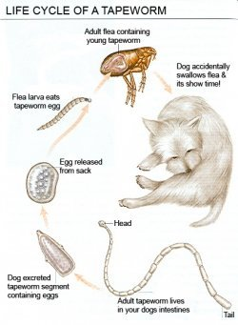
Helminths
Nematodes (round worms) e.g. threadworm
Intestinal/larva migrans/tissue
Treat with mebendazole
Trematodes (flukes/flat worms) e.g. schistosomiasis
Blood/lung/liver/intestinal
Treat with praziquantel
Cestodes (tape worms) e.g. beef tapeworm
Invasive or non-invasive
Treat with praziquantel
Diagnosis is stool microscopy for eggs if intestinal
Threadworm is common in the UK
Faecal-oral transmission
Hatch in duodenum and migrate to anus to lay eggs
Pruritis ani
Malabsorption
Can migrate to lungs

Slide 11
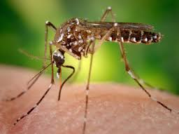
Tropical medicine
Communicable. How?
Vector-borne
Soil/water borne
Faecal-oral
Air
Sexual
Non-Communicable
Neoplastic (hepatoma)
Nutritional (kwashiorkor)
Venom
Blood dyscrasias (sickle cell)
Haemorrhagic fevers
Vector-borne (Dengue fever, Yellow fever, Japanese encephalitis)
Directly transmissible (Lassa fever, Ebola)
Symptoms?
Fever
Dehydration
Conjunctivitis
Pleuritic pain
Bleeding (GI, epistaxis, haematuria)
Renal failure, encephalitis, coma, death
Supportive treatment, isolation, barrier nursing

Slide 12
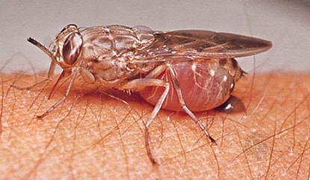
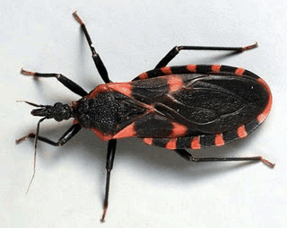
Tropical medicine
African Trypanosomiasis
Sleeping sickness
Vector = tsetse fly
Symptoms
Chancre surrounds bites
Fever, rash, rigors, headache
Joint pain
Convulsions, confusion, coma
Diagnosis on blood film/lymph nodes/CSF
American Trypanosomiasis
Chaga’s disease
Vector = triatomine bugs
Symptoms
Nodule (chagoma)
Rash, fever, myalgia, lymphadenopathy
Long latent period
Multi organ invasion
Diagnosis on blood film/lymph nodes/CSF
No satisfactory treatment

Slide 13
Any Questions?

Slide 14
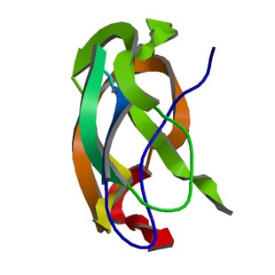
Amyloidosis
Disorder of protein metabolism
What is amyloid protein?
Beta pleated sheets, resistant to breakdown, insoluble
Aetiology
Primary (AL), familial or secondary (AA)
Pathophysiology
Primary due to proliferating plasma cells producing amyloidogenic immunoglobulins. Deposited in tissues
(kidney/heart/nerves/vessels/gut)
Secondary due to conversion of serum amyloid A conversion to amyloid in kidney/liver/spleen
Malabsorption/perforation/obstruction
Purpura, bleeding
Hepatosplenomegaly
Primary is fatal
Presentation usually age 55-65
Symptoms depend on affected organ
Proteinuria/nephrotic syndrome
Cardiomyopathy/arrhythmia/angina
Neuropathy/carpal tunnel
Notes:
Primary = Ig light chain associated (myeloma, lymphoma)
Familial is autosomal dominant, unstable protein formed in liver
Secondary is systemic/reactive due to chronic inflammation (rheumatoid, IBD, TB)

Slide 15
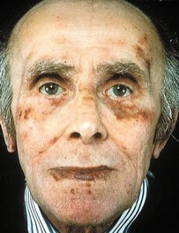
Amylodosis
Diagnosis?
Biopsy
Congo red stain under polarized light shows red green birefringence
Treatment
Primary
Melphalan (chemotherapy) and stem cell transplant or dexamethasone
Secondary
Manage underlying condition
Familial
Liver transplant
Notes:
Primary = Ig light chain associated (myeloma, lymphoma)
Familial is autosomal dominant, unstable protein formed in liver
Secondary is systemic/reactive due to chronic inflammation (rheumatoid, IBD, TB)

Slide 16
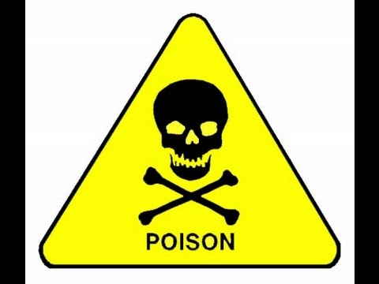
Poisoning
General abnormalities?
Rapid, irregular pulse
Altered respiratory rate
Dilated/constricted pupils
Hyper/hypo-glycaemia
Renal impairment
Coma
Seizures
Metabolic acidosis
General management
Bloods (always check paracetamol)
Empty stomach?
Consider antidote, consult TOXBASE
Monitor vital signs
Psychiatric assessment

Slide 17
Poisoning
Carbon monoxide
Pesticides
Salicylate (aspirin)
Paracetamol
Atropine, diazepam
Activated charcoal, N-acetylcysteine, liver transplant?
Activated charcoal, monitor urine output, sodium bicarbonate, dialysis?
100% oxygen. Mannitol if severe
Salivation, Lacrimation, Urination, Diarrhoea
Hyperventilation, tinnitus, vertigo, metabolic acidosis
Headache, fits, coma, “cherry red”, cerebral oedema
Often no symptoms, RUQ pain?, encephalopathy
Notes:
1 c iv, 2 a I, 3 b iii, 4 d ii

Slide 18
Any Questions?

Slide 19
Breast Anatomy
What is the blood supply to the breast?
Medial supply – Internal thoracic artery, branch of subclavian artery
Lateral supply – mammary artery, lateral mammary branches and lateral thoracic/thoroacromial branches.
2. What is the nerve supply to the breast?
Anterior and lateral cutaneous branches of 4th-6th intercostal nerves.
Notes:
Surface anatomy – horizontally from lateral border of the sternum to mid axillary line, vertically from 4-6th intercostal cartilages. Lies superficial to pec major/serratus anterior.
Composed of mammary glands (modified sweat glands) and connective tissue stroma
Mammary glands composed of 15-20 lobules that drain into a single duct
Ducts converge at the nipple
Fibrous stroma supports the breast, condenses to form the suspensory ligament of Cooper – this secures the breast to the pectoral fascia and serves to separate the secretory lobules of the breast
3. What controls milk secretion? Prolactin, from ant. Pituitary

Slide 20
Lymphatic Drainage
Notes:
. What are the 3 main groups of lymph nodes? Axillary (75%), parasternal (20%), posterior intercostal (5%).
5. Why is this relevant?

Slide 21
A 45 year old lady presents to her GP, a Dr N. Ipple, with a lump in her left breast. Can you name 5 differentials for a breast lump?
Notes:
Carcinoma
Fibroadenoma
Abscess
Breast cyst
Fat necrosis
Duct ectasia

Slide 22
INVESTIGATION OF A BREAST LUMP
Triple Assessment:
Clinical examination
Imaging (ultrasound <35years, mammography and ultrasound if >35 years)
Histology/cytology (fine needle aspiration, core needle biopsy)
Aims for CONCORDANCE between results
Mammograms:
Women aged 47 – 73, invited every 3 years
Indications for mammography:
Notes:
Triple assessment is line of investigation for all breast lumps
Mammograms – think how this could tie in to public health questions: principles of screening, number needed to treat etc
Indications – clinically suspicious lump in women > 40 years, solid mass left after cyst aspiration, blood stained nipple discharge, nipple skin change, part of national screening programme
Why ultrasound? Younger women have denser breasts, mammography works by squashing breast and flattening out tissue planes – in older fatty infiltrated breasts this is easier and tumours can be spotted, in younger breasts they’re not picked up – USS better

Slide 23
BREAST CANCER
Epidemiology – 1 in 9, ~ 40,000 cases p/a, men <1% of cases
Risk factors:
➡️ Think OESTROGEN exposure:
➡️Early menarche/late menopause
➡️ Nulliparity/late pregnancy
➡️ HRT
➡️ Obesity (fat cells produce estradiol – converted to oestrogen
➡️ Not breastfeeding (oestrogen suppressed whilst breast feeding
➡️ ALSO family history, BRCA 1 and 2, past breast cancer, increased age
➡️ Tumours can arise from ducts, lobules or stroma:
Ductal carcinoma in situ (pre invasive disease – detected by mammogram, increases your risk of developing malignant disease)
Malignant disease – ductal (70%) or lobular (10%)
Symptoms?
Notes:
Ductal – majority, affects women >55 years, tumour growth started in ducts and invaded stroma. DCIS is pre-malignant stage of invasive ductal carcinoma
Lobular – harder to palpate, more likely to be diffuse therefore harder to excise, more prone to being bilateral/multi focal
Intraductal papillary disease – fern like projections of tumour in ducts, also has an in situ stage (like DCIS), <3% of cancers, good prognosis
Remaining 20% rare types – mucinous, tubular, medularry carcinomas, Paget’s disease of the nipple etc
Symtoms – PAINLESS, hard immobile lump, nipple retraction, peau d’orange, bloody nipple discharge, weight loss/bone pain if mets

Slide 25
FAMILIAL BREAST CANCER
Risk increased if:
Mother/sister diagnosed <40 years
Mother/sister/daughter + one other relative from same side of family
3 relatives at any age
Father/brother at any age
Mother/sister with cancer in both breasts (1st diagnosis <50 years)
As above, but one with ovarian and one with breast
Relative of Ashkenazi Jewish origin with breast/ovarian cancer
Notes:
BRCA ½ - associated with hereditary breast cancer, contribute 5-10% of breast cancer and 15% of ovarian cancer
Tumour supressor genes
BRCA 1 has stronger association with ovarian cancer

Slide 26
STAGING
Staging
TNM staging (T1-4 based on size and fixation to chest wall), N (mobile ipsilateral nodes or fixed nodes), M (distant mets) OR stages I-IV
Grade
1 to 3: grade 1 tumours are well differentiated, grade 3 are poorly differentiated. Important prognostic marker for chemo.
Receptor status
Oestrogen R +ve – tumour growth responds to oestrogen therefore anti-oestrogen drugs (TAMOXIFEN) will stop growth. GOOD prognostic marker.
HER2 R +ve – receptor for EDGF, hence more receptors = more growth, poor prognostic marker – treatment with TRASTUZUMAB (trade name herceptin).
Notes:
Triple negative cancers – don’t express any receptor sub types– v aggressive, more commonly linked to BRCA, hard to treat, more common in younger women
Nottingham prognostic indicator used to predict survival/relapse rates
Stage 1 – confined to breast, mobile
2 – confined to breast, mobile, ipsilateral axillary nodes involved
3 – attached to muscle, skin involvement is larger than tumour
4 – fixation to chest wall, mets present

Slide 27
Treatment
Wide local excision or mastectomy and reconstruction
+ sentinel node biopsy/axillary clearance
All patients have radiotherapy after
Chemotherapy – either pre op to shrink tumour, as an adjuvant or palliative
Endocrine agents – tamoxifen (blocks E receptors), aromatase inhibitors (e.g. anastrozole, stops production of oestrogen, only if post menopausal)
Biologics – trastuzumab if HER2 positive
Late stage disease – radiotherapy and bisphonates to reduce pain from bone mets
Notes:
Stage 1-2 surgery, radiotherapy to decrease recurrence and increase survival
Endocrine agents – if ER/PR +ve
Tamoxifen

Slide 28
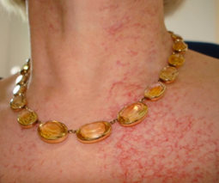
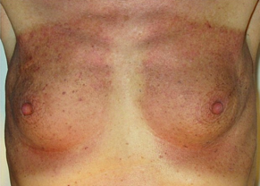
🌟What are some side effects of radiotherapy?
🌟 What are some side effects of tamoxifen?
🌟What are some side effects of anastrozole?
Notes:
Pneumonitis, pericarditis, rib fractures
Uterine cancer, venous thromboemoblism, mood change, weight gain, hot flushes, vaginal discharge
Menopausal symptoms as above, arthralgia, osteoporosis, rash

Slide 29
INTRADUCTAL PAPILLOMA
Arise from ductal epithelium
Benign, >40 years,
Either solitary – arise from large duct, near nipple
Multiple – small ducts involved, form in clusters, increased risk of breast cancer
Present – nipple retraction, nipple discharge, palpable lump, may be painful
Triple assessment and ultrasound

Slide 30
Other breast lumps:
Fibroadenoma
<30 years, ‘breast mice’
Benign overgrowth of connective tissue of breast lobule
Firm, smooth, mobile and painless
Rule of thirds – 1/3 stays the same, 1/3 regress, 1/3 get bigger
USS/fine needle aspiration or excision if large
Duct ectasia
Menopause, ducts become blocked and nipple retracts/bloody discharge
Blockage leaves a hard lump
Triple assessment to confirm, usually no treatment
Cystic disease
Common >35 years old, >> perimenopausal
Benign, fluid filled, not fixed to surrounding tissue
Can be painful
Diagnosis on fine needle aspiration
If fluid bloody send to cytology, if residual lump do a core biopsy
Fat necrosis
Post injury to breast tissue = fibrosis and calcification
Scarring = firm lump
Triple assessment, once diagnosis confirmed no treatment required.

Slide 31
Can you define lymphoedema?
Notes:
Chronic non-pitting oedema due to lymphatic insufficiency

Slide 32
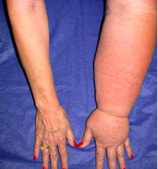
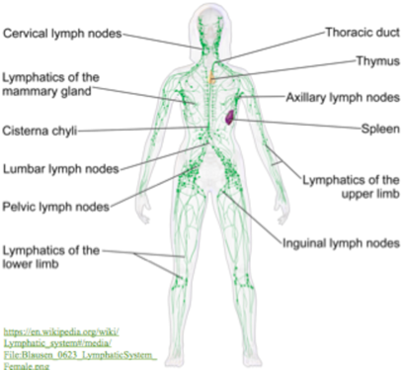
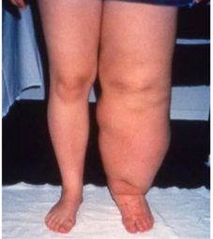
LYMPHOEDEMA
Notes:
Lymph accumulates in subcutaneous tissue due to obstruction, hypoplasia or maldevelopment of lymphatics
Lymphatic fluid containing plasma, extracellular proteins etc leaks from venous system into interstitium, should return to form lymphatics to throacic duct to venous system
High conc of protein in the extravascular space draws more draw out = swelling
Protein conc also stimualtes fibroblast proliferation – synthesise stroma
System not functioning leads to swelling of limb (unilateral or bilateral), genitals, face etc
Overlying skin then undergoes change – thickens, fissuring, ulceration, skin breakdown = more prone to infection – cellulitis etc
Autosomal dominant inheritance

Slide 33
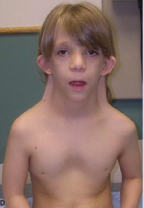
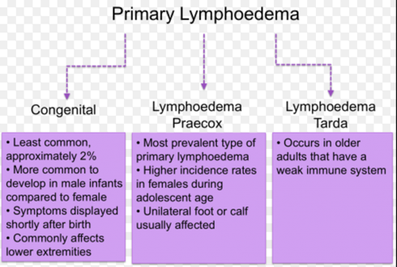
PRIMARY LYMPHOEDEMA
Congenital – Milroy’s Disease
Lymphoedema Praecox – puberty, Meige Disease
Lymphoedema Tarda – late onset
Meige/Milroy’s disease are associated with Noonan and Turner Syndromes.
Notes:
Herediatry – F>M, 1 in 6,000, Meige diease is the most common

Slide 34
SECONDARY LYMPHOEDEMA
Most common for of lymphoedema
When can secondary lymphoedema develop?
What % of patients develop lymphoedema of the arm after having breast surgery that involves radiotherapy or lymph node surgery?
How can this figure be reduced?
Notes:
Post surgery (esp breast), post radiation (esp head and neck), direct effect of tumour pressing on lymphatics, post lymphatic dissection (e.g. axillary node clearance)
Tropical areas – filariasis
Secondary to cellulitus, varicose veins or immobility
20%
Sentinel node biopsy
Precuations to minimise cuts and grazes – infection will cause lymphoedma
Avoid heat and sunburn (no v hot showers, use factor 50)
Moisturise skin
No heavy lifting, do arm and shoulder exercises post surgery

Slide 35
SENTINEL NODE BIOPSY
Post mastectomy treatment used to be axillary node clearance – remove all lymph nodes to prevent metastasis
Now = sentinel node biopsy
Blue dye injected into periareolar area or tumour at start of operation
A gamma probe is then used to detect uptake of dye in sentinel (first) node – sent for histology
Extent of axillary lymph node surgery based on result
Notes:
Sentinel node is most likely to be the first ‘stopping point’ for metastasing cancer cells
If histology –ve, no need to remove
If +ve, regional lymph nodes removed
Pros – reduces lymphoedema
Cons – possibility for false positives and negative results

Slide 36
TREATING LYMPHOEDEMA
Focuses on compression of the arm – bandages, elastic sleeves etc
Massage - manual lymphatic drainage
Lymphoedema specialist nurses
Manage symptoms - skin hygiene
AVOID SURGERY
Notes:
Diuretics will produce transient reduction in oedema, but ultimately fluid accumulates due to protein in extracellular space – fluid will be drawn back in again.

Slide 37
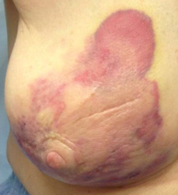
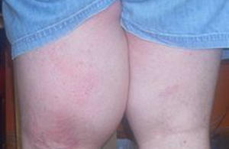
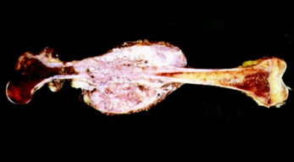
SARCOMA
Tumours of supporting or connective tissue – cells mesenchymal in origin, malignant
1. How many types of sarcoma can you name?
Notes:
Carcinoma – cells epithelial in origin
Leiomyosarcoma (smooth muscle tumour), osteosarcoma (bone sarcoma), liposarcoma (fat cells), GIST (gastrointestinal stromal tumour), Kaposi’s sarcoma (contraversially not a true sarcoma, arises from endotheloium of blood vessels/lymphatics – AIDS), angiosarcoma (sarcoma of blood vessels – skin, breast, liver and spleen), rhabdomyosarcoma (skeletal muscle tumour).
Angiosarcoma, liposarcoma, osteosarcoma

Slide 38
OSTEOSARCOMA
Most common malignant bone tumour
Affects children and teenagers
Distal femur, proximal tibia and proximal humerus most common sites
Risk factors – radiation, rapid growth (> in males), bone dysplasia disease (e.g. Paget’s), Li Fraumeni syndrome
How would osteosarcoma present?
Notes:
With bone pain (constant, wakes child at night, present throughout day), fracture, lung mets common

Slide 39
INVESTIGATION AND TREATMENT
List the possible investigations for osteocarcoma (or any sarocma!)
What is the treatment for osteosarcoma?
Notes:
X-ray, biopsy, MRI
Chemo, radiotherapy, limb sparing surgery or amputation

Slide 40
Any Questions?

Slide 41
Mental Capacity Act 2005
Conditions for consent?
Voluntary
Informed
Made with capacity
Person presumed to have capacity until proved otherwise!
How do we assess capacity?
UNDERSTAND the relevant information
RETAIN for long enough to make decision
WEIGH UP to make a decision
COMMUNICATE the decision they have made
Capacity is SITUATION SPECIFIC

Slide 42
5 principles of MCA 2005? Can you name any? (x5)

Slide 43
4 parts of capacity assessment??
Understand
Weigh up
Retain
Communicate

Slide 44
Best interests
What is considered when making a decision in the patient’s best interests?
Could they ever regain capacity
Past and present wishes
Beliefs and values
Other factors they would consider
Opinions of relevant people (e.g. spouse, lasting power of attorney)
Relatives cannot provide or refuse consent
What’s Gillick competence?
Does a child under 16 understand the
consequences of their decision
(Physical, social, emotional etc)
If they are not Gillick competent they cannot consent

Slide 46
Capacity
When must you obtain consent?
A. Upon admission to a care facility
B. When a person becomes ill
C. Each day
D. Each activity that you wish to carry out
Who does the MCA apply to?
A. Older People
B. People who have Learning Disabilites
C. People who have a Mental Illness
D. Everyone

Slide 47
Any Questions?

